Slide 1
EE3122: Analogue Circuit Fundamentals
Output Stages
Department of Electrical Engineering
City University of Hong Kong
Prof. Arindam BASU

Slide 2
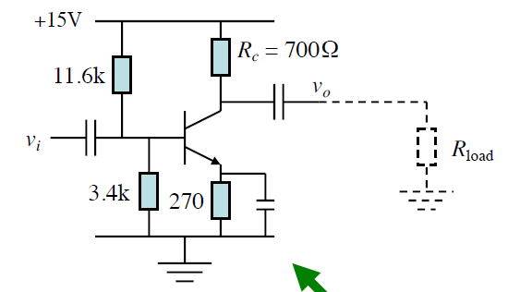
Motivation
Limitation of CE amplifier: It provides a good gain, but it fails to drive a low-resistance (high-power) load.
Find the gain

Slide 3
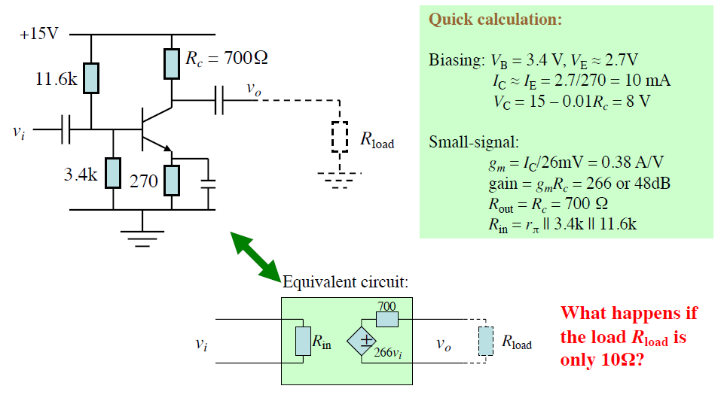
Motivation

Slide 4
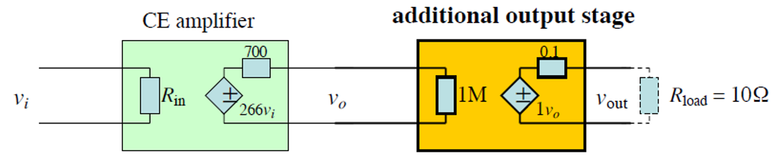
Solution
Never load the CE amplifier directly! Use an output stage or buffer.
Large input resistance!
Unit Gain and
Small output resistance!

Slide 5
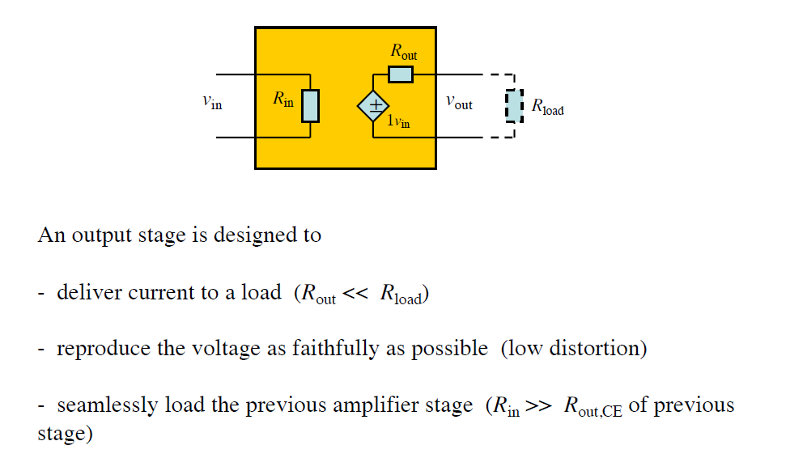
Output Stage

Slide 6
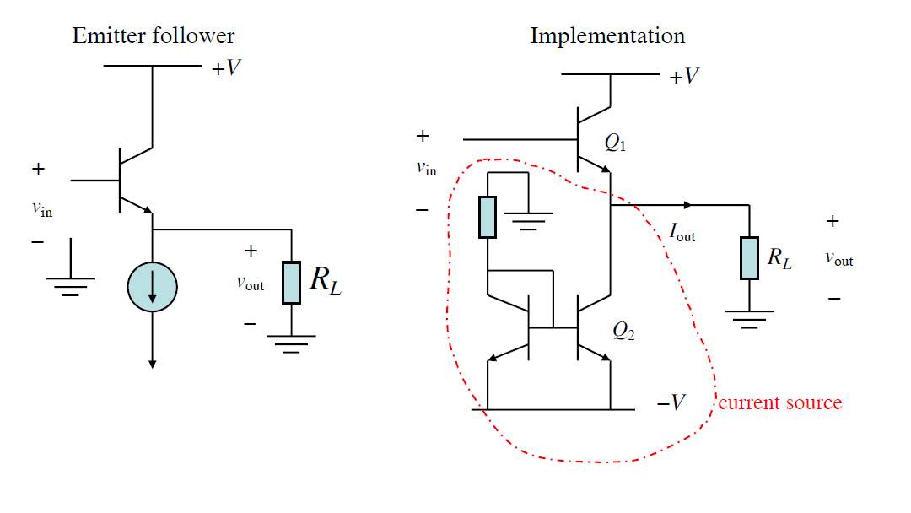
Emitter Follower (Class A)

Slide 7
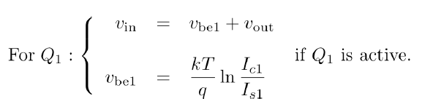
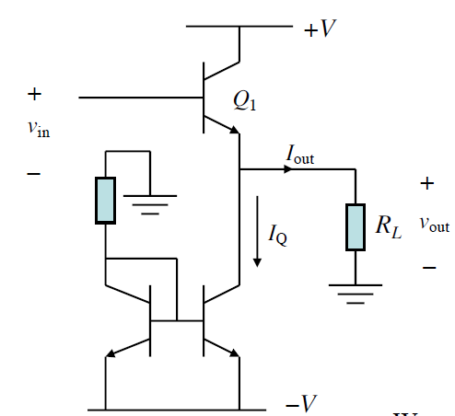

Emitter Follower: Large Signal Analysis
If v_{be1} = constant,
Linear, no distortion!
+V_{cc}
-V_{cc}

Slide 8
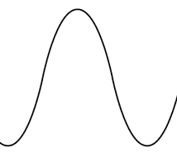
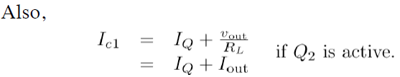
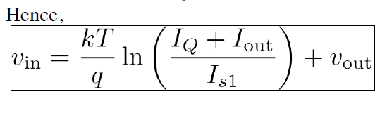
Emitter Follower: Large Signal Analysis
+ve cycle
I_{E1} = I_{Q} + I_{out}
-ve cycle
I_{E1}+I_{out} = I_{Q}
+V_{cc}
-V_{cc}
Weak nonlinearity

Slide 9
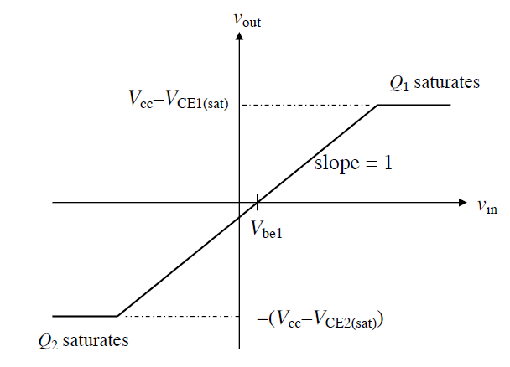
Emitter Follower: Signal Clipping
We note that the good linearity is only maintained if both Q1 and Q2 are kept in active region.
If Q1 saturates, the output voltage clips at the top.
If Q2 saturates, the output voltage clips at the bottom.
Operating range without clippings caused by saturation:
Clipping may also happen if V_{be} increases too much due to very large load current I_{out}.

Slide 10
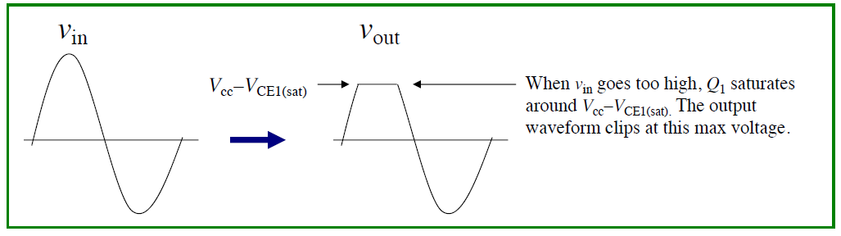
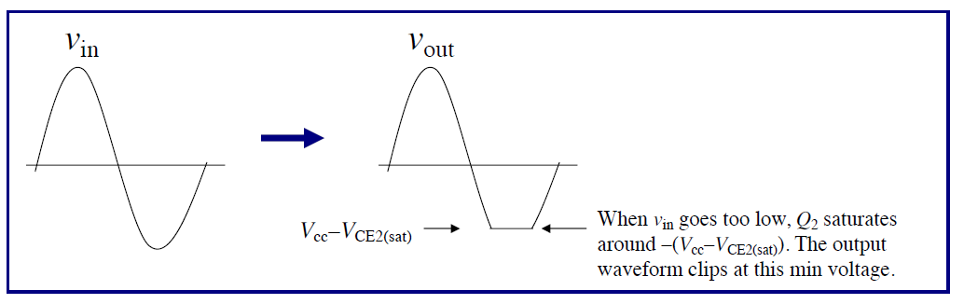
Emitter Follower: Signal Clipping

Slide 11
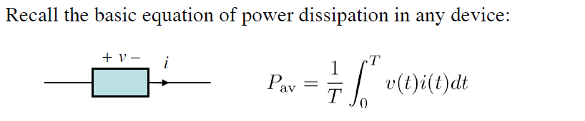
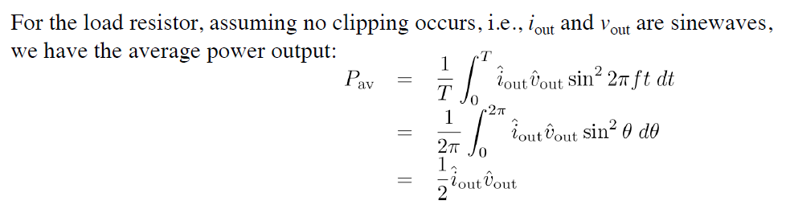
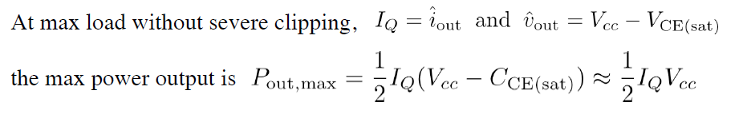
Class A: Power Efficiency
Efficiency = Output Power / Input Power
Output power: AC power to load
Input power: power taken from DC source
Note that this needs both I & V to reach maxima → only possible if I_{Q}R_{L} = (V_{cc} – V_{ce(sat)})
+I_{Q}
i_{out}
-I_{Q}
V_{CE (sat)}

Slide 12
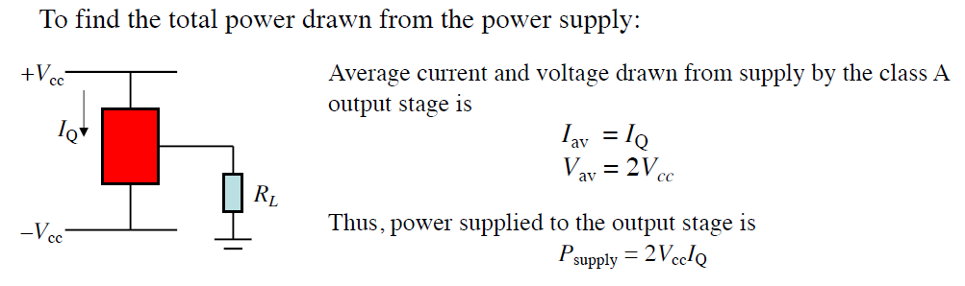
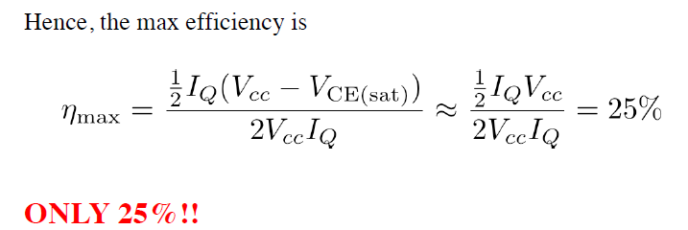
Class A: Power Efficiency
Class A has a poor efficiency, but very low distortion — high-fidelity!

Slide 13
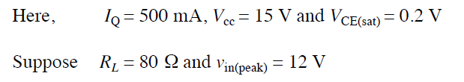
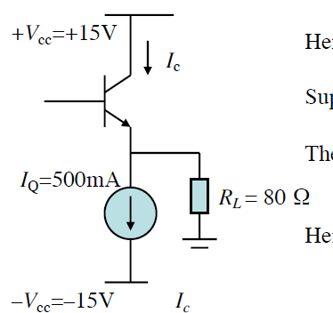

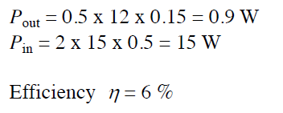
Example: Power Efficiency
Suppose we wish to find the efficiency of the following Class A power amplifier.
No clipping occurs!

Slide 14
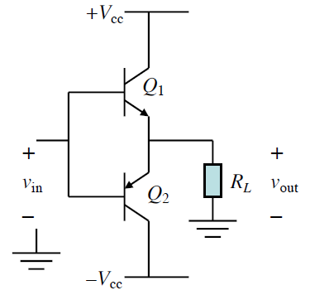
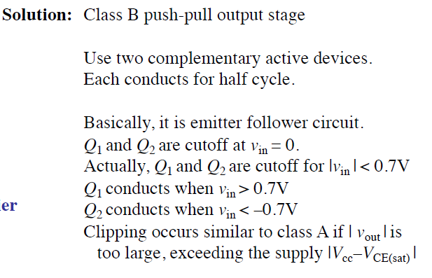
Push-Pull (Class B)
The main disadvantage of Class A power amplifier is the poor efficiency because of the large dissipation even at zero output.
To improve efficiency, we may try to eliminate the dissipation at zero output. That means, we aim to design an amplifier whose dissipation is zero when v_{in} = 0.

Slide 15
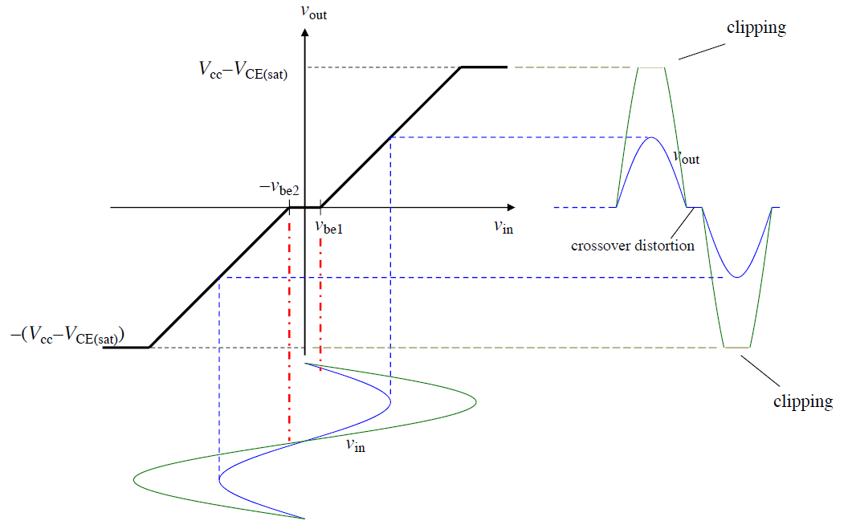
Push-Pull (Class B): Distortion

Slide 16
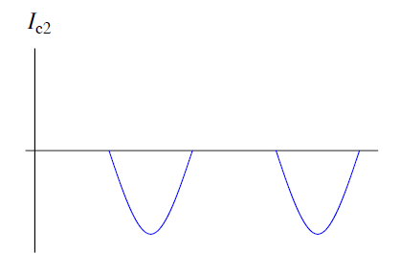
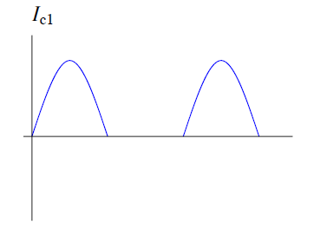
Push-Pull (Class B): Power Efficiency
Each device only conducts for half cycle, i.e., 180º. So, the current waveform for each device is a half -sinusoid.

Slide 17
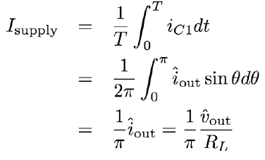
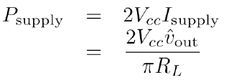
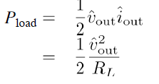
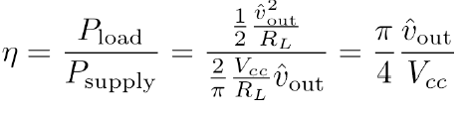
Push-Pull (Class B): Power Efficiency
Efficiency = Output Power / Input Power
Output power: AC power to load
Input power: power taken from DC source
For simplicity of analysis, we ignore the crossover distortion.
Supply current
Input power
Output power
Efficiency

Slide 18
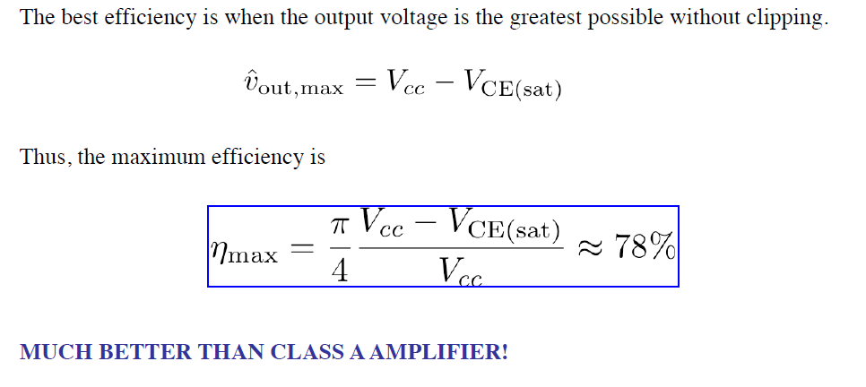
Push-Pull (Class B): Power Efficiency
Problem is distortion
To have high efficiency & low distortion – need class AB amplifier

Slide 19
Appendix

Slide 20
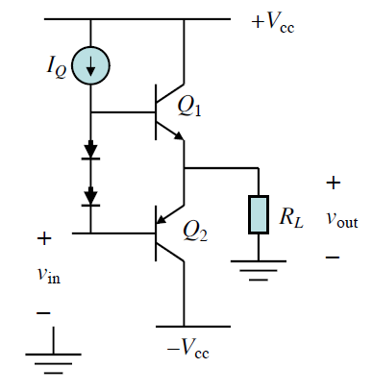
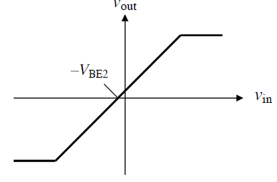
Class AB amplifier
To eliminate the crossover distortion, we may bias the active devices so that they conduct a small quiescent current near the crossover v_{in} = 0. Don’t let them cutoff!

Slide 21
Class AB amplifier
Here, for v_{in} < 0, Q2 turns on and out follows . But since the diodes maintain a const ant total bias voltage across the BE junctions of both Q1 turns Q2, V_{BE} of Q2 decreases by the same amount that V_{BE} of Q1 increases. Thus, Q1 stays on, but only allows a very small current to flow.
Similarly, for v_{in} > 0, we have the same situation, with Q1 and Q2 interchanged.

