Slide 1
EE3114 Systems and Control
Tutorial - 3
Semester B, 2018-19
2018-9-19

Slide 2
More on Laplace Transform and Inverse Laplace Transform

Slide 3
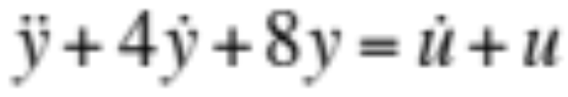
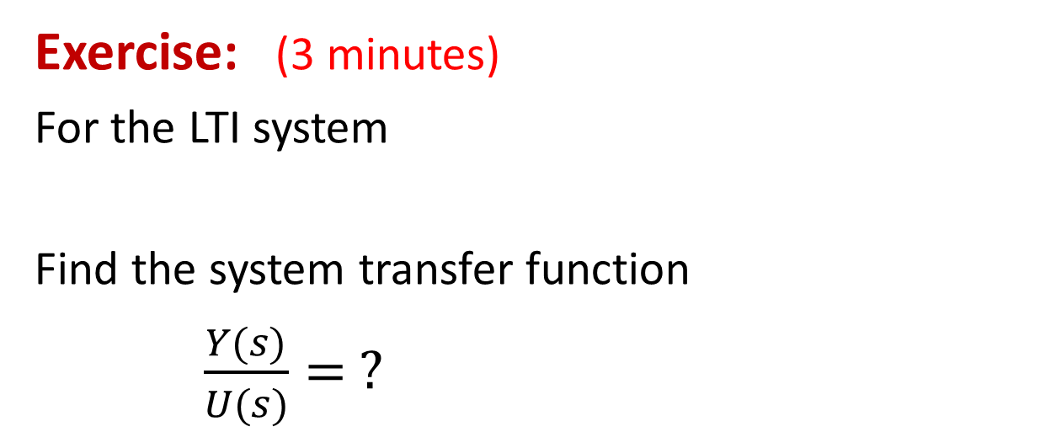
Laplace Transform
Exercise: (3 minutes)
For the LTI system
Find the system transfer function
$\frac{Y(s)}{U(s)}= ?$

Slide 4
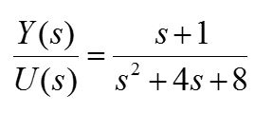
Exercise:
For the LTI system
Find the system transfer function
Answer:
%MatLab Code
H = tf([1 1],[1 4 8])
Transfer function:
s + 1
-------------
s^2 + 4 s + 8
Next, find its poles and zeros
(3 minutes)

Slide 5
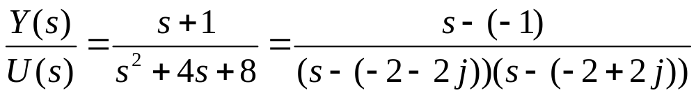
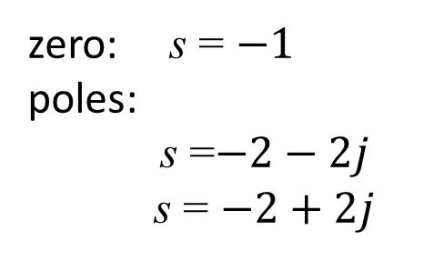
Exercise:
For the LTI system
Find the transfer function poles and zeros
Answer:
zero: s = $−1$
poles:
s =$−2−2j$
s = $−2+2j$
%MatLab Code
H = tf([1 1],[1 4 8]);
zero(H)
pole(H)

Slide 6
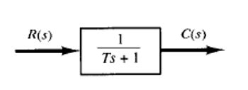
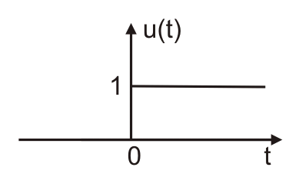
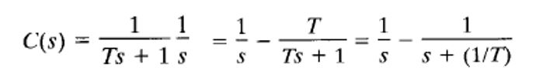
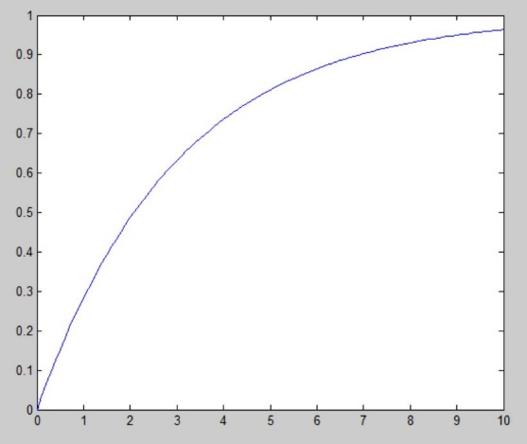

Inverse Laplace Transform
Example: First-Order LTI System
Unit Step Input:
(constant $T>0$)
Output:
Inverse Laplace Transform → Unit Step Response
%% MatLab code
Hs = tf(1,[3 1]); %T = 3
step(Hs);
[y,t] = step(Hs,10); %Time [0,10]
plot (t,y);

Slide 7
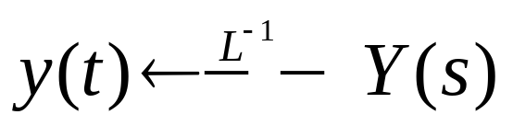
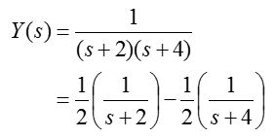
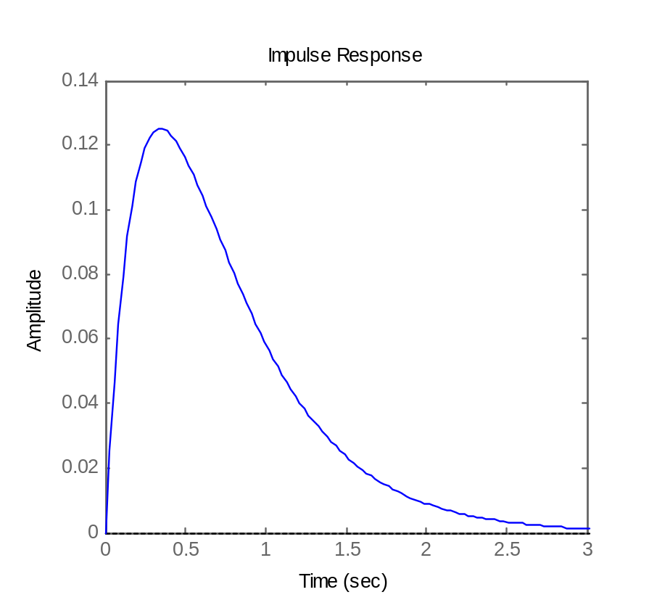

Inverse Laplace Transform
Partial fraction expansion and term-by-term inversion
Example (single poles):
%%MatLab code
syms s;
Ys = 1/((s+2)*(s+4));
F = ilaplace(Ys);
ezplot(F,[0:0.1:3)

Slide 8
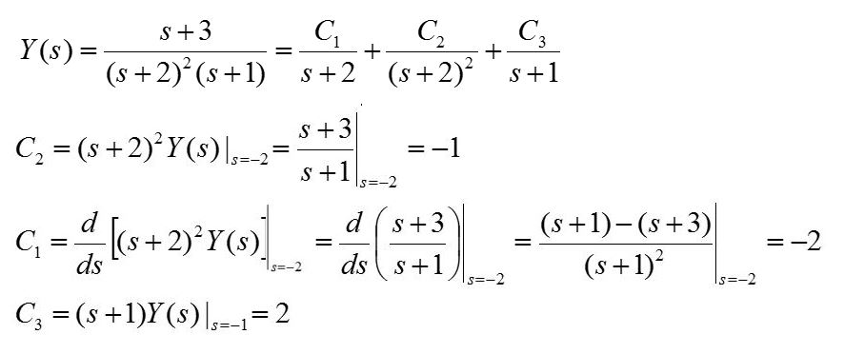
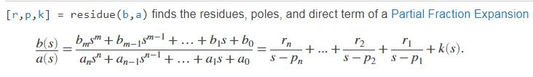
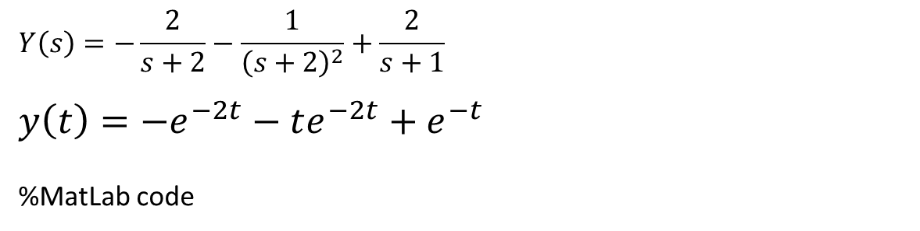
Example (multiple poles):
(Partial fraction)
$$Y\left(s\right)=−\frac{2}{s+2}−\frac{1}{{\left(s+2\right)}^{2}}+\frac{2}{s+1}$$
$$y\left(t\right)=−e^{−2t}−te^{−2t}+e^{−t}$$
%MatLab code

Slide 9
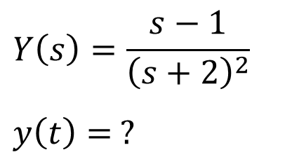
Exercise: (5 minutes)
$$Y\left(s\right)=\frac{s−1}{{\left(s+2\right)}^{2}}$$
$$y\left(t\right)= ?$$

Slide 10
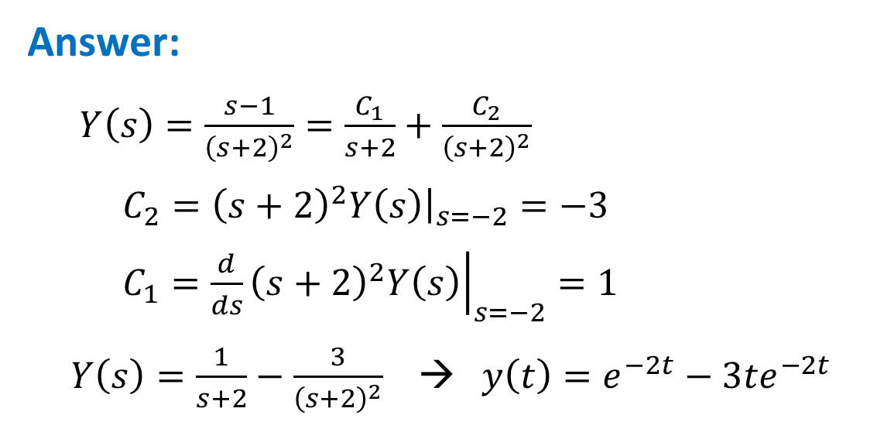
Exercise: (5 minutes)
$$Y\left(s\right)=\frac{s−1}{{\left(s+2\right)}^{2}}$$
$$y\left(t\right)= ?$$
Answer:
$Y\left(s\right)=\frac{s−1}{{\left(s+2\right)}^{2}}=\frac{C_{1}}{s+2}+\frac{C_{2}}{{\left(s+2\right)}^{2}}$
$C_{2}={\left(s+2\right)}^{2}Y\left(s\right){\left.​\right|}_{s=−2}=−3$
$C_{1}={\left.\frac{d}{ds}{\left(s+2\right)}^{2}Y\left(s\right)\right|}_{s=−2}=1$
$Y\left(s\right)=\frac{1}{s+2}−\frac{3}{{\left(s+2\right)}^{2}}$ → $y\left(t\right)=e^{−2t}−3{te}^{−2t}$

Slide 11
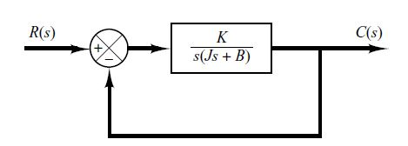

Exercise:
Constants:
K > 0, J > 0, B > 0
$K$ is called the “gain”
Closed-loop Transfer Function = ? (5 minutes)

Slide 12

Exercise:
Constants:
K > 0, J > 0, B > 0
$K$ is called the “gain”
Closed-loop Transfer Function = ? (5 minutes)
Answer:

Slide 13
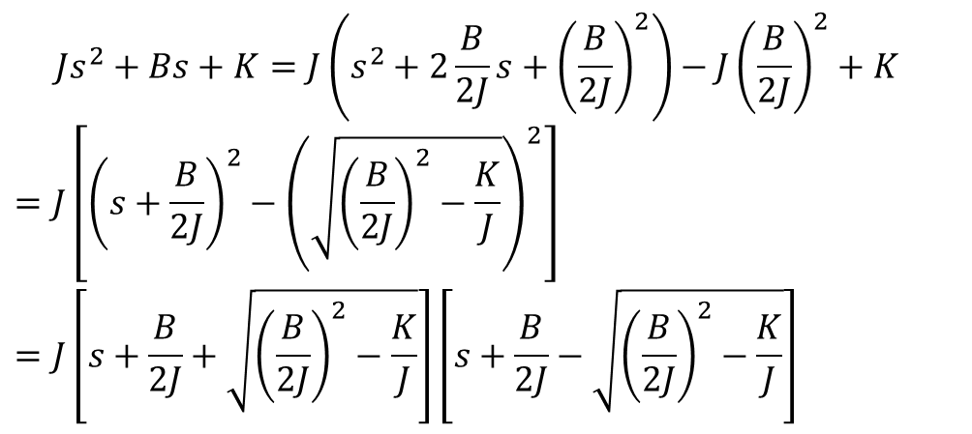
Example:
Closed-loop Transfer Function:
$$Js^{2}+Bs+K=J\left(s^{2}+2\frac{B}{2J}s+{\left(\frac{B}{2J}\right)}^{2}\right)−{J\left(\frac{B}{2J}\right)}^{2}+K$$
$$=J\left[{\left(s+\frac{B}{2J}\right)}^{2}−{\left(\sqrt{{\left(\frac{B}{2J}\right)}^{2}−\frac{K}{J}}\right)}^{2}\right]$$
$$=J\left[s+\frac{B}{2J}+\sqrt{{\left(\frac{B}{2J}\right)}^{2}−\frac{K}{J}}\right]\left[s+\frac{B}{2J}−\sqrt{{\left(\frac{B}{2J}\right)}^{2}−\frac{K}{J}}\right]$$
(Complex Conjugate Poles)

Slide 14
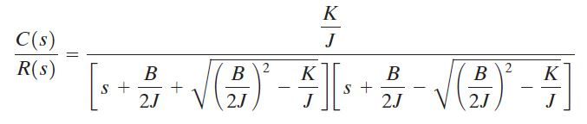
Example:
Closed-loop Transfer Function:

Slide 15
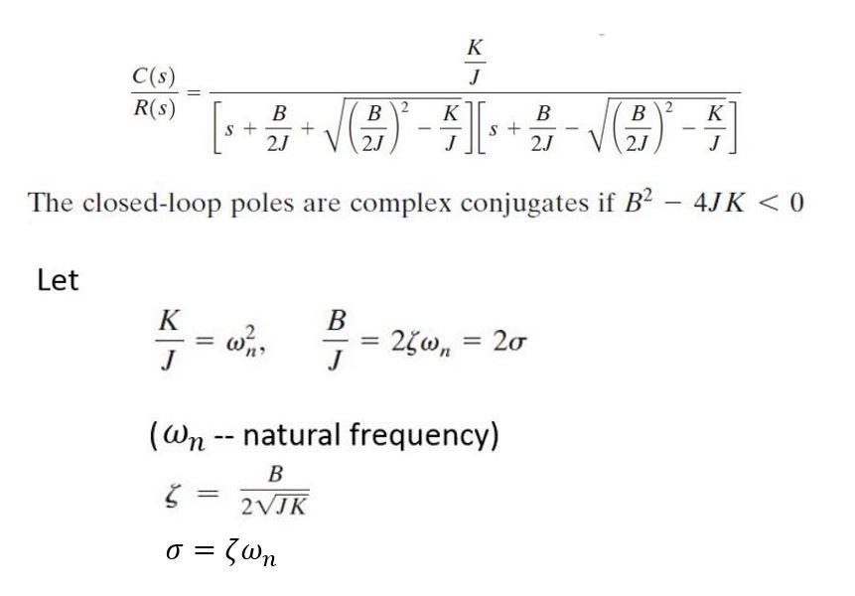

Slide 16
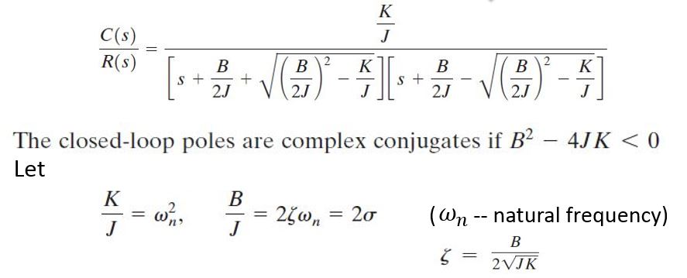


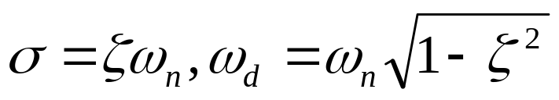

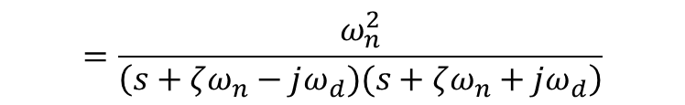
$$=\frac{ω_{n}^{2}}{\left(s+ζω_{n}−jω_{d})(s+ζω_{n}+jω_{d}\right)}$$
where

Slide 17
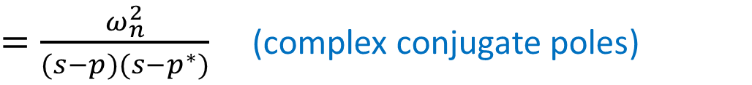
Summary:
$=\frac{ω_{n}^{2}}{(s−p)(s−p^{∗})}$ (complex conjugate poles)
where

Slide 18

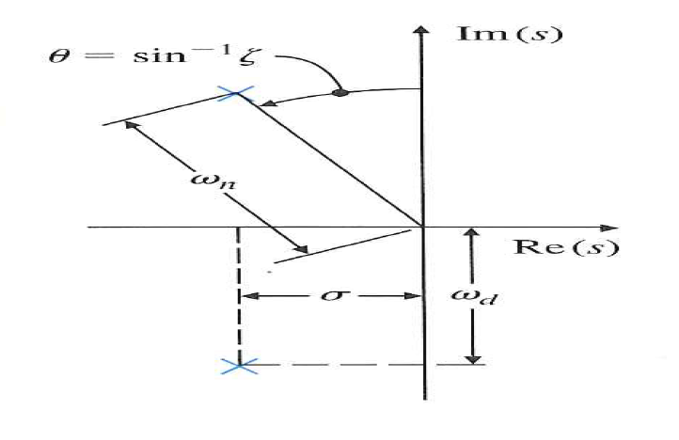

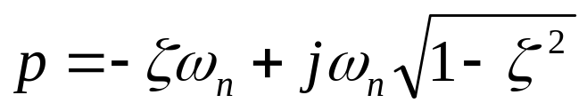

Geometric Meaning of Complex Conjugate Poles
(if ζ = 1 then ω_{n} = σ)

Slide 19
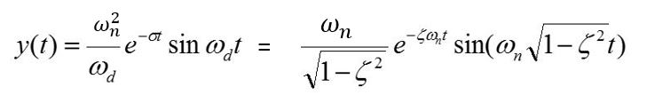
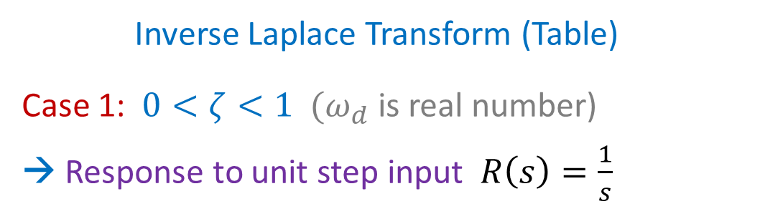
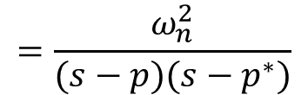
$$=\frac{ω_{n}^{2}}{(s−p)(s−p^{∗})}$$
Inverse Laplace Transform (Table)
Case 1: $0<ζ<1$ $(ω_{d}$ is real number)
→ Response to unit step input $R\left(s\right)=\frac{1}{s}$
c(t)
Verify this formula using Table of Laplace Transforms (not required)

Slide 20
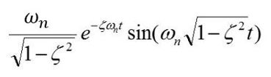
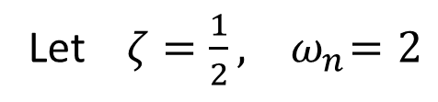

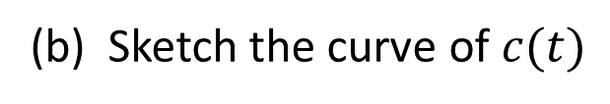
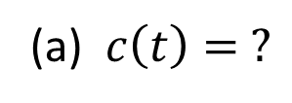
Exercise: (3 minutes)
Let $ζ=\frac{1}{2}, { ω}_{n}=2$
c(t) =
(a) $c\left(t\right)= ?$
(b) Sketch the curve of $c(t)$
$$t$$

Slide 21
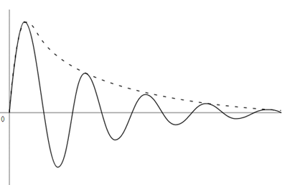
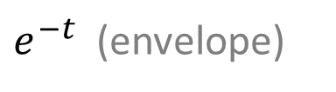
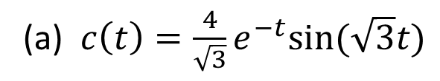
Answer:
Let $ζ=\frac{1}{2}, { ω}_{n}=2$
c(t) =
(a) $c\left(t\right)=\frac{4}{\sqrt{3}}e^{−t}sin⁡(\sqrt{3}t)$
(b) Sketch:
$e^{−t}$ (envelope)
$$t$$

Slide 22
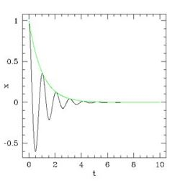
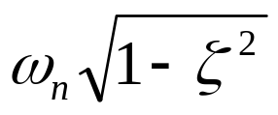
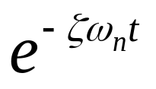
c(t)
→ (ω_{n}, ζ) Representation
Sinusoidal signal y(t) has
Frequency:
Decay envelop:
c(t)

Slide 23
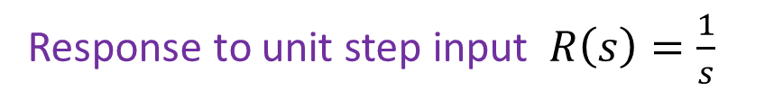

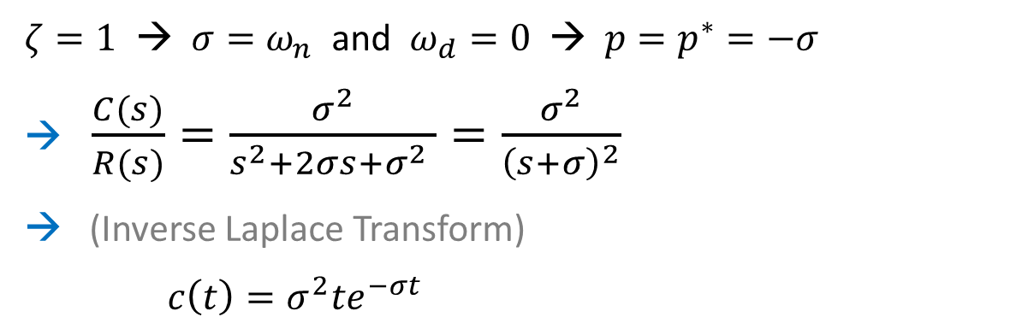
$$=\frac{ω_{n}^{2}}{(s−p)(s−p^{∗})}$$
Case 2: $ζ=1$
Response to unit step input $R\left(s\right)=\frac{1}{s}$
$ζ=1$ → $σ=ω_{n}$ and $ω_{d}=0$ → $p=p^{∗}=−σ$
→ $\frac{C(s)}{R(s)}=\frac{σ^{2}}{s^{2}+2σs+σ^{2} }=\frac{σ^{2}}{{\left(s+σ\right)}^{2}}$
→ (Inverse Laplace Transform)
$c\left(t\right)=σ^{2}te^{−σt}$

Slide 24
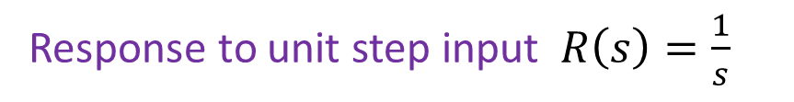
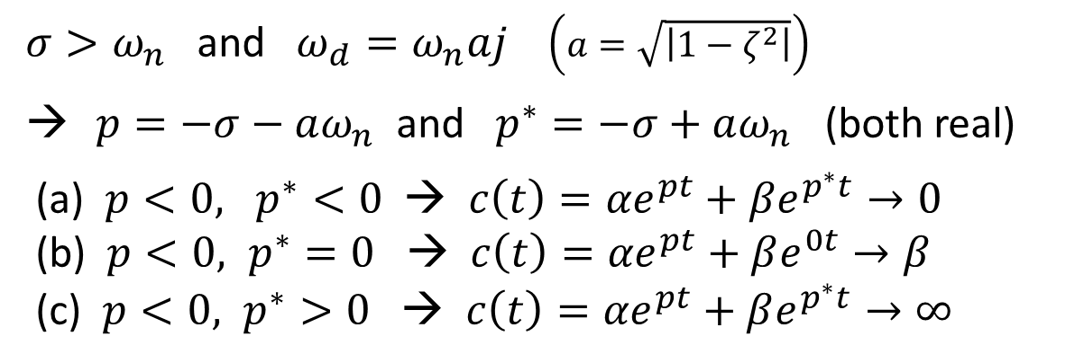

$$=\frac{ω_{n}^{2}}{(s−p)(s−p^{∗})}$$
Case 3: $ζ>1$
Response to unit step input $R\left(s\right)=\frac{1}{s}$
${σ>ω}_{n}$ and $ω_{d}=ω_{n}aj$ $\left(a=\sqrt{\left|1−ζ^{2}\right|}\right)$
$p=−σ−aω_{n}$ and $p^{∗}=−σ+aω_{n}$ (both real)
(a) $p<0, p^{∗}<0$ → $c\left(t\right)={αe}^{pt}+βe^{p^{∗}t}→0$
(b) $p<0, p^{∗}=0$ → $c\left(t\right)={αe}^{pt}+βe^{0t}→β$
(c) $p<0, p^{∗}>0$ → $c\left(t\right)={αe}^{pt}+βe^{p^{∗}t}→∞$

Slide 25
END

