Slide 1
CS2311 Computer Programming
Dr. Henry Xu
Lecture 11: Pointers Part II:
Arrays, Strings, and Dynamic Memory Allocation

Slide 2
Outline
Access array elements via pointers
Manage strings via pointers
Dynamic memory allocation

Slide 3
The NULL pointer
A special value that can be assigned to any type of pointer variable
A symbolic constant defined in several standard library headers, e.g. <iostream>
When assigned to a pointer variable, that variable points to nothing
Example
  int *ptr1 = NULL;
  int *ptr2 = 0;

Slide 4
Operations on pointers
Copying the address
  p = q;
  p and q point to the same variable
Copying the content
  Copy the value of the variable which is pointed by the p to the variable which is pointed by q
  *p = *q;
  p and q may point to different variables.

Slide 5
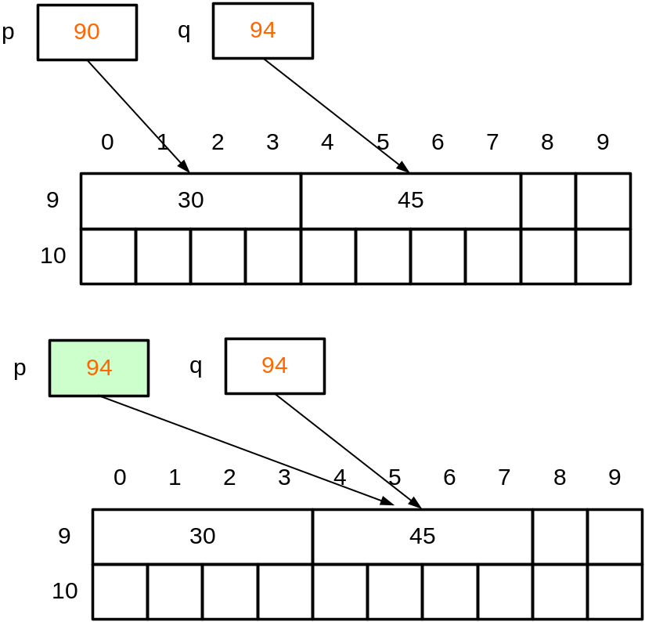
Copy the address
Assignment: p = q;
We copy the content (which is an address) of q to p.
After the assignment, p and q point to the same location in memory.
Therefore, if we change *p, *q will also be changed

Slide 6
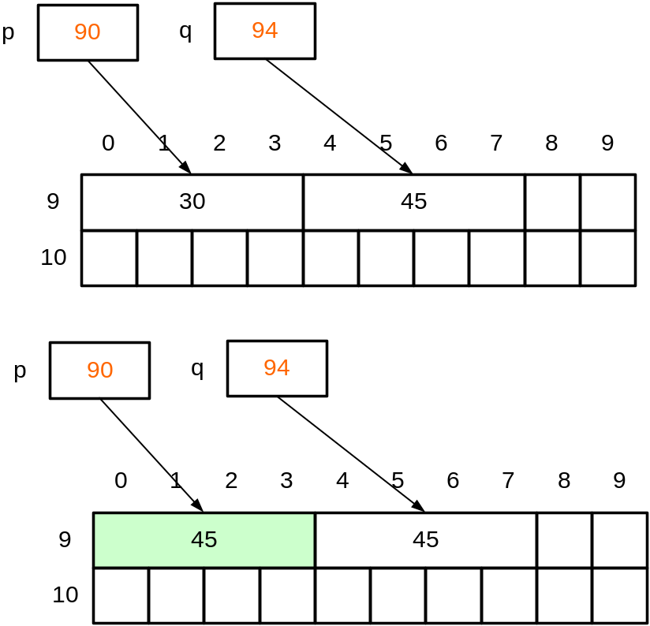
Copy the content
*p = *q;
We copy the value of the variable pointed by q to the variable pointed by p.
After the assignment, p and q still point to different locations in memory.
if we change *p, *q will not be changed as p and q points to different location in memory.

Slide 7
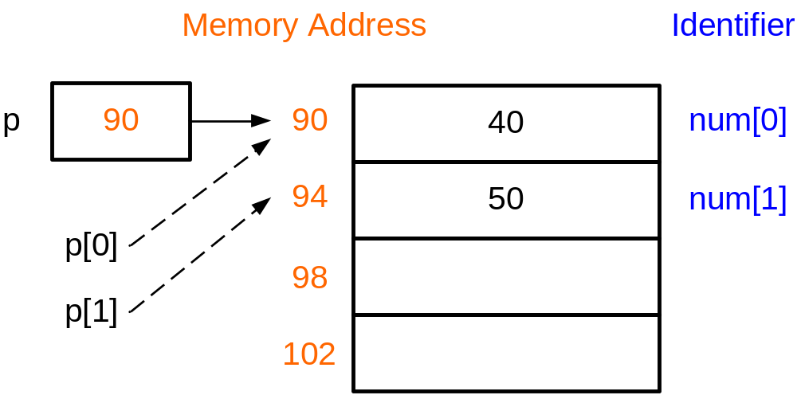
Relationship between arrays and pointers
int num[2]={40,50};
num[0]=400;
num[1]=500;
Equivalent to
int num[2]={40,50};
int *p;
p=num;
p[0]=400; p[1]=500;
We can use array-like notation in pointers
num is a constant pointer to the first byte of the array;
The value of p can be changed.
p=num;
However, the value of num cannot be changed.
num=p; /*illegal*/

Slide 8
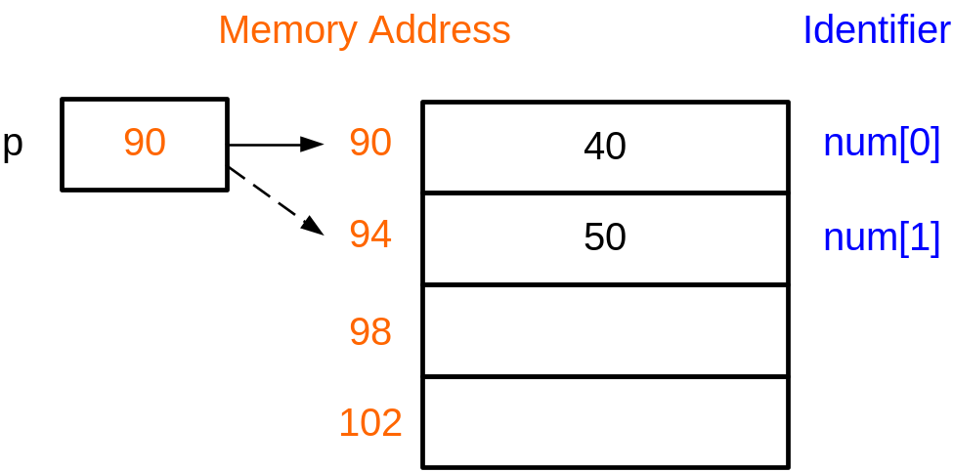
Relationship between arrays and pointers
int num[2]={40,50};
int *p;
p=num;
p[0]=400;
p[1]=500;
Equivalent to
int num[2]={40,50};
int *p;
p=num; /* p points to 90 */
*p=400;
++p; /*p points to 94 */
*p=500;
++p increments the content of p (an address) by sizeof(int) bytes

Slide 9
Arrays and pointers
Equivalent representation |  | Remark
num | &num[0] | num is the address of the 0th element of the array
num+i | &(num[i]) | Address of the ith element of the array
*num | num[0] | The value of the 0th element of the array
*(num+i) | num[i] | The value of the ith element of the array
(*num)+i | num[0]+i | The value of the 0th element of the array plus i

Slide 10
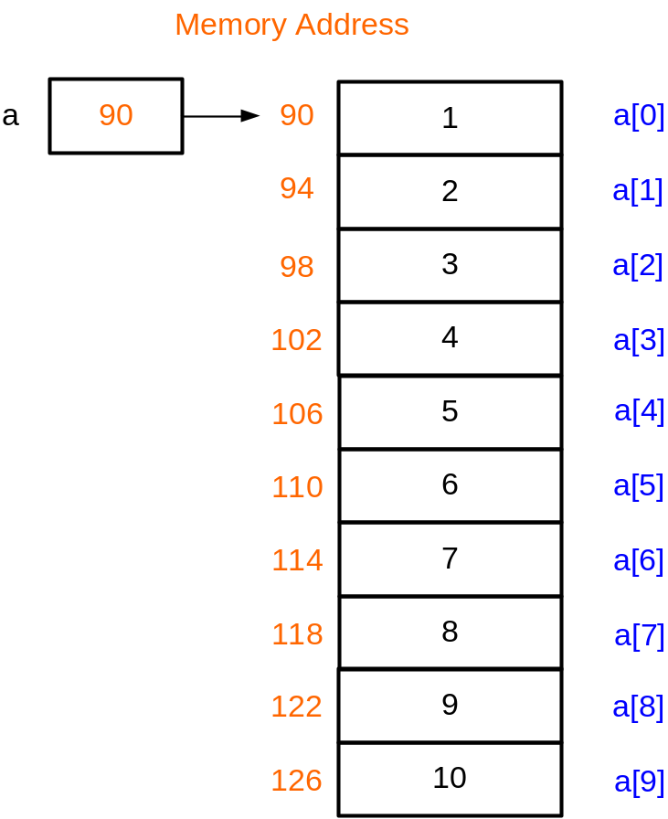
Example 2: summing an array
#define N 10
void main(){
int a[N]={1,2,3,4,5,6,7,8,9,10};
int i, sum = 0;
for (i = 0; i < N; ++i)
sum += *(a + i);
cout << sum; /*55 is printed*/
}
a+1 is the address of a[1]
a+2 is the address of a[2]
...
a+i is the address of a[i]
So, *(a+i) means a[i]

Slide 11
Passing arrays to functions
When an array is being passed, its base address is passed; the array elements themselves are not copied → This is call-by-reference
As a notational convenience, the compiler allows array bracket notation to be used in declaring pointers as parameters, e.g. (next page)
double sum(int *array); is the same as
double sum(int array[]);

Slide 12
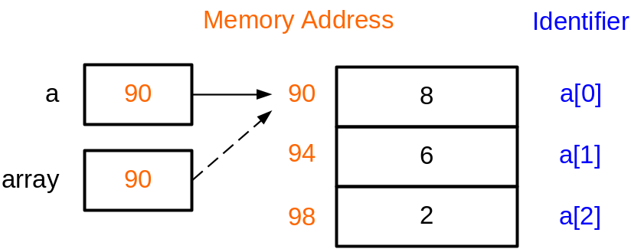
Example 3: Parameter Passing
/* Compute the mean value */
#include <iostream>
using namespace std;
#define N 5
double sum(int *);
int main(void)
{
int a[N] = {8,6,2,7,1};
double mean;
mean = sum(a)/N;
cout << "mean = “ << mean << endl;
return 0;
}
double sum(int *array)
{
int i;
double total = 0.0;
for (i=0; i<N; i++)
total += array[i];
return total;
}
When sum(a) is called, the content of a (address of a[0]) is assigned to the pointer array.
Therefore the pointer array points to a[0]
When array is passed as parameters, call-by-reference is used.
If we modify array[i] in sum, a[i] is also modified in main

Slide 13
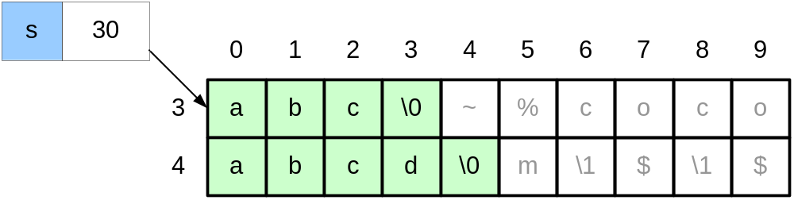
Arrays, pointers and strings
char s[]="abc";
s="abcd"; //illegal
Illegal as s is a constant pointer and cannot be modified

Slide 14
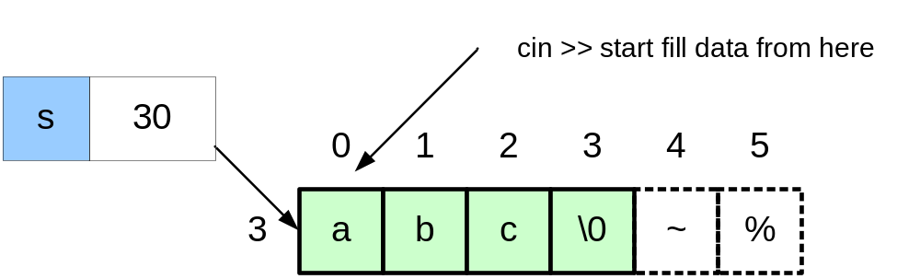
cin >> a string (I)
char s[]="abc";
cin >> s;
input: Hello_World

Slide 15
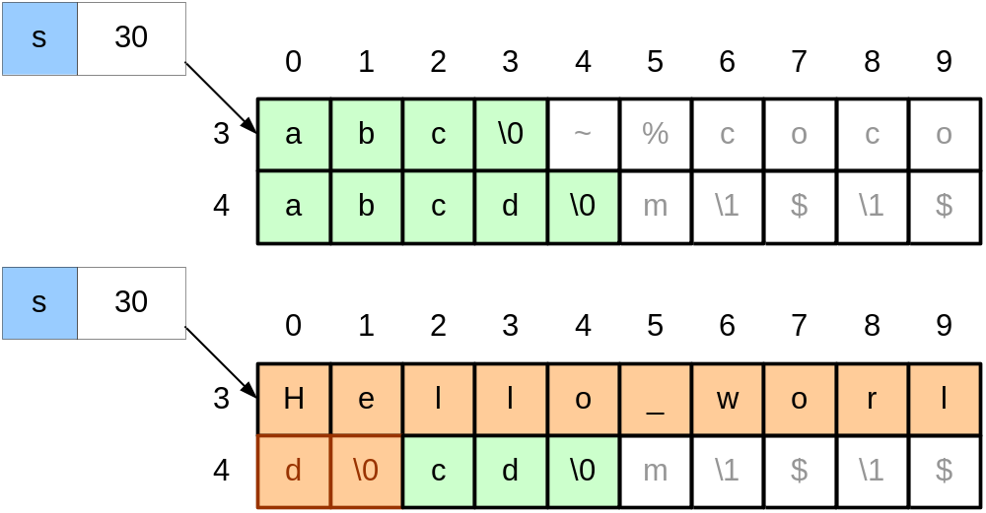
cin >> a string (I)
Size of s is 4. Array out-of-bound! cin >> does not perform bound-checking
Better to use:
cin.getline(s,4); /*read at most 3 characters*/
Remember to leave space for the final '\0' character

Slide 16
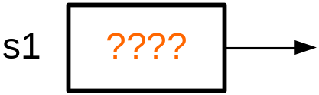
cin >> a string (II)
#include <iostream>
using namespace std;
void main () {
char *s1;
cin >> s1;
cout << s1;
}
Problem: when we declare the pointer s1, we do not know where s1 points to.
In this example, we try to read a string and store it in the location pointed by s1. This may generate errors as we may overwrite some important locations in memory

Slide 17
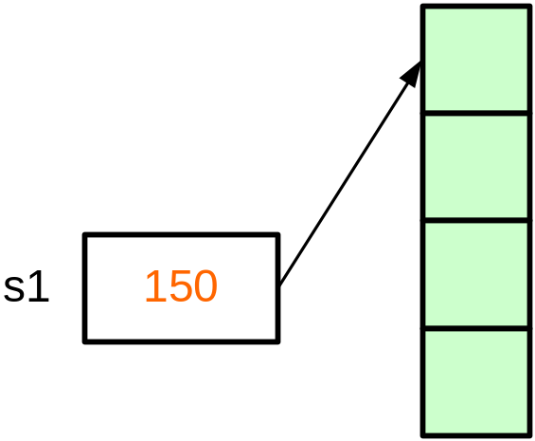
Dynamic memory allocation
#include <iostream>
void main () {
char *s1;
s1=new char[4];
cin >> s1; /*input "abc"*/
cout << s1;
delete s1;
s1=new char(6);
cin >> s1;
cout << s1;
delete s1;
s1=NULL;
}
new dynamically allocates 4 bytes of memory. new returns a pointer to the 1st byte of the chunk of memory, which is assigned to s1

Slide 18
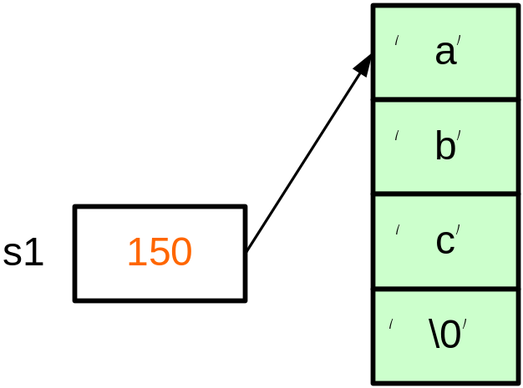
Example 4: Dynamic memory allocation
#include <iostream>
void main () {
char *s1;
s1=new char[4];
cin >> s1; /*input "abc"*/
cout << s1;
delete s1;
s1=new char(6); //same as char[6]
cin >> s1;
cout << s1;
delete s1;
s1=NULL;
}

Slide 19
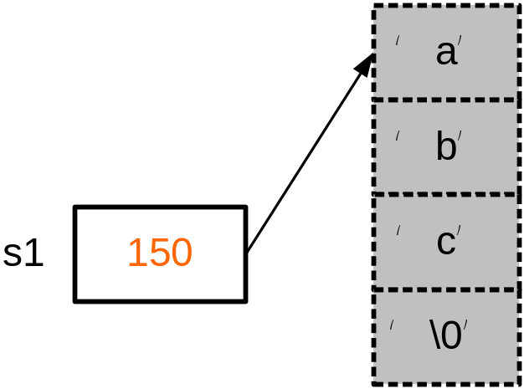
Example 4: Dynamic memory allocation
#include <iostream>
void main () {
char *s1;
s1=new char[4];
cin >> s1; /*input "abc"*/
cout << s1;
delete s1;
s1=new char(6); //same as char[6]
cin >> s1;
cout << s1;
delete s1;
s1=NULL;
}
Memory is free and can be used to store other data

Slide 20
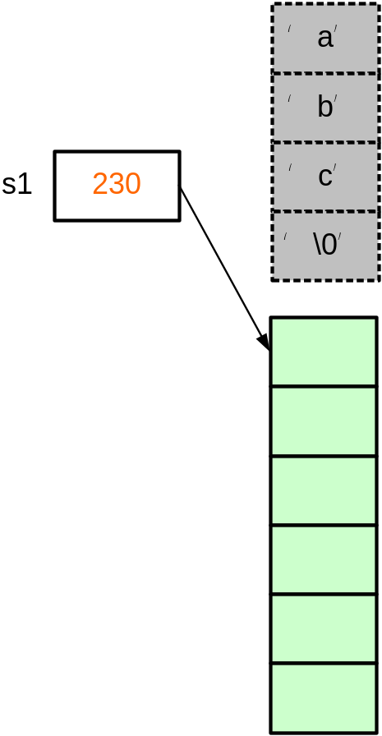
#include <iostream>
void main () {
char *s1;
s1=new char[4];
cin >> s1; /*input "abc"*/
cout << s1;
delete s1;
s1=new char(6); //same as char[6]
cin >> s1;
cout << s1;
delete s1;
s1=NULL;
}
new dynamically allocates 6 bytes of memory. new returns a pointer to the 1st byte of the chunk of memory, which is assigned to s1

Slide 21
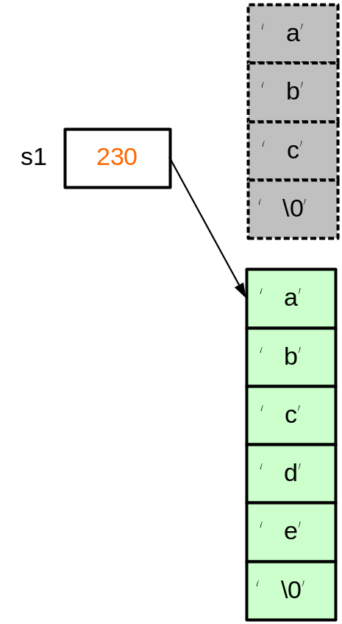
#include <iostream>
void main () {
char *s1;
s1=new char[4];
cin >> s1; /*input "abc"*/
cout << s1;
delete s1;
s1=new char(6); //same as char[6]
cin >> s1;
cout << s1;
delete s1;
s1=NULL;
}

Slide 22
Guidelines on using pointers
Initial a pointer to NULL after declaration
  char *cPtr=NULL;
Check its value before use
  if (cptr!=NULL){
  ….
  }
Free the memory allocated by the “new” operator using delete
  cPtr = new char[6]; …
  delete cPtr;
Set it NULL again after free
  delete cPtr;
  cPtr=NULL;

Slide 23
Summary
Pointers can be used to access array element.
Array name is a pointer pointing to the first element of the array.
A string is stored as an array of characters.
Strings must be terminated by an ‘\0’ character, therefore a string with 5 characters will take up 6 characters space.
Operator new allocates memory space and returns a pointer pointing to the newly allocated space.
Memory obtained by new must be deleted after use.
Extra care must be taken when handling pointers, as it may point to an invalid / unexpected location and make the program crashed.

