Slide 1

EE4803: Analog IC Design
Differential Amplifiers with Active Load
Department of Electrical Engineering
City University of Hong Kong
Prof. Arindam Basu

Slide 2
Outline
Differential Amplifiers—Characterization
Differential Amplifiers—Current mirror load
Differential Amplifiers—MOS diode load
Differential Amplifiers—Advanced topics
*With inputs from Phillip Allen’s course at Georgia Tech and Willy Sansen’s book

Slide 3
Outline
Differential Amplifiers—Characterization
Differential Amplifiers—Current mirror load
Differential Amplifiers—MOS diode load
Differential Amplifiers—Advanced topics
*With inputs from Phillip Allen’s course at Georgia Tech and Willy Sansen’s book

Slide 4
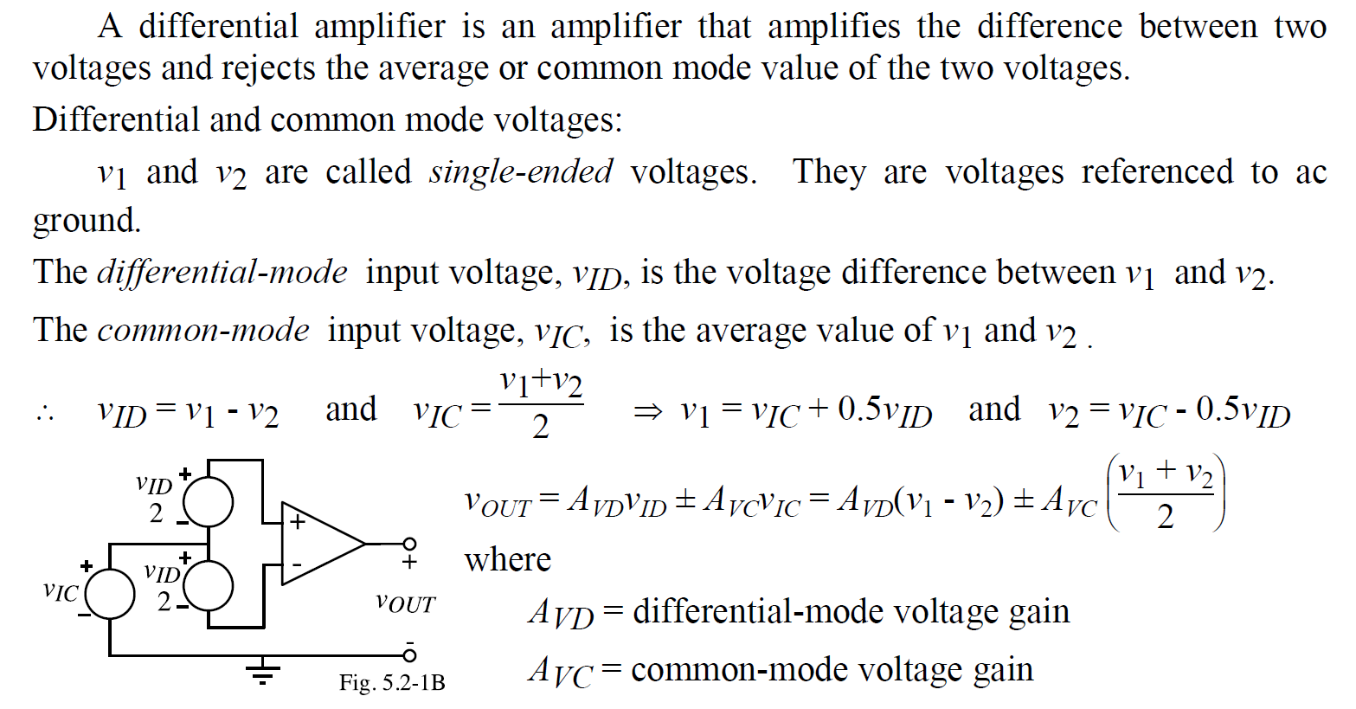
Differential Amplifiers: Characterization

Slide 5
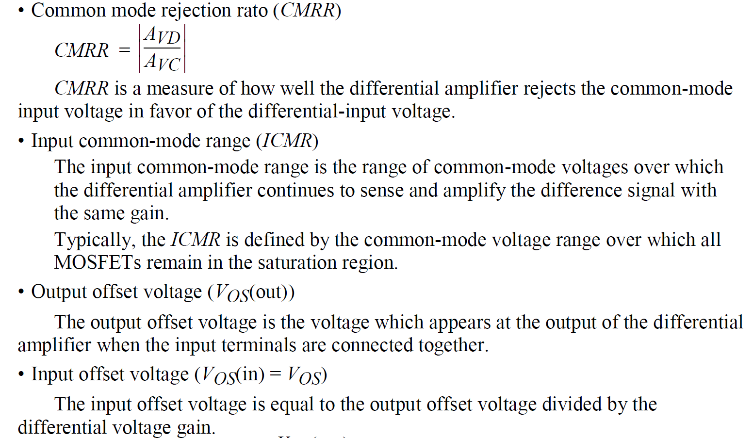
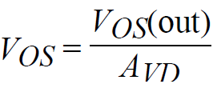
Differential Amplifiers: Characterization

Slide 6
Outline
Differential Amplifiers—Characterization
Differential Amplifiers—Current mirror load
Differential Amplifiers—MOS diode load
Differential Amplifiers—Advanced topics
*With inputs from Phillip Allen’s course at Georgia Tech and Willy Sansen’s book

Slide 7
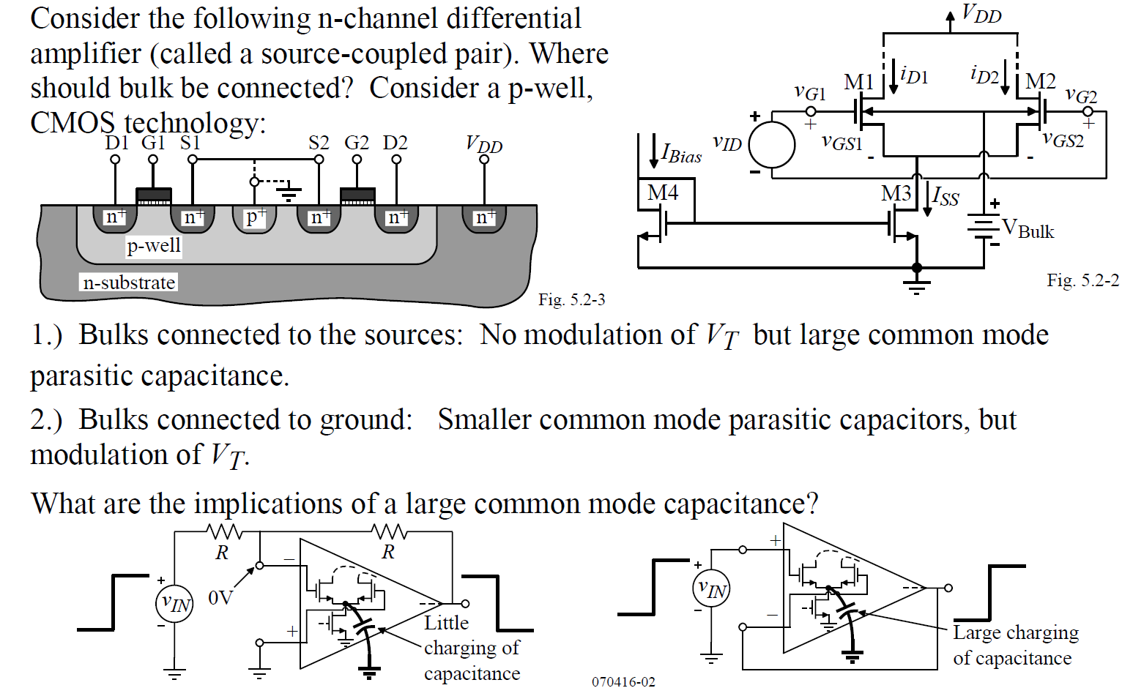
Differential Pair—Transconductance

Slide 8
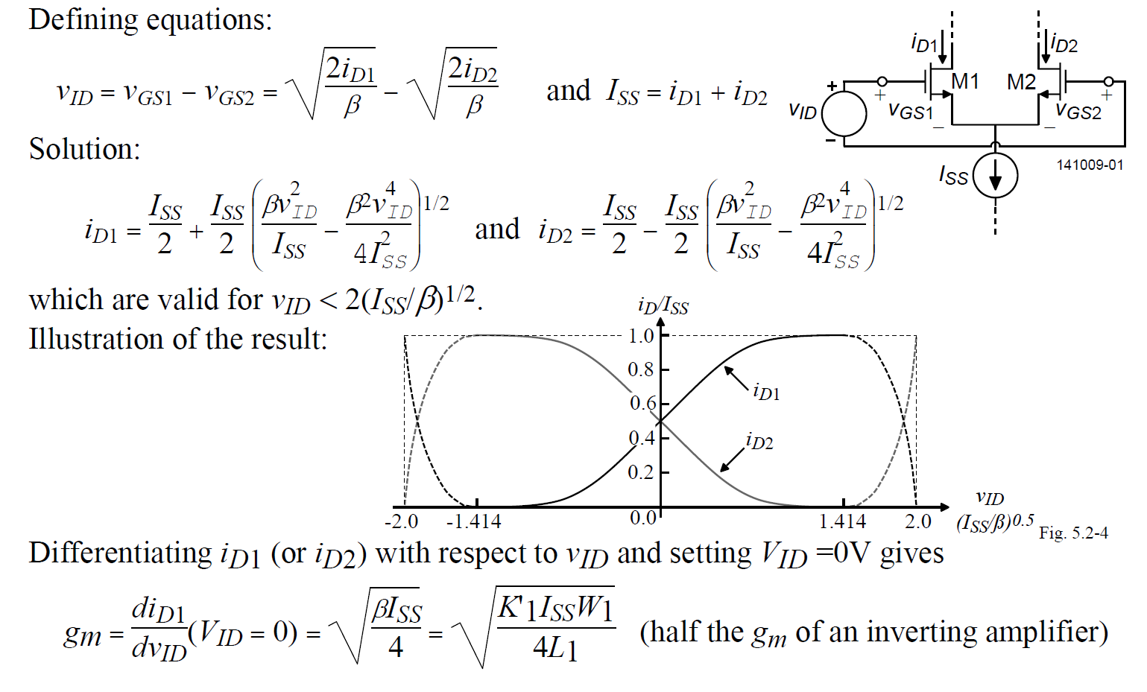
Differential Pair—Transconductance

Slide 9
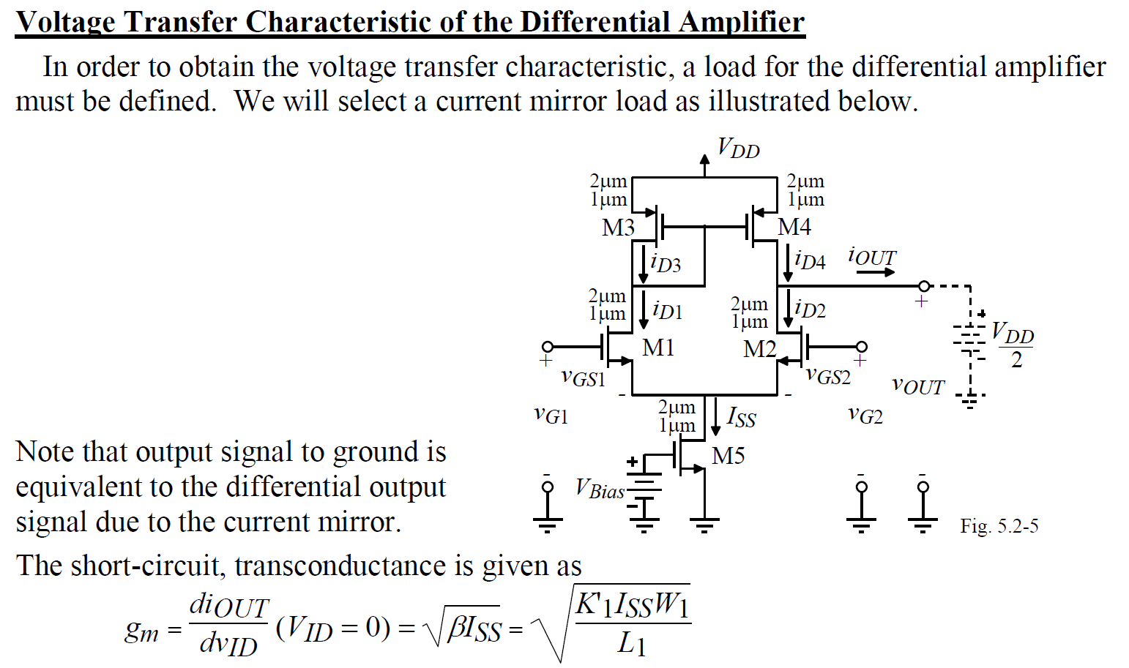
Differential Pair with Current Mirror

Slide 10
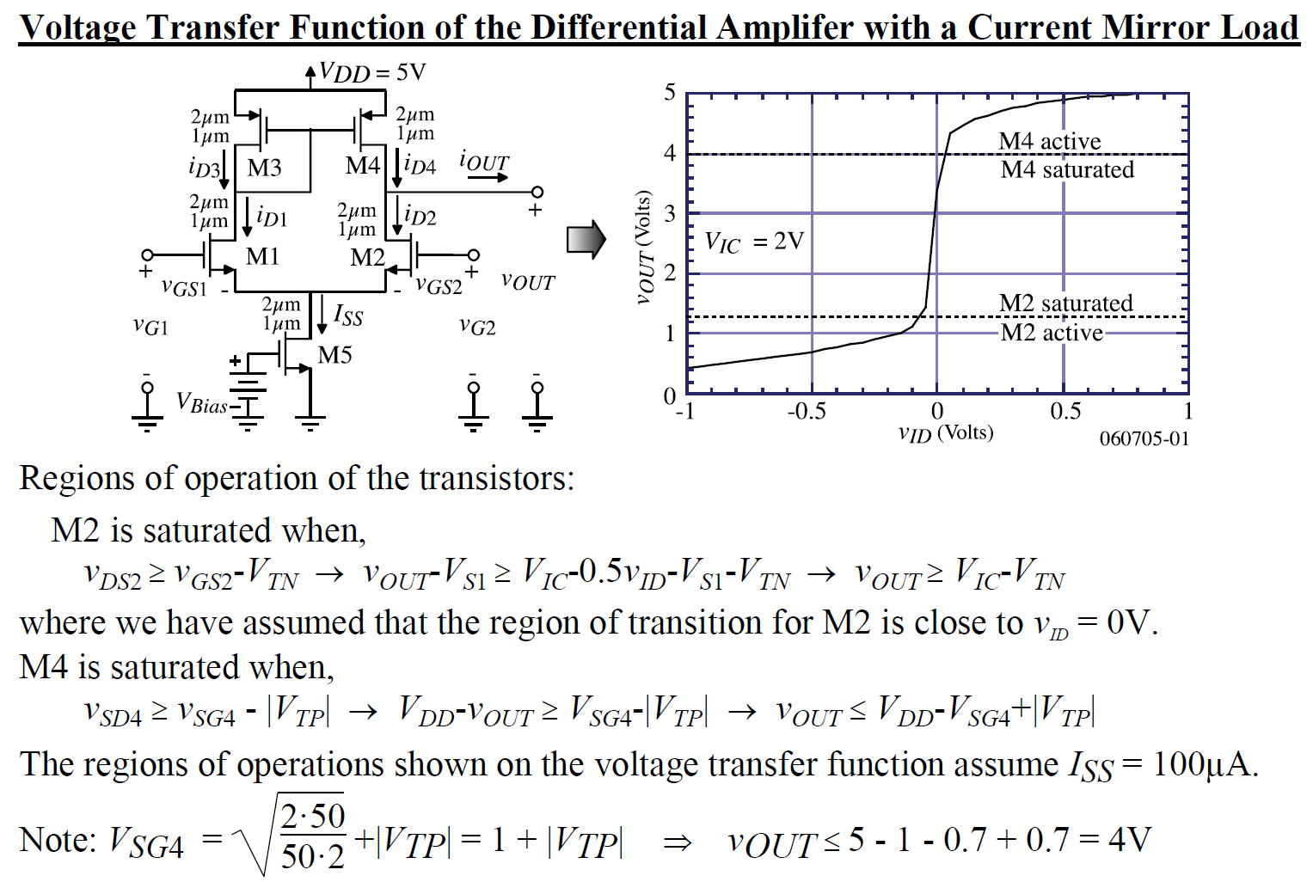
Differential Pair with Current Mirror

Slide 11
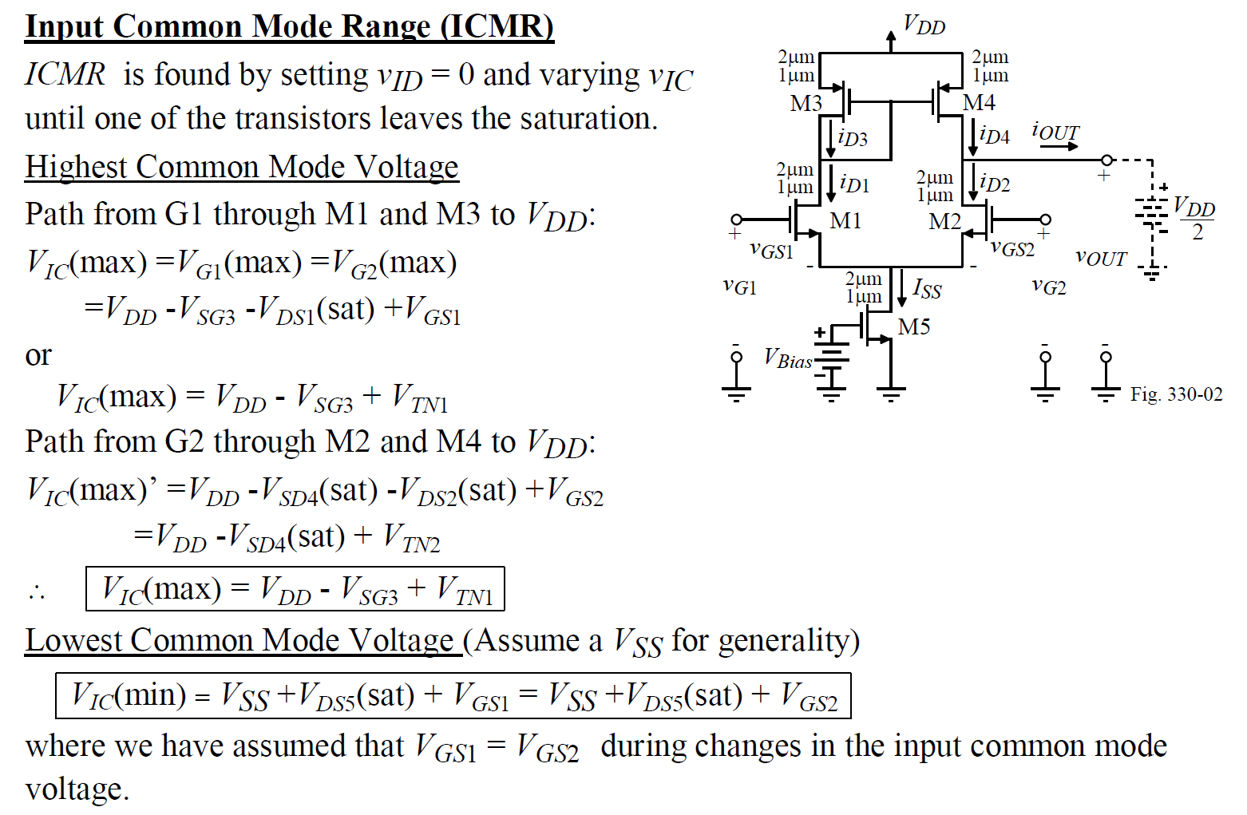
Differential Pair with Current Mirror

Slide 12
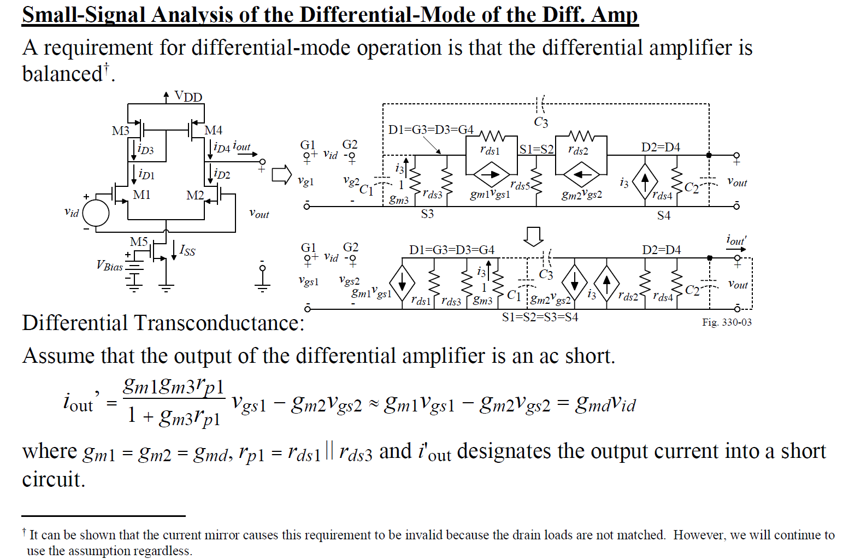
Differential Pair with Current Mirror

Slide 13
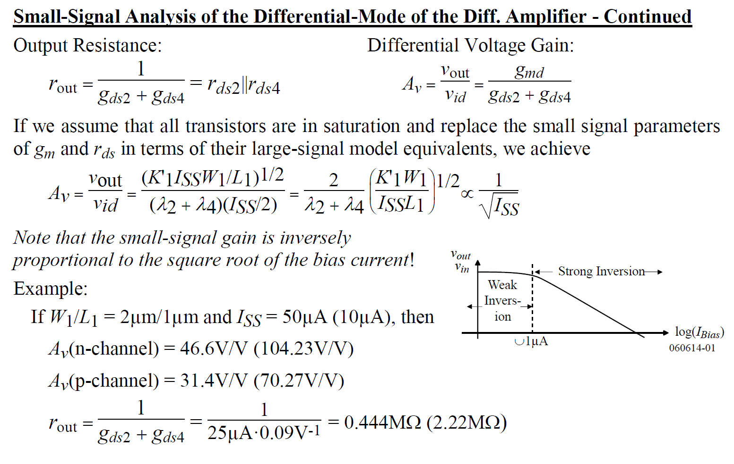
Differential Pair with Current Mirror

Slide 14
Outline
Differential Amplifiers—Characterization
Differential Amplifiers—Current mirror load
Differential Amplifiers—MOS diode load
Differential Amplifiers—Advanced topics
*With inputs from Phillip Allen’s course at Georgia Tech and Willy Sansen’s book

Slide 15
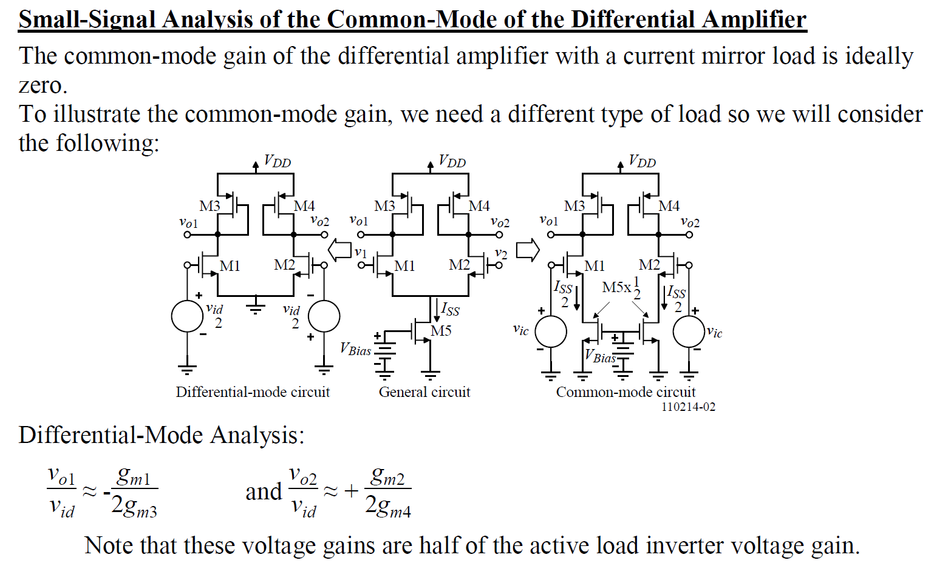
Differential Pair with MOS diode load

Slide 16
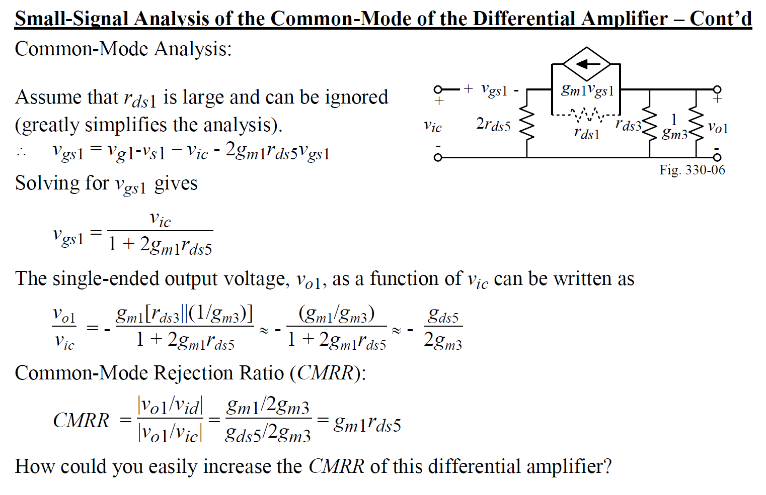
Differential Pair with MOS diode load

Slide 17
Outline
Differential Amplifiers—Characterization
Differential Amplifiers—Current mirror load
Differential Amplifiers—MOS diode load
Differential Amplifiers—Advanced topics
*With inputs from Phillip Allen’s course at Georgia Tech and Willy Sansen’s book

Slide 18
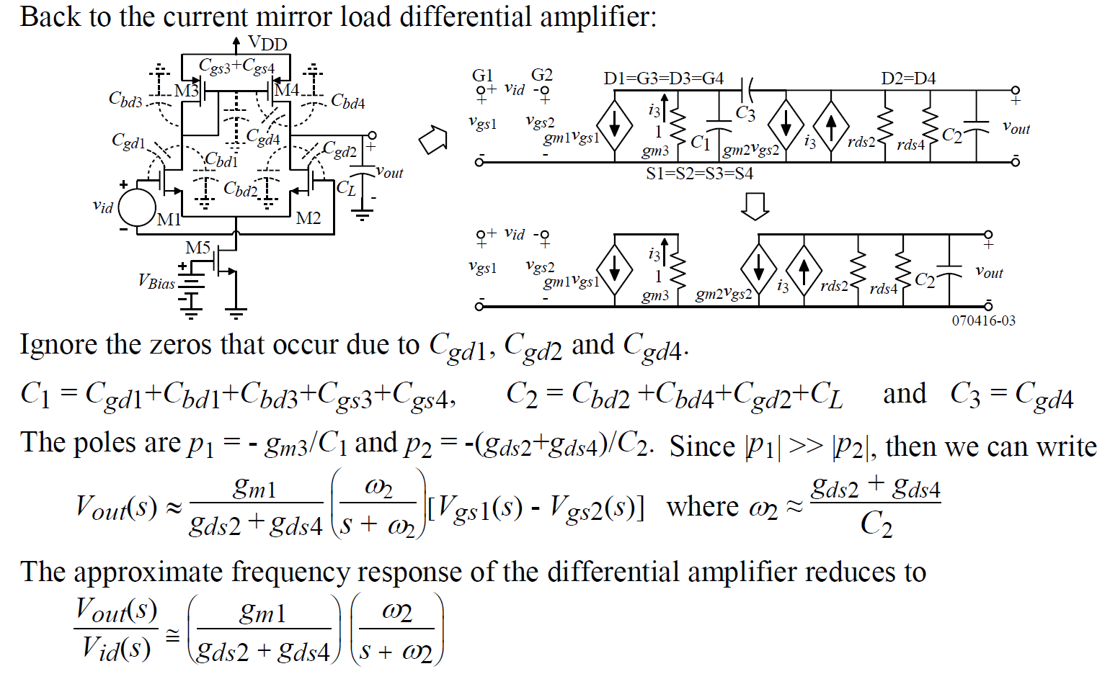
Frequency Response

Slide 19
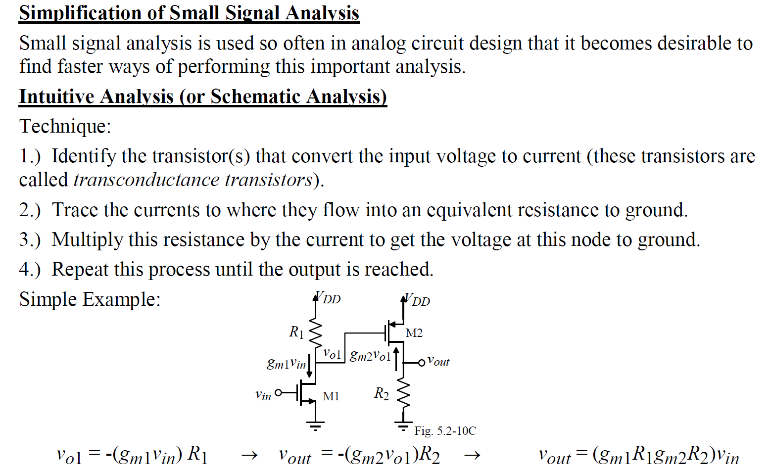
Intuitive Analysis

Slide 20
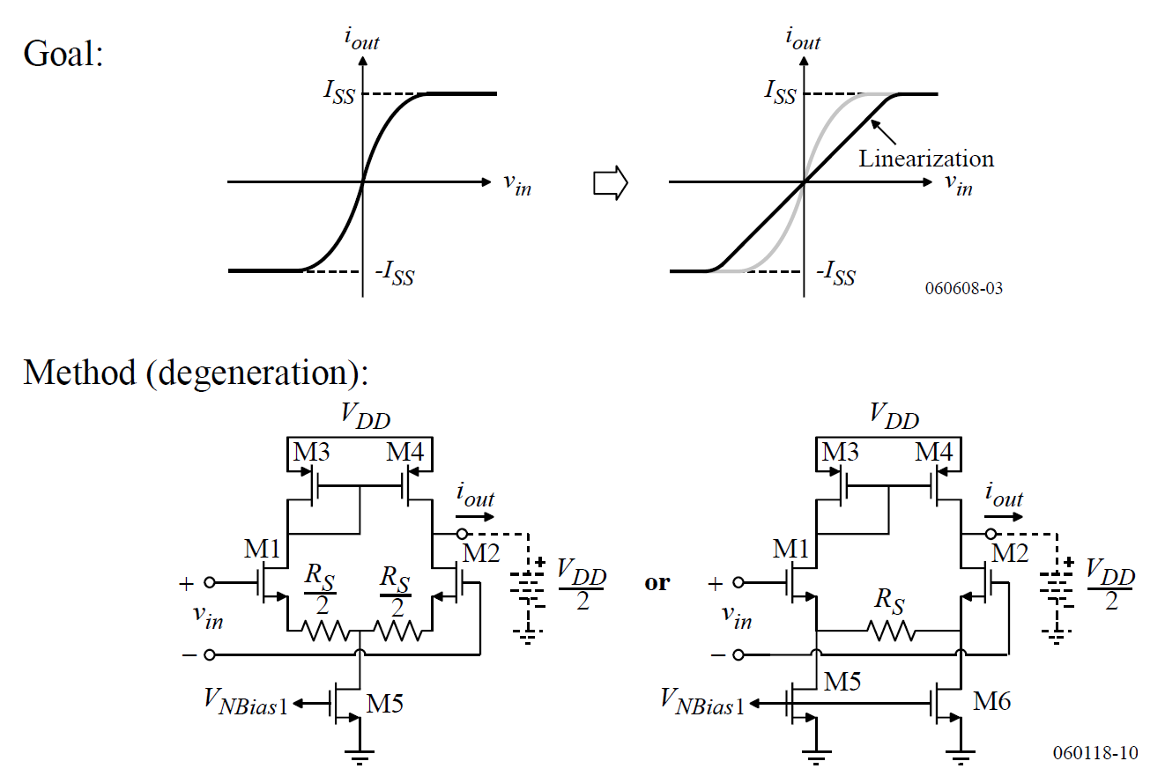
Linearization Techniques

Slide 21
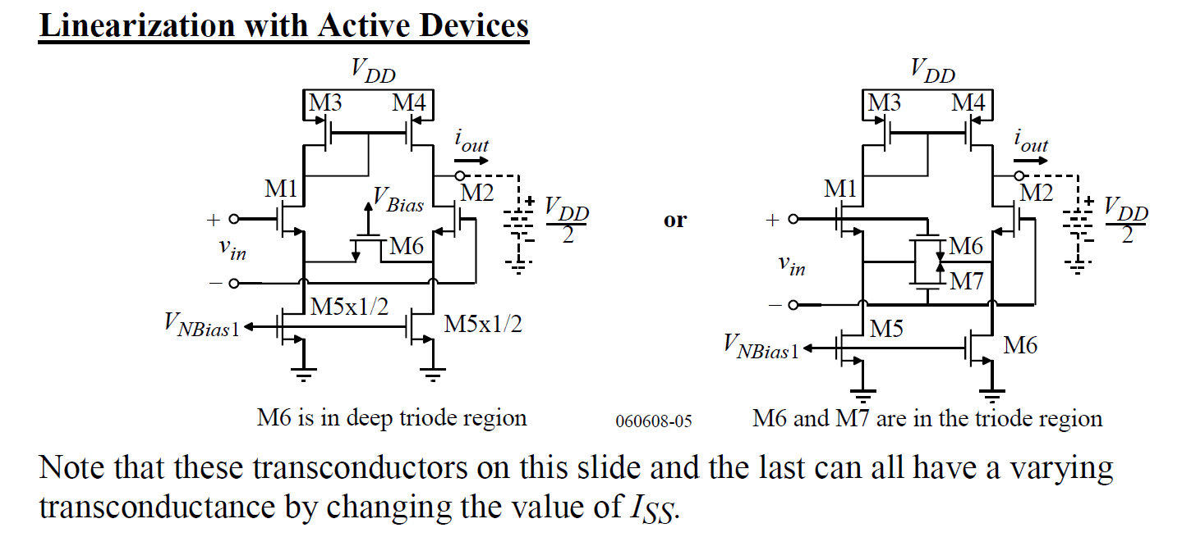
Linearization Techniques

Slide 22
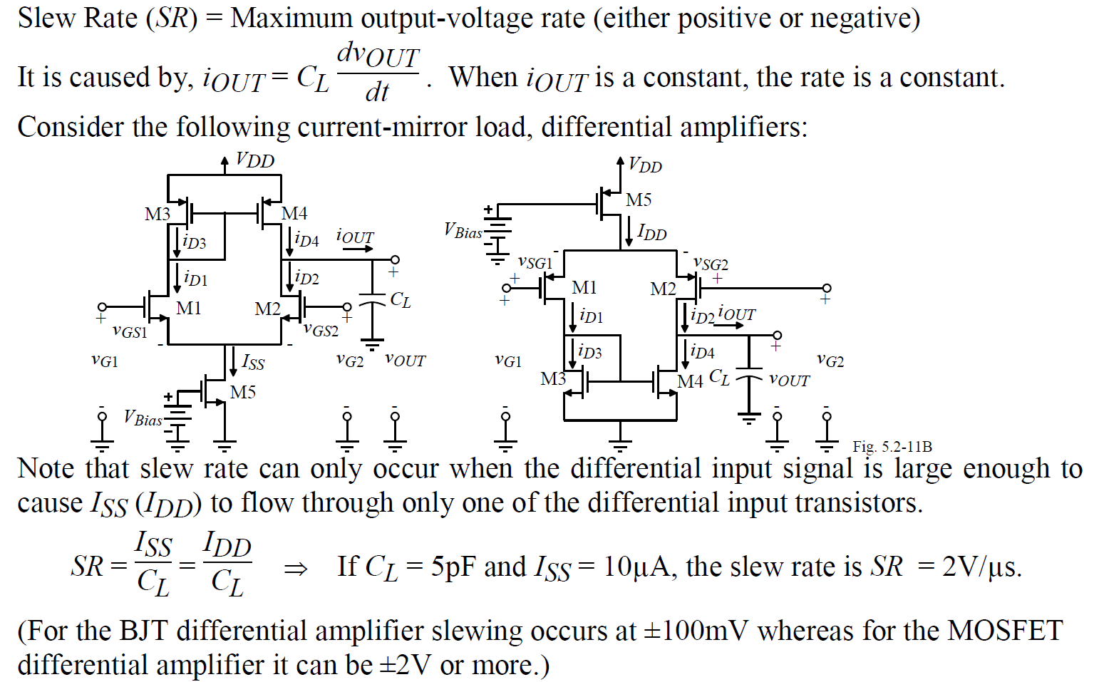
Slew Rate

Slide 23
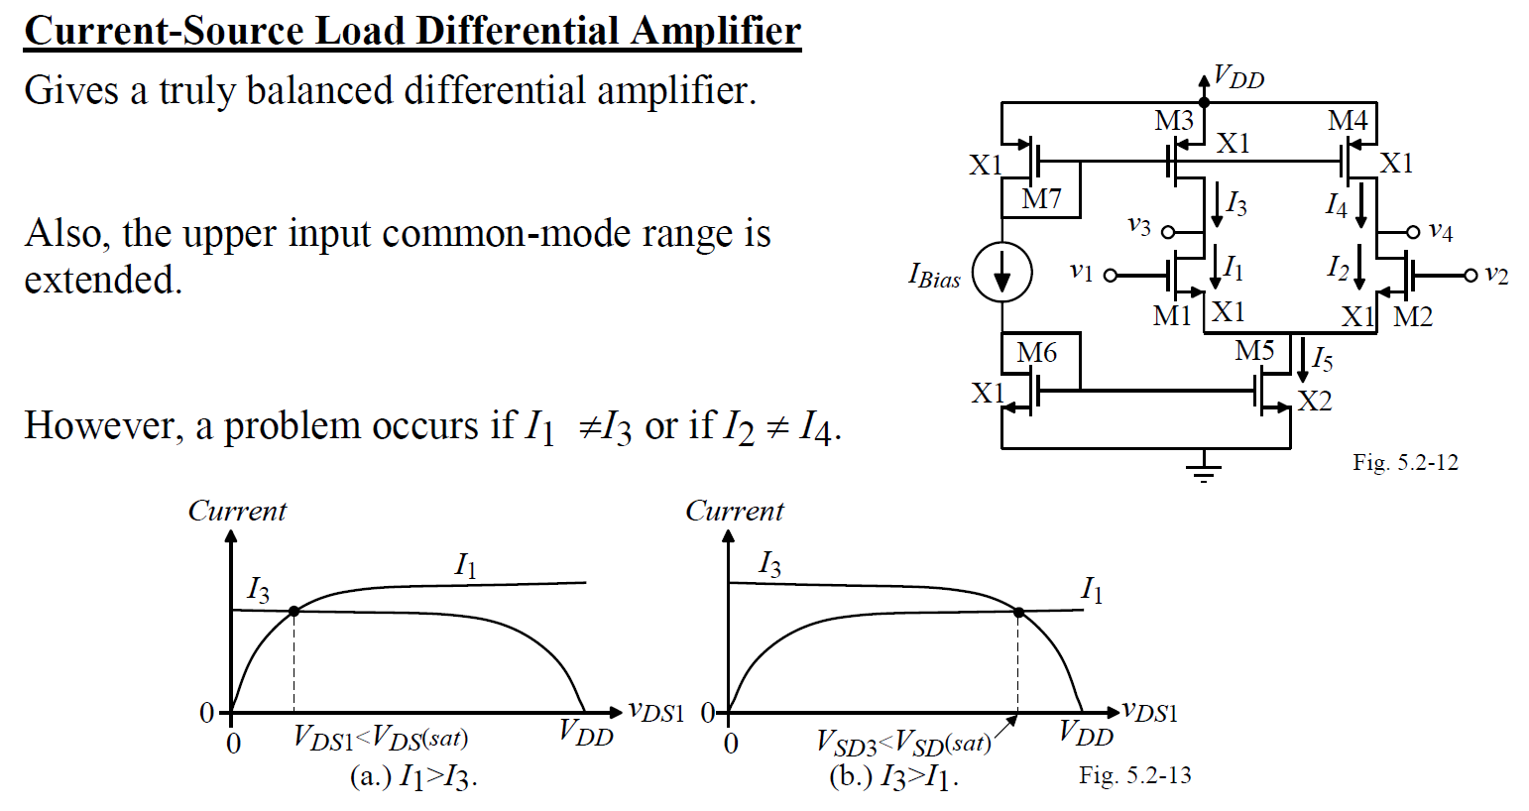
Current-source loads—CMFB

Slide 24
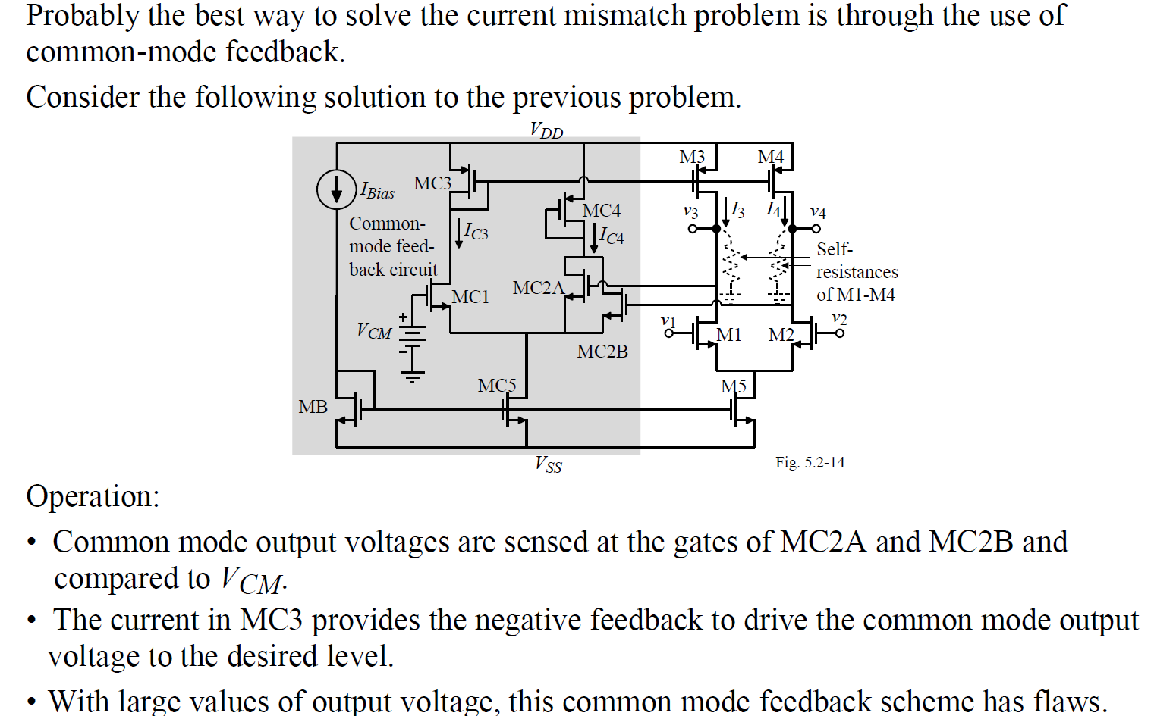
Current-source loads—CMFB
(CMFB)

Slide 25
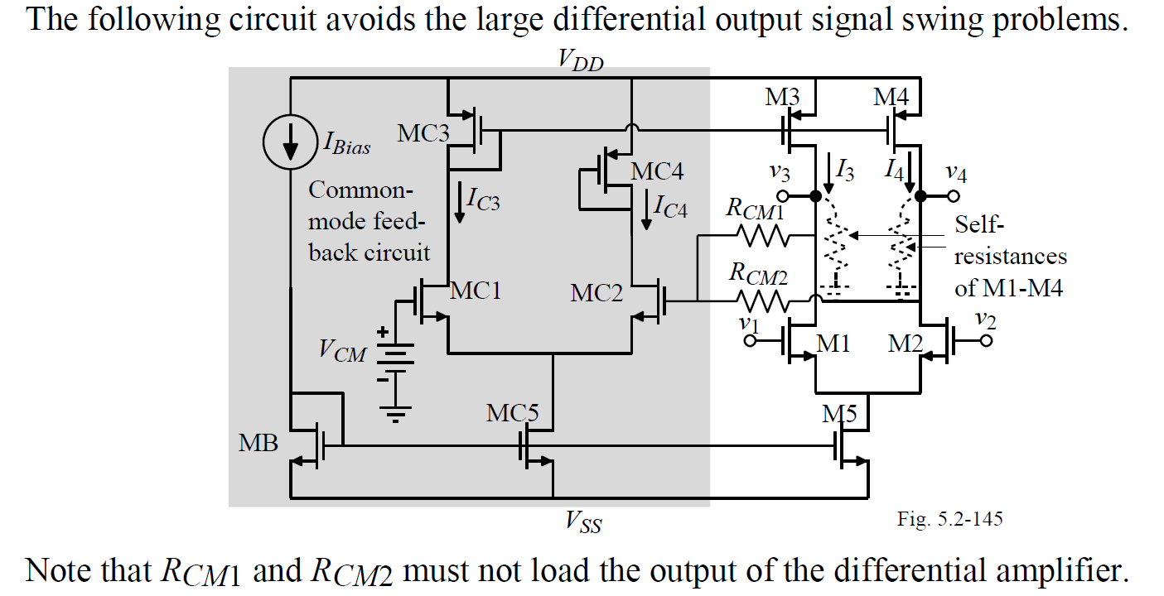
Current-source loads—CMFB

