Slide 1
Long Term Evolution (LTE)
References:
-4G: LTE/LTE-Advanced for Mobile Broadband. Erik Dahlman, Stefan Parkvall, and Johan Sköld. 2nd ed. Oxford, UK: Academic Press.
-An Introduction to LTE : LTE, LTE-Advanced, SAE, VoLTE and 4G Mobile Communications. Christopher Cox. 2nd ed. John Wiley & Sons.

Slide 2

Evolution of Mobile Networks
3G is the first mobile systems handling broadband data
4G, which includes LTE (Long-Term Evolution) and LTE-Advanced, provides even better support for mobile broadband

Slide 3
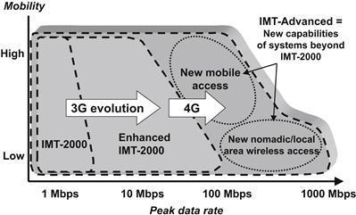

Slide 4
Drivers for 4G
Data rate: ever-increasing demand for higher data rates for mobile applications pushes the peak data rates for mobile systems from kbit/s for 2G to Mbit/s for 3G and getting close to Gbit/s for 4G
Delay: Interactive services such as real-time gaming have requirements for very low delay, making it a primary design target
Capacity: Besides the peak data rates, from the mobile system operator’s point of view, the total data rate that can be provided on average from each deployed base station site and per hertz of licensed spectrum is also important. This measure of capacity is called spectral efficiency.

Slide 5
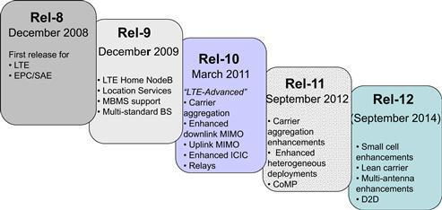
Developments in LTE

Slide 6
Data Rates
LTE was required to deliver a peak data rate of 100 Mbps in the downlink and 50 Mbps in the uplink
This requirement was exceeded in the eventual system, which delivers peak data rates 300 Mbps and 75 Mbps respectively
LTE-Advanced was required to deliver a peak data rate of 1000 Mbps in the downlink, and 500 Mbps in the uplink
In practice, the system has been designed so that it can eventually deliver peak data rates of 3000 and 1500 Mbps respectively

Slide 7
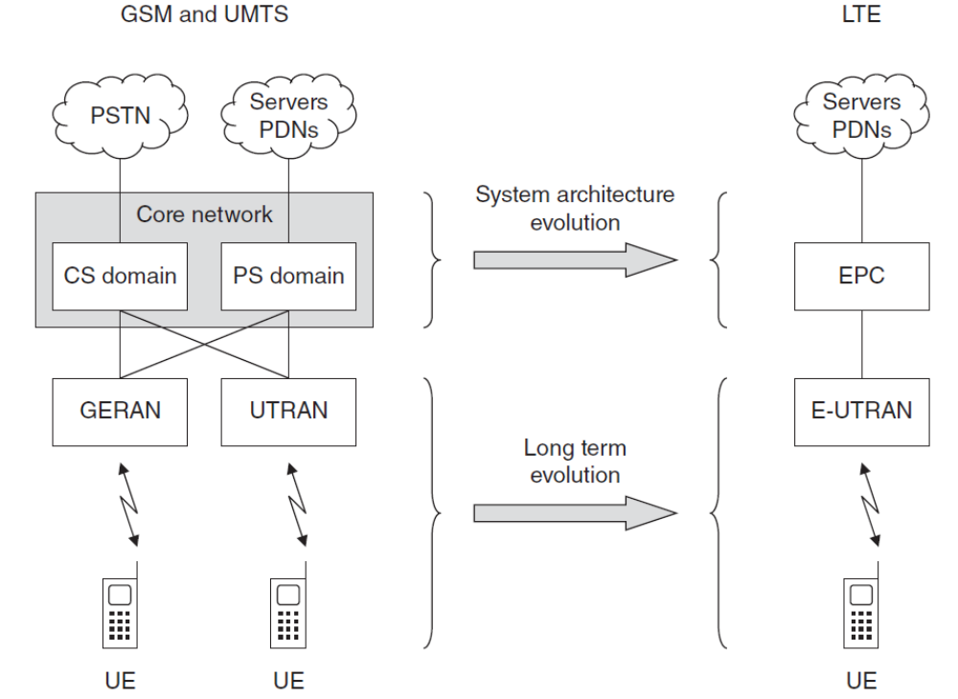
From UMTS to LTE

Slide 8
Overall System Architecture
The Evolved Packet Core (EPC) is a direct replacement of the PS domain of UMTS and GSM
There is no equivalent of CS domain, allowing LTE to be optimized for delivering data traffic. This is viable since voice calls can be transported by the voice over IP (VoIP) technique.
The evolved UMTS terrestrial radio access network (E-UTRAN) handles the EPC’s radio communications with the mobile, so is a direct replacement for the UTRAN.
Together, E-UTRAN and the EPC are referred to as the Evolved Packet System (EPS)
Although officially LTE refers only to the evolution of the air interface, it has become a colloquial name for the whole system,

Slide 9
EPC Functions
It is responsible for functions not related to the radio access but needed for providing a complete mobile-broadband network
This includes, for example, authentication, charging functionality, and setup of end-to-end connections

Slide 10
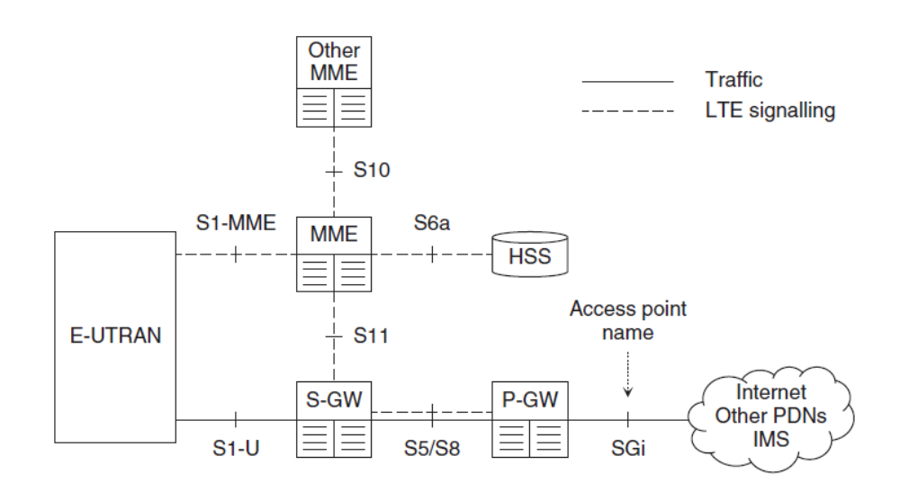
EPC Architecture
EPC

Slide 11
Four major elements
  Mobility Management Entity (MME)
  Serving Gateway (S-GW)
  Packet Data Network Gateway (PDN Gateway, P-GW)
  Home Subscriber Service (HSS) node

Slide 12
S-GW
acts as a high-level router, and forwards data between the base station and the PDN gateway
acts as a mobility anchor when UEs move between eNBs*, as well as a mobility anchor for earlier 3GPP technologies (GSM/GPRS and HSPA).
collects information and statistics necessary for charging
* eNB belongs to E-UTRAN

Slide 13
MME
operates in the control plane
responsible for connection/release of bearers to a terminal, handling of IDLE to ACTIVE transitions, and handling of security keys

Slide 14
P-GW
connects the EPC to the internet
allocates IP address for terminals
enforce quality-of-service (QoS) according to the policy controlled by the PCRF (see next slide)
it is also the mobility anchor for non-3GPP radio-access technologies, such as CDMA2000, connected to the EPC

Slide 15
HSS & Other Nodes
HSS node is a database containing subscriber information.
the EPC also contains other types of nodes such as Policy and Charging Rules Function (PCRF) responsible for QoS handling and charging, and equipment identity register (EIR) which lists the details of lost or stolen mobiles.

Slide 16
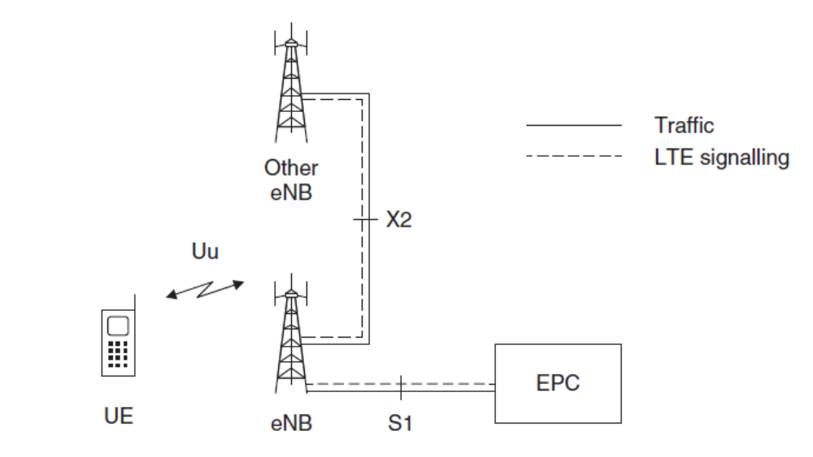
E-UTRAN

Slide 17
E-UTRAN has only one node type, the evolved Node B (eNB)
eNB is responsible for all radio-related functions in one or several cells
An eNB is connected to the S-GW by means of the S1 interface, and connected to another eNB via the X2 interface
Usually, the S1 and X2 interfaces are not direct physical connections. Instead, they are merely logical connections and realized in an IP transport network (see the figure in next page)

Slide 18
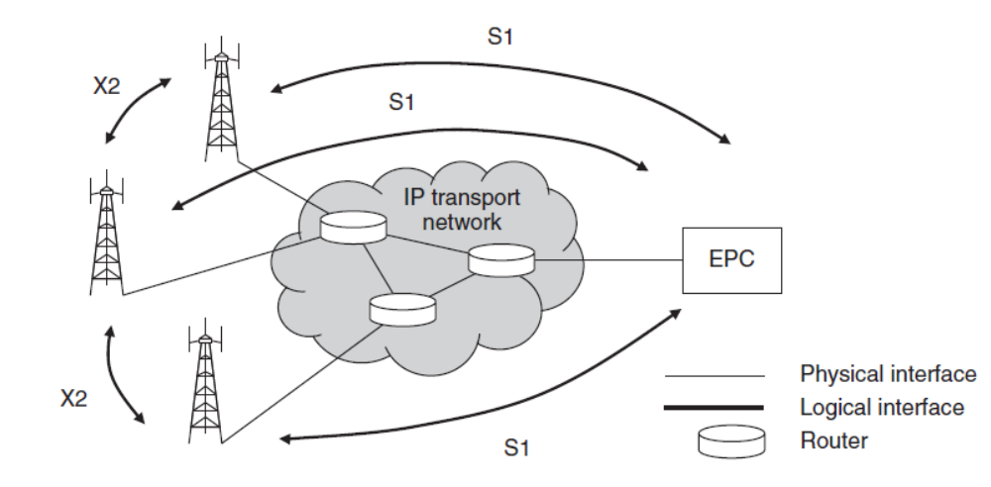
Internal Architecture of E-UTRAN

Slide 19
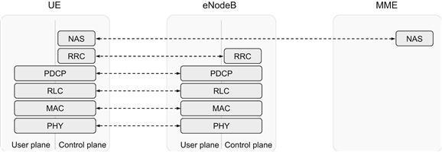
Radio Protocol Architecture
*The functionality operating between the EPC and UE is sometimes referred to as the Non-Access Stratum (NAS), while the Access Stratum (AS) handles functionality operating between UE and eNBs

Slide 20
User Plane Protocol Stack
Packet Data Convergence Protocol (PDCP)
Radio-Link Control (RLC)
Medium-Access Control (MAC)
Physical Layer (PHY)

Slide 21
PDCP
performs IP header compression to reduce the number of bits to transmit over the radio interface
also responsible for ciphering
for the control plane, integrity protection of the transmitted data, as well as in-sequence delivery and duplicate removal for handover

Slide 22
RLC
provides services to the PDCP
responsible for
  segmentation/concatenation
  retransmission handling, duplicate detection
  in-sequence delivery to higher layers

Slide 23
MAC
handles multiplexing of logical channels, hybrid-ARQ retransmissions, and uplink and downlink scheduling
the scheduling functionality is located in the eNB for both uplink and downlink
the hybrid-ARQ protocol part is present in both the transmitting and receiving ends of the MAC protocol

Slide 24
PHY
offers services to the MAC layer in the form of transport channels
handles coding/decoding, modulation/demodulation, multi-antenna mapping, and other typical physical-layer functions

Slide 25
LTE Basic Technologies
orthogonal frequency division multiplexing (OFDM)
channel-dependent scheduling and rate adaptation
inter-cell interference coordination
multi-antenna techniques

