Slide 1
EE2203 Modelling Techniques
Week 1

Slide 2
Topics covered in this course
Week | Topic
1 | MATLAB 101; types of optimization problems
2 | Search methods
3 | Nonlinear optimization
 | No class (CNY)
4 | Linear optimization
5 | Linear Algebraic equations and matrics
6 | Matrix Inverse and condition and iterative methods
7 | Midterm test
8 | Simple and Multiple regression
9 | Generalized linear models
10 | Logistic regression
11 | Variables selection
12 | Interaction
13 | Survival analysis

Slide 3
Assessment Activities
Continuous Assessment (40%)
  Tutorials (5%)
  Assignments (15%)
  Mid-term test (20%)
Examination (60%)

Slide 4


What is modelling?
creating a simplified representation of reality
Street view
Map
A good model is appropriate for the specific uses intended for it

Slide 5
working with this representation to understand or control some aspect of the world
e.g. find the location of a building, predict the outcome in the future

Slide 6
1.1.1 benefits of modelling
modelling can improve our understanding of the problem
using model can make better decision
modelling involves:
logical analysis
breaking down the problem into subproblems
making assumptions
improves our thinking skills

Slide 7
model has:
parameters
calculations
numerical outcome
improve our quantitative reasoning skills
modelling is widely used in:
science and engineering
business decision
marketing research
financial analysis …

Slide 8

Example
To predict the number of transistors that could be integrated onto a single chip
– Moore’s Law.

Slide 9
This lecture:
MATLAB
Types of optimization

Slide 10
4.1 MATLAB
MATrix LABoratory is a data analysis, prototyping, and visualization tool with built-in support for matrices and matrix operations, graphics capabilities, high-level programming language and development environment
MATLAB provides many built-in functions
many specialized functions are grouped as toolboxes

Slide 11
4.1.1 The MATLAB environment
when you start MATLAB, the command window will open with the prompt >>
user can enter commands or data in the command window
for each command typed in, you get the result immediately
if you do not assign the result to a variable, MATLAB will assign it to ans

Slide 12
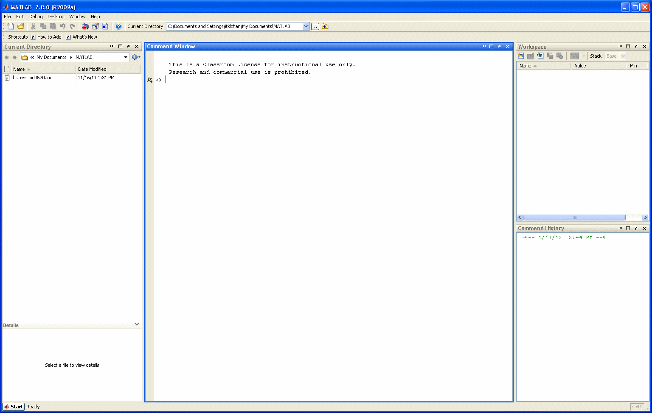

Slide 13
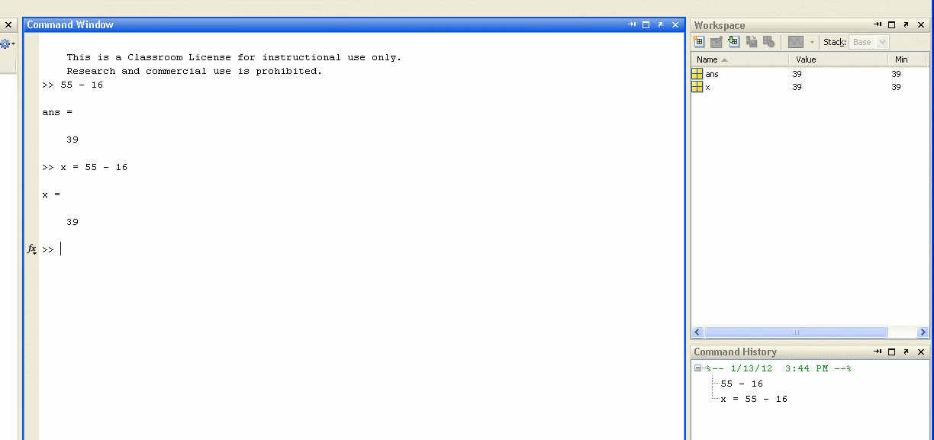

Slide 14
Data types:
uint8 unsigned integer (8 bits)
uint16 unsigned integer (16 bits)
uint32 unsigned integer (32 bits)
int8 signed integer (8 bits)
int16 signed integer (16 bits)
int32 signed integer (32 bits)
single single-precision floating-point number (4 bytes)
double double-precision floating-point number (8 bytes)
logical true (1) or false (0) (8 bits)
char characters (2 bytes)

Slide 15
Can’t remember how to use a command/function…
Type
help function_name

Slide 16
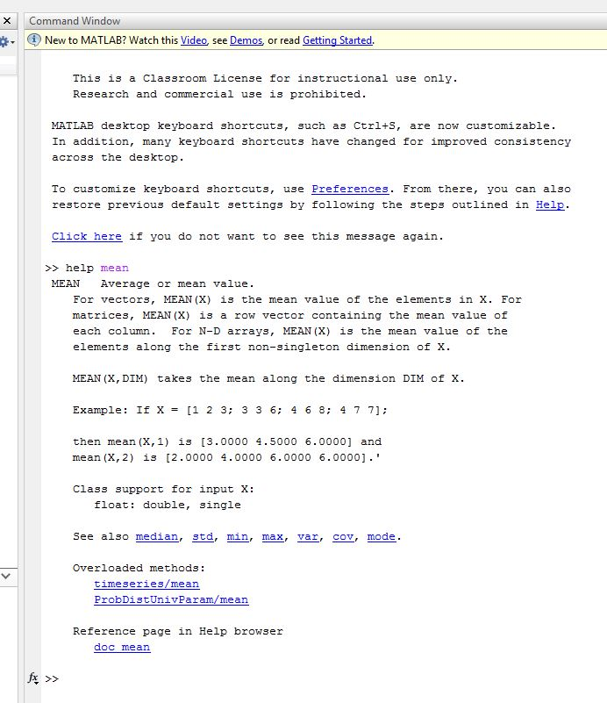

Slide 17
4.1.2 Assignment
assign value(s) to variable name(s)
scalar variable
>> a = 4
a =
4
>>
>> a = 4;
>>
>> a = 4, A = 6
a =
4
A =
6
>>
Separate multiple commands by comma
Case sensitive
No echo print

Slide 18
array
a collection of values represented by one variable name
one-dimensional array – vector
two-dimensional array – matrix
>> a = [1 2 3 4 5]
a =
1 2 3 4 5
>>
Row vector

Slide 19
>> a = [1;2;3;4;5]
a =
1
2
3
4
5
>>
>> a = [1 2 3 4 5]'
a =
1
2
3
4
5
>>
Use single quote as transpose operator
Column vector

Slide 20
>> A = [1 2 3; 4 5 6; 7 8 9]
A =
1 2 3
4 5 6
7 8 9
>>
>> A = [1 2 3
4 5 6
7 8 9]
A =
1 2 3
4 5 6
7 8 9
>>
Press Enter key
to separate the rows

Slide 21
To access individual element:
>> a(3)
ans =
3
>>
>> A(2,3)
ans =
6
>>
Column index
Row index

Slide 22
colon operator
>> A(2,:)
ans =
4 5 6
>>
Access the entire row
increment
(If it is omitted,
the default value is 1)
start
end
>> t = 1:0.5:3
t =
1.0000 1.5000 2.0000 2.5000 3.0000
>>

Slide 23
negative increment
>> t = 10:-1:5
t =
10 9 8 7 6 5
>>
To extract part of the array:
>> t(2:4)
ans =
9 8 7
>>

Slide 24
4.1.3 Mathematical operations
^ exponentiation
- negation
* / multiplication, division
\ left division
+ - addition, subtraction
priority order can be overridden with parentheses
Highest priority
Lowest priority

Slide 25
>> y = -4 ^ 2
y =
-16
>>
>> y = (-4) ^ 2
y =
16
>>

Slide 26
4.1.4 M-file
M-file provides an alternative way of using MATLAB to perform numerical analysis
starts with the word function
can have input argument(s) and output(s)
multiple inputs - separate by comma
multiple outputs – separate by comma, enclose in square brackets
it contains a series of statements
the file is stored with an extension .m

Slide 27
function [out_var] = func_name(arg_list)
% comments
statements
out_var = value;
end
out_var: name of output variable
func_name: name of function
arg_list: argument list
comments: information for user

Slide 28
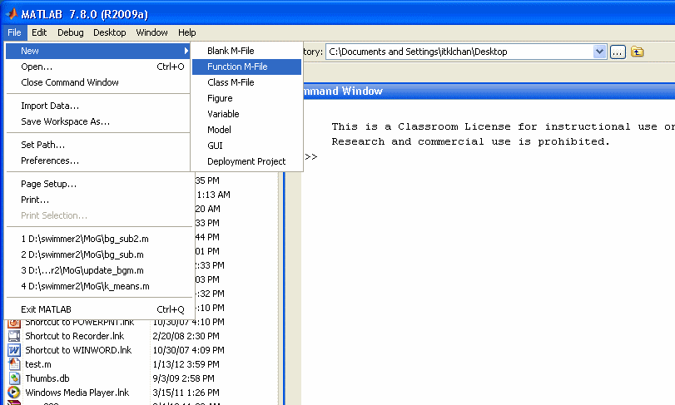

Slide 29
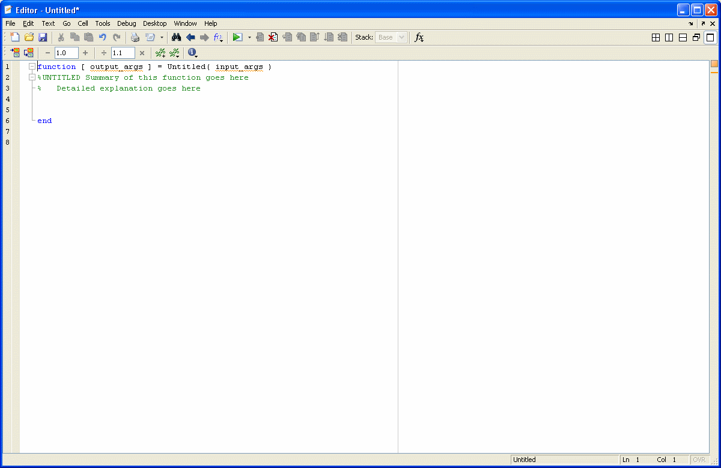

Slide 30
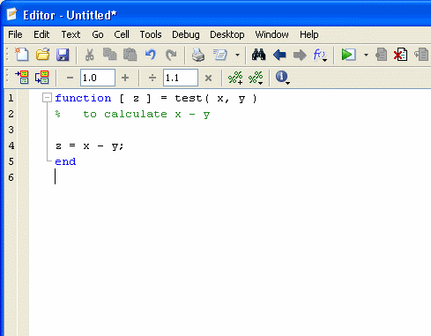

Slide 31
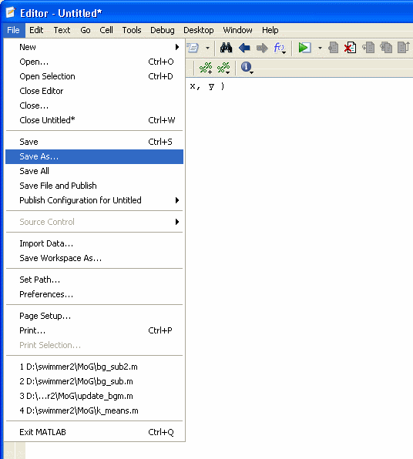

Slide 32
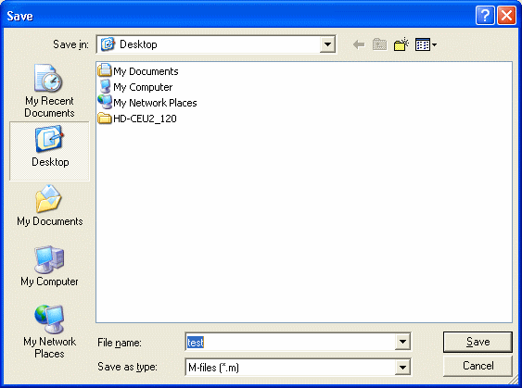

Slide 33
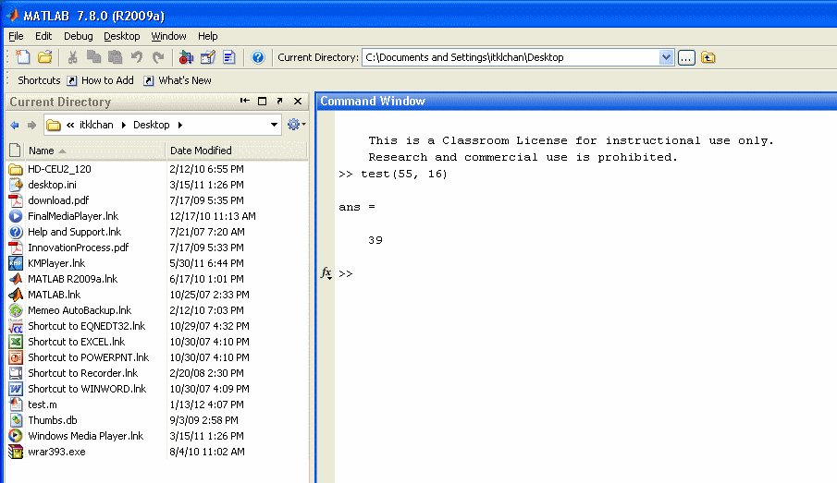

Slide 34
4.1.5 Structured programming
simple M-file performs command sequentially, from the first statement to the last
the program is highly restrictive
real programs usually have non-sequential execution paths, which can be achieved via decisions and loops

Slide 35
decision
the branching of execution flow based on a decision
if condition
statements
end
if condition 1
group 1 statements
elseif condition 2
group 2 statements
.
.
else
else statements
end
if condition
group 1 statements
else
group 2 statements
end

Slide 36
one simple form of condition is a relational expression that compares two values
value 1 relation value 2
operator relation
= = equal
~= not equal
< less than
> greater than
<= less than or equal to
>= greater than or equal to

Slide 37
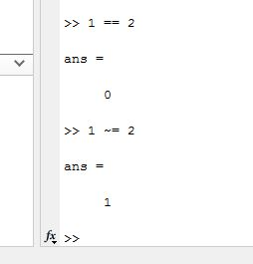

Slide 38
logical operators can be used to test more than one logical condition
there is priority order, use parentheses to override it
operator meaning
~ not
&& and
|| or
Highest priority
Lowest priority

Slide 39
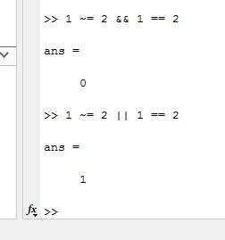

Slide 40
loop
the repetition of a group of statements
for index = start:step:finish
statements
end

Slide 41
for i = 1:2:5
disp(i)
end
for i = 5:-2:1
disp(i)
end
for i = 1:5
disp(i)
end
Positive step
Negative step
Default step = 1

Slide 42
while condition
statements
end
i = 5;
while i > 0
i = i – 1;
disp(i)
end

Slide 43
4.2 What is optimization
Find the best solution from among a number of possible solutions.
There will be a number of parameters that can be varied in the decision-making process.
There may be some constraints that need to be satisfied.
There will be a criterion that is to be minimized or maximized.

Slide 44
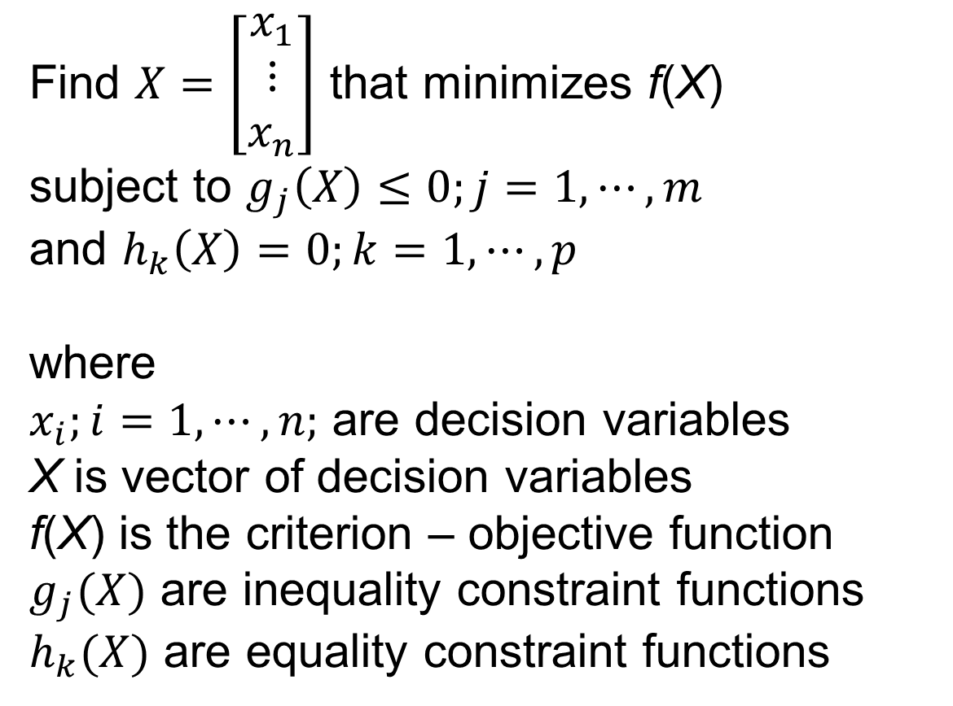
Find $X=\left[\begin{matrix}x_{1} \\ ⋮ \\ x_{n}\end{matrix}\right]$ that minimizes f(X)
subject to $g_{j}\left(X\right)≤0;j=1, ⋯, m$
and $h_{k}\left(X\right)=0;k=1,⋯,p$
where
$x_{i};i=1,⋯,n;$ are decision variables
X is vector of decision variables
f(X) is the criterion – objective function
$g_{j}(X)$ are inequality constraint functions
$h_{k}(X)$ are equality constraint functions

Slide 45
A set of numeric values, one for each decision variable, is a solution.
The objective function is used to judge whether one solution is better than another.
The decision maker is to select the solution that achieves the minimum objective function.
If the problem is to maximize f(X), solution can be found by minimizing –f(X).

Slide 46
f(X)
maximize
X
minimize
-f(X)

Slide 47
A set of decision variables that satisfy the constraints of the problem is a feasible solution.
A feasible solution that minimizes the objective function is the optimum solution.
f(X)
optimum solution
feasible solutions
X

Slide 48

If the problem has constraints, it is a constrained optimization problem.
In some situations, the constraints may be absent – unconstrained optimization problem.
Find $X=\left[\begin{matrix}x_{1} \\ ⋮ \\ x_{n}\end{matrix}\right]$ that minimizes f(X)

Slide 49
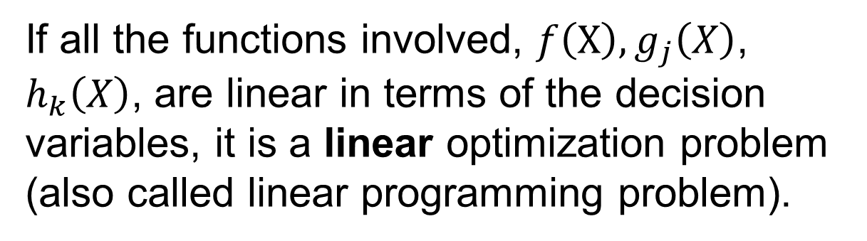
If all the functions involved, $f\left(X\right), g_{j}\left(X\right)$, $h_{k}\left(X\right)$, are linear in terms of the decision variables, it is a linear optimization problem (also called linear programming problem).
If at least one of the functions is nonlinear in terms of the decision variables, it is a nonlinear programming problem.

Slide 50
Solution of an optimization problem may be local or global.
local minimum
f(X)
global minimum
X₁
X*
X₂
X

Slide 51
Optimization is the goal of finding the best values of any problem.

Slide 52
Summary
fundamentals of MATLAB
terminology
types of optimization problems
Reference
Chapter 7, Applied Numerical Methods with MATLAB for Engineers and Scientists

