Slide 1
GE2262 Business Statistics
Topic 6
Hypothesis Testing
Reference
Levine, D.M., Krehbiel, T.C. and Berenson, M.L., Business Statistics: A First Course, Pearson Education Ltd, Chapter 9

Slide 2
Outline
Hypothesis Testing Procedure
Hypothesis Test for the Population Mean
  Critical Value Approach
  p-Value Approach
Potential Pitfalls and Ethical Issues

Slide 3
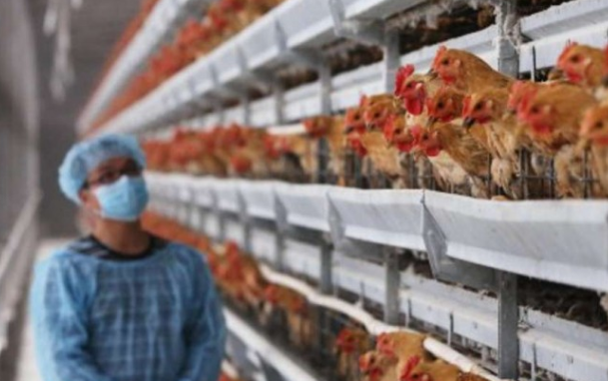
Live Chicken Supply Suspended in HK
http://www.scmp.com/news/hong-kong/health-environment/article/1965394/live-chicken-supply-suspended-hong-kong-after
SCMP, 05 June 2016: Sample taken from Yan Oi Market in Tuen Mun tests positive for bird flu virus. Live chicken supply suspended in Hong Kong
During the year 2015, there were 1,442 poultry imported daily on average. No more than 30 poultry were tested daily for bird flu virus
Decision on suspending live chicken supply is based on the test results of samples
  If a sample is tested positive for the virus, then
  live poultry supply will be suspended for 21 days
  If the tests for all samples are negative, no further
  action is required
Do you think this checking process is reliable?
What is the risk of making a wrong decision in either way?

Slide 4
What is a Hypothesis?
The precursor to a hypothesis is a research or business problem, usually framed as a question
  E.g., A teacher might want to know “Are the students performing well in academic?”
The question is then converted to a testable hypothetical statement
  A statistical hypothesis is a claim about the population parameter
    E.g. population mean, population standard deviation, or population proportion, etc.
I claim the mean GPA of this class is 3.5!
I claim the proportion of students passing the mid-term is 0.9!

Slide 5
Hypothesis Testing Procedure
Step 1: Define hypotheses
Step 2: Collect the data and identify the rejection region(s)
Step 3: Compute test statistic
Step 4: Make statistical decision

Slide 6
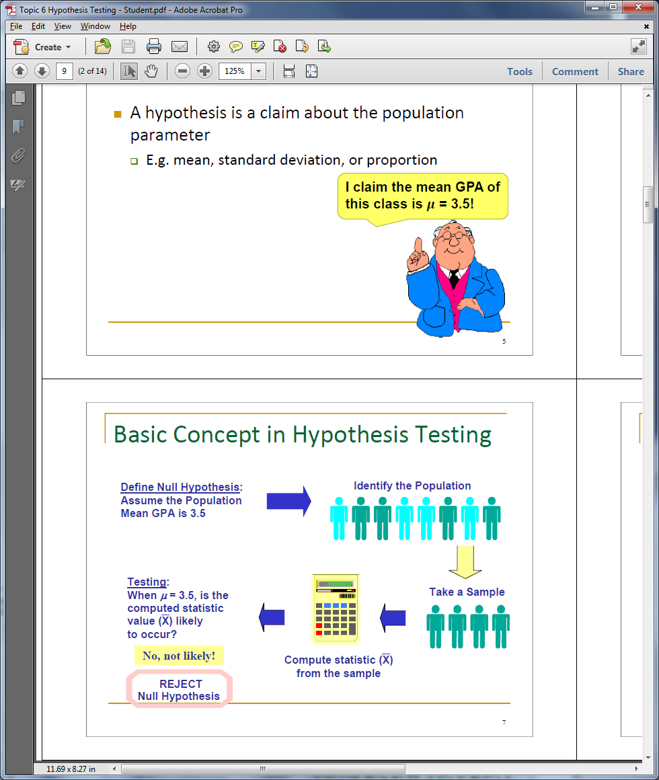
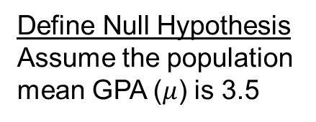
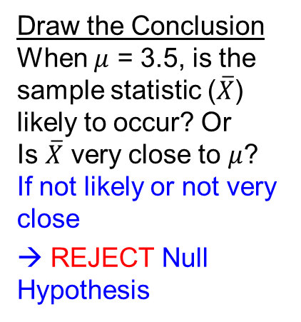
Hypothesis Testing Procedure
Cont’d
Define Null Hypothesis
Assume the population mean GPA ($μ$) is 3.5
Identify the Population
Draw the Conclusion
When $μ$ = 3.5, is the sample statistic ($\overline{X}$) likely to occur? Or
Is $\overline{X}$ very close to $μ$?
If not likely or not very close
→ REJECT Null Hypothesis
Compute Sample Statistic
Take a Random Sample

Slide 7

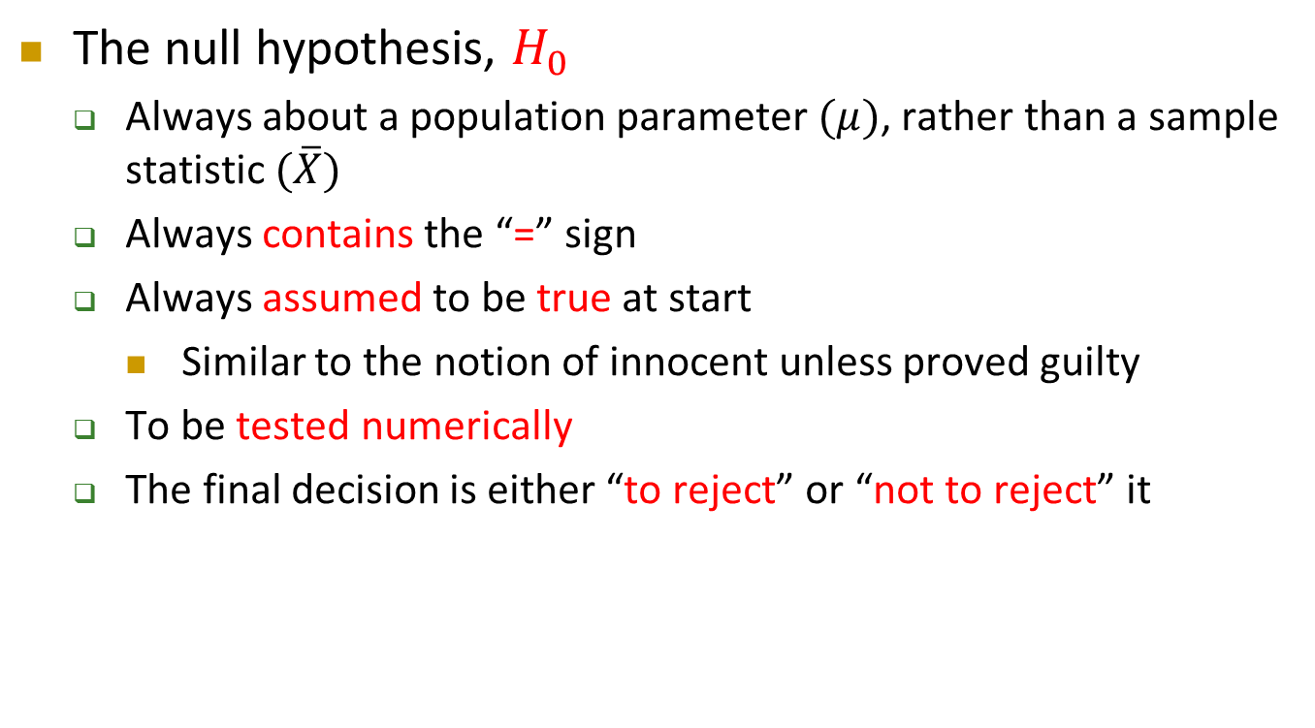
Step 1: Define Hypotheses
The null hypothesis, $H_{0}$
  Always about a population parameter $(μ)$, rather than a sample statistic $(\overline{X})$
  Always contains the “=” sign
  Always assumed to be true at start
    Similar to the notion of innocent unless proved guilty
  To be tested numerically
  The final decision is either “to reject” or “not to reject” it

Slide 8
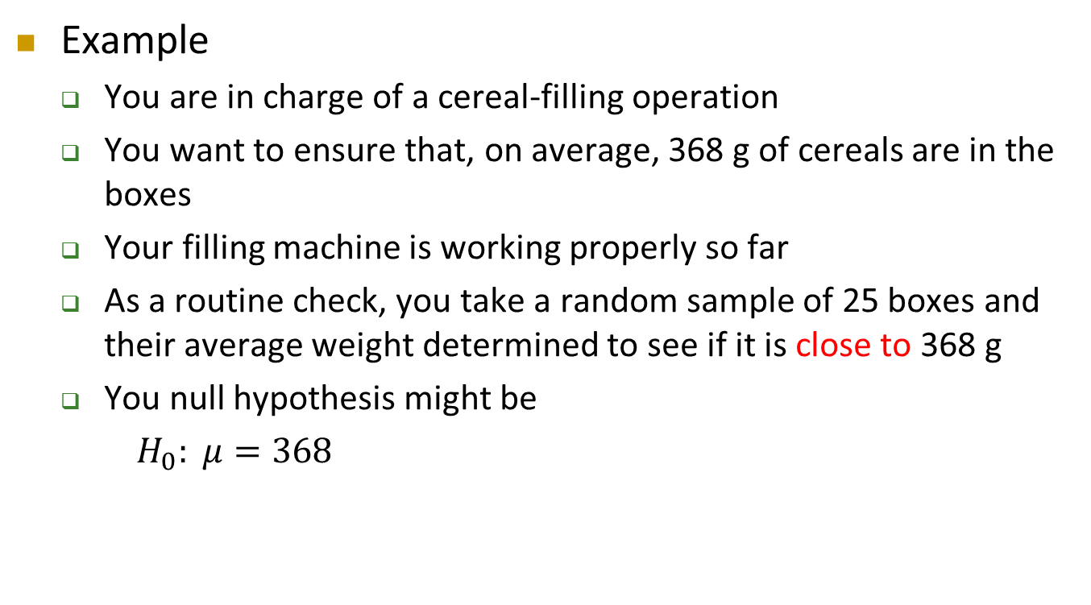
Step 1: Define Hypotheses
Cont’d
Example
  You are in charge of a cereal-filling operation
  You want to ensure that, on average, 368 g of cereals are in the boxes
  Your filling machine is working properly so far
  As a routine check, you take a random sample of 25 boxes and their average weight determined to see if it is close to 368 g
  You null hypothesis might be
  $H_{0}: μ=368$

Slide 9
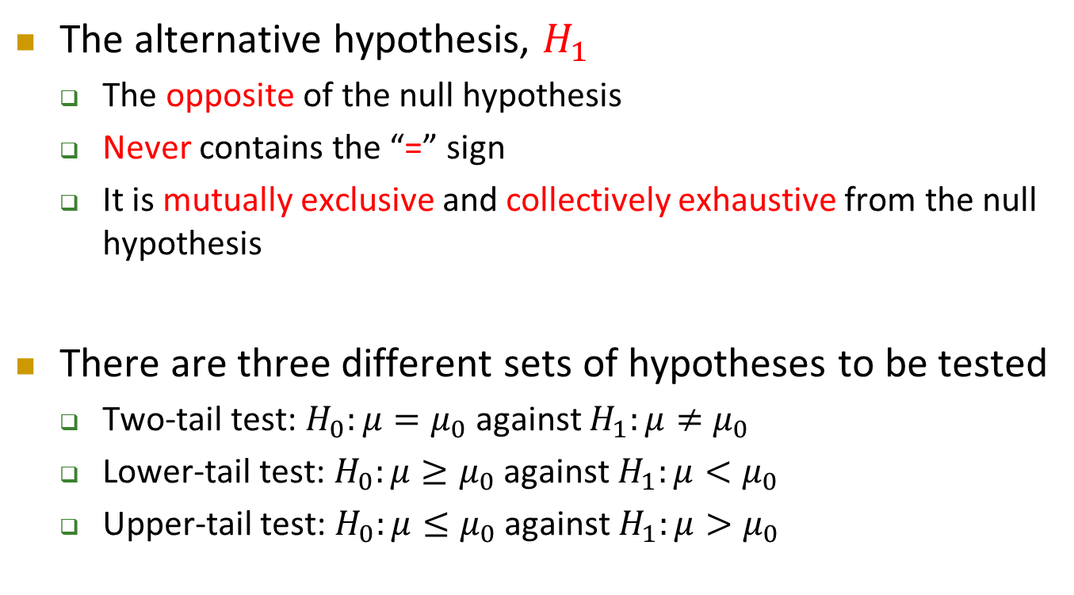
Step 1: Define Hypotheses
Cont’d
The alternative hypothesis, $H_{1}$
  The opposite of the null hypothesis
  Never contains the “=” sign
  It is mutually exclusive and collectively exhaustive from the null hypothesis
There are three different sets of hypotheses to be tested
  Two-tail test: $H_{0}:μ=μ_{0}$ against $H_{1}:μ≠μ_{0}$
  Lower-tail test: $H_{0}:μ≥μ_{0}$ against $H_{1}:μ<μ_{0}$
  Upper-tail test: $H_{0}:μ≤μ_{0}$ against $H_{1}:μ>μ_{0}$

Slide 10
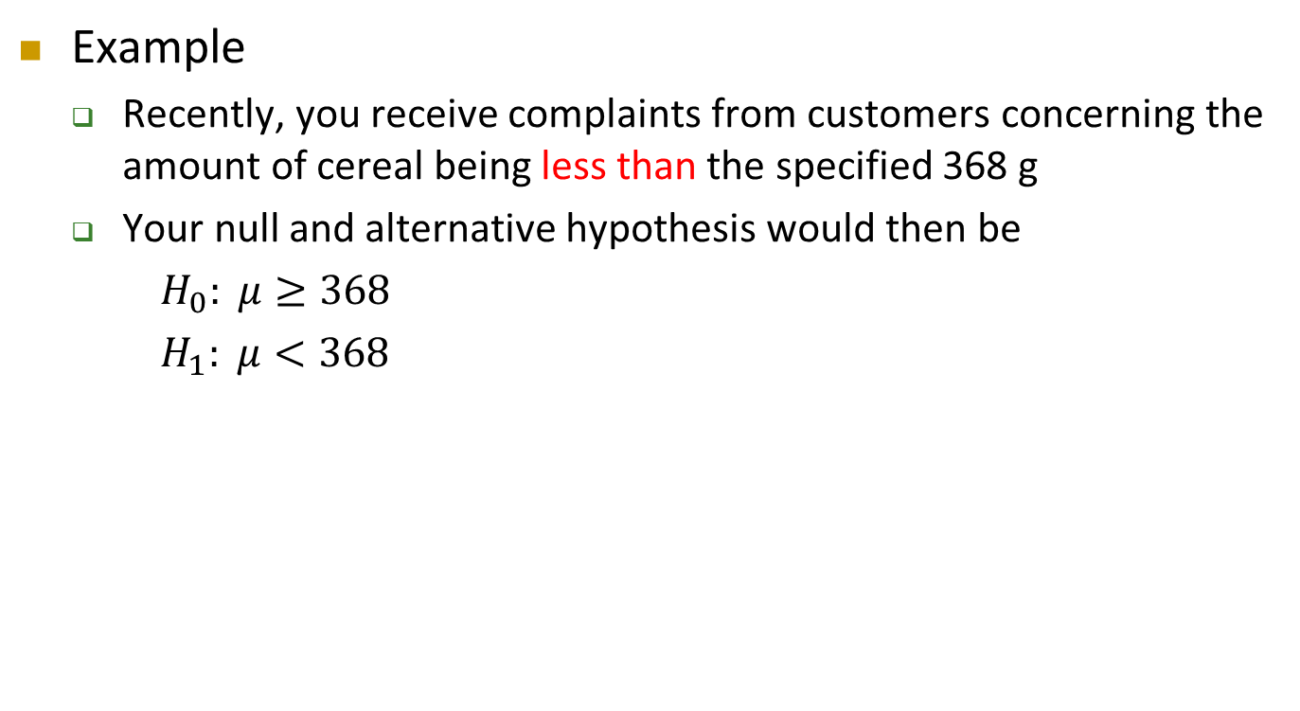
Step 1: Define Hypotheses
Cont’d
Example
  Recently, you receive complaints from customers concerning the amount of cereal being less than the specified 368 g
  Your null and alternative hypothesis would then be
  $H_{0}: μ≥368$
  $H_{1}: μ<368$

Slide 11
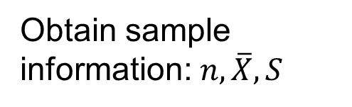
Step 2: Collect the Data and
Identify the Rejection Region(s)
Identify the Population
Fixed but unknown population parameter
Obtain sample information: $n, \overline{X}, S$
Take a Random Sample
We will assume that the given data set is a representative sample of the population concerned

Slide 12
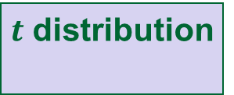

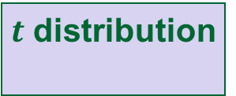
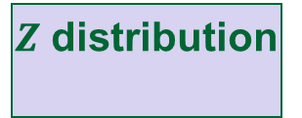

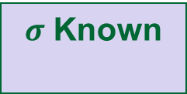
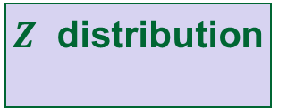
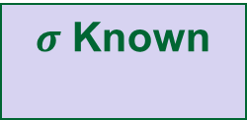
Step 2: Collect the Data and
Identify the Rejection Region(s)
Cont’d
Hypothesis Testing for μ
X ~ Normal distribution
X ~ other distribution
$σ$ Known
$σ$ Unknown
σ Known
Large Sample
(n ≥ 30)
Small Sample
(n < 30)
$Z$ distribution
$t$ distribution
$σ$ Known
$σ$ Unknown
$Z$ distribution
$t$ distribution

Slide 13
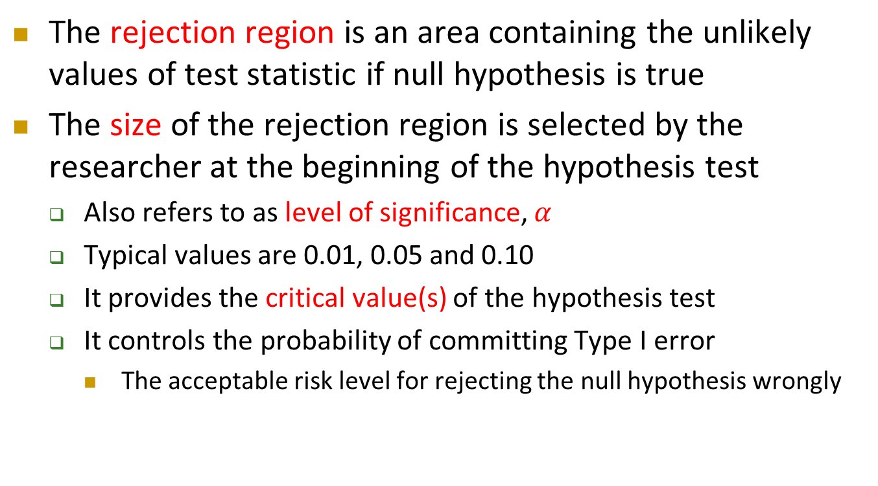
Step 2: Collect the Data and
Identify the Rejection Region(s)
Cont’d
The rejection region is an area containing the unlikely values of test statistic if null hypothesis is true
The size of the rejection region is selected by the researcher at the beginning of the hypothesis test
  Also refers to as level of significance, $α$
  Typical values are 0.01, 0.05 and 0.10
  It provides the critical value(s) of the hypothesis test
  It controls the probability of committing Type I error
    The acceptable risk level for rejecting the null hypothesis wrongly

Slide 14

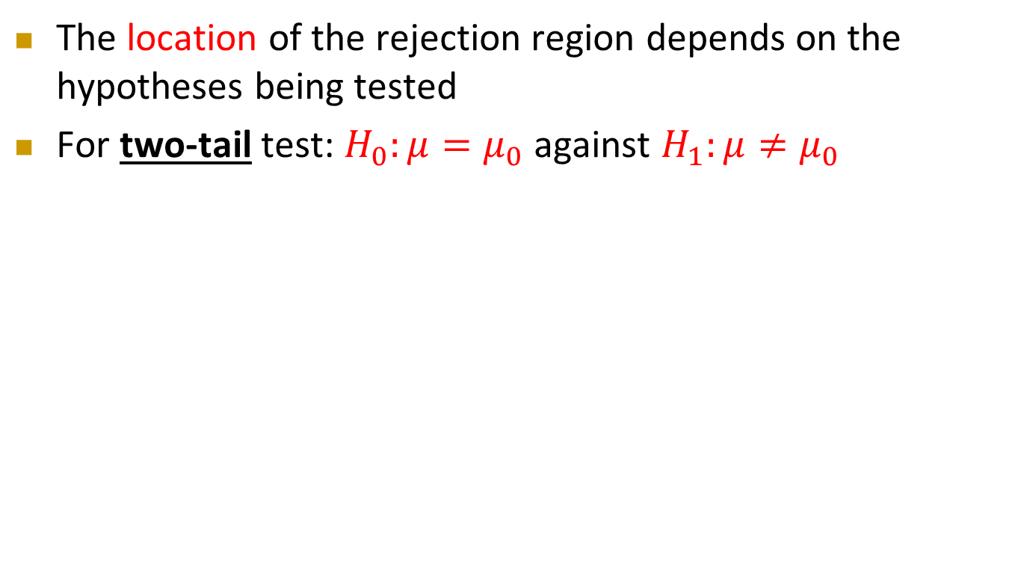

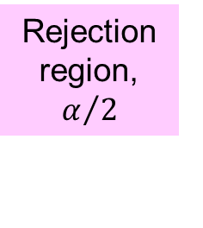

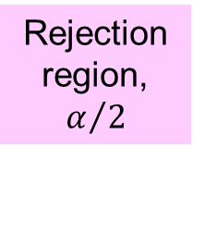
Step 2: Collect the Data and
Identify the Rejection Region(s)
Cont’d
The location of the rejection region depends on the hypotheses being tested
For two-tail test: $H_{0}:μ=μ_{0}$ against $H_{1}:μ≠μ_{0}$
Rejection region,$α/2$
Rejection region, $α/2$
Rejection region,$α/2$
Rejection region, $α/2$
$$μ_{0}$$
$$\overline{X}$$
$$0$$
$$Z$$
Critical value
Critical value
Critical value
Critical value
$\overline{X}$ must be significantly different from $μ_{0}$ to reject $H_{0}$
$Z$ must be significantly different from $0$ to reject $H_{0}$

Slide 15



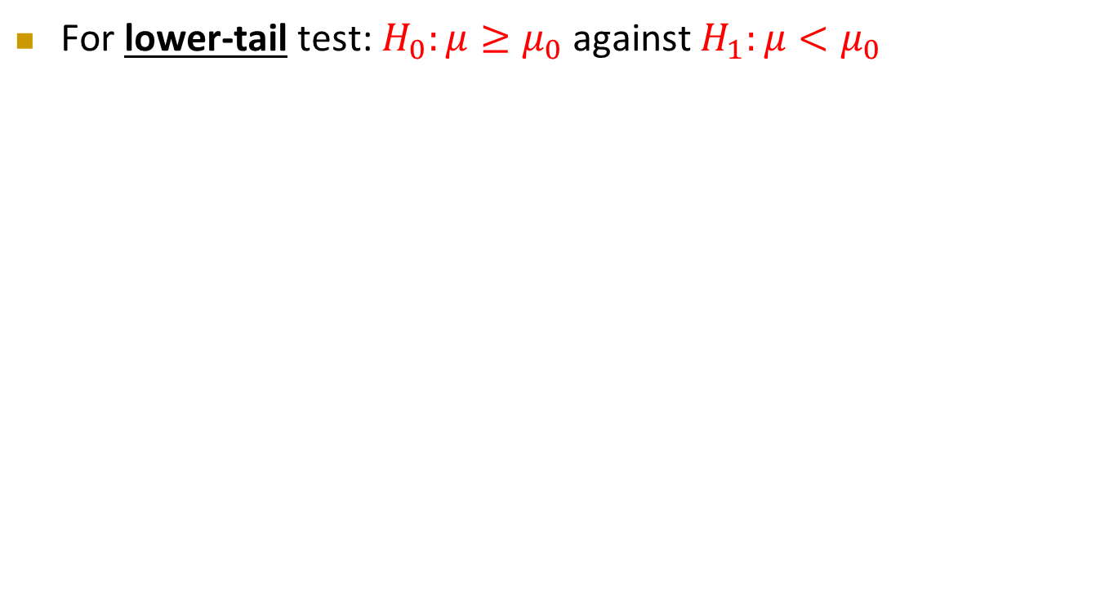
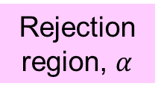
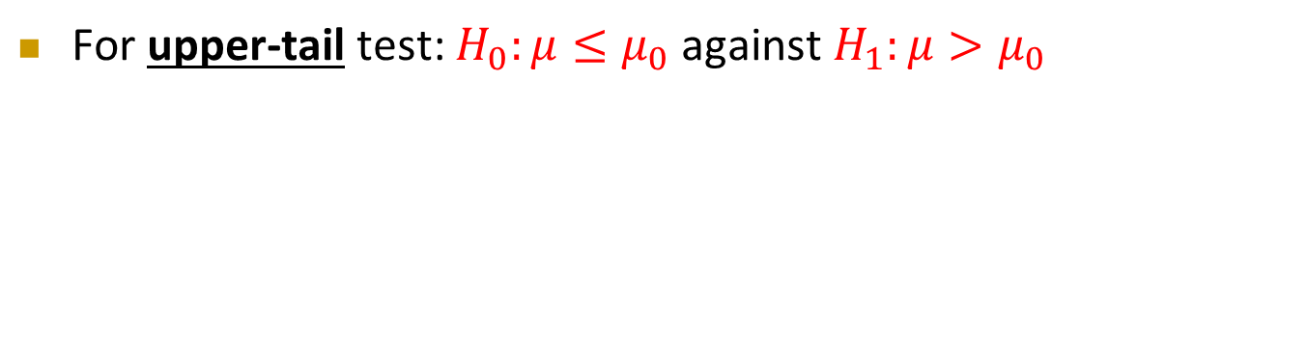
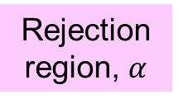

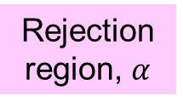

Step 2: Collect the Data and
Identify the Rejection Region(s)
Cont’d
For lower-tail test: $H_{0}:μ≥μ_{0}$ against $H_{1}:μ<μ_{0}$
Rejection region, $α$
Rejection region, $α$
$$\overline{X}$$
$$Z$$
Critical value
$$μ_{0}$$
Critical value
$$0$$
$\overline{X}$ must be significantly smaller than $μ_{0}$ to reject $H_{0}$
$Z$ must be significantly smaller than $0$ to reject $H_{0}$
For upper-tail test: $H_{0}:μ≤μ_{0}$ against $H_{1}:μ>μ_{0}$
Rejection region, $α$
Rejection region, $α$
$$\overline{X}$$
$$Z$$
$$μ_{0}$$
Critical value
$$0$$
Critical value
$\overline{X}$ must be significantly larger than $μ_{0}$ to reject $H_{0}$
$Z$ must be significantly larger than $0$ to reject $H_{0}$

Slide 16
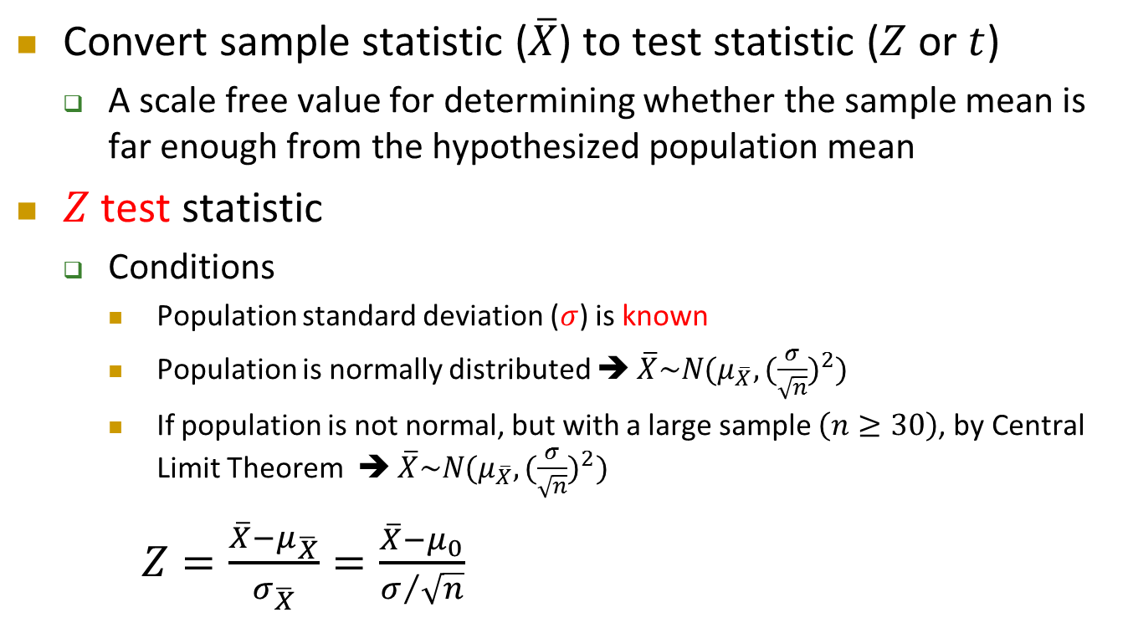
Step 3: Compute Test Statistic
Convert sample statistic ($\overline{X}$) to test statistic ($Z$ or $t$)
  A scale free value for determining whether the sample mean is far enough from the hypothesized population mean
$Z$ test statistic
  Conditions
    Population standard deviation ($σ$) is known
    Population is normally distributed ➔ $\overline{X}\sim N(μ_{\overline{X}},{(\frac{σ}{\sqrt{n}})}^{2})$
    If population is not normal, but with a large sample $\left(n≥30\right)$, by Central Limit Theorem ➔ $\overline{X}\sim N(μ_{\overline{X}},{(\frac{σ}{\sqrt{n}})}^{2})$
$Z=\frac{\overline{X}−μ_{\overline{X}}}{σ_{\overline{X}}}=\frac{\overline{X}−μ_{0}}{σ/{\sqrt{n}}}$

Slide 17
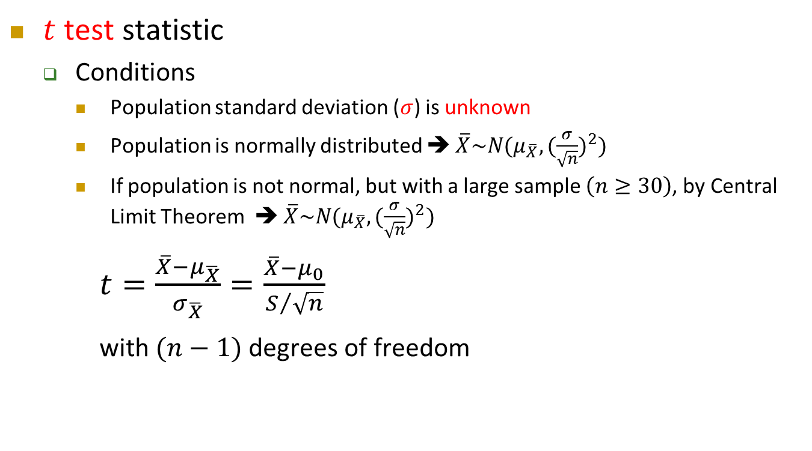
Step 3: Compute Test Statistic
Cont’d
$t$ test statistic
  Conditions
    Population standard deviation ($σ$) is unknown
    Population is normally distributed ➔ $\overline{X}\sim N(μ_{\overline{X}},{(\frac{σ}{\sqrt{n}})}^{2})$
    If population is not normal, but with a large sample $\left(n≥30\right)$, by Central Limit Theorem ➔ $\overline{X}\sim N(μ_{\overline{X}},{(\frac{σ}{\sqrt{n}})}^{2})$
$t=\frac{\overline{X}−μ_{\overline{X}}}{σ_{\overline{X}}}=\frac{\overline{X}−μ_{0}}{S/{\sqrt{n}}}$
with $(n−1)$ degrees of freedom

Slide 18
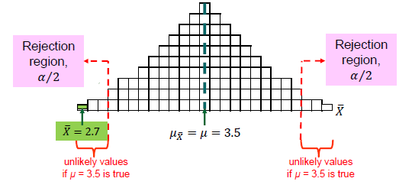
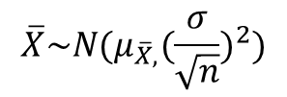
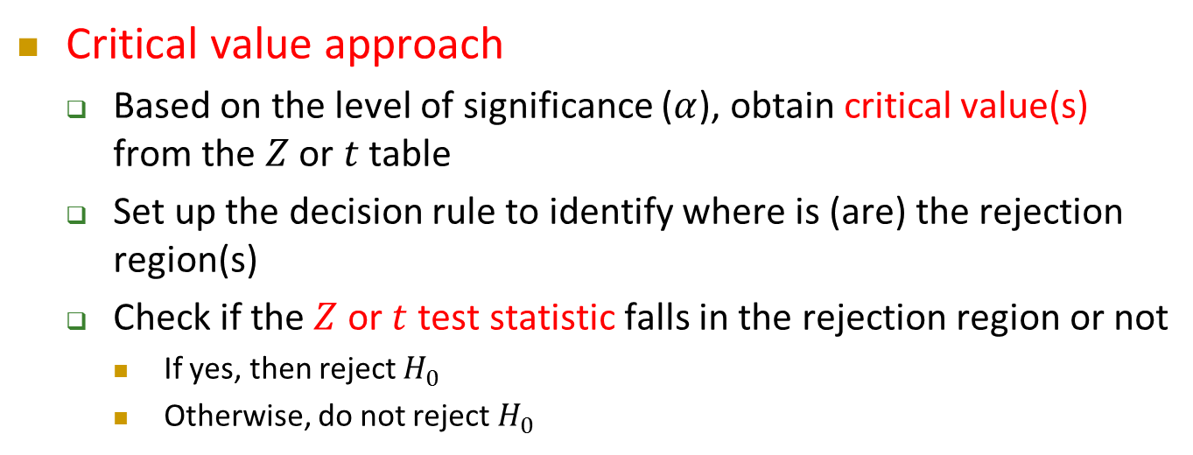
Step 4: Make Statistical Decision
$$\overline{X}\sim N(μ_{\overline{X},}{(\frac{σ}{\sqrt{n}})}^{2})$$
Critical value approach
  Based on the level of significance ($α$), obtain critical value(s) from the $Z$ or $t$ table
  Set up the decision rule to identify where is (are) the rejection region(s)
  Check if the $Z$ or $t$ test statistic falls in the rejection region or not
    If yes, then reject $H_{0}$
    Otherwise, do not reject $H_{0}$

Slide 19


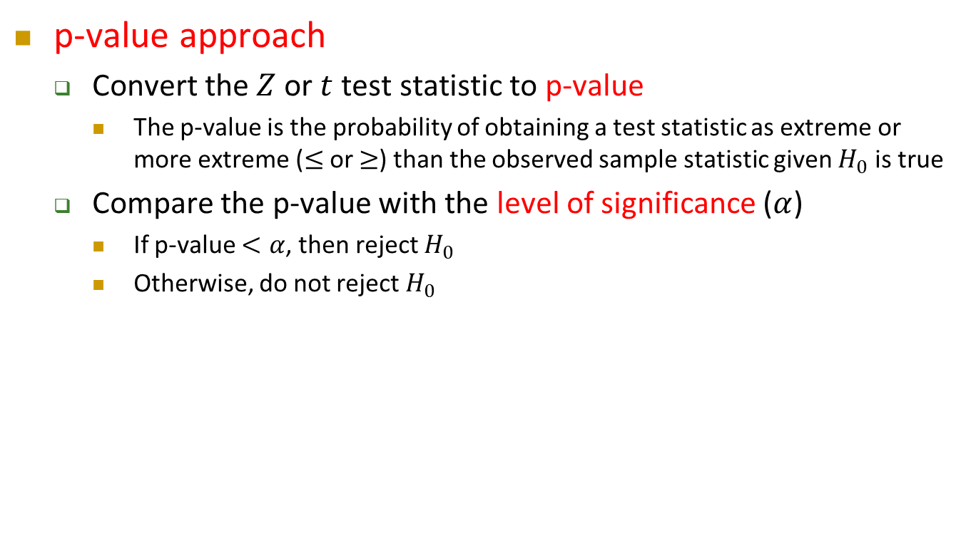


Step 4: Make Statistical Decision
Cont’d
p-value approach
  Convert the $Z$ or $t$ test statistic to p-value
    The p-value is the probability of obtaining a test statistic as extreme or more extreme ($≤$ or $≥$) than the observed sample statistic given $H_{0}$ is true
  Compare the p-value with the level of significance ($α$)
    If p-value $<α$, then reject $H_{0}$
    Otherwise, do not reject $H_{0}$
Rejection region, $α$
Rejection region, $α$
p-value
= $P\left(Z≤test statistic\right)$
$$Z$$
$$Z$$
$$0$$
$$0$$
Z test statistic
Z test statistic
Critical value
Critical value
Reject $H_{0}$ if Z test statistic < Critical value
Reject $H_{0}$ if p-value < α

Slide 20

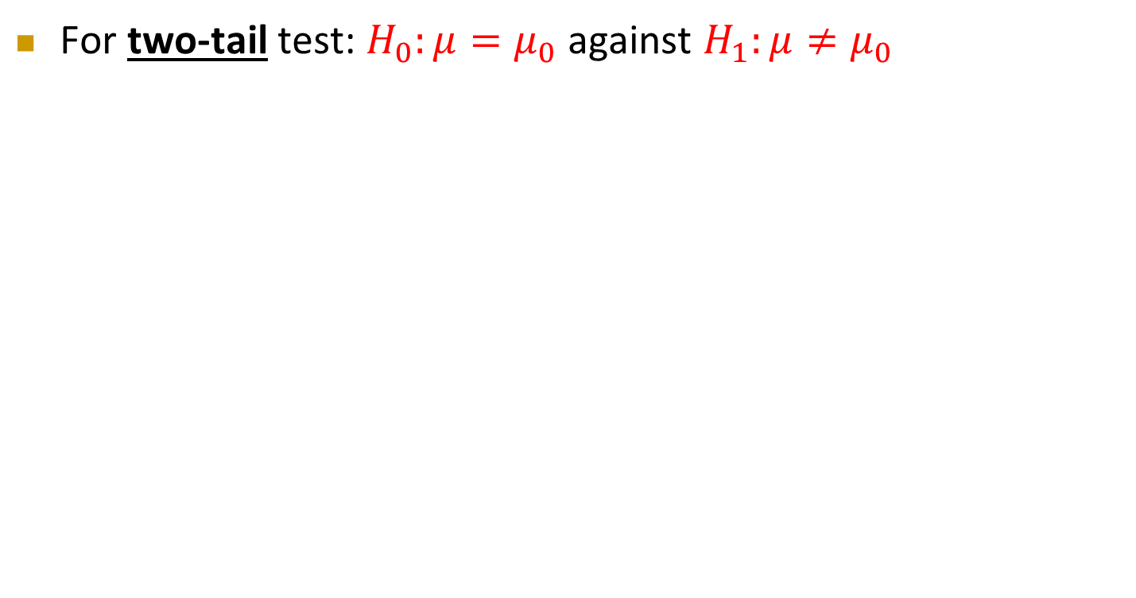
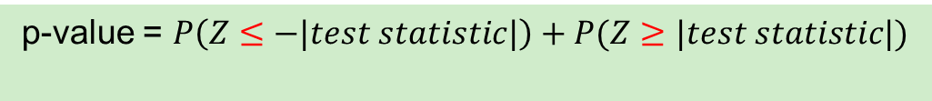


Step 4: Make Statistical Decision
Cont’d
For two-tail test: $H_{0}:μ=μ_{0}$ against $H_{1}:μ≠μ_{0}$
  p-value = $P\left(Z≤−|test statistic|\right)+P(Z≥|test statistic|)$
$$P\left(Z≤−|test statistic|\right)$$
$$P(Z≥|test statistic|)$$
$$0$$
$$Z$$
- Test statistic
Test statistic
    If p-value $<α$, then reject $H_{0}$
    Otherwise, do not reject $H_{0}$

Slide 21




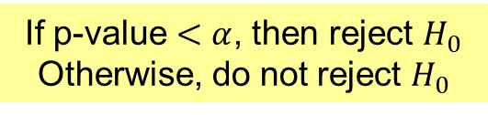
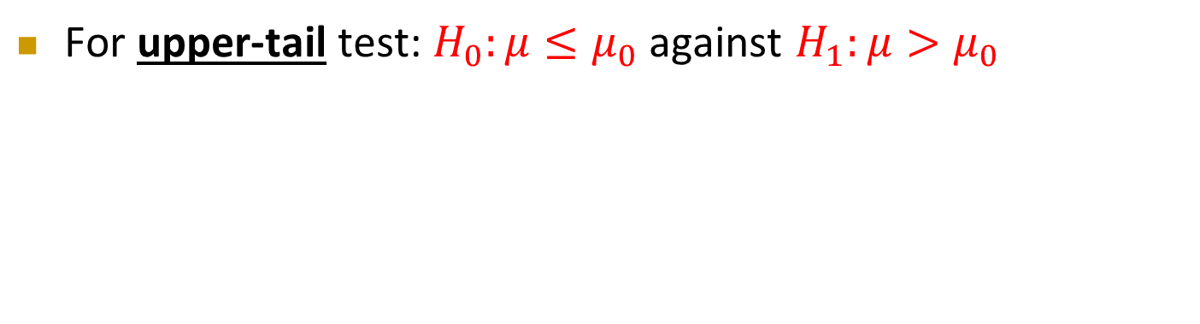


Step 4: Make Statistical Decision
Cont’d
For lower-tail test: $H_{0}:μ≥μ_{0}$ against $H_{1}:μ<μ_{0}$
p-value = $P\left(Z≤test statistic\right)$
    If p-value $<α$, then reject $H_{0}$
    Otherwise, do not reject $H_{0}$
$$Z$$
Test statistic
$$0$$
For upper-tail test: $H_{0}:μ≤μ_{0}$ against $H_{1}:μ>μ_{0}$
p-value = $P(Z≥test statistic)$
    If p-value $<α$, then reject $H_{0}$
    Otherwise, do not reject $H_{0}$
$$Z$$
$$0$$
Test statistic

Slide 22
Step 4: Make Statistical Decision
Cont’d
In statistical hypothesis testing, we make the decision based on only one sample, we do not have the information to claim that the null hypothesis is true or false with 100% certainty
Whether the null hypothesis is rejected or not rejected, we always facing a risk of making a wrong decision
We never prove any one of the two hypotheses is true or false, we simply reject or do not reject the null hypothesis with a risk

Slide 23
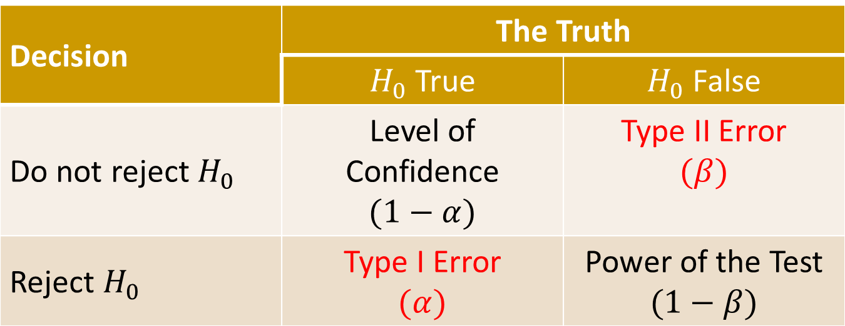
Step 4: Make Statistical Decision
Cont’d
Decision | The Truth
 | $H_{0}$ True | $H_{0}$ False
Do not reject $H_{0}$ | Level of Confidence $$(1−α)$$ | Type II Error $$(β)$$
Reject $H_{0}$ | Type I Error $$(α)$$ | Power of the Test $$(1−β)$$

Slide 24
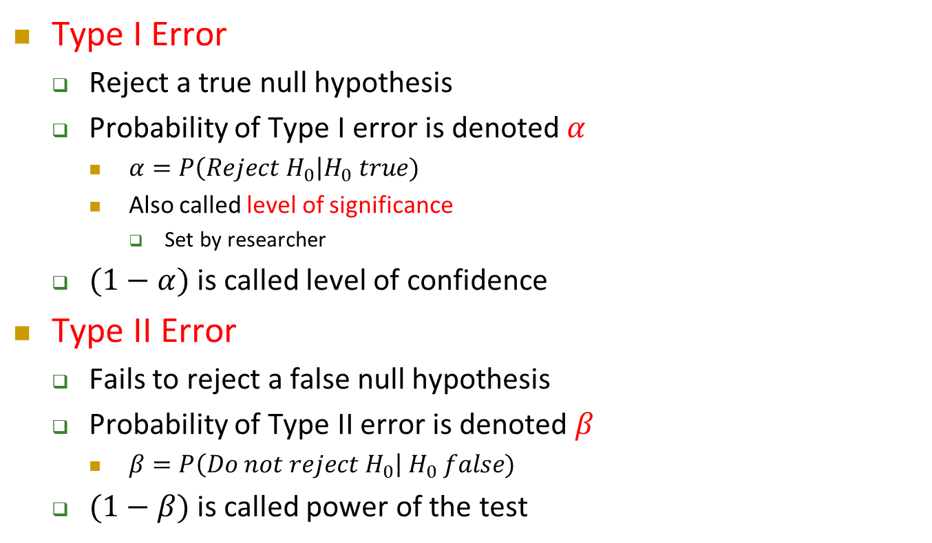
Step 4: Make Statistical Decision
Cont’d
Type I Error
  Reject a true null hypothesis
  Probability of Type I error is denoted $α$
    $α=P\left(Reject H_{0}\right|H_{0} true)$
    Also called level of significance
      Set by researcher
  $(1−α)$ is called level of confidence
Type II Error
  Fails to reject a false null hypothesis
  Probability of Type II error is denoted $β$
    $β=P\left(Do not reject H_{0}\right| H_{0} false)$
  $(1−β)$ is called power of the test

Slide 25
Step 4: Make Statistical Decision
Cont’d
Naturally, we would like both type of errors to be as small as possible
    While the Type I error is often pre-specified before the test ( e.g. α = 0.05), we cannot do much about the Type II error as the value of β depends on the true value of the parameter to be tested, which is often unknown to us if the null hypothesis is rejected
Ways to reduce the probability of making a Type II error
  By increasing α. This is preferred if the cost of committing Type II error is higher than that of Type I error
  By increasing the sample size for the test. This is preferred if there are sufficient resources to do so

Slide 26

$Z$ Test for the Population Mean
($σ$ Known)
Conditions
  Population standard deviation ($σ$) is known
  Population is normally distributed ➔ $\overline{X}\sim N(μ_{\overline{X}},{(\frac{σ}{\sqrt{n}})}^{2})$
  If population is not normal, but with a large sample $\left(n≥30\right)$, by Central Limit Theorem ➔ $\overline{X}\sim N(μ_{\overline{X}},{(\frac{σ}{\sqrt{n}})}^{2})$
Obtain critical value(s) from the $Z$-table
Test statistic, $Z=\frac{\overline{X}−μ_{\overline{X}}}{σ_{\overline{X}}}=\frac{\overline{X}−μ_{0}}{σ/{\sqrt{n}}}$

Slide 27
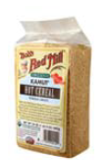
$Z$ Test for the Population Mean
($σ$ Known) – Example
A random sample of 25 boxes of cereals gave a mean 364.5 g
The company has specified the population distribution is Normal and the standard deviation to be 15 g
Test at the 5% level of significance and see if the average weight is close to 368 g

Slide 28
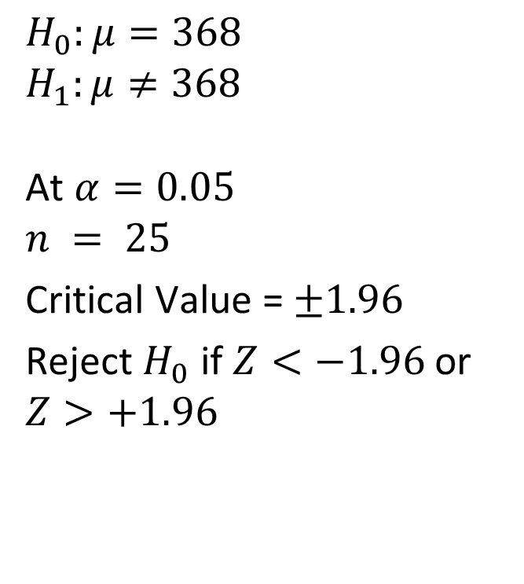

$Z$ Test for the Population Mean
($σ$ Known) – Example
Cont’d
$$H_{0}:μ=368$$
$$H_{1}:μ≠368$$
At $α=0.05$
$$n = 25$$
Critical Value = $±1.96$
Reject $H_{0}$ if $Z<−1.96$or $Z>+1.96$
$$Z=\frac{\overline{X}−μ_{0}}{σ/{\sqrt{n}}}=\frac{364.5−368}{{15}/{\sqrt{25}}}$$
$=−1.17$
At $α=0.05$, do not reject $H_{0}$
There is no evidence that the true mean weight is not 368 g
Rejection region, $α/2=0.025$
Rejection region, $α/2=0.025$
$$0$$
$$Z$$
-1.96
+1.96

Slide 29


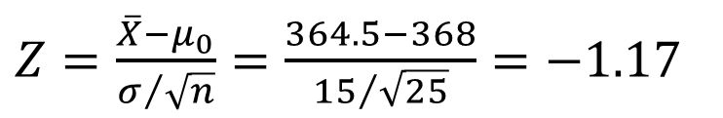
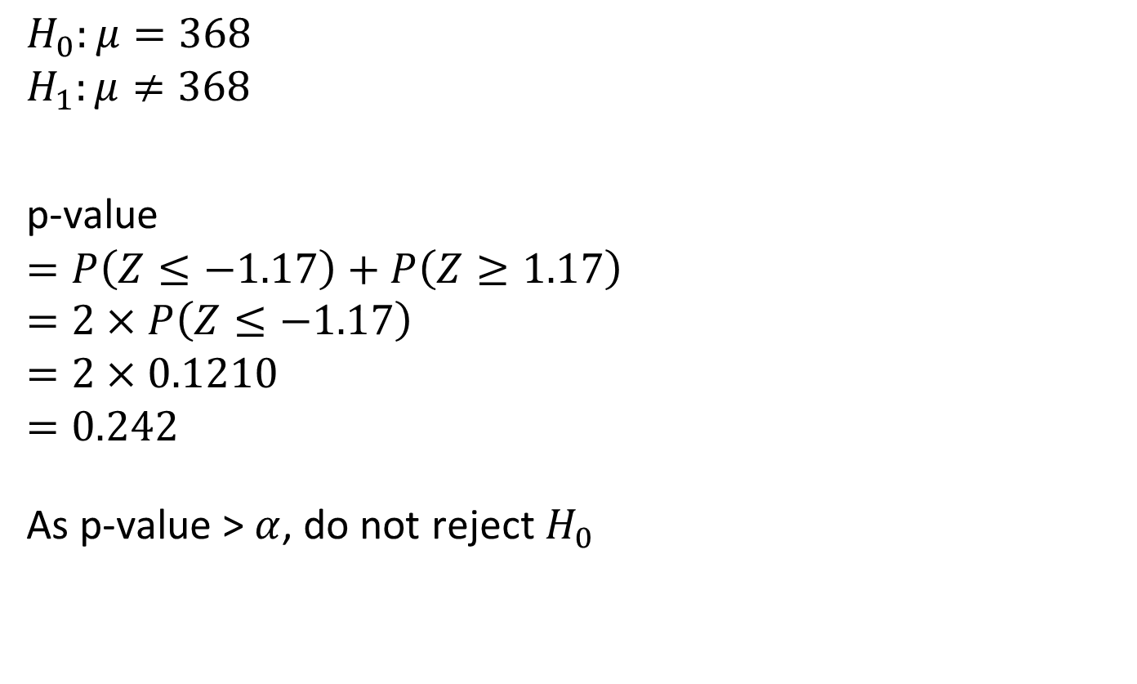
$Z$ Test for the Population Mean
($σ$ Known) – Example
Cont’d
$$H_{0}:μ=368$$
$$H_{1}:μ≠368$$
p-value
$$=P\left(Z≤−1.17\right)+P\left(Z≥1.17\right)$$
$$=2×P\left(Z≤−1.17\right)$$
$$=2×0.1210$$
$$=0.242$$
As p-value > $α$, do not reject $H_{0}$
$Z=\frac{\overline{X}−μ_{0}}{σ/{\sqrt{n}}}=\frac{364.5−368}{{15}/{\sqrt{25}}}$ $=−1.17$
p-value = $0.242$
Rejection region, $α/2=0.025$
Rejection region, $α/2=0.025$
$$0$$
$$Z$$
There is no evidence that the true mean weight is not 368 g
-1.17
+1.17

Slide 30

$Z$ Test for the Population Mean
($σ$ Known) – Exercise
Cont’d
How would you revise the analysis if you need to deal with the customers’ concerning about the amount of cereal being less than the specified 368 g?
Noted that
  The company has specified the population distribution is Normal
  The population standard deviation is 15 g
  Test at the 5% level of significance

Slide 31
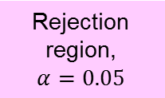
$Z$ Test for the Population Mean
($σ$ Known) – Exercise
Cont’d
Rejection region,
$$α=0.05$$
$$0$$
$$Z$$
-1.645

Slide 32
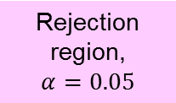
$Z$ Test for the Population Mean
($σ$ Known) – Exercise
Cont’d
p-value =0.1210
Rejection region,
$$α=0.05$$
$$0$$
$$Z$$
-1.17

Slide 33
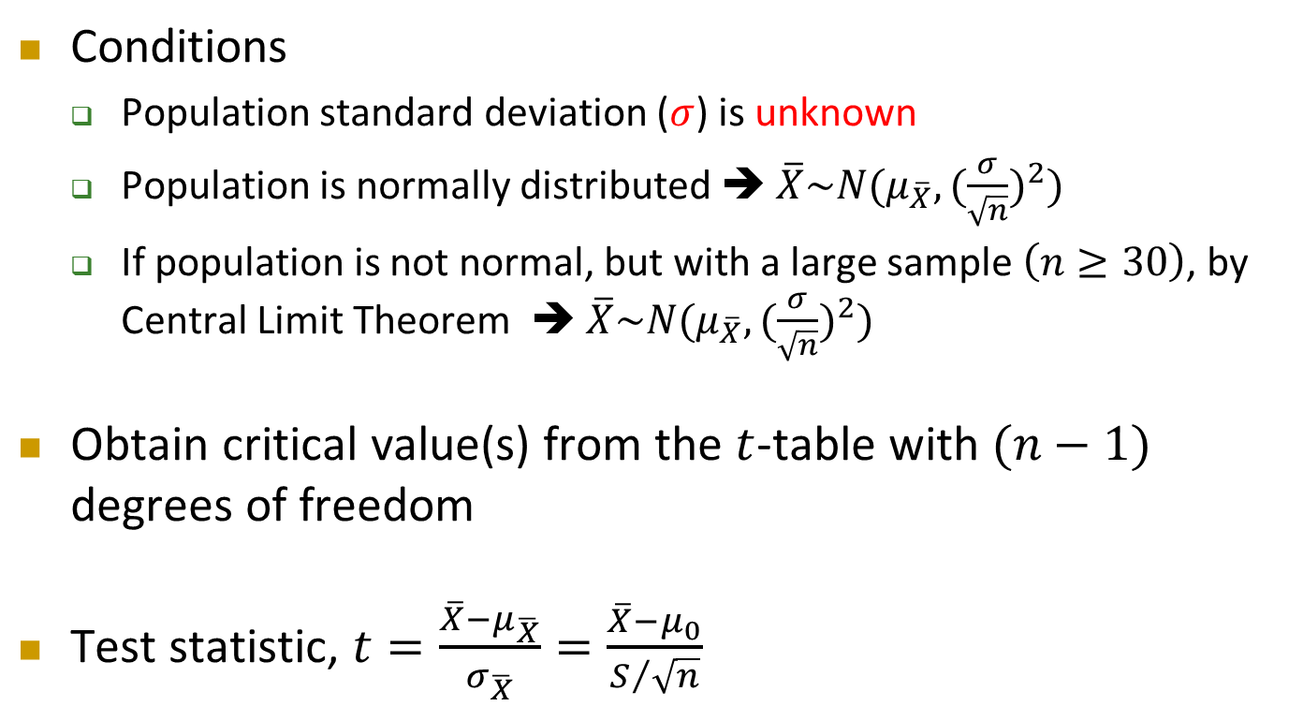
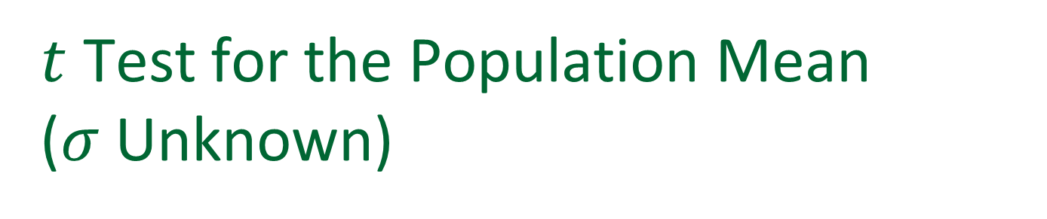
$t$ Test for the Population Mean
($σ$ Unknown)
Conditions
  Population standard deviation ($σ$) is unknown
  Population is normally distributed ➔ $\overline{X}\sim N(μ_{\overline{X}},{(\frac{σ}{\sqrt{n}})}^{2})$
  If population is not normal, but with a large sample $\left(n≥30\right)$, by Central Limit Theorem ➔ $\overline{X}\sim N(μ_{\overline{X}},{(\frac{σ}{\sqrt{n}})}^{2})$
Obtain critical value(s) from the $t$-table with $(n−1)$ degrees of freedom
Test statistic, $t=\frac{\overline{X}−μ_{\overline{X}}}{σ_{\overline{X}}}=\frac{\overline{X}−μ_{0}}{S/{\sqrt{n}}}$

Slide 34
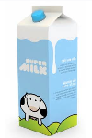
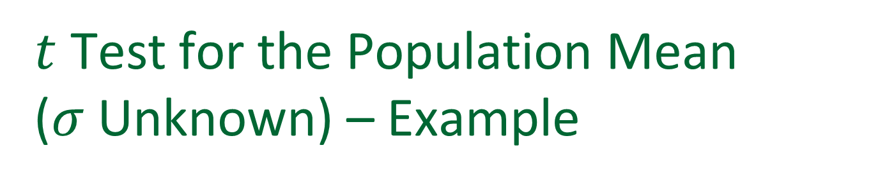
$t$ Test for the Population Mean
($σ$ Unknown) – Example
In addition to cereals, the company newly set up the filling machine for milk
Each bottle should contain 1 L of milk
A random sample of 40 bottles are selected, giving an average 1.03 L and standard deviation 0.08 L
At 10% level of significance, test to see is the filling machine is working properly

Slide 35
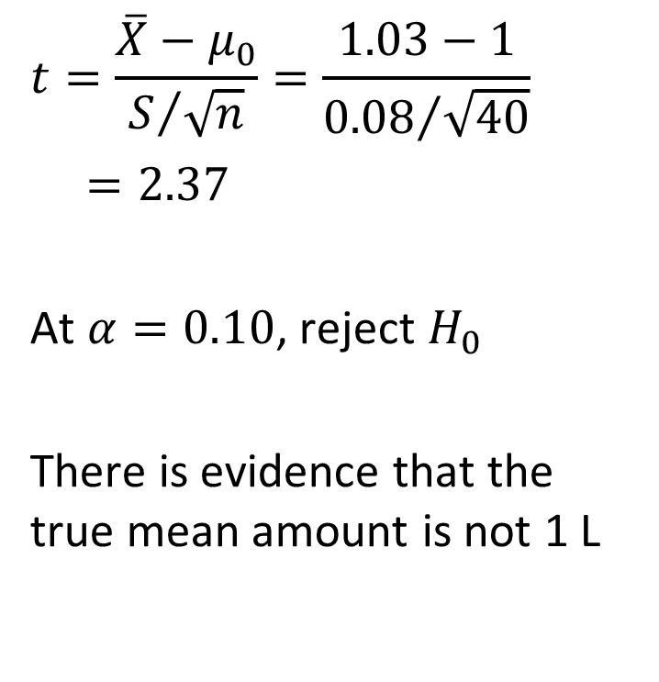
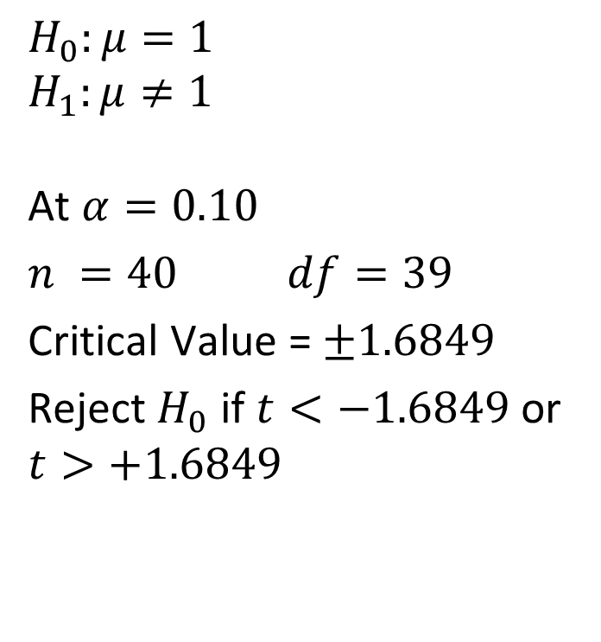
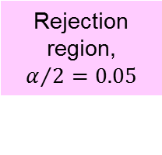
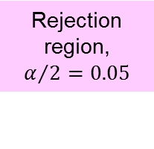

$t$ Test for the Population Mean
($σ$ Unknown) – Example
Cont’d
$$H_{0}:μ=1$$
$$H_{1}:μ≠1$$
At $α=0.10$
$n =40$ $df=39$
Critical Value = $±1.6849$
Reject $H_{0}$ if $t<−1.6849$or $t>+1.6849$
$$t=\frac{\overline{X}−μ_{0}}{S/{\sqrt{n}}}=\frac{1.03−1}{{0.08}/{\sqrt{40}}}$$
$=2.37$
At $α=0.10$, reject $H_{0}$
There is evidence that the true mean amount is not 1 L
Rejection region, $α/2=0.05$
Rejection region, $α/2=0.05$
$$0$$
$$t$$
-1.6849
+1.6849

Slide 36




$t$ Test for the Population Mean
($σ$ Unknown) – Example
Cont’d
$$H_{0}:μ=1$$
$$H_{1}:μ≠1$$
p-value
$$=P\left(t≤−2.37\right)+P\left(t≥2.37\right)$$
$$=2×P\left(t≥2.37\right)$$
$$=2×(0.01, 0.025)$$
$$=(0.02, 0.05)$$
As p-value < $α$, $H_{0}$ is rejected
There is evidence that the true mean amount is not 1 L
Using Excel “T.DIST” function, the p-value is found to be 0.0228
$t=\frac{\overline{X}−μ_{0}}{S/{\sqrt{n}}}=\frac{1.03−1}{{0.08}/{\sqrt{40}}}$ $=2.37$
$0.02<$ p-value$<0.05$
$$0$$
$$t$$
-2.37
+2.37

Slide 37

$t$ Test for the Population Mean
($σ$ Unknown) – Exercise
Cont’d
In the last example, we found that the mean amount of milk is not 1 L
Now, test to see if the mean amount is more than 1 L at 10% level of significance

Slide 38


$t$ Test for the Population Mean
($σ$ Unknown) – Exercise
Cont’d
Rejection region,
$$α=0.10$$
$$0$$
$$t$$
+1.3036

Slide 39

$t$ Test for the Population Mean
($σ$ Unknown) – Exercise
Cont’d
$0.01<$ p-value$<0.025$
$$0$$
$$t$$
+2.37
Using Excel “T.DIST” function, the p-value is found to be 0.0114

Slide 40

Hypothesis Test – More Exercise
Besides direct selling to the consumers, the milk is used to make processed cheese
It is known that excess water will change the freezing point of the milk
The freezing point of natural milk is distributed with a mean of -0.545 °C
14 randomly selected bottles of milk shows a mean -0.550 °C and standard deviation 0.016 °C
At 5% level of significance, is the milk containing excess water?

Slide 41

Hypothesis Test – More Exercise
Cont’d
Step 1: Define hypotheses
Step 2: Collect data and identify rejection region(s)
  Population distribution:
  Sample size:
  Any assumption needed?
    What is the assumption?
    Why?
  $σ$:
  Distribution to be used:

Slide 42





Hypothesis Test – More Exercise
Cont’d
Step 2: Collect data and identify rejection region(s)
  Significance level:
  Degrees of freedom:
  Critical value(s):
  Decision rule:
Rejection region, $α/2=0.025$
Rejection region, $α/2=0.025$
$$0$$
$$t$$
$$−2.1604$$
$$+2.1604$$

Slide 43
Hypothesis Test – More Exercise
Cont’d
Step 3: Compute test statistic
  Test statistic =
  p-value =
Step 4: Make statistical decision
  Decision:
  Conclusion:

Slide 44
Hypothesis Test – More Exercise
Cont’d
What would happened if the sample size is 144 rather than 14?
  Assumed the sample mean and standard deviation remain unchanged
Step 1: Define hypotheses

Slide 45




Hypothesis Test – More Exercise
Cont’d
Step 2: Collect data and identify rejection region(s)
  Population distribution:
  Sample size:
  Any assumption needed?
    What is the assumption?
    Why?
  $σ$:
  Distribution to use:
  Significance level:
  Degrees of freedom:
  Critical value(s):
  Decision rule:
Rejection region, $α/2=0.025$
Rejection region, $α/2=0.025$
$$0$$
$$t$$
$$−1.96$$
$$+1.96$$

Slide 46
Hypothesis Test – More Exercise
Cont’d
Step 3: Compute test statistic
  Test statistic =
  p-value
Step 4: Make statistical decision
  Decision:
  Conclusion:

Slide 47
Potential Pitfalls and Ethical Issues
What is the goal of the study? How can you translate the goal into a null hypothesis and an alternative hypothesis?
Is the hypothesis test a two-tail test or one-tail test?
Can you select a random sample from the underlying population of interest?
At what level of significance should you conduct the hypothesis test?
What conclusions and interpretations can you reach from the results of the hypothesis test?

Slide 48
Potential Pitfalls and Ethical Issues
Cont’d
Some of the areas where ethical issues can arise include
  The use of human subjects in experiments
  The data collection method
  The type of test (two-tail or one-tail test)
  The choice of level of significance
  The cleansing and discarding of data
  The failure to report pertinent findings

