Slide 1
EE3211 Modelling Techniques
Lecture 4
Hypothesis Testing: Two-sample Inference

Slide 2
Overview
Review the concepts of type I error and type II error
Discuss how to perform hypothesis testing using two-
sample inference:
  Longitudinal Study Design
  Cross-sectional Study

Slide 3
Hypothesis Testing
Recap
Two hypotheses in hypothesis-testing framework:
Null and alternative hypothesis
Objective framework for making decisions
- probabilities methods
- not subjective impressions
Uniform and consistent decision-making criterion
One-sample problem: specify hypotheses about a single distribution
Two-sample problem: compare two different distributions

Slide 4
Two-sample hypothesis-testing
Compare the parameters of two different populations
Neither of two sets of values is assumed known

Slide 5
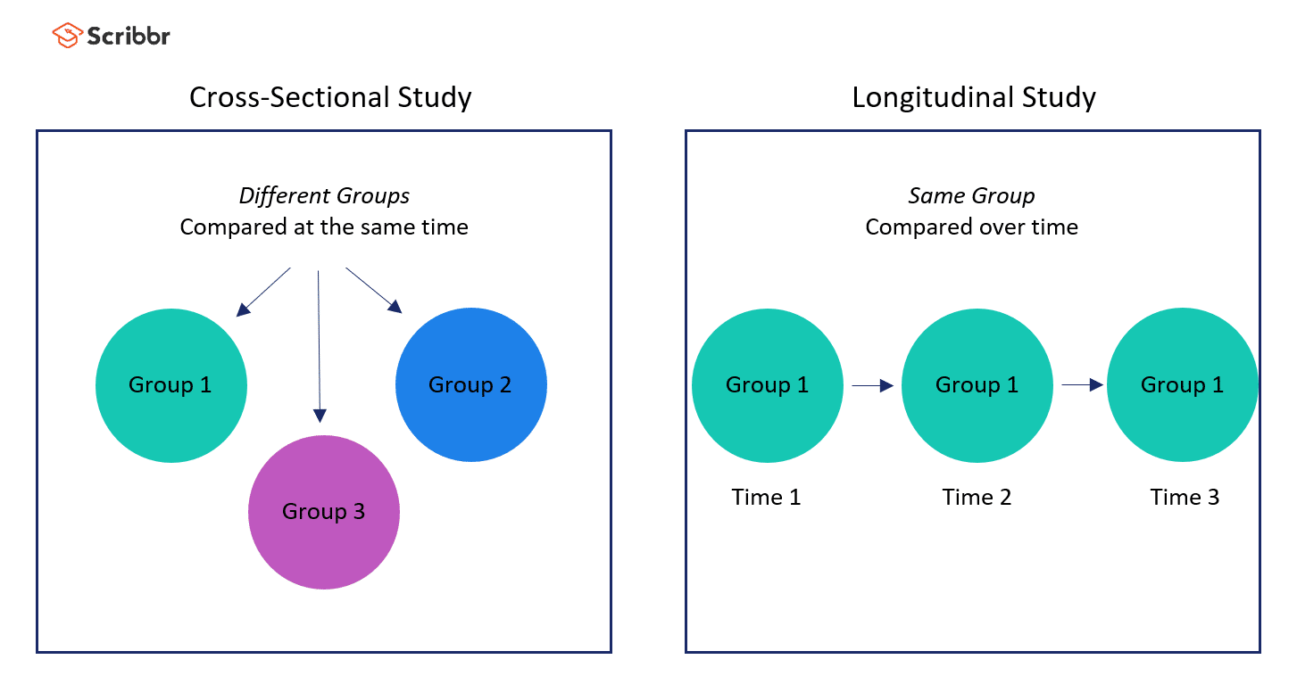
Example:
Two-sample Hypothesis Testing
Relationship between oral contraceptive (OC) use and blood pressure in women
  two different experimental designs

Slide 6
Longitudinal Study Design:
OC use vs. Blood Pressure
Baseline blood pressure measurement
Study population formation
Blood pressure measurement at follow-up
Nonpregnant
Premenopausal
Childbearing age (16-49 years old)
Rescreen these women 1 year later
Collect a subgroup who remained nonpregnant
OC users
Compare base and follow-up blood pressure of the women
Difference between blood pressure levels of women when they were using the pill at follow-up and when they were not using the pill at baseline
Longitudinal or follow-up study: same group of people is followed over time
Paired-sample design: each woman is used as her own control

Slide 7
Cross-Sectional Study
Blood pressure measurement
Identify two groups of participants: OC users and non-OC users
Nonpregnant, premenopaual women
Bearing age (16-49 years)
Compare blood pressure levels between the two groups
Difference between blood pressure levels of women who are OC users vs. non-OC users
Cross-sectional study: participants are seen at only one point in time
Independent-sample design: two completely different groups of women are being compared
Less expensive than a follow-up (longitudinal) study

Slide 8
Paired sample: when each data point in the first sample is matched to a unique data point in the second sample
  two sets of measurements on the same people
  different people selected using matching criteria e.g. age and gender
Independent samples: when data points in one sample are unrelated to data points in the second sample
Paired-study design: more definitive
  Example: most influencing factors present at first screening will also be there at the second screening and will not influence the comparison of BP levels
  A control group of non-OC users would completely rule out possible causes of BP change
The second type of study (independent design): suggestive
  other confounding factors may influence BP and cause an apparent difference to be found when none is actually present

Slide 9
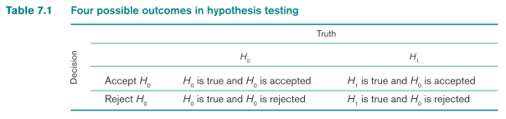
Recap
H_{o}: hypothesis to be tested
H₁: hypothesis contradicts the null hypothesis
H₀: μ = μ₀ vs. H₁: μ < μ₀
Only possible decisions : H₀ is true or H₁ is true
Outcomes: refer to H_{o}
Decision: H₀ is true→we accept H₀
H₁ is true→H₀ is not true or, we reject H₀
Four possible outcomes can occur:

Slide 10
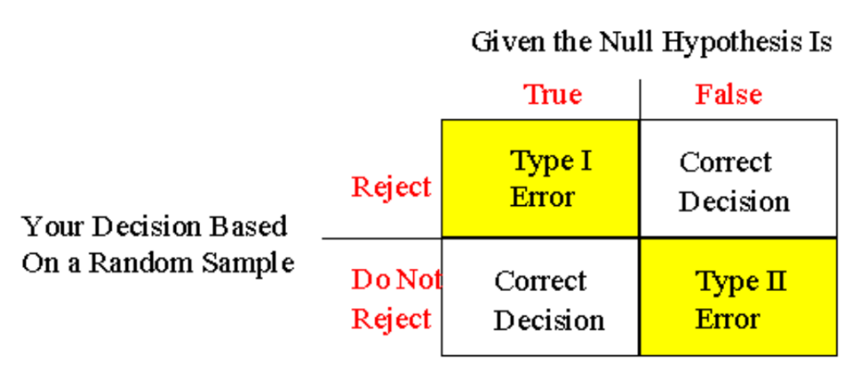
Recap
Hypothesis Testing
Probability of a type I error:
  α : significance level of a test
Probability of a type II error:
β: function of μ and other factors
Power of a test : 1 - β = 1 – probability of a type II error = Pr(rejecting H₀|H₁ true)
Objective of hypothesis testing: use statistical tests that make α and β as small as possible
α
β

Slide 11
Paired t-test
Compare two population means
Two samples (observations in sample 1 can be paired with observations in sample 2)
E.g.:
  Pre- and post- test on the same subjects
  Compare two treatments on the same subjects

Slide 12
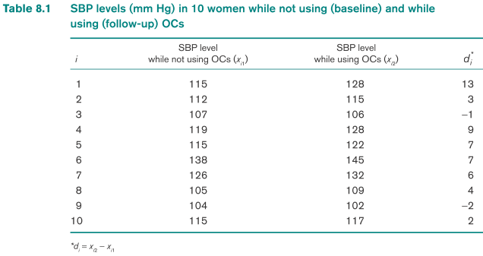
Example: Paired t Test
Systolic blood pressure (SBP) of the ith woman:
Baseline SBP ~N(μ_{I}, σ²)
Follow-up SBP ~N(μ_{i}+Δ, σ²)
Δ: mean difference in SBP between follow-up and baseline
  Δ = 0: difference is 0
  Δ > 0: OC pills associated with increased mean SBP
  Δ < 0: OC pills associated with lowered mean SBP

Slide 13


H₀: Δ = 0 vs. H₁: Δ ≠ 0
μ₁ is unknown
difference d_{i} = x_{i2} – x_{i1}
Though BP levels are different for each woman, the difference in BP between baseline and follow-up have the same mean and variance over the entire population of women
→ One-sample t test based on the differences (d_{i})
Mean difference d = (d₁ + d₂+ …+d_{n})/n
t = d/(s_{d}/√n)
s_{d} is the sample SD of the observed differences:
n = number of matched pairs
or
Notes:
H₀: Δ = 0 vs. H₁: Δ !=0; μυ₁ is unknown; difference d_{i} = x_{i2} – x_{i1}
Although BP levels are different for each woman, the difference in BP between baseline and follow-up have the same mean and variance over the entire population of women. Thus, it can be considered a one-sample t test based on the differences (d_{i}).
Mean difference d = (d₁ + d₂+ …+d_{n})/n
Denote the test statistic t = d/(s_{d}/√n) by t, where s_{d} is the sample standard deviation of the observed differences:
……..(slide)
n = number of matched pairs

Slide 14
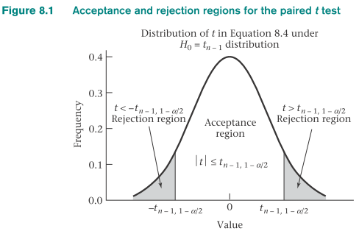
t > t_{n-1,1-α/2} or t < -t_{n-1,1-α/2} → reject H₀
-t_{n-1,1-α/2} ≤ t ≤ t_{n-1,1-α/2} → accept H₀

Slide 15
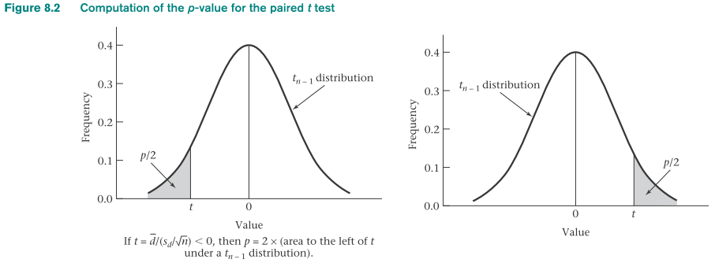
Computation of the p-Value
for the Paired t Test
t = d/(s_{d}/√n)
t < 0
p = 2 × [the area to the left of t under a t_{n-1} distribution]
t ≥ 0
p = 2 × [the area to the right of t under a t_{n-1} distribution]

Slide 16
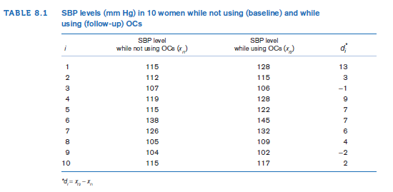
Example on Paired T-test:
Hypertension
Q: Assess the statistical significance of the OC–blood pressure data in the following table.

Slide 17




Example on Paired T-test:
Hypertension
$$\overline{d}=\frac{13+3+…+2}{10}=4.80$$
$$s_{d}^{2}=\frac{\left[{\left(13−4.8\right)}^{2}+…+{\left(2−4.8\right)}^{2}\right]}{9}=20.844$$
$$s_{d}=\sqrt{20.844}=4.566$$
$t=4.80/(4.566/\sqrt{10})$ = 4.80/1.444 = 3.32
Degree of freedom (df): 10-1 = 9 degrees of freedom (df)
t_{9,.975} = 2.262
Because t = 3.32 > 2.262→Paired t Test that H₀ can be rejected using a two-sided significance test with α = .05
approximate p-value:
- t_{9,.9995} = 4.781 and t_{9,.995} = 3.250
- because 3.25 < 3.32 < 4.781 → .0005 < p/2 < .005 or .001 < p < .01
R: t.test()

Slide 18
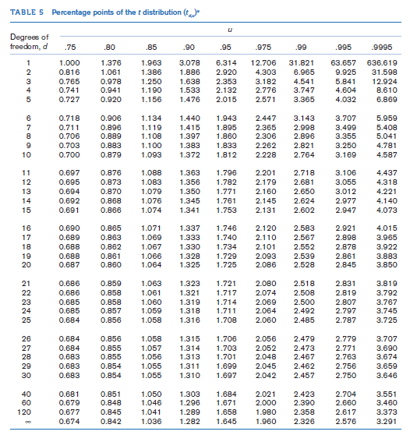

Slide 19
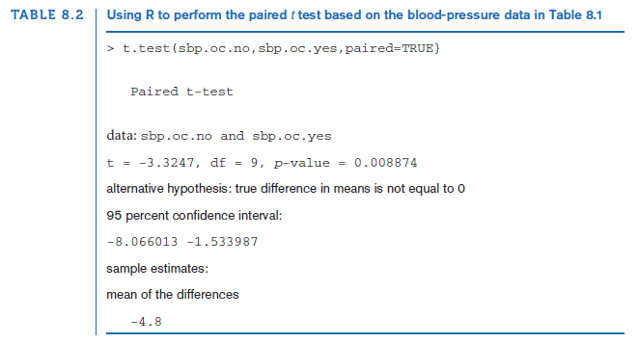

Slide 20
Interval Estimation for the Comparison of Means
from Two Paired Samples
Confidence Interval for the True Difference (Δ) Between the Underlying Means of Two Paired Samples (Two-Sided):
A two-sided 100% × (1-α) CI for the true mean difference (Δ) between two paired samples:
(d – t_{n-1,1-α/2} s_{d}/√n, d + t_{n-1,1-α/2} s_{d}/√n)
*standard error (SE)
*margin of error

Slide 21
Example on Interval Estimation for Two Paired Samples:
Hypertension
Q: compute a 95% CI for the true increase in mean SBP after starting OCs.

Slide 22

Example on Interval Estimation for Two Paired Samples:
Hypertension
Solution
We have $\overline{d}$ = 4.80mmHg, sd = 4.566 mm Hg, n = 10
A 95% CI for the true mean SBP change is given by:
$\overline{d}±t_{n−1, .975}s_{d}/\sqrt{n}$ = $4.80±t_{9, .975}\left(1.444\right)=4.80±2.262\left(1.444\right)=4.80±3.27=(1.53,8.07)$mmHg
The true change in mean SBP is most likely between 1.5 and 8.1 mm Hg.
R: t.test()

Slide 24
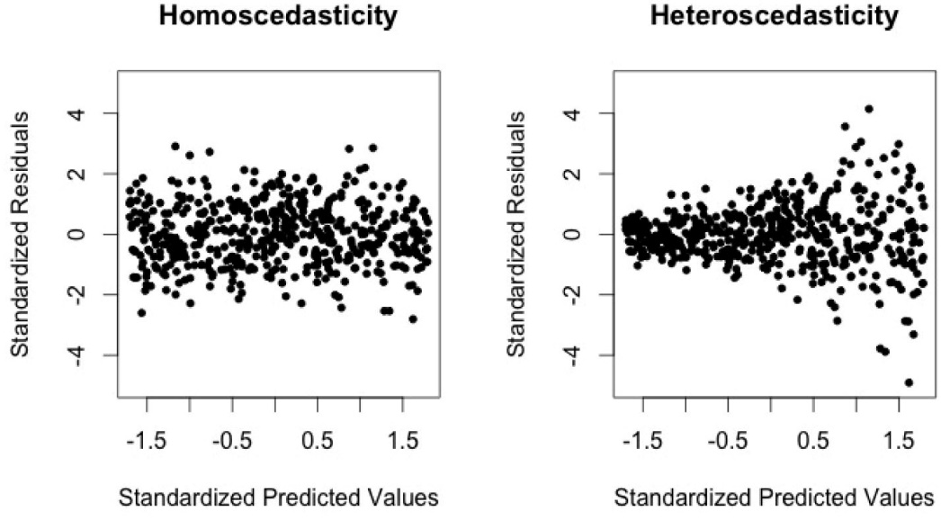
Equal vs. unequal variances
Homoscedasticity: equal variances
Heteroscedasticity: unequal variances
*Unequal variances → Type I error rate
*→ False positives (falsely reject H₀ when it is true)

Slide 25
Testing for the Equality of Two Variances
H₀: σ₁² = σ₂² vs. H₁: σ₁² ≠ σ₂²
Two independent random samples: N(μ₁,σ₁²) and N(μ₂,σ₂²)
Best test: the ratio of the sample variances (s₁²/s₂²) rather than on difference (s₁² – s₂²)
If the variance ratio is either too large or too small
→ reject H₀
Otherwise: → accept H₀

Slide 26
Statisticians R. A. Fisher and G. Snedecor: distribution of the variance ratio (S₁²/S₂²)
The variance ratio (S₁²/S₂²) follows an F distribution under the H₀ that σ₁² = σ₂²
A family of F distributions, rather than a unique F distribution
Two parameters: numerator and denominator degrees of freedom.
  n_{1:} first samples size
  n₂: second samples size
  variance ratio ~ F distribution with n₁- 1 (numerator df) and n₂ – 1 (denominator df) → F_{n1-1,n2-1} distribution
F distribution: positively skewed
  skewness : relative magnitudes of the two degrees of freedom
Numerator df is 1 or 2 → distribution has a mode at 0
  otherwise: mode > 0

Slide 27
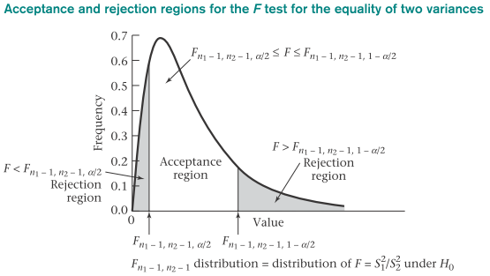
F Test for the Equality of Two Variances
H₀: σ₁² = σ₂² vs. H₁: σ₁² ≠ σ₂²
with significance level α
F = s₁²/s₂²
F > F_{n1-1,n2-1,1-α/2} or F < F_{n1-1,n2-1,α/2} → reject H₀
F_{n1-1,n2-1,1-α/2} ≤ F ≤ F_{n1-1,n2-1,1-α/2} → accept H₀

Slide 28
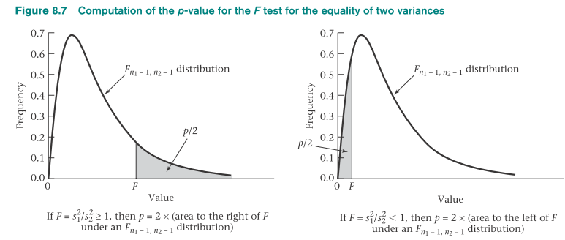
F ≥ 1 → p = 2 × Pr(F_{n1-1,n2-1} > F)
F < 1 → p = 2 × Pr(F_{n1-1,n2-1} < F)

Slide 29
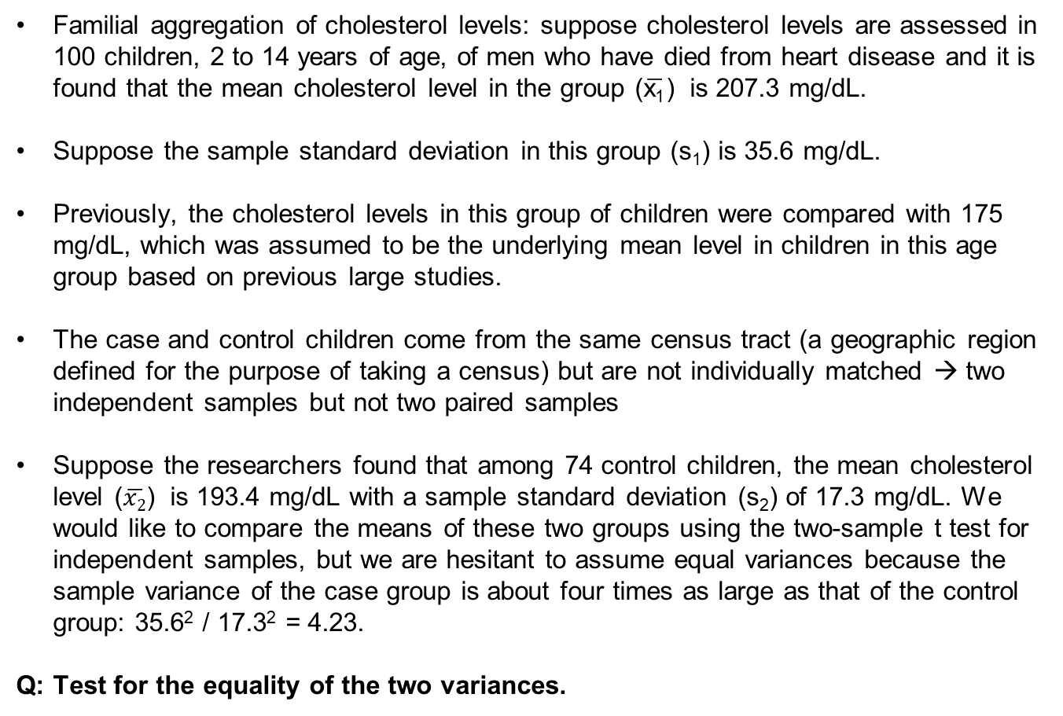
Example on F Test for the Equality of Two Variances:
Cardiovascular Disease and Pediatrics
Familial aggregation of cholesterol levels: suppose cholesterol levels are assessed in 100 children, 2 to 14 years of age, of men who have died from heart disease and it is found that the mean cholesterol level in the group ($\overline{\text{x}\text{1}}$) is 207.3 mg/dL.
Suppose the sample standard deviation in this group (s₁) is 35.6 mg/dL.
Previously, the cholesterol levels in this group of children were compared with 175 mg/dL, which was assumed to be the underlying mean level in children in this age group based on previous large studies.
The case and control children come from the same census tract (a geographic region defined for the purpose of taking a census) but are not individually matched → two independent samples but not two paired samples
Suppose the researchers found that among 74 control children, the mean cholesterol level ($\overline{x2}$) is 193.4 mg/dL with a sample standard deviation (s₂) of 17.3 mg/dL. We would like to compare the means of these two groups using the two-sample t test for independent samples, but we are hesitant to assume equal variances because the sample variance of the case group is about four times as large as that of the control group: 35.6² / 17.3² = 4.23.
Q: Test for the equality of the two variances.

Slide 30


Example on F Test for the Equality of Two Variances:
Cardiovascular Disease and Pediatrics
Solution:
$$F=\frac{s_{1}^{2}}{s_{2}^{2}}=\frac{{35.6}^{2}}{{17.3}^{2}}=4.23$$
The two samples have 100 and 74 people, respectively under H0, F ~ F_{99,73}
→ H₀ is rejected if
*cannot obtain relevant values from F table*
$$\text{F} \text{> }\text{F}\text{99,73,.975 }\text{or} \text{F} \text{< }\text{F}\text{99,73,.025}$$
obtain the percentiles using R:
find the value c1 = F_{99,73,.025} and c2 = F_{99,73,.975} such that:
Pr ($F_{99,73}≤c_{1}$) = .025 and Pr ($F_{99,73}≥c_{2}$) = .975
use the qf function of R :
c1 = qf(0.025, 99, 73)
c2 = qf(0.975, 99, 73)

Slide 31
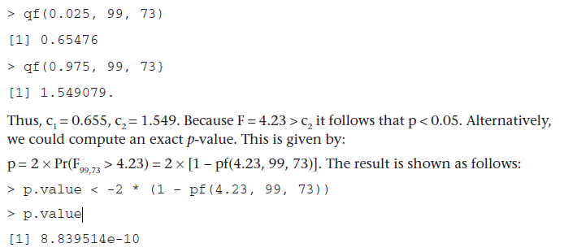
Example on F Test for the Equality of Two Variances:
Cardiovascular Disease and Pediatrics

Slide 32


Two-Sample t Test for Independent Samples with Equal Variances
Difference between the two sample means: x₁ – x₂
far from 0 → reject H₀
Close to 0 → accept H₀
The two samples are independent:
X₁ – X₂ ~ N(μ₁ - μ₂, σ²(1/n₁ + 1/n₂)):
Under H₀, μ₁ = μ_{2:}

Slide 33


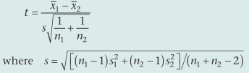
σ² were known:
X1 – X2 could be divided by σ√(1/n₁ + 1/n₂):
σ² is unknown (generally):
need to be estimated from the data using sample variances s₁² and
s₂²
The pooled estimate of the variance from two independent samples:
H₀: μ₁ = μ₂ vs. H₁: μ₁ ≠μ₂
significance level of α for two normally distributed populations
σ² is assumed to be the same for each population
Test statistic:

Slide 34
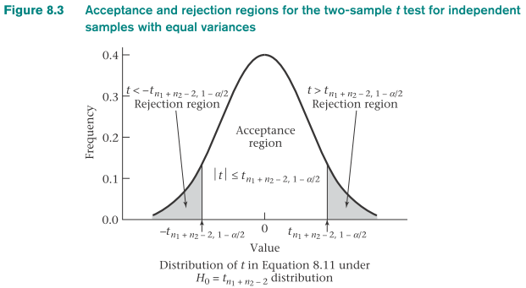
t > t_{n1 + n2 -2,1-α/2} or t < -t_{n1+ n2 -2,1-α/2} → reject H₀
–t_{n1+n2-2,1-α/2} ≤ t ≤ t_{n1+n2 -2,1-α/2} → accept H₀

Slide 35
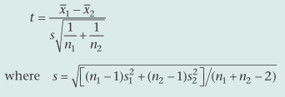
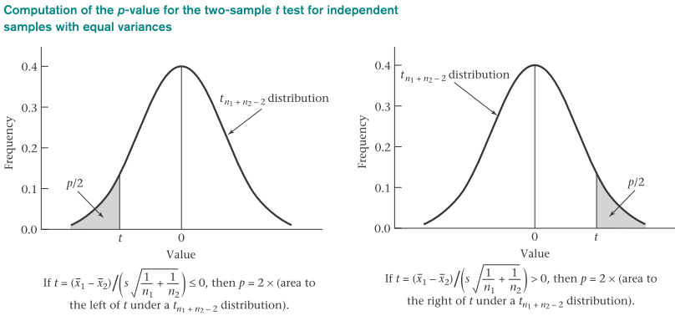
Computation of the p-value for the Two-Sample t Test for Independent Samples with Equal Variances
Test statistic:
t ≤ 0: p = 2 × (area to the left of t under a t_{n1+n2-2} distribution)
t > 0: p = 2 × (area to the right of t under a t_{n1+n2-2} distribution)

Slide 36
Example on Two-sample t test for Independent Samples with Equal Variances:
Hypertension
Suppose a sample of eight 35- to 39-year-old non-pregnant, premenopausal OC users who work in a company and have a mean systolic blood pressure (SBP) of 132.86 mm Hg and sample standard deviation of 15.34 mm Hg are identified. A sample of 21 nonpregnant, premenopausal, non-OC users in the same age group are similarly identified who have mean SBP of 127.44 mm Hg and sample standard deviation of 18.23 mm Hg.
Q: Assess the statistical significance of the data.

Slide 37

Example on Two-sample t test for Independent Samples with Equal Variances:
Hypertension
Solution
Let’s first estimate the common variance:
$$s^{2}=\frac{7{(15.34)}^{2}+20{(18.23)}^{2}}{27}=\frac{8293.9}{27}=307.18, s=17.527$$
The following test statistic is then computed:
$$t=\frac{132.86−127.44}{17.527\sqrt{1/8+1/21}}=\frac{5.42}{17.527×0.415}=\frac{5.42}{7.282}=0.74$$
Critical-value method:
- Under H₀: t comes from a t₂₇ distribution, t_{27,.975} = 2.052
- Because -2.052 ≤ 0.74≤2.052 → H₀ is accepted using a two-sided test at the
5% level
Conclusion: the mean blood pressures of the OC users and non-OC users do not significantly differ from each other
p-value approximation: t_{27,.75} = 0.684, t_{27,.80} = 0.855
Because 0.684 < 0.74 < 0.855 → .2 <p/2 < .25 or .4 < p < .5.
Exact p-value from statistical software: p = 2 × P(t₂₇ > 0.74) = .46
R command:
>pt(-0.74, 27)

Slide 39

Interval Estimation for the Comparison of Means from Two Independent Samples
(Equal Variance Case)
Two-sided 100% × (1-α) CI for true mean difference μ₁ - μ₂ (two independent samples):
Wide interval: need much larger sample to accurately assess the true mean difference

Slide 40
Example on Interval Estimation for the Comparison of Means from Two Independent Samples
(Equal Variance Case):
Hypertension
Q: Compute a 95% CI for the true mean difference in systolic blood pressure (SBP) between 35- to 39-year-old OC users and non-OC users.
Solution:
95% CI for the underlying mean difference in SBP between the population of 35- to 39-year-old OC users and non-OC users is:
$$\left[5.42−t_{27, .975}\left(7.282\right), 5.42+t_{27, .975}\left(7.282\right)\right]=\text{[5.42 − 2.052(7.282),5.42 + 2.052(7.282)] }$$
$\text{= (−9.52,20.36)}$
Wide interval
→ much larger sample is needed to accurately assess the true mean difference

Slide 41




Two-Sample t Test for Independent Samples with Unequal Variances
*Behrens-Fisher problem*
Two normally distributed samples
first sample: random sample of size n_{1,} N(μ₁,σ₁²)
second sample: N(μ₂,σ₂²)
σ₁² ≠ σ₂²
H₀: μ₁ = μ₂ vs. H₁: μ₁ ≠ μ₂
Under H₀, μ₁ - μ₂ = 0:
If σ₁² and σ₂² were known, test statistic:
σ₁² and σ₂² are unknown and estimated by s₁² and s₂²:

Slide 42


Difficult to derive the exact distribution of t under H₀
To determine t: Satterthwaite’s approximation method or the two-sample t test for independent samples with unequal variances
  Compute the approximate degrees of freedom d′ :
  Round d′ down to the nearest integer d″ :
t > t_{d ″,1-α/2} or t < -t_{d ″,1-α/2} → reject H₀
-t_{d ″,1-α/2} ≤ t ≤ t_{d ″,1-α/2} →accept H₀

Slide 43
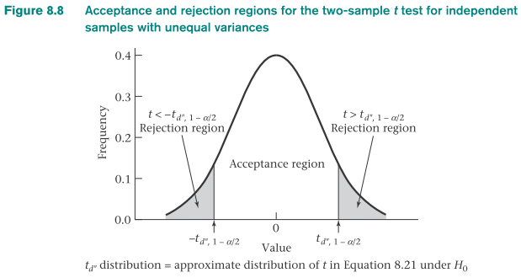
Test statistic:
t ≤ 0 → p = 2 × (area to the left of t under a t_{d″} distribution)
t > 0 → p = 2 × (area to the right of t under a t_{d″} distribution)

Slide 44
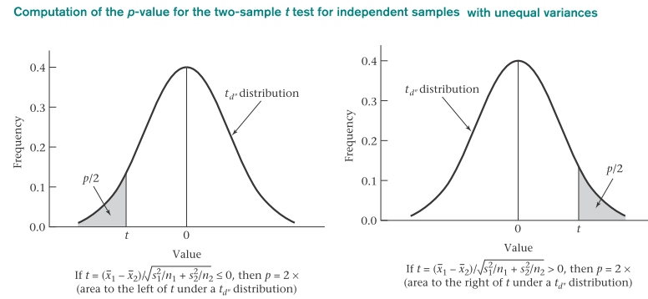

Slide 45
Two-sided 100% × (1-α) CI for μ₁ - μ₂ (σ₁² ≠ σ₂²)

Slide 46
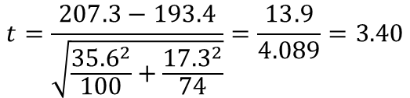
Example on Two-Sample t Test for Independent Samples with Unequal Variances:
Cardiovascular Disease, Pediatrics
Q: Consider the cholesterol data. Test for the equality of the mean cholesterol levels of the children whose fathers have died from heart disease vs. the children whose fathers do not have a history of heart disease.
Solution:
Tested for equality of the two variances: significantly different
Need to use two-sample t test for unequal variances
Test statistic:
$$t=\frac{207.3−193.4}{\sqrt{\frac{{35.6}^{2}}{100}+\frac{{17.3}^{2}}{74}}}=\frac{13.9}{4.089}=3.40$$
Degrees of freedom are now computed:
$$d^{′}=\frac{{(s_{1}^{2}/n_{1}+s_{1}^{2}/n_{2})}^{2}}{{{\left({s_{1}^{2}}/{n_{1}}\right)}^{2}}/{\left(n_{1}−1\right)}+{{\left({s_{2}^{2}}/{n_{2}}\right)}^{2}}/{\left(n_{2}−1\right)}}=\frac{{({35.6}^{2}/100+{17.3}^{2}/74)}^{2}}{{{\left({35.6}^{2}/100\right)}^{2}}/{99}+{{\left({17.3}^{2}/74\right)}^{2}}/{\left(73\right)}}=\frac{{16.718}^{2}}{1.8465}=151.4$$
Critical value method: t = 3.40 > t _{120,.975} = 1.980 > t _{151,0.975}

Slide 48

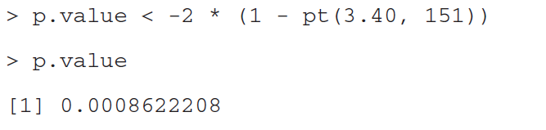
Example on Two-Sample t Test for Independent Samples with Unequal Variances:
Cardiovascular Disease, Pediatrics
use the qt command of R to evaluate t_{151,.975} directly as follows:
t = 3.40 > 1.976→ reject H0 using a two-sided test at the 5% level
exact p-value: use pt command of R :
two-sided p-value = 0.0009
Conclusion: mean cholesterol levels in children whose fathers have died from heart disease are significantly higher than mean cholesterol levels in children of fathers without heart disease
→cause of this difference? genetic factors, environmental factors such as diet,
or both?

Slide 49
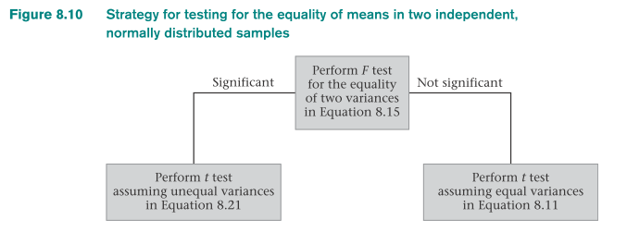
F = s₁²/s₂²
Two procedures for comparing two means from independent and normally distributed
First step: test for the equality of the two variances *F test*
  If this test is not significant →use the t test with equal variances
  If this test is significant → use the t test with unequal variances

Slide 50
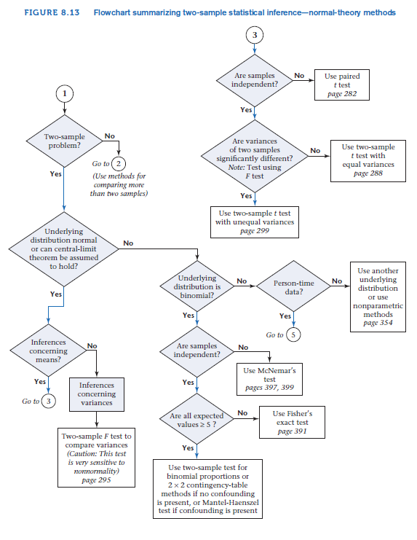

Slide 51
Summary
Methods of hypothesis testing for comparing the means and variances of two normally distributed samples
Paired t test and F test for two-sample problem:
  Two samples are paired → paired t test is appropriate
  samples are independent →F test for the equality of two variances is used to decide whether the variances are significantly different
  If the variances are not significantly different →two-sample t test with equal variances
  If the variances are significantly different →two sample t test with unequal variances

