Slide 1

EE4803: Analog IC Design
Intuitive Analysis
Department of Electrical Engineering
City University of Hong Kong
Prof. Arindam Basu

Slide 2
Outline
Intuitive analysis – concept
Intuitive analysis - example
*With inputs from Phillip Allen’s course at Georgia Tech and Willy Sansen’s book

Slide 3
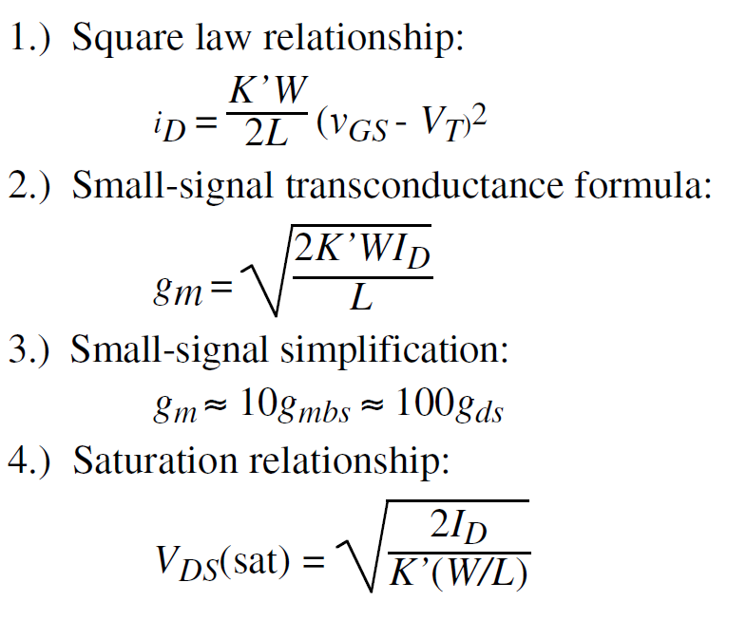
Important Relationships

Slide 4
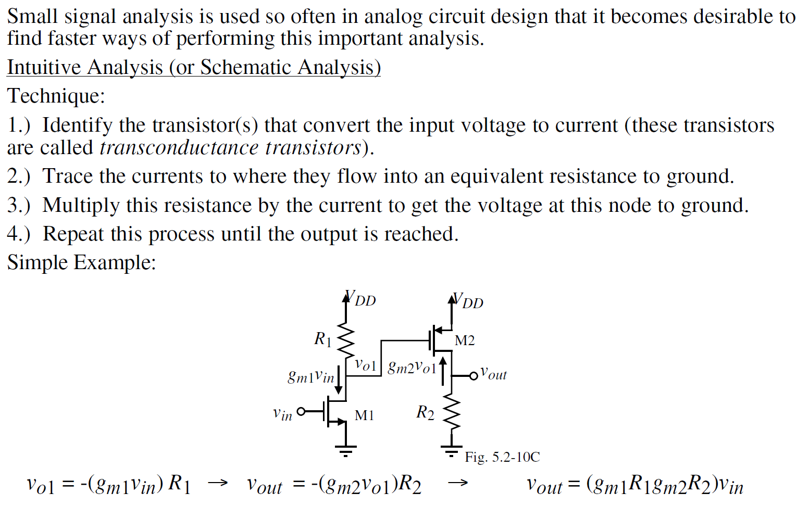
Intuitive Analysis

Slide 5
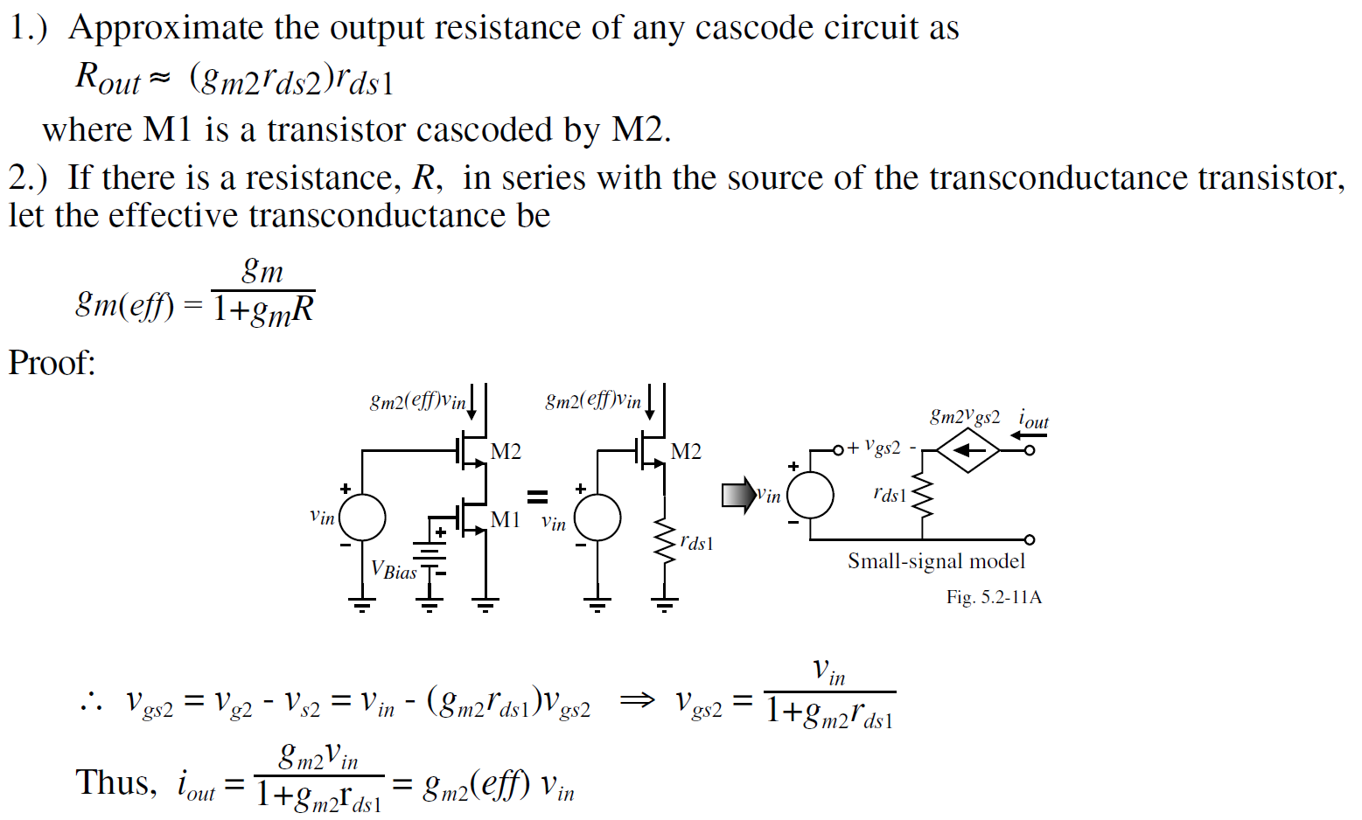
Additional shortcuts

Slide 6
Additional shortcuts
3. Resistance of diode connected transistor ~ 1/g_{m}
4. Resistance looking at source of MOS ~ 1/gm + R_{D}/(g_{m}r_{o})
5. Parallel combination of two resistors ~ smaller resistor

Slide 7
Outline
Intuitive analysis – concept
Intuitive analysis - example
*With inputs from Phillip Allen’s course at Georgia Tech and Willy Sansen’s book

Slide 8
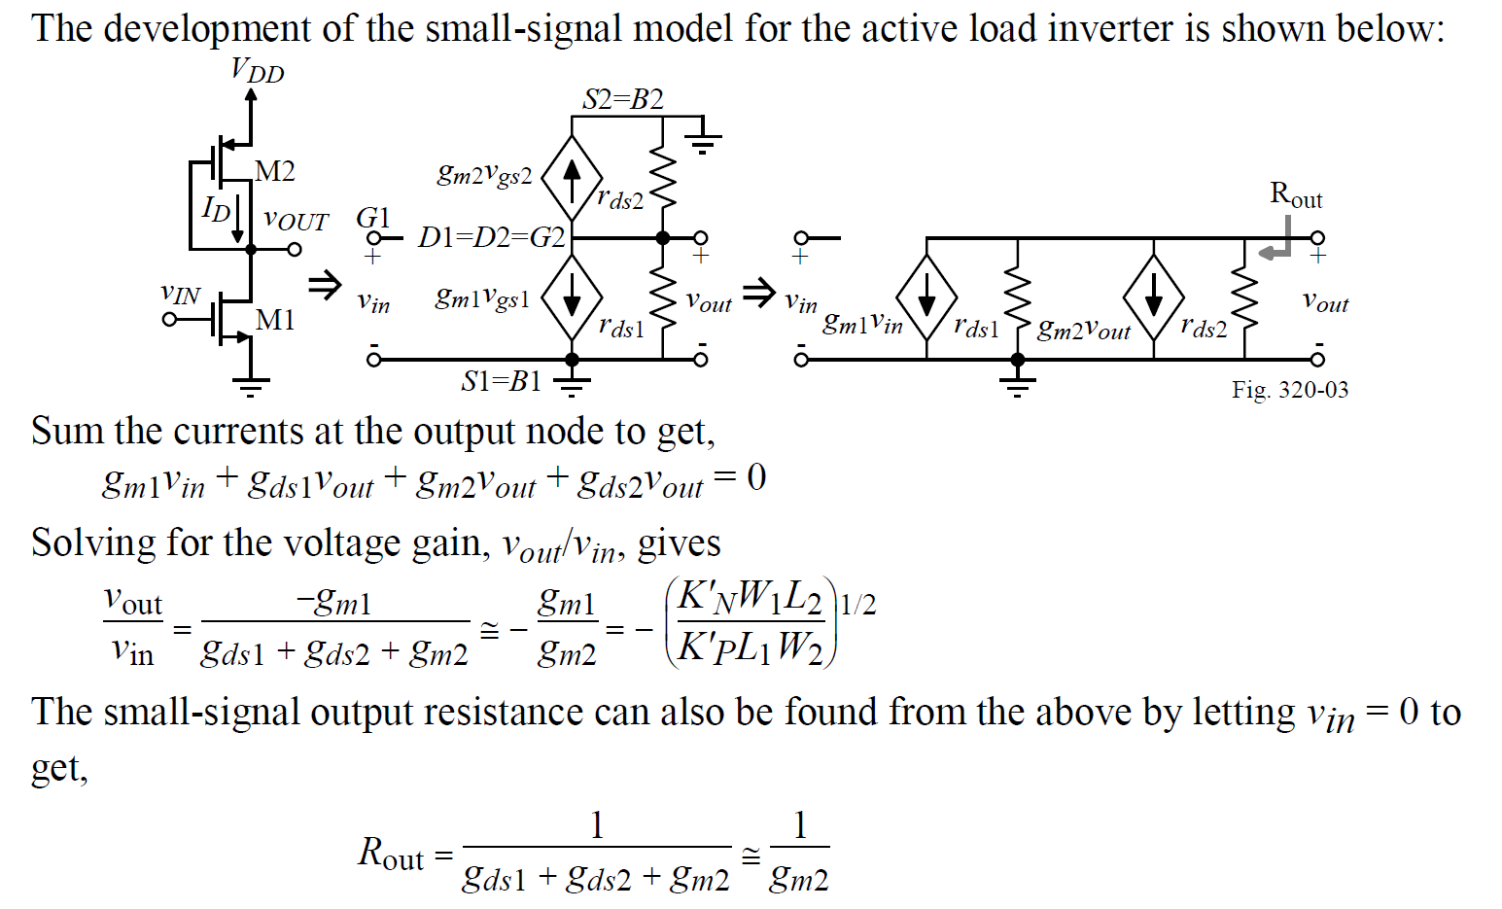
Example 1

Slide 9
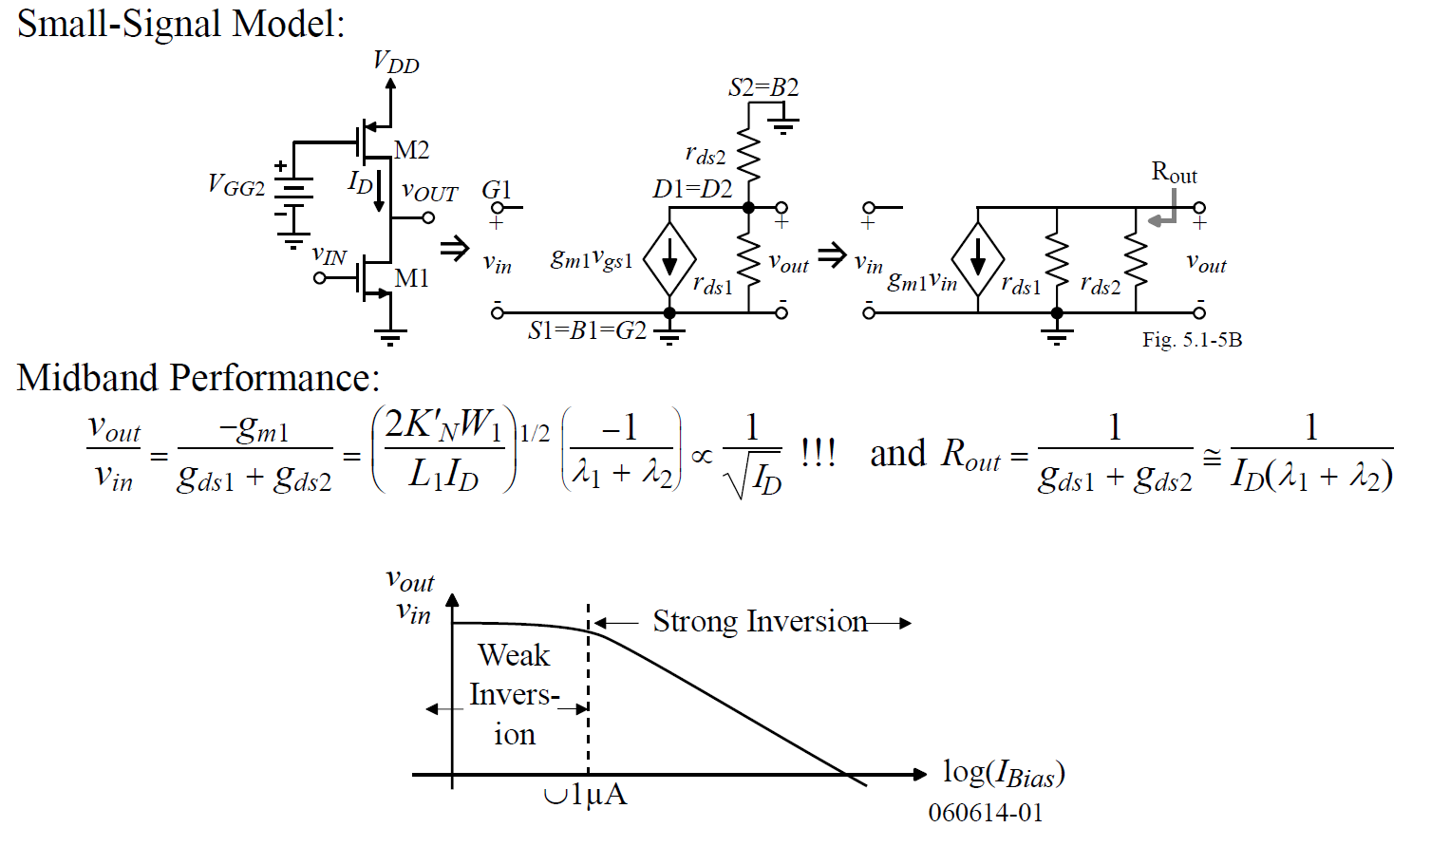
Example 2

Slide 10
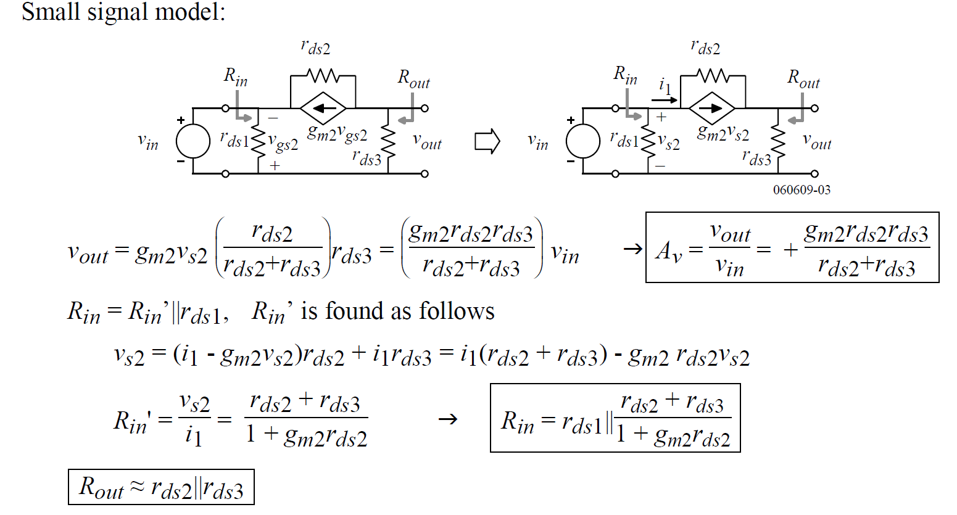
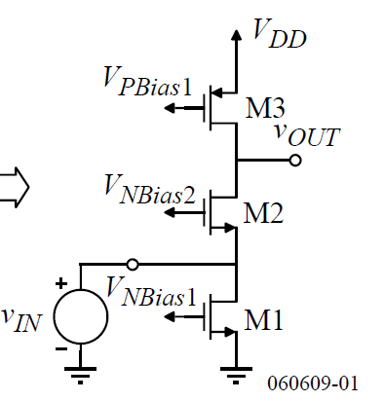
Example 3

