Slide 1
GE1202 Managing Your Personal Finance
Lecture 1
Introduction to Personal Finance Management

Slide 2
Who Need to Know Personal Finance Planning?
Every person has some money available
Most people want to handle their finances so that they get full satisfaction from each available dollar
Financial Goals
  Buying a new car or getting a larger home
  Pursuing advanced career training
  Contributing to charity
  Traveling extensively
  Ensuring self-sufficiency during working and retirement years
  Holding a fantastic wedding party

Slide 3
Financial Planning
As we have limited money, it is impossible to have all the goals to be realized
To achieve these goals, you need to identify and set priorities.
The process of managing your money to achieve personal economic satisfaction
  Personal money management or Personal financial planning
Financial decision must be planned to meet the unique situation facing each person.
  People in their 20s spend differently from those in their 50s
  Life situation/style – Adult Life Cycle

Slide 4
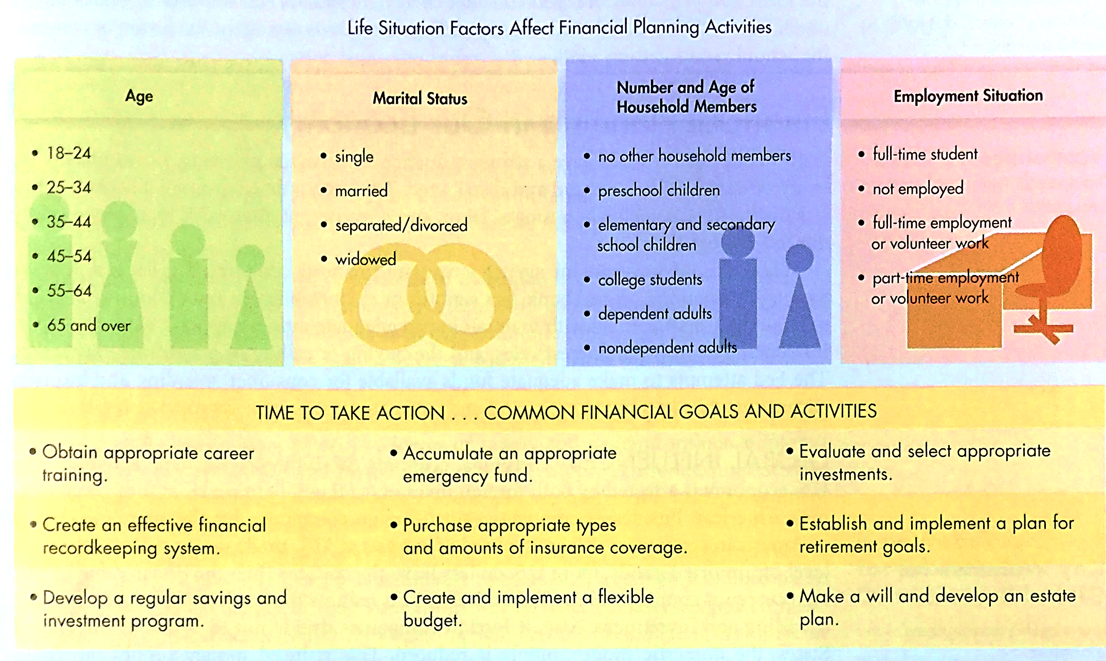
Adult Life Cycle

Slide 5
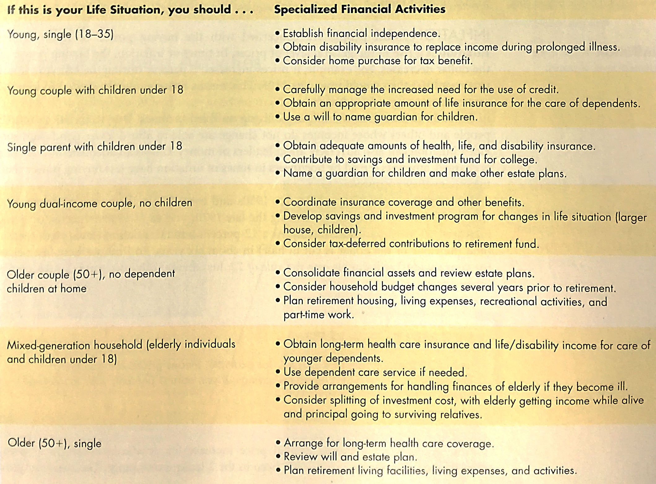

Slide 6
Financial Planning
Financial Plan
  A formalized report that summarize your current situation, analyzes your financial needs, and recommends future financial activities.
Advantages of effective personal financial planning
  Increased effectiveness in obtaining, using, and protecting your financial resources throughout your life
  Increased control of your financial affairs by avoiding excessive debt, bankruptcy, and dependence on others
  Improved personal relationships resulting from well-planned and effectively communicated financial decisions
  A sense of freedom from financial worries obtained by looking to the future, anticipating expenses, and achieving personal economic goals

Slide 7
Goal-Setting Guidelines
Financial goals should take a SMART approach.
  Specific – know exactly what your goals are and can create a plan to achieve those objectives
  Measurable – can be measured by a specific amount
  Action oriented - provide the basis for the personal financial activities you will undertake.
  Realistic – involve goals based on your income and life situation
  Time based – indicate a time frame for achieving the goal

Slide 8
Which is SMARTer?
A fresh graduate just starts his career as a secondary school teacher.
Plan A: Buy a flat in Kowloon Tong by 30.
Plan B: Put $5,000 into the saving account each month for 8 years as the down payment for a flat of $6M in Kowloon Bay.

Slide 9
Types of Financial Goal
There are 3 different financial goals
  Consumable-Product Goals
    Food, clothing, entertainment
  Durable-Product Goals
    “Big ticket” items like appliances and cars
  Intangible-Product Goals
    Health, education, relationships, service

Slide 10
Types of Financial Goal
There are 3 different time frames for achieving financial goals
  Short term goals
    Will be achieved within the next year
    Saving for a vacation, buying a new phone
  Intermediate goals
    Two to five years
    Further study, Wedding
  Long term goals
    More than five years
    Retirement, children’s education expenses

Slide 11
Components of Personal Financial Planning
There are Eight major personal financial planning areas
  Obtaining – the receipt of income and other financial resources
  Planning – actions to determine future financial directions
  Saving – set aside funds for expected and unexpected expenses
  Borrowing – appropriate use of short-and-long-term credit plans
  Spending – analysis of purchasing decisions for wise money use
  Managing Risk – insurance and other methods to reduce financial uncertainty
  Investing – accumulation of funds for long-term financial security
  Retirement and Estate Planning – efforts to provide for post-career years and transfer of assets

Slide 12
Factors Influence Financial Decisions
Personal factors
  Age
  Income
  Household size
  Personal beliefs
General factors
  Global economy
  Inflation rate
  Interest rate

Slide 13
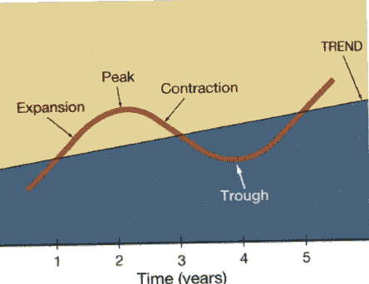
Global Economy
Economy influences financial planning
  Phases of the business cycle: expansion, peak, contraction, trough (takes 4-5 years on average)
Economics: the study of how wealth is created and distributed; strongly influences financial planning
Decisions made by Central Banks (e.g., interest rates, money supply)

Slide 14
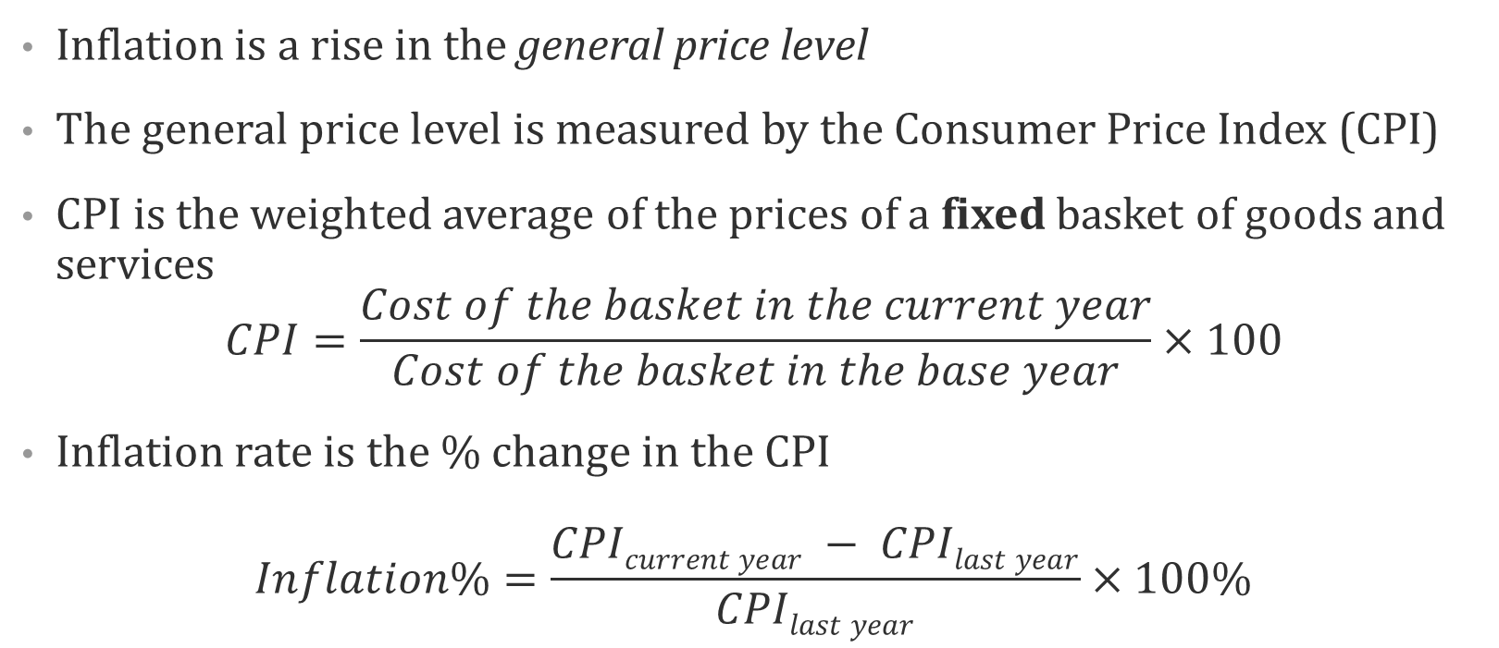
Inflation
Inflation is a rise in the general price level
The general price level is measured by the Consumer Price Index (CPI)
CPI is the weighted average of the prices of a fixed basket of goods and services
$$CPI=\frac{Cost of the basket in the current year}{Cost of the basket in the base year}×100$$
Inflation rate is the % change in the CPI
$$Inflation\%=\frac{CPIcurrent year − CPIlast year}{CPIlast year}×100\%$$

Slide 15
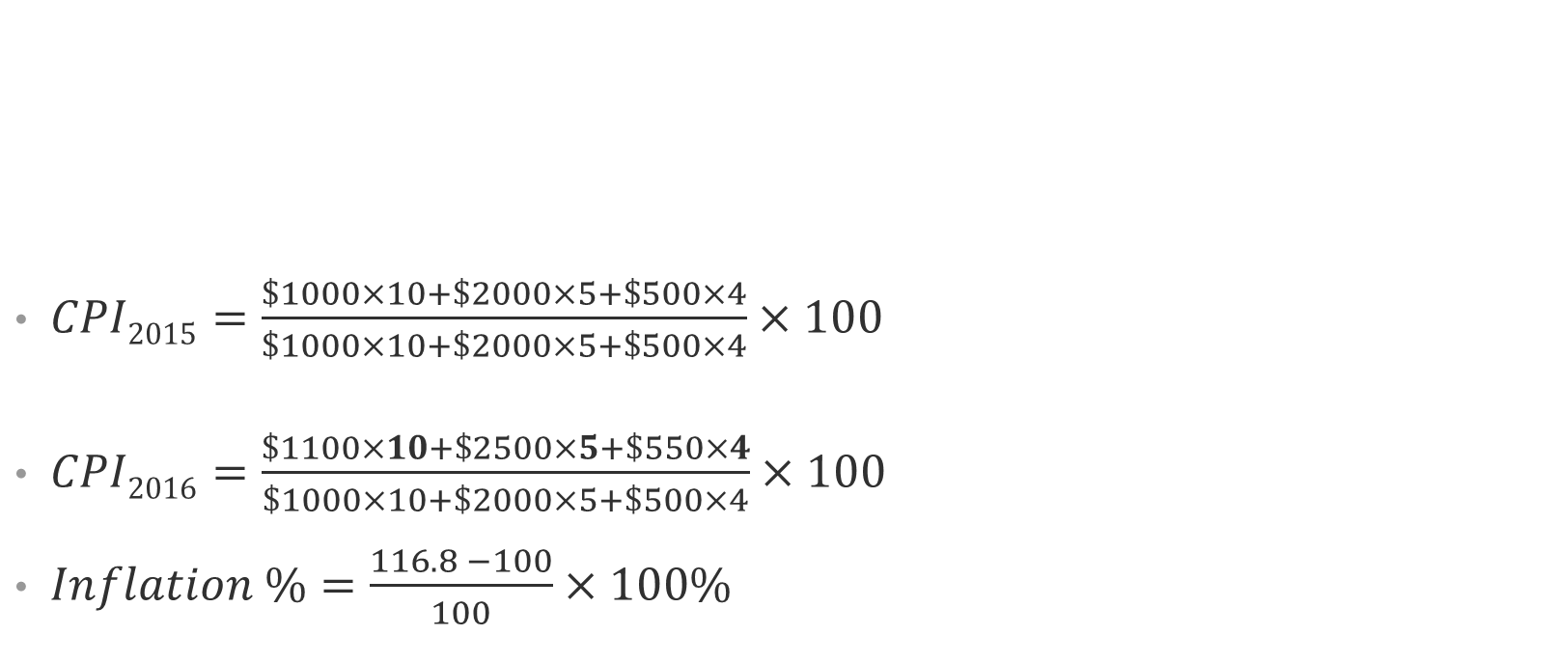
Inflation
$CPI2015=\frac{\$1000×10+\$2000×5+\$500×4}{\$1000×10+\$2000×5+\$500×4}×100$
$CPI2016=\frac{\$1100×10+\$2500×5+\$550×4}{\$1000×10+\$2000×5+\$500×4}×100$
$Inflation \%=\frac{116.8 −100}{100}$ $×100$%
Product | Price in 2015 | Quantity in 2015 | Price in 2016 | Quantity in 2016
iphone | $1000 | 10 | $1100 | 12
iMac | $2000 | 5 | $2500 | 6
ipod | $500 | 4 | $550 | 3
=
=
=

Slide 16
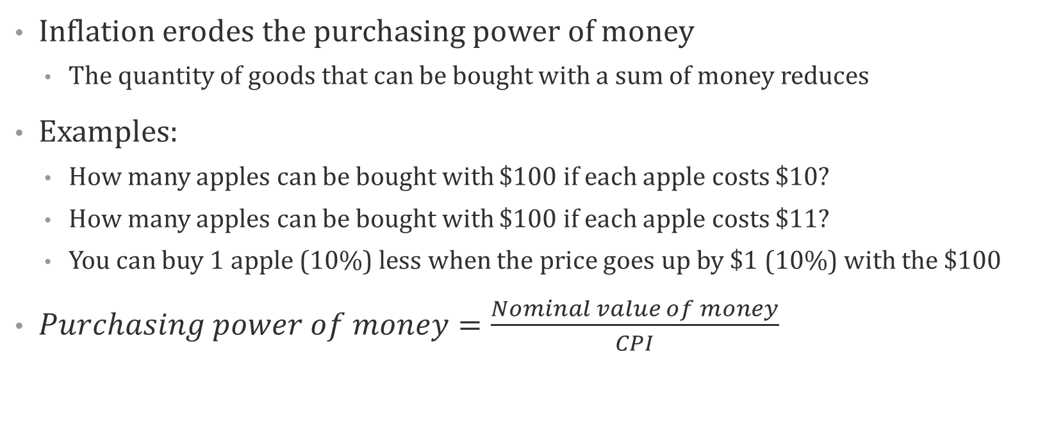
Inflation
Inflation erodes the purchasing power of money
  The quantity of goods that can be bought with a sum of money reduces
Examples:
  How many apples can be bought with $100 if each apple costs $10?
  How many apples can be bought with $100 if each apple costs $11?
  You can buy 1 apple (10%) less when the price goes up by $1 (10%) with the $100
$Purchasing power of money=\frac{Nominal value of money}{CPI}$
% △ Real value = % △ Nominal value – Inflation%

Slide 17
Interest
To maintain the purchasing power of money, you may invest them into interest-yielding assets.
What is interest?
  Lender – compensation for giving up earlier availability of resources
  Borrower – cost of acquiring earlier availability of resources
  Investor – return on financial investment
    Interest on deposits
    Interest on bonds
    Dividend and capital gains from stocks

Slide 18
Interest
Interest raises the nominal value of money
  You get back $110 a year later if you deposit $100 into a bank which pays interest 10% p.a.
Real value of money may increase, decrease or remain unchanged with interest during the time of inflation
  You save $100 into a deposit which gives interest 10% p.a. and the initial price level is 100
Inflation rate (π) | Nominal value | % △ Nominal value | Real value | % △ Real value
0%
10%
15%

Slide 19
Time Value of Money
Why do we need to pay interest?
As people prefer early consumption to late, people place higher value on current consumption
The dollar received today is worth more than a dollar that will be received one year from today

Slide 20
Time Value of Money
Compounding
  The process of finding the future value from a current sum based on a certain interest rate and period of time
  If you put $1000 into a bank deposit which offers an interest rate of 10% p.a., how much will you get after 10 years?
Discounting
  The process of finding the current value from a future sum based on a certain interest rate and period of time
  How much do you need to put into your bank account which offers an interest rate of 10% p.a., how much will you get after 10 years?

Slide 21
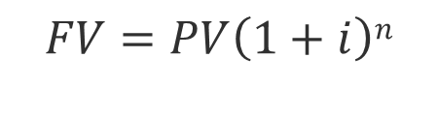
Compounding
If you put $100 into your bank account for 3 years with an interest of 10%p.a., how much should you expect to get back?
To find the future value of a Single amount
FV = Future Value; PV = Present Value; i = interest rate; n = time periods
$$FV=PV\left(1+i\right)n$$

Slide 22
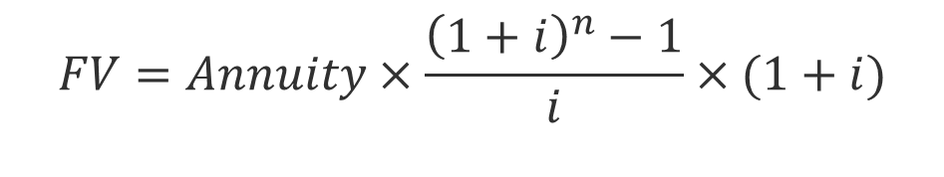
Compounding
If you put $100 into your bank account in the beginning of each year for 3 years with an interest of 10%p.a., how much should you expect to get back?
A stream of constant amount is called Annuity
To find the future value of a Series of equal amounts
$$FV=Annuity×\frac{{\left(1+i\right)}^{n}−1}{i}×(1+i)$$

Slide 23
Compounding
3rd
$100
What is the sum of these amounts?
2nd
$100
1st
$100
0
1
2
3

Slide 24
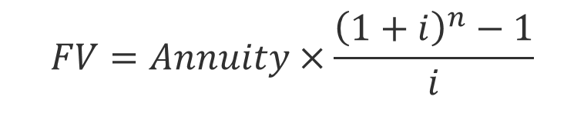
Compounding
If you put $100 into your bank account at the end of each year for 3 years with an interest of 10%p.a., how much should you expect to get back?
3rd
$100
What is the sum of these amounts?
2nd
$100
$110
1st
$100
$110
$121
0
1
2
3
$$FV=Annuity×\frac{{\left(1+i\right)}^{n}−1}{i}$$

Slide 25
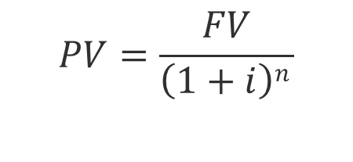
Discounting
How much should you put into your bank account with an interest of 10%p.a. so as that you can get back $133.1 after 3 years?
To find the present value of a Single amount
$$PV=\frac{FV}{\left(1+i\right)n }$$

Slide 26
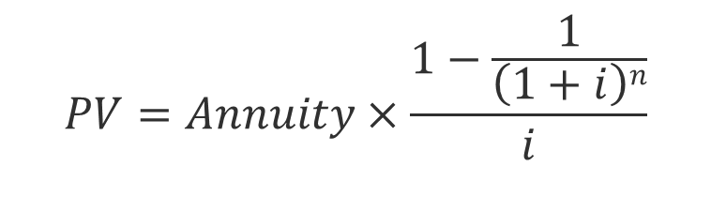
Discounting
If you wish to withdraw $100 at the end of each year for 3 years from an account that earns interest 10% p.a., how much you should deposit not?
To find the present value of a Series of equal amounts
$$PV=Annuity×\frac{1−\frac{1}{\left(1+i\right)n}}{i}$$

Slide 27
Discounting
What is the sum of these amounts?
$100
1st
$100
2nd
$100
3rd
0
1
2
3

Slide 28
Opportunity Cost
Opportunity cost is what you give up by making a choice
  Trade-off of a decision
Example 1:
  You may spend $200 to have meal with your friend or to buy the textbook.
  What is your opportunity cost for you to buy the textbook?
Example 2:
  You may spend $200 to buy the textbook or save it to earn an interest of 10%
  What is your opportunity cost for you to buy the textbook?
Interest rate is the opportunity cost for current consumption.

Slide 29
A Plan for Personal Financial Planning
We all make hundreds of decision each day
Some are complex and have long-term effects on our personal and financial situations
Few people consider how to make better decisions
Six-step financial planning process
Determine your current financial situation
  Review and revise the plan
  Develop your financial goals
  Create and implement your plan
  Evaluate alternatives
  Identify alternative courses of actions

Slide 30
Step 1: Determine Your Current Financial Situation
Check out your current financial situation
  Income
  Savings
  Living expenses
  Debts
Prepare your personal financial statement
  A list of current asset and debt balances and amounts spent for various items
  The foundation for financial planning activities

Slide 31
Step 2: Develop Your Financial Goals
Analyze your financial values and goals periodically
  Differentiate your needs from your wants
Your financial goals can range from spending all of your current income to developing an extensive savings and investment program for your future financial security

Slide 32
Step 3: Identity Alternative Courses of Action
Possible courses of action usually fall into these categories
  Continue the same course of action
  Expand the current situation
  Change the current situation
  Take a new course of action
Not all of these categories will apply to every decision
Consider all of the possible alternatives will help you make more effective and satisfying decisions

Slide 33
Step 3: Identity Alternative Courses of Action
Example:
  You are saving $1000 into your bank account every month. What are the possible courses of action available to you?
  Continue to save the same amount.
  Save $500 more
  Invest it into the stock market
  Pay off your credit card debts
  Do nothing!!!

Slide 34
Step 4: Evaluate Your Alternatives
Evaluating the alternatives, you should always keep in mind the following two aspects:
Consequences of choices
  Every decision has an opportunity cost.
  The trade-off cannot always be measured in money, but the resources you give up have a value that is lost
  Example:
    You are considering to take a Master degree after finishing your undergraduate degree or take up a job offer by a famous company.
    What is your opportunity cost if you end up with taking the master degree?
    Income; working experience; skills
    Job satisfaction

Slide 35
Step 4: Evaluate Your Alternatives
Evaluating risk
  Uncertainty is also a part of every decision
  Different decisions involve difference degree of risk
  In many financial decisions, identifying and evaluating risk are difficult.
  Common risk to consider
    Inflation risk
    Interest rate risk
    Income risk
    Personal risk
    Liquidity risk

Slide 36
Step 4: Evaluate Your Alternatives
The best way to consider risk is to gather information based on your and others’ experience and to use financial planning information sources.
Common sources
  The Internet
  Media sources
  Financial institutions
  Financial specialists
A larger amount and more advanced information is needed when more risks are associated with a decision.
Some more things to consider
  Your life situations; personal values, current economic conditions, etc

Slide 37
Step 5: Create and Implement Your Plan
Develop an action plan to achieve your goals
The plan has to be realistic and achievable
  Example
    Your friend is planning to have his own home after 3 years from graduate
    He is targeting on a flat of size 600 sq. feet, which selling at $5M
    He is expecting to get a job paying him $30,000 per month
    He will save $28,000 per month and get it accumulated to $1M in 3 years for the down payment
    What will you say to your friend?
    God Bless You!!!

Slide 38
Step 6: Review and Revise Your Plan
Financial planning is a dynamic process
Regularly assess your financial decisions
A complete review should be done at least once a year
Changing personal, social, and economic factor may require more frequent assessments
A regular review will help you make priority adjustments that will bring your financial goals and activities in line with your current life situation

