Slide 1
EE 3114 Systems and Control
11. Discrete LTI Systems
Semester A, 2024-25

Slide 2
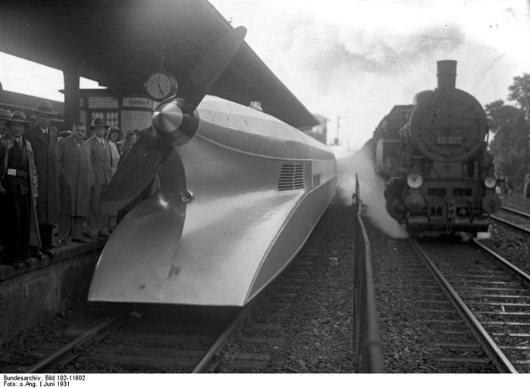



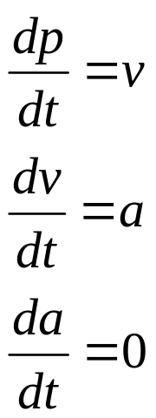
Mathematical Modeling
position
velocity
acceleration
Assume: constant acceleration
High-Speed Train (left), Germany, 1 July 1931

Slide 3
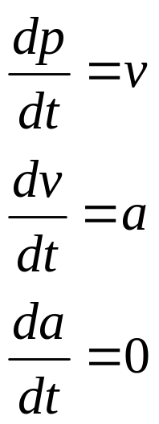
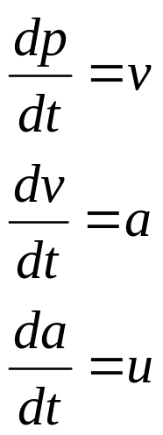
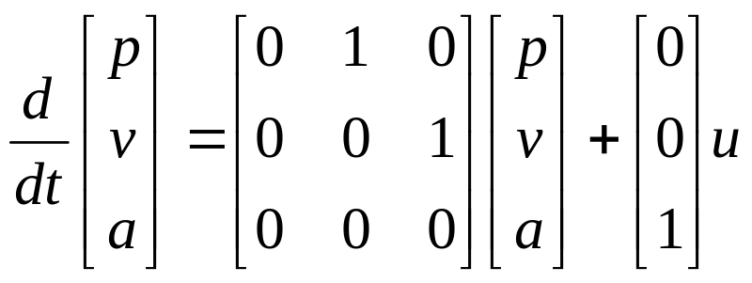
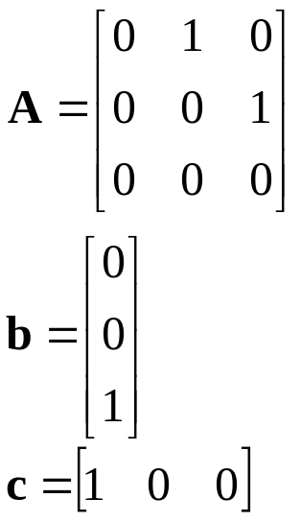
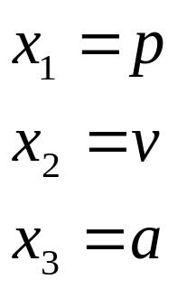
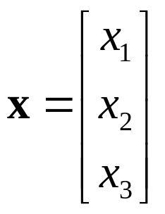
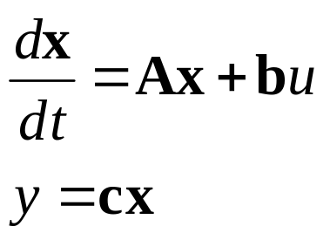

Mathematical Modeling
under control
Define
measurement

Slide 4
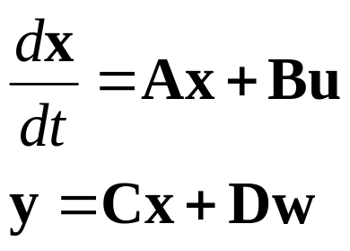
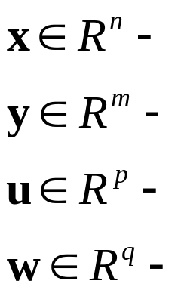

Mathematical Modeling
LTI system:
← State-space system
Here:
State vector
Output (measurement) vector
Input (control) vector
Disturbance vector (possibly, )

Slide 5
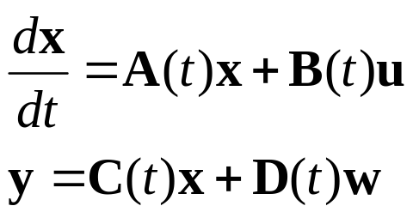

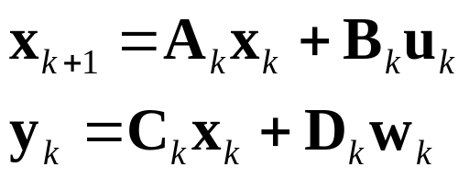
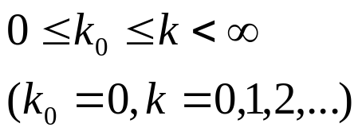


Mathematical Modeling
Continuous-time LTV system:
Discrete-time LTV system:
Here: initial time and initial state

Slide 6


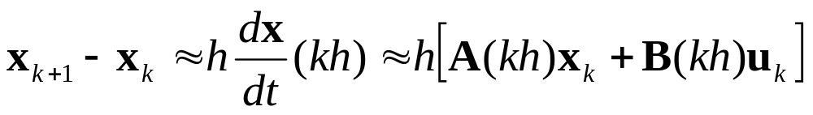



Discretization
h
h
k-1
k
k+1
t
Taylor expansion at gives
Use first-order approximation:
and

Slide 7






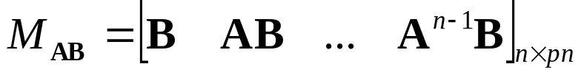
Controllability
Continuous-time LTI model:
Controllability: If, starting from any at any initial time , there exists a control input to drive the state vector to the origin in finite time
Controllability: The above continuous-time LTI system is (completely) controllable if and only if the following controllability matrix has full row-rank:

Slide 8
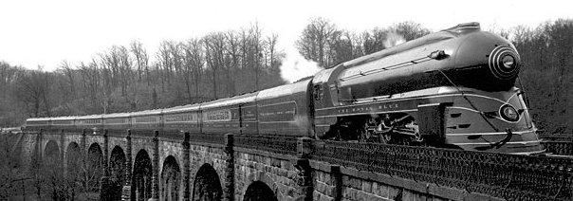
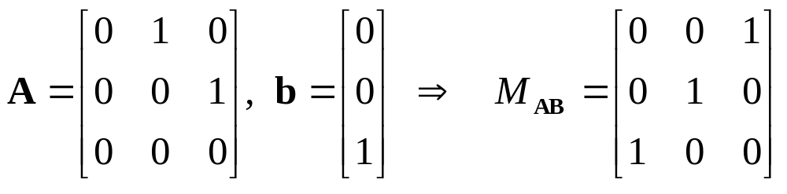
Controllability
Controllability: The above continuous-time LTI system is (completely) controllable if and only if the following controllability matrix has full row-rank:
Example:

Slide 9





Controllability
Discrete-time LTV system:
Controllability: If, starting from any at any initial time , there exists a control input sequence to drive the state vector sequence to the origin in finite time
For discrete-time LTI systems, the concept is similarly defined.

Slide 10
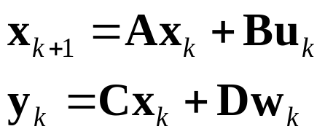
Controllability
Discrete-time LTI system:
Controllability: The above discrete-time LTI system is (completely) controllable if and only if the following controllability matrix has full row-rank:
Example:

Slide 11

Observability
Continuous-time LTV system:
Observability: If any input-output pair (u(t), y(t)), uniquely determines the initial state
Thus, the system is said to be observable at
The system is said to be (completely) observable if it is observable at every initial time

Slide 12
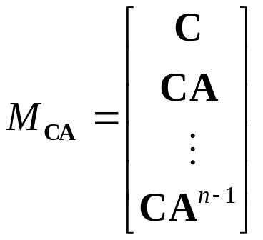
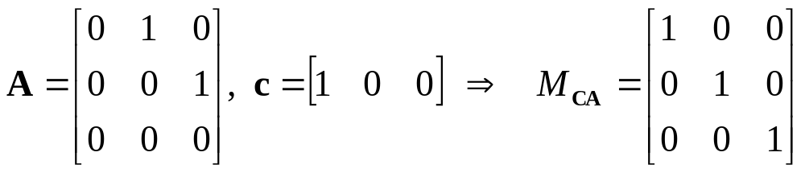
Observability
General continuous-time LTI system:
Observability: The above continuous-time LTI system is (completely) observable if and only if the following observability matrix has full column-rank:
Example:

Slide 13
Observability
Discrete-time LTI system:
Criterion: The above discrete-time LTI system is (completely) observable if and only if the following observability matrix has full column-rank:
Example:

Slide 14
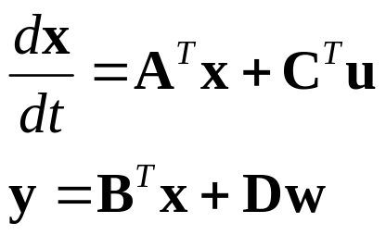
Duality
Continuous-time LTI system:
(1)
Dual system:
(2)
System (1) is controllable if and only if system (2) is observable
System (1) is observable if and only if system (2) is controllable

Slide 15

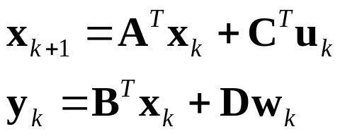
Duality
Discrete-time LTI system:
(1)
Dual system:
(2)
System (1) is controllable if and only if system (2) is observable
System (1) is observable if and only if system (2) is controllable

Slide 16
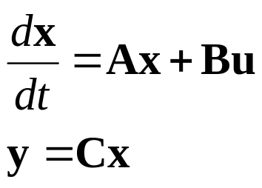
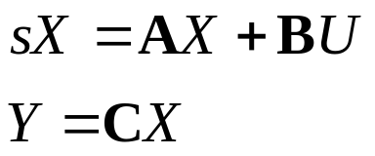
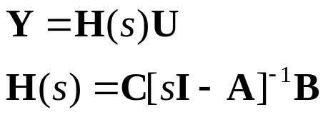
Transfer Matrix
Continuous-time LTI system:
Laplace transform →
→ Input-output transfer matrix:

Slide 17
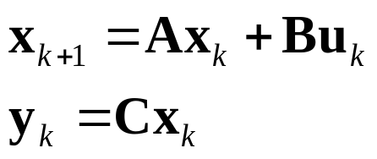

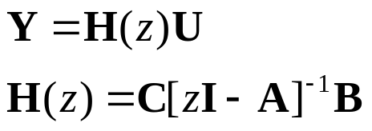
Transfer Matrix
Discrete-time LTI system:
z -Transform →
→ Input-output transfer matrix:

Slide 18
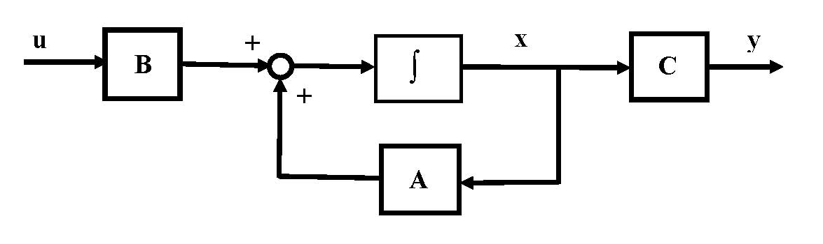
Stability
Input: u
Output: y
Input-output stability: bounded u → bounded y
→ bounded-input/bounded-output (BIBO) stability

Slide 19

Stability
Continuous-time LTI system:
Input-Output Transfer Matrix:
Criterion: The above continuous-time LTI system is stable if and only if all the poles of its transfer matrix are inside the LHP of the complex plane

Slide 20

Stability
Discrete-time LTI system:
Input-output transfer matrix:
Criterion: The above discrete-time LTI system is stable if and only if all the poles of its transfer matrix lie inside the unit circle of the complex plane

Slide 21
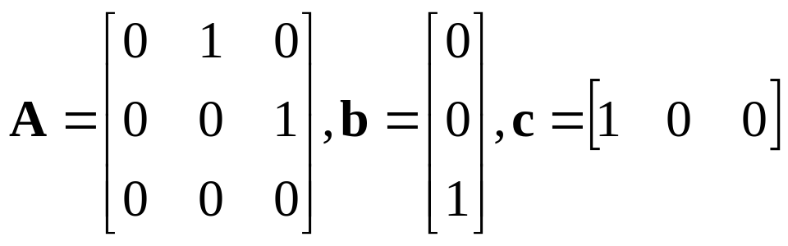
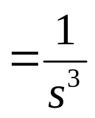
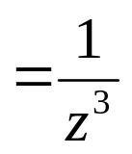
Example
Continuous-time LTI system:
→ Unstable
(marginally stable)
Discrete-time LTI system:
→ stable
Continuous-time and Discrete-time settings are very different!

Slide 22
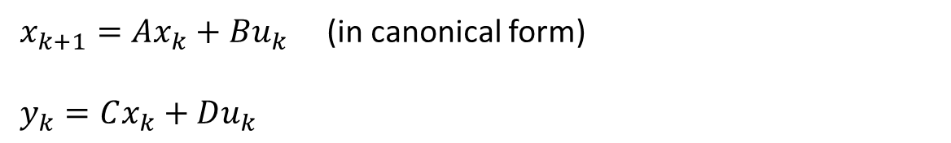

Controller Design via Pole Placement
$x_{k+1}=Ax_{k}+Bu_{k}$ (in canonical form)
$y_{k}=Cx_{k}+Du_{k}$
$$u_{k}=−Kx_{k}=\left[k_{1 } k_{2} ⋯ k_{n}\right]x_{k}$$
Desired poles: $p_{1}, p_{2}, …, { p}_{n}$
det$\left(zI−\left[A−BK\right]\right)=z^{n}+{(a}_{n}−k_{n})z^{n−1}+⋯+{(a}_{2}−k_{2}) z+{(a}_{1}−k_{1})$
$$Π\left(z−p_{1}\right)⋯(z−p_{n})=z^{n}+α_{n}z^{n−1}+⋯+α_{2}z+α_{1}$$
$$K=\left[k_{1} ⋯k_{n−1} k_{n}\right]=[a_{1}−α_{1} a_{2}−α_{2} ⋯ a_{n}−α_{n} ]$$
(Same as the continuous-time setting)

Slide 23
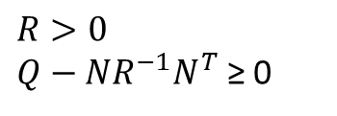
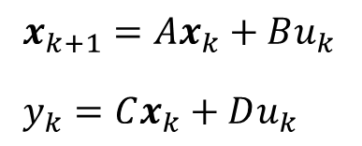

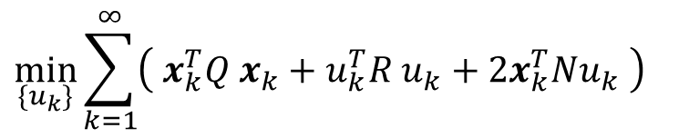
Discrete-Time LQR Optimal Control
$x_{k+1}=Ax_{k}+Bu_{k}$
$y_{k}=Cx_{k}+Du_{k}$
$$\min_{\{u_{k}\}}{\sum_{k=1}^{∞}{\left( x_{k}^{T}Q x_{k}+u_{k}^{T}R u_{k}+2x_{k}^{T}Nu_{k} \right)}}$$
$R>0$
$Q−NR^{−1}N^{T}$ ≥ 0
Solution:
$u_{k}=−Kx_{k}$ with $K={(B}^{T}PB+{R)}^{−1}(B^{T}PA+N^{T})$
where $P$ satisfies $(P>0)$:
$$A^{T}PA−A−\left(A^{T}PB+N\right){\left(B^{T}PB+R\right)}^{−1}\left(B^{T}PA+N^{T}\right)+Q=0$$
%MatLab code
[K,P] = dlqr(A,B,Q,R,N)

Slide 24
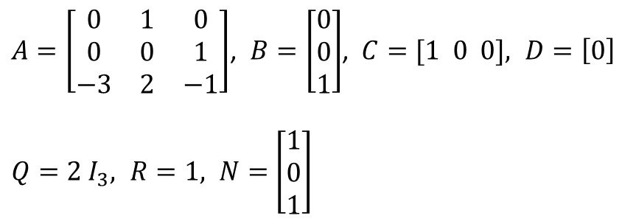
Example: (LQR optimal control)
$A=\left[\begin{matrix}0 & 1 & 0 \\ 0 & 0 & 1 \\ −3 & 2 & −1\end{matrix}\right]$, $B=\left[\begin{matrix}0 \\ 0 \\ 1\end{matrix}\right]$, $C=[1 0 0], D=\left[0\right]$
$Q=2{ I}_{3}, R=1, N=$ $\left[\begin{matrix}1 \\ 0 \\ 1\end{matrix}\right]$
%MatLab code
A=[0 1 0; 0 0 1;-3 2 -1];
B=[0; 0; 1];
C=[1 0 0];
D=[0];
Q=[2 0 0; 0 2 0; 0 0 2];
R=[1];
N=[1; 0; 1];
[K,P] = dlqr(A,B,Q,R,N)
K =
-2.8280 2.2794 -1.3738
P =
16.3118 -9.1175 8.4951
-9.1175 20.4973 -10.6898
8.4951 -10.6898 22.2493

Slide 25
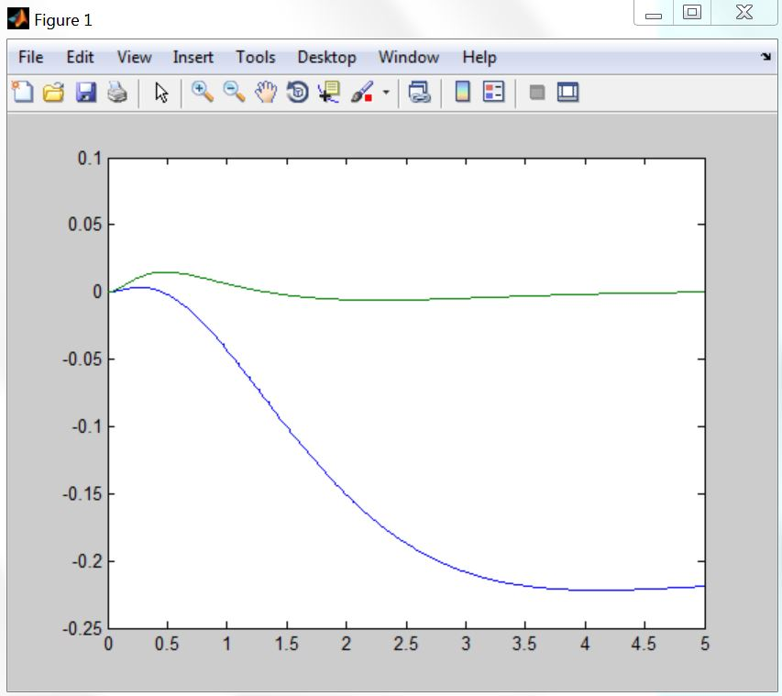
Example:
A = [1.0000 0.0100 0.0001 0.0000;
0 0.9982 0.0267 0.0001;
0 0.0000 1.0016 0.0100;
0 -0.0045 0.3119 1.0016];
B = [0.0001;
0.0182;
0.0002;
0.0454];
C = [1 0 0 0;
0 0 1 0];
Q = [1 0 0 0;
0 0 0 0;
0 0 1 0;
0 0 0 0];
R = [1];
K = dlqr(A,B,Q,R)
%%%
J = [0; 0]; %Desired poles
T = 0:0.01:5;
U = 0.2*ones(size(T));
[Y,X] = dlsim(A-B*K,B,C,J,U);
stairs(T,Y) % response →
(LQR + Pole placement)

Slide 26
Lecture 1-2
Lecture 1: Introduction
  Many motivating examples and application fields.
  Difference between open-loop control and closed-loop feedback control.
  Necessity of feedback control.
Lecture 2: Mathematical Modeling
  Modeling of mass-spring-damper system.
  Modeling of RLC circuit.
  Modeling of Electro-Mechano system.
  Laplace transform, transfer function, block diagram analysis.
  Review of basic systems concept.

Slide 27
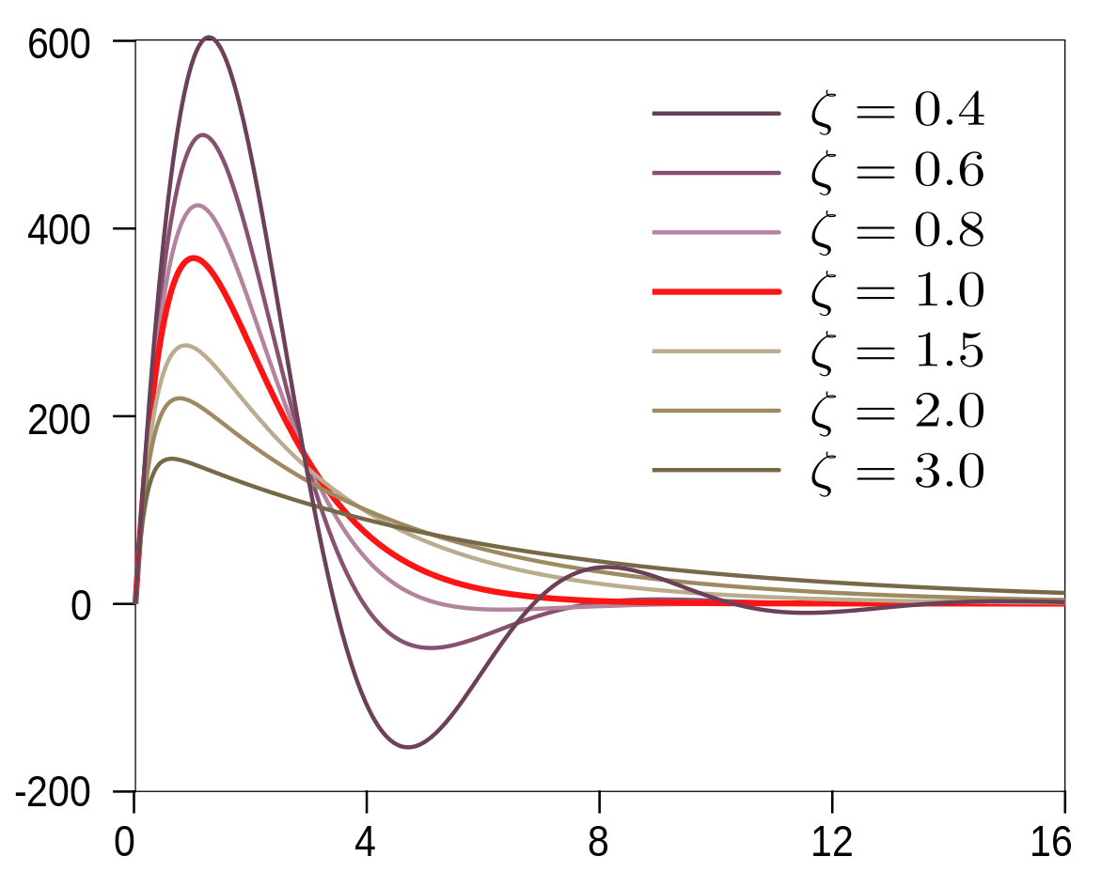
Lecture 3
Lecture 3: Response
  Impulse response, step response, ramp response.
  Inverse Laplace transform via partial fraction.
  Step response of second-order systems: under-damped, undamped, over-damped systems.

Slide 28
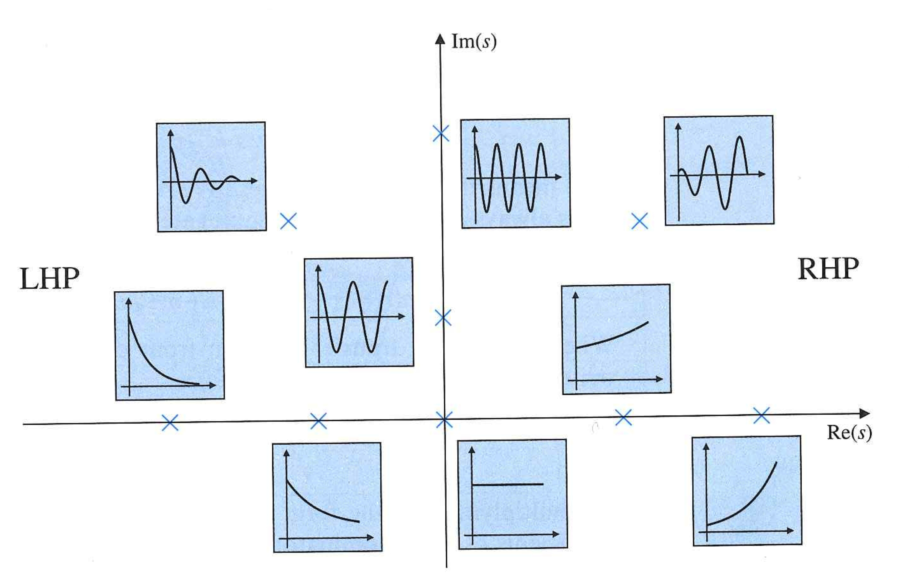


Pole Location and System Response
$$\cos{ω_{d}t }$$

Slide 29
Lecture 4
Lecture 4: Transient Performance
  Transient performance specifications: Rise time, settling time, overshoot-formulas for these specs.
  Stability: Routh-Hurwitz Criterion.

Slide 30
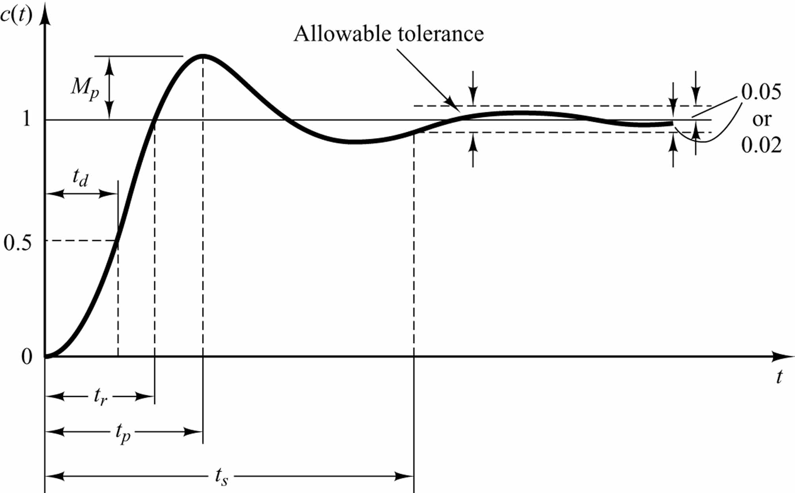
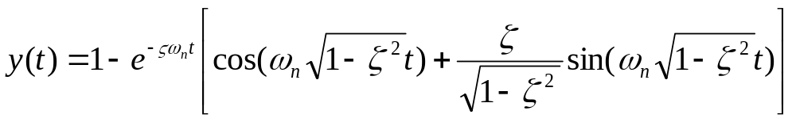
Transient Response Specifications
y(t)
Set-point value
Time to reach 50% of set-point value
For second-order LTI systems
Rise time t_{r}:
time required for response to rise from 0% to 100% of set-point value for under-damped systems;
Settling time t_{s}: time for output to settle within ±δ% of set-point value;
Overshoot M_{p}: maximum % of output overshooting the set-point value

Slide 31
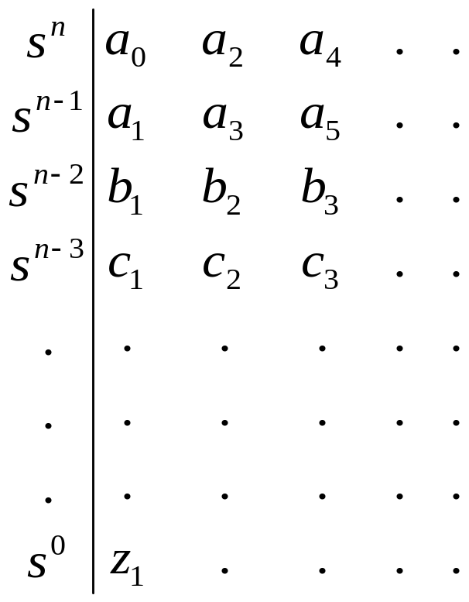
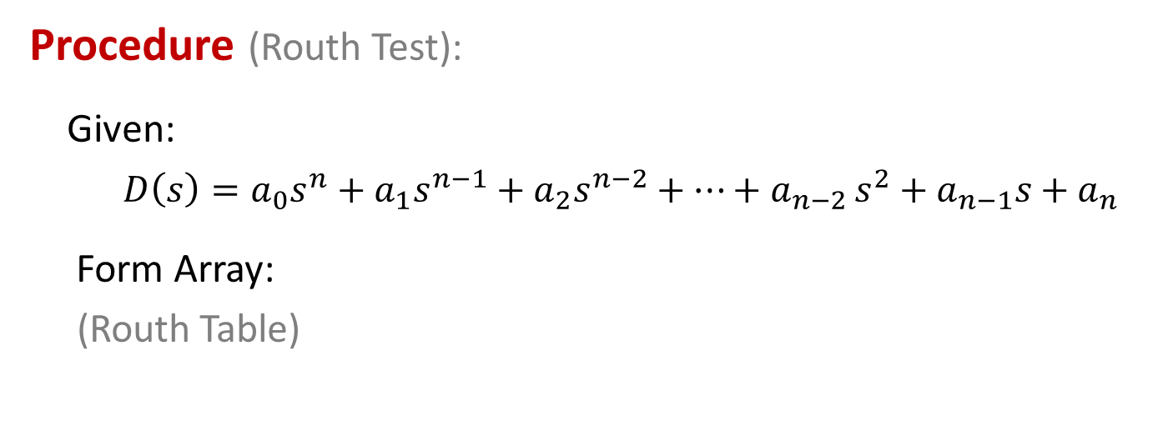
Routh-Hurwitz Stability Criterion
Procedure (Routh Test):
Given:
$D\left(s\right)=a_{0}s^{n}+a_{1}s^{n−1}+a_{2}s^{n−2}+⋯+a_{n−2 }s^{2}+a_{n−1}s+a_{n}$
Form Array:
(Routh Table)

Slide 32
Lecture 5
Lecture 5: Frequency Domain Analysis
  Root locus method.
  Nyquist diagram.
  Bode plots.
  Gain/phase margins.
  Nyquist stability criterion.

Slide 33
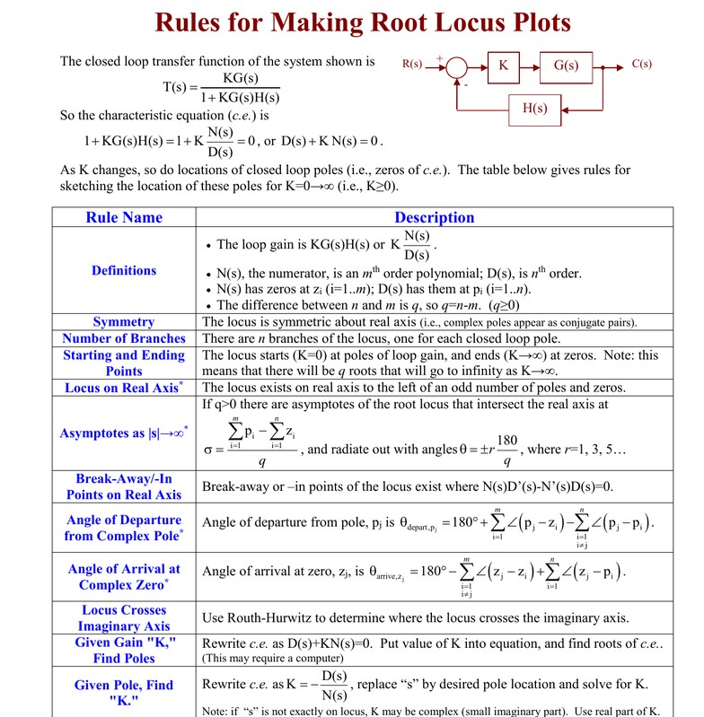

Slide 34
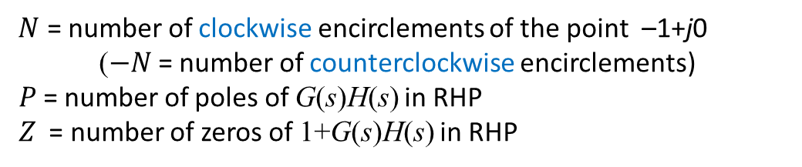
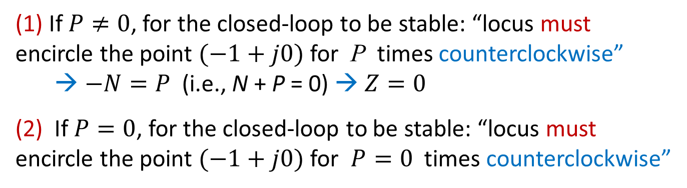
Nyquist Stability Criterion B: Argument Principle
N + P = Z
$N$ = number of clockwise encirclements of the point –1+j0
($−N$ = number of counterclockwise encirclements)
$P$= number of poles of G(s)H(s) in RHP
$Z$ = number of zeros of 1+G(s)H(s) in RHP
Remark
Recall: Nyquist Condition A (i): G(s)H(s) has P poles in RHP
(1) If $P≠0$, for the closed-loop to be stable: “locus must encircle the point $(−1+j0)$ for P times counterclockwise”
→ $−N=P$ (i.e., N + P = 0) → $Z=0$
(2) If $P=0$, for the closed-loop to be stable: “locus must encircle the point $(−1+j0)$ for $P=0$ times counterclockwise”
All other cases: namely, otherwise, closed-loop is unstable

Slide 35
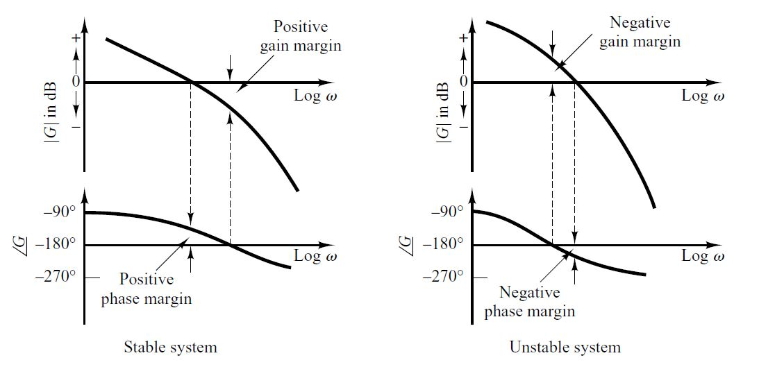
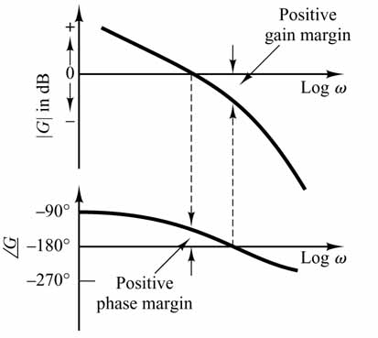
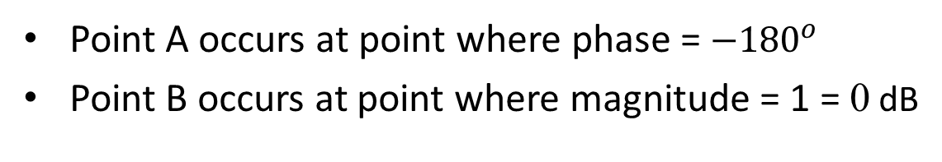
GM and PM from Bode Plot
Point A occurs at point where phase = $−{180}^{o}$
Point B occurs at point where magnitude = 1 = 0 dB
B
B
B
A
A
A

Slide 36

GM and PM from Bode Plot
Example: $50/(s^{3}+9s^{2}+30s+40)$
%MatLab code
bode(50, [1 9 30 40])
Gain Margin (GM) is the difference between the magnitude curve and 0dB at the point corresponding to the phase of -180 degree
Phase Margin (PM) is the difference between the phase curve and -180 degree at the point corresponding to the gain of 0dB
B
-180
A

Slide 37
Lecture 6
Lecture 6: PID controller, Steady-State Performance
  PID control.
  Ziegler-Nichols tuning rules.
  Steady-state tracking error: Step input, ramp input.
  System types.

Slide 38


PID (Proportional-Integral-Derivative) Control
$C\left(s\right)=K_{p}+\frac{K_{i}}{T_{I}s}+{K_{d}T}_{D}s$
$u\left(t\right)=K_{p}e\left(t\right)+\frac{K_{i}}{T_{I}}\int_{0}^{t}{e\left(τ\right)dτ}+{K_{d}T}_{D}\frac{de\left(t\right)}{dt}$
(output u(t) ∝ e(t) + integral of e(t) + derivative of e(t))

Slide 39


Steady-State Errors for Unity Feedback Systems
A stable feedback system is of Type-N, if
$G\left(s\right)=\frac{K(T_{a}s+1)⋯(T_{m}s+1)}{s^{N}(T_{1}s+1)⋯(T_{n}s+1)}$
where $T_{i}$ are distinct constants

Slide 40
Lecture 7
Lecture 7: Controller Design
  Two DoF controller.
  Tracking, disturbance attenuation, sensitivity to parameter variations.
  Lead-lag filters.

Slide 41


Lecture 8
Lecture 8: Introduction to State-Space Method
  State-space description and modeling.
  State response.
$x\left(t\right)$ = $Φ\left(t\right)x\left(0\right)+\int_{0}^{t}{Φ\left(t−τ\right)Bu\left(τ\right)dτ}$
$$Φ(t)=e^{At}$$

Slide 42
Lecture 9
Lecture 6: Controllability and observability
  Controllability: Controllability test, PBH test.
  Observability: Observability test, PBH test.
  Controllable canonical form.
  Observable canonical form.
  Diagonal canonical form.
  Equivalence (similarity) transformation.
  Minimal realization.
  Duality.

Slide 43

Controllability
Consider LTI system $\dot{x}=Ax+Bu$, with $A_{n×n}$and $B_{n×m}$
Theorem
LTI system $\dot{x}=Ax+Bu$ is controllable if and only if
Matrix $[B AB A^{2}B A^{3}B⋯A^{n−1}B ]$ has full row rank
or
Matrix $[λI−A B]$ has full row rank

Slide 44




Observability
$$\dot{x}=Ax+Bu$$
$$y=Cx+Du$$
Theorem
LTI system (A, B, C, D) is observable if and only if
$$\left[\begin{matrix}C \\ CA \\ \begin{aligned}CA^{2} \\ \begin{matrix}⋮ \\ CA^{n−1}\end{matrix}\end{aligned}\end{matrix}\right]$$
Matrix has full column rank
Or
$$\left[\begin{aligned}λI−A \\ C\end{aligned}\right]$$
Matrix has full column rank

Slide 45
Lecture 10
Lecture 10: State-Space Design
  State feedback design.
  Servo system design.
  State observer design.
  Observer-based output feedback design.
  Separation principle.

Slide 46













State Feedback Design for SISO LTI systems
D = 0
Suppose that the system is controllable:
State-feedback controller:
$$u=−Kx$$
Closed-loop system:
$$\dot{x}=\left(A−BK\right)x$$
Characteristic polynomial:
$$p\left(s\right)=det⁡(sI−\left(A−BK\right))$$
Desired poles:
$$p_{1},…,p_{n}$$
Desired characteristic polynomial:
$$\left(s−p_{1}\right)⋯(s−p_{n})$$
→ Choose gain matrix $K$ such that
$$det⁡(sI−(A−BK))=$$
$$\left(s−p_{1}\right)⋯(s−p_{n})$$

Slide 47







State Observer Design for SISO LTI systems
D = 0
Suppose that the system is observable:
State observer:
Characteristic polynomial:
$$p\left(s\right)=det⁡(sI−\left(A−LC\right))$$
Desired poles:
$$q_{1}…,q_{n}$$
Desired characteristic polynomial:
$$\left(s−q_{1}\right)⋯(s−q_{n})$$
→ Choose observer gain matrix $L$ such that
$$det⁡(sI−(A−LC))=$$
$$\left(s−q_{1}\right)⋯(s−q_{n})$$

Slide 48
Final Exam
Closed-book exam
Durations: 2 hours, 15 December, 14:00-16:00 pm.
Regular calculator is allowed.
No electronic devices are allowed.
Coverage: Week 2-Week 12; in this slide: Lecture 2-Lecture 10, excluding contents on observer design and output feedback.
Style: Similar to homework assignments and midterm tests

Slide 49
Final Exam
5 Problems, 100 Points
One problem on deriving closed-loop transfer function of block diagrams, determining stability, steady state tracking error, and property of root locus;
One problem on transient performance specifications (e.g., overshoot, settling time);
One problem on stability test (e.g., Nyquist criterion);
One problem on state-space representation, finding state-space equation, determining controllability and observability;
One problem on state feedback design, realization in canonical forms, design of state feedback, minimal realization

Slide 50

END

