Slide 1
EE3114 Systems and Control
6. PID Controllers
Semester A, 2018-19
2018-10-10

Slide 2
Framework of Lectures
System
Time Domain Frequency Domain
→ Laplace Transform →
State-Space Formulation Frequency Analysis
(dynamic responses, transients,
steady-states, root-locus,
PID controllers)
← mixed →
(State-feedback,
Controllability, controller
Observability, observer
Optimal control)
Today:
PID Controllers

Slide 3
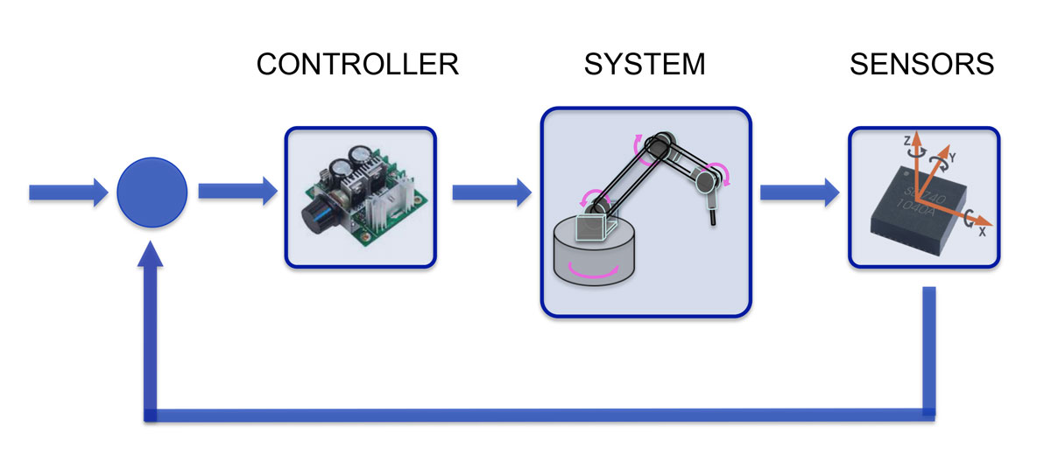
Closed-Loop Feedback Control Systems
REFERENCE
OUTPUT
Unity FEEDBACK

Slide 4
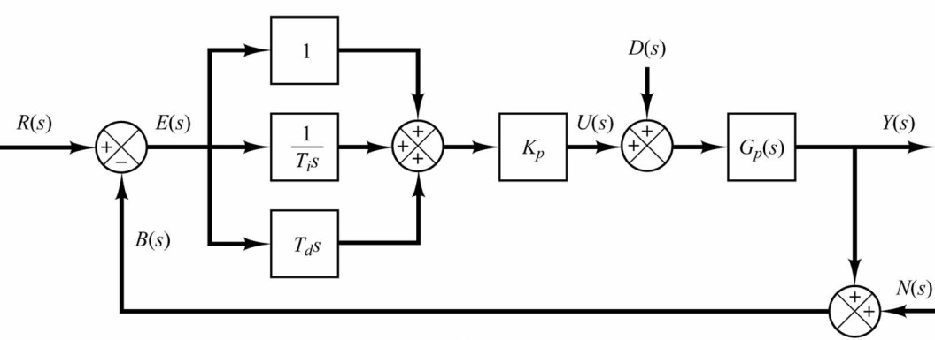
PID (Proportional-Integral-Derivative) Controller
Controller
Disturbance
Plant
Noise
More details will follow …

Slide 5
History
Christian Huygens in 1673: centrifugal governor to regulate the gap between millstones in windmills
James Watt in 1788: flyball governor for steam engine (proportional P-control)
James Clerk Maxwell in 1868: mathematical basis for control stability
Elmer Sperry in 1911: proportional-integral-derivative (PID) controller for ship-steering
Nicolas Minorsky in 1922: Formal control laws of PID control

Slide 6
Industrial PID control
Harold Black in late 1920s: Telephone engineering
Clesson E Mason in 1930: PI-controller, with negative feedback from the controller output
In the 1950s, when high gain electronic amplifiers available, electronic PID controllers became popular
Most modern PID controllers in industry are implemented in distributed control systems (DCS), programmable logic controllers (PLCs), or as a panel-mounted digital controller.
PID controllers are widely applied in industry, e.g., industrial assembly lines, chemical processes, electronic packaging, head positioning of disk drive, power conditioning of power supply, movement-detection circuit of modern seismometer, multirotor drones, … …

Slide 7
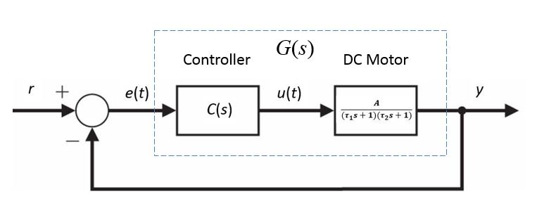
Second-Order Plants
G(s)
Typical 2nd-order system
Controller
DC Motor
Transfer Function $G(s)$ contains both the plant and the controller $C(s)$
Controller C(s):
Proportional-Integral-Derivative (PID) controller

Slide 8
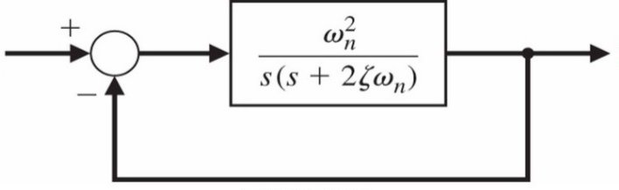
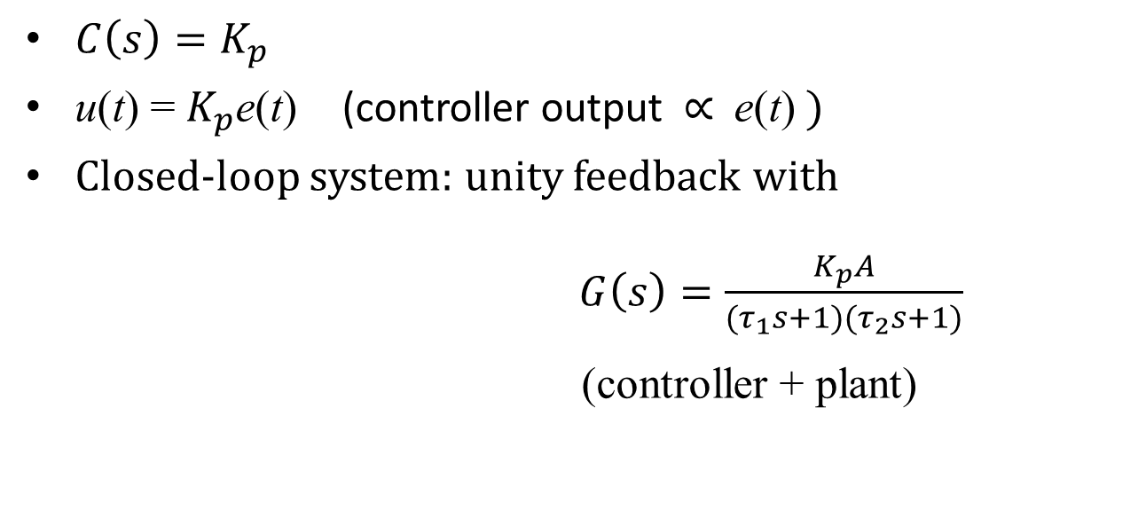
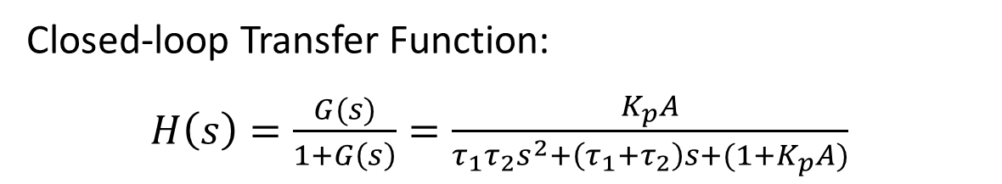

P (Proportional) Control
$C\left(s\right)=K_{p}$
u(t) = $K_{p}$e(t) (controller output ∝ e(t) )
Closed-loop system: unity feedback with
$G\left(s\right)=\frac{K_{p}A}{(τ_{1}s+1)(τ_{2}s+1)}$
(controller + plant)
$$G\left(s\right)$$
Closed-loop Transfer Function:
$H\left(s\right)=\frac{G(s)}{1+G\left(s\right)}=\frac{K_{p}A}{τ_{1}τ_{2}s^{2}+\left(τ_{1}+τ_{2}\right)s+(1+K_{p}A)}$

Slide 9
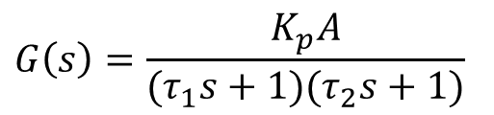
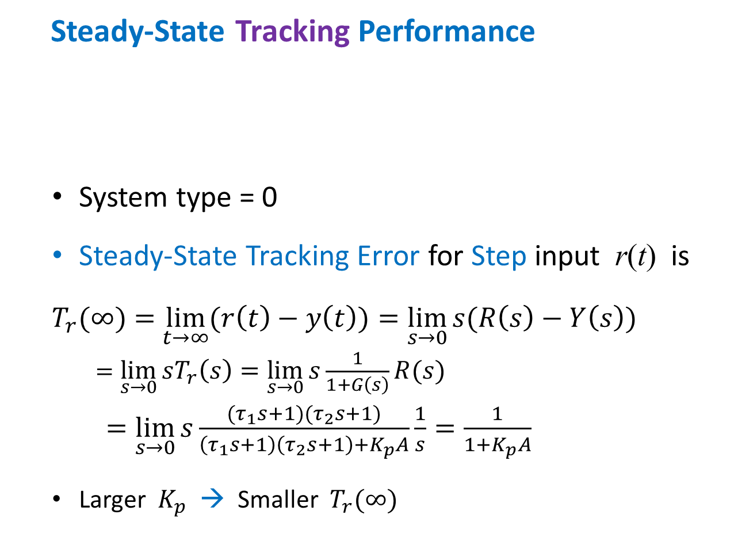
Steady-State Tracking Performance
  System type = 0
  Steady-State Tracking Error for Step input r(t) is
  $T_{r}(∞)=$ $\lim_{t→∞}{(r\left(t\right)−y\left(t\right))=\lim_{s→0}{s(R\left(s\right)−Y\left(s\right))}}$
  $=\lim_{s→0}{sT_{r}\left(s\right)=\lim_{s→0}{s\frac{1}{1+G\left(s\right)}R(s)}}$
  $=\lim_{s→0}{s\frac{(τ_{1}s+1)(τ_{2}s+1)}{\left(τ_{1}s+1\right)\left(τ_{2}s+1\right)+K_{p}A}}\frac{1}{s}=\frac{1}{1+K_{p}A}$
  Larger $K_{p}$ → Smaller $T_{r}(∞)$
$$G\left(s\right)=\frac{K_{p}A}{(τ_{1}s+1)(τ_{2}s+1)}$$

Slide 10
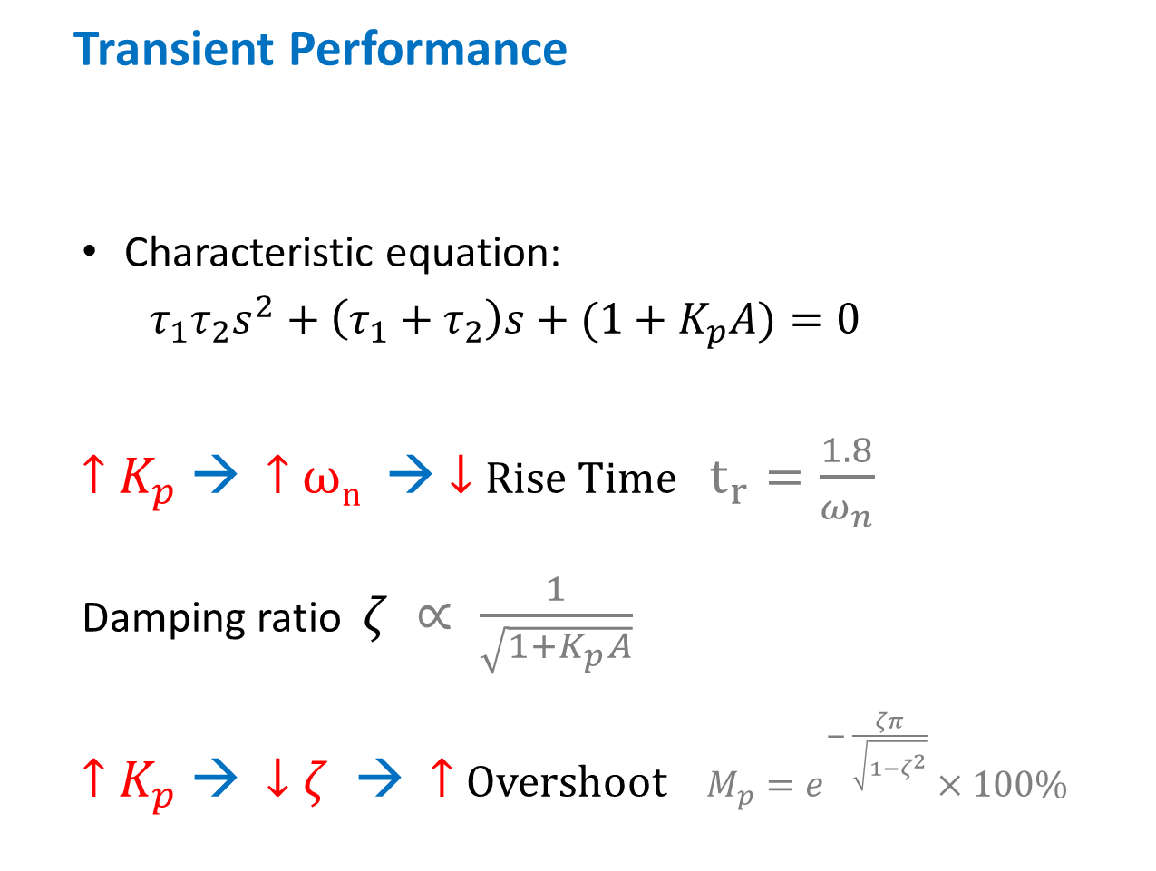

Transient Performance
  Characteristic equation:
  $τ_{1}τ_{2}s^{2}+\left(τ_{1}+τ_{2}\right)s+(1+K_{p}A)=0$
  ↑ $K_{p}$ → ↑ ω_{n} → ↓ Rise Time $t_{r}=\frac{1.8}{ω_{n}}$
  Damping ratio $ζ ∝ \frac{1}{\sqrt{1+K_{p}A}}$
  ↑ $K_{p}$ → ↓ $ζ$ → ↑ Overshoot $M_{p}=e^{− \frac{ζπ}{\sqrt{1−ζ^{2}}}}×100\%$
Closed-loop Transfer Function: $\frac{K_{p}A}{τ_{1}τ_{2}s^{2}+\left(τ_{1}+τ_{2}\right)s+(1+K_{p}A)}$
$( \sim ω_{n}^{2} )$

Slide 11
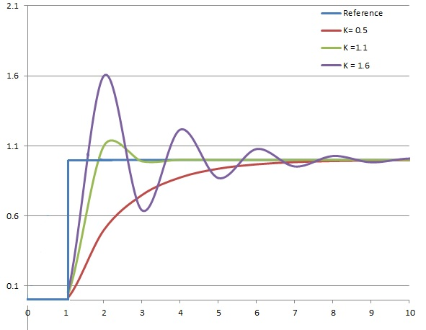


Typical Unit Step Response of P-Control
↑ $K_{p}$ → ↑ ω_{n} → ↓ Rise Time
↑ $K_{p}$ → ↓ $ζ$ → ↑ Overshoot

Slide 12
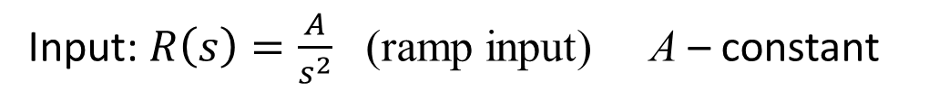
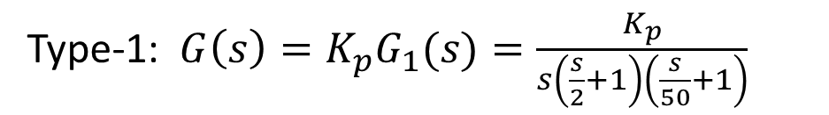

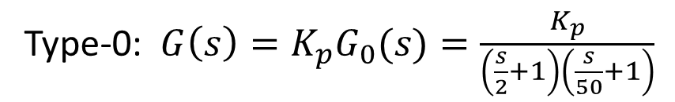
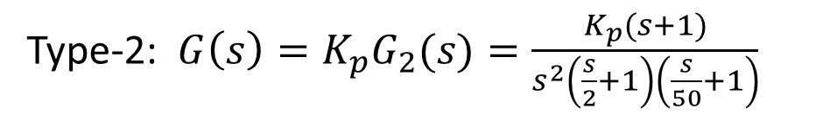
Example:
$$G\left(s\right)$$
$G\left(s\right)=$ (P-controller + Plant)
Type-0: ${G\left(s\right)=K_{p}G}_{0}(s)=\frac{K_{p}}{\left(\frac{s}{2}+1\right)\left(\frac{s}{50}+1\right)}$
Type-1: ${G\left(s\right)=K_{p}G}_{1}(s)=\frac{K_{p}}{s\left(\frac{s}{2}+1\right)\left(\frac{s}{50}+1\right)}$
Type-2: ${G\left(s\right)=K_{p}G}_{2}(s)=\frac{K_{p}(s+1)}{s^{2}\left(\frac{s}{2}+1\right)\left(\frac{s}{50}+1\right)}$
Input: $R\left(s\right)=\frac{A}{s^{2}}$ (ramp input) A – constant

Slide 13
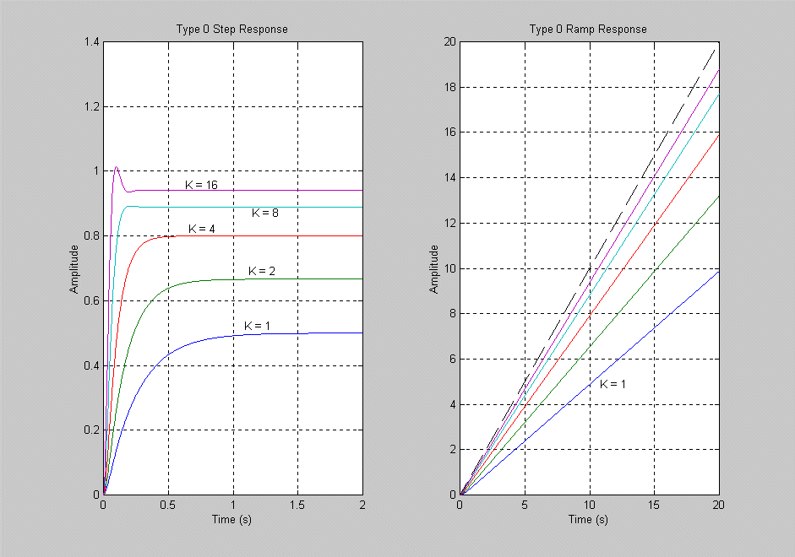
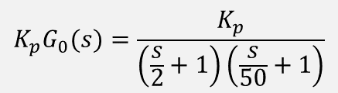
$${K_{p}G}_{0}(s)=\frac{K_{p}}{\left(\frac{s}{2}+1\right)\left(\frac{s}{50}+1\right)}$$
Type-0
↑ Kp → ↓ Rise Time
↑ Kp → ↑ Overshoot

Slide 14
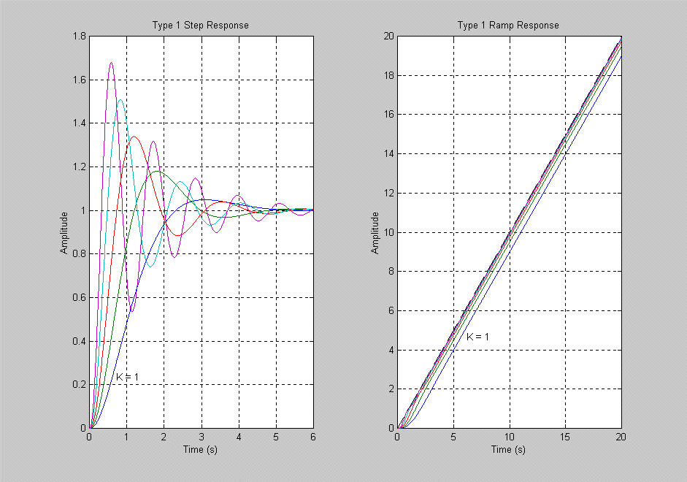
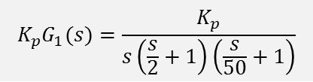
$${K_{p}G}_{1}(s)=\frac{K_{p}}{s\left(\frac{s}{2}+1\right)\left(\frac{s}{50}+1\right)}$$
Type-1

Slide 15
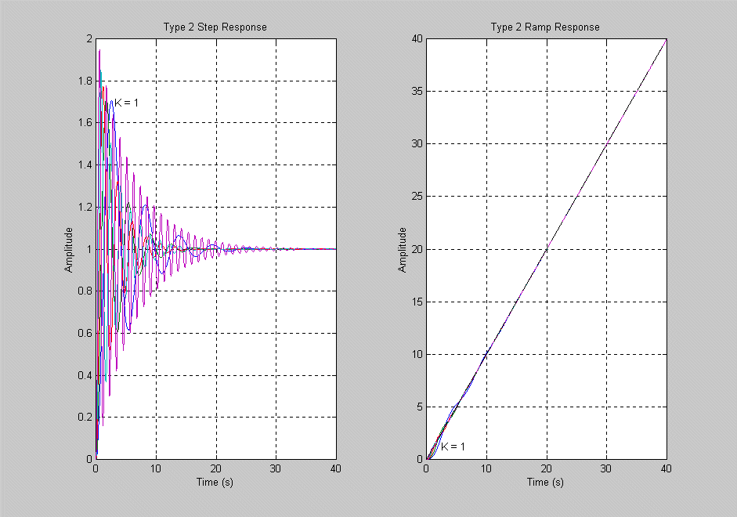
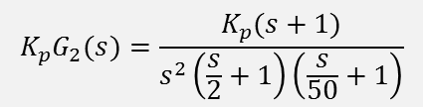
$${K_{p}G}_{2}(s)=\frac{K_{p}(s+1)}{s^{2}\left(\frac{s}{2}+1\right)\left(\frac{s}{50}+1\right)}$$
Type-2

Slide 16
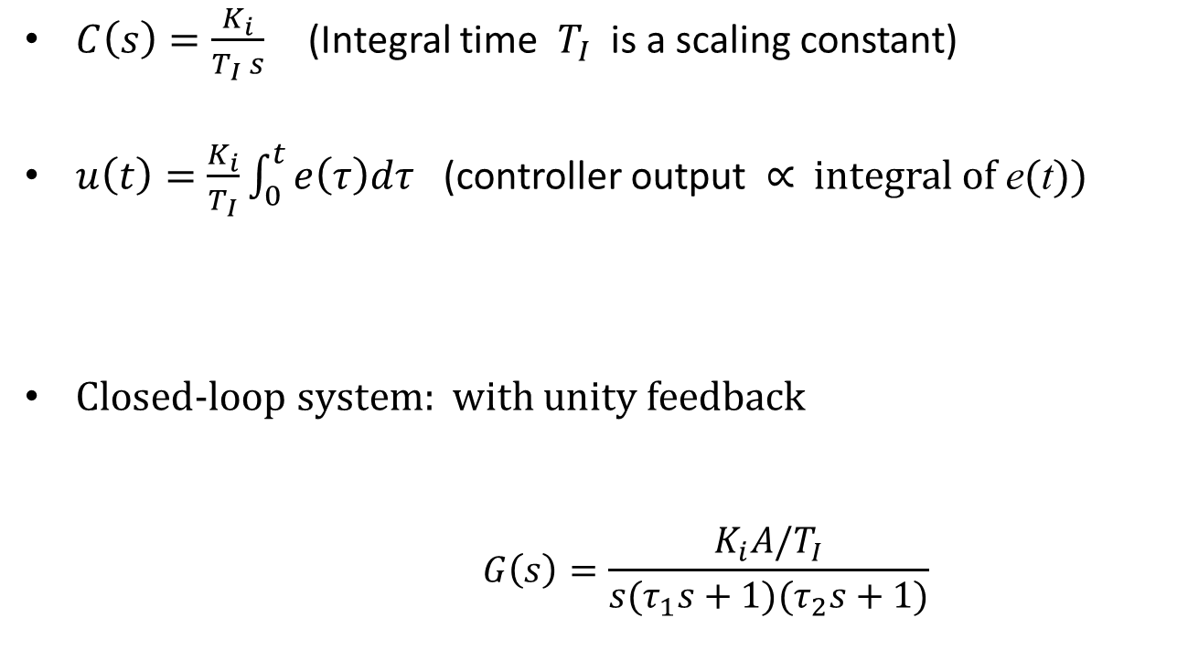
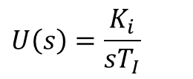

I (Integral) Control
$C\left(s\right)=\frac{K_{i}}{T_{I} s}$ (Integral time $T_{I}$ is a scaling constant)
$u\left(t\right)=\frac{K_{i}}{T_{I}}\int_{0}^{t}{e\left(τ\right)dτ}$ (controller output ∝ integral of e(t))
Closed-loop system: with unity feedback
$$G\left(s\right)=\frac{K_{i}A/T_{I}}{s(τ_{1}s+1)(τ_{2}s+1)}$$
$$U\left(s\right)=\frac{K_{i}}{sT_{I}}$$
(Integral control)
$$G\left(s\right)$$
(Type-1)

Slide 17

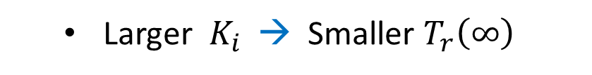
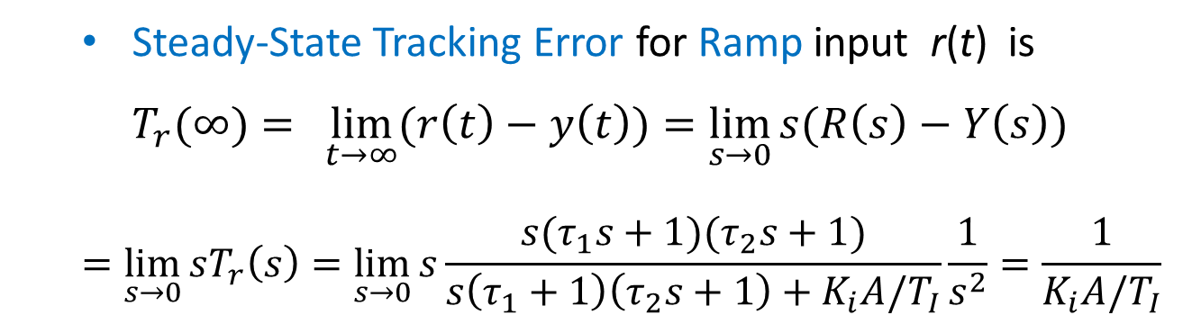
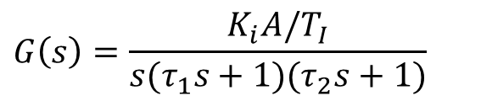
Steady-Sate Tracking Performance
$$G\left(s\right)$$
$$G\left(s\right)=\frac{K_{i}A/T_{I}}{s(τ_{1}s+1)(τ_{2}s+1)}$$
  Steady-State Tracking Error for Ramp input r(t) is
  $T_{r}(∞)= \lim_{t→∞}{(r\left(t\right)−y\left(t\right))=\lim_{s→0}{s(R\left(s\right)−Y\left(s\right)) }}$
  $$=\lim_{s→0}{sT_{r}\left(s\right)=\lim_{s→0}{s\frac{s(τ_{1}s+1)(τ_{2}s+1)}{s\left(τ_{1}+1\right)\left(τ_{2}s+1\right)+K_{i}A/T_{I}}\frac{1}{s^{2}}=\frac{1}{K_{i}A/T_{I}} }}$$
  Larger $K_{i}$ → Smaller $T_{r}\left(∞\right)$
  → Reduce steady-state error for ramp input
  (Performance better than P-control)

Slide 18
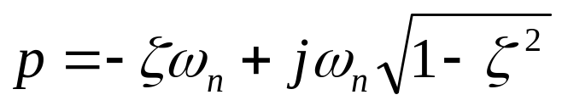
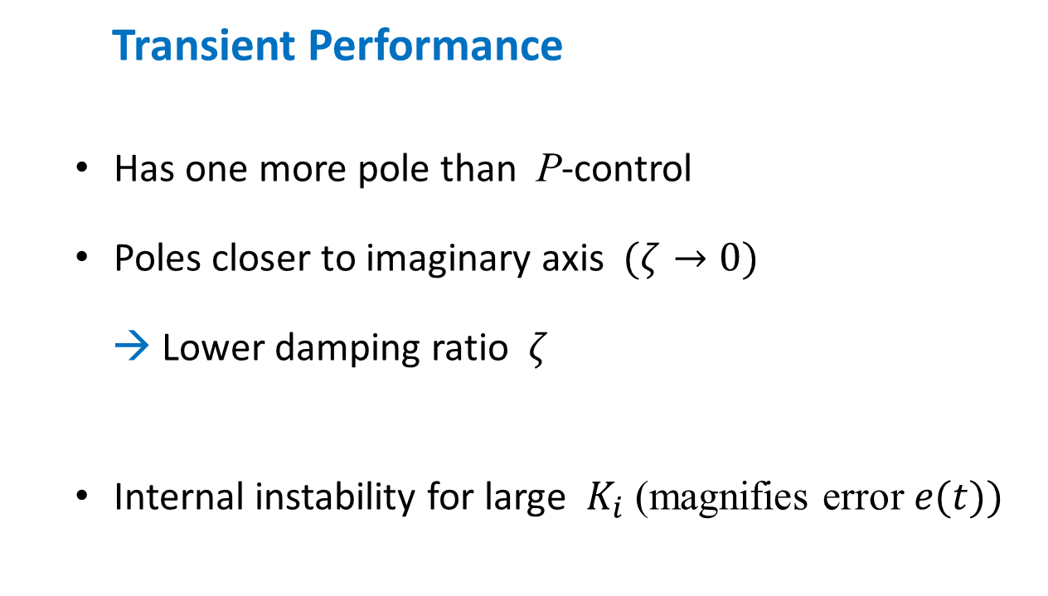

Transient Performance
  Has one more pole than P-control
  Poles closer to imaginary axis $(ζ→0)$
  → Lower damping ratio $ζ$
  Internal instability for large $K_{i}$ (magnifies error $e(t))$
$$±$$
Recall from Lectrure-3:
A zero near a pole reduces the effect of the pole on response
A zero on RHP --> non-minimum-phase system
A real zero on LHP moving towards imaginary axis will increase overshoot and rise time
A pair of complex conjugate zeros on LHP, moving toward imaginary axis, will increase overshoot

Slide 19
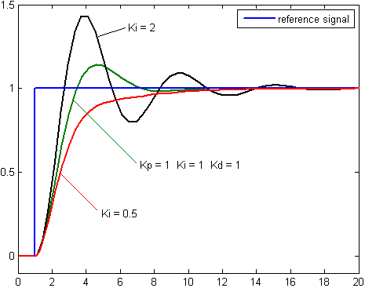

Typical Unit Step Response of I-Control
Ki = 1
Large $K_{i}$ →
small steady-state error
large overshoot

Slide 20
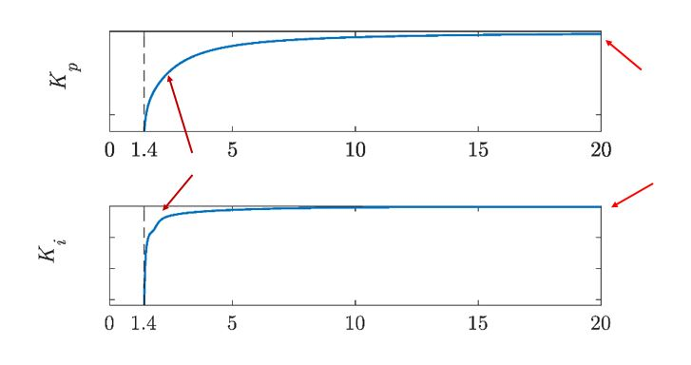
Comparison between P-control and I-control

Slide 21
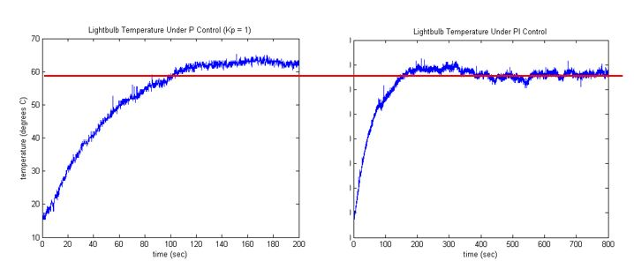
A real comparison between P-control and I-control
P-control I-control
(Lightbulb Temperature Control)

Slide 22
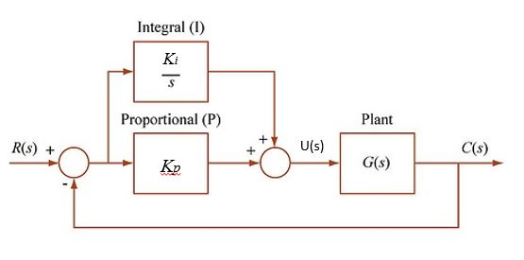
PI (Proportional-Integral) Control
This simple combination is much more powerful
PI-controller output u(t) ∝ e(t) + (integral of e(t) )

Slide 23
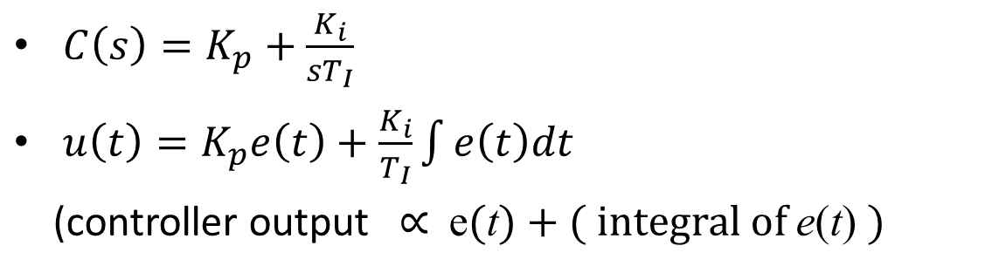
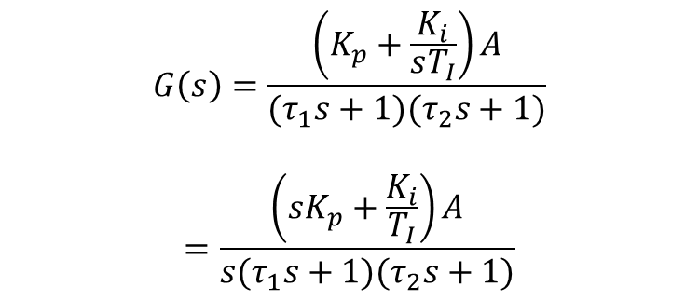
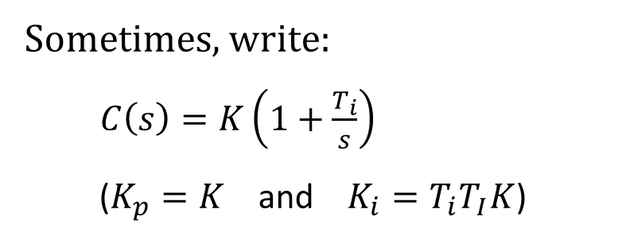
PI Control
$$G\left(s\right)=\frac{\left(K_{p}+\frac{K_{i}}{sT_{I}}\right)A}{(τ_{1}s+1)(τ_{2}s+1)}$$
$$=\frac{\left(sK_{p}+\frac{K_{i}}{T_{I}}\right)A}{s(τ_{1}s+1)(τ_{2}s+1)}$$
$$G\left(s\right)$$
$C\left(s\right)=K_{p}+\frac{K_{i}}{sT_{I}}$
$u\left(t\right)=K_{p}e\left(t\right)+\frac{K_{i}}{T_{I}}\int{e\left(t\right)dt}$
(controller output ∝ e(t) + ( integral of e(t) )
Sometimes, write:
$C\left(s\right)=K\left(1+\frac{T_{i}}{s}\right)$
($K_{p}=K$ and $K_{i}=T_{i}T_{I}K$)

Slide 24
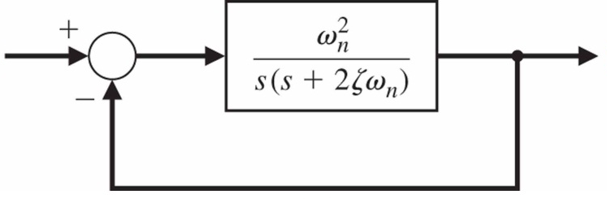
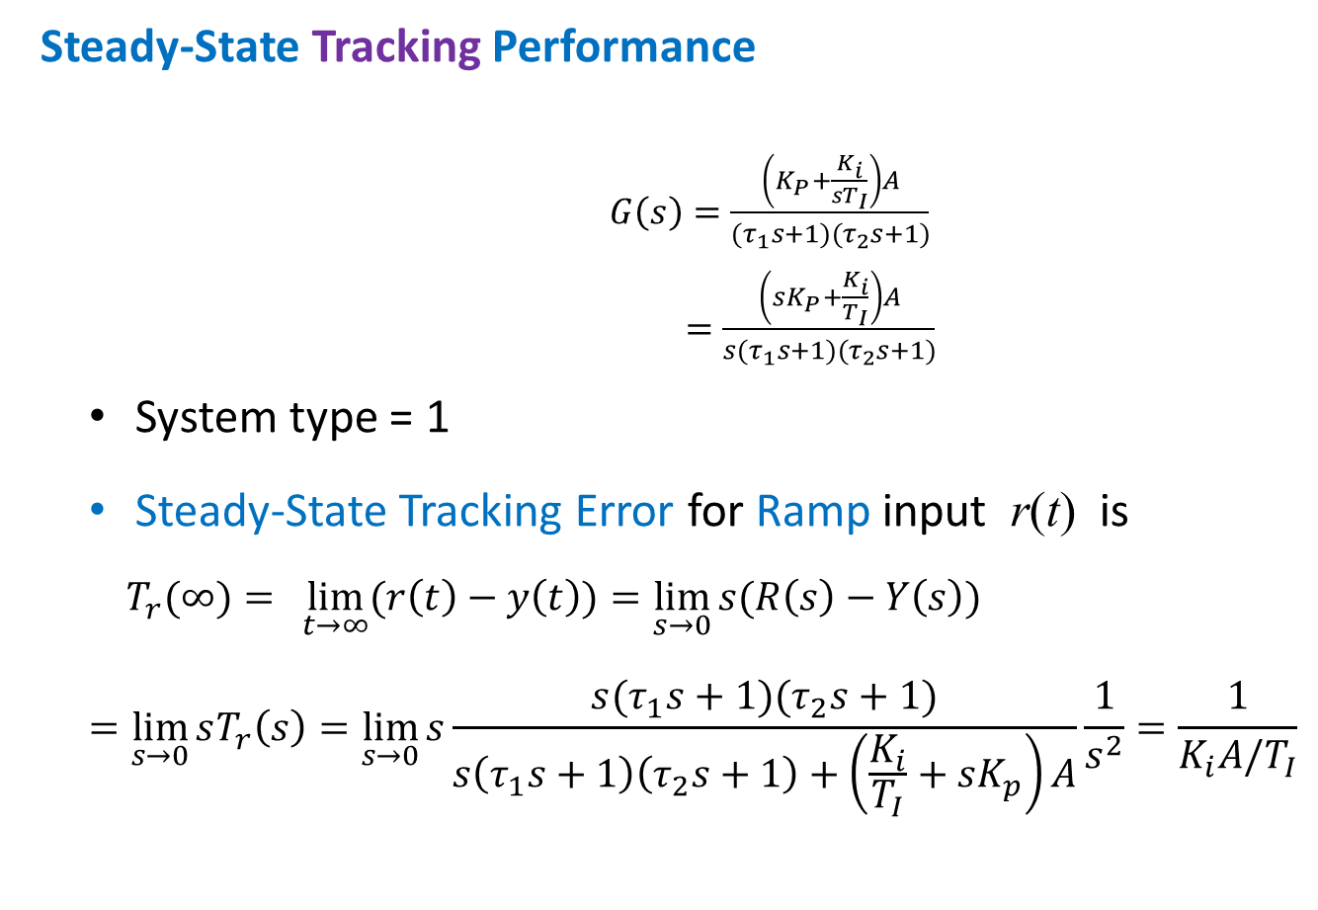
Steady-State Tracking Performance
$G\left(s\right)=\frac{\left(K_{P}+\frac{K_{i}}{sT_{I}}\right)A}{(τ_{1}s+1)(τ_{2}s+1)}$
$=\frac{\left(sK_{P}+\frac{K_{i}}{T_{I}}\right)A}{s(τ_{1}s+1)(τ_{2}s+1)}$
  System type = 1
  Steady-State Tracking Error for Ramp input r(t) is
  $T_{r}(∞)= \lim_{t→∞}{(r\left(t\right)−y\left(t\right))=\lim_{s→0}{s(R\left(s\right)−Y\left(s\right))}}$
  $$=\lim_{s→0}{sT_{r}\left(s\right)=\lim_{s→0}{s\frac{s(τ_{1}s+1)(τ_{2}s+1)}{s\left(τ_{1}s+1\right)\left(τ_{2}s+1\right)+\left(\frac{K_{i}}{T_{I}}+sK_{p}\right)A}\frac{1}{s^{2}}=\frac{1}{K_{i}A/T_{I}}}}$$
G(s)
  Same as I-control: Larger $K_{i}$ → Smaller $T_{r}(∞)$

Slide 25
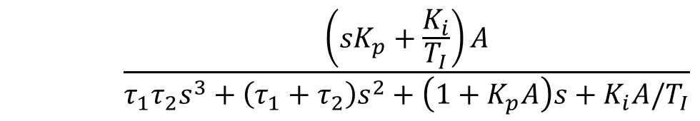
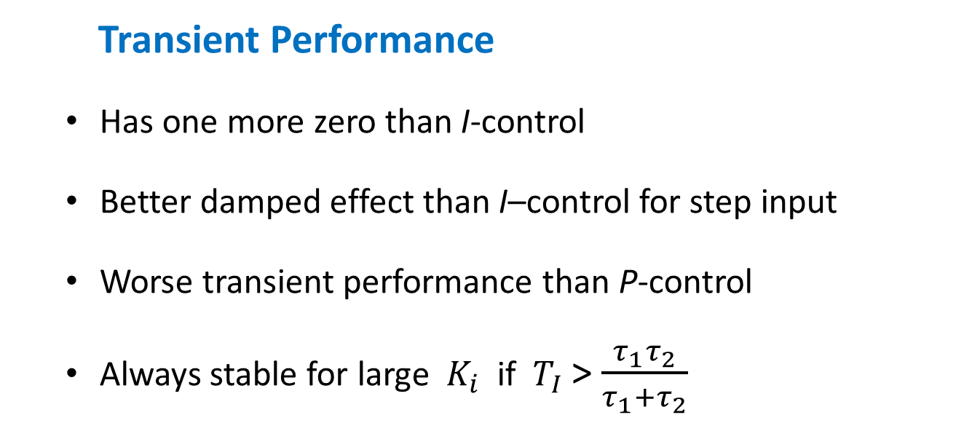
Transient Performance
  Has one more zero than I-control
  Better damped effect than I–control for step input
  Worse transient performance than P-control
  Always stable for large $K_{i}$ if $T_{I}$> $\frac{τ_{1}τ_{2}}{τ_{1}+τ_{2}}$
Verification:
Apply Routh criterion to
Closed-loop Transfer Function:
$$\frac{\left(sK_{p}+\frac{K_{i}}{T_{I}}\right)A}{τ_{1}τ_{2}s^{3}+\left(τ_{1}+τ_{2}\right)s^{2}+\left(1+K_{p}A\right)s+K_{i}A/T_{I}}$$

Slide 26
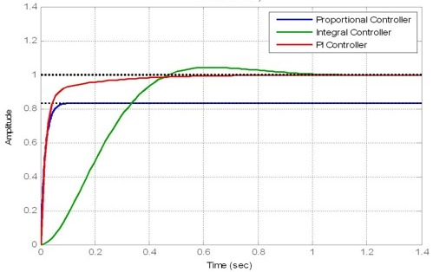
Comparison of Typical Unit Step Responses
Set-point
Transient performance: P > PI > I
Steady-state performance: PI > I > P

Slide 27
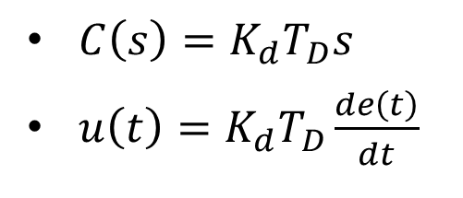
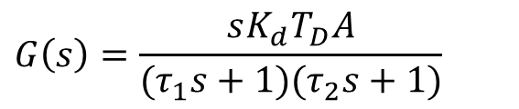
Derivative Control
$$G\left(s\right)$$
$$G\left(s\right)=\frac{sK_{d}T_{D}A}{(τ_{1}s+1)(τ_{2}s+1)}$$
$C\left(s\right)={K_{d}T}_{D}s$
$u\left(t\right)=K_{d}T_{D}\frac{de\left(t\right)}{dt}$
Taking derivative on signals → instability + large errors
Usually, not being used alone

Slide 28
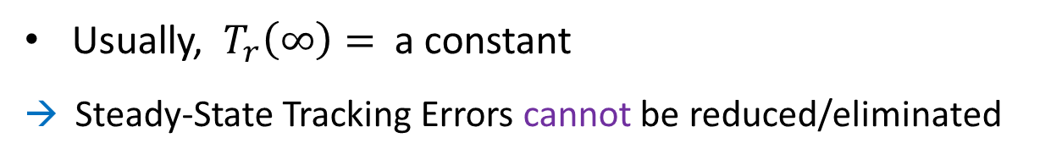
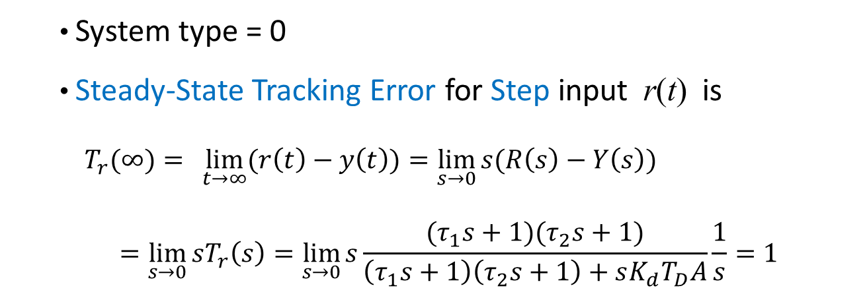
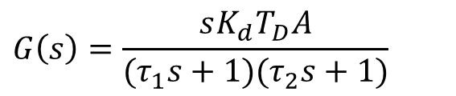
Steady-State Tracking Performance
$$G\left(s\right)$$
$$G\left(s\right)=\frac{sK_{d}T_{D}A}{(τ_{1}s+1)(τ_{2}s+1)}$$
  System type = 0
  Steady-State Tracking Error for Step input r(t) is
  $T_{r}(∞)= \lim_{t→∞}{(r\left(t\right)−y\left(t\right))=\lim_{s→0}{s(R\left(s\right)−Y\left(s\right))}}$
  $$=\lim_{s→0}{sT_{r}\left(s\right)=\lim_{s→0}{s\frac{(τ_{1}s+1)(τ_{2}s+1)}{\left(τ_{1}s+1\right)\left(τ_{2}s+1\right)+sK_{d}T_{D}A}\frac{1}{s}=1}}$$
Usually, ${ T}_{r}\left(∞\right)=$ a constant
→ Steady-State Tracking Errors cannot be reduced/eliminated

Slide 29
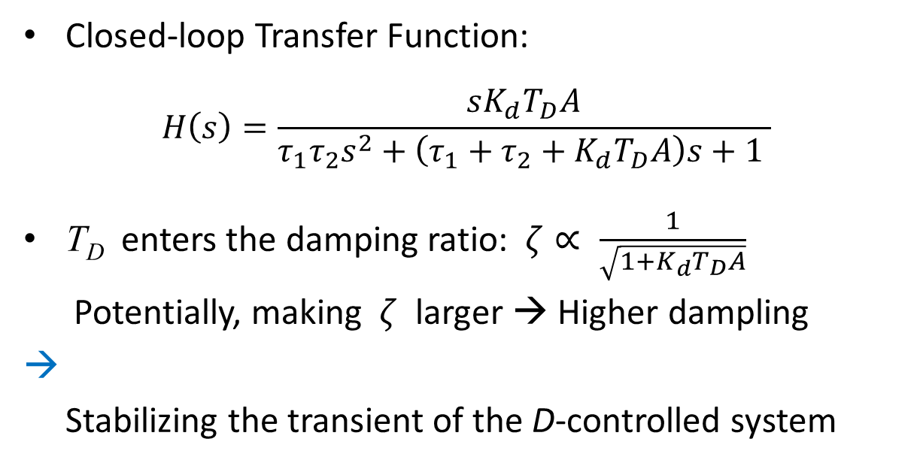
Transient Performance
$$G\left(s\right)$$
$$G\left(s\right)=\frac{sK_{d}T_{D}A}{(τ_{1}s+1)(τ_{2}s+1)}$$
Closed-loop Transfer Function:
$$H\left(s\right)=\frac{sK_{d}T_{D}A}{τ_{1}τ_{2}s^{2}+\left(τ_{1}+τ_{2}+K_{d}T_{D}A\right)s+1 }$$
T_{D} enters the damping ratio: $ζ∝ \frac{1}{\sqrt{1+K_{d}T_{D}A}}$
Potentially, making $ζ$ larger → Higher dampling
→
Stabilizing the transient of the D-controlled system

Slide 30
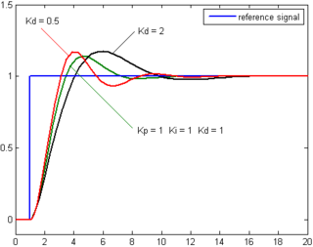
Typical Unit Step Response of D-Control
Kd = 1

Slide 31

PD (Proportional-Derivative) Control
This simple combination is more powerful
Derivative (D)
$$K_{d}s$$
PD-controller output u(t) ∝ e(t) + (derivative of e(t) )

Slide 32
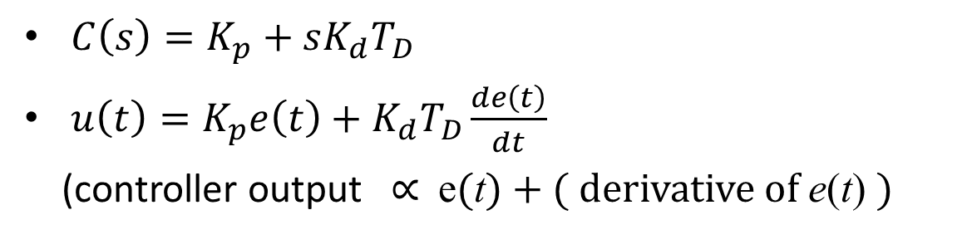
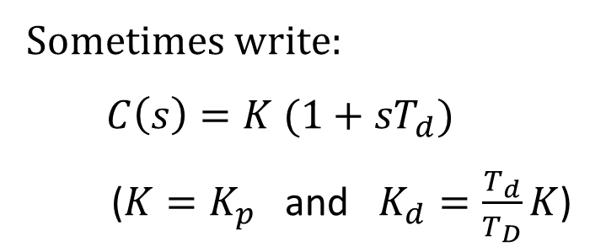
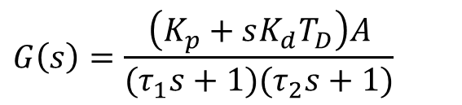
PD Control
$$G\left(s\right)$$
$$G\left(s\right)=\frac{\left(K_{p}+{sK_{d}T}_{D}\right)A}{(τ_{1}s+1)(τ_{2}s+1)}$$
$C\left(s\right)=K_{p}+{sK_{d}T}_{D}$
$u\left(t\right)=K_{p}e\left(t\right)+{K_{d}T}_{D}\frac{de\left(t\right)}{dt}$
(controller output ∝ e(t) + ( derivative of e(t) )
Sometimes write:
$C\left(s\right)=K (1+{sT}_{d})$
($K=K_{p}$ and $K_{d}=\frac{T_{d}}{T_{D}}K$)

Slide 33
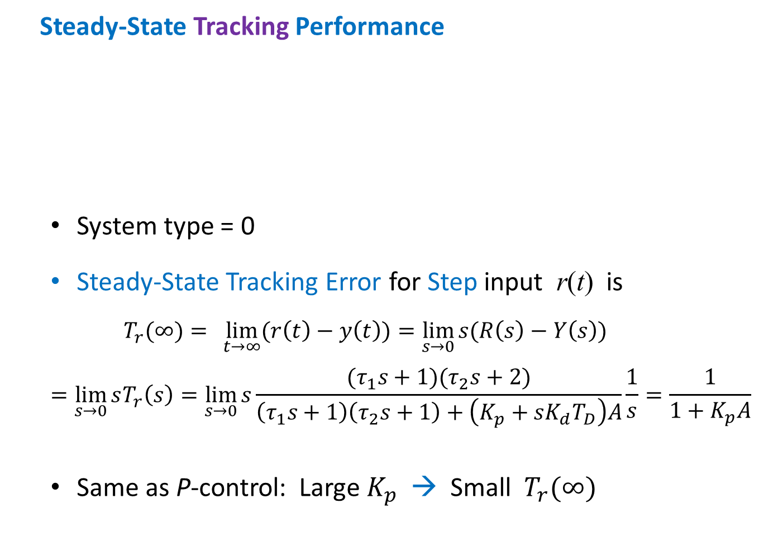

Steady-State Tracking Performance
  System type = 0
  Steady-State Tracking Error for Step input r(t) is
  $$T_{r}(∞)= \lim_{t→∞}{(r\left(t\right)−y\left(t\right))=\lim_{s→0}{s(R\left(s\right)−Y\left(s\right))}}$$
  $$=\lim_{s→0}{sT_{r}\left(s\right)=\lim_{s→0}{s\frac{(τ_{1}s+1)(τ_{2}s+2)}{\left(τ_{1}s+1\right)\left(τ_{2}s+1\right)+\left(K_{p}+sK_{d}T_{D}\right)A}\frac{1}{s}=\frac{1}{{1+K}_{p}A}}}$$
  Same as P-control: Large $K_{p}$ → Small $T_{r}(∞)$
G(s)
$$G\left(s\right)=\frac{\left(K_{p}+{sK_{d}T}_{D}\right)A}{(τ_{1}s+1)(τ_{2}s+1)}$$

Slide 34


Transient Performance
PD-Control can add some damping effect to the output
PD-Control can reduce the settling time considerably
To control the steady-state error, the gain $K_{p}$ (or time scale $T_{D}$) must be large
(This however may
make the system
sensitive to noise)
Effects of $K_{d}$ →

Slide 35


PID (Proportional-Integral-Derivative) Control
$C\left(s\right)=K_{p}+\frac{K_{i}}{T_{I}s}+{K_{d}T}_{D}s$
$u\left(t\right)=K_{p}e\left(t\right)+\frac{K_{i}}{T_{I}}\int_{0}^{t}{e\left(τ\right)dτ}+{K_{d}T}_{D}\frac{de\left(t\right)}{dt}$
(output u(t) ∝ e(t) + integral of e(t) + derivative of e(t))

Slide 36

PID (Proportional-Integral-Derivative) Control
Sometimes, write
$$C\left(s\right)=K_{p}+\frac{K_{i}}{T_{I}s}+{K_{d}T}_{D}s=K\left(1+\frac{1 }{T_{i}s}+T_{d}s\right)$$
($K=K_{p}$, $K_{i}=\frac{T_{I}}{T_{i}}K$ and $K_{d}=\frac{T_{d}}{T_{D}}K$)

Slide 37



PID (Proportional-Integral-Derivative) Control
Unity feedback system with
$G\left(s\right)=\frac{A\left(K_{p}+\frac{K_{i}}{T_{I}s}+{K_{d}T}_{D}s \right)}{(τ_{1}s+1)(τ_{2}s+1)}$
$=\frac{A K\left(1+\frac{T_{i}}{s}+T_{d}s \right)}{(τ_{1}s+1)(τ_{2}s+1)}$
( $K=K_{p}$, $K_{i}=T_{i}T_{I}K$ and $K_{d}=\frac{T_{d}}{T_{D}}K$ )

Slide 38

Steady-State Tracking Performance
$G\left(s\right)=\frac{A\left(K_{p}+\frac{K_{i}}{T_{I}s}+{K_{d}T}_{D}s \right)}{(τ_{1}s+1)(τ_{2}s+1)}$
  System type = 1
  Steady-State Tracking Error for Ramp input $r\left(t\right)$ is
  $$T_{r}(∞)= \lim_{t→∞}{(r\left(t\right)−y\left(t\right))=\lim_{s→0}{s(R\left(s\right)−Y\left(s\right))}}$$
  $=\lim_{s→0}{s}\frac{1}{1+G\left(s\right)}R(s)$
  $=\lim_{s→0}{s\frac{s (τ_{1}s+1)(τ_{2}s+1)}{s (τ_{1}s+1)(τ_{2}s+1)+A\left(K_{p}s+\frac{K_{i}}{T_{I}}+K_{d}T_{D}s\right)}\frac{1}{s^{2}}=\frac{1}{K_{i}A/T_{I}}}$
  Similarly improved performance as PI-control
  It improves transient performance (next page)

Slide 39
Transient Performance
  Has one more zero than PI-control
  Poles further away from imaginary axis
  → better damping effect than P-control
  Always stable for large K
Recall from Lectrure-3:
A zero near a pole reduces the effect of the pole on response
A zero on RHP --> non-minimum-phase system
A real zero on LHP moving towards imaginary axis will increase overshoot and rise time
A pair of complex conjugate zeros on LHP, moving toward imaginary axis, will increase overshoot

Slide 40

Typical Unit Step Response of PID-Control

Slide 41



Unity feedback system with
$$G\left(s\right)=\frac{A\left(K_{p}+\frac{K_{i}}{T_{I}s}+{K_{d}T}_{D}s \right)}{(τ_{1}s+1)(τ_{2}s+1)}$$
$=\frac{A K\left(1+\frac{T_{i}}{s}+T_{d}s \right)}{(τ_{1}s+1)(τ_{2}s+1)}$
( $K=K_{p}$, $K_{i}=T_{i}T_{I}K$ and $K_{d}=\frac{T_{d}}{T_{D}}K$ )
Example:
A = 1/6 , τ₁ = 1/2 , τ₂ = 1/3
→
$C\left(s\right)=K\left(1+\frac{1}{T_{i}s}+T_{d}s\right)=\frac{K_{D}s^{2}+K_{P}s+K_{I}}{s}$
$R\left(s\right)=\frac{1}{s}$

Slide 42

Comparison of Typical Unit Step Responses

Slide 43

PID Tuning
Tuning parameters: K_{p} , K_{i} , K_{d}
Control requirements:
  Steady-State Error
  Overshoot
  Rise Time
  Settling Time
PID Gain | Steady-State Error | % Overshoot | Rise Time | Settling Time
K_{p} | Decrease | Increase | Decrease | Small change
K_{i} | Large decrease | Increase | Decrease | Increase
K_{d} | No effects | Decreases | Small decrease | Decreases

Slide 44
Comparison
Control | Advantages | Disadvantages
P | ↓ Error | ↑ Gain may destabilize system
I | Improves tracking Provides robustness w.r.t. parameter variations | ↓ Stability
D | ↑ Damping Improves stability | Amplify high-frequency errors

Slide 45









PID Controller Implementation by Op-Amp

Slide 46


Slide 47

PI + PD Control

Slide 48
Ziegler-Nichols Rules for Tuning PID Controllers
$$C\left(s\right)=K_{p}+\frac{K_{i}}{T_{I}s}+{K_{d}T}_{D}s=K\left(1+\frac{1 }{T_{i}s}+T_{d}s\right)$$
Tuning the gains K_{P} , K_{i} , K_{d} are not easy
Ziegler and Nichols proposed two heuristic methods for tuning these parameters for good closed-loop responses
(This is a stable operation but may yield large overshoots)
Very useful when mathematical model of plant is unknown
(It can also be applied to the design of systems with
known plant models)

Slide 49



Ziegler-Nichols First Method
Record experimental output response of the plant to unit step input
Conditions:
Plant involves no integrators $\left(\frac{1}{s}\right)$ nor complex-conjugate poles
The response exhibits S-shaped curve
Then, the transfer function of the plant can be approximated by
Plant
Y(t)
Y(t)

Slide 50


Ziegler-Nichols first rule (Obtain T and L from figure)
ZN Table (First Method)
It suggests the following PID control parameters
 | K | T_{i} | T_{d}
P | T/L | ∞ | 0
PI | 0.9T/L | L/0.3 | 0
PID | 1.2T/L | 2L | 0.5L
It has double zeros: $z_{1}=z_{2}=−\frac{1}{L}$

Slide 51

Example:
Suppose that from an s-shaped plant response curve, one observes that
$L≈0.1$ and $T≈1.25$
Design PI control by Ziegler-Nichols first rule (Table):
K = K_{p} = 0.9T/L = 11.25
T_{I} = L/0.3 = 1/3
K_{i} = K/T_{I} = 33.75
→ Simulation result (next page)

Slide 52

Time Response of PI control with K_{p} = 11.25 and K_{i} = 33.75
Mp

Slide 53




Ziegler-Nichols Second Method
Set $T_{i}=∞$ and $T_{d}=0$
Using P-control only, increase K from 0 to a Critical Gain K_{cr} at which the output exhibits sustained oscillations (marginally stable):
If output does not exhibit oscillation for any value of K then this method cannot be applied
y(t)
K
Critical Period $P_{cr}$
y(t)

Slide 54



Ziegler-Nichols second rule
(Obtain $K_{cr}$ from tuning ${K and obtain P}_{cr}$ from figure)
ZN Table (Second Method)
It suggests PID control parameters:
 | K | T_{i} | T_{d}
P | 0.5K_{cr} | ∞ | 0
PI | 0.45K_{cr} | P_{cr} | 0
PID | 0.6K_{cr} | 0.5P_{cr} | 0.125P_{cr}

Slide 55



Tyreus-Luyben Method
(Closed-Loop P-Control Test)
Same as the Ziegler-Nichols method
Evaluate control parameters according to TL-Table
TL Table
$$K_{i}$$
$$K_{d}$$

Slide 56







Design Example:
Y(s)
Plant has integrator $\frac{1}{s}$ , so Ziegler–Nichols second method is used
Set
K
$$G_{c}\left(s\right)={K=K}_{p}$$
(P-controller)
$$\frac{Y(s)}{R(s)}=\frac{K_{p}}{s\left(s+1\right)\left(s+5\right)+K_{p}}$$
Routh Table
$$K_{cr}=30$$

Slide 57



ZN Table:
Y(s)

Slide 58



$$G_{c}\left(s\right)=\frac{6.3223{\left(s+1.4235\right)}^{2}}{s}$$
%MatLab code
num = [6.3223 18 12.811];
den = [1 6 11.3223 18 12.811];
step(num,den)
grid
Note: The overshoot can be further reduced by increasing the gain $K_{p}$ while keeping the double zero (s = – 0.65), e.g. till $K_{p}=39.42$
(numerically determined)

Slide 59




PID Design Based on Frequency Responses
Example: For a given plant, design a PID controller
$$G_{c}\left(s\right)=K\left(1+\frac{1}{T_{i}s}+T_{d}s\right)=\frac{K_{D}s^{2}+K_{P}s+K_{I}}{s}$$
Set $G_{c}\left(s\right)=\frac{K(as+1)(bs+1)}{s}$ with sinusoidal input
$$\lim_{s→0}{s}\frac{K(as+1)(bs+1)}{s}\frac{1}{s^{2}+1}=K$$
(steady velocity error)
Now, suppose that the specifications are:
$K=4$ , gain margin > 10 dB, phase margin > ${50}^{o}$
Need to determine a and b (to satisfy the two margins)

Slide 60



In steady state, $G_{c}\left(s\right)=K=4$ , so to find the gain margin and phase margin, consider the Transfer Function with step input
$$KG\left(s\right)\frac{1}{s}=\frac{4}{s(s^{2}+1)}$$
Using MatLab, with a = 5, b = 0.25
%MatLab code
num = [5 21 4];
den = [1 0 1 0];
w = logspace(-2,2,100);
bode(num,den,w)
title('Bode Diagram of 4(5s+1)(0.25s+1)/[s(s^2+1)]')
→ Specifications are satisfied

Slide 61


Frequency Responses of PI Control
$$G\left(s\right)=\frac{A\left(K_{p}+\frac{K_{i}}{sT_{I}}\right)}{(τ_{1}s+1)(τ_{2}s+1)}$$
$=\frac{A\left(sK_{p}+\frac{K_{i}}{T_{I}}\right)}{s(τ_{1}s+1)(τ_{2}s+1)}$
$$G\left(s\right)$$
$$u\left(t\right)=K_{p}e\left(t\right)+\frac{K_{i}}{T_{I}}\int{e\left(t\right)dt}$$
$$C\left(s\right)=K_{p}+\frac{K_{i}}{sT_{I}}=K\left(1+\frac{T_{i}}{s}\right)$$
To determine what part of the locus is acceptable:
Use MatLab: control gain K: 0 → ∞

Slide 62




Root Locus for PI-Control
$${T_{I}>τ}_{1}>τ_{2}$$
Im
Re
$$−\frac{1}{τ_{2}}$$
$$−\frac{1}{τ_{1}}$$
$$−\frac{1}{T_{I}}$$
MatLab plot shows all possible closed-loop pole locations for the control gain K: 0 → ∞

Slide 63


$$τ_{1}>T_{I}>τ_{2}$$
Im
Re
$$−\frac{1}{τ_{2}}$$
$$−\frac{1}{T_{I}}$$
$$−\frac{1}{τ_{1}}$$

Slide 64


Frequency Response of PD Control
$$G\left(s\right)$$
$$G\left(s\right)=\frac{\left(K_{p}+{sK_{d}T}_{D}\right)A}{(τ_{1}s+1)(τ_{2}s+1)}$$
$$u\left(t\right)=K_{p}e\left(t\right)+{K_{d}T}_{D}\frac{de\left(t\right)}{dt}$$
$$C\left(s\right)=K_{p}+{sK_{d}T}_{D}=K(1+{sT}_{d})$$
To determine what part of the locus is acceptable:
Use MatLab: control gain K: 0 → ∞

Slide 65




Root Locus for PD-Control
$$τ_{1}>T_{D}>τ_{2}$$
Im
Re
$$−\frac{1}{τ_{2}}$$
$$−\frac{1}{T_{D}}$$
$$−\frac{1}{τ_{1}}$$
MatLab plot shows all possible closed-loop pole locations for the control gain K: 0 → ∞

Slide 66



$$T_{D}>{ τ}_{1}>τ_{2}$$
Im
Re
$$−\frac{1}{τ_{2}}$$
$$−\frac{1}{τ_{1}}$$
$$−\frac{1}{T_{D}}$$

Slide 67




$${ τ}_{1}>τ_{2}>T_{D}$$
Im
Re
$$−\frac{1}{T_{D}}$$
$$−\frac{1}{τ_{2}}$$
$$−\frac{1}{τ_{1}}$$

Slide 68
END

