Slide 1
CS3103
Operating System
POSIX Threads Programming

Slide 2
Pthreads Basics
Standard API
  For UNIX systems, a standardized C language threads programming interface has been specified by the IEEE POSIX 1003.1c standard.
  Implementations that adhere to this standard are referred to as POSIX threads or Pthreads.
Compiling Pthreads programs
  To compile the program hello.cpp that uses the Pthreads API, link with the pthread library and produce an executable file hello.
    g++ ./hello.cpp -lpthread -o hello

Slide 3
Pthreads Basics
  Common Pthreads functions
  pthread_create
  pthread_exit
  pthread_join
Return value from Pthreads functions
  Pthreads functions return 0 on success or a positive value on failure.
Online tutorials
  http://www.tutorialspoint.com/cplusplus/cpp_multithreading.htm

Slide 4
pthread_create()
Thread Creation
  Your main() program comprises a single, default thread. All other threads must be explicitly created by you using
int pthread_create(pthread_t *thread,
const pthread_attr_t *attr,
void *(*start_routine)(void *),
void *arg);
  thread: a unique thread identifier for the new thread created.
  attr: an attribute object that may be used to set thread attributes.
  You can specify NULL to use the default values.
  start_routine: the routine that the thread will execute once it is created.
  arg: a single argument that may be passed to start_routine.
  It is declared as void *. NULL may be used if no argument is to be passed. (Reminder: void * is a generic data pointer that can be converted to any object pointer type).
Notes:
Question:
After a thread has been created, how do you know when it will be scheduled to run by the operating system?
Answer:
Unless you are using the Pthreads scheduling mechanism, it is up to the implementation and/or operating system to decide where and when threads will execute.
Robust programs should not depend upon threads executing in a specific order.

Slide 5
pthread_exit()
Thread Termination
  To exit a thread, you can use
void pthread_exit(void *retval);
  retval: specifies the return value for the thread that can be obtained in another thread by calling pthread_join().
  If main()finishes before the threads it has created, and exits with pthread_exit(), the other threads will continue to execute.
  Otherwise, they will be automatically terminated when main() finishes with exit().
Notes:
Question:
After a thread has been created, how do you know when it will be scheduled to run by the operating system?
Answer:
Unless you are using the Pthreads scheduling mechanism, it is up to the implementation and/or operating system to decide where and when threads will execute.
Robust programs should not depend upon threads executing in a specific order.

Slide 6
Thread Join
Thread Join
  “Joining” is one way to accomplish synchronization between threads.
  The pthread_join() subroutine blocks the calling (master) thread until the (worker) thread identified by thread identifier terminates.
  int pthread_join(pthread_t thread, void **retval);
  The worker thread’s return value can be obtained by retval if it was specified in the worker thread’s call to pthread_exit().
  It is a logical error to attempt simultaneous multiple joins on the same worker thread.
Master Thread
pthread_create()
pthread_join()
Worker Thread
Do Work
pthread_exit()
Worker Thread

Slide 7
Mutex
Mutex variables are used for enforcing mutual exclusion
They function as binary semaphores that can only be unlocked by the process or thread that locked them
Header
    #include <pthread.h>
Declaration
  A mutex can be allocated as a static variable of the type pthread_mutex_t.
  Before a mutex can be used, it must always be initialized, which can be done by assigning it the value PTHREAD_MUTEX_INITIALIZER, as shown below.
  pthread_mutex_t mymutex = PTHREAD_MUTEX_INITIALIZER;
Notes:
Question:
When more than one thread is waiting for a locked mutex, which thread will be granted the lock first after it is released?
Answer:
Unless thread priority scheduling (not covered) is used, the assignment will be left to the native system scheduler and may appear to be more or less random

Slide 8
Mutex
API calls
  pthread_mutex_lock(&mymutex);
    If the mutex is already locked by another thread, this call will block the calling thread until the mutex is unlocked
  pthread_mutex_unlock(&mymutex);
    An error will be returned if the mutex was already unlocked or the mutex is locked by another thread
  Reminder: return 0 on success or a positive error number on error
Notes:
Question:
When more than one thread is waiting for a locked mutex, which thread will be granted the lock first after it is released?
Answer:
Unless thread priority scheduling (not covered) is used, the assignment will be left to the native system scheduler and may appear to be more or less random

Slide 9
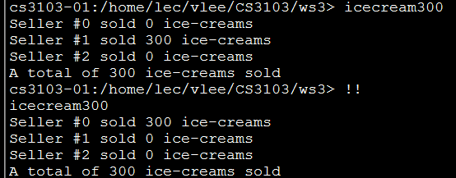
Error Code without Mutex
Tryout 1
Copy icecream.cpp from Canvas to your directory in our Linux servers. Compile and run it.
It simulates 3 sellers co-selling ice-creams until the stock becomes 0.
When we run the program, the total number of ice-creams sold is equal to the stock.
However, what has probably happened is that one of the sellers sold all the ice-creams and terminated before the other two sellers even started.
Run the previous command

Slide 10
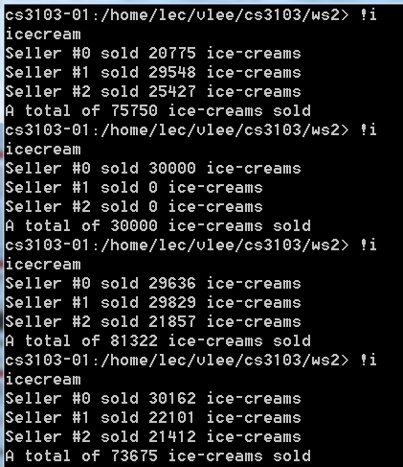
Error Code without Mutex
Tryout 2
Increase the stock from 300 ice-creams to a large number, say, 30000. You will see different results.
The total number of ice-creams sold could be more than the stock!
Errors due to race condition happened in this program.
If we run the program multiple times, we see that the total number of ice-creams sold fluctuates widely.
Run the most recent command starting with ‘i’

Slide 11
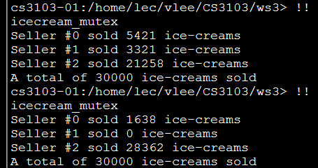
Correction with Mutex
Tryout 3
Add mutex to “protect” the global variable icecream in the program.
…
pthread_mutex_t mutex = PTHREAD_MUTEX_INITIALIZER;
/* declare a global mutex variable */
void *seller(void *arg) {
…
pthread_mutex_lock(&mutex);
/* lock before accessing the shared data */
if ( icecream > 0 ) {
…
}
else
done = 1;
pthread_mutex_unlock(&mutex);
/* unlock after data access */
…
}

Slide 12
Semaphore
POSIX semaphore types and functions are in <semaphore.h>
Header
    #include <semaphore.h>
Declaration
  sem_t mysem;
API calls
  sem_init(&mysem, 0, initialvalue);
    2nd argument 0 indicating this semaphore is to be shared between the threads of a process
  sem_wait(&mysem);
    It atomically decreases the value of the semaphore by 1
    If the value of the semaphore becomes negative, the calling thread blocks

Slide 13
Semaphore
API calls
  sem_post(&mysem);
    It atomically increases the value of the semaphore by 1
    It wakes up a blocked thread waiting on the semaphore, if any
  sem_getvalue(&mysem, &value);
    If one or more threads are currently blocked on the semaphore, then the returned value is 0 in Linux, else it returns the current value of the semaphore in value
    In several other implementations, if one or more threads are currently blocked on the semaphore, the returned value is a negative number whose absolute value is the number of blocked threads
  sem_destroy(&mysem);
  Reminder: return 0 on success or -1 on error

Slide 14
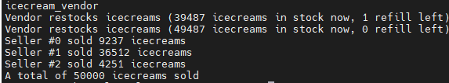
Semaphore – Code Example
Tryout 4
Copy icecream_vendor.cpp from Canvas to your directory in our Linux servers. Compile and run it.
A vendor refills 10,000 icecreams twice to the stock. But it may be scheduled to execute at any time (mostly before all sellers).

Slide 15
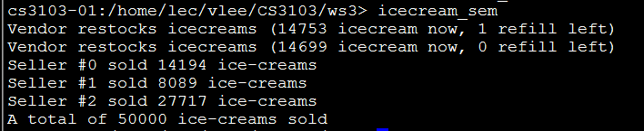
Semaphore – Code Example
Tryout 5
/* icecream_sem.cpp */
#include <semaphore.h>
…
#define LOWSTOCK 5000
…
sem_t refill;
void* seller(void *arg) {
…
if (icecream == LOWSTOCK)
sem_post(&refill);
…
}
void* vendor(void *arg) {
…
sem_wait(&refill);
…
}
Update the program so that the vendor is blocked at the beginning and only refills the stock after signaled by the seller at low stock.
void* main(void *arg) {
…
sem_init(&refill, 0, 0);
…
sem_destroy(&refill);
}

