Slide 1

EE4803: Analog IC Design
Single transistor Circuits
Department of Electrical Engineering
City University of Hong Kong
Prof. Arindam Basu

Slide 2
Outline
Analog Switch
Active Resistor
Current Sink/Source
*With inputs from Phillip Allen’s course at Georgia Tech and Willy Sansen’s book

Slide 3
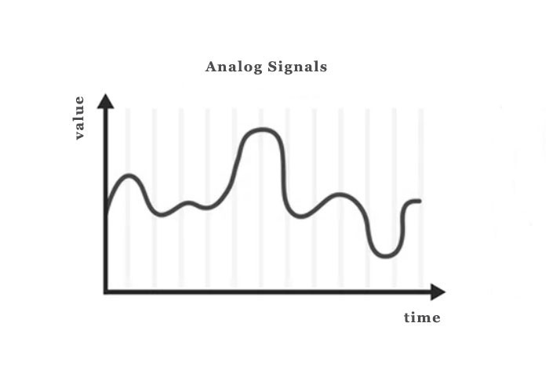

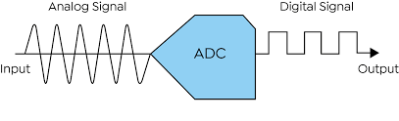
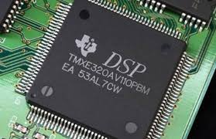
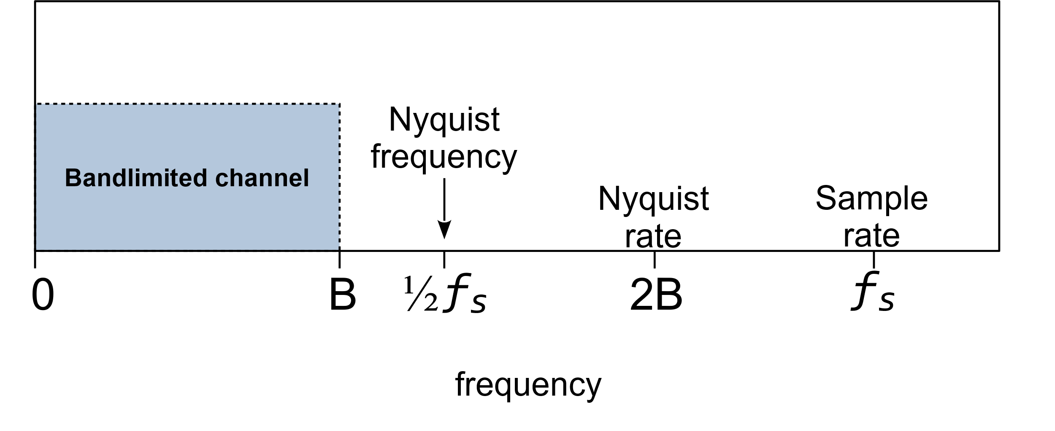
Analog Switch
Real world signal → Analog
Processor→ Digital
From continuous time, continuous amplitude TO discrete time, discrete amplitude

Slide 4
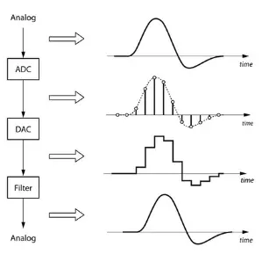
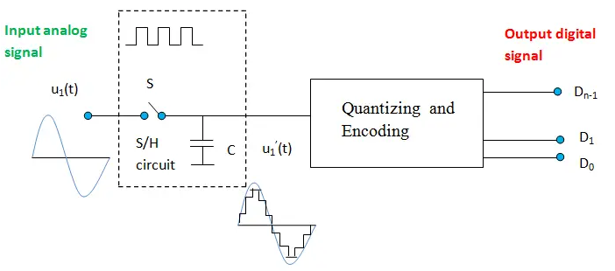
Analog Switch: ADC use case
Switch
ADC Process
There are mainly two steps involves in the process of conversion. They are
Sampling and Holding (S/H)
Quantizing and Encoding
From continuous time, continuous amplitude TO discrete time, discrete amplitude
Sampling and Holding
In Sampling and Holding (S/H), the continuous signal is sampled and held steady for a short period. This removes variations in the input signal that could affect conversion accuracy. The minimum sampling rate must be twice the maximum frequency of the input signal.

Slide 5
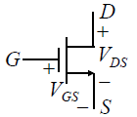
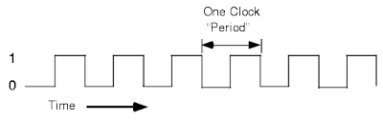
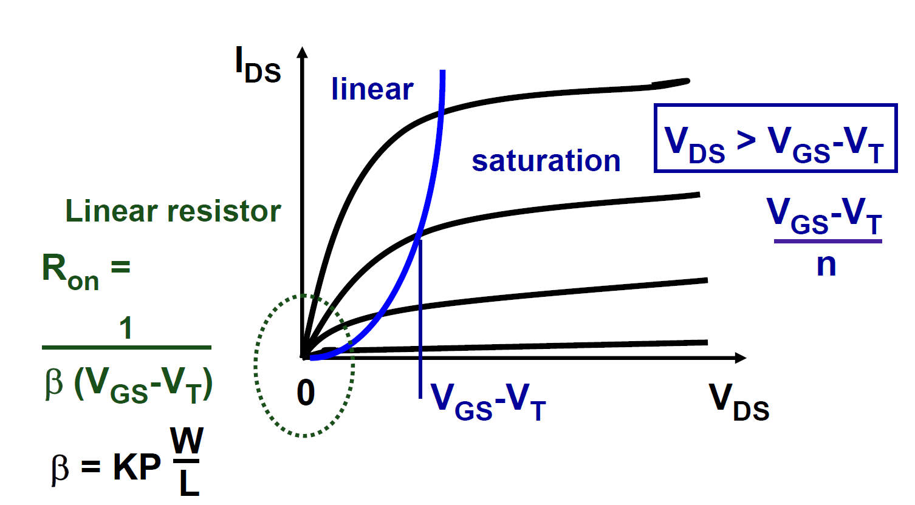
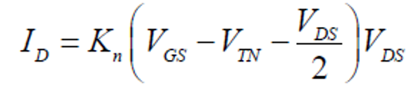

MOS as a Switch
Control clock = 1 → Switch Turns ON
Control clock = 0 → Switch Turns OFF
Good switch → R_{ON} very low, R_{OFF} very high
For R_{OFF}, need to consider sub-threshold equation
β
$$\frac{{dI}_{D}}{{dV}_{DS}}$$
1
β
More accurate
K’

Slide 6
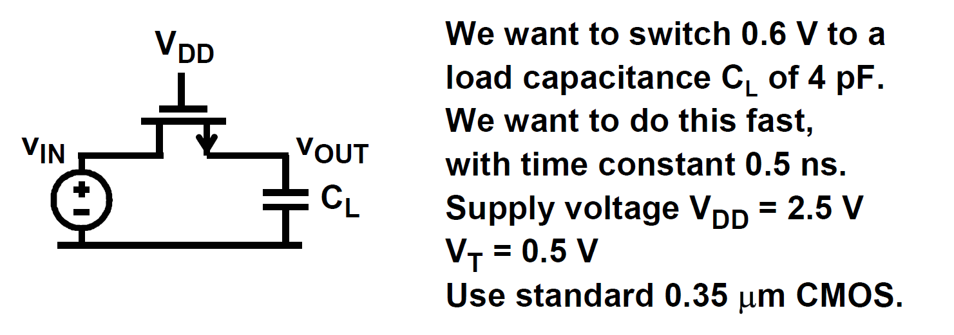
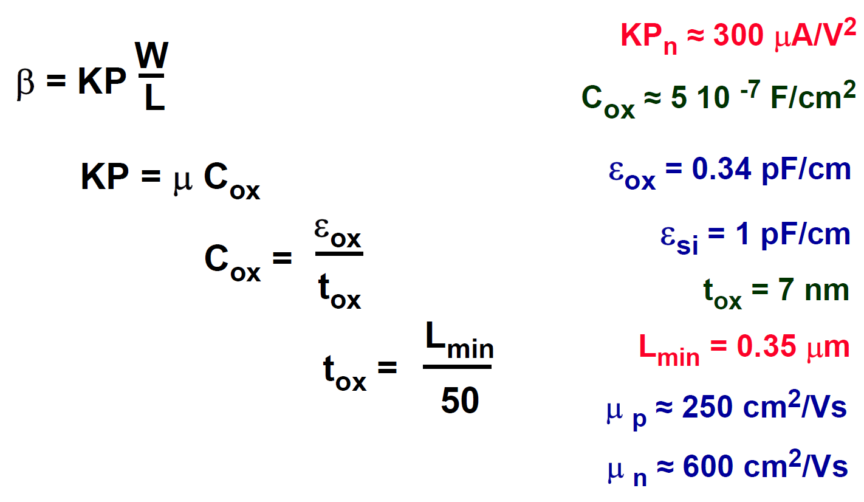
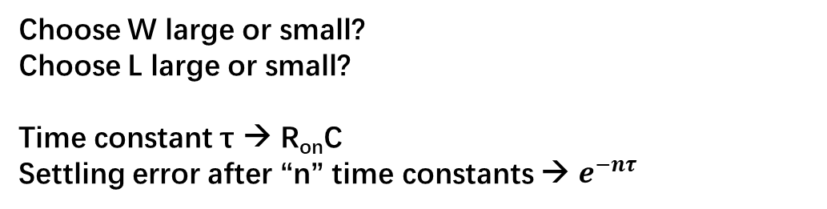
Switch driving capacitor
K’
K’
K’
Assume initial voltage on C_{L} is 0V.
What is V_{GS}? Which terminal is Source? Voltage on CL is changing..
Choose W large or small?
Choose L large or small?
Time constant τ → R_{on}C
Settling error after “n” time constants → $e^{−nτ}$

Slide 7
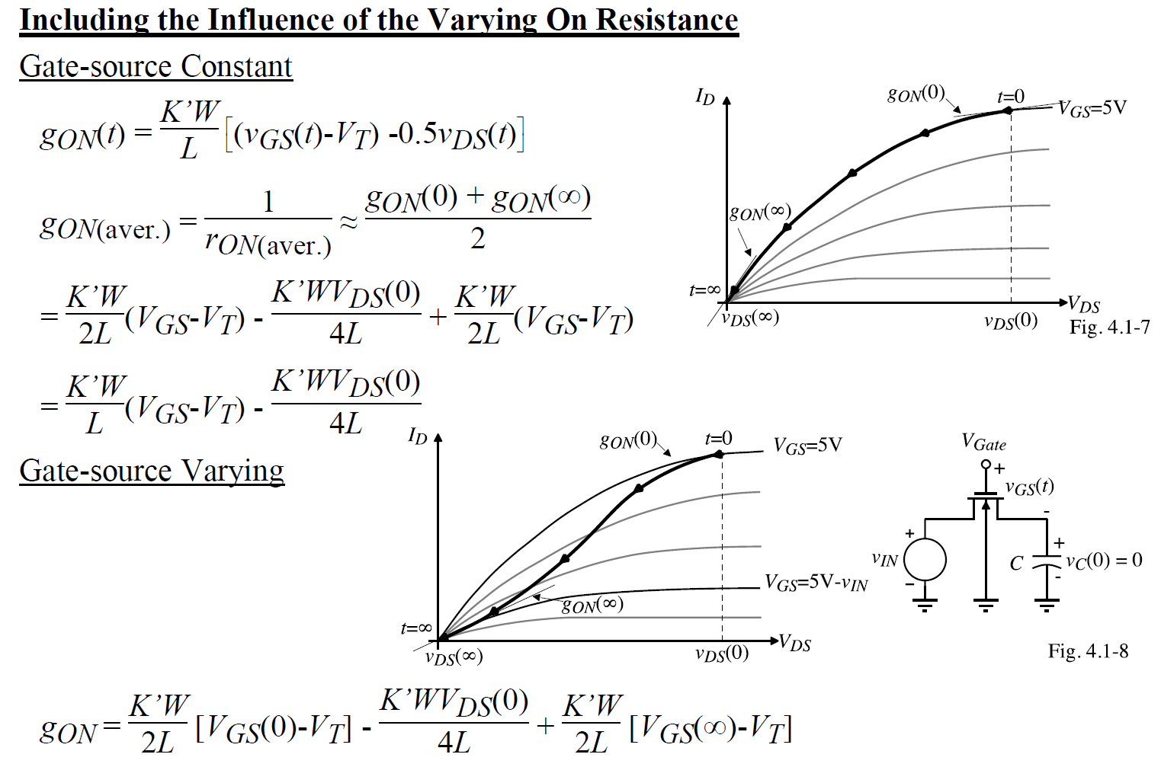
More accurate analysis

Slide 8
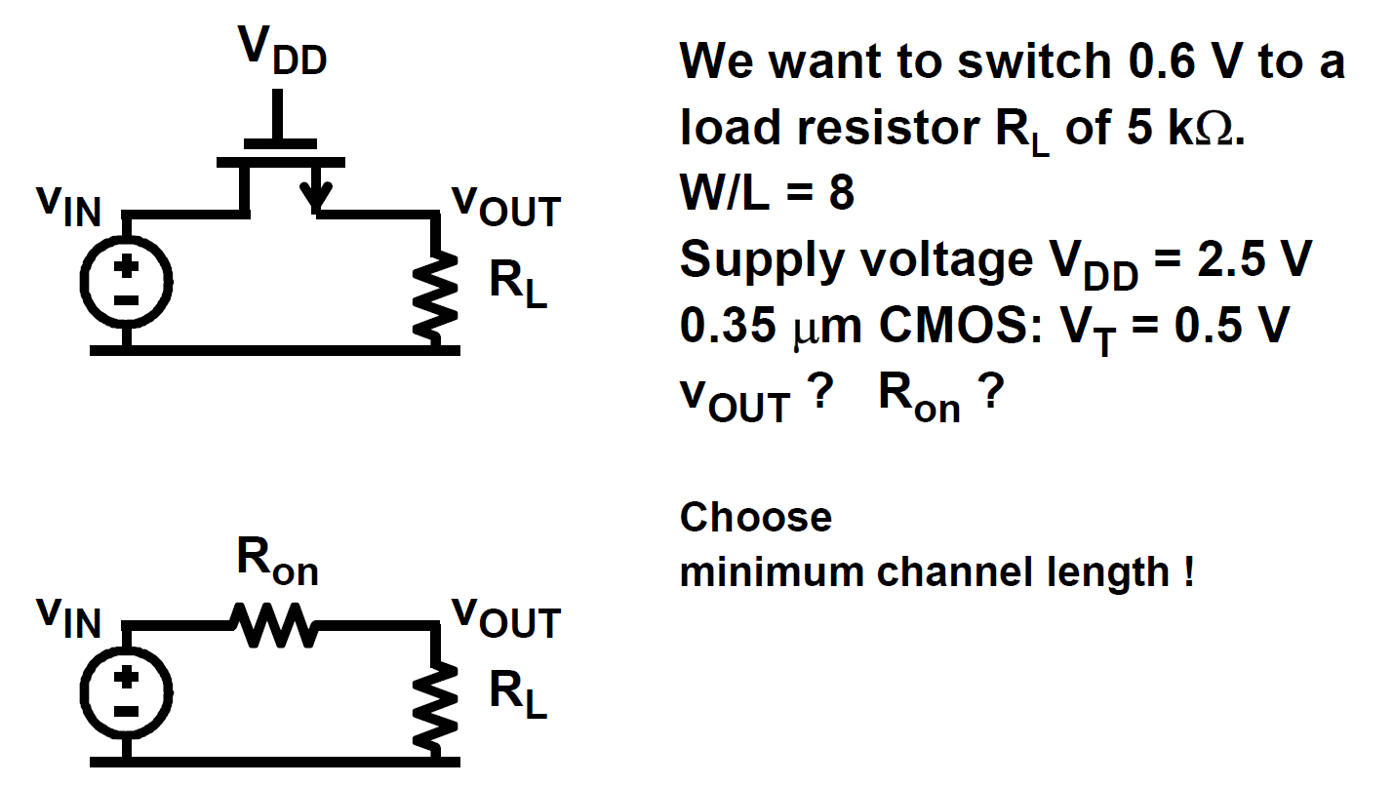
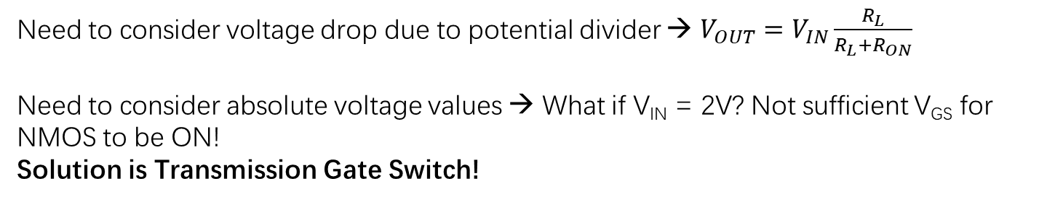
Switch driving resistor
Need to consider voltage drop due to potential divider → $V_{OUT}=V_{IN}\frac{R_{L}}{R_{L}+R_{ON}}$
Need to consider absolute voltage values → What if V_{IN} = 2V? Not sufficient V_{GS} for NMOS to be ON!
Solution is Transmission Gate Switch!

Slide 9
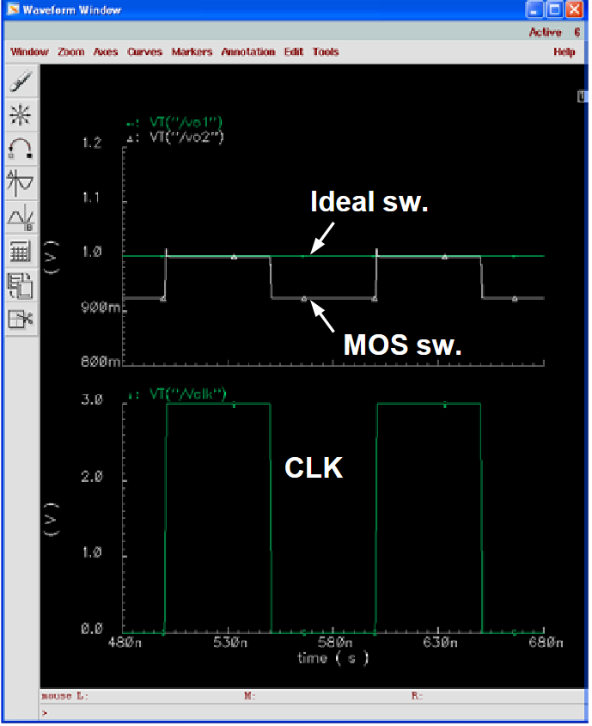
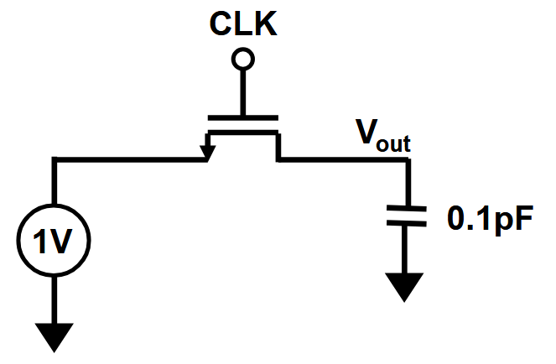
Switch driving capacitor: Non-idealities
Control clock = 1 → Switch Turns ON
Control clock = 0 → Switch Turns OFF
Errors caused by:
Clock feedthrough
Charge Injection

Slide 10
Switch driving capacitor: Non-idealities
Control clock = 1 → Switch Turns ON
Control clock = 0 → Switch Turns OFF
Errors caused by:
Clock feedthrough
Charge Injection

Slide 11
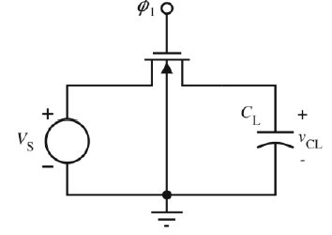
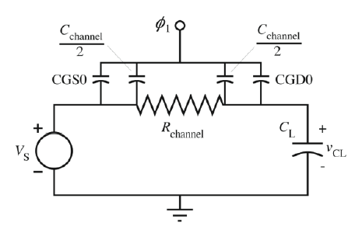
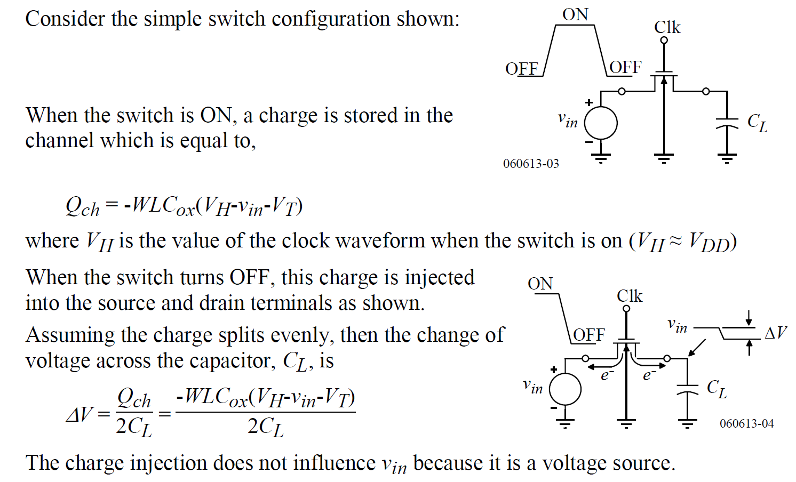
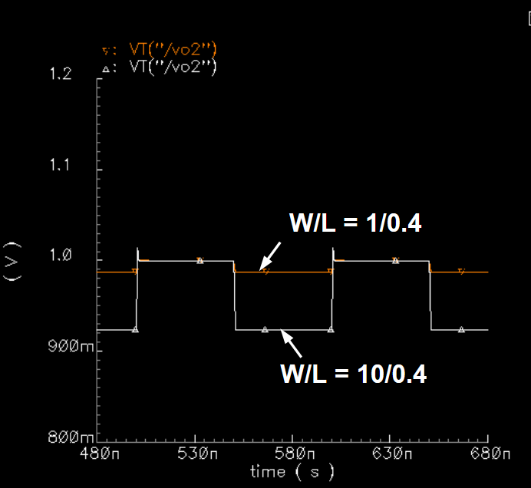
Switch Non-idealities: Parasitic Capacitor
Charge Injection
V_{GS}

Slide 12
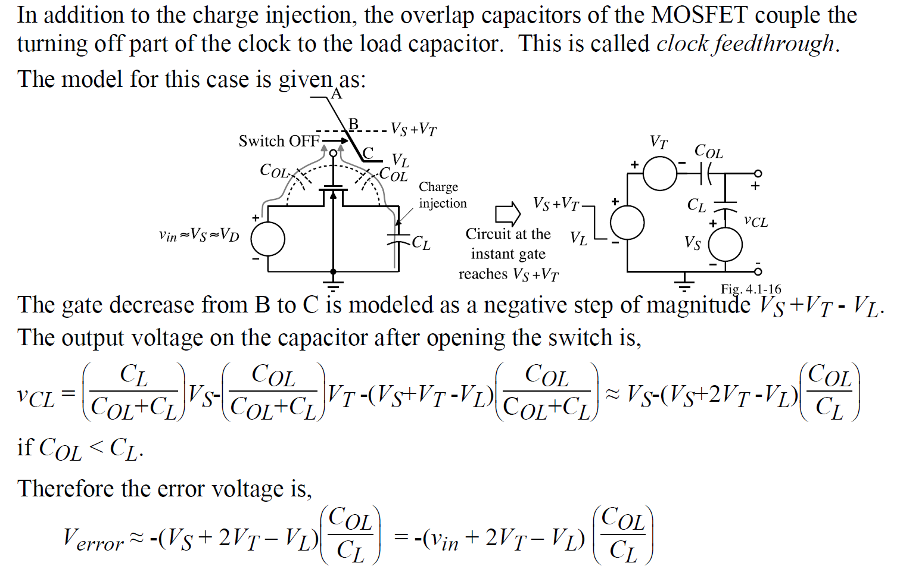
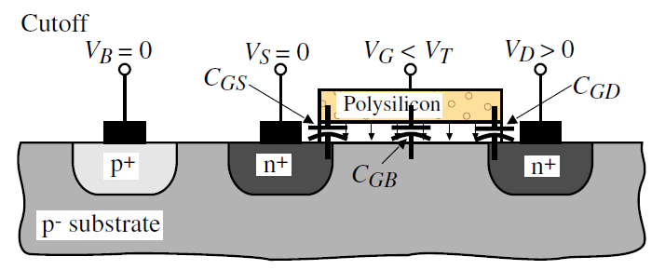
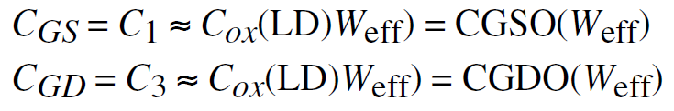
Switch Non-idealities: Parasitic Capacitor
Clock Feedthrough
LD
LD
Overlap Capacitors (C_{OL})
Proportional to
W

Slide 13
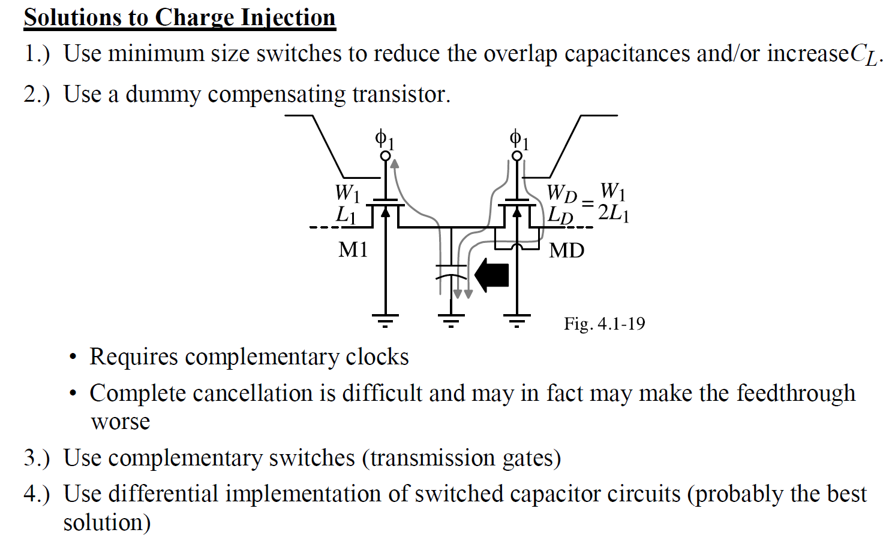
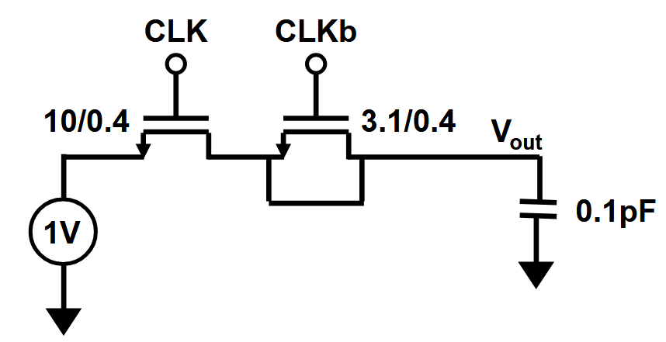
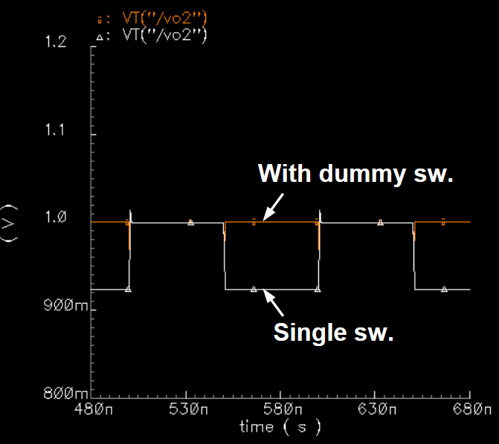
Switch Non-idealities: Parasitic Capacitor
Solutions

Slide 14
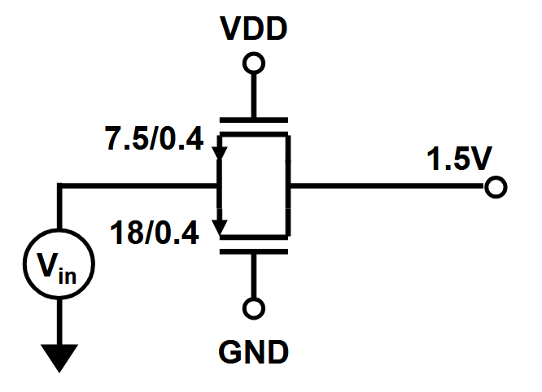
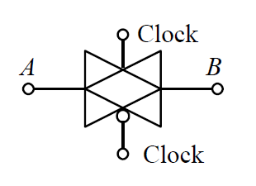
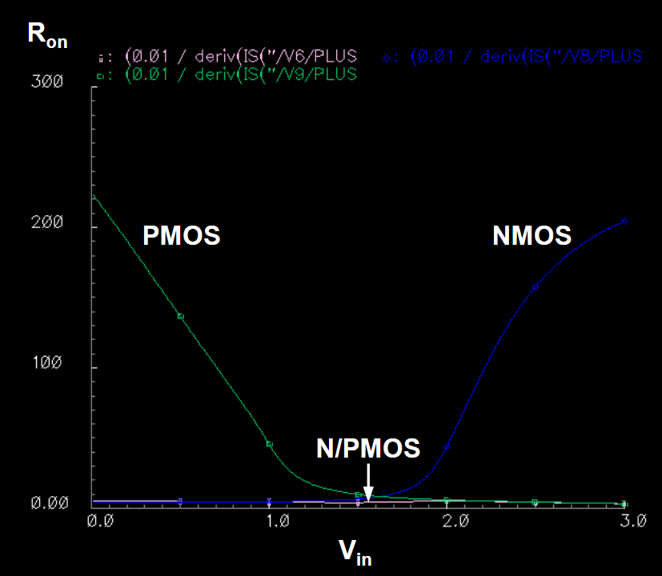
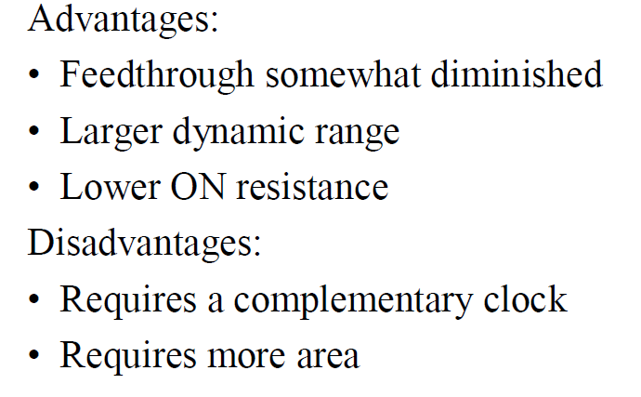
Switch Non-idealities: Dynamic Range
Transmission Gate/ Complementary Switch/ N-P Switch
Also solves Clock feedthrough/Charge injection due to usage of opposite polarity of clock for NMOS and PMOS! ☺
Depends on Vdd

Slide 15
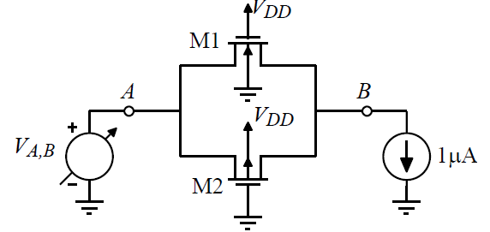
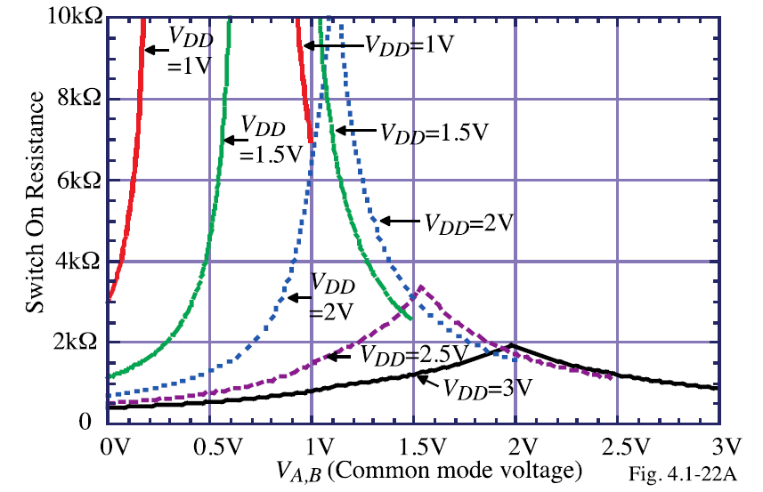
Switch Non-idealities: Dynamic Range
Low ON resistance is difficult when V_{DD} decreases
(Why attempt to reduce V_{DD} ? → to reduce power dissipation)
Solution → Boosted clock! (Charge pump)

Slide 16
Outline
Analog Switch
Active Resistor
Current Sink/Source
*With inputs from Phillip Allen’s course at Georgia Tech and Willy Sansen’s book

Slide 17
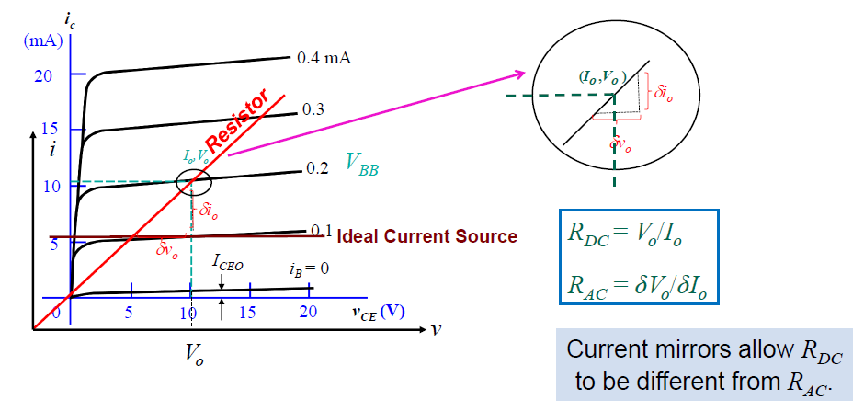
Current Sink/Source
Current Source in EE3122 → Tail Current Source in Differential Pair

Slide 18
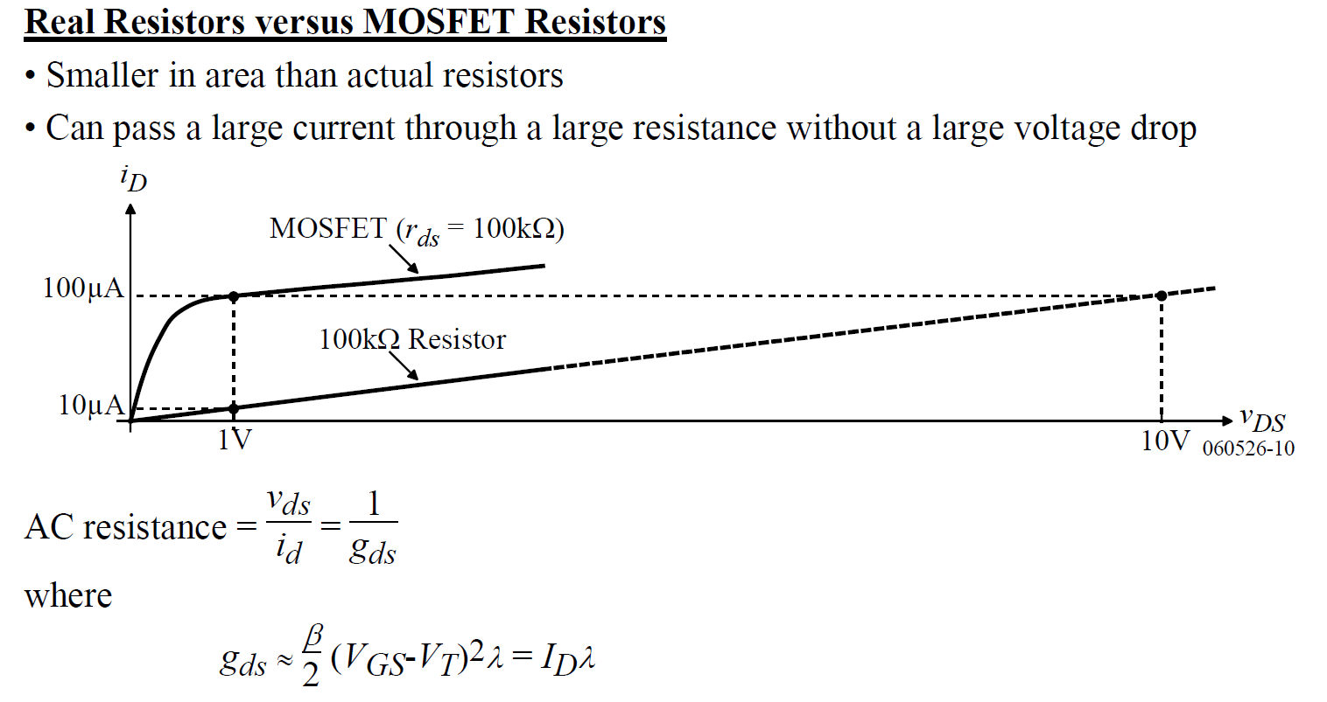
Active Resistor
(While this shows AC resistor, analog switch shows MOS can be used as DC resistor as well with smaller area)

Slide 19
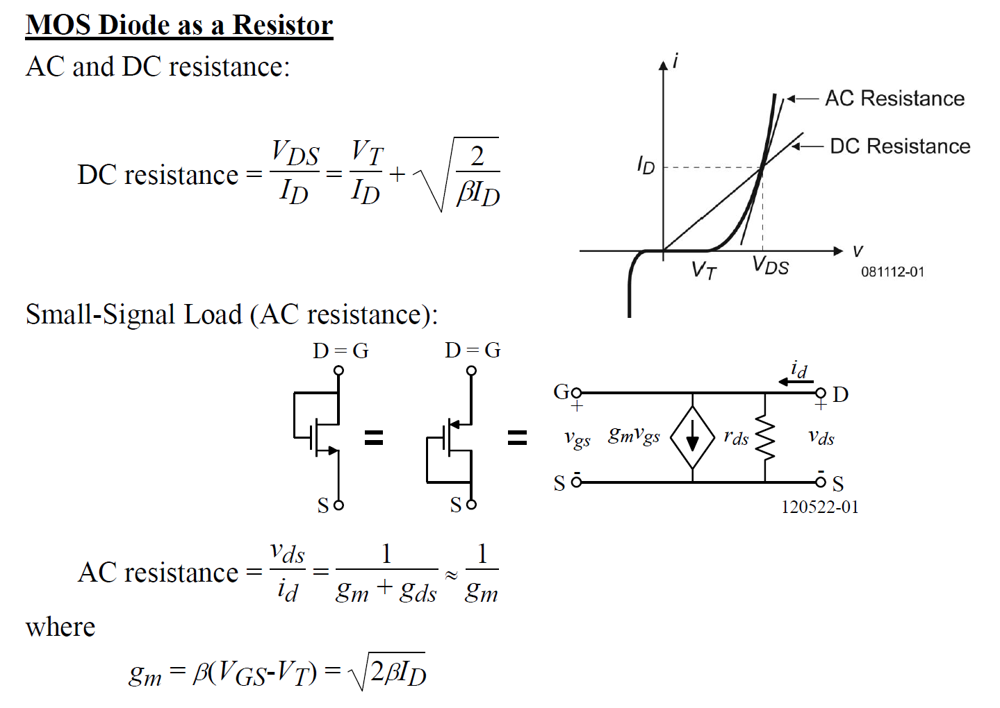
Active Resistor: MOS Diode

Slide 20
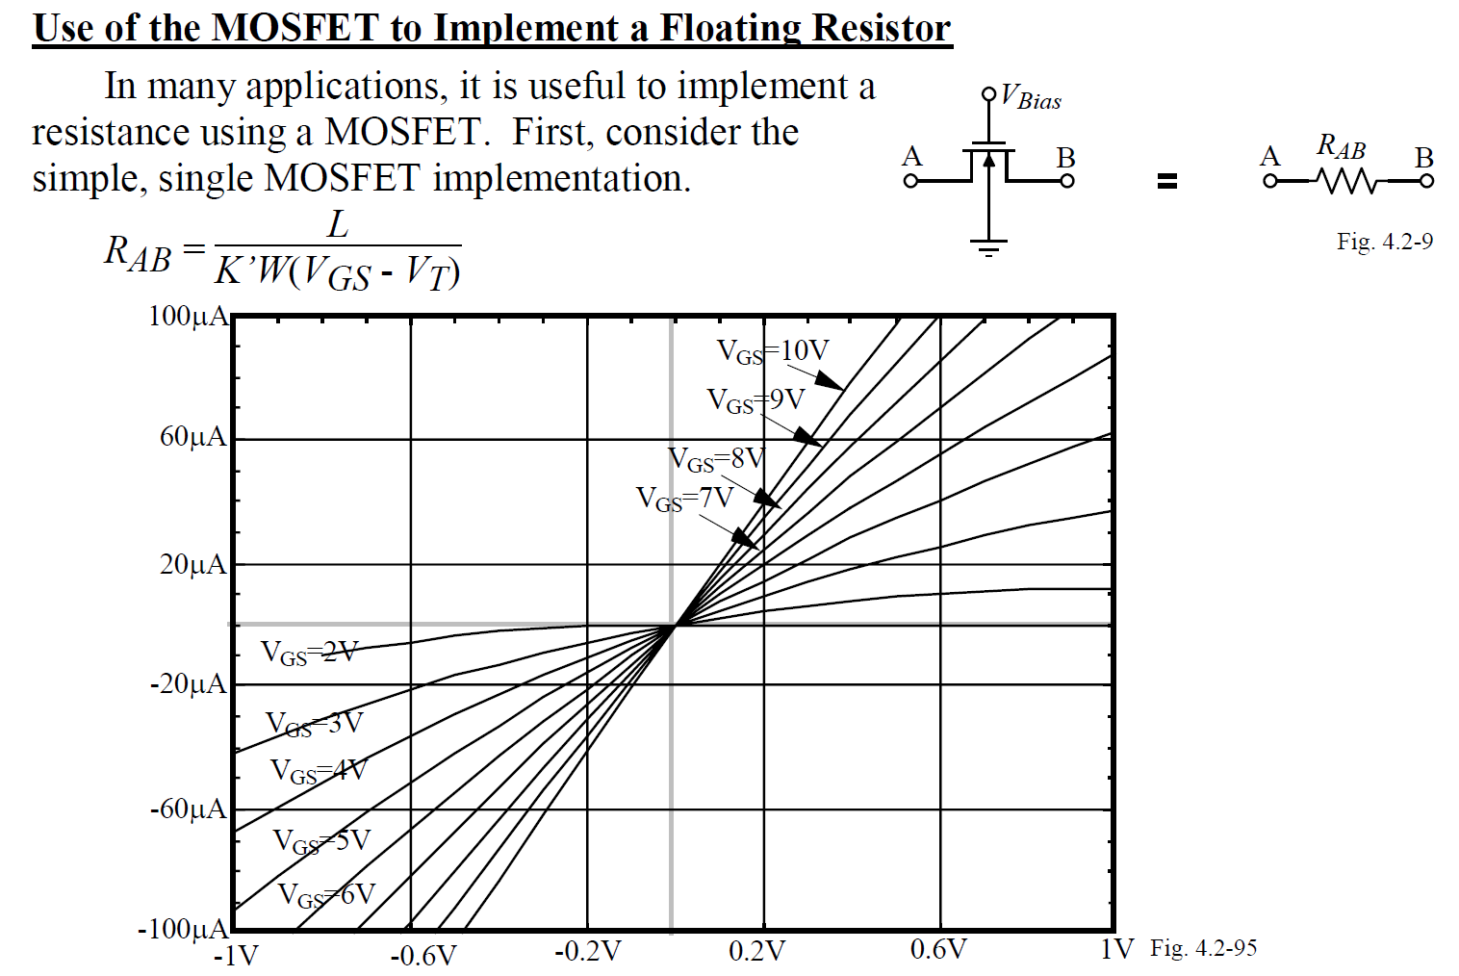
Active Resistor: Analog switch

Slide 21
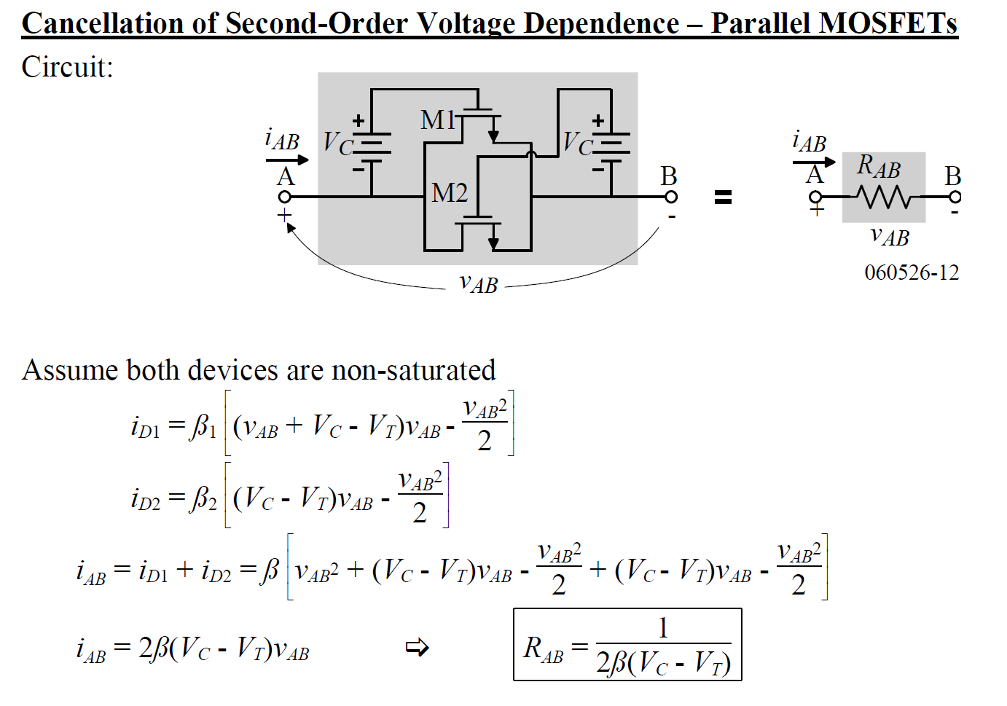
Active Resistor: Analog switch

Slide 22
Outline
Analog Switch
Active Resistor
Current Sink/Source
*With inputs from Phillip Allen’s course at Georgia Tech and Willy Sansen’s book

Slide 23
Current Sink/Source
Current Source in EE3122 → Tail Current Source in Differential Pair

Slide 24
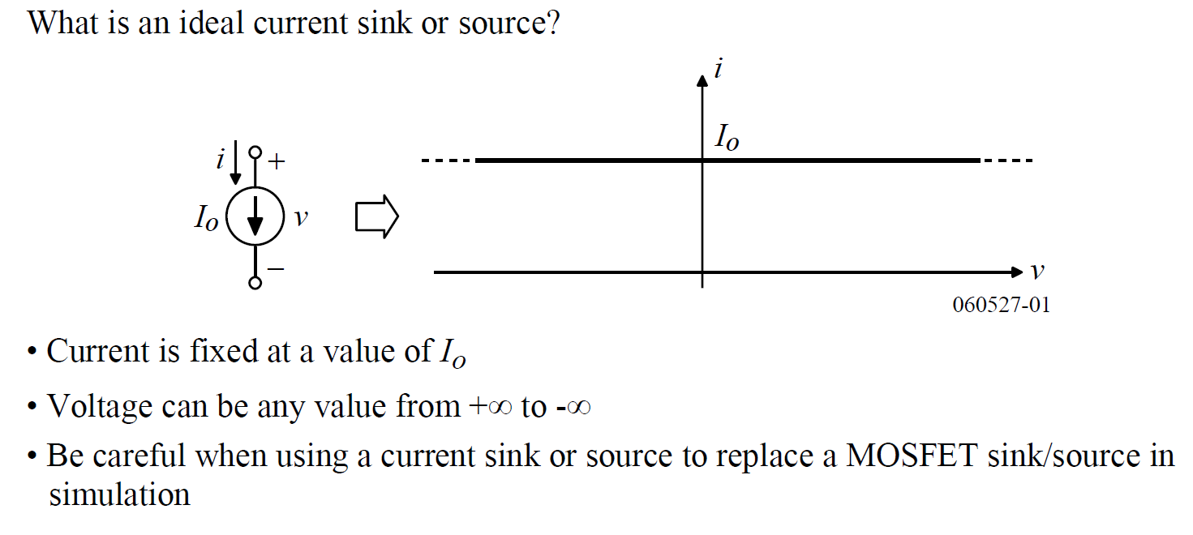
Ideal Current Sink/Source
V_{DD}
V_{DD}
CKT
SOURCE
CKT
SINK
GND
GND

Slide 25
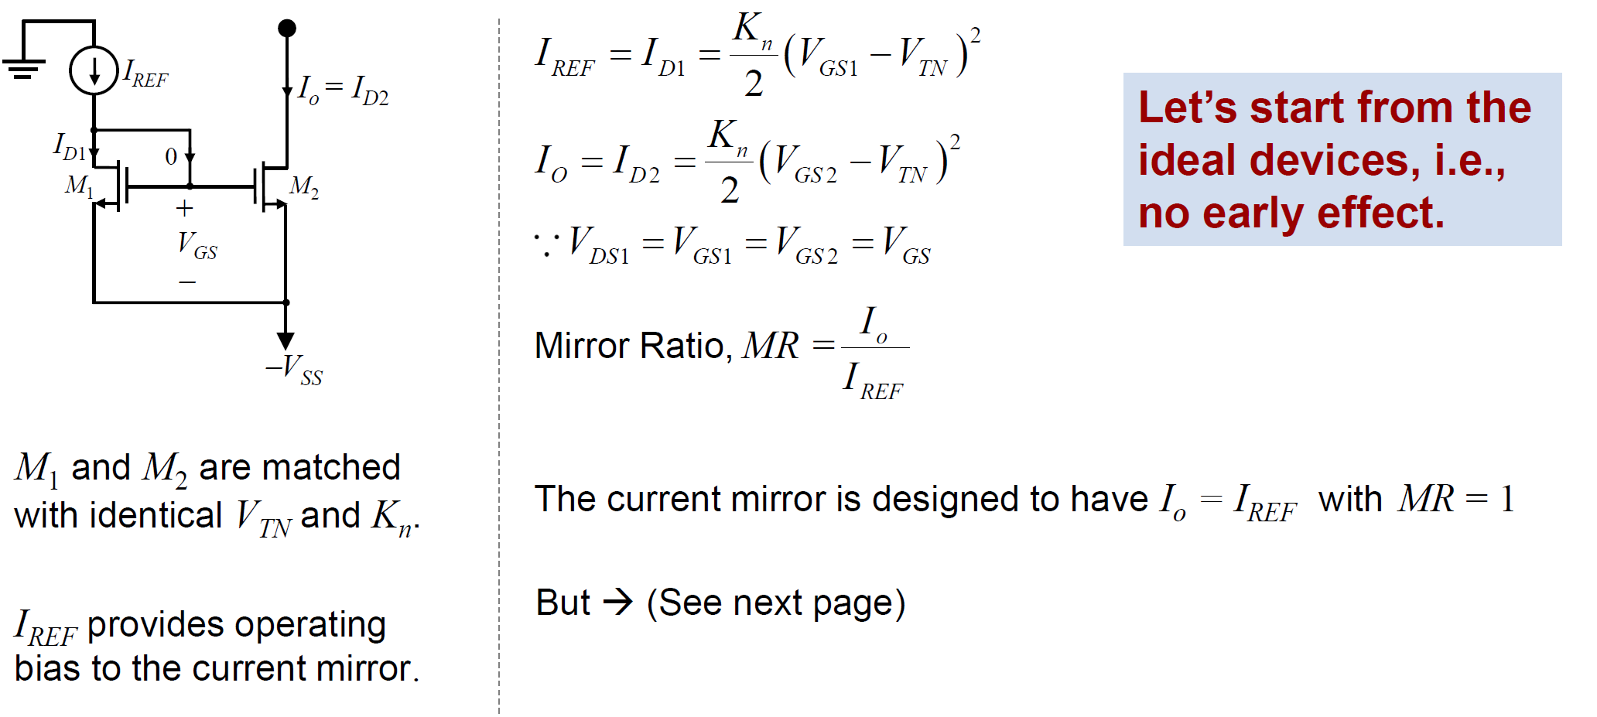
Ideal Current Mirror: DC Analysis
Current Source in EE3122 → Tail Current Source in Differential Pair
Current
reference
Current
mirror
Current
source

Slide 26
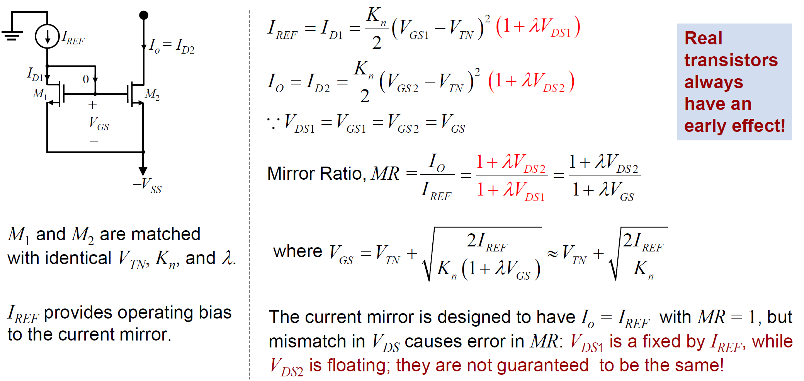
Current Mirror: Early Effect
Current Source in EE3122 → Tail Current Source in Differential Pair

Slide 27
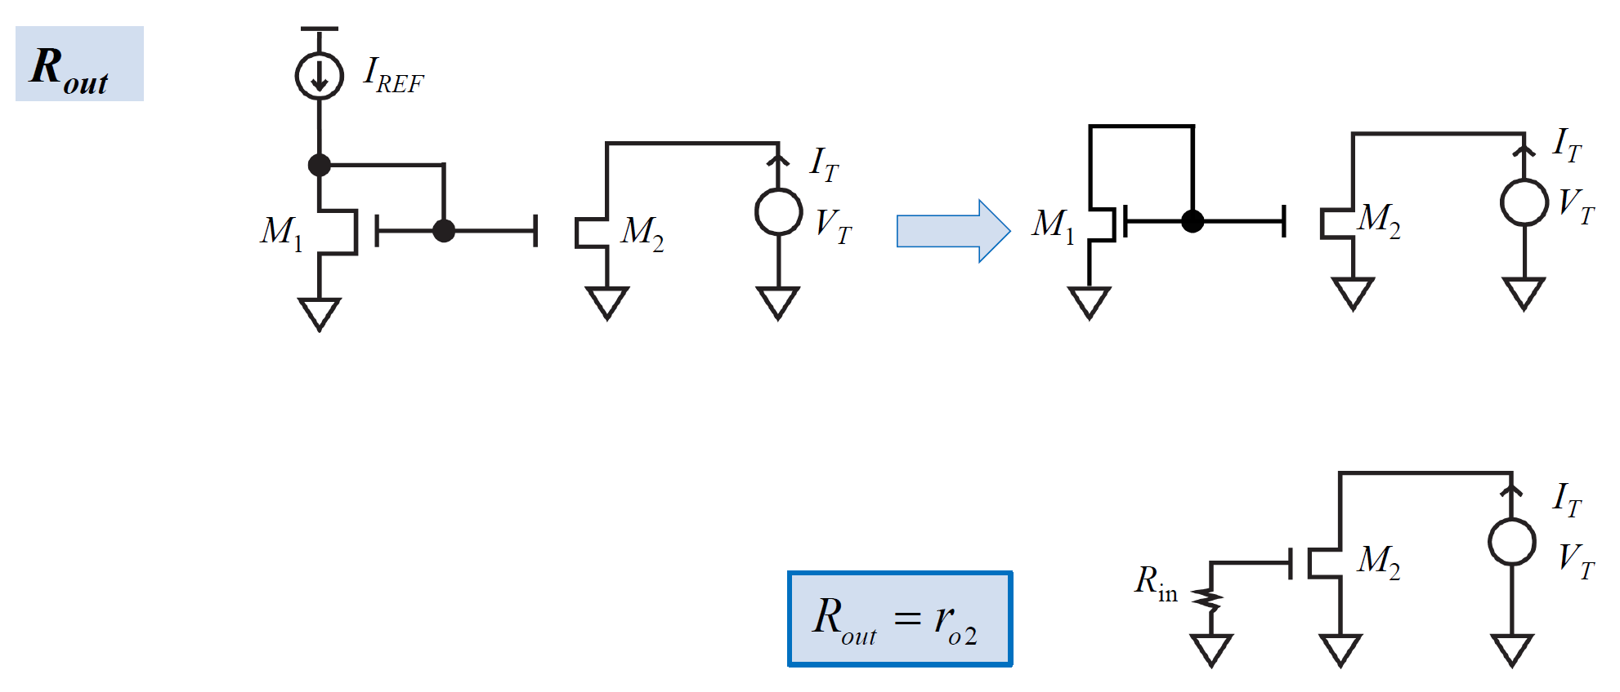
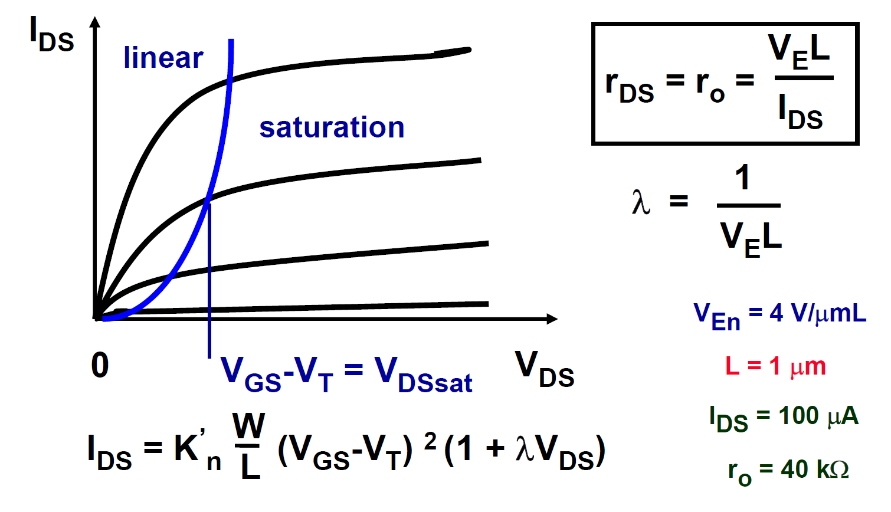
Current Source: AC analysis
Analyze R_{out} → As expected, it is r_{o} (OR r_{ds})
How to increase R_{out}?
Increase channel length → Smaller λ
Cascode current source (shown later)

Slide 28
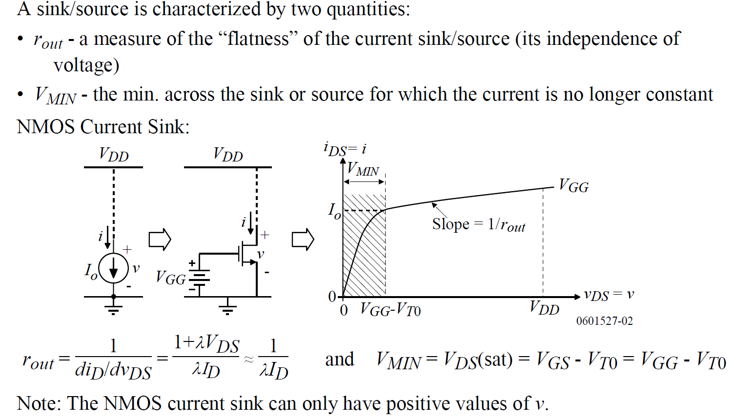
MOS Current Sink/Source

Slide 29
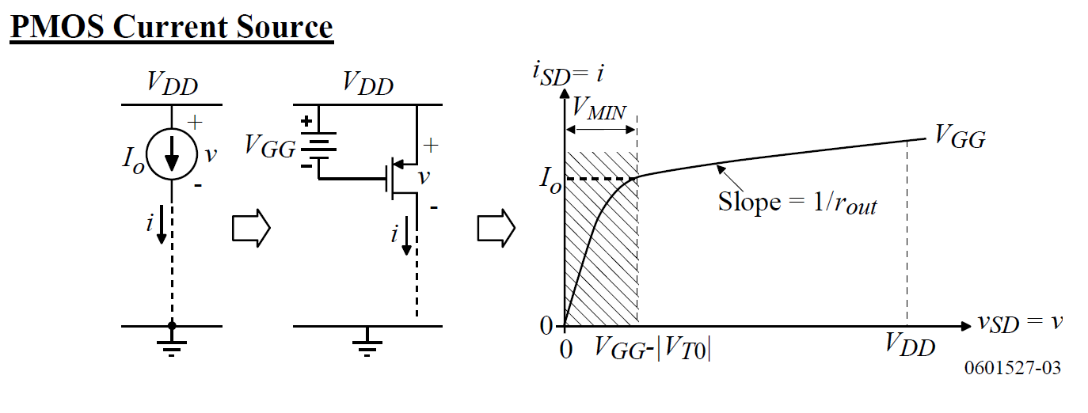
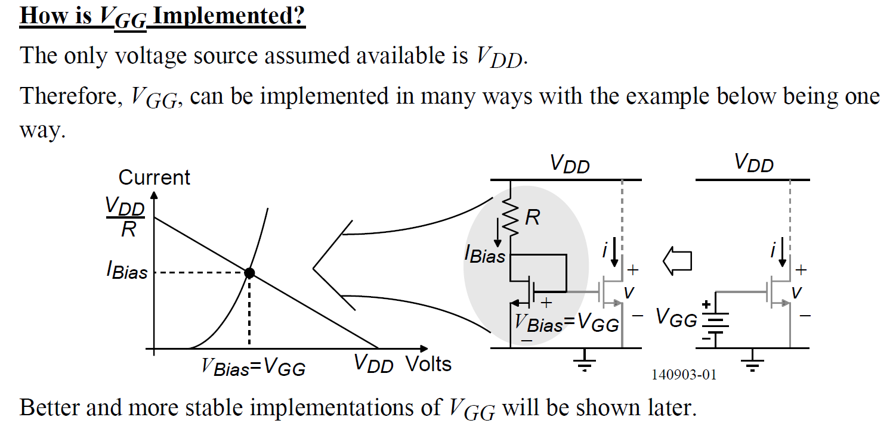
MOS Current Sink/Source
NOTE: V_{SD} = V_{DD} - V_{D}
NOTE: V_{G} = V_{DD} - V_{GG}
V_{D} = V_{DD}
V_{D} = 0

Slide 30
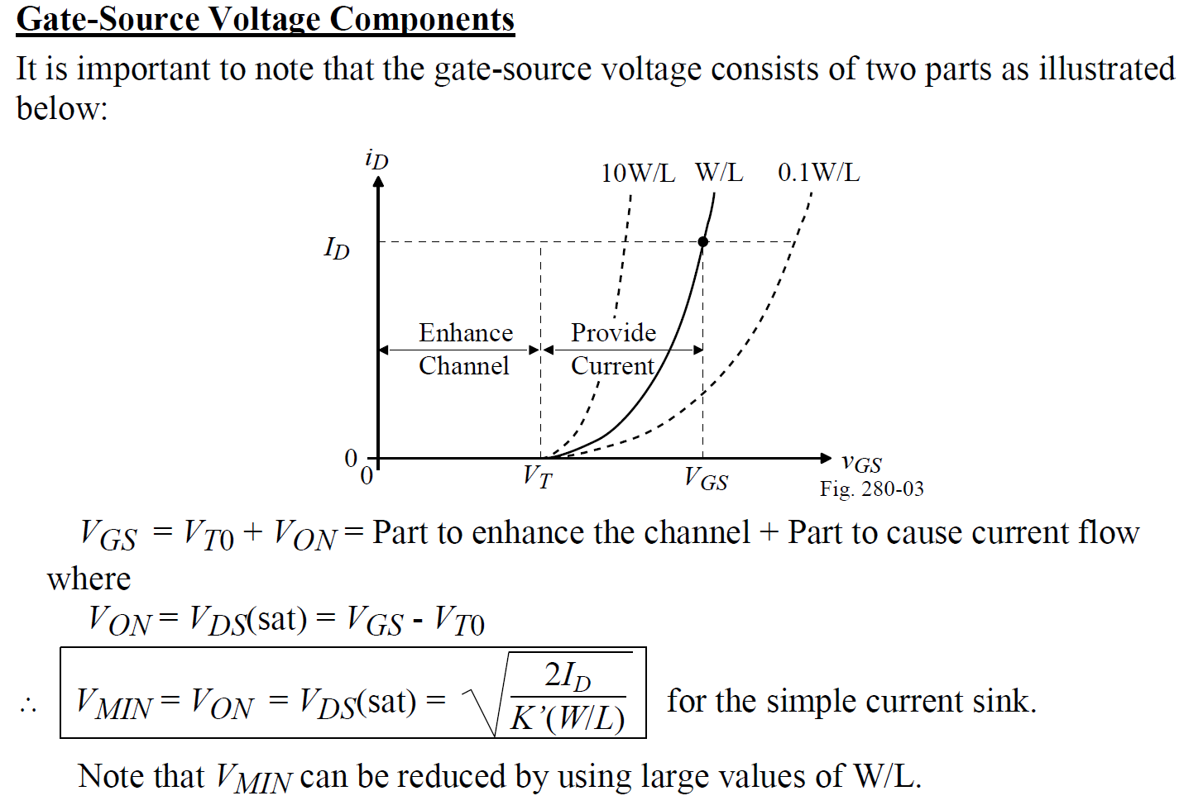
MOS Current Sink/Source: V_{MIN}

Slide 31
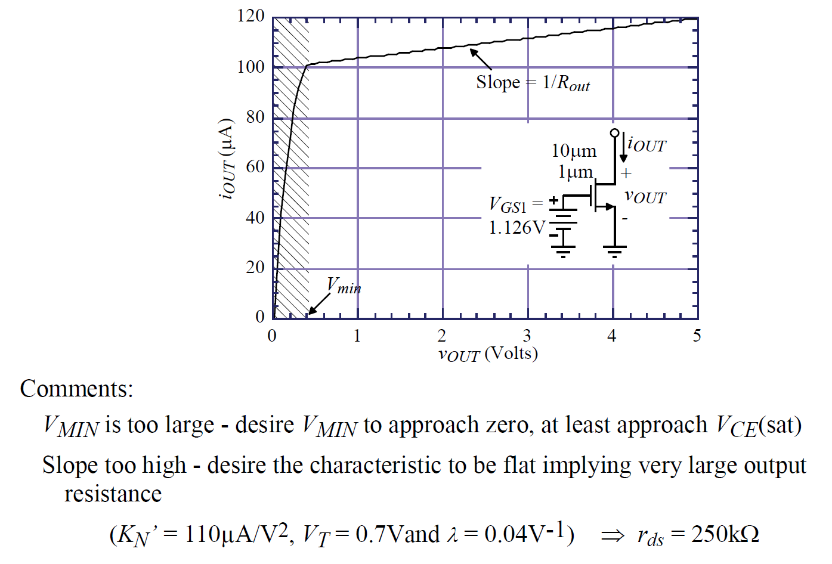
MOS Current Sink/Source: Simulation

Slide 32
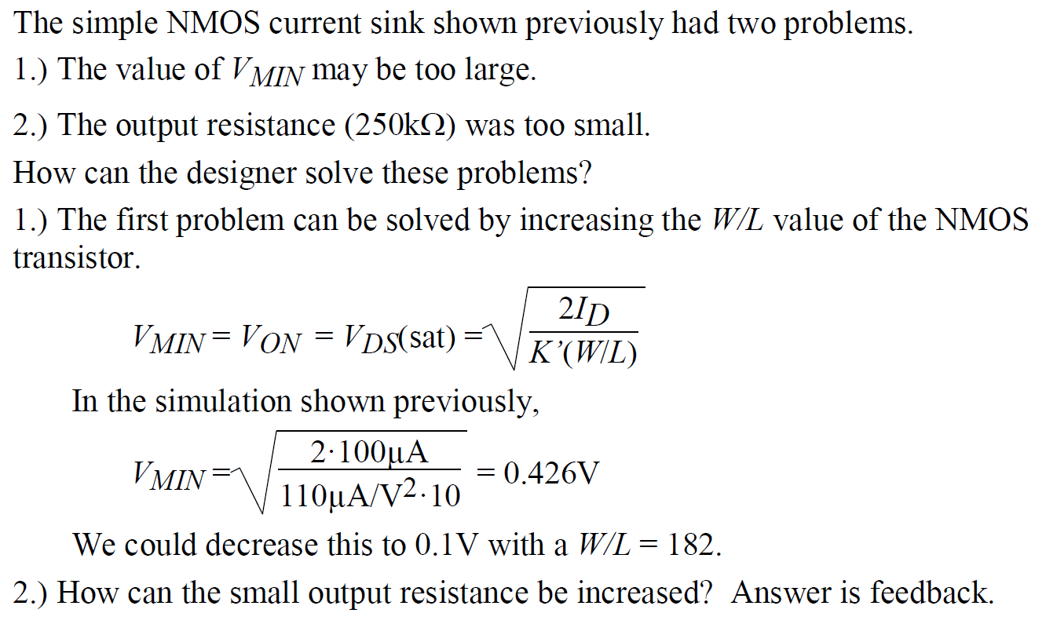
MOS Current Sink/Source: Improvements

Slide 33


MOS Current Sink/Source: Improvements
+
V_{o} g_{o} = V_{o}/r_{o}
$$≈$$

Slide 34

Cascode Current Sink: AC
g_{m,cas}r_{ds,cas}r_{ds,bot}

Slide 35

Cascode Current Sink: DC
Remember, condition for saturation
V_{DS} > V_{GS} – V_{T}
OR, V_{D} – V_{S} > V_{G} – V_{S} – V_{T}
OR, V_{D} > V_{G} - V_{T}

Slide 36

Cascode Current Sink: Bias voltage
Also, need extra bias current → More power dissipation!

Slide 37

Self-biased Cascode Current Sink
Also, drain voltages of M1 and M2 are matched now!

