Slide 1

Chapter 7 & 8
Memory Management and
Virtual Memory
Operating Systems:
Internals and Design Principles
William Stallings

Slide 2
Roadmap
Basic requirements of Memory Management
Basic blocks of memory management
  Paging
  Segmentation
Virtual Memory (VM) Basics
Hardware and Control Structures of VM
  Paging
  Segmentation
  Combined Paging and Segmentation
VM Management

Slide 3
Terminology
Real memory
  Main memory, the actual RAM, where a process executes.
  Real address (physical address) is the address of a storage location in main memory.
Virtual memory (memory on disk)
  A storage allocation scheme in which secondary memory can be addressed as though it were part of main memory.
  Virtual address (logical address) is the address assigned to a location in virtual memory.
Address space
  The range of memory addresses available to a process.

Slide 4
Memory Management
The principal operation of memory management is to bring processes into main memory for execution by the processor.
Memory is cheap today, and getting cheaper.
  But applications are demanding more and more memory, there is never enough!
In a multiprogramming system, if only a few processes are in memory, then for much of the time, all of the processes will be waiting for I/O and the processor will be idle.
Thus memory needs to be allocated to ensure a reasonable supply of ready processes to consume available processor time.

Slide 5
Memory Management Requirements
Relocation
Protection
Sharing
Logical organization
Physical organization

Slide 6
Requirements: Relocation
Programmers do not (need to) know where the program will be placed in memory when it is executed.
In fact, a process may occupy different actual memory locations during execution.
  In order to maximize processor utilization, active processes need to be swapped in and out of main memory.
  When a process is swapped back, may need to relocate the process to a different area of memory.

Slide 7
Different Types of Addresses
Logical address
  Reference to a memory location independent of the current assignment of data to memory.
Relative address
  An example of logical address.
  Address is expressed as a location relative to some known point such as the origin of the program.
Physical or Absolute address
  Actual location in main memory.

Slide 8
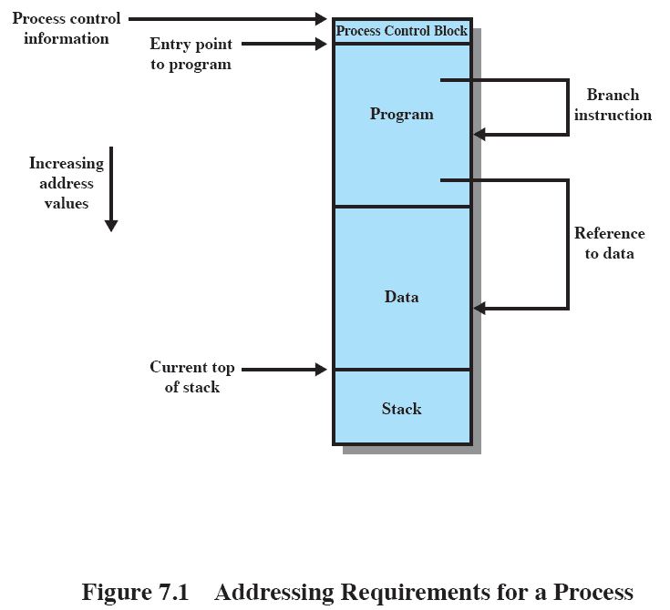
Relocation
The processor and OS must be able to translate the memory references (logical addresses) found in the code of the program into physical addresses before memory access can be achieved.
  Reference to program code
  Reference to data

Slide 9
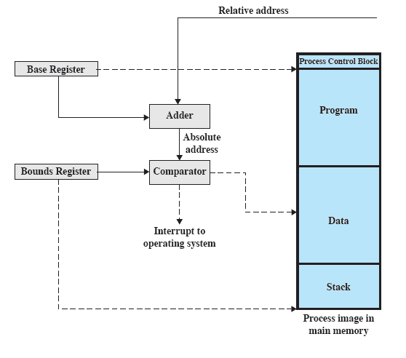
Relocation
Hardware Support
1200
1. Add the value in the base register to the relative address to produce an absolute address.
Base register stores the starting address of the process in main memory
x
x
LOAD 1200
2. Compare the address to the value in the bounds register. If within bounds, execution may proceed.
0. Initialize base and bounds registers when a process is assigned to the Running state.
error
1200+x
Bounds register stores the ending address of the process

Slide 10
Requirements: Protection
Processes should not be able to reference memory locations in another process without permission.
Impossible to check absolute addresses at compile time because the location of a program in main memory is unpredictable.
Memory references generated by a process must be checked at run time.
Mechanisms that support relocation also support protection.

Slide 11
Requirements: Sharing
Memory management must allow controlled access to shared areas of memory without compromising protection.
  Better to allow each process executing the same program access to the same copy of the program rather than have their own separate copy.
  Processes that are cooperating on some task may also need to share access to the same data structure.
Mechanisms used to support relocation support sharing capabilities.

Slide 12
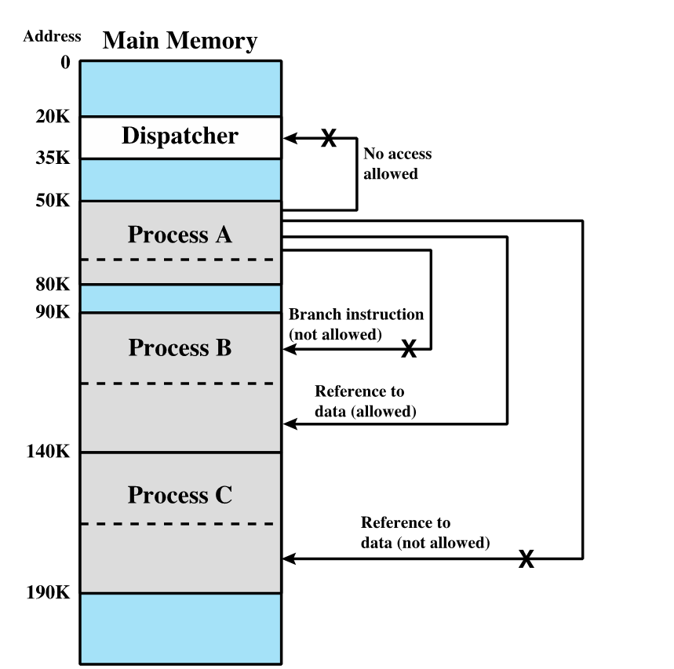
Protection and Sharing
Example

Slide 13
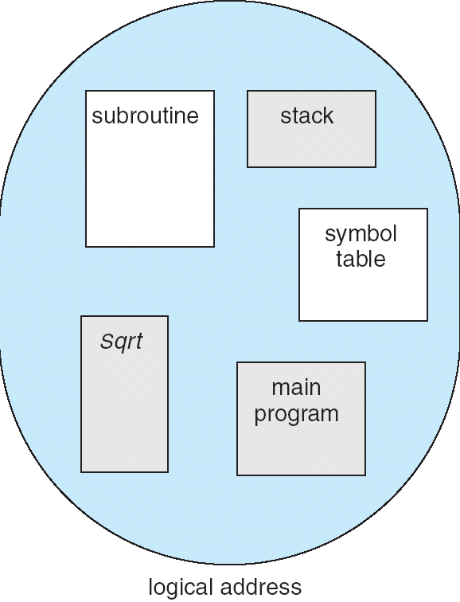
Requirements: Logical Organization
Memory is organized linearly (usually); in contrast, programs are written in modules
If OS and hardware can deal with user programs and data in the form of modules
  modules can be written and compiled independently
  different degrees of protection can be given to different modules (read-only, execute-only)
  easy to specify sharing on a module level

Slide 14
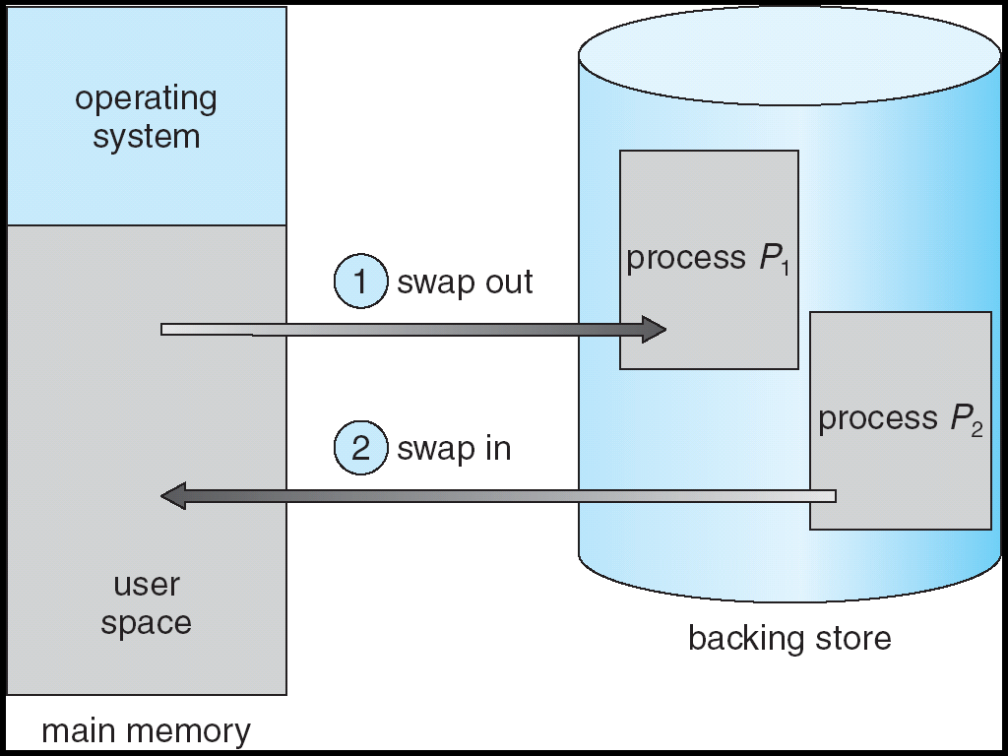
Requirements: Physical Organization
The task of moving information between different levels of memory should be a system responsibility.
Cannot leave the programmer with the responsibility to manage memory because
  memory available for a program plus its data may be insufficient.
  programmer does not know how much space will be available or where the space will be.

Slide 15
Roadmap
Basic requirements of Memory Management
Basic blocks of memory management
    Paging
    Segmentation
Virtual Memory (VM) Basics
Hardware and Control Structures of VM
  Paging
  Segmentation
  Combined Paging and Segmentation
VM Management

Slide 16
Paging
Partition memory into small equal fixed-size chunks (frames) and divide each process into the same size chunks (pages).
  A process is loaded by loading all of its pages into available, but not necessarily contiguous frames.
 No external fragmentation
  Every frame can be allocated to a page and so there is no waste space outside frames.
Only little internal fragmentation
  There is wasted space inside the frame which consists of only a fraction of the last page of a process.

Slide 17
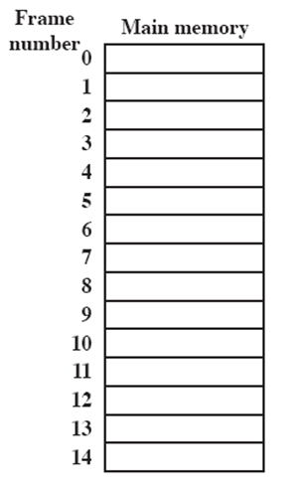
Paging
Processes and Frames
A.0
OS finds free frames and loads the pages of Process A, B & C.
Process B is suspended and is swapped out of main memory.
All of the processes in main memory are blocked, and OS brings in Process D.
A.1
A.2
A.3
B.0
D.0
B.1
D.1
B.2
D.2
C.0
C.1
C.2
C.3
D.3
D.4

Slide 18
Paging
Address Translation
OS maintains a page table for each process which contains the frame location for each page in the process.
Memory reference in the program uses logical address, which consists of a page number and an offset within the page.
During execution, the processor translates the logical address into a physical address by using the page table.

Slide 19
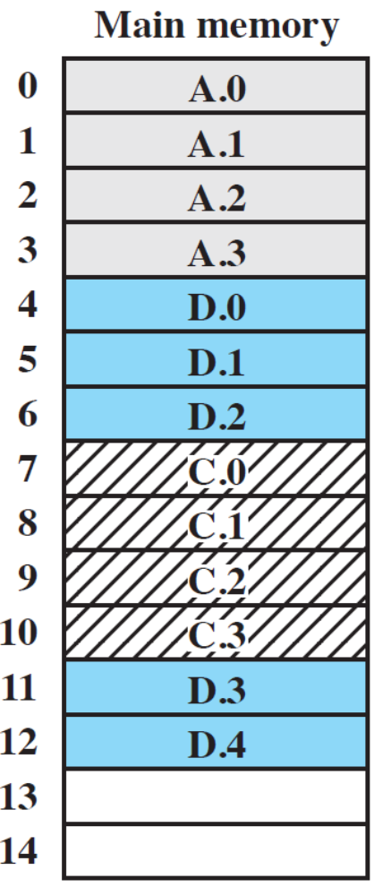
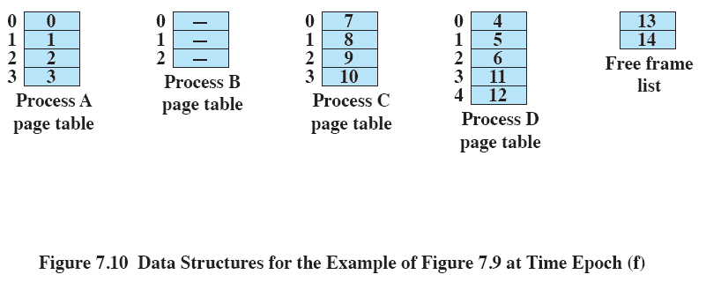
Paging
Page Table
page number
frame number

Slide 20
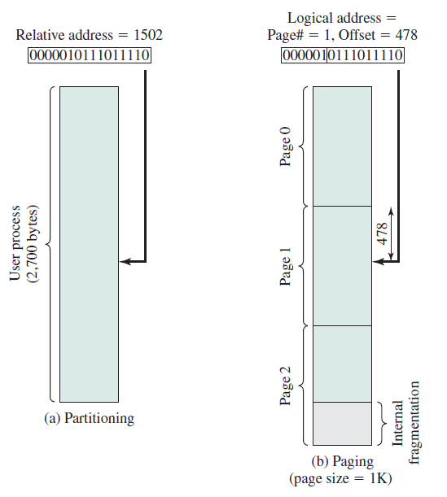
Paging
Logical Addresses
Using a page size that is a power of 2, a logical address (page no. and offset) is identical to its relative address
Example
  16-bit address
  2¹⁰ =1024-byte page
  10-bit offset
  6-bit page number
  A maximum of 2⁶ =64 pages

Slide 21
Paging
Logical Addresses
Using a page size that is a power of 2,
   the logical addressing scheme becomes transparent to the programmer, assembler and linker because a logical address is identical to its relative address.
   implementing a function in hardware to perform dynamic address translation at run time becomes relatively easy.

Slide 22
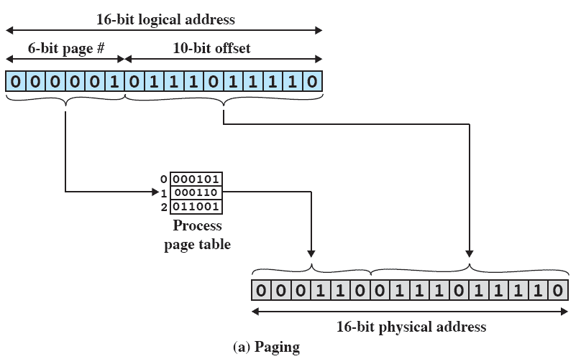
Paging
Logical to Physical Address Translation
Consider an address of n+m bits, where the leftmost n bits are the page no. and the rightmost m bits are the offset.
1. Extract the page no.
2. Use the page no. as an index into the process page table to find the frame number, k.
3. The physical address is constructed by appending the offset to k.

Slide 23
Segmentation
A program can be subdivided into variable-sized segments with a maximum length.
  A process is loaded by loading all of its segments that need not be contiguous.
Provided as a convenience for programmers to organize programs and data into different segments.
 No internal fragmentation
  Segments are allocated exactly as much memory as required.
 Suffers from external fragmentation
  Due to relocation, memory external to all segments becomes more and more fragmented, thus too small to fit any segment and become unusable.

Slide 24
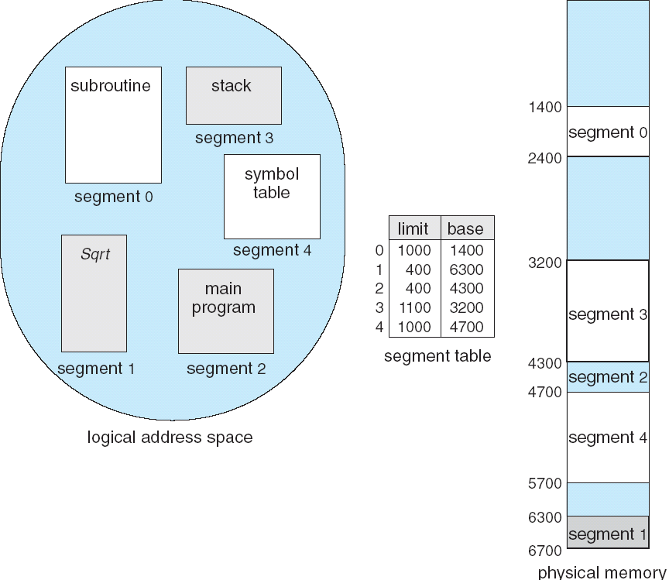
Segmentation
Memory reference in the program uses logical address, which consists of a segment number and an offset within the segment.
There is a segment table for each process.
Each segment table entry contains
  the starting (base) address in main memory of the corresponding segment.
  the length (limit) of the segment, to assure that invalid addresses are not used.

Slide 25
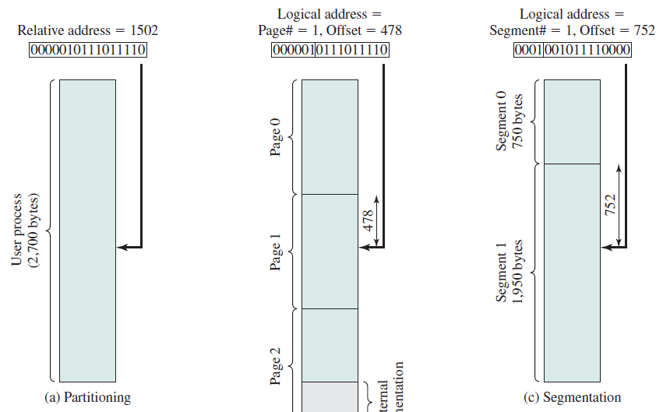
Segmentation
Logical Addresses
There is no simple relationship between a logical address (segment no. and offset) and the relative address.
Example
  16-bit address
  12-bit offset
  4-bit segment number
  maximum segment size= 2¹²=4096

Slide 26
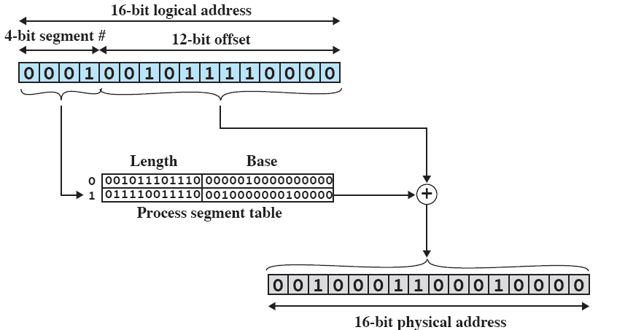
Segmentation
Logical to Physical Address Translation
Consider an address of n + m bits, where the leftmost n bits are the segment no. and the rightmost m bits are the offset.
3. If the offset ≥ the length of the segment, the address is invalid.
1.Extract the segment no.
4.The physical address is the sum of the starting physical address of the segment plus the offset.
2.Use the segment no. as an index into the process segment table to find the starting physical address of the segment.

Slide 27
Roadmap
Basic requirements of Memory Management
Basic blocks of memory management
  Paging
  Segmentation
Virtual Memory (VM) Basics
Hardware and Control Structures of VM
  Paging
  Segmentation
  Combined Paging and Segmentation
VM Management

Slide 28
Key Points in
Memory Management
1) Memory references are logical addresses that are dynamically translated into physical addresses at run time.
2) A process may be broken up into pieces (pages or segments) that do not need to be contiguously located in main memory during execution.
  If these two characteristics are present, it is not necessary that all of the pages or segments of a process be in main memory during execution.

Slide 29
Execution of a Process
OS brings into main memory a few pieces of the program.
  Resident set: portion of process that is in main memory
Execution proceeds smoothly as long as all memory references are to locations that are in the resident set.
When a needed address is not in main memory, an interrupt (memory access fault) is generated.
OS places the interrupted process in a Blocked state.
OS issues a disk I/O Read request.
Another process is dispatched to run while the disk I/O takes place.
Piece of the interrupted process that contains the logical address is brought into main memory.
Another interrupt is issued when disk I/O is complete, which causes OS to place the interrupted process in the Ready state.

Slide 30
Implications
More processes may be maintained in main memory.
  Only some of the pieces of any particular process are loaded, there is room for more processes.
  More efficient utilization of the processor because it is more likely that at least one of the many processes will be in a Ready state at any particular time.
A process may be larger than all of main memory.
  This restriction in programming is lifted.
  OS automatically loads pieces of a process into main memory as required.

Slide 31
Support Needed for
Virtual Memory
Hardware must support paging and segmentation for address translation and other basic functions.
OS must manage the movement of pages and/or segments between secondary memory and main memory.

Slide 32
Roadmap
Basic requirements of Memory Management
Basic blocks of memory management
  Paging
  Segmentation
Virtual Memory (VM) Basics
Hardware and Control Structures of VM
    Paging
    Segmentation
    Combined Paging and Segmentation
VM Management

Slide 33
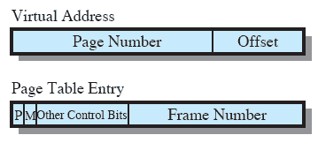
Paging in VM
Each process has its own page table.
Each page table entry (PTE) contains the frame number of the corresponding page in main memory.
Two extra bits are needed to indicate:
  P(resent): whether the page is in main memory or not
    If a desired page is not in main memory, a memory access fault, called a page fault, occurs
  M(odified): whether the contents of the page has been altered since it was last loaded
    It is not necessary to write an unmodified page out when it comes to time to replace the page

Slide 34
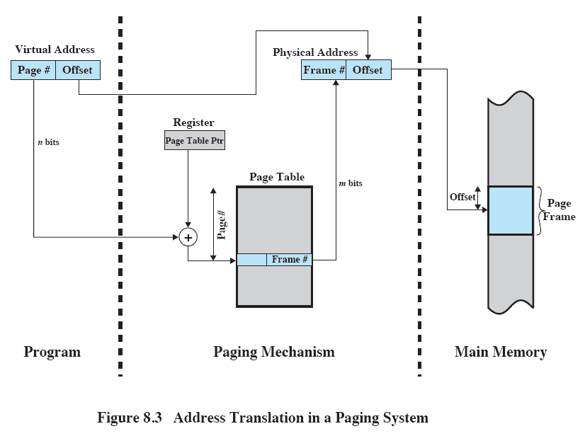
Address Translation
The frame # is combined with the offset to produce the real address
A register holds the starting address of the page table
The page # is used to index the page table and look up the frame #

Slide 35
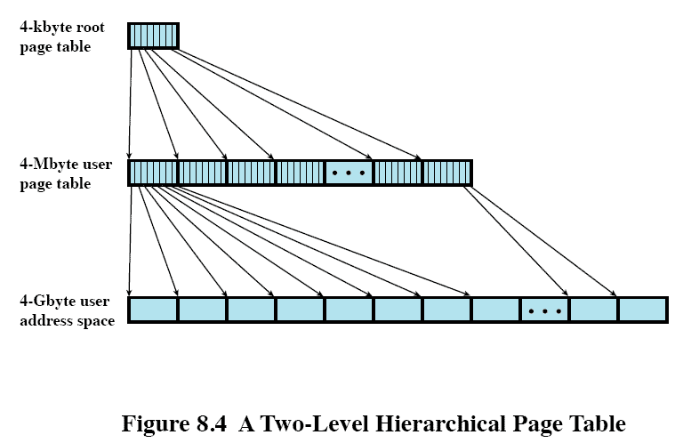
Page Tables
Page tables can be very large
  Consider a system that supports 4-Gbytes (2³²) virtual address space with 4-kbyte (2¹²) pages. The number of page table entries (PTEs) in a page table can be as many as 2²⁰
Composed of 2¹⁰ 4-byte PTEs in main memory
Composed of 2²⁰ 4-byte PTEs, occupying 2¹⁰ pages in virtual memory

Slide 36
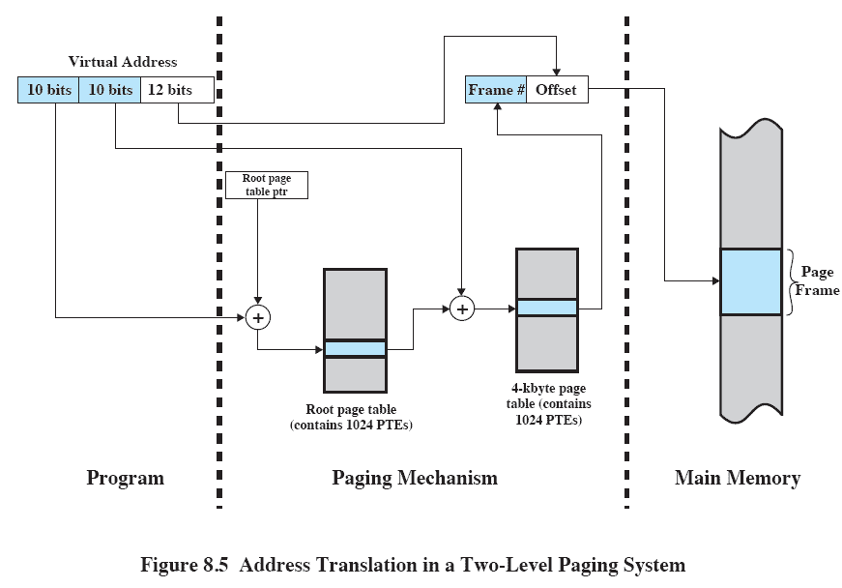
Address Translation for Hierarchical Page Table
The root page always remains in main memory
The next 10 bits index into user page to find the PTE of the referenced page
The first 10 bits index into root page to find a PTE for a page of user page table

Slide 37
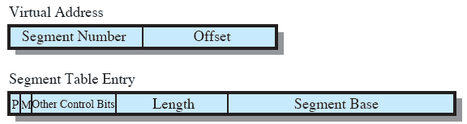
Segmentation in VM
Each process has its own segment table.
Each segment table entry contains
  Segment base: the starting address of the corresponding segment in main memory
  The length of the segment
  P-bit : determines if the segment is already in main memory
  M-bit: determines if the segment has been modified since it was loaded in main memory

Slide 38
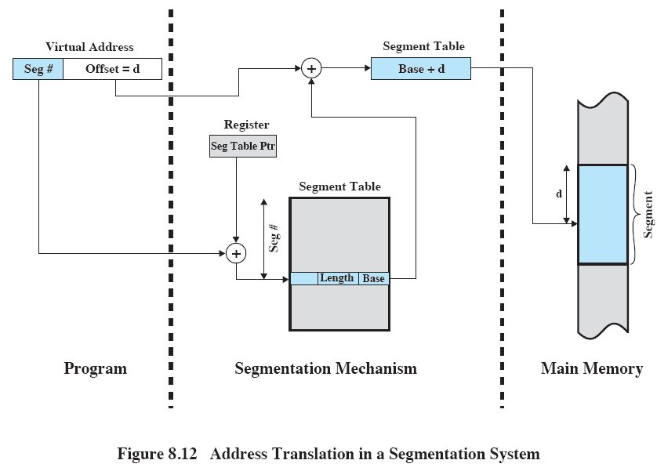
Address Translation in Segmentation
The segment base is added to the offset to produce the real address
A register holds the starting address of the segment table
The segment # is used to index into the segment table and look up the segment base

Slide 39
Combined Paging and Segmentation
A user’s address space is broken up into a number of segments and each segment is broken up into a number of fixed-size pages.
From the programmer’s point of view, a logical address still consists of a segment number and a segment offset.
  Segmentation is visible to the programmer.
From the system’s point of view, the segment offset is viewed as a page number and a page offset.
  Paging is transparent to the programmer.

Slide 40
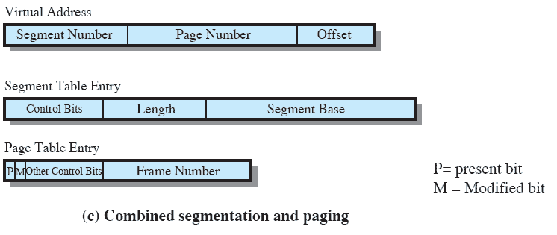
Combined Paging and Segmentation
The base now refers to a page table

Slide 41
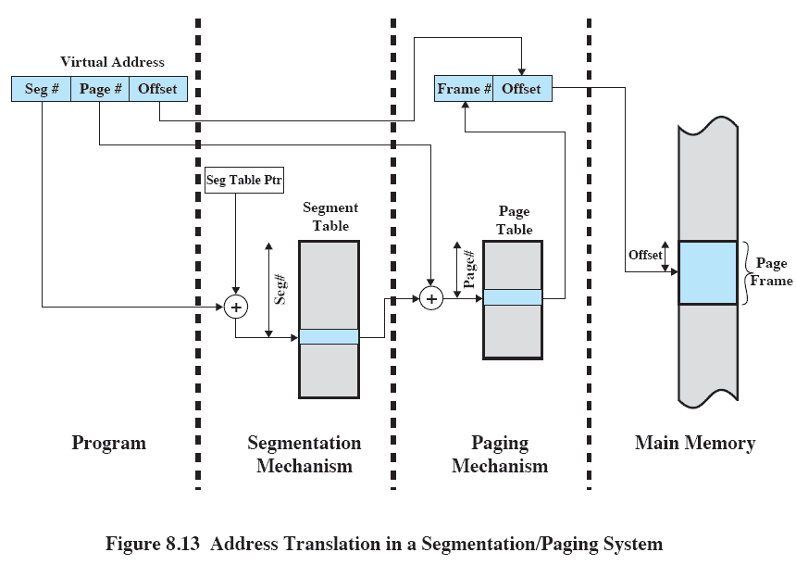
Address Translation
The frame # is combined with the offset to produce the real address
The page # is used to index the page table and look up the frame #
The segment # is used to index into the segment table to find the page table for that segment

Slide 42
Roadmap
Basic requirements of Memory Management
Basic blocks of memory management
  Paging
  Segmentation
Virtual Memory (VM) Basics
Hardware and Control Structures of VM
  Paging
  Segmentation
  Combined Paging and Segmentation
VM Management

Slide 43
OS Policies for VM
Fetch policy
Placement policy
Replacement policy
Resident set management
Cleaning policy
Load control
Key aim: to minimize
page faults

Slide 44
Fetch Policy
Determines when a page should be brought into memory.
Demand Paging
  only brings pages into main memory when a reference is made to a location on the page
  many page faults when process first started
  but, as more and more pages are brought in, due to the principle of locality, most future references will be to pages that have recently been brought in, and page faults should drop to a very low level
    Principle of locality: program and data references within a process tend to cluster, so, only a few pieces of a process will be needed over a short period of time
Prepaging
  pages other than the one demanded by a page fault are brought in
  if pages are stored contiguously on disk, it is more efficient to bring in a number of pages at one time

Slide 45
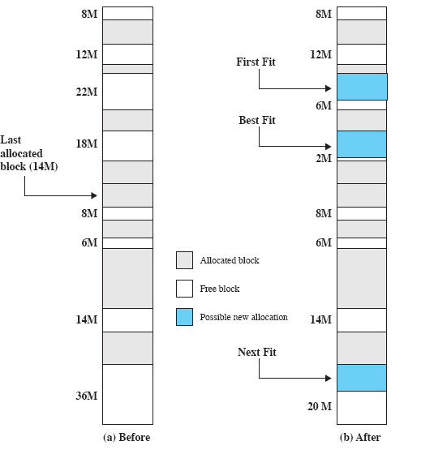
Placement Policy
Determines where in real memory a process piece is to reside.
Irrelevant for pure paging or combined paging with segmentation scheme.
Important in a segmentation system
  best-fit, first-fit, next fit

Slide 46
Replacement Policy
When all of the frames in main memory are occupied, the replacement policy determines which page in memory to be replaced when a new page must be brought in.
Objective: the page that is removed should be the page least likely to be referenced in the near future.
Tradeoff: the more sophisticated the replacement policy, the greater the overhead to implement it.

Slide 47
Replacement Restriction:
Frame Locking
  Some of the frames in main memory may be locked. When a frame is locked, the page currently stored in that frame may not be replaced.
  Kernel of the OS
  Key control structures
  I/O buffers
Locking is achieved by associating a lock bit with each frame.

Slide 48
Replacement Algorithms
Algorithms used for the selection of a page to replace:
  Optimal
  First-in-first-out (FIFO)
  Least recently used (LRU)
  Clock
Consider the following page address stream formed by executing a program with three frames allocated.
  2 3 2 1 5 2 4 5 3 2 5 2
  Which means that the first page referenced is 2, the second page referenced is 3, and so on.

Slide 49
Replacement Policy
Optimal
Selects the page for which the time to the next reference (i.e., the future reference) is the longest.
Results in the fewest number of page faults but it is impossible to have perfect knowledge of future events.
Serves as a standard to judge real-world practical algorithms.

Slide 50
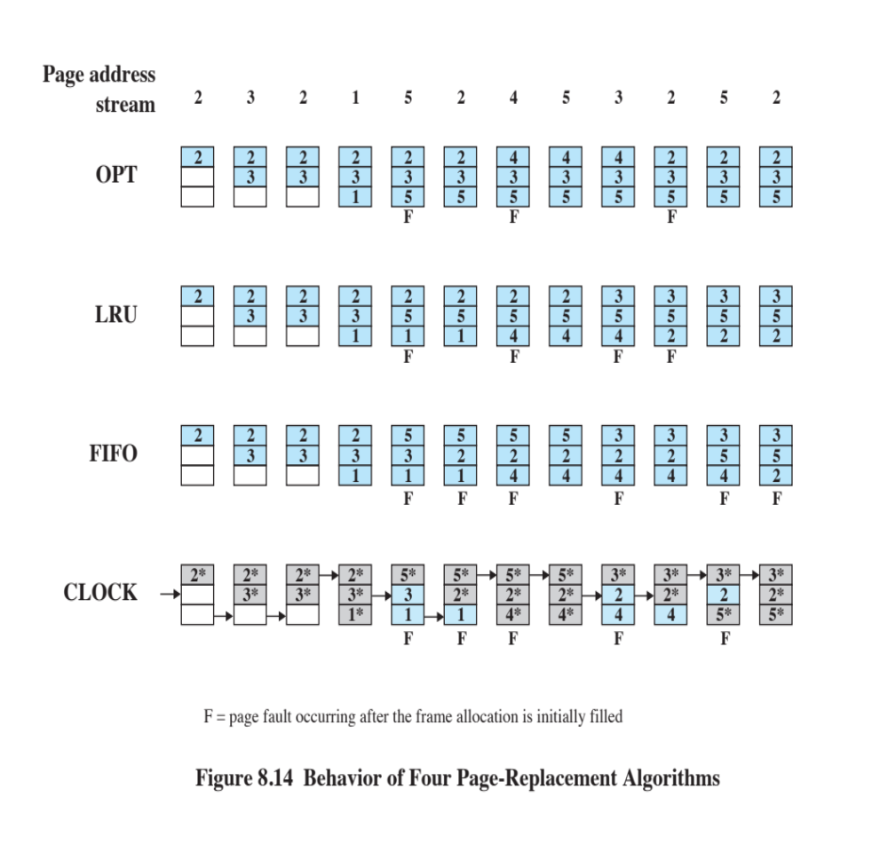
Optimal Replacement
Example
The optimal policy produces 3 page faults after the frame allocation has been filled

Slide 51
Replacement Policy
FIFO
FIFO (First In First Out) policy treats page frames allocated to a process as a circular buffer.
Pages are removed in round-robin style.
  Simplest replacement policy to implement (only requires a pointer circle through the page frames)
Page that has been in memory the longest is replaced.
  But, these pages may be needed again very soon if it hasn’t truly fallen out of use.

Slide 52
FIFO Replacement Example
The FIFO policy results in 6 page faults.
  Note that FIFO does not recognize that pages 2 and 5 are referenced more frequently than other pages.

Slide 53
Replacement Policy
Least Recently Used
LRU (Least Recently Used) policy replaces the page that has not been referenced for the longest time.
By the principle of locality, this should be the page least likely to be referenced in the near future.
Difficult to implement
  One approach is to tag each page with the time of last reference.
  This requires a great deal of overhead.

Slide 54
LRU Replacment Example
The LRU policy does nearly as well as the optimal policy.
  In this example, there are 4 page faults.

Slide 55
Replacement Policy
Clock
Clock replacement policy associates an additional bit called a use bit with each memory frame.
Similar to FIFO, except any frame with a use bit of 1 is passed over.
The set of frames is considered to be a circular buffer with a pointer set to the next frame after the page just replaced.
  When a page is first loaded in memory or referenced, the use bit is set to 1.
  When it is time to replace a page, OS scans the set of frames,
    any frame with a use bit of 1 is passed over and resetting the bit to 0
    the first frame encountered with the use bit already being 0 is replaced

Slide 56
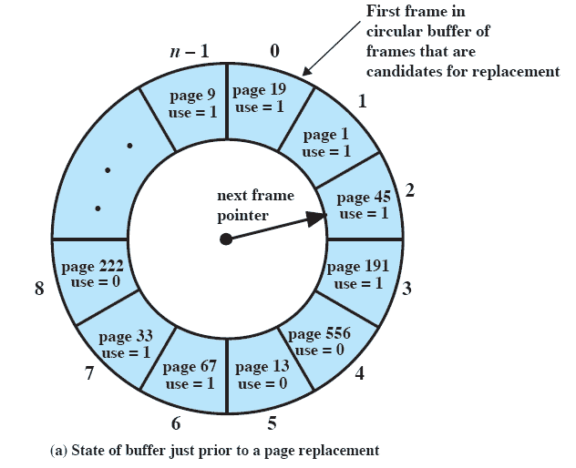
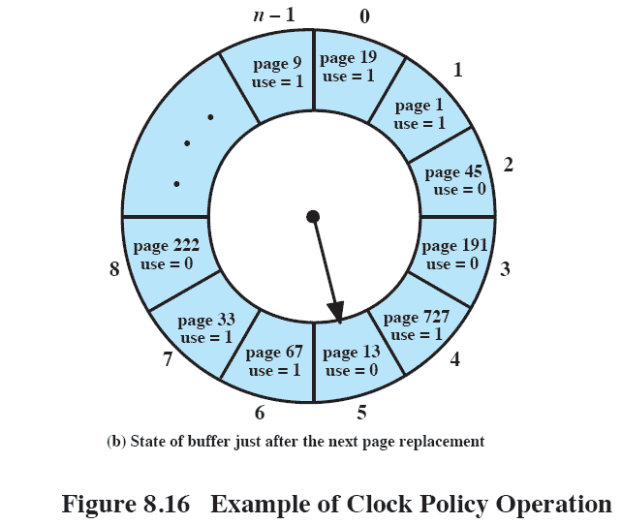
Clock Replacment Example
incoming page 727
Notes:
56

Slide 57
Clock Replacement Example
An asterisk indicates that the corresponding use bit is equal to 1.
The arrow indicates the current position of the pointer.
Note that the clock policy is good at protecting frame 2 from replacement.

Slide 58
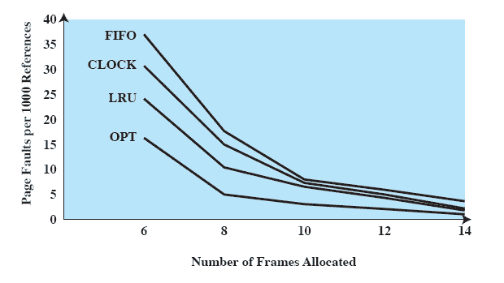
Comparison
Two conflicting constraints:
1. We would like to have a small page fault rate in order to run efficiently
2. We would like to keep a
small frame allocation

Slide 59
Cleaning Policy
A cleaning policy determines when a modified page should be written out to secondary memory.
Two approaches
  Demand cleaning
  Precleaning

Slide 60
Cleaning Policy
Demand cleaning
  A page is written out to secondary memory only when it has been selected for replacement.
   Minimizes page writes.
   A process that suffers a page fault may have to wait for two page transfers before it can be unblocked.
Precleaning
  Modified pages are written out before their frames are needed.
   Pages can be written out in batches.
   Pages written out may have been modified again before they are replaced → waste of I/O operations with unnecessary cleaning operations.

Slide 61
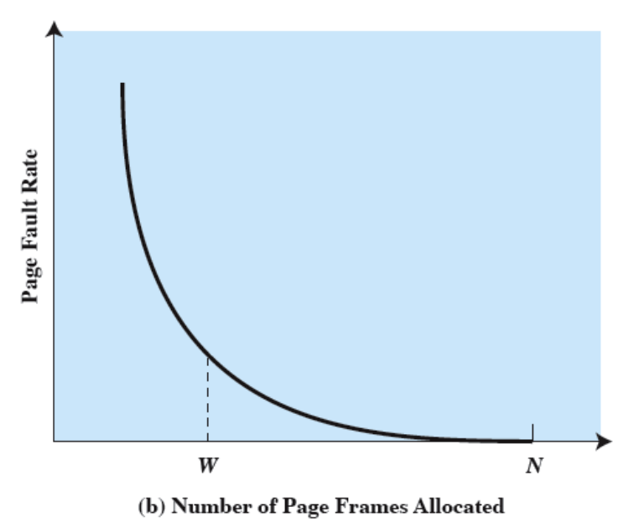
Resident Set
Management
The OS must decide how many pages to bring into main memory (how much main memory to allocate to a particular process).
  The smaller the amount of memory allocated to each process, the more processes that can reside in memory.
  Small number of pages loaded increases page faults.
  Beyond a certain number, further allocations of pages will have no noticeable effect on the page fault rate for that process because of the principle of locality.

Slide 62
Resident Set
Management
Fixed-allocation
  Gives a process a fixed number of frames in main memory.
  When a page fault occurs, one of the pages of that process must be replaced.
Variable-allocation
  Number of frames allocated to a process varies over the lifetime of the process.
  Give additional frames to process that is suffering persistently high levels of page faults.
  Reduce allocation to a process with an exceptionally low page fault rate.

Slide 63
Resident Set
Management
Replacement scope
  The scope of a replacement strategy can be categorized as global or local.
  Both types are activated by a page fault when there are no free page frames.
Local replacement policy
  Chooses only among the resident pages of the process that generated the page fault.
Global replacement policy
  Considers all unlocked pages in main memory.

Slide 64
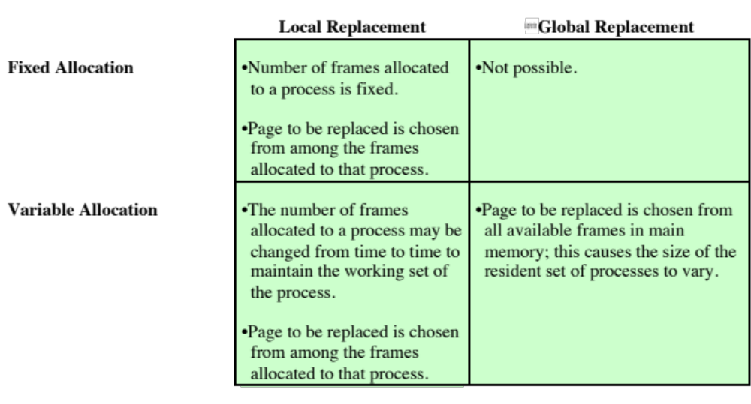
Resident Set
Management

Slide 65
Load Control
Determines the number of processes that will be resident in main memory.
  Multiprogramming level
Too few processes: many occasions when all processes will be blocked.
Too many processes: inadequate resident set leads to frequent faulting and results in thrashing.
      thrashing: a state in which the system spends most of its time swapping process pieces rather than executing instructions

Slide 66
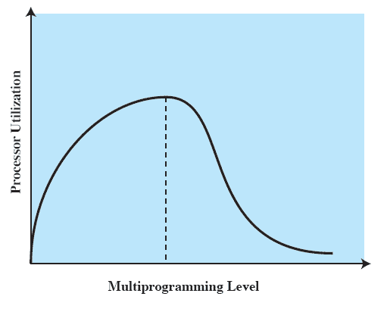
Load Control
The average resident set is inadequate and the number of page faults rises dramatically (thrashing)
There is less chance that all resident processes are blocked

Slide 67
Load Control
One way to approach the problem: monitor the rate at which the pointer scans the circular buffer of frames in the clock page replacement algorithm, using a global scope.
If the rate is below a given lower threshold, increase the multiprogramming level.
  few page faults are occurring
  there are many resident pages not being referenced and are readily replaceable
If the rate exceeds an upper threshold, the multiprogramming level is too high.

