Slide 1
EE3211 Project Assignment
2020-02-23
Clement

Slide 2
EE3211 Project Assignment
Continuous Assessment (60%)
  In-class Exercise / Project (20%)
    Skill test (5%)
    Project (15%)
  Test (20%)
  Assignments (20%)
Examination (40%)
Data source: NHANES publicly available datasets
Choose one out of three available projects to work on
Write a report which includes:
  Background and objective (3%)
  Methods (conduct statistical analyses with at least two methods taught) (5%)
  Results (3%)
  Conclusion (4%)
  *within five A4 pages
  (Deadline: End of Week 13, i.e. April 23rd 2021)

Slide 3
EE3211 Project Assignment
Question files: Canvas-Assignments-Project Assignment
(Deadline: 11:59pm, April 23rd)
Submit file: Zip / rar file (don’t use .7z file)within:
R code file (Topic_1/2/3_Name_SID.R)
Assignment Report (Topic_1/2/3_Name_SID.PDF)
Choose 1 out of 3 topics. There are 3-4 questions under each topic, of which the optional problem is difficult(not mandatory).

Slide 4
EE3211 Project Assignment
Data source: NHANES publicly available datasets (2017-2018)
Topic 2:
Datasets: Blood Pressure, Body Measures, Demographic Variables and Sample Weights (2017-2018).
Raw data & Data dictionary:
https://wwwn.cdc.gov/nchs/nhanes/Search/DataPage.aspx?Component=Questionnaire&CycleBeginYear=2017 (Questionnaire Datasets)
https://wwwn.cdc.gov/nchs/nhanes/Search/DataPage.aspx?Component=Demographics&CycleBeginYear=2017 (Demographic Data)
https://wwwn.cdc.gov/nchs/nhanes/Search/DataPage.aspx?Component=Examination&CycleBeginYear=2017 (Examination Data)

Slide 5

EE3211 Project Assignment
Data source: NHANES publicly available datasets (2017-2018)
Data Dictionary
(read before use)
Raw Data
(need download)

Slide 6
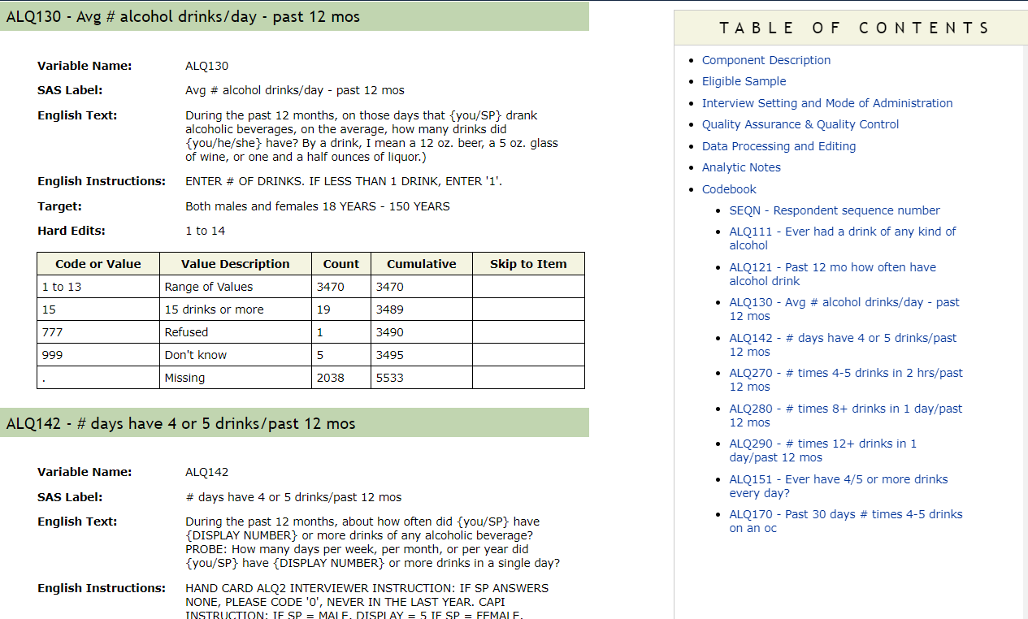
EE3211 Project Assignment
Data source: NHANES publicly available datasets (2017-2018)
Data Catalogue
Data Notes

Slide 7
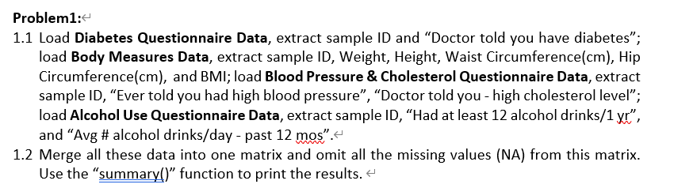

EE3211 Project Assignment
– Load Data
Topic 1:
Data File
Useful Columns
Data File: xxx.XPT
Data <-read.xport(‘Data_file_name.XPT’)

Slide 8
EE3211 Project Assignment
– Choose Useful Features, delete missing values
Topic 1:
Data_use <- select(Data, feature_1, feature_2, …)
table(is.na(Data)) # find: if has missing data or not
Data_omit = na.omit(Data) # delete “NA”

Slide 9
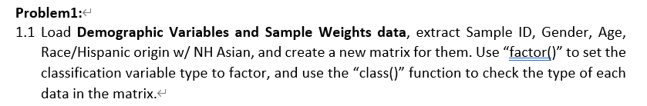
EE3211 Project Assignment
– Data type
Topic 2:
Numerical Data vs. Factor Data
0,1,2,3.5,7.90,10.222,…
M/F, Class 1/ Class2
Data$feature <- factor(Data$feature) # change data into factor

Slide 10

EE3211 Project Assignment
– Data merge
Topic 2:
By = shared feature (e.g., ID,name,…)
Data_merged <- merge(Data1,Data2) # merge data

Slide 11
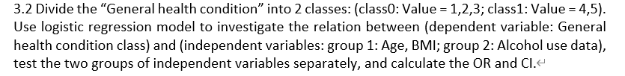
EE3211 Project Assignment
– Loop (for + if / else if)
Topic 3:
for (i in 1:nrow(Data)){ # loop row
for (j in column_p:column_q){ #loop columns
if (conditions){ # judging condition_1
do sth
}
else if (other conditions){ # judging condition_2
do sth
}
}
}

Slide 12
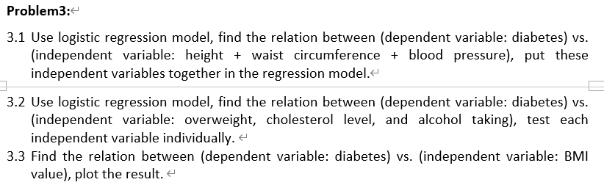
EE3211 Project Assignment
– Regression Models
Topic 1:
X
Y
Linear regression vs. Logistic regression
Numerical
Factor

Slide 13
EE3211 Project Assignment
– Regression Models
X
Linear regression
result<- lm (Y ~ feature_1 + feature_2+…, data = Data)
#linear regression
summary (result)
# show summary (p-value, coefficients etc.)
Logistic regression
result <- glm(Y ~ feature_1 + feature_2+…, data = Data, family = binomial())
summary (result)

Slide 14
EE3211 Project Assignment
– Plots
Topic 1:
ggplot(data = Data, aes(x= LabelName_X, y= LabekName_Y))+Plot_Type+labs(title=“Plot_Title")
x,y label
Histgram/box/…
Main title

Slide 15
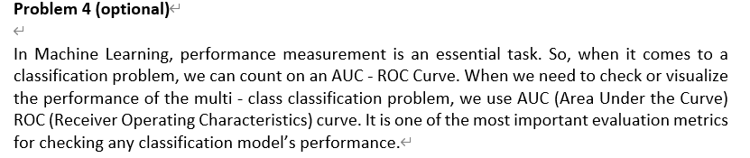
EE3211 Project Assignment
–ROC-AUC curve
Topic 3:

Slide 16
EE3211 Project Assignment
–ROC-AUC curve
Prediction table (Confusion Matrix)
 | Predicted Class
Actual Class |  | Class=Yes | Class=No
 | Class=Yes | a | b
 | Class=No | c | d
a: TP (true positive)
b: FN (false negative)
c: FP (false positive)
d: TN (true negative)

Slide 17
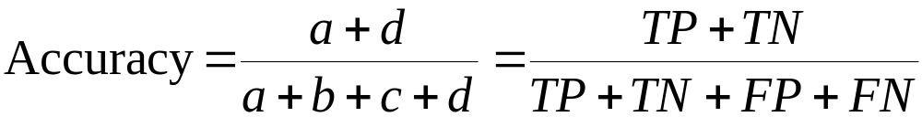
EE3211 Project Assignment
–ROC-AUC curve
Prediction table (Confusion Matrix)
 | Predicted Class
Actual Class |  | Class=Yes | Class=No
 | Class=Yes | a (TP) | b (FN)
 | Class=No | c (FP) | d (TN)

Slide 18
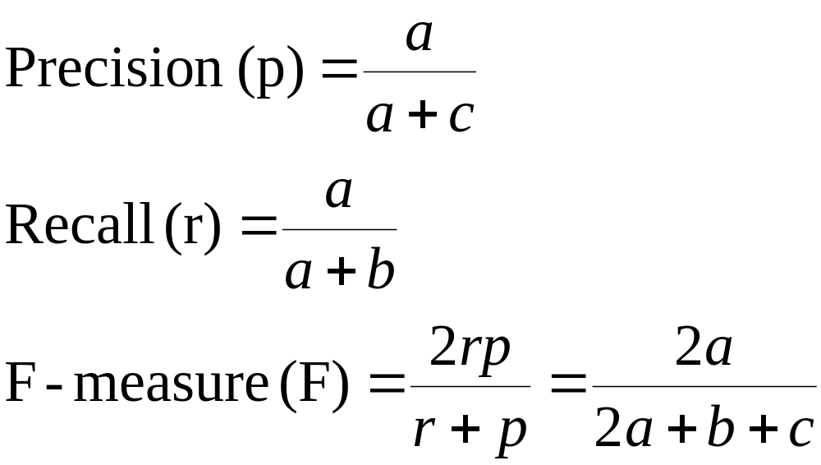
EE3211 Project Assignment
–ROC-AUC curve
Prediction table (Confusion Matrix)
 | Predicted Class
Actual Class |  | Class=Yes | Class=No
 | Class=Yes | a | b
 | Class=No | c | d

Slide 19
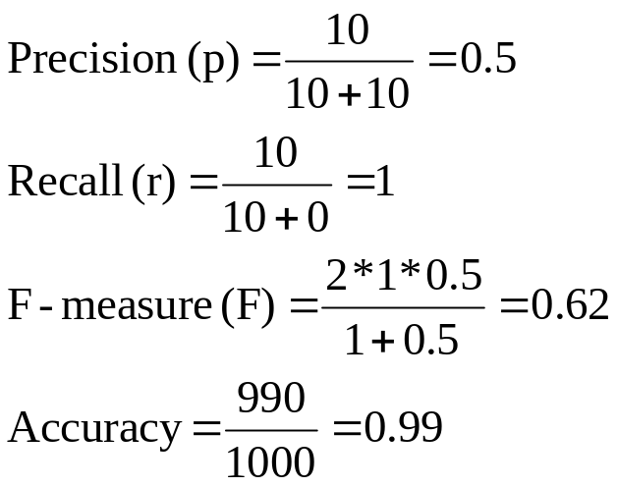
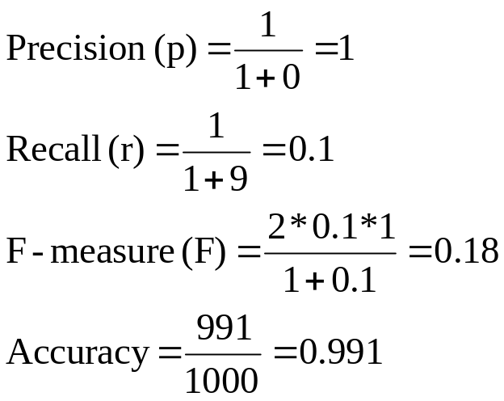
EE3211 Project Assignment
–ROC-AUC curve
 | Predicted Class
Actual Class |  | Class=Yes | Class=No
 | Class=Yes | 10 | 0
 | Class=No | 10 | 980
 | Predicted Class
Actual Class |  | Class=Yes | Class=No
 | Class=Yes | 1 | 9
 | Class=No | 0 | 990

Slide 20
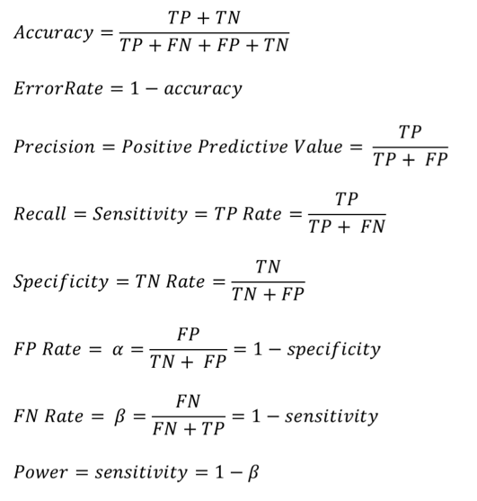
EE3211 Project Assignment
–ROC-AUC curve
 | Predicted Class
Actual Class |  | Yes | No
 | Yes | TP | FN
 | No | FP | TN
α is the probability that we reject the null hypothesis when it is true. This is a Type I error or a false positive (FP).
β is the probability that we accept the null hypothesis when it is false. This is a Type II error or a false negative (FN).

Slide 21
EE3211 Project Assignment
–ROC-AUC curve
ROC (Receiver Operating Characteristic)
A graphical approach for displaying trade-off between detection rate and false alarm rate
Developed in 1950s for signal detection theory to analyze noisy signals
ROC curve plots TPR against FPR
Performance of a model represented as a point in ROC curve
(Changing the threshold parameter of classifier changes the location of the point)

Slide 22
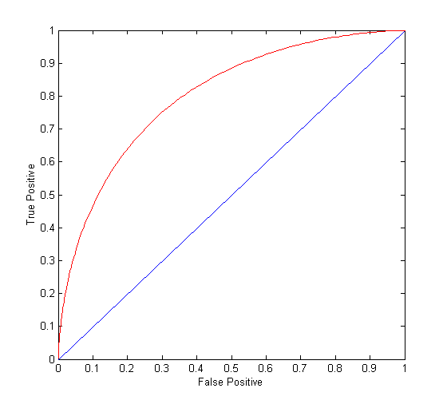
EE3211 Project Assignment
–ROC-AUC curve
(TPR,FPR):
(0,0): declare everything
to be negative class
(1,1): declare everything
to be positive class
(1,0): ideal
Diagonal line:
  Random guessing
  Below diagonal line:
    prediction is opposite
    of the true class

Slide 23
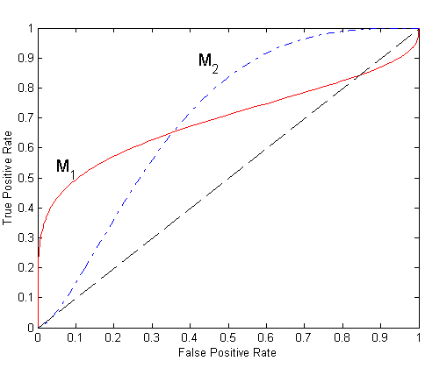
EE3211 Project Assignment
–ROC-AUC curve
No model consistently outperform the other
  M₁ is better for small FPR
  M₂ is better for large FPR
Area Under the ROC curve
  Ideal:
    Area = 1
  Random guess:
    Area = 0.5

Slide 24
EE3211 Project Assignment
–ROC-AUC curve
Package require “pROC”
additional arguments affecting the predictions produced.
Step1: Test: <- glm() # logistic regression
Step2: pre <- predict(Test, others, type = "response") # prediction
Step3: pred<-ifelse(pre>=0.5,group2,group1) # divide T/F
Step4: table (real,pred) # Confusion Matrix
Step5: roc(real,pre) #calculate ROC
Step6: 1-specificities (x) and sensitivities (y)
Step7: ggplot() # plot figure

