Slide 1
EE3121 Diff Equations for EE
Prof. CHUN, Young Jin
Week 6. Higher Order Differential Equation

Slide 2
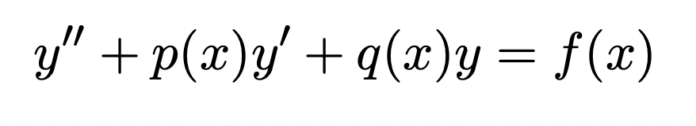
Solving Ordinary, Second-order, linear DE
Constant-coefficient, homogeneous DE
  Use characteristic equation
Constant-coefficient, inhomogeneous DE
  Undetermined Coefficients
  Variation of Parameters
Variable-coefficient, homogeneous DE
  Special Case: Euler-Cauchy DE
Variable-coefficient, inhomogeneous DE
  Variation of Parameters
  Series Solution

Slide 3
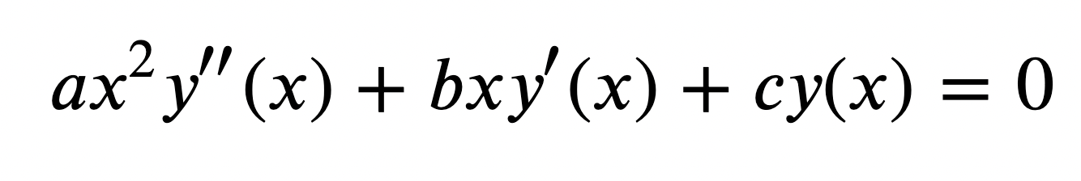
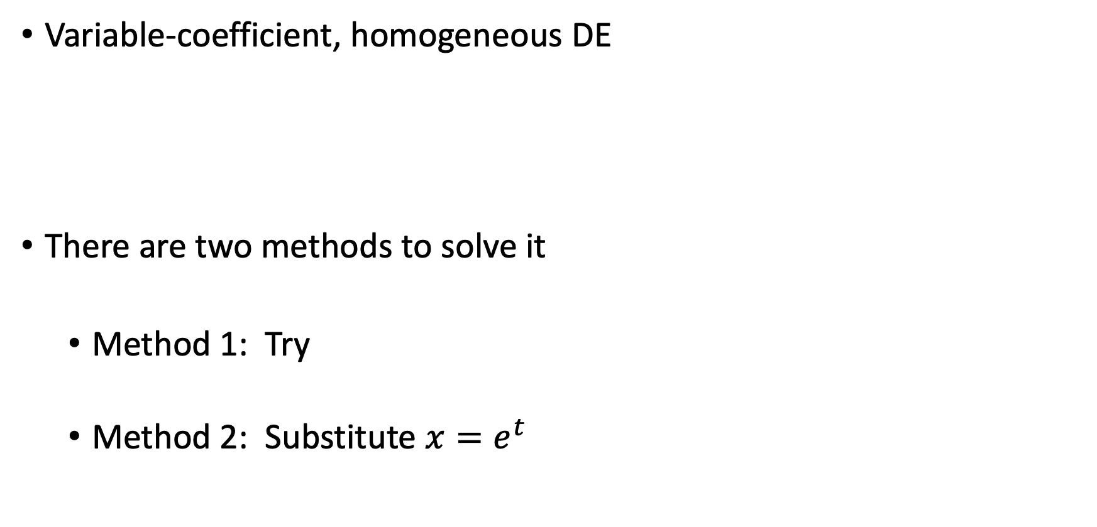
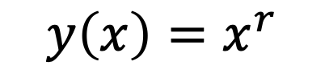
Euler-Cauchy DE (PP230 in the text)
Variable-coefficient, homogeneous DE
There are two methods to solve it
  Method 1: Try
  Method 2: Substitute $x=e^{t}$
$$y\left(x\right)=x^{r}$$

Slide 4
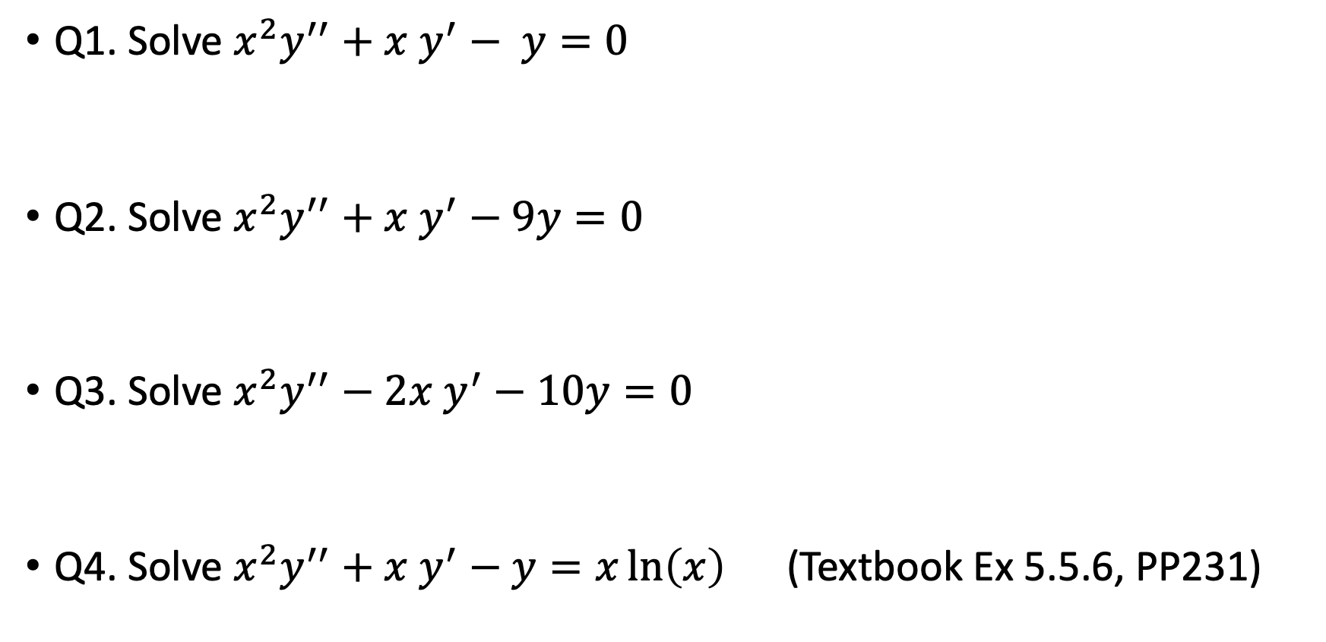
Examples
Q1. Solve $x^{2}y^{′′}+x y^{′}− y=0$
Q2. Solve $x^{2}y^{′′}+x y^{′}−9y=0$
Q3. Solve $x^{2}y^{′′}−2x y^{′}−10y=0$
Q4. Solve $x^{2}y^{′′}+x y^{′}−y=x\ln\left(x\right)$ (Textbook Ex 5.5.6, PP231)

