Slide 1
EE3122: Analogue Circuit Fundamentals
Frequency Response
Department of Electrical Engineering
City University of Hong Kong
Prof. Arindam BASU

Slide 2

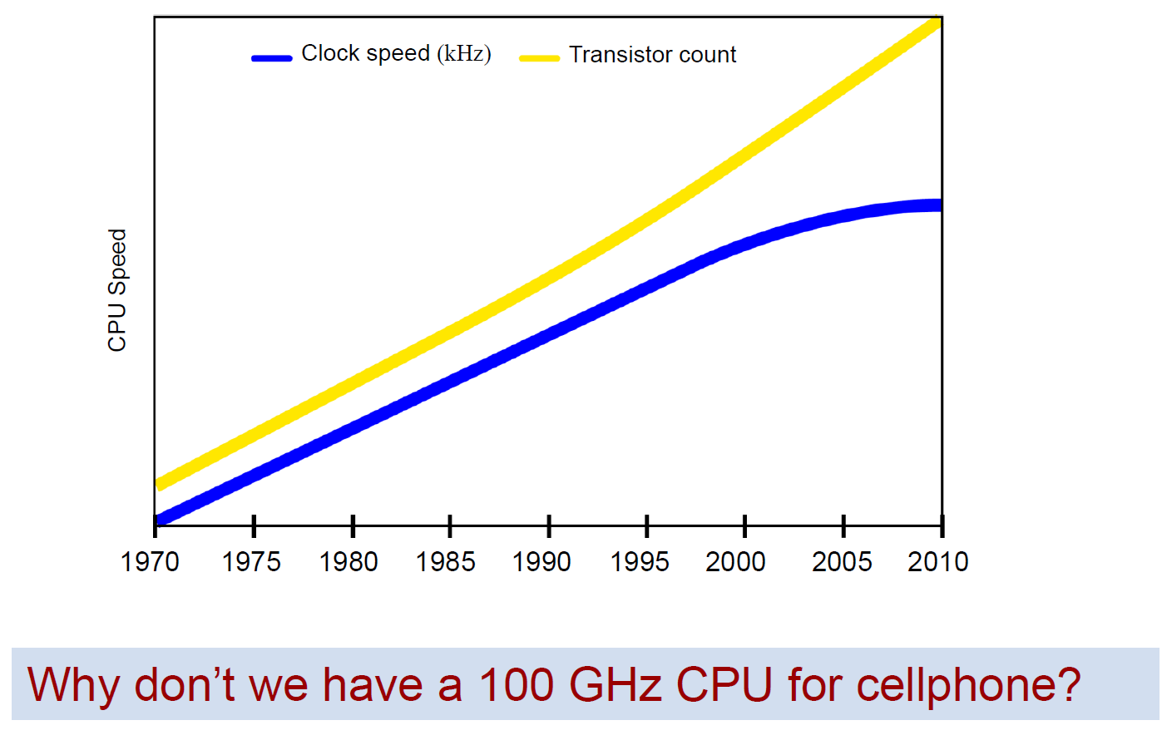
Introduction
Real life signals have different frequencies
For electronic circuits, what is the limitation for signal frequency?

Slide 3
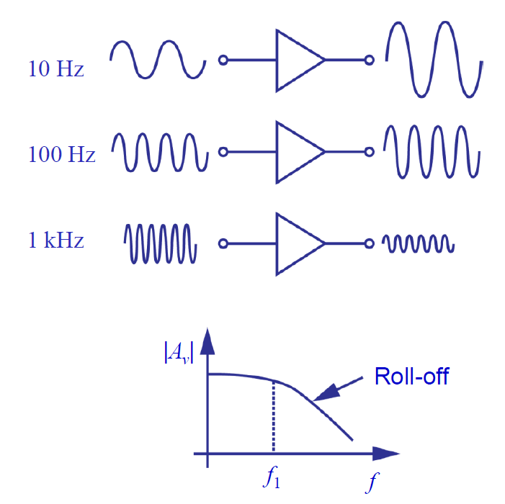
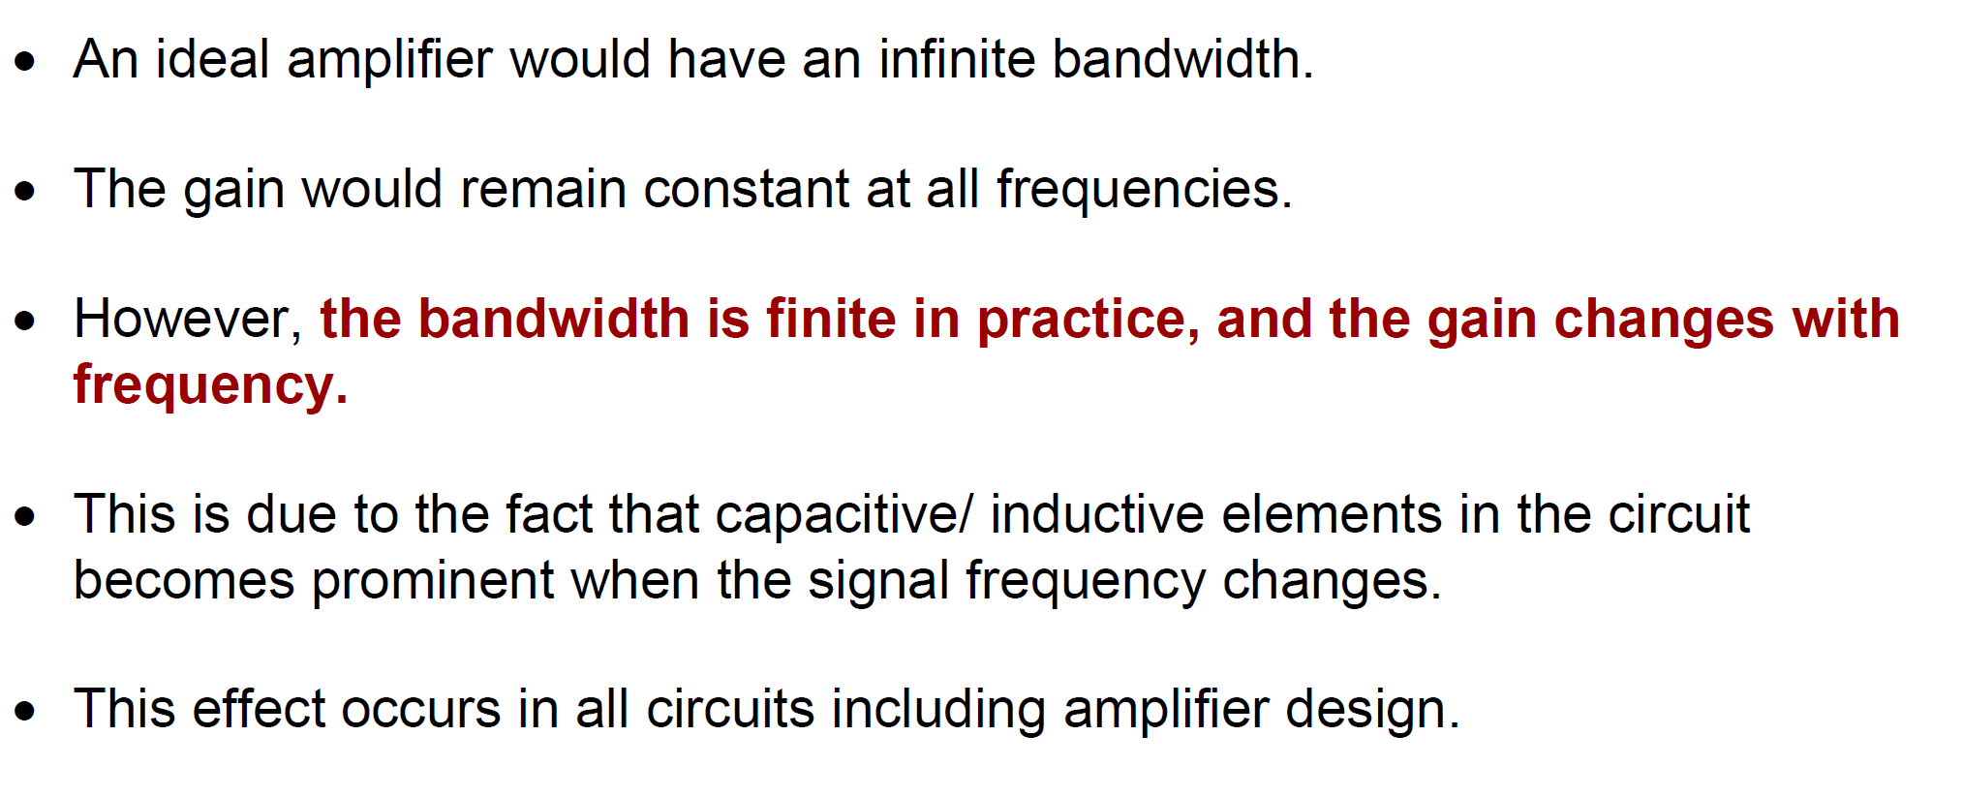
Motivation: Why study frequency response
Gain of amplifier reduces at high frequency! –WHY?
(Gain is a graph –not 1 number!)

Slide 4
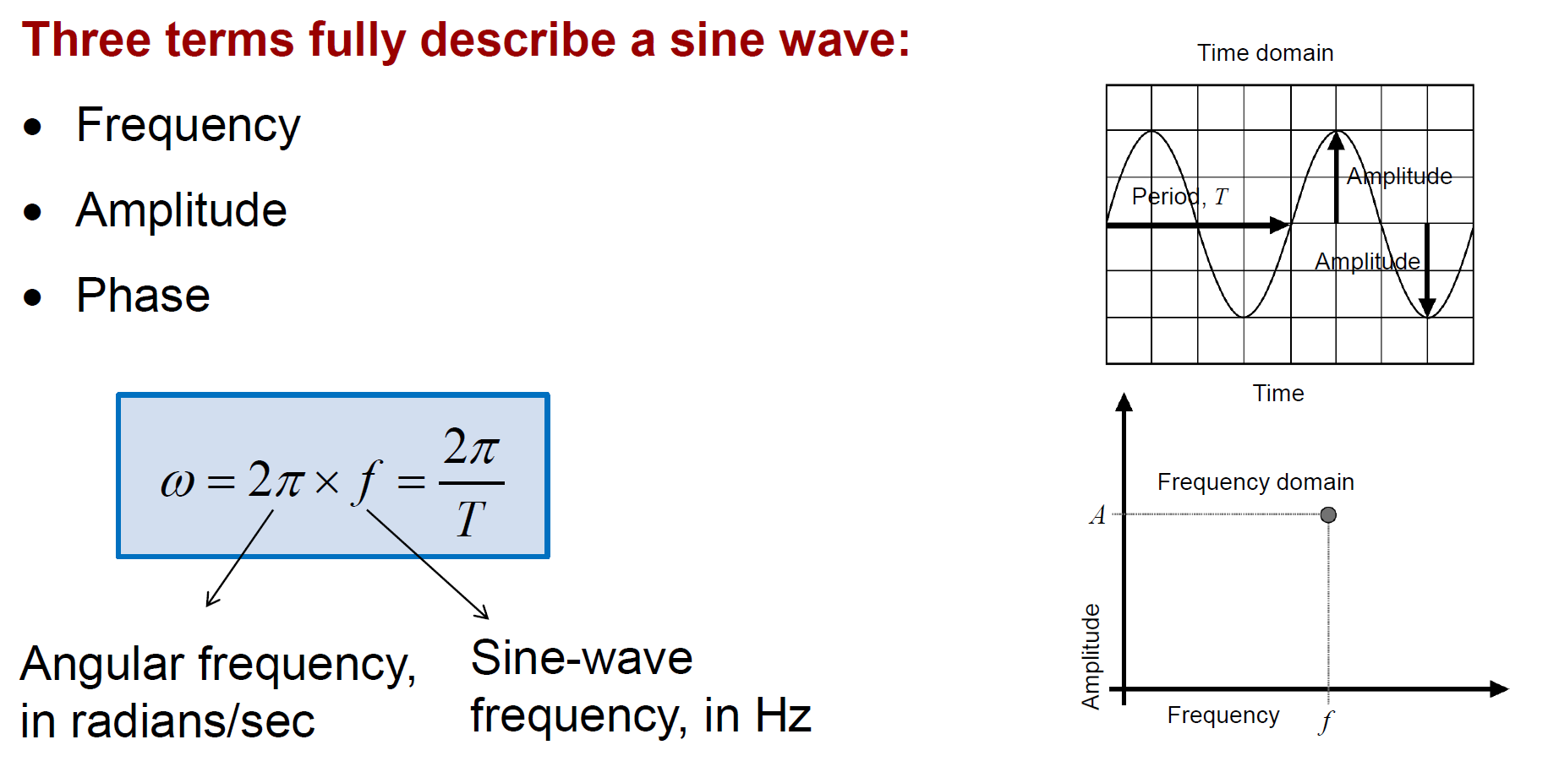
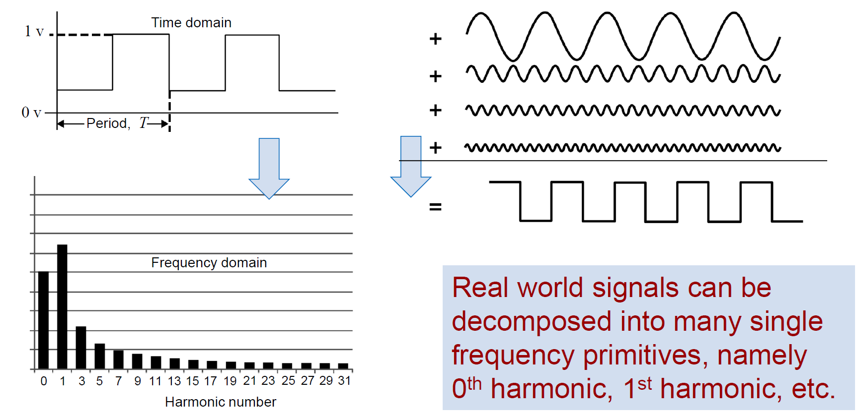
Recap
Periodic signals described in terms of sinusoids by Fourier series
Non-periodic signals analyzed in frequency domain by Fourier Transform

Slide 5
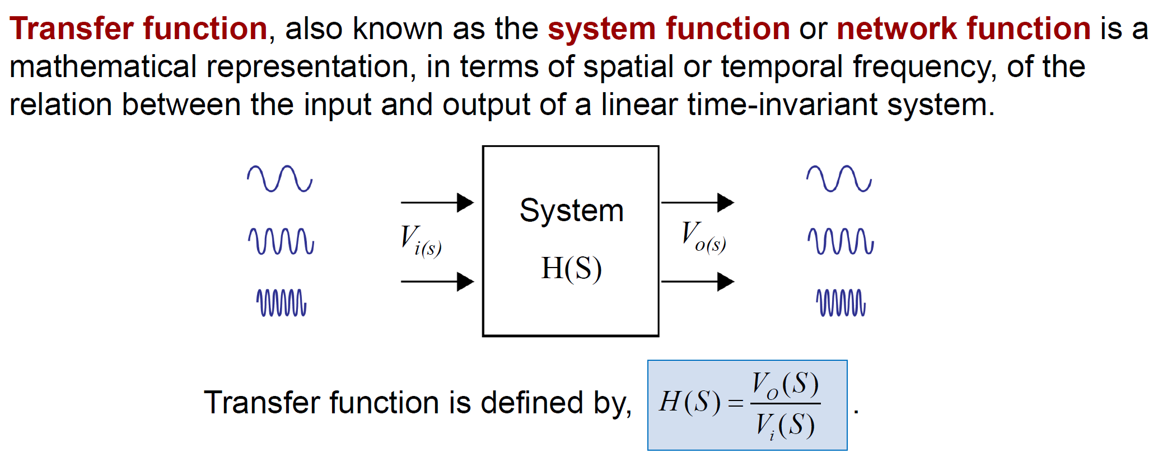
Recap: Transfer Function
(Laplace transform being used to capture frequency dependence)

Slide 6
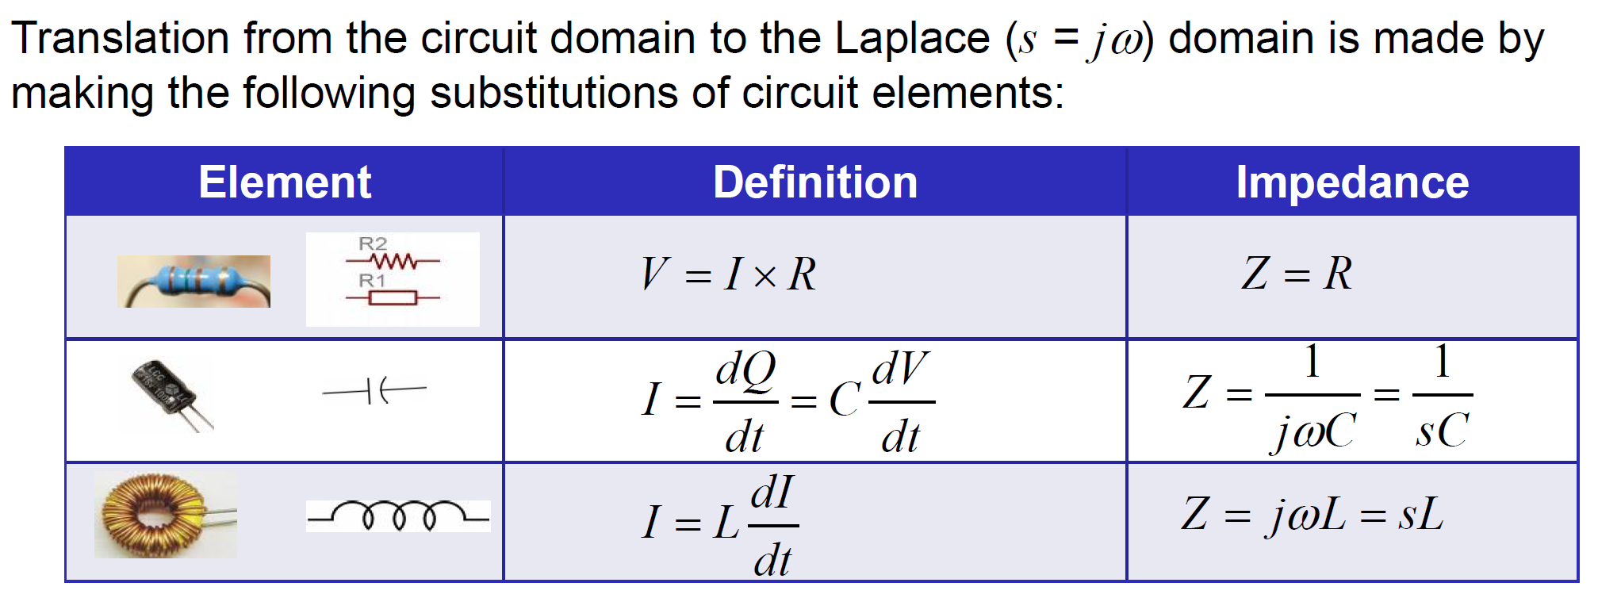
Impedances & frequency dependence

Slide 7
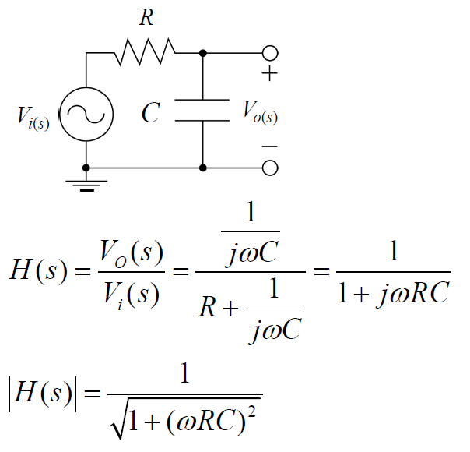
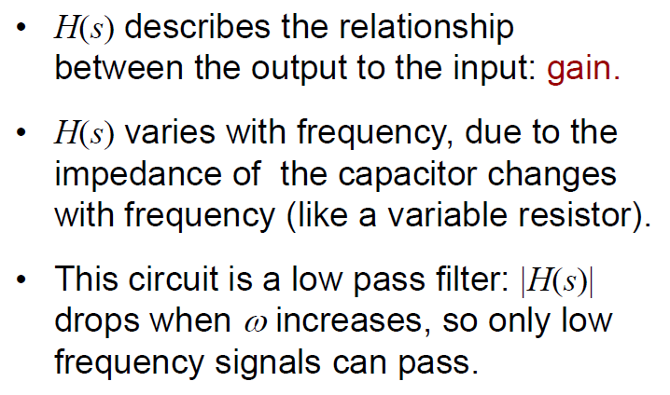
Example of RC circuit
To get intuition, always try to find the gain for small and large w

Slide 8
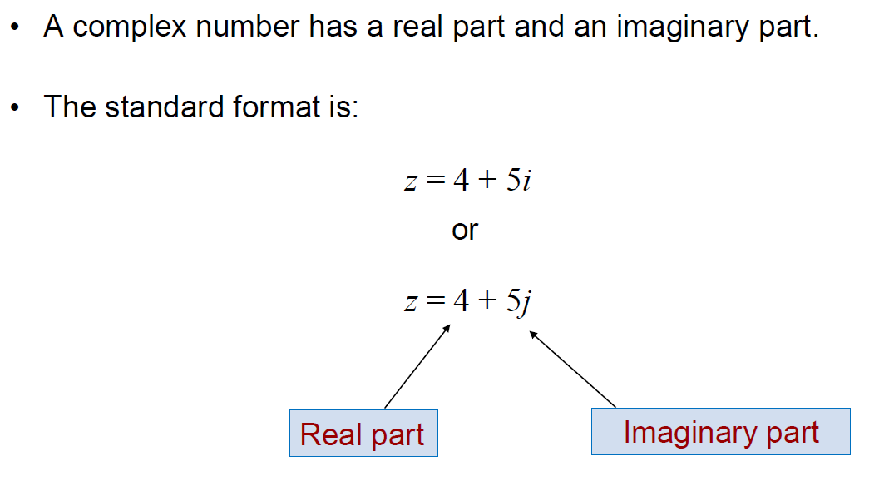
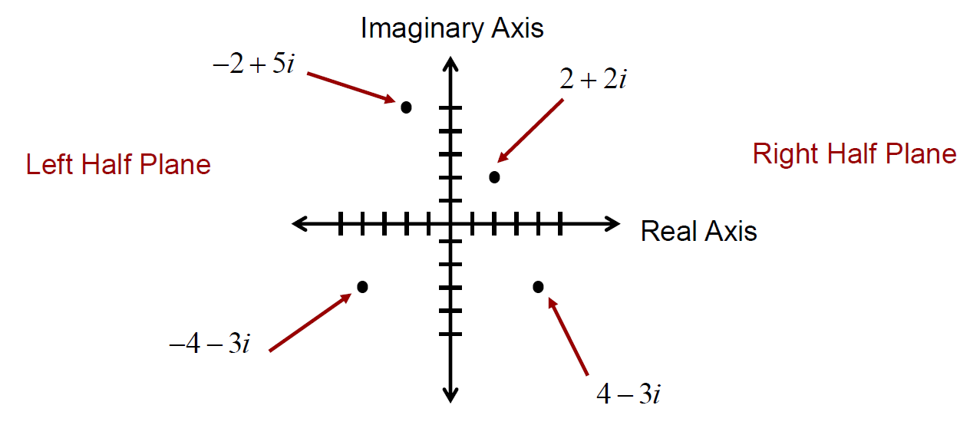
Recap: Complex Numbers

Slide 9
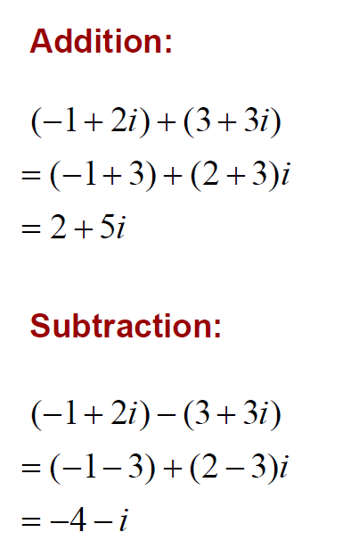
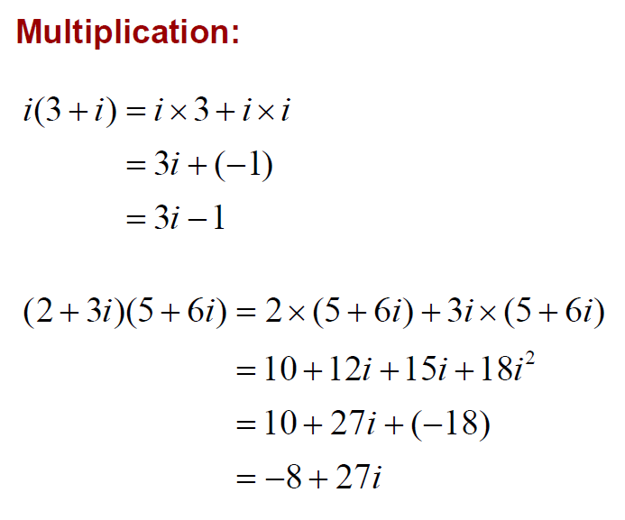
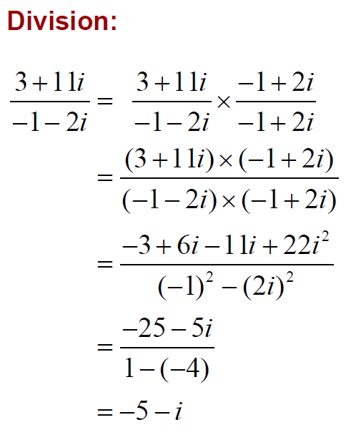
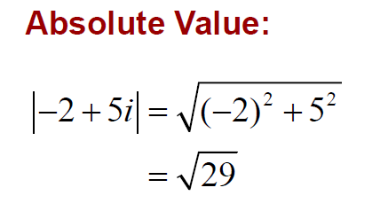
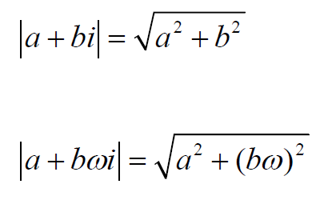
Complex Numbers Arithmetic

Slide 10
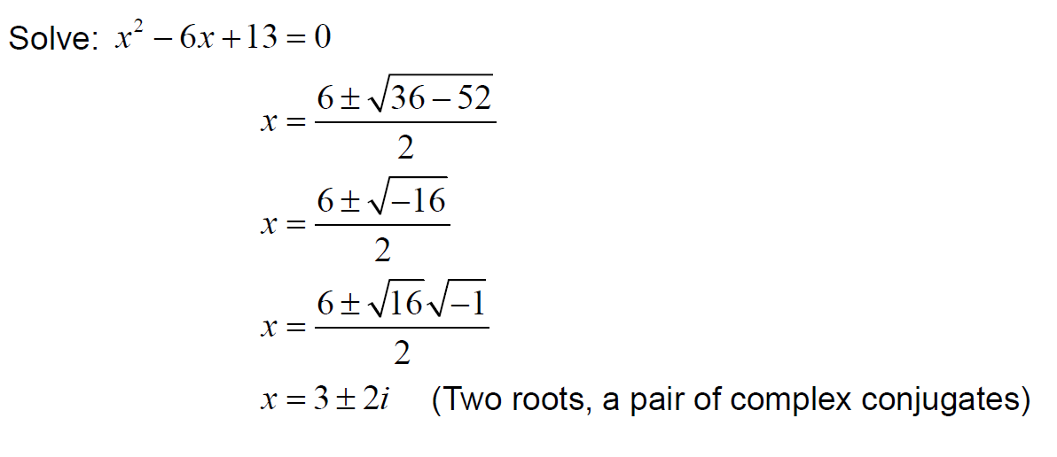
Complex Numbers: Roots of polynomials

Slide 11
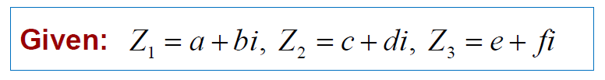
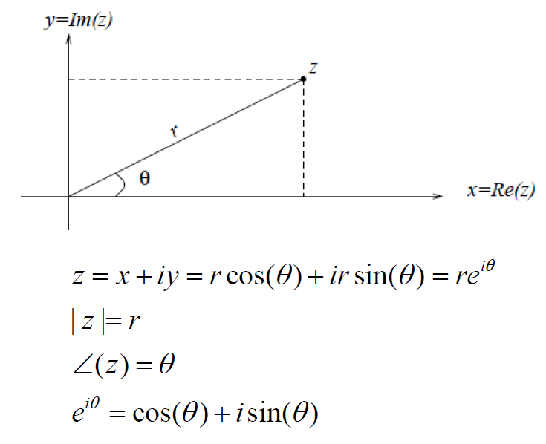
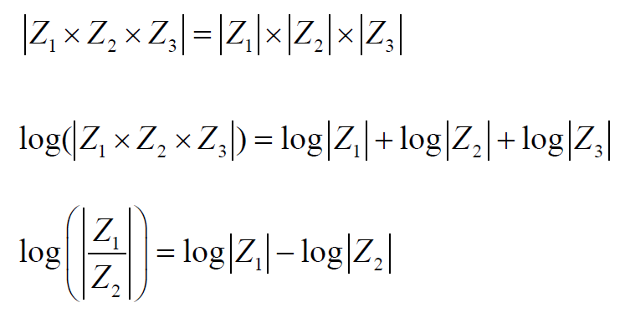
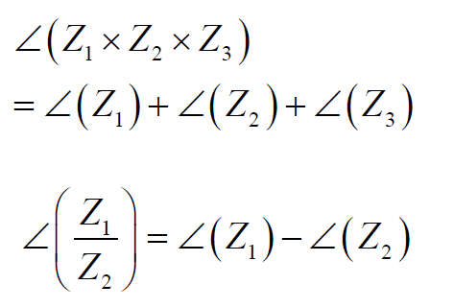
Complex Numbers: Polar Form

Slide 12
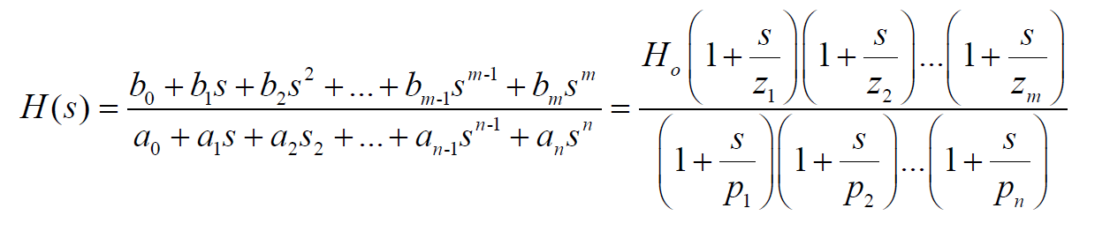
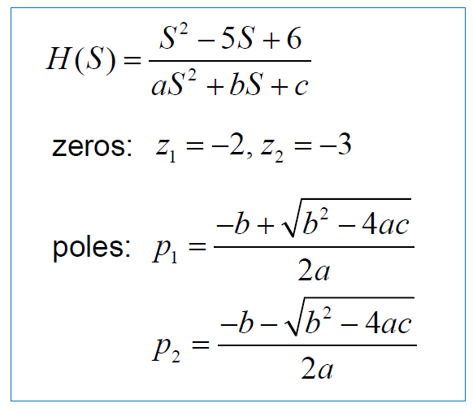
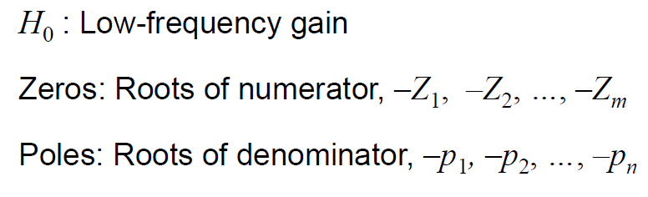
General Transfer Function

Slide 13
Poles and Zeros
• The values of poles and zeros can be either real or imaginary.
• For a physical system, all the coefficients are real, hence, the poles and zeros can only have two forms:
1.The roots are real.
2.If one root is complex, its complex conjugate has to be another root, i.e., if p = a + jb is a root, p*= a –jb must be another root.
• Both poles and zeros can be located in either left half-plane(LHP) or the right half-plane(RHP).

Slide 14
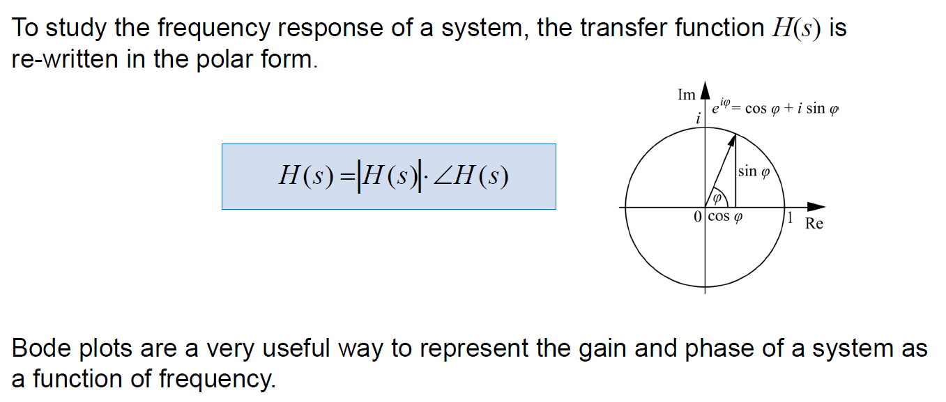
Bode Plots
In this course, we will only study Bode magnitude plots

Slide 15
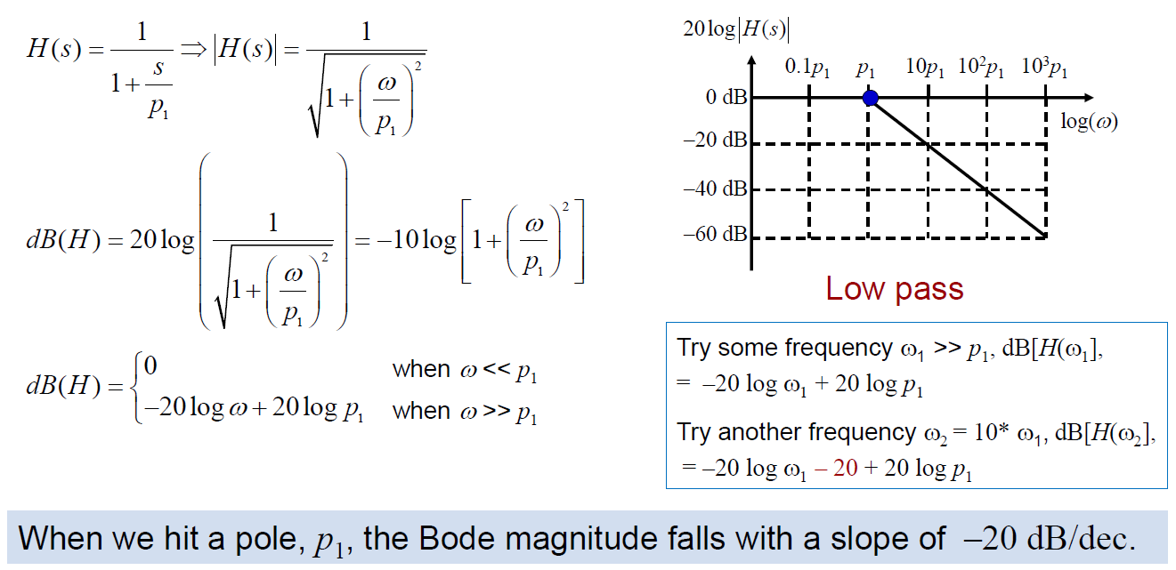
Bode Plots: Magnitude of Single pole system
|H(jw)|
The pole frequency is an important point on X axis-slope changes after this point

Slide 16
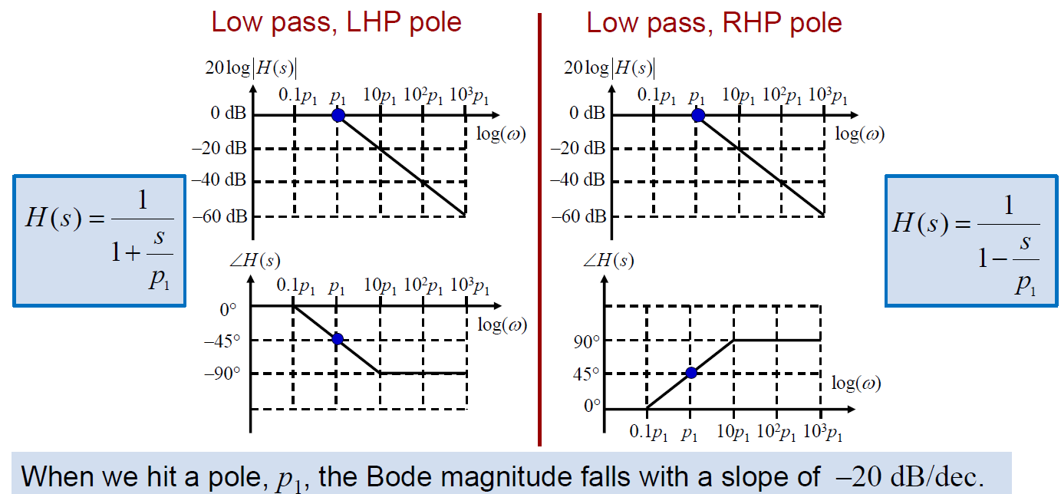
Bode Plots: Summary of Single pole system

Slide 17
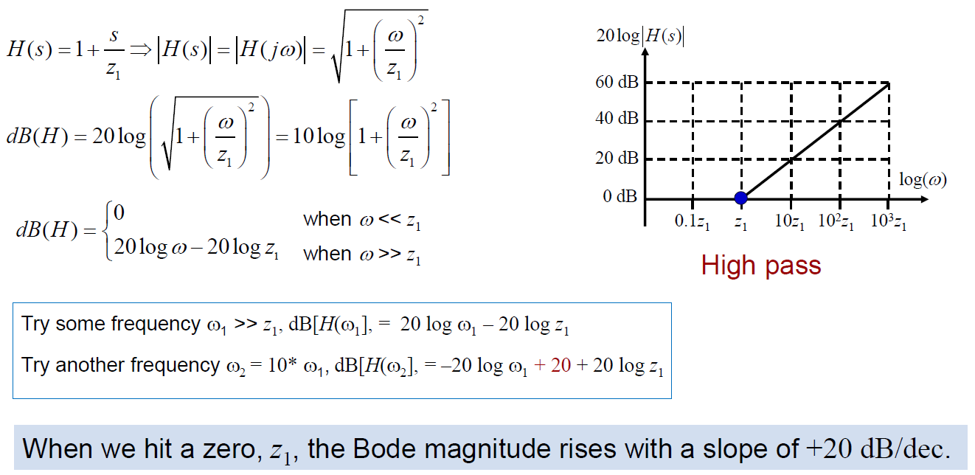
Bode Plots: Magnitude of Single zero system
The zero frequency is an important point on X axis-slope changes after this point

Slide 18
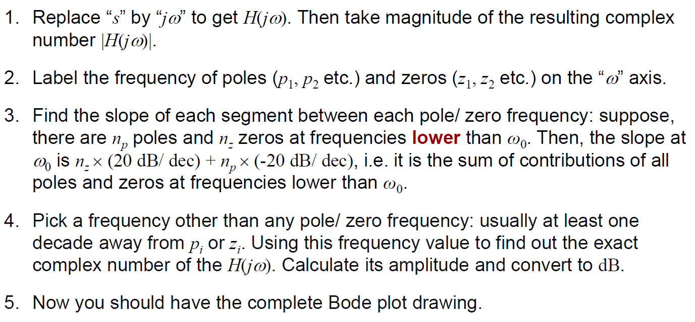
Bode Plots: Many pole-zero system
(only if $p_{i}≠0,z_{i}≠0$)
(this part only tells slope)
(this part adds exact magnitude information)

Slide 19
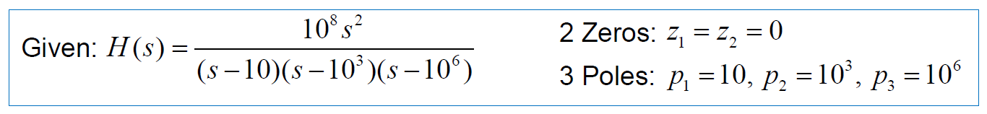
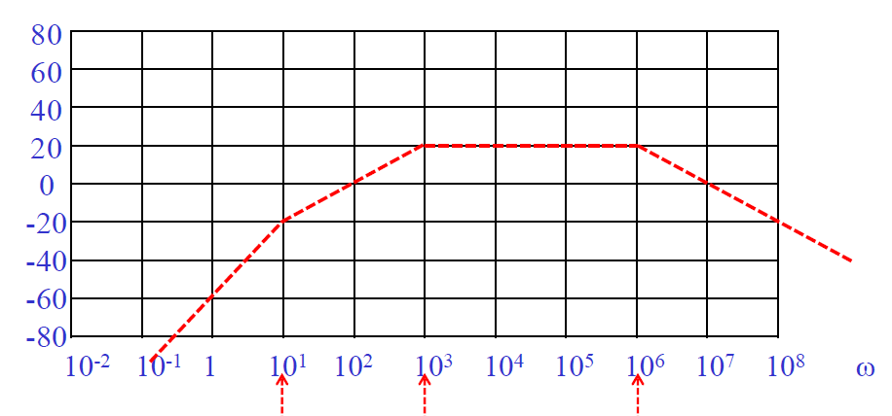
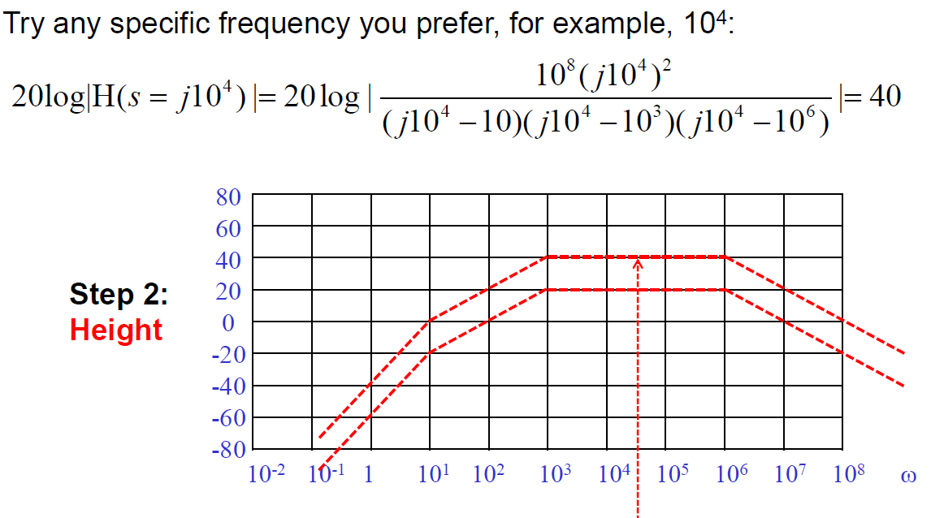

Bode Plots: Many pole-zero system

Slide 20
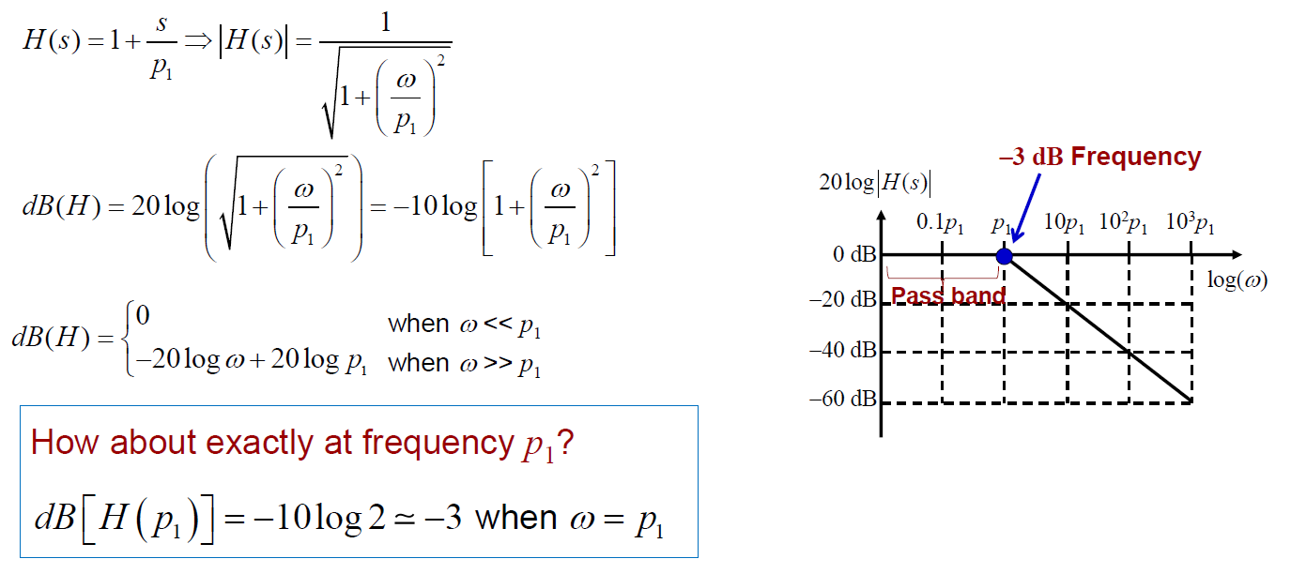
-3 dB frequency

Slide 21
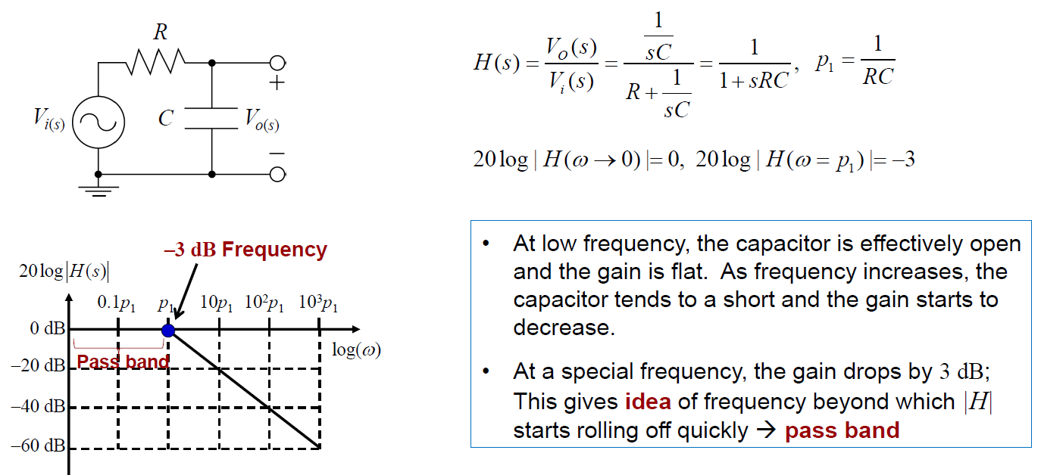
Real circuit examples

Slide 22
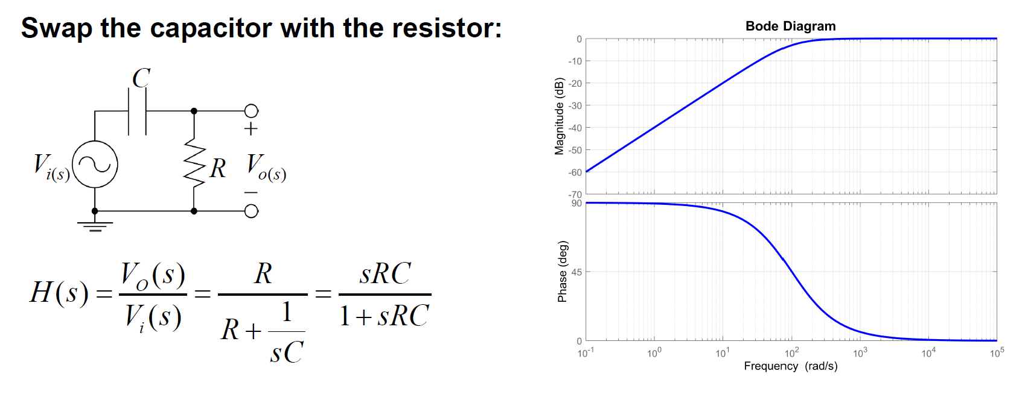
Real circuit examples

Slide 23
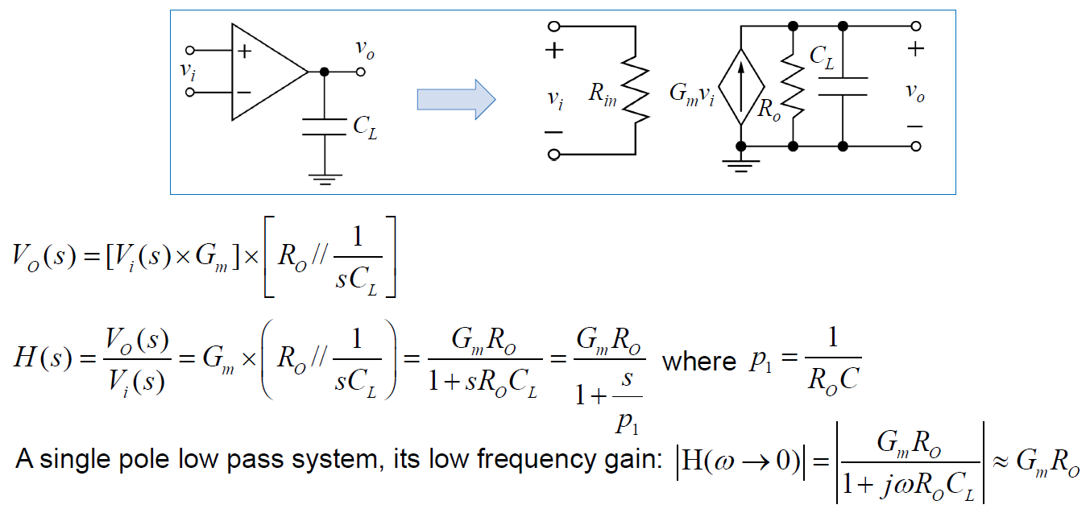
Real circuit examples

Slide 24
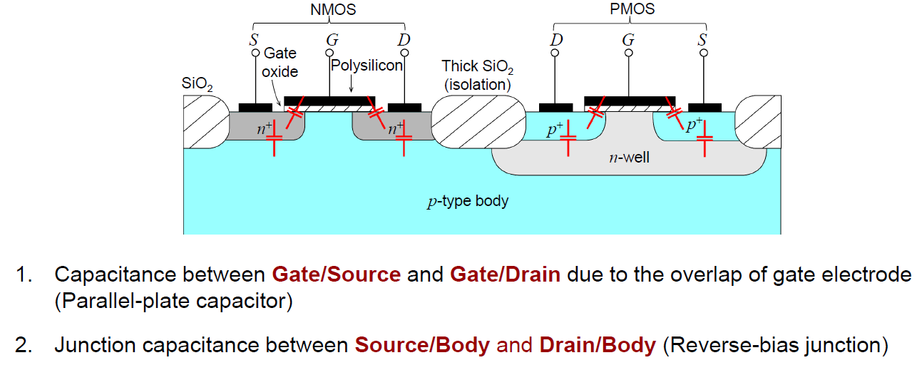
Parasitic Capacitors in Transistors
Typically Cgs >> Cgd (though effect of Cgd may be amplified by Miller Effect)

Slide 25
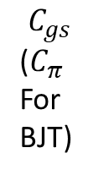

New small signal model
$$C_{gd}(C_{μ} for BJT)$$
v_{gs}
v_{gs}
/r_{o}
$$C_{gs}$$
($C_{π}$
For
BJT)
v_{gs}
v_{gs}
/r_{o}
Earlier model (valid for low frequency)
New model (including capacitors)
Typically Cgs >> Cgd (though effect of Cgd may be amplified by Miller Effect)

Slide 26
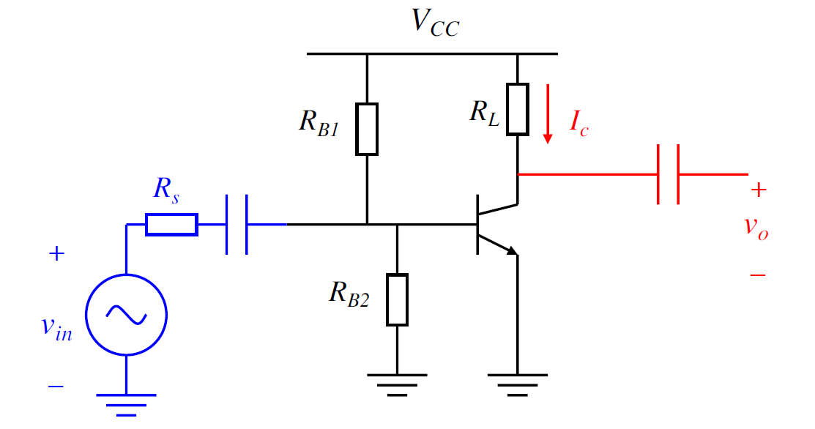
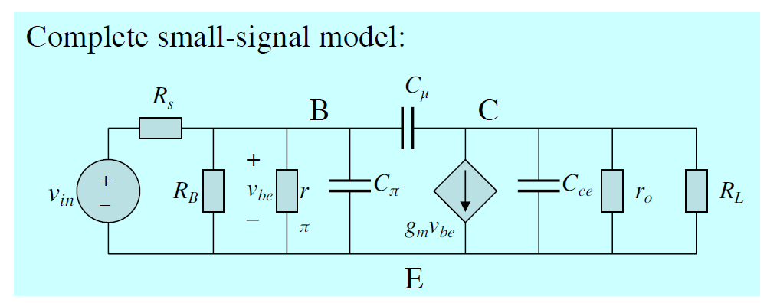


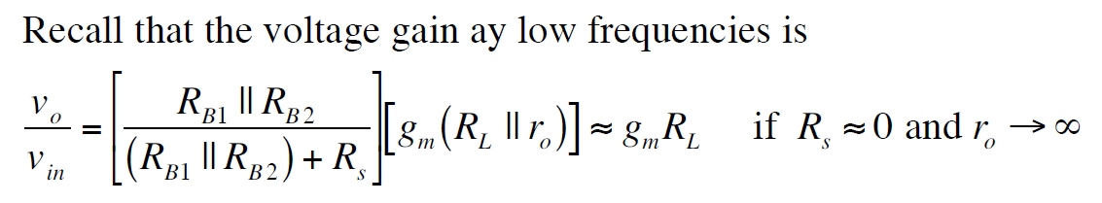
Example: CE amplifier
C_{c}
Ignored since very small
Also, Cc >> C_{Π}

Slide 27
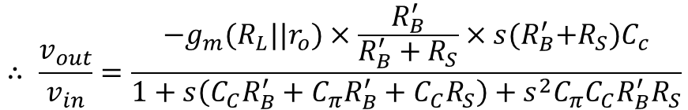
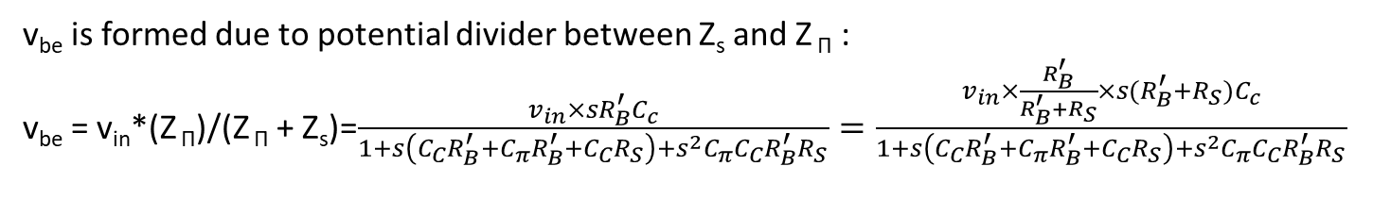
Example: CE amplifier
V_{out} = -g_{m}v_{be}*(R_{L}||r_{o})
Denote R_{B} || r_{Π} = R_{B}’
Denote Z _{Π} = R_{B}’ || (1/sC _{Π}) = R_{B}’/(1+s R_{B}’ C _{Π})
Denote Z_{s} = R_{s} + 1/sC_{c} =(1+s R_{s} C_{c})/sC_{c}
v_{be} is formed due to potential divider between Z_{s} and Z _{Π} :
v_{be} = v_{in}*(Z _{Π})/(Z _{Π} + Z_{s})=$\frac{v_{in}×sR_{B}^{′}C_{c}}{1+s\left(C_{C}R_{B}^{′}+C_{π}R_{B}^{′}+C_{C}R_{S}\right)+s^{2}C_{π}C_{C}R_{B}^{′}R_{S}}=\frac{v_{in}×\frac{R_{B}^{′}}{R_{B}^{′}+R_{S}}×s{(R}_{B}^{′}+R_{S})C_{c}}{1+s\left(C_{C}R_{B}^{′}+C_{π}R_{B}^{′}+C_{C}R_{S}\right)+s^{2}C_{π}C_{C}R_{B}^{′}R_{S}}$
$$∴ \frac{v_{out}}{v_{in}}=\frac{{−g}_{m}(R_{L}||r_{o})×\frac{R_{B}^{′}}{R_{B}^{′}+R_{S}}×s{(R}_{B}^{′}+R_{S})C_{c}}{1+s\left(C_{C}R_{B}^{′}+C_{π}R_{B}^{′}+C_{C}R_{S}\right)+s^{2}C_{π}C_{C}R_{B}^{′}R_{S}}$$

Slide 28
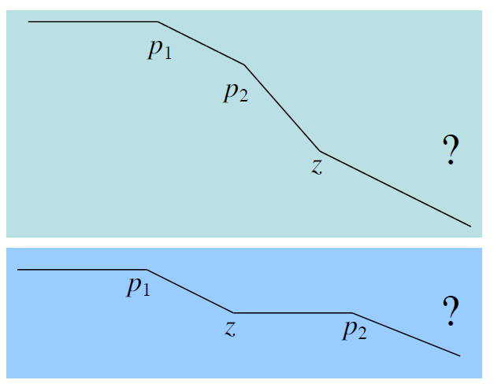
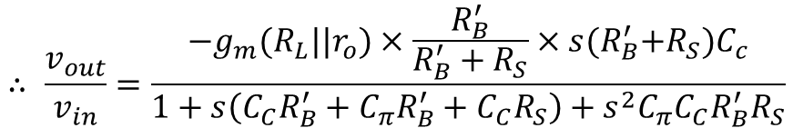
Example: CE amplifier
Highest power of s in numerator is 1 → 1 zero
Highest power of s in denominator is 2 → 2 poles
Tough to say anything else!!!
$$∴ \frac{v_{out}}{v_{in}}=\frac{{−g}_{m}(R_{L}||r_{o})×\frac{R_{B}^{′}}{R_{B}^{′}+R_{S}}×s{(R}_{B}^{′}+R_{S})C_{c}}{1+s\left(C_{C}R_{B}^{′}+C_{π}R_{B}^{′}+C_{C}R_{S}\right)+s^{2}C_{π}C_{C}R_{B}^{′}R_{S}}$$
Cc >> C_{Π}
Most important is p1 which dominates the bandwidth → Can approximate based on that!!

Slide 29
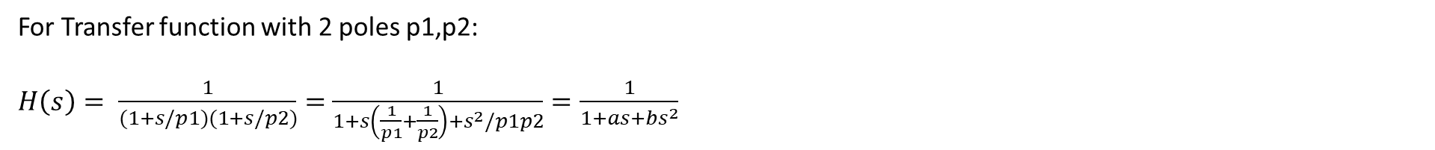
Dominant pole approximation
For Transfer function with 2 poles p1,p2:
$H\left(s\right)= \frac{1}{(1+s/p1)(1+s/p2)}=$ $\frac{1}{1+s\left(\frac{1}{p1}+\frac{1}{p2}\right)+s^{2}/p1p2}=\frac{1}{1+as+bs^{2}}$
Pole p1 is dominant means p1<<p2
Hence, a~1/p1 → p1 = 1/a
Also, b = 1/p1p2 ~a/p2 → p2 = a/b

Slide 30
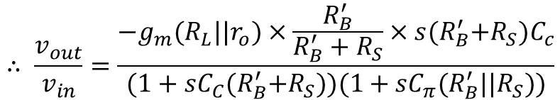
Example: CE amplifier
Applying dominant pole approximation,
p1 ~1/(C_{C}R_{B}’+C_{C}R_{S})
p2 ~C_{C}(R_{B}’+R_{S})/ C_{Π} C_{C}R_{B}’R_{S} =1/ (C_{Π}(R_{B}’||R_{S}))
$$∴ \frac{v_{out}}{v_{in}}=\frac{{−g}_{m}(R_{L}||r_{o})×\frac{R_{B}^{′}}{R_{B}^{′}+R_{S}}×s{(R}_{B}^{′}+R_{S})C_{c}}{1+s\left(C_{C}R_{B}^{′}+C_{π}R_{B}^{′}+C_{C}R_{S}\right)+s^{2}C_{π}C_{C}R_{B}^{′}R_{S}}$$
Cc >> C_{Π}
$$∴ \frac{v_{out}}{v_{in}}=\frac{{−g}_{m}(R_{L}||r_{o})×\frac{R_{B}^{′}}{R_{B}^{′}+R_{S}}×s{(R}_{B}^{′}+R_{S})C_{c}}{(1+sC_{C}{(R}_{B}^{′}+R_{S}))(1+sC_{π}(R_{B}^{′}||R_{S}))}$$

Slide 31
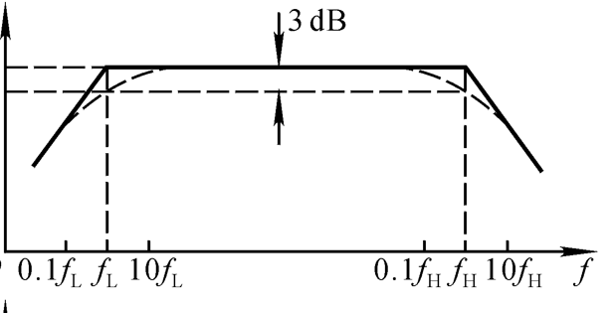
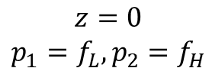
Example: CE amplifier
Applying dominant pole approximation,
p1 ~1/(C_{C}R_{B}’+C_{C}R_{S})
p2 ~C_{C}(R_{B}’+R_{S})/ C_{Π} C_{C}R_{B}’R_{S} =1/ (C_{Π}(R_{B}’||R_{S}))
(Open-circuit/Short-circuit time constant method can allow you to directly get p1,p2)
One zero, Two poles
20log|H(s)|
$$z=0$$
$$p_{1}=f_{L}, p_{2}=f_{H}$$
$$∴ \frac{v_{out}}{v_{in}}=\frac{{−g}_{m}(R_{L}||r_{o})×\frac{R_{B}^{′}}{R_{B}^{′}+R_{S}}×s{(R}_{B}^{′}+R_{S})C_{c}}{(1+sC_{C}{(R}_{B}^{′}+R_{S}))(1+sC_{π}(R_{B}^{′}||R_{S}))}$$

Slide 32
Appendix

Slide 33
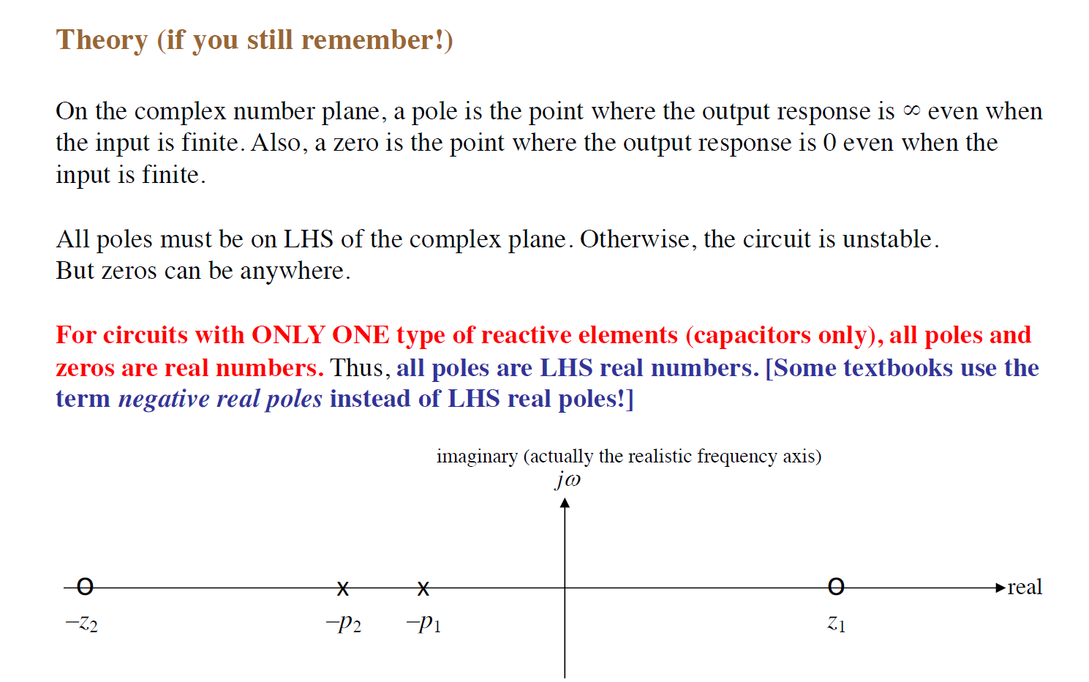
Poles & Zeros (Year 1 Linear Systems)

Slide 34

Poles & Zeros (Year 1 Linear Systems)

Slide 35

Poles & Zeros (Year 1 Linear Systems)

Slide 36

Poles & Zeros (Year 1 Linear Systems)

Slide 37

Bode Plots: Phase of Single pole system

Slide 38

Bode Plots: Summary of Single zero system

