Slide 1
CS2311 Computer Programming
LT3: Basic Syntax – Operators and basic I/O
Computer Science, City University of Hong Kong
Semester A 2021-22

Slide 2
Operators and punctuators
An operator specifies an operation to be performed on some values
  These values are called the operands of the operator
Some examples: +, -, *, /, %, ++, --,>>,<<
Some of these have meanings that depend on the context

Slide 3
Expressions
An expression is a combination of constants, variables, and function calls that evaluate to a result
Example:
  x = 3.0*4.0;
  y = 2.0 + x;
  z = 5.0 + x/y - sqrt(x*3.0);
constants
variables
function call

Slide 4
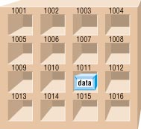
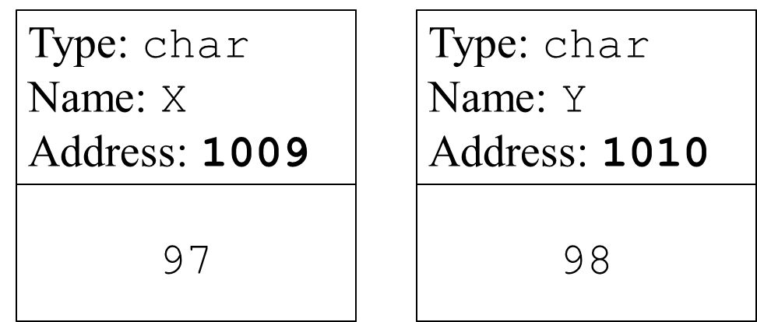
Assignment operator =
Generic form
  variable = expression;
Variable
  char x = ‘a’;

Slide 5
Assignment operator =
Generic form
  variable = expression;
= is an assignment operator that is different from the mathematical equality (which is == in C++)
An expression itself has a value, e.g.,
  a = (b = 2) + (c = 3);
  An assignment statement has a value equal to the operand
  In the example, the value of assignment statement “b=2” is 2 and “c = 3” is 3
  Therefore, “a = …” is 5
  a = 2 + 3;

Slide 6
Assignment operator =
Write-to a variable
After the write, the previous stored value in the variable no longer exists, and is replaced by the new value
97
Type: char
Name: X
Address: 1009
99
Type: char
Name: X
Address: 1009
Write ‘c’ to X
  x = ‘c’;

Slide 7
Examples of assignment statements
/* Invalid: left hand side must be a variable */
x + 10 = y;
/*assignment to constant is not allowed*/
2=x;
/* valid but not easy to understand */
int a, b, c;
a = (b = 2) + (c = 3);
/* avoid complex expressions*/
int a, b, c;
b = 2;
c = 3;
a = b + c;

Slide 8

Increment & decrement operators
Increment and decrement operators: ++ and --
  k++ and ++k are equivalent to k=k+1
  k-- and --k are equivalent to k=k-1
Post-increment and post-decrement: k++ and k--
  k’s value is altered AFTER the expression is evaluated
      int k=0, j;
      j=k++;
      (equal to: 1. j=k; 2. k=k+1;)
Pre-increment and pre-decrement: ++k and --k
  k’s value is altered BEFORE evaluating the expression
      int k=0, j;
      j=++k;
      (equal to: 1. k=k+1; 2. j=k;)
k += 1

Slide 9
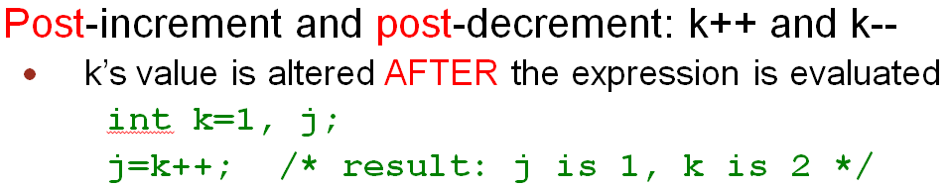
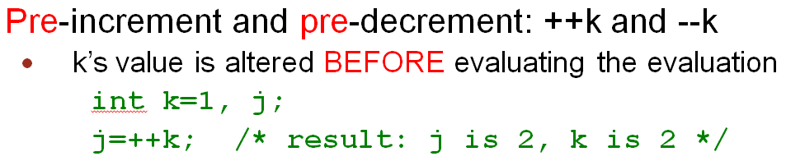
i=1+(k++);
k=0;
k=0;
i=1+(++k);
0
1
Use original value of k
Use updated value of k
i=1+0
=1
i=1+1
=2
Value of k will be 1 in both cases

Slide 10
What values are printed?
int k=0,i=0;
cout << "i= " << i << endl;
k=0;
i=1+(k++);
cout << "i= " << i << endl;
cout << "k= " << k << endl;
k=0;
i=1+(++k);
cout << "i= " << i << endl;
cout << "k= " << k << endl;
Output
i=0
i=1
k=1
i=2
k=1

Slide 11
Precedence & associativity of operators
An expression may have more than one operator and its precise meaning depends on the precedence and associativity of the involved operators
What is the value of variables a, b and c after the execution of the following statements
  int a, b = 2, c = 1;
  a = b+++c;
Which of the following interpretation is right?
  a = (b++) + c;
  or a = b + (++c);

Slide 12
Precedence & associativity of operators
Precedence: order of evaluation for different operators.
-Precedence determines how an expression like x R y S z should be evaluated (now R and S are different operators, e.g., x + y / z).
Associativity: order of evaluation for operators with the same precedence.
-Associativity means whether an expression like x R y R z (where R is a operator, e.g., x + y + z) should be evaluated `left-to-right' i.e. as (x R y) R z or
‘right-to-left' i.e. as x R (y R z);

Slide 13
Precedence & associativity of operators
Operator Precedence (high to low) | Associativity
:: | None
. -> [] | Left to right
() ++(postfix) --(postfix) | Left to right
+ - ++ (prefix) -- (prefix) | Right to left
* / % | Left to right
+ - | Left to right
= += -= *= /= etc. | Right to left
Example: a=b+++c
  a=(b++)+c; or
  a=b+(++c);
Example: int a, b=1;
  a=b=3+1;

Slide 14
Swapping the values
We want to swap the content of two variables, a and b.
What's wrong with the following program?
  void main(){
  int a=3, b=4;
  a=b;
  b=a;
  }

Slide 15
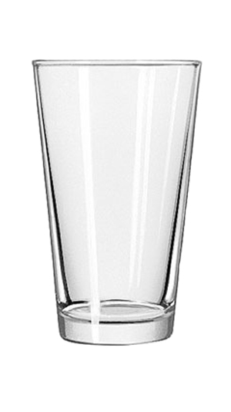
a=3
a=4
b=4
c
c=3
3
4

Slide 16
Swapping the values
We want to swap the content of two variables, a and b.
What's wrong with the following program?
  void main(){
  int a=3, b=4;
  a=b;
  b=a;
  }
We need to make use of a temporary variable
  c = a; /*save the old value of a*/
  a = b; /*put the value of b into a*/
  b = c; /*put old value of a (which is contained in c) to b*/

Slide 17
Efficient assignment operators
Generic form of efficient assignment operators
  variable op= expression;
  where op is an operator. The meaning is
        variable = variable op (expression);
Popular efficient assignment operators include
  += -= *= /= %=
Examples:
  a += 5; is same as a = a + 5;
  a -= 5; is same as a = a - 5;
  a += b*c; is same as a = a + (b*c);
  a *= b+c; is same as a = a * (b+c);

Slide 18

Basic I/O – Keyboard and Screen
A program can do little if it cannot take input and produce output
Most programs read user input from keyboard and secondary storage
After process the input data, result is commonly display on screen or write to storage (disk)

Slide 19
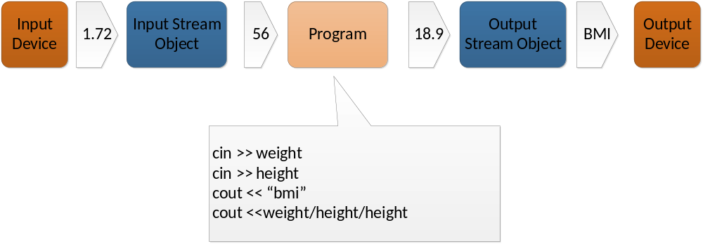
Basic I/O – cin and cout
C++ comes with an iostream package (library) for basic I/O.
cin and cout are objects defined in iostream for keyboard input and screen display, respectively
To read data from cin and write data to cout, we need to use input operator (>>) and output operator (<<)

Slide 20
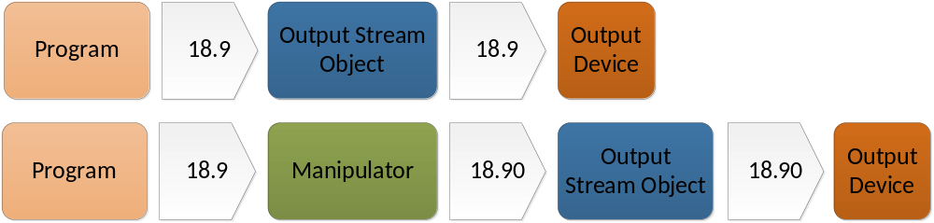
cout: Output Operator (<<)
Preprogrammed for all standard C++ data types
It sends bytes to an output stream object, e.g. cout
Predefined “manipulators” can be used to change the default format of arguments

Slide 21

cout: Output Operator <<
Type | Expression | Output
Integer | cout << 21 | 21
Float | cout << 14.5 | 14.5
Character | cout << ‘a’; cout <<‘H’ << ‘i’ | a Hi
Bool | cout << true cout << false | 1 0
String | cout << “hello” | hello
New line (endl) | cout << ‘a’ << endl << ‘b’; | a b
Tab | cout << ‘a’ << ‘\t’ << ‘b’; | a b
Special characters | cout << ‘\”’ << “Hello” << ‘\”’ <<endl; | “Hello”
Expression | int x=1; cout << 3+4 +x; | 8

Slide 22
cout – Change the Width of Output
Change the width of output
  Calling member function width(width) or using setw manipulator (which requires iomanip library: #include <iomanip>)
  Leading blanks are added to any value fewer than the width
  Effect last for one field only
  If formatted output exceeds the width, the entire value prints
Approach | Example | Output (: space key)
1. cout.width(width) 2. setw(width) | cout.width(5);//or cout<<setw(5); cout << 123 << endl; cout << 123 << endl; cout.width(5); //or cout<<setw(5); cout <<1234567 << endl; | 123 123 1234567

Slide 23
cout – Set the format and precision of floating point Output
Floating-point precision is six by default, i.e. 5 decimal points
Use fixed, scientific and setprecision manipulators to change the printing format and precision value.
Must #include <iomanip>
Effect is permanent
Default behavior
Example | Output
cout << 1.34 << endl; cout << 1.340 << endl; cout << 1.3401234 << endl; cout << 0.0000000134 << endl; | 1.34 1.34 1.34012 1.34e-008

Slide 24
fixed and scientific manipulators
cout<<fixed: always uses the fixed point notation (6 significant digits after the decimal point)
cout<< scientific: always uses the scientific notation
They change the meaning of precision (see the example)
Example | Output
cout << fixed; cout << 1.34 << endl; cout << 1.340 << endl; cout << 0.0000000134 << endl; | 1.340000 1.340000 0.000000
cout << scientific; cout << 1.34 << endl; cout << 1.340 << endl; cout << 0.000000012345671 << endl; cout << 0.000000012345675 << endl; | 1.340000e+00 1.340000e+00 1.234567e-08 1.234568e-08

Slide 25
setprecision manipulator
Normally, setprecision(n) means output n significant digits
But with “fixed” or “scientific”, setprecision(n) means output n significant digits after the decimal point
Example | Output
cout << setprecision(2); cout << 1.34 <<endl; | 1.3
cout << 0.0000000134 << endl; | 1.3e-008
cout <<fixed; cout << 1.34 << endl; cout << 0.0000000134 << endl; cout << scientific << 0.0005 << endl; | 1.34 0.00 5.00e-004

Slide 26
cout – Other Manipulator
Manipulators | Example | Output
fill | cout << setfill(‘*’); cout << setw(10); cout << 5.6 << endl; cout << setw(10); cout <<57.68 << endl; | *******5.6 *****57.68
radix | cout << oct << 11 << endl; // octal cout << hex << 11 << endl; // hexidecimal cout << dec << 11 << endl; | 13 b 11
alignment | cout << setiosflags(ios::left); cout << setw(10); cout << 5.6 <<endl; | 5.6

Slide 27
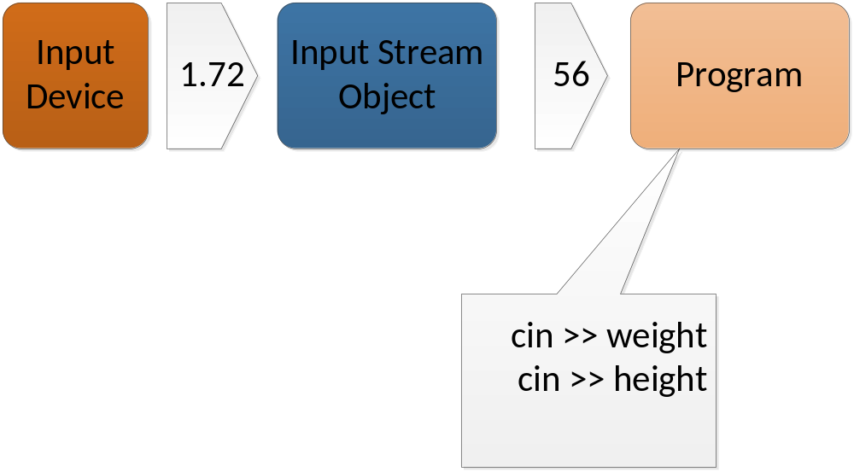
cin: Input Operator (>>)
  Preprogrammed for all standard C++ data types
Get bytes from an input stream object
Depend on white space to separate incoming data values

Slide 28
Input Operator
Type | Variable | Expression | Input | x | y
Integer | int x,y; | cin >> x; | 21 | 21
 |  | cin >> x >> y; | 5 3 | 5 | 3
Float | float x,y; | cin >> x; | 14.5 | 14.5
Character | char x,y; | cin >> x; | a | a
 |  | cin >> x >> y; | Hi | H | i
String | char x[20]; char y[20]; | cin >> x; | hello | hello
 |  | cin >> x >> y | Hello World | Hello | World

Slide 29
Programming styles
Programmers should write code that is understandable to other people as well
Meaningful variable names
Which is more meaningful
  tax=temp1*temp2;
  tax=price*tax_rate;
Meaningful comments
  Write comments as you're writing the program
Indentations

Slide 30
Indentation styles
void main()
{
int x, y;
x = y++;
}
void main() {
int x, y;
x = y++;
}
Both are good. Choose one and stick with it.
void main()
{
int x, y;
x= y++;}
BAD!! Avoid this!!

Slide 31
Use of comments
Top of the program
  Include information such as the name of organization, programmer’s name, date and purpose of program
What is achieved by the function, the meaning of the arguments and the return value of the function
Short comments should occur to the right of the statements when the effect of the statement is not obvious and you want to illuminate what the program is doing
Which one of the following comment is more meaningful?
  tax = price * rate; // sales tax formula
  tax = price * rate; // multiply price by rate

