Slide 1
Problem of the Points:
The Unfinished Game
CS 2402 Lecture 2

Slide 2
Objectives
Understand the “Problem of the Points” and explain the solution
Understand sample space and axioms of probability

Slide 3

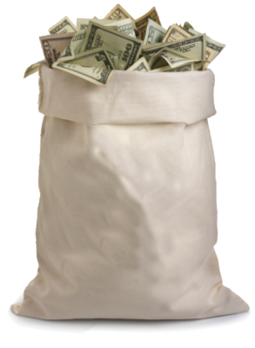



Problem of the Points
There are two players, Alice and Bob
  They place equal bets ($50 each)
  The pot ($100) goes to the winner of the best of nine tosses of a fair coin (i.e., 5 out of 9)
$100
Notes:
definition [TUG pg9]
(this is a simplified version…the real version involves dice)
Why problem of points? Each person is assigned points based on how many times they have won.
Also called Unfinished game.

Slide 4

Problem of the Points
There are two players, Alice and Bob
  They place equal bets ($50 each)
  The pot ($100) goes to the winner of the best of nine tosses of a fair coin (i.e., 5 out of 9)
(It’s called “Problem of the Points” because each player is assigned points based on how many rounds they have won)
$100
$100
Notes:
definition [TUG pg9]
(this is a simplified version…the real version involves dice)
Why problem of points? Each person is assigned points based on how many times they have won.
Also called Unfinished game.

Slide 5
The Unfinished Game
They stop in the middle of the game….
  How should they divide the pot?
  (Also called the “Division of Stakes” problem or the “Unfinished Game”)
$???
$100
$???
Notes:
definition [TUG pg9]
(this is a simplified version…the real version involves dice)
Why problem of points? Each person is assigned points based on how many times they have won.
Also called Unfinished game.

Slide 6
Simple Case
The game stops when Alice and Bob have equal number of points
  Intuitive solution: split the pot equally (1:1 ratio)
1/2
1/2
$50
$100
$50
after 4 rounds
1:1
after 8 rounds
Notes:
definition [TUG pg9]

Slide 7
Difficult Case
Stop after 6 throws, and Alice is ahead 4 to 2…
  How to split the pot?
$???
$100
$???
after 6 rounds
 | Alice | ratio | Bob
a) | $66.7 (2/3) | 4:2 | $33.3 (1/3)
b) | $85.7 (6/7) | 6:1 | $14.3 (1/7)
c) | $70.0 (7/10) | 7:3 | $30.0 (3/10)
d) | $75.0 (3/4) | 3:1 | $25.0 (1/4)
e) | $87.5 (7/8) | 7:1 | $12.5 (1/8)
Notes:
definition [TUG pg9]

Slide 8
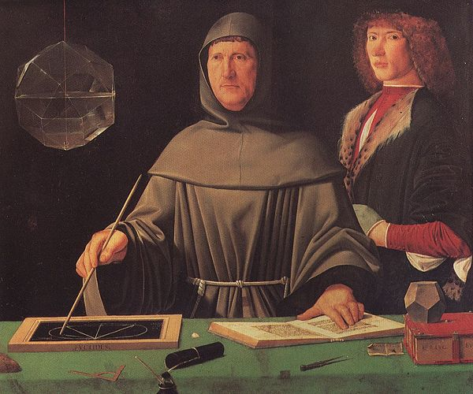
Pacioli’s Solution (1494)
Divide the pot according to the current state of play
  In our example,
    Alice has 4 points and Bob has 2 points
    The pot should be split 4:2 (or 2:1)
  What’s wrong with this solution?
2/3
1/3
$66.7
$100
$33.3
2:1
Notes:
Alice wins = a / (a+b)
Bob wins = b / (a+b)
an Italian mathematician, collaborator with Leonardo da Vinci, and an early contributor to the field now known as accounting. He is referred to as the father of accounting.

Slide 9
Cardano’s Criticism
Suppose the game is to 19
  Alice has 18 points and Bob has 9 points
  Pacioli’s solution is to split the pot 18:9 or 2:1
    Alice only needs 1 point and Bob needs 10 points
      Yet Alice only gets twice as much as Bob
2/3
1/3
$66.7
$100
$33.3
2:1
$100
Notes:
TUG [pg16-19]
an Italian polymath, whose interests and proficiencies ranged through those of mathematician, physician, biologist, physicist, chemist, astronomer, philosopher, writer, and gambler. He was one of the key figures in the foundation of probability and the earliest introducer of the binomial coefficients and the binomial theorem in the Western world.

Slide 10
Cardano’s Criticism
  Alice has 2 points and Bob has 0
  Pacioli’s solution is to split the pot 2:0
    Alice only has a modest lead
      Yet Alice gets the whole pot (as if she had won the game)!
    If Alice has a big lead 18 to 0, then the split is the same!
2/2
0/2
$100
$100
$0
2:0
$100
Notes:
TUG [pg16-19]
Alice = a/(a+b)
Bob = b/(a+b)

Slide 11
Cardano’s Solution (1539)
Divide the pot according to how many points the players need to win
  Winning each successive round increases difficulty
    2nd win is twice as hard as 1st win; 3rd win is 3 times as hard as 1st win
    “Difficulty” of Bob to win 3 rounds: 1 + 2 + 3 = 6
    “Difficulty” of Alice to win 1 round: 1
    (This is almost correct, but not quite)
6/7
1/7
$85.7
$100
$14.3
6:1
Notes:
Alice needs: PA = (n-a)(n-a+1)/2
Bob needs: PB = (n-b)(n-b+1)/2
Alice wins = PB/(PA+PB)
Bob wins = PA/(PA+PB)

Slide 12
Tartaglia’s Solution (1556)
  Each person gains or loses proportional to the difference in wins so far
    Alice is ahead by 2 points
    Hence, Alice should gain 2/5 the bet from Bob
    Alice gains $50 x 2/5 = $20. Bob loses $20
7/10
3/10
$100
7:3
$50+$20=$70
$50-$20=$30
Notes:
TUG [pg16-19]
an Italian mathematician, engineer (designing fortifications)

Slide 13
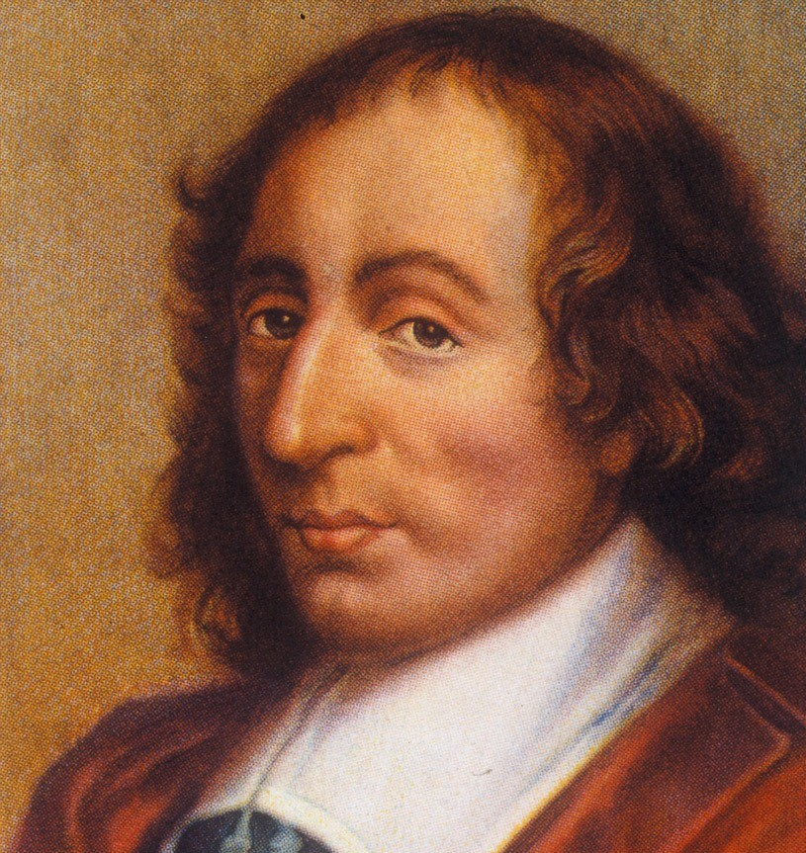
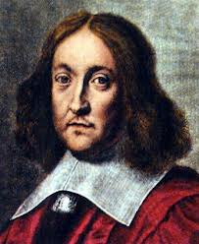

Pascal & Fermat
There was a lot of confusion until…
In 1654, A rich man in France asked his friend Pascal a few questions about games of chance, including the problem of the points
  Pascal came up with a possible solution
  He was unsure, so he sent a letter to Fermat
The resulting exchange of letters would start the theory of probability
  …and all its subsequent applications

Slide 14

My solution to the problem of the points
Find out how many rounds are needed for the game to be absolutely decided
List all the combination of outcomes of the remaining rounds
  (These outcomes are all equally likely)
From this list, find the number of ways that each player can win the game
Divide the stake according to proportion of possible wins
Fermat 1601
Notes:
Pascal/Fermat solution [TUG pg 24-30, pg 58-60]
Pascal’s solution (universal method) [pg 60-63]
Fermat’s solution [pg 65-66, pg 13] - and counterpoint [pg 31, pg 49]

Slide 15
Fermat’s Solution
7/8
1/8
$87.5
$100
$12.5
7:1
6 of 9 rounds already played → 3 rounds left
Possible outcomes of 3 remaining rounds:
AAA, AAB, ABA, BAA, ABB, BAB, BBA, BBB
Alice can win 7 ways; Bob can win 1 way
Split the pot 7:1 (outcomes are equally likely)

Slide 16

Okay, but…
We listed all outcomes of 3 rounds:
  AAA, AAB, ABA, BAA, ABB, BAB, BBA, BBB
Yet, sometimes it is not necessary to play all 3 rounds!
  The game can end in 1 or 2 rounds, with the remaining rounds not played
    For example, A ends in 1 round
    For example, BA ends in 2 rounds
  Why do we count each AAA, AAB, ABA, ABB separately instead of combining them into A?
Pascal
Notes:
Pascal/Fermat solution [TUG pg 24-30, pg 58-60]
Pascal’s solution (universal method) [pg 60-63]
Fermat’s solution [pg 65-66, pg 13] - and counterpoint [pg 31, pg 49]

Slide 17
BTW, I think you’re right
Even if Alice wins early, they can still complete the remaining rounds
The outcome will be the same
    Alice already has enough points to win
    Bob cannot win since there are not enough points left for him
Pascal
There is nothing wrong with playing all the rounds (even if it wastes time)
  The players are indifferent since there is no change in outcome
  Hence, playing the extra rounds is equivalent to stopping naturally
  So it must be correct
Notes:
Pascal/Fermat solution [TUG pg 24-30, pg 58-60]
Pascal’s solution (universal method) [pg 60-63]
Fermat’s solution [pg 65-66, pg 13] - and counterpoint [pg 31, pg 49]

Slide 18
I agree :)
Playing the extra rounds only serves to make the enumeration of the cases easier
Fermat 1601
Notes:
Pascal/Fermat solution [TUG pg 24-30, pg 58-60]
Pascal’s solution (universal method) [pg 60-63]
Fermat’s solution [pg 65-66, pg 13] - and counterpoint [pg 31, pg 49]

Slide 19
What If the Extra Rounds Are Not Played?
Look at the outcomes when the game stops immediately after the win:
  A, BA, BBA, BBB
  We also need to consider the frequency of each outcome
Fermat’s method of combinations is an elegant way to obtain the frequency of each of these outcomes
1/2
1/2
1 throw
A
B
1/4
1/4
1/4
1/4
2 throws
AA
AB
BA
BB
1/8
1/8
1/8
1/8
1/8
1/8
1/8
1/8
3 throws
AAA
AAB
ABA
ABB
BAB
BAA
BBA
BBB
Frequency of A is ½
A is 4 times more likely than BBB
Frequency of BA is ¼
BA is 2 times more likely than BBB
Notes:
Pascal/Fermat solution [TUG pg 24-30, pg 58-60]
Pascal’s solution (universal method) [pg 60-63]
Fermat’s solution [pg 65-66, pg 13] - and counterpoint [pg 31, pg 49]

Slide 20
Pascal’s Solution
I also solved the problem of the points using my own method, and my solution agrees with your method of combinations
  My solution uses recursive equations, algebra, and theory of combinations :P
  But your solution is simpler
Pascal
(Pascal’s method was used later to find general solutions to other related problems)
Notes:
Pascal/Fermat solution [TUG pg 24-30, pg 58-60]
Pascal’s solution (universal method) [pg 60-63]
Fermat’s solution [pg 65-66, pg 13] - and counterpoint [pg 31, pg 49]

Slide 21

Game with 3 Players
There are 3 players
  Roll a “3-sided” dice and get a point if their side comes up
Goal: first to 3 points
The game stops early with the score 2:1:1
  How to divide the pot?
$100
$???
$???
$???
Notes:
[pg 73-82]

Slide 22
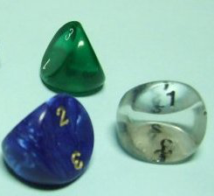
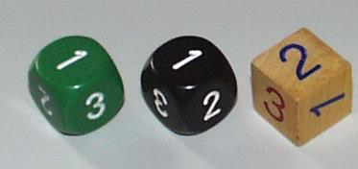
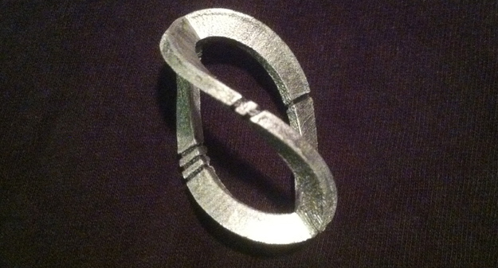
3-Sided Dice?

Slide 23
Fermat’s Method
The game is decided in 3 throws
  Alice needs 1 point, Bob needs 2, Charlie needs 2
27 possible outcomes in 3 throws
  Sometimes there are 2 winners!?
Outcome | Winner | Outcome | Winner | Outcome | Winner
AAA | A | BAA | A | CAA | A
AAB | A | BAB | A & B | CAB | A
AAC | A | BAC | A | CAC | A & C
ABA | A | BBA | A & B | CBA | A
ABB | A & B | BBB | B | CBB | B
ABC | A | BBC | B | CBC | C
ACA | A | BCA | A | CCA | A & C
ACB | A | BCB | B | CCB | C
ACC | A & C | BCC | C | CCC | C
Notes:
[pg 73-82]

Slide 24
Pascal
My Attempt using Fermat’s Method…
When there are 2 winners, I give half to each winner
Outcome | Winner | Outcome | Winner | Outcome | Winner
AAA | A | BAA | A | CAA | A
AAB | A | BAB | A & B | CAB | A
AAC | A | BAC | A | CAC | A & C
ABA | A | BBA | A & B | CBA | A
ABB | A & B | BBB | B | CBB | B
ABC | A | BBC | B | CBC | C
ACA | A | BCA | A | CCA | A & C
ACB | A | BCB | B | CCB | C
ACC | A & C | BCC | C | CCC | C
Player | No. Wins | Pot Split
Alice | 16 | 16/27
Bob | 5.5 | 5.5/27
Charlie | 5.5 | 5.5/27
Solution 16 : 5.5 : 5.5
But this solution doesn’t match the solution found using my recursive method, which is 17 : 5 : 5 :(
Notes:
[pg 73-82]

Slide 25
We must consider the order of the points
  The first person to 3 points is the winner!
  The remaining rounds are just bookkeeping
Fermat 1601
Outcome | Winner | Outcome | Winner | Outcome | Winner
AAA | A | BAA | A | CAA | A
AAB | A | BAB | A | CAB | A
AAC | A | BAC | A | CAC | A
ABA | A | BBA | B | CBA | A
ABB | A | BBB | B | CBB | B
ABC | A | BBC | B | CBC | C
ACA | A | BCA | A | CCA | C
ACB | A | BCB | B | CCB | C
ACC | A | BCC | C | CCC | C
Player | No. Wins | Pot Split
Alice | 17 | 17/27
Bob | 5 | 5/27
Charlie | 5 | 5/27
Solution 17 : 5 : 5
  See, my method gets the same answer as your method :)
Notes:
[pg 73-82]

Slide 26
I Get It Now
“Your last letter has satisfied me perfectly. I admire your method for the division, so much more as I understand it quite well; it is entirely yours, and it has nothing in common with mine; and arrives to the same but simply. Here is our understanding restored.”
Pascal
Notes:
Pascal/Fermat solution [TUG pg 24-30, pg 58-60]
Pascal’s solution (universal method) [pg 60-63]
Fermat’s solution [pg 65-66, pg 13] - and counterpoint [pg 31, pg 49]

Slide 27
Impact on Society
Pascal/Fermat’s solution was the first stepping stone to a better understanding of probability
With probability theory, we gained some control over our future
  For example, we can:
    calculate the probability of various events
    choose our actions to minimize the dangers and maximize our rewards
    buy insurance in case bad things happen
  In other words, we gained the ability to manage risk
Notes:
fate vs prediction [TUG 86-88]
fate vs predicatability [de Moivre pg 50-52]

Slide 28
Some Math about Probability

Slide 29
Sample Space
Sample space: the set of all possible outcomes of an experiment, usually denoted by S
Any two different outcomes must be mutually exclusive

Slide 30
Example
Throw a coin
  S = {H, T}
Throw a coin twice
  S = {HH, HT, TH, TT}
7 horse racing, {1, 2, 3, 4, 5, 6, 7}
  S = {all 7! permutations of {1,...,7}}

Slide 31
Type of Sample Space
Finite sample space: finite number of elements in the space S
Countable infinite sample space: e.g., natural numbers
Discrete sample space: if it has finite many or countable infinity of elements
Continuous sample space: if the elements constitute a continuum. E.g., all the points in a line

Slide 32
Event
Event: a subset of a sample space
Example 1: Throw a coin twice: S = {HH, HT, TH, TT}
A = {HH, HT}: the event that the first toss is H
B = {HT, TH}: the event that the two tosses are different

Slide 33
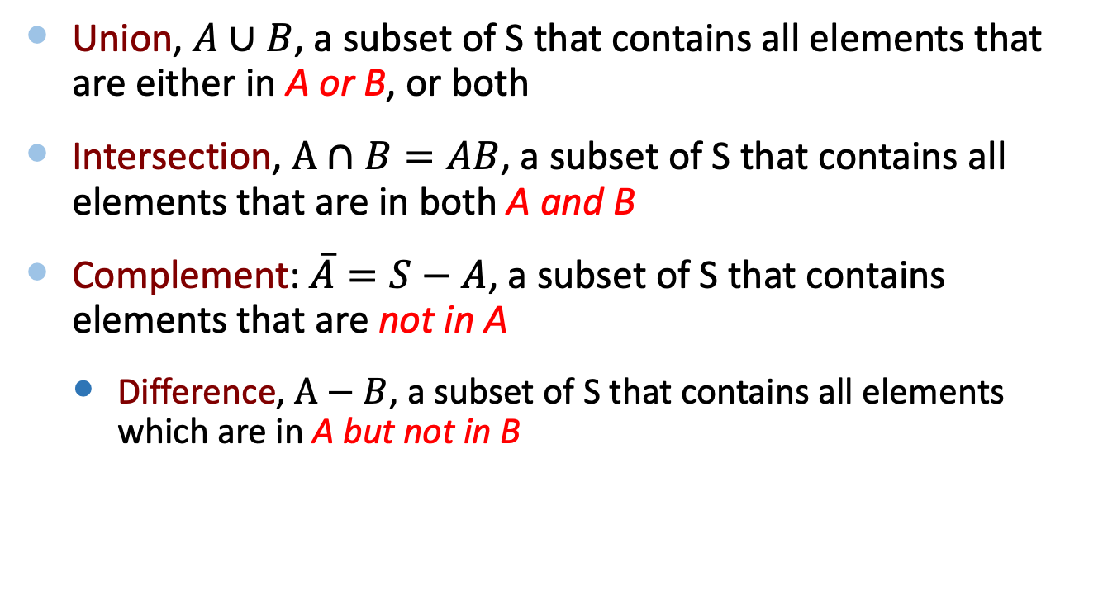
Events
Union, $A∪B$, a subset of S that contains all elements that are either in A or B, or both
Intersection, $A∩B=AB$, a subset of S that contains all elements that are in both A and B
Complement: $\overline{A}=S−A$, a subset of S that contains elements that are not in A
  Difference, $A−B$, a subset of S that contains all elements which are in A but not in B

Slide 34
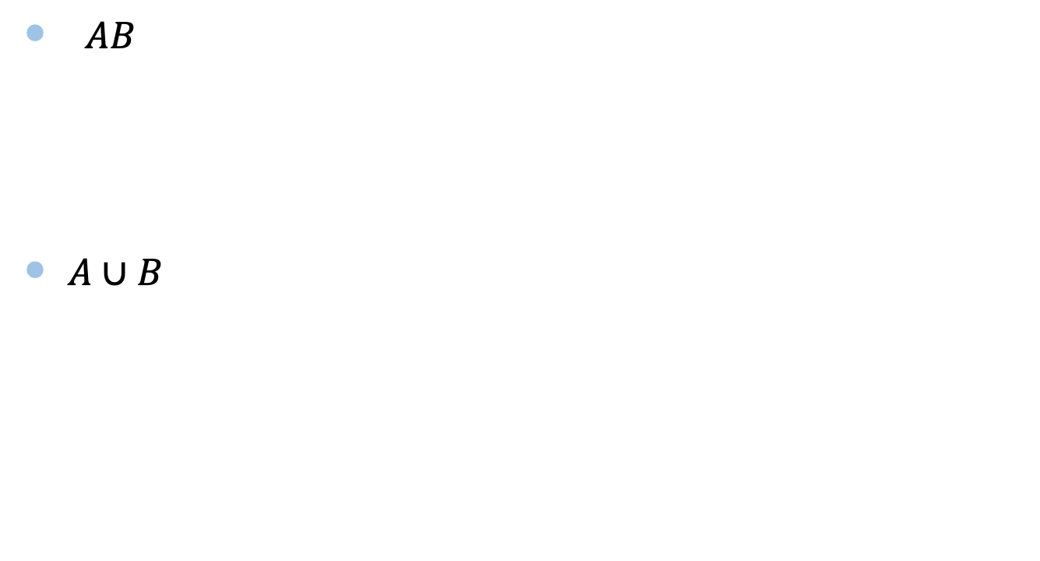
Venn Diagram
$AB$
$A∪B$
A
B
A
B

Slide 35
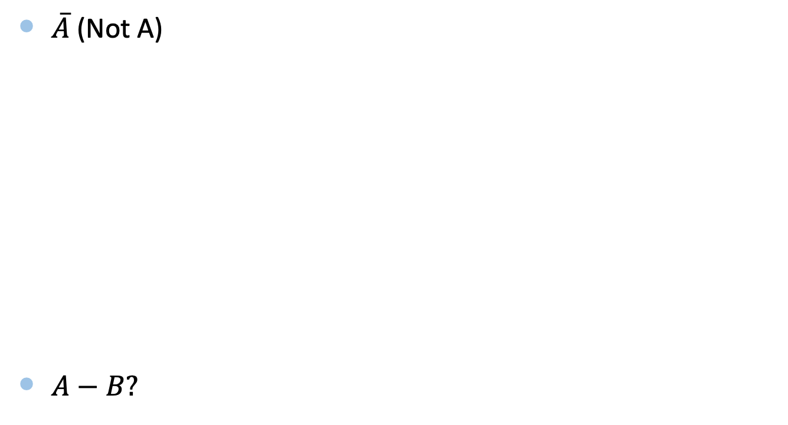
Venn Diagram
$\overline{A}$ (Not A)
$A−B?$
A

Slide 36
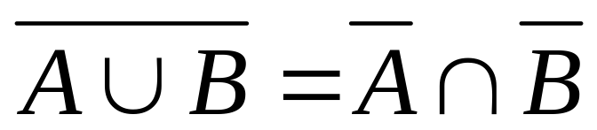
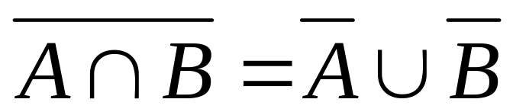
DeMorgan’s Law

Slide 37

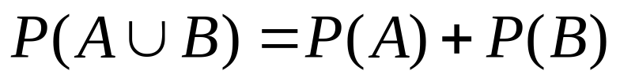
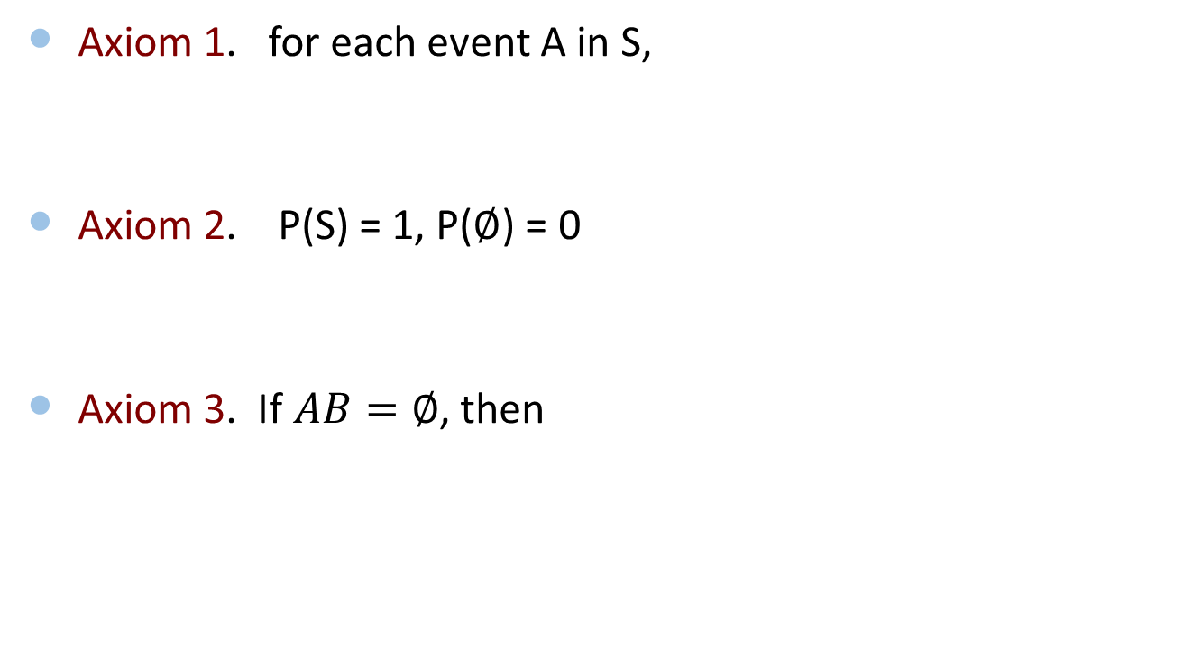
Axiom of Probability
Axiom 1. for each event A in S,
Axiom 2. P(S) = 1, P($∅$) = 0
Axiom 3. If $AB=∅$, then

Slide 38
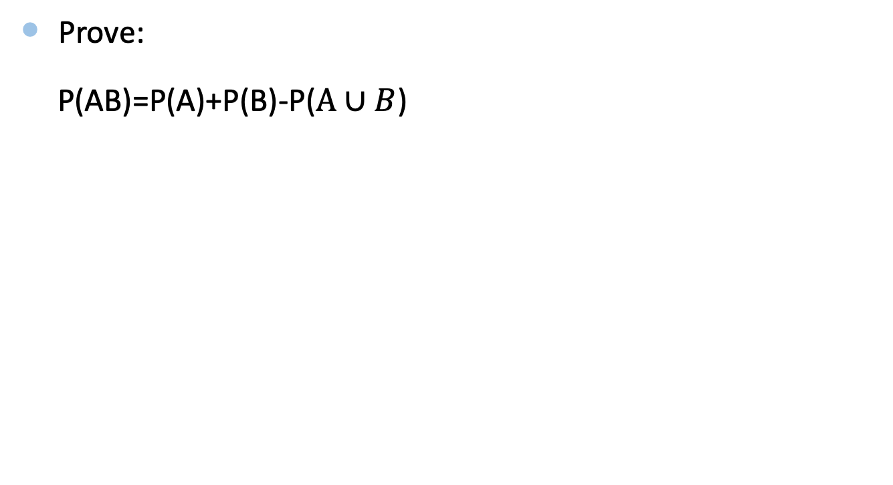
The Exercise
Prove:
P(AB)=P(A)+P(B)-P($A∪B$)

Slide 39
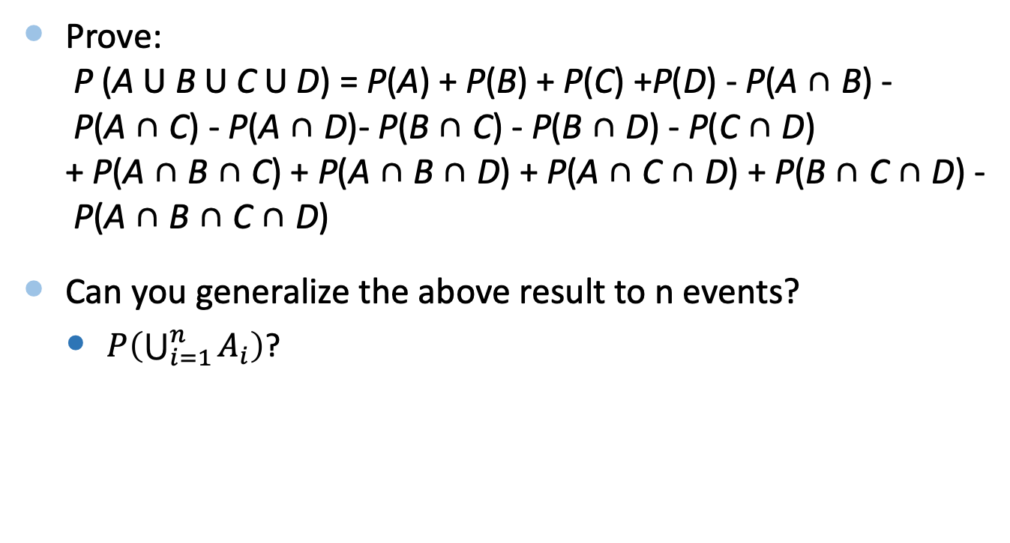
The Exercise (Optional)
Prove:
P (A U B U C U D) = P(A) + P(B) + P(C) +P(D) - P(A ∩ B) - P(A ∩ C) - P(A ∩ D)- P(B ∩ C) - P(B ∩ D) - P(C ∩ D) + P(A ∩ B ∩ C) + P(A ∩ B ∩ D) + P(A ∩ C ∩ D) + P(B ∩ C ∩ D) - P(A ∩ B ∩ C ∩ D)
Can you generalize the above result to n events?
  $P\left(\bigcup_{i=1}^{n}{A_{i}}\right)$?
https://en.wikipedia.org/wiki/Algebra_of_sets

Slide 40
Optional Reading
Pascal’s Recursion Method:
https://gbenthien.net/Pascal/pas-appendixB.html

Slide 41
Summary
The “problem of the points” is to determine how to split the pot when a game ends prematurely
  Fermat and Pascal solved it
  It was the birth of probability theory
Sample space and axioms of probability

