Slide 1
GE1202 Managing Your Personal Finance
Lecture 3
Saving

Slide 2
Savings
What is saving?
  Monthly income > monthly expenditure
  Scarifying current consumption in favour of future benefits
Building up savings helps to provide financial independence and security later on in life
  Keep away the need to resort to expensive loans or emergency lenders
A general rule of thumb
  Readily available savings should be equal to between 3 to 6 months’ income

Slide 3
Types of Savings
Saving involves people placing spare funds in
  A saving account
  An investment
  Pension fund
  Etc
The amount deposited is known as capital
The value of capital may change overtime
  The risk of saving
Different kinds of saving involve different degree of risk
  Capital in saving accounts in general should not be at risk of loss
  The value of capital of an investment fluctuates frequently

Slide 4
Saving Pattern
What affect the saving rate?
In general, low saving rate for three groups of people
  Young people
  Families with children
  Elderly

Slide 5
Why Do People save?
In general, people need to save whenever there is an inconsistency between the stream income and expenditure
  Pattern of expenditure is stable
  Pattern of income is more fluctuated
$
Saving
Expenditure
Dissaving
Dissaving
Income
Age
Study
Working
Retired

Slide 6
Reasons for saving
Three different motives of savings
  Transactions Motive
    Saving for the spending on “big ticket” items
    Housing, retirement, holidays, or other expensive items
  Precautionary Motive
    To protect their standard of living in the unexpected events
      Unemployment or illness
    To meet unforeseen expenditure
      Maintenance on a house or repair bill on a car
  Speculative Motive
    To be able to take advantage of good investment opportunities
      Starting up a business

Slide 7
Types of Savings Accounts
Banks in HK offer numerous types of saving accounts
  HK Dollar Savings Account
  HK Dollar Time Deposit
  Certificate of Deposit
  Foreign Currency Savings Account
  Foreign Currency Time Deposit

Slide 8
Types of Savings Accounts
Regular savings accounts
  Passbook or statement accounts
  Involve low or no minimum balance
  Withdraw money as needed
Time deposits
  Fixed maturity
  Cannot be withdrawn for a specific term or period of time
  When the term is over it can be withdrawn or it can be held for another term
  Higher interest rate than savings accounts

Slide 9
Types of Savings Accounts
Certificates of Deposit (CD)
  A form of time deposit
  CDs are negotiable and can be rediscounted when the holder needs some liquidity
  Some banks offer fixed rate and floating rate CD
    Fixed rate CD pays a fixed amount of interest at regular intervals
    Floating rate CD pays interest with reference with a designated benchmark interest rate
        Stock-indexed CDs – earnings based on the stock market
    Special feathers
      Callable CDs – the bank may “call” the account after a stipulated period
  Generally offers a higher interest rate than normal savings accounts or time deposits

Slide 10
Managing Time Deposits/CD
When first buying or rolling over a time deposit/CD, investigate potential earnings and costs
Do not allow your bank to automatically roll over your money for the same term
If interest have dropped, you may consider a shorter maturity
If you believe rates are at a peak and you will not need the money for some time, obtain one with longer term
Consider creating a time deposit/CD portfolio with different maturity

Slide 11
Evaluating Savings Accounts
Selection of a saving plan is usually influenced by
  Rate of return
  Inflation
  Tax considerations
  Liquidity
  Safety
  Restrictions
  Fees

Slide 12
Rate of Return
Rate of return (or Yield) is the percentage of increase in the value of savings as a result of interest earned.
  A $100 savings account that earned $5 after a year would have a rate of return of 5%
It is determined by dividing the interest earned by the amount in the savings account
The yield on your savings usually will be greater than the stated interest rate
  Compound interest
  The more frequent the compounding, the higher your rate of return will be
  A saving account which gives interest daily has a higher yield

Slide 13
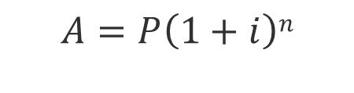
Rate of Return
Compound interest is interest paid on both the original deposit and also any accumulated
A = Amounts; P = Principle; i = interest rate; n = compound periods
Normally annual interest rate is stated
If interest is not paid annually, the compound period has to be adjusted accordingly
$$A=P\left(1+i\right)n$$

Slide 14
Rate of Return
$1000 is deposited into a savings account offering interest rate of 12% p.a. for a year.
Interest pay | Compound Period | Corresponding Interest Rate | Amount | Yield
Annually
Half-yearly
Monthly
Weekly
Daily

Slide 15
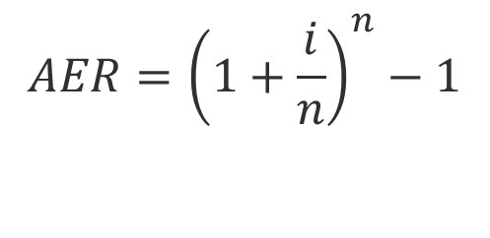
Rate of Return
Annual Equivalent Rate (AER), or Annual Percentage Yield (APY), is an interest rate that reflects what the interest rate would be if the interest was paid and compounded every year
The AER is based on the assumption that interest is accumulated in the account and is not withdrawn
The AER could be used to determine which banks offer better rates and which banks may be attractive investments
$$AER={\left(1+\frac{i}{n}\right)}^{n}−1$$

Slide 16
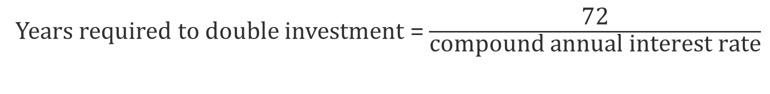
Rate of Return
How long does it take to double your savings?
The rule of 72 is a shortcut to estimate the number of years required to double your money at a given annual rate of return.
The rule of 72 is reasonably accurate for interest rates between 6% and 10%.
When dealing with rates outside this range, the rule can be adjusted by adding or subtracting 1 from 72 for every 3 points the interest rate diverges from 8%.
  For 11% annual compounding interest, the rule of 73 is more appropriate
  For 14%, it would be the rule of 74; for 5%, the rule of 71.
Years required to double investment = $\frac{\text{72}}{\text{compound} \text{annual} \text{interest} \text{rate}}$

Slide 17
Rate of Return
Comparing the AER for savings account and time deposit of HSBC
Savings Account
Account Balance | Interest Rate
Less than HKD5,000 | 0.000%
HKD5,000 to HKD9,999 | 0.001%
HKD10,000 to HKD149,999 | 0.001%
HKD150,000 or above | 0.001%
Time deposit
Deposit Period | HKD10,000 | HKD100,000 | HKD500,000 | HKD1,000,000
 | to | to | to | or above
 | HKD99,999 | HKD499,999 | HKD999,999
1 week | 0.001% | 0.001% | 0.001% | 0.001%
2 weeks | 0.001% | 0.001% | 0.001% | 0.001%
1 month | 0.010% | 0.010% | 0.010% | 0.010%
2 months | 0.010% | 0.010% | 0.010% | 0.010%
3 months | 0.010% | 0.010% | 0.010% | 0.010%
6 months | 0.050% | 0.050% | 0.050% | 0.050%
9 months | 0.100% | 0.100% | 0.100% | 0.150%
12 months | 0.150% | 0.150% | 0.150% | 0.200%

Slide 18
Inflation
The rate of return you earn on your savings should be compare with the inflation rate
In general, as the inflation rate increases, the interest rates offered to savers also increase
If Inflation rate < Nominal interest rate, you earn real return from your savings
If Inflation rate > Nominal interest rate, your real return from savings will be negative
Real Interest %= Nominal Interest % – Inflation%

Slide 19
Inflation

Slide 20
Tax Considerations
In some countries, government collect taxes on interest
  Interest earning is part of your income
Banks will act for the government as collectors
Tax will be deducted from the gross interest paid to savers
Taxpayers will receive the net interest
This reduces the return generated from savings
Consider the after-tax return when comparing accounts
No tax on interest in HK

Slide 21
Tax Considerations
You have the right of abode in both HK and UK.
You have £5000 and are considering to put into a savings account. There are two options available to you.
  Put it into a foreign currency account of HSBC in HK which offers a rate at 2.75%
  Put it into a savings account with HSBC in UK which offers a rate of 3%
Given that a interest tax of 20% in UK, which option is better to you?
Account | Gross Interest | Net Interest
HK@2.75% | £5000 x2.75%=£137.5 | £137.5
UK@3% | £5000x3%=£150 | £150 -(£150x20%)=£120

Slide 22
Liquidity
Liquidity allows you to withdraw your money on short notice without a loss of value of fees
In general, high interest rate compensates low liquidity
Some savings plan impose penalties for early withdrawal or have other restrictions
  Loss of interest or lower earnings rate
Consider the degree of liquidity you desire in relation to your savings goals.
  To achieve long term financial goas, you may decide trade off liquidity for a higher return.

Slide 23
Safety
Saving in bank is deemed to be one of the safest options
There is still possibility for you to lose your capital when banks fail
Bank run occurs when a bank fails to meet a massive withdrawal and become insolvent
  Maturity mismatch
When people holds the belief that a bank is at risk for insolvency, the risk arises no matter it is real or perceived
  The spread of rumours can cause bank runs
Failing of a bank can lead to a contagion effect
  Banking panic

Slide 24
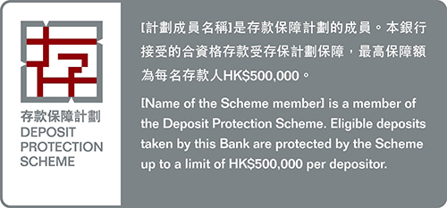
Safety
To reduce the risk of having a bank run due to the spread of rumours, the HK government launched the Deposit Protection Scheme (DPS) in 2006.
DPS protects eligible deposits held with banks in Hong Kong which are members of the Scheme.
It will pay you compensation up to a limit of HK$500,000 if the bank with which you hold your eligible deposits fails.
Your eligible deposits are protected regardless of the currency in which the deposits are denominated.
Eligible deposits include all types of ordinary deposits such as current accounts, savings accounts, secured deposits and time deposits with a maturity not exceeding five years.

Slide 25
Safety
The following types of financial products are not protected by the DPS
  structured deposits
  term deposits with a maturity exceeding 5 years
  deposits the repayment of which are secured on the assets of the Scheme member
  bearer instruments
  off-shore deposits
  deposits held for the account of the Exchange Fund
  deposits held by an excluded person
  financial products other than deposits
http://www.dps.org.hk/en/coverage.html

Slide 26
Restrictions and Fees
Some banks imposed restrictions and fees on saving accounts
  Monthly fee
  Minimum balance requirement
  ATM Savings Account Counter Service Fee
  Inactive Account Service Charges

Slide 27
Service | Hang Seng Bank | HSBC | Bank of China | Citibank | Standard Chartered
Monthly Fee | HKD Passbook / Statement Savings Account - HK$50 per month if average daily balance of account below HK$5,000; ATM Passbook / ATM Statement Savings Account - Not subject to Below Balance Service Fee | HK$50 (Accounts with monthly balance less than HK$5,000) | HK$60 (Combined average monthly balance in HKD current account(s) and savings account(s) below HK$5,000) | HK$60 (Accounts with monthly balance less than HK$10,000) | HK$100 (Accounts with monthly balance less than HK$10,000)
Transfer / cash withdrawal | HK$20 | HK$20 | HK$20 | NA | NA
HKD account transactions conducted through branches | Free (50 transactions or below); HK$30 per transaction (Above 50 transactions) | NA | NA | NA | NA
Inactive Account Service Charges | HK$100 - Inactive for two years and balance below HK$2000 | NA | NA | NA | NA

