Slide 1
EE2203 Modelling Techniques
Week 8
Simple Regression

Slide 2
Objectives
Describe the relationship between an independent variable X and a continuous dependent variable Y (as a straight line)
  Two scenarios:
    Fixed-X: values of X are preselected by investigator
    Variable-X: random sample of (X, Y) values
Draw inferences about this relationship
Predict value of Y for a given value of X

Slide 3
The Model
Mean of Y values at any given X: α + βX
Variance of Y values at any X: σ² (same for all X)
Y values are normally distributed at any given X (need for inference)

Slide 4
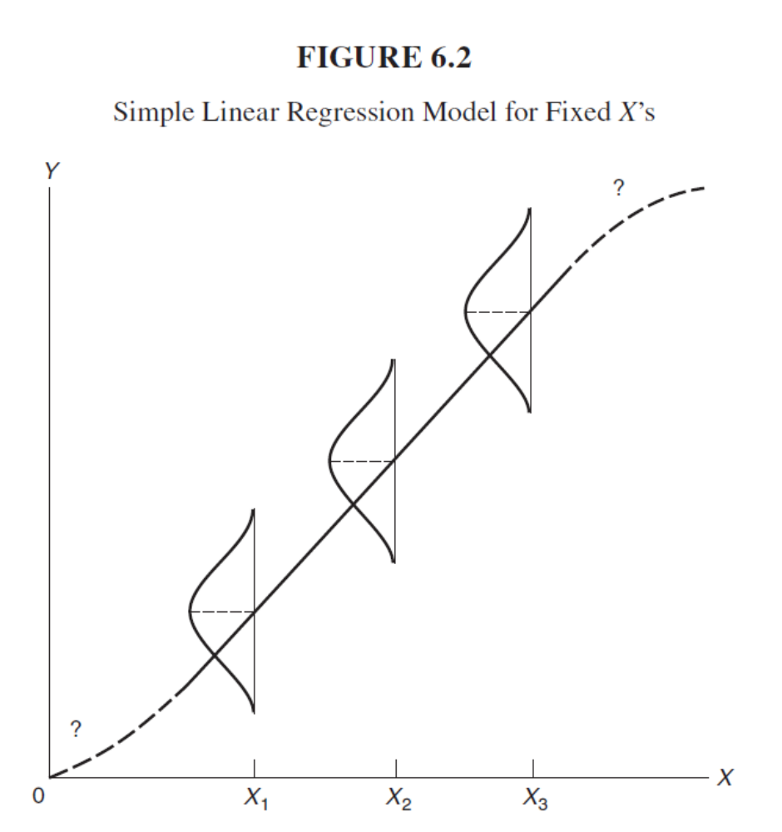

Slide 5
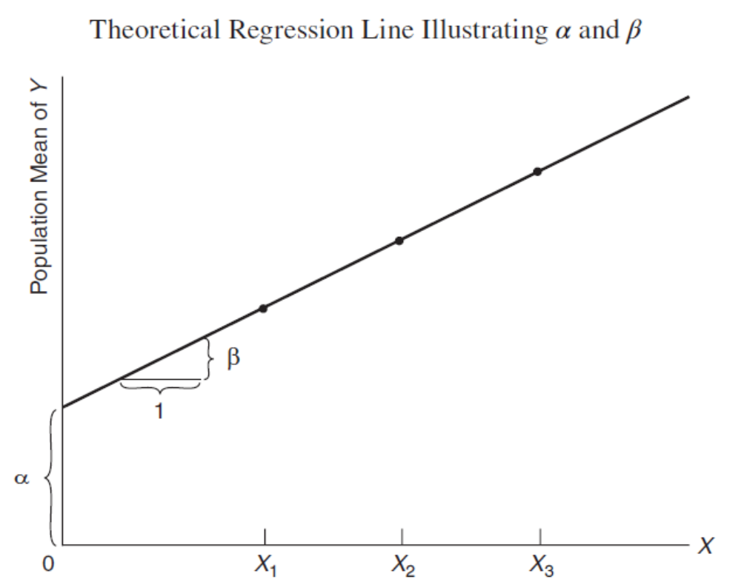

Slide 6
Analysis
Obtain estimates of slope (B) and intercept (A) using least squares
Residual mean square = estimate of variance (S²)
Test of β = β₀
  Usually test β = 0 (X has no effect on Y)

Slide 7
Confidence and Prediction Intervals
Confidence interval (CI) for mean of Y
Prediction interval (PI) for individual Y:
*PI is wider than CI*

Slide 8
Correlation Coefficient
Population covariance
  Positive σ_{XY} : X and Y increases or decreases together
  Negative σ_{XY}: X and Y goes in opposite direction
The correlation coefficient (ρ):
  Measures the strength of association between X and Y in the population
We estimate it by (r) or (R)

Slide 9
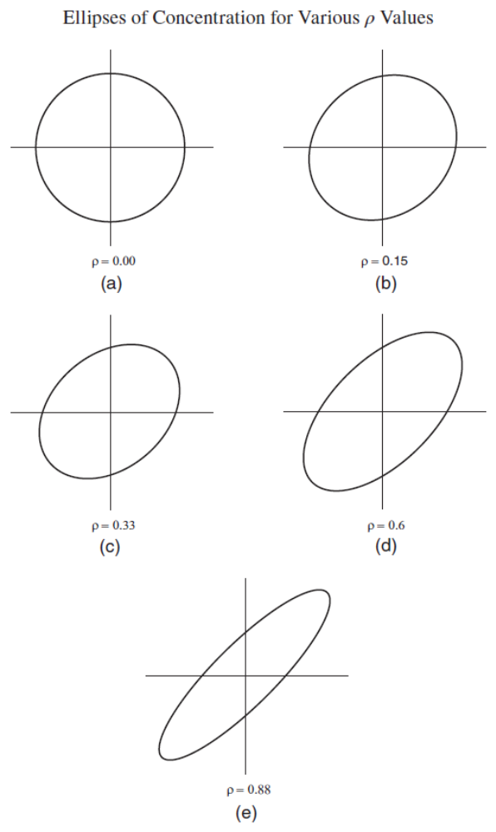

Slide 10
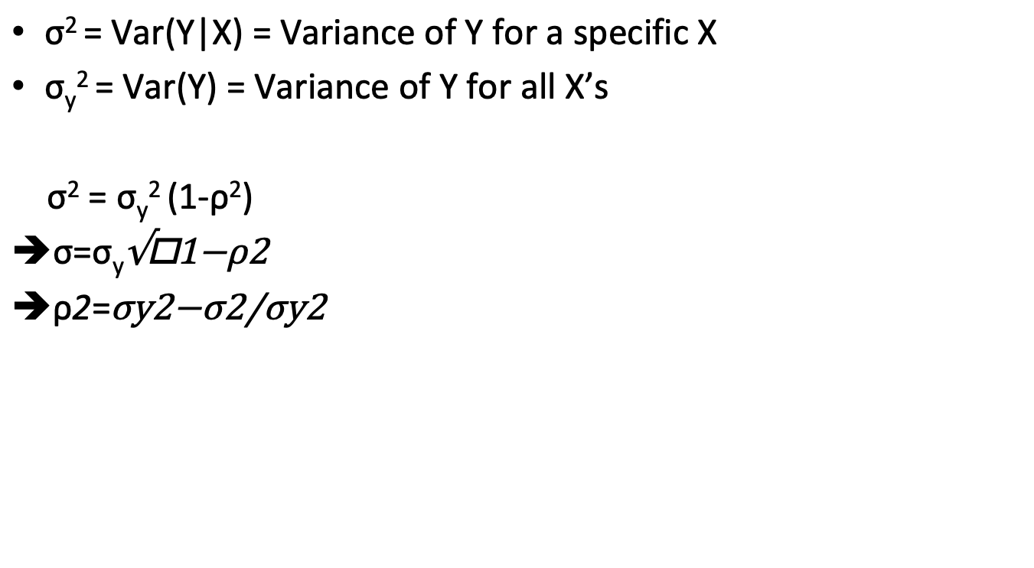
Value of ρ
σ² = Var(Y|X) = Variance of Y for a specific X
σ_{y}² = Var(Y) = Variance of Y for all X’s
σ² = σ_{y}² (1-ρ²)
➔$\text{σ}$=σ_{y}$\sqrt{\text{1−}\text{ρ}\text{2}}$
➔$\text{ρ}\text{2}$=$\frac{\text{σ}\text{y}\text{2}\text{−}\text{σ}\text{2}}{\text{σ}\text{y}\text{2}}$

Slide 11
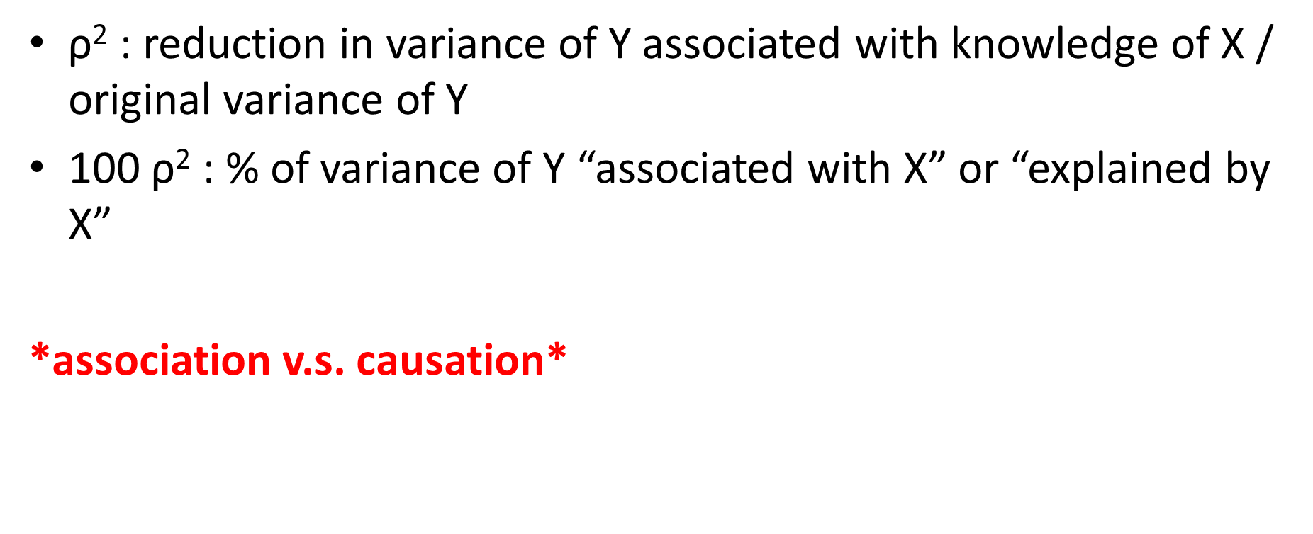
Interpretation of ρ
$\text{ρ}\text{2}$ : reduction in variance of Y associated with knowledge of X / original variance of Y
100 $\text{ρ}\text{2}$ : % of variance of Y “associated with X” or “explained by X”
*association v.s. causation*

Slide 12
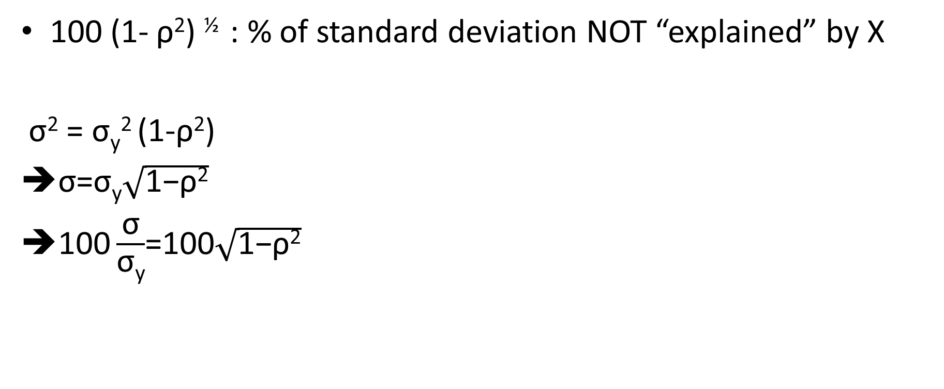
Another Interpretation of ρ
100 (1- ρ²) ^{½} : % of standard deviation NOT “explained” by X
σ² = σ_{y}² (1-ρ²)
➔$\text{σ}$=σ_{y}$\sqrt{\text{1−}\text{ρ}\text{2}}$
➔$\text{100}\frac{\text{σ}}{\text{σ}\text{y}}$=100$\sqrt{\text{1−}\text{ρ}\text{2}}$

Slide 13
Example of Interpretation of ρ
ρ | % of variance “explained” | % of variance not “explained” | % of SD “explained” | % of SD not “explained”
0.3 | 9% | 91% | 5% | 95%
0.5 | 25% | 75% | 13% | 87%
0.71 | 50% | 50% | 29% | 71%
0.95 | 90% | 10% | 69% | 31%

Slide 14
Example: Lung Function
Data were from an epidemiological study of households
  Living in four areas with different amounts and types of air pollution
We use only the data taken on the fathers, all are nonsmokers:
  X = height in inches
  Y =forced expiratory volumn in one second (FEV1)

Slide 15
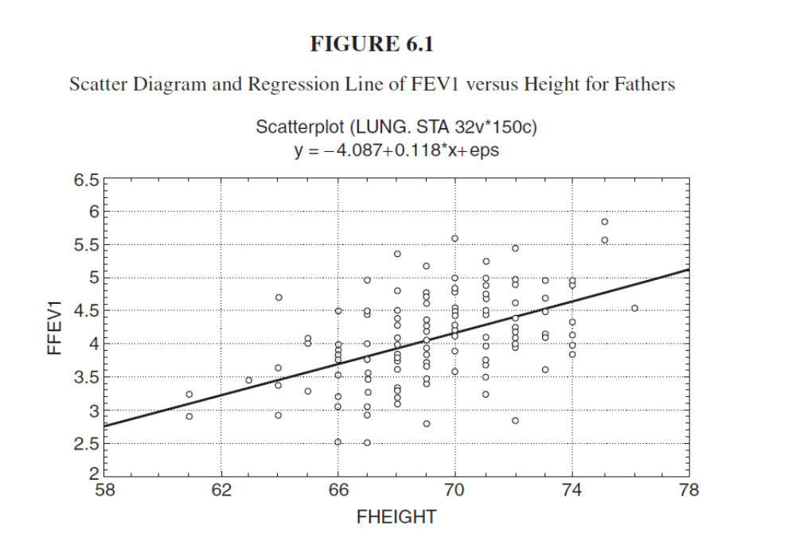

Slide 16

Results of the Example
Least-square equation:
Y=-4.087+0.118X
Correlation r = 0.504
Test ρ =0,
  t=7.1, p-value <0.0001
  T test can be one or two-sided
$$t=\frac{r\left(N−2\right)1/2}{\left(1−r2\right)1/2}$$

Slide 17
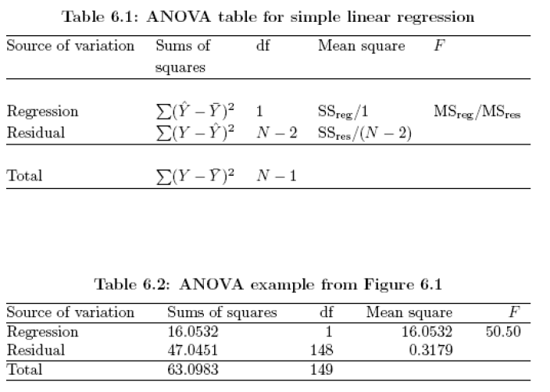

Slide 18
Test β = 0
From ANOVA table:
  F=50.5
  2-sided test: p-value <0.0001
  One-sided test: t=F^{1/2} = 7.1
  *Same as test for ρ = 0

Slide 19
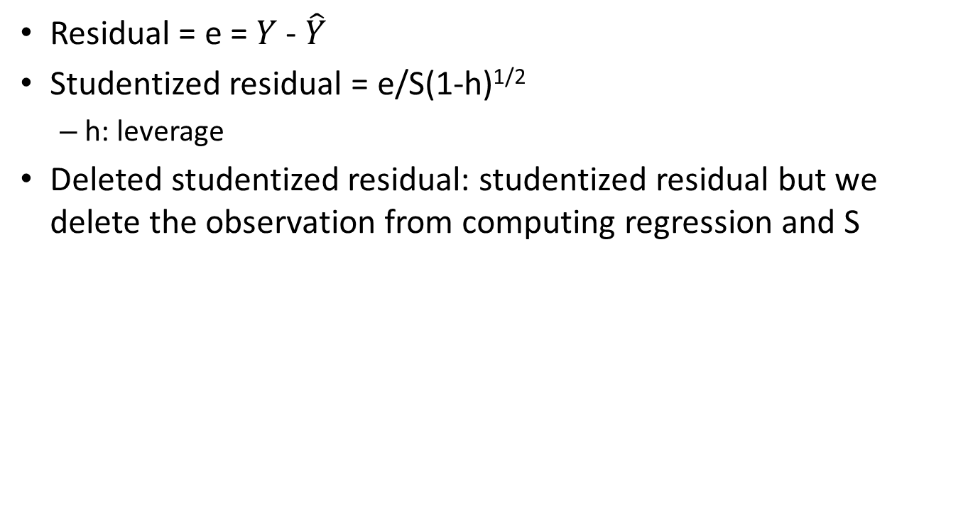
Residual Analysis
Residual = e = $Y$ - $\hat{Y}$
Studentized residual = e/S(1-h)^{1/2}
  h: leverage
Deleted studentized residual: studentized residual but we delete the observation from computing regression and S

Slide 20
Outliers
Outlier in Y if studentized (or deleted studentized) residual > 2
Leverage = h
  X’s far from the mean of X have large leverage (h)
  Observations with large h can have a large effect on the slope of the line
Outlier in X if h > 2(P+1)/N, where P=no. of predictor variables
  h>4/N

Slide 21
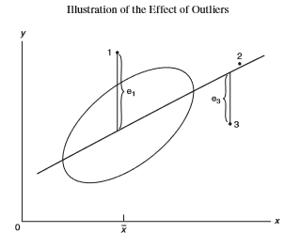
3: has high leverage and is an outlier in Y of outliers
1: an outlier in Y with low leverage
  Affects estimate of intercept but not slope
  Tends to increase the estimate of S and the SE of B
2: has high leverage, not an outlier in Y
  Will not affect the estimate of B or A
3: has high leverage and is an outlier in Y
  Affects the value of B, A and S
* Point 3 has the highest effect

Slide 22
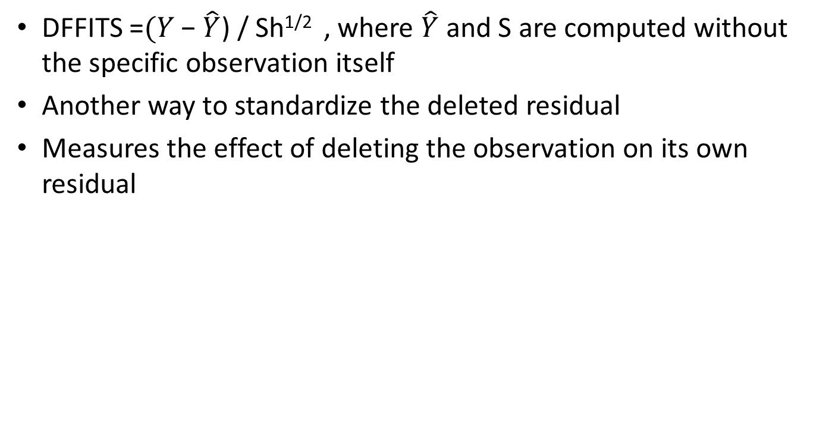
Influence measures:
DFFITS for a specific observation
DFFITS =$(Y\text{ − }\hat{Y}$) / Sh^{1/2} , where $\hat{Y}$ and S are computed without the specific observation itself
Another way to standardize the deleted residual
Measures the effect of deleting the observation on its own residual

Slide 23
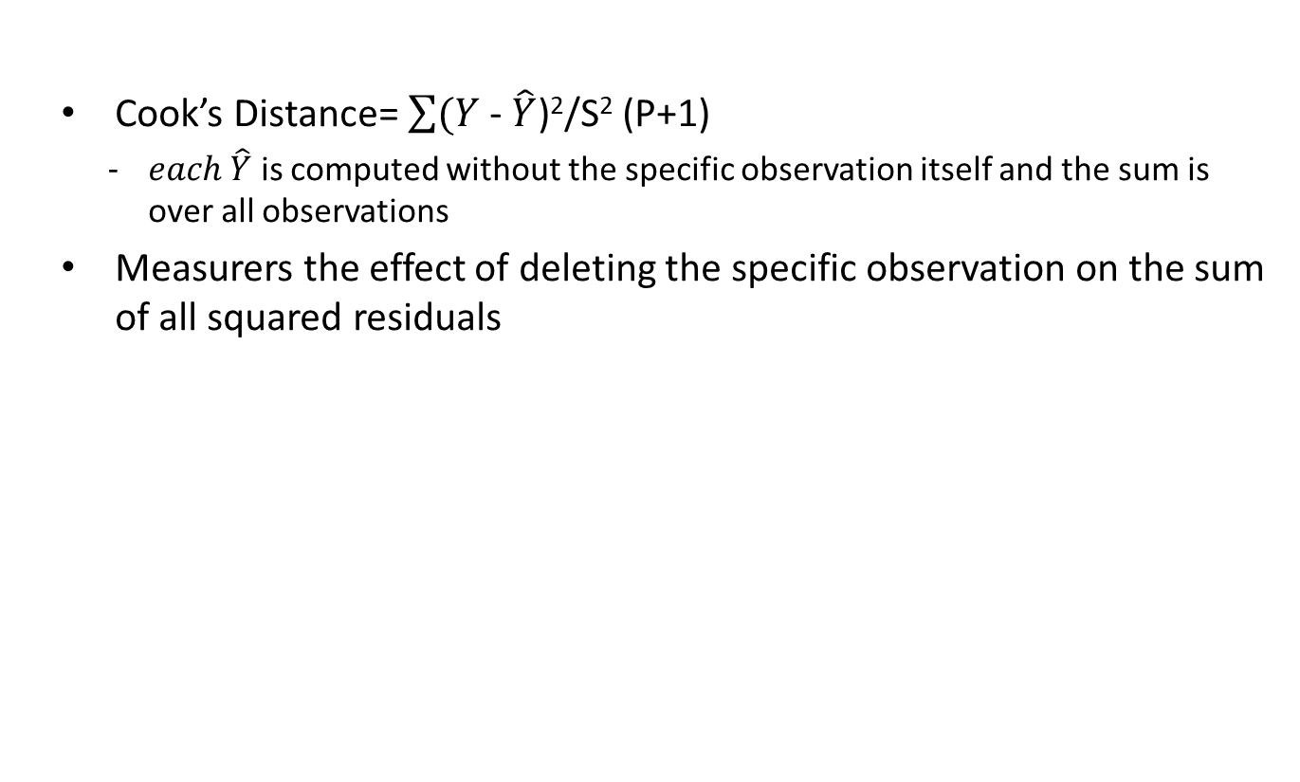
Influence measures:
Cook’s Distance for a specific observation
  Cook’s Distance= $\sum{(Y\text{ − }\hat{Y}\text{)}\text{2}\text{/}\text{S}\text{2}}$ (P+1)
    $each \hat{Y}$ is computed without the specific observation itself and the sum is over all observations
  Measurers the effect of deleting the specific observation on the sum of all squared residuals

Slide 24
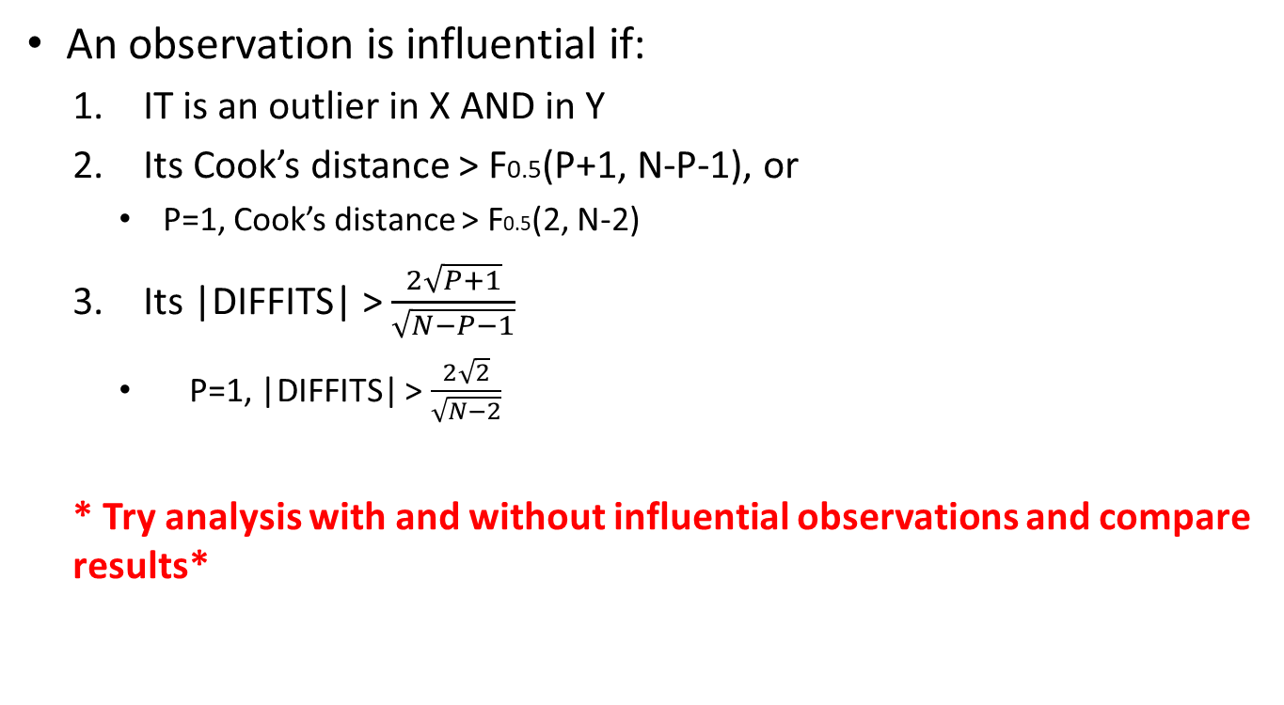
Influential observations
An observation is influential if:
  IT is an outlier in X AND in Y
  Its Cook’s distance > F0.5(P+1, N-P-1), or
    P=1, Cook’s distance > F0.5(2, N-2)
  Its |DIFFITS| > $\frac{2\sqrt{P+1}}{\sqrt{N−P−1}}$
    P=1, |DIFFITS| > $\frac{2\sqrt{2}}{\sqrt{N−2}}$
  * Try analysis with and without influential observations and compare results*

Slide 25
Assumptions
Homogeneity of variance (same σ² )
  Not extremely serious
  Can use transformations to achieve it
Normal residuals
  Slight departures are OK
  Can use transformations to achieve it
Randomness
  Very serious
  Can use hierarchical models for clustered samples

Slide 26
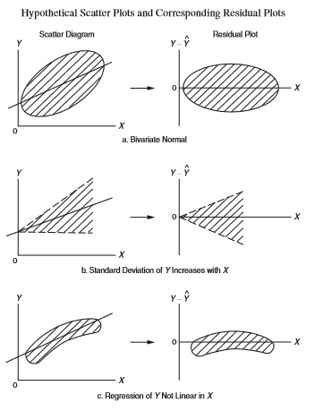
Checking Assumptions
Plot the residuals vs. X or vs. the predicted Y to check linearity and homogeneity of variance
Create normal probability plots of residuals to check for normality
Residuals plots:

Slide 27
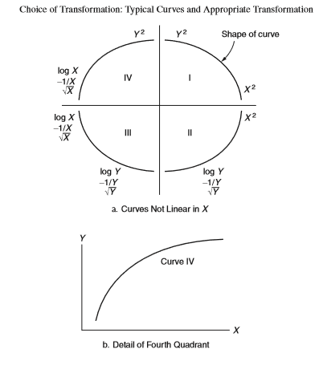
Transformations

Slide 28
What to watch out for
Need representative sample
Range of prediction should match observed range of X in sample
Use of nominal or ordinal, rather than interval or ratio data
Errors-in-variables
Correlation does not imply causation
Violation of assumptions
Influential points
Appropriate model

Slide 29
Acknowledgement
Textbook: Abdelmonem Afifi, Susanne May, Virginia A. Clark. Practical Multivariate Analysis. Fifth Edition. CRC Press Taylor & Francis Group
Thanks Professor Afifi for his courtesy to share the materials

