Slide 1
Greedy Algorithm
A technique to solve problems:
  always makes the locally best choice at the moment (local optimal).
  Hopefully, a series of locally best choices will lead to a globally best solution.
Greedy algorithms yield optimal solutions for many (but not all) problems.

Slide 2
Ideas for Interval Scheduling and Interval Partitioning
sort all the jobs in a list using a ‘greedy’ principle, and then choose it one by one.

Slide 3
Kruskal’s Algorithm
In the beginning, we have a forest where each node is a tree.
merge these trees step by step.
  We connect two trees with an edge. This edge is chosen to be a shortest one connecting two different trees.
Eventually, the forest becomes a tree.
Notes:
The first one Kruskal algorithm. The main idea behind this algorithm is to add links in a forest and eventually get a tree.
This algorithm starts with a forest where each node is a tree.
So If the network under consideration has 20 nodes. We start with 20 nodes without any links. In other words, the first forest has 20 trees, each tree has one node.
Then we merge these trees step by step. In each step, we add one link.
We connect two trees with a link. This link is chosen to be the one with the smallest cost among all the links which can connect two different trees.
In each step, you connect two trees. After n-1 steps, you will get a tree.

Slide 4
Prim’s algorithm
In the beginning, Set T as a single node.
At each step, add to T the shortest edge between a node in T and a node not in T.
Finally, T becomes a spanning tree.
Notes:
In this algorithm, at each step, H is a tree. You enlarge it step by step. At each step, you choose

Slide 5
Single-Source Shortest Paths
Problem Definition
Shortest paths and Relaxation
Dijkstra’s algorithm (a greedy algorithm)

Slide 6
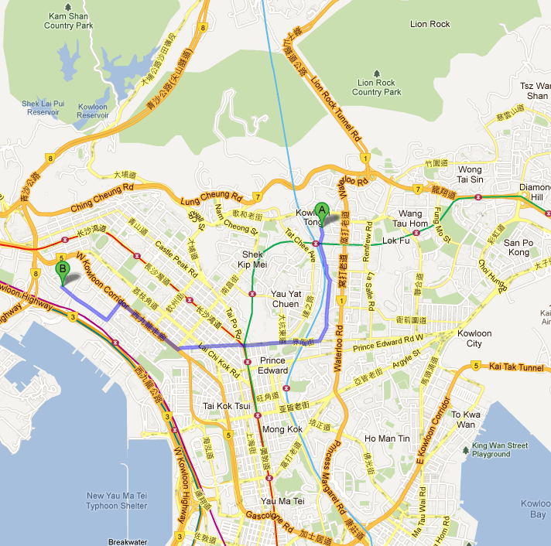
B
A
Find a shortest path from A to B.
-need serious thinking to get a correct algorithm.

Slide 7
Problem Definition:
Given a directed graph G=(V, E, W), where each edge has a weight (length, cost),
Find a shortest path from s to v.
  s—source
  v—destination.

Slide 8
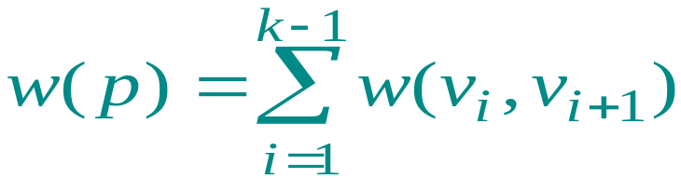
Paths in graphs
Consider a digraph G = (V, E) with edge-weight function w : E → R. The total weight (length) of path
p = v₁ →v₂ → …. → v_{k} is defined to be
.
Example:
v₁
v₃
v₅
4
2
5
1
v₂
v₄
w(p) = 4+2+5+1=12

Slide 9
Shortest paths
A shortest path from u to v is a path of minimum total weight from u to v. The shortest-path weight from u to v is defined as
δ(u, v) = min{w(p) : p is a path from u to v}.
Note: δ(u, v) = +∞ if no path from u to v exists.

Slide 10
Well-definedness of shortest paths
If a graph G contains a negative-weight cycle, then some shortest paths may not exist.
Example:
…
< 0
u
v

Slide 11


Negative-Weight edges:
negative-weight cycles
  the total weight in the cycle (circuit) is negative.
If no negative-weight cycles reachable from the source s, then for all v ∈V, the shortest-path weight remains well defined, even if it has a negative value.
If there is a negative-weight cycle on some path from s to v, we define = - .
We assume that all the edges have weights >=0.

Slide 12
Optimal substructure
Theorem. A subpath of a shortest path is a shortest path.
Outline of Proof.

Slide 13

Representing shortest paths:
we maintain for each node v∈V, a predecessor
[v] that is the vertex in the shortest path right before v.
With the values of , a backtracking process can give the shortest path. (example)

Slide 14
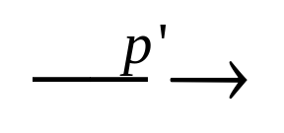
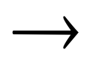

Observation: (basic)
Suppose that a shortest path p from a source s to a vertex v can be decomposed into
s u v
for some vertex u and path p’. Then, the weight of a shortest path from s to v is
We do not know what is u for v, but we know u is in V and we can try all nodes in V in O(n) time.
Also, if u does not exist, the edge (s, v) is the shortest.
Question: how to find (s, u), the first shortest from s to some node?

Slide 15

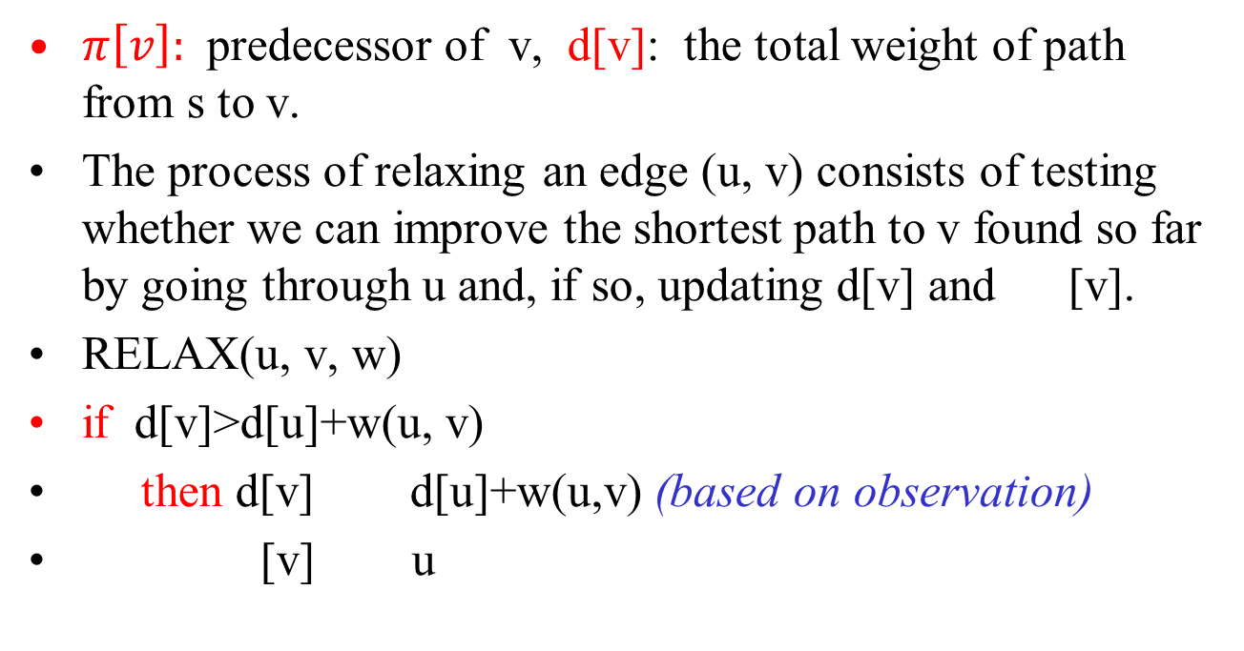
Relaxation
$π\left[v\right]:$ predecessor of v, d[v]: the total weight of path from s to v.
The process of relaxing an edge (u, v) consists of testing whether we can improve the shortest path to v found so far by going through u and, if so, updating d[v] and [v].
RELAX(u, v, w)
if d[v]>d[u]+w(u, v)
then d[v] d[u]+w(u,v) (based on observation)
[v] u

Slide 16

u
v
u
v
2
2
5
9
5
6
RELAX(u,v)
RELAX(u,v)
u
v
u
v
2
2
5
7
5
6
(a)
(b)
relaxation of an edge (u,v).The shortest-path estimate of each vertex
is shown within the vertex. (a)Because d[v]>d[u]+w(u,v) prior to relaxation,
the value of d[v] decreases. (b)Here, d[v] d[u]+w(u,v) before the relaxation
step,so d[v] is unchanged by relaxation.

Slide 17
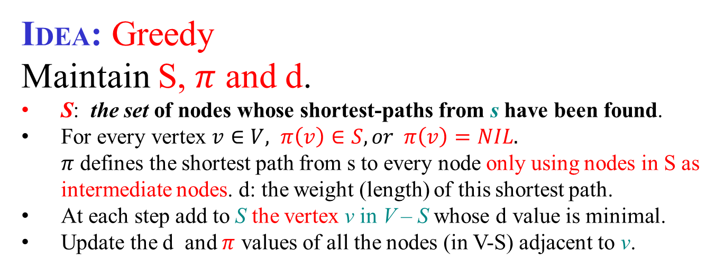
Single-source shortest paths
Problem. From a given source vertex s ∈ V, find a shortest-path from s to every v ∈ V.
IDEA: Greedy
Maintain S, $π$ and d.
S: the set of nodes whose shortest-paths from s have been found.
For every vertex $v∈V, π\left(v\right)∈S, or π\left(v\right)=NIL.$
  $π$ defines the shortest path from s to every node only using nodes in S as intermediate nodes. d: the weight (length) of this shortest path.
At each step add to S the vertex v in V – S whose d value is minimal.
Update the d and $π$ values of all the nodes (in V-S) adjacent to v.

Slide 18
Example of Dijkstra’s algorithm
2
B
D
10
A
8
1
4
7
9
3
C
E
2

Slide 19

Example of Dijkstra’s algorithm
∞
∞
Initialize:
2
B
D
10
Q:
A
B
C
D
E
0
A
8
d
0
Nil
∞
Nil
∞
Nil
∞
Nil
∞
Nil
1
4
7
9
$$π$$
3
C
E
2
∞
∞
S: {}

Slide 20




Example of Dijkstra’s algorithm
∞
∞
“A” ← EXTRACT-MIN(Q):
2
B
D
10
A
8
0
1
4
7
9
3
Q:
A
B
C
D
E
C
E
2
d
0
∞
∞
∞
∞
∞
∞
$$π$$
$$NIL$$
$$NIL$$
$$NIL$$
$$NIL$$
$$NIL$$
S: { A }

Slide 21


Example of Dijkstra’s algorithm
10/Α
∞
Relax all edges leaving A:
2
B
D
Q: can A be a better
predecessor for other vertices?
10
A
8
0
1
4
7
9
3
Q:
A
B
C
D
E
C
E
2
d
0
10
3
∞
∞
3/Α
∞
$$π$$
$$NIL$$
$$A$$
$$A$$
$$NIL$$
$$NIL$$
S: { A }

Slide 22






Example of Dijkstra’s algorithm
10/A
∞
“C” ← EXTRACT-MIN(Q):
2
B
D
10
A
8
0
1
4
7
9
3
C
C
E
Q:
A
B
C
D
E
2
d
0
10
3
∞
∞
3/A
∞
$$π$$
$$NIL$$
$$A$$
$$A$$
$$NIL$$
$$NIL$$
S: { A, C }

Slide 23






Example of Dijkstra’s algorithm
7/C
11/C
Relax all edges leaving C:
2
B
D
10
A
8
0
1
4
7
9
3
C
E
2
Q:
A
B
C
C
D
E
3/A
5/C
d
0
7
3
11
5
$$π$$
$$NIL$$
$$C$$
$$A$$
$$C$$
$$C$$
S: { A, C }

Slide 24






Example of Dijkstra’s algorithm
7
11
“E” ← EXTRACT-MIN(Q):
2
B
D
10
A
8
0
1
4
7
9
3
C
E
Q:
A
B
C
2
C
D
E
3
5
d
0
7
3
11
5
$$π$$
$$NIL$$
$$C$$
$$A$$
$$C$$
$$C$$
S: { A, C, E }

Slide 25






Example of Dijkstra’s algorithm
7/C
11/C
Relax all edges leaving E:
2
B
D
10
A
8
0
1
4
7
9
3
C
E
2
Q:
A
B
C
C
D
E
3/A
5/C
d
0
7
3
11
5
$$π$$
$$NIL$$
$$C$$
$$A$$
$$C$$
$$C$$
S: { A, C, E }

Slide 26

Example of Dijkstra’s algorithm
7/C
11/C
“B” ← EXTRACT-MIN(Q):
2
B
D
10
A
8
0
1
4
7
9
3
C
E
2
Q:
A
B
C
C
D
E
3/A
5/C
d
0
7
3
11
5
$$π$$
$$NIL$$
$$C$$
$$A$$
$$C$$
$$C$$
S: { A, C, E, B }

Slide 27
Example of Dijkstra’s algorithm
7/C
11/C
“B” ← EXTRACT-MIN(Q):
2
B
D
10
A
8
0
1
4
7
9
3
C
E
2
Q:
A
B
C
C
D
E
3/A
5/C
d
0
7
3
11
5
$$π$$
$$NIL$$
$$C$$
$$A$$
$$C$$
$$C$$
S: { A, C, E, B }

Slide 28






Example of Dijkstra’s algorithm
Relax all edges leaving B:
7/C
9/B
2
B
D
10
0
A
8
1
4
7
9
3
C
E
Q:
A
B
C
C
D
E
2
d
0
7
3
9
5
3/C
5/C
$$π$$
$$NIL$$
$$C$$
$$A$$
$$B$$
$$C$$
S: { A, C, E, B }

Slide 29
Example of Dijkstra’s algorithm
7/C
9/B
2
D
“D” ← EXTRACT-MIN(Q):
B
10
0
A
8
1
4
7
9
3
C
E
Q:
A
B
C
C
D
E
2
d
0
7
3
9
5
3/C
5/C
$$π$$
$$NIL$$
$$C$$
$$A$$
$$B$$
$$C$$
S: { A, C, E, B,D }

Slide 30

Example of Dijkstra’s algorithm
7/C
9/B
2
D
“D” ← EXTRACT-MIN(Q):
B
10
0
A
8
1
4
7
9
3
C
E
Q:
A
B
C
C
D
E
2
d
0
7
3
9
5
3/A
5/C
$$π$$
$$NIL$$
$$C$$
$$A$$
$$B$$
$$C$$
S: { A, C, E, B,D }
Backtracking to find the shortest path from A to D:
D$←$B $←$C $←$A

Slide 31
Backtracting code: print out the path from s to u.
print (u)
x=π(u)
while (x ≠ s)
print (x)
x=π(x)
print x

Slide 32
Initialization:
For each vertex v ∈ V, d[v] denotes the length of the shortest path found so far from source s to v.
d[v]– will be δ(s, v) after the execution of the algorithm.
initialize d[v] and π[v] as follows: .
INITIALIZE-SINGLE-SOURCE(G,s)
for each vertex v ∈ V\{s}
do d[v]
[v] NIL
d[s] 0

Slide 33
Dijkstra’s Algorithm:
Dijkstra’s algorithm assumes that w(e)≥0 for each e in the graph.
maintain a set S of vertices such that
  Every vertex v ∈S, d[v]=δ(s, v), i.e., the shortest-path from s to v has been found. (Initial values: S=empty, d[s]=0 and d[v]=∝)
(a) select the vertex u∈V-S such that
d[u]=min {d[x]|x ∈V-S}. Set S=S∪{u}
(b) for each node v adjacent to u do RELAX(u, v, w).
Repeat step (a) and (b) until S=V.

Slide 34
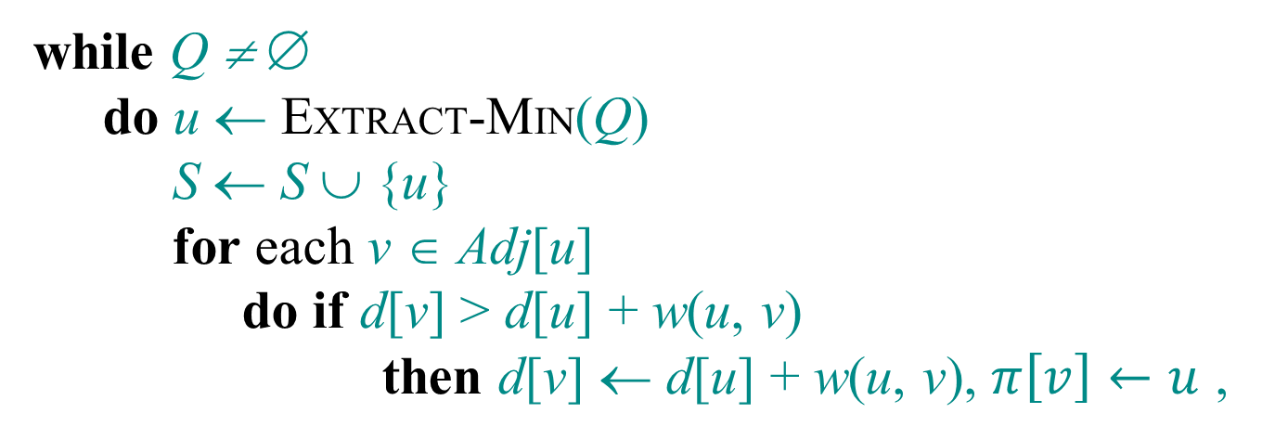
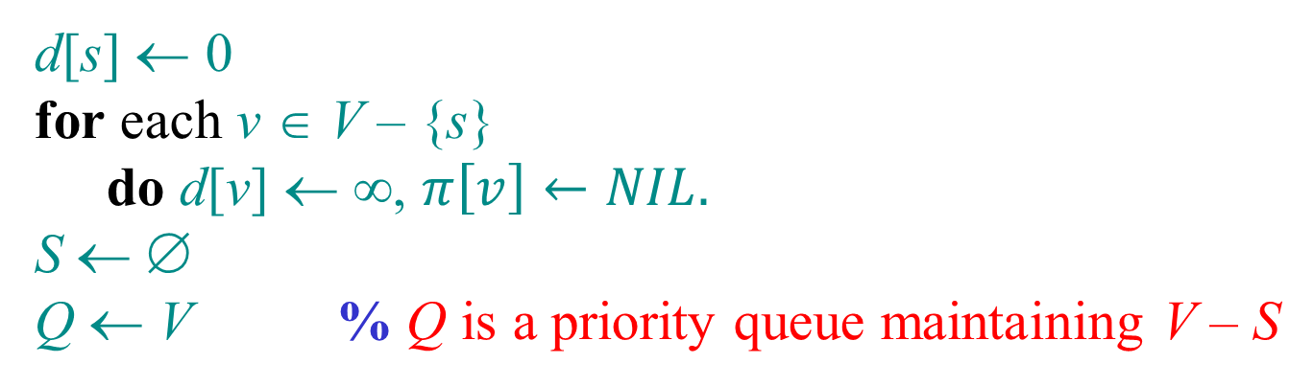
Dijkstra’s algorithm
d[s] ← 0
for each v ∈ V – {s}
  do d[v] ← ∞, $π\left[v\right]←NIL.$
S ← ∅
Q ← V % Q is a priority queue maintaining V – S
while Q ≠ ∅
  do u ← EXTRACT-MIN(Q)
    S ← S ∪ {u}
    for each v ∈ Adj[u]
      do if d[v] > d[u] + w(u, v)
        then d[v] ← d[u] + w(u, v), $π\left[v\right]←u$ ,
relaxation step
Implicit DECREASE-KEY using update(v,k)

Slide 35
Implementation:
a priority queue Q stores vertices in V-S, keyed by their d[] values.
the graph G is represented by adjacency lists.

Slide 36
Theorem: Consider the set S at any time in the algorithm’s execution. For each v∈ S, the current d[v] is the length of the shortest s-v path.
Proof: We prove it by induction on |S|.
If |S|=1, then the theorem holds. (Because d[s]=0 and S={s}.)
Suppose that the theorem is true for |S|=k for some k>0.
Now, we grow S to size k+1 by adding the node v.

Slide 37
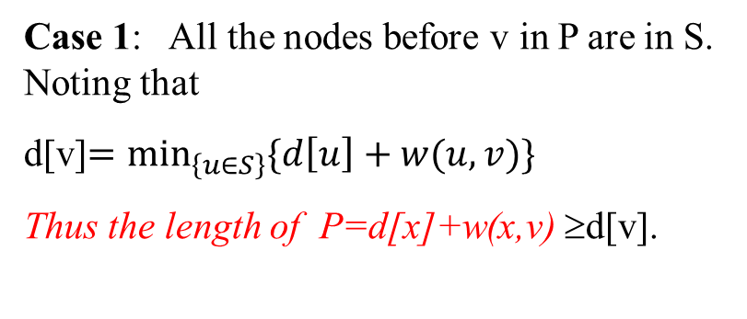
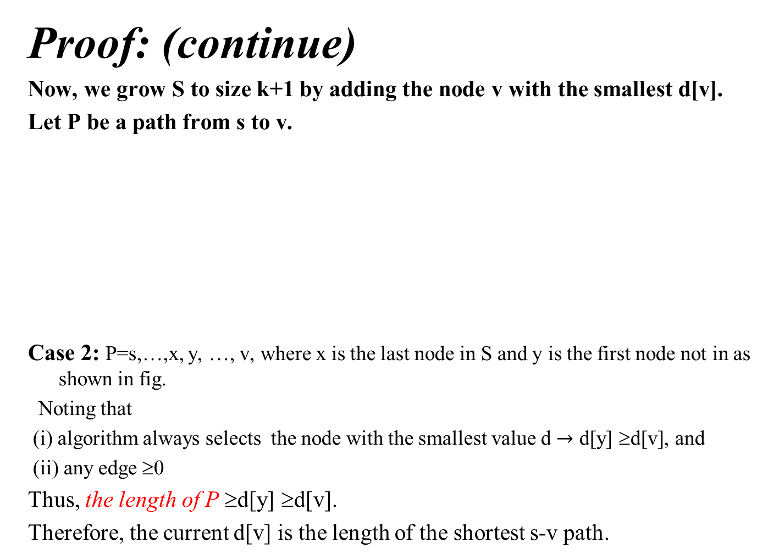
Proof: (continue)
Now, we grow S to size k+1 by adding the node v with the smallest d[v].
Let P be a path from s to v.
Case 2: P=s,…,x, y, …, v, where x is the last node in S and y is the first node not in as shown in fig.
Noting that
(i) algorithm always selects the node with the smallest value d $→$ d[y] ≥d[v], and
(ii) any edge ≥0
Thus, the length of P ≥d[y] ≥d[v].
Therefore, the current d[v] is the length of the shortest s-v path.
y
x
Case 1: All the nodes before v in P are in S. Noting that
d[v]$=\min_{\left\{u∈S\right\}}{\{d\left[u\right]+w(u,v)\}}$
Thus the length of P=d[x]+w(x,v) ≥d[v].
+
s
u
v
Set S

Slide 38
Time complexity of Dijkstra’s Algorithm:
Time complexity depends on implementation of the Queue.
Method 1: Use an array to story the Queue
EXTRACT -MIN(Q) --takes O(|V|) time.
  Totally, there are |V| EXTRACT -MIN(Q)’s.
  time for |V| EXTRACT -MIN(Q)’s is O(|V|²).
RELAX(u,v,w) --takes O(1) time.
  Totally |E| RELAX(u, v, w)’s are required.
  time for |E| RELAX(u,v,w)’s is O(|E|).
Total time required is O(|V|²+|E|)=O(|V|²)
Backtracking with π[] gives the shortest path in inverse order.
Method 2: The priority queue is implemented as a adaptable heap. It takes O(log n) time to do EXTRACT-MIN(Q) as well as | RELAX(u,v,w). The total running time is O(|E|log |V| ).

Slide 39
The algorithm does not work if there are negative weight edges in the graph
u
-10
2
v
s
1
s→v is shorter than s → u, but it is longer than
s → u → v.

