Slide 1
EE 3114 Systems and Control
2. Mathematical Modeling
Semester A, 2019-20

Slide 2
Mathematical Representation of a System
To control a system, a mathematical representation of the system is needed, which can be:
a functional relationship between input and
output of the system – map
2) a state-space description of the system
– ordinary differential equation

Slide 3
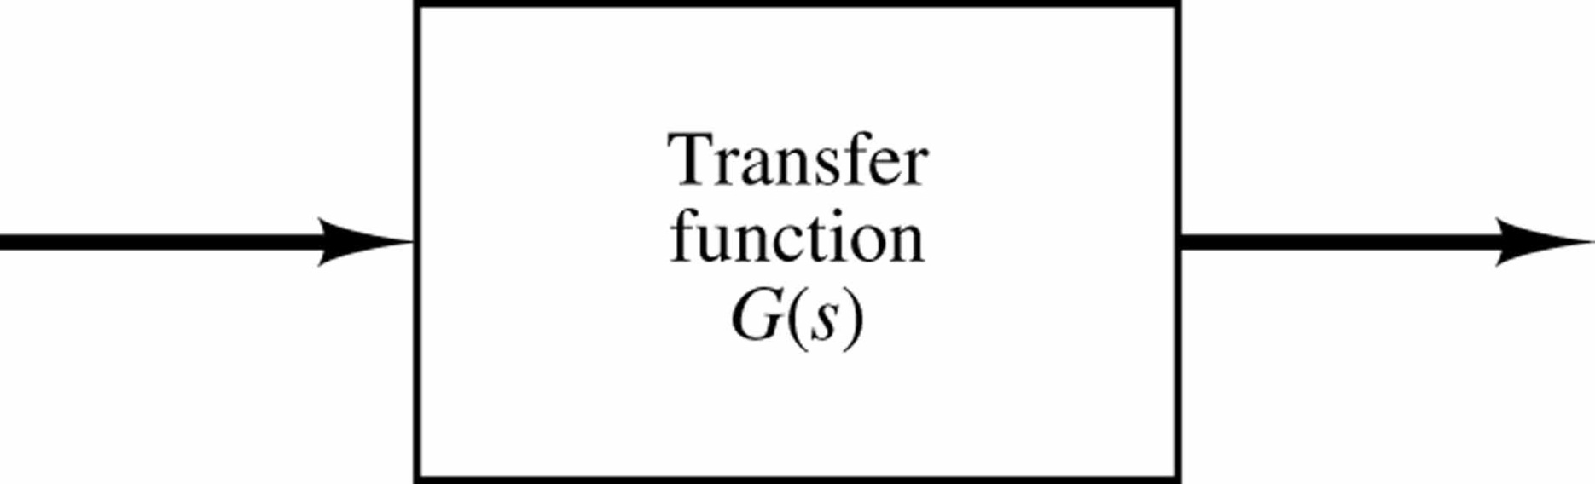
1) Input-Output Representation
The mathematical representation of a system can be described by a functional relationship between input and output:
Relationship between y and u is described by an operator (map) G:
y = G[u]
Example: y = G[u] = 3u
Input
u(t)
G
Output
y(t)

Slide 4
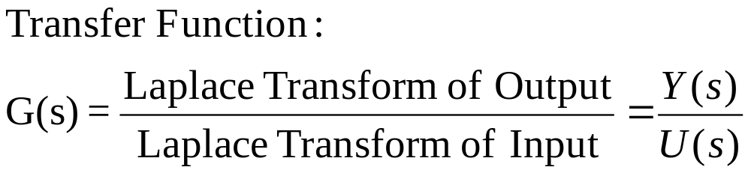
Transfer Function
Laplace Transforms:
  (with zero initial conditions)
Input
U(s)
G
Output
Y(s)

Slide 5
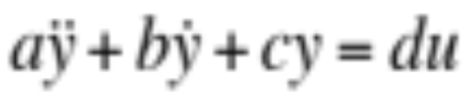

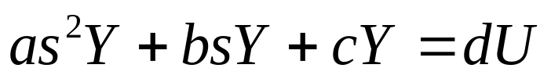
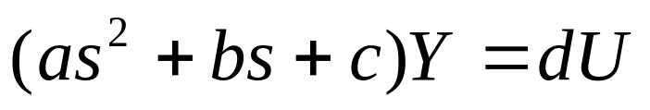
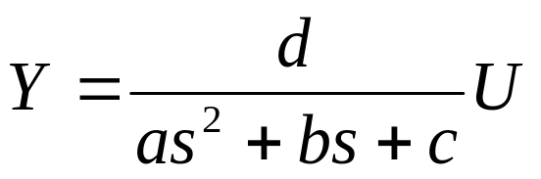
Example:
Laplace transforms:
i.e., Y = GU

Slide 6
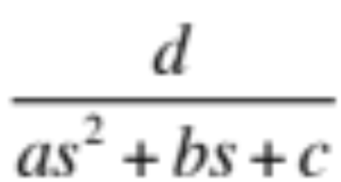
Laplace Transform converts differential equation description to transfer function description:
u(t)
y(t)
Plant
U(s)
Y(s)

Slide 7
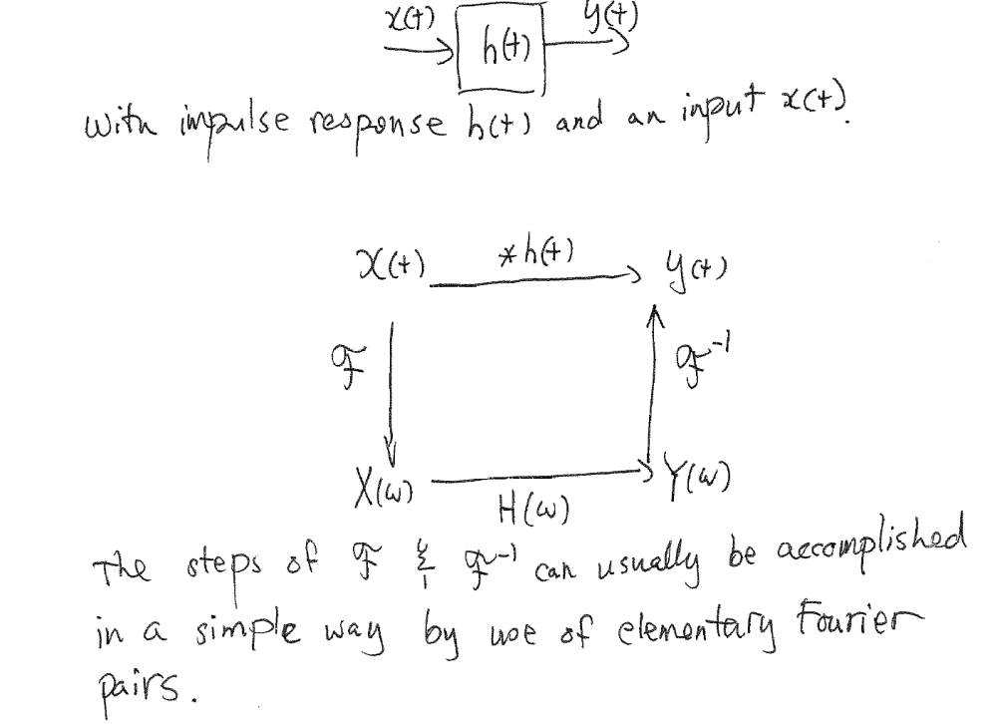
Computing Output Reponse
The diagram

Slide 8
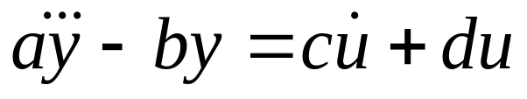
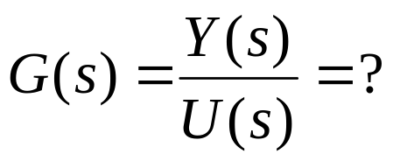
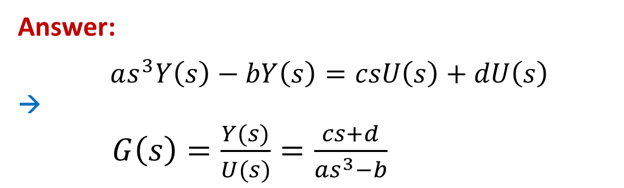
Exercise: (5 minutes)
Given:
Find: Transfer Function
(with zero initial conditions)
Answer:
$as^{3}Y\left(s\right)−bY\left(s\right)=csU\left(s\right)+dU\left(s\right)$
→
$G\left(s\right)=\frac{Y(s)}{U(s)}=\frac{cs+d}{as^{3}−b}$

Slide 9
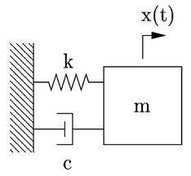
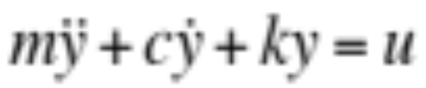
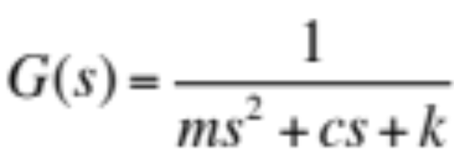
Example: Mass-Spring-Damper System
y
u
input force
Taking Laplace Transform (with zero initial conditions)
(ms²+cs+k)Y(s) = U(s)
yields the transfer function

Slide 10
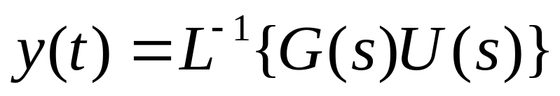
Input-output relationship of the system:
Y(s) = G(s)U(s)
Hence,
(Output obtained by Inverse Laplace Transform)
U(s)
Y(s)
G(s)

Slide 11
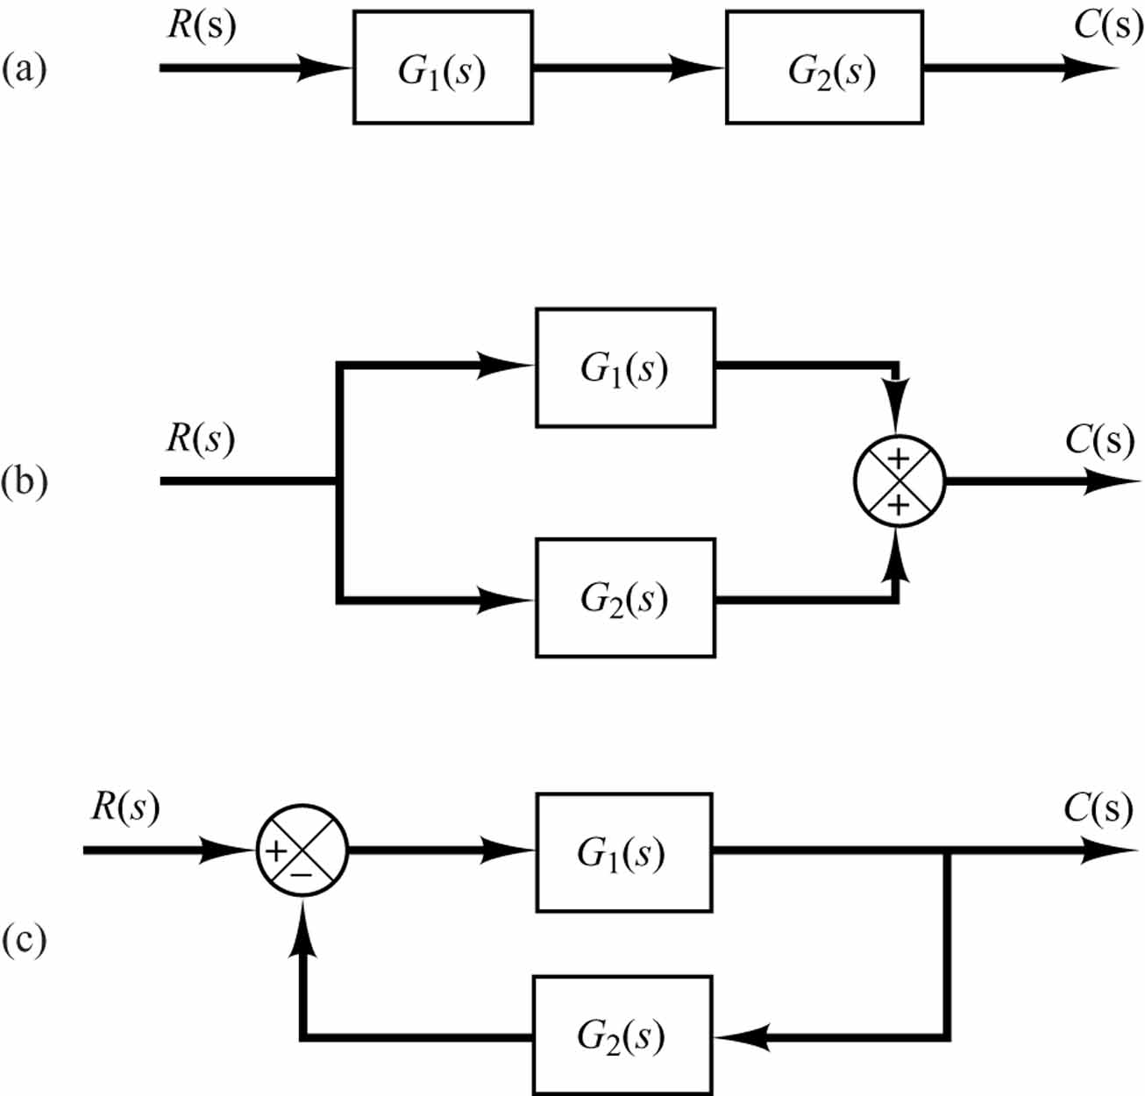
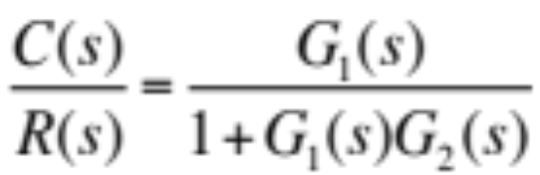
(1) Cascaded system
C/R = G₁G₂
(2) Parallel system
C/R = G₁+G₂
(3) Feedback (closed-loop) system
Reduction Rules for Complicated Systems
Summing Point

Slide 12
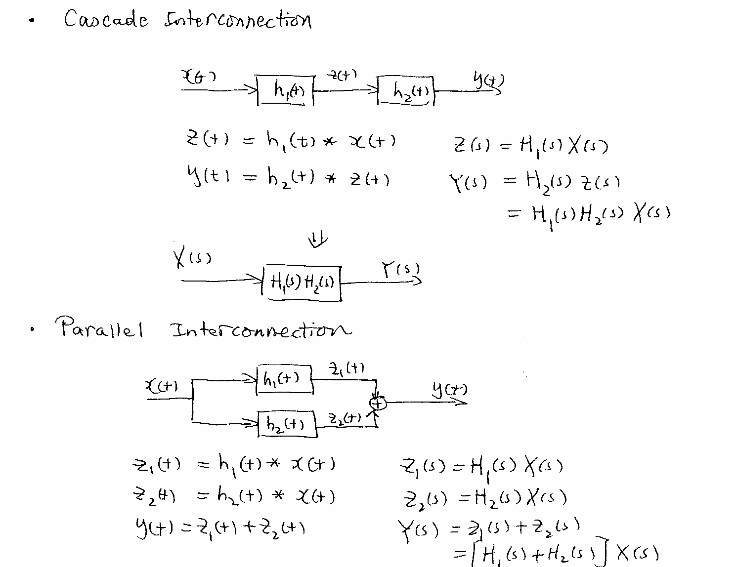
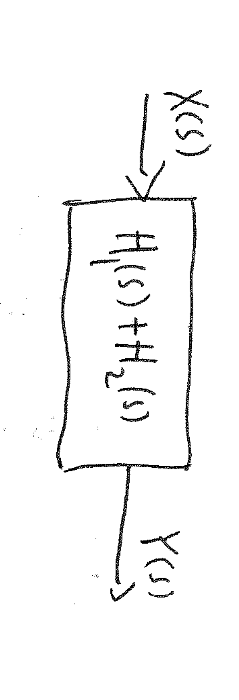
Block Diagram Operation

Slide 13
Block Diagram Operation

Slide 14
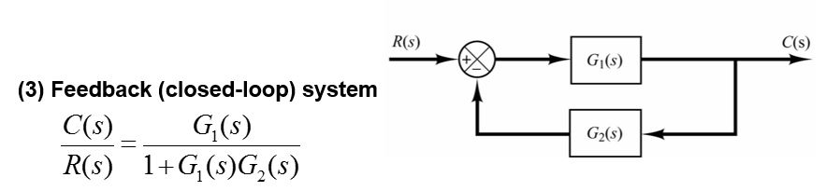
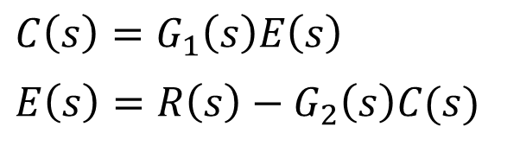
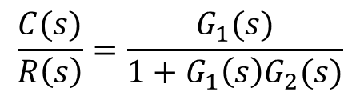
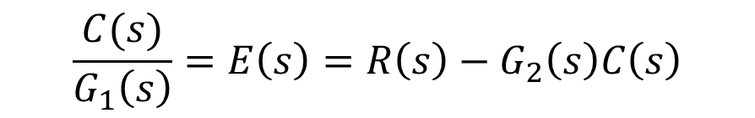
Verifying
E(s)
$$C\left(s\right)=G_{1}\left(s\right)E\left(s\right)$$
$$E\left(s\right)=R\left(s\right)−G_{2}\left(s\right)C(s)$$
$$\frac{C(s)}{G_{1}\left(s\right)}=E\left(s\right)=R\left(s\right)−G_{2}\left(s\right)C\left(s\right)$$
$$C\left(s\right)+{G_{1}\left(s\right)G}_{2}\left(s\right)C\left(s\right)=G_{1}\left(s\right)R\left(s\right)$$
$$\frac{C(s)}{R\left(s\right)}=\frac{G_{1}(s)}{1+G_{1}\left(s\right)G_{2}(s)}$$

Slide 15
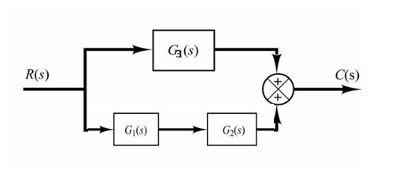
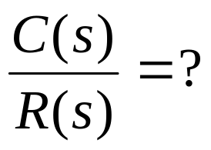

Exercise:
3
Answer:

Slide 16
Linear Time-Invariant (LTI) Systems
Let a system be described by an operator G as follows:
y(t) = G[u(t)]
Definition of a Linear System
The system described by the operator G is linear, if given
y₁(t) = G[u₁(t)]
y₂(t) = G[u₂(t)]
then for any constants α and β, one has
G[α u₁(t)+β u₂(t)] = α y₁(t) + β y₂(t)
Definition of a Time-Invariant System
System input-output relationship is time-independent
or
System can be represented by differential equations with constant coefficients

Slide 17
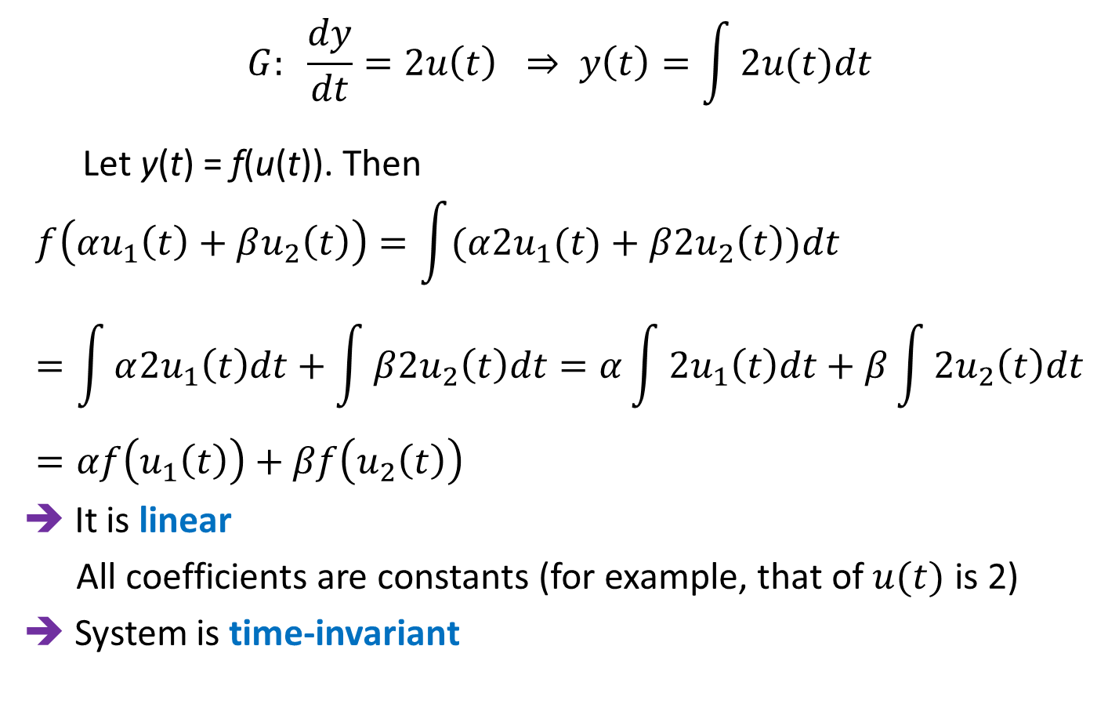
Case Study 1:
Input(s)
u(t)
G
Output(s)
y(t)
$$G: \frac{dy}{dt}=2u\left(t\right) ⇒ y\left(t\right)=\int{2u(t)dt}$$
Let y(t) = f(u(t)). Then
$$f\left(αu_{1}\left(t\right)+βu_{2}\left(t\right)\right)=\int{(α{2u}_{1}(t)+β{2u}_{2}\left(t\right))dt}=\int{α{2u}_{1}\left(t\right)dt+\int{β{2u}_{2}\left(t\right)dt}}=α\int{2u_{1}\left(t\right)dt+β\int{2u_{2}\left(t\right)dt}}=αf\left(u_{1}\left(t\right)\right)+βf\left(u_{2}\left(t\right)\right)$$
➔ It is linear
All coefficients are constants (for example, that of $u(t)$ is 2)
➔ System is time-invariant

Slide 18
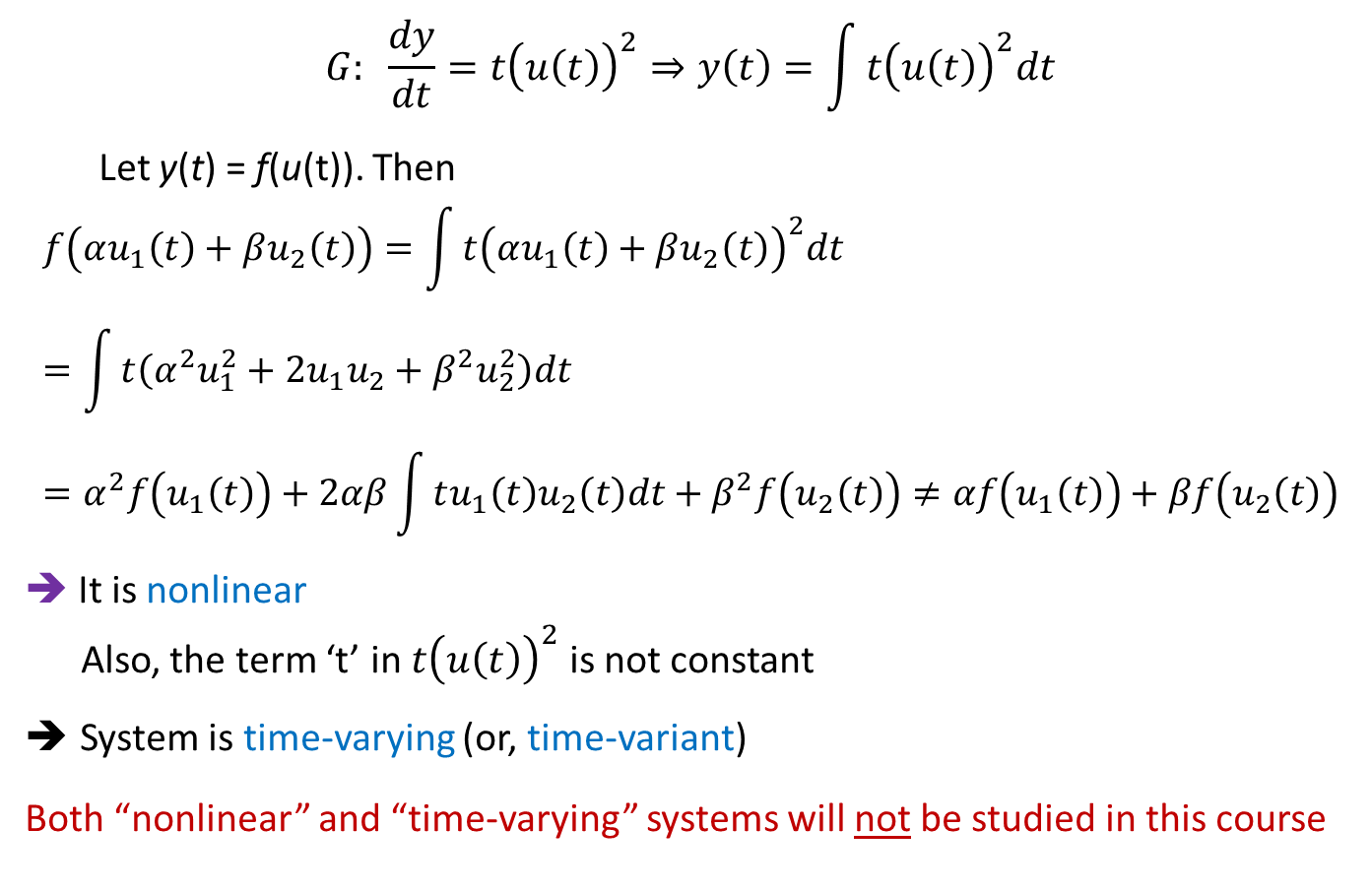
Case Study 2:
Input(s)
u(t)
G
Output(s)
y(t)
$$G: \frac{dy}{dt}=t{\left(u\left(t\right)\right)}^{2}⇒y\left(t\right)=\int{t{\left(u\left(t\right)\right)}^{2}dt}$$
Let y(t) = f(u(t)). Then
$$f\left(αu_{1}\left(t\right)+βu_{2}\left(t\right)\right)=\int{t{\left(αu_{1}\left(t\right)+βu_{2}\left(t\right)\right)}^{2}dt}=\int{t\left(α^{2}u_{1}^{2}+2u_{1}u_{2}+β^{2}u_{2}^{2}\right)dt}=α^{2}f\left(u_{1}\left(t\right)\right)+2αβ\int{tu_{1}\left(t\right)u_{2}\left(t\right)dt}+β^{2}f\left(u_{2}\left(t\right)\right)≠αf\left(u_{1}\left(t\right)\right)+βf\left(u_{2}\left(t\right)\right)$$
➔ It is nonlinear
Also, the term ‘t’ in $t{\left(u\left(t\right)\right)}^{2}$ is not constant
System is time-varying (or, time-variant)
Both “nonlinear” and “time-varying” systems will not be studied in this course

Slide 19
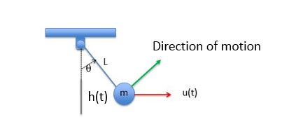
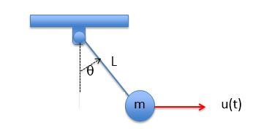


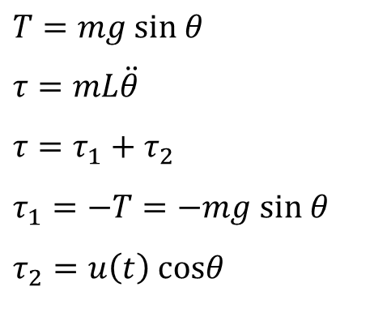


Models of Mechanical Structures: Pendulum
Mass: m
Input: force u(t)
Output: horizontal displacement h(t) (measurement)
Direction of motion
$$τ$$
$$T=mg sin θ$$
$$τ=mL\ddot{θ}$$
$$τ=τ_{1}+τ_{2}$$
$$τ_{1}=−T=−mg sin θ$$
$$τ_{2}=u\left(t\right) cosθ$$
h(t)
$$θ$$
T
$$mg$$
$$mL\ddot{θ}=−mg sinθ+u cosθ$$

Slide 20
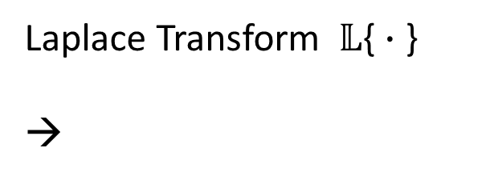

$$mL\ddot{θ}=−mg sinθ+u cosθ$$
h(t)
Laplace Transform $𝕃${ $∙$ }
→
$mLs^{2}Θ\left(s\right)=−mg 𝕃\{\sin\left(θ\left(t\right))\right\}+𝕃\{u\left(t\right)cos$($θ\left(t\right)$)}
This involves “nonlinear” functions
This types of “nonlinear” systems will not be studied in this course
Notes:
NONLINEAR!

Slide 21
Linear Mechanical System: Mass-Spring-Damper
y
u
input force
Taking Laplace Transform (with zero initial conditions)
(ms²+cs+k)Y(s) = U(s)
yields the transfer function

Slide 22
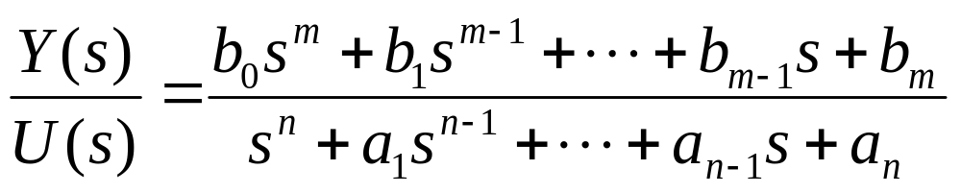
Single-Input Single-Output (SISO) Systems
A state representation of a given transfer function is not unique, namely, it may have different forms.
Given a system transfer function:
For physical systems, because of casualty and delay, m < n
Some models have same order of input and output, m = n
SISO refers to the dimension, not the order (m or n), of the input-output (i.e., both input and output are scalers but not vectors)

Slide 23
Models of Electric Circuits
Basic Equations of Electric Circuits:
Kirchhoff’s Current Law
  The algebraic sum of currents leaving a junction (a node) is equal to the algebraic sum of currents entering that node
Kirchhoff’s Voltage Law
  The algebraic sum of all voltages taken around a closed path in a circuit is 0

Slide 24
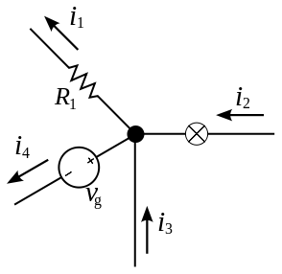

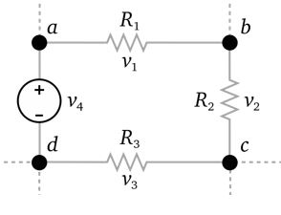

Kirchhoff’s Current Law
Kirchhoff’s Voltage Law

Slide 25
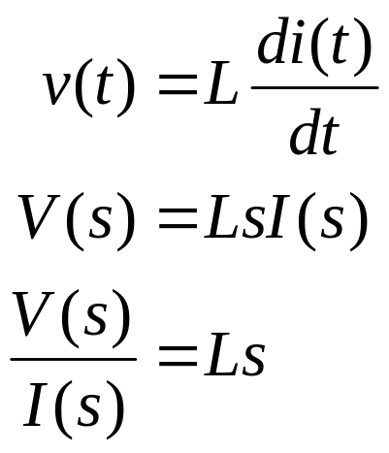
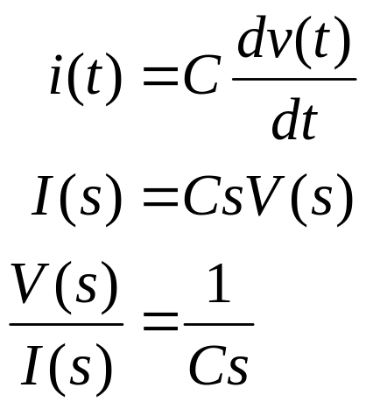
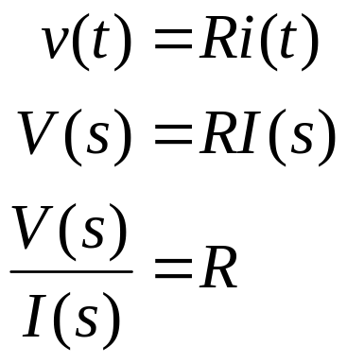
Impedance
Resistor
Inductor (with zero initial current)
Capacitor (with zero initial voltage)
Impedance

Slide 26
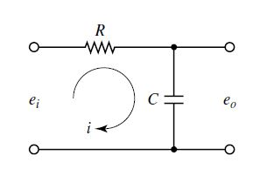
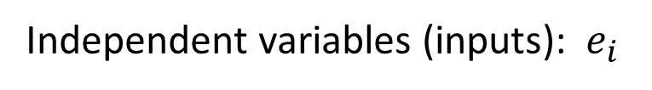
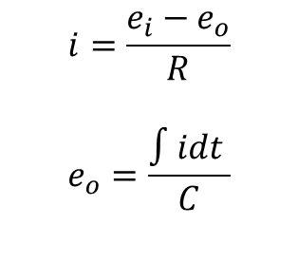
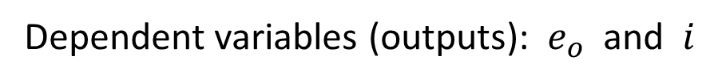
RC Circuit
$$i=\frac{e_{i}−e_{o}}{R}$$
$$e_{o}=\frac{∫idt }{C}$$
Parameters: R, C
Independent variables (inputs): $e_{i}$
Dependent variables (outputs): $e_{o}$ and $i$

Slide 27

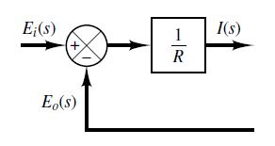


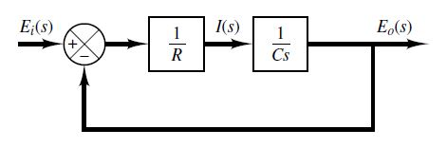
Laplace Transforms:

Slide 28
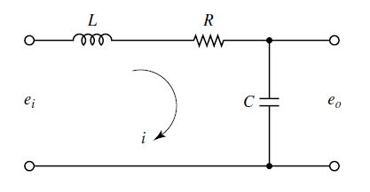
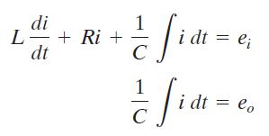
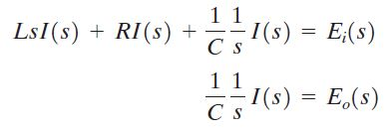

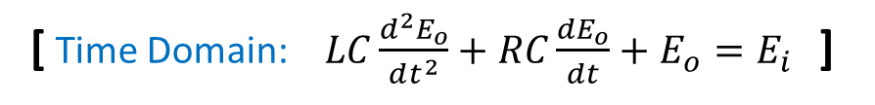
LRC Circuit
Transfer Function:
[ Time Domain: $LC\frac{d^{2}E_{o}}{dt^{2}}+RC\frac{dE_{o}}{dt}+E_{o}=E_{i}$ ]

Slide 29
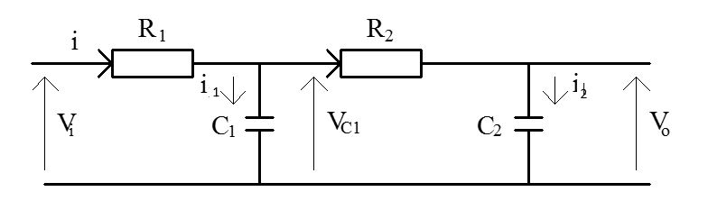
Transfer Function of a Cascaded Network
Example:
Steps: (1) find the circuit equations
(2) find their Laplace Transforms
(3) find the overall transfer function
(4) build the block diagram

Slide 30
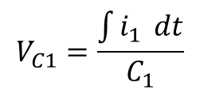

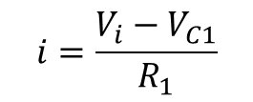


First, find the circuit equations
$$i=\frac{V_{i}−V_{C1}}{R_{1}}$$
$$i_{2}=\frac{V_{C1}−V_{o}}{R_{2}}$$
$$i=i_{1}+i_{2}$$
$$V_{C1}=\frac{\int{i_{1}} dt}{C_{1}}$$
$$V_{o}=\frac{\int{i_{2}}dt}{C_{2}}$$

Slide 31










$$i=\frac{V_{i}−V_{C1}}{R_{1}}$$
$$i_{2}=\frac{V_{C1}−V_{o}}{R_{2}}$$
$$i=i_{1}+i_{2}$$
$$V_{C1}=\frac{\int{i_{1}} dt}{C_{1}}$$
$$V_{o}=\frac{\int{i_{2}}dt}{C_{2}}$$
Then, find their Laplace Transforms
$$I\left(s\right)=\frac{\left.V_{I}\left(s\right)−V_{C1}(s\right)}{R_{1}}$$
$$I_{2}\left(s\right)=\frac{\left.V_{C1}\left(s\right)−V_{o}(s\right)}{R_{2}}$$
$$I\left(s\right)=I_{1}\left(s\right)+I_{2}\left(s\right)$$
$$V_{C1}\left(s\right)=\frac{\left.I_{1}(s\right)}{C_{1}s}$$
$$V_{o}\left(s\right)=\frac{\left.I_{2}(s\right)}{C_{2}s}$$

Slide 32











$$I\left(s\right)=\frac{\left.V_{I}\left(s\right)−V_{C1}(s\right)}{R_{1}}$$
$$I_{2}\left(s\right)=\frac{\left.V_{C1}\left(s\right)−V_{o}(s\right)}{R_{2}}$$
$$I\left(s\right)=I_{1}\left(s\right)+I_{2}\left(s\right)$$
$$V_{C1}\left(s\right)=\frac{\left.I_{1}(s\right)}{C_{1}s}$$
$$V_{o}\left(s\right)=\frac{\left.I_{2}(s\right)}{C_{2}s}$$
Then, find the overall transfer function
$$I\left(s\right)=I_{1}\left(s\right)+I_{2}\left(s\right)$$
$$I_{2}\left(s\right)=\frac{\left.V_{C1}\left(s\right)−V_{o}(s\right)}{R_{2}}$$
$$\frac{\left.V_{I}\left(s\right)−V_{C1}(s\right)}{R_{1}}=C_{1}sV_{C1}\left(s\right)+C_{2}sV_{o}\left(s\right)$$
$$V_{C1}\left(s\right)=R_{2}I_{2}\left(s\right)+V_{o}\left(s\right)$$
$=R_{2}C_{2}s V_{o}\left(s\right)+V_{o}\left(s\right)$
$$\left.V_{I}\left(s\right)=\left[ R_{1}C_{1}R_{2}C_{2}s^{2}+{\left(R\right.}_{1}C_{1}+R_{2}C_{2}+R_{1}C_{2}\right)s+1]V_{o}(s\right)$$
[ Time domain: $R_{1}C_{1}R_{2}C_{2}\frac{d^{2}V_{o}}{dt^{2}}+\left(R_{1}C_{1}+R_{2}C_{2}+R_{1}C_{2}\right)\frac{dV_{o}}{dt}+V_{o}=V_{I}$ ]

Slide 33





Finally, build the block diagram
$$\left.V_{I}\left(s\right)=\left[ R_{1}C_{1}R_{2}C_{2}s^{2}+{\left(R\right.}_{1}C_{1}+R_{2}C_{2}+R_{1}C_{2}\right)s+1]V_{o}(s\right)$$
$$\frac{\left.V_{o}(s\right)}{\left.V_{I}(s\right)}=\frac{1}{\left.\left[ R_{1}C_{1}R_{2}C_{2}s^{2}+{\left(R\right.}_{1}C_{1}+R_{2}C_{2}+R_{1}C_{2}\right)s+1\right]}$$
A second-order system

Slide 34
Framework of Lectures
System
Time Domain Frequency Domain
→ Laplace Transform →
State-Space Formulation Frequency Analysis
This course is mainly about
engineering systems described by
Second-Order Ordinary Differential Equations

Slide 35


For a system with input and output
System
Typically it can be described by a second-order ODE
Example:
Time domain:
$$LC\frac{d^{2}E_{o}}{dt^{2}}+RC\frac{dE_{o}}{dt}+E_{o}=E_{i}$$
Frequency domain:

Slide 36
For a system with input and output
System
Typically it can be described by a second-order ODE
Example:
y
Time domain:
u
Frequency domain:
input force

Slide 37





DC Motor:
Electro-Mechanical System
$$τ$$
B
$V\left(t\right)=$ Armature Voltage
$i\left(t\right)=$ Armature Current
$e\left(t\right)=$ Back EMF
$$θ\left(t\right)= \text{Angular} \text{Position}$$
$J=$ Rotor Inertia
$B=$ Viscous Friction
$K=$Motor Constant

Slide 38



$$τ$$
B
The DC motor armature circuit is described based on the Kirchhoff voltage law by
$V\left(t\right)=Ri\left(t\right)+L\frac{di(t)}{dt}+K\dot{θ}(t)$
The mechanical load is described via the torque balance by
$J\ddot{θ}(t)=τ(t)−B\dot{θ}(t)$
where
$V\left(t\right)=$ Armature Voltage
$i\left(t\right)=$ Armature Current
$e\left(t\right)=$ Back EMF
$$θ\left(t\right)= \text{Angular} \text{Position}$$
$J=$ Rotor Inertia
$B=$ Viscous Friction
$K=$Motor Constant

Slide 39






Motor torque is proportional to the armature current:
Back EMF is proportional to the angular velocity of the shaft:
$e(t)=K\dot{θ}(t)$
$τ(t)=K_{τ}i(t)$
Assuming that the motor torque and the back EMF constants are equal: $K_{τ}=K$, the above governing equations become
$τ(t)=Ki(t)$
$e(t)= K\dot{θ}(t)$
$V\left(t\right)=Ri\left(t\right)+L\frac{di(t)}{dt}+K\dot{θ}(t)$
$J\ddot{θ}\left(t\right)=Ki\left(t\right)−B\dot{θ}(t)$
$T\left(s\right)=$?
$E\left(s\right)=$ ?
$V\left(s\right)=$ ?
$Θ(s)=$ ?
Laplace Transforms
Exercise
(5 Minutes)
$H\left(s\right)=\frac{Θ\left(s\right)}{V\left(s\right)}=$ ?

Slide 40


Motor torque is proportional to the armature current:
Back EMF is proportional to the angular velocity of the shaft:
$e(t)=K\dot{θ}(t)$
$τ(t)=K_{τ}i(t)$
Assuming that the motor torque and the back EMF constants are equal: $K_{τ}=K$, the above governing equations become
$τ(t)=Ki(t)$
$e(t)= K\dot{θ}(t)$
$V\left(t\right)=Ri\left(t\right)+L\frac{di(t)}{dt}+K\dot{θ}(t)$
$J\ddot{θ}\left(t\right)=Ki\left(t\right)−B\dot{θ}(t)$
$T\left(s\right)=KI\left(s\right)$
$$E\left(s\right)=KsΘ\left(s\right)$$
$V\left(s\right)=\left(R+Ls\right)I\left(s\right)+KsΘ (s)$
$s(Js+B)Θ(s)=KI\left(s\right)$
Laplace Transforms
$$H\left(s\right)=\frac{Θ\left(s\right)}{V\left(s\right)}=\frac{K}{s\left(\left(R+Ls\right)\left(Js+B\right)+K^{2}\right)}$$

Slide 41

$$I\left(s\right)=\frac{\left.V\left(s\right)−KsΘ(s\right)}{\left(R+Ls\right)}$$
$$s(Js+B)Θ(s)=K\frac{\left.V\left(s\right)−KsΘ(s\right)}{\left(R+Ls\right)}$$
$$H\left(s\right)=\frac{Θ\left(s\right)}{V\left(s\right)}=\frac{K}{s\left(\left(R+Ls\right)\left(Js+B\right)+K^{2}\right)}$$
Block diagram of the DC motor from input $V(s)$ to output $Θ(s)$:

Slide 42
Framework of Lectures
System
Time Domain Frequency Domain
→ Laplace Transform →
State-Space Formulation Frequency Analysis
(dynamic responses, transients,
steady-states, root-locus,
PID controllers)
← mixed →
(State-feedback,
Controllability, controller
Observability, observer
Optimal control)
This course is mainly about
engineering systems described by
Second-Order Ordinary Differential Equations

Slide 43
Classification of Systems
Memoryless
Causality
Stability
Time-invariance
Linearity

Slide 44
(1). Memoryless
A system is memoryless if the output at ANY given time depends ONLY on the input value at that (same) time.
A system with memory is called a dynamic system.

Slide 45


Examples
A resister is a memoryless component:
(1) y(t) = R x(t)
(2) y(t) = x(t-1), y(t) = x(t+1), y(t) = x(2t)
(3) y(t) = sin[x(t)], y(t) = [x(t)]^2
(4) y(t) =
Inductors and capacitors are components having infinite memory.
The following system has finite memory:

Slide 46


(3). Causality
A system is causal if the output at ANY time depends ONLY on the input values at and prior to that time.
Past, Present, and Future
Examples
  Causal:
  Non-causal:

Slide 47

Examples of Causal & Non-Causal Systems
(1) y(t) = R x(t)
(2) y(t) = x(t-1), y(t) = x(t+1), y(t) = x(2t)
(3) y(t) = sin[x(t)], y(t) = [x(t)]^2
(4) y(t) =
(5)
Observation: Every memoryless system is causal.

Slide 48
Remarks on Causality
Causality is a must for real-time processing and implementation, which governs the fundamental principle of cause-and-effect.
Any system that is not causal cannot be realized by physical devices; a system that is causal can in principle be built.
Examples: A differentiator cannot be built in reality, an integrator can be readily built using, e.g., an Op-Amp.

Slide 49
(4). Stability
Informally, a system is stable if small inputs lead to responses (i.e. outputs) that do not diverge.
  x(t) : the horizontal force; y(t) : vertical displacement
x(t)
y(t)
y(t)
x(t)
Stable System
Unstable System

Slide 50


(4). Stability (BIBO stable)
Formally, a system is stable if every bounded input results in a bounded output.
Given that the input signal has an upper bound A, i.e.,
there exists a number B such that

Slide 51

Examples
Is the squaring system y(t) = x²(t) stable?
Is the accumulator system stable?
Hint: Consider the input x[n] = {1, 1, 1, 1, …}.
Yes
No

Slide 52
Examples of Stable Systems
(1) y(t) = R x(t) stable
(2) y(t) = x(t-1), y(t) = x(t+1), y(t) = x(2t) stable
(3) y(t) = sin[x(t)], y(t) = [x(t)]^2 stable
(4) y(t) = unstable
(5) unstable
Proving stability: Show for all bounded inputs the output is bounded.
Disapproving stability: Construct one bounded input and show that the corresponding output is unbounded-one strike rule.

Slide 53
(5). Time Invariance
A system is time invariant if a time shift in the input causes the SAME time shift in the output:
If x[n] → y[n], then x[n-n₀] → y[n-n₀];
If x(t) → y(t), then x(t-t₀) → y(t-t₀).
The system doesn’t change with time.
A system that is not time invariant is said to be time varying.

Slide 54
Example
Is the system described by y[n] = n x[n] time invariant?
No

Slide 55
Examples of Time-Invariant Systems
(1) y(t) = R x(t)
(2) y(t) = x(t-1), y(t) = x(t+1), y(t) = x(2t)
(3) y(t) = sin[x(t)], y(t) = [x(t)]^2
(4) y(t) =
Proving and disapproving time invariance: Construct a shifted input x(t-t0), use the system definition, see if you can get y(t-t0).

Slide 56
(6). Linearity
Let x₁(t) → y₁(t) , x₂(t) → y₂(t) .
A system is linear if it satisfies these conditions:
1. x₁(t)+x₂(t) → y₁(t) +y₂(t) --- additivity
2. a x₁(t) → a y₁(t), where a is any complex constant. --- scaling (homogeneity)

Slide 57
Superposition Property
Taking the two properties together, we have
a x₁(t)+ b x₂(t) ⇒ a y₁(t) + b y₂(t)
--- superposition property
A system is linear if it satisfies the superposition property.

Slide 58
Example
Consider a system described by
y(t) = t x(t).
Is it linear?
Hint: Procedure to test linearity:
  Let y₁(t) = t x₁(t) and y₂(t) = t x₂(t).
  Consider the input x(t) = a x₁(t) + b x₂(t).
  Find the corresponding output y(t).
  The system is linear iff y(t) = a y₁(t) + b y₂(t).
Yes

Slide 59
Example
Consider a system described by
y[n] = 2 x[n] + 3.
Is it linear?
No, because it does not have the zero-in zero-out property.
Note: This system belongs to a class called affine or incrementally linear system.

Slide 60
END

