Slide 1
CS2311 Computer Programming
LT4: Control Flow – Conditional Statements
Computer Science, City University of Hong Kong
Semester A 2021-22

Slide 2

Sequential Flow of Control
So far, the control flow is completely sequential
  Program always executes the same sequence of statements from the start of the program to the end

Slide 3
But
In some situations, we want to our program to produce different effects based on different program conditions
  In other words, we want our code to produce different sequences of statements

Slide 4
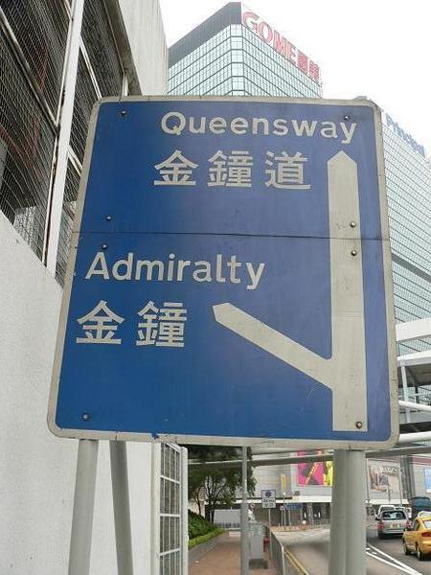
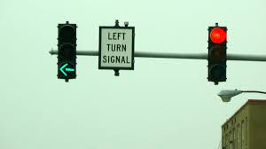
Decision and Action
We make decisions everyday
    AC-1 canteen? AC-2? AC-3?
Decision will be followed by one or more action(s)
In programming:
  Decision is based on conditions, e.g., logical expressions
  Action is in the form of programming statements

Slide 5
Comparative Operators
Binary operators which accept two operands and compare them
Relational operators | Syntax | Example
Less than | < | x<y
Greater than | > | z>1
Less than or equal to | <= | b<=1
Greater than or equal to | >= | c>=2
Equality operators | Syntax | Example
Equal to | == | a==b
Not equal to | != | b!=3

Slide 6
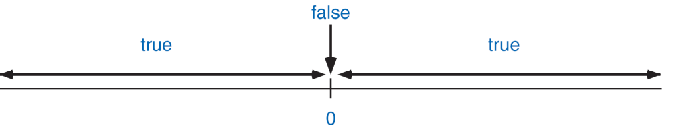
Logical expression and operators
Logical expressions can be true or false only
  x==3
  y==x
  x>10
In C++, any non-zero expression will be treated as logical true
  3-2
  1-1
  x=0
  x=1

Slide 7
Assignment (=) and equality operator (==)
Example: x = 1
Assignment operator
variable on the left
The value of this expression will always equal to the value on the right (1)
Example x==1
Equality operator
True (evaluates to 1)
  value of x is 1
False (evaluates to 0)
  value of x is not 1
No space between the two '='

Slide 8
Logical Operators
Used for combining logical values and create new logical values
Logical AND (&&)
  return true if both operands are true, false otherwise (e.g., a>1&&b<1)
  Example: 18 < age < 60 should be written as: 18 < age && age < 60;
Logical OR (||)
  return false if both operands are false, true otherwise
Logical NOT (!)
  invert the Boolean value of the operand
x | y | x&&y
true | true | true
true | false | false
false | true | false
false | false | false
x | y | x||y
true | true | true
true | false | true
false | true | true
false | false | false
x | !x
true | false
false | true

Slide 9
The Logical-NOT Operator
Logical-NOT (!) is a unary operator (it only takes one operand). So how does it work?
To check if age is not between 18 and 65, we simply write:
!(age >= 18 && age <= 65)
The Logical-NOT operator only takes one operand, evaluates the operand to true or false, then flips the result

Slide 10
Effect of Logical-Not Operator
Original Expression | Equivalent Expression
!(x<y) | x>=y
!(x>y) | x<=y
!(x!=y) | x==y
!(x<=y) | x>y
!(x>=y) | x<y
!(x==y) | x!=y
! (A && B) is the same as (!A) || (!B)
! (A || B) is the same as (!A) && (!B)

Slide 11
Relational, equality & logical operators (Summary)
Relational operators
  less than <
  greater than >
  less than or equal to <=
  greater than or equal to >=
Equality operators
  equal to ==
  not equal to !=
Logical operators
  logical not !
  logical and &&
  logical or ||
PS: Expressions with above operators have a true or false value.

Slide 12
Precedence & associativity of popular operators
Operator precedence (high to low) | Associativity
* / % | Left to right
+ - | Left to right
< <= > >= | Left to right
== != | Left to right
&& | Left to right
|| | Left to right
?: | Right to left

Slide 13
Conditional statements
In decision making process, logical value can be used to determine the actions to take.
Examples
  If AC2 canteen is too crowded, then go to AC1/AC3 for lunch
In programming, certain statements will only be executed when certain condition is fulfilled. We call them conditional statements

Slide 14
Conditional statement: if
One statement will be executed if the condition is true
Syntax:
  if (logical expression)
  statement;
Only one statement will be executed
“If (logical expression) statement” is one statement in C++.
C++ example:
  cin >>x;
  if (x<0)
  x = -x;
  cout << x << endl;
Statement 1
if (logical expression)
true
Statement 2
Statement 3

Slide 15
Two-way selection
If the condition is true, one statement will be executed.
If the condition is false, another statement will be executed.
  ………………
  if (logical expression)
  //action for true
  statement a;
  else
  //action for false
  statement b;
Statement 1
false
if (logical expression)
true
Statement b
Statement a
Statement 3

Slide 16
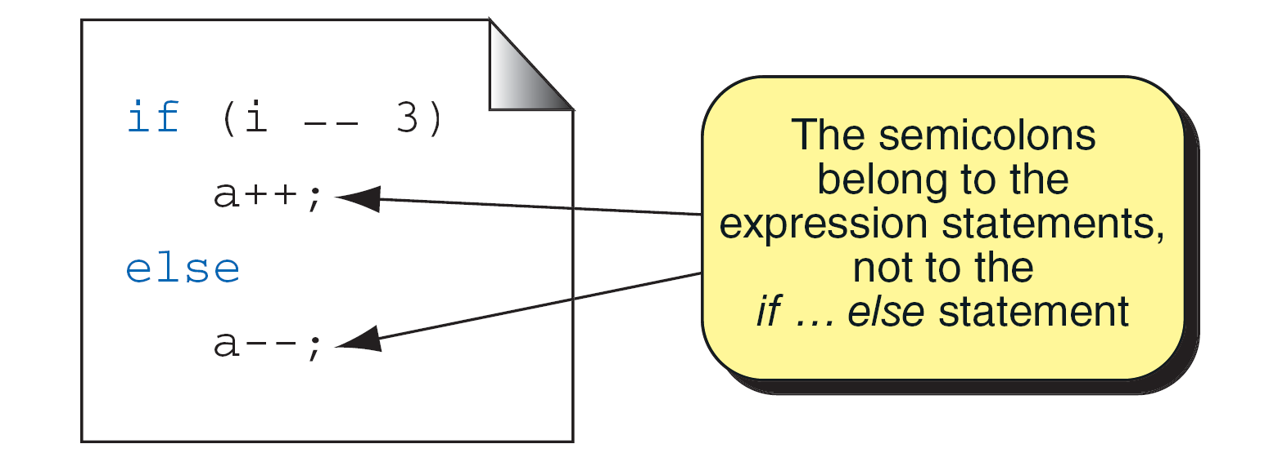
Some points to note
The expression should be enclosed with parenthesis ()
No semi-colon after if or else
==
The else part is optional

Slide 17
Compound statement
Group multiple statements into one block using {} to be executed for a certain if, else if, or else statement
Must use {} if there’re more than one statements for an if, else, or else if statement,
  if (conditional expression)
  {
  statements_{true ...}
  }
“If (condition) {statement; statement; ...}” is one statement
if (mark>=90)
{
cout << “You get grade A.\n";
cout << "Excellent!\n";
}

Slide 18
Example 1a: Pass or Fail?
int mark;
cout << "What is your mark?\n";
cin >> mark;
if (mark >= 34)
cout << "You passed in CS2311!\n";
The condition should be enclosed within ()
If the input mark is greater than or equal to 34, the blue statement is executed.

Slide 19
Example 1b: Pass or Fail?
int mark;
cout << "What is your mark?\n";
cin >> mark;
if (mark >= 34){
cout << "You passed in CS2311!\n";
cout << "Congratulations!\n";
}
If more than 1 statements are specified within an if statement, group the statements in a pair of braces { }

Slide 20
Example 1c: Pass or Fail?
int mark;
cout << "What is your mark?\n";
cin >> mark;
if (mark >= 34){
cout << "You passed in CS2311!\n";
cout << "Congratulations!\n";
}
else
cout << "You failed in CS2311…\n";
The else statement is executed when the condition mark>=34 is false

Slide 21
Example 1c: Pass or Fail?
int mark;
cout << "What is your mark?\n";
cin >> mark;
if (mark >= 34){
cout << "You passed in CS2311!\n";
cout << "Congratulations!\n";
}
else
cout << "You failed in CS2311…\n";
cout << “You should retake the course.\n “;
Suppose the user inputs 35. The output is:
You passed in CS2311!
Congratulations!
You should retake the course.
Why?

Slide 22
Example 1c: Pass or Fail?
int mark;
cout << "What is your mark?\n";
cin >> mark;
if (mark >= 34){
cout << "You passed in CS2311!\n";
cout << "Congratulations!\n";
}
else{
cout << "You failed in CS2311…\n";
cout << “You should retake the course.\n “;
}
Include a brace to group the statements in the else part

Slide 23
Compound statement
We may group multiple statements to form a compound statement using a pair of braces {}
if (j!=3)
{
b++;
cout << b;
}
else
cout < j;
if (j!=5 && d==2)
{
j++;
d--;
cout << j <<d;
}
else
{
j--;
d++;
cout << j << d;
}
Compound statements are treated as one statement

Slide 24
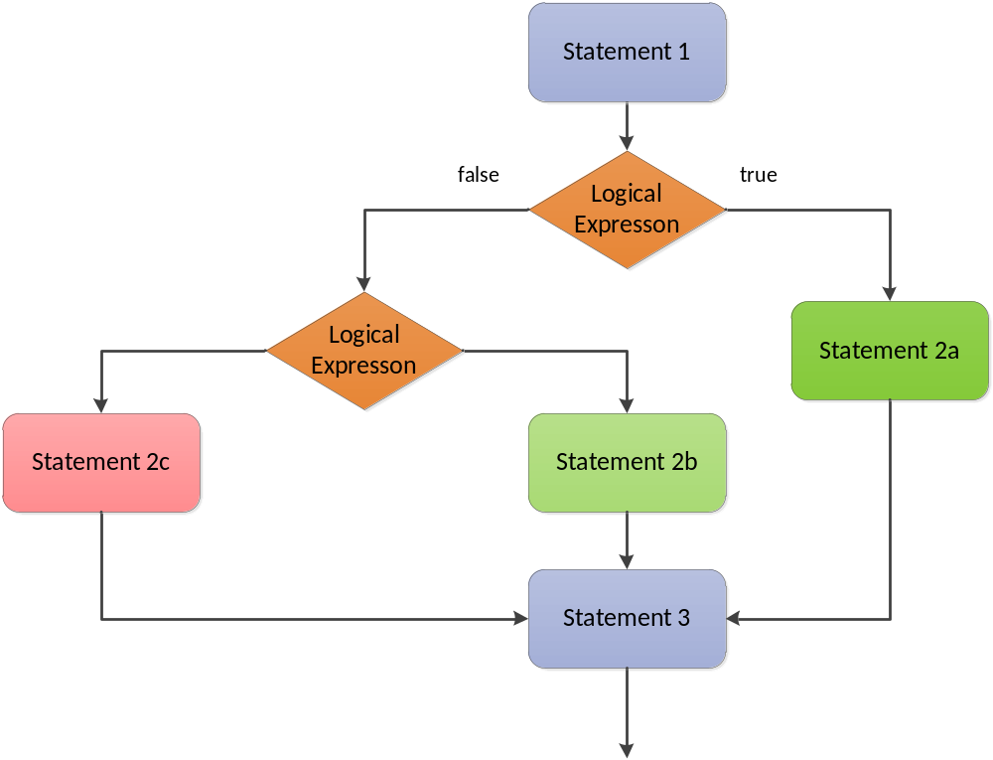
Beyond two way condition…
Statement 1
false
if (logical expression)
true
Statement b
Statement a
Statement 3

Slide 25
Multiple else if statements
You can have many nested “else if” statements.
  if (logical expression 1)
  //action for true
  statement a;
  else if (logical expression 2)
  //action for true
  statement b;
  else
  //action for false
  statement;
An example: input a score, display grade according to:
A: 100 ~ 90, B: 89 ~ 75
C: 74 ~ 55, D: 54 ~0
  if (score >= 90)
  grade = ‘A’;
  else if (score >=75)
  grade = ‘B’;
  else if (score >=55)
  grade = ‘C’;
  else
  grade = ‘D’;

Slide 26
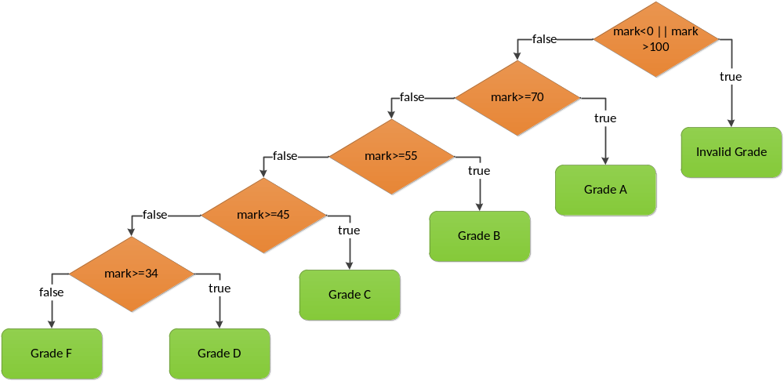
Mark to grade conversion

Slide 27
Mark to grade conversion
if (mark>=70 && mark<=100)
cout << "A";
if (mark>=55 && mark<70)
cout << "B";
if (mark>=45 && mark<55)
cout << "C";
if (mark>=34 && mark<45)
cout << "D";
if (mark<34 && mark>0)
cout << "F";
if (mark<0 || mark>100)
cout << "Invalid Grade";
if (mark<0 || mark>100)
cout << "Invalid Grade";
else if (mark>=70)
cout << "A";
else if (mark>=55)
cout << "B";
else if (mark>=45)
cout << "C";
else if (mark>=34)
cout << "D";
else
cout << "F";

Slide 28
Beyond two way condition…
In C++, conditional statements have the following format:
  if (logical expression 1) {
  statements when expression 1 is true
  }
  else if (logical expression 2){
  statements when expression 1 is false and expression 2 is true
  }
  else if (…){
  …
  }
  else{
  statements when all the logical expressions are false
  }
The else if and else part is optional
The curly brackets {} can be omitted if the block contains one statement only.

Slide 29
Beware of empty statements!
int x=5;
if (x!=5);
x=3;
cout << x;
/*output is 3*/
int x=5;
if (x!=5)
x=3;
cout << x;
/*output is 5*/
An empty statement can be specified by a semi-colon ';'. Empty statement specifies that no action should be performed.
For program on the right, x=3 statement will NOT be executed if x is equals to 5.
For the program on the left, x=3 statement will be always executed.

Slide 30
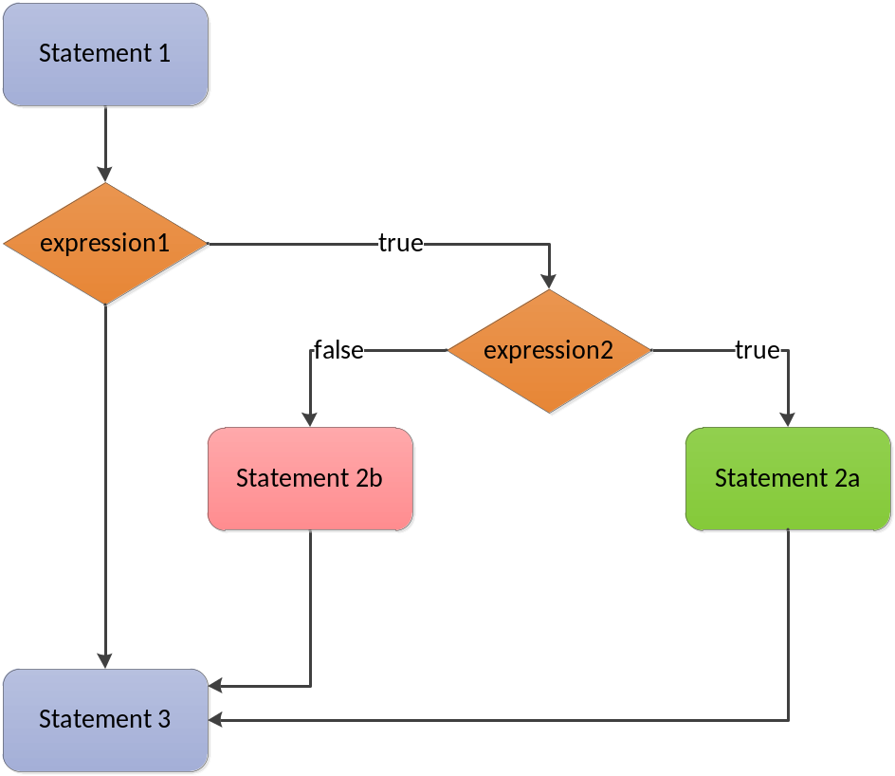
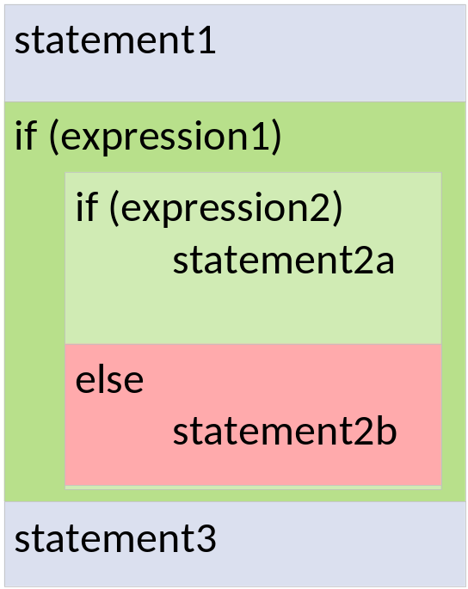
Nested if statement
An if-else statement is included with another if or else statement

Slide 31
Nested if statement
With which “if” the “else” part is associated?
if (a==1)
if (b==2)
cout << “***\n”;
else
cout << “###\n”;
if (a==1)
if (b==2)
cout << “***\n”;
else
cout << “###\n”;

Slide 32
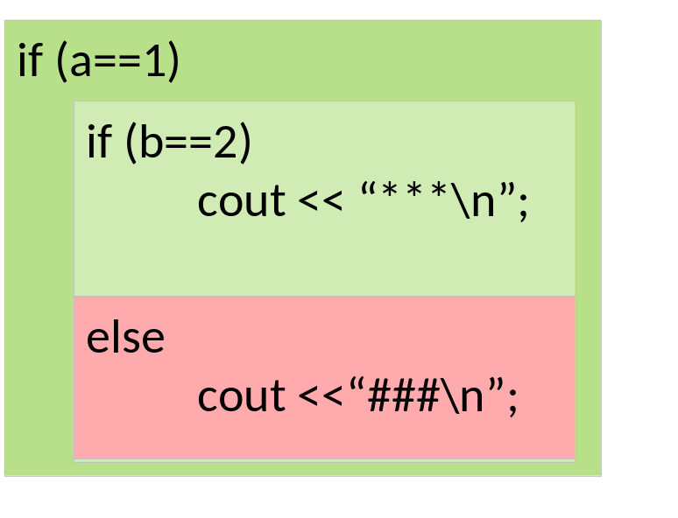
An else attached to the nearest if.
if (a==1)
if (b==2)
cout << “***\n”;
else
cout << “###\n”;

Slide 33
Nested-if
An if statement can be nested within another if statement
if(mark>=70 && mark <=100) //get an A grade but can be A-, A or A+
{
if (mark>90)
cout << "You get grade A+.\n";
else if (mark>80)
cout << "You get grade A.\n";
else
cout << You get grade A-.\n";
}
else if ……

Slide 34
Example 2b
Modify the program so that if the mark is 100, "Full mark!" will be printed (in addition to the grade).
if(mark>=70 && mark <=100) //get an A grade but can be A-, A or A+
{
if (mark>90)
cout << "You get grade A+.\n";
else if (mark>80)
cout << "You get grade A.\n";
else
cout << You get grade A-.\n";
}
else if ……

Slide 35
The program
if (mark>=70 && mark <=100){
if (mark>90)
{
cout << "You get grade A+.\n";
if (mark==100)
cout << "Full mark!\n";
}
else if (mark>80)
cout << "You get grade A.\n";
else
cout << "You get grade A-.\n";
}
else if ……

Slide 36
Do not mix == and =
x=0;
y=1;
if (x = y){
cout << “x and y are equal";
}
else
cout << "unequal";
Output: “x and y are equal"
The expression x = y
Assign the value of y to x: x becomes 1
The value of this expression is the value of x (which represents 1/TRUE)
  False is represented by 0
  Non-zero represents TRUE

Slide 37
C++ syntax is different from the math syntax
if (mark>=70 && mark<=100)
……
Can we express the above condition as follows?
if (70<=mark<=100)
……
Ans: No

Slide 38
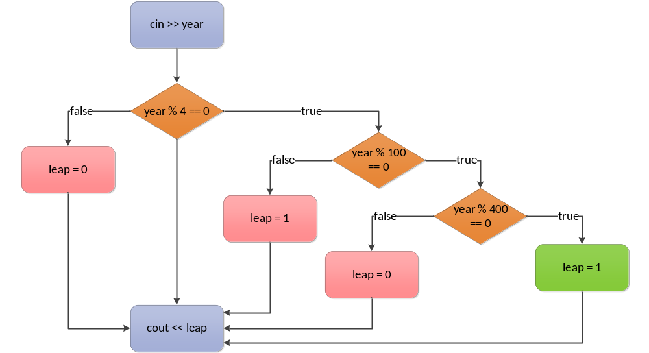
E.g.: check if a year is a leap year

Slide 39
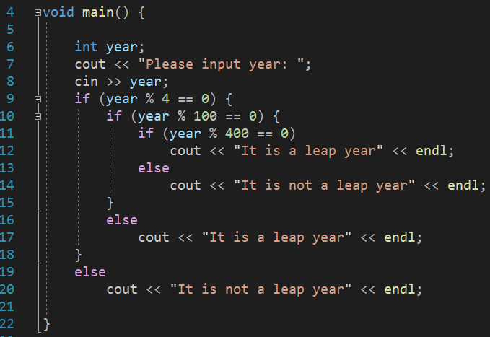
E.g.: check if a year is a leap year

Slide 40
Short-circuit evaluation
Evaluation of expressions containing && and || stops as soon as the outcome true or false is known and this is called short-circuit evaluation
x
y
x&&y
x
y
x||y
true
true
true
true
true
true
?
true
false
false
true
false
true
false
true
false
false
true
true
false
false
false
false
false
false

Slide 41
Short-circuit evaluation
Evaluation of expressions containing && and || stops as soon as the outcome true or false is known and this is called short-circuit evaluation,
E.g., if( 1<0 && y=2 ) is the same as if (false && true), and thus y=2 is not executed!
x
y
x&&y
x
y
x||y
true
true
true
true
true
?
true
false
false
true
true
false
false
false
true
true
false
false
false
false
false

Slide 42
Short-circuit evaluation
Evaluation of expressions containing && and || stops as soon as the outcome true or false is known and this is called short-circuit evaluation,
E.g., if( 1<0 && y==2 ) is the same as if (false && true/false), and thus ….
Short-circuit evaluation can improve program efficiency
Short-circuit evaluation exists in some other programming languages, e.g., C and Java

Slide 43
Short-circuit evaluation
Given integer variables i, j and k, what are the outputs when running the program below?
k = (i=2) && (j=2);
cout << i << j << endl;
/* 2 2 */
k = (i=0) && (j=3);
cout << i << j << endl; /* 0 2 */
k = i || (j=4);
cout << i << j << endl; /* 0 4 */
k = (i=2) || (j=5);
cout << i << j << endl; /* 2 4 */
x && y
x
y
x&&y
true
true
true
?
true
false
false
false
false
false
false
x
y
x||y
true
true
true
true
false
true
true
false
false
false

Slide 44
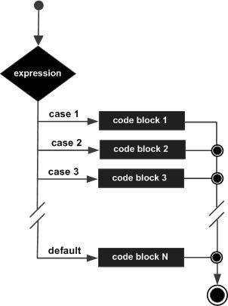
switch statement: Syntax
switch(expression) //similar to if(expression)
{
case constant-expression:
statement(s);
break; //optional
case constant-expression:
statement(s);
break; //optional
// you can have any number of case statements.
default : //Optional
statement(s);
}

Slide 45
switch statement
Syntax (selection statement)
  switch (expression) {
  case constant-expr1: statement1
  case constant-expr2: statement2
  ...
  ...
  case constant-exprN: statementN
  default: statement
  }

Slide 46
switch statement: Syntax
switch(expression) //e.g., switch(x)
{
case constant-expression://case 1:
statement(s);
break; //optional
tatement(s);
break; //optional
// you can have any number of case statements.
default : //Optional
statement(s);
}
  Terminate the switch when a break statement is encountered
  Go to the case label having a constant value that matches the value of the switch expression;
  if a match is not found, go to the default label; if default label does not exist, terminate the switch

Slide 47
switch statement: Syntax
switch(expression) //similar to if(expression)
{
case constant-expression://case 1:
statement(s);
break; //optional
case constant-expression://case 2:
statement(s);
break; //optional
// you can have any number of case statements.
default : //Optional
statement(s);
}
  If there is no break statement,
  execution “falls through” to the next statement in the succeeding case

Slide 48
Example
#include <iostream>
using namespace std;
void main(){
int x;
cin >> x;
switch (x){
case 0:
cout << “Zero”;
break; /* no braces is needed */
case 1:
cout << “One”;
break;
case 2:
cout << “Two”;
break;
default:
cout << “Greater than two”;
} //end switch
}

Slide 49
Example
#include <iostream>
using namespace std;
void main(){
int x=0;
switch (x){
case 0:
cout << “Zero”;
x=1;
break; /* no braces is needed */
case 1:
cout << “One”;
break;
case 2:
cout << “Two”;
break;
default:
cout << “Greater than two”;
} //end switch
}

Slide 50
switch statement
Semantics
  Evaluate the switch expression which results in an integer type (int, long, short, char)
  Go to the case label having a constant value that matches the value of the switch expression; if a match is not found, go to the default label; if default label does not exist, terminate the switch
  Terminate the switch when a break statement is encountered
  If there is no break statement, execution “falls through” to the next statement in the successful case

Slide 51
conditional (?:) operator
Syntax of ?: operator is
  expr1 ? expr2 : expr3
  E.g., (a>b) ? a=1 : a=0
Semantics
  expr1 is evaluated
  If the result is non-zero/true, then execute expr2;
  else expr3 is executed
  The value of the whole ?: expression is the value of expression evaluated at the end
  E.g., finds the maximum value of x and y

Slide 52
Summary
Boolean logic has two values only; true or false.
Conditional statements are the statements that only execute under certain conditions.
In C++, there are two approaches to construct conditional statement
  if (…){…}else{…}
  switch(…){…case:break}

