Slide 1
GE2262 Business Statistics
Topic 3
Discrete & Continuous
Probability Distributions
Reference
Levine, D.M., Krehbiel, T.C. and Berenson, M.L., Business Statistics: A First Course, Pearson Education Ltd, Chapter 3 & 5 & 6

Slide 2
Outline
Discrete Probability Distribution
Binomial Distribution
Continuous Probability Distribution
Normal Distribution

Slide 3
Random Variables
Random Variable
outcomes of an experiment with probabilistic occurrence
Discrete Random Variable
produces outcomes that
come from a counting process
(e.g. number of courses you are taking in this semester)
Continuous Random Variable
produce outcomes that
come from a measurement
(e.g. your annual salary,
or your weight)

Slide 4
Discrete Probability Distributions
A probability distribution for a discrete variable is a mutually exclusive listing of all possible numerical outcomes for that variable and a probability of occurrence associated with each outcome
  The probabilities are obtained based on either priori knowledge (priori probability) or empirical approach (empirical probability)
    Examples
      Probability of selecting a black card from a deck of cards
      Probability of a respondent who will purchase a HDTV
The probability distribution of a variable forms a theoretical model which allows us to derive statistics and probabilities for the events related to the variable

Slide 5

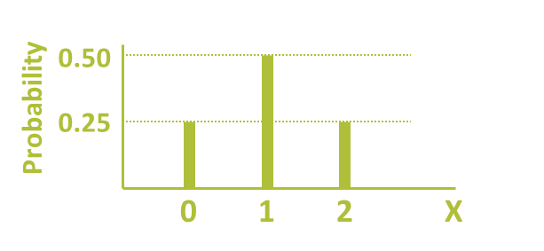
Discrete Probability Distribution
Experiment: Toss 2 coins let X = No. of heads
Probability Distribution
X Value Probability
T
T
T
0 1/4 = 0.25
1 2/4 = 0.50
T
2 1/4 = 0.25

Slide 6
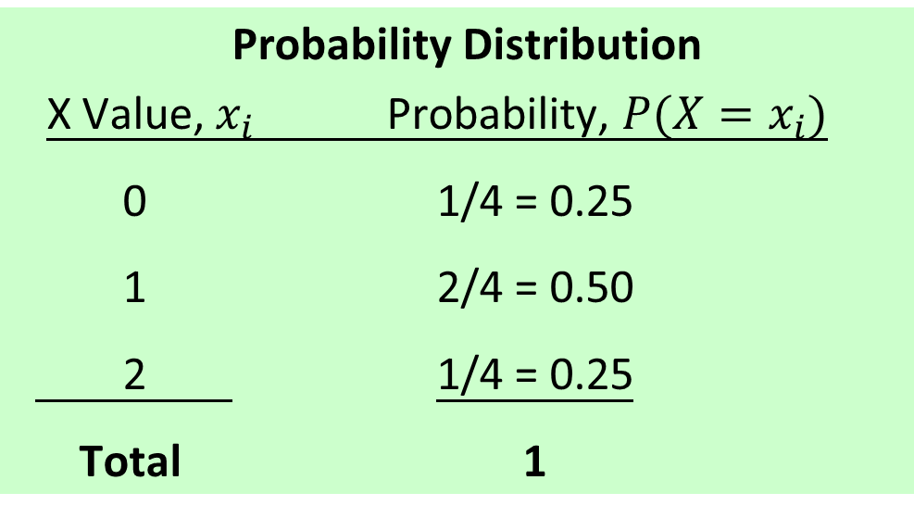
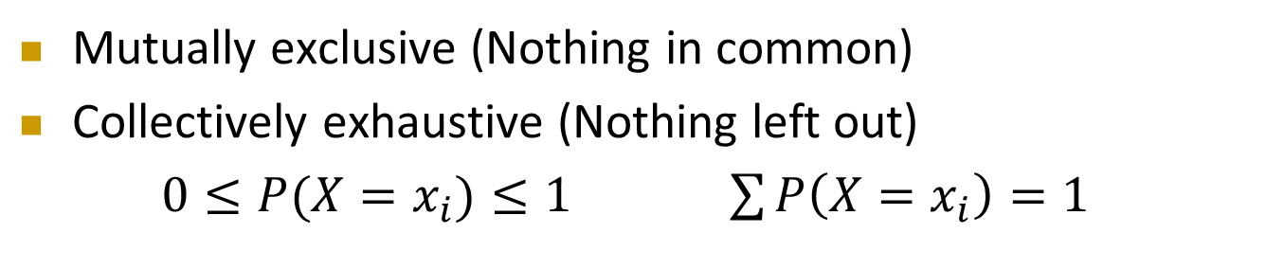
Discrete Probability Distribution
Cont’d
Probability Distribution
X Value, $x_{i}$ Probability, $P({X=x}_{i})$
0 1/4 = 0.25
1 2/4 = 0.50
2 1/4 = 0.25
Total 1
Mutually exclusive (Nothing in common)
Collectively exhaustive (Nothing left out)
$0≤P({X=x}_{i})≤1$ $\sum{P\left({X=x}_{i}\right)}=1$

Slide 7
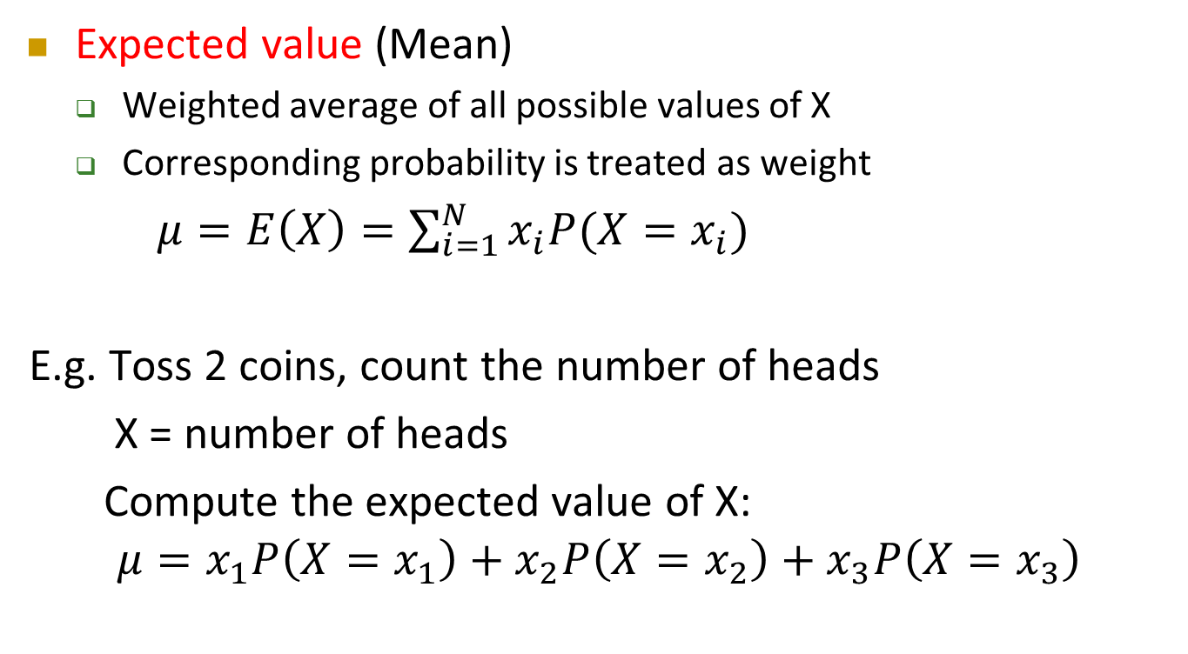
Discrete Random Variables – Measuring Center
Cont’d
Expected value (Mean)
  Weighted average of all possible values of X
  Corresponding probability is treated as weight
  $μ=E\left(X\right)=\sum_{i=1}^{N}{x_{i}P(X=x_{i})}$
E.g. Toss 2 coins, count the number of heads
X = number of heads
Compute the expected value of X:
$$μ=x_{1}P\left(X=x_{1}\right)+x_{2}P\left({X=x}_{2}\right)+x_{3}P\left(X=x_{3}\right)$$
X P(X)
0 0.25
1 0.50
2 0.25

Slide 8
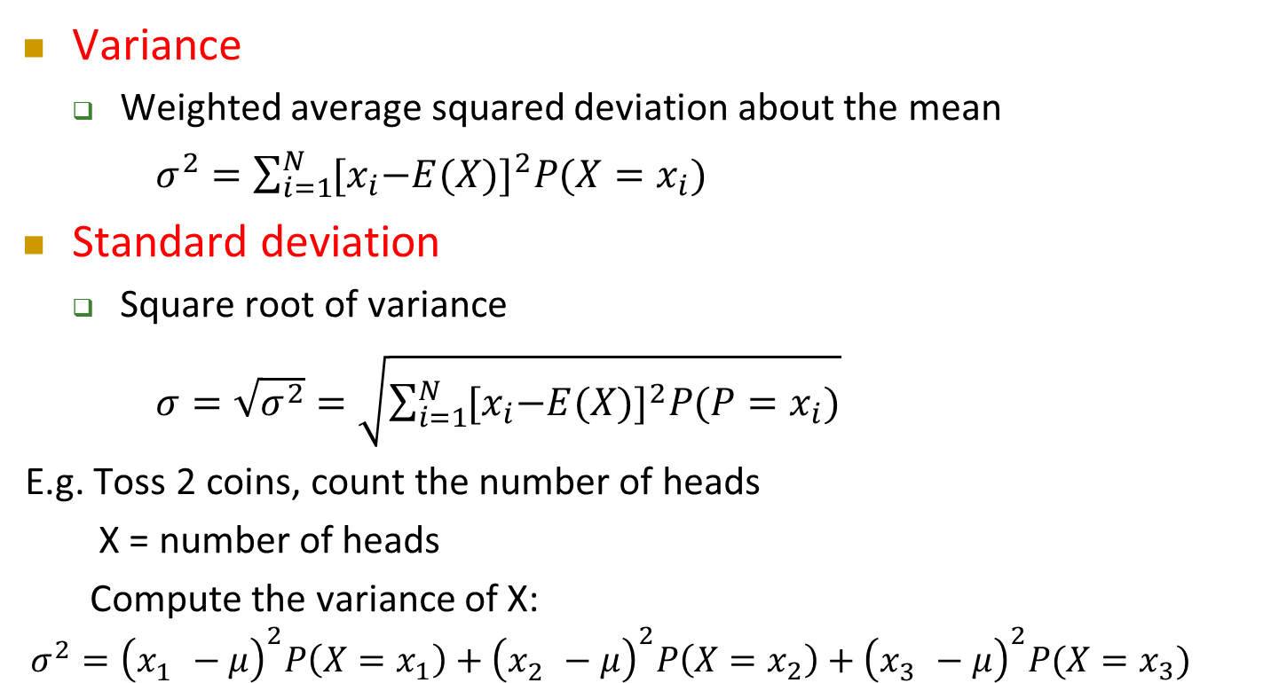
Discrete Random Variables – Measuring Variation
Cont’d
Variance
  Weighted average squared deviation about the mean
  $σ^{2}=\sum_{i=1}^{N}{{{[x}_{i}−E(X)]}^{2}P({X=x}_{i})}$
Standard deviation
  Square root of variance
  $σ=\sqrt{σ^{2}}=\sqrt{\sum_{i=1}^{N}{{{[x}_{i}−E(X)]}^{2}P({P=x}_{i})}}$
E.g. Toss 2 coins, count the number of heads
X = number of heads
Compute the variance of X:
$$σ^{2}={\left(x_{1}^{}−μ\right)}^{2}P\left({X=x}_{1}\right)+{\left(x_{2}^{}−μ\right)}^{2}P\left({X=x}_{2}\right)+{\left(x_{3}^{}−μ\right)}^{2}P(X=x_{3})$$
X P(X)
0 0.25
1 0.50
2 0.25

Slide 9
Discrete Random Variables – Example
Cont’d
Roll a fair die once. What is the expected value of the number rolled?
Number Rolled (x_{i}) | Probability P(X = x_{i}) | x_{i}P(X = x_{i})
1 | 1/6 | (1)(1/6) = 1/6
2 | 1/6 | (2)(1/6) = 2/6
3 | 1/6 | (3)(1/6) = 3/6
4 | 1/6 | (4)(1/6) = 4/6
5 | 1/6 | (5)(1/6) = 5/6
6 | 1/6 | (6)(1/6) = 6/6
 |  | μ = E(X) = 3.5
The expected value of the number rolled is 3.5

Slide 10
Discrete Random Variables – Example
Cont’d
For the results of rolling a fair die, the expected value of the number rolled is 3.5
Since you can never obtain a number of 3.5 by rolling a die, so what is the meaning of these statistics?
How much money should we be willing to put up in order to have the opportunity of rolling a fair die if we were to be paid, in dollars, the amount on the face of the die?
  On any particular roll, our payoff will be $1.0, $2.0, …, or $6.0, but over many many rolls, the payoff can be expected to average out to $3.5 per roll
  If you pay less than $3.5 for a roll, you are going to make a profit in long run
  If you pay more than $3.5 for a roll, you are going to loss in long run

Slide 11
Discrete Random Variables – Exercise
Cont’d
Assume the following table shows the return per $1,000 for an investment under different economic conditions
Compute the expected return and standard deviation
Return in amount, Y_{i} | Economic Condition | P (Y_{i})
-$200 + 50 + 350 | Recession Stable Economy Expanding Economy | 0.2 0.5 0.3
Should you, from a statistical stand point, invest or not?

Slide 12
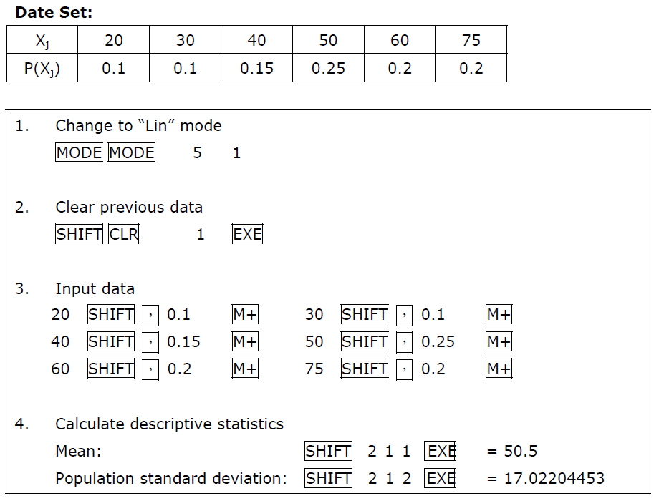
Calculating the Mean and Variance in Calculator (For Casio fx-50F)

Slide 13
Binomial Distribution
A mathematical model is a mathematical expression representing some underlying phenomenon
With such mathematical expressions are available, the exact probability of occurrence of any particular outcome of the random variable can be computed
For discrete random variables, this mathematical expression is known as a probability distribution function
One of the such probability distribution functions is called Binomial Distribution
  A very important mathematical model used in many business situations

Slide 14
Binomial Distribution
What is the probability that, among 3 students,
any 2 of them getting a pass in the test,
with the probability of passing the test equals 0.7?
Cont’d
Student | A | B | C | Probability
Case 1 | P | P | F | 0.7 × 0.7 × 0.3 = 0.147
Case 2 | P | F | P | 0.7 × 0.3 × 0.7 = 0.147
Case 3 | F | P | P | 0.3 × 0.7 × 0.7 = 0.147
P(Any 2 getting pass)= 0.147 + 0.147 + 0.147 = 0.441
What is the probability that, among 30 students,
any 20 of them getting a pass in the test,
with the probability of passing the test equals 0.7?

Slide 15
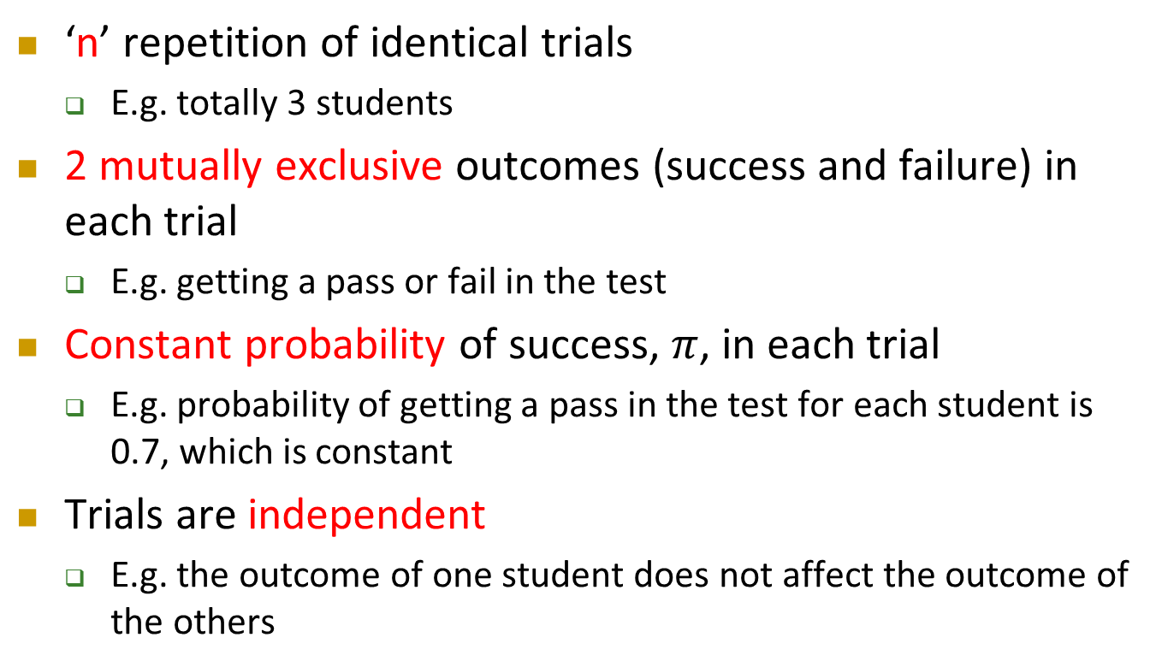
Binomial Distribution – Conditions
Cont’d
‘n’ repetition of identical trials
  E.g. totally 3 students
2 mutually exclusive outcomes (success and failure) in each trial
  E.g. getting a pass or fail in the test
Constant probability of success, $π$, in each trial
  E.g. probability of getting a pass in the test for each student is 0.7, which is constant
Trials are independent
  E.g. the outcome of one student does not affect the outcome of the others

Slide 16
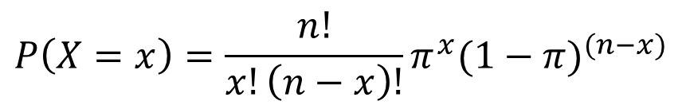
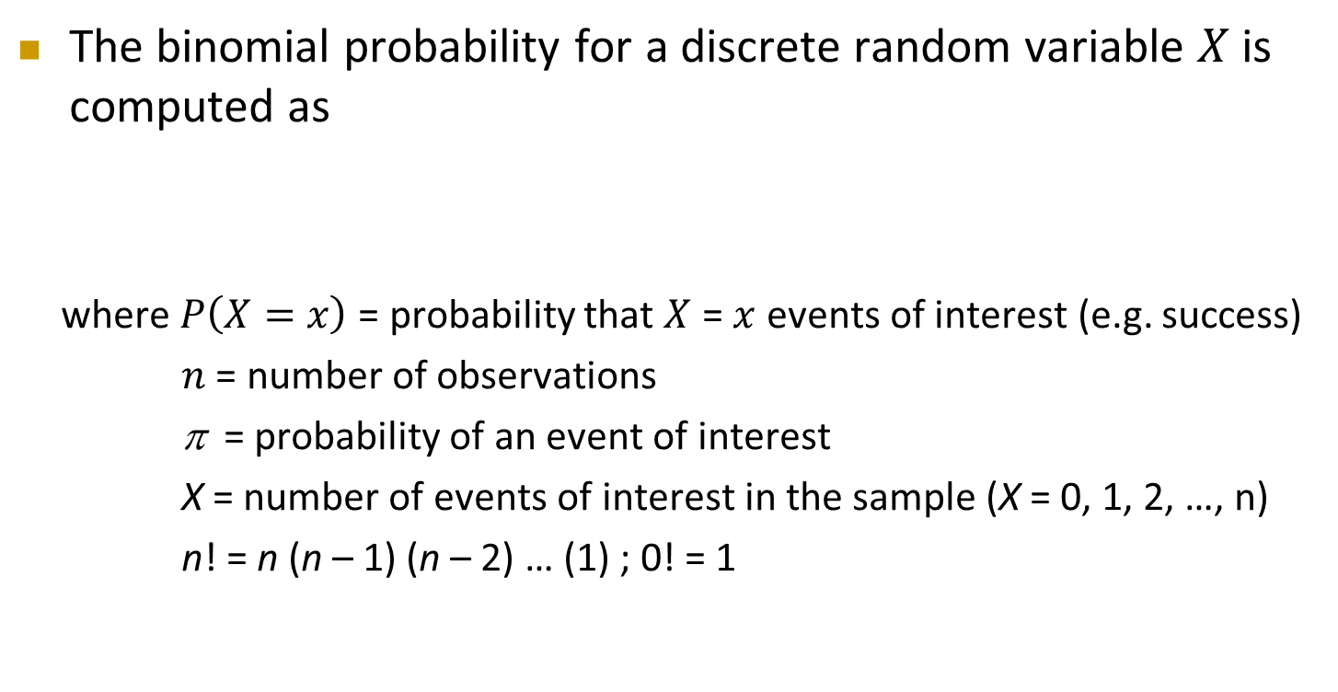
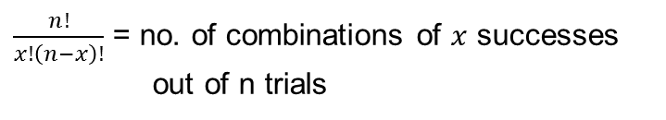
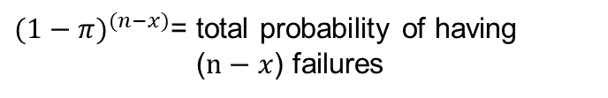
Binomial Distribution
Cont’d
  The binomial probability for a discrete random variable $X$ is computed as
  where $P\left(X=x\right)$ = probability that $X$ = $x$ events of interest (e.g. success)
      $n$ = number of observations
      π = probability of an event of interest
      X = number of events of interest in the sample (X = 0, 1, 2, …, n)
      n! = n (n – 1) (n – 2) … (1) ; 0! = 1
$$P\left(X=x\right)=\frac{n!}{x!\left(n−x\right)!}π^{x}{(1−π)}^{(n−x)}$$
Probability mass function
$\frac{n!}{x!\left(n−x\right)!}$ = no. of combinations of $x$ successes out of n trials
$π^{x}$= total probability of having $x$ successes
${(1−π)}^{(n−x)}$= total probability of having ($n−x$) failures

Slide 17
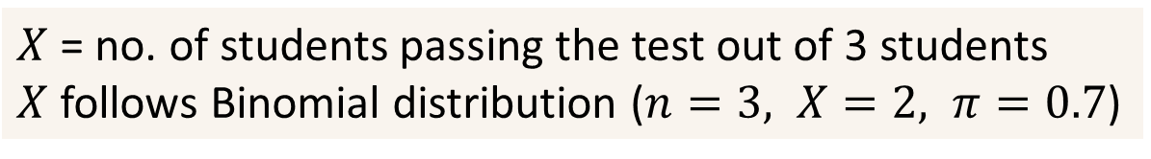
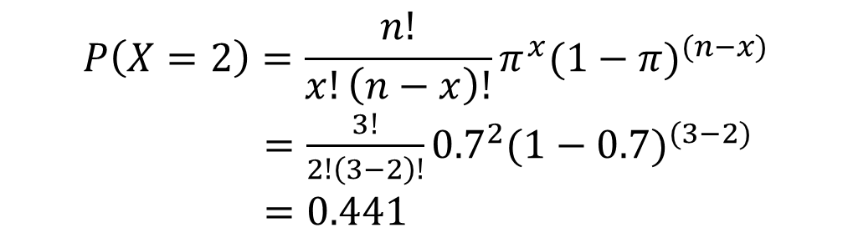
Binomial Distribution – Example
What is the probability that, among 3 students,
any 2 of them getting a pass in the test,
with the probability of passing the test equals 0.7?
Cont’d
$X$ = no. of students passing the test out of 3 students
$X$ follows Binomial distribution ($n=3, X=2, π=0.7$)
$$P\left(X=2\right)=\frac{n!}{x!\left(n−x\right)!}π^{x}{(1−π)}^{(n−x)}$$
    $=\frac{3!}{2!\left(3−2\right)!}{0.7}^{2}{(1−0.7)}^{(3−2)}$
$=0.441$
What is the probability that, among 30 students,
any 20 of them getting a pass in the test,
with the probability of passing the test equals 0.7?

Slide 18
Binomial Distribution
Cont’d
Possible applications for the Binomial Distribution
  A manufacturing plant labels items as either defective or acceptable
  A firm bidding for contracts will either get a contract or not
  A marketing research firm receives survey responses of “yes, I will buy” or “no, I will not”
  New job applicants either accept the offer or reject it

Slide 19
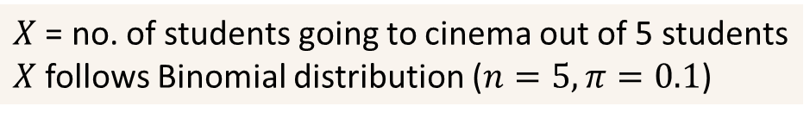
Binomial Distribution – Exercise
Cont’d
An experiment about the interest of going to the cinema is conducted in a secondary school. Five students are selected randomly.
Assume the probability of going to cinema within a week is 0.1.
$X$ = no. of students going to cinema out of 5 students
$X$ follows Binomial distribution ($n=5,π=0.1$)
The probability of 3 students going to the cinema out of these 5 students:

Slide 20
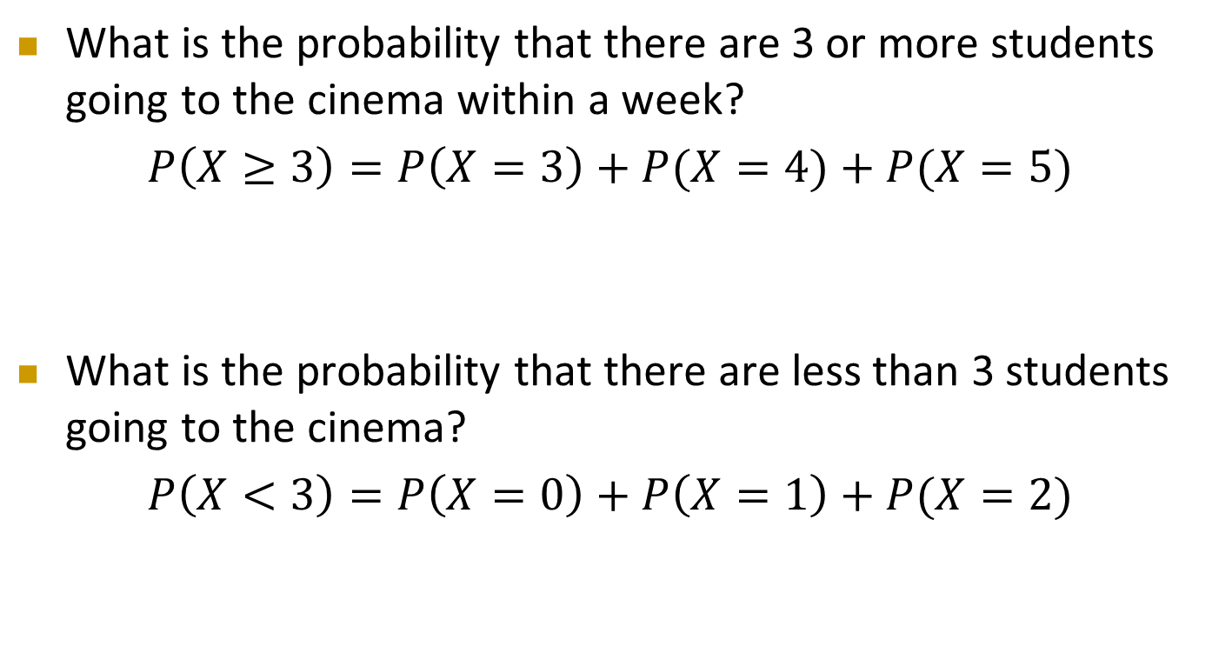
Binomial Distribution – Exercise
Cont’d
What is the probability that there are 3 or more students going to the cinema within a week?
$P\left(X≥3\right)=P\left(X=3\right)+P(X=4)+P(X=5)$
What is the probability that there are less than 3 students going to the cinema?
$P\left(X<3\right)=P\left(X=0\right)+P\left(X=1\right)+P(X=2)$

Slide 21
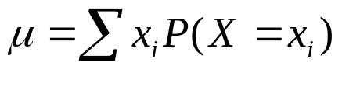

Binomial Distribution Mean and Standard Deviation
Binomial Probability Distribution:
X_{i} | P(X_{i})
0 | 0.59049
1 | 0.32805
2 | 0.0729
3 | 0.0081
4 | 0.00045
5 | 0.00001

Slide 22
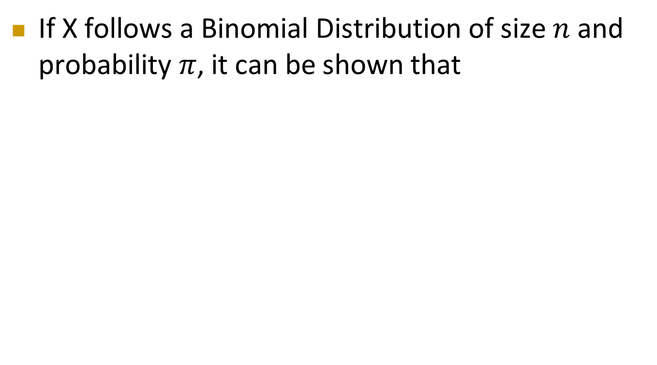



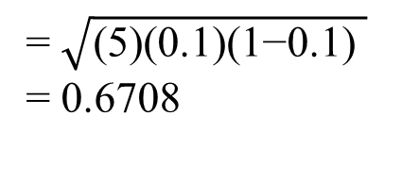
Binomial Distribution Mean and Standard Deviation
Cont’d
If X follows a Binomial Distribution of size $n$ and probability $π$, it can be shown that
$$μ=nπ$$
$$σ^{2}=nπ(1−π)$$
$$σ=\sqrt{nπ(1−π)}$$
= (5)(0.1)
= 0.5
= (5)(0.1)(1-0.1)
= 0.45
= $\sqrt{\text{(5)(0.1)(1−0.1) }}$
= 0.6708

Slide 23
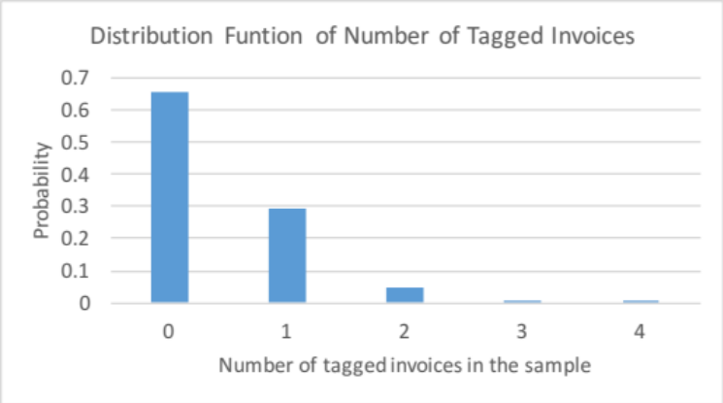
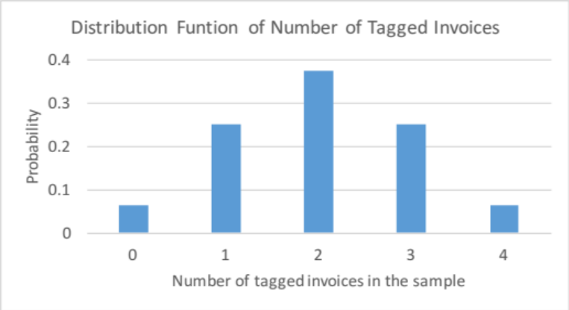
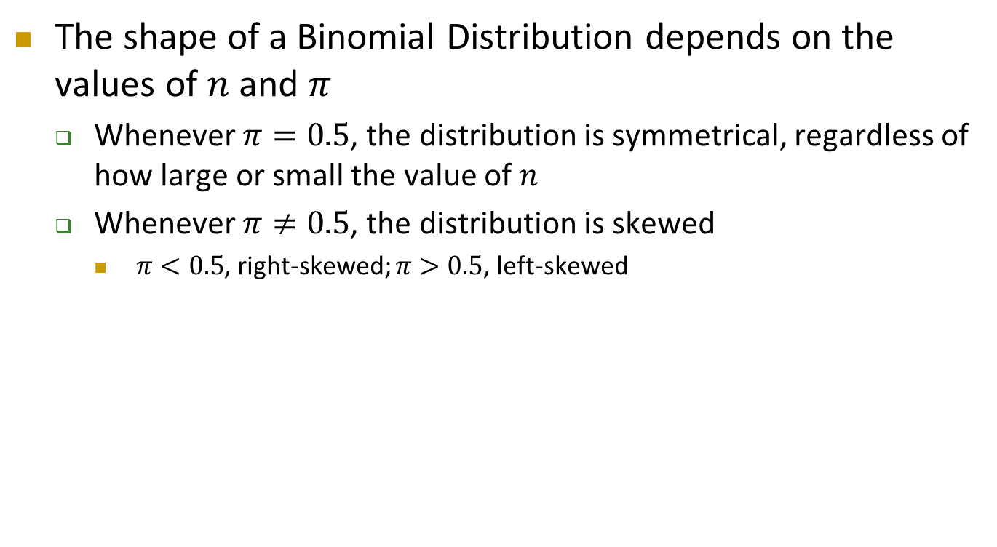


Binomial Distribution
Cont’d
The shape of a Binomial Distribution depends on the values of $n$ and $π$
  Whenever $π=0.5$, the distribution is symmetrical, regardless of how large or small the value of $n$
  Whenever $π≠0.5$, the distribution is skewed
    $π<0.5$, right-skewed; $π>0.5$, left-skewed
n = 4, $π$ = 0.1
n = 4, $π$ = 0.5

Slide 24
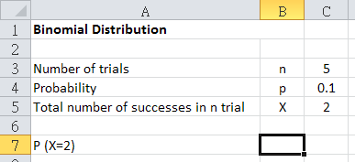
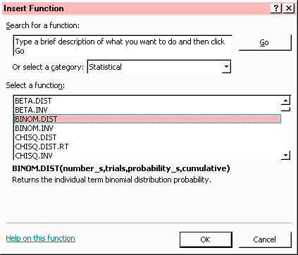
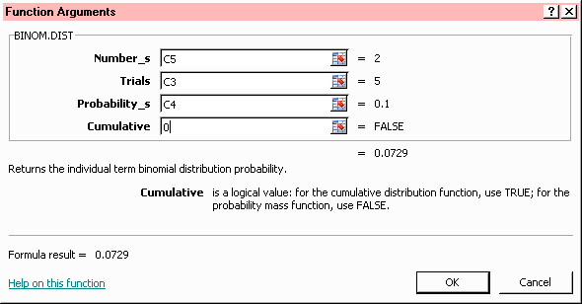

Binomial Distribution in Excel
Using Excel to find out the probability that 2 students out of 5 going to cinema within 1 week
  Type the required information ($n$, $X$, $π$)
  Use BINOM.DIST function
$$π$$
Cumulative:
where 1 is used to calculate P(X≤2)
0 is used to calculate P(X=2)

Slide 25
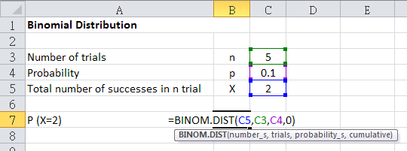
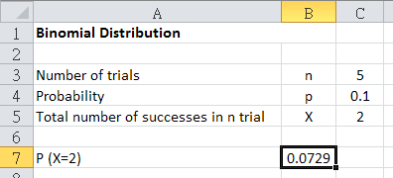


Binomial Distribution in Excel
Cont’d
Using Excel to find out the probability that 2 students out of 5 going to cinema with 1 week
$$π$$
=BINOM.DIST(X,n,π,0)
$$π$$

Slide 26
Continuous Probability Distributions
A continuous variable is a variable that can be assume any value on a continuum (can assume an uncountable number of values)
Examples
  Time required to travel from home to campus
  Temperature of a drink
  Height, in inches
These can potentially take on any value depending only on the ability to precisely and accurately measure
In practice, a discrete numerical variable with large range of values is often considered as a continuous variable

Slide 27
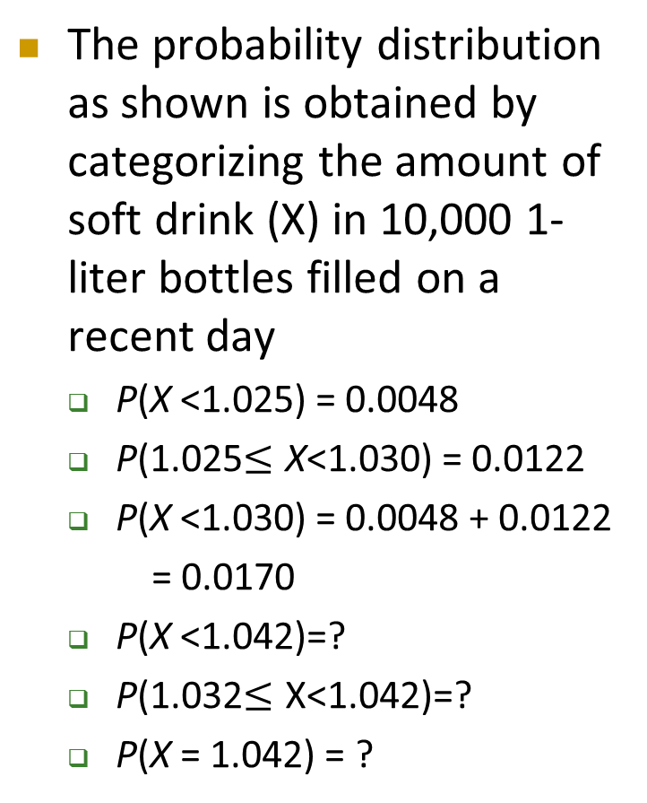
Continuous Probability Distributions – Example
Cont’d
The probability distribution as shown is obtained by categorizing the amount of soft drink (X) in 10,000 1-liter bottles filled on a recent day
  P(X <1.025) = 0.0048
  P(1.025$≤\text{X}$<1.030) = 0.0122
  P(X <1.030) = 0.0048 + 0.0122
  = 0.0170
  P(X <1.042)=?
  P(1.032$≤\text{X}$<1.042)=?
  P(X = 1.042) = ?
Amount of Fill (liters) |  | Frequency | Relative Frequency
< | 1.025 | 48 | 0.0048
1.025 < | 1.030 | 122 | 0.0122
1.030 < | 1.035 | 325 | 0.0325
1.035 < | 1.040 | 695 | 0.0695
1.040 < | 1.045 | 1198 | 0.1198
1.045 < | 1.050 | 1664 | 0.1664
1.050 < | 1.055 | 1896 | 0.1896
1.055 < | 1.060 | 1664 | 0.1664
1.060 < | 1.065 | 1198 | 0.1198
1.065 < | 1.070 | 695 | 0.0695
1.070 < | 1.075 | 325 | 0.0325
1.075 < | 1.080 | 122 | 0.0122
 | 1.080 or above | 48 | 0.0048
 |  |  | 1.0000

Slide 28
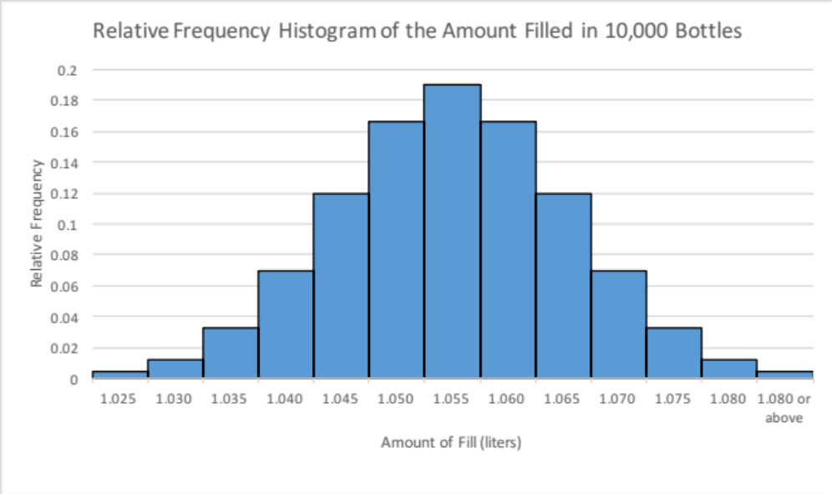
Continuous Probability Distributions – Example
Cont’d
Any required probabilities concerning the amount of soft drink filled can be obtained either from the raw data observed or from the relative frequency histogram
Treat the relative frequency as the area of of each group
  P(X < 1.042) = the area on the left of 1.042
  =0.0048 + 0.0122 + 0.0325 + 0.0695 + (1.042-1.040)/0.005*0.1198
  =0.1190 + 0.0479 = 0.1669
The area under a single point is 0. Hence, P(X = 1.042) = 0
< 1.042

Slide 29
Continuous Probability Distributions
Cont’d
Computing the probability of a continuous variable over a specified interval is like determining the area of the corresponding relative frequency histogram over the same interval
  It is time consuming to construct such relative frequency histogram as many data values need to be collected
  Sometimes it may not be possible to get the required data points
Is there an alternative way to compute probabilities of a continuous variable without involving the relative frequency histogram?

Slide 30
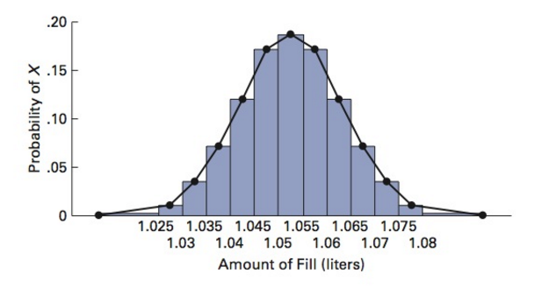
Continuous Probability Distributions
Cont’d
The figure below shows the relative frequency histogram and percentage polygon for the distribution of the amount filled in 10,000 bottles
  Polygon is a graph made by joining the middle top points of each class interval of relative frequency histogram
Determining the area of a relative frequency histogram over an interval is approximately equivalent to finding the area under the polygon over the same interval
If we can assume that the polygon actually follows some known mathematical curve, then finding the area under such curve becomes very easy

Slide 31
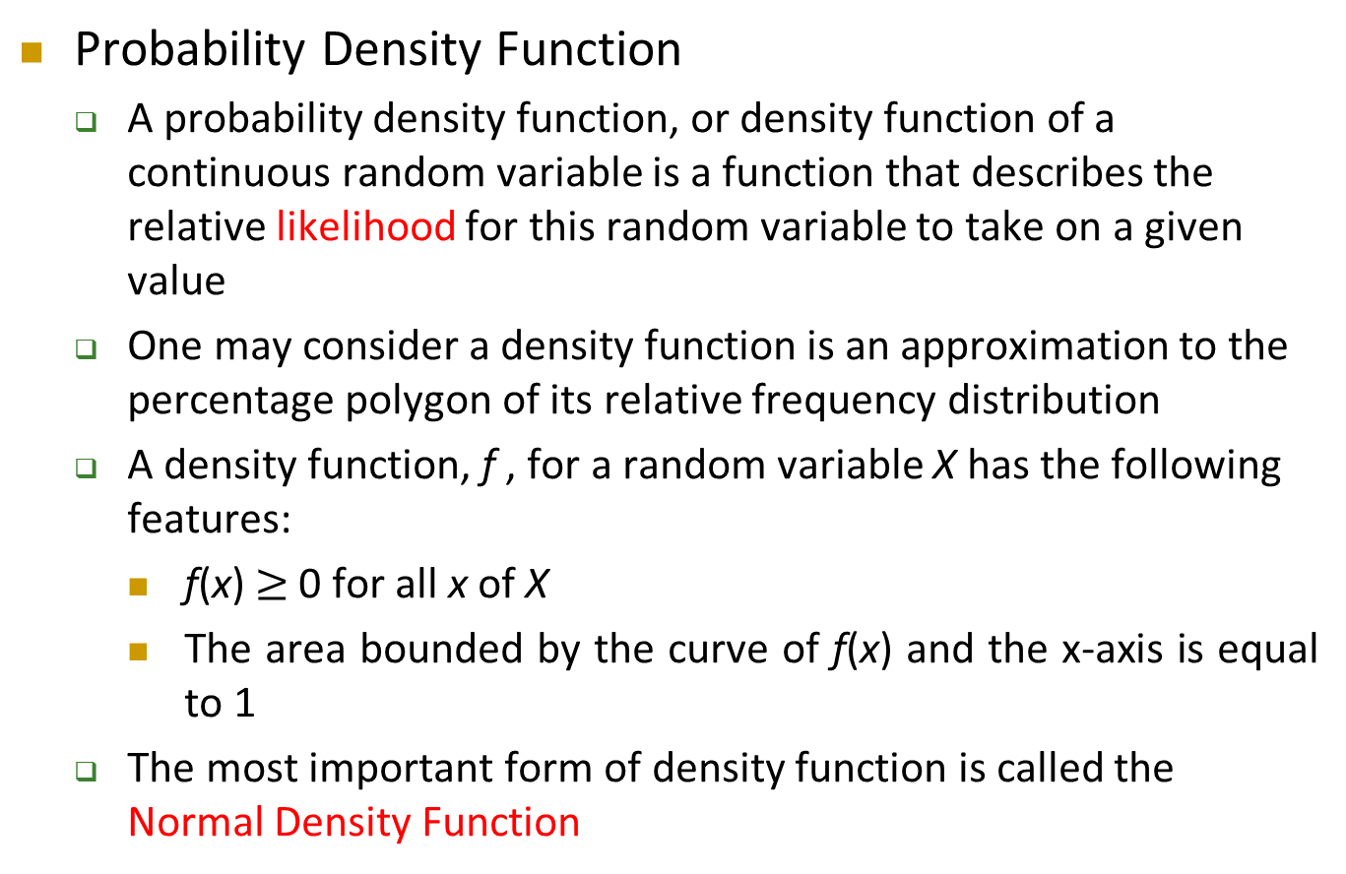
Continuous Probability Distributions
Cont’d
Probability Density Function
  A probability density function, or density function of a continuous random variable is a function that describes the relative likelihood for this random variable to take on a given value
  One may consider a density function is an approximation to the percentage polygon of its relative frequency distribution
  A density function, f , for a random variable X has the following features:
    f(x) $≥$ 0 for all x of X
    The area bounded by the curve of f(x) and the x-axis is equal to 1
  The most important form of density function is called the Normal Density Function

Slide 32
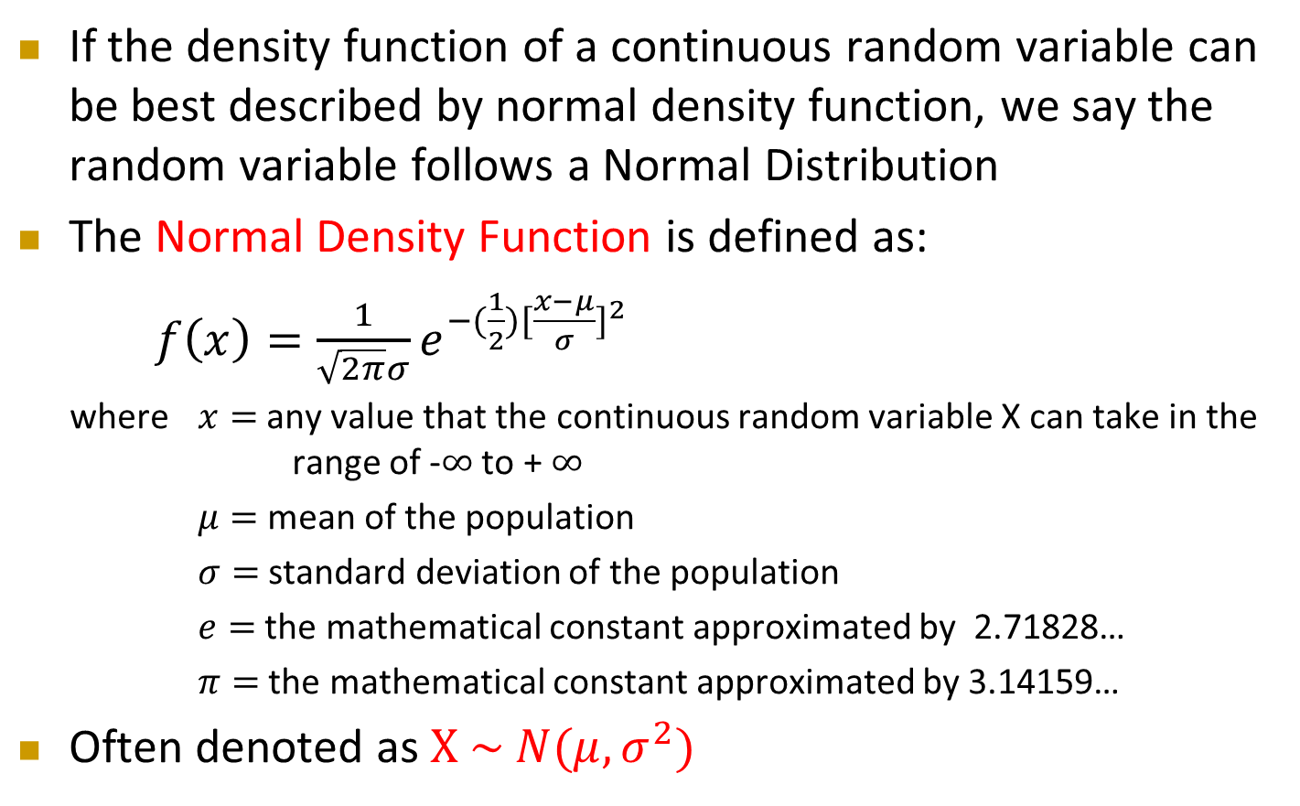
Normal Distribution
Cont’d
If the density function of a continuous random variable can be best described by normal density function, we say the random variable follows a Normal Distribution
The Normal Density Function is defined as:
$f\left(x\right)=\frac{1}{\sqrt{2π}σ}e^{−(\frac{1}{2}){[\frac{x−μ}{σ}]}^{2}}$
where $x=$ any value that the continuous random variable X can take in the range of -$∞$ to + $∞$
$μ=$ mean of the population
$σ=$ standard deviation of the population
$e=$ the mathematical constant approximated by 2.71828…
$π=$ the mathematical constant approximated by 3.14159…
Often denoted as $X \sim N(μ,σ^{2})$

Slide 33

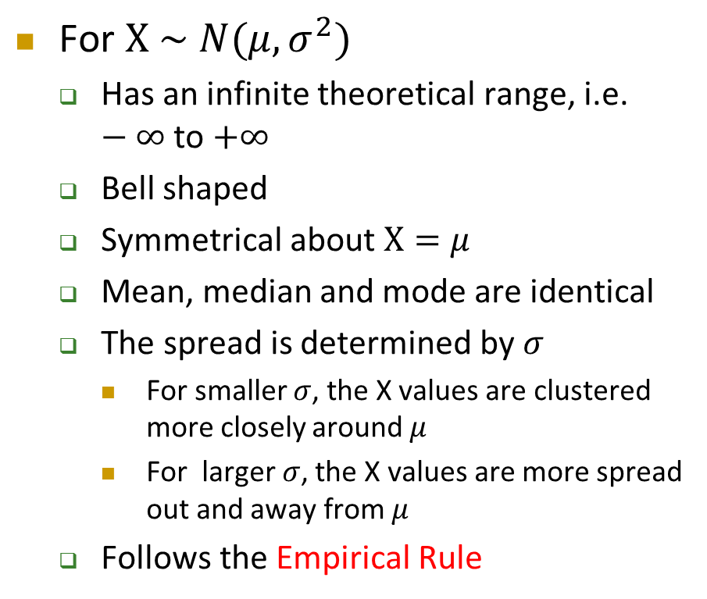

Normal Distribution
Cont’d
For $X \sim N(μ,σ^{2})$
  Has an infinite theoretical range, i.e. $−∞$ to $+∞$
  Bell shaped
  Symmetrical about $X=μ$
  Mean, median and mode are identical
  The spread is determined by $σ$
    For smaller $σ$, the X values are clustered more closely around $μ$
    For larger $σ$, the X values are more spread out and away from $μ$
  Follows the Empirical Rule
Smaller σ
Larger σ
$$μ$$
$$X$$

Slide 34

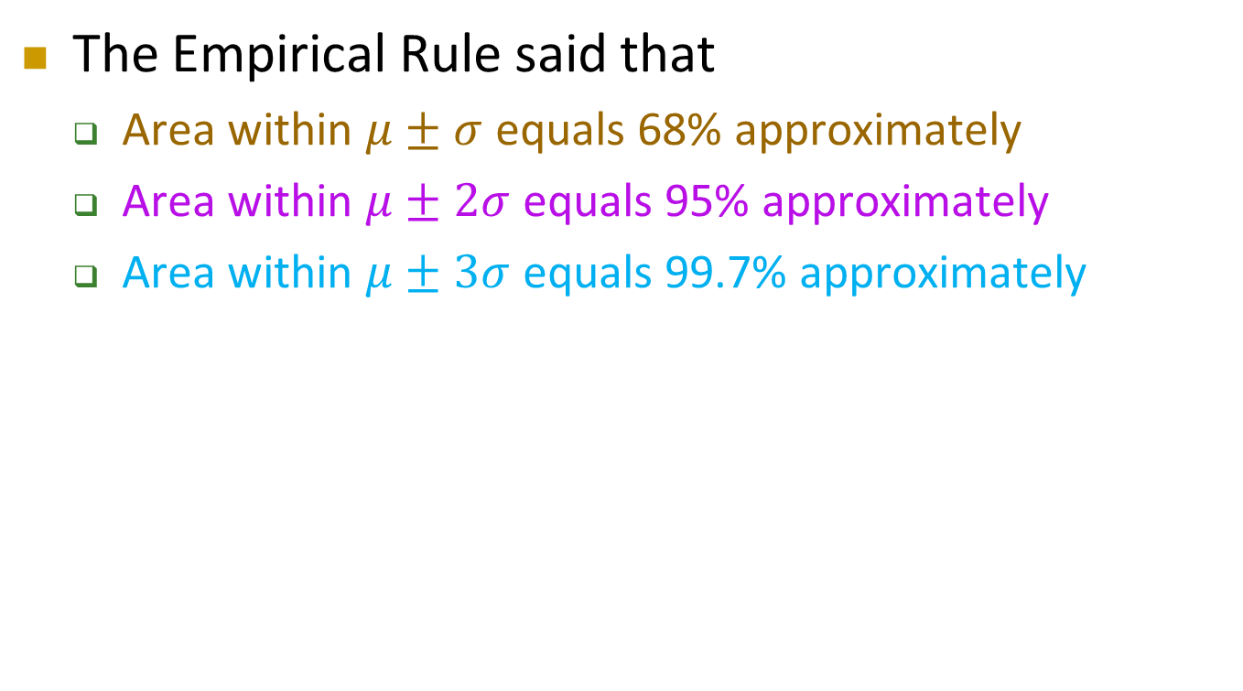







The Empirical Rule
The Empirical Rule said that
  Area within $μ±σ$ equals 68% approximately
  Area within $μ±2σ$ equals 95% approximately
  Area within $μ±3σ$ equals 99.7% approximately
68%
95%
99.7%
$$σ$$
$$σ$$
$$X$$
$$3σ$$
$$2σ$$
$μ$
$$2σ$$
$$3σ$$

Slide 35
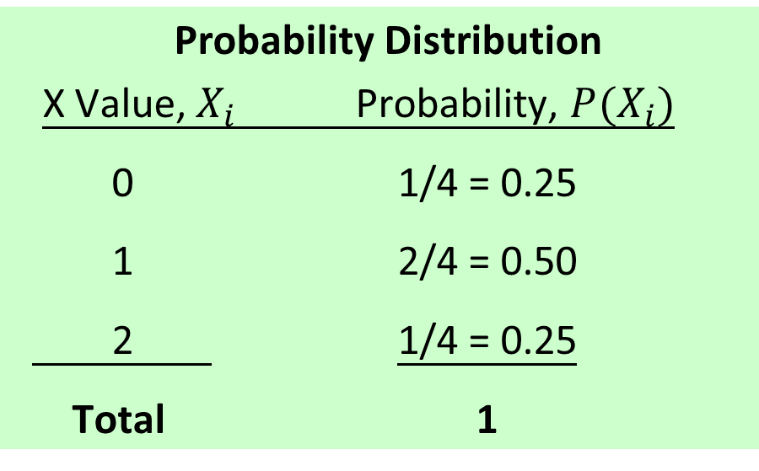
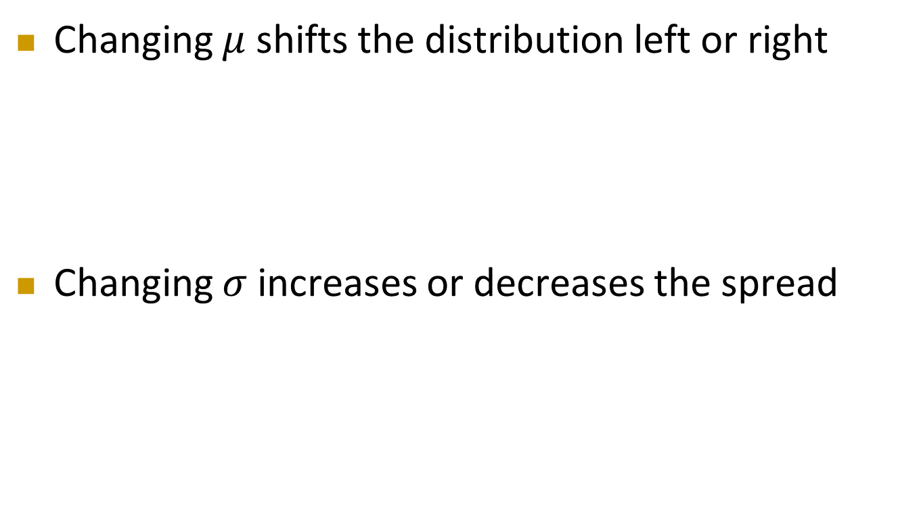
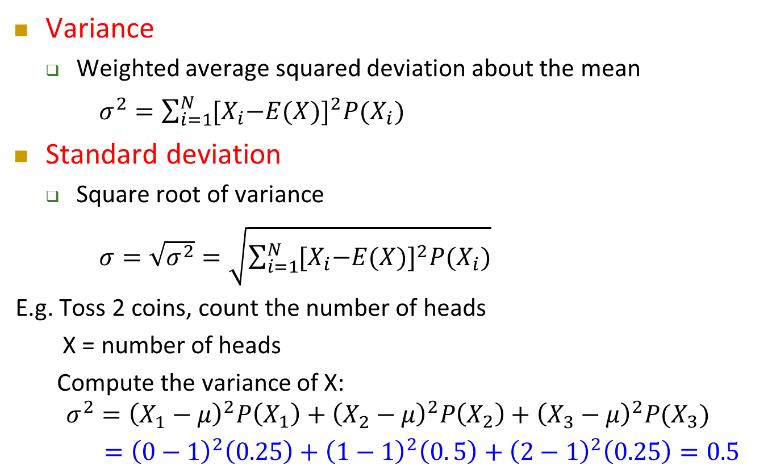
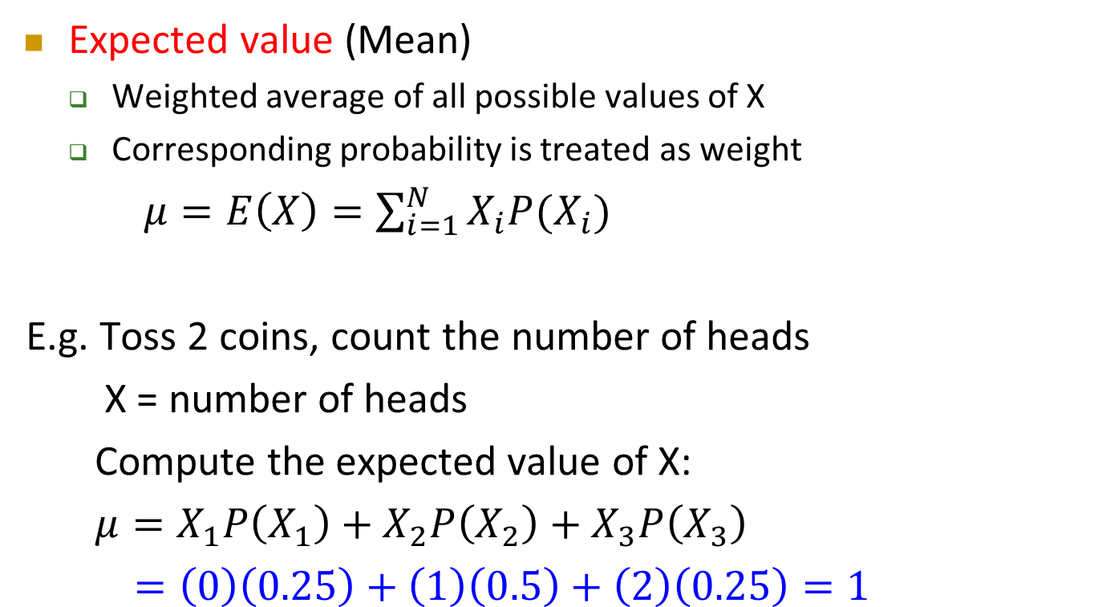

Normal Distribution
Cont’d
Changing $μ$ shifts the distribution left or right
Changing $σ$ increases or decreases the spread
$$μ=0$$
$μ$ = 2
$$σ=1$$
$σ$ = 2

Slide 36

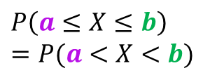

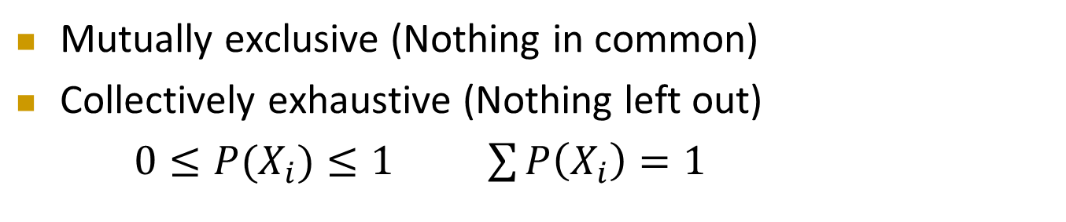

Computing Normal Probabilities
The total area under the curve is 1
Probability is measured by the area under the curve
Note that the probability of any individual value is zero by definition, i.e. $P\left(X=a\right)=0$
$$f(X)$$
$$P\left(a≤X≤b\right)$$
$$=P(a<X<b)$$
$$X$$
$$a$$
$$b$$

Slide 37
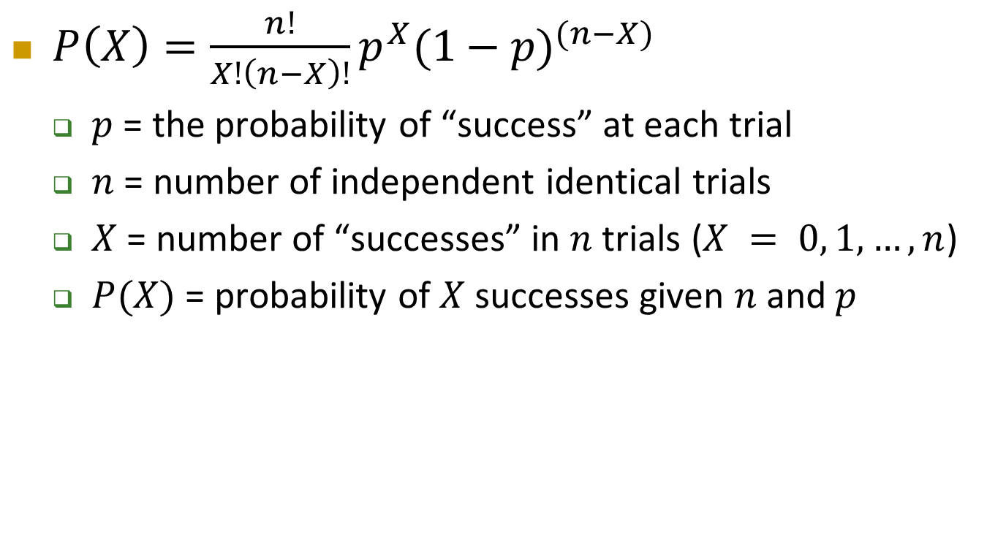
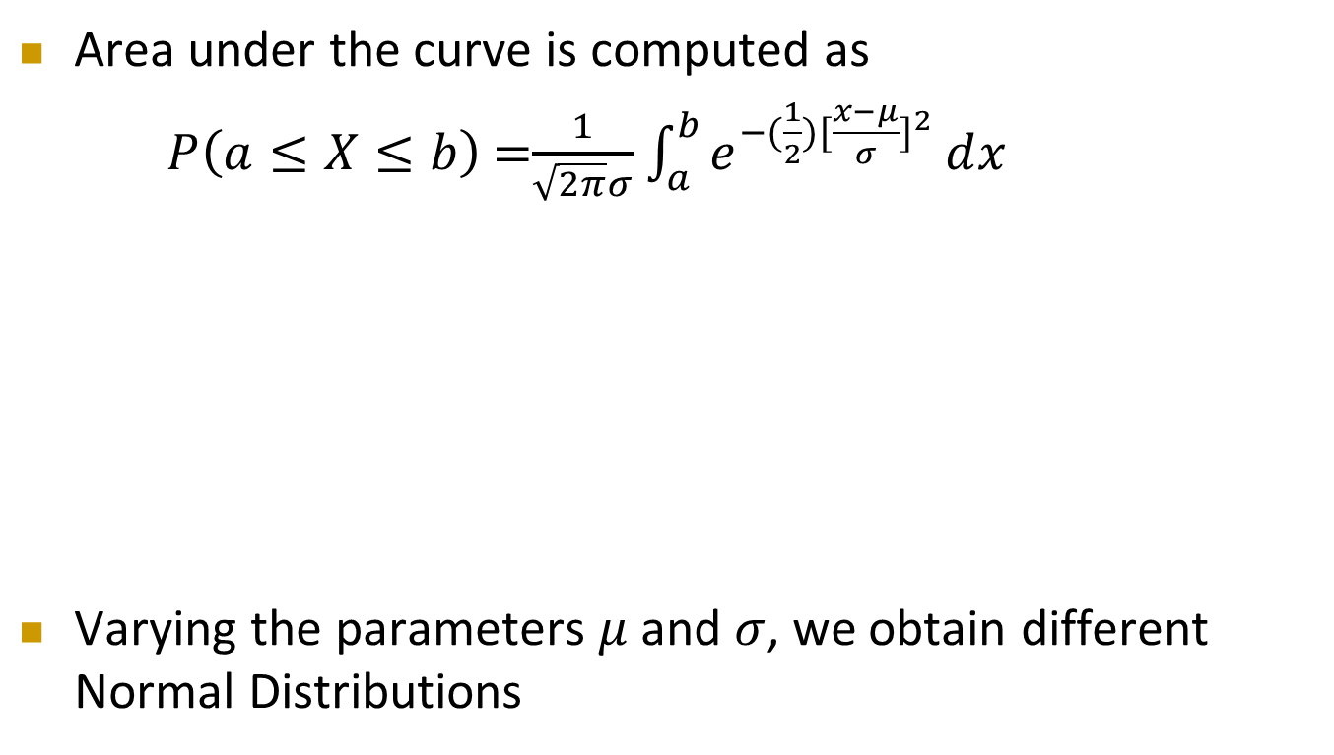
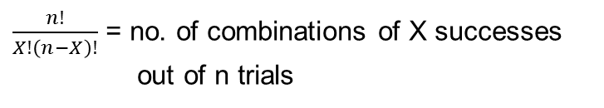
Computing Normal Probabilities
Cont’d
Area under the curve is computed as
$P\left(a≤X≤b\right)$ =$\frac{1}{\sqrt{2π}σ}$ $\int_{a}^{b}{e^{−(\frac{1}{2}){[\frac{x−μ}{σ}]}^{2}}ⅆx}$
Varying the parameters $μ$ and $σ$, we obtain different Normal Distributions
$$a b$$
$$X$$

Slide 38
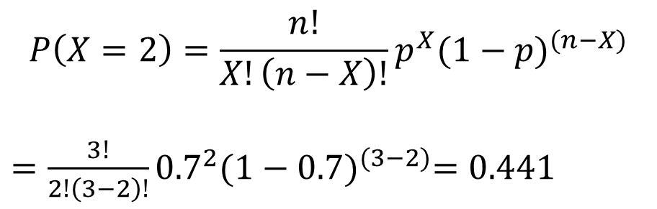
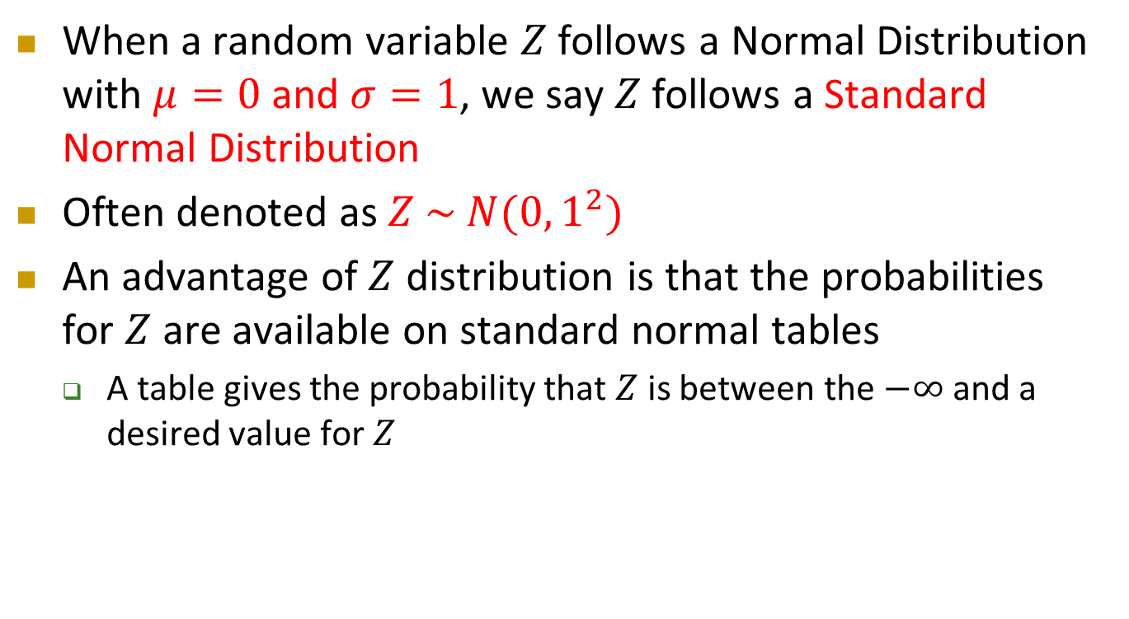


The Standardized Normal Distribution
When a random variable $Z$ follows a Normal Distribution with $μ=0$ and $σ=1$, we say $Z$ follows a Standard Normal Distribution
Often denoted as $Z \sim N(0,1^{2})$
An advantage of $Z$ distribution is that the probabilities for $Z$ are available on standard normal tables
  A table gives the probability that $Z$ is between the $−∞$ and a desired value for $Z$
$$σ=1$$
$$Z$$
$$μ=0$$

Slide 39
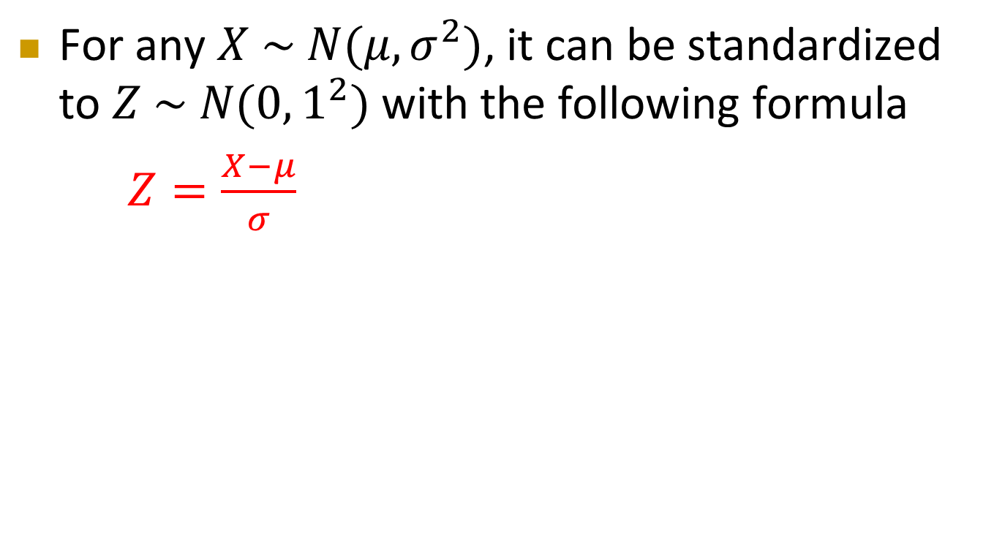
The Standardized Normal Distribution
Cont’d
For any $X \sim N(μ,σ^{2})$, it can be standardized to $Z \sim N(0,1^{2})$ with the following formula
$Z=\frac{X−μ}{σ}$

Slide 40

Standardization of Normal Distributions
The idea of standardization is
Step 1: $X$
Step 2: $X−μ$
Step 3: $Z=\frac{X−μ}{σ}$
0
0
0

Slide 41
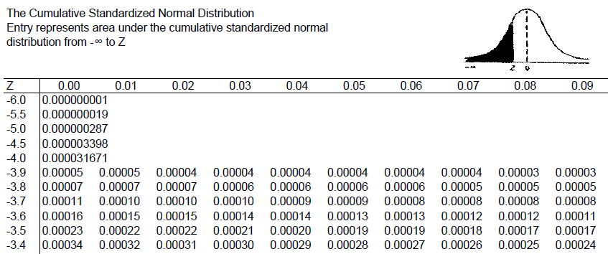

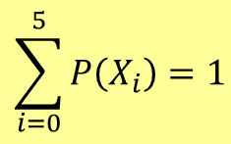
The Standardized Normal Table
The column gives the value of $Z$ to the second decimal point
The row shows the value of $Z$ to the first decimal point
The value within the table gives the probability from $Z=−∞$ up to the desired $Z$ value
$$P\left(Z<−3.45\right)=0.00028$$

Slide 42

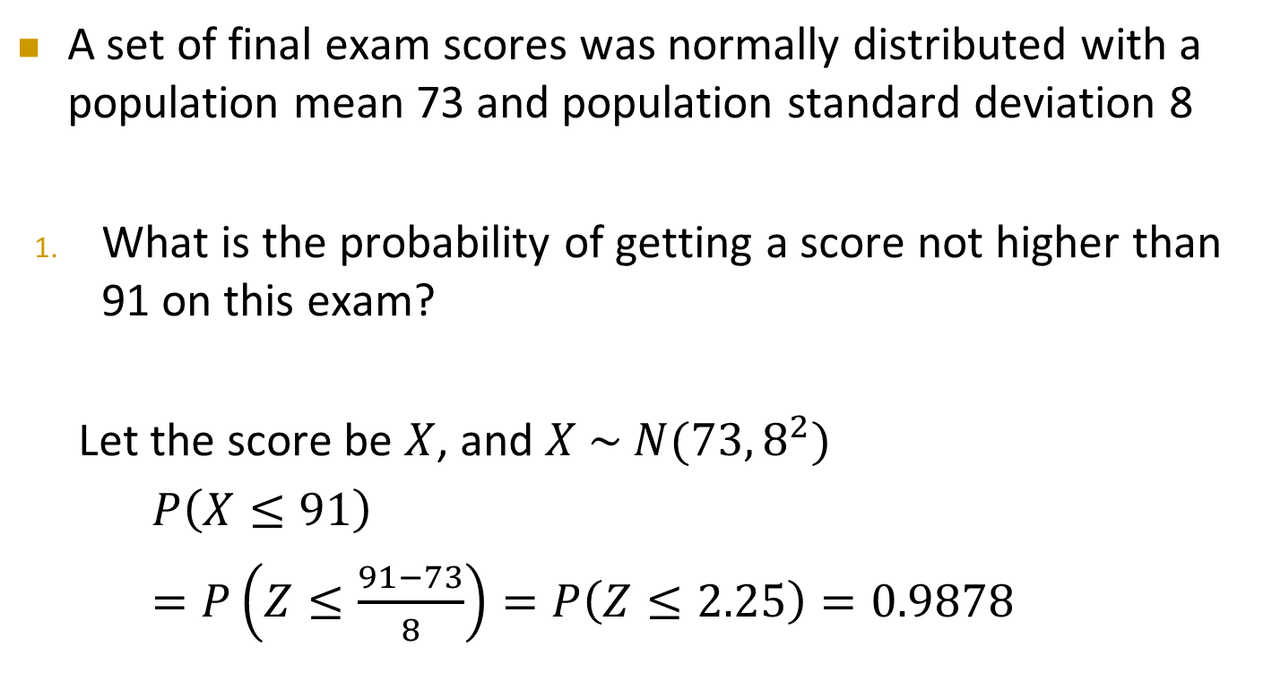
Computing Normal Probabilities – Example
A set of final exam scores was normally distributed with a population mean 73 and population standard deviation 8
What is the probability of getting a score not higher than 91 on this exam?
Let the score be $X$, and $X \sim N(73, 8^{2})$
$P\left(X≤91\right)$
$=P\left(Z≤\frac{91−73}{8}\right)=P\left(Z≤2.25\right)=0.9878$
$$X=91$$

Slide 43

Computing Normal Probabilities – Exercise
Cont’d
If the passing score is 50, what is the chance that a student can pass the exam?
$$X=50$$

Slide 44



Computing Normal Probabilities – Exercise
Cont’d
What percentage of students scored between 50 and 91?
$$−2.875$$
$$2.25$$
$$Z$$

Slide 45



Computing Normal Probabilities – Exercise
Cont’d
What percentage of students scored below 45 or above 85?
$$−3.5$$
$$1.5$$
$$Z$$

Slide 46


Computing Normal Probabilities – Exercise
Cont’d
What is the probability for a student to score exactly 85?
Not an area,
but just a line!!!
$$85$$
$$X$$

Slide 47
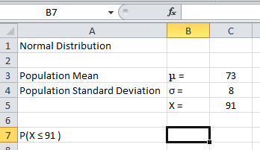
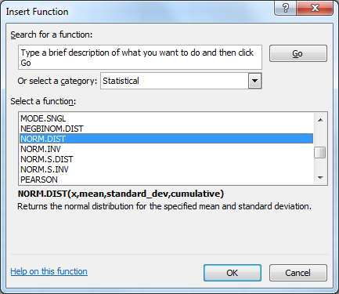


Computing Normal Probabilities in Excel
Step 1: Type the given information ($μ,σ,X$)
Step 2: Insert the “NORM.DIST” function
Cumulative:
where 1 is used to calculate the probability, P(X ≤ 91)
0 is used to calculate the frequency, f(X = 91)

Slide 48



Computing Normal Probabilities in Excel
Cont’d
=NORM.DIST($X,μ,σ,1$)

Slide 49


Recovering $X$ Values from Known Probabilities
With a given (cumulative) probability, we can use the $Z$ table to recover the $Z$ value
With $μ$ and $σ$ of the $X$ variable, we can recover the $X$ value

Slide 50




Recovering $X$ Values –
Example
Given that the exam scores, $X$, follow normal distribution with mean 73 and standard deviation 8, i.e. $X\sim N(73,8^{2})$
What is the minimum score a student needs in order to be in the top 5% of the class?
For $P\left(Z≥a\right)=0.05$, $a=1.645$
As $Z=\frac{X−μ}{σ}$,
hence $X=μ+Zσ$
$$=73+1.645×8=86.16$$
0.05
$$0$$
$$a$$
$$Z$$

Slide 51





Recovering $X$ Values –
Exercise
Cont’d
The middle 50% of the students scored between what two scores?
0.50
$$a$$
$$b$$
$$Z$$
$$0$$

Slide 52





Recovering $X$ Values in Excel
Step 1: Type the given information ($μ,σ,P$)
Step 2: Insert the “NORM.S.INV” function for recovering $Z$ value; “NORM.INV” for recovering $X$ value

Slide 53



Recovering $X$ Values in Excel
Cont’d
=NORM.S.INV($P$)
=NORM.INV($P,μ,σ)$

Slide 54
Importance of Normal Distribution
Most common continuous distribution used in statistics
Provides the basis for statistical inference because of its relationship to the Central Limit Theorem
  To be discussed in Topic 4
Can be used to approximate various discrete probability distributions, such as Binomial distribution, for large sample size, therefore, simplifying computations
  To be discussed in Topic 7

Slide 55

You Sometimes Get More Than You Pay For
According to McDonald’s “fact sheet”, their ice cream cones weigh 3.7 ounces and contain 170 calories
Do the ice cream cones really weigh exactly 3.7 ounces?
To get 3.7 ounces for every cone would require a very fine-tuned machine, or an employee with a very good skill and sense of timing
Thus, we expect some natural variation in the weight of these cones

Slide 56
You Sometimes Get More Than You Pay For
Cont’d
If you buy one ice cream cone everyday through out the week, you may be surprised that they all weighed more than 3.7 ounces
How likely this would happened?

