Slide 1
CS3342 Software Design
Course Revision – April 2024
Prof. Jacky Keung
Final Exam: 2-hours Exam
Tentative:
Tuesday - 30 April 2024 (Closed-book)

Slide 2
What have we learned so far?
Software Design?
Processes, Steps and Methods toward good designs
Software Dev. Teamwork? Project?

Slide 3
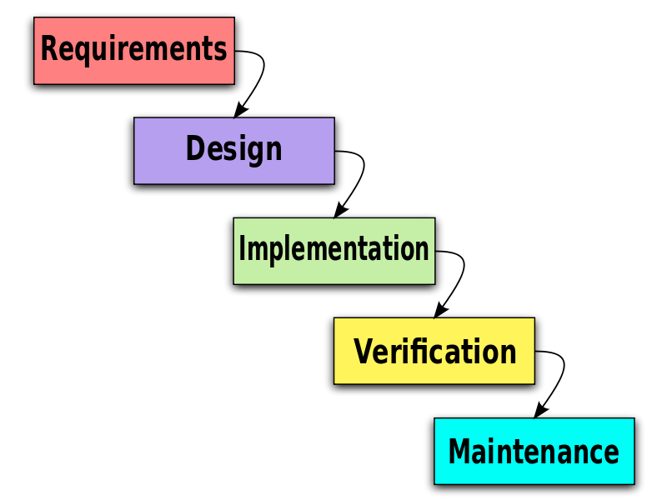
Software Development Processes
CS3342
Requirements gathering, and software design
Software Testing
(Other courses)
Maintenance, service, upgrades, deployments
(Other courses)

Slide 4
Assessment Components 50/50
Course Work 50%:
  1x Assignment 15% - Individual
  1x Midterm 15% - Individual
  1x Group Project 20% - In a group of 6 students
    Group Presentation (5%) week 13
    Software Design Group Report (15%)
Exam 50%:
  1x Final Examination (50%) ☺ Week 15

Slide 5
Course Schedule
 | Lecture | Tutorial
Week 1 | Introduction to Software Design | Review of OO/OOP basics
Week 2 | OO Programming Concepts I | OOP Concepts
Week 3 | OO Programming Concepts II | OOP Concepts
Week 4 | OO Modeling (Classes, Use Cases) | Role of Variables
Week 5 | OO Modeling (Sequence Diagram) | Use Case Diagrams Exercises
Week 6 | OO Design Principles (OCP, LSP, DIP) | Sequence Diagram Exercises
Week 7 | OO Design Principles (SRP, ISP, LOD) | Design Principles Exercises
Week 8 | OO Design Patterns I | Design Principles and Patterns
Week 9 | OO Design Patterns II | Design Patterns
Week 10 | Mid-Term | Design Patterns
Week 11 | Software Ethics + Course Revision | Software Ethics
Week 12 | Exam Revision | Group Project
Week 13 | Group Presentations | Group Presentations

Slide 6
Course Review 1
Week 1 – Software Engineering Introduction
  What is Software Engineering and SE as a Profession?
  Importance of Software Engineering in the IT Industry?
  Visual Paradigm and BlueJ-UML Tools
  Model driven software development, UML <-> Code
Week 2 – Concepts of Object-Oriented Programming
  Advantages of OO Paradigm?
  Class Diagrams, Attributes, Operations, Classes
Week 2 – Software Development Processes
  Process models and their pros and cons (waterfall…spiral..)
  Component based Software Engineering - CBSE

Slide 7
Course Review 2
Week 3 – OO Programming and Roles of Variables
  Inheritance*, Polymorphism*
  Roles of Variables *
    Be able to identify Roles from code fragments *
    Be able to produce code fragments to demonstrate roles
Week 4 – User Requirements and Design Modeling
  Requirements Elicitation and Analysis
  UML Use Case Diagram (Actors, Use cases, etc..)
  Use Case Relationships (include, extend, etc..)
  Use Case Specification
  UML Class Diagram
  Class Linkages – 3 types * (assoc.,aggreg., composition)

Slide 8
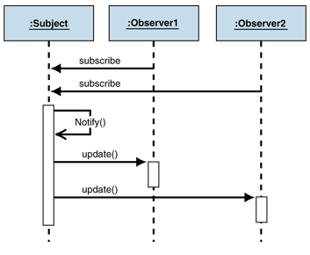
Course Review 3
Week 5 – Object Interactions - Sequence Diagram
  Notations, such as :Object
  Linkage to sequence of calls
  Lifelines, Create Objects
  Combined Fragments
  Control blocks etc..
  Reference example
  http://msdn.microsoft.com/en-us/library/ff649896.aspx

Slide 9
Course Review 4
Week 6 – Software Design Principles I
  Monster and Knight example*
  SOLID Principles
  Open-Closed Principle (OCP)
  Liskov Substitution Principle (LSP)
  Dependency Inversion Principle (DIP)
Week 7 – Software Design Principles II
  Single Responsibility Principle (SRP)
  Interface Segregation Principle (ISP)
  Law of Demeter (LoD)
  Measures of Coupling and Cohesion

Slide 10
Course Review 5
Week 8 – Software Design Patterns I
  State and Strategy Pattern*
  Singleton Pattern*
  Factory Method Pattern
  Façade Pattern
Week 9 – Software Design Patterns II
  Observer Pattern*
  Command Pattern*

Slide 11
Course Review 6
Week 10 – Software Ethics*
  Ethics and Laws, Compliances
  Five Ps*
  Code of ethics in SE
  Be able to map Code of ethics to case studies in SE*
Week 11 – Mid-Term Assessment
  Covering topics from Week 1 to Week 8
Week 12 ~ Week 13
  Exam Preparation
  Group Project Presentations (week 13)

Slide 12
Study Plan (For Exam) Tasks
I would study:
  Review All Lectures + Tutorials**
  Prepare roles of variables**
  Study code of ethics Five Ps*
Focus on Software Design Diagrams
  Use case diagram and include/extend notations*
  Class diagram and association/linkage types*
  Sequence diagram creation*/black holes*/loops*
  Design Patterns (class diagrams and notations)*
  Coding examples for design patterns, design principles*

Slide 13
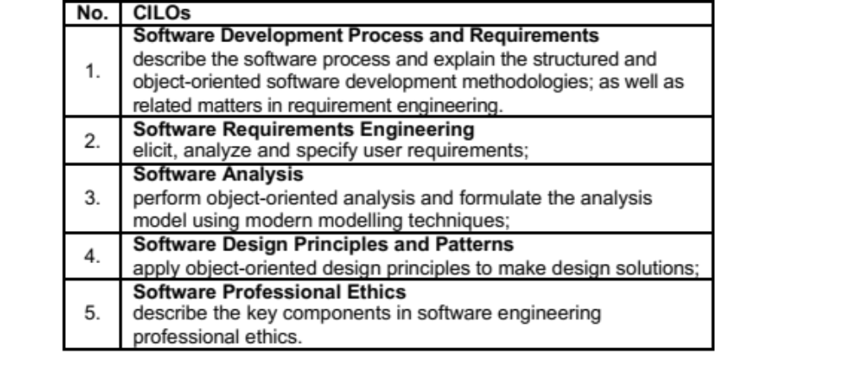
Final Exam 50%
Coverage: Week 1 ~ Week 10

Slide 14
Exam Coverage A
CILO 1 - Software Development Process – 10~15%
  Software Engineering in General *
  Waterfall, Prototyping *
  Incremental, spiral
  … CBSE .. etc *
  Functional and non-functional requirements*
  Definitions, Advantages and Disadvantages
CILO 2 – Software Requirements – 10~15%
  X1 Case study
  X1 Use Case Diagram
  X1 A selected requirements use case (table)

Slide 15
Coverage B
CILO 3 – Object Oriented Analysis – 30%
  Class Diagrams*
  Class Linkages*
  Associative Entity**
  Sequence Diagram**
CILO 4 - Design Principles and Patterns–35~40%
  Roles of Variables** (Table not Given)
  SOLID Principles*
  All patterns we have learn, such as State*, Singleton*
  Others such as Observer Pattern*, Command**, Factory method*, Singleton*, State*, Façade

Slide 16
Coverage C
CILO 5 – Professional Ethics – 5~10%
  Code of Ethics in Software Engineering (Table Not Given)
  Five Ps for ethical evaluation process*
  Given a case study, mapping (follows/violates)*
  See ACM Paper on Ethics (PDF)

Slide 17
Details

Slide 18
Exam Overview 2024
Tuesday 30 April 2024 (TBA on actual time)
Closed-book Exam
2 Hours Exam
5 Main Sections (CILOS)
  Software Engineering Development Process (C1) 10%
  Software Requirements (C2) 25%
  Object-Oriented Design and Modeling (C5) 30%
  Design Principles and Design Patterns (C4) 30%
  Professional Ethics (C5) – 5%

Slide 19
Software Development Process
Look at your Mid-Term and Assignment*

Slide 20
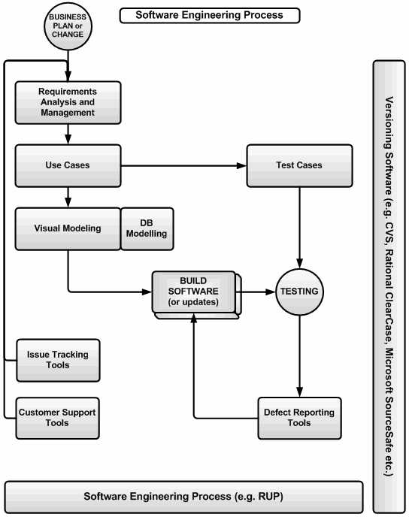
CILO 1 – Software Development Process
Software Engineering
  The study and an application of engineering to design, development, and maintenance of software.
Software Design – CS3342
  SE Activities in :
  Conceptualizing
  Framing
  Implementing
  Modifying
  Following Requirements Spec.
  Before Programming

Slide 21
What is Software Process?
Software process
Process Model
Linear
Incremental
Evolutionary
Other
CASE
A series of predictable steps, road maps, that help us to create a timely, and high-quality result.
The road map defines tasks or activities that take place during the process.
The process depends on the SW we are building (the nature of the software development project)
  Web application vs. computer game vs. automobile control system, they are using different processes
Step 1: define req
Step 2: analysis …
Step 3: design …
Step 4: coding …
Step 5: ….

Slide 22
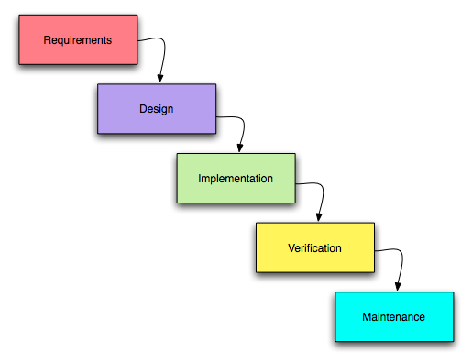

Slide 23
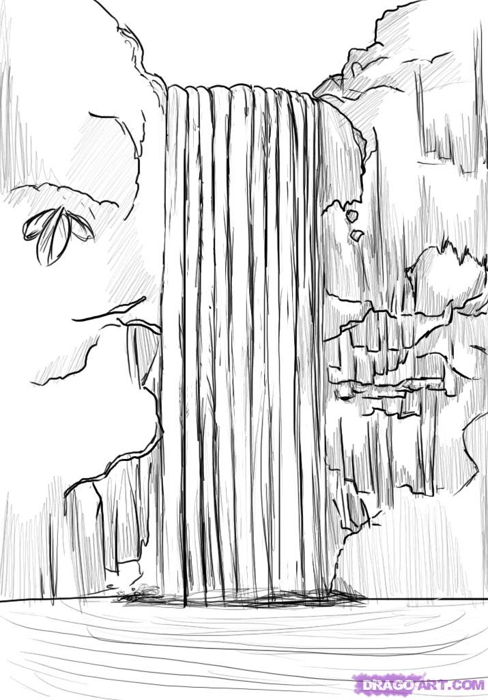
Waterfall Model ?

Slide 24
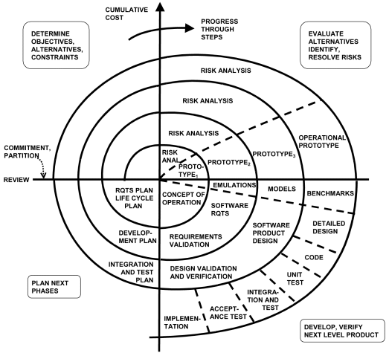
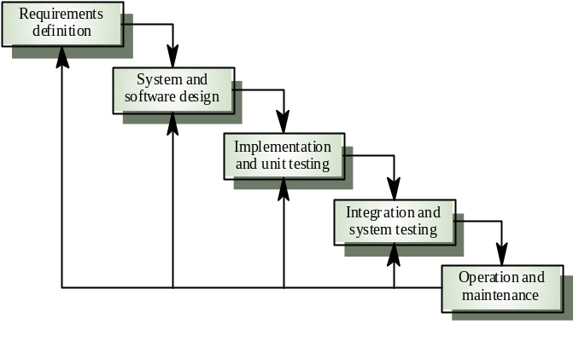
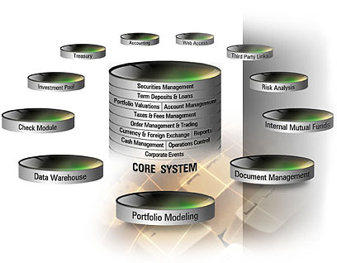
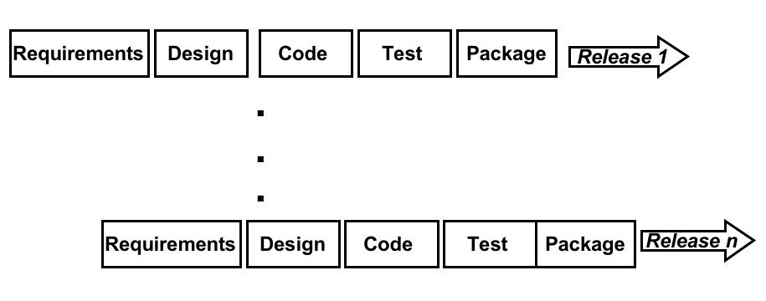
4 Types of Process Model
Software Process
Process Model
Linear
Incremental
Evolutionary
Other
CASE
  1. Linear
  Waterfall
  2. Incremental
  Incremental model
  RAD – Rapid Application Development
  3. Evolutionary
  Prototype
  Spiral
  Concurrent
  4. Other
  CBSE
  Agile

Slide 25
Waterfall Model
Software Process
Process Model
Linear
Incremental
Evolutionary
Other
CASE
Disadvantages
Sequential, does not reflect reality*
Does not produce a prototype
Advantages
Easy to follow*
Structured
Provide a template into which methods for analysis, design, code, testing and maintenance can be placed.
Relies heavily on being able to accurately assess requirements at the start
Little feedback from users until it might be too late. Therefore cannot adapt to users’ needs, lack of intelligence and adaptability
Problems in the specification may be found very late (at Coding or integration)
It can take a long time before the first version is out

Slide 26
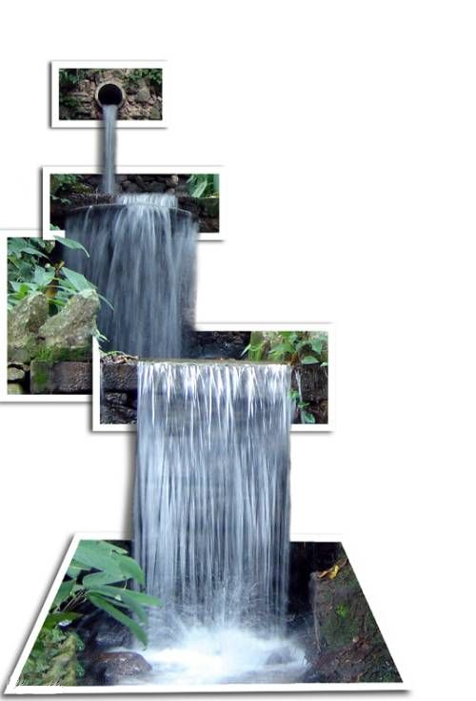
Pure Waterfall
Software Process
Process Model
Linear
Incremental
Evolutionary
Other
CASE
The “god parent” of models
Linear sequence of phases
  “Pure” model: no phases overlap
Risky!
  Integration and testing occur at the end
  Too late!!
When to use?
Simple Projects
Limited amount of time
Requirements are well understood
Use well-understood technologies

Slide 27
Incremental Process Models
Software Process
Process Model
Linear
Incremental
Evolutionary
Other
CASE
Goal: provide core functionalities to the users first*
Iteratively adds new functionality in each release cycle*
Process is not linear
Requirements are well defined
Software is completed in small increments
The system “Grows” in a number of small steps

Slide 28
Incremental Model
Software Process
Process Model
Linear
Incremental
Evolutionary
Other
CASE
1st build provides the CORE functionalities
Each increment “deliverable” adds a new functionality.
This is repeated until the product is complete
It combines characteristics of the waterfall model and the iterative nature of the prototyping model.
When to use?
When the software can be broken into increments and each increment represent a solution
Build
This first
Then
This 2nd
This 3rd
This 4th
Complete system

Slide 29
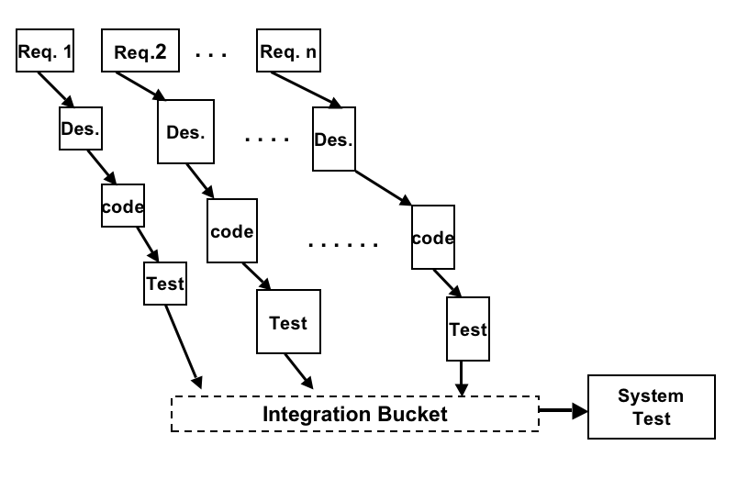
The Incremental Model
Software Process
Process Model
Linear
Incremental
Evolutionary
Other
CASE
Example:
Facebook (a social networking website) with parts like member registration, sign in, forget password, member profile, search members, friends list, blog, blog search, photos, photo search and messaging.
1st increment
2nd
3rd
1st increment: member registration, sign in, member profile and search members.
2nd increment: friends list, blog, blog search.
3rd increment: photos, photo search, messaging and password retrieval .
Same team develops all the increments
Notes:
Waterfall model will do Design of all functions, then coding all functions together, then testing.

Slide 30
The Rapid Application Development (RAD) Model
Software Process
Process Model
Linear
Incremental
Evolutionary
Other
CASE
Builds on the Incremental model with emphases on short development cycle.*
A speed waterfall model
Components are built using this model as a fully functional units in a relatively short time
It assumes that the system can be modularized
Involves multiple teams!*
RAD will fail if we don’t have strong and skillful teams

Slide 31
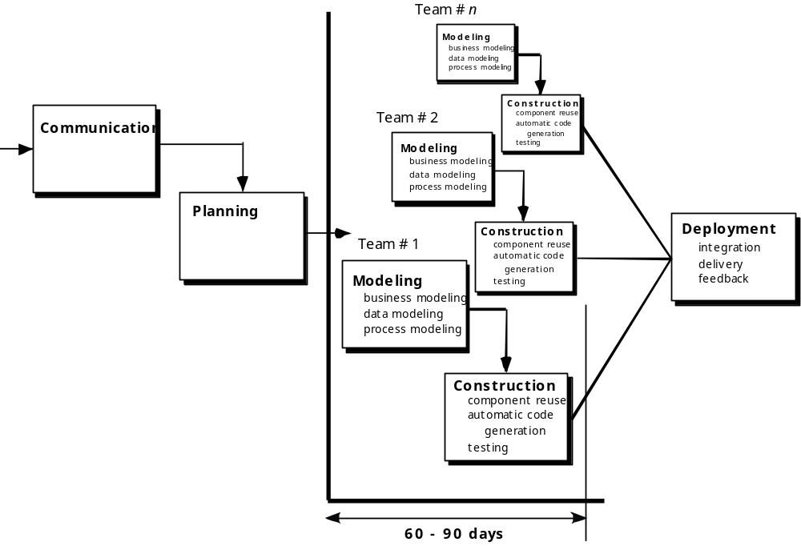
RAD Model
Software Process
Process Model
Linear
Incremental
Evolutionary
Other
CASE

Slide 32
Evolutionary Process Models
Software Process
Process Model
Linear
Incremental
Evolutionary
Other
CASE
Specification, development and validation activities are carried out concurrently with rapid feedback across these activities *
Core requirements are somewhat understood but additional requirements are evolving and changing fast. *
Design most prominent parts first
  Usually via a visual prototype
Good for situations with:
  Rapidly changing requirements
  Non-committal customer
  Vague problem domain

Slide 33
Evolutionary Process Models
Software Process
Process Model
Linear
Incremental
Evolutionary
Other
CASE
Advantages
  Do not require full knowledge of the requirements
  Iterative (software gets more complex with each iteration)
  Divide project into builds (standalone software package - binaries)
  Allows feedback, show user something sooner
  Use to develop more complex systems
  Provide steady, visible progress to customer
Disadvantages
  Time estimation is difficult
  Project completion date may be unknown
Notes:
build: the process of creating the application binaries for a software release. They are done in a periodic manner by the build teams to provide baseline binaries for daily work.
Automated build process will automatically take the source code from the CVS repository and perform the software build. Any missed items will surface during the build process itself (makefiles etc.,) or during the regression testing of the product (older version of the file checked in).
The developers then check out the latest build for further development!

Slide 34
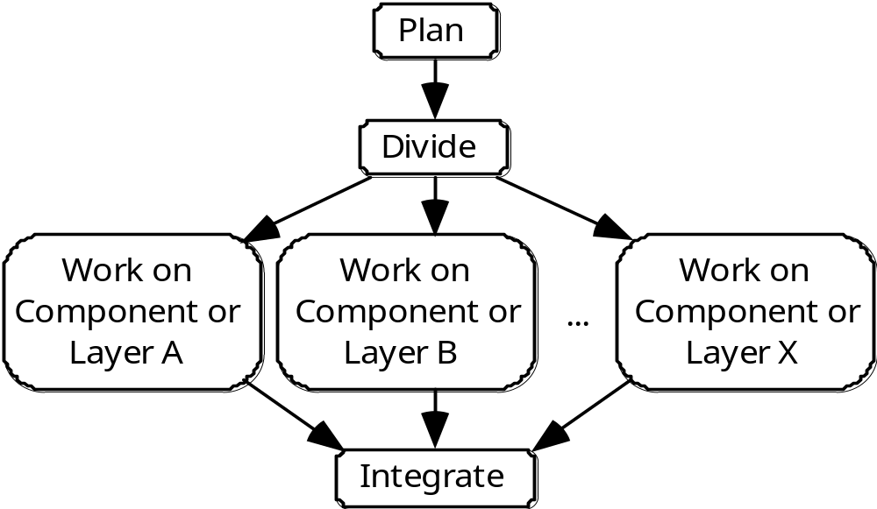
3. Concurrent Engineering Model
Software Process
Process Model
Linear
Incremental
Evolutionary
Prototype
Spiral
  Concur E
Other
CASE
Parallel development
It explicitly use the *divide and conquer principle.
Each team works on its own component in parallel with the other teams*
Integrates these components periodically*
There has to be some initial planning, and periodic integration.

Slide 35
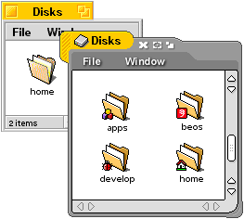
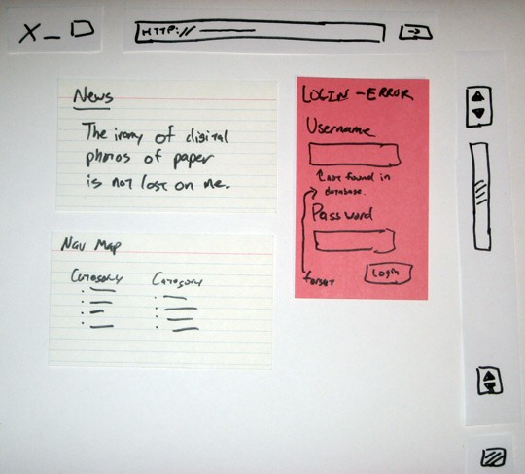
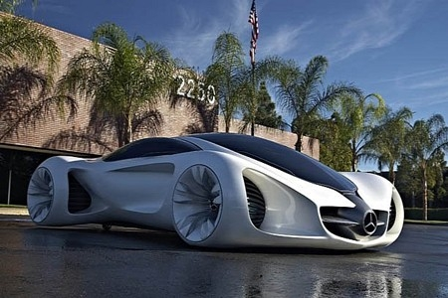
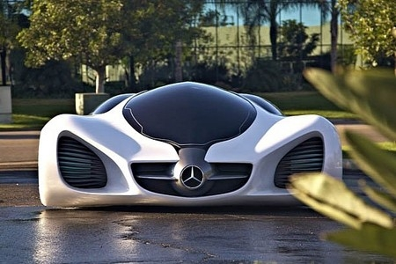
Prototyping Model*
Software Process
Process Model
Linear
Incremental
Evolutionary
  Prototype
  Spiral
  Concur E
Other
CASE
Start with what is known about requirements.
*Provides a high level conceptual understanding.
Build the prototype by focusing on what will be seen by the user.
Use the prototype to show the user and help refining requirements.
Better communication*
Notes:
Japanese Prof. Dr. Hiroshi Shimizu from Faculty of Environmental Information of the Keio University created the limousine of the future: the Eliica (Electric Lithium Ion Car) has 8 wheels with electric 55 kW hub motors (8WD) with an output of 470 kW and zero emissions. With a top speed of 190 km/h and a maximum reach of 320 km provided by lithium-ion-batteries.

Slide 36
Prototype Model
Software Process
Process Model
Linear
Incremental
Evolutionary
  Prototype
  Spiral
  Concur E
Other
CASE
Disadvantages**
Customer might think that the prototype is the final product and forget the lack of quality i.e. PERFORMANCE, RELIABILITY.
i.e. Leads to incorrect perception about the final product.*
Advantages**
Prototype can serve as a way for identifying requirements.
It is developed very quickly.
When to use?
When the customer define general objectives for the SW but does NOT identify details about INPUT, OUTPUT, or processing requirements.
The developer is unsure of the efficiency of an algorithm, human machine interaction, etc.

Slide 37
Spiral Model
Software Process
Process Model
Linear
Incremental
Evolutionary
Prototype
  Spiral
  Concur E
Other
CASE
Iterative (like Prototype) and controlled (like waterfall)
Software is developed using evolutionary releases*
Complexity increase with each release
  A spiral process rather than as a sequence of activities with backtracking
  Each loop in the spiral represents a phase in the process.
  No fixed phases such as req. specification or design - loops in the spiral are chosen depending on what is required—more flexible
  Emphasize risk analysis and management (Risks are explicitly assessed and resolved throughout the process)

Slide 38
The Spiral Model
A series of Mini-projects
Each addresses a set of “risks”
  Start small, explore risks, prototype, plan, repeat
Number of spirals is variable
Software Process
Process Model
Linear
Incremental
Evolutionary
Prototype
  Spiral
  Concur E
Other
CASE
Customer communication
Customer feedback

Slide 39
Spiral Model
Software Process
Process Model
Linear
Incremental
Evolutionary
Prototype
  Spiral
  Concur E
Other
CASE
Advantages
  Can be combined with other models
  Risk orientation provides early warning of problems*
Disadvantages
  More complex*
  Requires more management
When to use?
Very large projects, mission critical systems
When technical skills must be evaluated at each step.

Slide 40
Other Process Model: Component based software engineering (CBSE)
Software Process
Process Model
Linear
Incremental
Evolutionary
Other
  CBSE
CASE
Pre-fabricated
Components
When reuse** is a development objective
Based on systematic reuse where systems are integrated from existing components or COTS (Commercial-off-the-shelf) systems. (E.g., data conversion, encryption, device drivers, data mining modules)
A new system
The main difference is that CBSE emphases on composing solutions from prepackaged software components or classes

Slide 41
CBSE: The Key Questions
Software Process
Process Model
Linear
Incremental
Evolutionary
Other
  CBSE
CASE
*When faced with the possibility of reuse, the software team asks:
  *Are commercial off-the-shelf (COTS) components available to implement the requirement?
  Are internally-developed reusable components available to implement the requirement?
  Are the interfaces for available components compatible within the architecture of the system to be built?
First rule of CBSE: never build what you can buy!
Because: it becomes solution oriented, built based on features available in the components, not from customer requirements (problem-oriented).

Slide 42
CBSE and design principles
Software Process
Process Model
Linear
Incremental
Evolutionary
Other
  CBSE
CASE
CBSE is based on sound software engineering design principles:
  Components are independent so do not interfere with each other;
  Component implementations are hidden;
  Communication is through well-defined interfaces; (method calls)
  Component platforms are shared and reduce development efforts / costs.

Slide 43

What is a Component?
Software Process
Process Model
Linear
Incremental
Evolutionary
Other
  CBSE
CASE
*Components provide a service without regard to where the component is executing or its programming language
  The component interface is published and all interactions are through the published interface;
  An independent, executable entity.
  The services offered by a component are made available through an interface API.

Slide 44

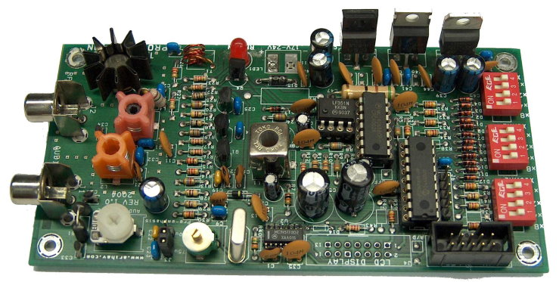
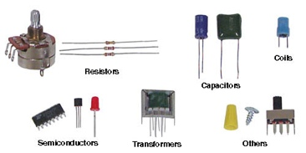
Component-based Engineering

Slide 45
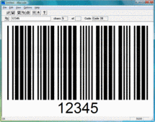
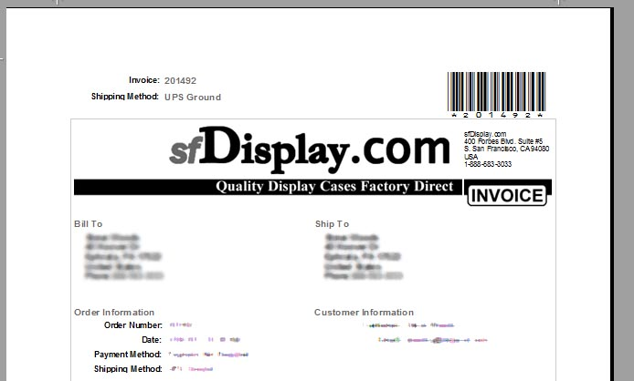
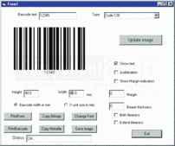
Example: Bar Code Component
If you are building a POS application…
Use a bar code generator component, do not write your own.

Slide 46
Software Requirements
Use Case Diagrams
Use Case Specifications and Interactions in Tables
Review Mid-Term*

Slide 47
CILO2 – Software Requirements
Use-Case Diagrams *
Use-Case Specifications *
Functional vs Non-Functional Requirements

Slide 48
Functional Requirements *
Functional requirement specifies what the system should perform :
  Business calculations, logics, rules
  Transactions, adjustments, cancellations
  Administrative functions
  Authentications
  Tracking features
  Other technical functional requirements..

Slide 49
Non-Functional Requirements*
Non-Functional requirement specifies how the system performs a certain function
  Performance of calculation (response time, throughout..)
  Scalability (horizontal, vertical expansion on resources)
  Reliability (number of acceptable fails)
  Recoverability
  Security (encryption standards and requirements, 256bit)
  Accessibility (e.g 24x7 online availability)
  Usability (User Interface Usability)
  Environmental (Energy efficiency, power consumption etc)

Slide 50

Use Cases – visualize functional interactions
Register User
admin
Use Case Diagram
Use Case Specification
Typically, a use case is a contract of an interaction between the system and an actor.
The Actor can be a human or an external system / machine.
A full use-case model comprise of:
  A Use Case Diagram, describing relations between
  use-cases (system tasks, roles) and actors (external parties).
  Use Case Specifications (usually one per each use case)
    Documents describe the use case in details

Slide 51
Use Case Diagram Objective
Create a semi-formal model of the functional requirements (What the system does…)
Analyze and define:
  Scope (What are the main functions?)
  External parties (who will interact with the system?)
  External interfaces (how they are related?)
  Scenarios and reactions (One Big Picture)

Slide 52
Steps to Build an Use-Case Model
Choose the system boundary – what are you modeling? System? Business organization?
Identify the primary actors – they have user goals fulfilled by using the services of the system
For each primary actor, identify their user goals – define what they want to do with the system. Describe their goals at the correct level
Define use cases that satisfy user goals. Name each according to its goal. [You may find out other actors, which we call secondary actors of that particular use case.]

Slide 53
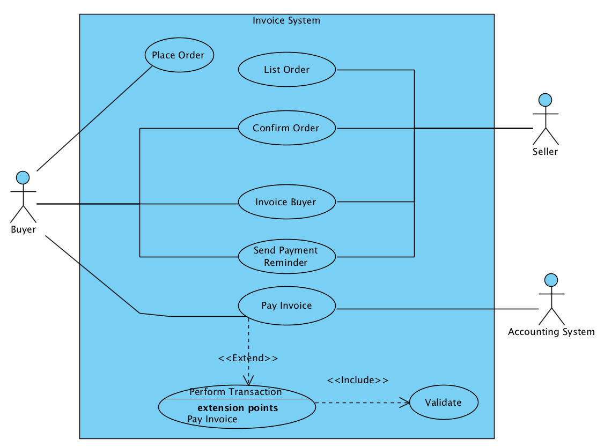
A Use Case Diagram
System
boundary
Notes:
22

Slide 54
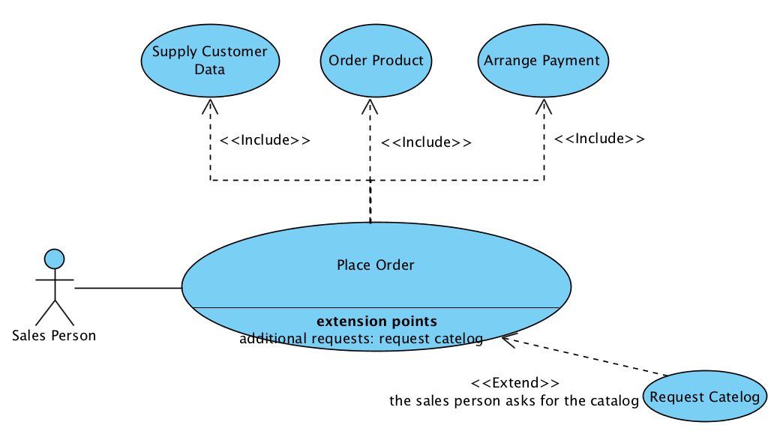
Three Basic Types of Relationship in Use Case Model
Inclusion
IF_Extension
Association

Slide 55
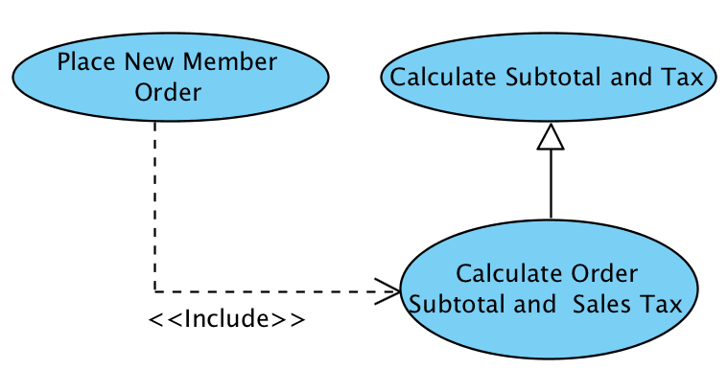
Yet another relationship:
Generalization
Generalization (Inheritance)
  A generalization from use case A to use case B
  indicates that A inherits B.
Generalization

Slide 56
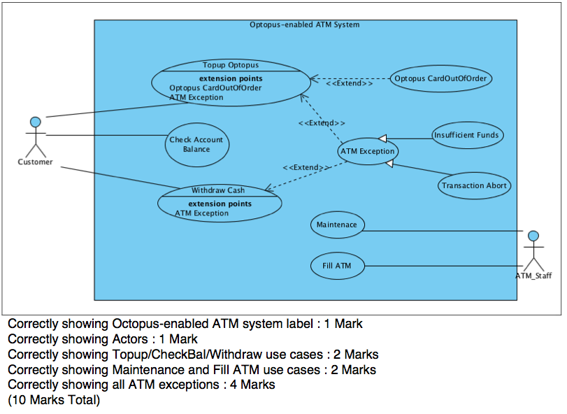
Example**

Slide 57
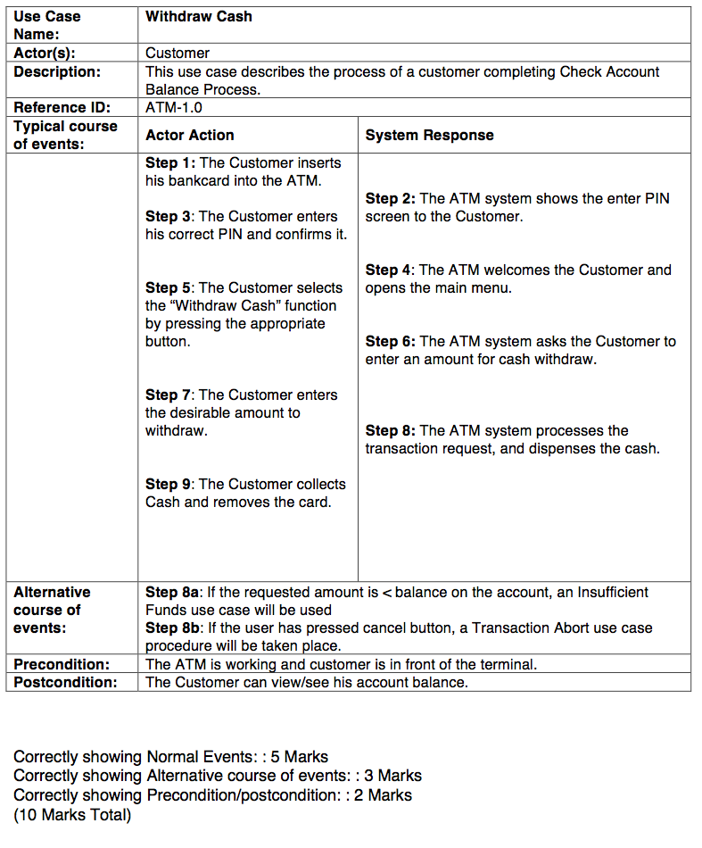
*

Slide 58
OO Modeling
Review All related tutorial
CityLibrary Design BlueJ* (week 2,3 tutorial)
CityOnlineStore BlueJ* (week 2,3 tutorial)

Slide 59
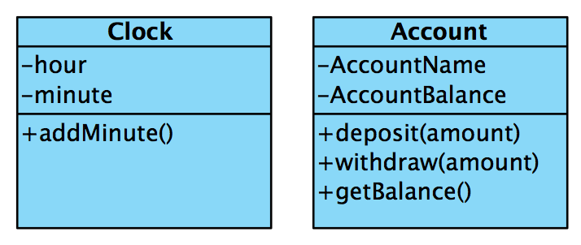
CILO3 - UML Class Diagram
A class diagram is used to visualize object-oriented classes and their relationships in our system.
This slide shows two classes, but there is no relationships.
Need to define class linkages.
Class name
Attributes
Class
Operators
Notes:
303
When constructing the diagram, we will use James Rumbaugh’s Object Modelling Technique (OMT), object model notation. Our examples are created with Popkin Software’s System Architect CASE tool.

Slide 60
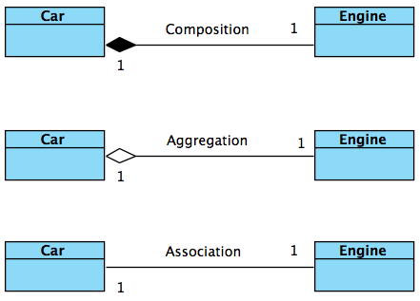
Class Linkages – 3 Types
Composition
  A has B
  Must/Compulsory
Aggregation
  A has B
  Optional
Association
  A uses B

Slide 61
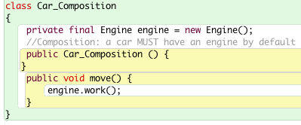
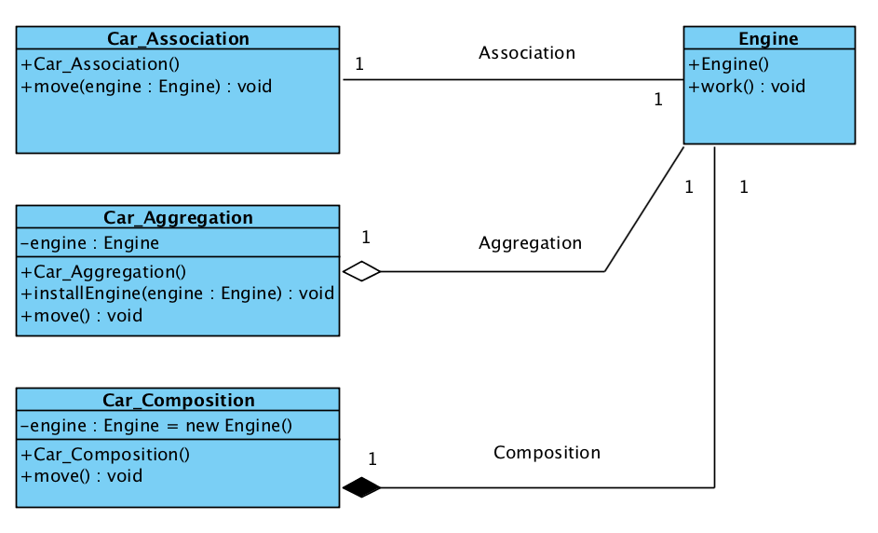
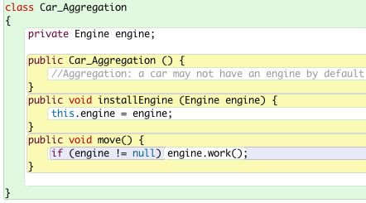
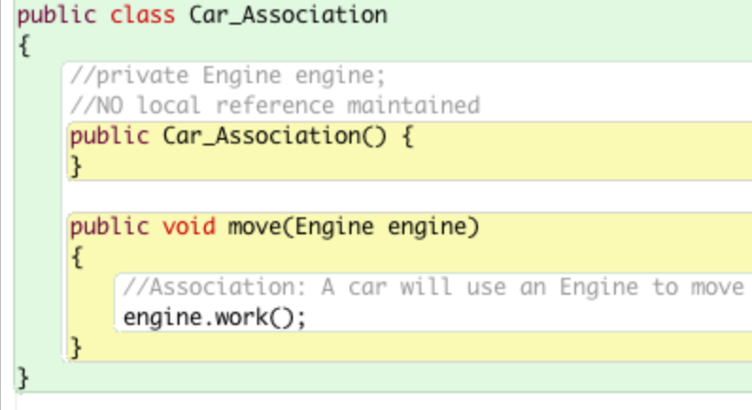
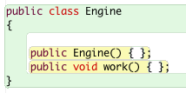
Example

Slide 62
Case Study Example
The Banana Software Company is one of the leading software development firms in the world. With employees exceeding 20,000 to work on over 1,000 software development projects, they need a new system to manage different kind of employees (staffs) and be able to allocate them to specific projects.
The company needs to keep each employee’s employeeID, lastName, firstName, DOB(date of birth) and gender, and be able to compute their pay using an operation called computePay().
Given the diversity and the size of the company, Banana employs both full-time and part-time employees. Full-time employees has a record of their annualSalary and a operation computeTax() to workout their annual tax commitments. For the part-time employee, they are normally be paid by a pre-agreed hourlyWage, therefore the operation to compute their pay is different to other employees, which is using computePay(hours).
As mentioned, there are many employees as well as there are many projects developing by the company, and each project has a projectID, and projectName, as well as their startDate and endDate of the project. Each employee(staff) is allocated/assigned to projects (we called this ProjectStaffAllocation in the system), more importantly their role in the projects are different and needs to be recorded. For example Employee Miss Ada can be allocated to Project A as the role of Project Manager, and she can also be allocated to Project B as the role of Test Engineer.
Develop a complete class diagram to show the above scenario using what you have learned and best practices in software design. Multiplicity and class relationships must be shown in the diagram.

Slide 63
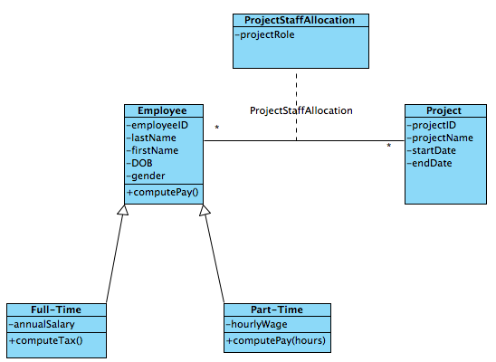
Inheritance and Association Class

Slide 64
Inheritance and Association Class
Many Employees (with unique IDs)
Many Projects (with unique project IDs)
Assign/Allocate Employee i to Project j for role (String) = “Manager”
Use Association Class
Class: ProjectStaffAllocation
Emp_ID | Proj_ID | ProjectRole
e007 | p16 | “Manager”
e007 | p15 | “Designer”
e009 | p16 | “Programmer”

Slide 65
Further Design Enhancements
Role has a data type “String”
Can we modify this class diagram, further expand it
So it can use a design pattern for different ProjectRoles, to serve different purpose?
Emp_ID | Proj_ID | ProjectRole
e007 | p16 | “Manager”
e007 | p15 | “Designer”
e009 | p16 | “Programmer”

Slide 66
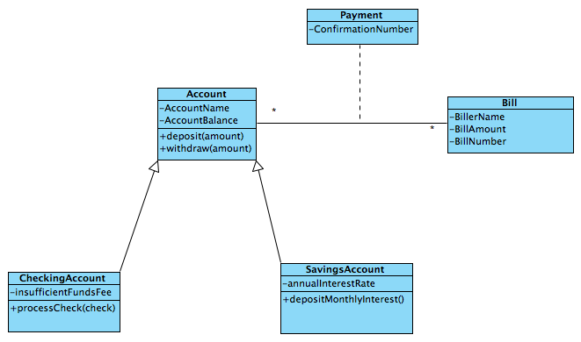
Another Example

Slide 67
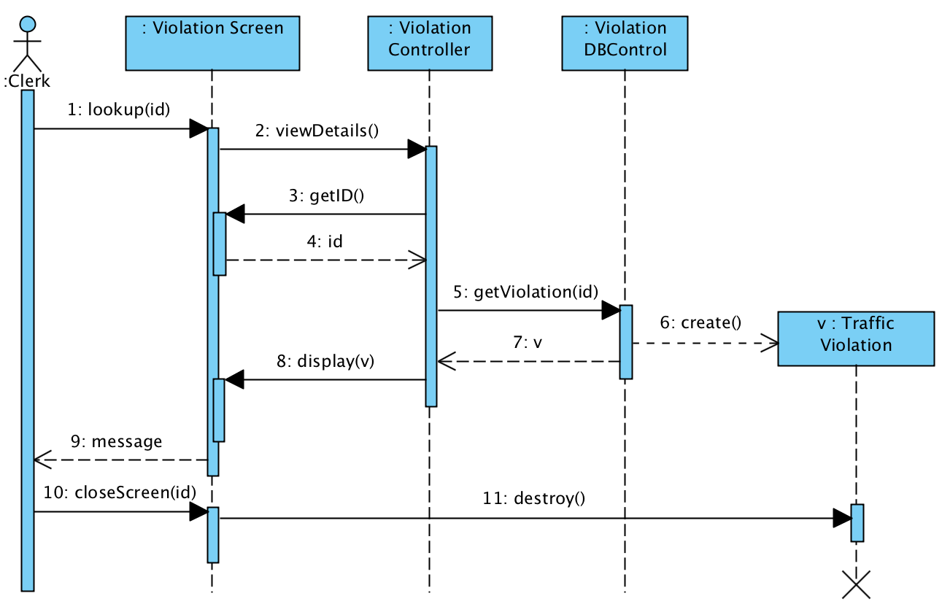
Sequence Diagram Example:
Traffic Violations Lookup Screen
DB is queried within the object and the result is returned as a new object v

Slide 68
Sequence Diagrams T6
import java.util.*;
public class RegisterController {
private List<Account> _accounts = new ArrayList<Account>();
public void register(String name, int age) {
Account account = new Account();
account.setName(name);
account.setAge(age);
_accounts.add(account);
}
public Account search (String name) {
for (int i=0; i< _accounts.size(); i++)
{
if (_accounts.get(i).getName() == name)
return _accounts.get(i);
}
return null;
}
}
public class Account {
private String _name;
private int _age;
public void setName(String name){
_name = name;
}
public String getName(){
return _name;
}
public void setAge(int age){
_age = age;
}
public int getAge(){
return _age;
}
}

Slide 69
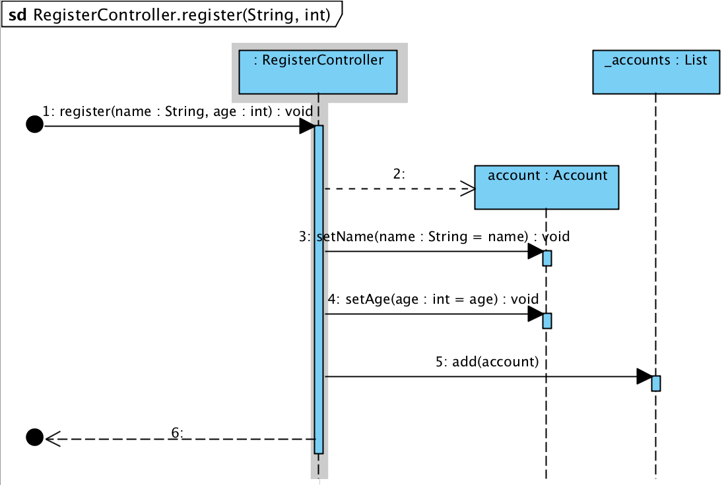
T6 Example
import java.util.*;
public class RegisterController {
private List<Account> _accounts = new ArrayList<Account>();
public void register(String name, int age) {
Account account = new Account();
account.setName(name);
account.setAge(age);
_accounts.add(account);
}
public Account search (String name) {
for (int i=0; i< _accounts.size(); i++)
{
if (_accounts.get(i).getName() == name)
return _accounts.get(i);
}
return null;
}
}

Slide 70
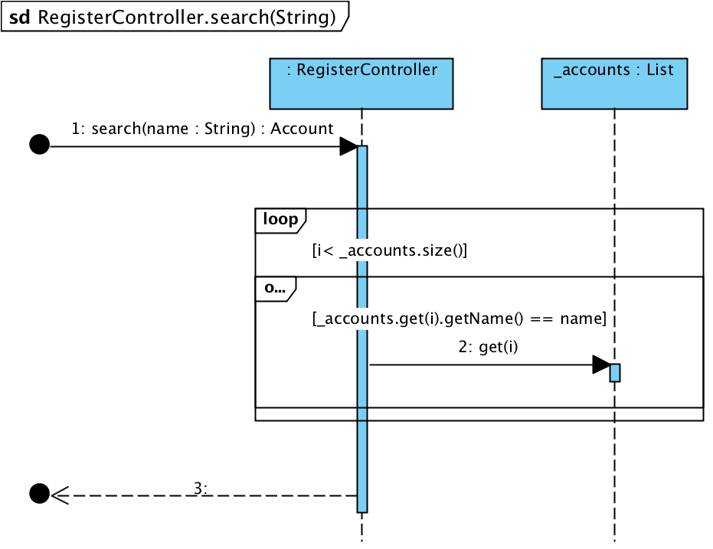
T6 Example
import java.util.*;
public class RegisterController {
private List<Account> _accounts = new ArrayList<Account>();
public void register(String name, int age) {
Account account = new Account();
account.setName(name);
account.setAge(age);
_accounts.add(account);
}
public Account search (String name) {
for (int i=0; i< _accounts.size(); i++)
{
if (_accounts.get(i).getName() == name)
return _accounts.get(i);
}
return null;
}
}

Slide 71
Design Principles and Patterns
Review All related lecture examples (BlueJ)
Examples of Tutorial Week 8*
Tutorial Week 9, 10

Slide 72
SOLID – Design Principles**
  For remembering with ease..
  The “SOLID” principles are:
  Single Responsibility Principle (SRP)
  Open-Closed Principle (OCP)
  Liskov Substitution Principle (LSP)
  Interface Segregation Principle (ISP)
  Dependency Inversion Principle (DIP)

Slide 73
State Pattern* – Objects for States
Intend
  Allow an object to alter its behavior when its internal state changes. The object will appear to change its class.
Motivation
  An object’s behavior depends on its state
  According to different classifications at run-time
  Ability to change to another state with ease
Example – Membership Classification
  Provides different behaviors/actions for different members
  Customers can be treated differently due to memberships
  Customers can be easily changed to another membership

Slide 74
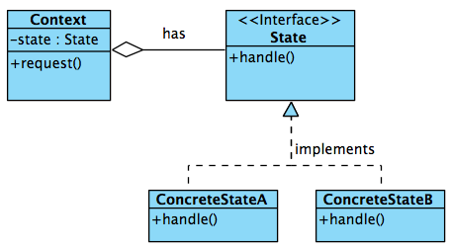
State Pattern - Structure
State Interface
  Implemented by concrete classes
  Different Handle() functions
Context Class
  Maintains a State
  Aggregation link
  Different Request() functions
    state.handle()
    Implemented by different ConcreteState
  state object can be changed.

Slide 75
Example – Membership State
Loyalty Customer has 3 Membership Types
  Green (New Customer)
    No discount (pays 100%)
    Deposit (needs to pay 100% upfront)
  Silver (After spending >$5,000, upgraded)
    20% discounts (pays 80%)
    Deposit (only need to pay 50% upfront)
  Gold (After spending >$10,000, upgraded)
    50% discounts (pays 50%)
    Deposit (do not need to pay, 0% upfront)

Slide 76
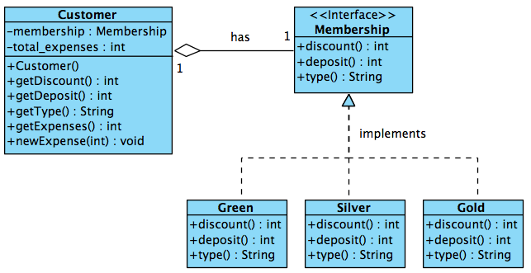
Example – Membership State
Solution:
  Apply State Pattern
State Pattern (Standard)
State Pattern (Membership Problem)

Slide 77
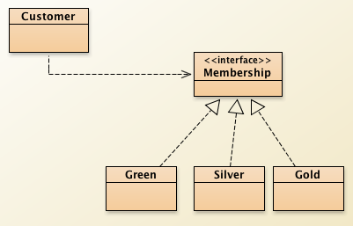
Example – Membership State
Implementation
State Pattern (VP UML)
State Pattern (BlueJ classes)

Slide 78
Singleton Pattern*
Motivation/when to use
  Need to have ONLY one (1) instance for a class.
  Singleton instantiate itself, and only one(1) of such.
Intent
  Ensure that only 1 object instance is created.
  Provide a global point of access.
  Save the number of duplicated objects being created. Such as in State Pattern.
  More Memory Efficient*.

Slide 79
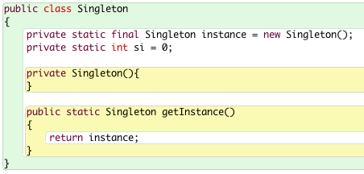
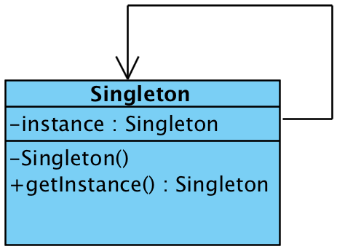
Singleton Pattern*
Implementation
  Variable instance (refers to itself, initialized before constructor is called).
  Constructor > private(-) Constructor (non-accessible)
  Method > getInstance() (returns the single instance)

Slide 80
Factory-Method Pattern
Motivation/when to use
  Also known as “Virtual Constructor”
  Defines an interface for creating an object
  Leaves the “choice” of its type to the subclasses
  Creation of object to be determined at run-time.
Intent
  Defines an interface for creating object
  Let subclasses to decide which class to create.
  Provides the newly created object through a common interface

Slide 81
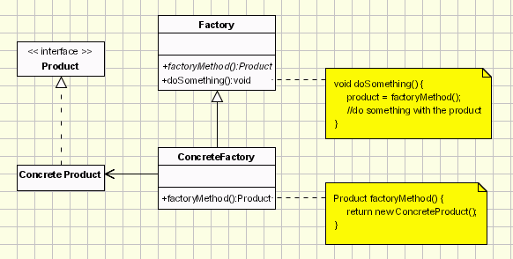
Factory-Method Pattern – Ex1
Implementation
  Product (interface) ConcreteProduct implements the Product interface
  Factory creates/generate Product object via factoryMethod()
  ConcreteFactory implements and produces ConcreteProduct object.

Slide 82
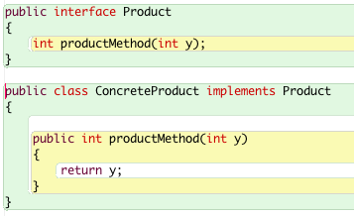
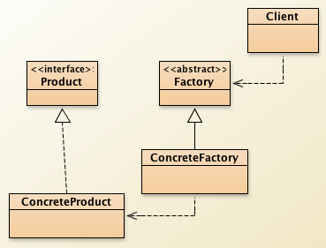
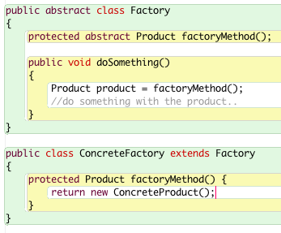
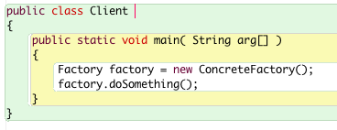
Factory-Method Pattern
s

Slide 83


Factory-Method Pattern – Ex2
Document Application
  Document class that needs to be created is specific to the application at runt-time by user. So it doesn’t know which class to use in advance.
  Factory Method design pattern solves this problem

Slide 84
Factory Method Pattern: Participants and Communication
Product (Document): Defines the interface of objects the factory method creates.
ConcreteProduct (MyDocument, HtmlDocument, PdfDocument): Implements the Product interface.
Creator (Application): Declares factory method which returns an object of type Product(Document). Also, may define the factory method to create a Product(Document) object.
ConcreteCreator (DocumentFactory): Extends and overrides the factory method to return an object instance of ConcreteProduct (MyDocument, HtmlDocument, PdfDocument) upon request.

Slide 85



s

Slide 86


s

Slide 87

Factory Method Pattern: Summary
The solution uses Factory Method Pattern
  To generate required object based upon request
Allows objects to be dynamically created at runtime
  Subject to user’s input etc.
Factory Method Pattern
  One of the most commonly used Design Patterns in SE
  Provides an mechanism to produce different objects.

Slide 88

Façade Pattern - Structure

Slide 89
Design Pattern: Observer
- For Broadcasting Messages to Subscribers*

Slide 90
Observer Pattern*
Needs to “Notify/update ALL its dependents”
  Defines one-to-many dependency amongst objects so that when one object changes its state, all its dependents are notified.
  Broadcasting
Needs to separate presentation layer with the data layer, i.e. separate views and data.
  Change in one view automatically reflects in other views. Any changes in the application data will be reflected in all views.

Slide 91

Observer Pattern - Standard

Slide 92
Observer Pattern – 3 Steps
Three Step Cycle (Observer Pattern)
1 Server (Subject)
Attach/Register Observers (many)
Notify All attached Observers (many)
Observers calls back the Server for new updates.
The result:
All attached observers get informed, and data can be updated to all observers consistently.

Slide 93

Observer Pattern – Example *

Slide 94

OP – Example 2* – Subject/Observer
Standard Subject / Object Skeleton
Observer Pattern
Subject Class
  Attach()/Detech()
  set/getState()
  Notify_all()
Observer Class
  Update()

Slide 95




Slide 96



Slide 97
Observer Pattern: Summary
Support for broadcast communication. A subject need not specify the receivers; all interested objects receive the notification as long as these objects have been attached to the subject.
Unexpected updates: Observers do not need to concern about when the updates to be occurred. They are not concerned about each other’s presence. In some cases this may lead to unwanted updates, so design with care.

Slide 98

Command Pattern**
The Command Pattern has the following
  Command (interface), ConcreteCommand (implementation)
  Invoker (asks the command to execute the request)
  Received (performs actual actions)
  Client (e.g. main() function)

Slide 99
Command Pattern
Intend
  Encapsulate commands (method calls) in objects
  Issue requests/commands without knowing underlying requests
  Allows clients to issue different requests with ease
  Allows saving requests in a queue for reference (e.g. logs)
Example – Light Switch
  A Light object has TurnOn() and TurnOff() functions
  A new Switch needs to control and issue commands (on/off)
  This switch needs to maintain an operation record/log
  Use Command Pattern

Slide 100


Example – Light Switch

Slide 101
Command Pattern for Redo/Undo
Command Pattern is commonly used in software design for applications requiring Redo/Undo functionalities.
  E.g. : MS Word: Redo/Undo function
Given commands are recorded in an ArrayList for example, it is reasonable to:
  Redo / Replay Commands executed
  Undo Commands by reversing to previous object states
For example, in Photoshop application:
  Commands such as: Brush (x,y,)->Paint(x,y)->Brightness (+10)->Contrast(-2)->resize(30)….-> Gaussian_Blur(+15)
  Using Command Pattern to store commands, allowing commands to Redo. E.g. Redo Gaussian_blur(+15)

Slide 102
Roles of Variables
Mid-Term and Examples in Tutorials
Input parameters of a function are constants*

Slide 103
Roles of Variables
Role | Description
Constant / Fixed value | A variable which is initialized without any calculation and whose value does not change thereafter.
Stepper | A variable stepping through values that can be predicted as soon as the succession starts.
Most-recent holder | A variable holding the latest value encountered in going through a succession of values.
Gatherer | A variable accumulating the effect of individual values in going through a succession of values.
Transformation | A variable that always gets its new value from the same calculation from value(s)of other variable(s).
One-way flag | A two-valued variable that cannot get its initial value once its value has been changed.
Temporary | A variable holding some value for a very short time only.
Organizer | An array which is only used for rearranging its elements after initialization.

Slide 104
Constant
Purpose: Write once and read many
  Value is never changed after initialization (or the first assignment by users)
Example: read the radius of a circle, then print the area of the circle
  variable r is a fixed value, gets its value once, never changes after that (e.g., the variable PI in the following example).
We usually declare such a variable as “final” in Java or “const” in C/C++.
public class AreaOfCircle {
public static void main(String[] args) {
float PI = 3.14F; // PI is a constant
float r = 0.0;
System.out.print("Enter circle radius: ");
r = UserInputReader.readFloat();
System.out.println(“Circle area is " + PI * r * r);
}
}
“PI” is a constant.

Slide 105
Organizer
An array for rearranging elements
  Example: input ten characters and output in reverse order.
public class Reverse {
public static void main(String[] args) {
char[] word = new char[10];
char tmp; int i;
System.out.print("Enter ten letters: ");
for (i = 0; i < 10; i++) word[i] = UserInputReader.readChar();
for (i = 0; i < 5; i++) {
tmp = word[i];
word[i] = word[9-i];
word[9-i] = tmp;
}
for (i = 0; i < 10; i++) System.out.print(word[i]);
System.out.println();
}}
“word” is an organizer
“tmp” is a temporary

Slide 106
Transformation
Another example: “Speed” is a transformation.
Speed = Distance / Time
Purpose: Compute value in new unit
E.g.,: ask the user for capital amount, calculate interest and total capital for ten years.
Variable interest is a transformation and is always calculated from the capital.
public class Growth {
public static void main(String[] args) {
float capital, interest; int i;
System.out.print("Enter capital (positive or negative): ");
capital = UserInputReader.readFloat();
for (i = 1; i <=10; i++) {
interest = 0.05 * capital;
capital += interest;
System.out.println("After "+i+" years interest is "
+ interest + " and capital is " + capital);
}
}}
“i” is a stepper.
“interest” is a transformation
“capital” is a gatherer.

Slide 107
Stepper
Purpose: Goes through a sequence of values systematically
  E.g., counting items, moving through array index
The Code Example: loop where multiplier is used as a stepper.
  outputs multiplication table, stepper goes through values from 1 to 10.
public class MultiplicationTable {
public static void main(String[] args) {
int multiplier;
for (multiplier = 1; multiplier <= 10; multiplier++)
System.out.println(multiplier + " * 3 = "
+ multiplier * 3);
}
}
“multiplier” is a stepper.

Slide 108
Most-Recent Holder
* http://www.java-made-easy.com/java-scanner.html
Most recent member of a group, or simply latest input value
  E.g.,: ask the user for an input until the input value is valid.
Variable s is a most-recent holder since it aims to hold the latest input value
public class AreaOfSquare {
public static void main(String[] args) {
float s = 0.0;
while (s <= 0) {
System.out.print("Enter side of square: ");
s = UserInputReader.readFloat();
}
System.out.println(“Area of square is " + s * s);
}
}
“s” is the most-recent holder

Slide 109
Gatherer
Purpose: Accumulates values seen so far.
  E.g.,: accepts integers, then calculates mean.
Variable sum is a gatherer
  the total of the inputs is gathered in it.
public class MeanValue {
public static void main(String[] argv) {
int count=0;
float sum=0, number=0;
while (number != -999) {
System.out.print("Enter a number, -999 to quit: ");
number = UserInputReader.readFloat();
if (number != -999) { sum += number; count++; }
}
if (count>0) System.out.println("The mean is " + sum / count);
}}
“count” is not a stepper.
“number” is the most-recent holder
“sum” is a gatherer.

Slide 110
Professional Ethics
Only 5%*
Review last few slides within Ethics Lecture*
Needs to know all x8 ACM Software Engineering Code of Ethics

Slide 111

Code of Ethics in Software Engineering
Read and understand why is ethics important to Software Engineer, details in that* article, (PDF)

Slide 112
Case Study
In a software development project, Mary is the programmer, and Angela supervises Mary. They are good friends of one another. Sam is the user of the software.
Mary presents a user interface (UI) of the software to Sam, but Sam considers the UI very bad in design. Because Mary does not want to make changes, she tells Sam that he has to follow the current way to input data.
Mary reports to Angela that Sam is happy with the current UI.
Angela is surprised by Mary’s report because Angela tried the UI herself, but did not consider the current UI easy to use. She thus contacts Sam directly and finds out that Sam also finds the UI is not usable.
Angela therefore coaches Mary about professionalism, and suggests Mary to consult Sam again and improve the UI accordingly.

Slide 113
Explain at least two codes of ethics Mary violates; and explain at least three codes of ethics Angela follows.
Mary Violates:
  [Client and employer] Act in the best interests of their clients and employer
  [Product] Develop and maintain the product (e.g., software and documentation) with the highest standards possible
  [Judgment] Maintain integrity and independence (of oneself)
  …
Angela Follows:
  … Homework…

Slide 114
Ethics: Four Virtues(美德)
Prudence(慎重): Thinking about a moral problem
clearly and completely
Temperance(節制): Avoiding either rash or
suppressing our emotions
Fortitude(剛毅): Not moving blindly away from
something we do not like
Justice(正義): Having the will to act in truth on the
way things actually are and to act with fairness
to all concerned

Slide 115
Ethical Evaluation Process: Five P’s
Ask yourself :
Purpose(目的):
What is the objective for which you are striving?
Are you comfortable with that as your purpose?
Does your purpose hold up when you look at yourself in the mirror?
Pride(自豪感):
Can you take pride in the solution you have developed?
Is there any false pride or self-doubt involved?
Patience(耐心):
Have you taken the time to think through all the ramifications and implications of your solution?

Slide 116
Ethical Evaluation Process: Five P’s
Persistence(把持):
Are you sticking to your guns and not being dissuaded by other demands?
Have you given up too soon on finding a solution that is fair and balanced to all concerned?
Perspective(宏觀透視):
Have you taken the time to focus inside yourself to be sure everything fits with your ideals and beliefs?
How does the solution fit into the “Big Picture?”

Slide 117

Interrelationship Between 5 P’s **
Perspective is the inner guidance gained from the other P’s that allows us to see the issue more clearly.

Slide 118
Overall Summary

Slide 119
Exam Coverage A
CILO 1 - Software Development Process
Waterfall Model
  Prototyping
  Incremental
  …
  Definitions, Advantages and Disadvantages
CILO 2 – Software Requirements –
  X1 Case study
  X1 Use Case Diagram
  X1 Requirements use case table

Slide 120
Coverage B
CILO 3 – Object Oriented Analysis –
  Class Diagram**
  Class Linkages*
  Associative Entity*
  Sequence Diagram**
CILO 4 - Design Principles and Patterns–
  Roles of Variables**
  SOLID Principles**
  All patterns we have learn, such as State**, Singleton**
  Others such as Observer Pattern*, Command**, Factory method

Slide 121
Coverage C
CILO 5 – Professional Ethics –
  Code of Ethics in Software Engineering* (Table Not Given)
  Given a case study, mapping (follows/violates)
  See ACM Paper on Ethics* (PDF)
  Ethical Evaluation Process: Five P’s
    Purpose
    Pride
    Patience
    Persistence
    Perspective (and interrelationship between 5Ps)

Slide 122


