Slide 1
EE3114 Systems and Control
Tutorial - 5
Semester B, 2018-19
2018-10-3

Slide 2
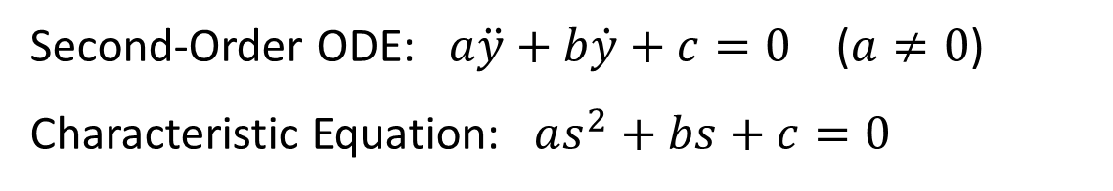
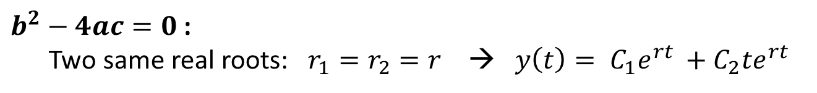
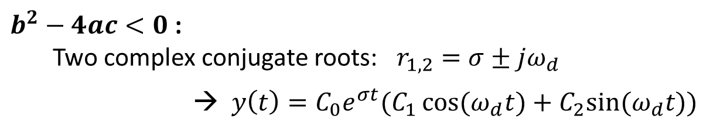
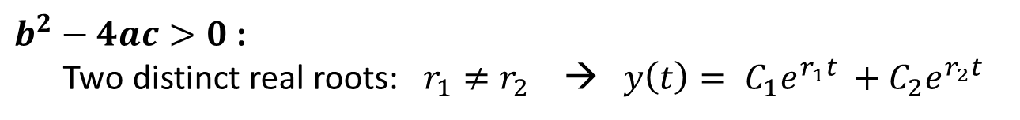
Review: ODE
Second-Order ODE: $a\ddot{y}+b\dot{y}+c=0$ ($a≠0$)
Characteristic Equation: $as^{2}+bs+c=0$
$b^{2}−4ac>0$:
Two distinct real roots: $r_{1}≠r_{2}$ → $y\left(t\right)= {C_{1}e}^{r_{1}t }+C_{2}e^{r_{2}t}$
$b^{2}−4ac<0$:
Two complex conjugate roots: $r_{1,2}=σ±jω_{d}$
→ $y\left(t\right)=C_{0}e^{σt}(C_{1}\cos{(ω_{d}t)+C_{2}sin⁡(ω_{d}t))}$
$b^{2}−4ac=0$:
Two same real roots: $r_{1}=r_{2}=r$ → $y\left(t\right)= {C_{1}e}^{rt }+C_{2}{te}^{rt}$

Slide 3
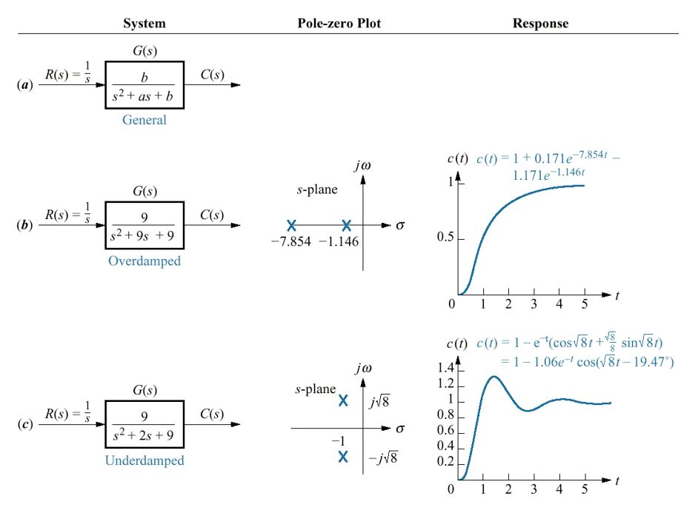


Open-Loop System Stability
$$ζ>1$$
$$ζ<1$$

Slide 4
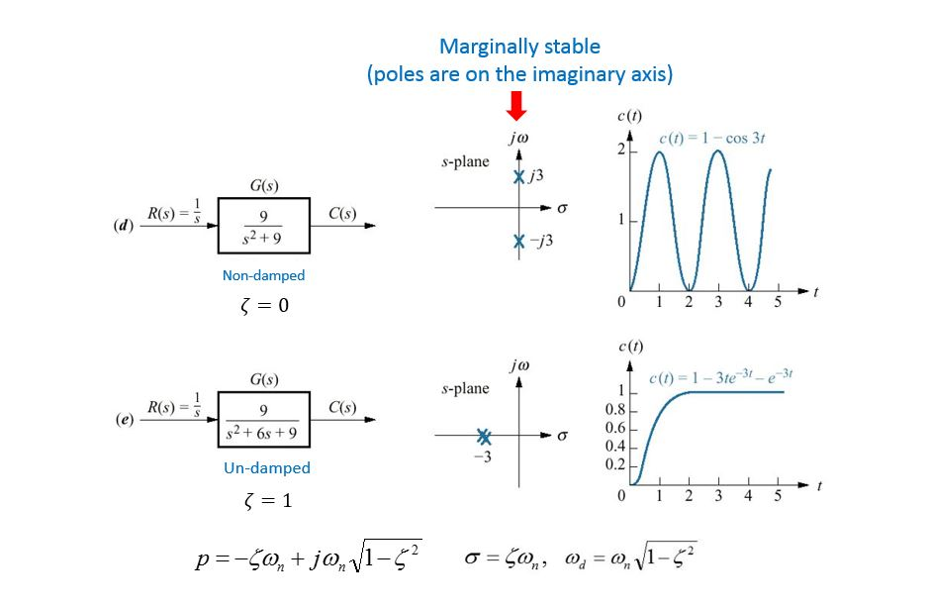
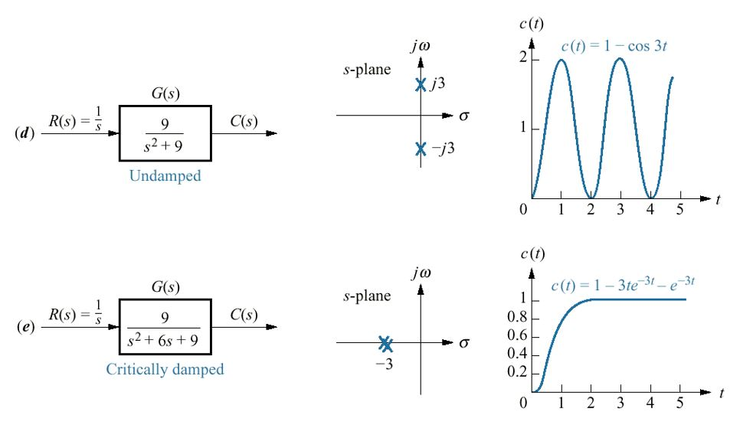




Open-Loop System Stability
Marginally stable
(poles are on the imaginary axis)
Non-damped
$$ζ=0$$
Un-damped
$$ζ=1$$

Slide 5
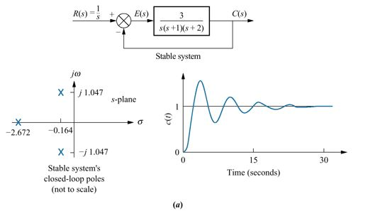
Closed-Loop System Stability
(Asymptotically) Stable → BIBO Stable

Slide 6
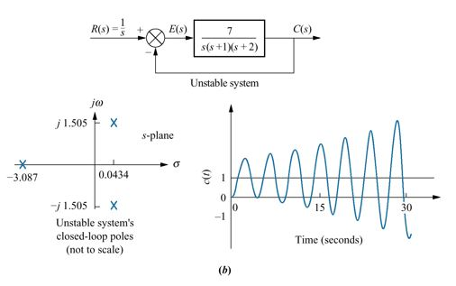
Closed-Loop System Stability
Unstable

Slide 7
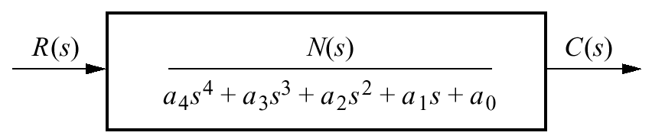
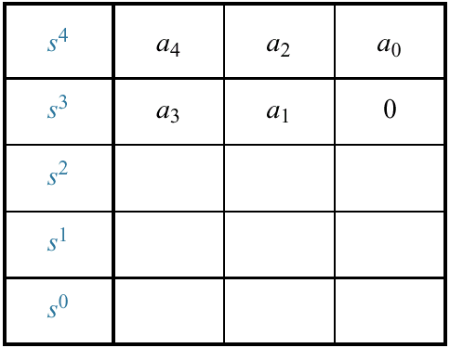
Determine the Stability of a Transfer Function
Routh Table

Slide 8
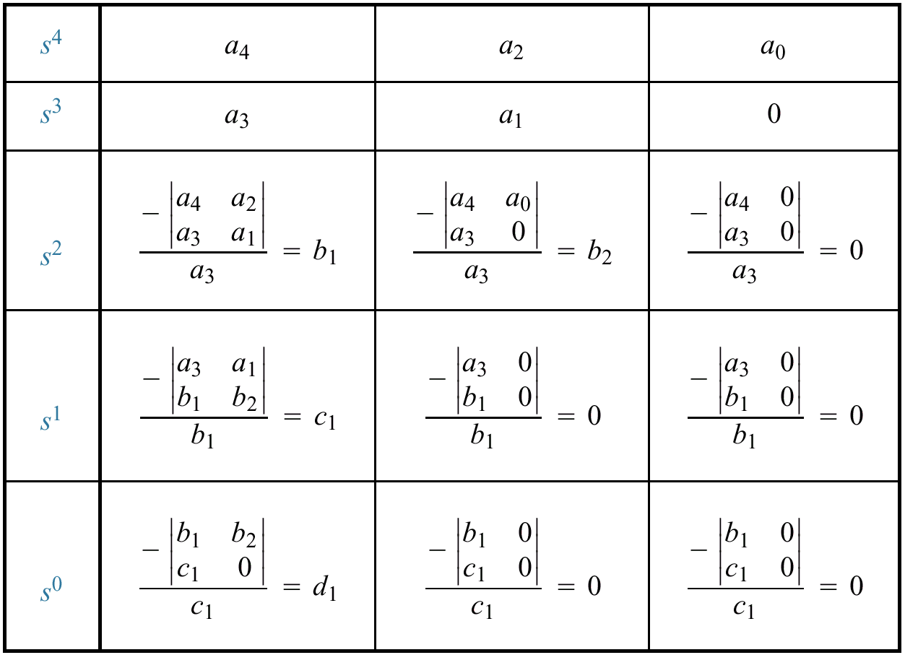
Case (i): If no sign changes → stable

Slide 9
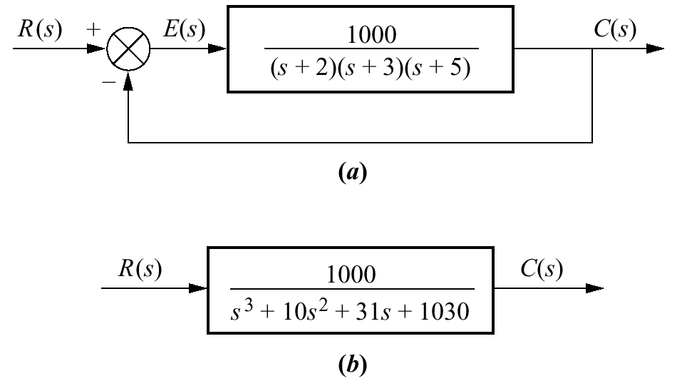
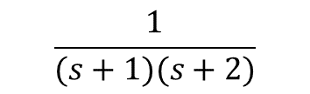
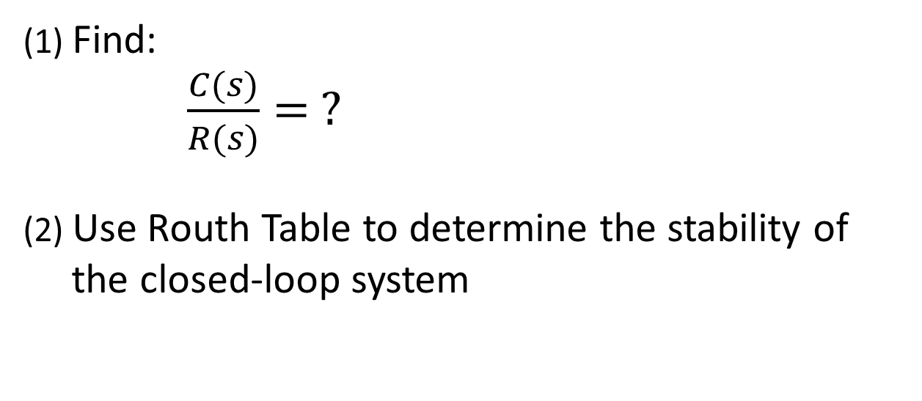
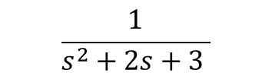
Exercise: (5 minutes)
$$\frac{1}{(s+1)(s+2)}$$
Find:
$\frac{C(s)}{R(s)}= ?$
(2) Use Routh Table to determine the stability of
the closed-loop system
$$\frac{1}{s^{2}+2s+3 }$$

Slide 10
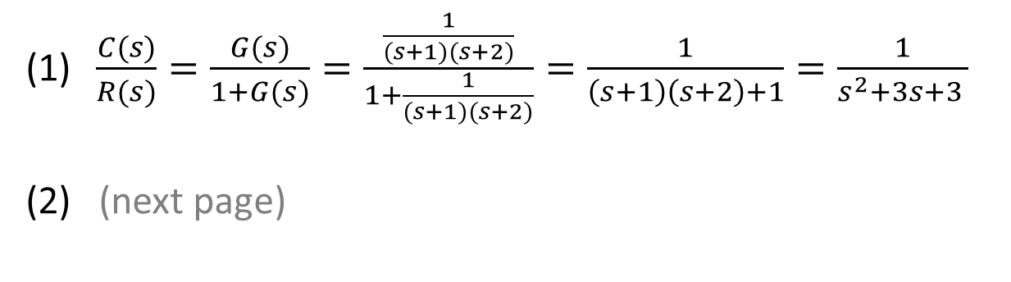
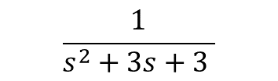
Answer:
$$\frac{1}{(s+1)(s+2)}$$
$$\frac{1}{s^{2}+3s+3 }$$
$\frac{C(s)}{R(s)}=\frac{G(s)}{1+G(s)}=\frac{\frac{1}{(s+1)(s+2)}}{1+\frac{1}{(s+1)(s+2)}}=\frac{1}{\left(s+1\right)\left(s+2\right)+1}=\frac{1}{s^{2}+3s+3 }$
(2) (next page)

Slide 11
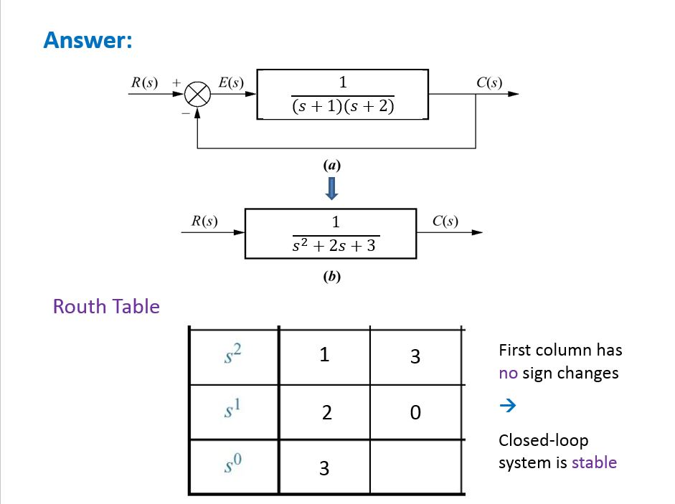

3

Slide 12


Example:
$$G(s)$$
$$\frac{G(s)}{1+G(s)}$$
Now, suppose: $\frac{C(s)}{R(s)}=\frac{N(s)}{D(s)}=\frac{N(s)}{s^{4}+2s^{3}+3s^{2}+4s+5}$

Slide 13
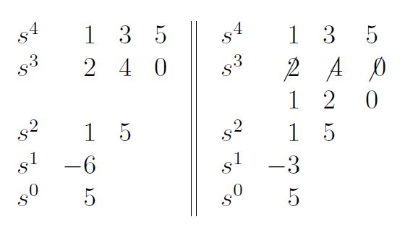

$${D\left(s\right)=s}^{4}+2s^{3}+3s^{2}+4s+5$$
Routh Table
Case (i): Two sign changes → two unstable poles (in RHP)

Slide 14
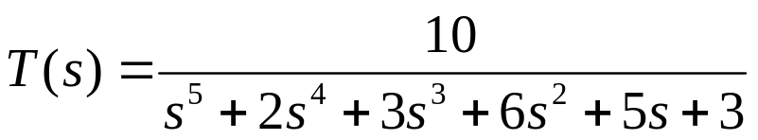
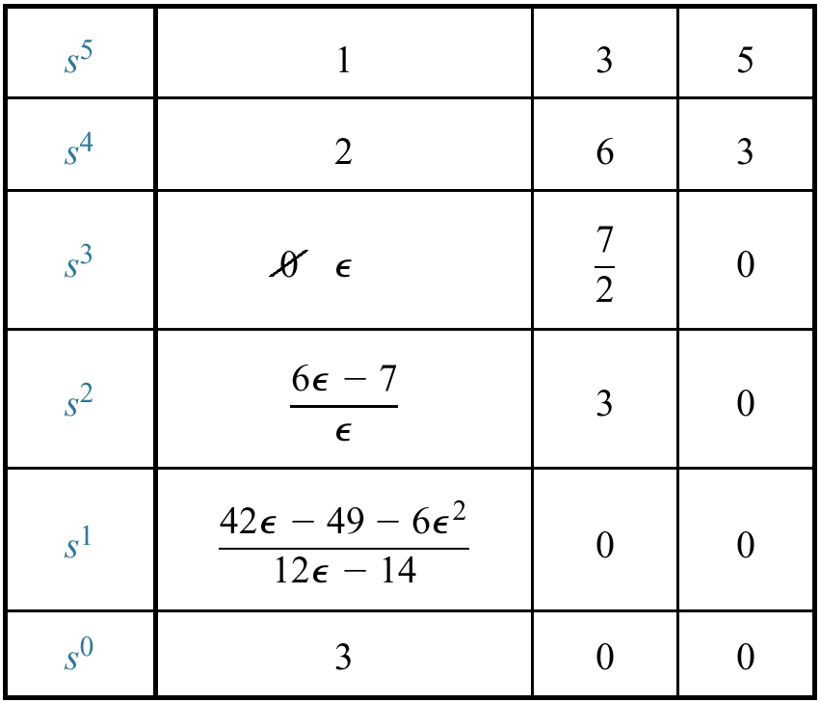
Example:
G(s)
No sign change →
(> 0)
Sign change →
Sign change →
No sign change →
Case (ii): 0 appears in the first column

Slide 15
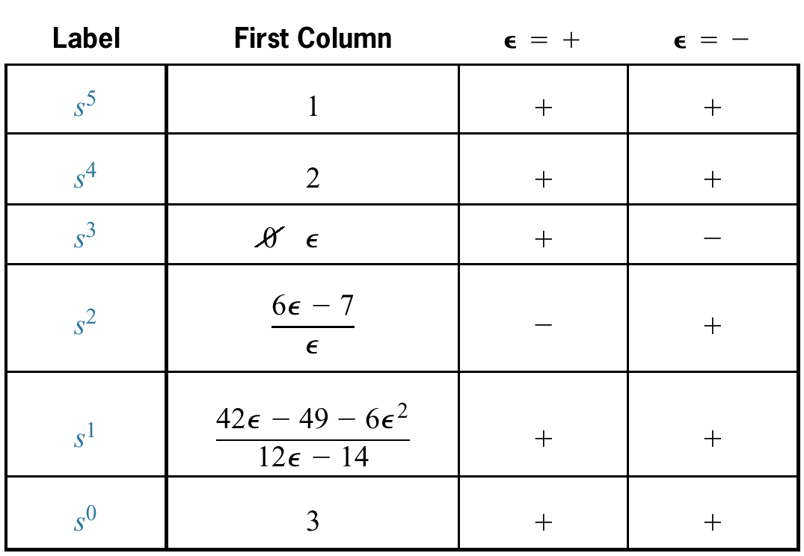
(> 0)
Two sign changes → Unstable (2 poles in RHP)

Slide 16
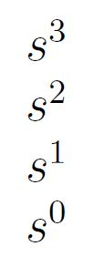
Exercise: (5 minutes)
$$D\left(s\right)=s^{3}+2s^{2}+s+2$$
Routh Table

Slide 17
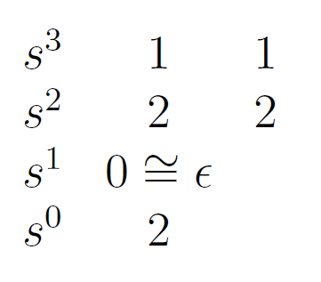

Answer:
$$D\left(s\right)=s^{3}+2s^{2}+s+2$$
Routh Table
$$ε^{+}$$
No sign changes → Stable

Slide 18
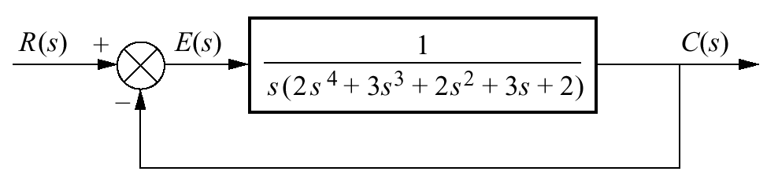
Exercise:
Y(s)
(1) Closed-loop Transfer Function = ? (5 minutes)

Slide 19
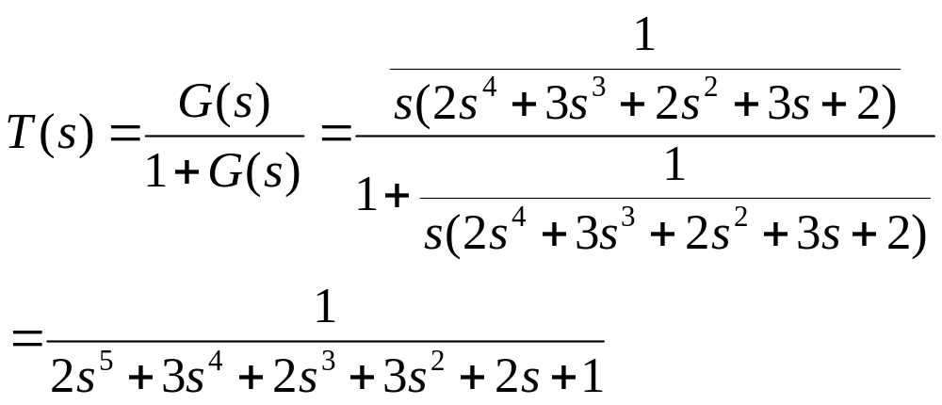

Exercise:
Y(s)
Closed-loop Transfer Function = ?
Answer:
$$\frac{Y(s)}{R(s)}$$
(2) Determine its stability using Rough Table (10 minutes)

Slide 20
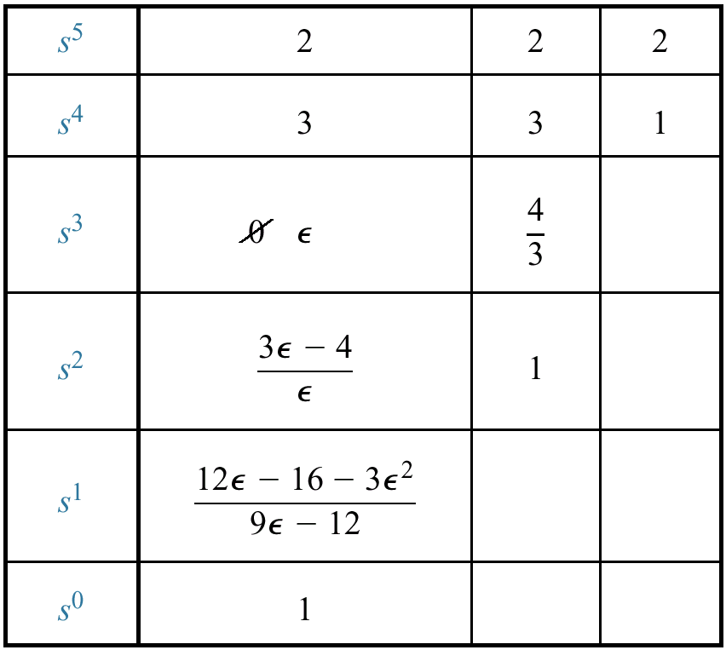
(2) Determine its stability using Rough Table (Answer)
+
-
+
Two sign changes → unstable (with 2 poles on RHP)

Slide 21
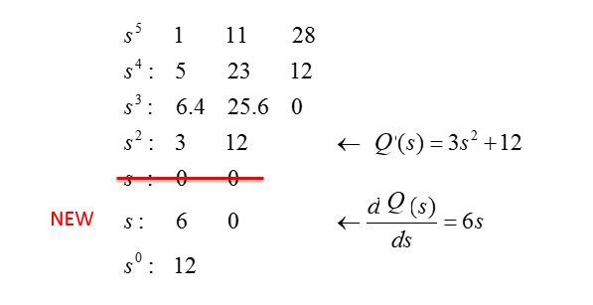
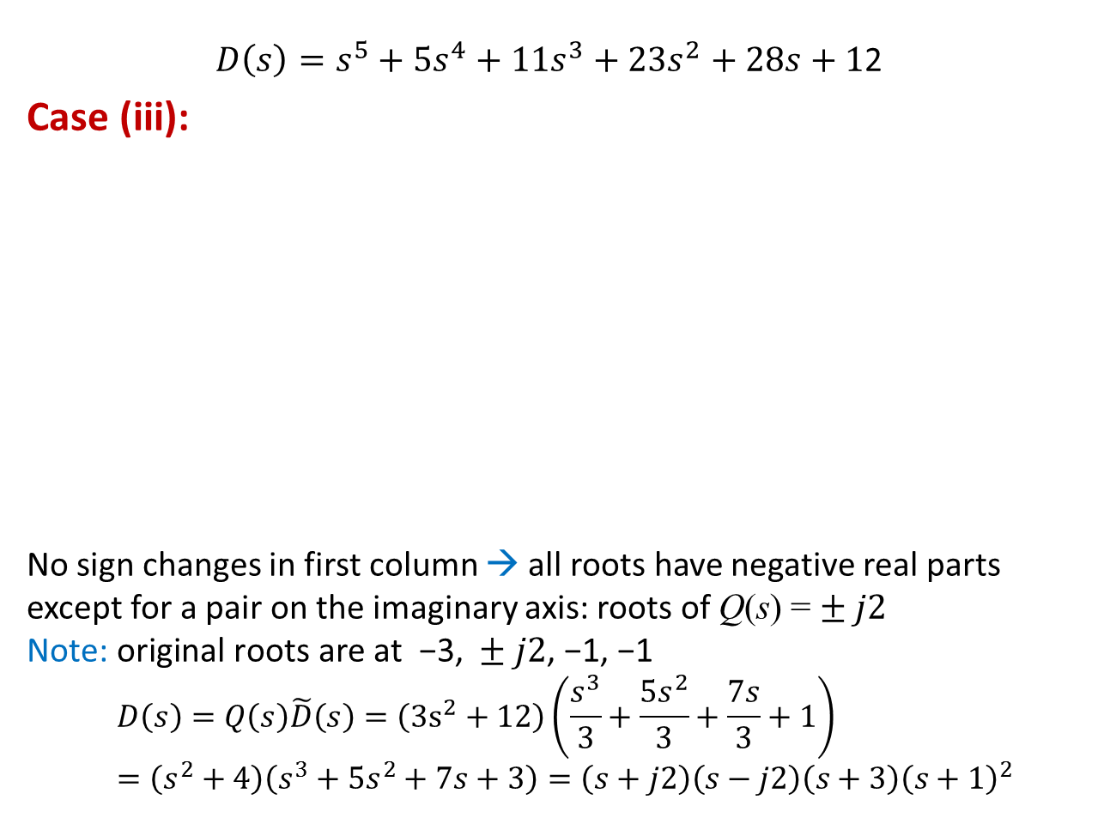
Example:
$D\left(s\right)=s^{5}+5s^{4}+11s^{3}+{23s}^{2}+28s+1$2
Case (iii):
No sign changes in first column → all roots have negative real parts except for a pair on the imaginary axis: roots of Q(s) = $± j2$
$$\text{Note}\text{: }\text{original} \text{roots} \text{are} \text{at} \text{ −3, }±j2\text{, −1, −1}$$
$$D\left(s\right)=Q\left(s\right)\tilde{D}\left(s\right)=\left(3s^{2}+12\right)\left(\frac{s^{3}}{3}+\frac{5s^{2}}{3}+\frac{7s}{3}+1\right)=\left(s^{2}+4\right)\left(s^{3}+5s^{2}+7s+3\right)=\left(s+j2\right)\left(s−j2\right)\left(s+3\right){\left(s+1\right)}^{2}$$
Q
Q
NEW

Slide 22
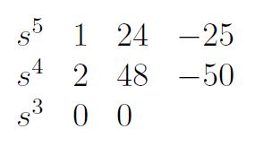

Example:
$$D\left(s\right)=s^{5}+2s^{4}+24s^{3}+48s^{2}−25s−50$$
First Test → Unstable
As exercise, use Routh Table:

Slide 23
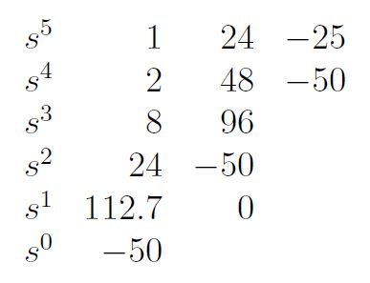

Example:
$$D\left(s\right)=s^{5}+2s^{4}+24s^{3}+48s^{2}−50$$
First Test → Unstable
As exercise, use Routh Table:
One sign change → Unstable
(with one root in RHP)

Slide 24
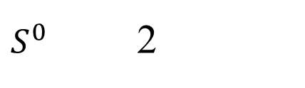


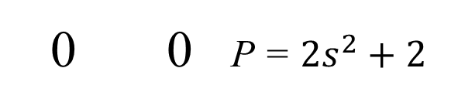

Remark: Treatments on (ii) and (iii) are consistent
Recall: $D\left(s\right)=s^{3}+2s^{2}+s+2$
Routh Table Treating case (ii) as case (iii):
$$ε^{+}$$
0 0 P = $2s^{2}+2$
4 0 $\frac{dP}{ds}=4s$
$S^{0}$ 2
(ii) No sign changes
→ Stable
(iii) No sign changes
→ Same conclusion

Slide 25
END

