Slide 1

EE3207
Verilog DATAFLOW MODELING

Slide 2
Dataflow Modeling
For small circuits, the gate-level modeling approach works very well because the number of gates is limited and the designer can instantiate and connect every gate individually. Also, gate-level modeling is very intuitive to a designer with a basic knowledge of digital logic design. However, in complex designs the number of gates is very large. Thus, designers can design more effectively if they concentrate on implementing the function at a level of abstraction higher than gate level. Dataflow modeling provides a powerful way to implement a design. Verilog allows a circuit to be designed in terms of the data flow between registers and how a design processes data rather than instantiation of individual gates.
With logic synthesis, dataflow modeling has become a popular design approach as logic synthesis tools have become sophisticated. It allows the designer to concentrate on optimizing the circuit in terms of data flow. The viable approach employs the concept of RTL (Register Transfer Level) design with a combination of dataflow modeling and behavioral modeling for digital system design.

Slide 3
Learning Objectives
Describe the continuous assignment (assign) statement, restrictions on the assign statement, and the implicit continuous assignment statement.
Explain assignment delay, implicit assignment delay, and net declaration delay for continuous assignment statements.
Define expressions, operators, and operands.
List operator types for all possible operations—arithmetic, logical, relational, equality, bitwise, reduction, shift, concatenation, and conditional.
Use dataflow constructs to model practical digital circuits in Verilog.

Slide 4
CONTENTS
Continuous Assignments
Delays
Expressions, Operators, and Operands
Types of Operator
Design Examples

Slide 5
Continuous Assignment
Continuous Assignments
Implicit Continuous Assignments
Implicit Net Declaration

Slide 6
Continuous Assignment

Slide 7
Continuous Assignment
A continuous assignment is the most basic statement in dataflow modeling, used to drive a value onto a net. This assignment replaces gates in the description of the circuit and describes the circuit at a higher level of abstraction. The assignment statement starts with the keyword assign.
Syntax
wire wire_variable = value;
assign wire_variable = expression;

Slide 8
Continuous Assignment
Continuous assignments have the following characteristics:
Left hand side of an assignment must always be a scalar or vector net or a concatenation of scalar and vector nets. It cannot be a scalar or vector register.
Continuous assignments are always active. The assignment expression is evaluated as soon as one of the right-hand-side operands changes and the value is assigned to the left-hand-side net.
The operands on the right-hand side can be registers or nets or function calls. Registers or nets can be scalars or vectors.
Delay values can be specified for assignments in terms of time units. Delay values are used to control the time when a net is assigned the evaluated value. This feature is similar to specifying delays for gates. It is very useful in modeling timing behavior in real circuits.

Slide 9
Continuous Assignment
// Continuous assign. out is a net. i1 and i2 are nets.
assign out = i1 & i2;
// Continuous assign for vector nets. addr is a 16-bit vector net
// addr1 and addr2 are 16-bit vector registers.
assign addr[15:0] = addr1_bits[15:0] ^ addr2_bits[15:0];
// Concatenation. Left-hand side is a concatenation of a scalar
// net and a vector net.
assign {c_out, sum[3:0]} = a[3:0] + b[3:0] + c_in;

Slide 10
Implicit Continuous Assignment
Verilog provides a shortcut by which a continuous assignment can be placed on a net when it is declared. There can be only one implicit declaration assignment per net because a net is declared only once.
//Regular continuous assignment
wire out;
assign out = in1 & in2;
//Same effect is achieved by an implicit continuous assignment
wire out = in1 & in2;

Slide 11
Implicit Net Declaration
If a signal name is used to the left of the continuous assignment, an implicit net declaration will be inferred for that signal name. If the net is connected to a module port, the width of the inferred net is equal to the width of the module port.
// Continuous assign. out is a net.
wire i1, i2;
assign out = i1 & i2; //Note that out was not declared as a wire
//but an implicit wire declaration for out
//is done by the simulator

Slide 12
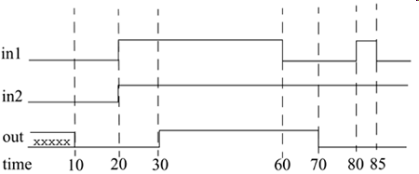
Regular Assignment Delay
The first method is to assign a delay value in a continuous assignment statement. The delay value is specified after the keyword assign.
assign #10 out = in1 & in2; // Delay in a continuous assign
Noted, 10 units after time 80, in1 is 0. Thus, out gets the value 0. A pulse of width less than the specified assignment delay is not propagated to the output.

Slide 13
Implicit Continuous Assignment Delay
An equivalent method is to use an implicit continuous assignment to specify both a delay and an assignment on the net.
//implicit continuous assignment delay
wire #10 out = in1 & in2;
//same as
wire out;
assign #10 out = in1 & in2;
The declaration above has the same effect as defining a wire out and declaring a continuous assignment on out.

Slide 14
Net Declaration Delay
A delay can be specified on a net when it is declared without putting a continuous assignment on the net. If a delay is specified on a net out, then any value change applied to the net out is delayed accordingly.
Net declaration delays can also be used in gate-level modeling.
    //Net Delays
    wire # 10 out;
    assign out = in1 & in2;
    //The above statement has the same effect as the following.
    wire out;
    assign #10 out = in1 & in2;

Slide 15
Expressions, Operators, and Operands
Expressions
Operators
Operands

Slide 16
Expressions

Slide 17
Expressions
Dataflow modeling describes the design in terms of expressions instead of primitive gates. Expressions, operators, and operands form the basis of dataflow modeling.
Expressions are constructs that combine operators and operands to produce a result.
// Examples of expressions. Combines operands and operators
a ^ b
addr1[20:17] + addr2[20:17]
in1 | in2

Slide 18
Operands
Operands can be constants, integers, real numbers, nets, registers, times, bit-select (one bit of vector net or a vector register), part-select (selected bits of the vector net or register vector), and memories or function calls (functions are discussed later).
integer count, final_count;
final_count = count + 1; //count is an integer operand
real a, b, c;
c = a - b; //a and b are real operands
reg [15:0] reg1, reg2;
reg [3:0] reg_out;
reg_out = reg1[3:0] ^ reg2[3:0];
//reg1[3:0] and reg2[3:0] are part-select register operands
reg ret_value;
ret_value = calculate_parity(A, B);
//calculate_parity is a function type operand

Slide 19
Operators
Operators act on the operands to produce desired results. Verilog provides various types of operators.
  d1 && d2 // && is an operator on operands d1 and d2
  !a[0] // ! is an operator on operand a[0]
  B >> 1 // >> is an operator on operands B and 1

Slide 20
Types of Operator
Arithmetic Operator
Logical Operator
Relational Operator
Equality Operator
Bitwise Operator
Reduction Operator
Shift Operator
Concatenation Operator
Replication Operator
Conditional Operator
Operator Precedence

Slide 21
Types of Operator
Verilog provides many different operator types. Operators can be arithmetic, logical, relational, equality, bitwise, reduction, shift, concatenation, or conditional. Some of these operators are similar to the operators used in the C programming language. Each operator type is denoted by a symbol.
Operator Type | Operator Symbol | Operation Performed | Number of Operands
Arithmetic | * / + - % ** | multiply divide add subtract modulus power (exponent) | two two two two two two
Logical | ! && || | logical negation logical and logical or | one two two
Relational | > < >= <= | greater than less than greater than or equal less than or equal | two two two two

Slide 22
Operator Type Operator Symbol Operation Performed Number of Operands
Equality
==
!=
===
!==
equality
inequality
case equality
case inequality
two
two
two
two
Bitwise
~
&
|
^
^~ or ~^
bitwise negation
bitwise and
bitwise or
bitwise xor
bitwise xnor
one
two
two
two
two
Reduction
&
~&
|
~|
^
^~ or ~^
reduction and
reduction nand
reduction or
reduction nor
reduction xor
reduction xnor
one
one
one
one
one
one
Shift
>>
<<
>>>
<<<
Right shift
Left shift
Arithmetic right shift
Arithmetic left shift
Two
Two
Two
Two

Slide 23
Operator Type Operator Symbol Operation Performed Number of Operands
Concatenation
{ }
Concatenation
Any number
Replication
{ { } }
Replication
Any number
Conditional
?:
Conditional
Three

Slide 24
Arithmetic Operators

Slide 25
Arithmetic Operators
There are two types of arithmetic operators: binary and unary.
Binary Operators
Binary arithmetic operators are multiply (*), divide (/), add (+), subtract (-), power (**), and modulus (%). Binary operators take two operands.
A = 4'b0011; B = 4'b0100; // A and B are register vectors
D = 6; E = 4; F=2// D and E are integers
A * B // Multiply A and B. Evaluates to 4'b1100
D / E // Divide D by E. Evaluates to 1. Truncates any fractional part.
A + B // Add A and B. Evaluates to 4'b0111
B - A // Subtract A from B. Evaluates to 4'b0001
F = E ** F; //E to the power F, yields 16

Slide 26
Binary Operators
If any operand bit has a value x, then the result of the entire expression is x. This seems intuitive because if an operand value is not known precisely, the result should be an unknown.
Modulus operators produce the remainder from the division of two numbers. They operate similarly to the modulus operator in the C programming language.
in1 = 4'b101x;
in2 = 4'b1010;
sum = in1 + in2; // sum will be evaluated to the value 4'bx
13 % 3 // Evaluates to 1
16 % 4 // Evaluates to 0
-7 % 2 // Evaluates to -1, takes sign of the first operand
7 % -2 // Evaluates to +1, takes sign of the first operand

Slide 27
Unary Operators
The operators + and - can also work as unary operators. They are used to specify the positive or negative sign of the operand. Unary + or – operators have higher precedence than the binary + or – operators.
-4 // Negative 4
+5 // Positive 5
Negative numbers are represented as 2's complement internally in Verilog. It is advisable to use negative numbers only of the type integer or real in expressions. Designers should avoid negative numbers of the type <sss> '<base> <nnn> in expressions because they are converted to unsigned 2's complement numbers and hence yield unexpected results.
//Advisable to use integer or real numbers
-10 / 5 // Evaluates to -2
//Do not use numbers of type <sign> '<base> <value>
-'d10 / 5 // Is equivalent (2's complement of 10)/5 = (232 - 10)/5
// where 32 is the default machine word width.
// This evaluates to an incorrect and unexpected result

Slide 28
Logical Operators

Slide 29
Logical Operator
Logical operators are logical-and (&&), logical-or (||) and logical-not (!). Operators && and || are binary operators. Operator ! is a unary operator. Logical operators follow these conditions:
Logical operators always evaluate to a 1-bit value, 0 (false), 1 (true), or x (ambiguous).
If an operand is not equal to zero, it is equivalent to a logical 1 (true condition). If it is equal to zero, it is equivalent to a logical 0 (false condition). If any operand bit is x or z, it is equivalent to x (ambiguous condition) and is normally treated by simulators as a false condition.
Logical operators take variables or expressions as operands.
Use of parentheses to group logical operations is highly recommended to improve readability. Also, the user does not have to remember the precedence of operators.

Slide 30
Logical Operator
// Logical operations
A = 3; B = 0;
A && B // Evaluates to 0. Equivalent to (logical-1 && logical-0)
A || B // Evaluates to 1. Equivalent to (logical-1 || logical-0)
!A // Evaluates to 0. Equivalent to not(logical-1)
!B // Evaluates to 1. Equivalent to not(logical-0)
// Unknowns
A = 2'b0x; B = 2'b10;
A && B // Evaluates to x. Equivalent to (x && logical 1)
// Expressions
(a == 2) && (b == 3)
/* Evaluates to 1 if both a == 2 and b == 3 are true. Evaluates to 0 if either is false. */

Slide 31
Relational Operators

Slide 32
Relational Operators
Relational operators are greater-than (>), less-than (<), greater-than-or-equal-to (>=), and less-than-or-equal-to (<=). If relational operators are used in an expression, the expression returns a logical value of 1 if the expression is true and 0 if the expression is false. If there are any unknown or z bits in the operands, the expression takes a value x. These operators function exactly as the corresponding operators in the C programming language.
// A = 4, B = 3
// X = 4'b1010, Y = 4'b1101, Z = 4'b1xxx
A <= B // Evaluates to a logical 0
A > B // Evaluates to a logical 1
Y >= X // Evaluates to a logical 1
Y < Z // Evaluates to an x

Slide 33
Equality Operators

Slide 34
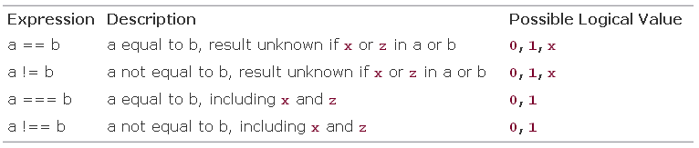
Equality Operators
Equality operators are logical equality (==), logical inequality (!=), case equality (===), and case inequality (!==). When used in an expression, equality operators return logical value 1 if true, 0 if false. These operators compare the two operands bit by bit, with zero filling if the operands are of unequal length.
The difference between the logical equality operators (==, !=) and case equality operators (===, !==). The logical equality operators (==, !=) will yield an x if either operand has x or z in its bits.
The case equality operators ( ===, !== ) compare both operands bit by bit and compare all bits, including x and z. The result is 1 if the operands match exactly, including x and z bits. The result is 0 if the operands do not match exactly. Case equality operators never result in an x.

Slide 35
Equality Operators
// A = 4, B = 3
// X = 4'b1010, Y = 4'b1101
// Z = 4'b1xxz, M = 4'b1xxz, N = 4'b1xxx
A == B // Results in logical 0
X != Y // Results in logical 1
X == Z // Results in x
Z === M // Results in logical 1 (all bits match, including x and z)
Z === N // Results in logical 0 (least significant bit does not match)
M !== N // Results in logical 1

Slide 36
Bitwise Operators

Slide 37
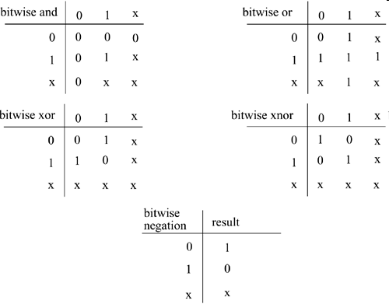
Bitwise Operators
Bitwise operators are negation (~), and(&), or (|), xor (^), xnor (^~, ~^). Bitwise operators perform a bit-by-bit operation on two operands.
They take each bit in one operand and perform the operation with the corresponding bit in the other operand. If one operand is shorter than the other, it will be bit-extended with zeros to match the length of the longer operand.
Logic tables for the bit-by-bit computation are shown in the Table.
A z is treated as an x in a bitwise operation.
The exception is the unary negation operator (~), which takes only one operand and operates on the bits of the single operand.

Slide 38
Example
// X = 4'b1010, Y = 4'b1101
// Z = 4'b10x1
~X // Negation. Result is 4'b0101
X & Y // Bitwise and. Result is 4'b1000
X | Y // Bitwise or. Result is 4'b1111
X ^ Y // Bitwise xor. Result is 4'b0111
X ^~ Y // Bitwise xnor. Result is 4'b1000
X & Z // Result is 4'b10x0
It is important to distinguish bitwise operators ~, &, and | from logical operators !, &&, ||. Logical operators always yield a logical value 0, 1, x, whereas bitwise operators yield a bit-by-bit value. Logical operators perform a logical operation, not a bit-by-bit operation.
// X = 4'b1010, Y = 4'b0000
X | Y // bitwise operation. Result is 4'b1010
X || Y // logical operation. Equivalent to 1 || 0. Result is 1.

Slide 39
Reduction Operators

Slide 40
Reduction Operators
Reduction operators are and (&), nand (~&), or (|), nor (~|), xor (^), and xnor (~^, ^~). Reduction operators take only one operand. Reduction operators perform a bitwise operation on a single vector operand and yield a 1-bit result. The logic tables for the operators are the same as bitwise operators.
Bitwise operations are on bits from two different operands
Reduction operations are on the bits of the same operand.
Reduction operators work bit by bit from right to left. Reduction nand, reduction nor, and reduction xnor are computed by inverting the result of the reduction and, reduction or, and reduction xor, respectively.
// X = 4'b1010
&X //Equivalent to 1 & 0 & 1 & 0. Results in 1'b0
|X //Equivalent to 1 | 0 | 1 | 0. Results in 1'b1
^X //Equivalent to 1 ^ 0 ^ 1 ^ 0. Results in 1'b0
/* A reduction xor or xnor can be used for even or odd parity generation of a vector. */

Slide 41
Shift Operators

Slide 42
Shift Operators
Shift operators are right shift ( >>), left shift (<<), arithmetic right shift (>>>), and arithmetic left shift (<<<).
Regular shift operators shift a vector operand to the right or the left by a specified number of bits. The operands are the vector and the number of bits to shift. When the bits are shifted, the vacant bit positions are filled with zeros. Shift operations do not wrap around. Arithmetic shift operators use the context of the expression to determine the value with which to fill the vacated bits. Shift operators are useful to model shift operations, shift-and-add algorithms for multiplication, and other useful operations.
// X = 4'b1100
Y = X >> 1; //Y is 4'b0110. Shift right 1 bit. 0 filled in MSB position.
Y = X << 1; //Y is 4'b1000. Shift left 1 bit. 0 filled in LSB position.
Y = X << 2; //Y is 4'b0000. Shift left 2 bits.
integer a, b, c; //Signed data types
a = 0;
b = -10; // 00111...10110 binary
c = a + (b >>> 3); //Results in -2 decimal, due to arithmetic shift

Slide 43
Concatenation Operators

Slide 44
Concatenation Operators
The concatenation operator ( {, } ) provides a mechanism to append multiple operands. The operands must be sized. Unsized operands are not allowed because the size of each operand must be known for computation of the size of the result.
Concatenations are expressed as operands within braces, with commas separating the operands. Operands can be scalar nets or registers, vector nets or registers, bit-select, part-select, or sized constants.
// A = 1'b1, B = 2'b00, C = 2'b10, D = 3'b110
Y = {B , C} // Result Y is 4'b0010
Y = {A , B , C , D , 3'b001} // Result Y is 11'b10010110001
Y = {A , B[0], C[1]} // Result Y is 3'b101

Slide 45
Replication Operators

Slide 46
Replication Operators
Repetitive concatenation of the same number can be expressed by using a replication constant. A replication constant specifies how many times to replicate the number inside the brackets ( { } ).
  reg A;
  reg [1:0] B, C;
  reg [2:0] D;
  A = 1'b1; B = 2'b00; C = 2'b10; D = 3'b110;
  Y = { 4{A} } // Result Y is 4'b1111
  Y = { 4{A} , 2{B} } // Result Y is 8'b11110000
  Y = { 4{A} , 2{B} , C } // Result Y is 8'b1111000010

Slide 47
Conditional Operators

Slide 48
Conditional Operators
The condition expression (condition_expr) is first evaluated. If the result is true (logical 1), then the true_expr is evaluated. If the result is false (logical 0), then the false_expr is evaluated. If the result is x (ambiguous), then both true_expr and false_expr are evaluated and their results are compared, bit by bit, to return for each bit position an x if the bits are different and the value of the bits if they are the same.
The action of a conditional operator is similar to a multiplexer. Alternately, it can be compared to the if-else expression.
The conditional operator(?:) takes three operands.
Usage: condition_expr ? true_expr : false_expr ;

Slide 49
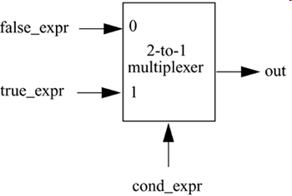
Conditional Operators
Conditional operators are frequently used in dataflow modeling to model conditional assignments. The conditional expression acts as a switching control.
//model functionality of a tristate buffer
assign addr_bus = drive_enable ? addr_out : 36'bz;
//model functionality of a 2-to-1 mux
assign out = control ? in1 : in0;

Slide 50
Conditional Operators
Conditional operations can be nested. Each true_expr or false_expr can itself be a conditional operation. In the example that follows, convince yourself that (A==3) and control are the two select signals of 4-to-1 multiplexer with n, m, y, x as the inputs and out as the output signal.
assign out = (A == 3) ? ( control ? x : y ): ( control ? m : n) ;

Slide 51
Operator Precedence

Slide 52
Operator Precedence
Operators
Operator Symbols
Precedence
Unary
+ - ! ~
Highest precedence
Multiply, Divide, Modulus
* / %
Add, Subtract
+ -
Shift
<< >>
Relational
< <= > >=
Equality
== != === !==
Reduction
&, ~&
^ ^~
|, ~|
Logical
&&
||
Conditional
?:
Lowest precedence

Slide 53
Examples
4-to-1 Multiplexer
4-bit Full Adder
Ripple Counter

Slide 54
Design Examples
A design can be represented in terms of gates, data flow, or a behavioral description. In this section, we consider the 4-to-1 multiplexer and 4-bit full adder described in structural modeling . Previously, these designs were directly translated from the logic diagram into a gate-level Verilog description. Here, the same designs are modeled in data flow approach. More examples are discussed here.
A SR flip flop
Use DeMorgan’s Rule, write a dataflow description of the above SR flip flop.
module SR_flip_flop(q, qbar, s, r);
output q,qbar; // outputs
input s,r; // inputs
assign q = ~(s & qbar),
qbar = ~(r & q);
endmodule

Slide 55
4-to-1 Multiplexer

Slide 56
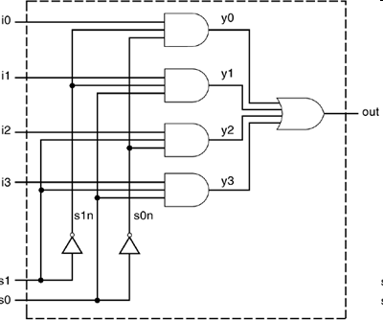
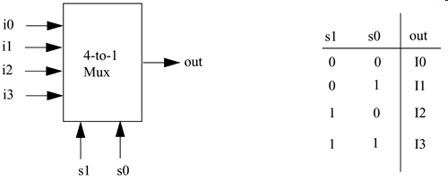
4-to-1 Multiplexer
Method 1: Logic Equation
Assignment statements are used instead of gates to model the logic equations of the multiplexer.
Notice that everything is same as the gate-level Verilog description except
that computation of out is done by specifying one logic equation by using
operators instead of individual gate instantiations.
I/O ports remain the same. This is important so that the interface with the
environment does not change.
Only the internals of the module change. Notice how concise the description
is compared to the gate-level description.

Slide 57
4-to-1 Multiplexer, Using Logic Equations
// Module 4-to-1 multiplexer using data flow. logic equation
// Compare to gate-level model
module mux4_to_1 (out, i0, i1, i2, i3, s1, s0);
// Port declarations from the I/O diagram
output out;
input i0, i1, i2, i3;
input s1, s0;
//logic equation for out
assign out = (~s1 & ~s0 & i0)|
(~s1 & s0 & i1)|
( s1 & ~s0 & i2)|
( s1 & s0 & i3) ;
endmodule

Slide 58
4-to-1 Multiplexer, Using Logic Equations
Method 2: Conditional Operator
There is a more concise way to specify the 4-to-1 multiplexers with conditional operator.
// Module 4-to-1 multiplexer using data flow. Conditional operator.
// Compare to gate-level model
module multiplexer4_to_1 (out, i0, i1, i2, i3, s1, s0);
// Port declarations from the I/O diagram
output out;
input i0, i1, i2, i3;
input s1, s0;
// Use nested conditional operator
assign out = s1 ? ( s0 ? i3 : i2) : (s0 ? i1 : i0) ;
endmodule
true false

Slide 59
4-bit Full Adder

Slide 60
4-bit Full Adder
Method 1: dataflow operators
A concise description of the adder is defined with the + ‘ add arithmetic operator ’ and { } concatenation operators
// Define a 4-bit full adder by using dataflow statements.
module fulladd4(sum, c_out, a, b, c_in);
// I/O port declarations
output [3:0] sum;
output c_out;
input[3:0] a, b;
input c_in;
// Specify the function of a full adder
assign {c_out, sum} = a + b + c_in;
endmodule

Slide 61
4-bit Full Adder
Method 2: full adder with carry lookahead
In ripple carry adders, the carry must propagate through the gate levels before the sum is available at the output terminals.
An n-bit ripple carry adder will have 2n gate levels.
The propagation time can be a limiting factor on the speed of the circuit.
One of the most popular methods to reduce delay is to use a carry lookahead mechanism.
Logic equations for implementing the carry lookahead mechanism is omitted as a revision exercise.
The propagation delay is reduced to four gate levels, irrespective of the number of bits in the adder

Slide 62
4-bit Full Adder
Method 2: full adder with carry lookahead
In ripple carry adders, the carry must propagate through the gate levels before the sum is available at the output terminals.
An n-bit ripple carry adder will have 2n gate levels.
The propagation time can be a limiting factor on the speed of the circuit.
One of the most popular methods to reduce delay is to use a carry lookahead mechanism.
Logic equations for implementing the carry lookahead mechanism is omitted as a revision exercise.
The propagation delay is reduced to four gate levels, irrespective of the number of bits in the adder

Slide 63
4-bit Full Adder
module fulladd4(sum, c_out, a, b, c_in);
// Inputs and outputs
output [3:0] sum;
output c_out;
input [3:0] a,b;
input c_in;
// Internal wires
wire p0,g0, p1,g1, p2,g2, p3,g3;
wire c4, c3, c2, c1;
// compute the p for each stage
assign p0 = a[0] ^ b[0],
p1 = a[1] ^ b[1],
p2 = a[2] ^ b[2],
p3 = a[3] ^ b[3];
// compute the g for each stage
assign g0 = a[0] & b[0],
g1 = a[1] & b[1],
g2 = a[2] & b[2],
g3 = a[3] & b[3];
// compute the carry for each stage
/* Note that c_in is equivalent c0 in the arithmetic equation for carry lookahead computation */
assign c1 = g0 | (p0 & c_in),
c2 = g1 | (p1 & g0) | (p1 & p0 & c_in),
c3 = g2 | (p2 & g1) | (p2 & p1 & g0) |
(p2 & p1 & p0 & c_in),
c4 = g3 | (p3 & g2) | (p3 & p2 & g1) |
(p3 & p2 & p1 & g0) |
(p3 & p2 & p1 & p0 & c_in);
// Compute Sum
assign sum[0] = p0 ^ c_in,
sum[1] = p1 ^ c1,
sum[2] = p2 ^ c2,
sum[3] = p3 ^ c3;
// Assign carry output
assign c_out = c4;
endmodule

Slide 64
Ripper Counter

Slide 65
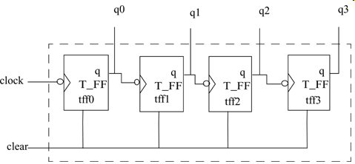
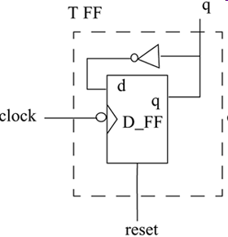
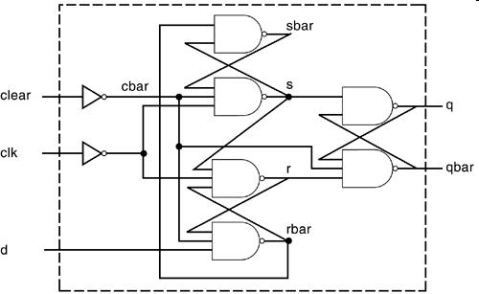
Ripple Counter

Slide 66
Ripple Counter
Using dataflow statements in a top-down fashion, design of the module counter starts with the code contains instantiation of four T_FF modules.
// Ripple counter
module ripple_counter (Q , clock, clear);
// I/O ports
output [3:0] Q;
input clock, clear;
// Instantiate the T flipflops
T_FF tff0(Q[0], clock, clear);
T_FF tff1(Q[1], Q[0], clear);
T_FF tff2(Q[2], Q[1], clear);
T_FF tff3(Q[3], Q[2], clear);
endmodule

Slide 67
Ripple Counter
Next is the Verilog description for T_FF . Notice that instead of the not gate, a dataflow operator ~ negates the signal q, which is fed back.
// Edge-triggered T-flipflop. Toggles every clock
// cycle.
module T_FF (q, clk, clear);
// I/O ports
output q;
input clk, clear;
// Instantiate the edge-triggered DFF, Complement of output q is fed back. Notice qbar not needed. Unconnected port.*/
edge_dff ff1(q, ,~q, clk, clear);
endmodule

Slide 68
Ripple Counter
Finally, the lowest level module D_FF (edge_dff ) is modeled with dataflow statements. The dataflow statements correspond to the logic diagram corresponding exactly to the declared nets.
// Edge-triggered D flipflop
module edge_dff(q, qbar, d, clk, clear);
// Inputs and outputs
output q,qbar;
input d, clk, clear;
// Internal variables
wire s, sbar, r, rbar,cbar;
// dataflow statements
//Create a complement of signal clear
assign cbar = ~clear;
/* Input latches; A latch is level sensitive. An edge-sensitive flip-flop is implemented by using 3 SR latches.*/
assign sbar = ~(rbar & s),
s = ~(sbar & cbar & ~clk),
r = ~(rbar & ~clk & s),
rbar = ~(r & cbar & d);
// Output latch
assign q = ~(s & qbar),
qbar = ~(q & r & cbar);
endmodule

Slide 69
Testbench of the Ripple Counter
The design block is instantiated inside the stimulus block to test the design. The clock has a time period of 20 with a 50% duty cycle.
// Top level stimulus module
module stimulus;
// Declare variables for stimulating input
reg CLOCK, CLEAR;
wire [3:0] Q;
Initial
$monitor($time, " Count Q = %b Clear= %b", Q[3:0],CLEAR);
// Instantiate the design block counter
counter c1(Q, CLOCK, CLEAR);
// Stimulate the Clear Signal initial
begin
CLEAR = 1'b1; #34 CLEAR = 1'b0;
#200 CLEAR = 1'b1; #50 CLEAR = 1'b0;
end
/* Set up the clock to toggle every 10 time units */
initial
begin
CLOCK = 1'b0;
forever #10 CLOCK = ~CLOCK;
end
// Finish the simulation at time 400
initial
begin
#400 $finish;
end
endmodule

Slide 70
Summary
Continuous assignment is one of the main constructs used in dataflow modeling. A continuous assignment is always active and evaluated concurrently. The assignment expression is evaluated as soon as one of the right-hand-side variables changes. The left-hand side of a continuous assignment must be a net. Any logic function can be realized with continuous assignments.
Delay values control the time between the change in a right-hand-side variable and when the new value is assigned to the left-hand side. Delays on a net can be defined in the assign statement, implicit continuous assignment, or net declaration.
Assignment statements contain expressions, operators, and operands.
The operator types are arithmetic, logical, relational, equality, bitwise, reduction, shift, concatenation, replication, and conditional. Unary operators require one operand, binary operators require two operands, and ternary require three operands. The concatenation operator can take any number of operands.
The conditional operator behaves like a multiplexer in hardware or like the if-then-else statement in programming languages.
Dataflow description of a circuit is more concise than a gate-level description. The 4-to-1 multiplexer and the 4-bit full adder discussed in the gate-level modeling can also be designed by use of dataflow statements. Two dataflow implementations for both circuits were discussed. A 4-bit ripple counter using negative edge-triggered D-flipflops was designed.

