Slide 1
EE2000 Logic Circuit Design
Latch and Flip-Flop Circuits

Slide 2
Outline
7.1 Latch
  Active High
  Active Low
7.2 Flip-Flop (FF)
  - SR-, D-, JK-, T- FFs
7.3 Master-Slave FF
7.4 Edge-Triggered FF
7.5 Synchronous and Asynchronous Inputs

Slide 3
Two classes of logic circuits
Combinational logic circuit
Previous lectures have been discussed
Sequential logic circuit
Output depends on present input + past history
Memory circuit (previous STATE information) is required

Slide 4
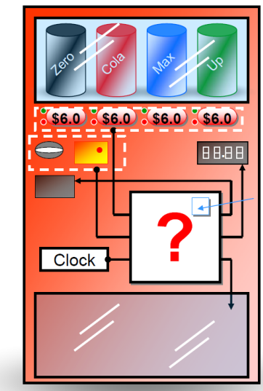

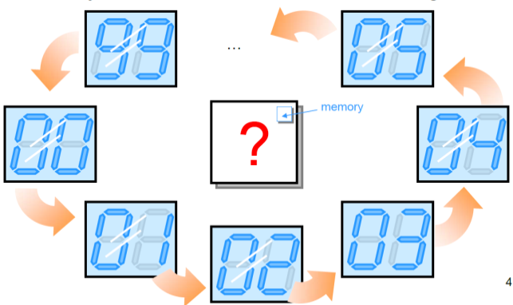
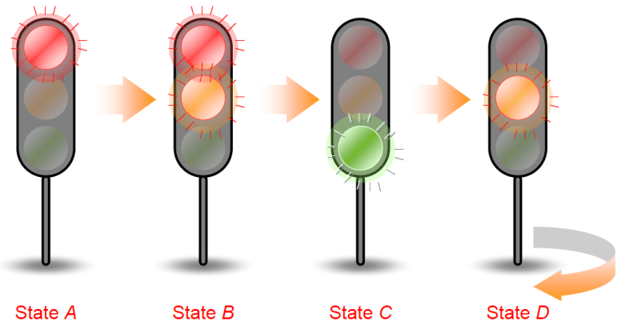
Sequential logic circuit
Examples
Vending Machine
Food/ drink / MTR tickets
Digital counter / clock
Traffic light controller

Slide 5
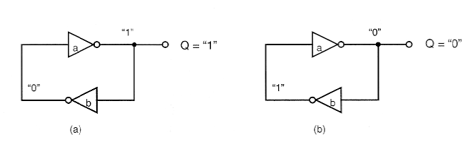
Latch
Two cross-coupled inverters have two stable states: “1” and “0”
The state can be reset with input.
0
1

Slide 6
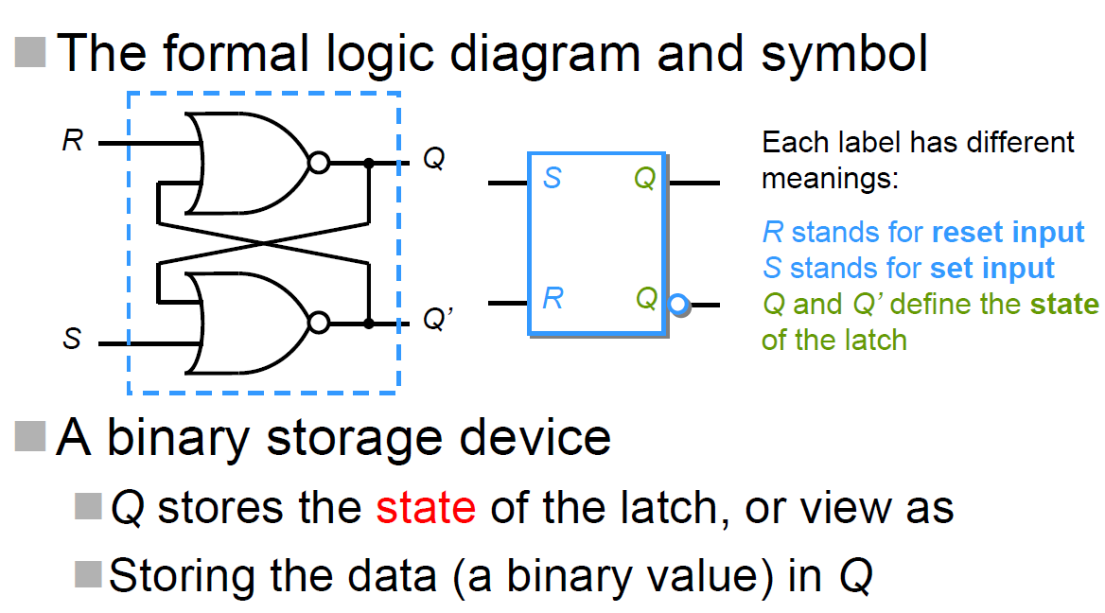
7.1 Latch
The output state of a latch is controlled by its excitation input signals
Latch and flip-flop are memory devices and implemented using bistable circuit - its output will remain in either 0 or 1 state

Slide 7
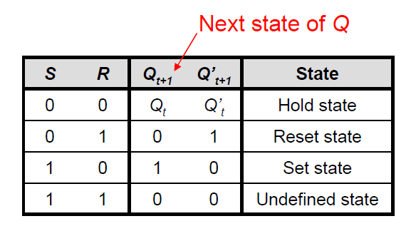
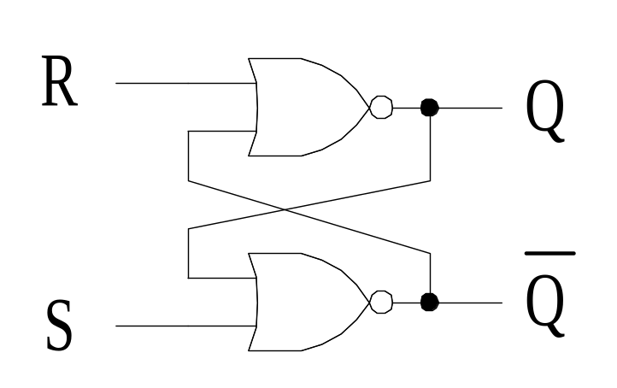
Latch
SR (set-reset) latch circuit
When S (set) is set to 1, the output Q will be set to 1. Likewise, when R (reset) is set to 1, the output Q will be set to 0. It is invalid to set both S and R to 1
Active High Latch
NOR gate implementation

Slide 8
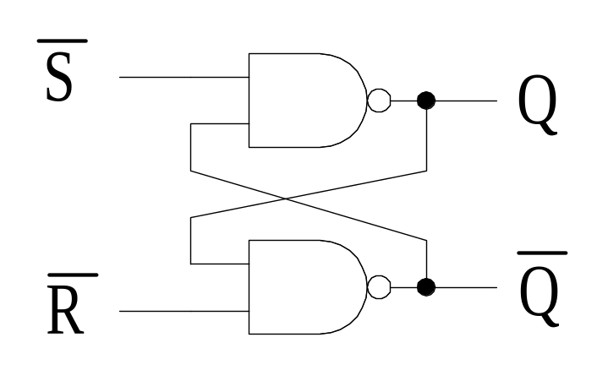
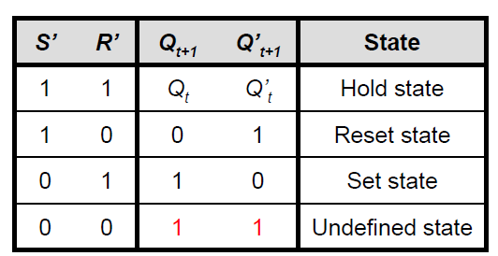
Latch
S’R’ latch circuit
When S’ (set) is set to 1, the output Q will be set to 0. Likewise, when R’ (reset) is set to 1, the output Q will be set to 1. It is invalid to set both S’ and R’ to 1
Active Low Latch
NAND gate implementation

Slide 9
Latch
Note that the input is active high for NOR gate implementation, whereas the input is active low for NAND gate implementation
  Require a 1 signal to change its state
  Require a 0 signal to change its state

Slide 10
Drawbacks
If inputs S, R are unstable (or noise), output produces a unstable short pulse
Solution:
Prevention of input noise
Using “Gated Latch”
The latches will enter undefined state for some inputs (e.g. R = S = 1)
Solution:
Prevent R and S set to 1 simultaneously
Using “D Latch”

Slide 11
7.2 Flip-Flop (FF)
The state of flip-flop changes on the transition of the clock
Four types of FF
SR FF
D-type FF
JK FF
T FF

Slide 12
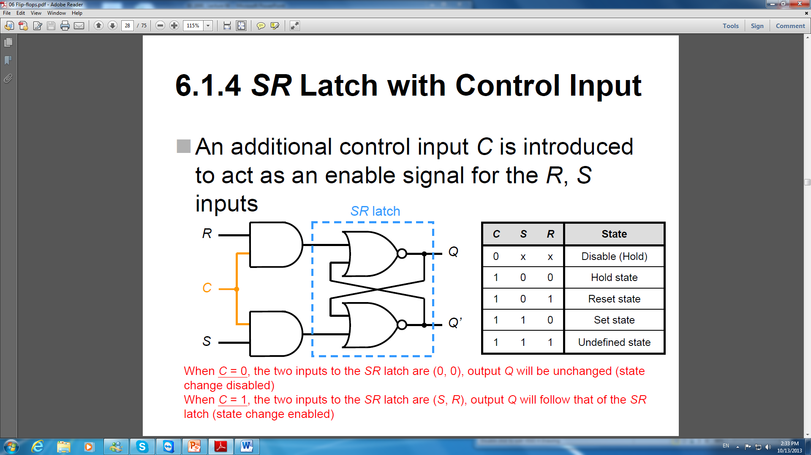
Clocked SR FF
C can be presented by a clocked signal. Then the latch with the clocked signal is called Flip-flop
CLK or

Slide 13
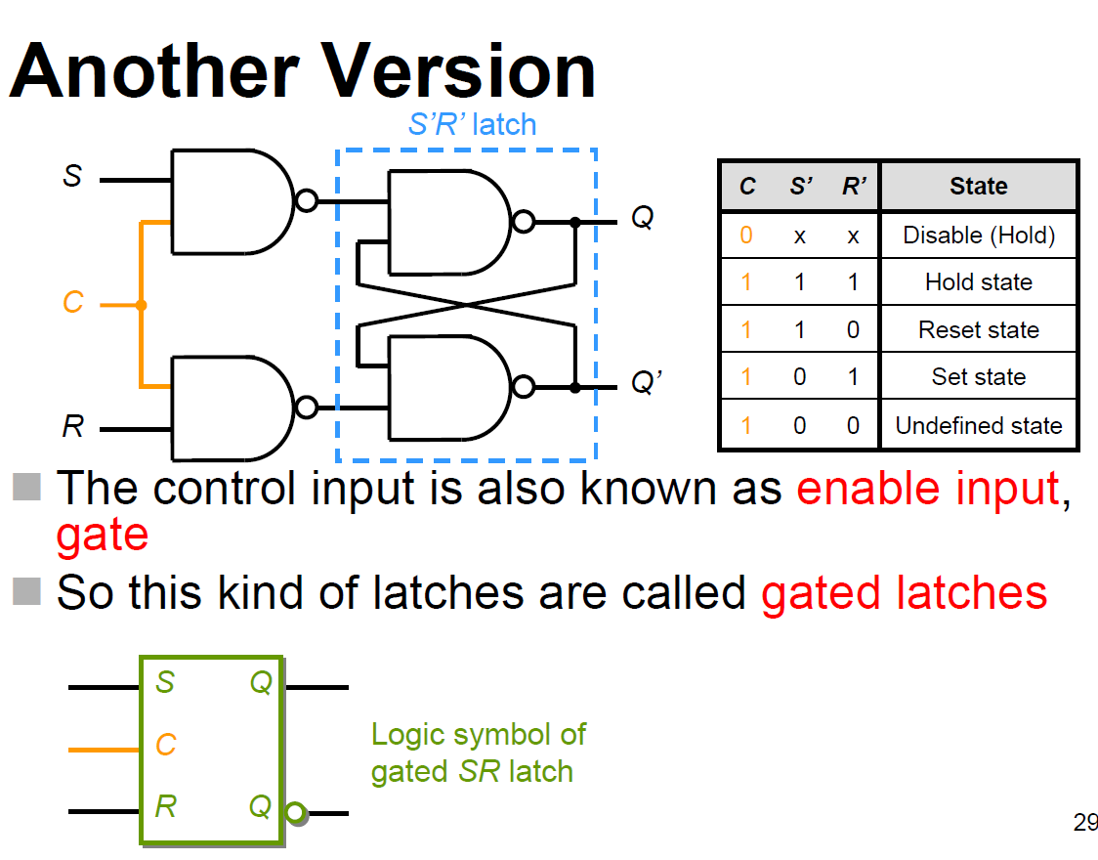
CLK or

Slide 14
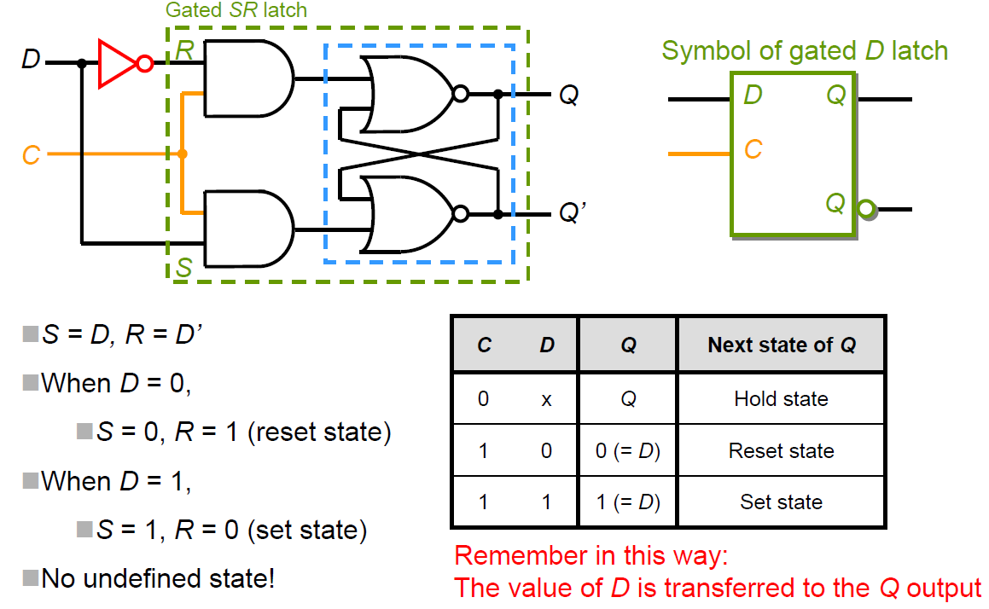
D-type FF
C can be presented by a clocked signal.
Inputs R and S are correlated with D but differentiate by a NOT-gate
CLK or

Slide 15
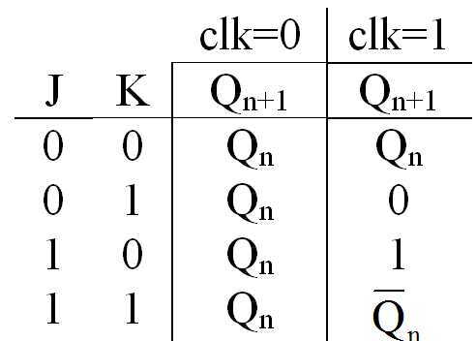
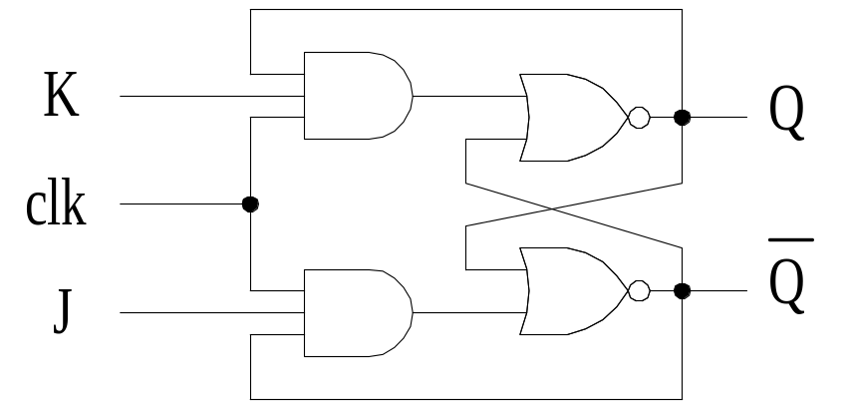
JK FF
The JK FF is a refinement of the SR FF in that the undetermined state of the SR type is defined in the JK type. Inputs J and K behave like inputs S and R to set and reset (clear) the FF, respectively. The input marked J is for set and the input marked K is reset.
hold
Reset
Set
toggle

Slide 16
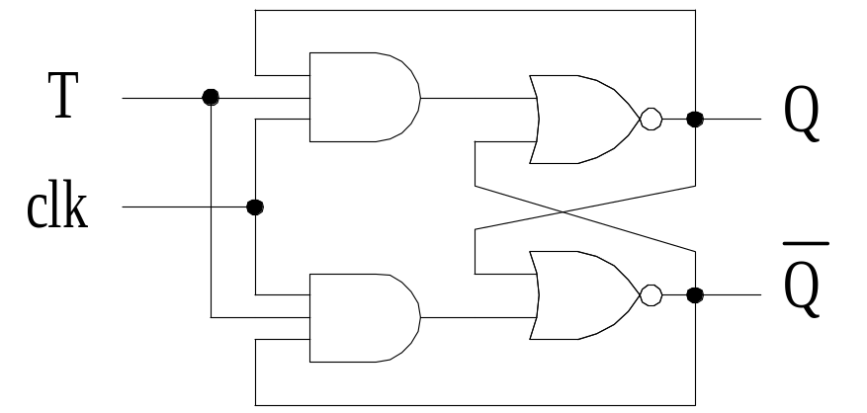
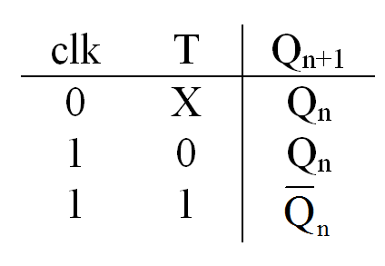
T-type FF
The toggle (T) FF has a clock input which causes the output state changed for each clock pulse if T is in its active state. It is useful in counter design

Slide 17
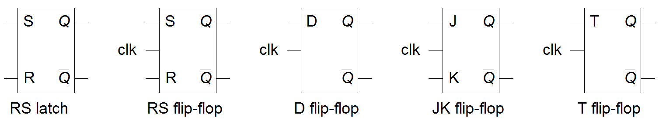
Logic symbols of various latch and flip-flops
SR
SR

Slide 18
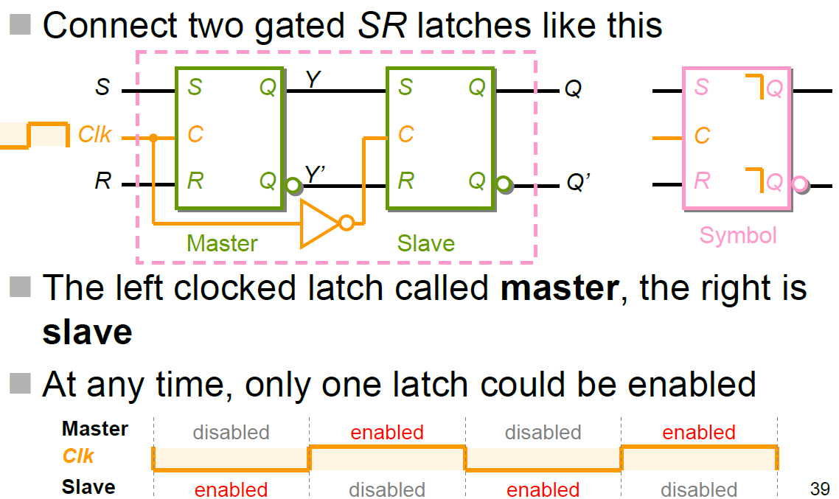
7.3 Master-Slave Flip-Flop
- Master-Slave SR Flip-Flop

Slide 19
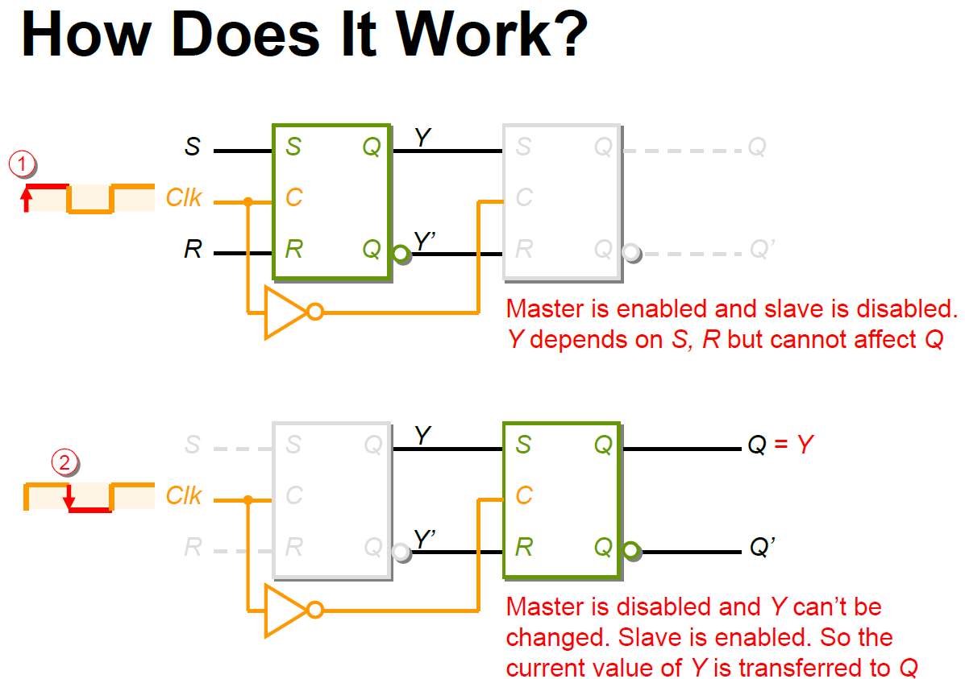

Slide 20
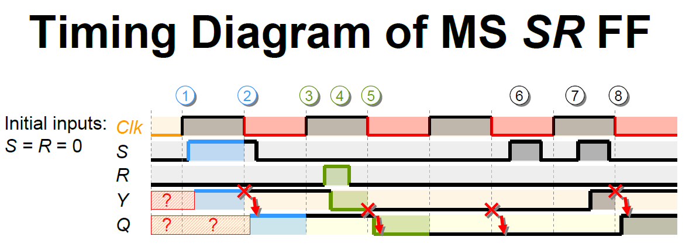
Clk goes to 1, S affects the output of Y (master enabled)
Clk goes to 0, the output of Q is enabled (slave enabled)
Clk goes to 1 again
R goes to 1, Y is 0 (reset enabled)
The new Y is transferred to Q when Clk goes back to 0
Now Clk is 0 (master disabled), so any change in S, R can’t affect Y
S goes to 1, and back to 1, Y set to 1 again
Q follows Y until Clk falls from 1 to 0

Slide 21
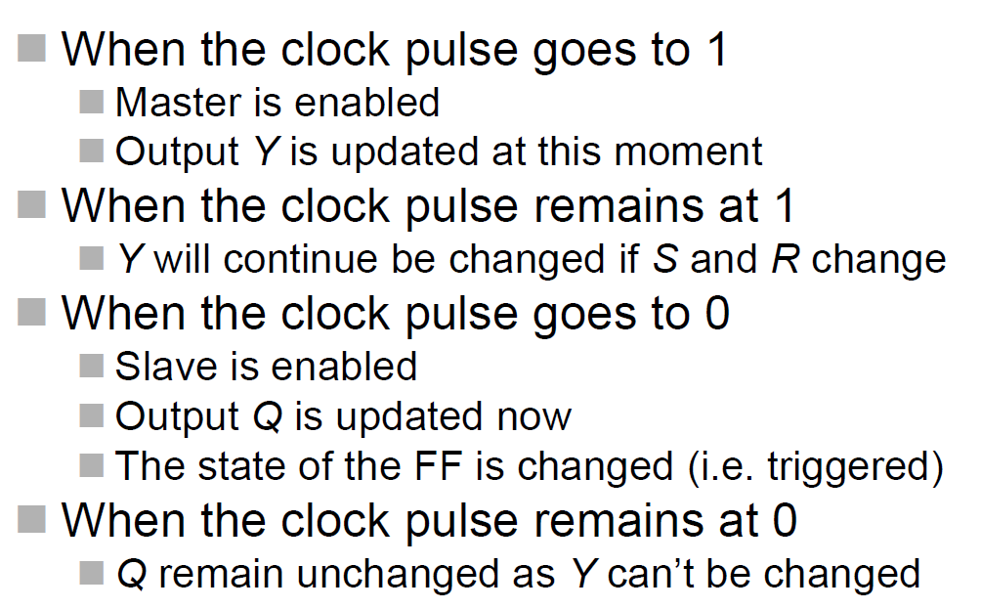
Pulse-Triggered FF
Its behavior depends on:
The rising and the period of the pulse remain at high (Y) and the falling edges (Q)
So referred to as pulse-triggered flip-flops

Slide 22
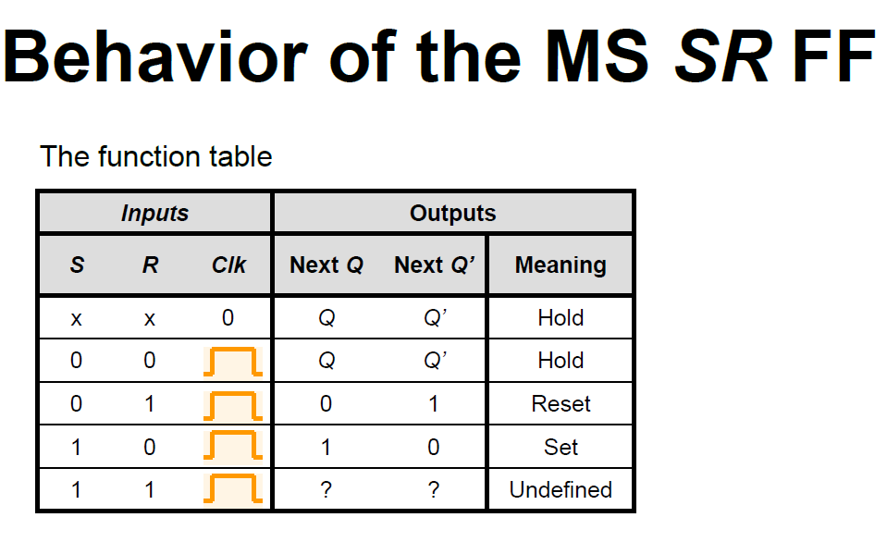

Slide 23
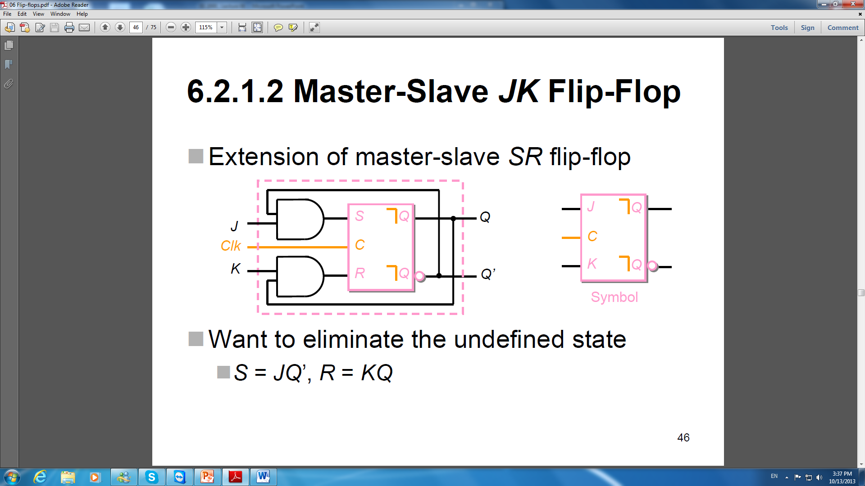
Master-Slave JK Flip-Flop

Slide 24
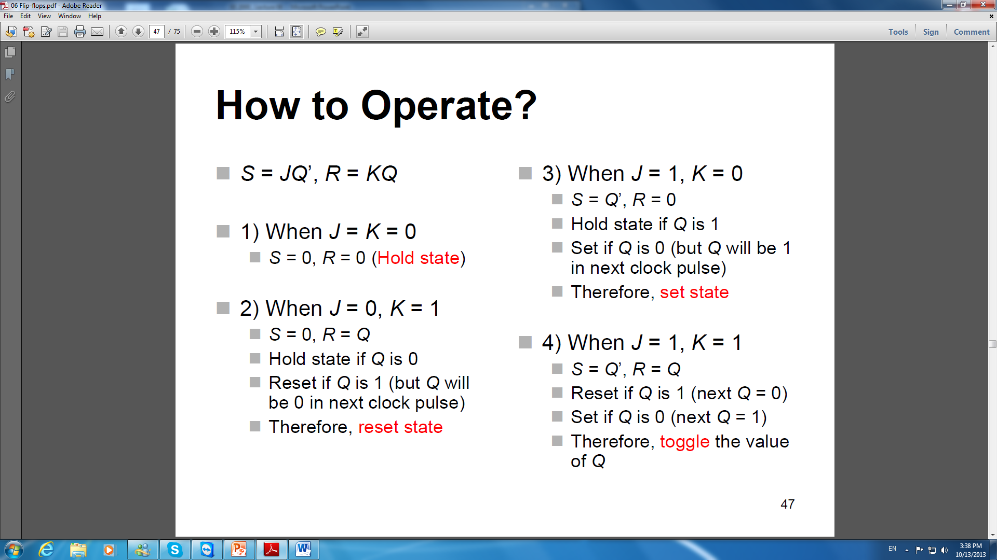

Slide 26
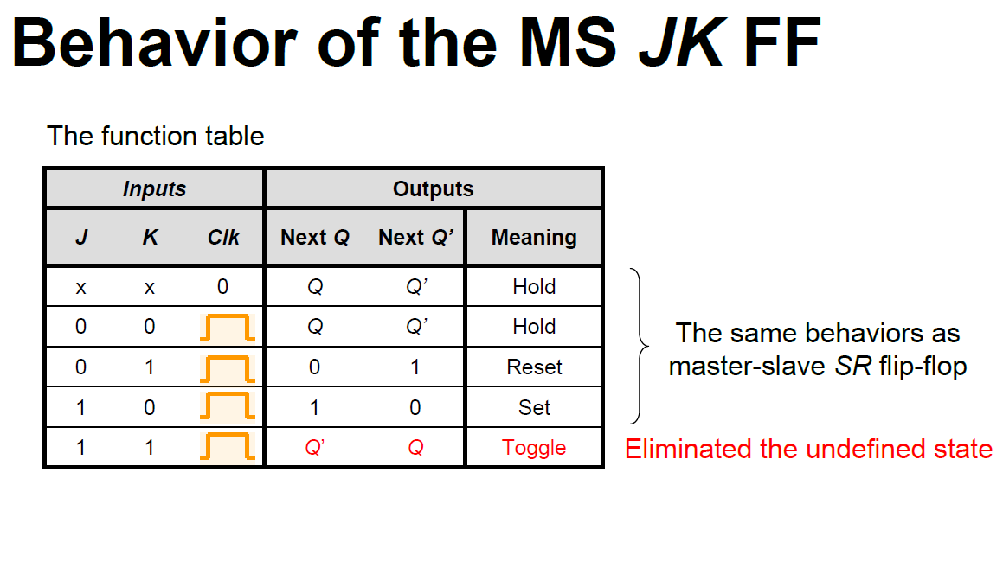

Slide 27
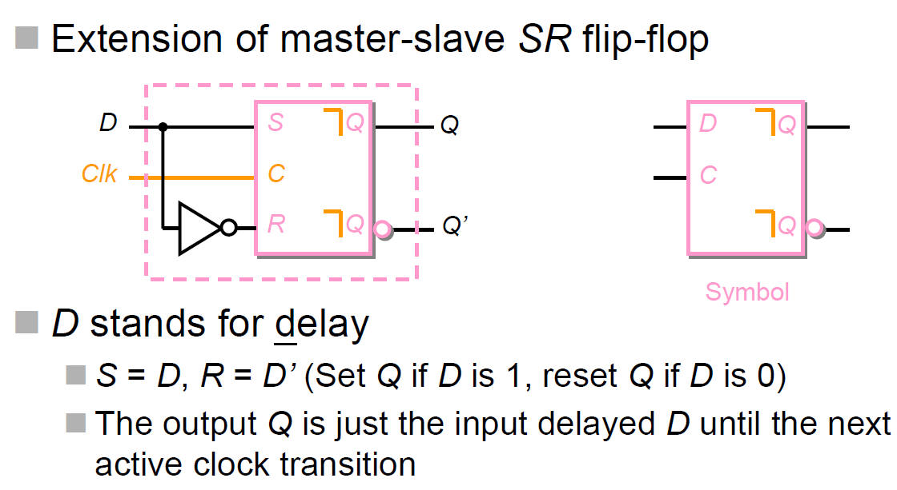
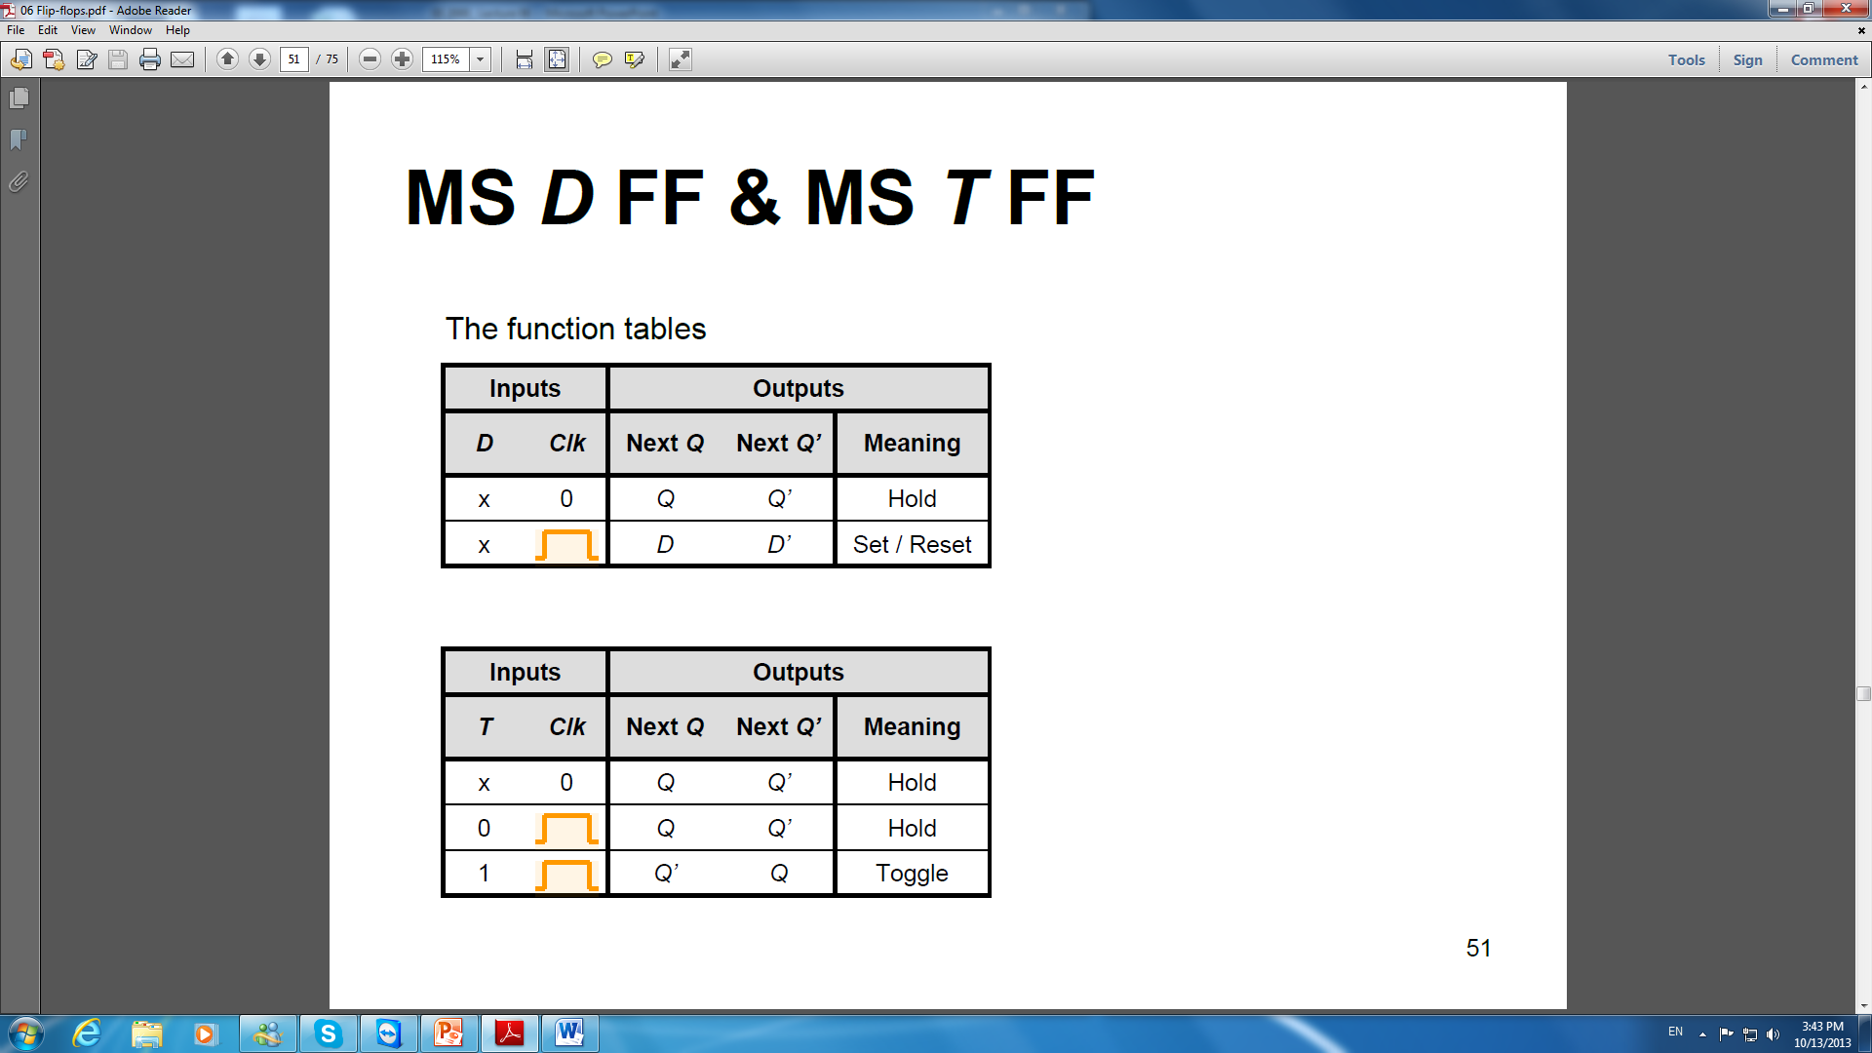
Master-Slave D Flip-Flop

Slide 28
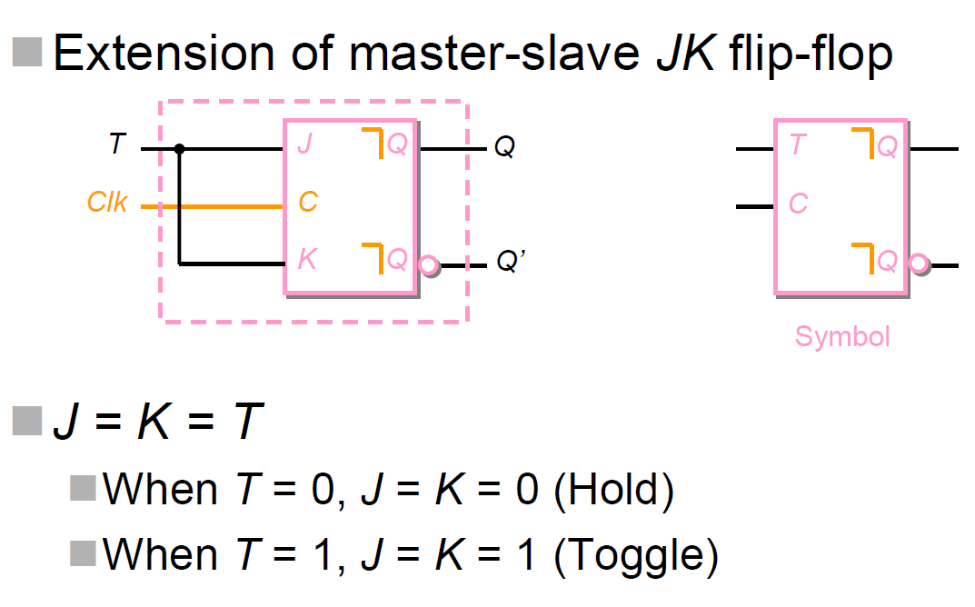
Master-Slave T Flip-Flop

Slide 30
Problems
For MSFF, master is enabled during the period of clock pulse is 1
Undesired behavior produced when inputs values of S and R (or J, K, D, T) change at that period
Better solution: Edge-triggered flip-flops

Slide 31
7.4 Edge-Triggered Flip-Flop
Use one of the edges of the clock signal to read the input values
- either positive or negative transition
- triggering edge
The response to the triggering edge at the output of the flip-flop is almost immediate
The flip-flops remains unresponsive to the input change until the next triggering edge

Slide 32
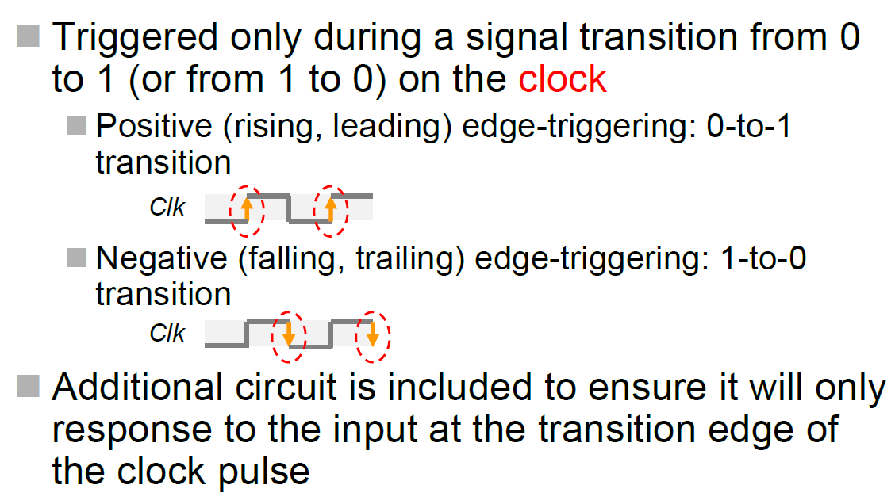
Triggering Edge

Slide 33
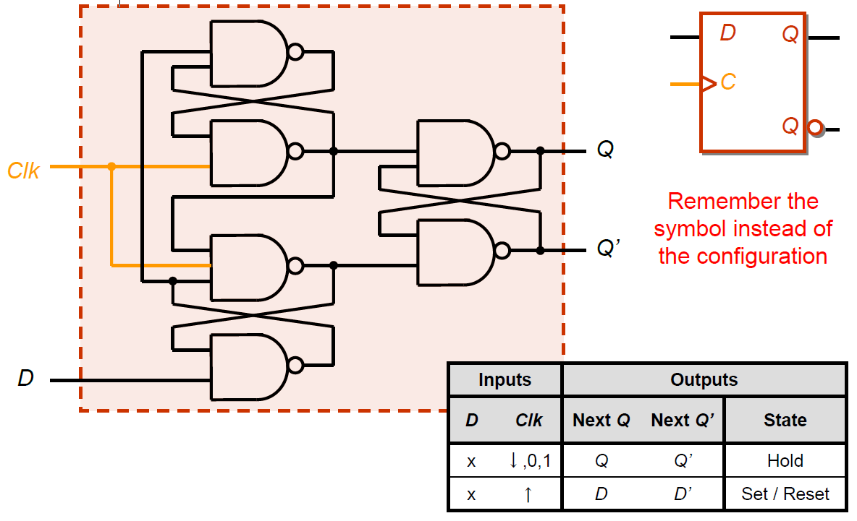
Positive-Edge-Triggered D FF

Slide 34
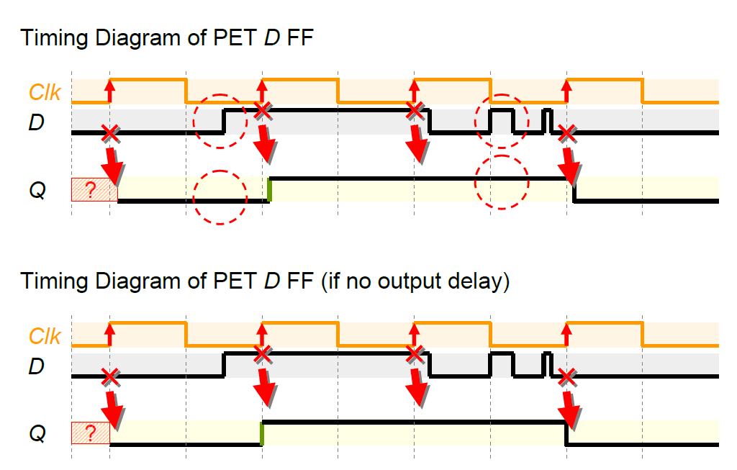
Timing Diagram

Slide 35
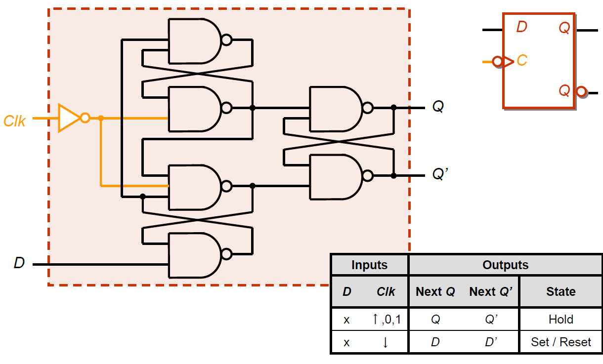
Negative-Edge-Triggered D FF

Slide 36
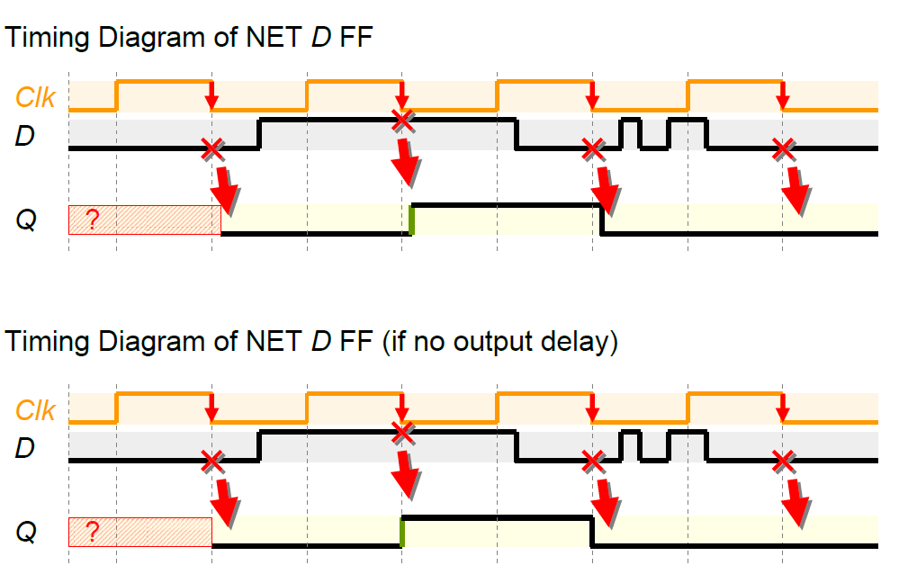
Timing Diagram

Slide 37
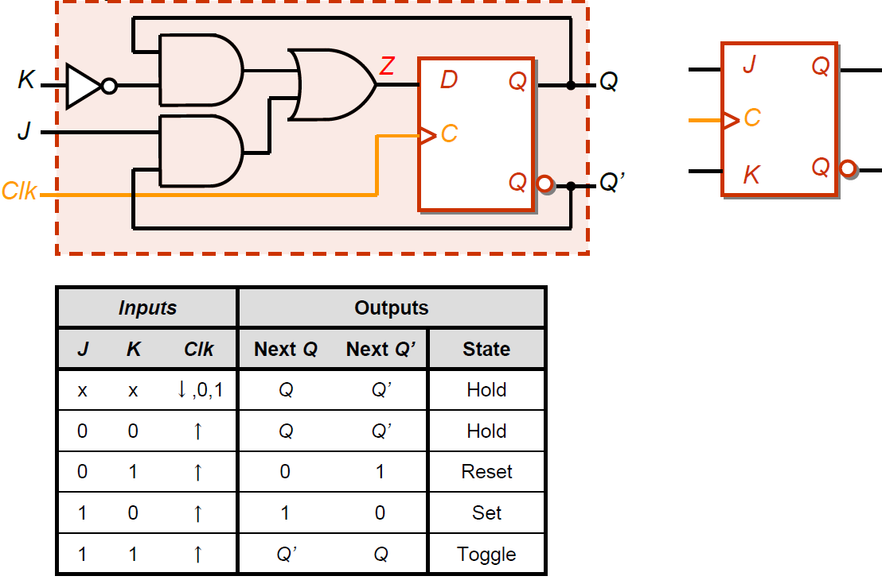
Edge-Triggered JK Flip- Flop

Slide 38
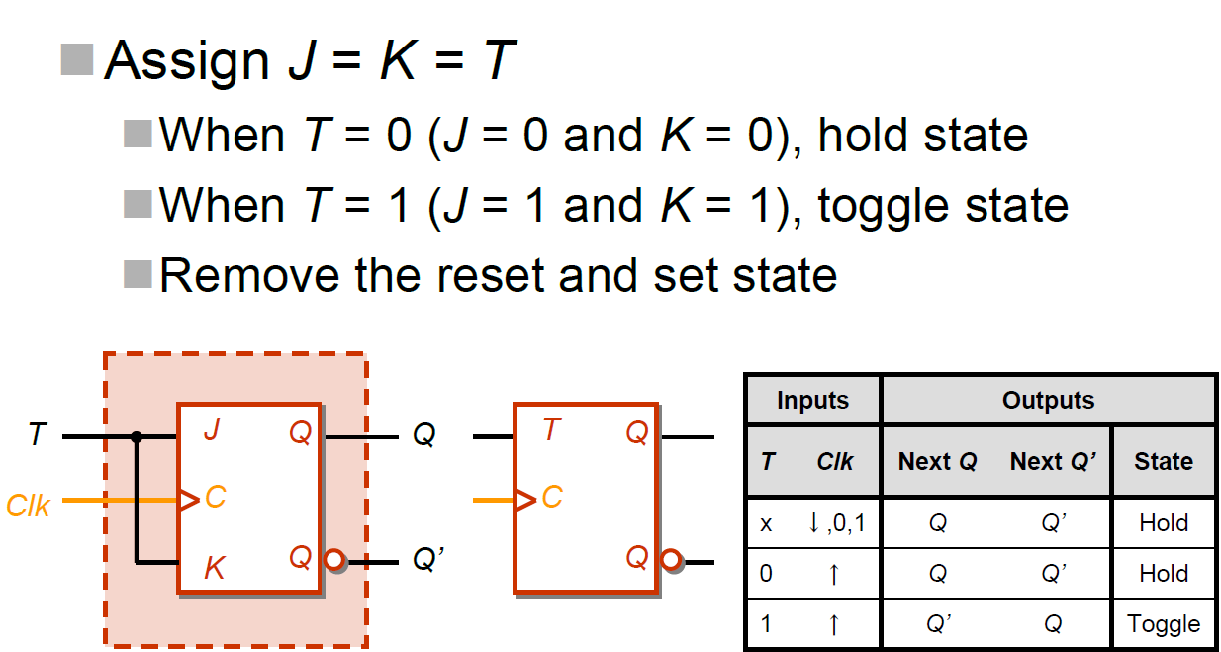
Edge-Triggered T Flip- Flop

Slide 39
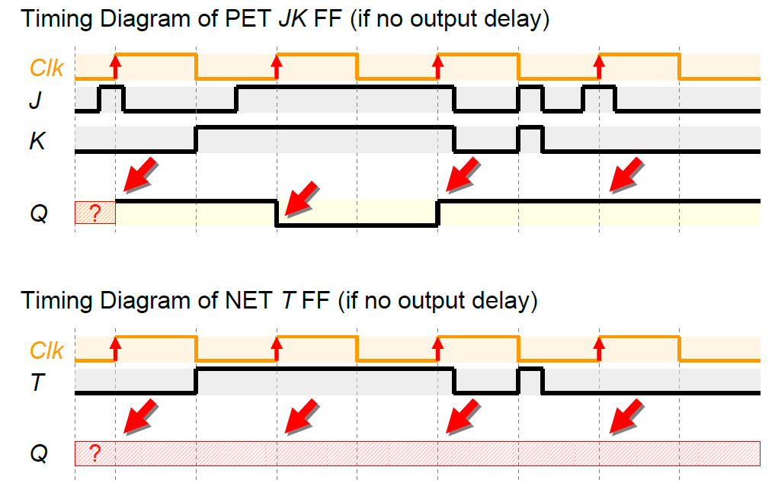
Timing Diagram
PET

Slide 40
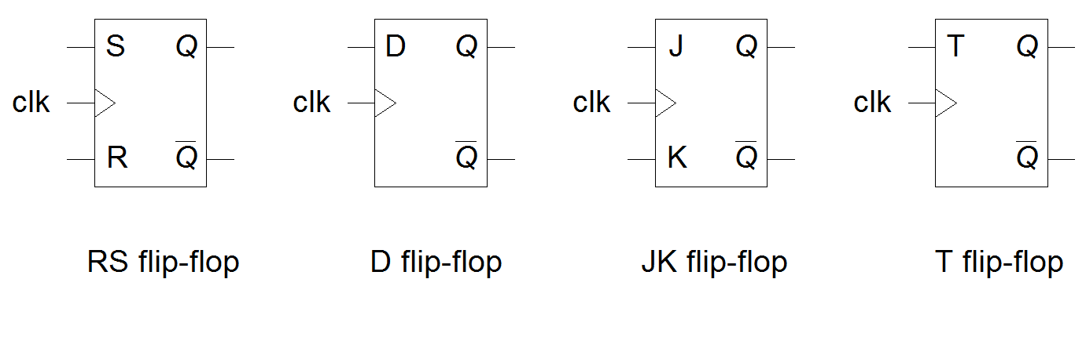
Logic symbols of various edge-triggered flip-flops
SR

Slide 41
7.5 Synchronous and Asynchronous Inputs
Inputs of flip-flops are categorized into two types
Synchronous and asynchronous
All inputs to FFs presented so far are synchronous inputs

Slide 42
Asynchronous Inputs
The output will response to the sync. inputs only if all async. inputs are inactive
Particularly useful for bringing a FF into a desired initial state prior to normal clocked operation
The asynchronous (or direct) inputs usually called - Preset (denoted by PRE) and clear (denoted CLR)
- Used to forcibly set and reset the state of flip-flop

Slide 43
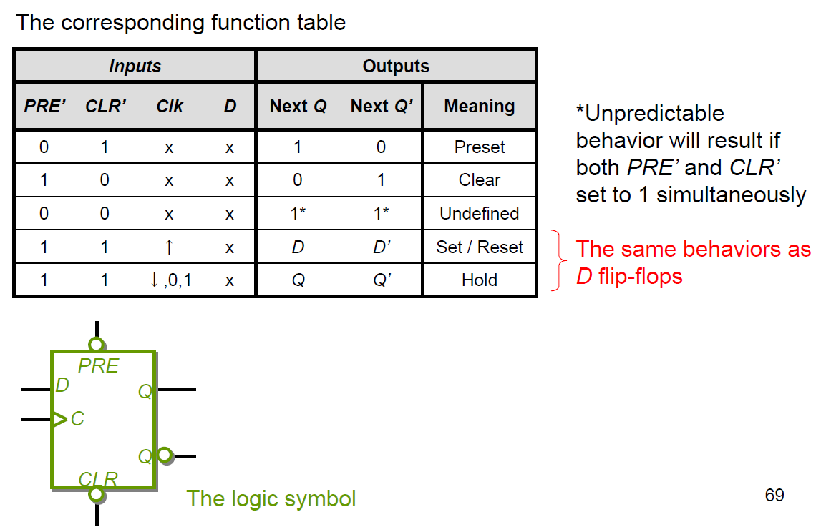
Example

Slide 44
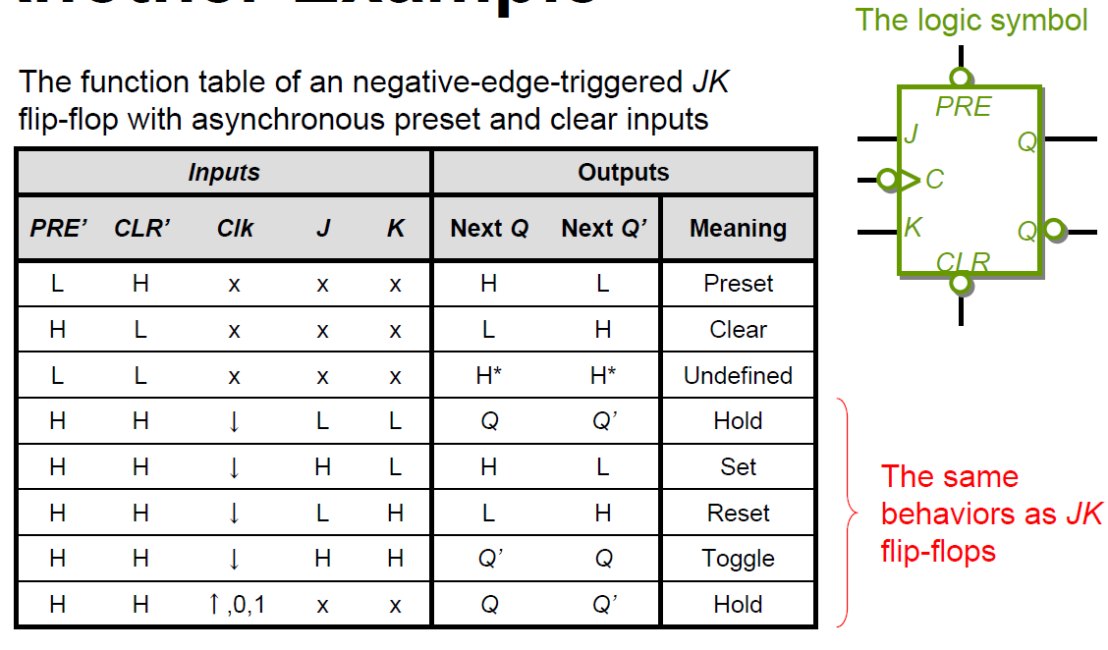
Example

Slide 45
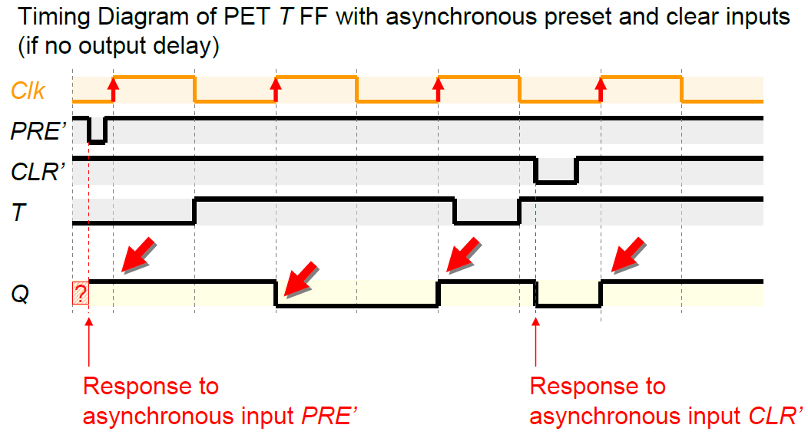
Timing Diagram

Slide 46
Summary
Flip-flips as memory elements
- To store the value in Q
- One FF can store 1-bit data
Different types of FFs
- SR-type, D-type, JK-type, T-type
- By controlling the inputs (S, R, D, J, K, T) to change, set, reset or hold the value of Q
Different Triggering Methods
- Pulse-triggered
- Edge-triggered

