Slide 1
EE 3114 Systems and Control
9. Controllability and Observability
Semester B, 2018-19

Slide 2
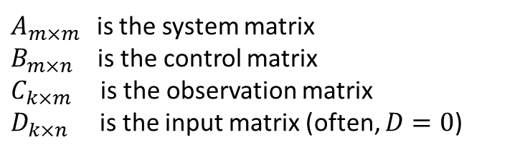
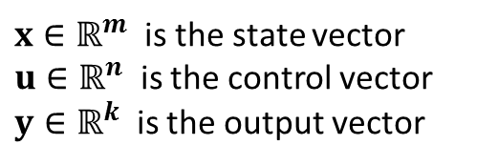


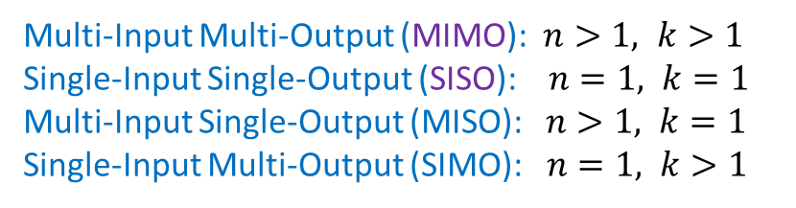
LTI State-Space Systems
$$\dot{x}=Ax+Bu$$
$$y=Cx+Du$$
$x∈ℝ^{m}$ is the state vector
$u∈ℝ^{n}$ is the control vector
$y∈ℝ^{k}$ is the output vector
$A_{m×m }$ is the system matrix
$B_{m×n}$ is the control matrix
$C_{k×m }$ is the observation matrix
$D_{k×n}$ is the input matrix (often, $D=0$)
Multi-Input Multi-Output (MIMO): $n>1, k>1$
Single-Input Single-Output (SISO): $n=1, k=1$
Multi-Input Single-Output (MISO): $n>1, k=1$
Single-Input Multi-Output (SIMO): $n=1, k>1$

Slide 3




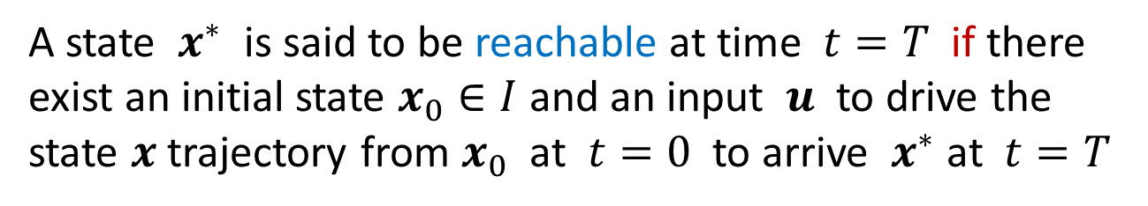

Reachability
Given an LTI system: $\dot{x}=Ax+Bu$
Given a set of initial states: $I=\{x\left(0\right)\}$
A state $x^{∗}$ is said to be reachable at time $t=T$ if there exist an initial state $x_{0}∈I$ and an input $u$ to drive the state $x$ trajectory from $x_{0}$ at $t=0$ to arrive $x^{∗}$ at $t=T$
$$x^{∗}$$
$$x_{0}$$

Slide 4
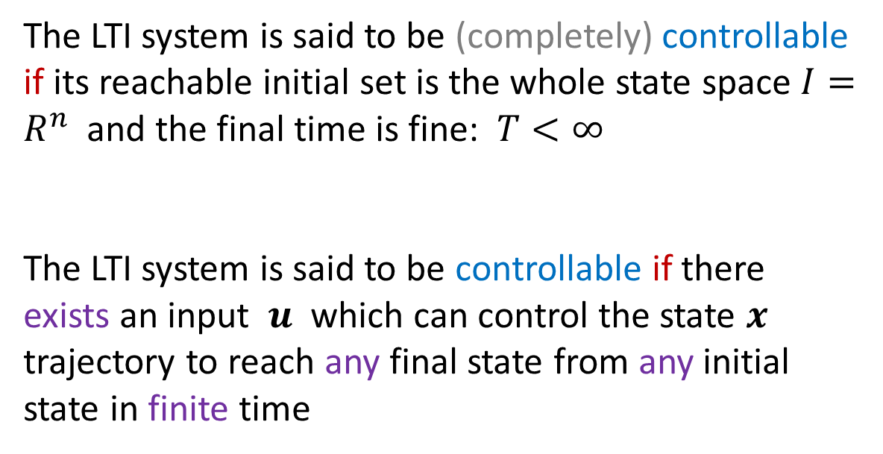

Controllability
Given an LTI system: $\dot{x}=Ax+Bu$
Given a set of initial states: $I=\{x\left(0\right)\}$
The LTI system is said to be (completely) controllable if its reachable initial set is the whole state space $I=R^{n}$ and the final time is fine: $T<∞$
The LTI system is said to be controllable if there exists an input $u$ which can control the state $x$ trajectory to reach any final state from any initial state in finite time

Slide 5
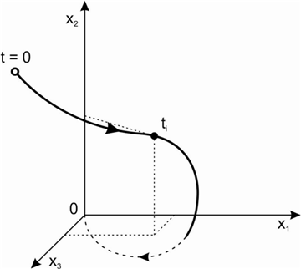
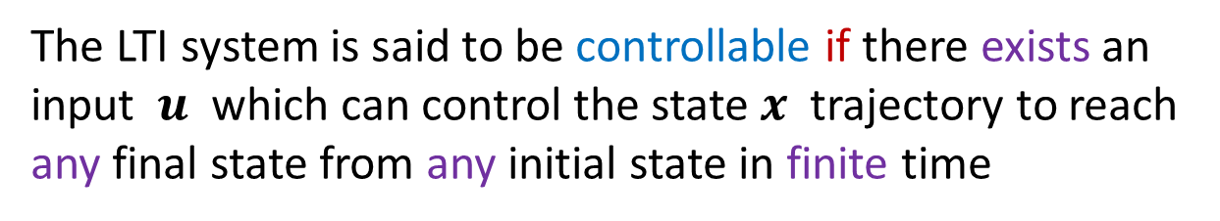


Controllability
The LTI system is said to be controllable if there exists an input $u$ which can control the state $x$ trajectory to reach any final state from any initial state in finite time
$$T_{1}<∞$$
$$T_{2}<∞$$

Slide 6

Controllability
Consider LTI system $\dot{x}=Ax+Bu$, with $A_{n×n}$and $B_{n×m}$
Theorem
LTI system $\dot{x}=Ax+Bu$ is controllable if and only if
Matrix $[B AB A^{2}B A^{3}B⋯A^{n−1}B ]$ has full row rank
(Proof given below)
Example:
$A= \left[\begin{matrix}1 & 0 \\ 0 & 1\end{matrix}\right]$ and $B=\left[\begin{matrix}0 & 1 \\ 1 & 0\end{matrix}\right]$ → $\left[B AB\right]=\left[\begin{matrix}0 & 1 \\ 1 & 0\end{matrix} \begin{matrix}0 & 1 \\ 1 & 0\end{matrix}\right]$
(Full row rank)
This LTI system $(A,B)$ is controllable

Slide 7
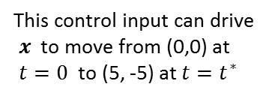

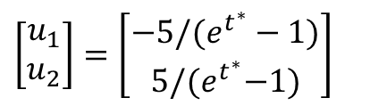
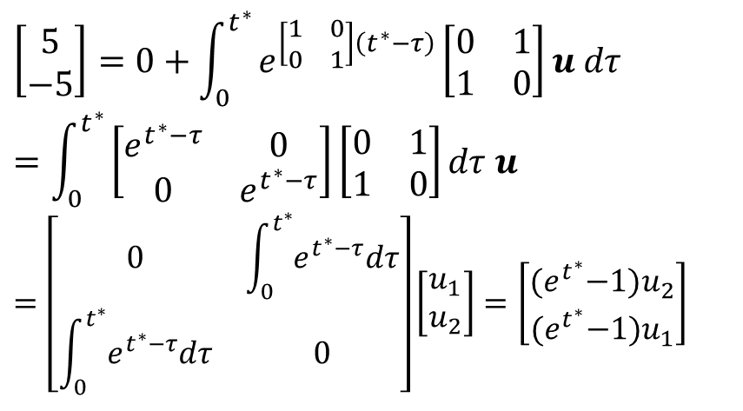


Example:
$A= \left[\begin{matrix}1 & 0 \\ 0 & 1\end{matrix}\right]$ and $B=\left[\begin{matrix}0 & 1 \\ 1 & 0\end{matrix}\right]$ → $\left[B AB\right]=\left[\begin{matrix}0 & 1 \\ 1 & 0\end{matrix} \begin{matrix}0 & 1 \\ 1 & 0\end{matrix}\right]$
(Full row-rank)
This LTI system $(A,B)$ is controllable
Q: Can the state $x(t)$ of this system go, say, from (0,0) to (5, -5) ?
A: Yes, even for constant control input $u=\left[\begin{matrix}u_{1} \\ u_{2}\end{matrix}\right]$
$x\left(t^{∗}\right)$ = $e^{At^{∗}}x\left(0\right)+\int_{0}^{t^{∗}}{e^{A\left(t^{∗}−τ\right)}Budτ}$
$$\left[\begin{matrix}5 \\ −5\end{matrix}\right]=0+\int_{0}^{t^{∗}}{e^{\left[\begin{matrix}1 & 0 \\ 0 & 1\end{matrix}\right]\left(t^{∗}−τ\right)}\left[\begin{matrix}0 & 1 \\ 1 & 0\end{matrix}\right]}u dτ$$
$$=\int_{0}^{t^{∗}}{\left[\begin{matrix}e^{t^{∗}−τ} & 0 \\ 0 & e^{t^{∗}−τ}\end{matrix}\right]\left[\begin{matrix}0 & 1 \\ 1 & 0\end{matrix}\right]dτ u}$$
$$=\left[\begin{matrix}0 & \int_{0}^{t^{∗}}{e^{t^{∗}−τ}dτ} \\ \int_{0}^{t^{∗}}{e^{t^{∗}−τ}dτ} & 0\end{matrix}\right]\left[\begin{matrix}u_{1} \\ u_{2}\end{matrix}\right]=\left[\begin{matrix}{(e}^{t^{∗}}−1)u_{2} \\ {(e}^{t^{∗}}−1)u_{1}\end{matrix}\right]$$
$$\left[\begin{matrix}u_{1} \\ u_{2}\end{matrix}\right]=\left[\begin{matrix}{−5/(e}^{t^{∗}}−1) \\ 5{/(e}^{t^{∗}}−1)\end{matrix}\right]$$
This control input can drive $x$ to move from (0,0) at $t=0$ to (5, -5) at $t=t^{∗}$

Slide 8
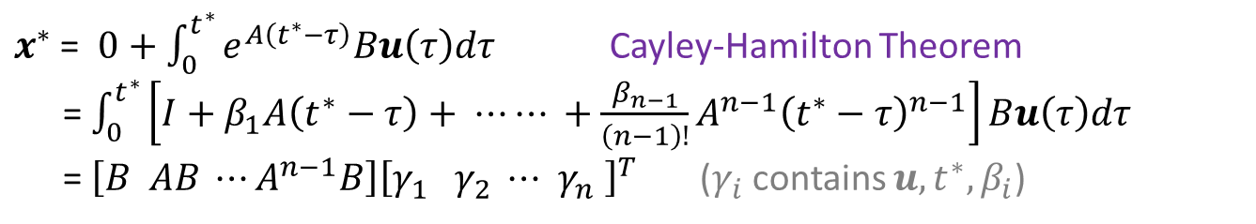
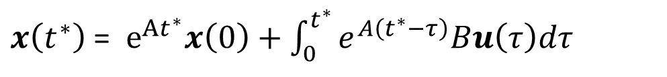

Theorem
LTI system $\dot{x}=Ax+Bu$ is controllable if and only if
Matrix $[B AB A^{2}B A^{3}B⋯A^{n−1}B ]$ has full row rank
Proof:
Starting, say, from $x\left(0\right)=0$ going to any $x^{∗}$ at $t=t^{∗}$
$x\left(t^{∗}\right)$ = $e^{At^{∗}}x\left(0\right)+\int_{0}^{t^{∗}}{e^{A\left(t^{∗}−τ\right)}Bu\left(τ\right)dτ}$
$x^{∗}$ = $0+\int_{0}^{t^{∗}}{e^{A\left(t^{∗}−τ\right)}Bu\left(τ\right)dτ}$ Cayley-Hamilton Theorem
= $\int_{0}^{t^{∗}}{\left[I+β_{1}A\left(t^{∗}−τ\right)+ ⋯⋯ +{\frac{β_{n−1}}{\left(n−1\right)!}A}^{n−1}{\left(t^{∗}−τ\right)}^{n−1}\right]Bu\left(τ\right)dτ}$
= $\left[B AB ⋯A^{n−1}B\right]{\left[γ_{1} γ_{2} ⋯{ γ}_{n} \right]}^{T}$ ($γ_{i}$contains $u, t^{∗},β_{i}$)
This has a solution $\left(u, t^{∗}\right)$if and only if $[B AB⋯A^{n−1}B]$ has full row rank

Slide 9
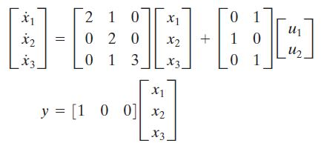
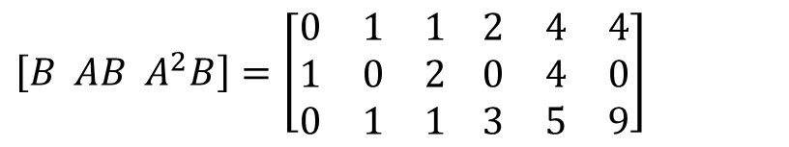
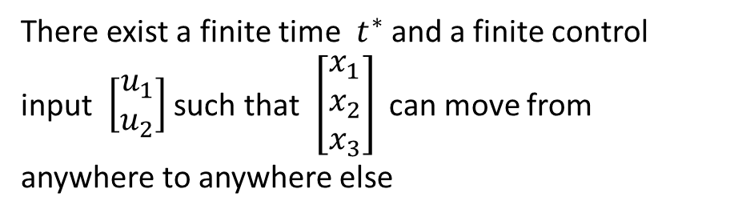
Example:
$$\left[B AB A^{2}B\right]=\left[\begin{matrix}0 & 1 & 1 \\ 1 & 0 & 2 \\ 0 & 1 & 1\end{matrix} \begin{matrix}2 & 4 & 4 \\ 0 & 4 & 0 \\ 3 & 5 & 9\end{matrix}\right]$$
(Full row rank)
Controllable
There exist a finite time $t^{∗}$ and a finite control input $\left[\begin{matrix}u_{1} \\ u_{2}\end{matrix}\right]$ such that $\left[\begin{matrix}x_{1} \\ x_{2} \\ x_{3}\end{matrix}\right]$ can move from anywhere to anywhere else

Slide 10
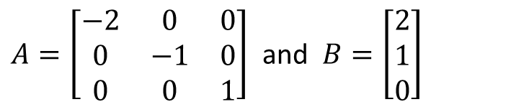
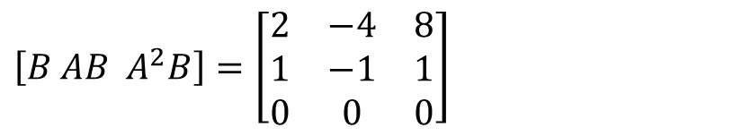
Not all systems are controllable
Example:
$A=\left[\begin{matrix}−2 & 0 & 0 \\ 0 & −1 & 0 \\ 0 & 0 & 1\end{matrix}\right]$ and $B=\left[\begin{matrix}2 \\ 1 \\ 0\end{matrix}\right]$
$$\left[B AB A^{2}B\right]=\left[\begin{matrix}2 & −4 & 8 \\ 1 & −1 & 1 \\ 0 & 0 & 0\end{matrix}\right]$$
(Not full row-rank)
Uncontrollable

Slide 11
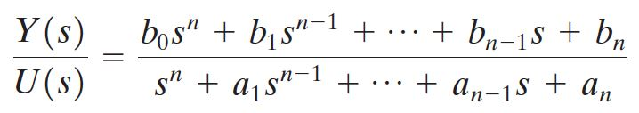
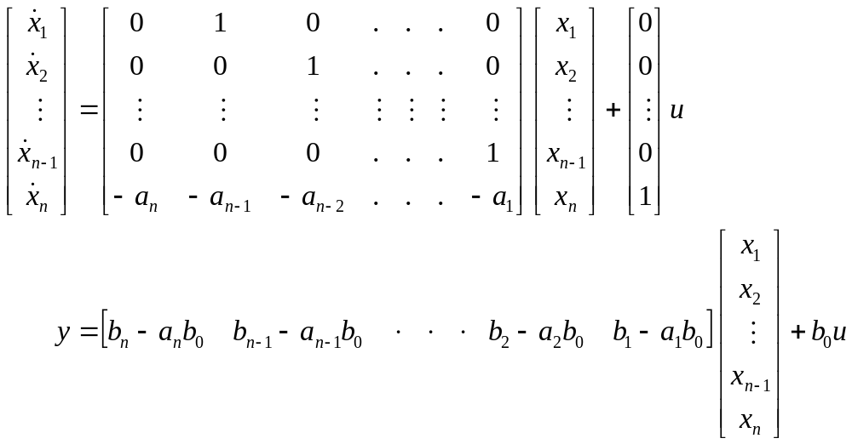
Controllability Canonical Form (1)
Note: Both controllable and uncontrollable SISO systems can be into such “controllability canonical form”

Slide 12
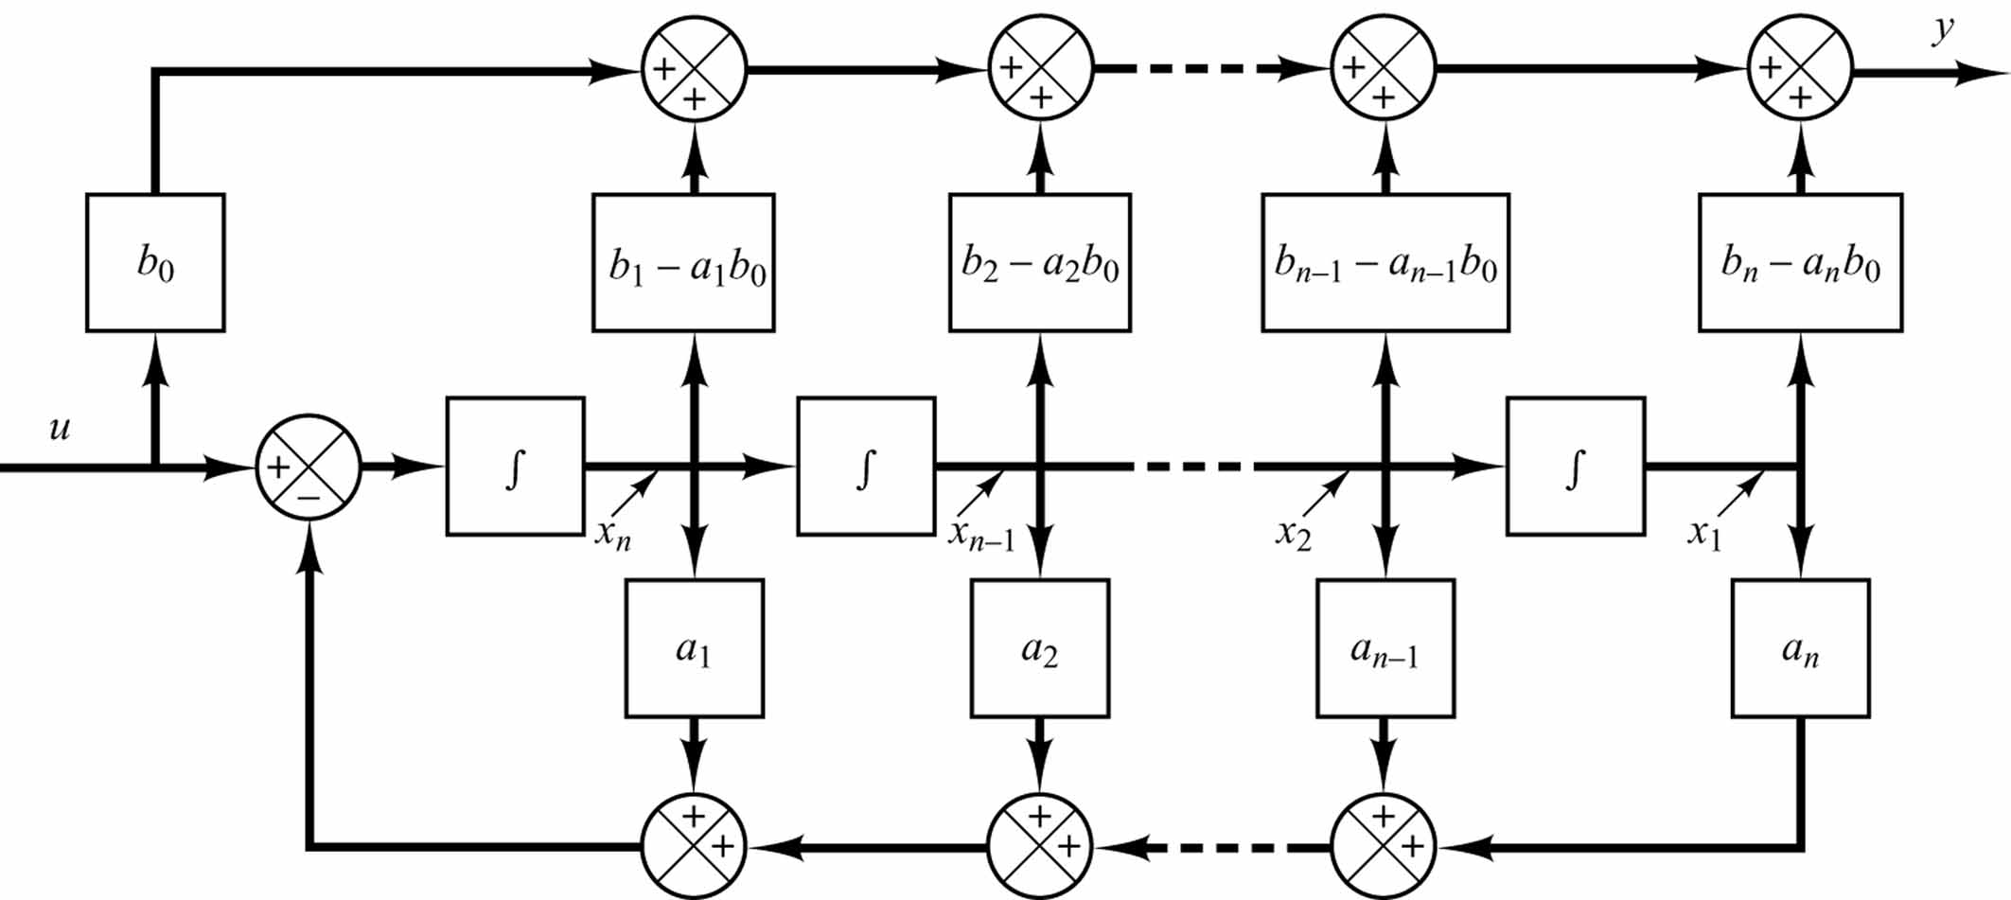
Block diagram representation of the system
-- Controllability canonical form (1)

Slide 13
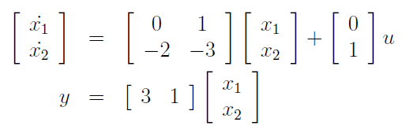
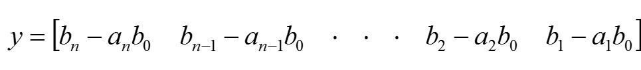
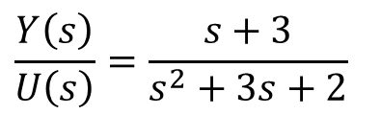
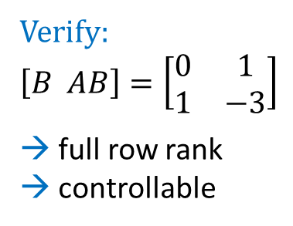
Example:
$$\frac{Y\left(s\right)}{U\left(s\right)}=\frac{s+3}{s^{2}+3s+2}$$
$$n=2, { a}_{2}=2, { a}_{1}=3, b_{2}=3, b_{2}=1$$
Verify:
$$\left[B AB\right]=\left[\begin{matrix}0 & 1 \\ 1 & −3\end{matrix}\right]$$
→ full row rank
→ controllable
Recall:

Slide 14
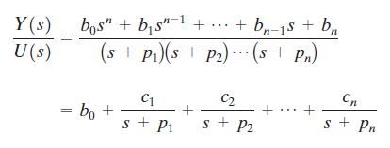
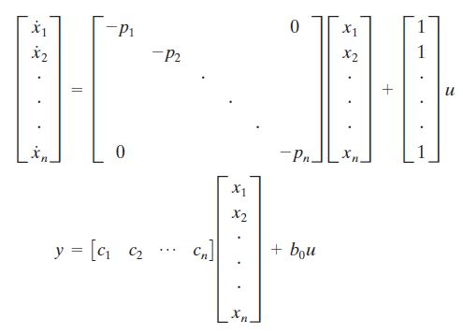
Controllability Canonical Form (2)
Diagonal Canonical Form
(with single real poles)

Slide 15
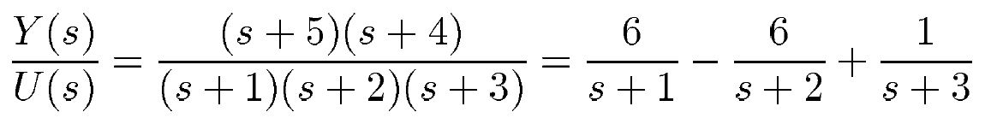
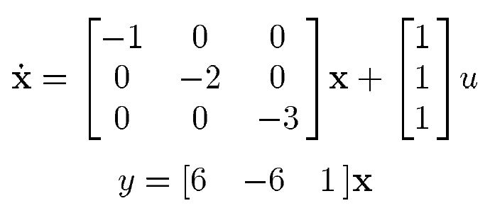
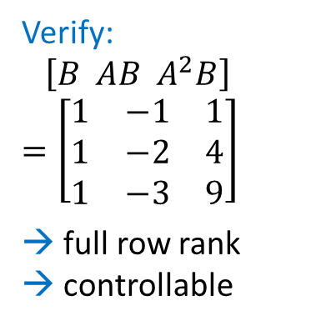
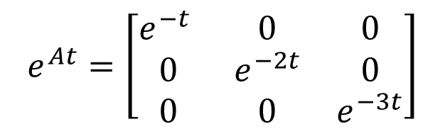
Example:
Verify:
$\left[B AB A^{2}B\right]$
$$=\left[\begin{matrix}1 & −1 & 1 \\ 1 & −2 & 4 \\ 1 & −3 & 9\end{matrix}\right]$$
→ full row rank
→ controllable
Recall (Advantage):
$$e^{At}=\left[\begin{matrix}e^{−t} & 0 & 0 \\ 0 & e^{−2t} & 0 \\ 0 & 0 & e^{−3t}\end{matrix}\right]$$

Slide 16


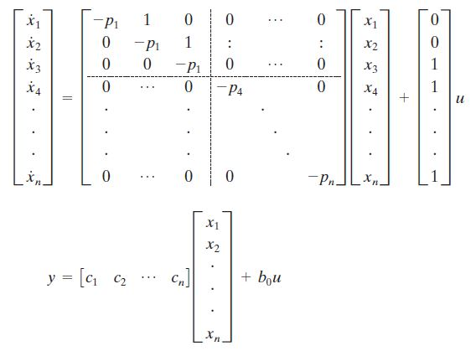
Controllability Canonical Form (3)
Jordan Canonical Form
(with multiple real poles)

Slide 17
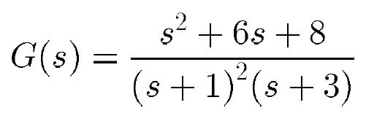
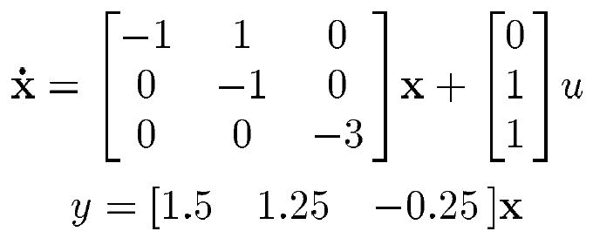
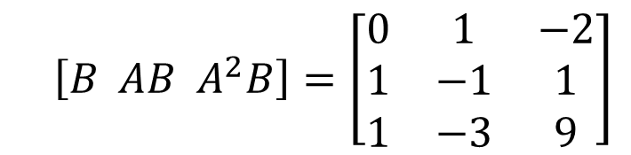
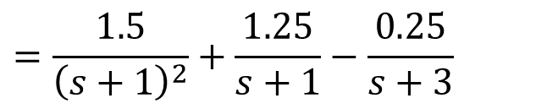
Example:
$$=\frac{1.5}{{\left(s+1\right)}^{2}}+\frac{1.25}{s+1}−\frac{0.25}{s+3}$$
$\left[B AB A^{2}B\right]=\left[\begin{matrix}0 & 1 & −2 \\ 1 & −1 & 1 \\ 1 & −3 & 9\end{matrix}\right]$
→ full row rank
→ controllable

Slide 18

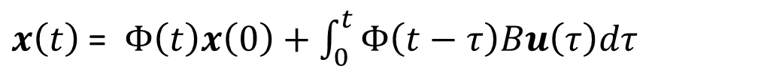
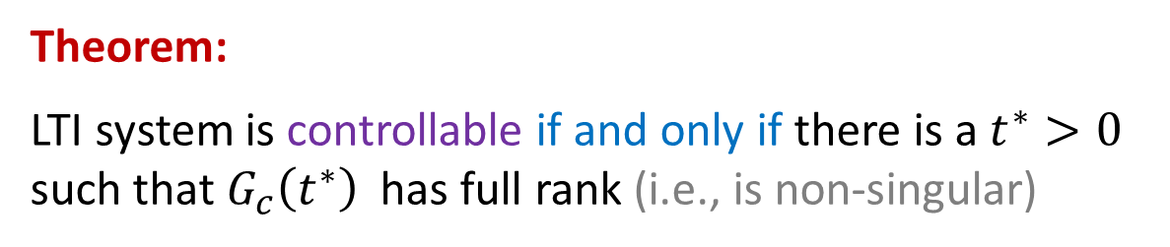
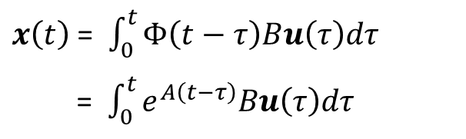
Gramian Controllability Condition
Recall:
$x\left(t\right)$ = $Φ\left(t\right)x\left(0\right)+\int_{0}^{t}{Φ\left(t−τ\right)Bu\left(τ\right)dτ}$
For simplicity, let $x\left(0\right)=0$
$x\left(t\right)$ = $\int_{0}^{t}{Φ\left(t−τ\right)Bu\left(τ\right)dτ}$
= $\int_{0}^{t}{e^{A\left(t−τ\right)}Bu\left(τ\right)dτ}$
Gramian Matrix:
$G_{c}(t^{∗})=\int_{0}^{t^{∗}}{e^{A\left(t^{∗}−τ\right)}BB^{T}e^{A^{T}\left(t^{∗}−τ\right)}dτ}$ $(n×n)$
Theorem:
LTI system is controllable if and only if there is a $t^{∗}>0$ such that $G_{c}\left(t^{∗}\right)$ has full rank (i.e., is non-singular)

Slide 19

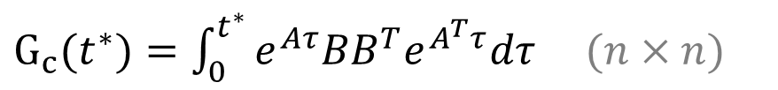
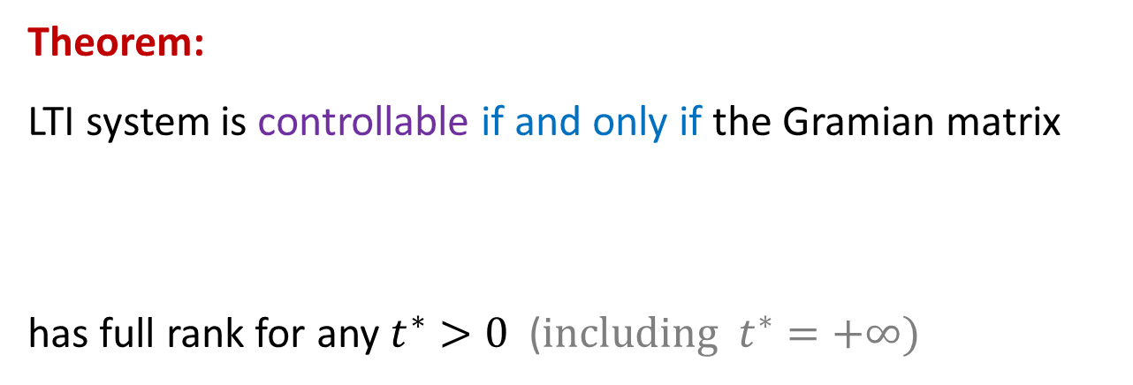

LTI State-Space Systems
$$\dot{x}=Ax+Bu$$
$$y=Cx+Du$$
Theorem:
LTI system is controllable if and only if the Gramian matrix
has full rank for any $t^{∗}>0$ ($including t^{∗}=+∞)$
$G_{c}(t^{∗})=\int_{0}^{t^{∗}}{e^{Aτ}BB^{T}e^{A^{T}τ}dτ}$ $(n×n)$

Slide 20
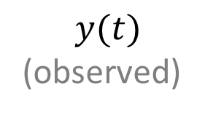


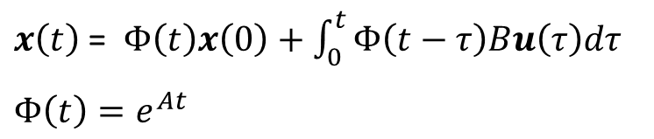
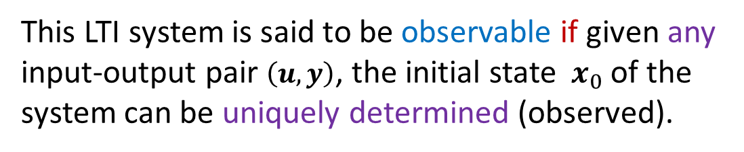



Observability
Consider LTI system
$$\dot{x}=Ax+Bu$$
$x\left(t\right)$ = $Φ\left(t\right)x\left(0\right)+\int_{0}^{t}{Φ\left(t−τ\right)Bu\left(τ\right)dτ}$
$$Φ\left(t\right)=e^{At}$$
$$y=Cx+Du$$
This LTI system is said to be observable if given any input-output pair $\left(u, y\right)$, the initial state $x_{0}$of the system can be uniquely determined (observed).
$$u(t)$$
$$x(t)$$
System
(Test input signal)
$x_{0}= ?$
$$y(t)$$
(observed)

Slide 21

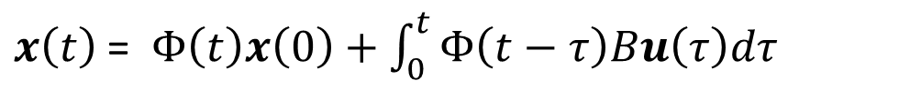

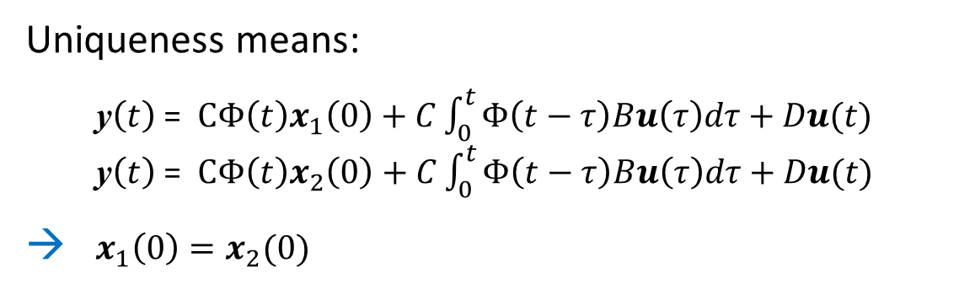
Observability
$x\left(t\right)$ = $Φ\left(t\right)x\left(0\right)+\int_{0}^{t}{Φ\left(t−τ\right)Bu\left(τ\right)dτ}$
$$y\left(t\right)=Cx\left(t\right)+Du(t)$$
Uniqueness means:
y$\left(t\right)$ = $CΦ\left(t\right)x_{1}\left(0\right)+C\int_{0}^{t}{Φ\left(t−τ\right)Bu\left(τ\right)dτ+Du(t)}$
y$\left(t\right)$ = $CΦ\left(t\right)x_{2}\left(0\right)+C\int_{0}^{t}{Φ\left(t−τ\right)Bu\left(τ\right)dτ+Du(t)}$
→ $x_{1}\left(0\right)=x_{2}(0)$
Condition:
There exists $t^{∗}>0$ such that $CΦ\left(t^{∗}\right)$ has full column rank
(Proof on next page)

Slide 22
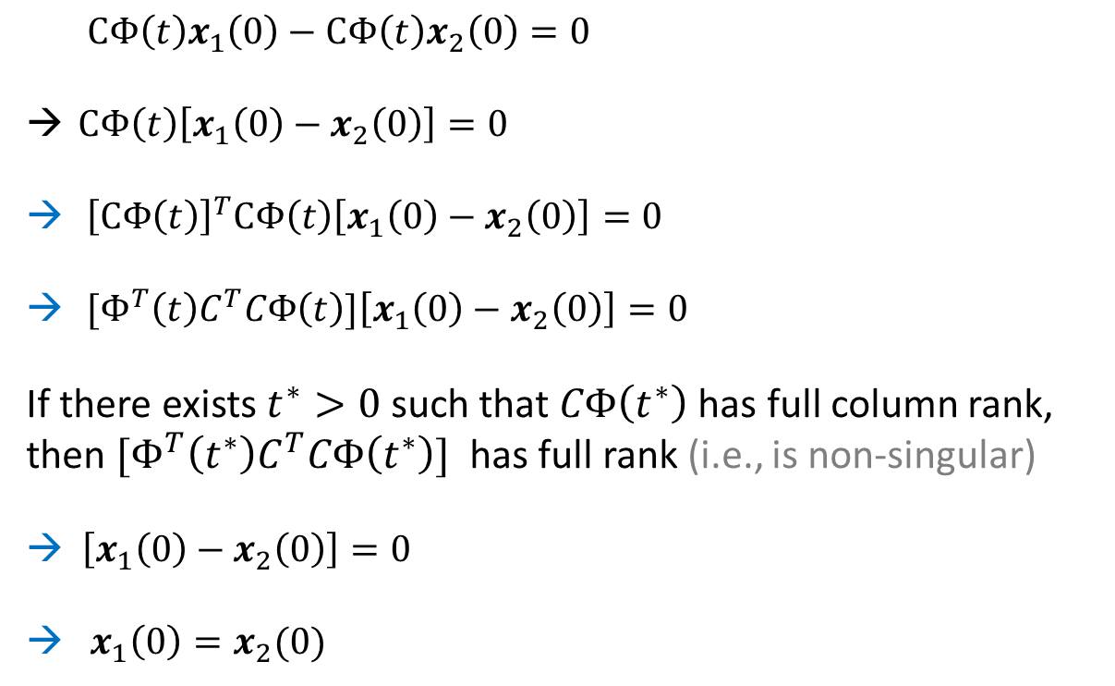
Proof:
Subtraction
$CΦ\left(t\right)x_{1}\left(0\right)−CΦ\left(t\right)x_{2}\left(0\right)=0$
$CΦ\left(t\right)\left[x_{1}\left(0\right)−x_{2}\left(0\right)\right]=0$
${\left[CΦ\left(t\right)\right]}^{T}CΦ\left(t\right)\left[x_{1}\left(0\right)−x_{2}\left(0\right)\right]=0$
${[Φ}^{T}\left(t\right)C^{T}CΦ\left(t\right)]\left[x_{1}\left(0\right)−x_{2}\left(0\right)\right]=0$
If there exists $t^{∗}>0$ such that $CΦ\left(t^{∗}\right)$ has full column rank, then ${[Φ}^{T}\left(t^{∗}\right)C^{T}CΦ\left(t^{∗}\right)]$ has full rank (i.e., is non-singular)
→ $\left[x_{1}\left(0\right)−x_{2}\left(0\right)\right]=0$
→ $x_{1}\left(0\right)=x_{2}(0)$

Slide 23


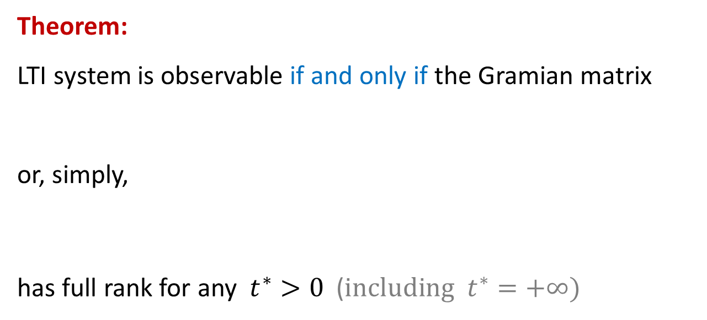

LTI State-Space Systems
$$\dot{x}=Ax+Bu$$
$$Φ\left(t−τ\right)=e^{A(t−τ)}$$
$$y=Cx+Du$$
Theorem:
LTI system is observable if and only if the Gramian matrix
or, simply,
has full rank for any $t^{∗}>0$ ($including t^{∗}=+∞)$
$G_{o}(t^{∗})=\int_{0}^{t^{∗}}{e^{A^{T}(t^{∗}−τ)}{C^{T}Ce}^{A(t^{∗}−τ)}dτ}$ $(n×n)$
$G_{o}(t^{∗})=\int_{0}^{t^{∗}}{e^{A^{T}τ}{C^{T}Ce}^{Aτ}dτ}$ $(n×n)$

Slide 24

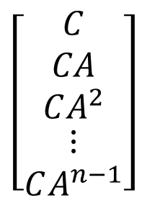

LTI State-Space Systems
$$\dot{x}=Ax+Bu$$
$$y=Cx+Du$$
Theorem
LTI system (A, B, C, D) is observable if and only if
$$\left[\begin{matrix}C \\ CA \\ \begin{aligned}CA^{2} \\ \begin{matrix}⋮ \\ CA^{n−1}\end{matrix}\end{aligned}\end{matrix}\right]$$
Matrix has full column rank
(Proof is similar to the controllability condition above)

Slide 25

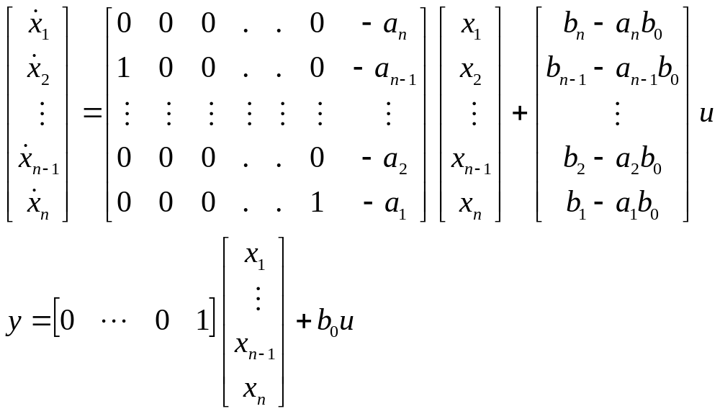
Observability Canonical Form
Note: Similarly to controllability canonical forms, there are other observability canonical forms

Slide 26
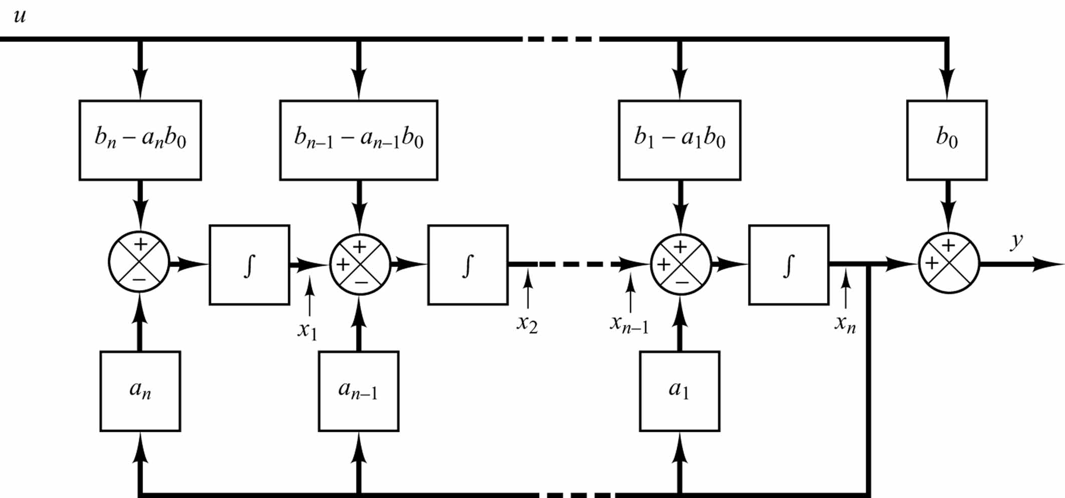
Block Diagram Representation
(Observability Canonical Form)

Slide 27




Example:
$$\frac{Y\left(s\right)}{U\left(s\right)}=\frac{s+3}{s^{2}+3s+2}$$
$\left[\begin{matrix}C \\ CA\end{matrix}\right]=\left[\begin{matrix}0 & 1 \\ 1 & −3\end{matrix}\right]$ (Full column rank) → Observable
Recall:

Slide 28



Example:
$$\left[B AB A^{2}B\right]=\left[\begin{matrix}0 & 1 & 0 \\ 1 & 0 & 2 \\ 0 & 1 & 3\end{matrix} \begin{matrix}2 & 0 & 4 \\ 0 & 4 & 0 \\ 1 & 9 & 1\end{matrix}\right]$$
(Full row rank)
$$\left[\begin{matrix}C \\ CA \\ CA^{2}\end{matrix}\right]=\left[\begin{aligned}\begin{matrix}1 & 0 & 0 \\ 0 & 1 & 0 \\ 2 & 0 & 0\end{matrix} \\ \begin{matrix}0 & 2 & 0 \\ 4 & 0 & 0 \\ 0 & 4 & 0\end{matrix}\end{aligned}\right]$$
(Not full column-rank)
Controllable but not Observable

Slide 29


Equivalence Transformation
Consider
Equivalence Transformation: $\overline{x}=Px$ ($P$ is nonsingular)
where

Slide 30



Theorem:
The controllability and observability of an LTI system remain unchanged after an equivalence transformation
Proof: Because
$$\left[\overline{B} \overline{A}\overline{B} ⋯{\overline{A}}^{n−1} \overline{B} \right]=P\left[ B AB ⋯ A^{n−1}B \right]$$
$$\left[\begin{matrix}C \\ CA \\ \begin{aligned}CA^{2} \\ \begin{matrix}⋮ \\ CA^{n−1}\end{matrix}\end{aligned}\end{matrix}\right]$$
=
$$P^{−1}$$

Slide 31




Theorem:
The Transfer Matrix (Function) of an LTI system remains unchanged after an equivalence transformation
Recall:
p is nonsingular
$$\hat{G}\left(s\right)=G(s)$$
These two LTI systems are equivalent

Slide 32



Pole-Zero Cancelation of Transfer Functions
Example:
$$A=\left[\begin{matrix}−2 & 0 \\ 0 & 3\end{matrix}\right], B=\left[\begin{matrix}1 \\ 2\end{matrix}\right], C=\left[1 0\right], D=[0]$$
Transfer Function: $G\left(s\right)=C{\left(sI−A\right)}^{−1}B=\frac{s−3}{(s−3)(s+2)}=\frac{1}{s+2}$
There is a pole-zero cancelation → reduced order
Transfer function $G\left(s\right)=\frac{1}{s+2}$ is stable, but system $(A,B,C,D)$ is not:

Slide 33

Minimum Realization
Theorem:
If an LTI system is both controllable and observable, then its transfer function has no pole-zero cancelation.
Note: The converse may not be true.
Recall: Equivalence transformation does not change the Transfer matrix (Function) of an LTI system.
An LTI system is called a minimal realization if its order cannot be reduced by any equivalence transformation.
Theorem:
LTI system $(A,B,C,D)$ is a minimal realization if and only if it is both controllable and observable.

Slide 34


Duality
$$\dot{x}=Ax+Bu$$
$$y=Cx+Du$$
is controllable (observable)
if and only if
$$\dot{x}=A^{T} x+C^{T}u$$
$$y=B^{T}x+D^{T}u$$
is observable (controllable)
Proof:
The controllability (observability) matrix of the 1st system is the transpose of the observability (controllability) matrix of the 2nd system

Slide 35


State Space Decomposition
Diagonal Canonical Form
$C$ - Controllable
$\overline{C}$ - Uncontrollable
$O$ - Observable
$\overline{O}$ - Unobservable

Slide 36

State Space Decomposition
General Case
where
→

Slide 37

Transfer Matrix Decomposition

Slide 38

Block Diagram

Slide 39



State-Space Decomposition

Slide 40




LTV State-Space Systems
$$\dot{x}=A(t)x+B(t)u$$
$$y=C(t)x+D(t)u$$
$x∈ℝ^{m}$ is the state vector
$u∈ℝ^{n}$ is the control vector
$y∈ℝ^{k}$ is the output vector
$A_{m×m }$ is the system matrix
$B_{m×n}$ is the control matrix
$C_{k×m }$ is the observation matrix
$D_{k×n}$ is the input matrix (often, $D=0$)
Multi-Input Multi-Output (MIMO): $n>1, k>1$
Single-Input Single-Output (SISO): $n=1, k=1$
Multi-Input Single-Output (MISO): $n>1, k=1$
Single-Input Multi-Output (SIMO): $n=1, k>1$

Slide 41




LTV State-Space Systems
$$\dot{x}=A(t)x+B(t)u$$
$$y=C(t)x+D(t)u$$
Theorem:
LTI system is controllable if and only if the Gramian matrix
has full rank for any $t^{∗}>0$ ($including t^{∗}=+∞)$
$G_{c}(t^{∗})=\int_{0}^{t^{∗}}{Φ\left(t^{∗}−τ\right)BB^{T}Φ^{T}\left(t^{∗}−τ\right)dτ}$ $(n×n)$
Note: For LTV systems, $Φ(t−τ)≠e^{A(t−τ)}$

Slide 42




LTV State-Space Systems
$$\dot{x}=A(t)x+B(t)u$$
$$y=C(t)x+D(t)u$$
Theorem:
LTV system is observable if and only if the Gramian matrix
has full rank for any $t^{∗}>0$ ($including t^{∗}=+∞)$
$G_{o}(t^{∗})=\int_{0}^{t^{∗}}{{Φ^{T}\left(t^{∗}−τ\right)C}^{T}CΦ\left(t^{∗}−τ\right)dτ}$ $(n×n)$
Note: For LTV systems, $Φ(t−τ)≠e^{A(t−τ)}$

Slide 43
END

