Slide 1
EE2203 Modelling Techniques
Week 13
Survival Analysis

Slide 2
Objectives
Describe distribution of length of time to an event
Predict length of time, based on explanatory variables
Incorporate information from censored observations

Slide 3
Example
Survival study
Start in 1990 to enroll patients
Continue to enroll patients for a certain period, say the first eight years of the study
For each patients, collect baseline data and begin follow-up
Record time at which the patient dies if this occurs before termination of the study, say 2000, …
… or the length of time in the study (if we do not observe that the patient died during the period of study)

Slide 4
The Data
Patient Number | Years Survived | Status
1 | 2 | Died
2 | 6 | Died
3 | 2+ | Lost to follow up
4 | 3+ | Withdrawn alive
5 | 1 | Died

Slide 5
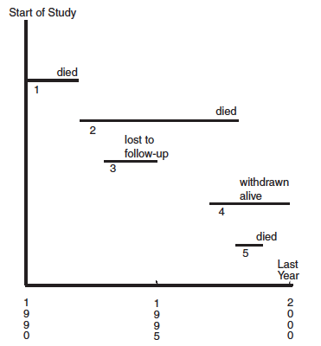
Calendar Event Chart of Five Patients
Patient Number | Years Survived | Status
1 | 2 | Died
2 | 6 | Died
3 | 2+ | Lost to follow up
4 | 3+ | Withdrawn alive
5 | 1 | Died

Slide 6
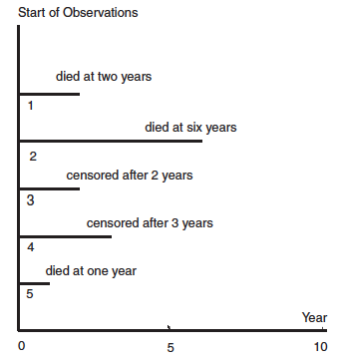
Patients Represented by a Common Starting Time
Patient Number | Years Survived | Status
1 | 2 | Died
2 | 6 | Died
3 | 2+ | Lost to follow up
4 | 3+ | Withdrawn alive
5 | 1 | Died

Slide 7
Censoring
Observations No. 3 & 4 are censored from the right, or right censored
  we know event happened after that time
Left censoring: we know event happened before that time, e.g. before first visit
Interval censoring: we know event happened in a given time interval, e.g. between follow-up visits
Q: How to handle? Will discuss right censoring
For others, do best to estimate.

Slide 8
Estimation Methods
Parametric: assume distribution, has parameters
Get estimates of parameters from sample
Non-parametric: do not assume distribution
→use Kaplan-Meier method to estimate survival curve from sample

Slide 9
Kaplan-Meier Estimate:
Main idea
Estimate the probability of surviving beyond a specific time point
  Conditioning on surviving up to that time point,
Compute the products of the conditional probabilities over time
*Allow for incorporating both censored and non-censored observations

Slide 10
Example
Years Survived | Status
1 | Died
2 | Died
2+ | censored
3+ | censored
6 | Died

Slide 11
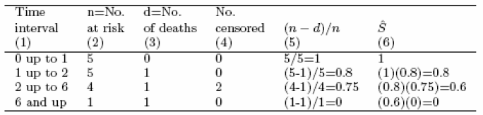
Computing Kaplan-Meier Estimate
Years Survived | Status
1 | Died
2 | Died
2+ | censored
3+ | censored
6 | Died
Compute only when
death occurs

Slide 12
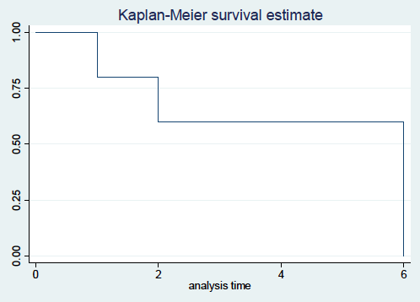
Graph of Kaplan-Meier Estimate

Slide 13
Modified Example
Years Survived | Status
1 | Died
2 | Died
2+ | censored
3+ | censored
6 | Died
Years Survived | Status
1+ | censored
2 | Died
2 | Died
3 | Died
6+ | censored
Changes:
1 → 1+
2+ → 2
3+ →3
6 → 6+

Slide 14
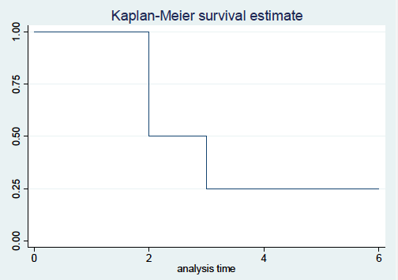
Graph of Kaplan-Meier Estimate of Modified Example

Slide 15
Example:
Lung function data
401 patients with lung cancer
Total length of the study was approximately ten years
Several variables, including tumor size

Slide 16
Variable number | Variable name | Description
1 | ID | Identification number from 1 to 401
2 | Staget | Tumor size 0=small 1=large
3 | Stagen | Stage of nodes 0=early 1=late
4 | Hist | Histology 1=squamous cells 2=other types of cells
5 | Treat | Treatment 0=saline (control) 1=BCG (experiment)
6 | Perfbl | Performance status at baseline 0=good 1=poor

Slide 17
7 | Poinf | Post-operative infection 0=no 1=yes
8 | Smokfu | Smoking status at follow-up 1=smokers 2=ex-smokers 3=never smokers
9 | Smokbl | Smoking status at baseline 1=smokers 2=ex-smokers 3=never smokers
10 | Days | Length of observation time in days
11 | Death | Status at end of observation time 0=alive (censored) 1 = dead

Slide 18
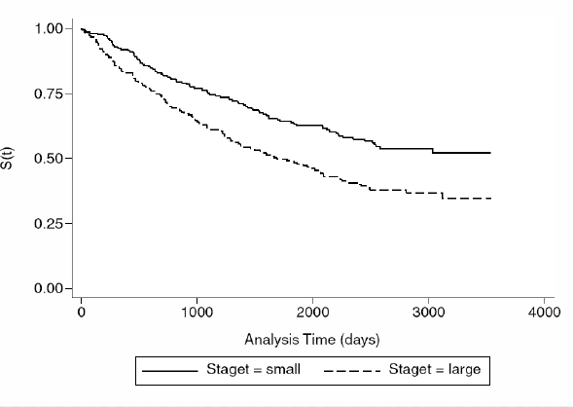
Kaplan-Meier Survival Functions for Lung Cancer Data
People with
large tumors
die faster

Slide 19
Common Survival Distribution:
Exponential Distribution
h(t) = λ
f(t) = λe^{-λt}
S(t) = e^{-λt}

Slide 20
Common Survival Distribution:
Weibull Distribution
h(t) = αλ(λt)^{α-1}, H(t)=(λt)^{α}
α = shape parameter:
  α < 1 → decreasing hazard rate
  α = 1 → constant hazard rate, i.e. exponential
  α > 1 → increasing hazard rate
λ = scale parameter: stretches or squeezes distribution

Slide 21
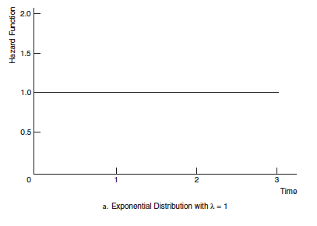
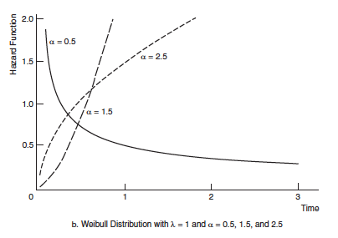
Hazard Functions for the Exponential and Weibull Distributions
and α = 1

Slide 22
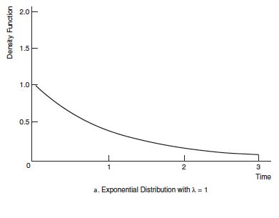
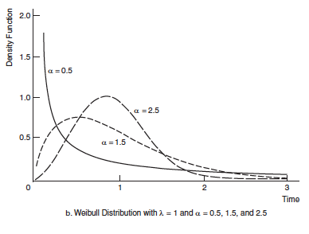
Death Density Functions for the Exponential and Weibull Distributions

Slide 23
Regression of Survival Data
Have survival time (T) and P covariates (X’s)
Relate survival to covariates:
  Log-linear model – parametric
  Cox-proportional hazard model – semi-parametric

Slide 24
Example:
Lung cancer clinical trial
401 patients followed for 10 years
Survival studied as a function of:
  Tumor size (Staget) : small vs. large
  Initial performance status (Perfbl): good vs. poor
  Post-operative infection (Poinf): no vs. yes
  Treatment (Treat): control vs. experimental

Slide 25
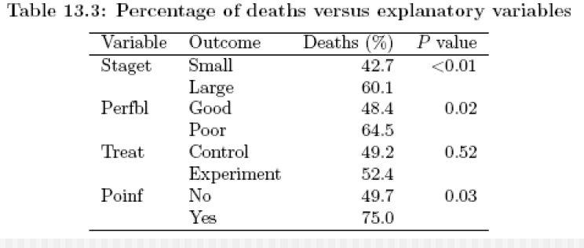
Unadjusted Analysis
*Length of time, and other covariates not considered

Slide 26
Regression:
Survival Function
T = survival time
Log-linear regression model: assume
  log (T) = linear function of X’s + error (e)
Called accelerated failure-time model (AFT) if, in addition, assume T follows a Weibull distribution
  ln (e) follows the extreme value distribution
  This is a parametric model

Slide 27
Estimation and model check
Coefficients estimated by maximum likelihood
Plot log(-log S(t)) vs. log(t) to check Weibull assumption:
  Straight line → Weibull OK

Slide 28
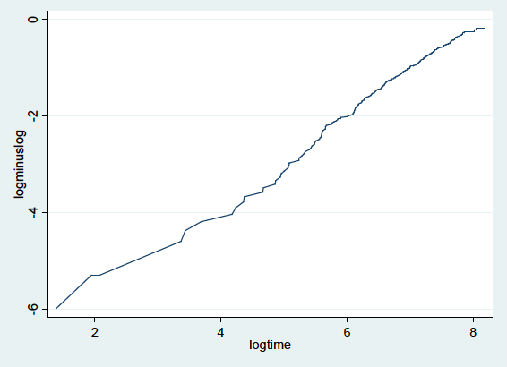
Example Plot: log(-logS(t)) vs. log(t)

Slide 29
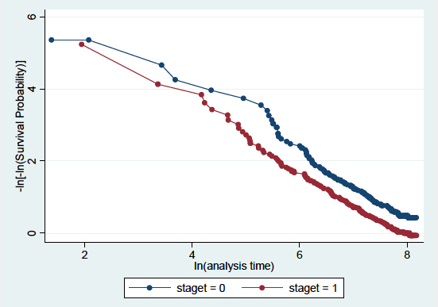
Example plot: by tumor stage

Slide 30
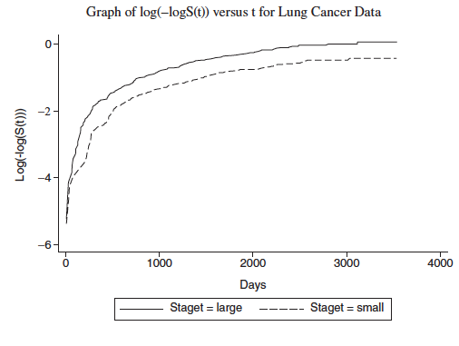
Check of PH model

Slide 31
Interpretation of coefficients
X binary (0, 1): Model→ ln[E(t|X)]=A+BX
  Ln[M(t|X=1)]=A+B, ln[M(t|X=0)]=A
  where M=median
  ln[M(t₁)/M(t₀)]=B, M(t₁)/M(t₀)=e^{B}
  CI for [M(t₁)/M(t₀)]=e^{B±Z*SE(B)}
For continuous X, B compares (X+1) to X

Slide 32
Example:
Post-operative infection
B for Poinf = -0.71, SE=0.31
e^{-0.71}=0.49
People with poinf are expected to live half as long as people without
CI for [M(t₁)/M(t₀)]=e^{-0.71±(1.96)(0.31)} = (0.27, 0.90)

Slide 33
Regression:
Hazard function
Hazard function h(t,X) in general will depend on t and covariates (X’s)
Cox proportional hazards model assumes:
h(t,X) = h₀(t) * e^{βX}
  h₀(t) : depends only on t
  e^{βX}: depends only on X’s
*This is a semi-parametric model

Slide 34
Implications of the Cox proportional hazards (PH) model
When X = 0, then hazard = h₀(t) = “baseline hazard”
Individual hazards are proportional to baseline hazard
  Ratio of hazards for two individuals is independent of time
Can check if assumption holds by plotting log(-log (S(t)) vs. t for various X’s:
  Constant difference → PH model OK

Slide 35
Interpretation of coefficients
X binary (0,1):
  h(t,1) = h₀(t)e^{B}, h(t,0) = h₀(t)
  h(t,1) / h(t,0) =e^{B}
  CI for [h(t,1) / h(t,0)] = [HR] = e ^{B±Z*SE(B)}
  HR = Hazard Ratio = Risk Ratio = RR
For continuous X, B compares (X+1) to X

Slide 36
Example:
Post-operative infection
B for Poinf = 0.67, SE = 0.28
HR = e^{0.67} = 1.95
People with poinf have double the hazard rate (risk) of people without
CI for HR = e^{0.67±(1.96)(0.28)} = (1.13, 3.38)

Slide 37
Summary of Results for Post-operative Infection
Analysis | Results | Comments
Unadjusted: Percent died | No infection: 42.7% Yes infection: 60.1% | Χ² significant Survival time, and other covariates not considered
Model: Log-linear (AFT) Cox PH | (coeff. ± SE) -0.71±0.31 M(t₁) / (Mt₀) =0.5 0.67±0.28 HR =2 | Significant effect Survival time and other covariates taken into account

Slide 38
Example:
X with > 2 levels
Symptom = low, medium, high
Symptom | RR (HR)
Low | reference
Medium | 1.4
High | 2.1
Q: What is HR for high vs. medium?
high/medium = (high/low) / (medium/low)
→HR for high vs. medium = 2.1/1.4=1.5

Slide 39
Cox PH Model with Interactions:
Duration of marriage
T – time to divorce
Censored if widowed or still married
X₁ = age at marriage
X₂ = 1 if similar education, = 0 if not

Slide 40
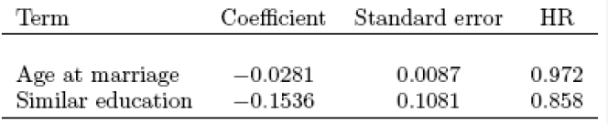
Marriage example: no interaction
HR (similar vs. dissimilar education) = e^{-0.154} = 0.858,
regardless of age
HR [ age (a+10) vs. age (a)] = e^{10*-0.28} = 0.755,
regardless of education
HR (a+10 & similar education vs. a & dissimilar education)
= 0.858*0.755 = 0.648: multiplicative

Slide 41
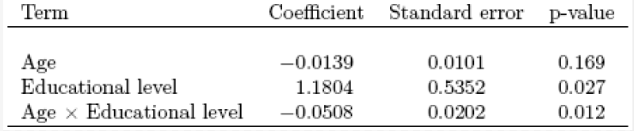
Marriage example: with interaction
HR [X₁ = a+10 vs. a|X₂ =1, i.e., similar education]
= e-0.14*(a+10)+1.18*(1)-0.51*(a+10)(1) /
e^{-0.14*(a)+1.18*(1)-0.51*(a)(1)}
= 0.52
NOT 0.755 (no interaction)

Slide 42
Marriage example: with interaction (cont’d)
HR [X1 = a+10 vs. a|X2 = 0 , i.e. dissimilar education ]
= 0.870
NOT 0.755 (no interaction)
HR [similar vs. dissimilar education |age=20]=1.179 not 0.858
HR [similar vs. dissimilar education |age=30]=0.709 not 0.858
HR [similar vs. dissimilar education |age=40]=0.427 not 0.858
HR [similar vs. dissimilar education |age=50]=0.257 not 0.858
HR [30 & similar edu. vs. 20 & dissimilar edu.]=0.617 not 0.648

Slide 43
What to watch out for
Subjects entering study at different times should be similar
Censoring should be independent of subject characteristics and survival time
Beginning and end points must be defined the same across studies being compared
Follow-up procedures should be thorough
Small samples or extensive censoring may distort stepwise regression results

Slide 44
Acknowledgement
Textbook: Chapter 13. Abdelmonem Afifi, Susanne May, Virginia A. Clark. Practical Multivariate Analysis. Fifth Edition. CRC Press Taylor & Francis Group
Thanks Professor Afifi for his courtesy to share the materials
Thanks our teaching assistance team for preparing the tutorial materials

