Slide 1
CS2115 Computer Organization 2023/2024 Sem A
Chapter 6: Memory
Dr. Nan Guan
Department of Computer Science
City University of Hong Kong
Notes:
Now we are going to discuss memory hierarchy design mainly consist of cache memory design and the DRAM based main memory.
Why do we require to study memory hierarchy design?

Slide 2
Memory
By the word "memory", we mean
  Wide sense: state elements
    Main memory, hard disk, flash memory, register, cache …
  Narrow sense: main memory

Slide 3
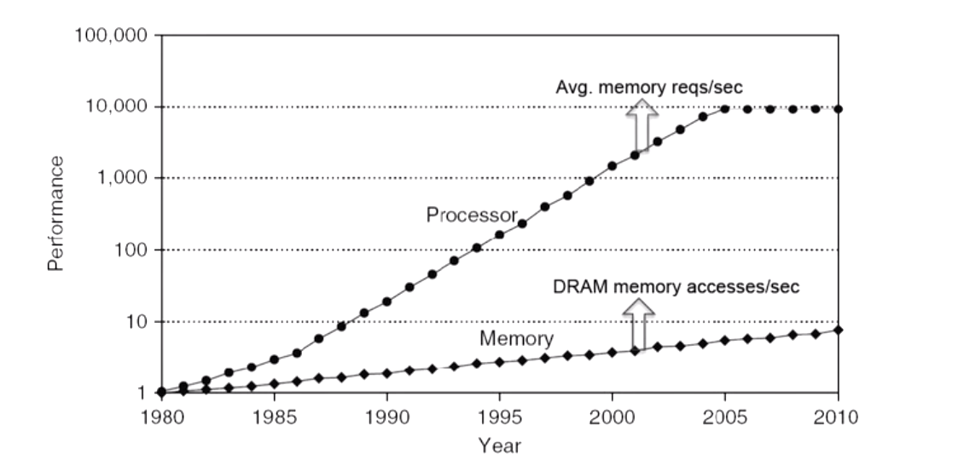
The Memory Wall
The processor performance is significantly increasing over the years, but the performance of the memory is not increasing at the same pace.
The low memory speed becomes the performance bottleneck
Notes:
This graph shows that the processor performance is significantly increasing over the years, but the performance of the memory is not increasing at that particular pace. So, as a result as time progresses, we have a significant gap between the processor performance and the DRAM performance. In this graph the X axis shows the time line and the Y axis shows the performance. And the processor line is actually specifies the rate at which the average memory requests per second is increasing and the memory line shows the number of DRAM memory accesses per second.
As we can clearly see that the gap is widening significantly and in order to deal with this wide gap in the performance between the processors and the memory we definitely need to have multi levels of cache hierarchy. And remember this graph is only for a single core processor performance, but these days we are having multi-core systems where two, four, eight, sixteen processors are there in a single chip. And all these cores when they are executing different applications require so much memory band width and to support that there is a significant pressure on the memory.
And so as a result we need to definitely have large spaces of the intermediate memories in the memory hierarchy. So, this says that the aggregate band width requirement grows with the number of cores. So, as a result we need to have efficient memory system hierarchy design which takes care of the demands from the multiple cored of a chip multi-processor so that, the overall performance of the system can be improved. So, having discussed this memory hierarchy and before going to discuss the internals of the cache memory and DRAM memory and so on. Let us see what is the performance improvement we get if the cache memory is provided in the system? To do that, we need to have quantification for cache performance.

Slide 4
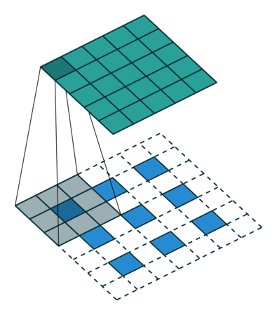
Principle of Locality
Temporal locality: accesses to the same memory location that occur close in time
Spatial locality: accesses to the memory locations that occur close in space
Notes:
We know that programs exhibit principle of locality, which states that the processor accesses some data and instructions now,
there is a high chance that the same data will be required in future or the neighboring data may be required in future. So, for example, consider a scenario where the simple piece of code which is matrix multiplication. Here we are performing matrix multiplication on 2 matrices B and C and the result is stored in matrix A.
We assume in this particular example the data stored in row major order. So, all the elements of a row is stored first and then go the next row and so on. So, given this example we know that B[0][0] is accessed first and then B[0][1], B[0][2] and so on because the k value is changing based on the innermost for loop and i value is fixed for all the iterations of the two inner for loops. So which says that if I access element B[0][0] I am going to access B[0][1] in the next cycle and similarly B[0][2], B[0][3] and so on in the following cycles.
And similarly, when I consider elements of array A, so A[0][0] is repeatedly used for all the iterations of the innermost for loop. That means for k equal to 0 to n, A[0][0] is used and now A[1][0] will be used only after the complete iterations of the innermost for loop is done. And also the complete iterations of the second for loop. So, in the second iteration, so when I equal to 1, again for j equal to 0 to n and k equal to 0 to n. So, we are going to use A[1][0] and after that again this will be repeated for A[1][1], A[1][2] and so on. So, this says that an element of array A when I am accessing now, I am going to access this in the near future. This is true with the other elements of the other arrays also.
From this example it is clear that the elements which are accessed now there is a high chance that, the same elements may be repeatedly used in the near future or elements which are neighboring to the previously accessed elements will be required in the near future. So, this says that the principle of locality can be exploited either in time or in space. So, accesses to the same memory location that occur close together in time is called as temporal locality. Whereas, if it happens close in space that is nothing but accesses to the same memory location that occurs close together in space is called a spatial locality.
And the thumb rule says that ninety percentage of the execution of programs spends in only 10% of the code. So, to exploit this principle of locality available in most of the programs, we need to come up with a memory hierarchy. Rather than storing the entire code and accessing from the memory, it is always better to keep the repeatedly accessed data in the faster memory which is very close to the processor, so that the access time will be very short.
So, effectively all the cache memory designs or the memory hierarchy design what we consider typically exploits the principle of locality that is available in the programs. So, organize your memory system into a hierarchy with the faster, but the smaller memory closer to the processor and large memory which has high access latency will be kept very far from the processor. Let us look at the memory hierarchy.

Slide 5
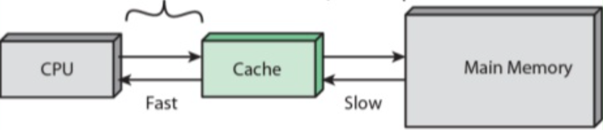
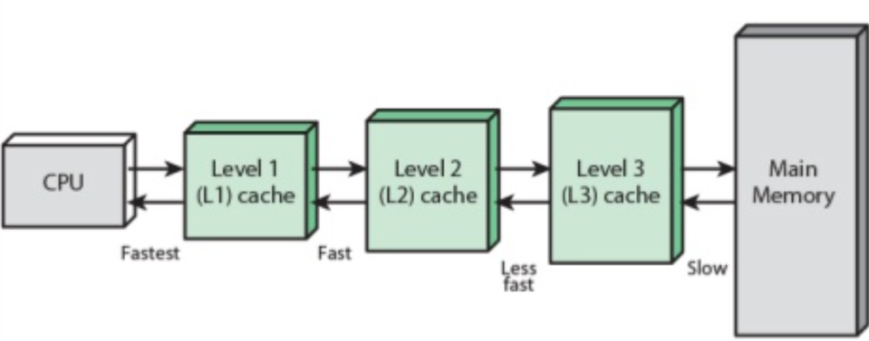
Memory Hierarchy
Organize memory system into a hierarchy with faster (but smaller) memory closer to processor

Slide 6
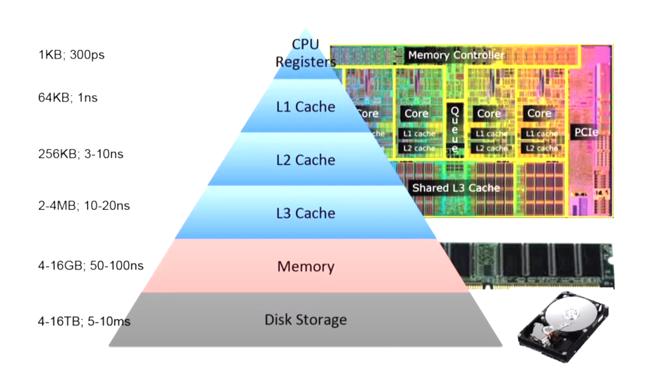
Memory Hierarchy
Notes:
It consists of multiple levels in the hierarchy and this particular example is typically used for server type of systems. At the top of the pyramid we have the processor registers or CPU registers, which typically take less space in the order of less than 1kb, kilobytes of space, but the access time is very fast. It will take typically the orders of picoseconds. The next level of the memory in the memory hierarchy is the level 1 cache memory which again the size of the L1 cache is typically around 32kb to 64kb and the access time it takes 1 nanosecond or something.
As we move further down in the pyramid, the size of the memory is increasing. The access time also is increasing, but the cost per bit is reducing significantly. The size of L2 memory is 256kb to 512kb, depending on the system we consider. And the access times are 3 to 10 nanoseconds and some systems can consider third level of cache which is in the orders of 2 to 4 megabytes of space and takes 10 to 20 nanoseconds. Remember the CPU registers, L1, L2, L3 caches all these are actually designed using SRAM technology, because of that the access times are very low compared to the main memory which is typically designed using DRAM based technology.
In the case of main memory, as I mentioned earlier we consider DRAM based technology, where a single bit is stored in a DRAM cell which consists of a transistor and a capacitor. And the access times for the main memory is typically in the range of 50 to 100 nanoseconds, but the size of the DRAM based memory is 4 to 16 GB which is very huge.
In the pyramid we have a disc storage, which is having a size in the range of 4 to 16 terabytes, but the access times are in the range of milliseconds mainly because of these mechanical components involved in hard disk. Of course, these days we are also having the solid state drives which are based on flash technology and provide non-volatility. We know that the caches and the memory are volatile memories. So, that means when the power is off, the data will be lost.
We consider flash based memories as a replacement for the hard disc and that is the reason why the latest laptops and so on we are having the flash based solid state drives, but the size of flash based solid state drives is not in the range of the size of HDDs, but they are decent enough to provide good storage space. And the advantage with the solid state drives is their access times are much smaller compared to the HDDs. So, once you have your memory in the multi-levels of hierarchy with the faster memory faster and the smaller sized memory closer to the processor.
So we are going to keep repeatedly accessed data in these faster memories, but, because the size is very small so, we have to be selective in keeping data in these faster memories. So, as part of our cache memory designs we are going to discuss different mechanisms of how to keep selective data. So, is it really required to have so many levels of memory hierarchy in our computer design? Yes it is required this is mainly because of the famous memory wall problem.

Slide 7
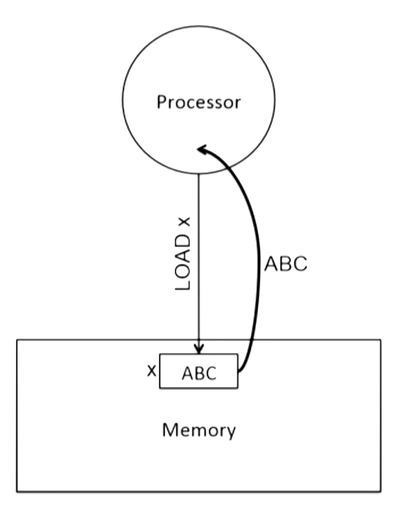
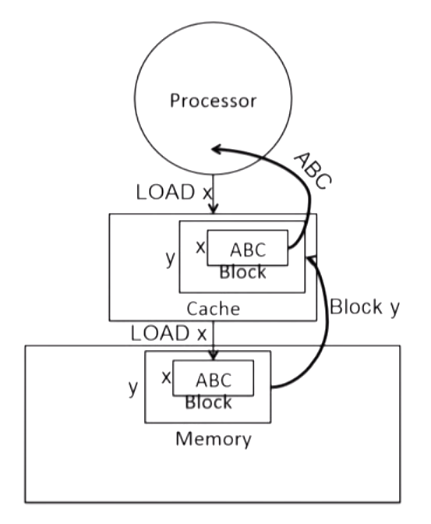
Cache Memory
Notes:
Consider a scenario where a system without a cache memory. So, when processor wants to read the data which is stored at an address x in the memory. So, it sends a request, load request to the memory and the memory supplies the data stored in the address x. Let us assume that the data stored in that particular address is ABC. We know that memory access takes lot of time hundreds of cycles. So, this operation will be very costly.
And every time if you are going to the memory and spending hundreds of cycles, our overall performance will be degraded significantly. To minimize the performance penalty what we can do is we can consider a faster memory between the processor and the main memory which is called as a cache memory. We send the request from the processor to load the data which is stored at an address x. We first search in the cache and the cache is initially empty. So, there is no data, we will go to the memory and get the data, but because we are spending anyway hundreds of cycles to get the data from the memory, rather than reading only the required word of data, we read a collection of data items which are needed to this address x.
So, we bring this chunk of data from the memory and store it in the cache memory. So, that in the future, if processor requires any data in this particular chunk, the cache memory can service. So, effectively the cache memories improve the overall performance of the system. DRAM cell takes more time to access compared to an access from an SRAM cell. So, that is the reason typically why cache memories are designed using SRAM technology. The DRAM memory density is much higher where it typically takes one transistor and a capacitor for one bit of information compared to 4 to 10 transistors in the case of SRAM cache memory.
So, because of that reason the size of the cache is also considered typically smaller. And another point is, the access time of the cache also depends on the size of the cache. So, if the bigger size cache is considered then automatically it is going to take more amount of time to supply the data to the processor. Keeping all these reasons, typically we consider the cache memories of reasonable size compared to the size of the main memory. In addition to that because the cache memory typically placed on the chip and the chip real estate is very costly.
So, we cannot dedicate too much space on the chip for these cache memories and so on. And because we are bringing chunk of data from the memory, to minimize the number of accesses to the memory as long as cache supplies the data required by the processor. So, what is the size of the block we have to consider? Typically, we consider a block size either as 32 bytes or 64 bytes. If you consider the smaller block size the applications may not exploit the spatial locality properly. At the same time, if the block size is very large then the number of blocks stored in the cache memory is limited and as a result the overall conflicts miss rate may increase. So, that is the reason why typically the current processors are considering a block size of 32 bytes or 64 bytes. So, having discussed, why we require a cache memory.

Slide 8
Direct-Mapped Caches
Simplified Example
Suppose the cache has 8 lines, the memory has 32 words,
each cache line stores one word
data
address
000
00000
01000
10000
11000
001
00001
01001
10001
11001
010
00010
01010
10010
11010
011
00011
01011
10011
11011
Cache
100
00100
01100
10100
11100
Memory
101
00101
01101
10101
11101
110
00110
01110
10110
11110
111
00111
01111
10111
11111

Slide 9
Direct-Mapped Caches
Simplified Example
Suppose the cache has 8 lines, the memory has 32 words,
each cache line stores one word
Cache_Index = Memory_Address mod Cache_Size
Cache_Tag = Memory_Address/Cache_Size
Index
Tag
Contents
000
00
00000
01000
10000
11000
001
00
00001
01001
10001
11001
010
00
00010
01010
10010
11010
011
00
00011
01011
10011
11011
Cache
100
00
00100
01100
10100
11100
Memory
101
00
00101
01101
10101
11101
110
00
00110
01110
10110
11110
111
00
00111
01111
10111
11111

Slide 10
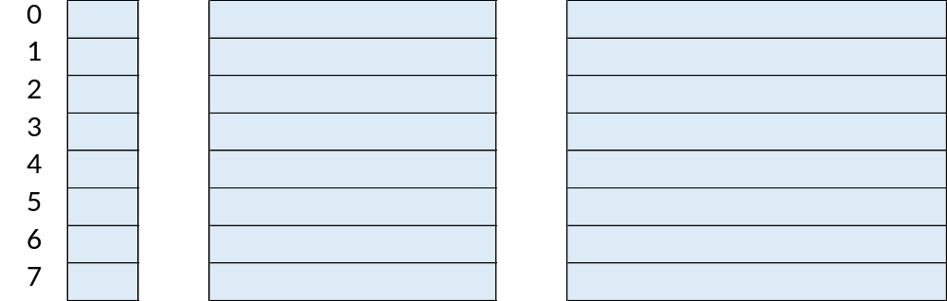
Direct-Mapped Caches
When access the cache with 2^{w} lines:
  Index into cache with W address bits (the index bits)
  Read out valid bit, tag, and data
  If valid bit == 1 and tag matches -> Cache Hit
  Otherwise -> Cache Miss
  Offset bits: number of memory blocks in each cache line
A cache line is invalid if its value is inconsistent with the memory any longer, e.g., because the data is modified by other elements (DMA, other cores…)
Valid bit Tag(27 bits) Data (32 bits)
Example: 8-blocks Direct-Mapped cache (W=3)
32-bit BYTE address
(suppose each cache line stores one word)
Tag bits
Index
bits
Offset
bits
HIT
=?

Slide 11
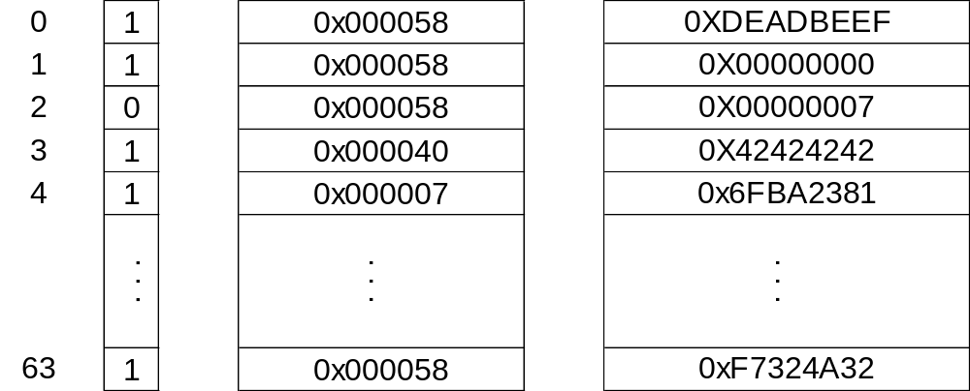
Direct-Mapped Caches
64-line direct-mapped cache → 64 indexes → 6 index bits
Valid bit Tag(24 bits) Data (32 bits)
Read Mem[0x0000400C]
  0000 0000 0000 0000 0100 0000 0000 1100
  TAG: 0x000040
  INDEX: 0x3
  OFFSET: 0x0
  Hit!
  Read from cache: 0x42424242

Slide 12
Direct-Mapped Caches
64-line direct-mapped cache → 64 indexes → 6 index bits
Valid bit Tag(24 bits) Data (32 bits)
Read Mem[0x00004004]
  0000 0000 0000 0000 0100 0000 0000 0100
0x000040
0x12345678
  TAG: 0x000040
  INDEX: 0x1
  OFFSET: 0x0
  Miss!
  Load from memory: 0x12345678
  Tag updated to 0x000040

Slide 13
Direct-Mapped Caches
64-line direct-mapped cache → 64 indexes → 6 index bits
Valid bit Tag(24 bits) Data (32 bits)
Read Mem[0x0000400C]
  0000 0000 0000 0000 0100 0000 0000 1100
  TAG: 0x000040
  INDEX: 0x3
  OFFSET: 0x0
  HIit! Read Data: 0x42424242
  Would Read Mem [0x00004008] be hit?
  INDEX:0x2 → tag mismatch → miss
  What are the addresses of data in indexes 0, 1, and 2?
  TAG:0x58 → 0000 0000 0000 0000 0101 1000 iiii ii00 (substitute iiiiii by index 0, 1, 2)
  → 0x5800,0x5804,0x5808

Slide 14
Fully-Associative Cache
A memory block can be stored in any cache line
Cache
Memory
000
00000
01000
10000
11000
001
00001
01001
10001
11001
010
00010
01010
10010
11010
011
00011
01011
10011
11011
100
00100
01100
10100
11100
101
00101
01101
10101
11101
110
00110
01110
10110
11110
111
00111
01111
10111
11111

Slide 15
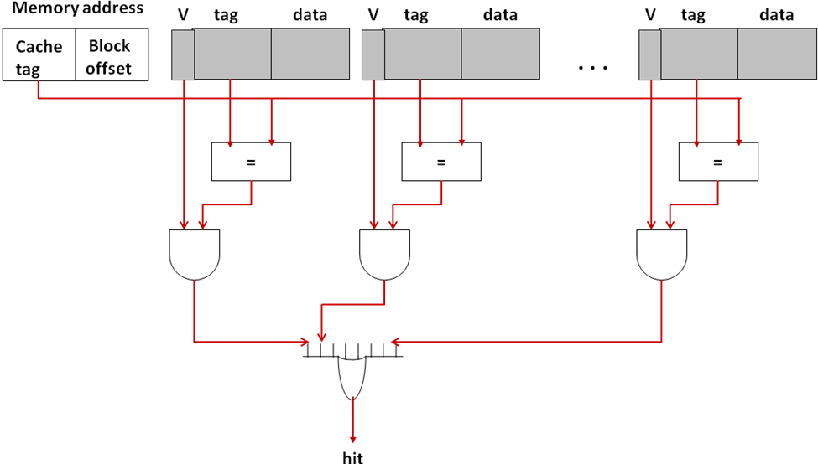
Fully-Associative Cache
A memory block can be stored in any cache line
To check if an access is a cache hit
  Need to check all cache lines
Example:
32-bit BYTE address
each cache line stores 1 word
Tag bits
Offset
bits
cache line 1
cache line 2
cache line N
tag
offset

Slide 16
Fully-Associative Cache
When a cache miss occurs, we need to load the missed data from memory to cache
Some data currently stored in cache will be replaced
Replacement policy decides which data to be replaced
Many different policies
  Random, FIFO (First-In-First-Out), LRU (Least Recently Used) … …

Slide 17
Fully-Associative Cache
FIFO replacement policy
  Each cache line has an age
  When miss, loaded data is the youngest
    Other data’s age increased by 1
  When hit, no change
LRU replacement policy
  Same to FIFO when miss
  When hit, the accessed data becomes
  the youngest
  Previously younger ones’ age increase by 1
miss
hit
young
a
f
f
b
f
a
b
a
c
b
b
old
d
c
c
miss
hit
young
a
f
b
b
f
a
b
f
c
b
a
old
d
c
c

Slide 18
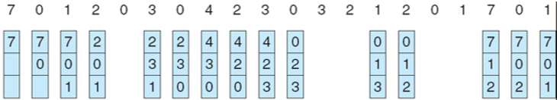
FIFO Algorithm
FIFO (First-In-First-Out): replaces earliest loaded page
Example:
Sequence →

Slide 19

LRU Algorithm
LRU (Least Recently Used): replaces pages that have not been used for the longest time
Example:
Sequence →

Slide 20
Direct-Mapped v.s. Fully-Associative
Fully-associative cache is more flexible
  Higher utilization of the resource
    a memory block can be stored in any cache line, so lower chance to conflict
  More difficult to search
    Need to search the entire cache
Direct-mapped cache is simpler
  Easier to search
    Only need to check one cache line
Cache
Memory
000
00000
01000
10000
11000
001
00001
01001
10001
11001
010
00010
01010
10010
11010
011
00011
01011
10011
11011
100
00100
01100
10100
11100
101
00101
01101
10101
11101
110
00110
01110
10110
11110
111
00111
01111
10111
11111

Slide 21
Set-Associative Cache
Can we combine the easy searching of direct-mapped and the flexibility of fully-associative caches?
Yes: set-associative
— Each cache block can go in only 1 set (same modulo addressing)
— But, each set can have multiple blocks (associative searching)
  Easy to search:
  — You know which set based on the address
  — Only have to check the few cache blocks in the set
  Flexible:
  — Can put each cache block anywhere in the set
  — Reduces (but doesn’t eliminate) conflict misses

Slide 22
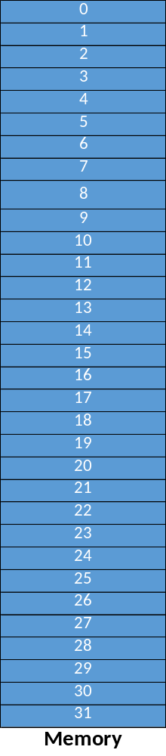
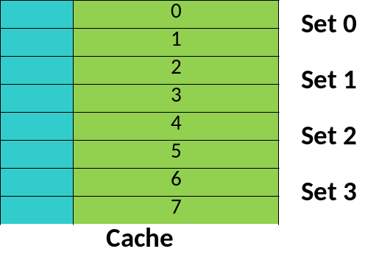
Set-Associative Cache
Simplified Example
Use modulo addressing
— 0 → (0 mode 4) = anywhere is Set 0
— 1 → (1 mode 4) = anywhere is Set 1
— 2 → (2 mode 4) = anywhere is Set 2
— 8 → (8 mode 4) = anywhere is Set 0
We know which set any address will go to, so we only have to search the set.
— 9 → (9 mode 4) = anywhere is Set 1
— 18 → (18 mode 4) = anywhere is Set 2
Just look at last 2 bits
— 0 → 000000 → Set 0
— 1 → 000001 → Set 1
— 2 → 000010 → Set 2
— 8 → 001000 → Set 0
— 9 → 001001 → Set 1
— 18→010010 → Set 2
Tag bits

Slide 23
Set-Associative Cache
Address: suppose the cache has 2³ = 8 sets
Way number: the number of cache lines in each set
  Called X-way Set Associative cache if way number = X
Replacement policy is used within each set
32-bit BYTE address
Tag bits
Set
index
Offset
bits
Set number = 4
Way number = 2

Slide 24
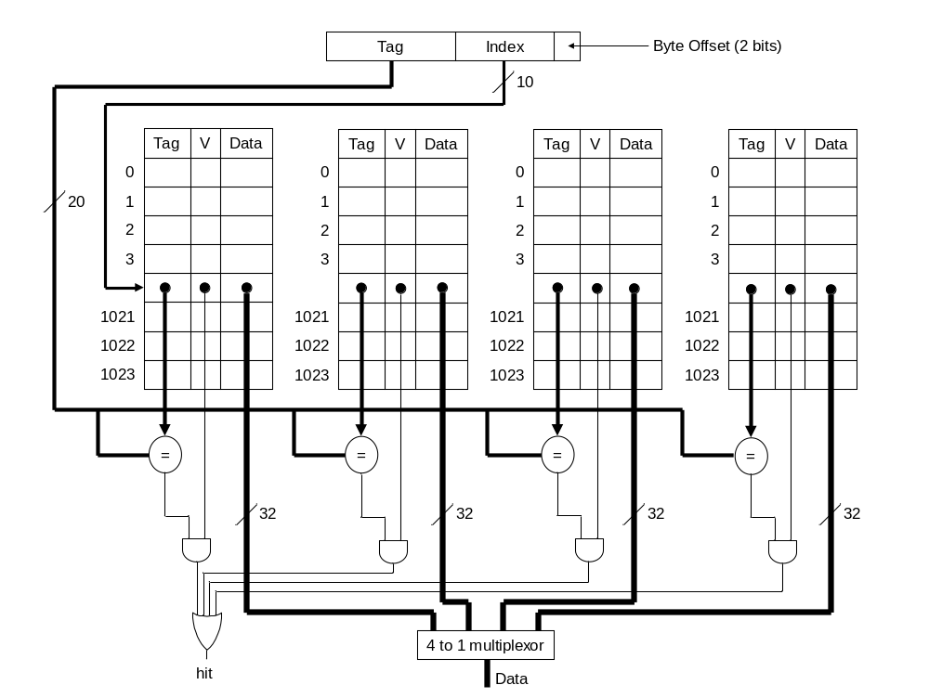
Set-Associative Cache
Set number = 1024
Way number = 4
a set

Slide 25
Quantifying Cache Performance
When a perfect cache is considered:
CPU time = CPU clock cycles × Clock cycle time
If processor is stalled for a memory access
CPU time = (CPU clock cycles + Memory stall cycles) × Clock cycle time
Memory stall cycles (MemStall) = Number of misses × Miss Penalty
Notes:
We already discussed the performance equation for CPUs where,
CPU time can be expressed as CPU clock cycles multiplied by the clock cycle time.
So, here this expression is considered with the assumption that our cache memory is perfect. When I say cache memory is perfect, whatever the memory request issued by the processor it will be satisfied by the cache memory. So, effectively the processor is not stalled for servicing any memory request. This is an ideal scenario, but in reality this is not the case, where processor may be stalled for servicing memory request. So, when you have memory stalls this equation can be written as,
CPU time is equal to ‘the sum of CPU clock cycles’ plus ‘memory stall cycles’ and their sum is multiplied by ‘the clock cycle time’.
So, CPU clock cycles are the cycles spent by the processor in performing ALU operations or all the requests which are hit in the cache memory. And the memory stall cycles are the cycles the processor sitting idle to get the data from either the 1 level of the cache or 2 levels of the cache or any level in the memory hierarchy. So, memory stall cycles is nothing but 'the number of misses incurred by the processor' times' the total time incurs for servicing 1 memory miss or 1 cache miss’. So, it is effectively the number of misses times the miss penalty, This can be further expressed as ‘the instruction count’ times ‘the number of misses per instruction’ times ‘miss penalty’.
Because previously we have given the expression for CPU time in terms of instruction count. So, effectively we can rewrite our memory stalls also in terms of instruction count.
‘The total number of instructions in the program’ times ‘the number of misses incurred per instruction’ times ‘a miss penalty’.
This can be further rewritten as ,
instruction count’ times ‘memory accesses per instruction’ times ‘misses per memory accesses’ times ‘missed penalty’.
So, the ratio of misses per memory accesses, the ratio of misses and memory accesses is called as a miss rate. So, our total memory stalls can be expressed as ‘instruction count’ times ‘memory accesses per instruction’ times ‘miss rate’ times ‘missed penalty’.
So, we can substitute this memory stall equation in our CPU time equation to get the overall CPU time if we have a cache memory. And using this equation we can get the performance improvement using a cache memory. So, to illustrate that let us consider an example.

Slide 26
Example #1
Assume that the CPI (cycle per instruction) of a computer is 1. If 30% of the instructions access data memory, miss penalty is 100 cycles and the overall miss rate of accesses to both data and instructions is 5%, how much faster the computer be if all instructions were cache hits?
If all memory accesses are cache hits
CPU time_{ideal} = CPU clock cycles × Clock cycle time
= IC × CPI × Clock cycle time
= IC × 1.0 × Clock cycle time
With cache misses
Memory stall cycles= IC × (1.0 + 0.3) × miss rate × miss penalty
= IC × 1.3 × 0.05 × 100 × Clock cycle time
CPU time_{MemStall} = (IC × 1.0 + IC × 6.5) × Clock cycle time
= 7.5 × IC × Clock cycle time
Speedup = 7.5
IC (instruction count): the total number of instructions
Notes:
Assume that the CPI of a computer is 1 when all memory accesses hit in the cache. This is effectively an ideal scenario where you are not waiting for any memory request to be serviced. So, effectively memory stalls are 0, but if 30% of the instructions are loads and stores and the miss penalty is hundred cycles and the miss rate is 5%.How much faster the computer be, if all instructions were cache hits?
So, first start with the ideal scenario, when all the memory accesses are hit in the cache. So, our memory stall cyclesequal to 0. So, CPU time is ‘CPU clock cycles’ times ‘the clock cycle time’, which is equal to ‘IC’ into ‘CPI’ into ‘clock cycle time’ where CPI is equal to 1.
So, it is effectively IC into clock cycle time.Remember we have not given any clock frequency for the processor and we have also not given the number of instructions in the program. So, effectively we consider IC and clock cycle time as it is.
Now, consider the scenario where we have imperfect cache which has some percentage of memory request will incur miss and there is a miss penalty. So, memory stall cycles due to this,the miss rate is given as ‘IC’ into ‘memory access per instructions’ into ‘miss rate’ into ‘miss penalty’ which is effectively 6.5 times IC.
And so overall CPU time because of this memory stalls is equal to ‘CPU time in the ideal scenario’ plus ‘the CPU time’ because of memory stalls, which is effectively 7.5 times IC times ‘clock cycle time’. So, the speed up we achieve because of our perfect cache compared to an imperfect cache is equal to 7.5. So, this gives a motivation that we need to keep the useful data in the cache memory so that, the overall performance can be improved. And if you do not have a cache in this particular scenario for every request we have to go to the memory and which is going to take hundred cycle latency.
And so as a result the performance penalty will be significant, if we do not consider a cache memory, but whereas, if we consider a cache memory with some miss rate the performance can be improved compared to the case where no cache memory is considered. But of we have a cache memory which is perfect we can improve the performance even with respect to a cache memory with some percentage of misses and so on.
So, this motivates us to come up with the efficient cache memory between your processor and the main memory or we may have to have multiple levels of cache memory to improve the overall performance of the system. So, with this I am concluding this module and in the next module we are going to discuss the internals of the cache memory design.

Slide 27
Memory Hierarchy
Notes:
It consists of multiple levels in the hierarchy and this particular example is typically used for server type of systems. At the top of the pyramid we have the processor registers or CPU registers, which typically take less space in the order of less than 1kb, kilobytes of space, but the access time is very fast. It will take typically the orders of picoseconds. The next level of the memory in the memory hierarchy is the level 1 cache memory which again the size of the L1 cache is typically around 32kb to 64kb and the access time it takes 1 nanosecond or something.
As we move further down in the pyramid, the size of the memory is increasing. The access time also is increasing, but the cost per bit is reducing significantly. The size of L2 memory is 256kb to 512kb, depending on the system we consider. And the access times are 3 to 10 nanoseconds and some systems can consider third level of cache which is in the orders of 2 to 4 megabytes of space and takes 10 to 20 nanoseconds. Remember the CPU registers, L1, L2, L3 caches all these are actually designed using SRAM technology, because of that the access times are very low compared to the main memory which is typically designed using DRAM based technology.
In the case of main memory, as I mentioned earlier we consider DRAM based technology, where a single bit is stored in a DRAM cell which consists of a transistor and a capacitor. And the access times for the main memory is typically in the range of 50 to 100 nanoseconds, but the size of the DRAM based memory is 4 to 16 GB which is very huge.
In the pyramid we have a disc storage, which is having a size in the range of 4 to 16 terabytes, but the access times are in the range of milliseconds mainly because of these mechanical components involved in hard disk. Of course, these days we are also having the solid state drives which are based on flash technology and provide non-volatility. We know that the caches and the memory are volatile memories. So, that means when the power is off, the data will be lost.
We consider flash based memories as a replacement for the hard disc and that is the reason why the latest laptops and so on we are having the flash based solid state drives, but the size of flash based solid state drives is not in the range of the size of HDDs, but they are decent enough to provide good storage space. And the advantage with the solid state drives is their access times are much smaller compared to the HDDs. So, once you have your memory in the multi-levels of hierarchy with the faster memory faster and the smaller sized memory closer to the processor.
So we are going to keep repeatedly accessed data in these faster memories, but, because the size is very small so, we have to be selective in keeping data in these faster memories. So, as part of our cache memory designs we are going to discuss different mechanisms of how to keep selective data. So, is it really required to have so many levels of memory hierarchy in our computer design? Yes it is required this is mainly because of the famous memory wall problem.

Slide 28
RAM
RAM: Random-Access Memory
  allows data items to be read or written in almost the same amount of time irrespective of the physical location of data inside the memory
  (there are other types of memory which are not the case)
Two major types:
  SRAM (static random-access memory)
  DRAM (dynamic random-access memory)
SRAM and DRAM are both volatile memory
  The data is lost when powered off

Slide 29
SRAM vs DRAM
SRAM (static random-access memory)
  Use flip-flops to store bits
  Usually used for Cache and registers
DRAM (dynamic random-access memory)
  Use capacitors to store bits
  Access speed is much slower than SRAM

Slide 30
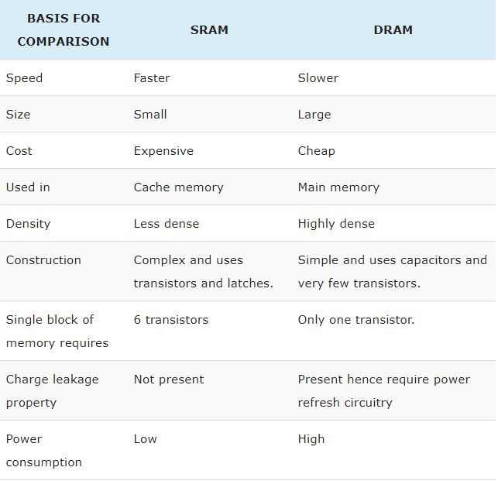
SRAM vs DRAM

Slide 31
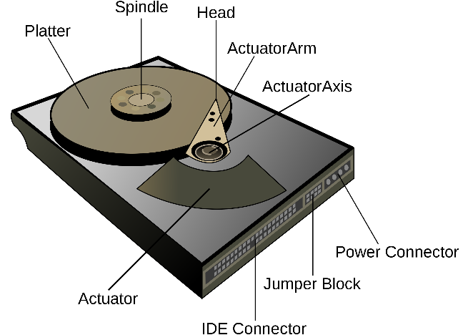
Hard Disk Drive
HDD: Hard Disk Drive
  electro-mechanical data storage device using magnetic storage and one or more rigid rapidly rotating platters coated with magnetic material
  HDDs are a type of non-volatile memory (NVM), retaining stored data even when powered off
  Used to store mass data

Slide 32
Solid State Disk
SSD: Solid State Disk
  uses integrated circuit assemblies to store data persistently, typically using flash memory
  Compared with HDD, SSDs are typically more resistant to physical shock, run silently, and have quicker access time and lower latency

Slide 33
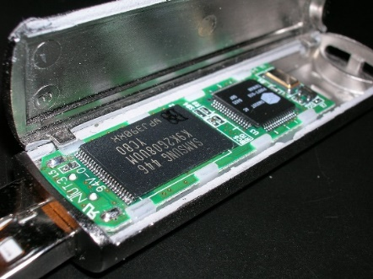
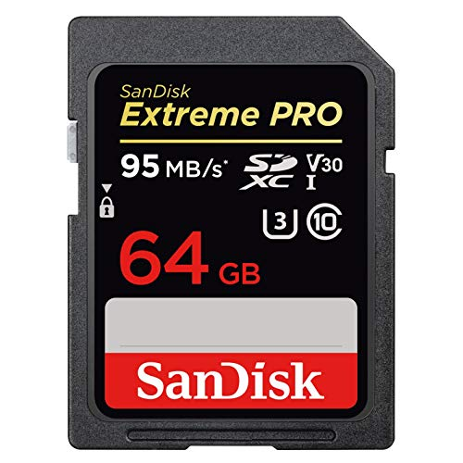


Flash Memory
Toshiba developed flash memory in the 1980s
Two main types of flash memory: NAND (for data) and NOR (for code)
Started to be heavily used because of digital cameras
Exponential growth with smartphones/tablets

Slide 34
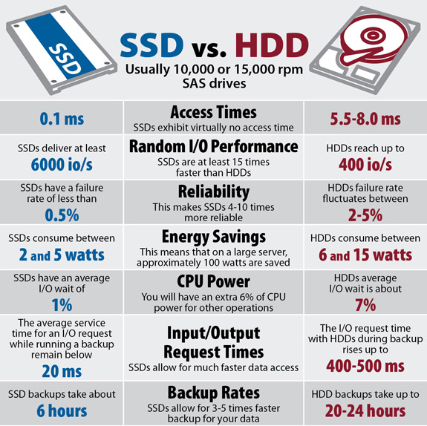
Comparison of SSD and HDD

Slide 35
Basic NAND Flash Cell
Store charges in the floating gate
Threshold voltage (Vth) represents data
Control Gate
e
e
e
e
e
Gate Oxide
e
e
Read voltage
e
e
Floating Gate
Tunnel Oxide
1
0
S
D
V_{th}
Substrate
Erased
Programmed
Floating-Gate Cell
Notices, high voltage is 0, low voltage is 1

Slide 36
Flash Cell Organization
BL
BL
BL
BL
BL
BL
Control Gate
Source Gate Line
Gate Oxide
WL 3
Page: 4 K to 32 KB
For read and write
36
One page
e
e
e
e
WL 2
Floating Gate
WL 1
Tunnel Oxide
WL 0
S
D
Substrate
Source Gate Line
Source Line
Floating-Gate Cell
Block: 64 to 1024 pages
For erase

Slide 37
Read from Flash
V_{pass} = 5.0 V
Pass (5V)
3.0V
3.8V
3.9V
4.8V
Page 1
V_{read} = 2.5 V
Read (2.5V)
3.5V
2.9V
2.4V
2.1V
Page 2
V_{pass} = 5.0 V
Pass (5V)
2.2V
4.3V
4.6V
1.8V
Page 3
V_{pass} = 5.0 V
Pass (5V)
3.5V
2.3V
1.9V
4.3V
Page 4
values for page 2:
0
0
1
1

Slide 38
Write to Flash
One can only charge each individual Flash Cell
  i.e., can only change an individual bit from 1 to 0, but not from 0 to 1
In order to write 1, we have to erase the entire block
  Erase: change the entire block to 1
After that, we can write those 0 bits as needed
Control Gate
e
e
e
e
e
Gate Oxide
e
e
e
e
Read voltage
Floating Gate
Tunnel Oxide
1
0
S
D
V_{th}
Substrate
Erased
Programmed
Floating-Gate Cell

Slide 39
Garbage Collection
Three basic operations: read, write (page) and erase (block)
Out-of-place update
Garbage collection to reclaim space
  To get continuous space
Example:
Write page 0 and 1
Update page 0
Write page 2 and 3
Update page 2
Garbage collection on block 1
Block 1
Block 2
clean
Page 0
Page 1
Page 1
Page 0
valid
Page 0
Page 3
Page 2
Page 2
invalid
Page 3
Page 2

Slide 40
SLC Threshold Voltage Distribution
SLC: single level cell
–
–
V_{read}
–
Lower Voltage State
Higher Voltage State
Probability
Read Reference Voltage
1
0
Threshold Voltage

Slide 41
MLC Threshold Voltage Distribution
MLC: multi-level cell
V₁
V₂
V₃
–
–
–
–
–
–
Lowest Voltage State
Highest Voltage State
Probability
Read Reference Voltage
Read Reference Voltage
Read Reference Voltage
LSB
1
1
1
0
0
0
0
1
MSB
Threshold Voltage

Slide 42
Different Densities of Flash
e
e
e
e
e
e
e
e
e
e
e
e
e
e
e
V
V1
V2
V3
1
0
1
1
1
0
0
0
0
1
V_{th}
V_{th}
Erased
Programmed
Single Level Cell (SLC)
1 bit per cell
Multi Level Cell (MLC)
2 bits per cell
V1
V2
V3
V4
V5
V6
V7
1
1
1
0
1
1
0
0
1
1
0
1
1
0
0
0
0
0
0
1
0
1
1
0
1
1
1
1
0
1
1
1
0
0
1
1
1
0
1
1
1
0
0
1
0
0
0
1
0
1
0
0
1
1
0
1
1
1
0
0
0
1
0
0
0
0
0
0
1
0
0
0
1
0
1
0
0
0
1
0
0
1
1
0
1
1
1
0
V_{th}
V_{th}
Triple Level Cell (TLC)
3 bits per cell
Quad Level Cell (QLC)
4 bits per cell

Slide 43
Comparison among Different Types
Types of flash | SLC | MLC | TLC | QLC
bit/cell | 1 | 2 | 3 | 4
P/E cycles (K) | 100 | 3 | 1 | <1
Read time (µs) | 30 | 50 | 75 | 110
Program time (µs) | 300 | 600 | 1000 | 2000
Erase time (µs) | 1500 | 3000 | 4500 | 5000
Price ($/GB) | 0.37 | 0.33 | 0.2 | 0.12
Higher density, lower cost
Worse performance, worse lifetime

Slide 44
Exercise
If you have 100$ budget to build the memory hierarchy for a computer. The cost of SRAM is 10$/Mbyte, the cost of DRAM is 1$/Mbyte and the cost of Flash is 0.1$/Mbyte.
There are 3 options:
  Option 1: 50$ for SRAM, 49$ for DRAM and 1$ for Flash
  Option 2: 10$ for SRAM, 20$ for DRAM and 70$ for Flash
  Option 3: 60$ for SRAM, 5$ for DRAM and 35$ for Flash
Which option do you think is the best? Why?
Notes:
The principle of designing memory hierarchy is to use small faster memory, and large slower memory. Speed: SRAM > DRAM > Flash
a. Option 1: 5M byte SRAM, 49M bytes DRAM, 10M byte Flash: bad choice since flash is smaller than DRAM
b. Option 2: 1M byte SRAM, 2M bytes DRAM, 800M byte Flash: good choice
c. Option 3: 6M byte SRAM, 5M bytes DRAM, 350M byte Flash: bad choice since DRAM is smaller than SRAM

Slide 45
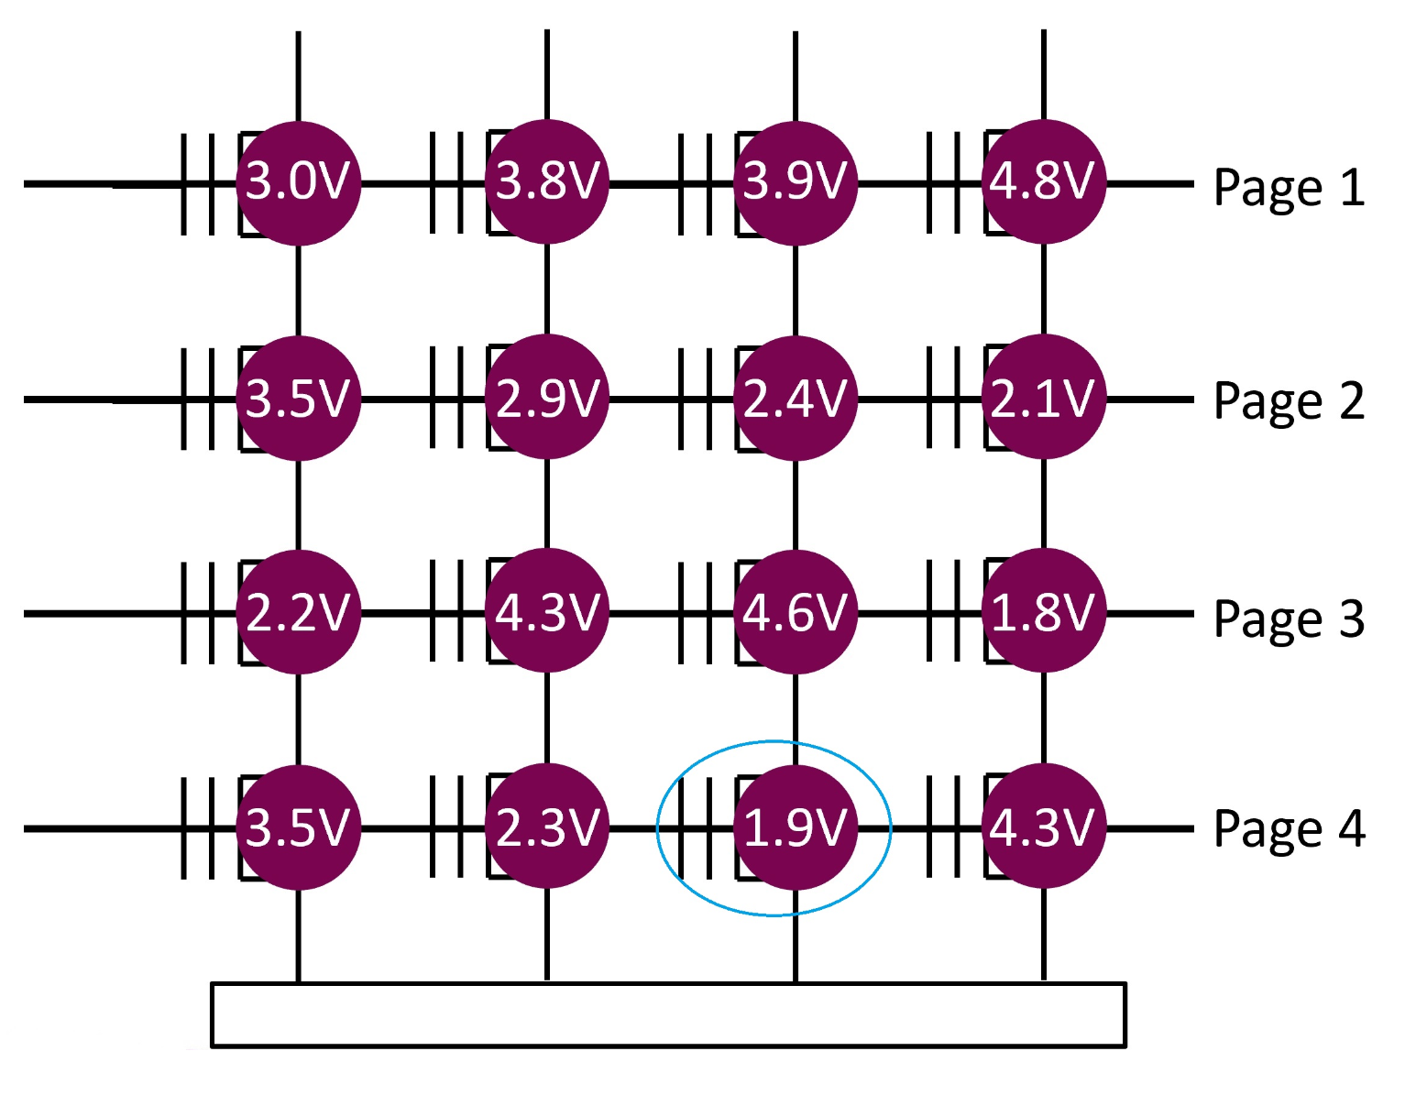
Exercise
In a flash memory, the high voltage (2.5V-5V) represents 0 and low voltage (0V-2.5V) represents 1. Suppose currently the voltage in each cell is shown in the following figure. What voltages should we add to page 1, 2, 3 and 4 respectively, in order to read the value store in the cell in the blue circle in the picture?
Notes:
Page 1: 5
Page 2: 5
Page 3: 5
Page 4: 2.5

