Slide 1
GE2262 Business Statistics
Topic 5
Confidence Interval Estimation
Reference
Levine, D.M., Krehbiel, T.C. and Berenson, M.L., Business Statistics: A First Course, Pearson Education Ltd, Chapter 8

Slide 2
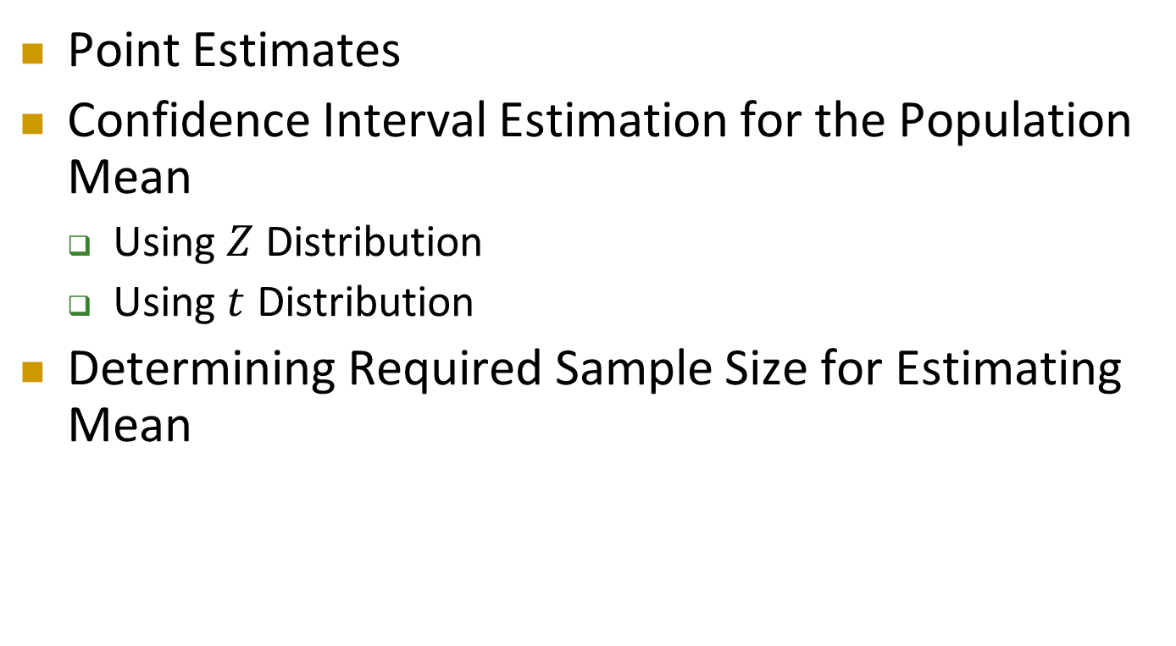
Outline
Point Estimates
Confidence Interval Estimation for the Population Mean
  Using $Z$ Distribution
  Using $t$ Distribution
Determining Required Sample Size for Estimating Mean

Slide 3
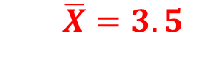
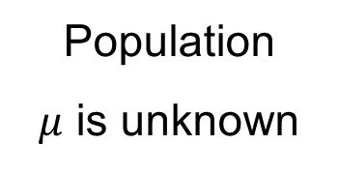
Point Estimates
2. Select a Random Sample and Obtain the Sample Statistics
1. Define the Population
3. Make an Estimation
I estimate that the population mean GPA is 3.5
Population
$μ$ is unknown
$\overline{X}=3.5$
Sample

Slide 4
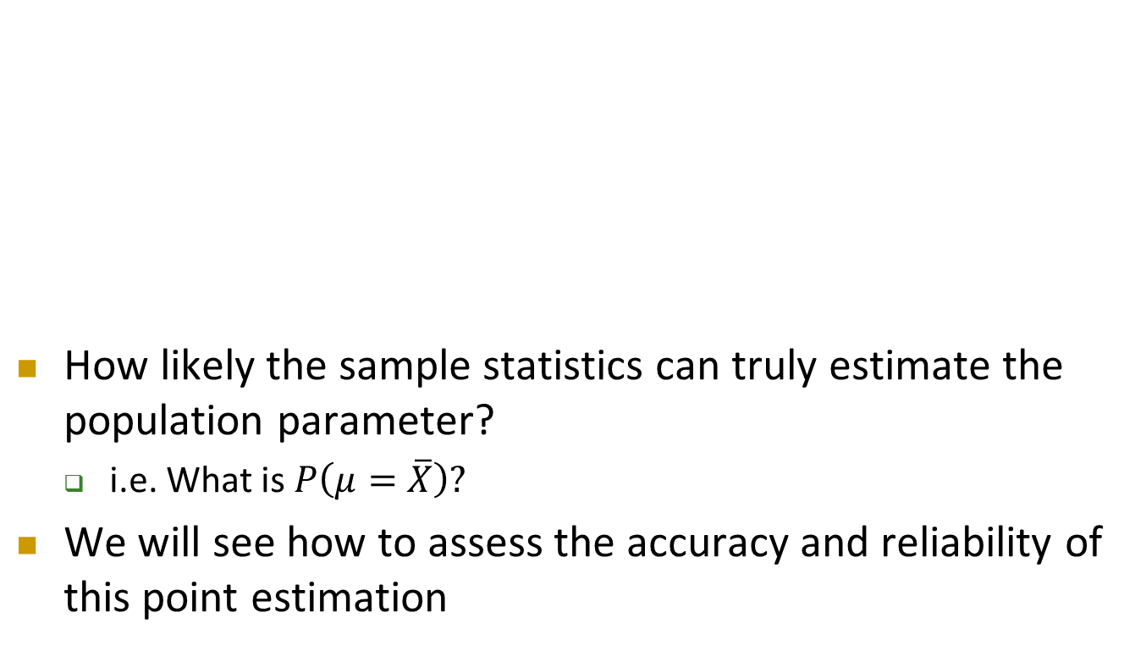
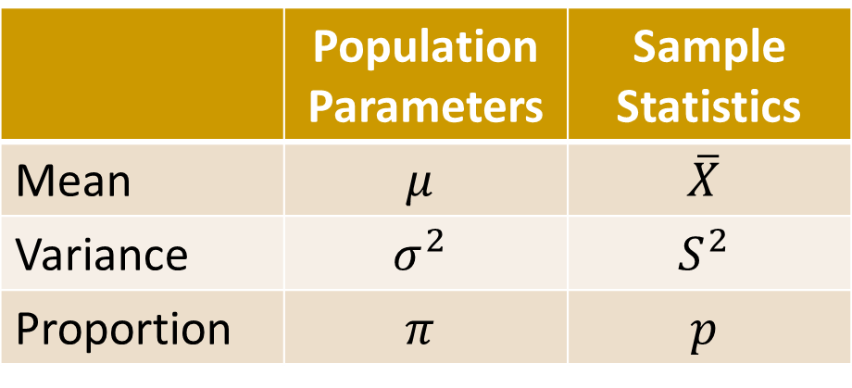
Point Estimates
Cont’d
 | Population Parameters | Sample Statistics
Mean | $$μ$$ | $$\overline{X}$$
Variance | $$σ^{2}$$ | $$S^{2}$$
Proportion | $$π$$ | $$p$$
How likely the sample statistics can truly estimate the population parameter?
  i.e. What is $P\left(μ=\overline{X}\right)?$
We will see how to assess the accuracy and reliability of this point estimation
To be discussed in Topic 7

Slide 5
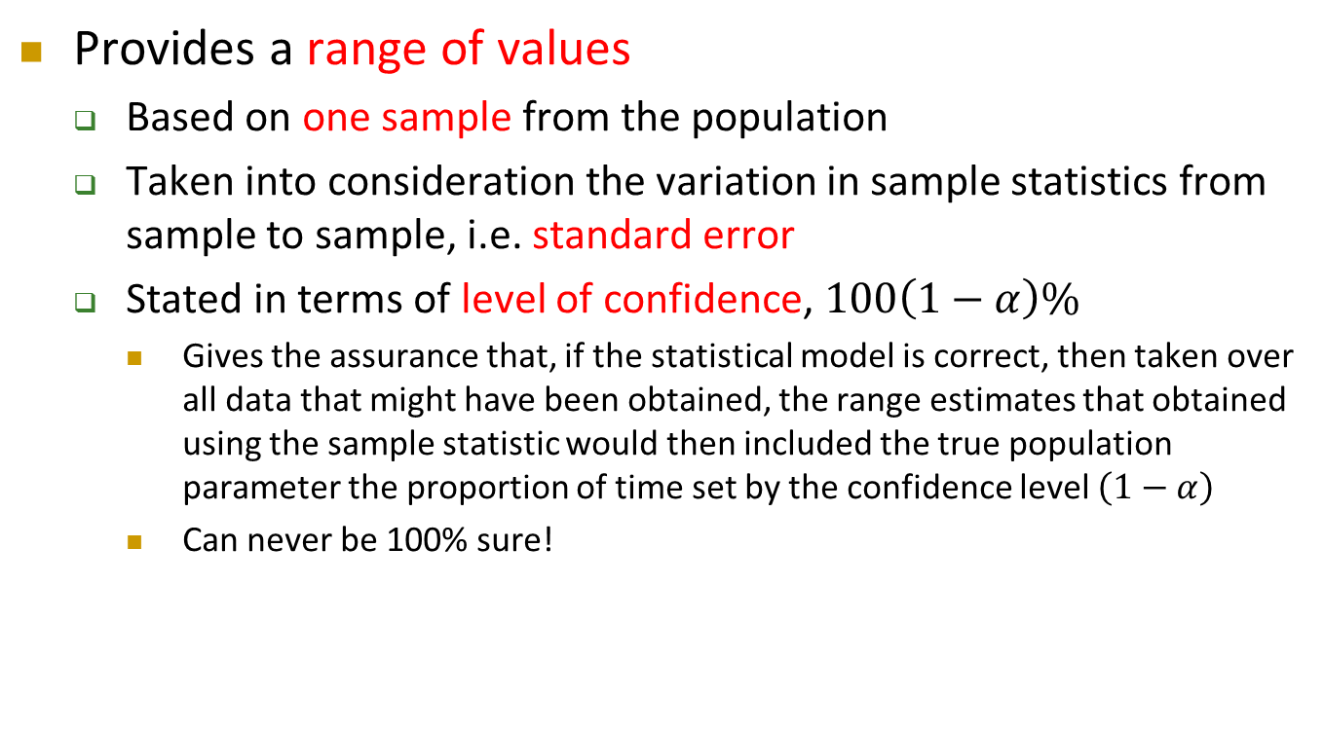
What is a Confidence Interval?
Provides a range of values
  Based on one sample from the population
  Taken into consideration the variation in sample statistics from sample to sample, i.e. standard error
  Stated in terms of level of confidence, $100\left(1−α\right)\%$
    Gives the assurance that, if the statistical model is correct, then taken over all data that might have been obtained, the range estimates that obtained using the sample statistic would then included the true population parameter the proportion of time set by the confidence level $\left(1−α\right)$
    Can never be 100% sure!

Slide 6
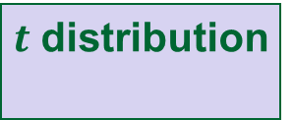

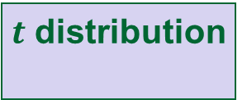
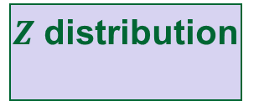

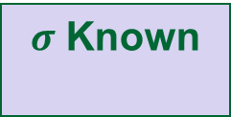
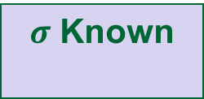
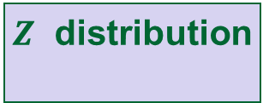
Confidence Interval Estimation
Confidence
Intervals for μ
X ~ Normal distribution
X ~ other distribution
$σ$ Known
$σ$ Unknown
σ Known
Large Sample
(n ≥ 30)
Small Sample
(n < 30)
$Z$ distribution
$t$ distribution
$σ$ Known
$σ$ Unknown
$Z$ distribution
$t$ distribution

Slide 7
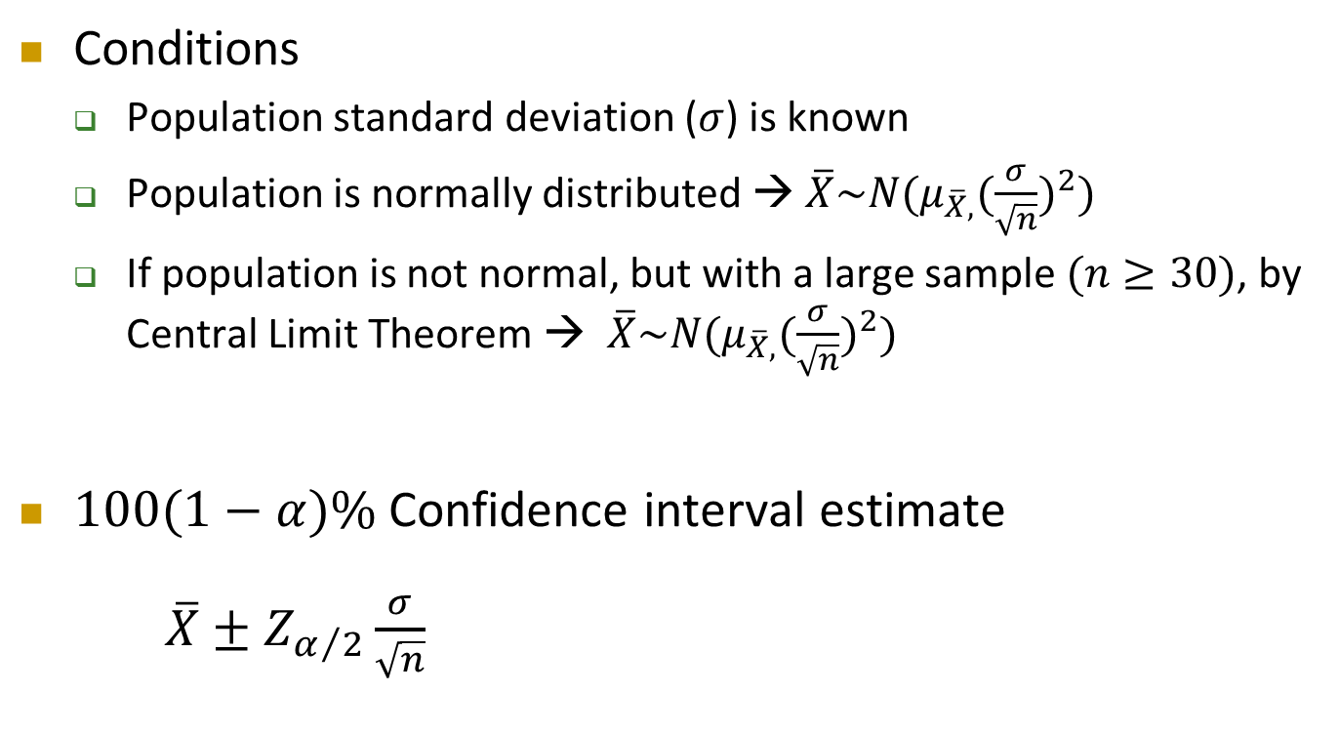
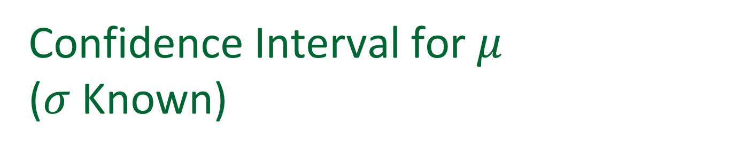

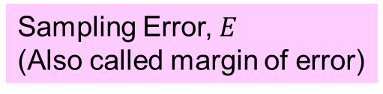
Confidence Interval for $μ$
($σ$ Known)
Conditions
  Population standard deviation ($σ$) is known
  Population is normally distributed → $\overline{X}\sim N(μ_{\overline{X},}{(\frac{σ}{\sqrt{n}})}^{2})$
  If population is not normal, but with a large sample $(n≥30)$, by Central Limit Theorem → $\overline{X}\sim N(μ_{\overline{X},}{(\frac{σ}{\sqrt{n}})}^{2})$
$100(1−α)\%$ Confidence interval estimate
  $\overline{X}±Z_{α/2}\frac{σ}{\sqrt{n}}$
Standard Error, $σ_{\overline{X}}$
Sampling Error, $E$
(Also called margin of error)
Critical Value

Slide 8
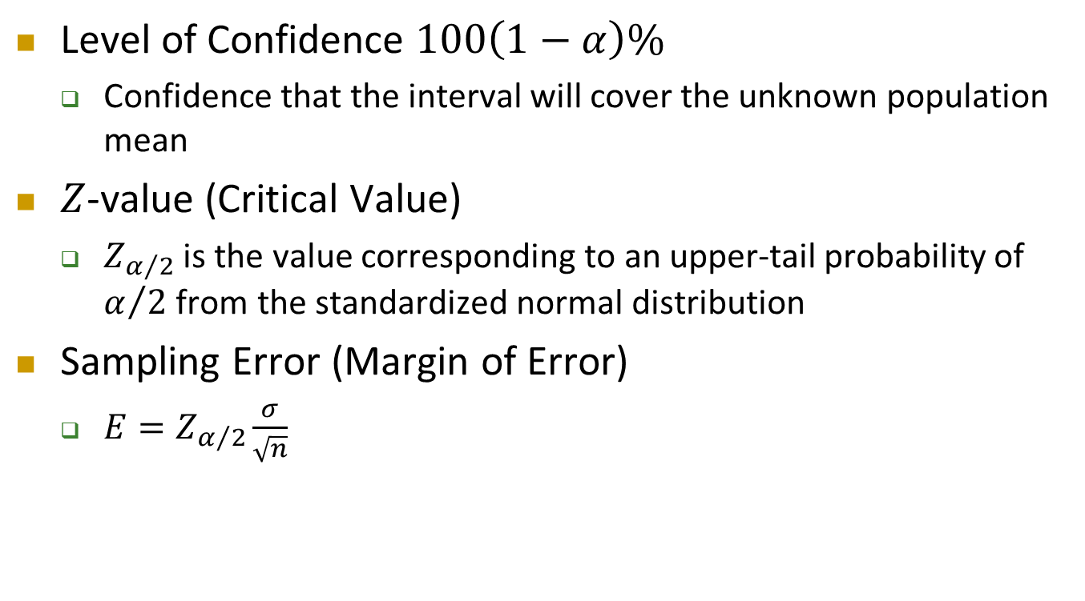
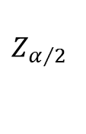

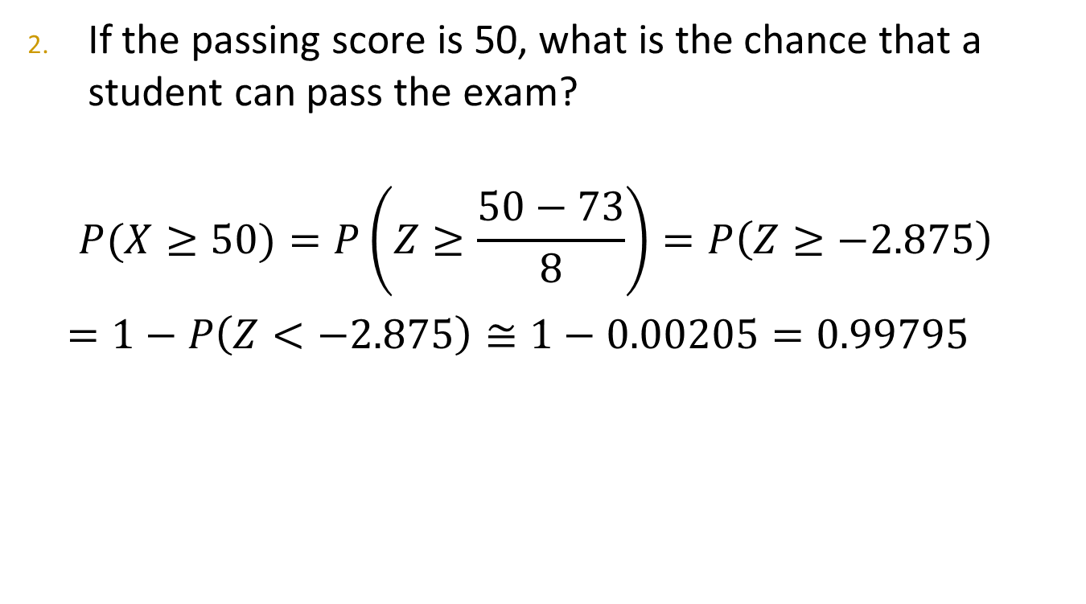
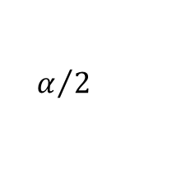
Confidence Interval for $μ$
($σ$ Known)
Cont’d
Level of Confidence $100\left(1−α\right)\%$
  Confidence that the interval will cover the unknown population mean
$Z$-value (Critical Value)
  $Z_{α/2}$ is the value corresponding to an upper-tail probability of $α/2$ from the standardized normal distribution
Sampling Error (Margin of Error)
  $E=Z_{α/2}\frac{σ}{\sqrt{n}}$
$$α/2$$
$$0$$
$$Z_{α/2}$$
$$Z$$

Slide 9

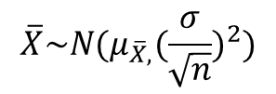

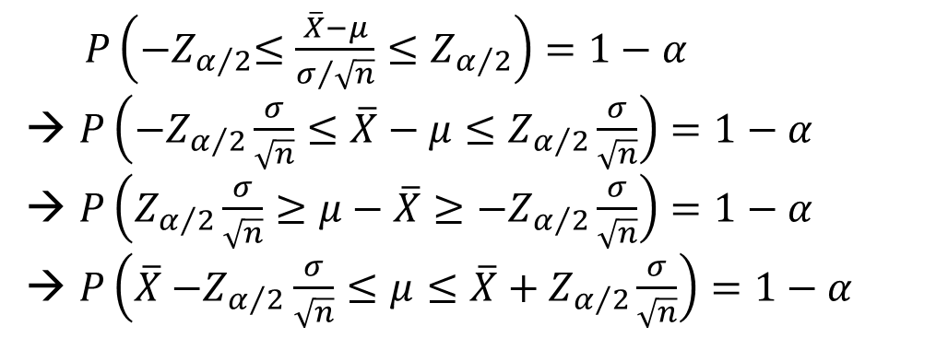

Confidence Interval for $μ$
($σ$ Known)
Cont’d
Derivation
$$\overline{X}\sim N(μ_{\overline{X},}{(\frac{σ}{\sqrt{n}})}^{2})$$
α/2
α/2
$$1− α$$
$$\overline{X}$$
$$μ_{\overline{X}}=μ$$
$P\left({−Z}_{α/2}≤\frac{\overline{X}−μ}{σ/{\sqrt{n}}}≤Z_{α/2}\right)=1−α$
→ $P\left({−Z}_{α/2}\frac{σ}{\sqrt{n}}≤\overline{X}−μ≤Z_{α/2}\frac{σ}{\sqrt{n}}\right)=1−α$
→ $P\left(Z_{α/2}\frac{σ}{\sqrt{n}}≥μ−\overline{X}≥{−Z}_{α/2}\frac{σ}{\sqrt{n}}\right)=1−α$
→ $P\left(\overline{X}{−Z}_{α/2}\frac{σ}{\sqrt{n}}≤μ≤\overline{X}+Z_{α/2}\frac{σ}{\sqrt{n}}\right)=1−α$

Slide 10
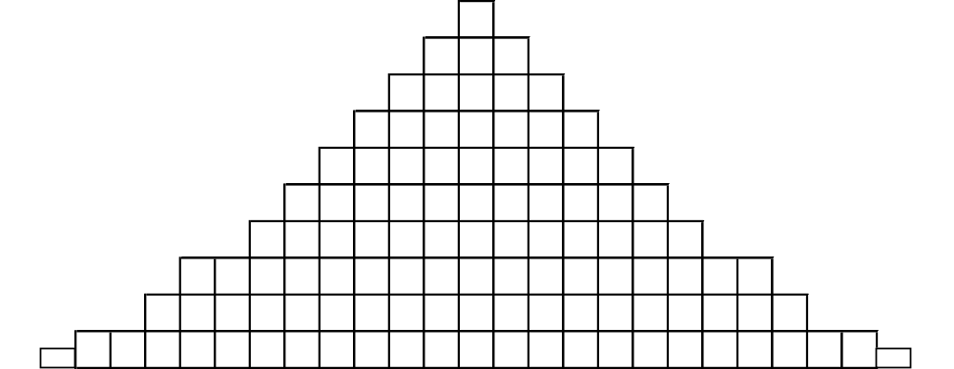

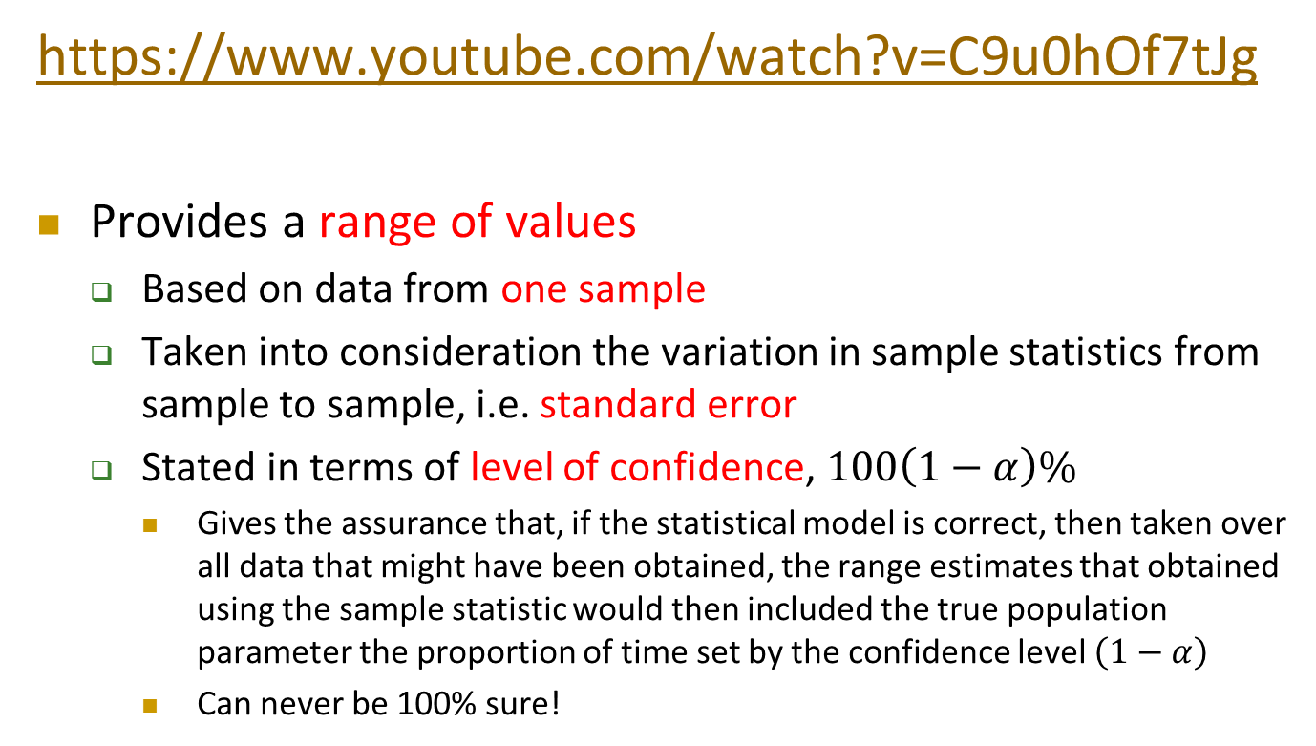
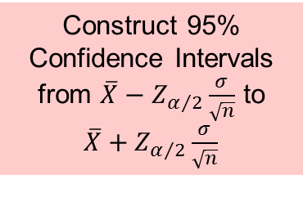

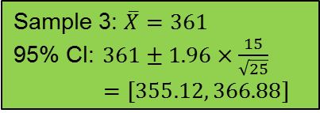
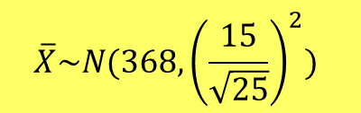
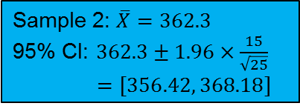
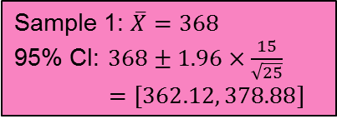
Confidence Interval for $μ$
($σ$ Known)
$$\overline{X}\sim N(368, {\left(\frac{15}{\sqrt{25}}\right)}^{2})$$
Cont’d
Construct 95% Confidence Intervals
from $\overline{X}−Z_{α/2}\frac{σ}{\sqrt{n}}$ to $\overline{X}+Z_{α/2}\frac{σ}{\sqrt{n}}$
$$\overline{X}$$
$$μ_{\overline{X}}=μ=368$$
Sample 1: $\overline{X}=368$
95% CI: $368±1.96×\frac{15}{\sqrt{25}}$
$$=[362.12, 378.88]$$
362.12
378.88
Sample 2: $\overline{X}=362.3$
95% CI: $362.3±1.96×\frac{15}{\sqrt{25}}$
$$=[356.42, 368.18]$$
356.42
368.18
Sample 3: $\overline{X}=361$
95% CI: $361±1.96×\frac{15}{\sqrt{25}}$
$$=[355.12, 366.88]$$
355.12
366.88
If you repeat the sampling by 100 times, you will find that $95\%$ of intervals constructed cover $μ$; $5\%$ do not.

Slide 11
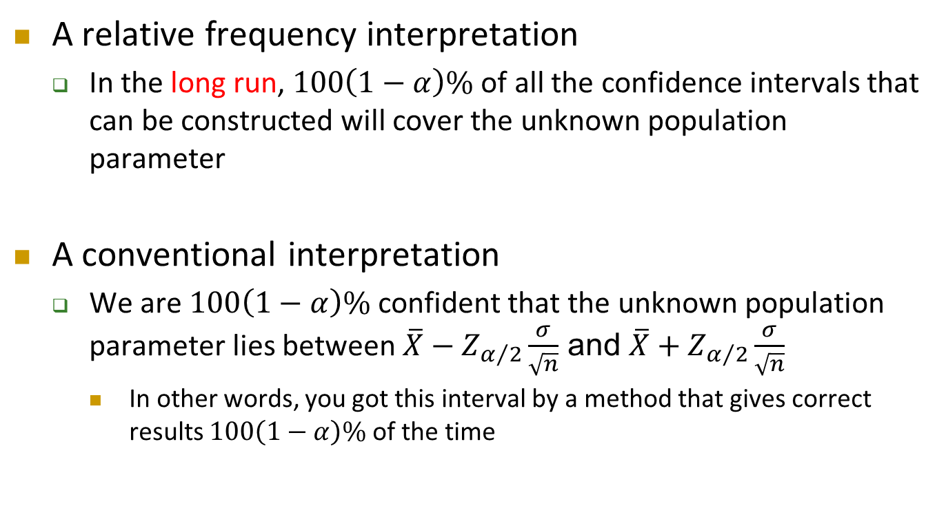
Confidence Interval for $μ$
($σ$ Known)
Cont’d
A relative frequency interpretation
  In the long run, $100\left(1−α\right)\%$ of all the confidence intervals that can be constructed will cover the unknown population parameter
A conventional interpretation
  We are $100\left(1−α\right)\%$ confident that the unknown population parameter lies between $\overline{X}−Z_{α/2}\frac{σ}{\sqrt{n}}$ and $\overline{X}+Z_{α/2}\frac{σ}{\sqrt{n}}$
    In other words, you got this interval by a method that gives correct results $100\left(1−α\right)\%$ of the time

Slide 12
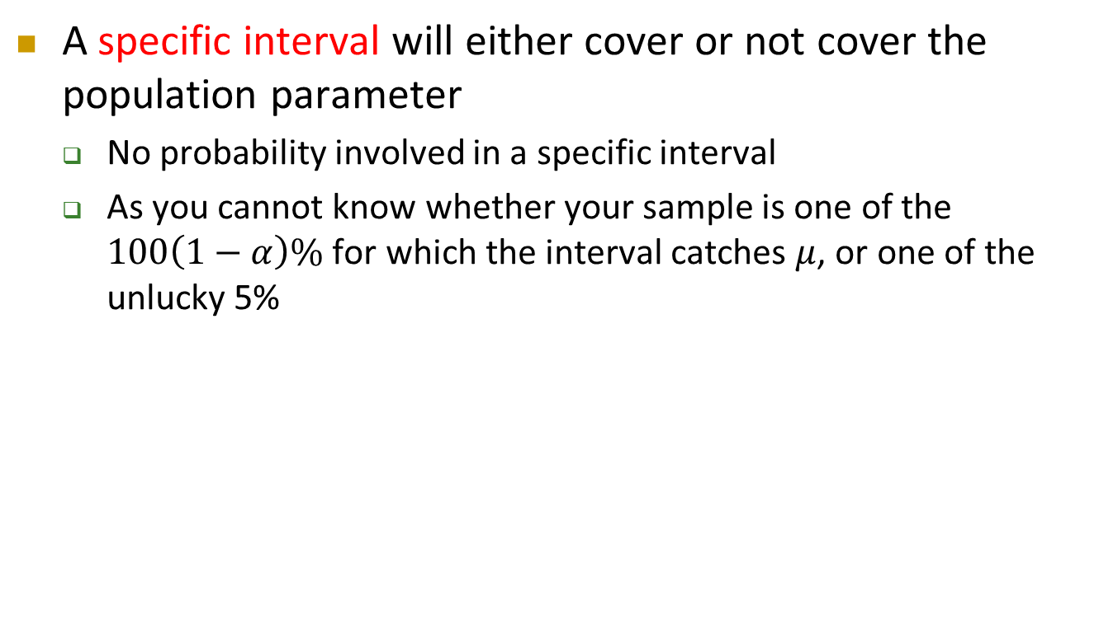
Confidence Interval for $μ$
($σ$ Known)
Cont’d
A specific interval will either cover or not cover the population parameter
  No probability involved in a specific interval
  As you cannot know whether your sample is one of the $100\left(1−α\right)\%$ for which the interval catches $μ$, or one of the unlucky 5%

Slide 13
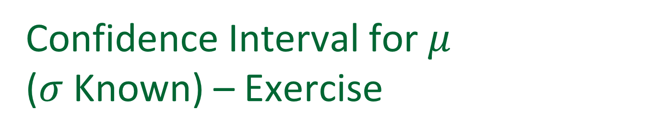
Confidence Interval for $μ$
($σ$ Known) – Exercise
A random sample of 15 stocks traded on the Hang Seng Index showed an average shares traded to be 215,000
From the past experience, it is believed that the population standard deviation of shares traded is 195,000 and the shares traded are very close to a Normal distribution
Construct a 99% confidence interval for the average shares traded on the Hang Seng Index. Interpret the result.

Slide 14
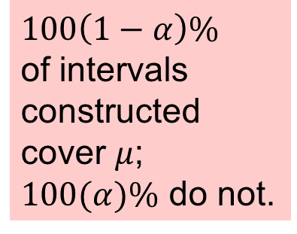

Confidence Interval for $μ$
($σ$ Known) – Exercise
Cont’d
$$\frac{0.01}{2}=0.005$$
$$Z_{\frac{0.01}{2}}$$
$$Z$$
$$0$$

Slide 15
Confidence Interval for $μ$
($σ$ Known) – Exercise
Cont’d
Interpretation
  If all possible samples of size 15 are taken and the corresponding 99% confidence intervals are constructed, 99% of these intervals will cover the unknown population mean
  We are 99% confident that the population average number of shares traded on the Hang Seng Index is between 85351.88 and 344648.12
  There is 99% chance that the unknown population mean will be in between 85351.88 and 344648.12
✓
✓
✗

Slide 16
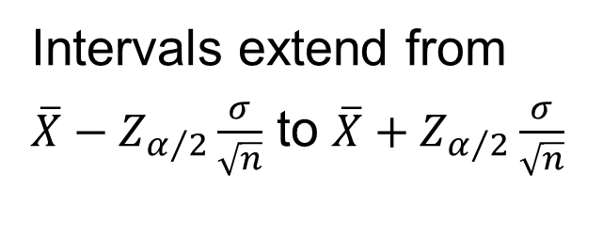
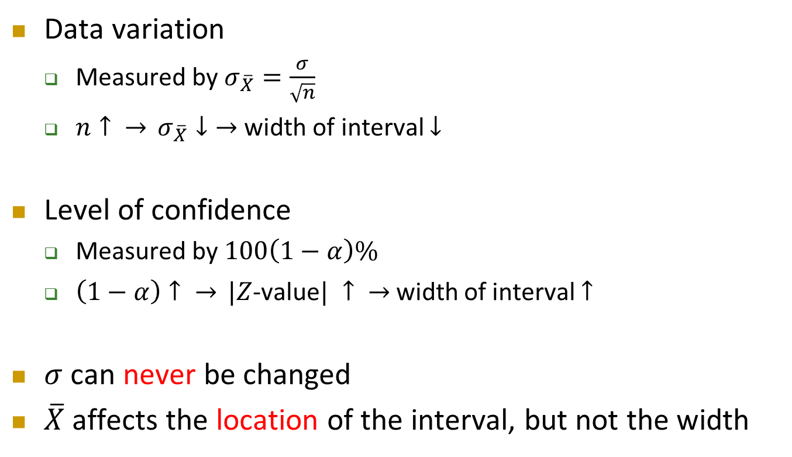
Factors Affecting Interval Width (Precision)
Data variation
  Measured by $σ_{\overline{X}}=\frac{σ}{\sqrt{n}}$
  $n↑ \overset{→}{} σ_{\overline{X}}↓\overset{→}{}$width of interval $↓$
Level of confidence
  Measured by $100\left(1−α\right)\%$
  $\left(1−α\right)↑ \overset{→}{} |Z$-value$| ↑ \overset{→}{}$width of interval $↑$
$σ$ can never be changed
$\overline{X}$ affects the location of the interval, but not the width
Intervals extend from $\overline{X}−Z_{α/2}\frac{σ}{\sqrt{n}}$ to $\overline{X}+Z_{α/2}\frac{σ}{\sqrt{n}}$
  http://www.rossmanchance.com/applets/ConfSim.html

Slide 17
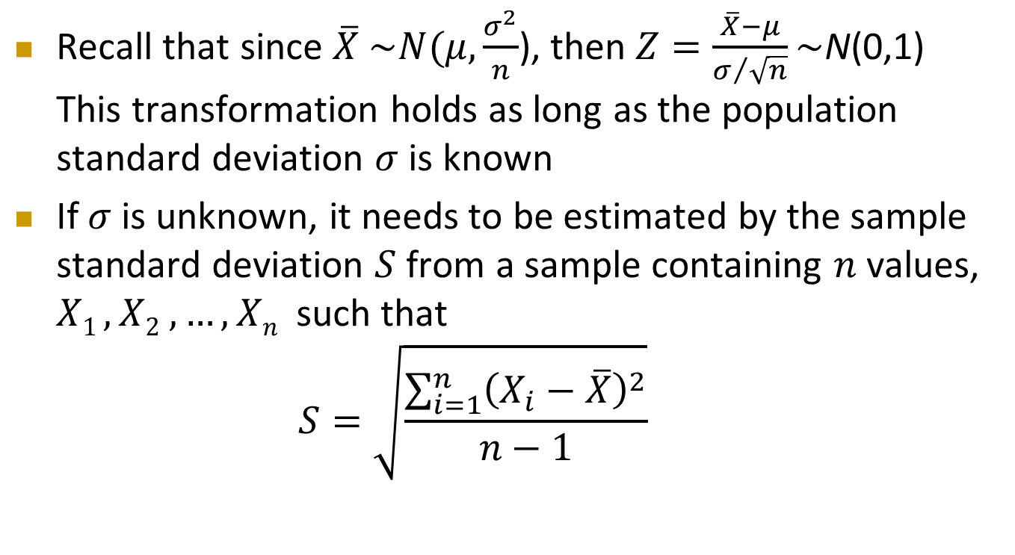

Confidence Interval for $μ$
($σ$ Unknown)
Recall that since $\overline{X}$ $\sim N(μ,\frac{σ^{2}}{n}$), then $Z=\frac{\overline{X}−μ}{σ/{\sqrt{n}}}\sim$N(0,1) This transformation holds as long as the population standard deviation $σ$ is known
If $σ$ is unknown, it needs to be estimated by the sample standard deviation $S$ from a sample containing $n$ values, $X1 , X2 , …, Xn$such that
  $$S=\sqrt{\frac{\sum_{i=1}^{n}{{\left(X_{i}−\overline{X}\right)}^{2}}}{n−1}}$$

Slide 18
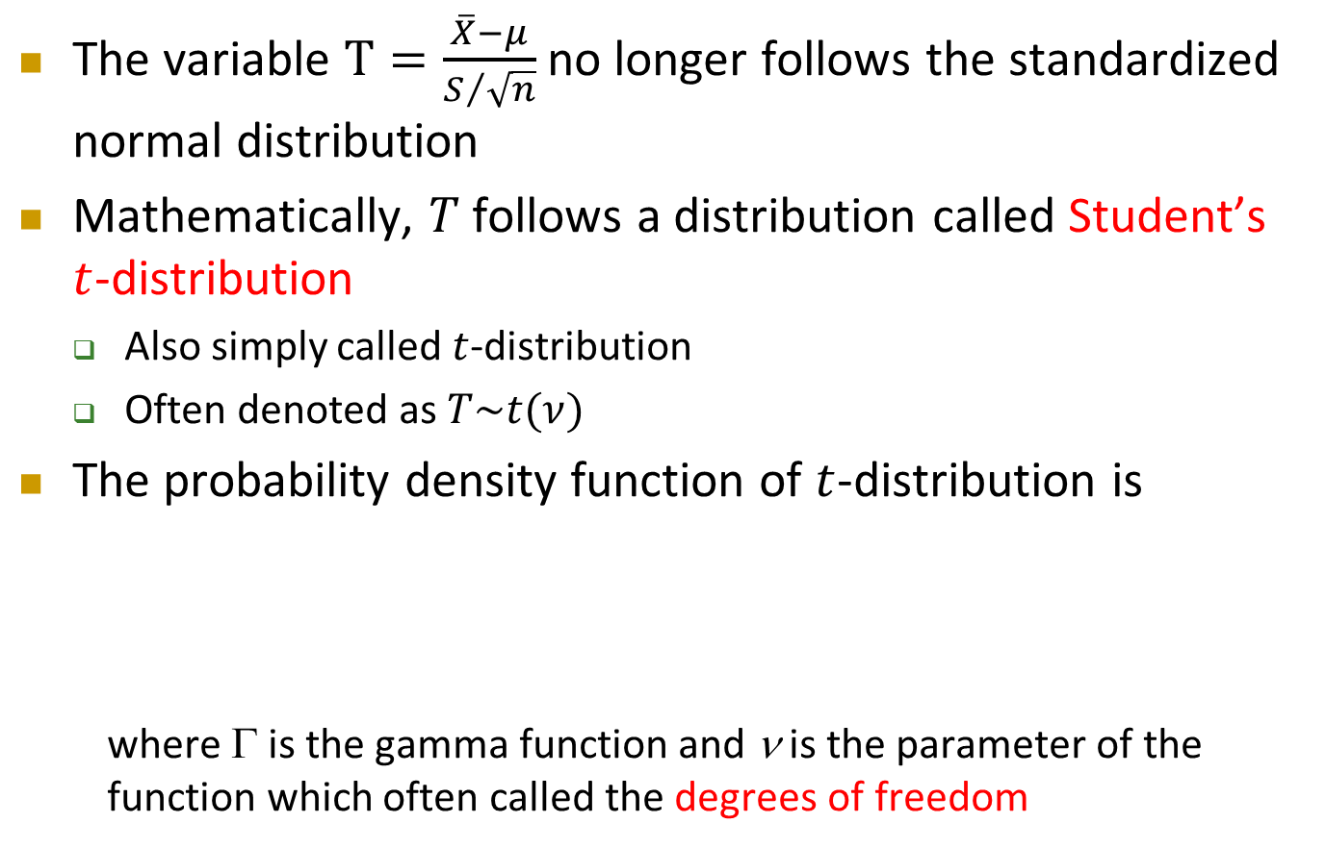

Student’s $t$-distribution
Cont’d
The variable $T=\frac{\overline{X}−μ}{S/{\sqrt{n}}}$ no longer follows the standardized normal distribution
Mathematically, $T$ follows a distribution called Student’s $t$-distribution
  Also simply called $t$-distribution
  Often denoted as $T\sim t(ν)$
The probability density function of $t$-distribution is
  where Γ is the gamma function and ν is the parameter of the function which often called the degrees of freedom
$$ν>0$$

Slide 19
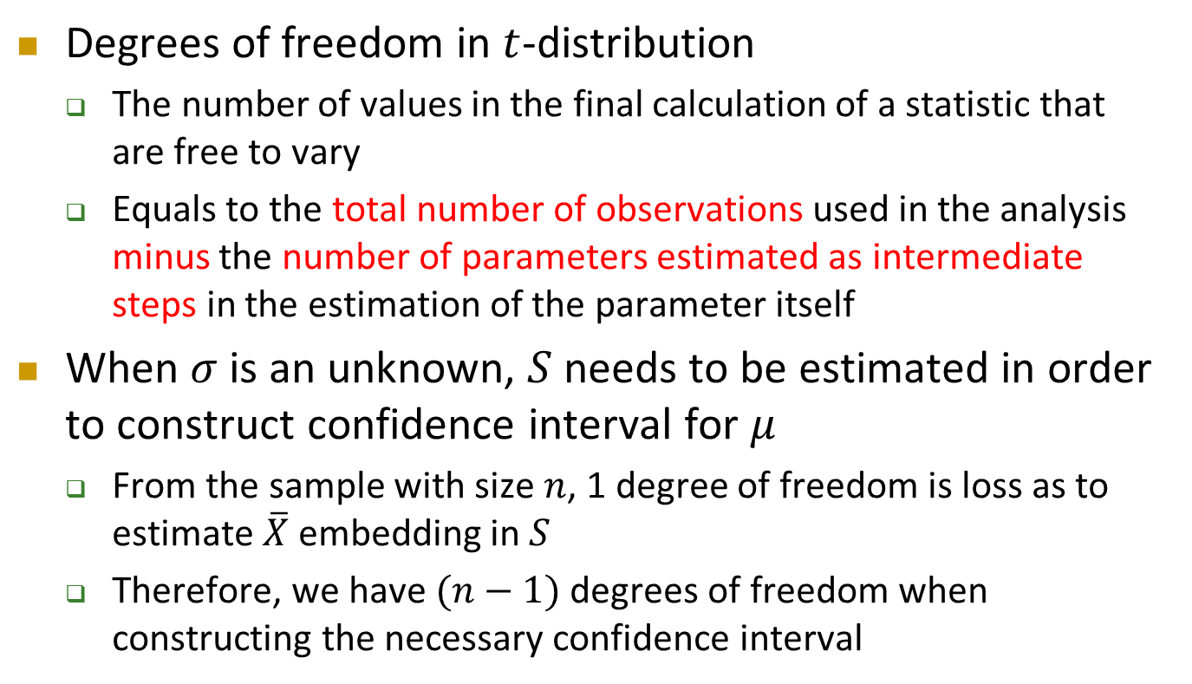

Student’s $t$-distribution
Cont’d
Degrees of freedom in $t$-distribution
  The number of values in the final calculation of a statistic that are free to vary
  Equals to the total number of observations used in the analysis minus the number of parameters estimated as intermediate steps in the estimation of the parameter itself
When $σ$ is an unknown, $S$ needs to be estimated in order to construct confidence interval for $μ$
  From the sample with size $n$, 1 degree of freedom is loss as to estimate $\overline{X}$ embedding in $S$
  Therefore, we have $(n−1)$ degrees of freedom when constructing the necessary confidence interval

Slide 20
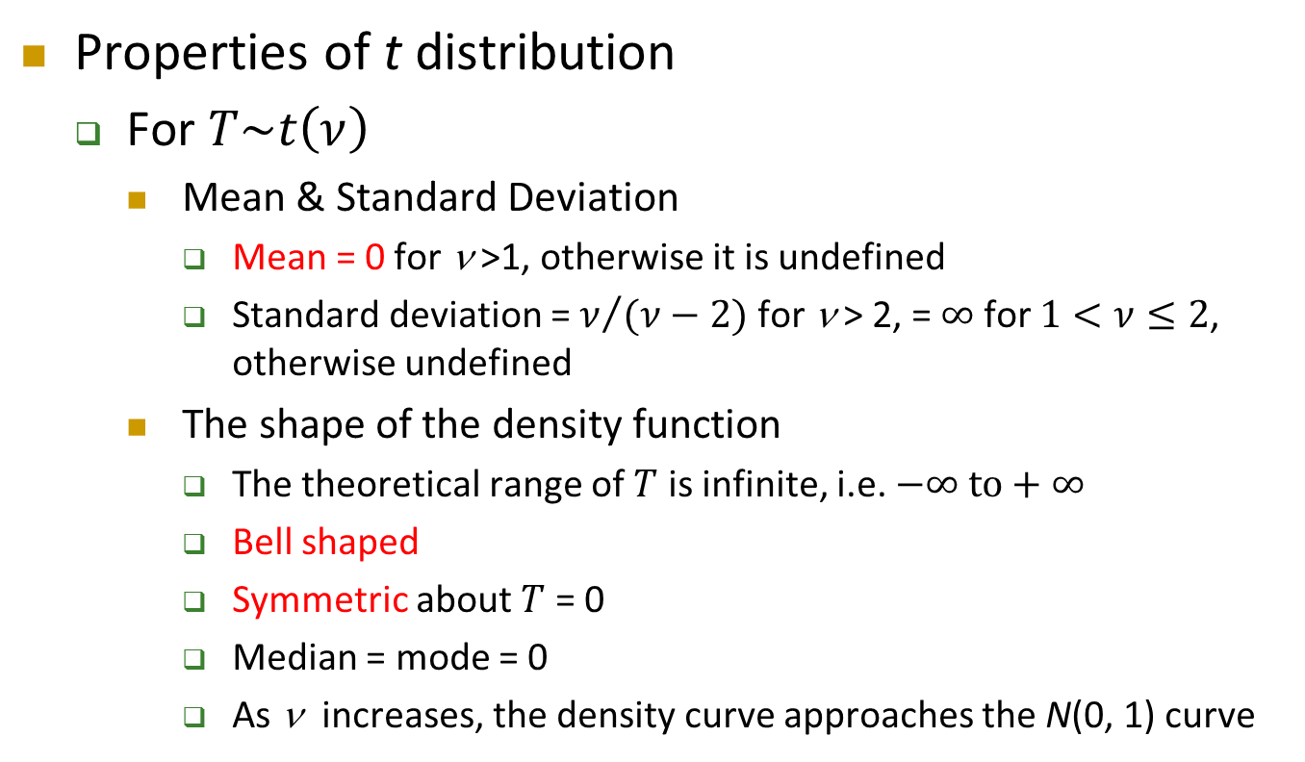

Student’s $t$-distribution
Cont’d
Properties of t distribution
  For $T\sim t\left(ν\right)$
    Mean & Standard Deviation
      Mean = 0 for ν >1, otherwise it is undefined
      Standard deviation = $ν/{(ν−2)}$ for ν > 2, = $∞$ for $1<ν≤2$, otherwise undefined
    The shape of the density function
      The theoretical range of $T$ is infinite, i.e. $−∞ \text{to}+∞$
      Bell shaped
      Symmetric about $T$ = 0
      Median = mode = 0
      As ν increases, the density curve approaches the N(0, 1) curve

Slide 21

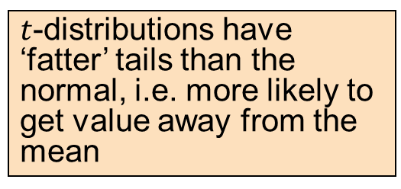
Student’s $t$-distribution
Cont’d
Standard Normal
(t with ν = ∞)
t (ν = 13)
$t$-distributions have ‘fatter’ tails than the normal, i.e. more likely to get value away from the mean
t (ν = 5)
$$T$$
0

Slide 22
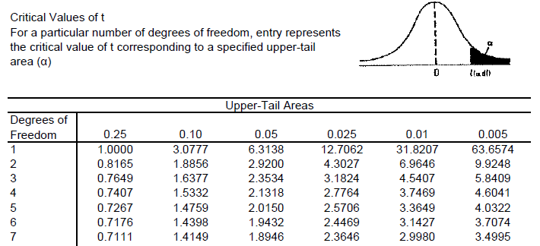
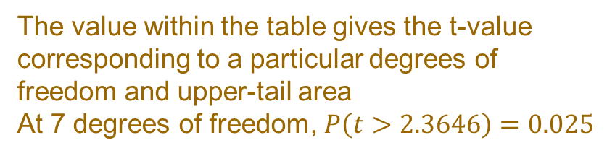
Student’s $t$-distribution
Cont’d
The column gives the upper tail area
The value within the table gives the t-value corresponding to a particular degrees of freedom and upper-tail area
At 7 degrees of freedom, $P\left(t>2.3646\right)=0.025$
The row shows the degrees of freedom

Slide 23
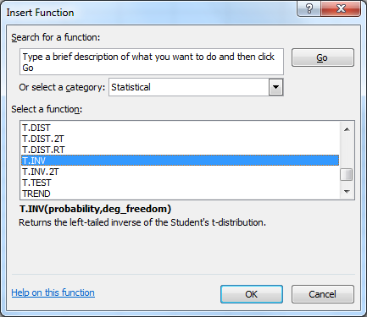
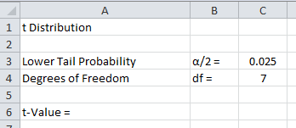
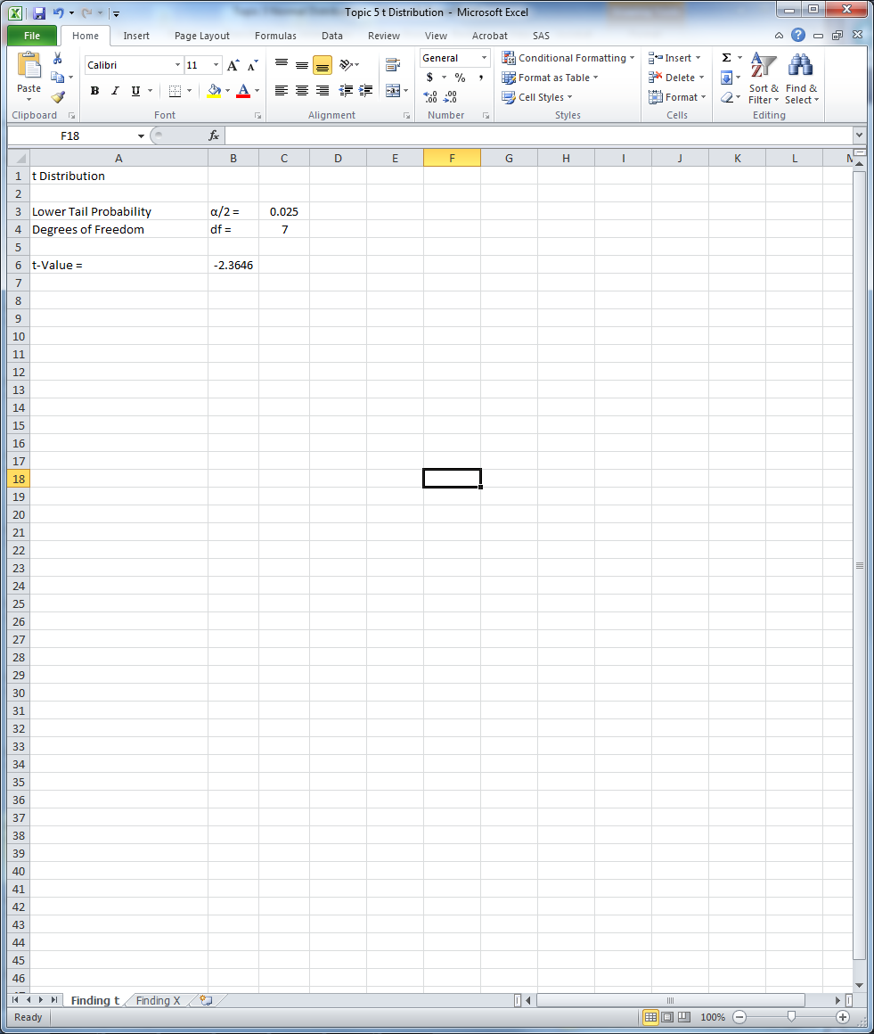
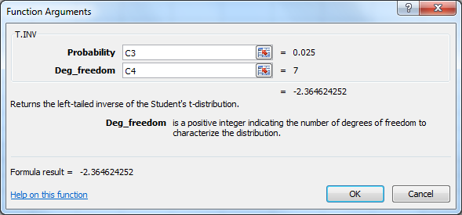
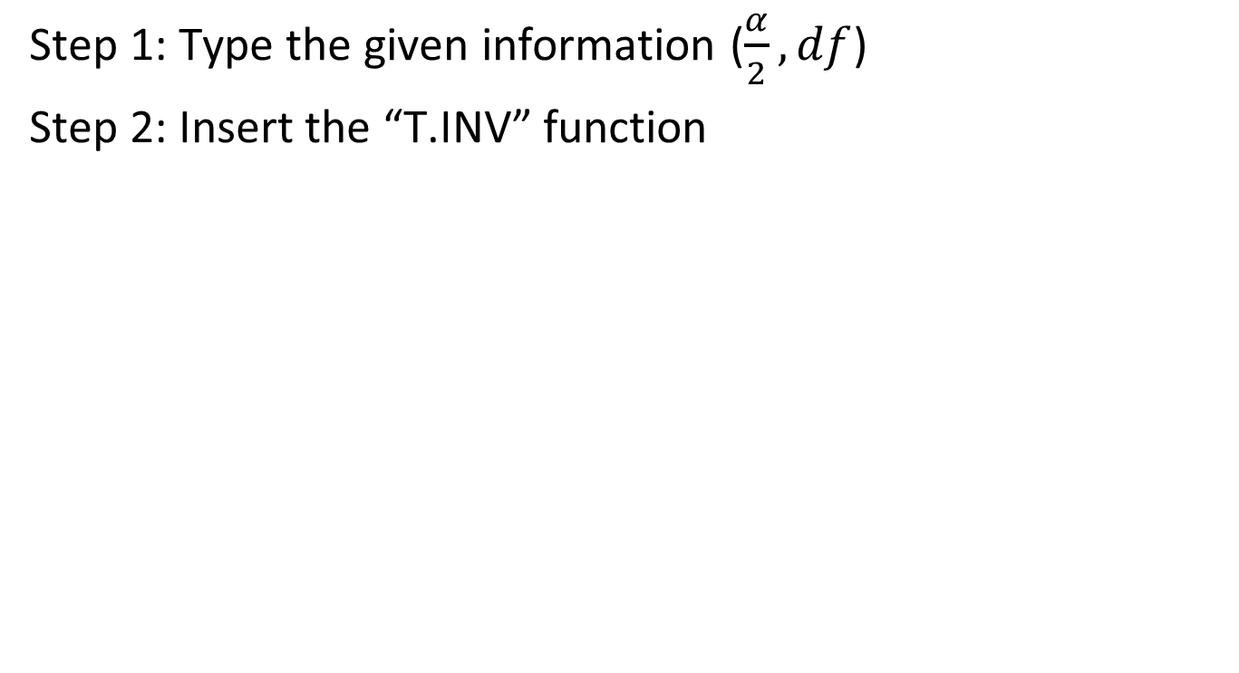

Finding $t$-Value in Excel
Step 1: Type the given information ($\frac{α}{2},df$)
Step 2: Insert the “T.INV” function
=T.INV(lower tail probability, df)

Slide 24
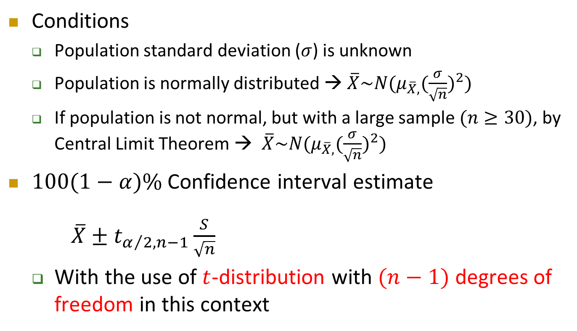
Confidence Interval for $μ$
($σ$ Unknown)
Cont’d
Conditions
  Population standard deviation ($σ$) is unknown
  Population is normally distributed → $\overline{X}\sim N(μ_{\overline{X},}{(\frac{σ}{\sqrt{n}})}^{2})$
  If population is not normal, but with a large sample $(n≥30)$, by Central Limit Theorem → $\overline{X}\sim N(μ_{\overline{X},}{(\frac{σ}{\sqrt{n}})}^{2})$
$100(1−α)\%$ Confidence interval estimate
  $\overline{X}±t_{α/2,n−1}\frac{S}{\sqrt{n}}$
  With the use of $t$-distribution with $(n−1)$ degrees of freedom in this context

Slide 25

Confidence Interval for $μ$
($σ$ Unknown) – Example
The monthly salary of brokers is found to be Normally distributed
A random sample of 25 brokers has a mean monthly salary HK$80K and a standard deviation of HK$16K
Set up a 95% confidence interval estimation for the population mean

Slide 26
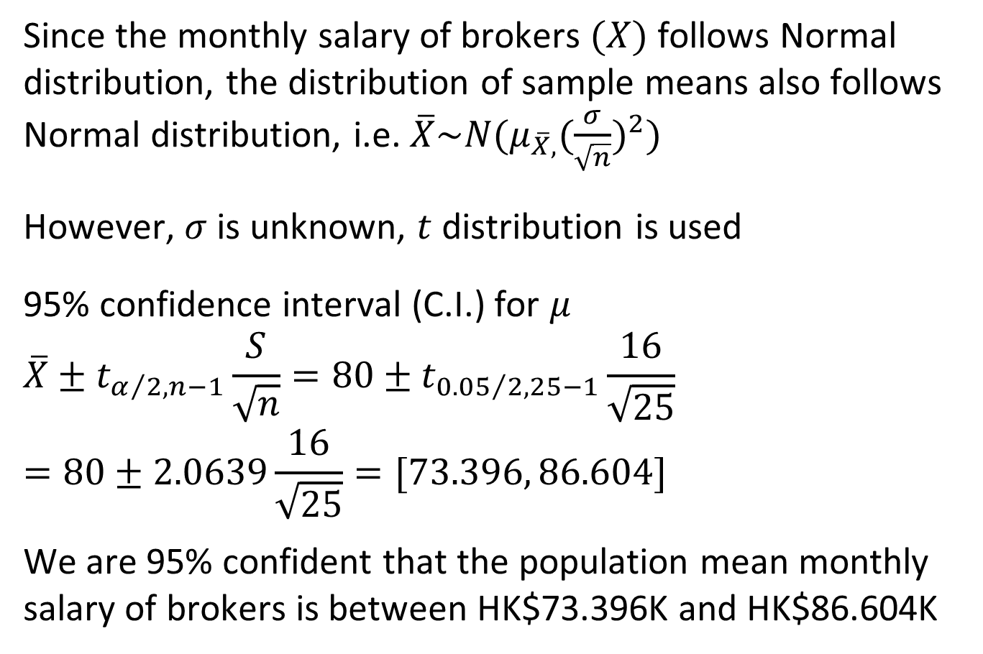



Confidence Interval for $μ$
($σ$ Unknown) – Example
Cont’d
Since the monthly salary of brokers $(X)$ follows Normal distribution, the distribution of sample means also follows Normal distribution, i.e. $\overline{X}\sim N(μ_{\overline{X},}{(\frac{σ}{\sqrt{n}})}^{2})$
However, $σ$ is unknown, $t$ distribution is used
95% confidence interval (C.I.) for $μ$
$$\overline{X}±t_{α/2,n−1}\frac{S}{\sqrt{n}}=80±t_{{0.05}/2,25−1}\frac{16}{\sqrt{25}}$$
$$=80±2.0639\frac{16}{\sqrt{25}}=[73.396, 86.604]$$
We are 95% confident that the population mean monthly salary of brokers is between HK$73.396K and HK$86.604K
$$\frac{0.05}{2}=0.025$$
$$t$$
$$0$$
$$t_{\frac{0.05}{2},25−1}$$

Slide 27

Confidence Interval for $μ$
($σ$ Unknown) – Exercise
Cont’d
  The branch manager of an outlet of a nationwide chain of pet supply stores want to study characteristics of her customers. In particular, she would like to estimate the population mean amount spent in the pet supply store. A random sample of 200 customers is selected. The sample mean of amount of money spent is $21.34, and the sample standard deviation is $9.22. Construct a 95% confidence interval estimate for the population mean amount spent in the pet supply store.

Slide 28
Confidence Interval for $μ$
($σ$ Unknown) – Exercise
Cont’d

Slide 29

Determining Sample Size
Large sample
  Requires more resources
  Smaller standard error
Small sample
  Less precise estimation

Slide 30

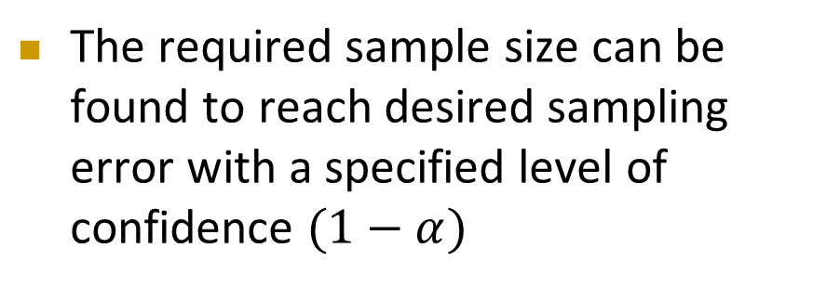
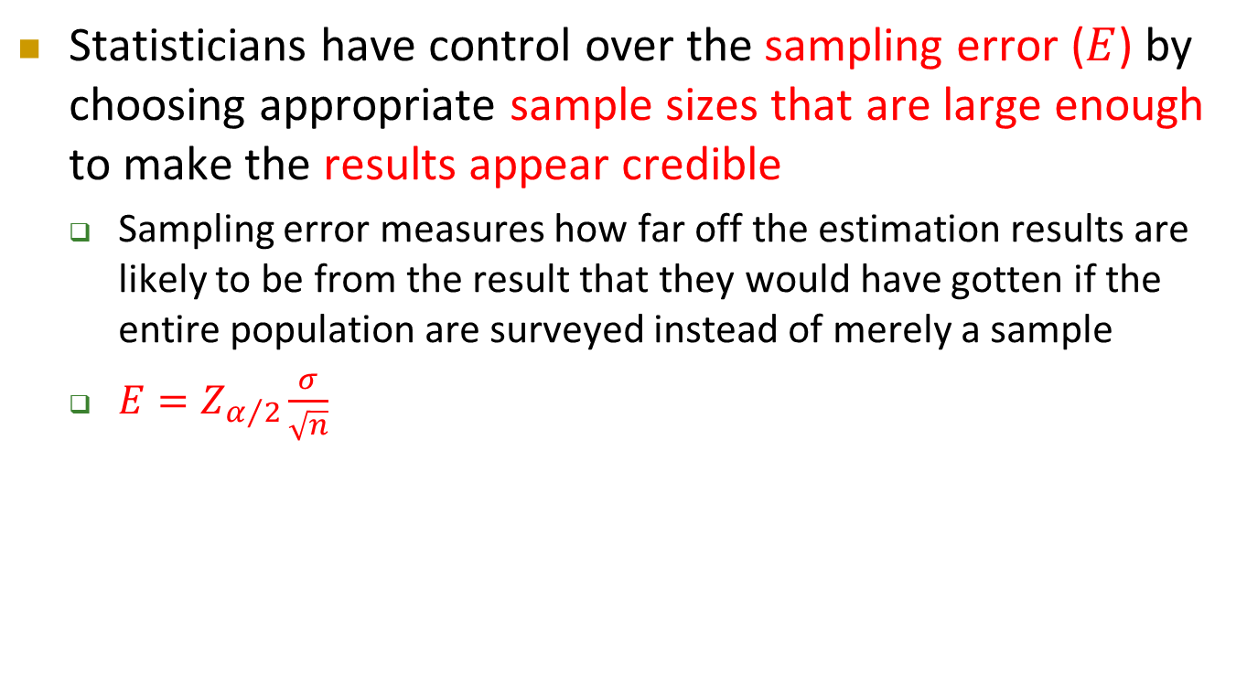



Determining Sample Size
Cont’d
Statisticians have control over the sampling error ($E$) by choosing appropriate sample sizes that are large enough to make the results appear credible
  Sampling error measures how far off the estimation results are likely to be from the result that they would have gotten if the entire population are surveyed instead of merely a sample
  $E=Z_{α/2}\frac{σ}{\sqrt{n}}$
The required sample size can be found to reach desired sampling error with a specified level of confidence $(1−α)$
$$\overline{X}$$
$$\overline{X}−Z_{α/2}\frac{σ}{\sqrt{n}}$$
$$\overline{X}+Z_{α/2}\frac{σ}{\sqrt{n}}$$
$E$ = Sampling Error

Slide 31


Determining Sample Size
Cont’d
What sample size is needed to be $100\left(1−α\right)\%$ confidence of being correct to within $±E$?
Assume $σ$ is known
$P\left(μ−E≤\overline{X}≤μ+E\right)=1−α$
$P\left(−E≤\overline{X}−μ≤E\right)=1−α$
$E=Z_{α/2}\frac{σ}{\sqrt{n}}$
→ $n={(\frac{Z_{α/2}σ}{E})}^{2}$

Slide 32



Determining Sample Size – Example
Source: Hong Kong Free Press, 30 October 2019

Slide 33

Determining Sample Size – Example
Cont’d
http://hkupop.hku.hk/english/index.html
https://www.pori.hk/
POP Poll is a regularly survey aims to monitor to what extend does the general public support to the Chief Executive Mrs. Carrie Lam
The target population is Cantonese speakers in Hong Kong of age 18 or above
Randomly selected respondents are asked to rate their extend of support by using a scale of 0 – 100
  0 indicating absolutely not supportive
  100 indicating absolutely supportive

Slide 34


Determining Sample Size – Example
Cont’d
According to the POP Poll conducted between 17-23 October 2019, the 1038 random sampled respondents give a mean score is 20.23 with standard deviation 28.84
In order to be 90% confident of being correctly reflecting the population opinion to within $±2$.5 points, what sample size is needed?
$$n={(\frac{Z_{α/2}σ}{E})}^{2}={(\frac{1.645×28.84}{2.5})}^{2}=360.12≅361$$
Use $S$ to replace $σ$ when $σ$ is unknown
Round Up

Slide 35
Determining Sample Size – Exercise
Cont’d
If we want to increase our confidence to 95%, how many individuals should we interview? Keep all other factors remain unchanged.

Slide 36
Determining Sample Size
Cont’d
If the population standard deviation is unknown, we need to guess the value of standard deviation based on some prior information such as the sample standard deviation in earlier similar studies
If no previous sample data are available, one practical approach is to develop an estimate of the range of the data and then estimate the standard deviation as range/4

Slide 37
Determining Sample Size – Example
Cont’d
Suppose you want to estimate the mean GPA (μ) of all the students at your university at a margin of error of 0.3 and 95% confidence. How many students should be sampled?
  For 95% confidence level, α = 0.05, then $Z_{α/2}$ = 1.96
  Since the range of GPA is 4.3, we estimate the standard deviation as 4.3/4
  The required sample size is
  $n={(\frac{Z_{α/2}σ}{E})}^{2}={(\frac{1.96×(\frac{4.3}{4})}{0.3})}^{2}=49.33≅50$

Slide 38

Determining Sample Size
Cont’d
Warning:
  The value of $n$ does not depend on the size of the population. This is true as long as the population is much larger than the sample
  The derived sample size should only be taken as a rough indicator for the desired margin of error
  The true required sample size, which is unknown to us in practice, might be larger or smaller than the computed value
  Many statistical studies report the margin of error of involved estimates. This should not be taken as the error of a study. The margin of error only reports the possible error size of an estimate due to sampling, at a specified confidence level and under a “perfect environment”

