Slide 1
EE2000 Logic Circuit Design
Number Systems & Arithmetic

Slide 2
Outline
1.1 Number Systems
Introduction to decimal, binary, octal, hexadecimal
Conversion between these number systems
1.2 Binary Arithmetic
Representation of negative numbers
Addition and subtraction of binary numbers
1.3 Binary Codes for Decimal Digits
BCD, Gray codes, ASCII
1.4 Parity and Error Correction

Slide 3
Number Systems
Decimal (base 10)
E.g. 1, 2, 3, 4, 5, … 10, 11, 12, …
Binary (base 2)
  E.g. 000, 001, 010, 011, …
Octal (base 8)
  E.g. 00, 01, 02, …, 07, 10, 11, …17, 20, …
Hexadecimal (base 16)
    E.g. 1, 2, 3, …, 9, A, B, C, D, E, F, 10, 11, …

Slide 4
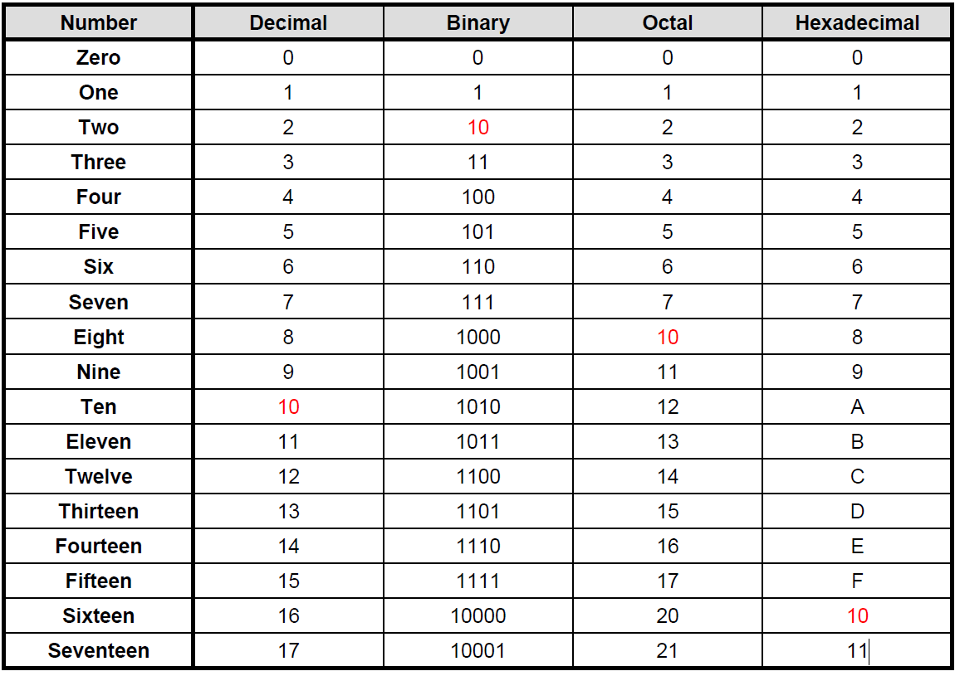

Slide 5
Number with radix
Given a number with radix (or base) r (r is usually a positive integer, but not necessarily)
a_{n}a_{n-1}...a₁a₀a₋₁…a_{-m+1}a_{-m}
where a_{i} = x , x (0,1, ... , r )
its decimal value is given by
a_{n-1} r^{n-1} + a_{n-2} r^{n-2} + … + a₂ r² + a₁ r + a₀
n: number of digits
r: radix (base)
a_{n} : coefficients (digits)

Slide 6
Polynomial Form
For decimal number, r = 10
e.g. (7392)₁₀
= 7 x 10³ + 3 x 10² + 9 x 10¹ + 2 x 10⁰
For binary number, r = 2
e.g. (1101.011)₂
= 1 x 2³ + 1 x 2² + 0 x 2¹ + 1 x 2⁰ + 0 x 2⁻¹ + 1 x 2⁻² + 1 x 2⁻³
For octal number, r = 8
e.g. (527)₈
= 5 x 8² + 2 x 8¹ + 7 x 8⁰

Slide 7
Conversion
Binary to Decimal
For binary number, r = 2
e.g. (1101.01)₂
= 1 x 2³ + 1 x 2² + 0 x 2¹ + 1 x 2⁰ + 0 x 2⁻¹ + 1 x 2⁻² = 8 + 4 + 0 + 1 + 0 + 0.25
= (13.25)₁₀

Slide 8
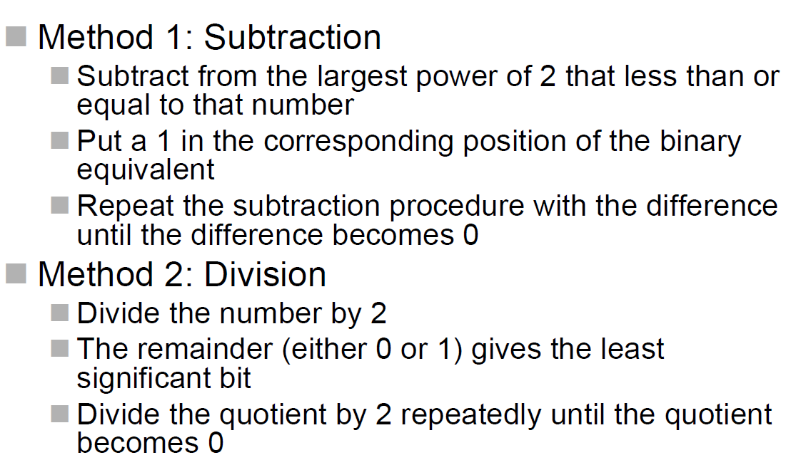
Conversion
Decimal to Binary

Slide 9
Division Method Decimal to Binary
(98)₁₀
98 / 2 = 49 Remainder = 0 0
49 / 2 = 24 Remainder = 1 10
24 / 2 = 12 Remainder = 0 010
12 / 2 = 6 Remainder = 0 0010
6 / 2 = 3 Remainder = 0 00010
3 / 2 = 1 Remainder = 1 100010
1 / 2 = 0 Remainder = 1 1100010
Ans = (1100010)₂
LSB, least significant bit
MSB, most significant bit

Slide 10
Division Method Decimal to Octal /hexadecimal
(611)₁₀
611 / 8 = 76 Remainder = 3 3
76 / 8 = 9 Remainder = 4 43
9 / 8 = 1 Remainder = 1 143
1 / 8 = 0 Remainder = 1 1143
Ans = (1143)₈
611 / 16 = 38 Remainder = 3 3
38 / 16 = 2 Remainder = 6 63
2 / 16 = 0 Remainder = 2 263
Ans = (263)₁₆

Slide 11
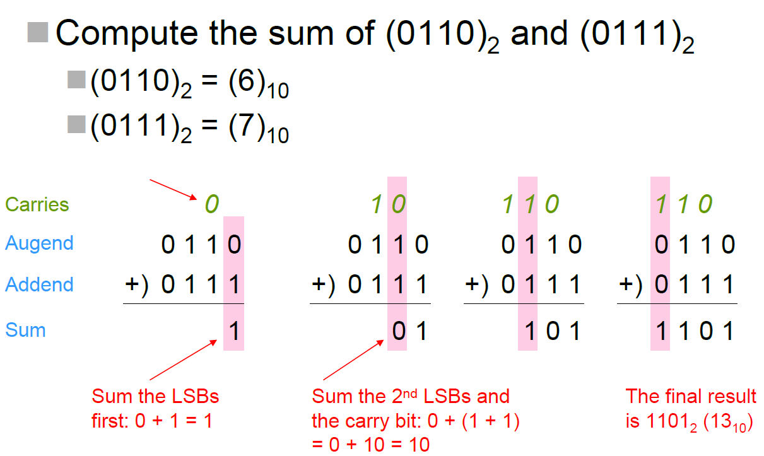
Binary Arithmetic

Slide 12
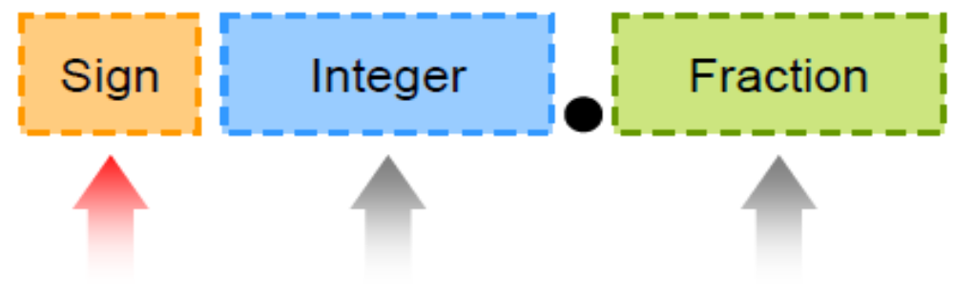
Signed Number Representation
Negative binary number?
1) Sign-magnitude format
2) Complement format

Slide 13
Sign-Magnitude Binary
The MSB be a sign bit
  0 means positive “+”
  1 means negative “-”
  For example:
  4-bit system ( +5 = 0101; -5= 1101)
  Last 3 bits used for magnitude

Slide 14
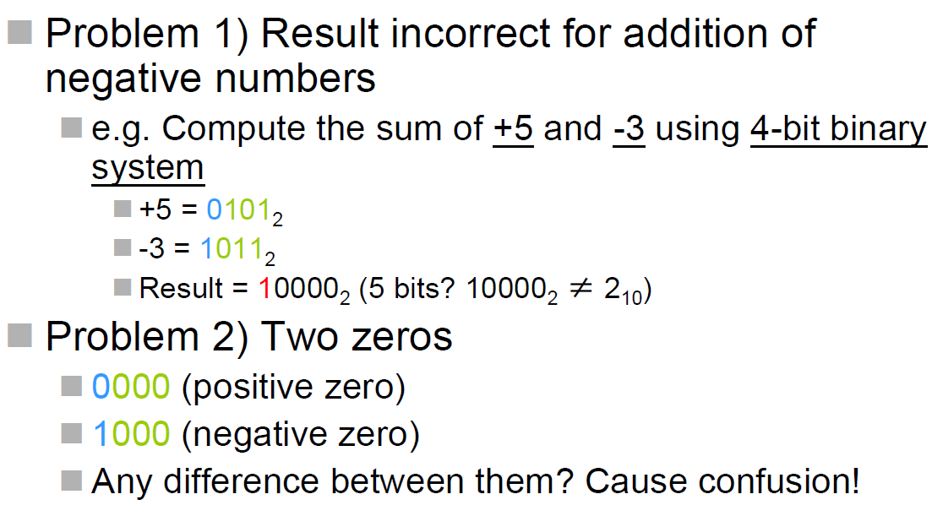
Problems of Sign-Magnitude
Overflow!!

Slide 15
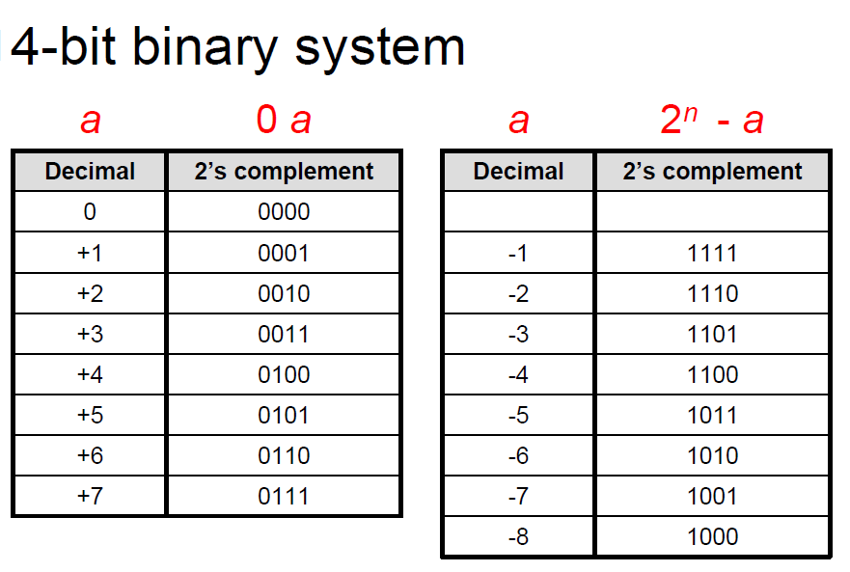
Two’s Complement
  4-bit system
  ( +5 = 0101; -5= 1101) Sign-Magnitude Binary
  ( +5 = 0101; -5= 1011) Two’s Complement Binary

Slide 16
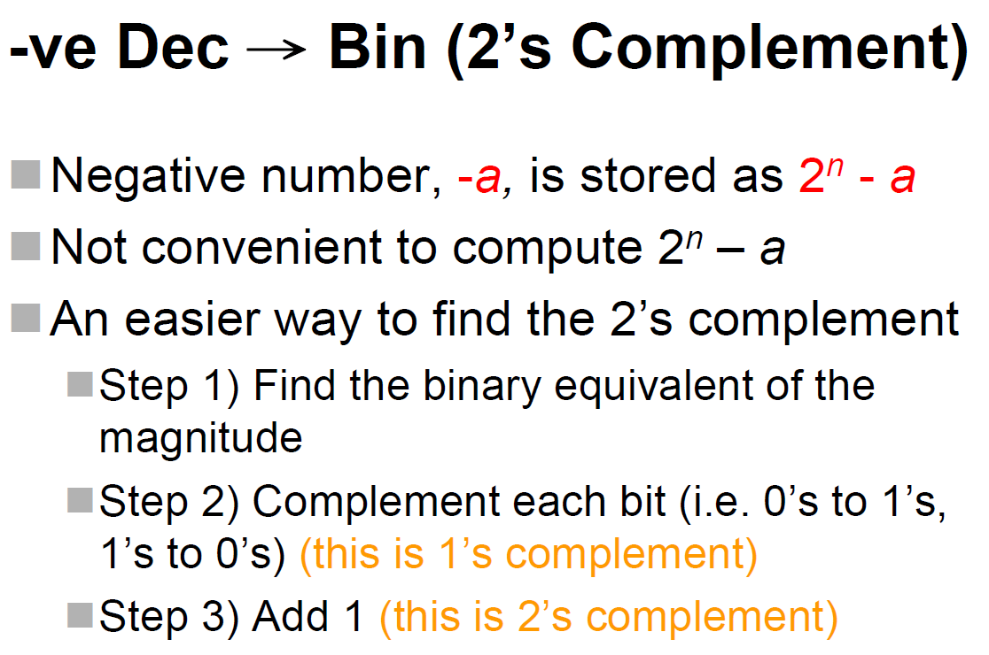

Slide 17
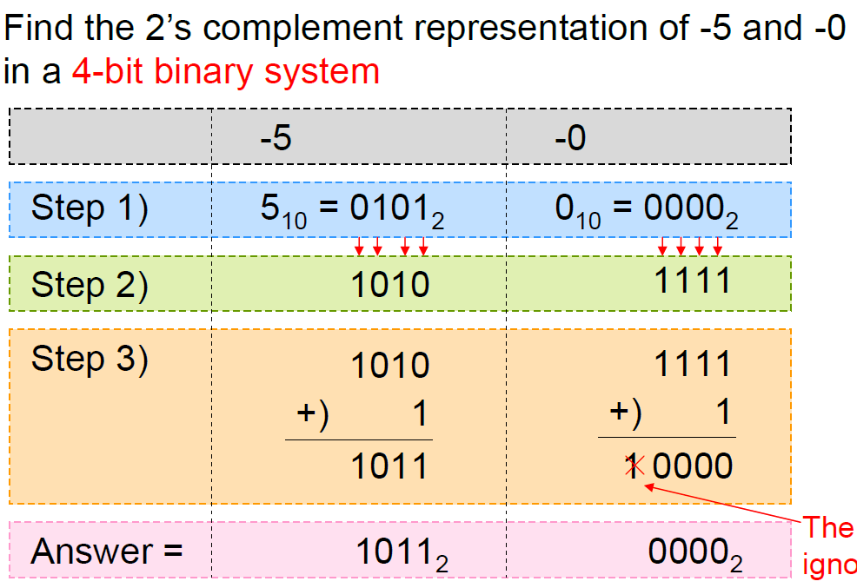
Positive to negative conversion
The carry bit can be ignored.

Slide 18
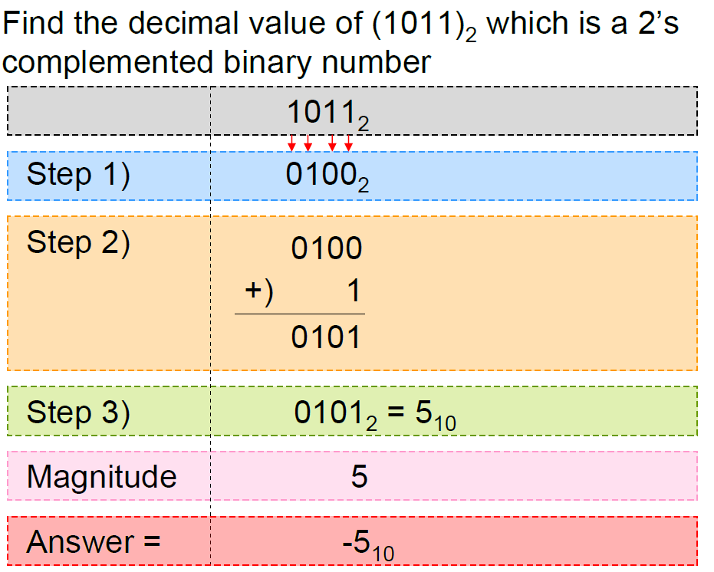
Negative to positive conversion

Slide 19
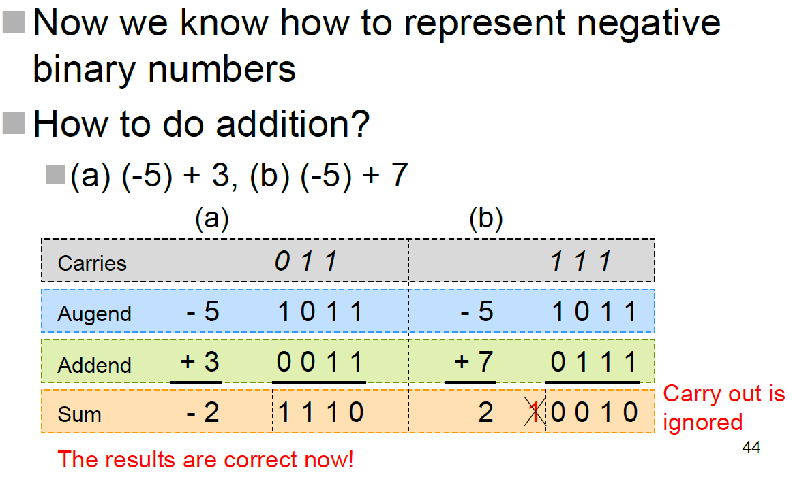
Addition of 2’s complement
The carry bit can be ignored.

Slide 20
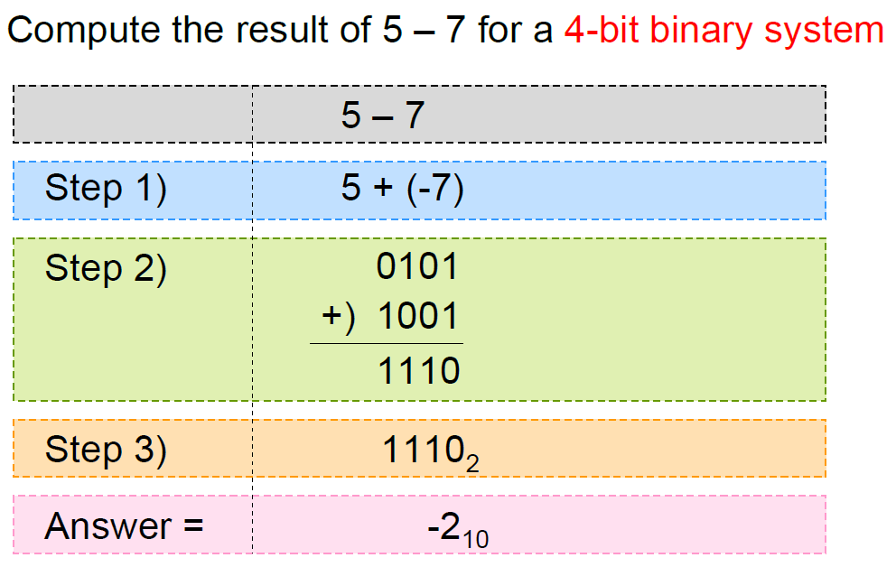
Binary Subtraction
A – B = A + (-B) = A + (2’s complement of B)

Slide 21
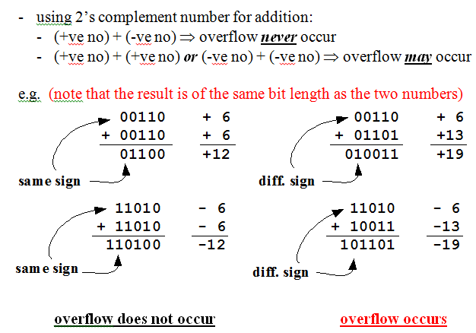
Problem on Addition using 2’s complement
Therefore, the addition of 2’s complement is excellent for (+ve) and (-ve) numbers arithmetic.

Slide 22
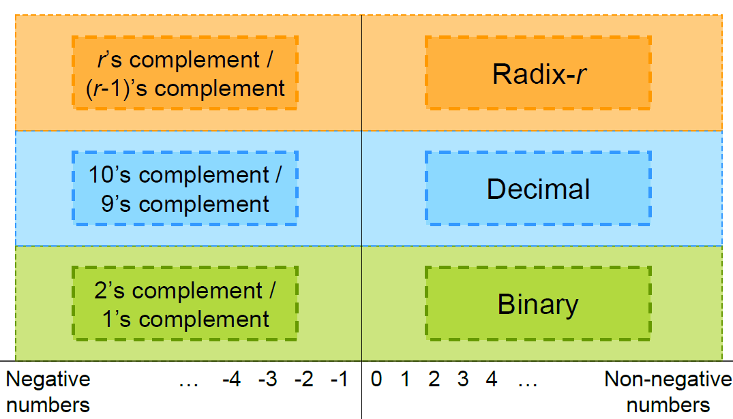
Radix Complement
There are 2 types of complement for any radix-r number system
  r’s complement and (r-1)’s complement
  For n-digit radix-r number system
  The r’s complement number a is r^{n}-a
  The (r-1)’s complement number a is r^{n}-a-1

Slide 23
Binary Arithmetic
Addition (+)
Subtraction (-)
Multiplication (x)
  Series of addition
Division (÷)
  Series of subtraction

Slide 24
Binary Coded Decimal
There are several BCD
  8421 code
  5421 code
  2421 code
  Excess 3 code
  2-of-5 code
  To perform arithmetic operations directly with BCD
When communicating with computer systems
Input: convert decimal no. to binary
Process: perform arithmetic calculations in binary
Output: convert binary result back to decimal
To develop code for human-computer communications
Digits: Binary Coded Decimal (BCD), Gray Code
Alphanumeric: ASCII Code

Slide 25
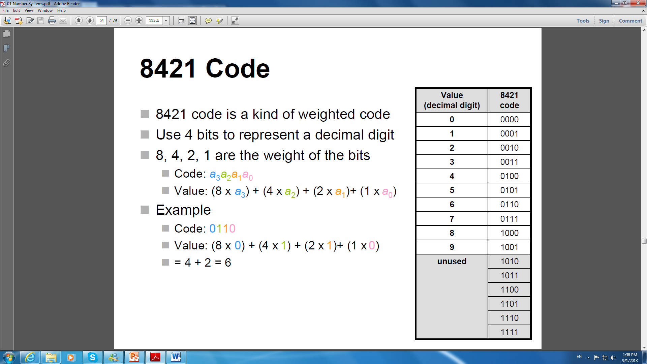

Slide 26
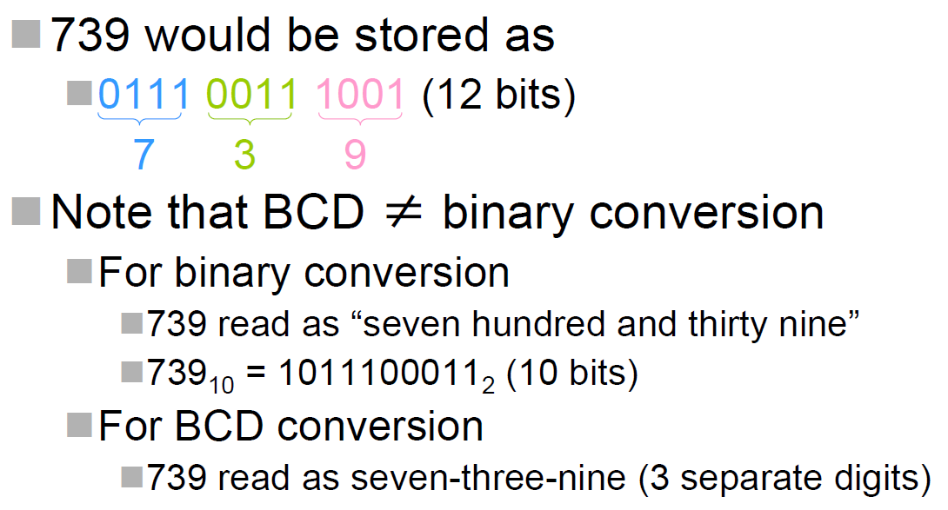
8421 BCD Example

Slide 27
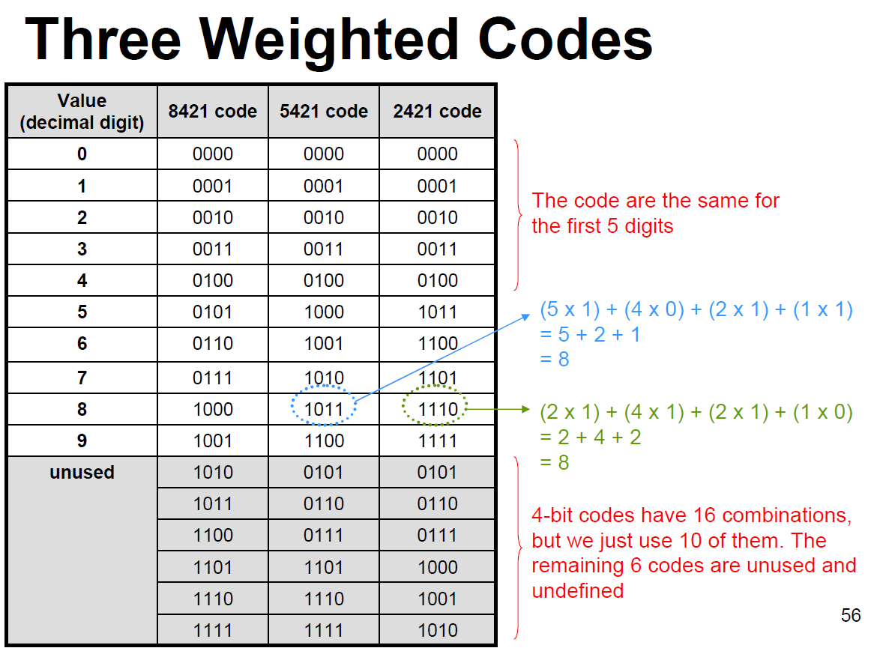
o.

Slide 28
Properties of 2421 code
A self-complementing code (9’s complement)
  The complement of 0 is 9 (0000 ⇔ 1111)
  The complement of 1 is 8 (0001 ⇔ 1110)
  The complement of 2 is 7 (0010 ⇔ 1101)
  The complement of 3 is 6 (0011 ⇔ 1100)
  The complement of 4 is 5 (0100 ⇔ 1011)

Slide 29
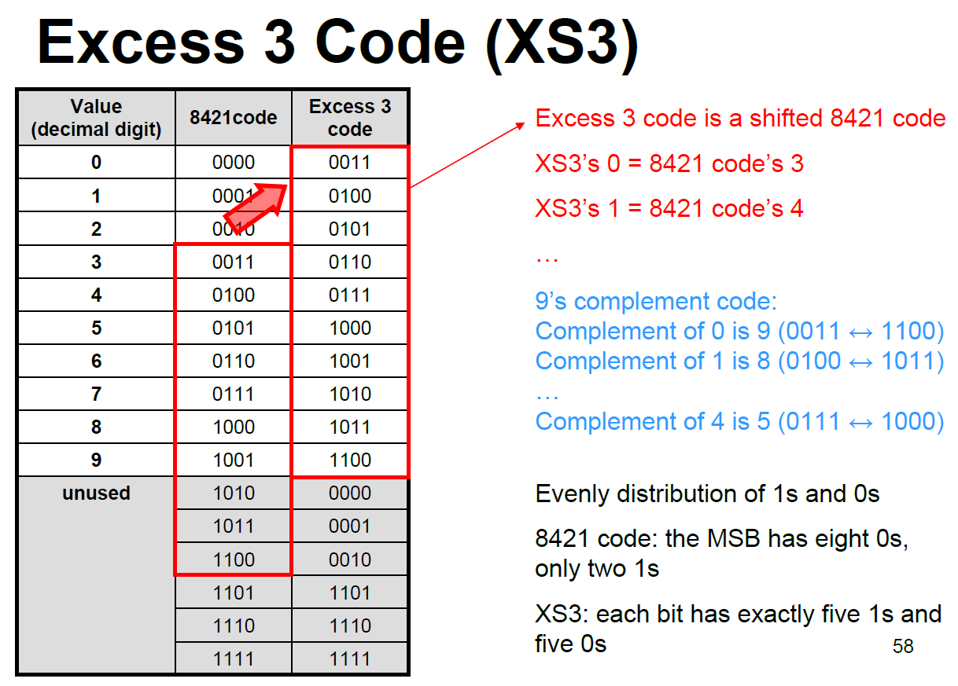
o.

Slide 30
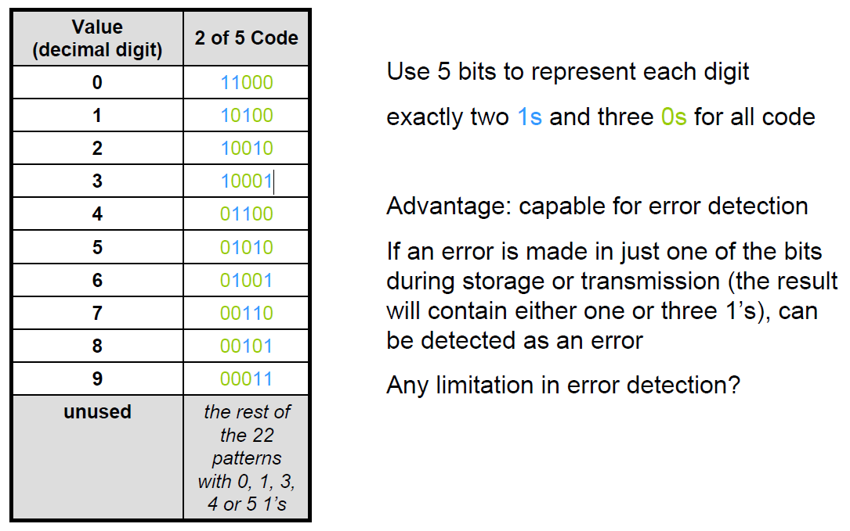
2-of-5 code
o.

Slide 31
BCD Summary
Weighted codes
  8421, 5421, 2421 codes
Non-weight codes
  XS3, 2-of-5 code
Self-complement
  2421, XS3 codes
Able to detect error
  2-of-5 code

Slide 32
BCD Drawbacks
Inefficiency of storage
  For weighted codes and XS3 code
    Used 10 out of 16 combinations
    6 combinations waste
  For 2-of-5 code
    Used 10 out of 32 combinations
    22 combinations wasted
Complex arithmetic calculations

Slide 33
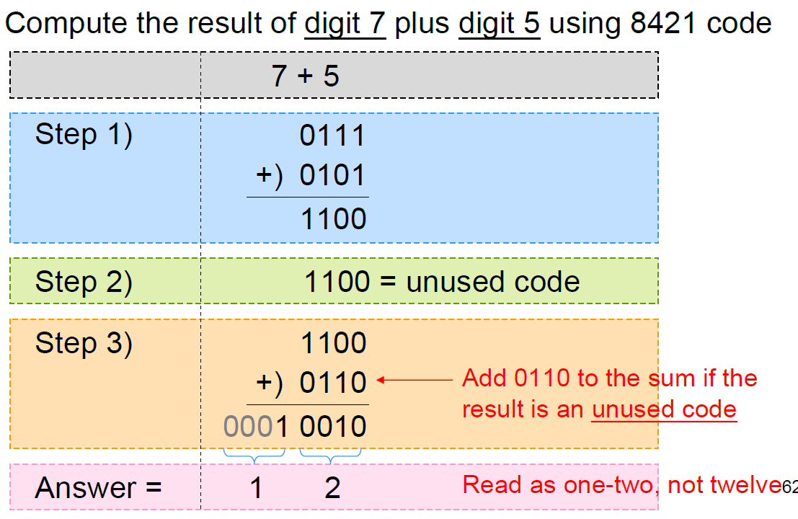
8421 Code Addition
o.

Slide 34
Gray Code
2-bit gray code | 3-bit gray code | 4-bit gray code | decimal
00 | 000 | 0000 | 0
01 | 001 | 0001 | 1
11 | 011 | 0011 | 2
10 | 010 | 0010 | 3
00 | 110 | 0110 | 4
 | 111 | 0111 | 5
 | 101 | 0101 | 6
 | 100 | 0100 | 7
 |  | 1100 | 8
 |  | 1101 | 9
 |  | 1111 | 10
 |  | 1110 | 11
 |  | 1010 | 12
 |  | 1011 | 13
 |  | 1001 | 14
 |  | 1000 | 15
Gray code (after Frank Gray) originally designed to prevent spurious output from mechanical switches.
Today, Gray codes are widely used for error corrections in digital communications such as digital TV and cable TV systems.
One bit difference in the next or adjacent code word independent of the direction taken in the code.

Slide 35
35
Binary code to Gray code conversion
Place a leading 0 before the MSB.
XOR adjacent bits together starting from the left hand side of this number will result in gray code.
XOR
e.g. 82₁₀ ---> 1010010₂ 00 → 0
01 → 1
0 1 0 1 0 0 1 0 10 → 1
∨ ∨ ∨ ∨ ∨ ∨ ∨ 11 → 0
1 1 1 1 0 1 1 ←⎯ Gray code

Slide 36
36
Gray code to Binary code conversion
copy the first 1 starting from left hand side and continue with 1 until the next 1 appears in the gray code.
change to 0 and continue with 0 until the next 1 appears in the gray code.
change to 1 and follow steps (i) & (ii).
10001011 ←⎯ gray code
11110010 ←⎯ binary code

Slide 37
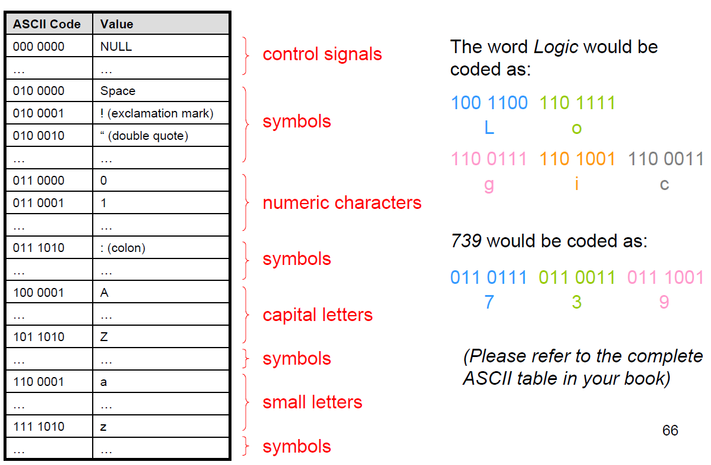
ASCII Code
American Standard Code for Information Interchange
o.

Slide 38
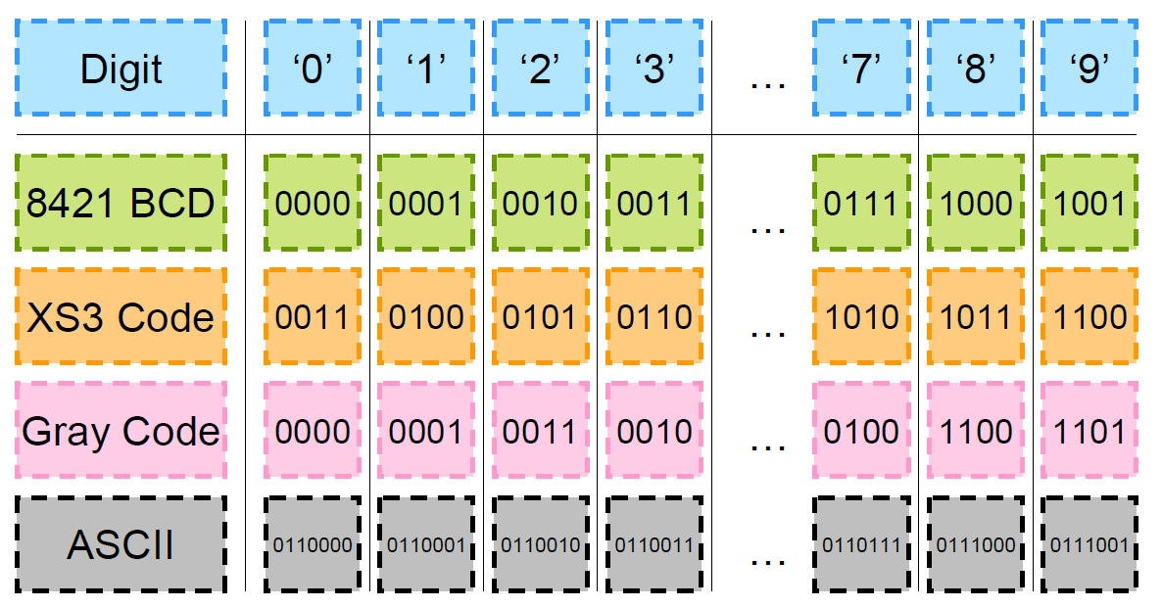
Code Summary

Slide 39
Parity and Error Correction
The simplest method for error detection is using parity bit
  An additional bit attaches to the original code
  Two kinds of party bit (even or odd parities)
The value of parity bit is defined by the total no. of “1” in the resulting codeword either even or odd

Slide 40
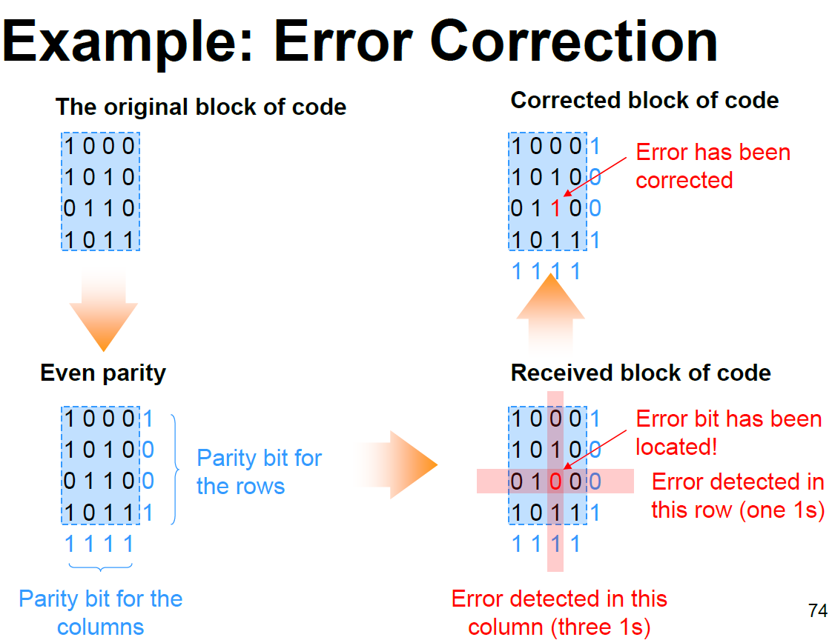
o.

