Slide 1

EE4803: Analog IC Design
Design of Differential Amplifiers
Department of Electrical Engineering
City University of Hong Kong
Prof. Arindam Basu

Slide 2
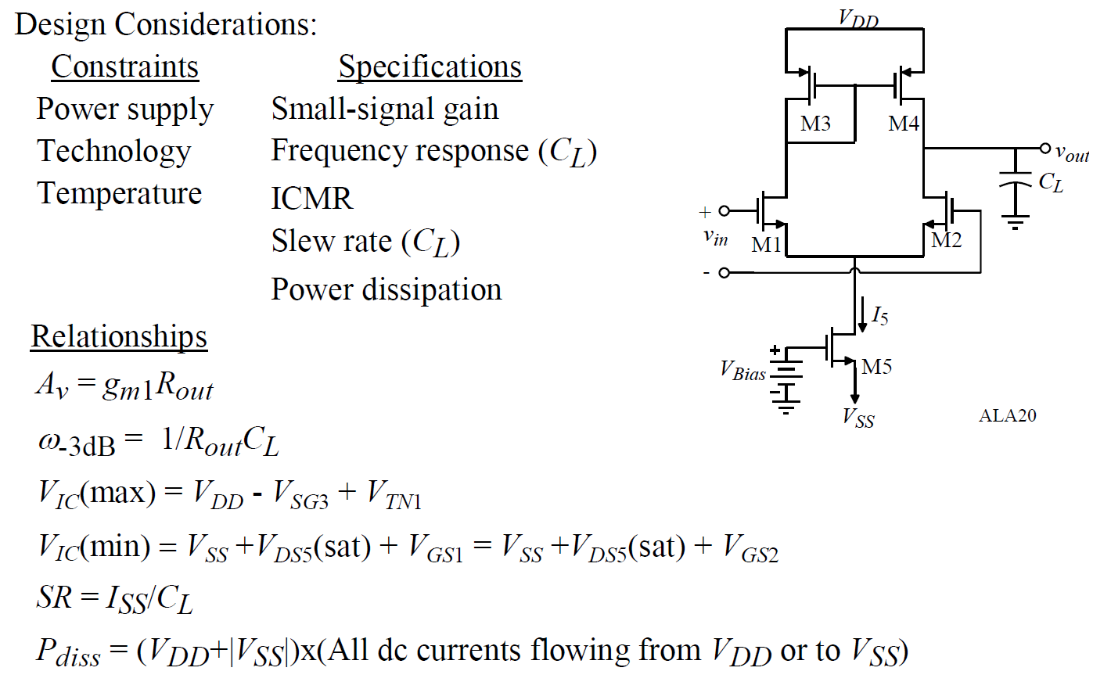
Differential Amplifier with Current Mirror
*With inputs from Phillip Allen’s course at Georgia Tech and Willy Sansen’s book

Slide 3
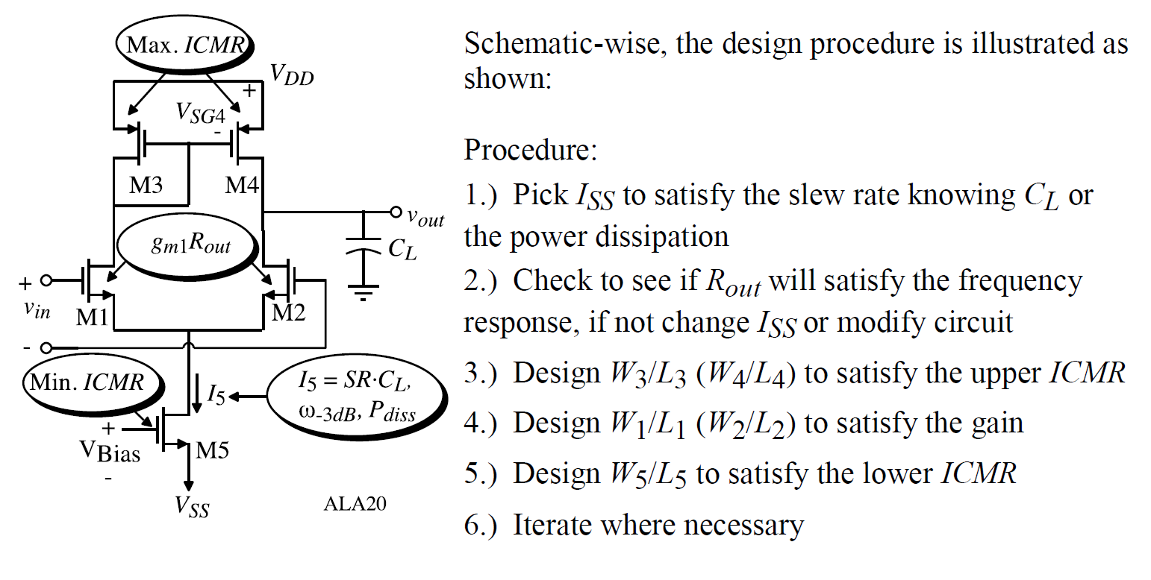
Differential Amplifier with Current Mirror

