Slide 1
Last week…
What was the session about?
What’s the structure of the public presentation?
What are the strategies for introduction? (slide 44)
What are the strategies for body? (slide 48)
What are the strategies for conclusion? (slide 53)
What are the strategies for Q&A? (slide 71)

Slide 2

GE2410
Unit 2: Writing Progress Reports

Slide 3
About the course
01/10/2018
Week 6 & 7
04/11/2018
Week 12 &13
Report a real world problem & your ideas about the solutions & progress
Give a public seminar about your ideas & attract potential clients
Negotiate with line managers & clients (e.g., email)
Design a blueprint to clients’ needs
1. Why did the module leader design this course?
Engineering students don’t know how to communicate throughout a project in workplace even if they’ve taken general English modules in the universities.
2. Why it is useful for you?
The course will take you through the whole process of a project step by step.
3. Why are there four assessments?
To match the steps and possible situations you may go through in a project.
4. What does the lecturer want from you?
To master the spoken and written skills needed for each step and be able to apply them at work.

Slide 4
Why bother?
In your future career as an engineer, you will be required to write a variety of reports on different technical matters.

Slide 5



Aims and objectives
In this unit, you will learn how to compose a progress report. By the end of this unit, you should be able to analyse and describe its-
  purposes
  generic organisation
  contents
  major language features

Slide 6


Assessed Task 1

Slide 7
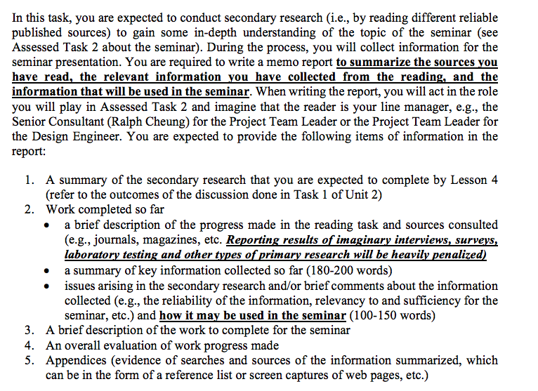

Slide 8


Assessment criteria
Task Fulfilment
  Required information
  Relevances
  Clarity
Organisation
  Cohesion of ideas
  Paragraphing / sectioning
Language
  Grammar
  Vocabulary
  Style

Slide 9


Task 1
Together with your project team formed for Assessed Task 2, decide the following for the seminar and keep a record of the decisions made:
  confirm the topic
  types of information to present in the seminar
  types of sources to consult for the information
  where to look for reliable sources (ask your subject lecturers)
  allocation of work for the information searches

Slide 10
Task 1
Team leaders:
1. make sure you have assigned different tasks to your group mates
2. make sure your group mates know which keywords / type of information to look for in the next 2 weeks
3. set a deadline for them to report back their progress
4. make sure there is an effective platform for the team to communicate regarding the project.

Slide 11
Task 1
The record will form the reference (Part 1) for the progress report which you will need to produce for Assessed Task 1.

Slide 12
Task 1
It is expected that by lesson 4 you will have gathered some information you are responsible for as agreed in this discussion and have written your progress report draft. There will be a peer review session in that lesson.

Slide 13
Task 1
The final report will be due on Monday, October 1st 23:59 (through Turnitin on your section’s Canvas.
Keep a receipt of your submission for future reference

Slide 14


Audience & Purposes

Slide 15
Audience
(the readers)

Slide 16


Audience
External
  the liaison person from the client organisation
  the leader of the client team
Internal
  Senior consultant
  Supervisor / project leader

Slide 17
Why do you need to report to them?

Slide 18
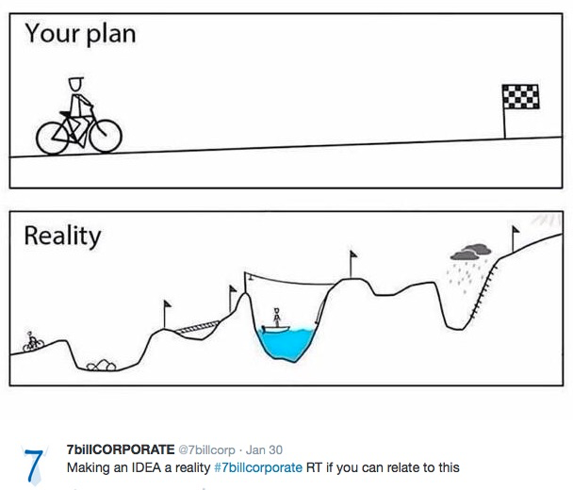
Credit: Debbie and Me! @ TeacherTweaks

Slide 19

Purposes
To reassure the audience:
  that you are making progress
  that the project is going smoothly
  the project will be completed on time
To let the audience to
  evaluate your work
  make decisions

Slide 20


Purposes
A chance to discuss problems and forewarn the recipient the possible delays / needs for making changes.
Forces you to evaluate the progress you are making so that you can complete the work on time.

Slide 21
External vs Internal Reports

Slide 22


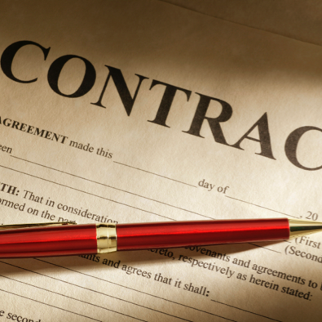
External Reports
Generated for clients
Produced at regular intervals
Usually specified in contract

Slide 23


Internal Reports
Generated for line manager
Produced at regular intervals
Reporting the progress made for the part the writer is responsible for

Slide 24
Task 2
Study the sample reports shown in the Appendix. For each sample, state whether it is an internal or an external report. Also specify the form that each sample represents (e.g. report with a cover letter, memo, email, chart).

Slide 25
Sample A

Slide 26
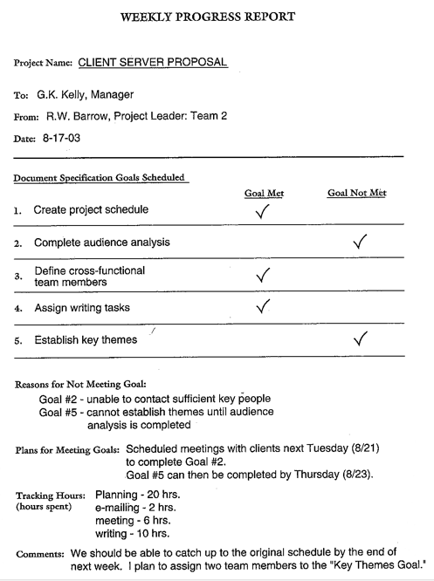

Slide 29
Sample B

Slide 30
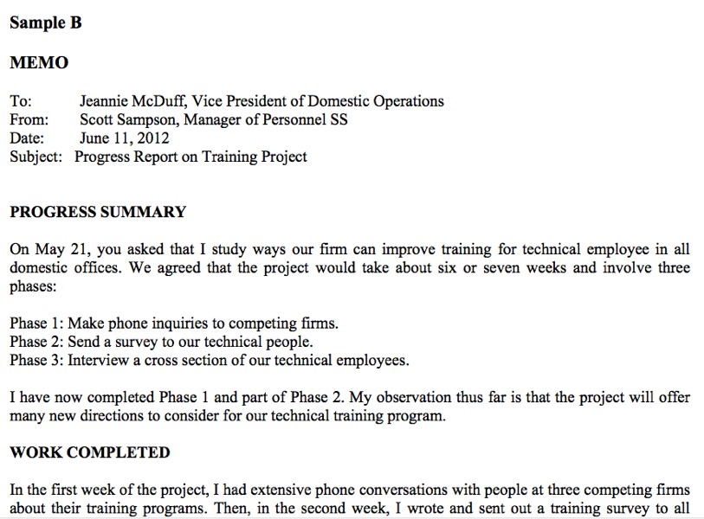

Slide 31
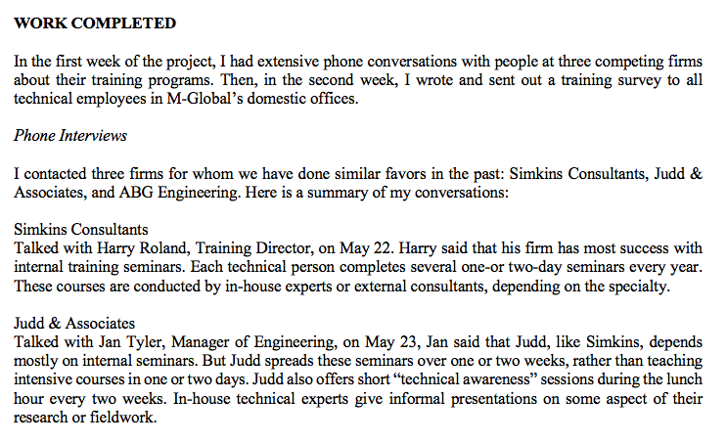

Slide 32
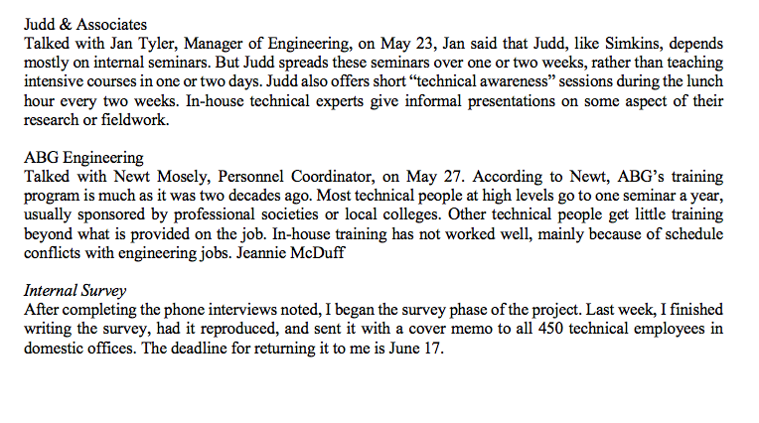

Slide 33
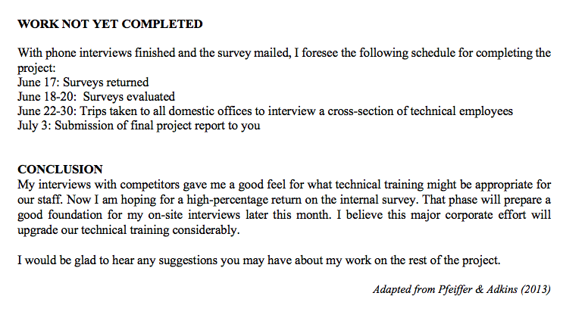

Slide 34
Sample C

Slide 35
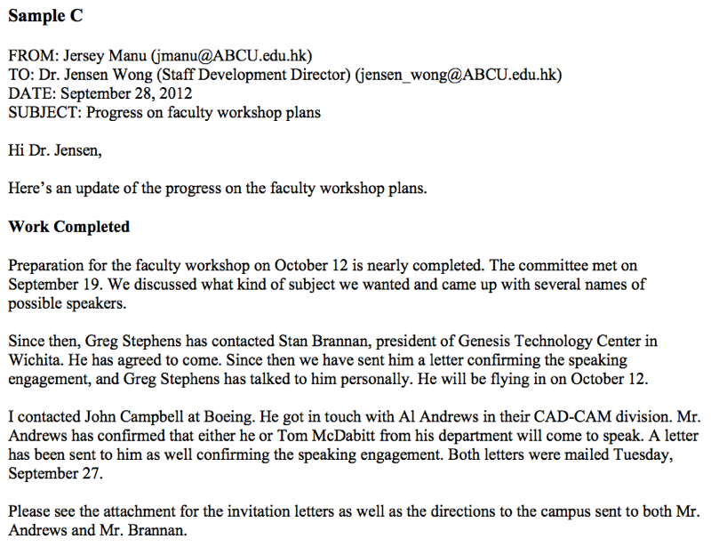

Slide 36
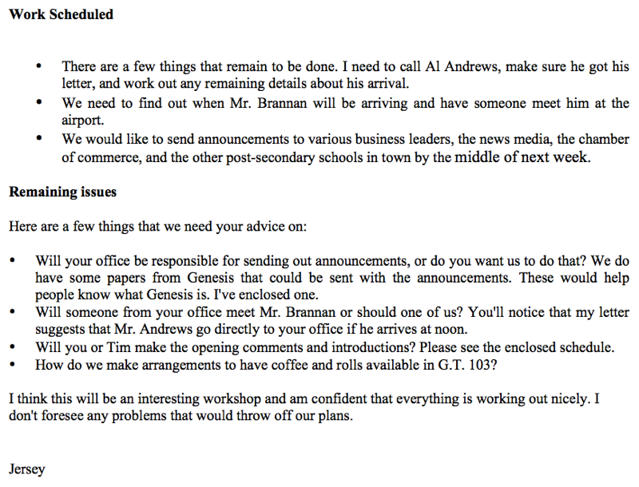

Slide 37
Sample D

Slide 38
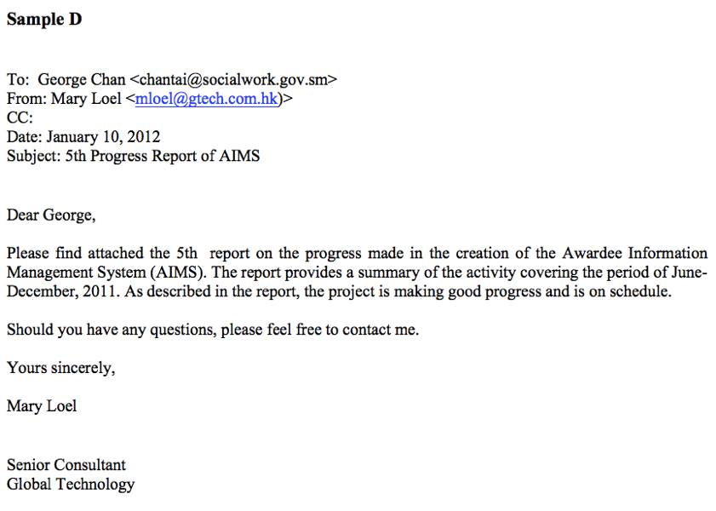

Slide 39
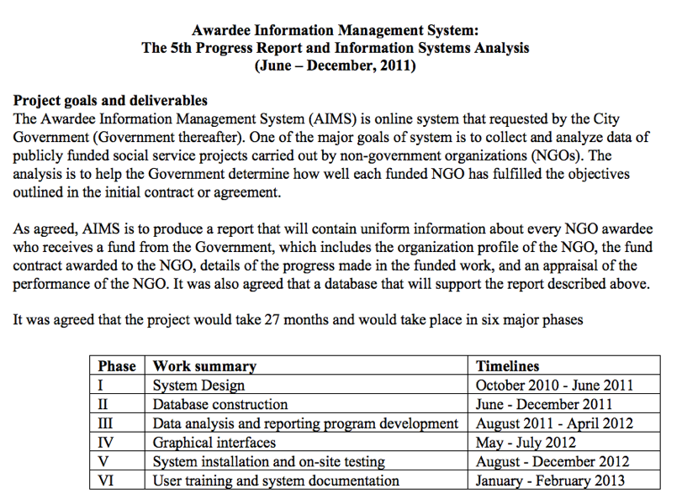

Slide 40
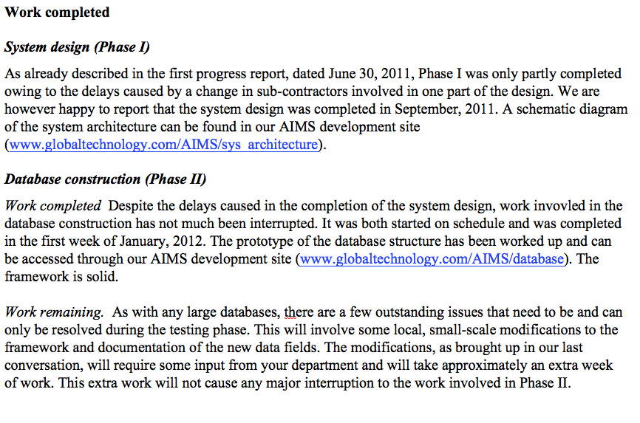

Slide 41
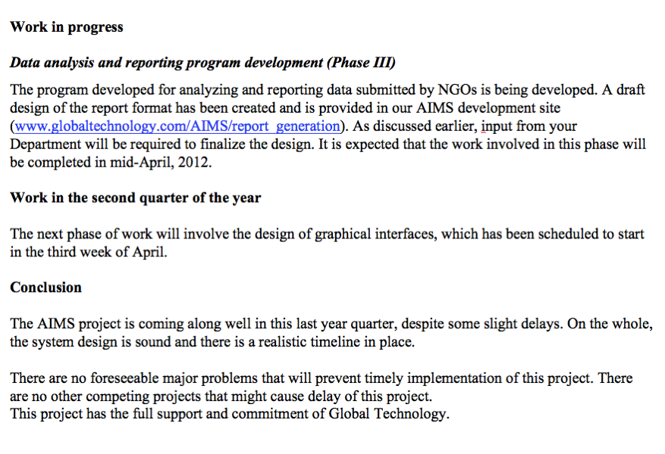

Slide 42


Forms and Organisation

Slide 43


Forms
Verbal vs Written

Slide 44
Verbal
reporting the progress verbally in a meeting
formal / informal
  meeting room
  a short progress report in supervisor’s office / over lunch at a restaurant

Slide 45
Written
Formal report to client with formal cover email/letter
an email
a memo
a chart

Slide 46

Components
The report header
The report body

Slide 47

The header
To: | name of the recipient
From: | name of the writer
Date: | date the memo was written
Subject: | the subject line that shows the subject matter of the report

Slide 48
Task 3
Study Sample Reports B to D as examined in Task 2.
Identify the major sections in each sample, describe the types of information presented in each of the sections and state the purpose(s) that the information serves.

Slide 49
Sample B

Slide 54
Sample C

Slide 57
Sample D

Slide 62



What are the common sections?
Project background / Progress Summary
Work completed and issues arising
Work in progress
Future tasks
Conclusion

Slide 63

Project background
Quick overview:
Scope of the work agreed earlier
Specific tasks supposed to have been completed by reporting time and outcomes of the tasks also as agreed earlier

Slide 64
Useful language in the samples?

Slide 65

Work completed and Issues Arising
The tasks actually completed
The actual outcomes of the tasks
Issues that have arisen
Consequences of the issues
Actions taken

Slide 66
Useful language in the samples?

Slide 67

Work in progress
Tasks that are being carried out
Expected outcomes of the tasks
Expected dates of completion

Slide 68
Useful language in the samples?

Slide 69


Future tasks
List tasks that will be carried out in the next reporting period and their expected outcomes.

Slide 70
Useful language in the samples?

Slide 71


Conclusion
Provides an overall evaluation of the progress made in the reporting period
Reassures the reader that the project is running well and forecasts the project completion date.
Restores the reader’s confidence in the team/the project if an adverse circumstance such as a delay or an interruption has been reported in a previous section.

Slide 72
Useful language in the samples?

Slide 73
Reminder
Remember that the work you report in your progress report for Assessed Task 1 is totally different from that presented in the sample reports. You are supposed to summarize the reading that you have done and how the information you gathered from the reading will be used in the seminar. (See the instructions for the assessed task.) Do not report results of interviews, surveys, or experiments that you have never conducted. Doing so will result in a heavy penalty.

Slide 74


Language use

Slide 75
Task 4
Study Samples B-D and observe the tense(s) that are used to describe actions that have been completed.

Slide 76
Sample B

Slide 81
Sample C

Slide 88
Sample D

Slide 93
Task 5
Study the samples again. This time, pay attention to the tone used in the reports. State whether an impersonal or personal tone (I/We) used in the samples. Why is a personal tone used?

Slide 94
Sample B

Slide 99
Sample C

Slide 102
Sample D

Slide 107
Task 6
It is quite common to see previous communication referred to in a written progress report.
Can you identify a few references made to prior communication in the Sample D? Why are the references made?

Slide 108
Sample D

Slide 113
Task 7
Study Report Sample D and circle the parts where emerging problems or issues (negative news) are reported.
How does the writer present the events to reduce the negative impression they may create on the reader?

Slide 114
Sample D

Slide 119
Next lesson
Progress report draft

