Slide 1
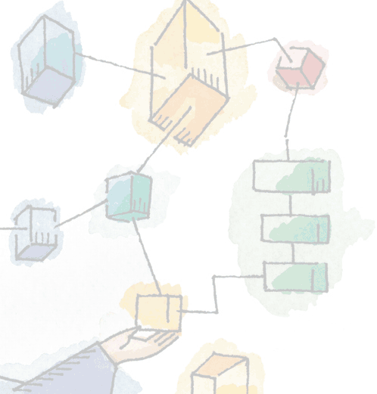
Chapter 1, 2
Computer System & Operating System Overview
Operating Systems:
Internals and Design Principles
William Stallings

Slide 2
Roadmap
  Basic Elements
  Instruction Execution
  Interrupts
  The Memory Hierarchy
  I/O Communication Techniques
  Operating System Objectives & Functions

Slide 3
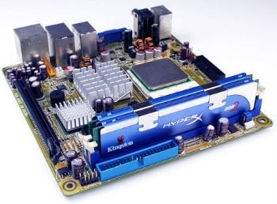
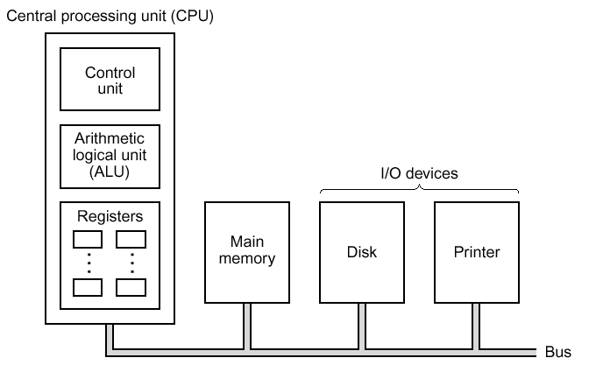
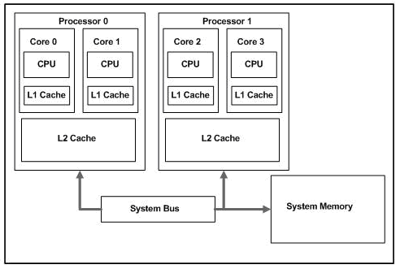
A Computer’s
Basic Elements
Processor
Main Memory
I/O Modules
System Bus
The OS manages computer system hardware on behalf of its users, so it is important to know them before studying OS.

Slide 4
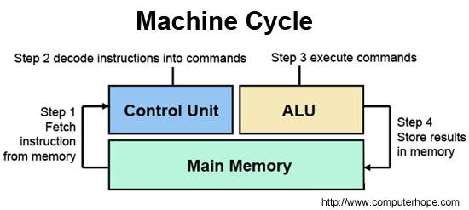
Processor
Referred to as the Central Processing Unit (CPU)
Two internal components
  Control Unit
  Arithmetic & Logic Unit (ALU)
Controls operation, performs data processing
Works repeatedly and continuously in cycles to execute instructions

Slide 5
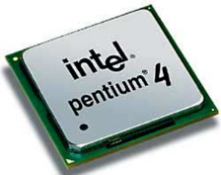
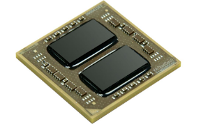
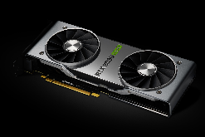
More about Processor
Microprocessor
  Invention that brought about desktop and handheld computing
  Contains a processor on a single chip
Multiprocessors
  Each chip contains multiple processors (cores)
Graphical Processing Units (GPU’s)
  Provide efficient computation on arrays of data using Single-Instruction Multiple Data (SIMD) techniques

Slide 6
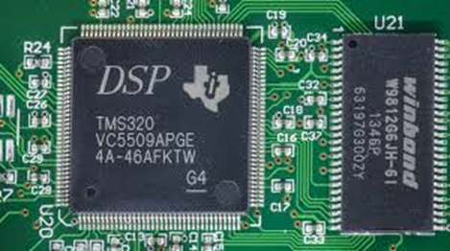
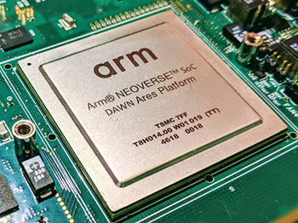
More about Processor
Digital Signal Processors (DSPs)
  Encoding/decoding speech and video (codecs)
  Provide support for encryption and security
System on a Chip (SoC)
  Satisfy the requirements of handheld devices
  CPUs, caches, DSPs, GPUs, I/O devices and main memory are on the same chip

Slide 7
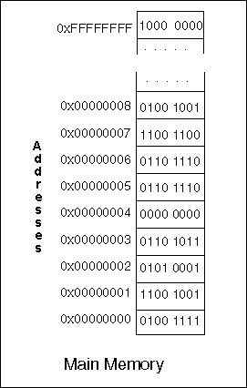
Main Memory
Referred to as primary memory or simply RAM
Consists of a set of locations defined by sequentially numbered addresses
Stores data and programs
Volatile
  Contents of the memory is lost when the computer is shut down

Slide 8
I/O Modules
Moves data between the computer and the external environment such as:
  Storage / secondary memory devices (e.g. hard disks)
  Communications equipment
  Terminals

Slide 9
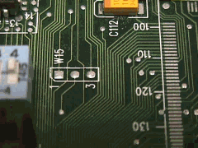
System Bus
Provides for communication among processors, main memory, and I/O modules

Slide 10
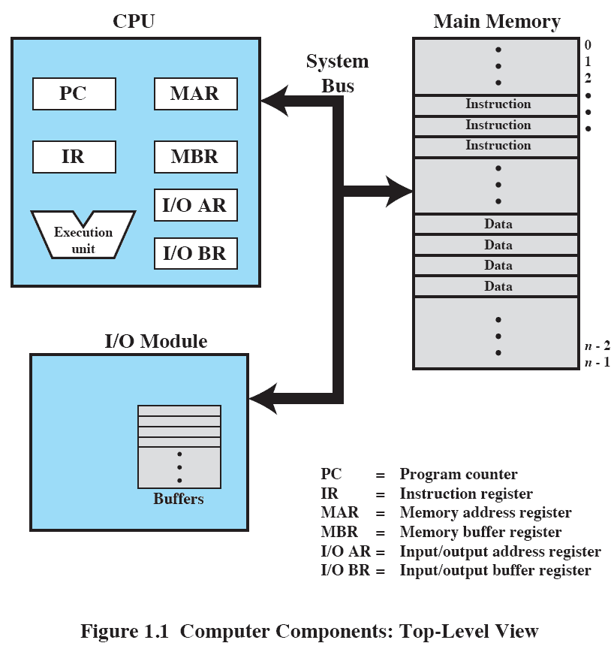
Top-Level View

Slide 11
Roadmap
  Basic Elements
  Instruction Execution
  Interrupts
  The Memory Hierarchy
  I/O Communication Techniques
  Operating System Objectives & Functions

Slide 12
Instruction Execution
A program consists of a set of instructions stored in memory
4 steps in a machine cycle
  Processor reads (fetches) instruction from memory
  Processor interprets (decodes) the current instruction
  Processor executes the instruction
  Processor stores the result back to memory

Slide 13
Processor Registers
Registers: special memory locations inside the processor that can be accessed very fast
  Program Counter (PC) holds address of the next instruction to be fetched
    PC is incremented after each fetch
  Fetched instruction is loaded into Instruction Register (IR)
  Execution result stored in Accumulator (AC) temporarily
  Program Status Word (PSW) contains execution status information

Slide 14
Roadmap
  Basic Elements
  Instruction Execution
  Interrupts
  The Memory Hierarchy
  I/O Communication Techniques
  Operating System Objectives & Functions

Slide 15
Interrupts
An event external to the currently executing process that causes a change in (interrupts) the normal flow of instruction execution;
  Usually generated by hardware devices external to the CPU
  Typically indicate that some device needs service
Why interrupts?
  A computer is much more than the CPU
    Keyboard, mouse, screen, disk drives, printer, sound card, camera, etc.
  These devices occasionally need CPU service
    But we can’t predict when
  We want to keep the CPU busy between events
    Need a way for CPU to find out that devices need attention

Slide 16
Interrupts
Give each device a wire (interrupt line) that it can use to signal the processor
When interrupt signaled, processor executes a routine called an interrupt handler to deal with the interrupt
Provided to improve processor utilization
  Most I/O devices are slower than the processor
  Processor pauses to wait for device →  wasteful use of the processor
  Example: a 1GHz CPU could run 2,000 MIPS (0.5ns per instruction) vs. fast RAM chip with an access time of 50ns vs. 7200rpm HDD takes 5ms for a half-track rotation
    → ? : ? : ?

Slide 17
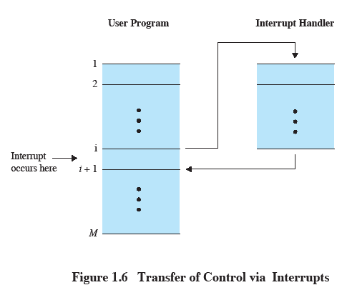
Transfer of Control via Interrupts
an interrupt suspends normal sequence of execution
execution resumes when the interrupt processing is completed

Slide 18
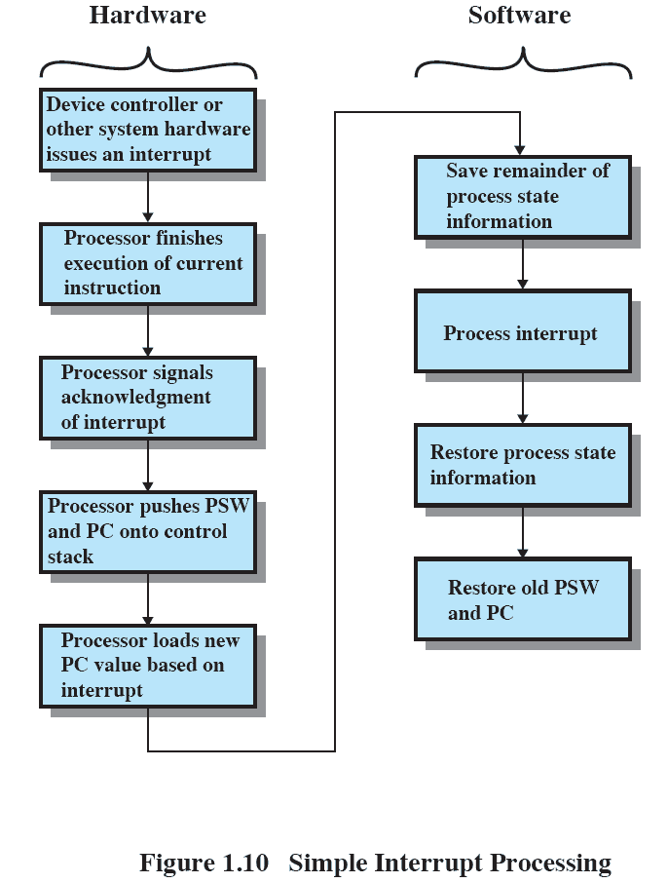
Simple Interrupt Processing

Slide 19
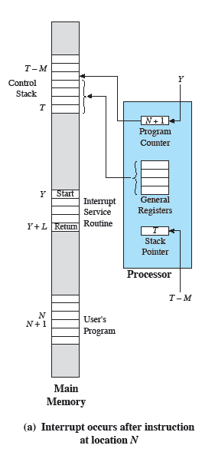
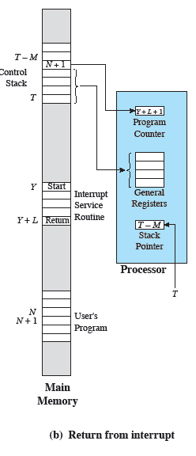
Changes in Memory and Registers for an Interrupt
stack: a certain memory area allocated as scratch space for a program to run

Slide 20

Uniprogramming vs Multiprogramming
Uniprogramming: only one program is running at a given time.
  The processor spends a certain amount of time executing, until it reaches an I/O instruction; it must then wait for the I/O instruction to complete before proceeding

Slide 21
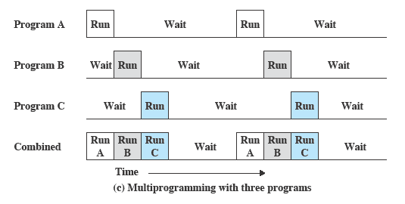
Uniprogramming vs Multiprogramming
Multiprogramming (also known as multitasking): processor has more than one program to execute.
  When one job needs to wait for I/O, the processor can switch to the other job.

Slide 22
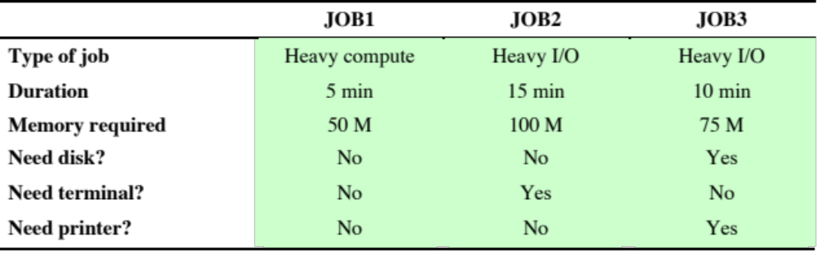
Multiprogramming Example
Consider a computer with 250 Mbytes of available memory, a disk, a terminal, and a printer.
Three programs, JOB1, JOB2 and JOB3 are submitted for execution at the same time.
Assume minimal processor requirements for JOB2 and JOB3 and continuous disk and printer use by JOB3.

Slide 23
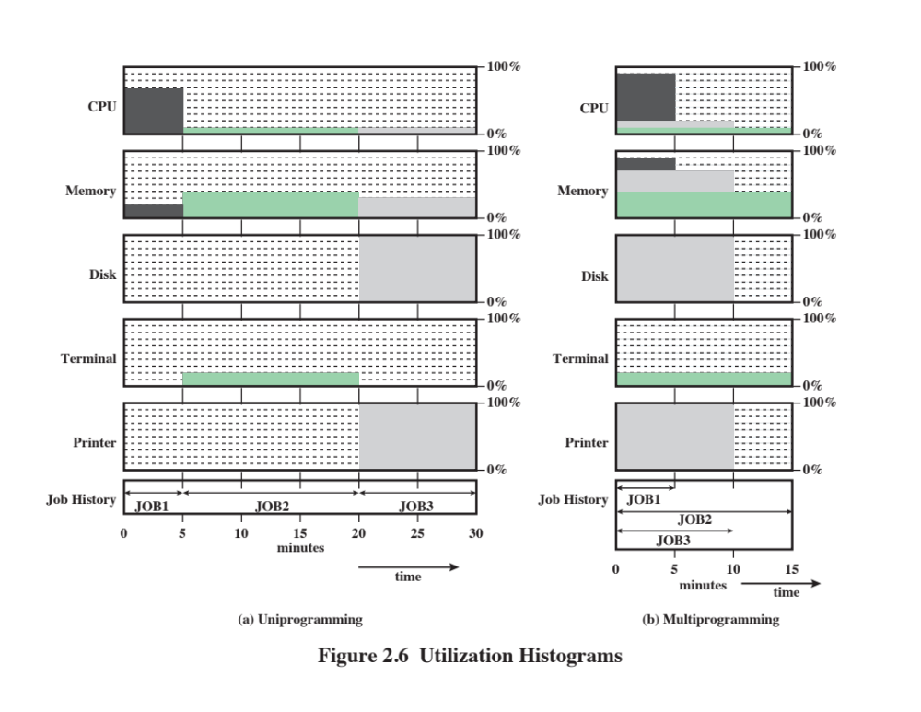
Multiprogramming Example

Slide 24
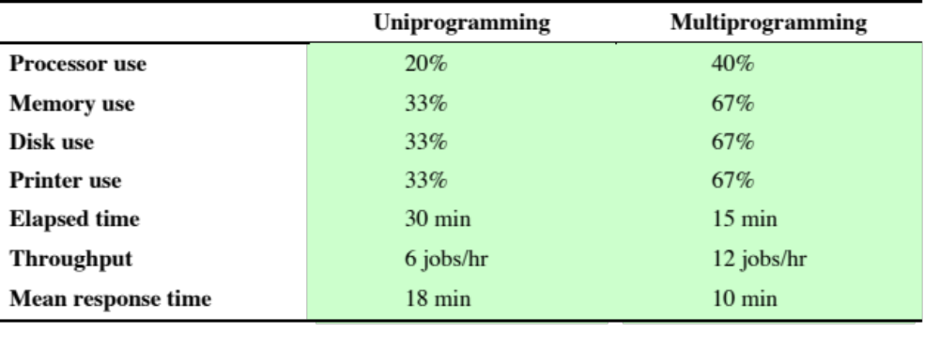
Multiprogramming Example
With uniprogramming, there is gross underutilization of all resources.
With multiprogramming, the improvement of average resource utilization, throughput and response times is evident.

Slide 25
Roadmap
  Basic Elements
  Instruction Execution
  Interrupts
  The Memory Hierarchy
  I/O Communication Techniques
  Operating System Objectives & Functions

Slide 26
Memory Hierarchy
Design constraints on a computer’s memory
  How much?
  How fast?
  How expensive?
Faster access time, greater cost per bit
Greater capacity, smaller cost per bit
Greater capacity, slower access speed

Slide 27
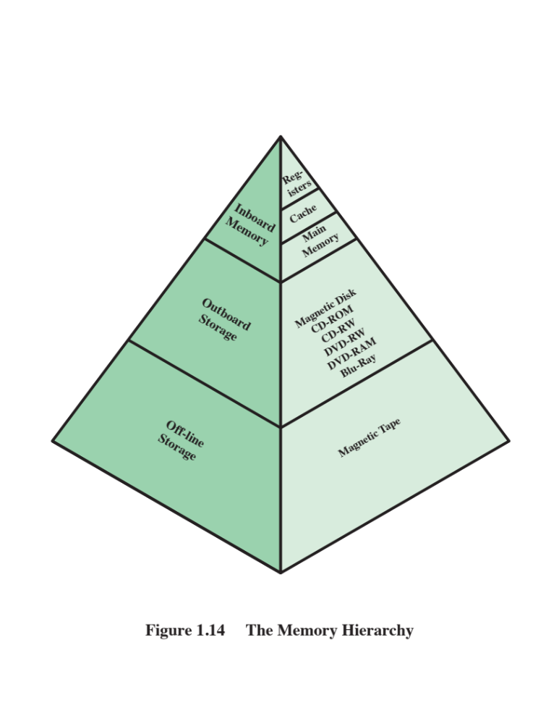
The Memory Hierarchy
Going down the hierarchy
  Decreasing cost per bit
  Increasing capacity
  Increasing access time
  Decreasing frequency of access to the memory by the processor

Slide 28
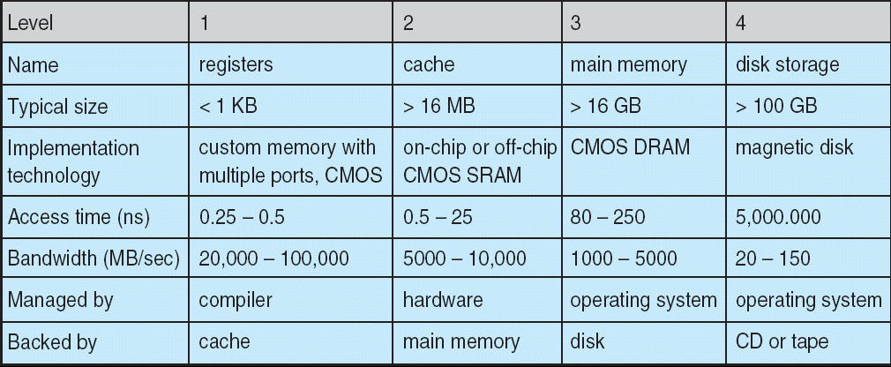
Performance Comparison
To compare various levels

Slide 29
Cache Memory
Reminder: processor must access memory at least once per instruction cycle → processor execution is limited by memory cycle time, but processor speed is much faster than memory access speed!
Solution: copy information in use from slower to faster (but smaller) storage (cache) temporarily.
Cache is checked first to determine if information is there.
  If it is, information used directly from the cache
  If not, data copied to cache and used there

Slide 30
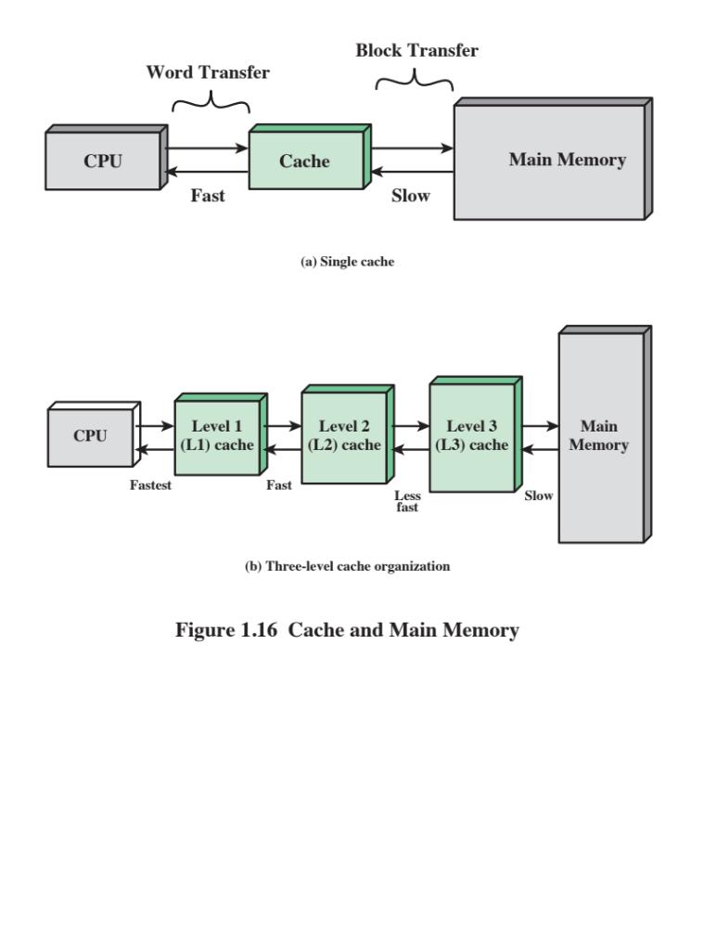
Cache Memory
Principle of locality: Data which is required soon is often close to the current data. If data is accessed, then it’s neighbors might also be accessed in the near future.

Slide 31
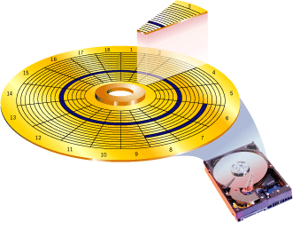
Secondary Memory
Also known as storage devices
  Extension of main memory that provides large nonvolatile storage capacity
  Used to store program and data files
  Most commonly used: magnetic disks
  Disk surface is logically divided into tracks, which are subdivided into sectors.
  The disk controller determines the logical interaction between the device and the computer.

Slide 32
Roadmap
  Basic Elements
  Instruction Execution
  Interrupts
  The Memory Hierarchy
  I/O Communication Techniques
  Operating System Objectives & Functions

Slide 33
I/O Techniques
When the processor encounters an instruction relating to I/O,
  it executes that instruction by issuing a command to the appropriate I/O module.
Three techniques are possible for I/O operations:
  Programmed I/O
  Interrupt-driven I/O
  Direct memory access (DMA)

Slide 34
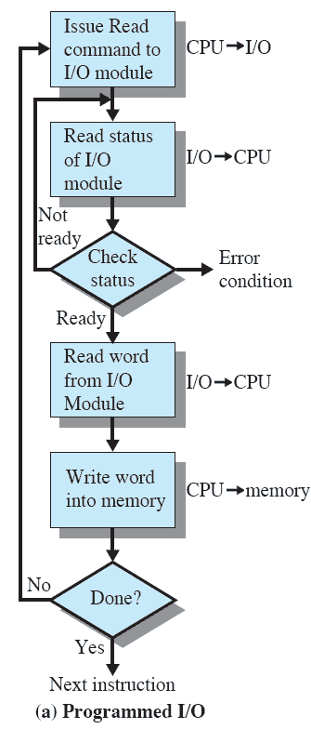
Programmed I/O
CPU issues an I/O command to the I/O module (e.g., a read command to read in a word of data from an external device into memory).
I/O module performs the requested action
  then sets the appropriate bits in the I/O status register (but takes no further action to alert CPU).
CPU periodically checks the status of I/O module until it determines the instruction is completed.
The performance is poor.

Slide 35
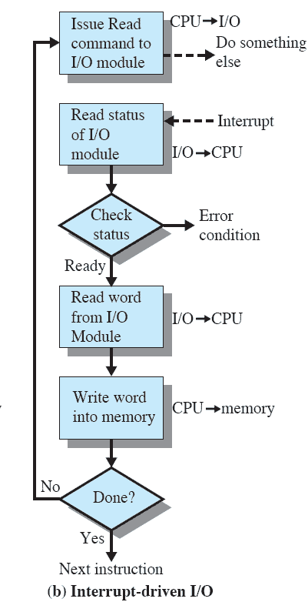
Interrupt-Driven
I/O
CPU issues an I/O command to the I/O module and then goes on to do some other useful work.
I/O module will then interrupt CPU to request service when it is ready to exchange data with CPU.
CPU executes the data transfer and then resumes its former processing.
 More efficient than programmed I/O (no needless waiting)
 Requires active intervention of CPU to perform data transfer.

Slide 36
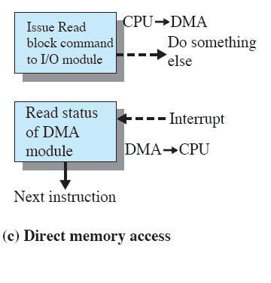
Direct Memory Access
Performed by a separate module.
When CPU wishes to read/write, it issues a command to DMA module containing:
  Whether a read or write is requested
  The address of the I/O device involved
  The starting location in memory to read/write
  The number of words to be read/written
DMA transfers the entire block of data directly to and from memory without going through CPU, sends interrupt when finished.
 More efficient than interrupt-driven or programmed I/O.

Slide 37
Roadmap
  Basic Elements
  Instruction Execution
  Interrupts
  The Memory Hierarchy
  I/O Communication Techniques
  Operating System Objectives & Functions

Slide 38
Operating System (OS)
A program that controls the execution of application programs.
An interface between applications and hardware.
Main objectives of an OS:
  Convenience
    Making a computer more convenient to use
  Efficiency
    Allowing computer resources to be used efficiently
  Ability to evolve
    Permitting effective development, testing and introduction of new system functions without interfering with service.
      hardware upgrade / new hardware
      new services
      fixes

Slide 39
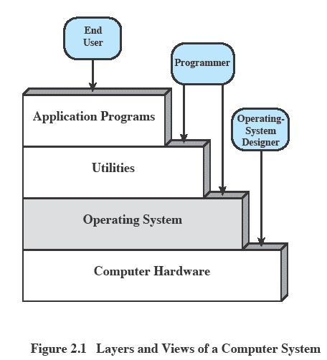
OS as a User/Computer Interface
End user
  views a computer system in terms of a set of applications
  is not concerned with the details of computer hardware.
Programmer
  makes use of a set of system programs (utilities) in developing an application
  a running application invokes the utilities to perform certain functions.
OS
  the most important collection of system programs (frequently used functions)
  masks the details of the hardware from the programmer and provides the programmer with a convenient interface for using the system.

Slide 40
OS Services
Program development
  OS provides a variety of facilities and services, such as editors and debuggers, to assist the programmer in creating programs.
Program execution
  OS handles steps need to be performed to execute a program.
Access I/O devices
  OS provides a uniform interface so that programmers can access I/O devices using simple reads and writes.
Controlled access to files
  In the case of a system with multiple users, OS provides protection mechanisms to control access to the files.

Slide 41
OS Services
System access
  For shared or public systems, OS controls access to the system as a whole and to specific system resources in order to provide protection of resources and data from unauthorized users and resolve conflicts for resource contention.
Error detection and response
  A variety of errors can occur while a computer system is running. OS must provide a response that clears the error condition with the least impact on running applications.
Accounting
  A good OS will collect usage statistics for various resources and monitor performance parameters such as response time.

Slide 42
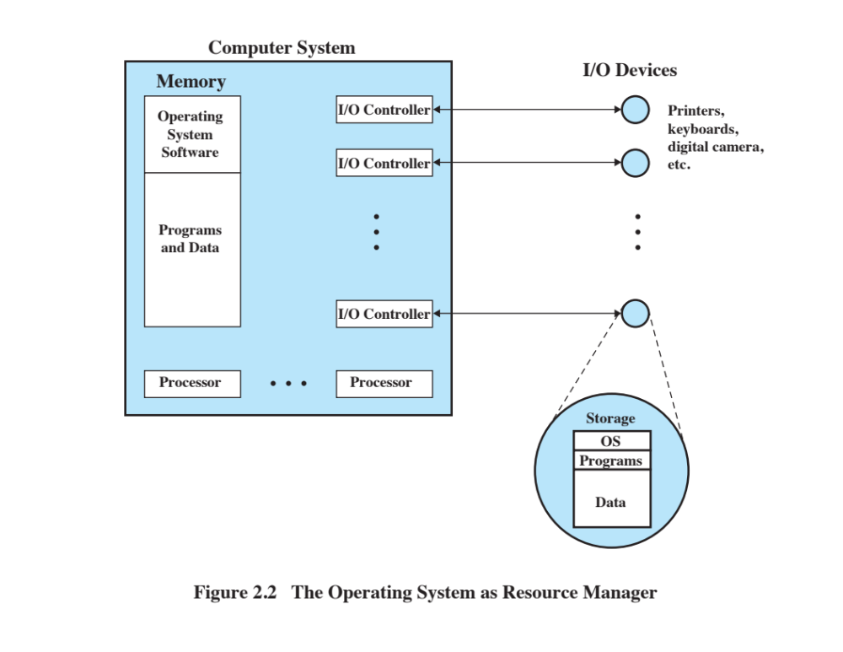
OS as Resource Manager
A computer is a set of resources for the movement, storage, and processing of data.

Slide 43
OS as Resource Manager
The OS is responsible for managing these resources.
  determines how much processor time is to be devoted to the execution of a particular user program
  controls the allocation of main memory
  decides when an I/O device can be used by a program in execution
  controls access to and use of files.

Slide 44
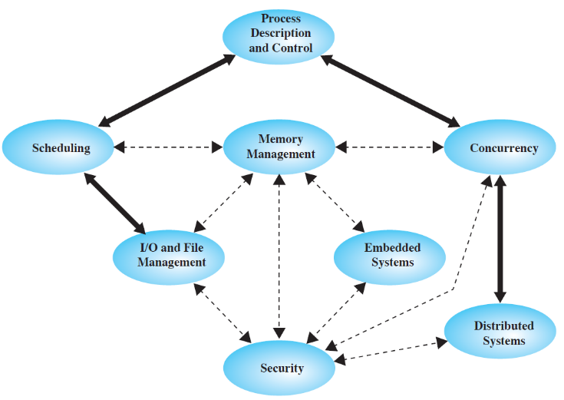
Major Topics of an OS
Operating Systems are among the most complex pieces of software ever developed.
Major topics to be covered in this course include:
  Processes
  Concurrency
  Scheduling
  Memory
  Input/Output and Files
✓
✓
✓
✓
✓

Slide 45
Summary
A computer platform consists of a collection of hardware resources.
Computer applications are developed to perform some tasks.
It is inefficient for applications to be written directly for a given hardware platform.
The OS was developed to provide a convenient, feature-rich, secure, and consistent interface for applications to use.
We can think of the OS as providing a uniform, abstract representation of resources that can be requested and accessed by applications.

