Slide 1
EE2004
Timer ConT

Slide 2
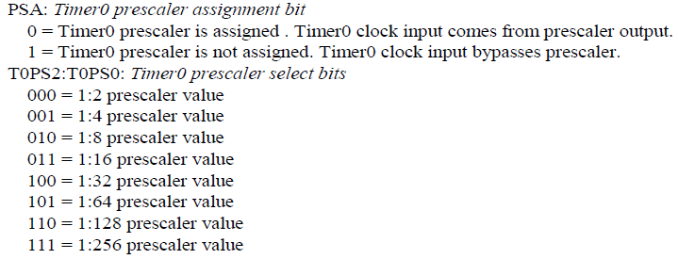
Prescaler
With prescaler, the instruction clock (Fosc/4) can be divided further before fed into the TIMER0 with PSA set a ‘0’.
The lower three bit of T0CON defines the scaling factor.

Slide 3
Example
T0CON = 0000 0101
16 bit mode and internal clock, prescaler at 64.

Slide 4
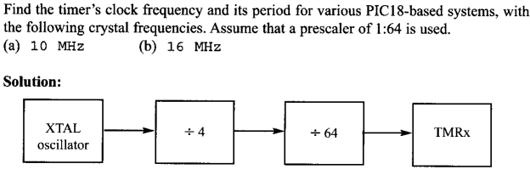
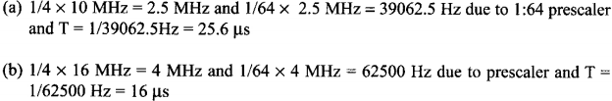
Prescaler

Slide 5
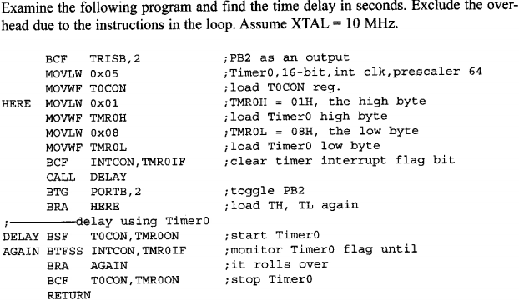
Program Example

Slide 6
Solution
T0CON = 0x05H, prescaler at 64, (Fosc/4)/64
TMR0H:TRM0L = 0108H = 264 decimal.
65,536 – 264 = 65,272
With Fosc at 10 Mhz, 65,272 x scaling factor x 0.4 µsec
65,272 x 64 x 0.4 µsec = 1.671 sec
The period of toggled output = 3.342 sec or 0.299 Hz

Slide 7
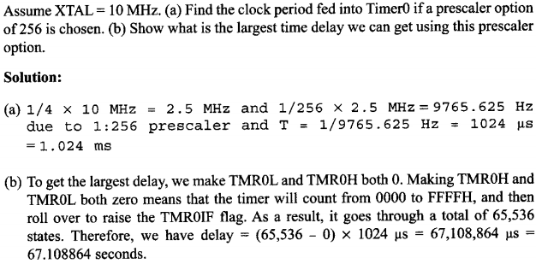
Prescaler

Slide 8
In Class Exercise 1
Assuming Fosc = 10 MHz, write a program to generate a
square ware of 50 Hz frequency on PORTB.7
with 16 bit mode, and prescaler at 128.

Slide 9
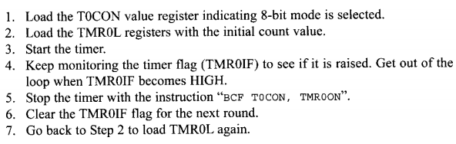
TIMER0 – 8 bit Mode
Similar to 16 bit mode, but only TIM0L is used.
Steps

Slide 10
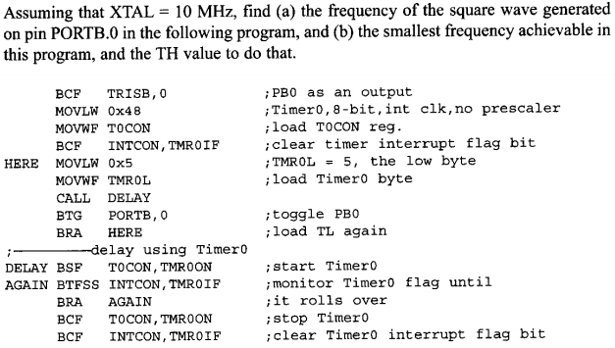
Example
TL

Slide 11
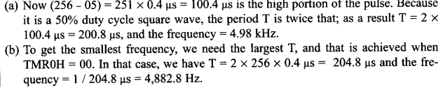
Solution
T0CON = 0x48 H = 01001000 (no prescaler)
L

Slide 12
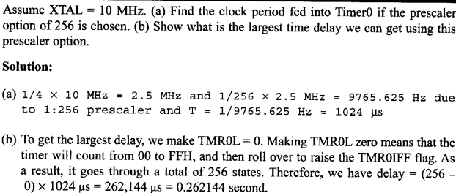
More Example

Slide 13

Assemblers and Negative Value
Recall to have a n (decimal) delay,
256 – n = value to be put at TIM0L

Slide 14
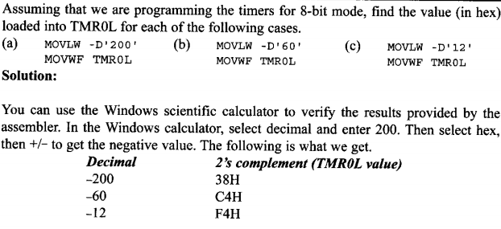
Example

Slide 15
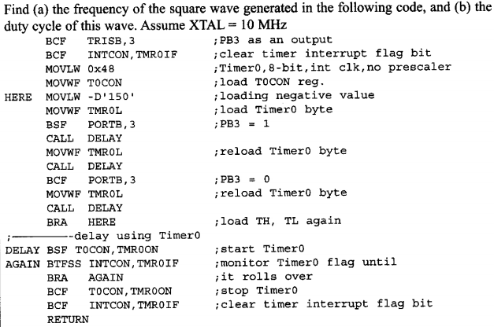
In Class Exercise 2

Slide 16
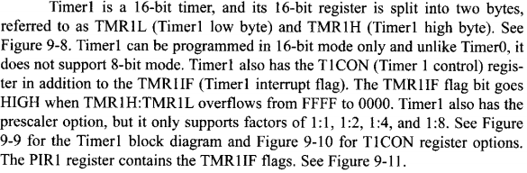
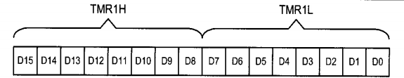
TIMER1 Programming

Slide 17
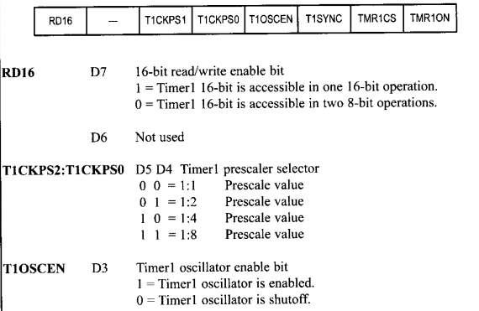
T1CON Register

Slide 18
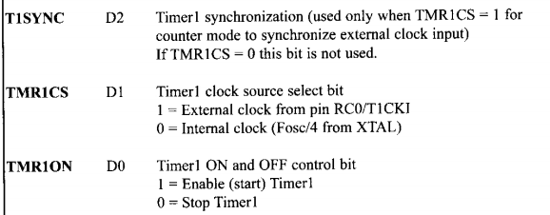
T1CON Register

Slide 19
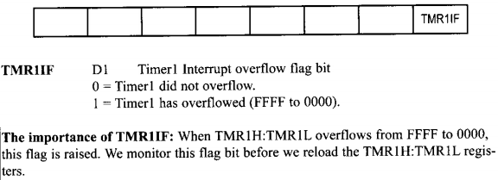
PIR1 (Interrupt Control Register)

Slide 20
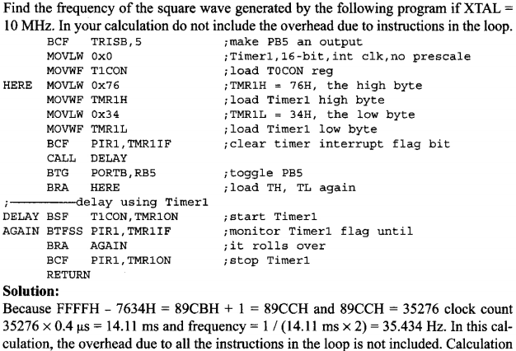
Example of Using TIMER1
T1CON Reg

Slide 21
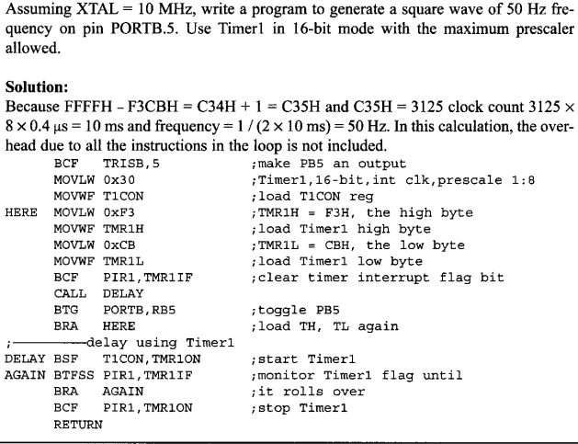
More Example

Slide 22
Counter Programming

Slide 23
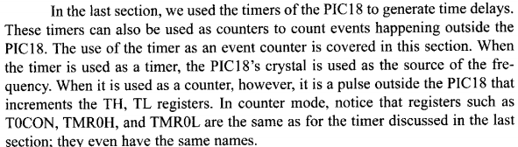
Counter Programming
External pulse is used for triggering

Slide 24
T0CS at T0CON

Slide 25
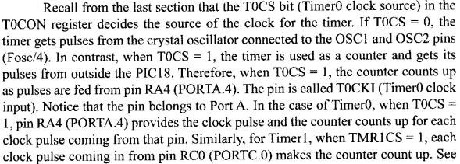
T0CS at T0CON

Slide 26
T0CS at T0CON
Used to counts event outside the PIC
  Increments the TMR0H and TMR0L registers
T0CS in T0CON reg. determines the clock source,
  If T0CS = 1, the timer is used as a counter. TMR0 count up (NOT count down)
  Counts up as pulses are fed from pin RA4 (T0CKI)

Slide 27
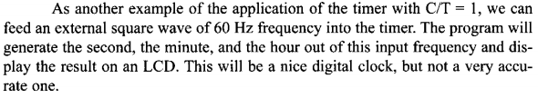
Application

Slide 28
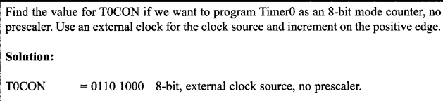
T0CON for Counter Programming

Slide 29
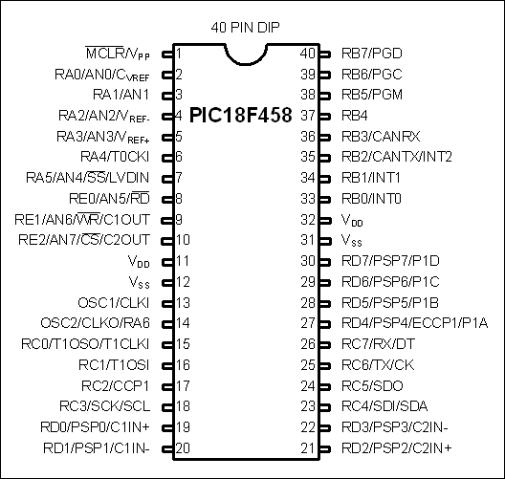
Using external Crystal for Timer cCock
Timer0 comes with two options
  clock fed into T0CKI (RA4)
    T0CS=0
  Clock from a crystal
    T0CS=1

Slide 30
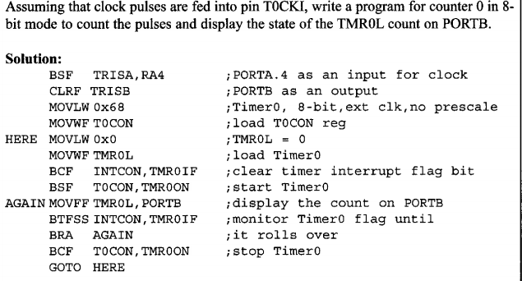
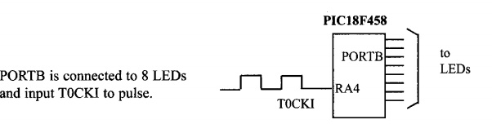
Programming Example

Slide 31

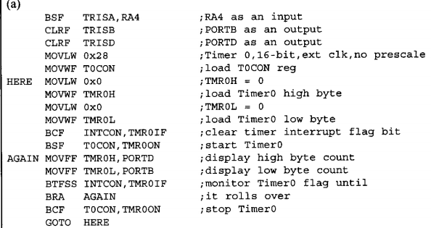
More Example

Slide 32
In Class Exercise 3
Repeat the example with a prescaler of 1:16

Slide 33
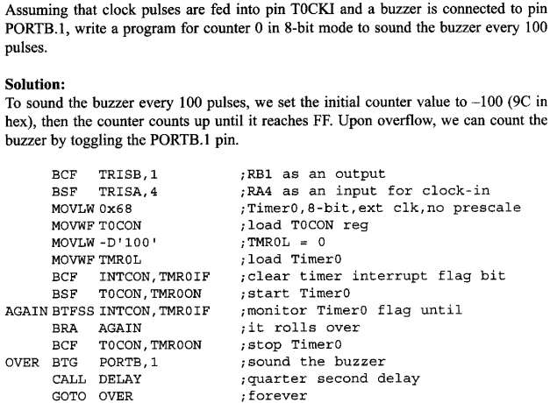
Real Counter Application Example

Slide 34

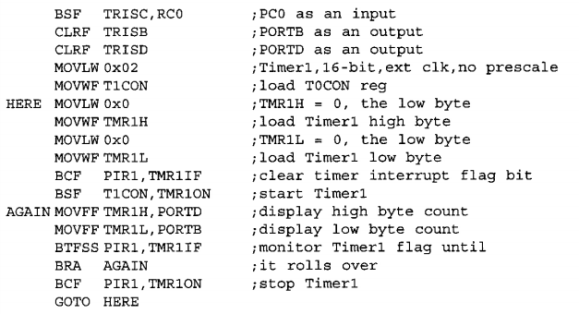
More Example but with TIMER1

Slide 35
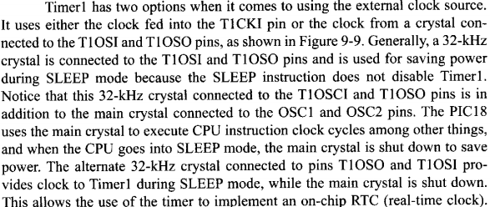
TIMER1 with External Crystal
TMRSC1 =1 , to choose external clock source, in T1CON Reg
T1OSCEN = 1, to enable Timer 1 Oscillator

Slide 36
To Be Continued

