Slide 1
EE3211 Modelling Techniques
Final Review

Slide 2
Notes for Project
Deadline for submission: April 23rd, 2021
  Choose one out of the three topics
  Make sure to arrange submission earlier than the deadline
Cite research paper (Endnote)

Slide 3
Exam
3 hours
All topics covered in this course
Open-book
Format:
  30 questions: multiple choice, true/false, fill in blanks
  3 long questions (with sub questions)

Slide 4
Choice of statistical test

Slide 5
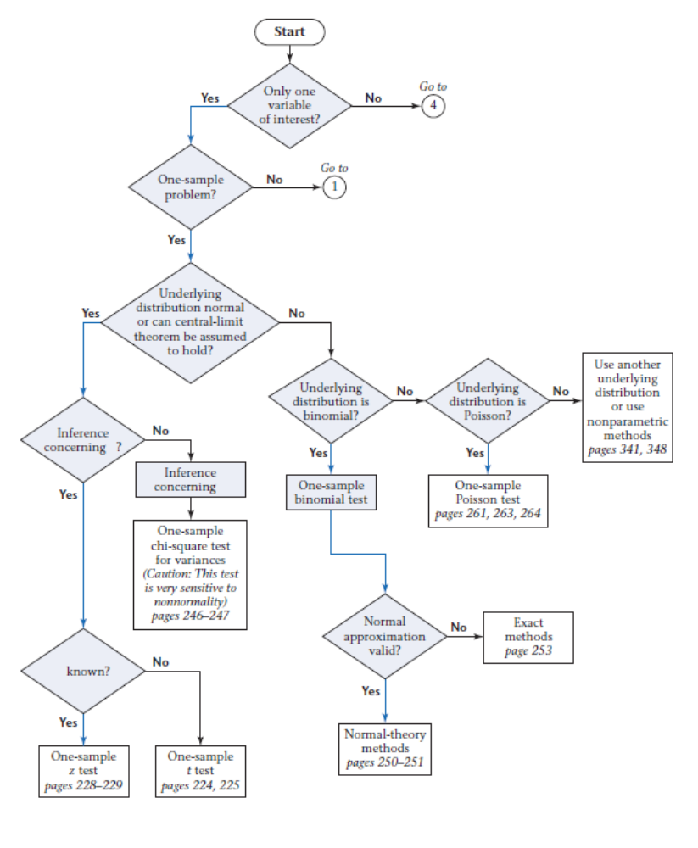

Slide 6
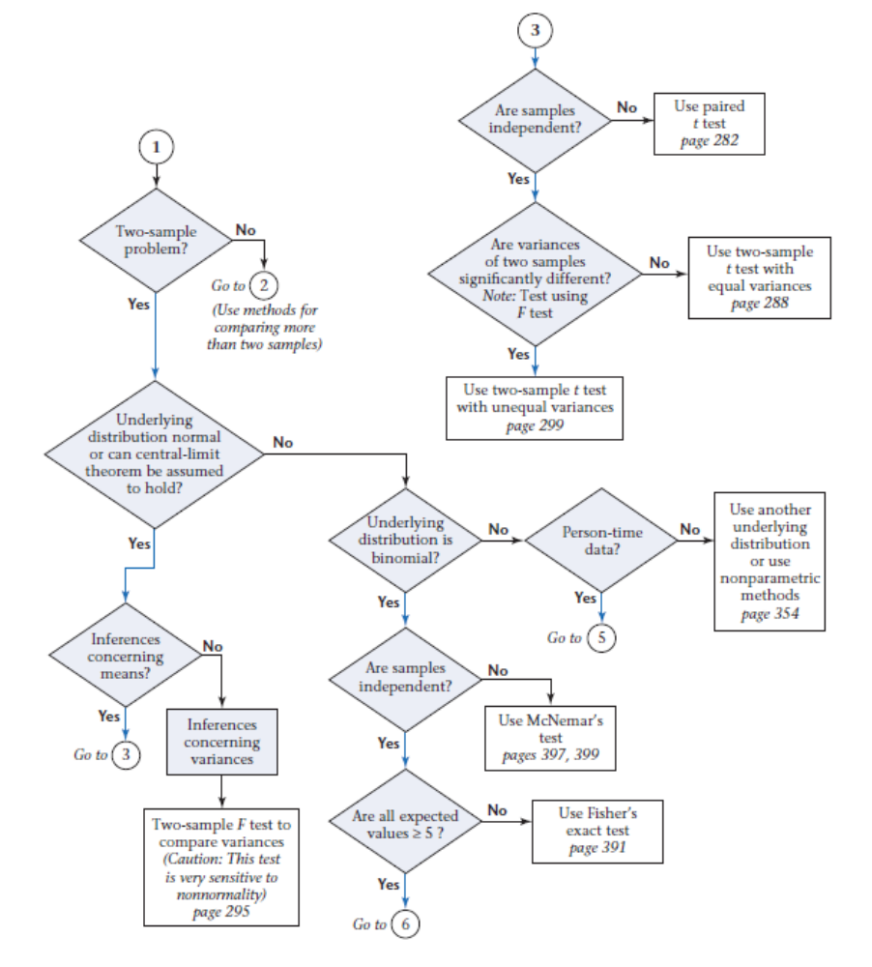

Slide 7
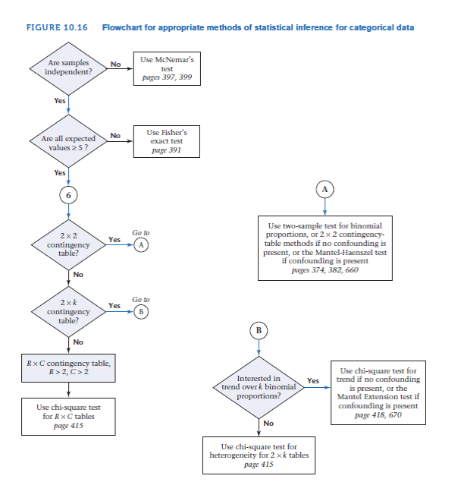

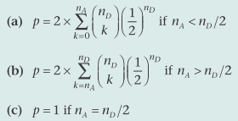
n_{D} ≥20: Normal Theory test:
or X² = (|n_{A} – n_{B}| -1)²/(n_{A} +n_{B})
n_{D} <20: Exact test:
No more than 1/5 of the cells have expected values <5
No cell has an expected value <1
Continuity correction is not needed

Slide 8
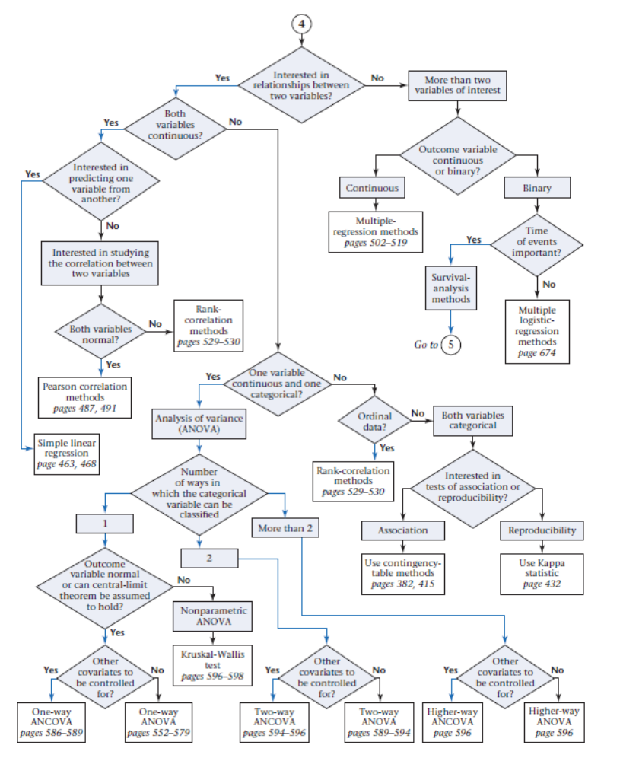

Slide 9
Descriptive statistics
Measures of location e.g. mean, median, mode
Measures of spread e.g. standard deviation
Graphic methods e.g. boxplot, stem-and-leaf plot
  Symmetric distribution
  Unsymmetric distribution (skewed to the right / left)

Slide 10
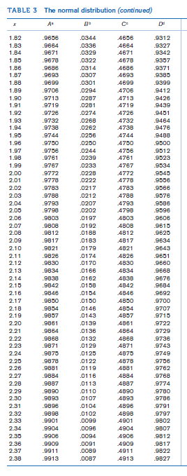
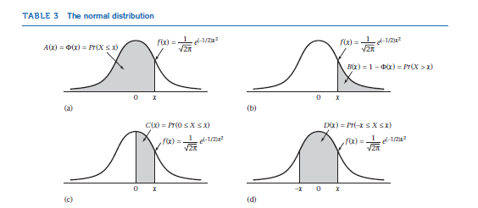
Probability distribution
Discrete vs. continuous
Measure of location
Measure of spread
Standardization of a normal variable
Z-table

Slide 11
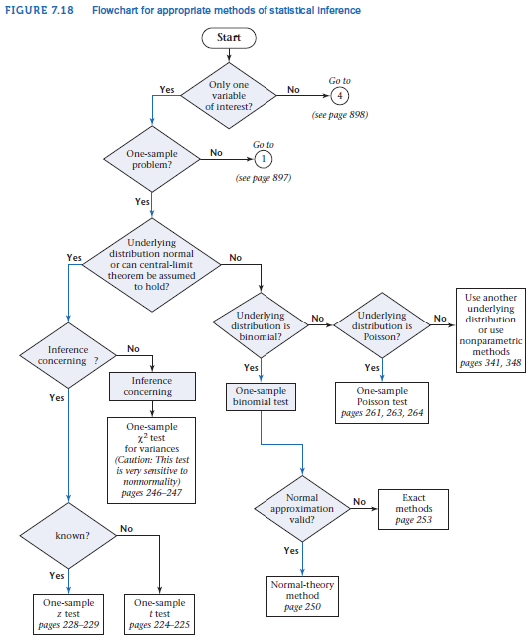
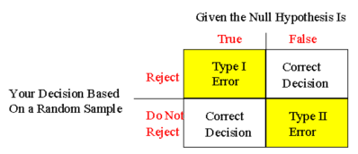
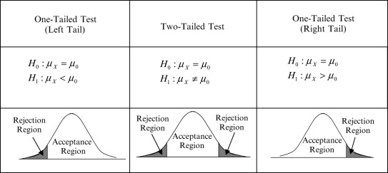
Hypothesis testing: one and two sample inference
Type 1 error
Type 2 error
Two-sided test
One-sided test
P-value
Z-test (Normal distribution table) *when population variance is known
T-test (t distribution table) *when population variance is unknown
Power and sample size
z=$\frac{\overline{x}−μ_{0}}{σ/\sqrt{n}}$
t=$\frac{\overline{x}−μ_{0}}{s/\sqrt{n}}$

Slide 12
Hypothesis testing: Categorical data
Contingency Table Approach
  Expected number of units in the (i,j)
  cell (E_{ij}):
ith row margin X jth column margin
grand total
  none of the four expected values < 5
Fisher’s exact test
  1 of the cells with expected values <=5
McNemar’s Test
Normal Theory test (n_{D} ≥20)
Exact Method (n_{D} < 20)
RxC Contingency Table
  Test statistic:
  H₀ ~ ꭓ² distribution with (R - 1) × (C - 1) df

Slide 13

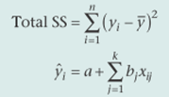
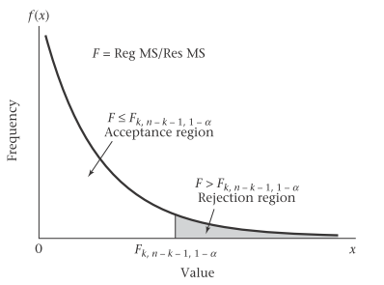
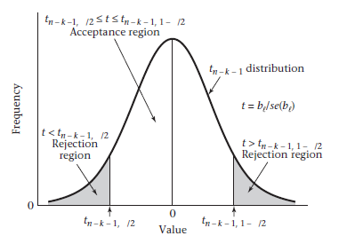
Regression and Correlation
Interpretation of regression line
Correlation (Pearson’s vs. Spearman ranks)
Hypothesis testing for multiple regression
  F test:
H₀: β₁ = β₂ = …= β_{k} = 0
vs. H₁: at least one of the β_{j} ≠ 0 in multiple linear regression
  Test statistic:
  F = Reg MS/Res MS, df = n-k-1 where n=sample size, k =no of independent
  T test:
  H₀: β_{l} = 0, All other β_{j} ≠ 0 vs. H₁: β_{l} ≠ 0 , all other β_{j} ≠ 0 in multiple linear regression
Statistical output for multiple regression model

Slide 14
Nonparametric Methods
Parametric Methods: data of known distribution
Non-parametric methods: data of unknown distribution, skewed / not normally distributed, ordinal
Analysis Type | Example | Parametric Procedure | Nonparametric Procedure | Note
Compare means between two distinct/independent groups | Is the mean systolic blood pressure (at baseline) for patients assigned to placebo different from the mean for patients assigned to the treatment group? | Two-sample t-test | Wilcoxon rank-sum test | Both n1 and n2≥10: normal approximation method 2) n1 or n2 <10: small-sample Wilcoxon rank-sum test table (two- tailed critical values)
Compare two quantitative measurements taken from the same individual | Was there a significant change in systolic blood pressure between baseline and the six-month follow-up measurement in the treatment group? | Paired t-test | Wilcoxon signed-rank test | No. of non-zero di’s (differences of magnitudes)≥16 → normal approximation method
Estimate the degree of association between two quantitative variables | Is systolic blood pressure associated with the patient’s age? | Pearson coefficient of correlation | Spearman’s rank correlation | Pearson: actual values Spearman: rank scores

Slide 15
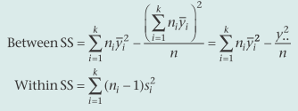
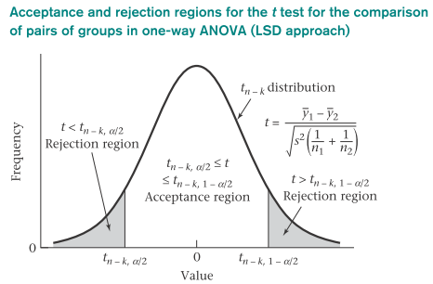


Multisample Inference
ANOVA test: compare means of >2 groups
Assumption: each group follows a normal distribution with the same variance
  F test:
H₀: α_{i} = 0 for all i
H₁: at least one α_{i} ≠ 0
Between MS = Between SS/(k-1)
Within MS = Within SS/(n-k)
Test statistic: F = Between MS/Within MS, df=k-1,n-k
  (n=sample size, k=no. of group)
  T test:
  H₀: α₁ = α₂ vs. H₁: α₁ ≠ α₂
  Pooled estimate of variance =
  Test statistic: , df=n-k
Methods to adjust for multiple comparisons: Bonferroni correction and false-discovery rate

Slide 16



Odds ratio and logistic regression
Main epidemiological study designs and relevant effect estimates:
Multiple logistic regression: p = α + β₁x₁ + …+ β_{k}x_{k}
₋
OR: links exposure variable to the dependent variable:
  95% CI for OR:
Study Design | Prospective cohort study | Case and Control
Effect Estimate | Relative Risk/ Risk Ratio | Odds ratio

