Slide 1
EE2004
Lecture 2 The PIC18 Microcontroller

Slide 2
Objective
  Von Neumann and Harvard Architectures
  Compare the contrasts in microprocessors and microcontrollers.
  Explain the concept of embedded system.

Slide 3
Section 2.1
Von Neumann and Harvard Architectures

Slide 4
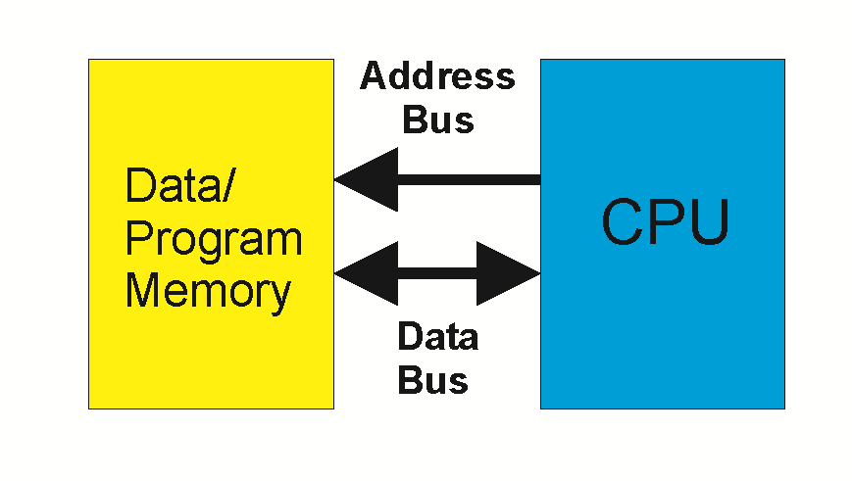
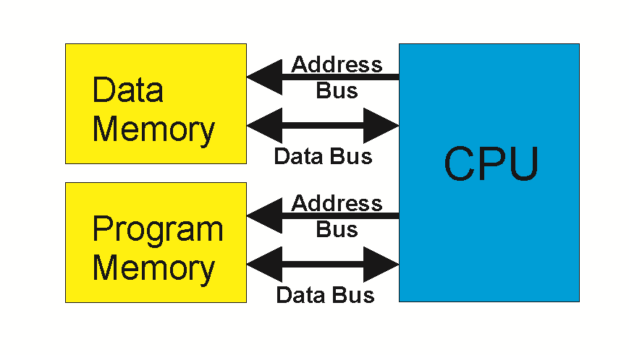
Harvard vs von Neumann Architecture
von Neumann – uses the same address and data bus for code ROM space and data RAM space.
Harvard – uses different address and data buses to access code ROM space and data RAM space.
von Neumann architecture is slow because ROM and RAM cannot be accessed simultaneously.
Implementing Harvard architecture is expensive.
von Neumann Harvard
Notes:
esp when the RAM and ROM space are external to the CPU.
e.g., Pentium μP with 64-bit data bus and 32-bit address bus needs about 100 wires. Number of wires is doubled for Harvard architecture.

Slide 5
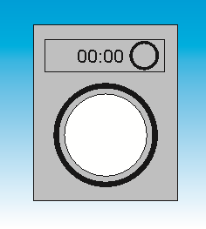
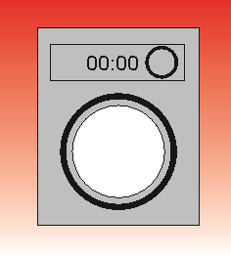
Von Neumann Architecture is Slow
 | 30 | 30 | 30 | 30 | 30 | 30 | 30 | 30




1
2
3
4

Slide 6
Advantage of Harvard Architecture - Pipelining
 | 30 | 30 | 30 | 30 | 30




1
2
3
4

Slide 7
Disadvantage of Harvard Architecture
μP 64-bit data bus and 32-bit address bus needs about 200 wires.

Slide 8
Section 2.2 microprocessors and microcontrollers

Slide 9
General-purpose microprocessor
CPU for Computers
No RAM, ROM, I/O on CPU chip itself
Example：Intel’s x86, Motorola’s 680x0
Many chips on mother’s board
Data Bus
CPU
General-Purpose Micro-processor
Serial COM Port
RAM
ROM
I/O Port
Timer
Address Bus
Figure 1-1 (a) General-Purpose Microprocessor System
9
Notes:
2019/1/23

Slide 10
Microcontrollers
Embedded Systems
  Operations managed behind the scenes by a microcontroller
Microcontroller (MCU)
  An integrated electronic computing device that includes three major components on a single chip
    Microprocessor (MPU)
    Memory
    I/O (Input/Output) ports
10
Notes:
10

Slide 11
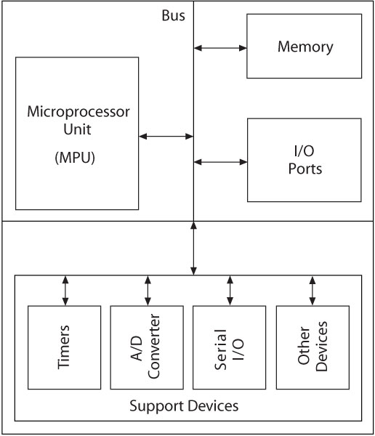

Slide 12
Microcontrollers
12
Support Devices (Peripheral)
a device attached to a computer
  Timers (counting number of pulses)
  A/D converter (Analog to Digital )
  Serial I/O (example keyboard to main board)
All components connected by common communication lines called the system bus.
Notes:
12

Slide 13
Microcontroller
A smaller computer
On-chip RAM, ROM, I/O ports...
Example：Motorola’s 6811, Intel’s 8051, Zilog’s Z8 and PIC 18
CPU
RAM
ROM
A single chip
Serial COM Port
I/O Port
Timer
Figure 1-1 (b) Microcontroller
13
Notes:
2019/1/23
13

Slide 14
Microprocessor v.s. Microcontroller
Microprocessor
CPU is stand-alone, RAM, ROM, I/O, timer are separate
Designer can decide on the amount of ROM, RAM and I/O ports.
General-purpose
Expensive
Microcontroller
CPU, RAM, ROM, I/O and timer are all on a single chip
Fix amount of on-chip ROM, RAM, I/O ports
Single-purpose
Cheap
For applications in which cost, power and space are critical
14
Notes:
2019/1/23

Slide 15
Section 2.3
Embedded System

Slide 16
Embedded System
Embedded system means the processor is embedded into that application.
An embedded product uses a microprocessor or microcontroller to do specified tasks only.
In an embedded system, there is only one application software that is typically burned into ROM.
Some embedded products using microcontrollers. Example：printer, keyboard, video game player, door opener, copier, ABS,
fax machine, camera, cellular phone,
keyless entry, microwave...
16
Notes:
2019/1/23

Slide 17
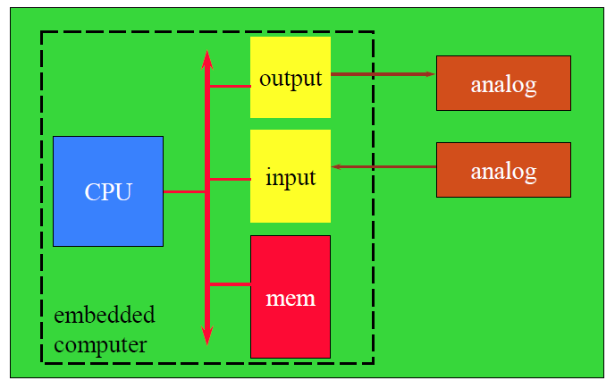
Embedded System
17
Notes:
2019/1/23

Slide 18
Processors in Embedded Systems
Which is your choice for an embedded product？
microcontroller
  cost down
  embedded processor ＝ microcontroller
  In future, an entire computer on a chip, SOC
  System on a Chip
  high-end embedded systems may use microprocessors

Slide 19
Three criteria in Choosing a Microcontroller
meeting the computing needs of the task efficiently and cost effectively
  speed, the amount of ROM and RAM, the number of I/O ports and timers, size, packaging, power consumption
  easy to upgrade
  cost per unit
availability of software development tools
  assemblers, debuggers, C compilers, emulator, simulator, technical support
wide availability and reliable sources of the microcontrollers.

Slide 20
Section 2.4
Overview of PIC18

Slide 21
PIC18F Microcontroller Families
PIC microcontrollers are designed using the Harvard Architecture which includes:
  Microprocessor unit (MPU)
  Program memory for instructions
  Data memory for data
  I/O ports
  Support devices such as timers

Slide 22
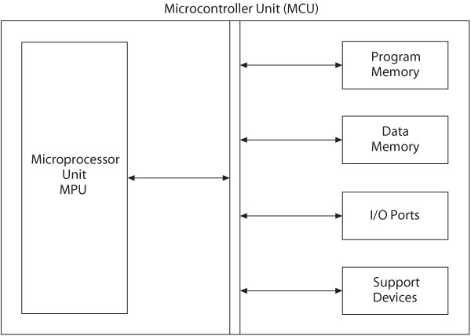

Slide 23
Microprocessor Unit
Includes Arithmetic Logic Unit (ALU), Registers, and Control Unit
  Arithmetic Logic Unit (ALU)
    Instruction decoder
      16 bit instructions
    Status register that stores flags
      5 bits
    WREG – working register
      8 bit accumulator

Slide 24
Microprocessor Unit
  Registers
    Program Counter (PC)
      21 bit register that holds the program memory address while executing programs
    Bank Select Register (BSR)
      4 bit register used in direct addressing the data memory
    File Select Registers (FSRs)
      12 bit registers used as memory pointers in indirect addressing data memory
  Control unit
    Provides timing and control signals to various Read and Write operations

Slide 25
PIC18F - Address Buses
Address bus
  21-bit address bus for program memory addressing capacity: 2 MB of memory
  12-bit address bus for data memory addressing capacity: 4 KB of memory

Slide 26
Data Bus and Control Signals
Data bus
  16-bit instruction/data bus for program memory
  8-bit data bus for data memory
Control signals
  Read and Write

Slide 27
PIC18F452/4520 Memory
Program Memory: 32 K
  Address range: 000000 to 007FFF_{H}
Data Memory: 4 K
  Address range: 000 to FFF_{H}
Data EEPROM
  Not part of the data memory space
  Addressed through special function registers

Slide 28
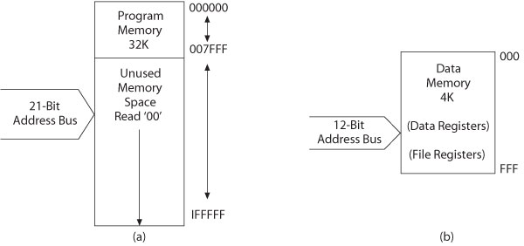
PIC18F452/4520 Memory
Program memory
Data memory

Slide 29
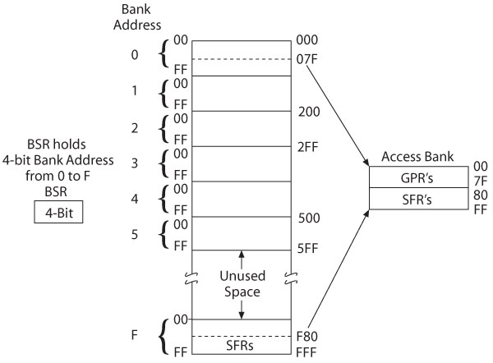
PIC18F452/4520 – Data Memory with Access Banks

Slide 30
PIC18F452 I/O Ports
Five I/O ports
  Digital IO is the most fundamental mode of connecting a MCU to external world. The interface is done using what is called a PORT.
  The IO ports can be programmed as input or output.
  PORT A through PORT E
  Most I/O pins are multiplexed
  Generally have eight I/O pins with a few exceptions
  Addresses already assigned to these ports in the design stage
  Each port is identified by its assigned SFR

Slide 31
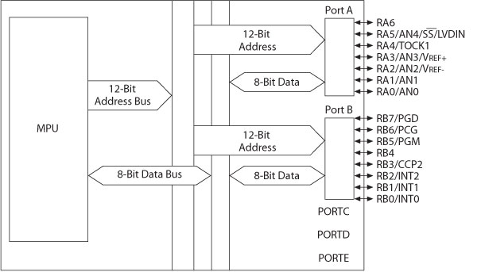
PIC18F452—I/O Ports A and B

Slide 32
MCU Support Devices
Timers
  Capture, Compare and PWM (CCP Modules)
Serial Communications
  Master Synchronous Serial Port (MSSP)
  Addressable USART
A/D converter
Parallel Slave Port (PSP)
Data EEPROM

Slide 33
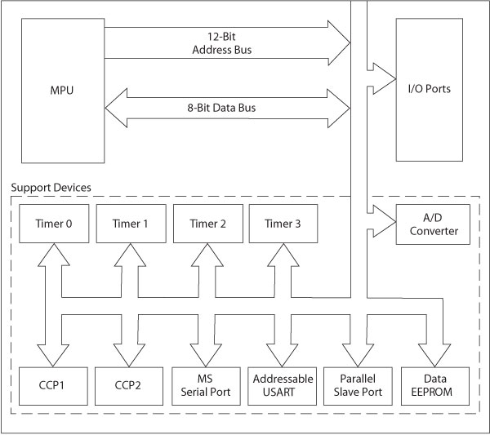
MCU Support Devices

Slide 34
PIC18F Special Features
Sleep mode
Watchdog timer (WDT)
Code protection
In-circuit serial programming
In-circuit debugger

Slide 35
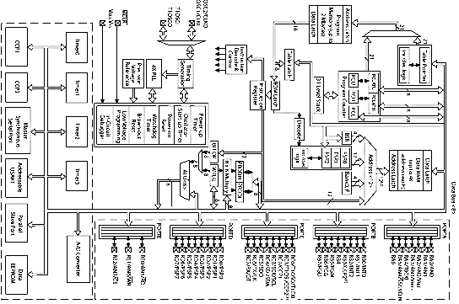
PIC18F4X2 Architecture Block Diagram

Slide 36
PIC18F Instructions and Assembly Language
Has 77 instructions
  Earlier PIC family of microcontrollers have either 33 or 35 instructions
In PIC18F instruction set, all instructions are 16-bit word length except four instructions that are 32-bit length

Slide 37
Instruction Description and Illustrations
Copy (Move) 8-bit number (Literal) into W register
  Mnemonics: MOVLW 8-bit
  Binary format:
0000 1110 XXXX XXXX (any 8-bit number)
Copy (Move) contents of W register into PORTC (File)
  Mnemonics: MOVWF PORTC, a
    (‘a’ indicates that PORTC is in the Access Bank)
  Binary format:
0110 1110 1000 0010 (82_{H} is PORTC address)

Slide 38
Illustrative Program: Displaying a Byte at an I/O Port
Problem statement:
  Write instructions to light up alternate LEDs at PORTC
Hardware:
  PORTC
    bidirectional (input or output) port; should be setup as output port for display
  Logic 1 will turn on an LED

Slide 39
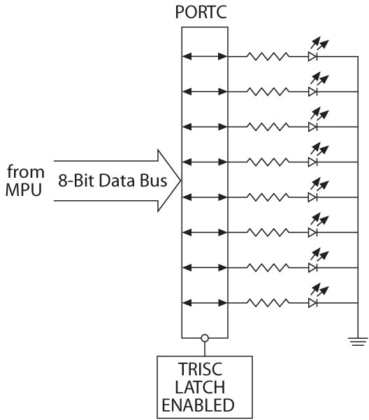
Illustration
Interfacing LEDs to PORTC

Slide 40
Illustration
Program (software)
  Logic 0 to TRISC sets up PORTC as an output port
  Byte 55_{H} turns on alternate LEDs
    MOVLW 00 ;Load W register with 0
    MOVWF TRISC,0 ;Set up PORTC as output
    MOVLW 0x55 ;Byte 55_{H} to turn on LEDS
    MOVWF PORTC,0 ;Turn on LEDs

Slide 41
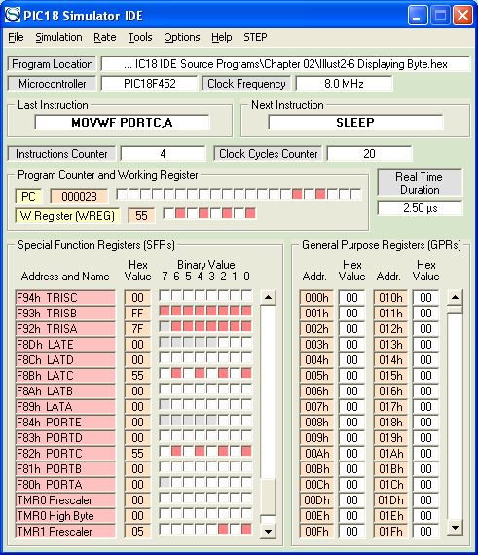
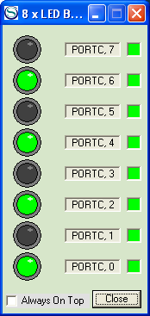
PIC18 Simulator IDE

Slide 42
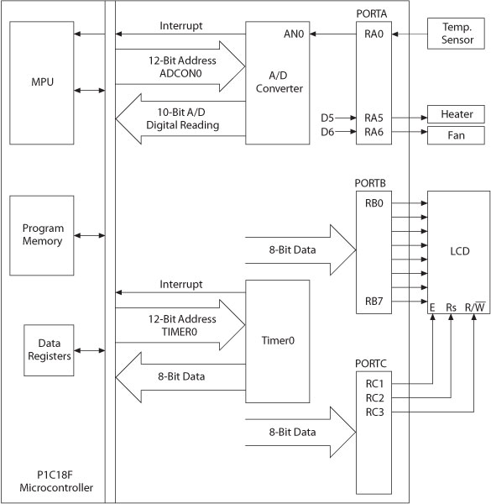
Embedded System
Microcontroller-based
Time and
Temperature
System

Slide 43
You are able to
Compare and contrast microprocessors and microcontrollers
Describe the advantages of microcontrollers for some applications
Explain the concept of embedded systems
Discuss criteria to consider in choosing a microcontroller
Explain the variations of speed, packaging, memory, and cost per unit and how these affect choosing a microcontroller
Some basic feature of PIC18

