Slide 1
EE3122: Analogue Circuit Fundamentals
Current Mirror
Department of Electrical Engineering
City University of Hong Kong
Prof. Arindam BASU

Slide 2
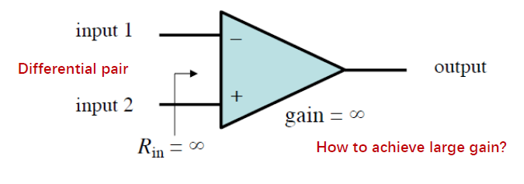
Motivation
How to achieve very high gain?
How to achieve very high CMRR?

Slide 3
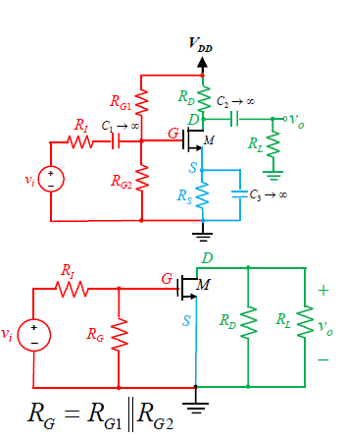
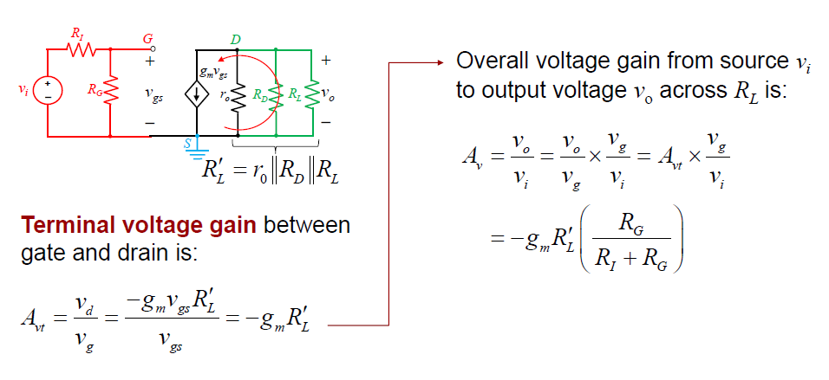
Voltage gain in fully bypassed CS Amplifier
Can increase gain by increasing R_{D} & R_{L}.
But DC bias issue if increase R_{D} → voltage headroom limited due to V_{DD}
  E.g.: If I_{bias} = 1mA & R_{D} = 100 kΩ, need V_{DD} = 100 V!!

Slide 4
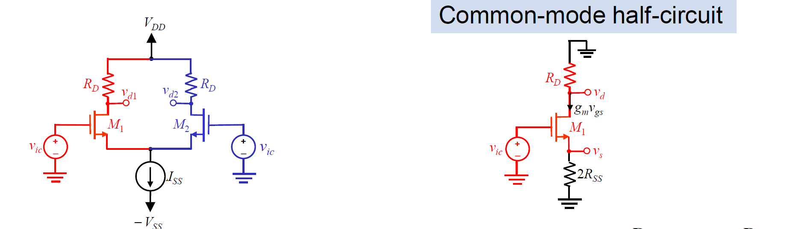
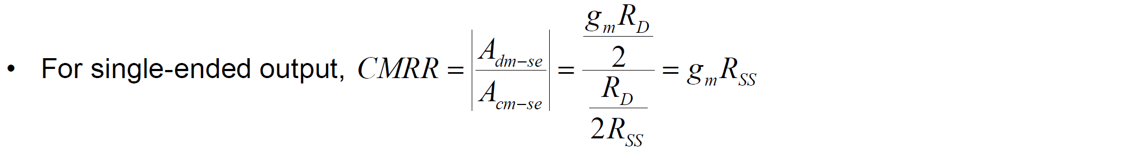
CMRR in Differential Amplifier
If use normal resistor, increase R_{SS} → DC power supply limit due to I_{SS}R_{SS} drop!

Slide 5
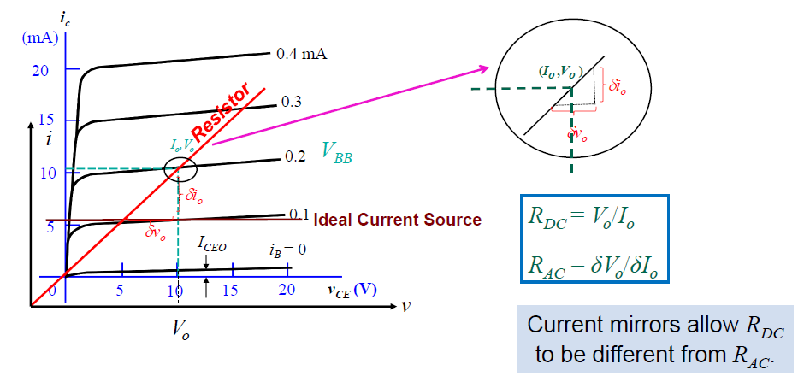
Active load
Need resistor with different AC & DC resistance → transistor as solution!

Slide 6
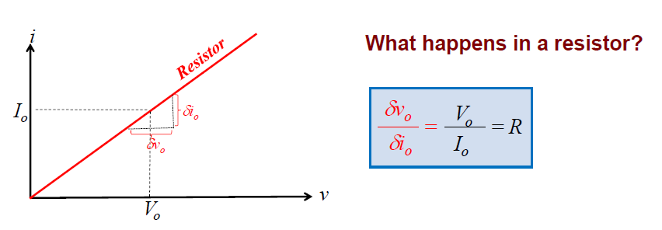
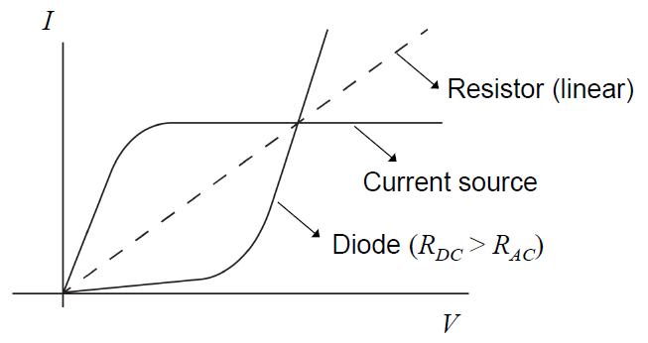
DC & AC resistances

Slide 7
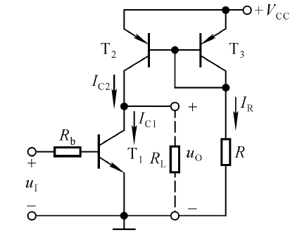
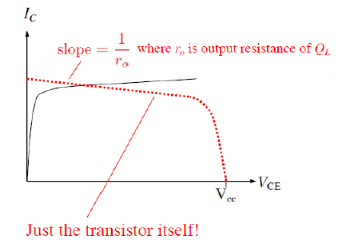
BJT as Active Load
Current Mirror

Slide 8
Current Mirror
Current in the MOS/BJT current source is fixed by the Current Mirror
Also has advantage of making many copies with arbitrary gain!
Current Mirror
Output current
Circuit to be biased with DC current from transistor
Input
current

Slide 9
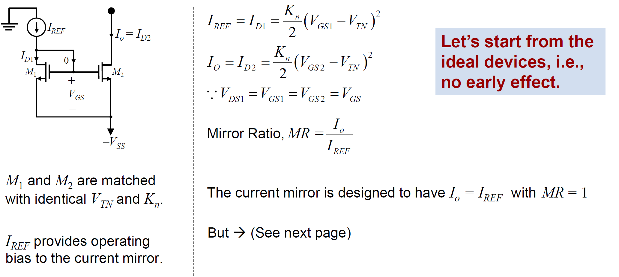
MOS Current Mirror: DC Analysis

Slide 10
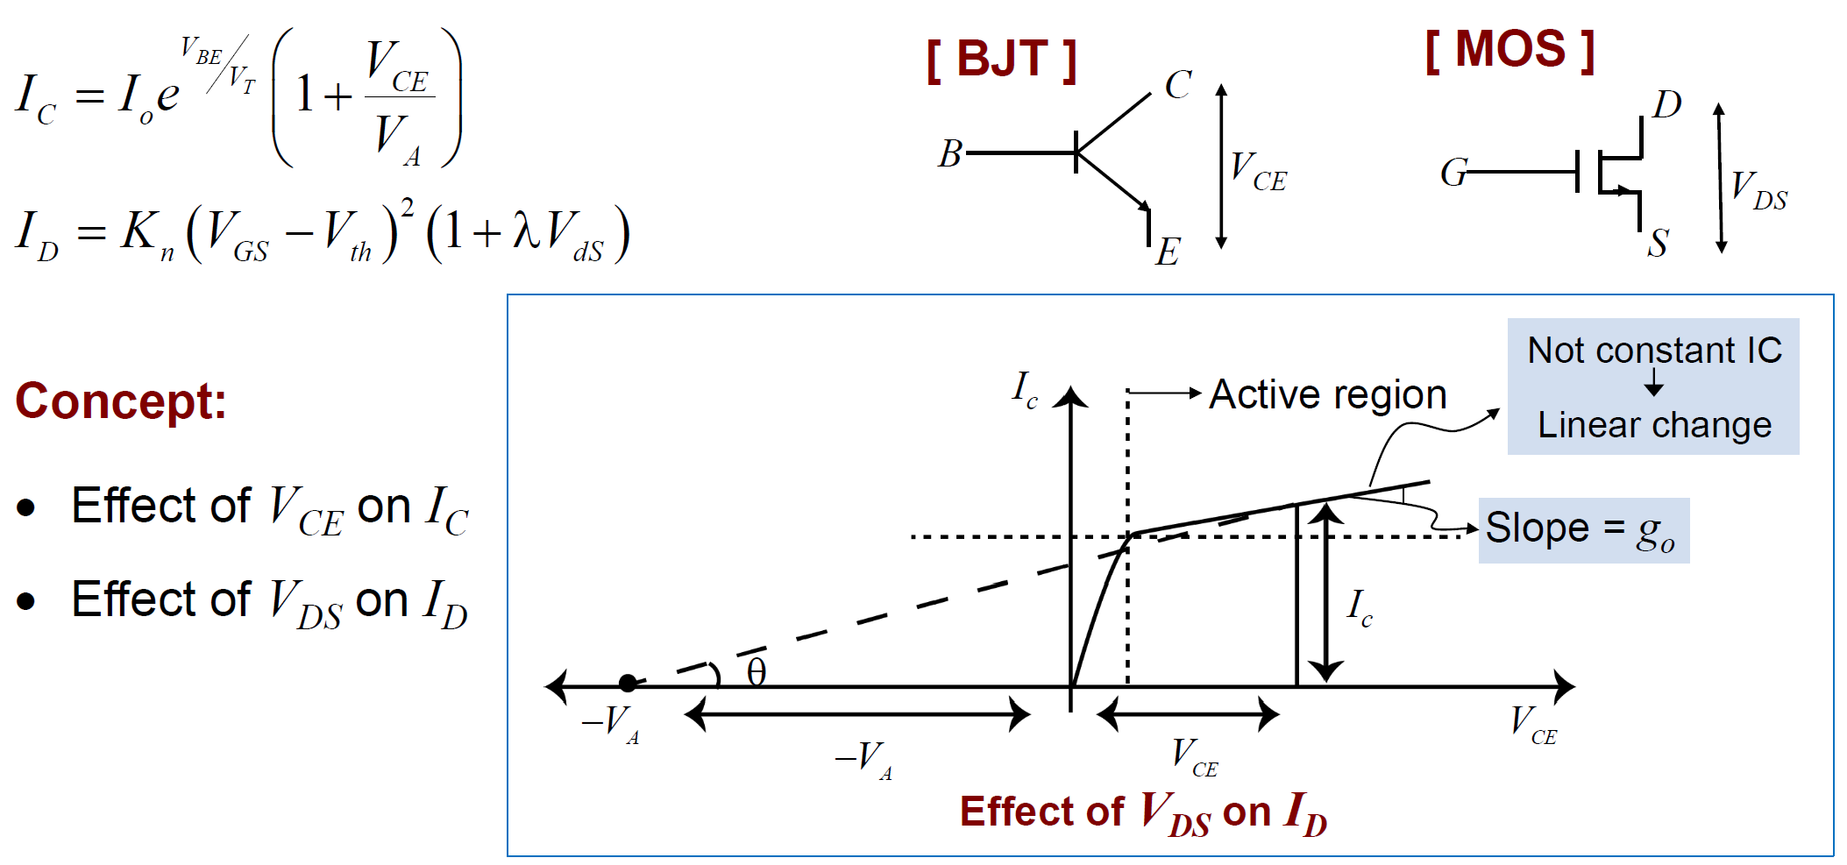
Early Effect & Connection with Small-signal model

Slide 11
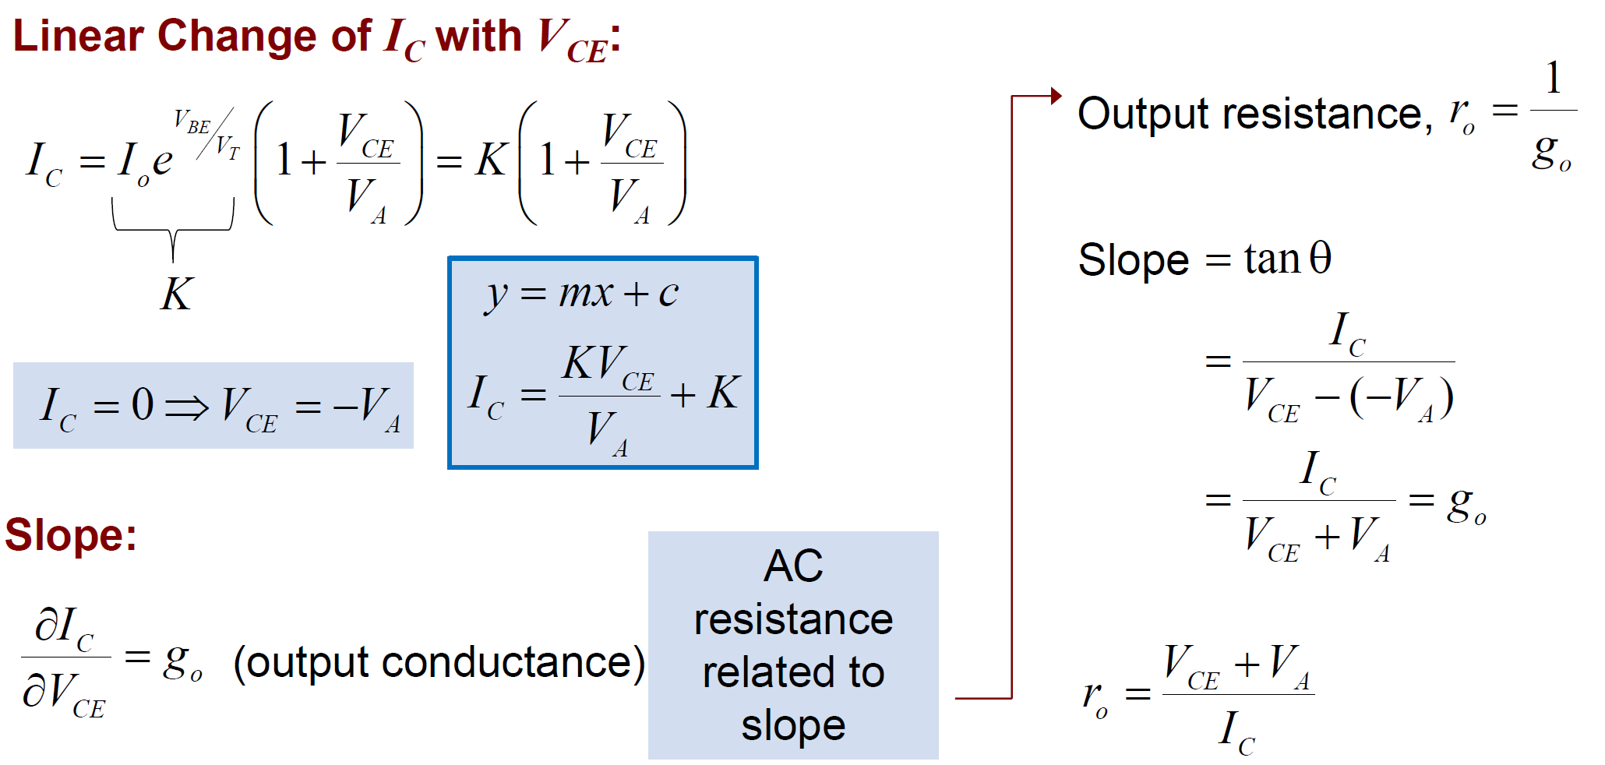
Early Effect & Connection with Small-signal model

Slide 12
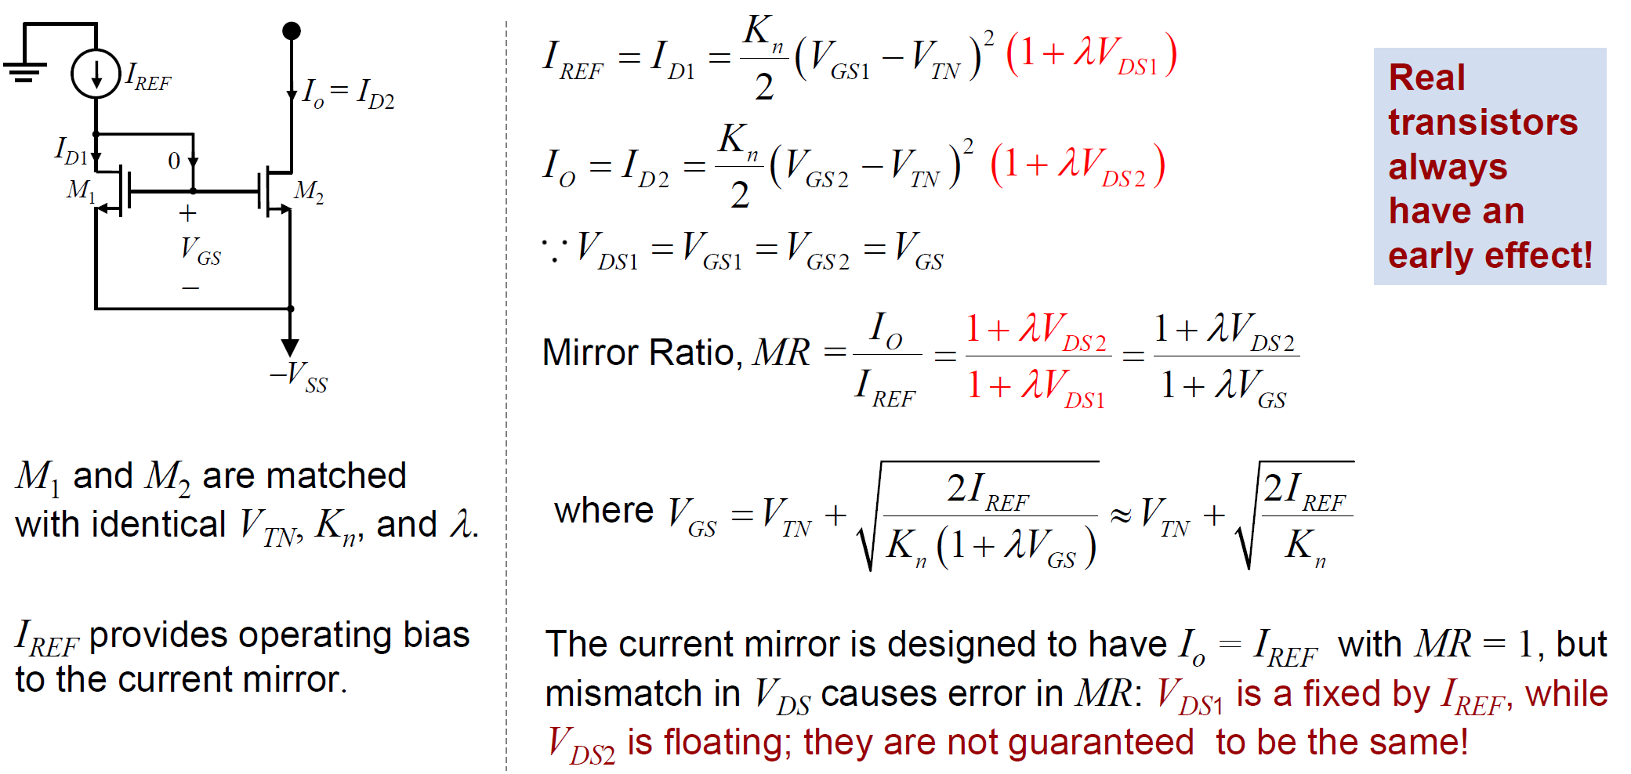
MOS Current Mirror: DC Analysis with Early Effect

Slide 13
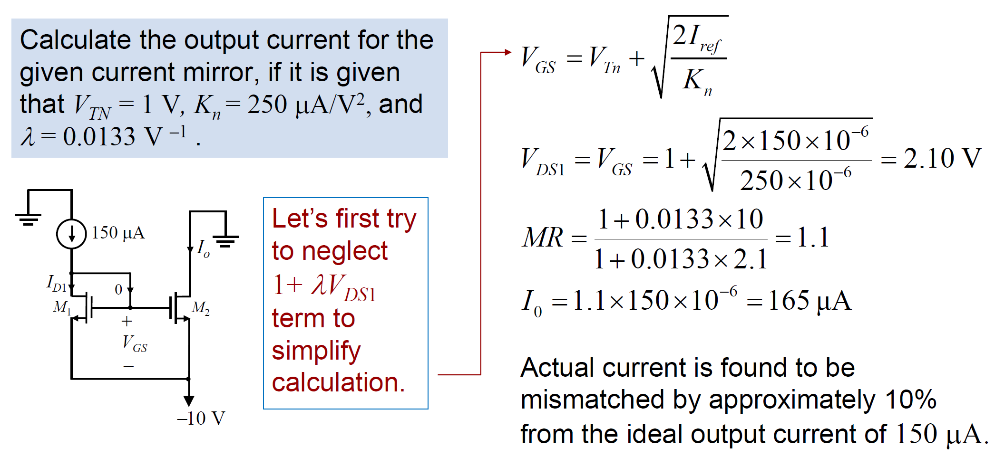
MOS Current Mirror: Example

Slide 14
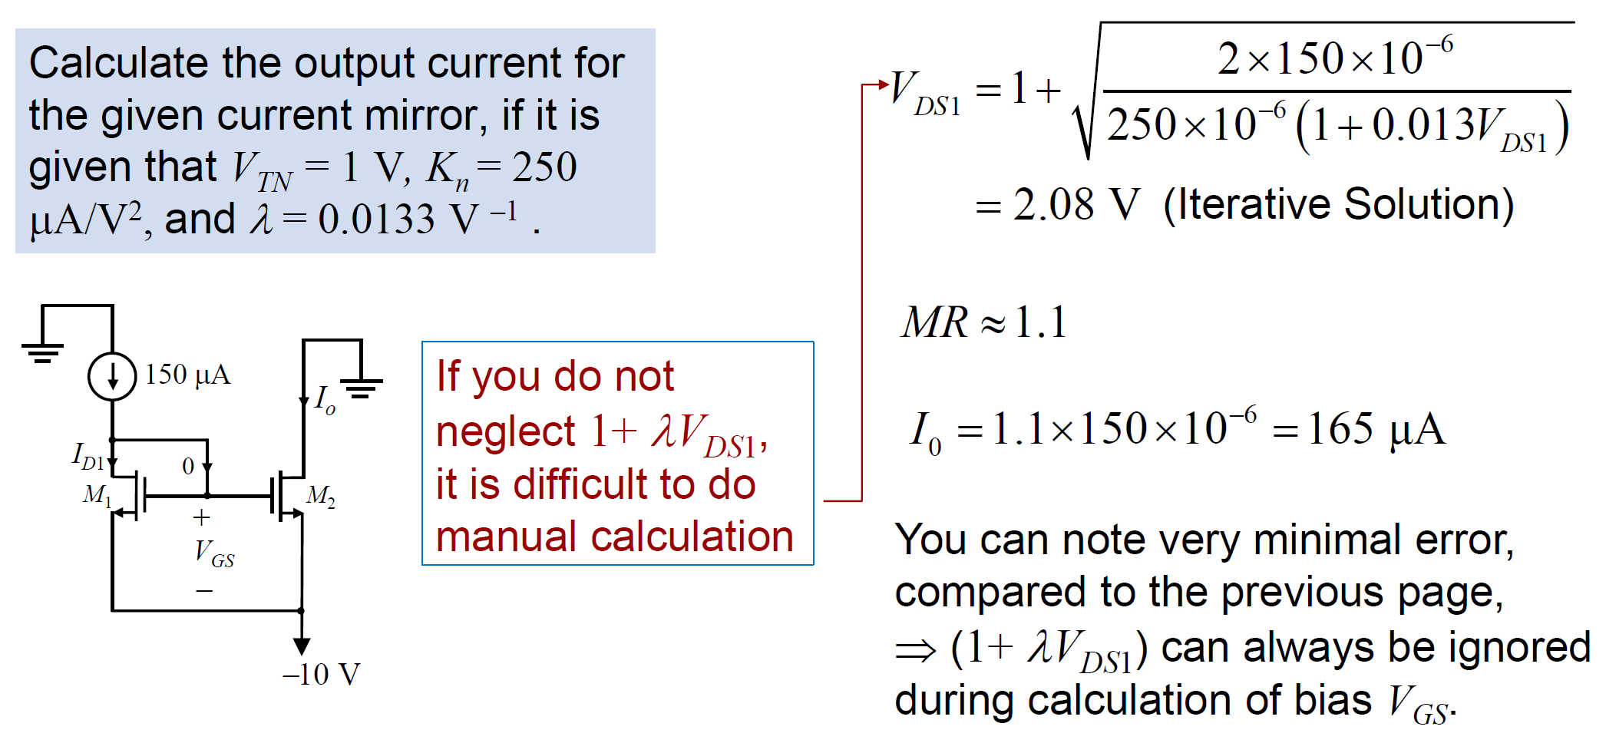
MOS Current Mirror: Example

Slide 15
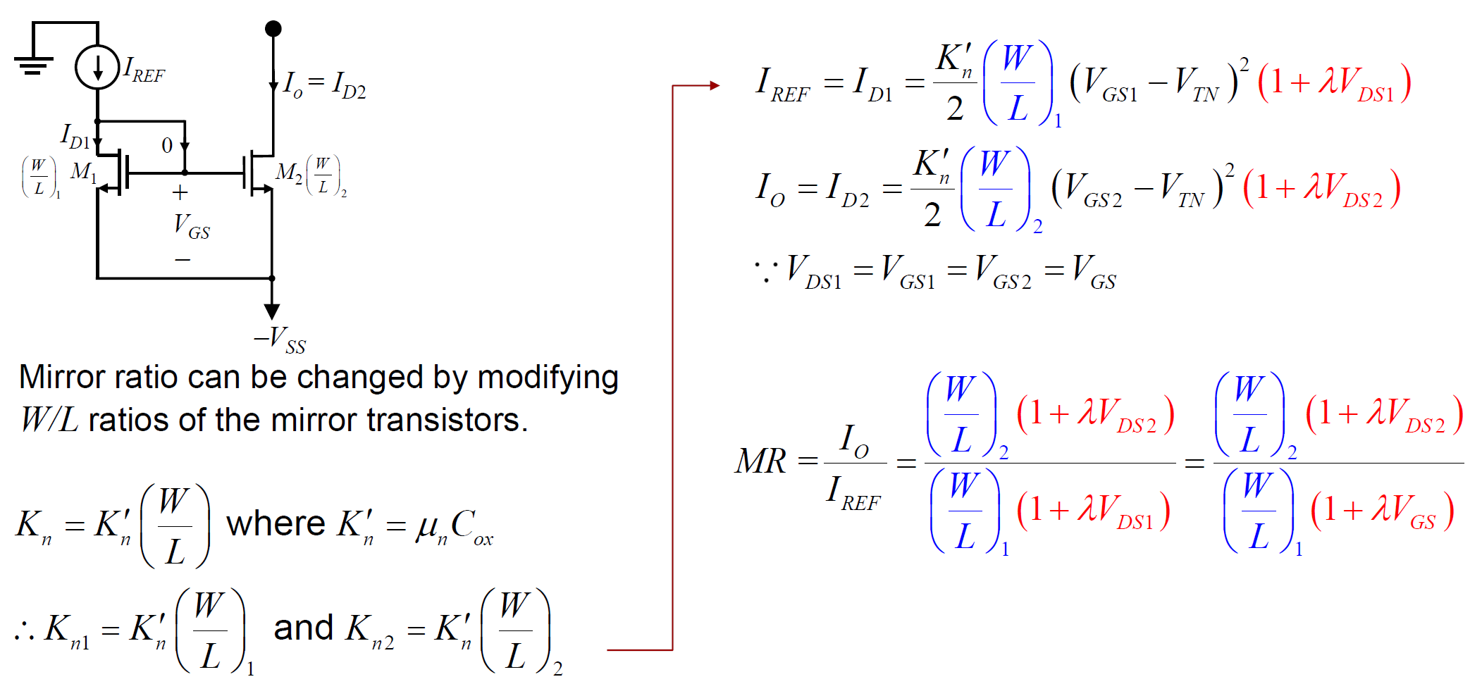

MOS Current Mirror: Gain ($MR≠1$)

Slide 16
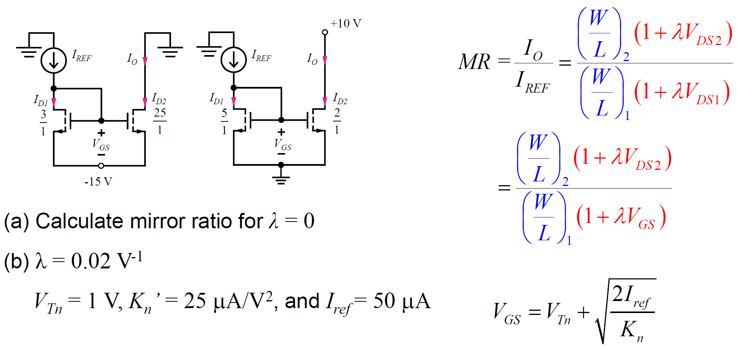
MOS Current Mirror: Example

Slide 17
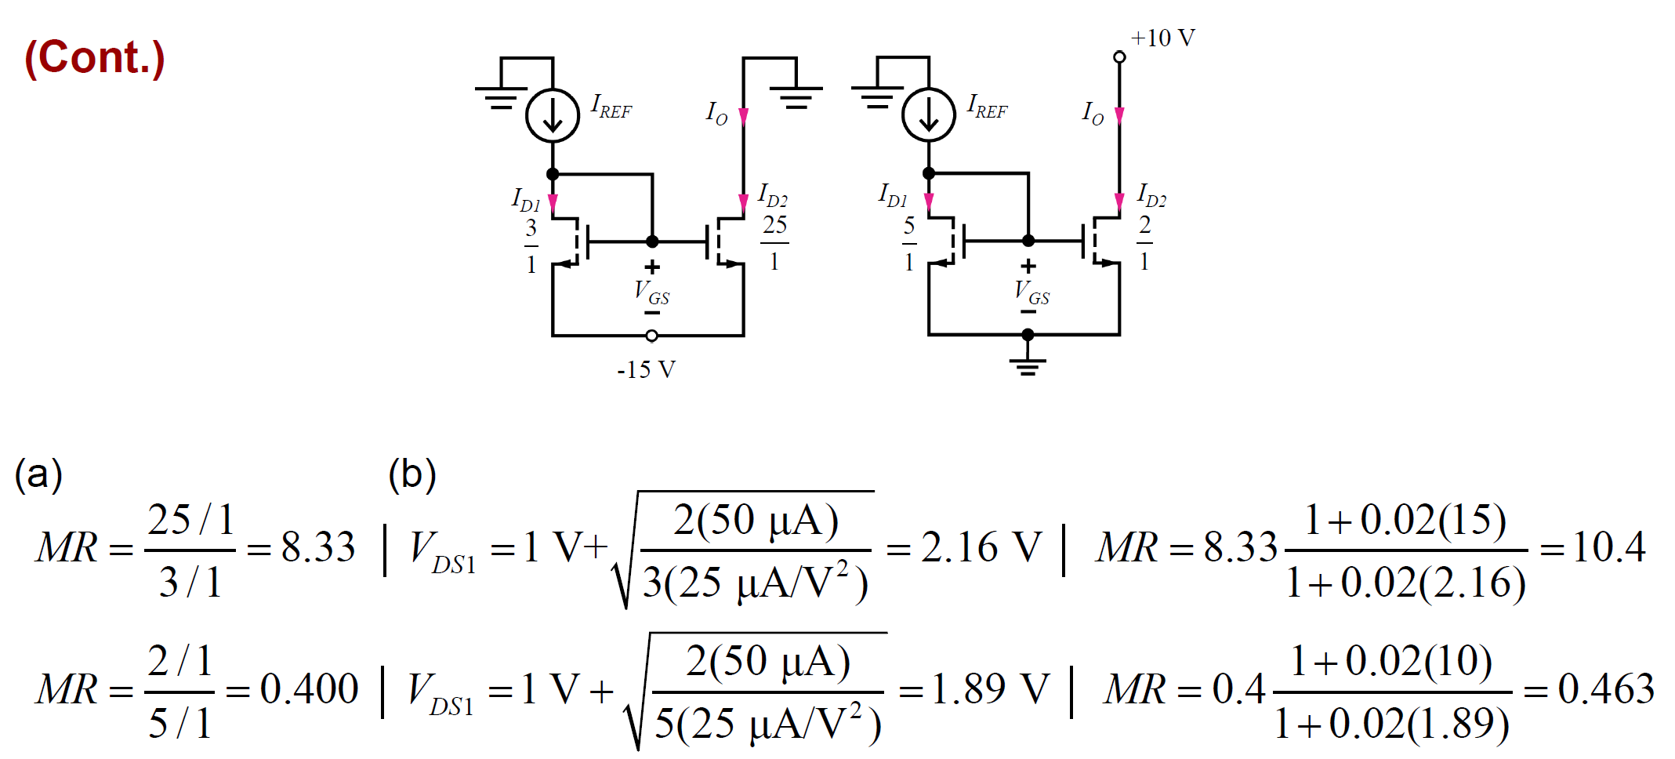
MOS Current Mirror: Example

Slide 18
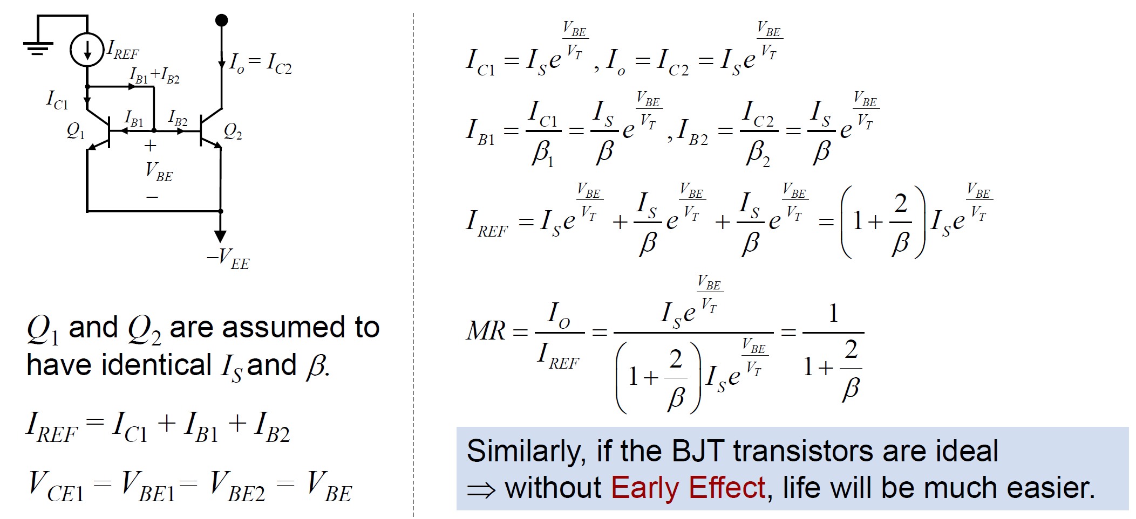
BJT Current Mirror
Even in ideal case, BJT current mirror has MR < 1 due to base currents!!

Slide 19
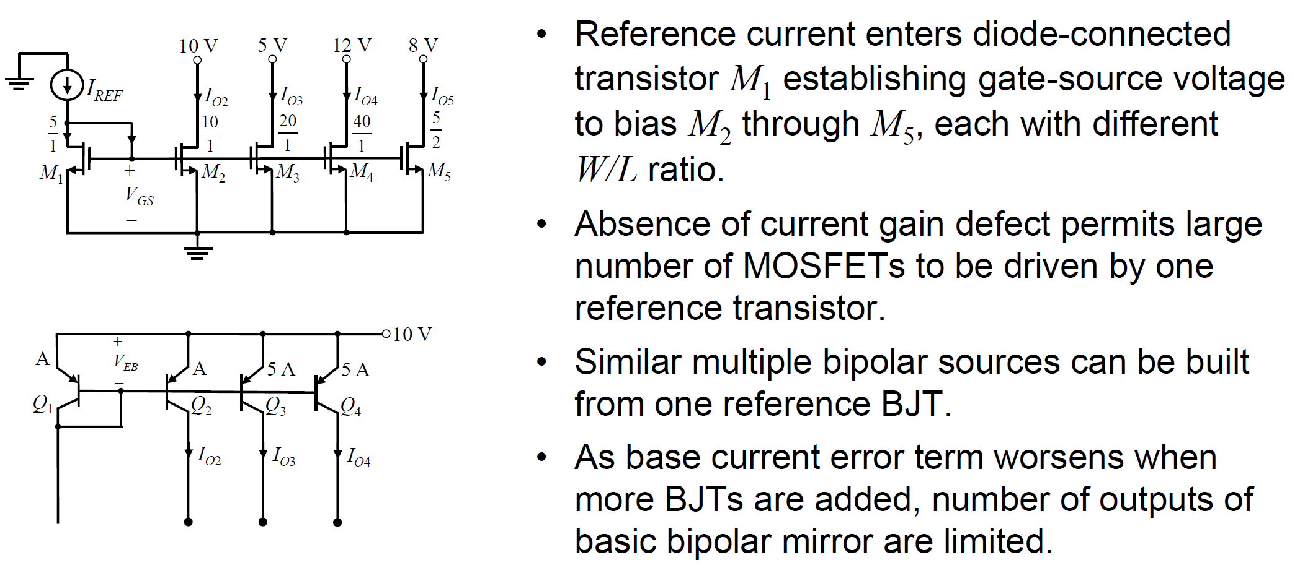
Multiple Current Sources

Slide 20
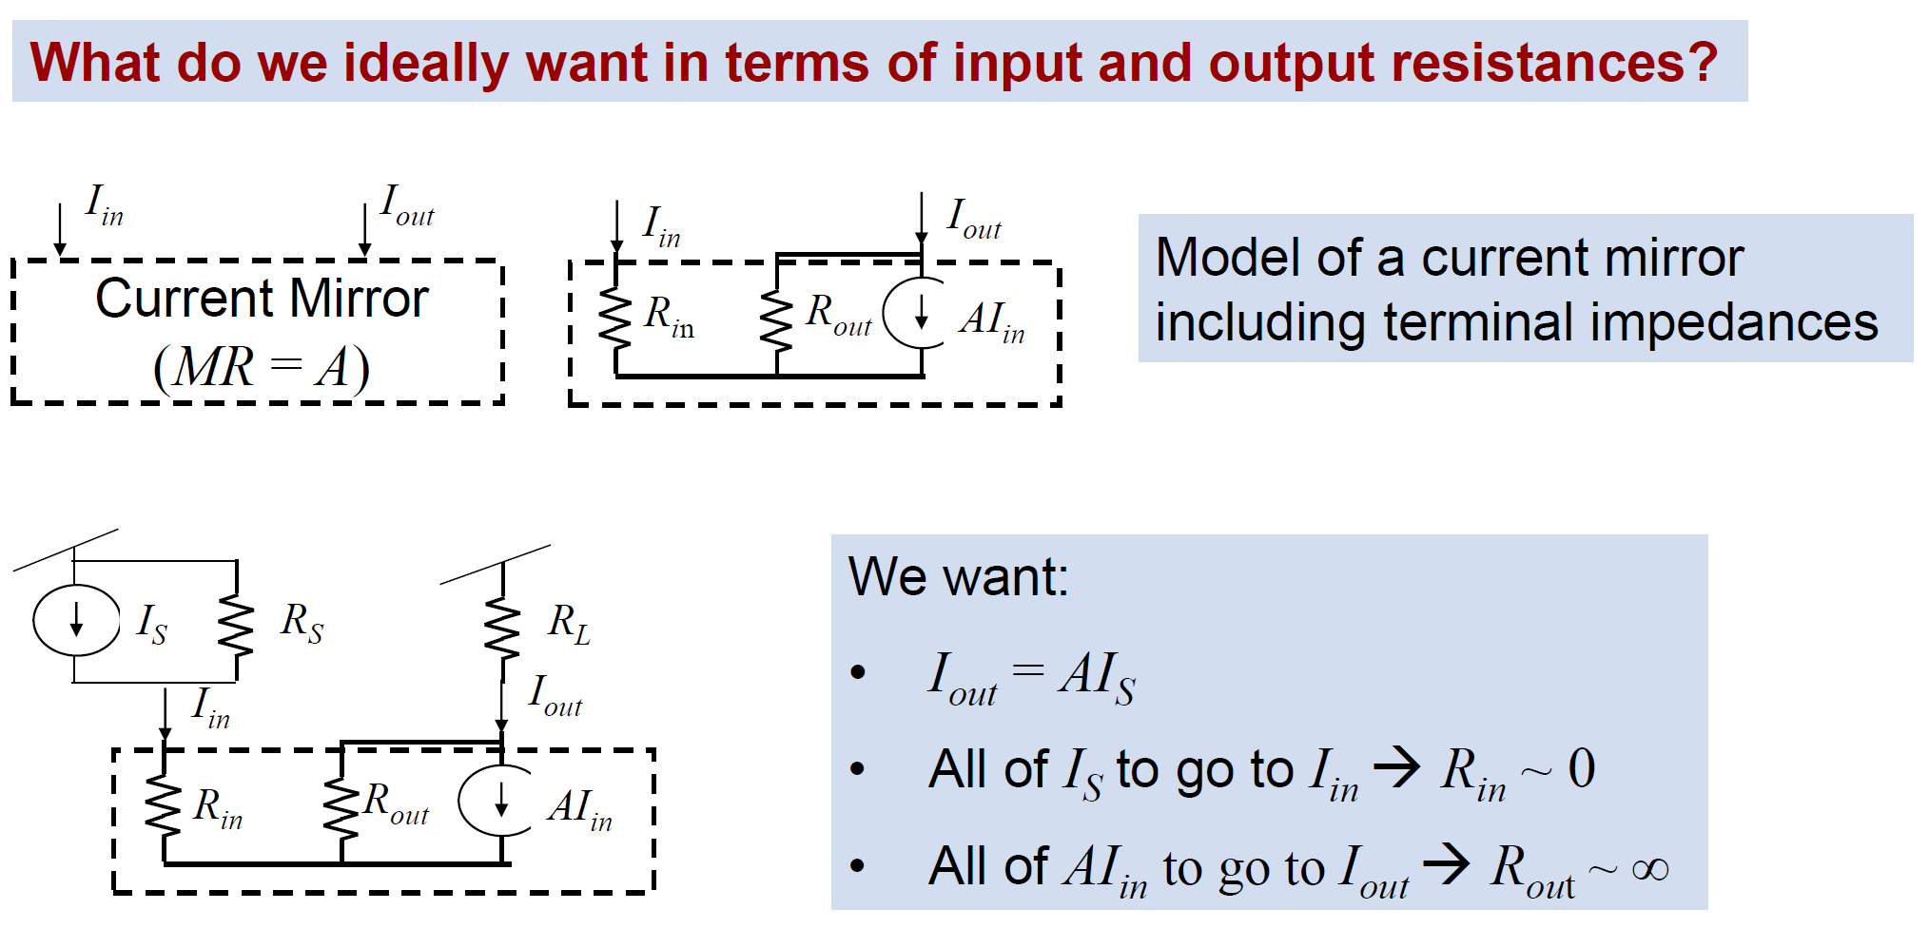
Terminal Resistances of Current Mirrors

Slide 21
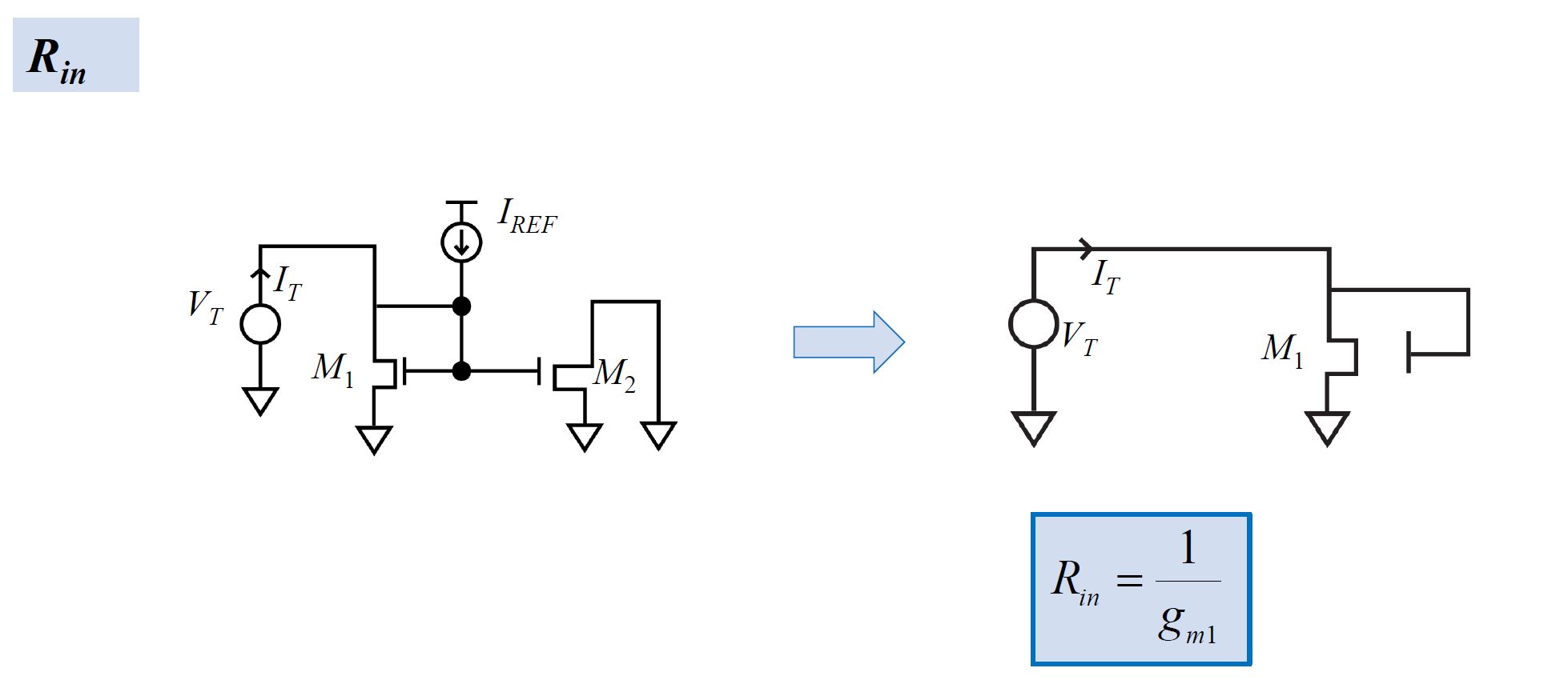
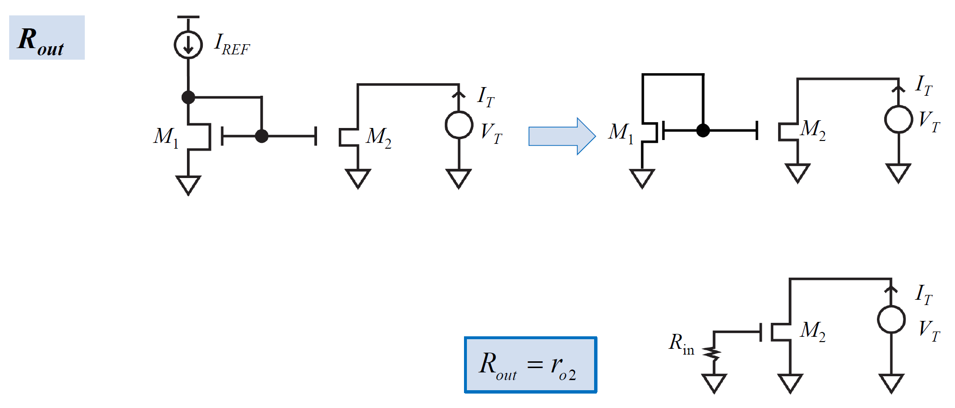
MOS Current Mirror: AC Analysis

Slide 22
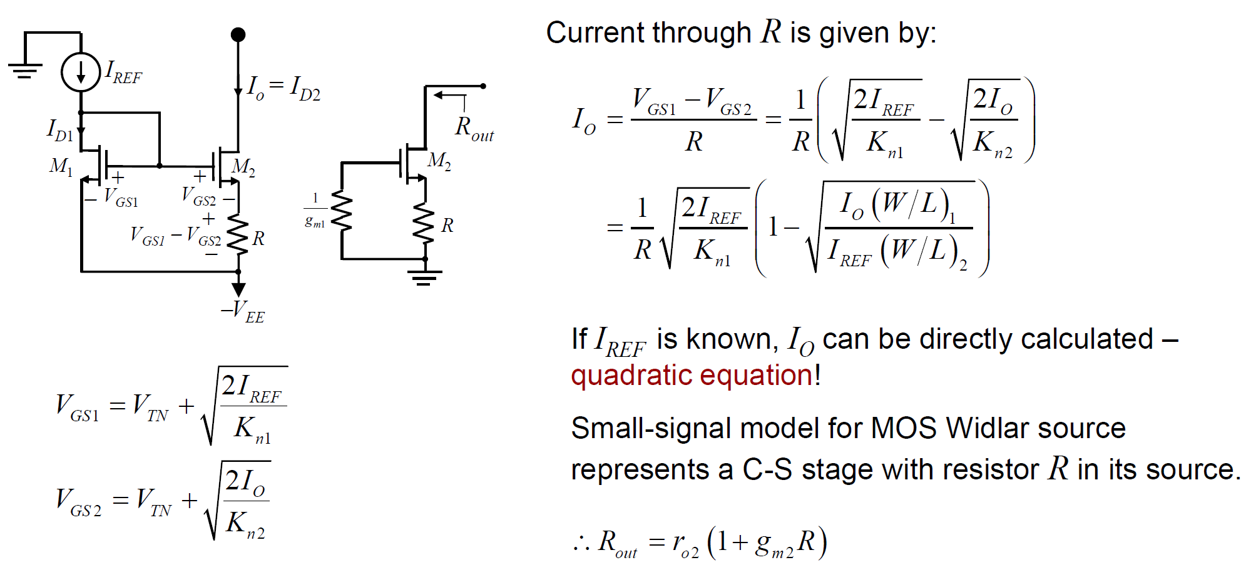

Advanced Current Mirror: Increasing R_{out}
MOS Widlar current mirror
$$≈$$

Slide 23
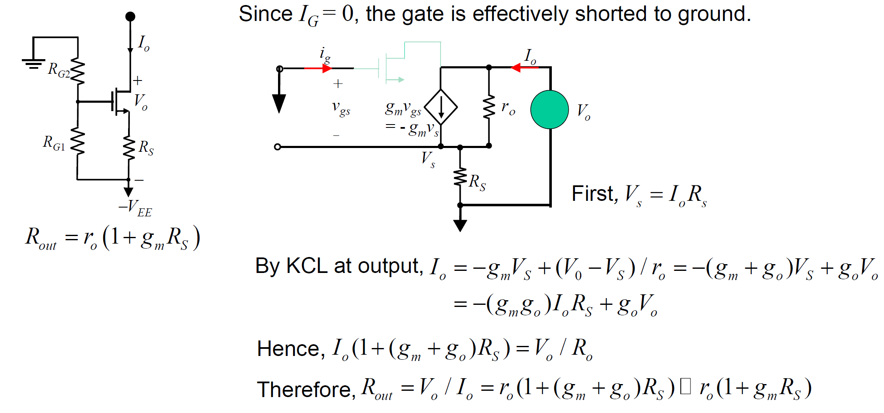

Advanced Current Mirror: Increasing R_{out}
+
V_{o} g_{o} = V_{o}/r_{o}
$$≈$$

Slide 24
Appendix

Slide 25
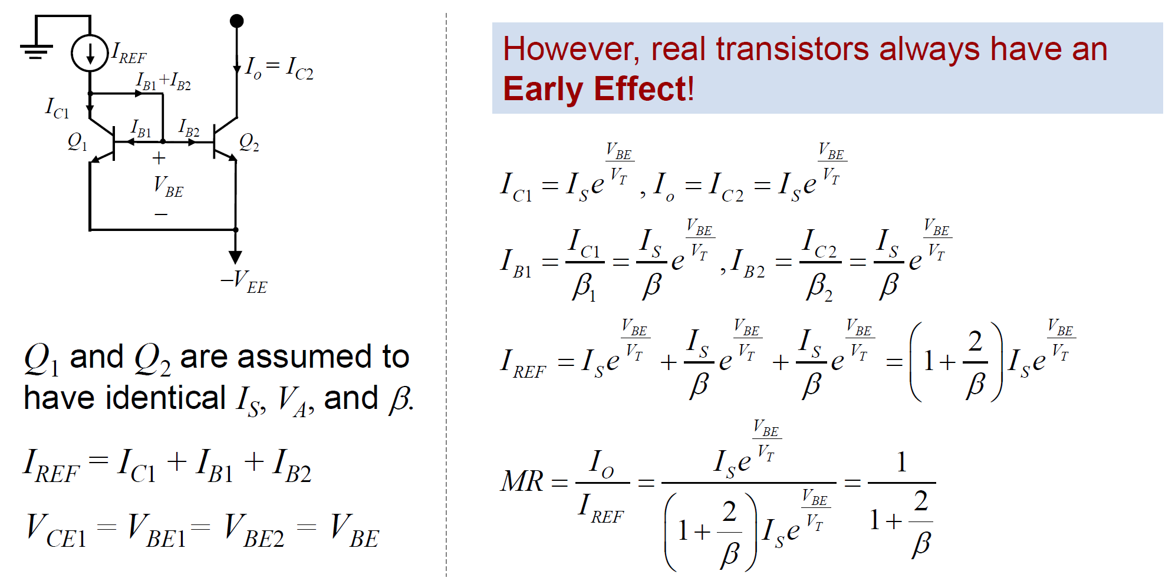
BJT Current Mirror: DC Analysis

Slide 26
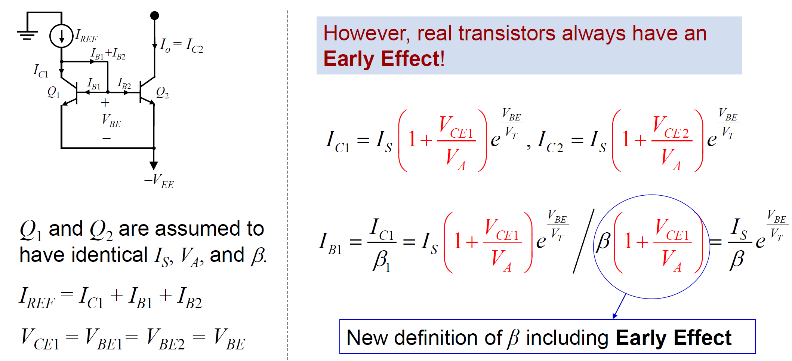
BJT Current Mirror: DC Analysis

Slide 27
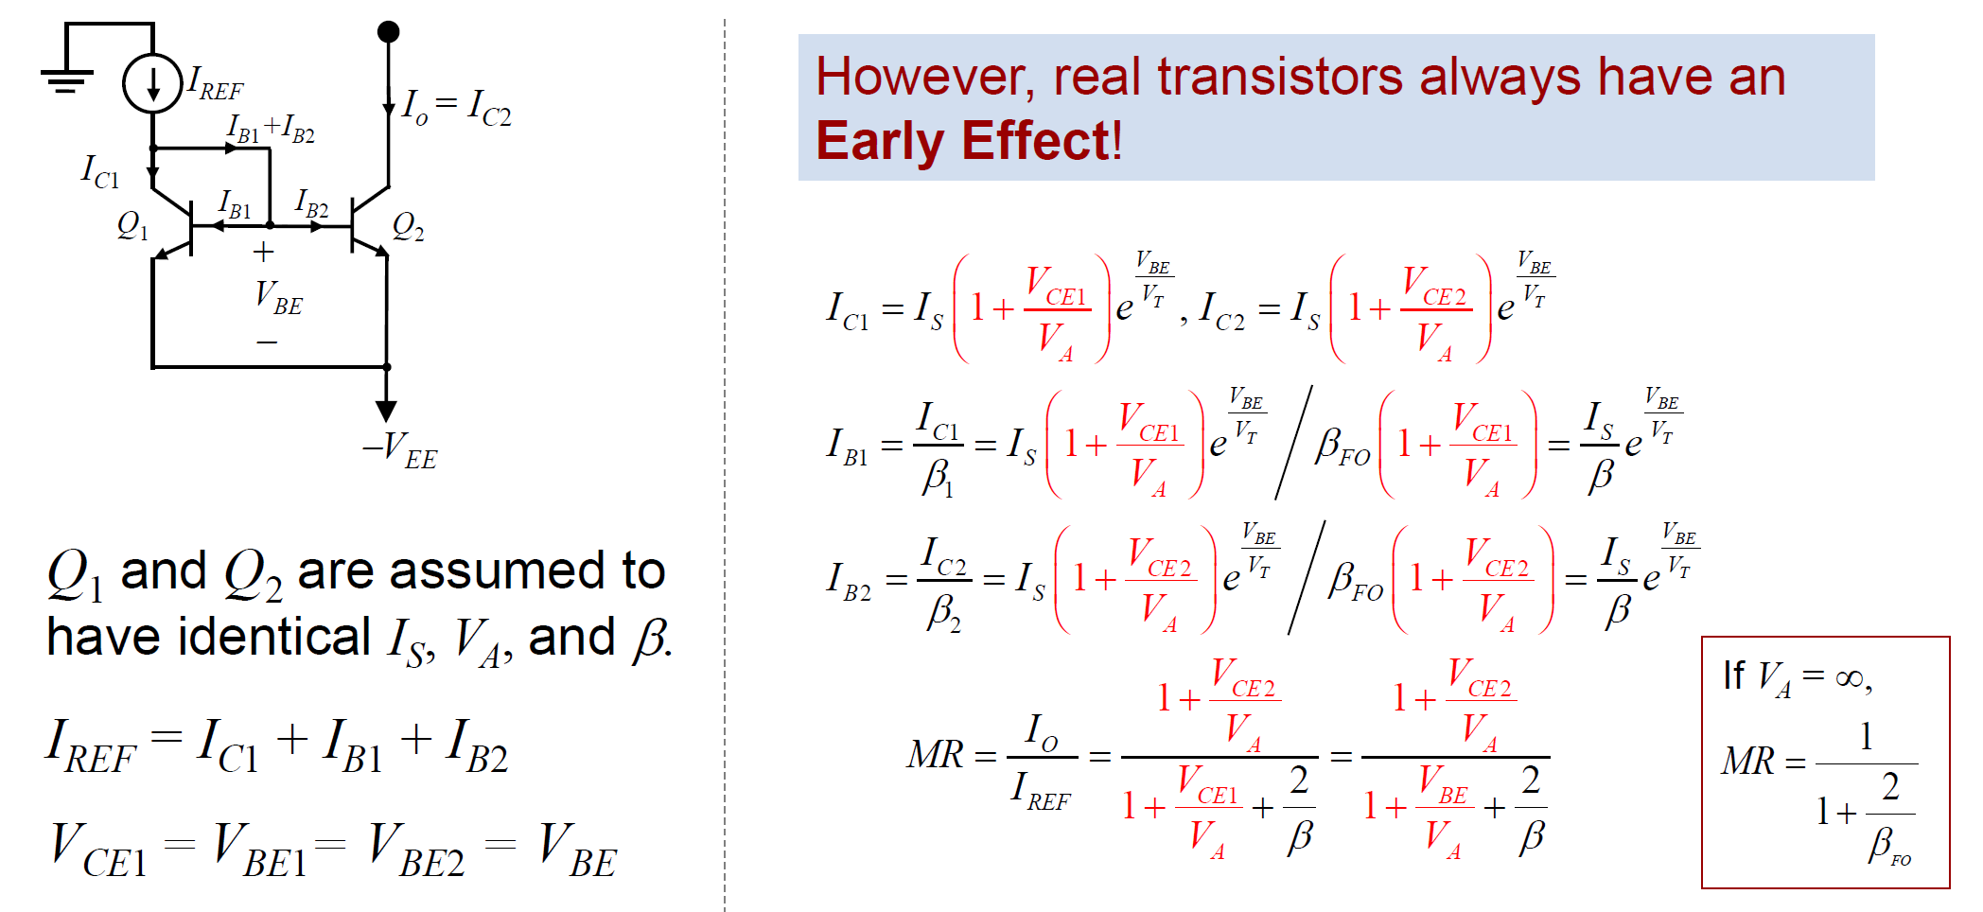
BJT Current Mirror: DC Analysis

Slide 28
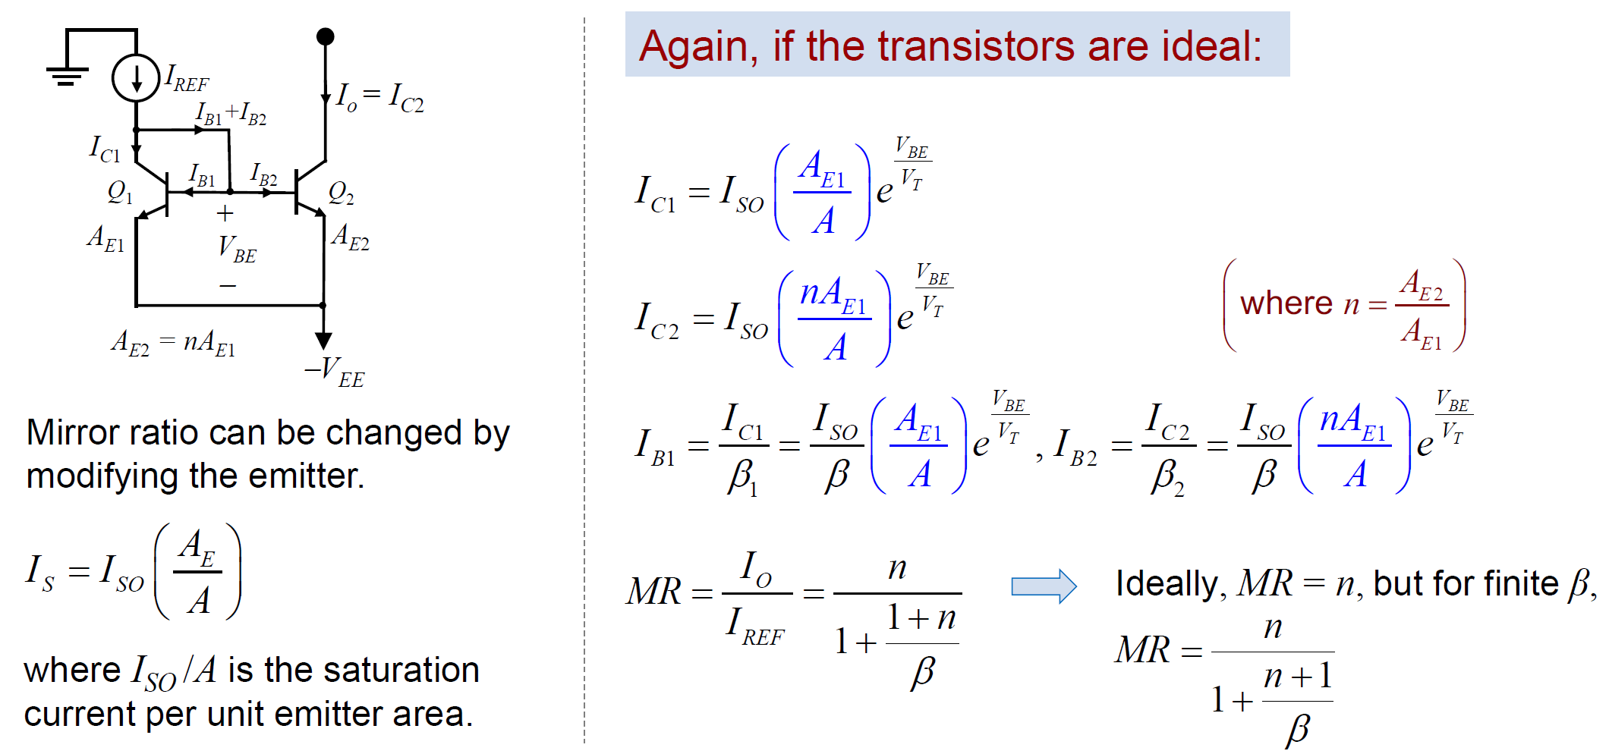
BJT Current Mirror: Changing Gain

Slide 29
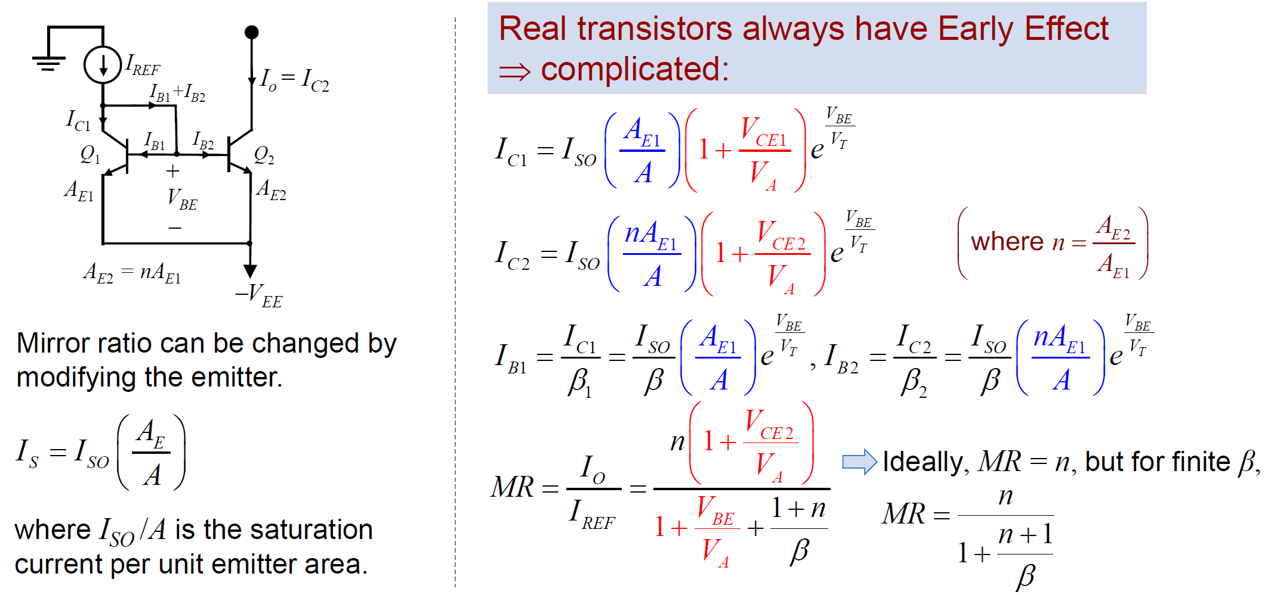
BJT Current Mirror: Changing Gain

