Slide 1
CS2311 Computer Programming
LT7: Function
Computer Science, City University of Hong Kong
Semester A 2021-22

Slide 2
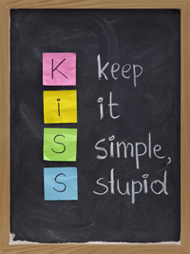
What is function?
A collection of statements that perform a specific task.
Functions are used to break a problem down into manageable pieces
  KISS principle: “Keep it simple, Stupid!”
  Break the problem down into small functions, each does only one simple task, and does it correctly
A function can be invoked multiple times. No need to repeat the same code in multiple parts of the program.

Slide 3
Structured programming guidelines
Flow of control in a program should be as simple as possible
Construction of program should embody a top-down design
  Decompose a problem into small problems repeatedly until they are simple enough to be coded easily
  From another perspective, each problem can be viewed from different levels of abstraction (or details)
  Top-down approach of problem solving is well exercised by human beings

Slide 4
Function in C++
The C++ standard library provides a rich collection of functions
Mathematical calculations (#include <cmath>)
String manipulations (#include <cstring>)
Input/output (#include <iostream>)
Some functions are defined in multiple library in some platform, e.g. function sqrt is defined in both cmath and iostream in VS

Slide 5
How to use function written by others?
Tell compiler that you are going to use functions defined in iostream package
#include <iostream>
using namespace std;
void main()
{
float area,side;
cout << "Enter the area of a square:";
cin >> area;
side=sqrt(area);
cout << "The square has perimeter: “ << 4*side;
}
Pass area to the function sqrt which will return the square root of area

Slide 6
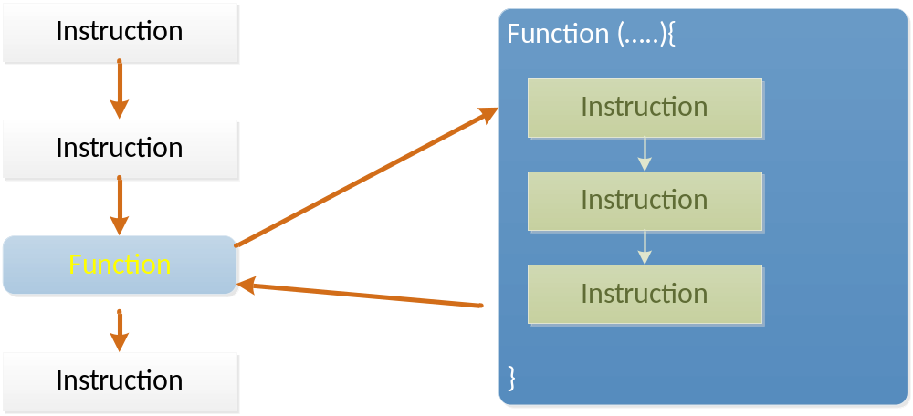
Function invocation
During program execution, when a function name followed by parentheses is encountered, the function is invoked and the program control is passed to that function; when the function ends, program control is returned to the statement immediately after the function call in the original function

Slide 7
Write your own function
(User defined functions)
Define a function printHello which accepts an integer n as input
The function should print "Hello" n times, where n is an integer

Slide 8
Function Components
Return type
Function name
Input (Parameter/Argument)
void printHello (int n){
int i;
for (i=0; i<n; i++)
cout <<"Hello\n";
}
Function body
n is defined as input, therefore there is no need to declare n in the function body again

Slide 9
Calling a function (I)
To make a function call, we only need to specify a function name and provide parameter(s) in a pair of ()
Function name
Input
printHello (3);
We don't need the return type when calling a function.
Syntax error:
int printHello (3);

Slide 10
Calling a function (II)
int x=4;
printHello (x);
printHello (x+2);
Print "hello" 4 times and then 6 times.
We don't need the parameter type when calling a function.
Syntax error:
printHello (int x);
Advantage of using a function: we don't need to write two loops, one to print "Hello" 4 times and the other to print "Hello" 6 times

Slide 11
Flow of control
void main(){
int x=4;
printHello(x); cout << "bye";
}
void printHello (int n){
int i;
for (i=0; i<n; i++)
cout << "Hello\n";
}
The program first start execution in main()
printHello(x)is called
The value of x is copied to the variable n. As a result, n gets a value of 4.
The loop body is executed.
After executing all the statements within printHello(), control go back to main() and "bye" is printed

Slide 12
Function with no input
void printHello (){
cout << "hello";
}

Slide 13
Parameters Passing: Call-by-Value
When a function is invoked, the arguments within the parentheses are passed using a call-by-value
Each argument is evaluated, and its value is used locally in place of the corresponding formal parameter
main function
Function f(y)
int y=32
y=100
What is y?
Ans: 32

Slide 14
Function variables
Local to the function

Slide 15
Parameters Passing: Call-by-Value
void f (int x){
x=4; //we modify the value x to 4
//Do we modify y at the same time? NO
y=4; //syntax error: y is local to main
}
void main(){
int y=3;
f(y);
cout << y; //print 3, y remains unchanged
}
The variable x and y are local variables.
y is local to main (), so we cannot use y in f().
x and y are two independent variables. When x is modified, y will not be affected.

Slide 16
What if we change x to y in f()?
void f (int y){
y=4; //modify y in f(), not the one in main()
}
void main(){
int y=3;
f(y);
cout << y; //print 3, y remains unchanged
}
In this program, there are two variables called y.
One is defined in f() and one is defined in main().
In f(), y in f() is modified.
However, y in main() is not affected.

Slide 17
How to modify y in f()?
int f (int x){
x=4; //we modify the value x to 4
//Do we modify y at the same time? NO
return x;
}
void main(){
int y=3;
y=f(y);
cout << y; //print 4
}
By assigning the return value of f(y) to y
After the function call, y gets a value of 4

Slide 18
Return value
Function f(y)
int y=32
y=100
return y;
y=f(y)
100
We assign the return value of f(y) to the variable y.
What is y? Ans: 100

Slide 19
The return statement
When a return is encountered, the value of the (optional) expression after the keyword return is sent back to the calling function
The returning value of a function will be converted, if necessary, to the type specified in the function definition
Syntax:
  return expression;
  return;
Example:
return (a+b*2);

Slide 20
Examples: Function with return value
Function | Parameter | return value | Examples:
getX | nil | int | int getX (){ int d; cin >> d; return d; }
calMax | double f1 double f2 | double | double calMax (double f1,double f2){ if (f1>f2) return f1; else return f2; }
getInput | int n1, double n2 | char | char getInput(int n1,double n2){ char c; ……………………….. return c; }

Slide 21
Examples: Function w/o return value
Function | Parameter | return value | Examples:
printHello | nil | nil | void printHello(){ cout << "Hello\n"; }
printHellos | int n | nil | void printHello(int n){ int i; for (i=0;i<n;i++) cout << "Hello\n"; }
printMax | float n1 float n2 | nil | void printMax(float n1,float n2){ cout << ((n1>n2)?n1:n2)<< endl; }
printFloats | int n float data | nil | void printFloats(int n, float data){ …………………………. } or void printFloats(float data,int n){ …………………………… }

Slide 22
Example: findMax
We can define a function findMax, which accepts two integers as input.
The function returns the larger value of the two integers.
E.g.
When x>y, the expression findMax(x, y) should evaluate to a value of x
cout << findMax(4, 3); //print x (4)
When y>x, the expression findMax(x, y) should evaluate to a value of y
cout << findMax(3, 4); //print y (4)

Slide 23
Function Implementation
int findMax (int n1, int n2) {
if (n1 > n2)
return n1;
else
return n2;
}
The return type of the variable is int
When there are more than one arguments, they are separated by a comma.
The type of each variable should be specified individually.
Error:
int findMax (int a, b);

Slide 24
Calling findMax()
int max;
int x=3;
int y=4;
max=findMax(x, y);
The value of this expression is 4. Assign 4 to max
The variable max will hold the value of x when x>y.
Otherwise, max will hold the value of y.

Slide 25
Flow of control
void main(){
  int max;
  int x=3;
  int y=4;
  max=findMax(x, y);
}
int findMax (int n1, int n2) {
if (n1>n2)
return n1;
else
return n2;
}
When findMax() is called,
the value of x(3) is copied to the variable n1
the value of y(4) is copied to the variable n2

Slide 26
Finding the max of 3 numbers, i, j, k
int i,j,k;
int max;
cin >> I >> j >> k;
//find the max of i, j, k
___ = findMax(___, ___);
___ = findMax(___, ___);
cout << "max is “ << max;

Slide 27
Answer
int i,j,k;
int max;
cin >> i >> j >>k;
//find the max of i, j, k
max = findMax(i, j); /*m stores 3*/
max = findMax(max, k); /*m stores 2*/
cout <<"max is " << max;

Slide 28
What is the output of the following program?
void f(int y, int x){
cout << "x=" << x << endl;
cout << "y=" << y << endl;
}
void main(){
int x=3, y=4;
f(x, y);
}
x=4
y=3

Slide 29
Parameter Passing: Default Parameters
We can also provide some default values for certain parameters
Example:
  void f(int a, int b, int c = 0){
  …
  }
Default parameter with a default value

Slide 30
Parameter Passing: Default Parameters
If no value is passed to the default parameter, the complier will use its default value in the function call
  void f(int a, int b, int c = 0){
  …
  }
  void main(){
  f(3, 4)// c = 0 in the function call
  f(3, 4, 5)// c= 5 in the function call
  }

Slide 31
Parameter Passing: Default Parameters
All the default parameters must locate at the right-hand side of normal parameters
Invalid examples:
  void f(int a, int b = 0, int c, int d = 0){
  // invalid definition, the default parameter b
  // locates at left-hand side of c
  }
  void f(int a, int b, int c = 0, int d = 0){
  // valid definition
  }

Slide 32
Parameters Passing: arrays
When passing an array to a function, we only need to specify the array name
The following example is invalid
  void f(int x[20]){
  …
  }
  void main(){
  int y[20];
  f(y[0]); //invalid, type mismatch
  }

Slide 33
Parameters Passing: arrays
if the content of a[i] is modified in the function, the modification will persist even after the function returns (Call by pointer)
The size of array is optional.
void f(int a[])
void f(int a[3]){
cout << a[0] <<endl; //1 is printed
a[0]=10;
}
void main (void) {
int a[3]={1,2,5}; //an array with 3 elements
f(a); //calling f() with array a
cout << a[0] <<endl; //10 is printed
}
Only need to input the array name!

Slide 34
Parameter Passing: 2D arrays
The way to pass a 2D array is similar as the 1D array
For example: define a function which reads a 2D array as the input and sort each row of the input 2D array
  void sort2D(int x[][10]){
  …
  }
  void main(){
  int y[20][10];
  sort2D(y);
  }
The size of the first dimension is optional, while the size of the second dimension must be given

Slide 35
Example: sort rows of 2D arrays
void sort2D(int a[][3]) {
int tmp;
for(int i = 0; i<3;i++) // each row
for (int j = 0; j < 3 - 1; j++) // bubble sort
for (int k = 3 - 1; k > j; k--)
if (a[i][k] < a[i][k - 1]) {
tmp = a[i][k]; // swap neighbors
a[i][k] = a[i][k - 1];
a[i][k - 1] = tmp;
}
}
void main()
{
int a[3][3] = { 0 };
for (int i = 0; i < 3; i++)
for(int j = 0; j < 3; j++)
cin >> a[i][j];
sort2D(a);
}

Slide 36
Defining and calling functions
Correct
Syntax Error
void f(){
}
void main(){
f();
}
void main(){
f(); //f() is undefined
}
void f(){
}
A function should be defined before use.

Slide 37
Function Prototype
C++ language allows us to define the function prototype and then call the function
Function prototype
  Specifies the function name, input and output type.
  The following statement specifies that f is a function, there is no input and no return value
  void f(void);
The function can be implemented later

Slide 38
Function Prototype
void f (void);
void main(){
f();
}
void f(){
//define f() here
}
int findMax (int, int);
void main(){
int x=findMax (3,4);
}
int findMax (int n1, int n2){
//define findMax() here
}

Slide 39
Function Prototype
The prototype
int findMax (int, int);
specifies that findMax is a function name.
The return type is int.
There are two arguments and their types are int.
Another way to write the prototype is:
int findMax (int n1, int n2);
However, the variable names are optional.

Slide 40
Function Prototype
In C++, function prototypes and definitions can be stored separately
Header file (.h):
  With extension .h, .e.g stdio.h, string.h
  Contain function prototypes only
  To be included in the program that will call the function
Implementation file (.cpp):
  Contain function implementation (definition)
The name of .h and .cpp files should be the same

Slide 41
Function Prototype
main.cpp
mylib.h
#include “mylib.h”
void main(){
int x,y=2,z=3;
……….
x=calMin(y,z);
……….
}
int calMin(int,int);
mylib.cpp
int calMin(int a,int b){
if (a>b)
return b;
else
return a;
}

Slide 42
Function prototype (cont’d)
void is used if a function has no return value.
Prototypes allow the compiler to check the code more thoroughly
Values passed to a function are coerced where necessary, e.g., printDouble (4) where the integer 4 will be promoted as a double data type 4
#include <iostream>
using namespace std;
void printDouble(double d){
cout <<fixed;
cout <<d <<endl;
}
void main()
{
int x=4;
printDouble(x);
}

Slide 43
Recursions
One basic problem solving technique is to break the task into subtasks
If a subtask is a smaller version of the original task, you can solve the original task using a recursive function
A recursive function is one that invokes itself, either directly or indirectly

Slide 44
Example: Factorial
The factorial of n is defined as:
0! = 1
n! = n*(n-1)*…2*1 for n>0
A recurrence relation: (induction)
n! = n*(n-1)! for n>0
E.g.:
  3! = 3 * 2!
  = 3 * 2 * 1!
  = 3 * 2 * 1 * 0!
  = 3 * 2 * 1 * 1

Slide 45
Iterative vs. Recursive
Iterative
Recursive
int factorial(int n)
{
int i, fact = 1;
for (i = 1; i <= n; i++)
{
fact = i * fact;
}
return fact;
}
int factorial(int n)
{
if (n==0) return 1;
return n*factorial(n-1);
}

Slide 46
Checkpoints
There is no infinite recursion (check exist condition)
Each stopping case performs the correct action for that case
For each of cases that involve recursion, if all recursive calls perform their actions correctly, then the entire case performs correctly.

Slide 47
Summary
Functions help programmer write a more simple program and make the problem more easy to solve
return_type Function_name(paramaters);
Function prototype must declared before it can be used.
Header files can be used to store function prototypes but not the body.
Parameters can be passed with call by value or call by pointer.

