Slide 1

Chapter 4
Threads
Operating Systems:
Internals and Design Principles
William Stallings

Slide 2
Roadmap
Threads: Resource ownership and execution
Categories of thread implementation
Thread library
  POSIX Threads (Pthreads)

Slide 3
Processes and Threads
Processes have two characteristics:
  Resource ownership
    A process is allocated ownership of resources including a virtual address space to hold the process image
    The OS performs a protection function to prevent unwanted interference between processes with respect to resources
  Dispatching/scheduling/execution
    The execution of a process follows an execution path that may be interleaved with other processes
    A process has an execution state (Running, Ready, etc.) and a dispatching priority, and is the entity that is scheduled and dispatched by the OS

Slide 4
Multithreading
These two characteristics can be treated independently by the OS
  The unit of dispatching is referred to as a thread or lightweight process
  The unit of resource ownership is referred to as a process or task
Multithreading is the ability of an OS to support multiple, concurrent paths of execution within a single process.

Slide 5
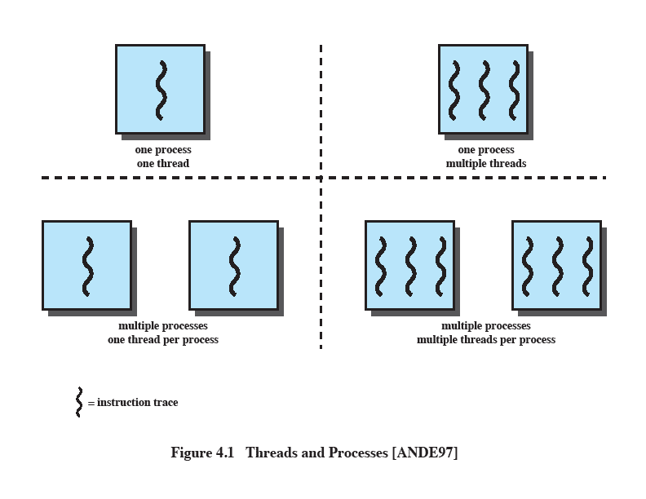
Single-threaded Approaches
A single thread of execution per process, in which the concept of a thread is not recognized.
  MS-DOS supports a single-user process and a single thread
  Some variants of UNIX support multiple user processes but only support one thread per process

Slide 6
Multithreaded Approaches
A Java run-time environment is a system of one process with multiple threads.
The use of multiple processes, each of which supports multiple threads are found in Windows, Solaris, and many modern versions of UNIX.

Slide 7
Process vs. Thread (1)
In an OS, a process is
  A unit of resource allocation: a virtual address space that holds the process image (code + data + stack + PCB)
  A unit of protection: protected access to processors, other processes (for inter-process communication), files, I/O resources
In a process, each thread has
  An execution state (running, ready, etc.)
  A saved thread context when not running
  An execution stack
  Some per-thread static storage for local variables
  Access to the memory and resources of its process, shared by all threads in that process

Slide 8
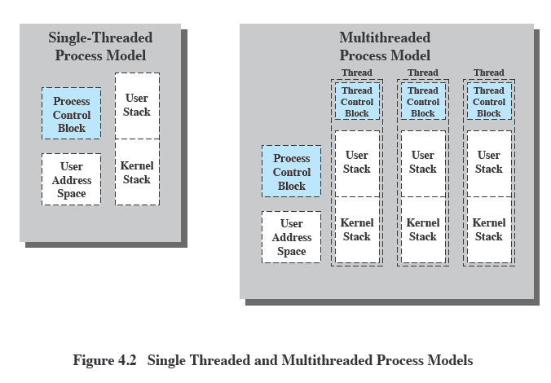
Process vs. Thread (2)
One way to view a thread is as an independent program counter operating within a process.

Slide 9
Activities Similar to Processes
  Similar to processes, threads have execution states and need to synchronize with one another.
  Execution states
    Reminder: In an OS that supports threads, scheduling and dispatching is done on a thread basis.
    Most of the state information dealing with execution is maintained in thread-level data structures.
    The key states for a thread are: Running, Ready, Blocked.
    Some states are at process-level.
      Suspending a process involves suspending all threads of the process because they share the address space.
      Termination of a process terminates all threads within the process.

Slide 10
Activities Similar to Processes
  Similar to processes, threads have execution states and need to synchronize with one another.
  Threads need to synchronize with one another so that they don’t interfere with each other or corrupt data structures.
    All threads of a process share the same address space and other resources.
    Any alteration of a resource by one thread affects the other threads in the same process.

Slide 11
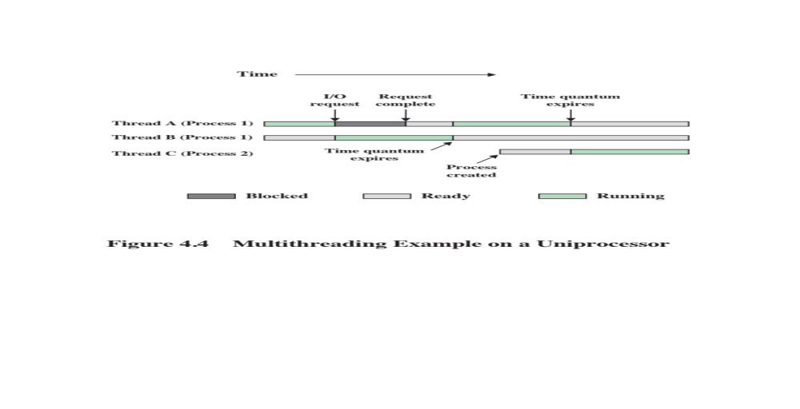
Multithreading on a Uniprocessor
  Multiprogramming enables the interleaving of multiple threads within multiple processes.

Slide 12
Thread Use Examples
Foreground and background work
  In a spreadsheet program, one thread could display menus and read user input, while another thread executes user commands and updates the spreadsheet.
Asynchronous processing
  In a word processor, a thread can be created to do periodic backup to write its RAM buffer to disk once every minute by scheduling itself directly with the OS.
Speed of execution
  In computer graphics, matrix data can be divided and distributed into multiple threads to be calculated in parallel (on multiple cores)

Slide 13
Benefits of Threads
If an application is implemented as a set of related units of execution, it is far more efficient to do so as a collection of threads rather than a collection of separate processes. Reasons include:
  Takes less time to create a new thread than a process
  Less time to terminate a thread than a process
  Switching between two threads takes less time that switching between processes
  Threads enhance efficiency in communication because threads within the same process share memory and files, they can communicate with each other without invoking the kernel

Slide 14
Roadmap
Threads: Resource ownership and execution
Categories of thread implementation
Thread library
  POSIX Threads (Pthreads)

Slide 15
Categories of
Thread Implementation
User Level Thread (ULT)
Kernel level Thread (KLT), also called:
  kernel-supported threads
  lightweight processes

Slide 16
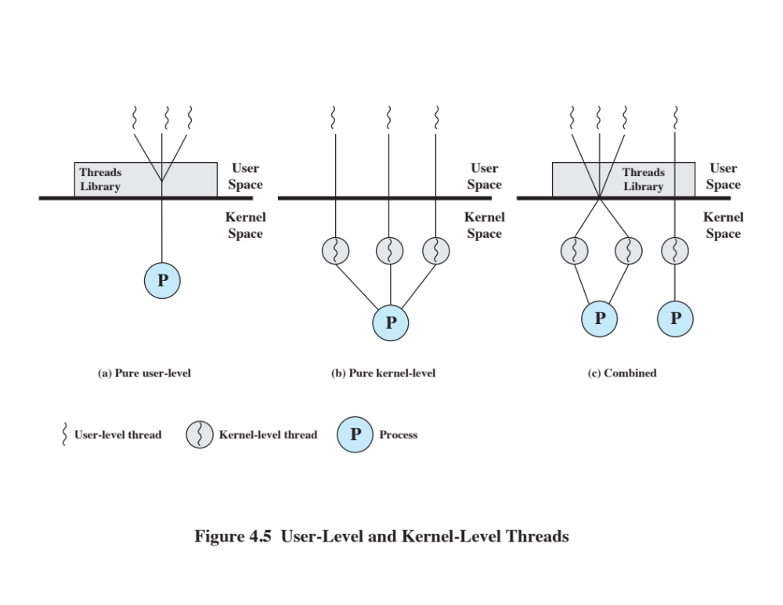
User-Level Threads
All thread management is done within the application by calling a threads library.
  The application and its threads are allocated to a single process managed by the kernel.
  The kernel is not aware of the existence of threads.
  Kernel scheduling is done on a process basis.

Slide 17
Kernel-Level Threads
  Thread management is done by the kernel.
  No thread management done by application, just an API to the kernel thread facility.
  Each user-level thread is mapped to a kernel-level thread.
  Kernel maintains context information for the whole process and individual threads within the process.
  Scheduling is done on a thread basis.
Example: Windows

Slide 18
Pros & Cons (ULT)
Pros
  Process does not switch to the kernel mode to do thread management → saves the overhead of two mode switches.
  Scheduling can be application specific.
  Can run on any OS because the threads library is a set of application-level functions.
Cons
  Only a single thread within a process can execute at a time → a multithreaded application cannot take advantage of multiprocessing.
  When a ULT executes a blocking system call, all of the threads within the process are blocked.

Slide 19
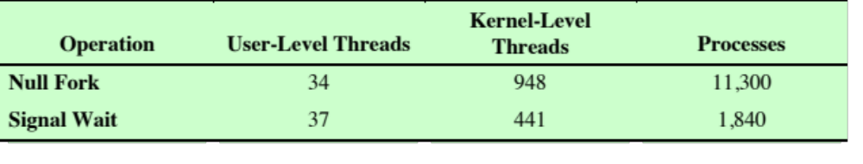
Pros & Cons (KLT)
  Pros
  The kernel can simultaneously schedule multiple threads from the same process onto multiple processors.
  If one thread in a process is blocked, the kernel can schedule another thread of the same process.
  Kernel routines themselves can be multithreaded.
  Cons
  The transfer of control from one thread to another within the same process requires a mode switch to the kernel.
  Managing KLTs is slower than ULTs.
  KLT implementation needs OS support.

Slide 20
Combined Approach
m-to-n mapping hybrid implementation
  Application creates m ULTs.
  OS provides pool of n KLTs.
  Multiple ULTs are mapped onto a smaller or equal number of KLTs.
  Multiple threads within the same application can run in parallel on multiple processors.
  A blocking system call need not block the entire process.
  Example: Solaris

Slide 21
Roadmap
Threads: Resource ownership and execution
Categories of thread implementation
Thread library
  POSIX Threads (Pthreads)
    Source: https://computing.llnl.gov/tutorials/pthreads/

Slide 22
Thread Libraries
Thread library provides programmer with API (application program interface) for creating and managing threads.
Three main thread libraries are in use today:
  POSIX Pthreads
  Win32
  Java
UNIX and Linux systems often use Pthreads.

Slide 23
Pthreads (POSIX Threads)
Historically, hardware vendors have implemented their own proprietary versions of threads.
For UNIX systems, a standardized C language threads programming interface has been specified by the IEEE POSIX 1003.1c standard (Portable Operating System Interface).
  Implementations that adhere to this standard are referred to as POSIX threads, or Pthreads.
  Most hardware vendors now offer Pthreads in addition to their proprietary API's.

Slide 24
What are Pthreads?
Pthreads are defined as a set of C language programming types and procedure calls.
Implemented with a pthread.h header/include file and a thread library.
This makes it easy for programmers to develop portable threaded applications.

Slide 25
The Pthreads API
The subroutines which comprise the Pthreads API can be informally grouped into four major groups:
  Thread management
    Create, detach, join
    Set/query thread attributes
  Mutexes
    Deal with synchronization via a “mutex” (mutual exclusion)
  Condition variables
    Address communications between threads that share a mutex
  Synchronization
    Manage read/write locks and barriers

Slide 26
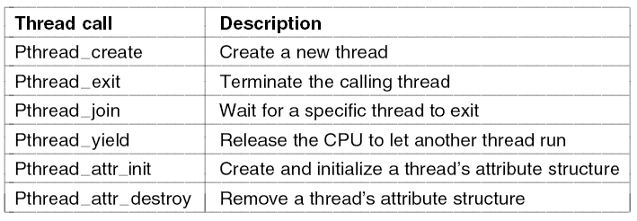
The Pthreads API
Some of the thread-management function calls
Naming conventions
  All identifiers in the threads library begin with pthread_

Slide 27
Multithreading
Consequences
Because threads within the same process share resources
  Changes made by one thread to shared system resources (such as closing a file) will be seen by all other threads
  Two pointers having the same value point to the same data
  Reading and writing to the same memory locations is possible
  No guarantee as to the order that threads will run
  Therefore requires explicit synchronization by the programmer

