Slide 1
CS3103 Operating System
2023/2024 Sem B
Chapter 4: CPU Scheduling
Dr. Nan Guan
Department of Computer Science
City University of Hong Kong

Slide 2
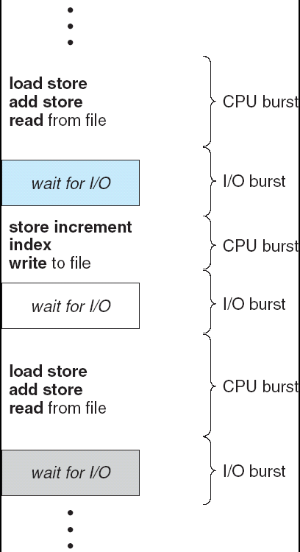
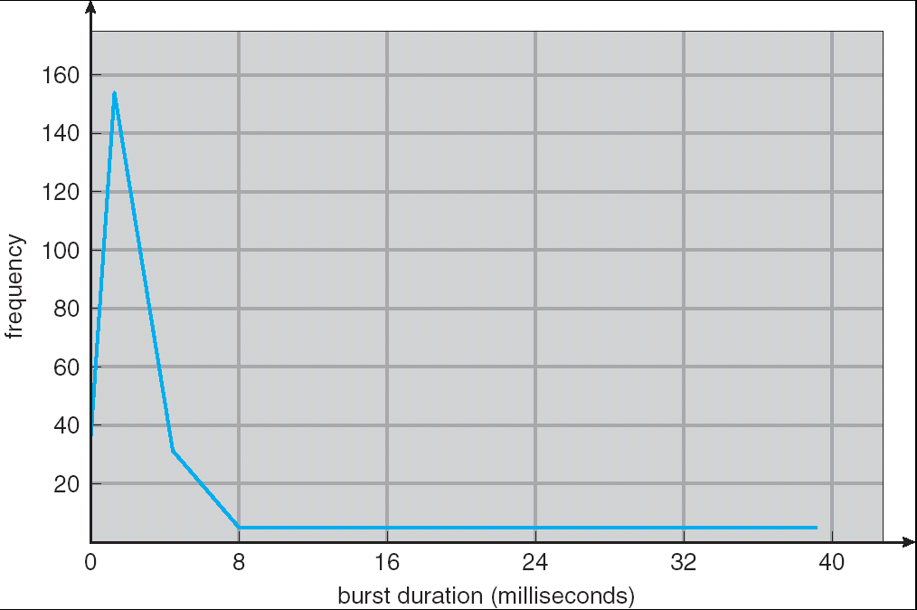
Why Scheduling is Needed?
Maximum CPU utilization
  CPU–I/O Burst Cycle: Process execution consists of a cycle of CPU execution and I/O wait
  CPU burst distribution
  Alternating Sequence of CPU and I/O Bursts

Slide 3
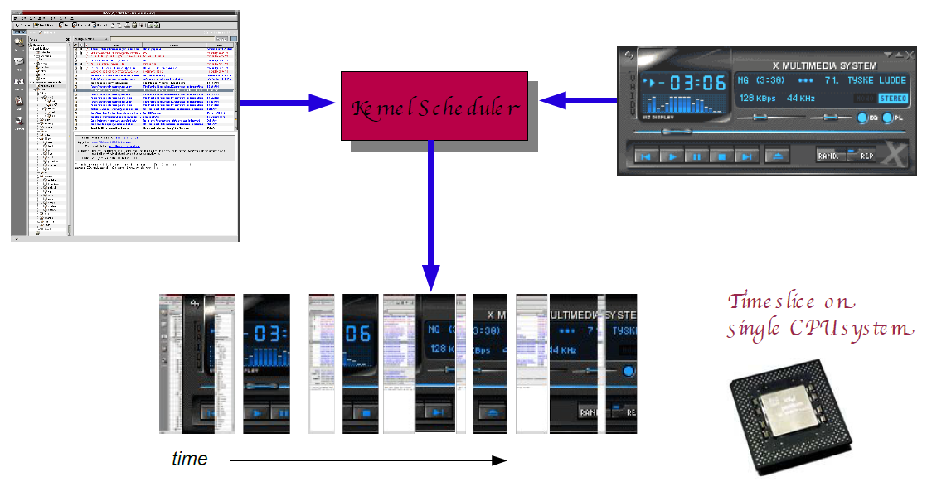
Why Scheduling is Needed?
Do multiple tasks concurrently
Scheduler

Slide 4
Scheduler
CPU Scheduler (Short-term Scheduler)
  Selects from among the tasks (processes, threads) in memory that are ready to execute, and allocates the CPU to one of them
  CPU scheduling decisions may take place when a task
    Switches from running to waiting state
    Switches from running to ready state
    Switches from waiting to ready
    Terminates
Notes:
Task: process, thread

Slide 5
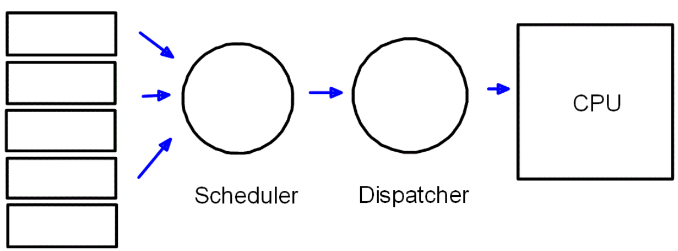
Dispatcher
Dispatcher
  Dispatcher module gives control of the CPU to the task selected by the short-term scheduler; this involves:
    switching context
    switching to user mode
    jumping to the proper location in the user program to restart that program
  Dispatch latency – time it takes for the dispatcher to stop one task and start another running

Slide 6
Scheduling Criteria
We want to
CPU utilization – keep the CPU as busy as possible
Throughput – # of tasks that complete their execution per time unit
Waiting time – amount of time a task has been waiting in the ready queue
Turnaround time – time takes from when a request was submitted until the task is finished
Response time – time takes from when a request was submitted until the start of its execution
maximize
maximize
minimize
minimize
minimize
Optimizing for different criteria often conflicts

Slide 7
Scheduling Policy
An algorithm used for distributing resources among parties which simultaneously and asynchronously request them
  In the context of CPU scheduling, an algorithm decides which task to execute on CPU at which time
Many scheduling policies
  First-Come First-Served (FCFS)
  Shortest-Job-First (SJF)
  Round Robin (RR)
  Priority Scheduling
  … …

Slide 8
First-Come First-Served (FCFS)
Process | Arrival Time | Burst Time
P₁ | 0 | 24
P₂ | 2 | 3
P₃ | 4 | 3
P₁
P₂
P₃
0
24
27
30
Waiting time for P₁ = 0; P₂ = 22; P₃ = 23
Average waiting time: (0 + 22 + 23)/3 = 15

Slide 9
First-Come First-Served (FCFS)
Suppose that the processes all arrive at time 0, but in the order
Waiting time for P₁ = 6; P₂ = 0; P₃ = 3
Average waiting time: (6 + 0 + 3)/3 = 3
P₂ , P₃ , P₁
P₂
P₃
P₁
0
3
6
30

Slide 10
Shortest-Job-First (SJF)
Schedule the process with the shortest length of its next CPU burst time (execution time)
Two schemes:
  nonpreemptive – once CPU given to a process, it cannot be preempted until completes its CPU burst
  preemptive – if a new process arrives with CPU burst length less than remaining time of current executing process, preempt. This scheme is also known as the Shortest-Remaining-Time-First (SRTF)
SJF is optimal regarding average waiting time

Slide 11
Non-Preemptive SJF
Average waiting time = (0 + 6 + 3 + 7)/4 = 4
Process | Arrival Time | Burst Time
P₁ | 0 | 7
P₂ | 2 | 4
P₃ | 4 | 1
P₄ | 5 | 4
P₁
P₃
P₂
P₄
0
4
7
8
12
16

Slide 12
Preemptive SJF
Average waiting time = (9 + 1 + 0 +2)/4 = 3
Process | Arrival Time | Burst Time
P₁ | 0 | 7
P₂ | 2 | 4
P₃ | 4 | 1
P₄ | 5 | 4
P₁
P₂
P₃
P₂
P₄
P₁
0
2
4
5
7
11
16

Slide 13
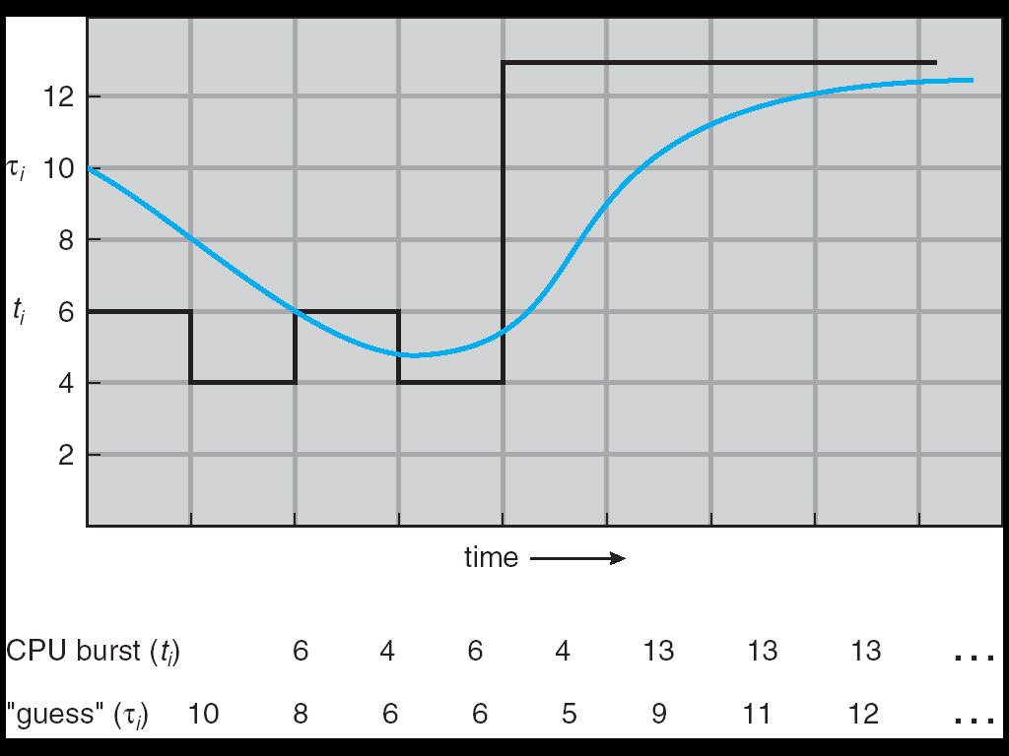
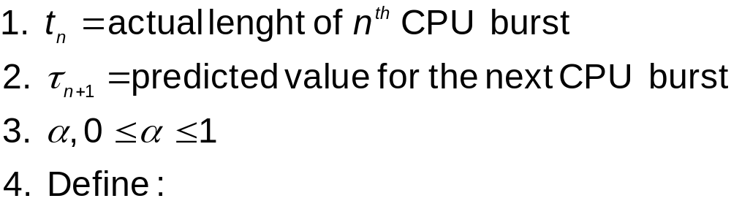

Determining Length of Next CPU Burst
We can only estimate the length of future CPU bursts
Can be done by using the length of previous CPU bursts
  For example, exponential averaging

Slide 14
Examples of Exponential Averaging
α =0
  τ_{n+1} = τ_{n} (recent history does not count)
α =1
  τ_{n+1} = α t_{n} (only the actual last CPU burst counts)
In general:
    τ_{n+1} = α t_{n}+(1 - α)α t_{n-1} + …
    +(1 - α )^{j} α t_{n} _{-j} + …
    +(1 - α )^{n +1} τ₀
Since both α and (1 - α) are less than or equal to 1, each successive term has less weight than its predecessor

Slide 15
Priority Scheduling
A priority number (integer) is associated with each task
The CPU is allocated to the task with the highest priority (usually, smallest integer ←→ highest priority)
  Preemptive or Nonpreemptive
SJF is a priority scheduling where priority is the (predicted) CPU burst time

Slide 16
Example of Priority Scheduling
Process | Arrival Time | Burst Time | Priority*
P₁ | 0 | 6 | 4
P₂ | 2 | 4 | 2
P₃ | 4 | 4 | 3
P₄ | 5 | 2 | 1
*smaller number → higher priority
P1
P2
P4
P2
P3
P1
0
2
4
6
8
10
12
14
16
18
20

Slide 17
Round Robin (RR)
Each task gets a small unit of CPU time (time quantum)
  Typically 10-100 milliseconds
  Once elapsed, preempted and added to the end of the ready queue
If there are n tasks and the time quantum is q, then each process gets 1/n of the CPU time in chunks of at most q time units at once
  No task waits more than (n-1)q time units
Performance
  q large ⇒ slow responsiveness (wait for longer until the next turn to run)
  q small ⇒ high context switch overhead

Slide 18
Example of RR with Time Quantum = 20
Process | Burst Time
P₁ | 53
P₂ | 17
P₃ | 68
P₄ | 24
P₁
P₂
P₃
P₄
P₁
P₃
P₄
P₁
P₃
P₃
0
20
37
57
77
97
117
121
134
154
162

Slide 19
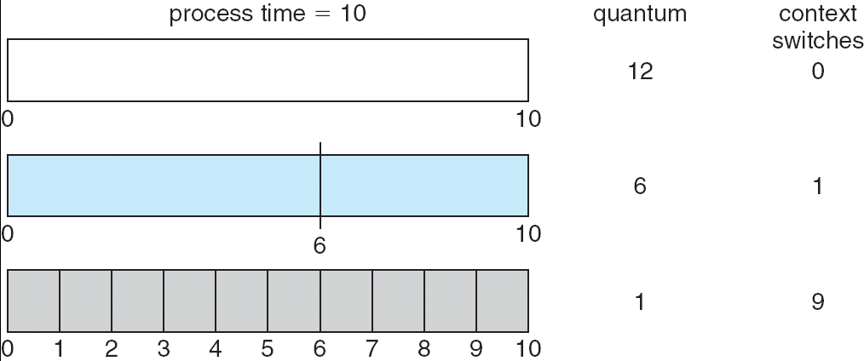
Time Quantum and Context Switch Overhead
If the time quantum is extremely large, the RR policy is the same as the FCFS policy
If the time quantum is small, high context switch overhead
  The time quantum must be much larger than context switch overhead

Slide 20
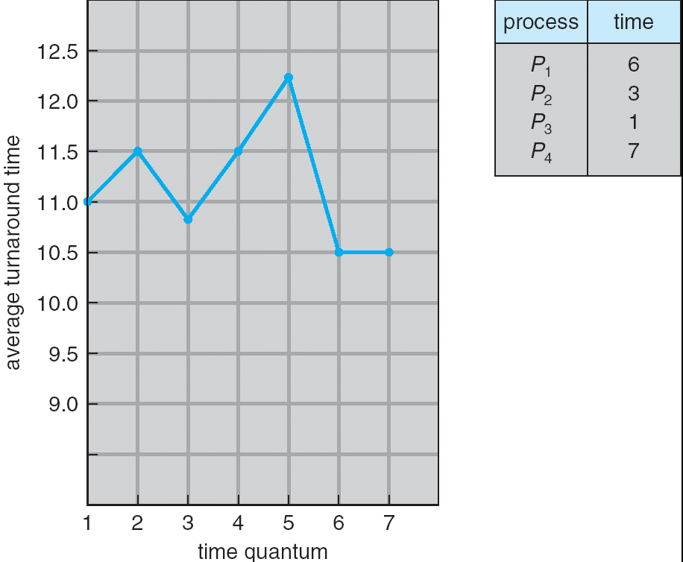
Turnaround Time Varies With Time Quantum
Turnaround time – amount of
time to execute a particular task

Slide 21
Multilevel Queue
Ready queue is partitioned into separate queues, e.g.,
  foreground (interactive applications)
  background (batch applications)
Each queue has its own scheduling algorithm, e.g.,
  foreground – RR
  background – FCFS
Scheduling must be done between the queues
  Fixed priority (i.e., serve all from foreground then from background)
  Time slice – each queue gets a certain amount of CPU e.g., i.e., 80% to foreground in RR and 20% to background in FCFS

Slide 22
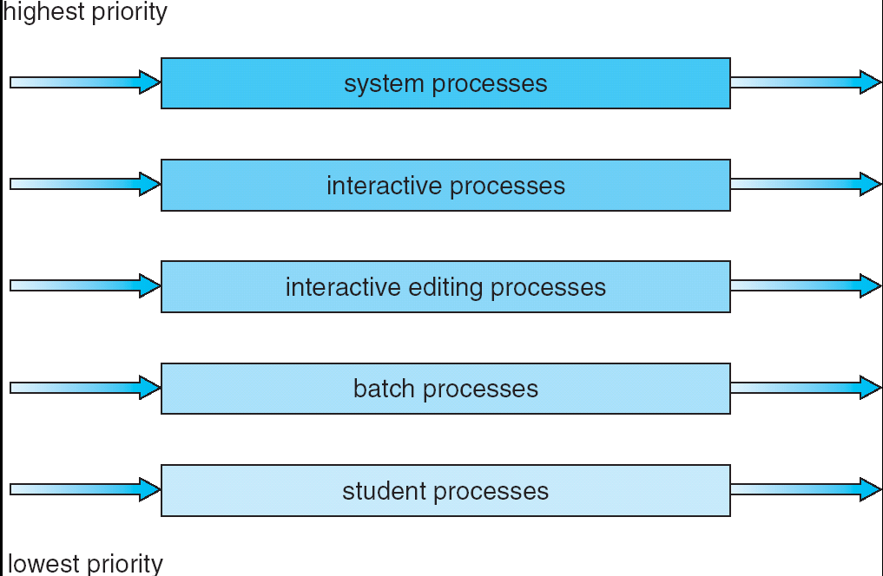
Multilevel Queue
For example, 5-level queues

Slide 23
Multilevel Feedback Queue
A task can move between the various queues
Multilevel-feedback-queue scheduler defined by
  number of queues
  scheduling algorithms for each queue
  method used to determine when to upgrade a task
  method used to determine when to demote a task
  method used to determine which queue a task will enter when that task needs service
Flexible yet complex algorithms to implement

Slide 24
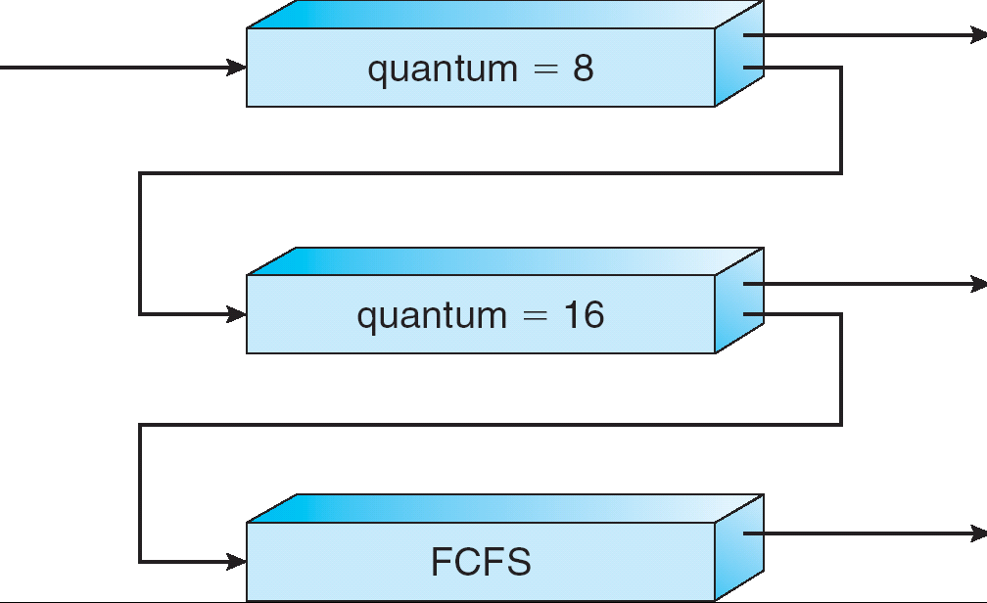
Example of Multilevel Feedback Queue
Three queues
  Q0 – RR with time quantum 8 milliseconds
  Q1 – RR with time quantum 16 milliseconds
  Q2 – FCFS
Scheduling
  A new task enters queue Q0. When it gains CPU, task receives 8 milliseconds. If it does not finish in 8 milliseconds, moved to queue Q1
  If it still does not complete in Q1, it is preempted and moved to queue Q2

Slide 25
Example: CPU Scheduling in Linux (2.6.23)
Scheduling classes
  Default: scheduled by Completely Fair Scheduler (CFS)
  Real-time: scheduled according to priority
  (other classes can be added)
Real-time tasks have priority over CFS tasks

Slide 26
Example: CPU Scheduling in Linux (2.6.23)
Completely Fair Scheduler (CFS)
  Rather than quantum based on fixed time allotments, based on proportion of CPU time (nice value)
    Nice value from -20 to +19
    Larger nice values correspond to a lower priority
      you are “nice” to the other processes
  Maintains task virtual run time
    Associated with decay factor based on nice value
      Larger nice value, higher decay rate
  Scheduler picks the task with lowest virtual run time to run next
virtual_runtime += t* (weight_nice_value)

Slide 27
The following slides are optional

Slide 28
Multipleprocessor Scheduling
Multiprocessor may be any one of the following architectures
  Multicore CPUs
  Multithreaded Cores
  Heterogeneous multiprocessing
  … …

Slide 29
Multipleprocessor Scheduling
CPU scheduling more complex when multiple CPUs are available
  Even if processors are identical (homogeneous) in functionality
Approaches to multiple-processor scheduling
  asymmetric multiprocessing (AMP): only one processor makes scheduling decisions, I/O processing, and other activity; other processors act as dummy processing units
  symmetric multiprocessing (SMP): each processor is self-scheduling; scheduling data structure are shared, needs to be synchronized
    Commonly used in modern OS

Slide 30
Multipleprocessor Scheduling
If SMP, need to keep all CPUs loaded for efficiency
Load balancing attempts to keep workload evenly distributed
  Push migration: periodic task checks load on each processor, and if found pushes task from overloaded CPU to other CPUs
  Pull migration: idle processors pulls waiting task from busy processor

Slide 31
Multipleprocessor Scheduling
Thread having affinity for a processor (i.e. “processor affinity”)
  When a thread has been running on one processor, the cache contents of that processor stores the memory accesses by that thread
Load balancing may affect processor affinity as a thread may be moved from one processor to another to balance loads
Soft affinity: the operating system attempts to keep a thread running on the same processor, but no guarantees
Hard affinity: allows a process to specify a set of processors it may run on

Slide 32
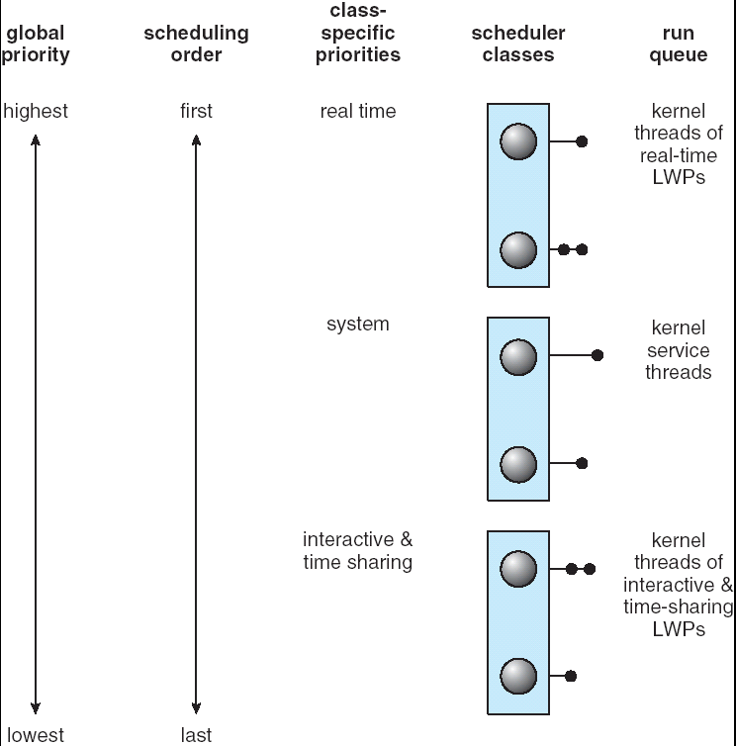
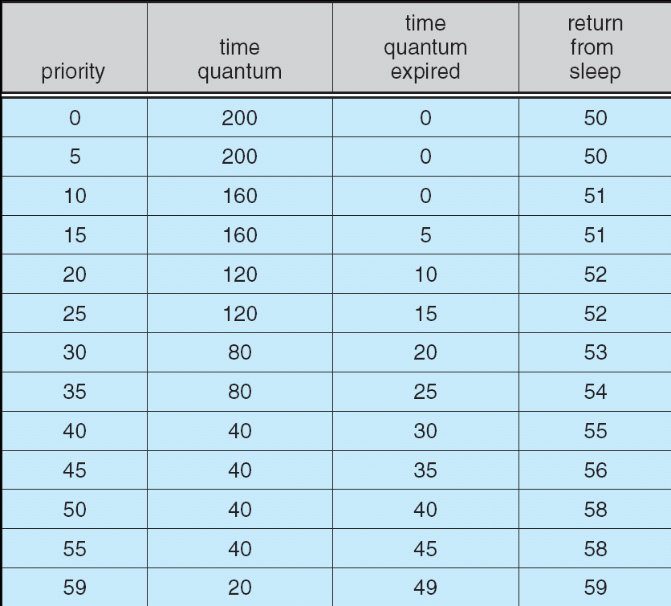
Example: CPU Scheduling in Solaris 2
*larger number → higher priority
Inverse relationship between priorities and time slices.
Priority lowered after time quantum expired.
Priority boosted when return from sleep ( When I/O is ready ).

