Slide 1
EE3114 Systems and Control
4. Transient and Steady-State Response Analysis
Semester B, 2018-19
2018-9-26

Slide 2
Framework of Lectures
System
Time Domain Frequency Domain
→ Laplace Transform →
State-Space Formulation Frequency Analysis
(dynamic responses,
transients, steady-states,
root-locus, PID controllers)
← mixed →
(State-feedback,
Controllability, controller
Observability, observer
Optimal control)
Today:
Transient and Steady-State Analysis

Slide 3
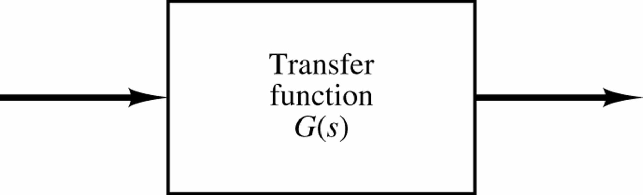
Given Transfer Function G(s) and Input U(s):
Y(s) = G(s)U(s)
U(s)
Y(s)
G(s)
Objective of Control :
To obtain a desired output
“Desired” --- described by some “Specifications” for the system output from some common input (impulse, step, ramp)

Slide 4
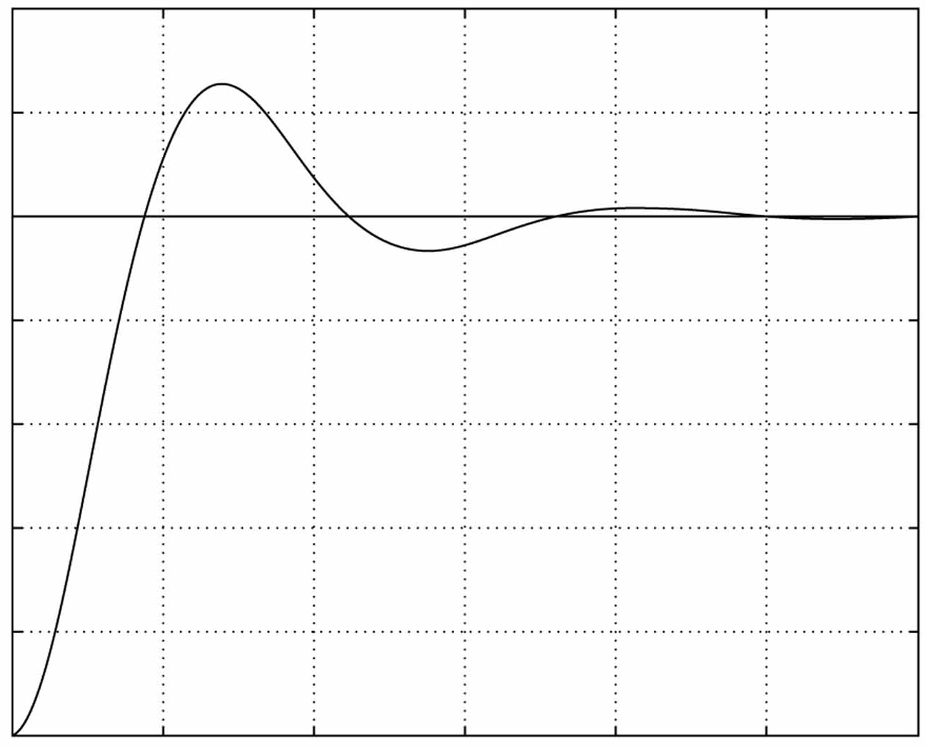
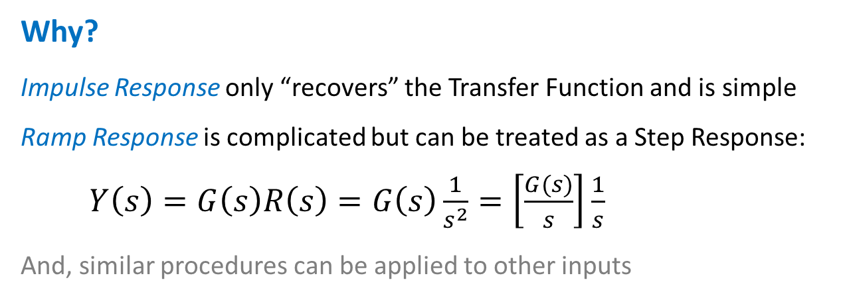
Time Response Specifications
Focus: Specifications for Step Response
System
Why?
Impulse Response only “recovers” the Transfer Function and is simple
Ramp Response is complicated but can be treated as a Step Response:
$Y\left(s\right)=G\left(s\right)R\left(s\right)=G\left(s\right)\frac{1}{s^{2}}=\left[\frac{G(s)}{s}\right]\frac{1}{s}$
And, similar procedures can be applied to other inputs

Slide 5
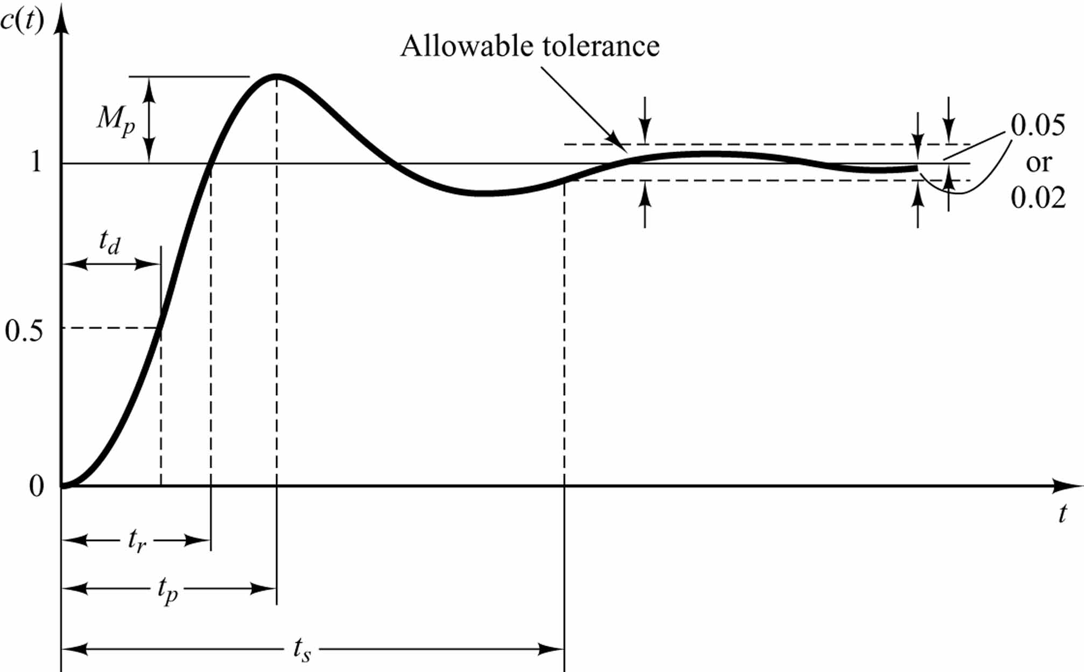
Transient Response Specifications
y(t)
Set-point value
Time to reach 50% of set-point value
For second-order LTI systems
Rise time t_{r}:
time required for response to rise from 0% to 100% of set-point value for under-damped systems;
time required for response to rise from 10% to 90%of set-point value for over-damped systems;
Settling time t_{s}: time for output to settle within ±δ% of set-point value

Slide 6
Transient Response Specifications
y(t)
Set-point value
Time to reach 50% of set-point value
For second-order LTI systems
Overshoot M_{p}: maximum % of output overshooting the set-point value
Peak time t_{p}: time for output to reach max value
t_{r} , t_{s} ,M_{p} , t_{p} measure the system output responding to the step function
“Fastness” measured by (t_{r} , t_{p}) versus “Nearness” measured by (M_{p} , t_{s} )

Slide 7
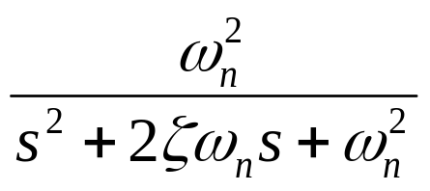
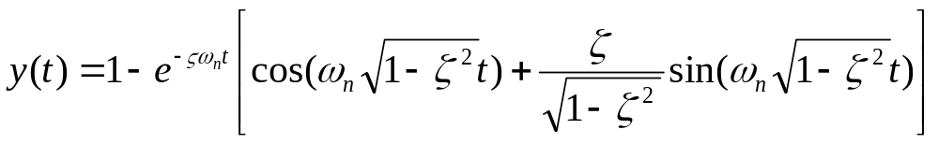
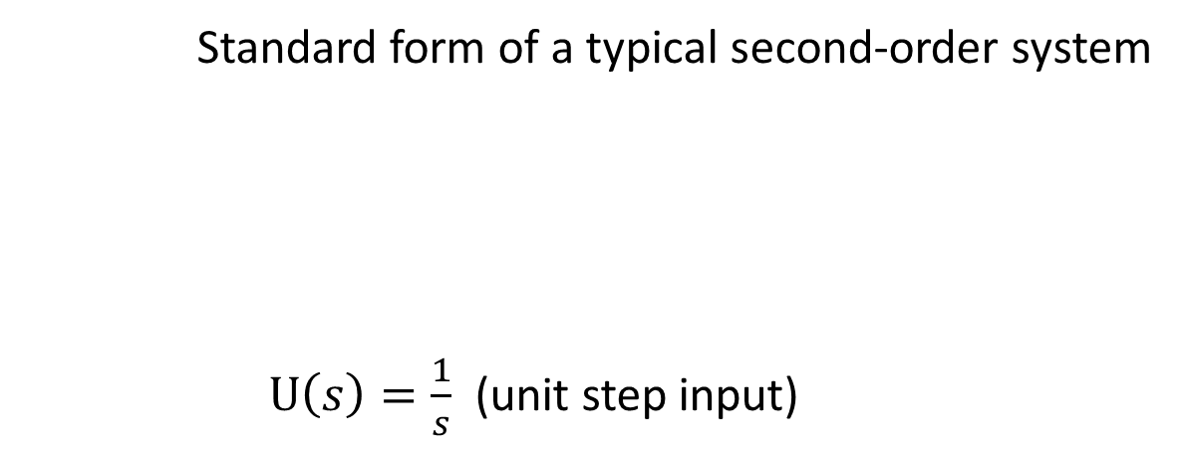
For a second-order system, given ω_{n} and ζ
Find: t_{r} , t_{s} ,M_{p} , t_{p}
Standard form of a typical second-order system
  $U\left(s\right)=\frac{1}{s}$ (unit step input)
U(s)
Y(s)
(Recall Lecture-3 or Tutorial-4)

Slide 8
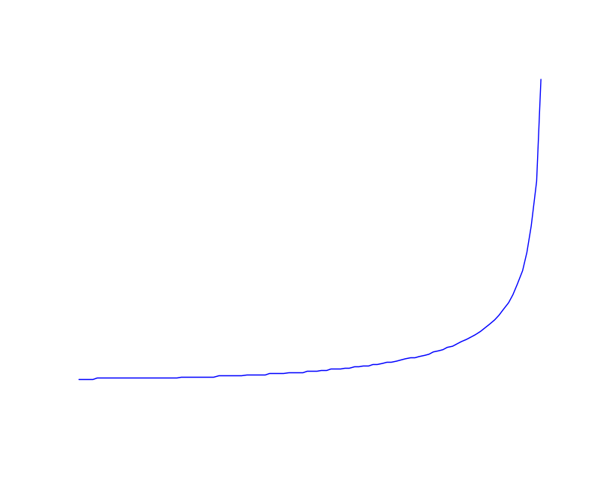
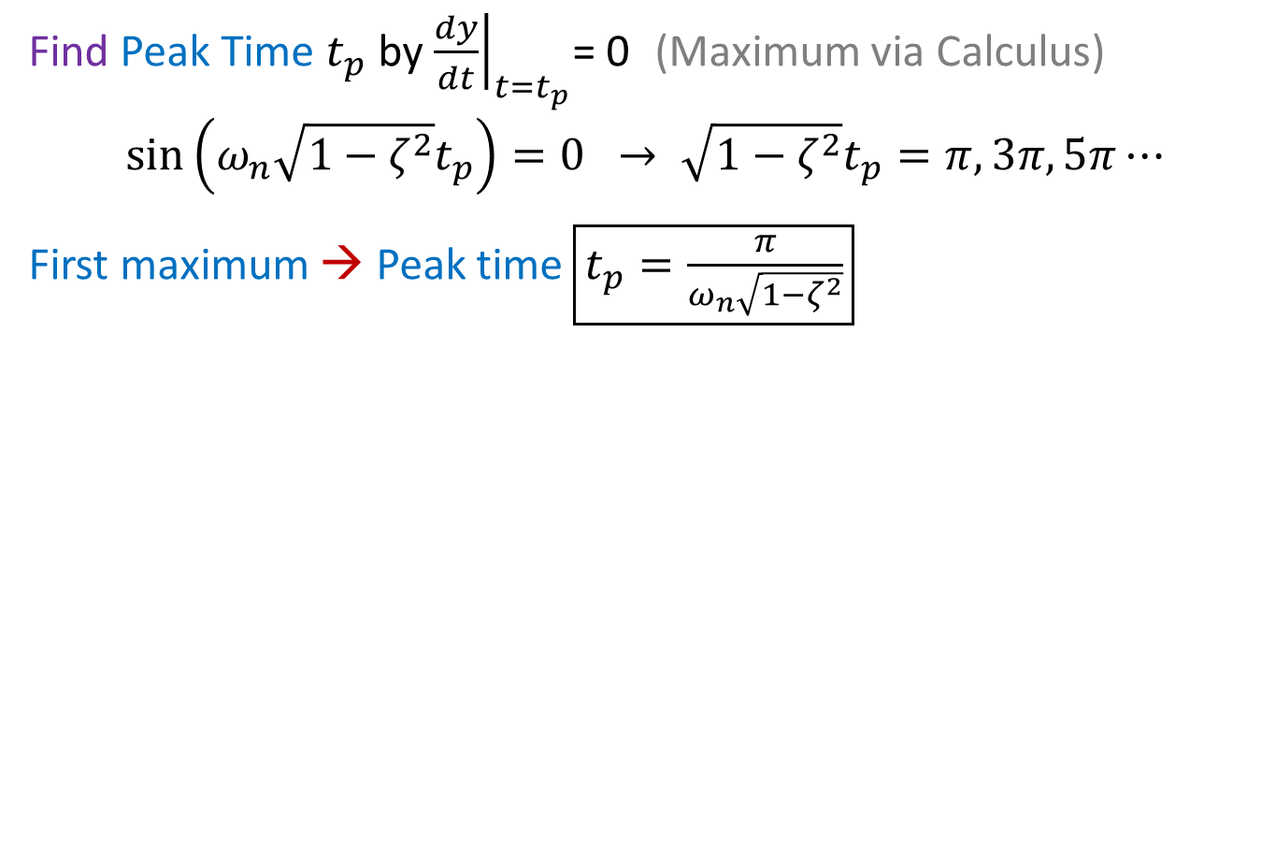




Find Peak Time $t_{p}$ by ${\left.\frac{dy}{dt}\right|}_{t=t_{p}}$= 0 (Maximum via Calculus)
$$\sin\left(ω_{n}\sqrt{1−ζ^{2}}t_{p}\right)=0 → \sqrt{1−ζ^{2}}t_{p}=π,3π,5π⋯$$
First maximum → Peak time $\boxed{t_{p}=\frac{π}{ω_{n}\sqrt{1−ζ^{2}}}}$
Peak time $t_{p}$
y
$$t_{p}$$
%MatLab code
DR = 0:0.01:1;
tp = pi./sqrt(1-DR.^2);
plot(DR,tp);
%axis off;
$$\frac{π}{ω_{n}}$$
t
0
$$ζ$$
1

Slide 9
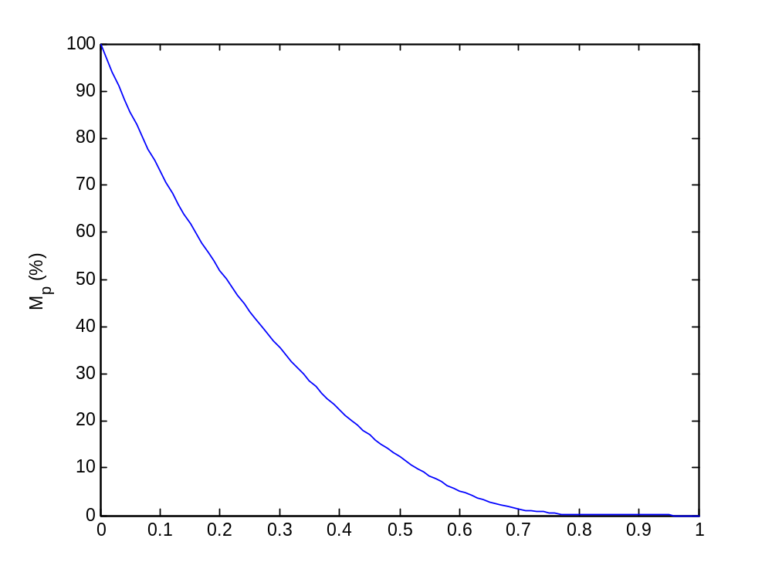
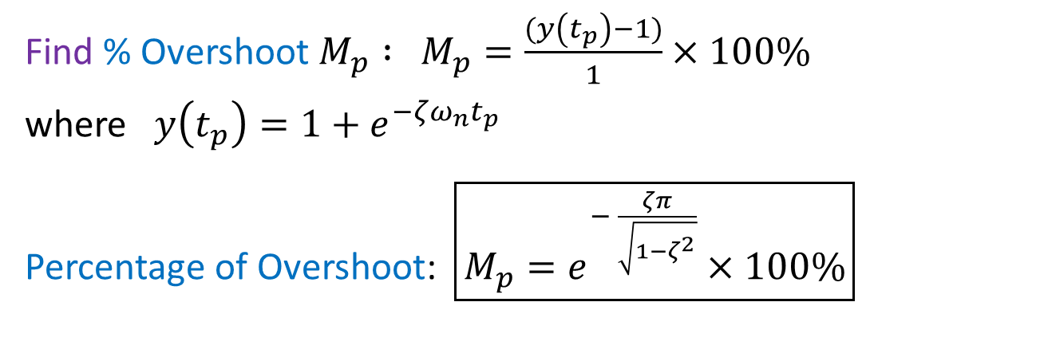

Find % Overshoot $M_{p} :$ $M_{p}=\frac{(y\left(t_{p}\right)−1)}{1}×100\%$
where $y\left(t_{p}\right)=1+e^{{−{ζω}_{n}t}_{p}}$
Percentage of Overshoot: $\boxed{M_{p}=e^{− \frac{ζπ}{\sqrt{1−ζ^{2}}}}×100\%}$
%MatLab code
DR = 0:0.01:1;
Mp =exp(-DR*pi./(1-DR.^2))*100;
plot(DR,Mp)
ylabel('M_p (%)');
$$ζ$$

Slide 10

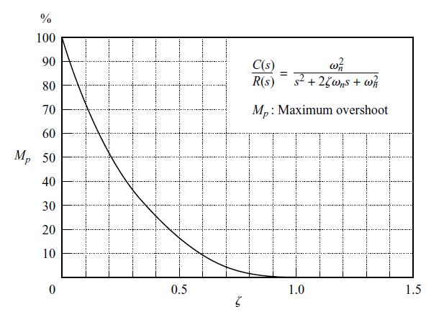
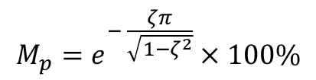
$$M_{p}=e^{− \frac{ζπ}{\sqrt{1−ζ^{2}}}}×100\%$$
Y(s)

Slide 11
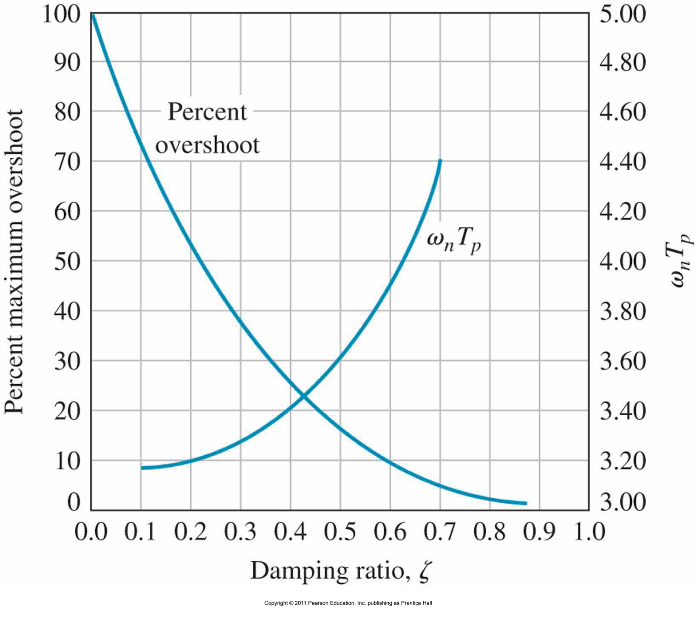
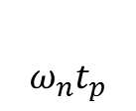

Trade-off between Response Fastness and Allowable Overshoot
$$ω_{n}t_{p}$$
$$ω_{n}t_{p}$$

Slide 12


Recall:
y(t)
$δ\%$
$t_{s}$ - Settling Time

Slide 13

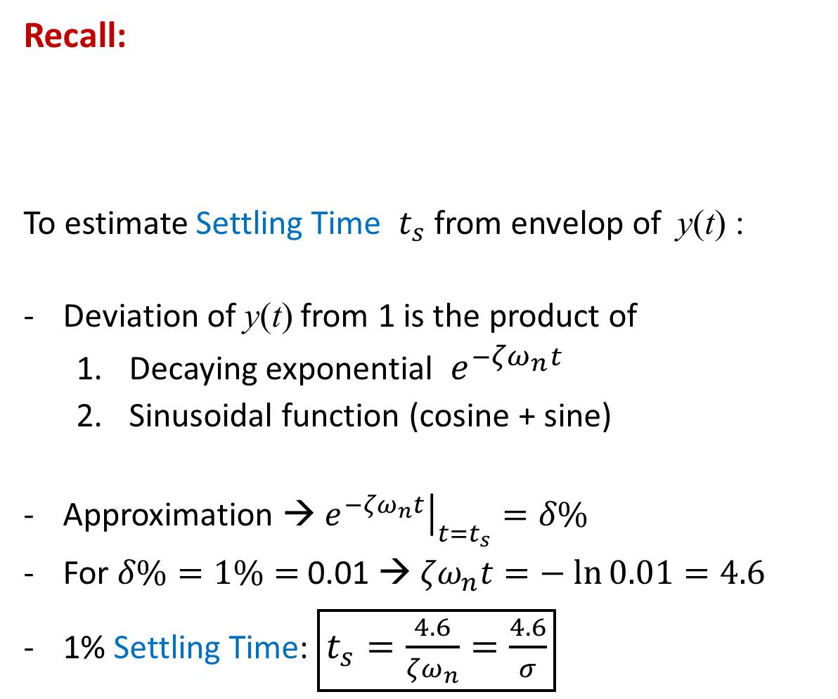
Recall:
To estimate Settling Time $t_{s}$ from envelop of y(t) :
Deviation of y(t) from 1 is the product of
  Decaying exponential ${ e}^{−{ζω}_{n}t}$
  Sinusoidal function (cosine + sine)
Approximation → ${\left.e^{−{ζω}_{n}t}\right|}_{t=t_{s}}=δ\%$
For $δ\%=1\%=$ 0.01 → ${ζω}_{n}t=− ln{0.01}=4.6$
1% Settling Time: $\boxed{t_{s}=\frac{4.6}{{ζω}_{n}}=\frac{4.6}{σ}}$

Slide 14
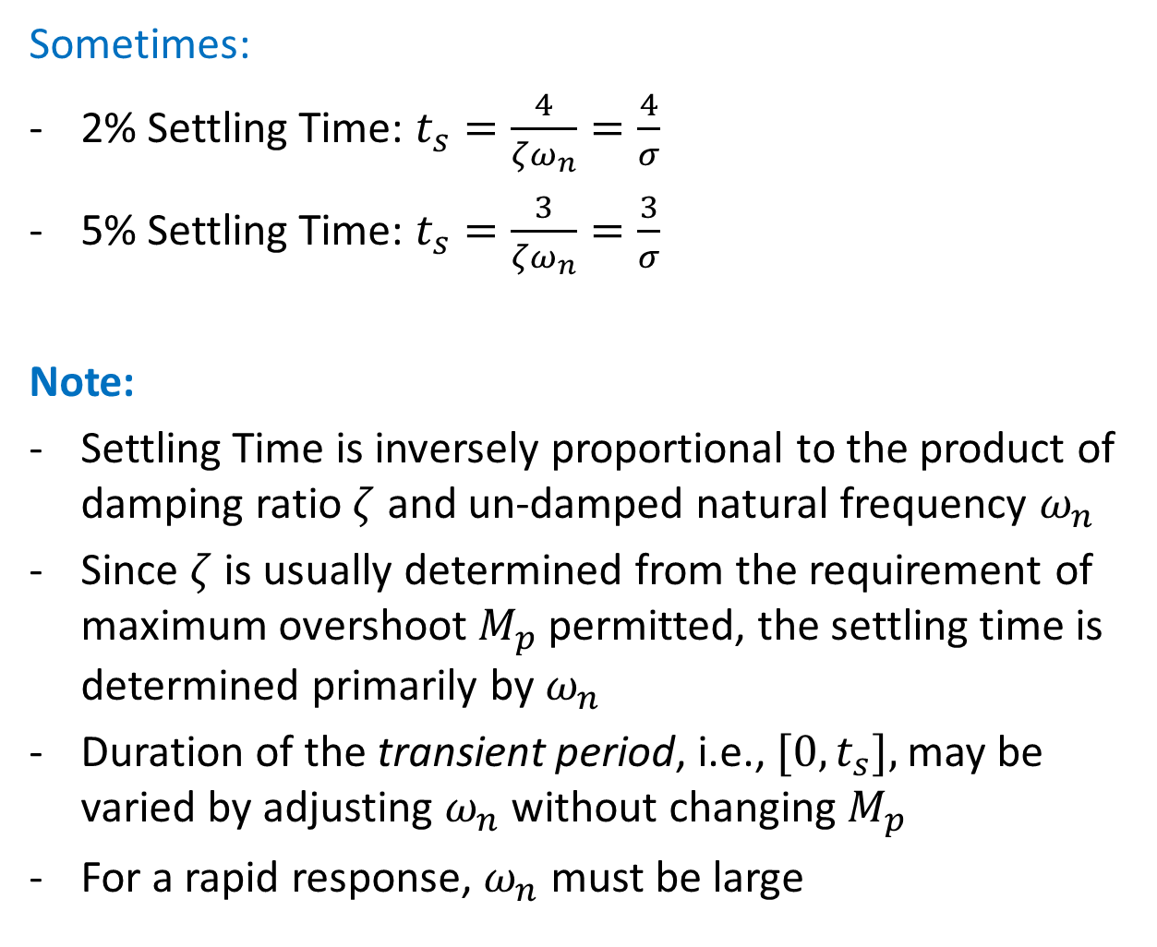
Sometimes:
2% Settling Time: $t_{s}=\frac{4}{{ζω}_{n}}=\frac{4}{σ}$
5% Settling Time: $t_{s}=\frac{3}{{ζω}_{n}}=\frac{3}{σ}$
Note:
Settling Time is inversely proportional to the product of damping ratio $ζ$ and un-damped natural frequency $ω_{n}$
Since $ζ$ is usually determined from the requirement of maximum overshoot $M_{p}$ permitted, the settling time is determined primarily by $ω_{n}$
Duration of the transient period, i.e., ${[0,t}_{s}],$ may be varied by adjusting $ω_{n}$ without changing $M_{p}$
For a rapid response, $ω_{n}$ must be large

Slide 15
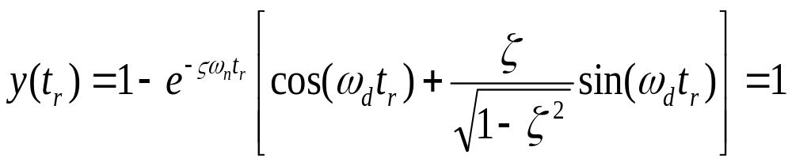

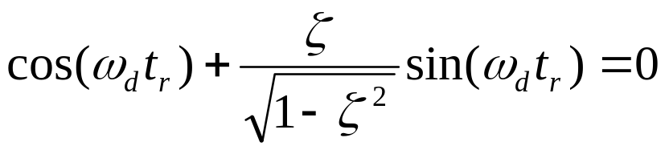
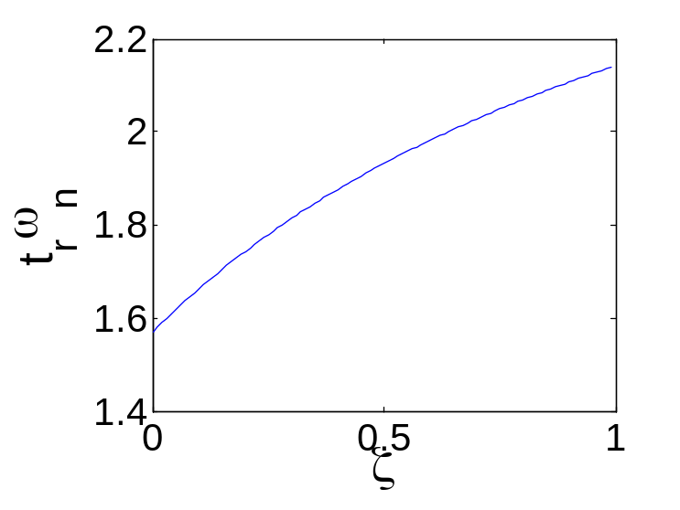
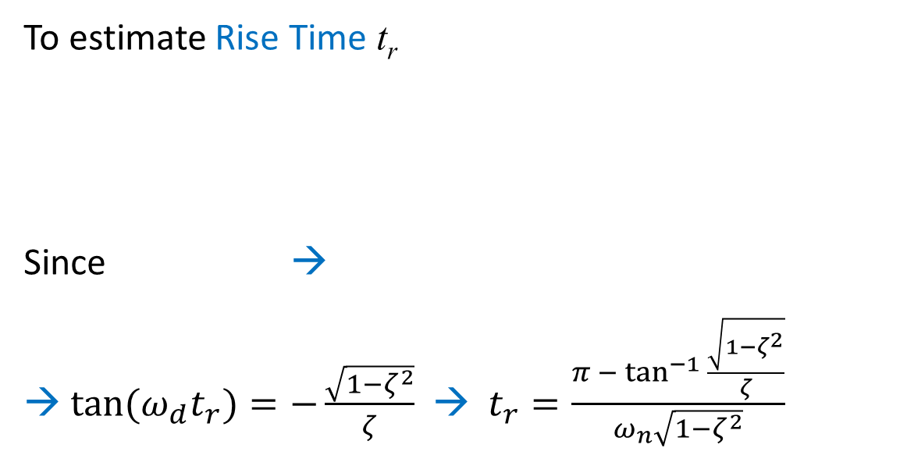
To estimate Rise Time t_{r}
Since →
→ $\tan{{(ω}_{d}t_{r})}=−\frac{\sqrt{1−ζ^{2}}}{ζ}$ → $t_{r}=\frac{π −\tan^{−1}{\frac{\sqrt{1−ζ^{2}}}{ζ}}}{ω_{n}\sqrt{1−ζ^{2}}}$
%MatLab code
DR = 0:0.01:1;
plot(DR,pi-atan(sqrt(1-DR.^2)./DR)./sqrt(1-DR.^2))
ylabel('t_r\omega_n')
xlabel('\zeta')

Slide 16
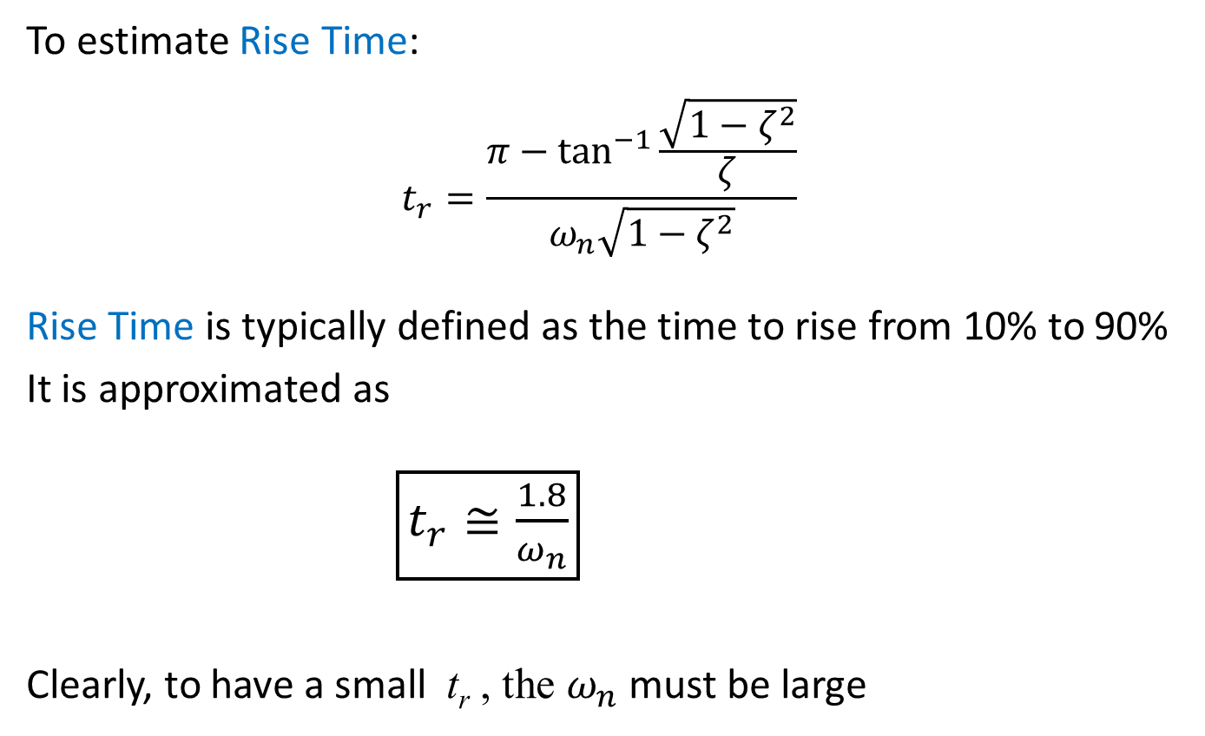
To estimate Rise Time:
$$t_{r}=\frac{π−\tan^{−1}{\frac{\sqrt{1−ζ^{2}}}{ζ}}}{ω_{n}\sqrt{1−ζ^{2}}}$$
Rise Time is typically defined as the time to rise from 10% to 90%
It is approximated as
$\boxed{t_{r}≅\frac{1.8}{ω_{n}}}$
Clearly, to have a small t_{r} , the $ω_{n}$ must be large

Slide 17
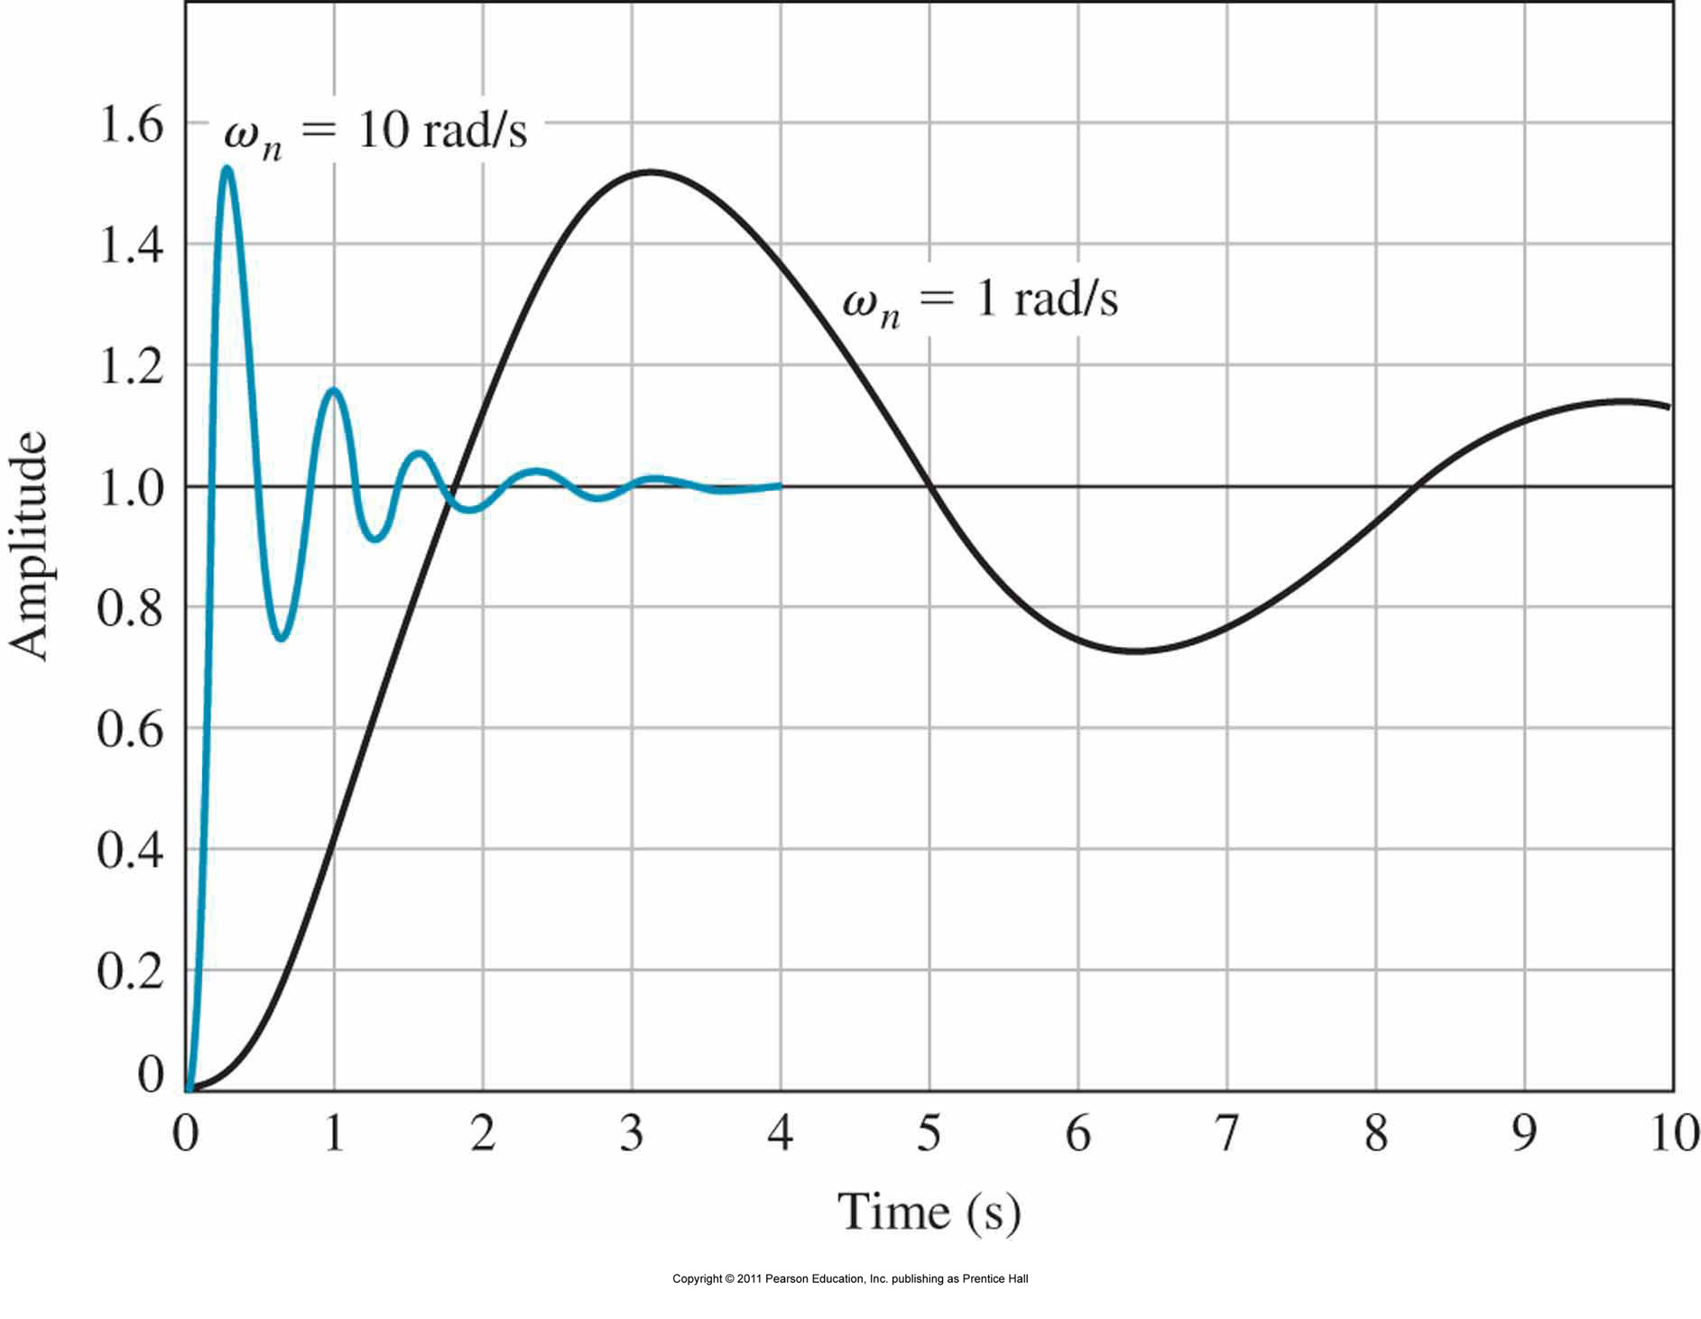


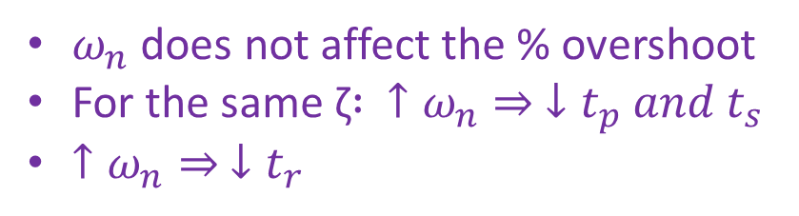
Step Response: with ζ = 0.2 for ω_{n} = 1 and ω_{n} = 10
$$M_{p}=e^{− \frac{ζπ}{\sqrt{1−ζ^{2}}}}×100\%$$
$ω_{n}$ does not affect the % overshoot
For the same ζ$: ↑ω_{n}⇒ ↓t_{p} and t_{s}$
$↑ω_{n}⇒ ↓t_{r}$
$$t_{r}≅\frac{1.8}{ω_{n}}$$

Slide 18

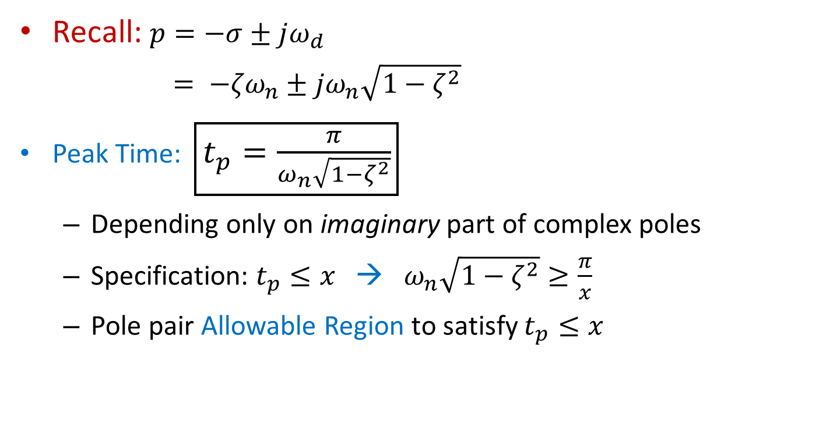

Allowable Region on s-Plane
Recall: $p=−σ±jω_{d}$
$= {−{ζω}_{n}±jω}_{n}\sqrt{1−ζ^{2}}$
Peak Time: $\boxed{t_{p}=\frac{π}{ω_{n}\sqrt{1−ζ^{2}}}}$
  Depending only on imaginary part of complex poles
  Specification: $t_{p}≤x$ → $ω_{n}\sqrt{1−ζ^{2}}≥\frac{π}{x}$
  Pole pair Allowable Region to satisfy $t_{p}≤x$
Im
$$\frac{π}{x}$$
Re
$$−\frac{π}{x}$$

Slide 19

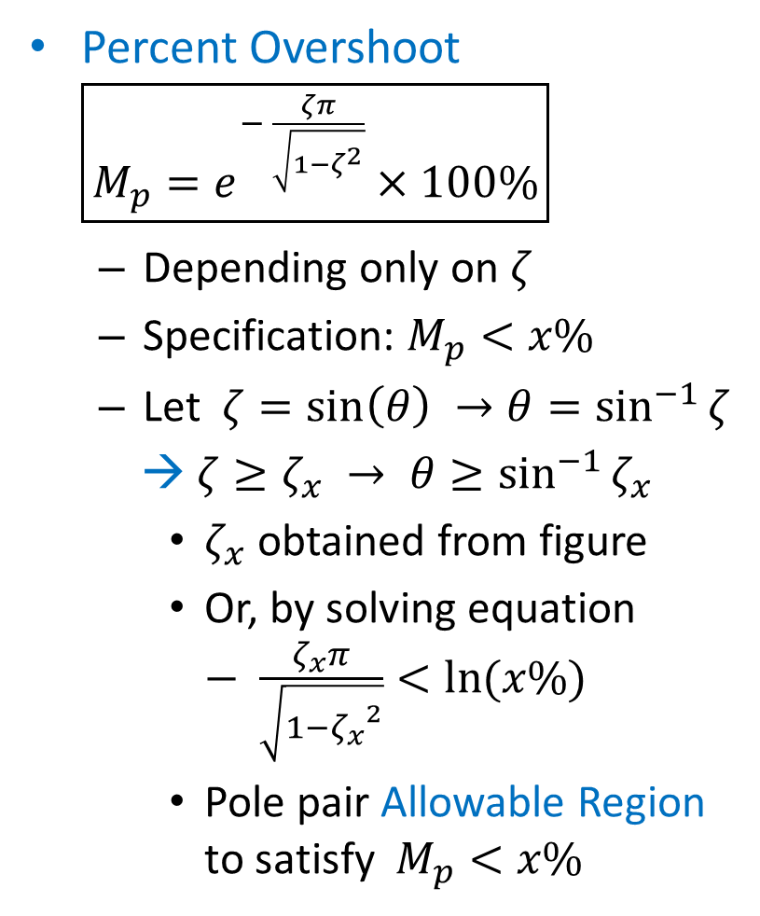


Percent Overshoot $\boxed{M_{p}=e^{− \frac{ζπ}{\sqrt{1−ζ^{2}}}}×100\%}$
  Depending only on $ζ$
  Specification: $M_{p}<x\%$
  Let $ζ=\sin\left(θ\right) →θ=\sin^{−1}{ζ}$
  → $ζ≥ζ_{x} → θ≥\sin^{−1}{ζ_{x}}$
    $ζ_{x}$ obtained from figure
    Or, by solving equation $− \frac{ζ_{x}π}{\sqrt{1−{ζ_{x}}^{2}}}<\ln{(x\%)}$
    Pole pair Allowable Region to satisfy $M_{p}<x\%$
$$ζ$$
Im
$$\sin^{−1}{ζ_{x}}$$
$$θ$$
Re
$$\sin^{−1}{ζ_{x}}$$

Slide 20

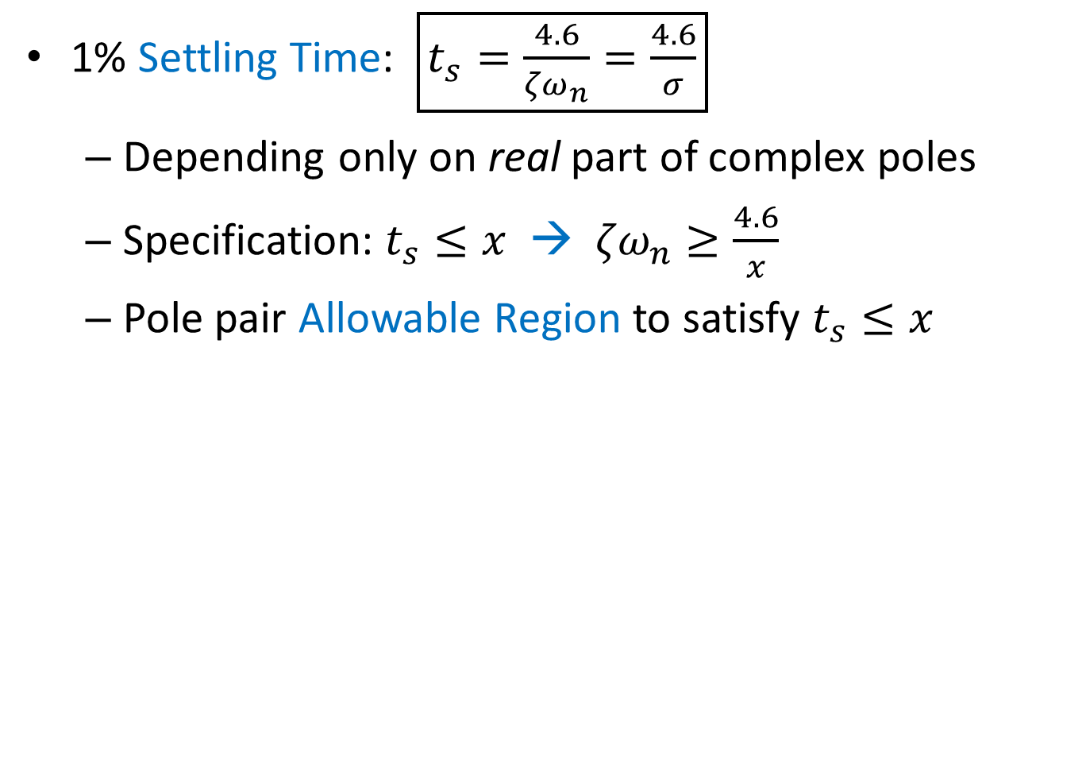
1% Settling Time: $\boxed{t_{s}=\frac{4.6}{{ζω}_{n}}=\frac{4.6}{σ}}$
  Depending only on real part of complex poles
  Specification: $t_{s}≤x$ → ${ζω}_{n}≥\frac{4.6}{x}$
  Pole pair Allowable Region to satisfy $t_{s}≤x$
Im
Re
$$\frac{4.6}{x}$$

Slide 21

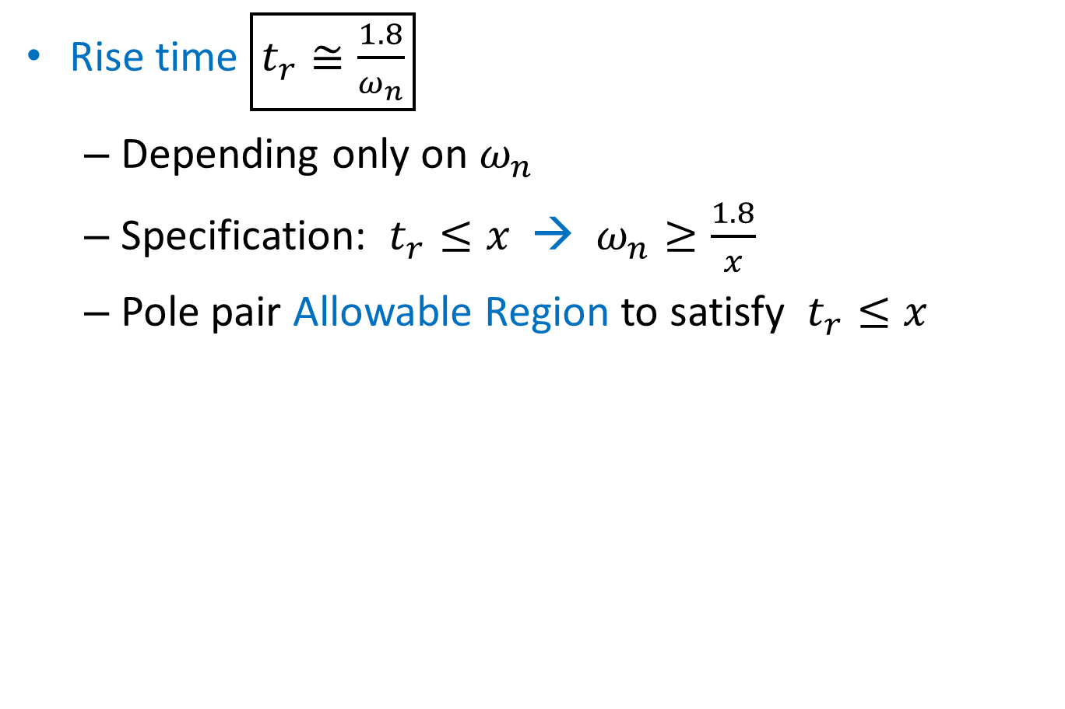
Rise time $\boxed{t_{r}≅\frac{1.8}{ω_{n}}}$
  Depending only on $ω_{n}$
  Specification: $t_{r}≤x$ → $ω_{n}≥\frac{1.8}{x}$
  Pole pair Allowable Region to satisfy $t_{r}≤x$
Im
$$\frac{1.8}{x}$$
Re

Slide 22
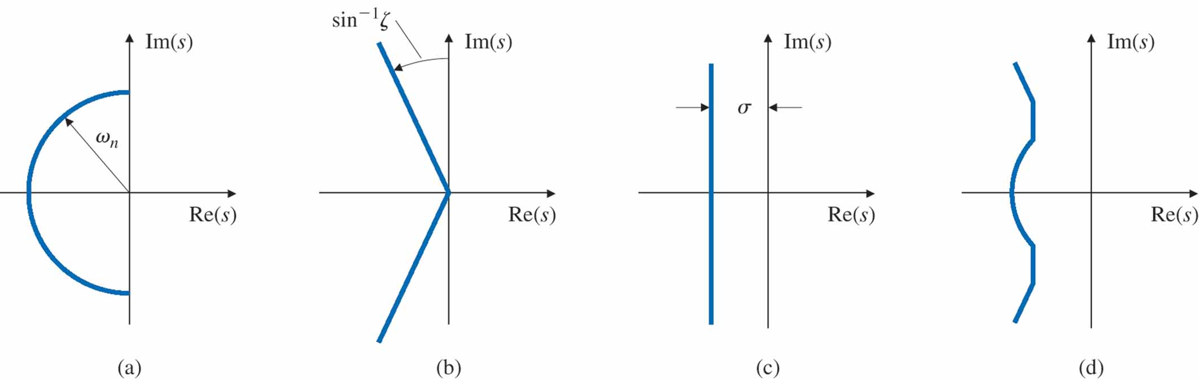
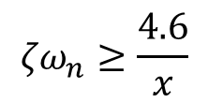
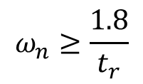
Allowable Region on s-Plane
(delineated all by transient requirements)
$$ω_{n}≥\frac{1.8}{t_{r}}$$
$${ζω}_{n}≥\frac{4.6}{x}$$
+
+
=
Rise Time
Overshoot
1% Settling Time
Composite of all 3 requirements

Slide 23
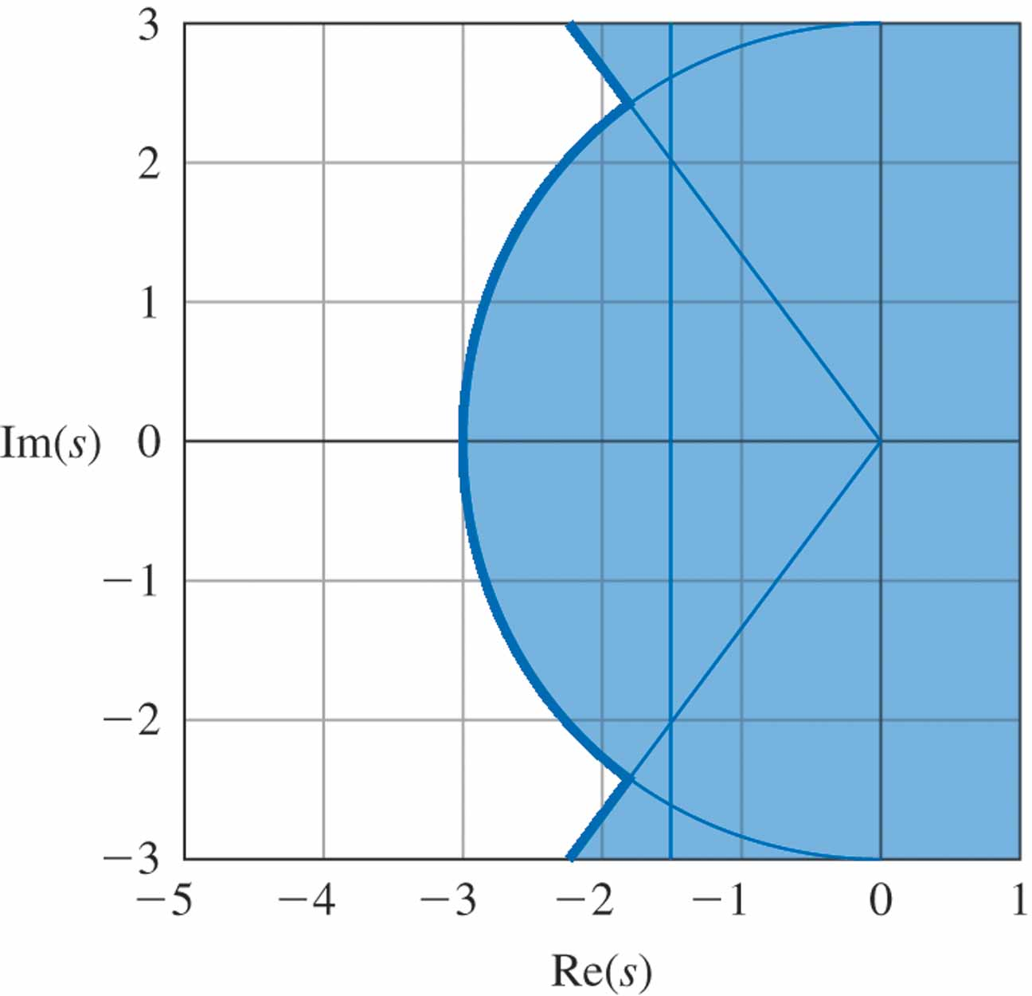
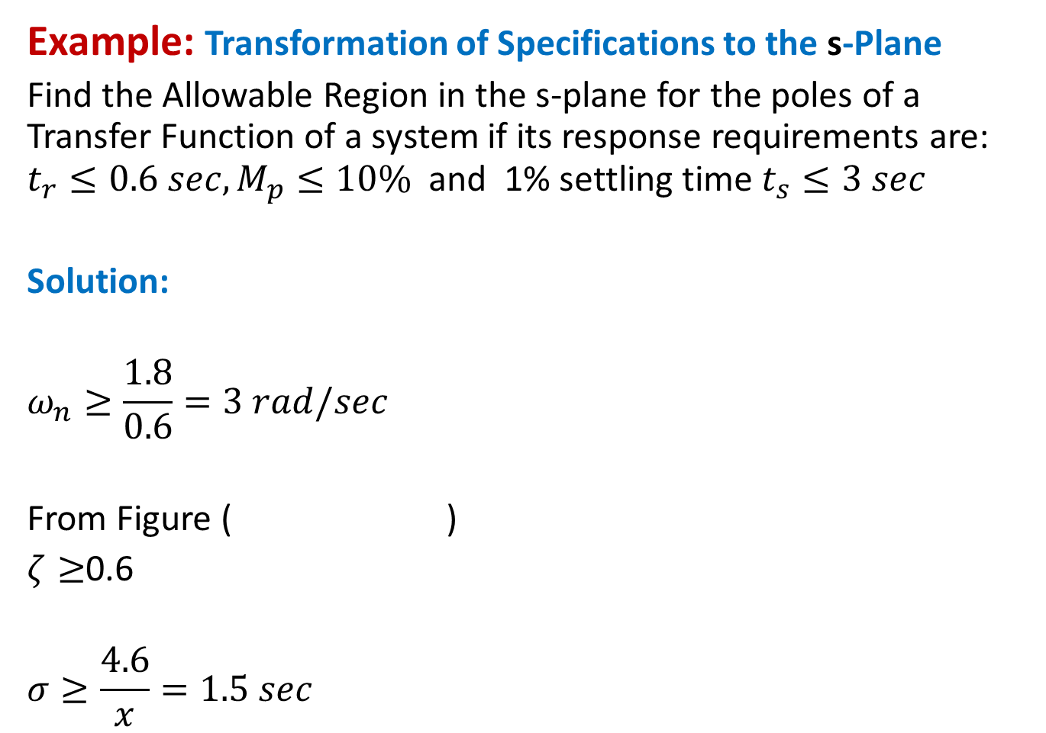
Example: Transformation of Specifications to the s-Plane
Find the Allowable Region in the s-plane for the poles of a Transfer Function of a system if its response requirements are: $t_{r}≤0.6 sec, M_{p}≤10\%$and 1% settling time $t_{s}≤3 sec$
Solution:
$$ω_{n}≥\frac{1.8}{0.6}=3 rad/sec$$
From Figure ( )
$ζ≥$0.6
$$σ≥\frac{4.6}{x}=1.5 sec$$
☹

Slide 24
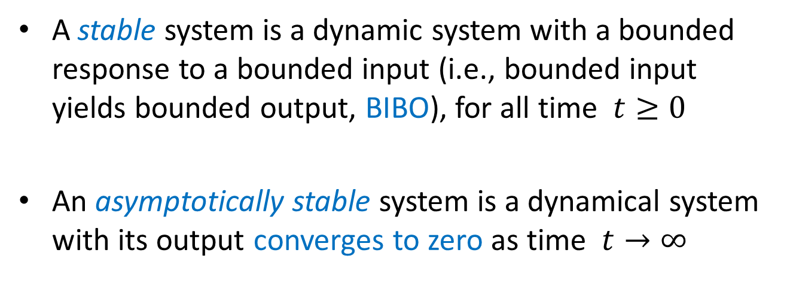
System Stability
R(s)
G(s)
Y(s)
A stable system is a dynamic system with a bounded response to a bounded input (i.e., bounded input yields bounded output, BIBO), for all time $t≥0$
An asymptotically stable system is a dynamical system with its output converges to zero as time $t→∞$

Slide 25
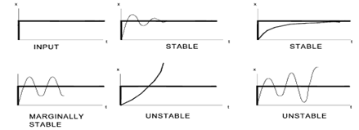






Recall: Step Response of Second-Order LTI systems
Poles: $− {ζω}_{n}±ω_{n}\sqrt{ζ^{2}−1}$
$$ζω_{n}>0$$
$$ζω_{n}>0$$
unit step
asymptotically
BIBO
$$ζω_{n}=0$$
$$ζω_{n}<0$$
$$ζω_{n}<0$$
BIBO

Slide 26
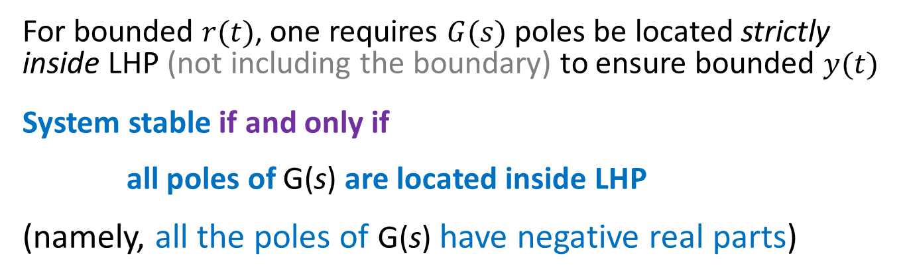
Stability Condition
R(s)
G(s)
Y(s)
For bounded $r(t)$, one requires $G(s)$ poles be located strictly inside LHP (not including the boundary) to ensure bounded $y(t)$
System stable if and only if
all poles of G(s) are located inside LHP
(namely, all the poles of G(s) have negative real parts)
  A system is unstable if any pole has a positive real part, or
  if there are double poles on the imaginary axis
  A system is marginally stable (or marginally unstable)
  if some poles on the imaginary axis, with other poles in LHP

Slide 27
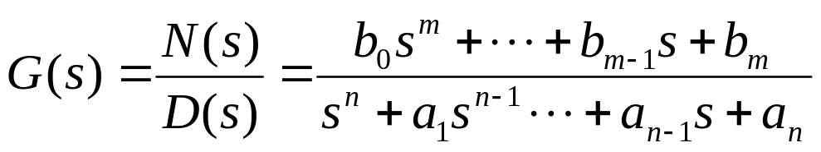
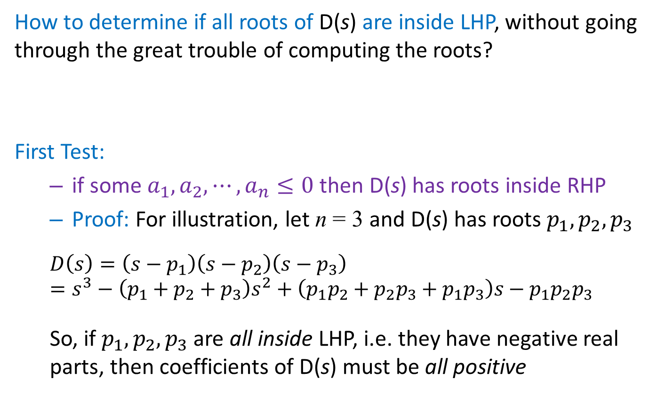
Determining System Stability
How to determine if all roots of D(s) are inside LHP, without going through the great trouble of computing the roots?
First Test:
  if some $a_{1},a_{2},⋯,a_{n}≤0$ then D(s) has roots inside RHP
  Proof: For illustration, let n = 3 and D(s) has roots $p_{1},p_{2},p_{3}$
  $$D\left(s\right)=\left(s−p_{1}\right)\left(s−p_{2}\right)\left(s−p_{3}\right)$$
  $$=s^{3}−\left(p_{1}+p_{2}+p_{3}\right)s^{2}+\left(p_{1}p_{2}+p_{2}p_{3}+p_{1}p_{3}\right)s−p_{1}p_{2}p_{3}$$
  So, if $p_{1},p_{2},p_{3}$ are all inside LHP, i.e. they have negative real parts, then coefficients of D(s) must be all positive

Slide 28


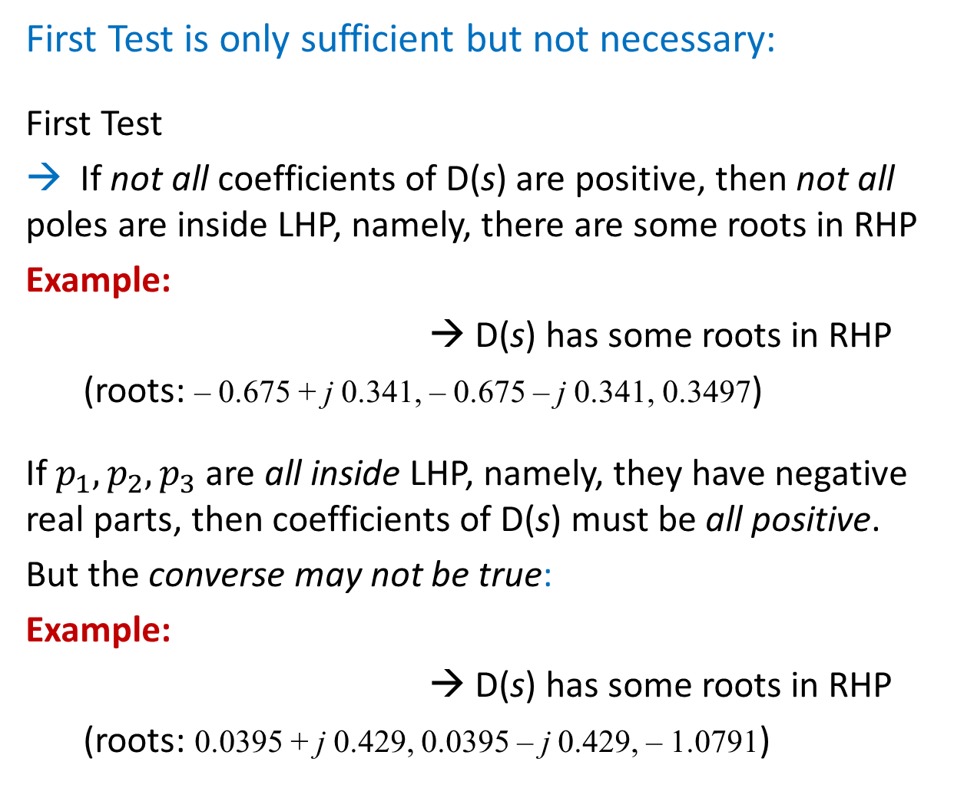
First Test is only sufficient but not necessary:
First Test
→ If not all coefficients of D(s) are positive, then not all poles are inside LHP, namely, there are some roots in RHP
Example:
→ D(s) has some roots in RHP
(roots: – 0.675 + j 0.341, – 0.675 – j 0.341, 0.3497)
If $p_{1},p_{2},p_{3}$ are all inside LHP, namely, they have negative real parts, then coefficients of D(s) must be all positive.
But the converse may not be true:
Example:
→ D(s) has some roots in RHP
(roots: 0.0395 + j 0.429, 0.0395 – j 0.429, – 1.0791)

Slide 29
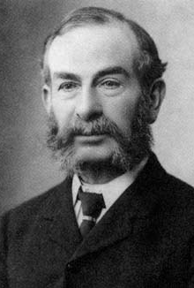
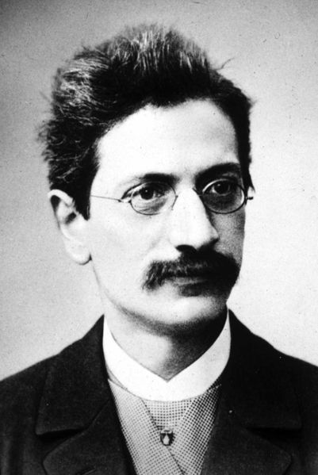
Routh-Hurwitz Stability Criterion
A necessary and sufficient (if and only if) condition
Edward Routh (1831 – 1907)
Adolf Hurwitz (1859-1919)

Slide 30
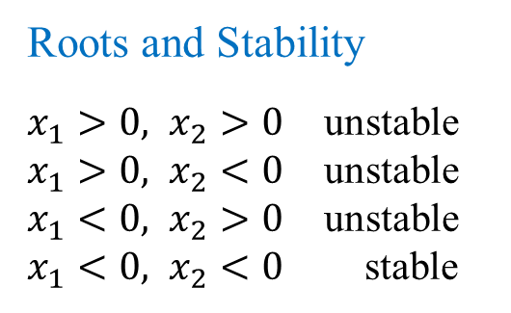
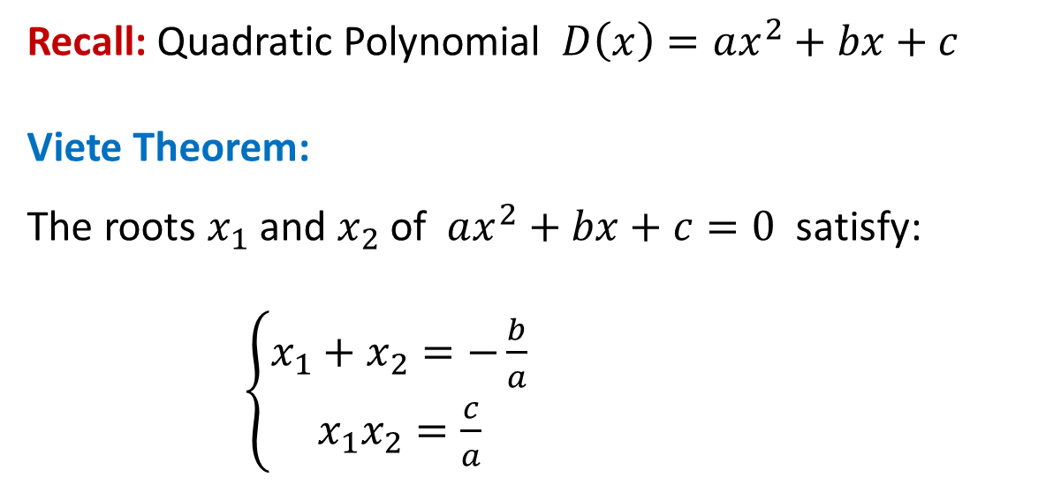
Recall: Quadratic Polynomial $D\left(x\right)=ax^{2}+bx+c$
Viete Theorem:
The roots $x_{1}$ and $x_{2}$ of $ax^{2}+bx+c=0$ satisfy:
$\left\{\begin{aligned}x_{1}+x_{2}=−\frac{b}{a} \\ x_{1}x_{2}=\frac{c}{a}\end{aligned}\right.$
Roots and Stability
$x_{1}>0, x_{2}>0$ unstable
$x_{1}>0, x_{2}<0$ unstable
$x_{1}<0, x_{2}>0$ unstable
$x_{1}<0, x_{2}<0$ stable

Slide 31
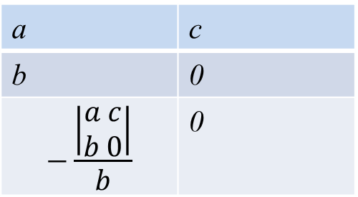
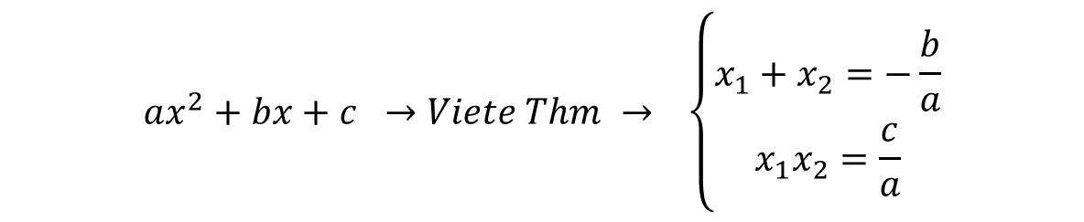
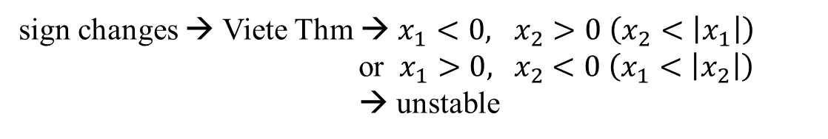
$$ax^{2}+bx+c →Viete Thm → \left\{\begin{aligned}x_{1}+x_{2}=−\frac{b}{a} \\ x_{1}x_{2}=\frac{c}{a}\end{aligned}\right.$$
Put in Table:
a | c
b | 0
$$−\frac{\left|\begin{aligned}a c \\ b 0\end{aligned}\right|}{b}$$ | 0
a | c
b | 0
c | 0
a > 0
b > 0
c > 0
no sign change → Viete Thm → $x_{1}<0, x_{2}<0$ → stable
a > 0
b > 0
c < 0
sign changes → Viete Thm → $x_{1}<0, x_{2}>0 \left(x_{2}<\left|x_{1}\right|\right)$
or $x_{1}>0, { x}_{2}<0 \left(x_{1}<\left|x_{2}\right|\right)$
→ unstable

Slide 32
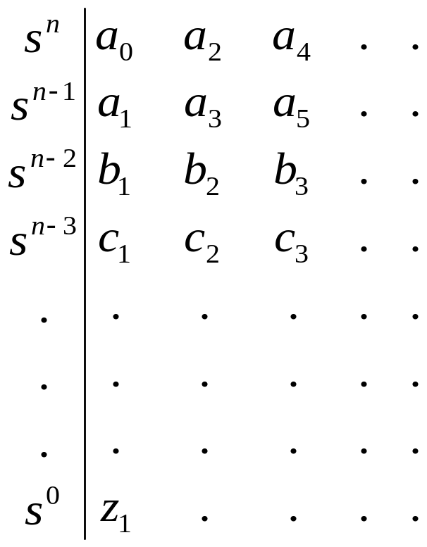
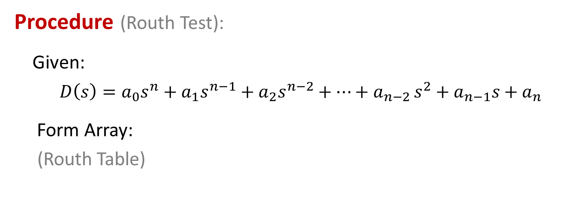
Routh-Hurwitz Stability Criterion
Procedure (Routh Test):
Given:
$D\left(s\right)=a_{0}s^{n}+a_{1}s^{n−1}+a_{2}s^{n−2}+⋯+a_{n−2 }s^{2}+a_{n−1}s+a_{n}$
Form Array:
(Routh Table)

Slide 33
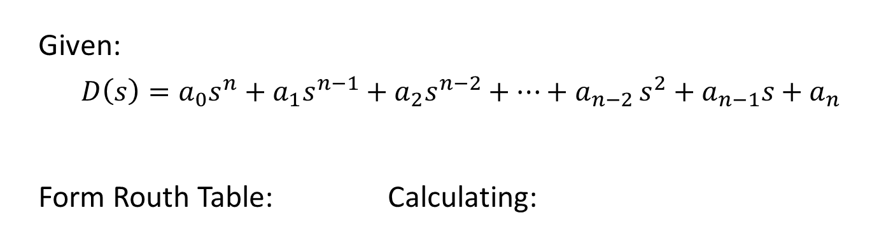
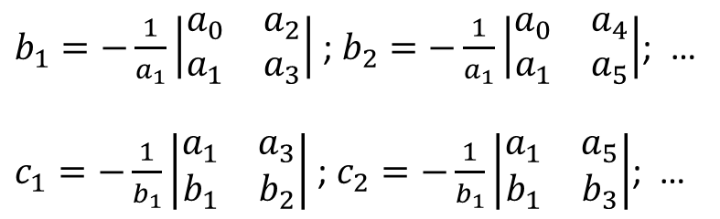
Given:
$D\left(s\right)=a_{0}s^{n}+a_{1}s^{n−1}+a_{2}s^{n−2}+⋯+a_{n−2 }s^{2}+a_{n−1}s+a_{n}$
Form Routh Table: Calculating:
$b_{1}=−\frac{1}{a_{1}}\left|\begin{matrix}a_{0} & a_{2} \\ a_{1} & a_{3}\end{matrix}\right|$ ;$b_{2}=−\frac{1}{a_{1}}\left|\begin{matrix}a_{0} & a_{4} \\ a_{1} & a_{5}\end{matrix}\right|$; …
$c_{1}=−\frac{1}{b_{1}}\left|\begin{matrix}a_{1} & a_{3} \\ b_{1} & b_{2}\end{matrix}\right|$ ; $c_{2}=−\frac{1}{b_{1}}\left|\begin{matrix}a_{1} & a_{5} \\ b_{1} & b_{3}\end{matrix}\right|$; …

Slide 34

Row $s^{n}$ and $s^{n−1}$ are directly from coefficients of D(s)
$s^{n−2}$ computed from rows $s^{n}$ and $s^{n−1}$
$b_{1}=−\frac{1}{a_{1}}\left|\begin{matrix}a_{0} & a_{2} \\ a_{1} & a_{3}\end{matrix}\right|$ ; $b_{2}=−\frac{1}{a_{1}}\left|\begin{matrix}a_{0} & a_{4} \\ a_{1} & a_{5}\end{matrix}\right|$; …
Row $s^{n−3}$ computed from rows $s^{n−1}$ and $s^{n−2}$
$c_{1}=−\frac{1}{b_{1}}\left|\begin{matrix}a_{1} & a_{3} \\ b_{1} & b_{2}\end{matrix}\right|$ ; $c_{2}=−\frac{1}{b_{1}}\left|\begin{matrix}a_{1} & a_{5} \\ b_{1} & b_{3}\end{matrix}\right|$; …
and so on, until row $s^{0}$
Check: first column of the table:
If all elements are positive, then all roots of D(s) are in LHP
→ System is stable
If some elements are negative, then
→ System is unstable
# of sign changes in column = # of roots of D(s) in RHP

Slide 35




Example:
Given:
$$D\left(s\right)=s^{3}+6s^{2}+8s+6$$
Solution: Routh Array is
→ D(s) has all roots in LHP → System is stable
$$\begin{matrix}s^{3} & 1 & 8 \\ s^{2} & 6 & 6 \\ \begin{aligned}s^{1} \\ \\ s^{0}\end{aligned} & \begin{aligned}−\frac{1×6−8×6}{6}=7 \\ −\frac{6×0−7×6}{7}=6\end{aligned} & \begin{aligned}0 \\ \end{aligned}\end{matrix}$$

Slide 36


Example:
Given:
$D\left(s\right)=s^{6}+4s^{5}+3s^{4}+2s^{3}+s^{2}+4s+4$
Solution: Routh Table is
D(s) has roots in RHP → System is unstable
There are 2 sign changes → There are 2 poles in RHP
sign change

Slide 37

% Verified by Matlab
D = [1 4 3 2 1 4 4];
roots(D)
% 6 roots: -0.8858, -3.2644, -0.6046 + 0.9935i, -0.6046 - 0.9935i,
% 0.6797 + 0.7488i, 0.6797 - 0.7488i (these 2 roots are in RHP)
% To compare step responses when N(s) = 1 and N(s) = s+1, respectively
N1 = 1;
N2 = [1 1];
SYS1 = tf(N1,D)
SYS2 = tf(N2,D)
step(SYS1,SYS2,0:0.01:20)
legend('N(s) = 1','N(s) = s + 1')

Slide 38

Special Case I:
A row has first element = zero but not all elements are zero
D(s) has roots in RHP (including imaginary axis)
This case is unstable, but more detail can be revealed
Procedure:
Replace this first zero by ε > 0
Complete table as before
Let $ε→0^{+}$ and check the first column again:
  No sign changes → some roots on imaginary axis
  # of sign changes → # of roots in RHP
Note: $ε→0^{+}$, where + is important (cannot be $0^{−}$)

Slide 39



Example:
$D\left(s\right)=s^{5}+3s^{4}+2s^{3}+{6s}^{2}+6s+9$
Solution: Routh table is
First column: 2 sign changes → 2 poles in RHP
NEW
$$\frac{6ε−9}{ε}→−∞ as ε→0^{+}$$

Slide 40

% Validation by Matlab,
D = [1 3 2 6 6 9];
roots(D)
% the roots are -2.9043, -0.7046 + 0.9929i, -0.7046 - 0.9929i
% 0.6567 + 1.2881i, 0.6567 - 1.2881i (2 roots in RHP)
%
% To compare step response when N(s) = 1 and N(s) = s+1,
N1 = 1;
N2 = [1 1];
SYS1 = tf(N1,D)
SYS2 = tf(N2,D)
step(SYS1,SYS2,0:0.001:100)
legend('N(s) = 1','N(s) = s + 1')

Slide 41

Special Case II: One row has all zero elements
D(s) has some roots on imaginary axis or inside RHP
This case is unstable, but more detail can be revealed
Procedure:
Form auxiliary polynomial Q(s) with coefficients from previous row
Use coefficients of $\frac{dQ(s)}{ds}$ to replace the zero row
Complete the Ruth table and check first column again:
  No sign changes → some roots on imaginary axis
  # of sign changes → # of roots in RHP
Note:
  D(s) can be factorized by Q(s): $D\left(s\right)=Q(s)\tilde{D}(s)$
  Pair of roots of Q(s) are purely real or purely imaginary

Slide 42




Example:
$D\left(s\right)=s^{5}+5s^{4}+11s^{3}+{23s}^{2}+28s+12$
Solution: Routh array is
No sign changes in first column → all roots have negative real parts except for a pair on the imaginary axis: roots of Q(s) = $± j2$
$$\text{Note}\text{: }\text{original} \text{roots} \text{are} \text{at} \text{ −3, }±j2\text{, −1, −1}$$
$$D\left(s\right)=Q\left(s\right)\tilde{D}\left(s\right)=\left(3s^{2}+12\right)\left(\frac{s^{3}}{3}+\frac{5s^{2}}{3}+\frac{7s}{3}+1\right)=\left(s^{2}+4\right)\left(s^{3}+5s^{2}+7s+3\right)=\left(s+j2\right)\left(s−j2\right)\left(s+3\right){\left(s+1\right)}^{2}$$
$$Q\left(s\right)=3s^{2}+12$$
NEW
$$\frac{dQ(s)}{ds}=6s$$

Slide 43

% To compare step and ramp responses when
% N(s) = 1, N(s) = s+1, and N(s) = s^2+s+1
D = [1 5 11 23 28 12];
N1 = 1;
N2 = [1 1];
N3 = [1 1 1];
SYS1 = tf(N1,D);
SYS2 = tf(N2,D);
SYS3 = tf(N3,D);
t = 0:0.01:10; % Simulation time
subplot(2,1,1);
step(SYS1,SYS2,SYS3,t)
subplot(2,1,2);
lsim(SYS1,SYS2,SYS3,t,t); % Ramp input u = t
legend('N(s) = 1','N(s) = s + 1','N(s) = s^2 + s + 1')
%title('Ramp Response')

Slide 44



Example:
$$D\left(s\right)=s^{5}+s^{4}+4s^{3}+{24s}^{2}+3s+63,$$
Solution: Routh array is
There are 2 sign changes in first column → D(s) has 2 roots in RHP
Q$\left(s\right)=21s^{2}+63=21(s+j\sqrt{3})(s−j\sqrt{3})$
→ D(s) has 2 imaginary roots $±j\sqrt{3}$
$$\text{N}\text{ote}\text{:} \text{The} \text{original} \text{roots} \text{are}\text{: }\text{ −3, 1}±j\sqrt{6}, ±j\sqrt{3}$$
$$D\left(s\right)=Q\left(s\right)\tilde{D}\left(s\right)=\left(21s^{2}+63\right)\left(\frac{s^{3}}{21}+\frac{s^{2}}{21}+\frac{s}{21}+1\right)=\left(s^{2}+3\right)\left(s^{3}+s^{2}+s+21\right)=\left(s^{2}+3\right)(s+3)(s^{2}−2s+7)$$
Q(s)
dQ(s)
NEW

Slide 45



Example:
$D\left(s\right)=s^{5}+2s^{4}+24s^{3}+48 s^{2}−25s−50=0$
Routh Table
One sign change → one pole in RHP
$$D\left(s\right)=s^{5}+2s^{4}+24s^{3}+48 s^{2}−25s−50$$
$$=\left(2s^{4}+48s^{2}−50\right)\left(\frac{s}{2}+1\right)$$

Slide 46



Application to Control System Analysis
Closed-loop Transfer Function: $\frac{Y(s)}{R(s)}=\frac{K}{s\left(s^{2}+s+1\right)\left(s+2\right)+K}$
Characteristic Equation:
${D\left(s\right)=s}^{4}+3s^{3}+3s^{2}+2s+K=0$
Routh Table:
For stability, all coefficients in first column must be positive → 14/9 > K > 0
(when K = 14/9, system is marginally stable, so becomes oscillatory)
Y(s)

Slide 47

% Matlab plot
K = [1 14/9 2];
t = 0:0.001:50;
for i = 1:length(K);
D0 = conv([1 1 1],[1 2]);
SYS1 = tf(K(i),[D0 0]);
SYS = feedback(SYS1,1);
subplot(length(K),2,(i-1)*2+1);
step(SYS,t);
subplot(length(K),2,i*2);
lsim(SYS,t,t);
%title('Ramp Response');
legend(['K = ',num2str(K(i))],'location','NorthWest');
end

Slide 48
END

