Slide 1
EE3122: Analogue Circuit Fundamentals
Multiple Transistor Amplifiers
Department of Electrical Engineering
City University of Hong Kong
Prof. Arindam BASU

Slide 2
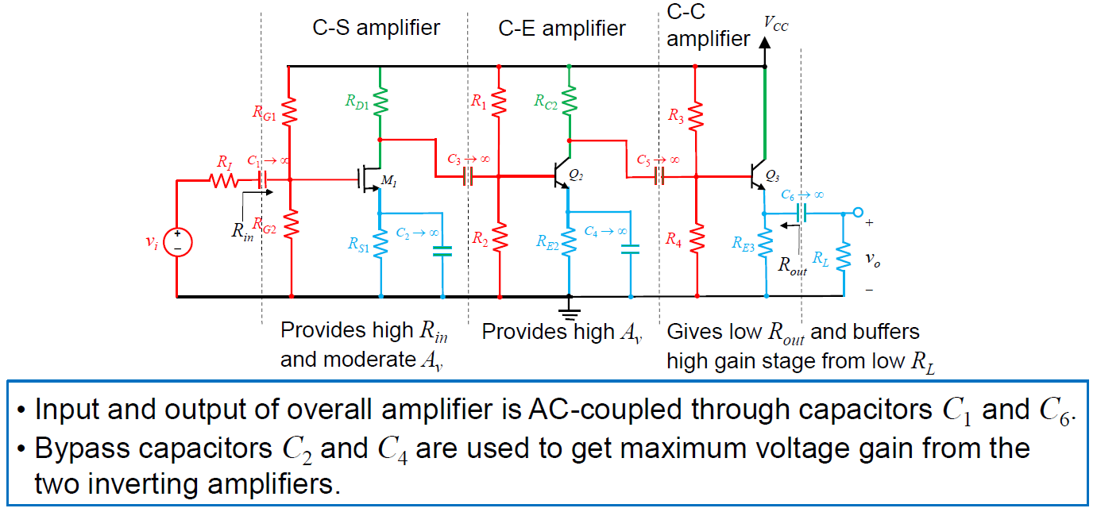
Example of 3 stage amplifier

Slide 3
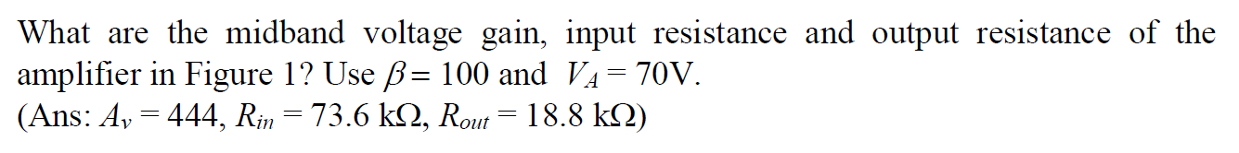
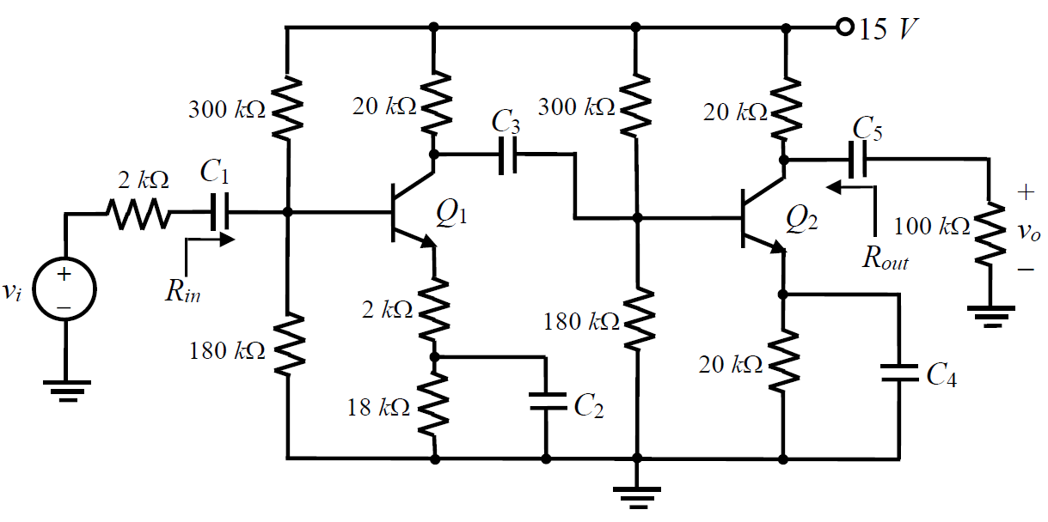
2 stage amplifier: Example

Slide 4
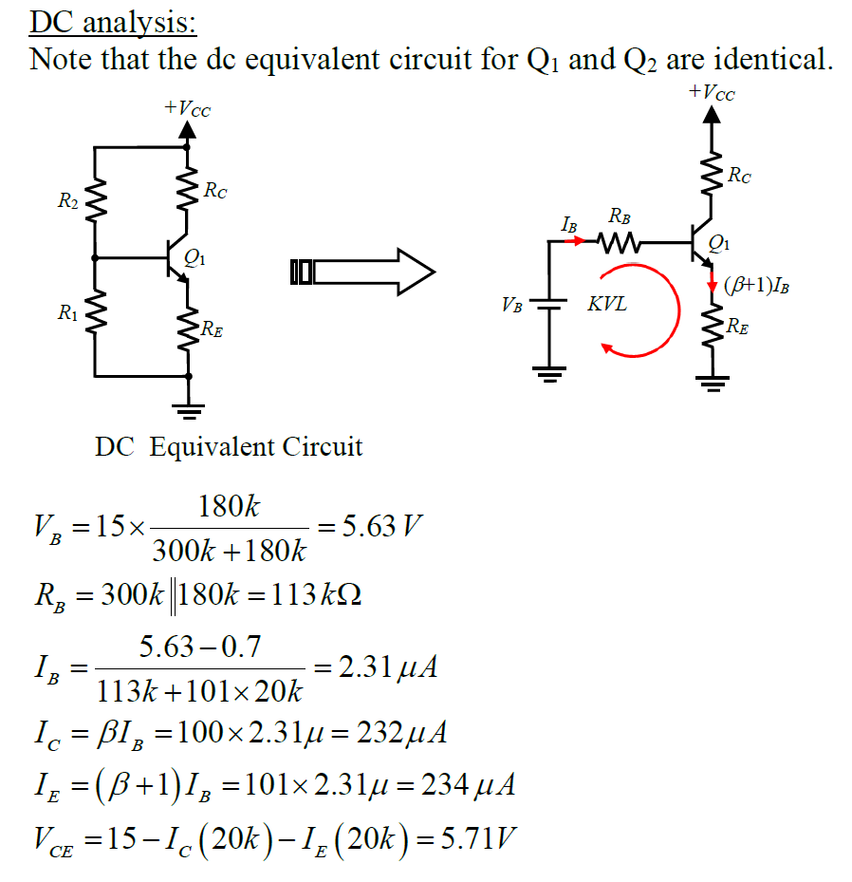
2 stage amplifier: DC Analysis

Slide 5
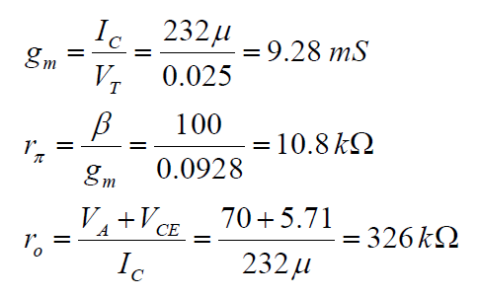
2 stage amplifier: AC Analysis

Slide 6
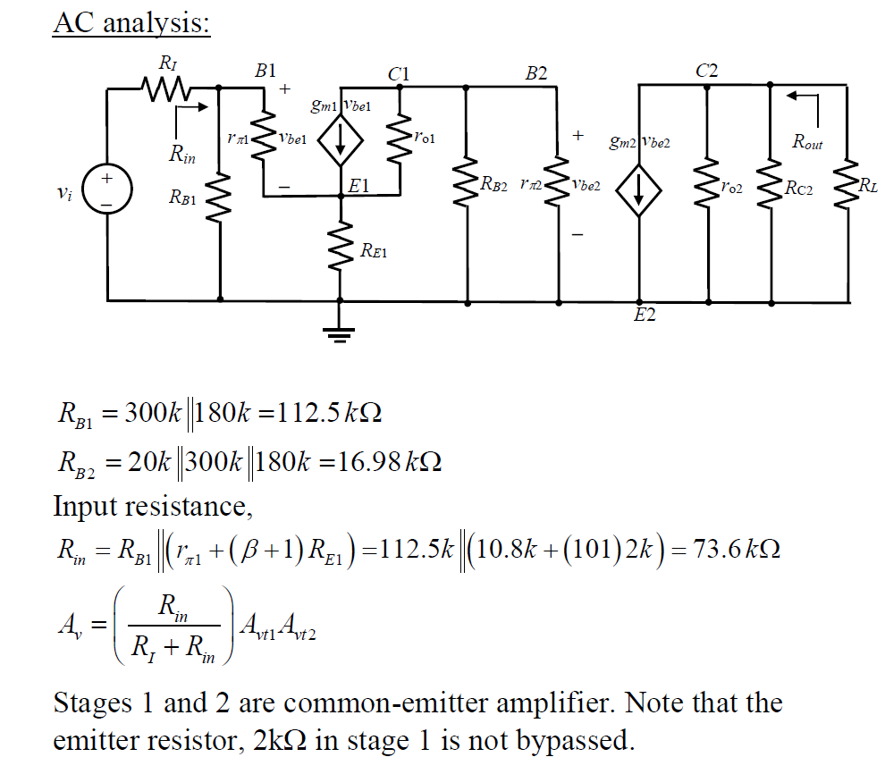
2 stage amplifier: AC Analysis

Slide 7
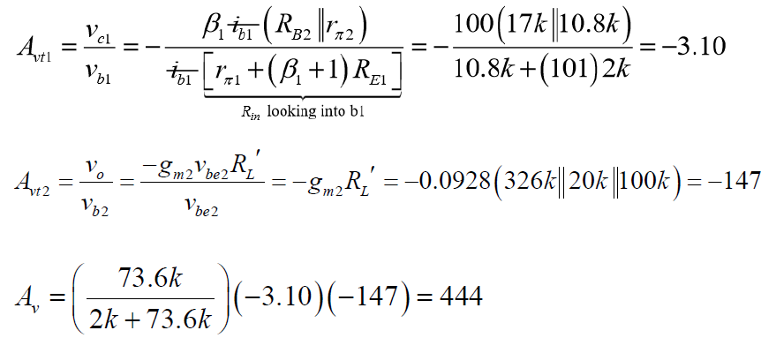
2 stage amplifier: AC Analysis

Slide 8
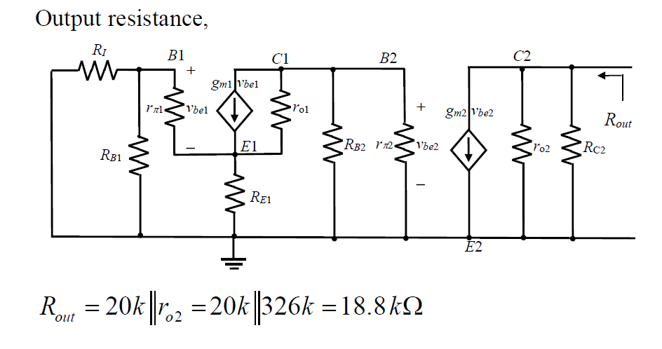
2 stage amplifier: AC Analysis

Slide 9
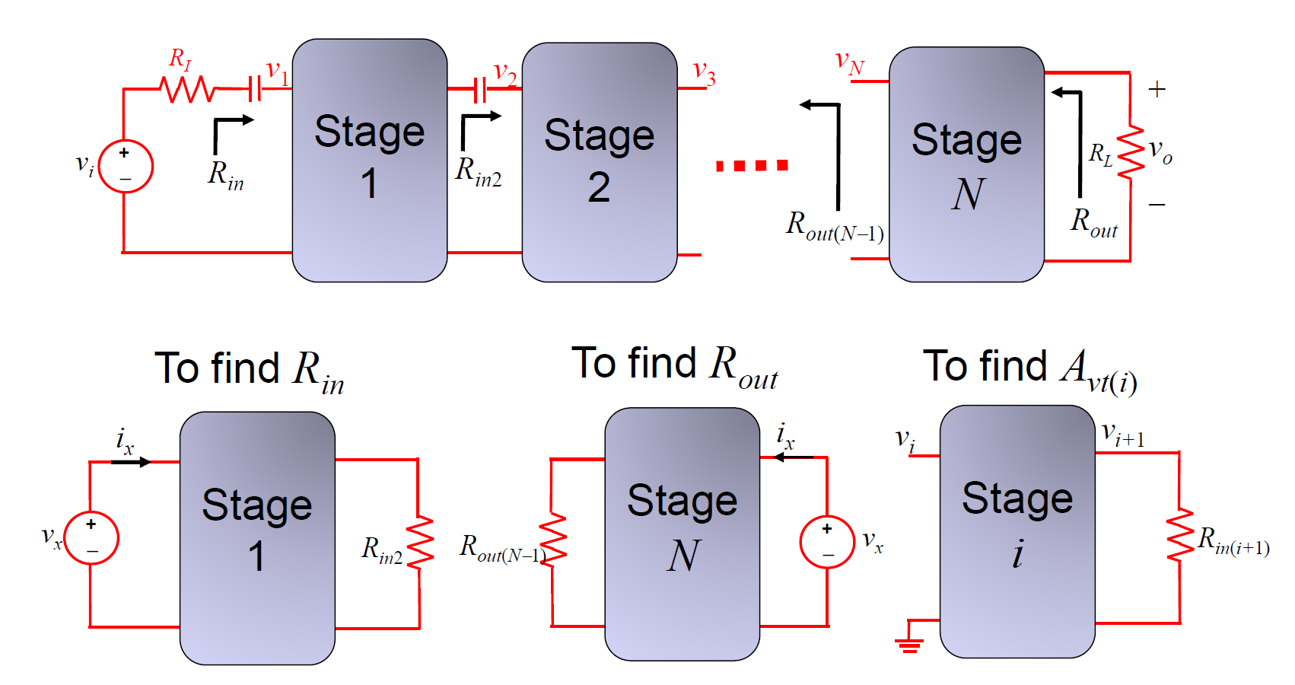
General case

Slide 10
Appendix: Additional Example

Slide 11
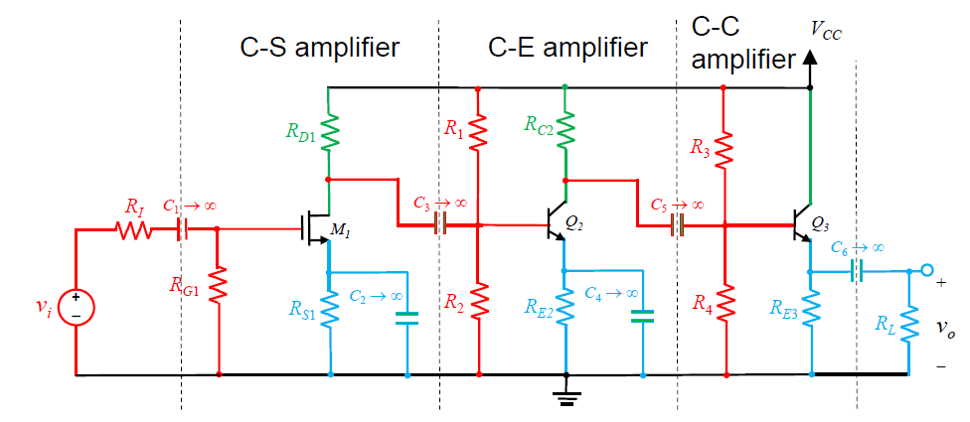
3 stage amplifier: DC equivalent
Inter-stage coupling capacitors allow coupling of AC signals
For DC analysis, capacitors open → DC biasing of each stage is independent. Q point unchanged

Slide 12
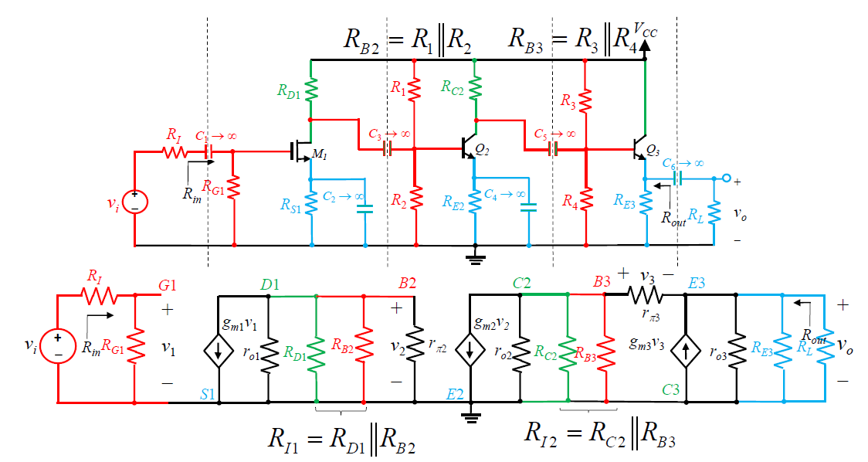
3 stage amplifier: AC equivalent

Slide 13
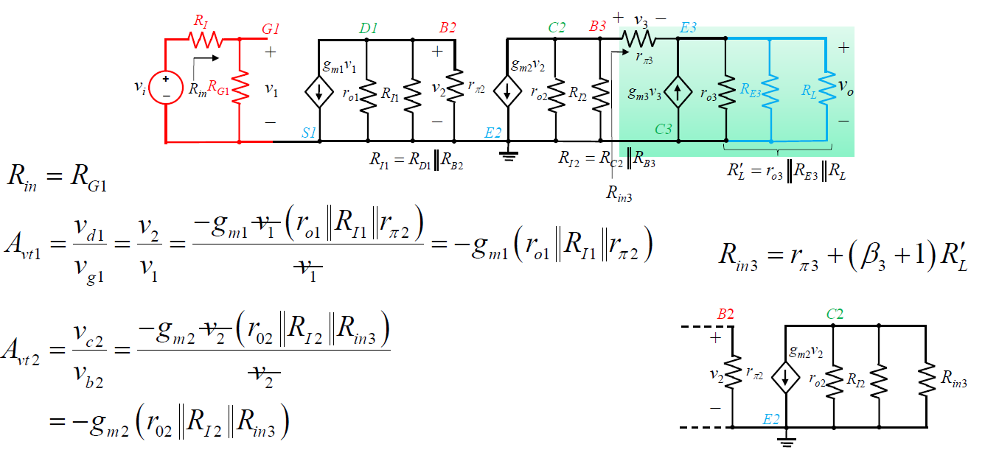
3 stage amplifier: Input resistance & Voltage gain

Slide 14
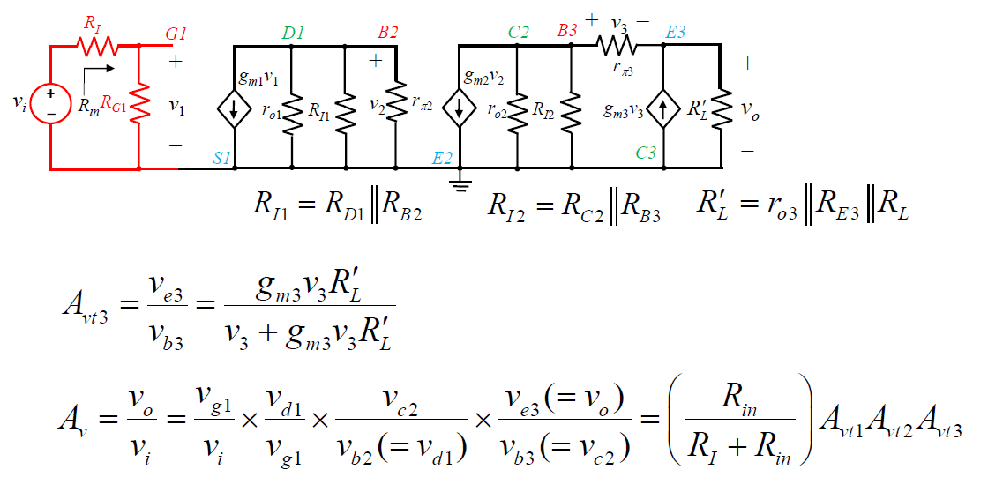
3 stage amplifier: Voltage gain

Slide 15
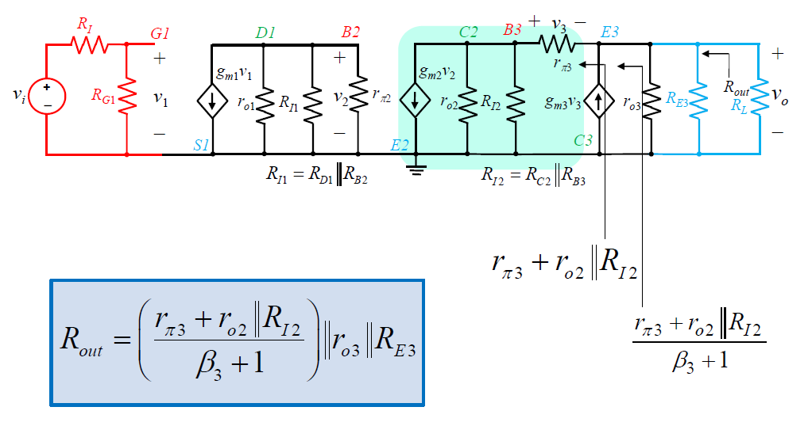
3 stage amplifier: Output resistance

