Slide 1
EE 3114 Systems and Control
10. State Space Design
Semester A, 2021-22

Slide 2
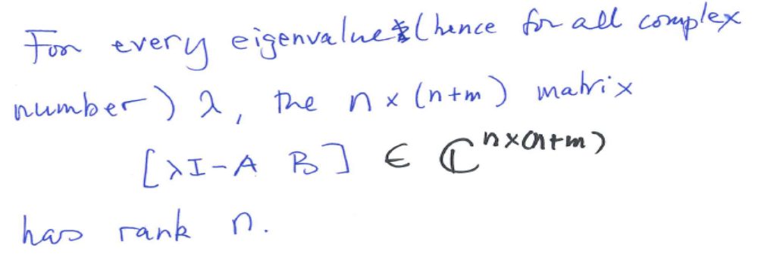
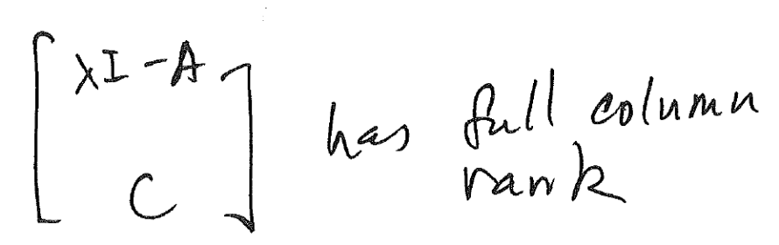
PBH Tests for Controllability/Observability
Controllability:
Observability:

Slide 3
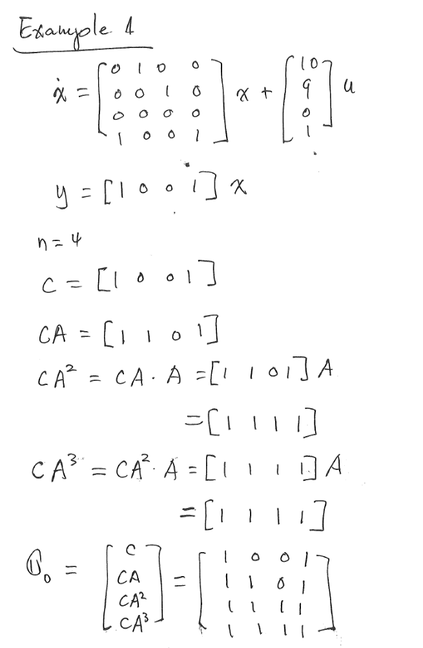
An Example

Slide 4
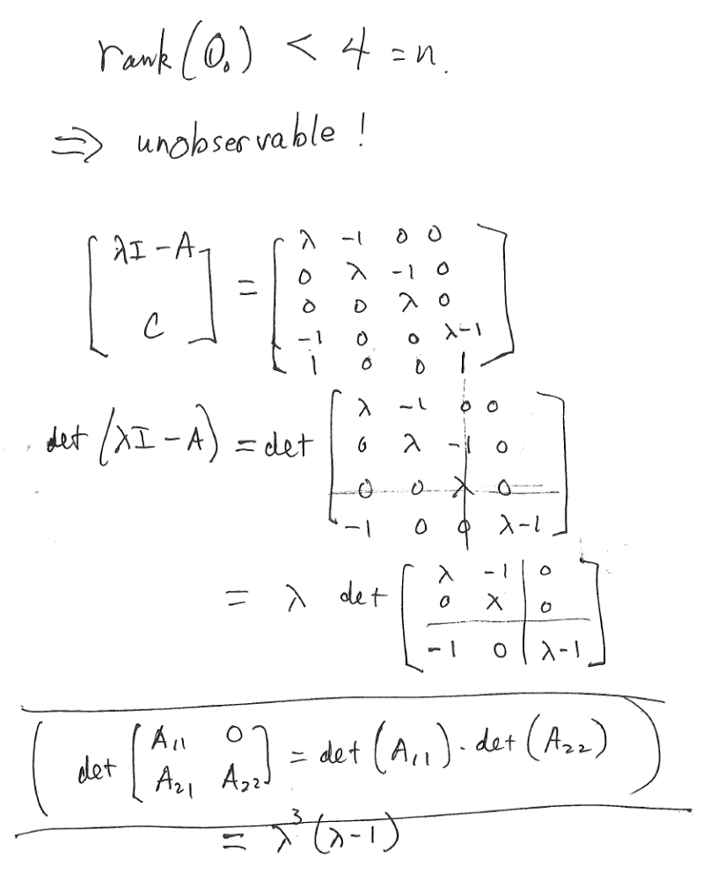
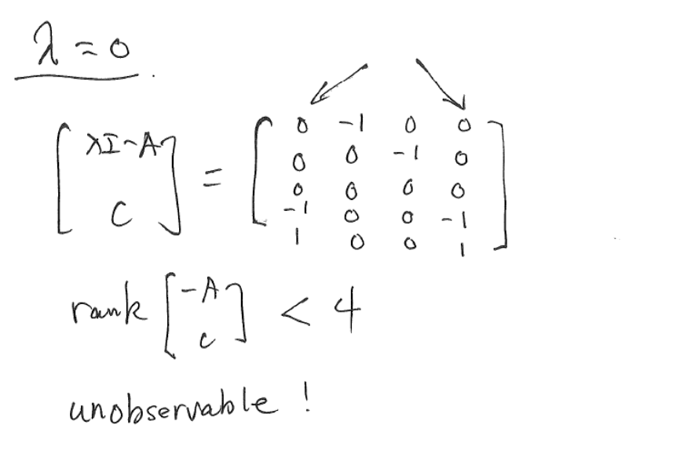
An Example

Slide 5
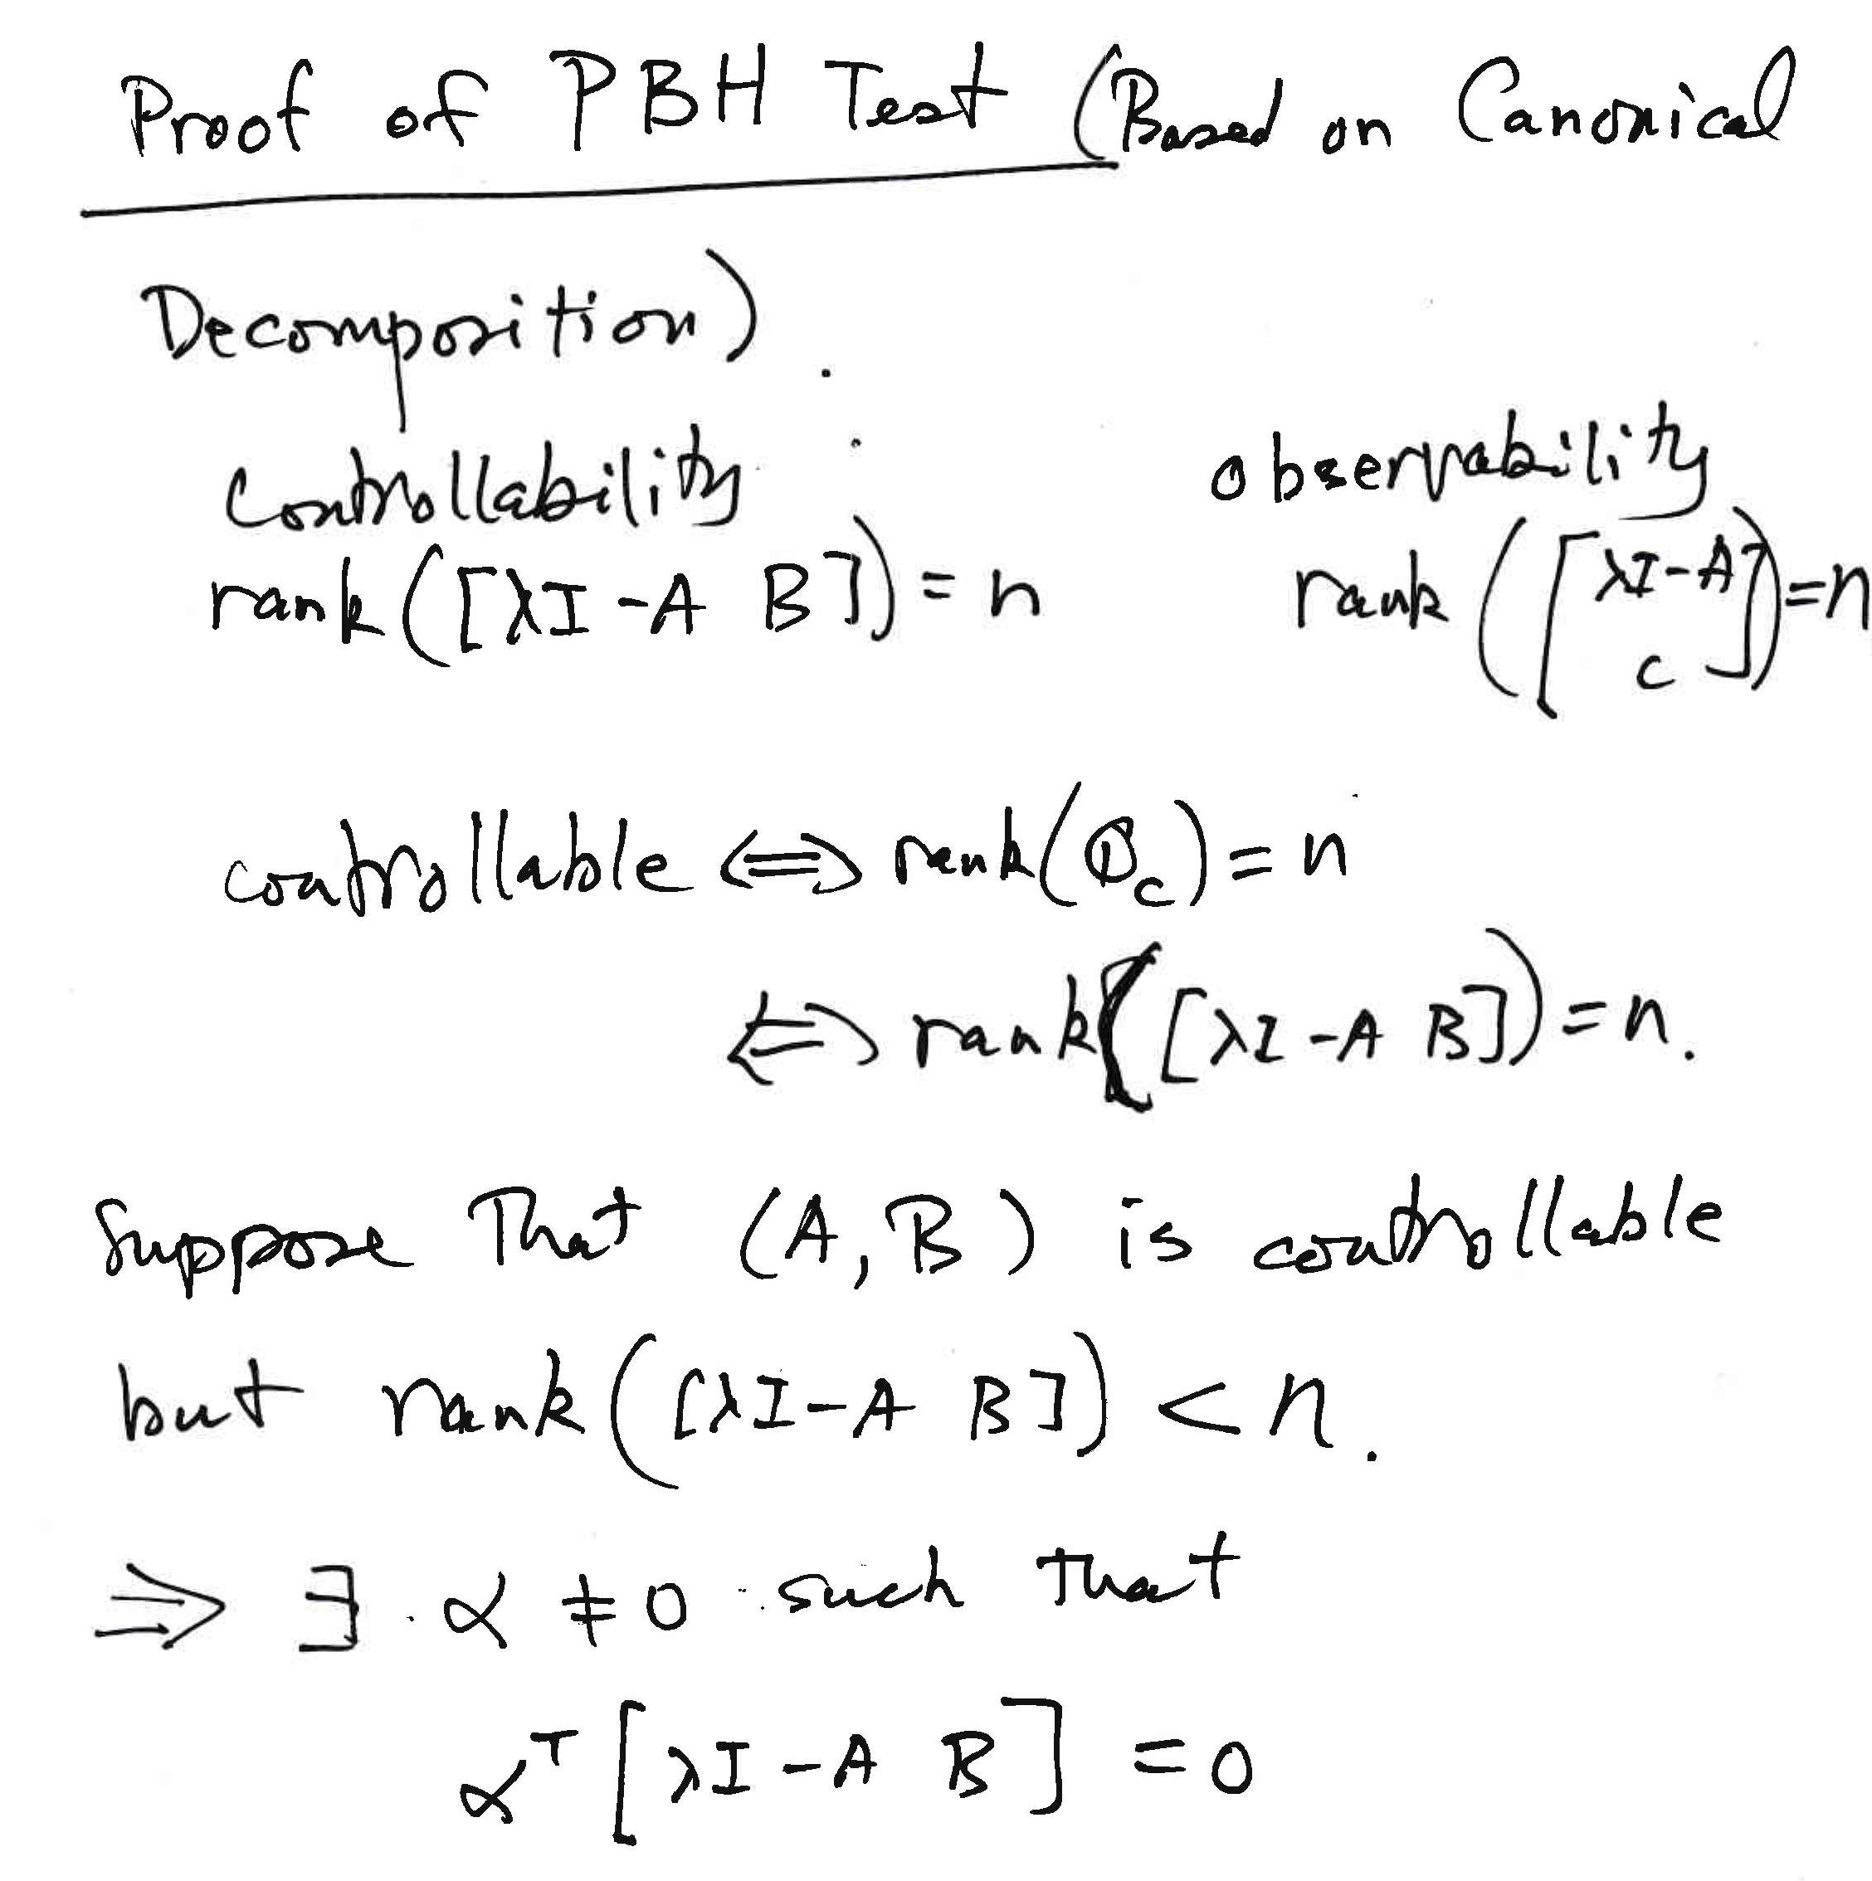

Slide 6
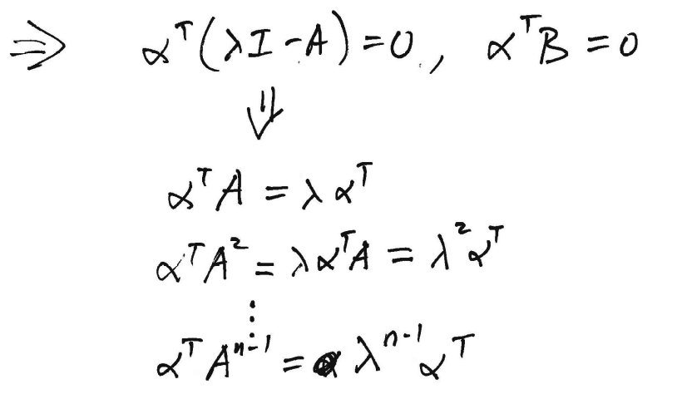
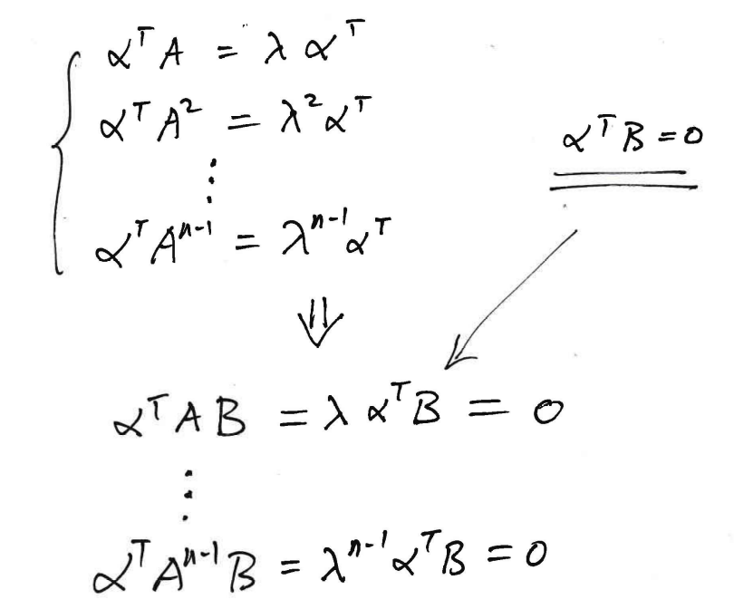
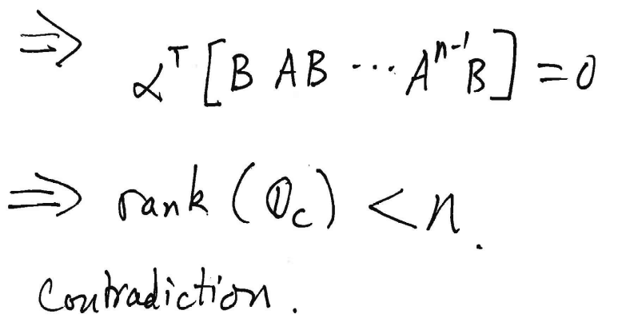

Slide 7
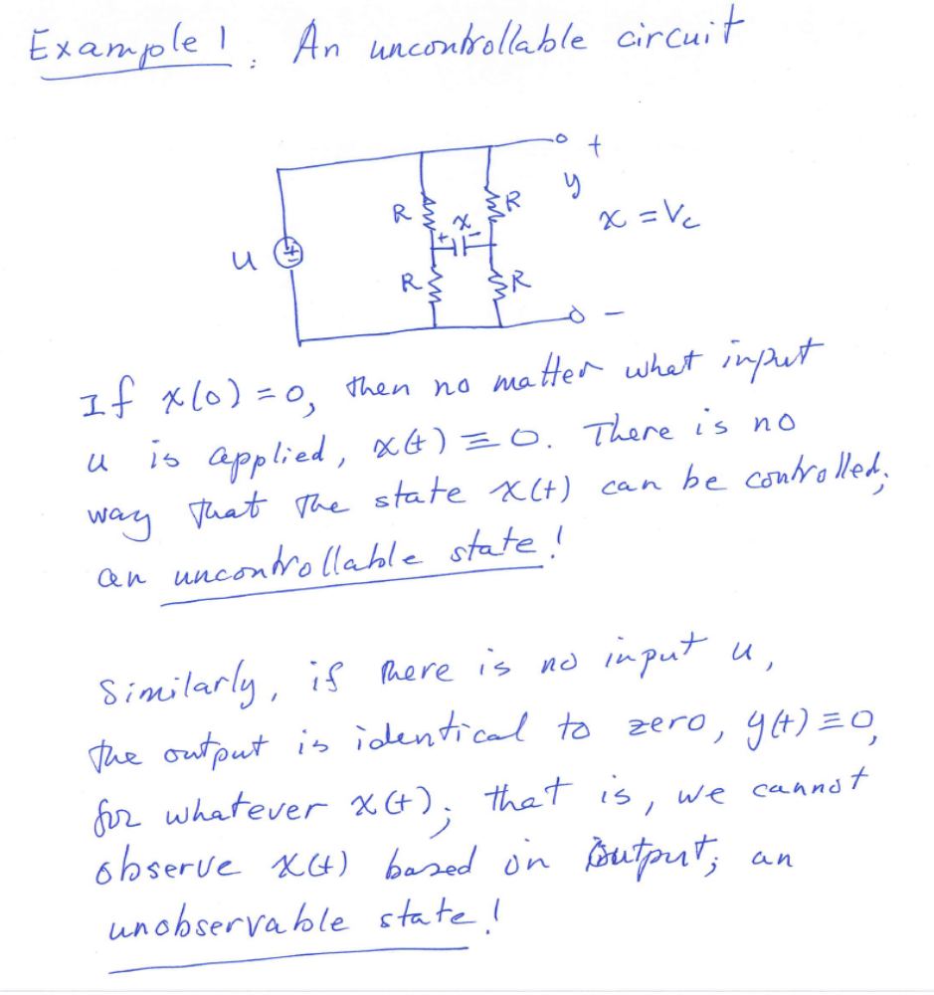
Example of Uncontrollable/Unobservable Circuits

Slide 8
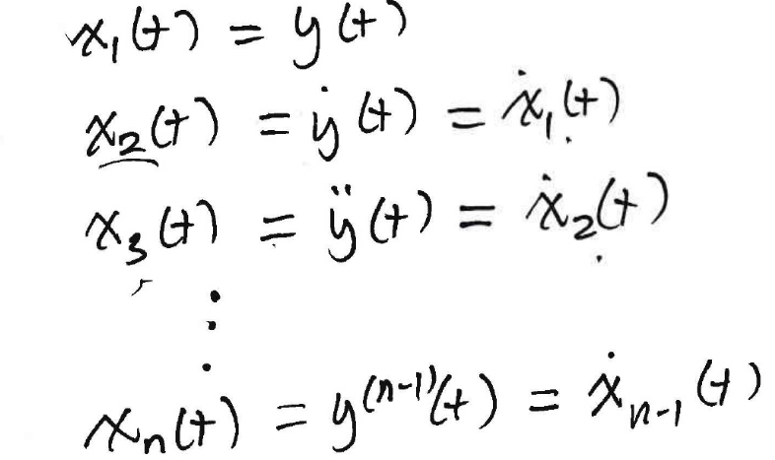
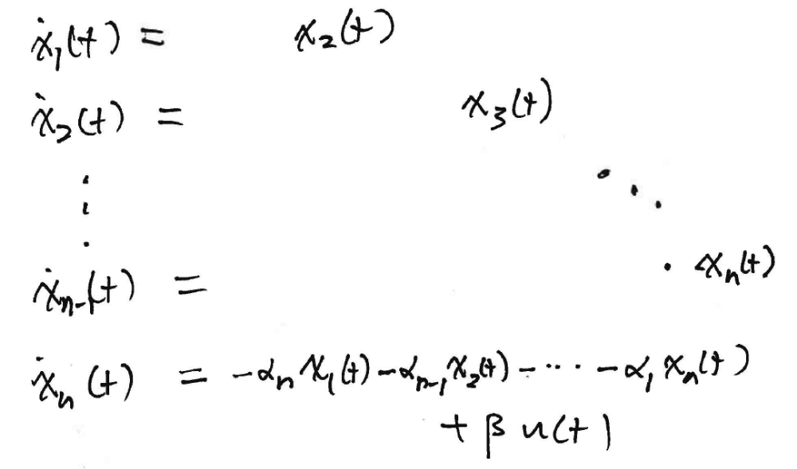
Controllable Canonical Form

Slide 9
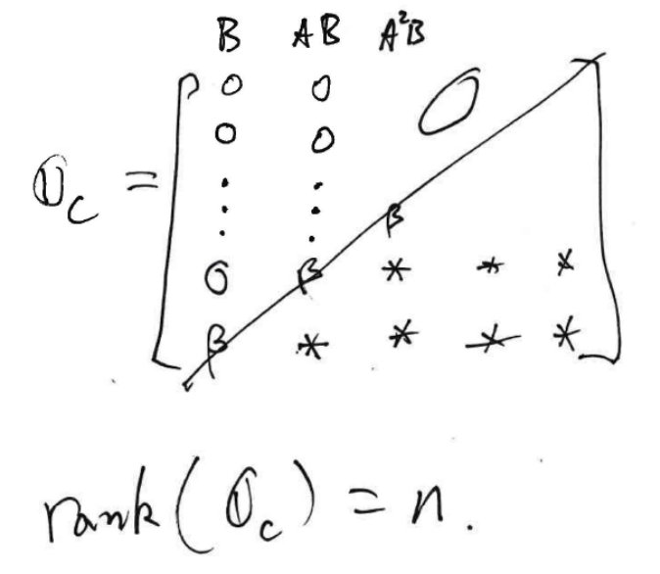

Slide 10
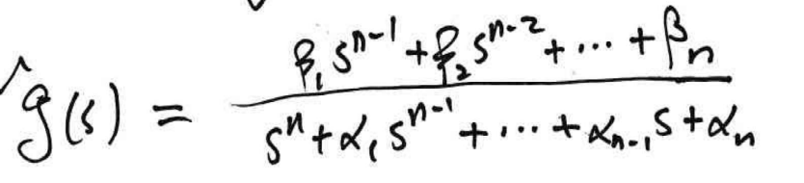
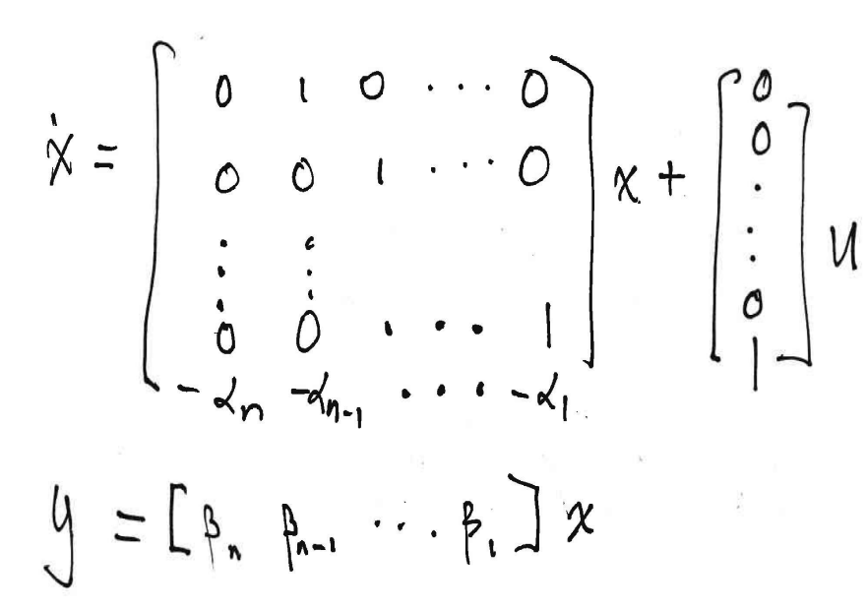

Slide 11
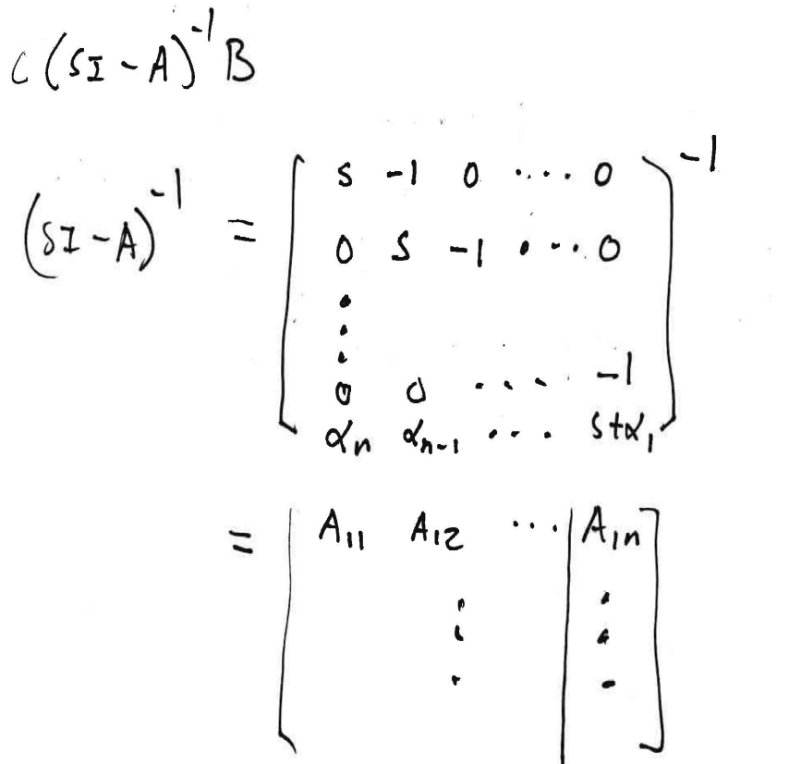
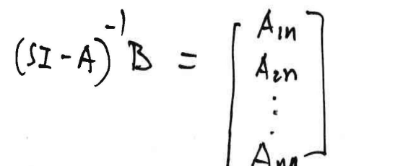

Slide 12
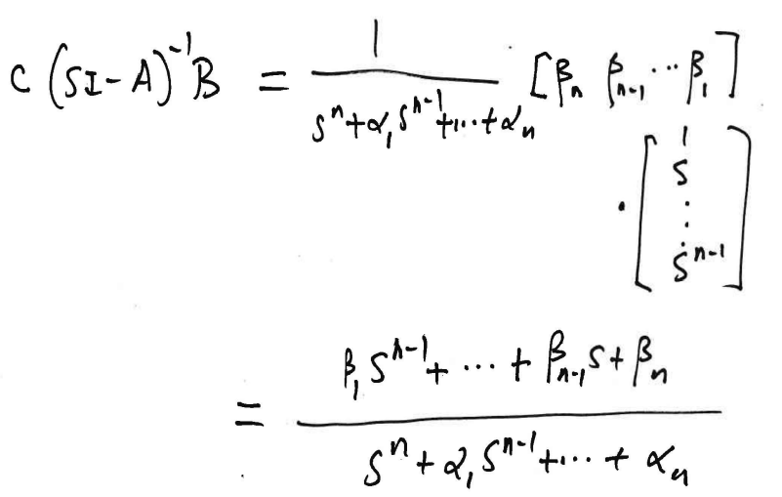

Slide 15
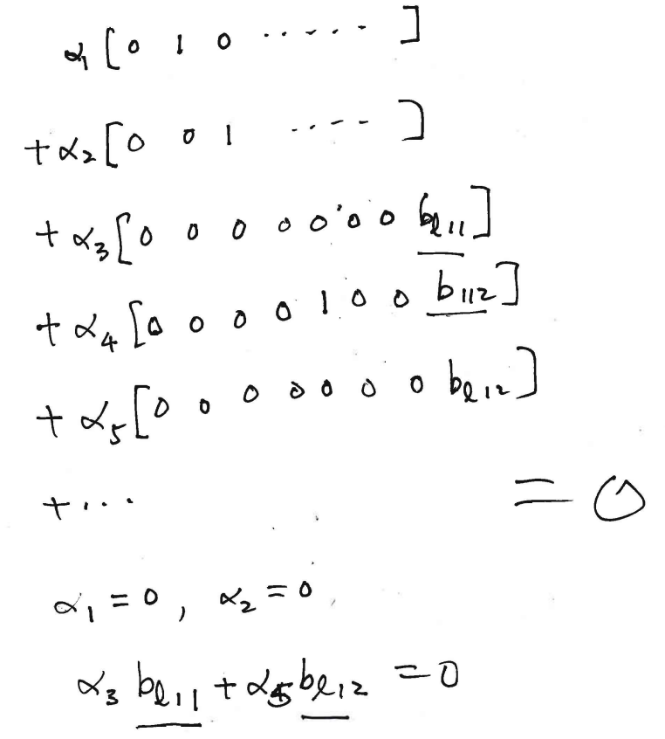

Slide 16
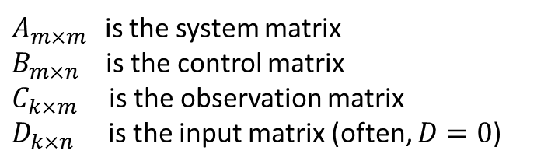
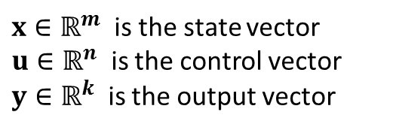
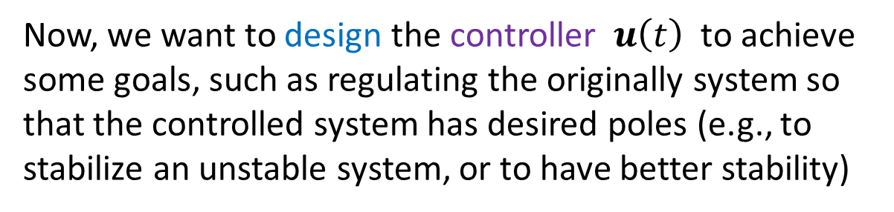


LTI State-Space Systems
$$\dot{x}=Ax+Bu$$
$$y=Cx+Du$$
$x∈ℝ^{m}$ is the state vector
$u∈ℝ^{n}$ is the control vector
$y∈ℝ^{k}$ is the output vector
$A_{m×m }$ is the system matrix
$B_{m×n}$ is the control matrix
$C_{k×m }$ is the observation matrix
$D_{k×n}$ is the input matrix (often, $D=0$)
Now, we want to design the controller $u\left(t\right)$ to achieve some goals, such as regulating the originally system so that the controlled system has desired poles (e.g., to stabilize an unstable system, or to have better stability)
Note:
Only SISO systems are studied, but MIMO systems can be similarly handled

Slide 17

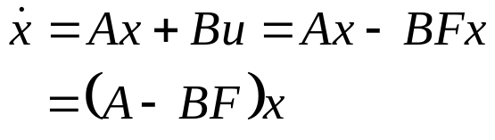
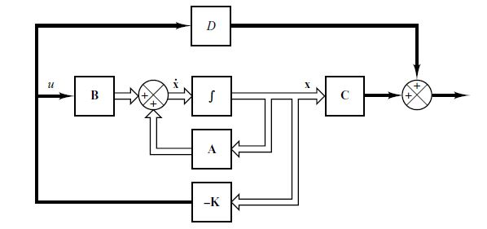


Regulation via State Feedback
Plant:
y = Cx +Du
State-Feedback Controller:
$$u=−Kx$$
Closed-Loop System:
$$=\left(A−BK\right)x$$
y

Slide 18
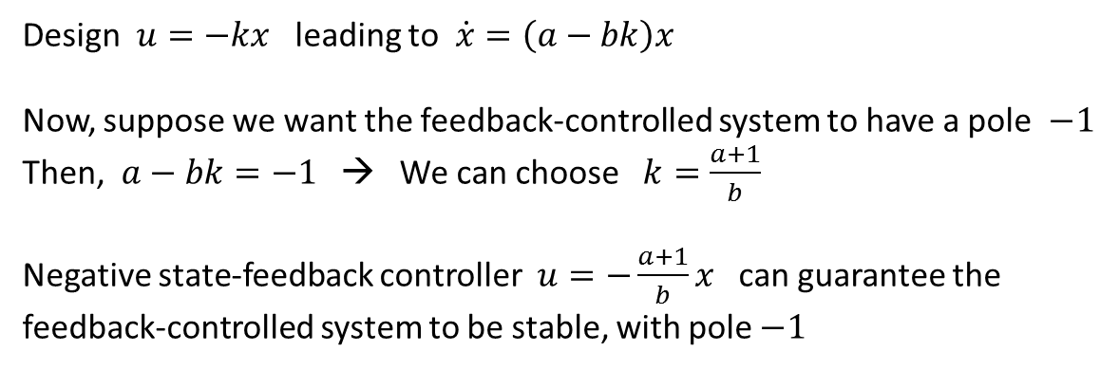


y = Cx +Du
$$u=−Kx$$
$$\dot{x}=\left(A−BK\right)x$$
Idea:
$\dot{x}=ax+bu$ with $a>0$, hence the uncontrolled system is unstable
Design $u=−kx$ leading to $\dot{x}=\left(a−bk\right)x$
Now, suppose we want the feedback-controlled system to have a pole $−1$
Then, $a−bk=−1$ → We can choose $k=\frac{a+1}{b}$
Negative state-feedback controller $u=−\frac{a+1}{b}x$ can guarantee the feedback-controlled system to be stable, with pole $−1$

Slide 19

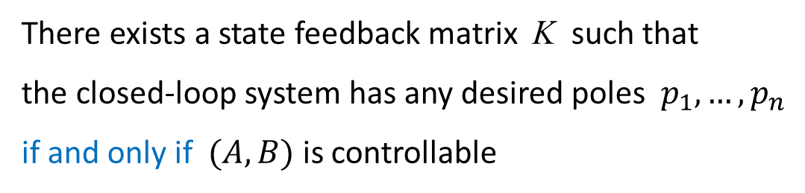

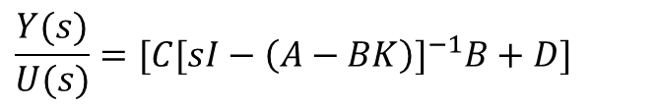

y = Cx +Du
$$u=−Kx$$
$$\dot{x}=\left(A−BK\right)x$$
$$X\left(s\right)={[sI−\left(A−BK\right)]}^{−1}x_{0}$$
(non-zero initial condition)
$$\frac{Y(s)}{U(s)}=[C[sI−{\left(A−BK\right)]}^{−1}B+D]$$
(zero initial condition)
Theorem:
There exists a state feedback matrix K such that
the closed-loop system has any desired poles $p_{1},…,p_{n}$
if and only if $(A,B)$ is controllable

Slide 20
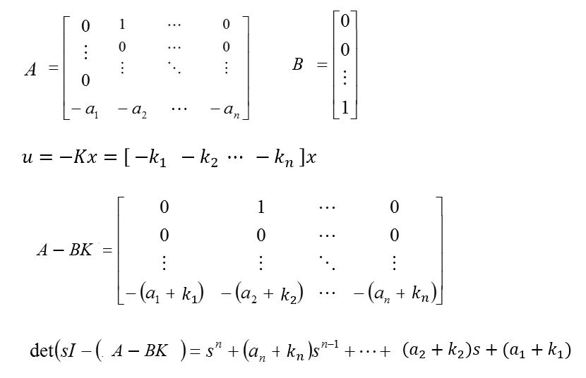
Recall: State-Space Canonical Form
(Denominator of the transfer matrix)

Slide 21
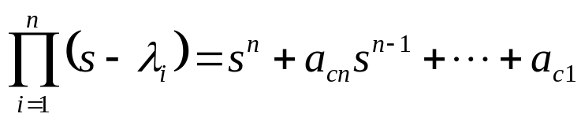
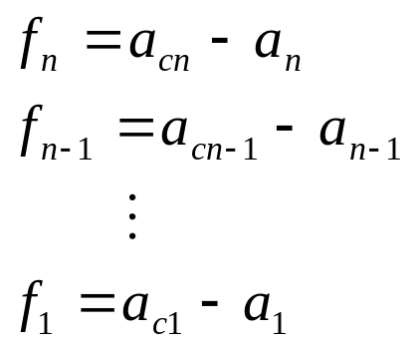





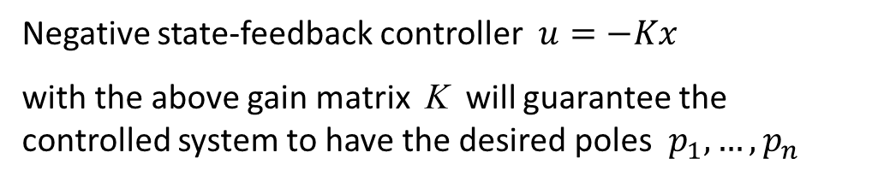
Suppose the desired characteristic polynomial is
$$p_{i}$$
(poles: $p_{1},…,p_{n}$ )
Comparing the coefficients of the above two formulas gives
$$k_{n}$$
$$k_{n−1}$$
$$k_{1}$$
K
Negative state-feedback controller $u=−Kx$
with the above gain matrix K will guarantee the controlled system to have the desired poles $p_{1},…,p_{n}$

Slide 22
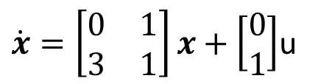
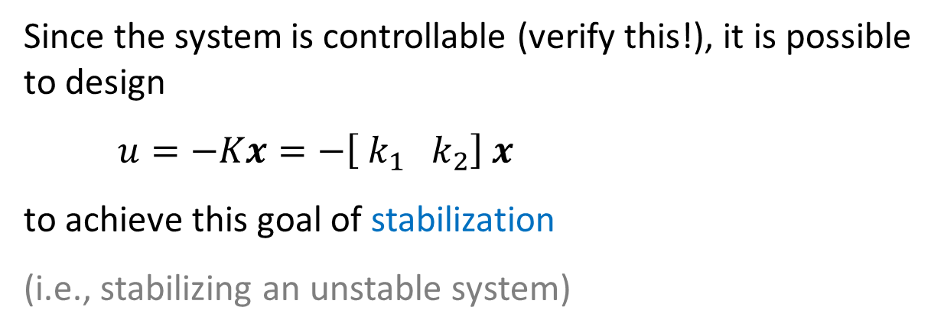


Example: (To stabilize an unstable system)
$\dot{x}=\left[\begin{matrix}0 & 1 \\ 3 & 1\end{matrix}\right]x+\left[\begin{matrix}0 \\ 1\end{matrix}\right]$u
Poles: $\frac{1}{2}±\frac{\sqrt{13} }{2}$ → unstable
We want the feedback-controlled system to have poles:
$$−1 ± j2$$
Since the system is controllable (verify this!), it is possible to design
$u=−Kx=−\left[{ k}_{1} { k}_{2}\right] x$
to achieve this goal of stabilization
(i.e., stabilizing an unstable system)

Slide 23


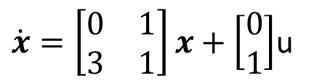


$\dot{x}=\left[\begin{matrix}0 & 1 \\ 3 & 1\end{matrix}\right]x+\left[\begin{matrix}0 \\ 1\end{matrix}\right]$u
We want the feedback-controlled system to have poles:
$$p_{1,2}=−1 ± j2$$
Formulas:
$$Π_{i=1}^{2} \left(s−p_{i}\right)=\left(s−(−1+j2)\right)\left(s−(−1−j2)\right)=s^{2}+2s+5$$
Comparing coefficients → $k_{2}−1=2$ and $k_{1}−3=5$
$K=\left[k_{1} k_{2}\right]=[$ 8 3 ]
$$\dot{x}=\left(A−BK\right)x$$
with desired poles:
$$−1 ± j2$$

Slide 24
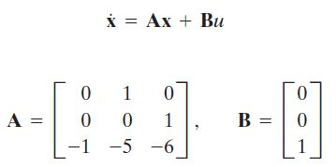
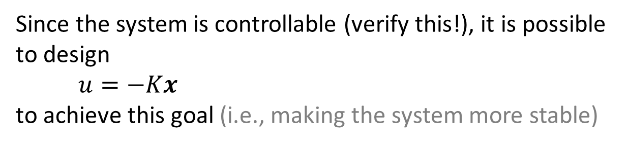
Example: (to achieve better stability)
with
Although this system is stable (verify this!), we want the feedback-controlled system to have “more stable” poles:
$p_{1}=−2+j4, p_{2}=−2−j4, p_{3}=−10$
Since the system is controllable (verify this!), it is possible to design
$u=−Kx$
to achieve this goal (i.e., making the system more stable)

Slide 25
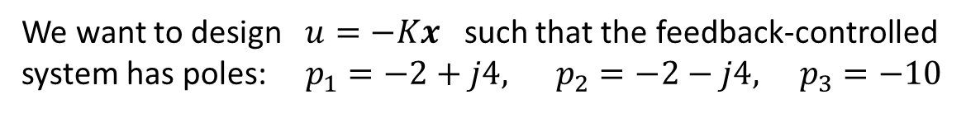

with
We want to design $u=−Kx$ such that the feedback-controlled system has poles: $p_{1}=−2+j4, p_{2}=−2−j4, p_{3}=−10$
Formulas:
$$\det\left(sI−\left(A−BK\right)\right)=s^{3}+\left(6+k_{3}\right)s^{2}+\left(5+k_{2}\right)s+(1+k_{1})$$
$$Π_{i=1}^{3} \left(s−p_{i}\right)=s^{3}+14s^{2}+60s+200$$
Comparing coefficients →
$$K=\left[a_{c1}−a_{1} a_{c2} −a_{2} a_{c3}−a_{3}\right]=[199 55 8]$$
$$\dot{x}=\left(A−BK\right)x$$
with desired poles:
$$p_{1}=−2+j4, p_{2}=−2−j4, p_{3}=−10$$

Slide 26
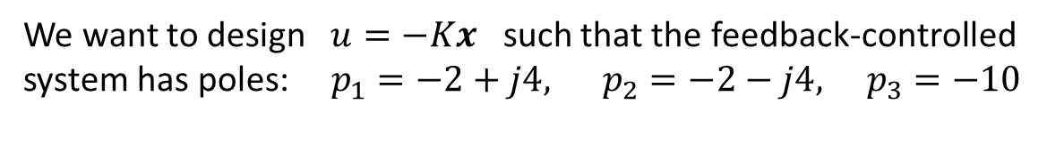
with
We want to design $u=−Kx$ such that the feedback-controlled system has poles: $p_{1}=−2+j4, p_{2}=−2−j4, p_{3}=−10$
%MatLab code
A = [0 1 0; 0 0 1; -1 -5 -6];
B = [0; 0; 1];
J = [-2+j*4 -2-j*4 -10];
K = acker(A,B,J) %Or: K = place(A,B,J)
%Result: row vector
K =
199 55 8

Slide 27













Summary: SISO LTI systems
D = 0
Suppose that the system is controllable:
State-feedback controller:
$$u=−Kx$$
Closed-loop system:
$$\dot{x}=\left(A−BK\right)x$$
Characteristic polynomial:
$$p\left(s\right)=det⁡(sI−\left(A−BK\right))$$
Desired poles:
$$p_{1},…,p_{n}$$
Desired characteristic polynomial:
$$\left(s−p_{1}\right)⋯(s−p_{n})$$
→ Choose gain matrix $K$ such that
$$det⁡(sI−(A−BK))=$$
$$\left(s−p_{1}\right)⋯(s−p_{n})$$

Slide 28
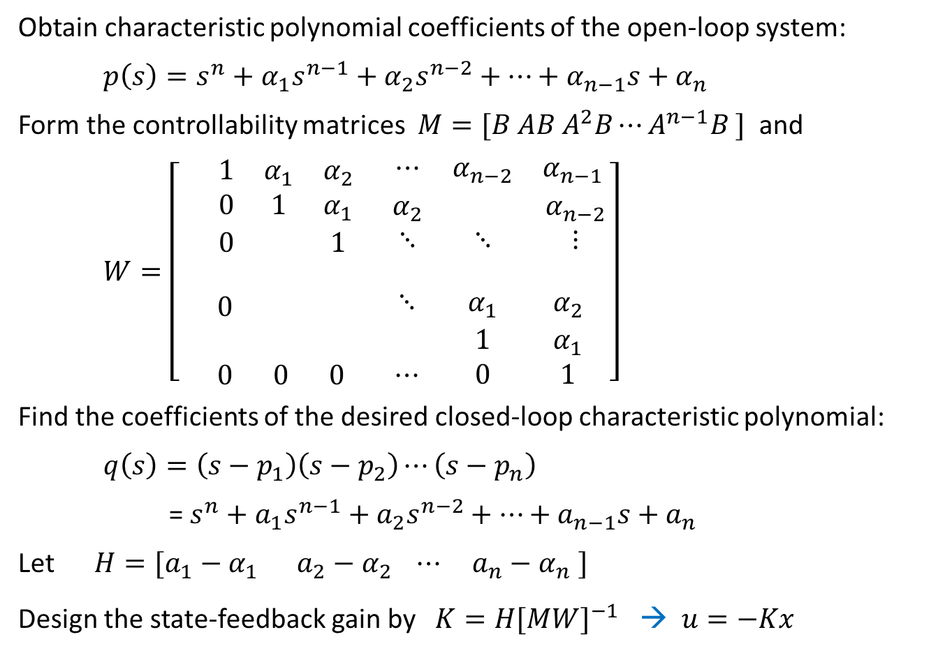
Design Procedure for General Case (non-canonical forms)
Obtain characteristic polynomial coefficients of the open-loop system:
$p\left(s\right)=s^{n}+α_{1}s^{n−1}+α_{2}s^{n−2}+⋯+α_{n−1}s+α_{n}$
Form the controllability matrices $M=[B AB A^{2}B⋯A^{n−1}B ]$ and
$W=\left[ \begin{aligned}\begin{matrix} 1 & α_{1} & α_{2} \\ 0 & 1 & α_{1} \\ 0 & & 1\end{matrix} \begin{matrix}⋯ & α_{n−2} & α_{n−1} \\ α_{2} & & α_{n−2} \\ ⋱ & ⋱ & ⋮\end{matrix} \\ \\ \begin{matrix}0 & & \\ & & \\ 0 & 0 & 0\end{matrix} \begin{matrix} ⋱ & { α}_{1} & { α}_{2} \\ & 1 & α_{1} \\ ⋯ & 0 & 1\end{matrix}\end{aligned}\right]$
Find the coefficients of the desired closed-loop characteristic polynomial:
$q\left(s\right)=\left(s−p_{1}\right)\left(s−p_{2}\right)⋯\left(s−p_{n}\right)$
= $s^{n}+a_{1}s^{n−1}+a_{2}s^{n−2}+⋯+a_{n−1}s+a_{n}$
Let $H=[a_{1}−α_{1} a_{2}−α_{2} ⋯ a_{n}−α_{n} ]$
Design the state-feedback gain by $K=H[{MW]}^{−1}$ → $u=−Kx$

Slide 29


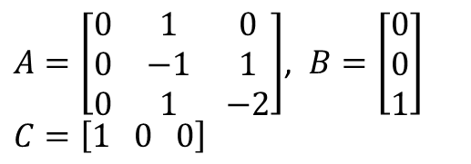
State-Space Feedback Controller Design
To meet time-domain specifications
Given a state-space system in canonical form:
$A=\left[\begin{matrix}0 & 1 & 0 \\ 0 & −1 & 1 \\ 0 & 1 & −2\end{matrix}\right]$, $B=\left[\begin{matrix}0 \\ 0 \\ 1\end{matrix}\right]$
$$C=\left[1 0 0\right]$$
Design a state-feedback controller:
$$u=−Kx$$
such that the closed-loop system:
$$\dot{x}=\left(A−BK\right)x$$
satisfies:
2% settling time < 0.5s
Overshoot of step response < 10%
Steady-state error → 0

Slide 30
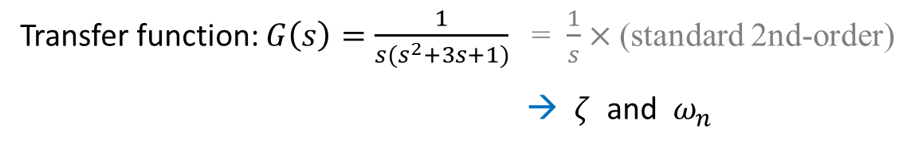
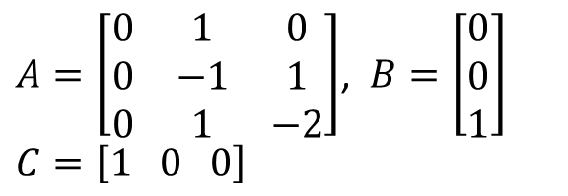
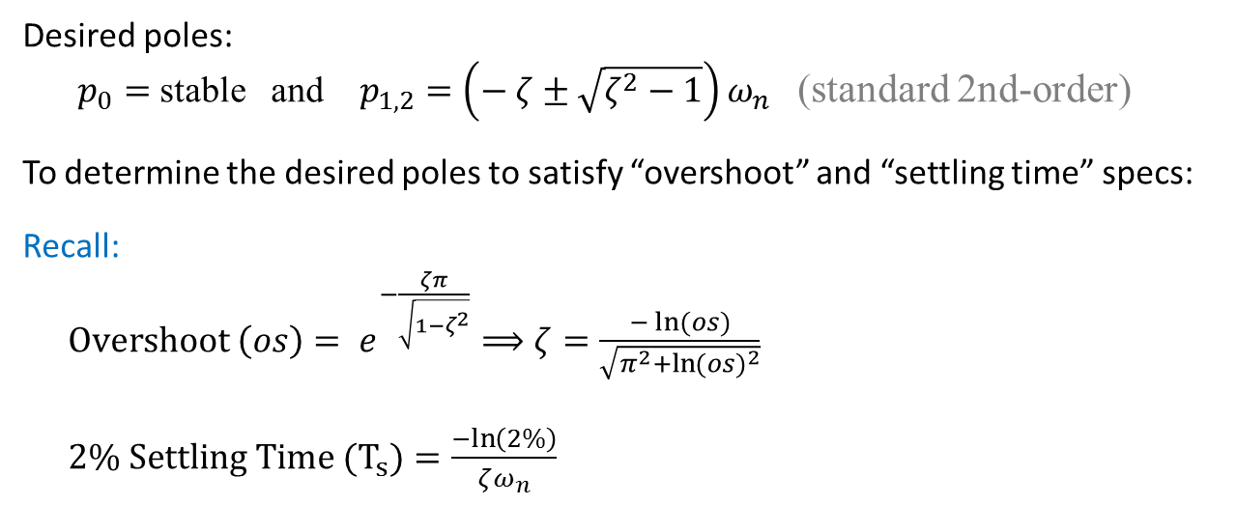
$A=\left[\begin{matrix}0 & 1 & 0 \\ 0 & −1 & 1 \\ 0 & 1 & −2\end{matrix}\right]$, $B=\left[\begin{matrix}0 \\ 0 \\ 1\end{matrix}\right]$
$$C=\left[1 0 0\right]$$
(Use non-canonical form formulation)
Transfer function: $G\left(s\right)=\frac{1}{{s(s}^{2}+3s+1)}$ = $\frac{1}{s}×$(standard 2nd-order)
→ $ζ$ and $ω_{n}$
Minimal realization: Yes (both controllable and observable)
Desired poles:
$p_{0}=$ stable and $p_{1,2}=\left(− ζ±\sqrt{ζ^{2}−1}\right)ω_{n}$ (standard 2nd-order)
To determine the desired poles to satisfy “overshoot” and “settling time” specs:
Recall:
$Overshoot \left(os\right)= e^{−\frac{ζπ}{\sqrt{1−ζ^{2}}}}⟹ζ=\frac{−\ln{(os)}}{\sqrt{π^{2}+\ln{{(os)}^{2}}}}$
$2\% Settling Time (T_{s})=\frac{−ln\left(2\%\right)}{ζω_{n}}$

Slide 31
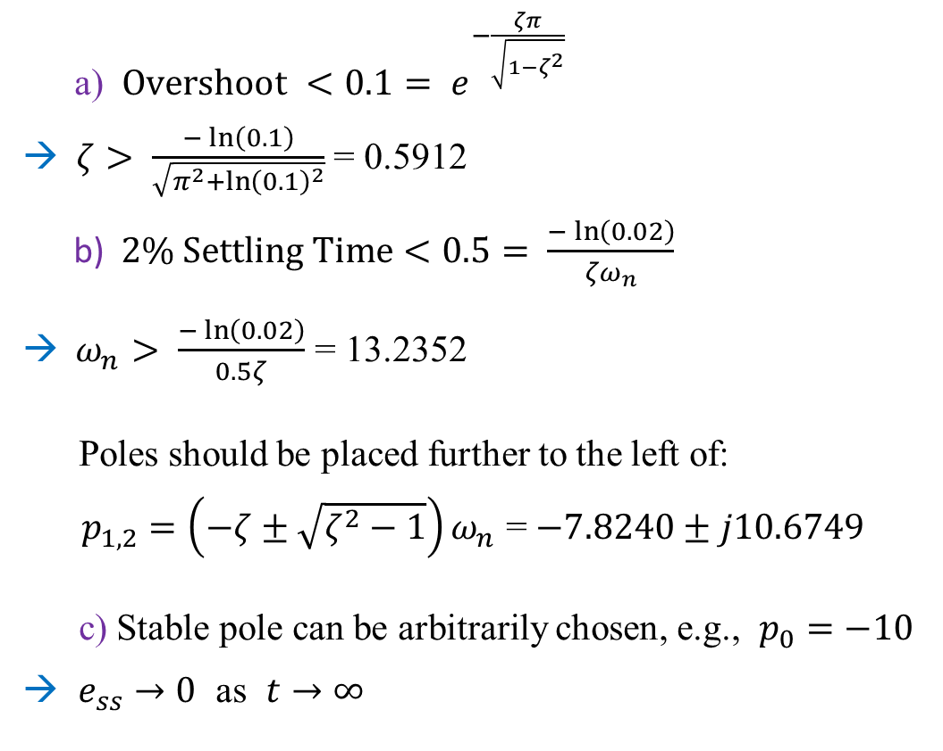
Specs:
2% settling time < 0.5s
Overshoot of step response < 10%
Steady-state error → 0
a) $Overshoot <0.1= e^{−\frac{ζπ}{\sqrt{1−ζ^{2}}}}$
→ $ζ> \frac{−\ln\left(0.1\right)}{\sqrt{π^{2}+{\ln\left(0.1\right)}^{2}}}$ = 0.5912
b) $2\% Settling Time<0.5= \frac{−\ln\left(0.02\right)}{{ζω}_{n}}$
→ $ω_{n}> \frac{−\ln\left(0.02\right)}{0.5ζ}$ = 13.2352
Poles should be placed further to the left of:
$p_{1,2}=\left(−ζ±\sqrt{ζ^{2}−1}\right)ω_{n}$ = $−7.8240±j10.6749$
c) Stable pole can be arbitrarily chosen, e.g., $p_{0}=−10$
→ $e_{ss}→0$ as $t→∞$

Slide 32
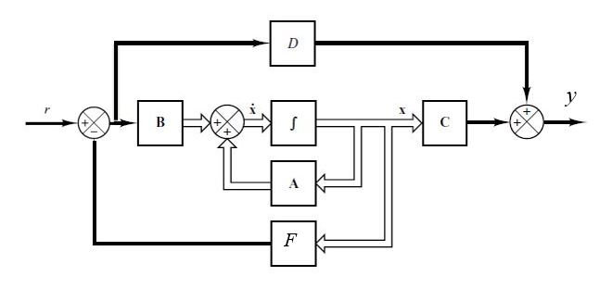


Servo System via State Feedback
Plant:
y = Cx +Du
Goal: Also track a reference input:
$$y\left(∞\right)=r$$
State-Feedback Controller:
$$u=−Kx+r$$
Closed-Loop System:
$$\dot{x}=Ax+Bu=\left(A−BK\right)x+Br$$
K

Slide 33





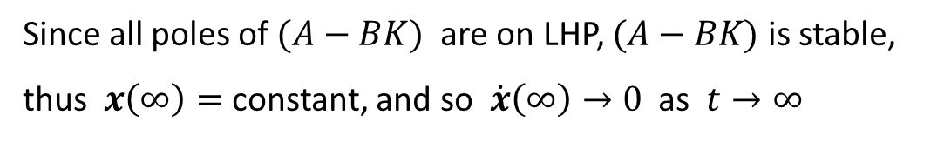


$$u(t)=−Kx(t)+r$$
$$\dot{x}(t)=Ax(t)+Bu(t)=\left(A−BK\right)x(t)+Br$$
In steady state (since $r$ is constant):
$$\dot{x}(∞)=\left(A−BK\right)x(∞)+Br$$
Since all poles of $(A−BK)$ are on LHP, $(A−BK)$ is stable,
thus $x\left(∞\right)=$ constant, and so $\dot{x}\left(∞\right)→0$ as $t→∞$
$$0=\left(A−BK\right)x(∞)+Br$$
$$x\left(∞\right)={−\left(A−BK\right)}^{−1}Br$$
$$u(t)=−Kx(t)+r$$
$$u\left(∞\right)=−Kx\left(∞\right)+r=\left[ K{\left(A−BK\right)}^{−1}B+1 \right] r$$

Slide 34


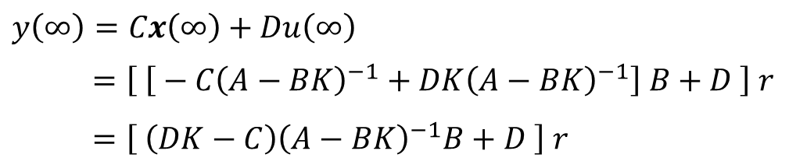


$$\dot{x}(t)=Ax(t)+Bu(t)=\left(A−BK\right)x(t)+Br$$
In steady state:
$$x\left(∞\right)={−\left(A−BK\right)}^{−1}Br$$
$$u\left(∞\right)=−Kx\left(∞\right)+r=\left[ K{\left(A−BK\right)}^{−1}B+1 \right] r$$
$$y=Cx+Du$$
$$y\left(∞\right)=Cx\left(∞\right)+Du\left(∞\right)$$
$=\left[ \left[ − C{\left(A−BK\right)}^{−1}+DK{\left(A−BK\right)}^{−1}\right] B+D \right] r$
$=\left[ \left(DK−C\right){\left(A−BK\right)}^{−1}B+D \right] r$
Goal: $y\left(∞\right)=r$
$\left[ \left(DK−C\right){\left(A−BK\right)}^{−1}B+D \right]=$ 1

Slide 35


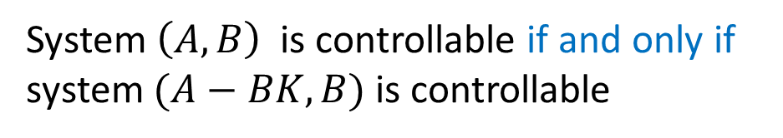
Invariance of Controllability
$$u=−Kx$$
$$\dot{x}=\left(A−BK\right)x$$
Theorem:
System $\left(A, B\right)$ is controllable if and only if
system $(A−BK, B)$ is controllable
This is the invariance property of LTI systems under state-feedback control
Note: Observability does not have such invariance

Slide 37

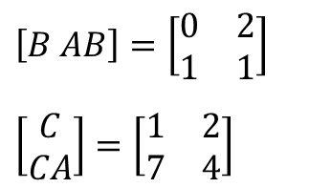
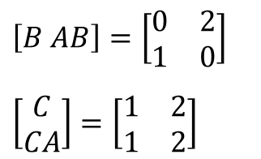


Example:
$\dot{x}=\left[\begin{matrix}1 & 2 \\ 3 & 1\end{matrix}\right]x+\left[\begin{matrix}0 \\ 1\end{matrix}\right]$u
$$y=\left[1 2\right]x$$
$$\left[B AB\right]=\left[\begin{matrix}0 & 2 \\ 1 & 1\end{matrix}\right]$$
$$\left[\begin{matrix}C \\ CA\end{matrix}\right]=\left[\begin{matrix}1 & 2 \\ 7 & 4\end{matrix}\right]$$
controllable and observable
Design:
$$u=− \left[3 1\right] x$$
$\dot{x}=\left[\begin{matrix}1 & 2 \\ 0 & 0\end{matrix}\right]x+\left[\begin{matrix}0 \\ 1\end{matrix}\right]$u
$$y=\left[1 2\right]x$$
$$\left[B AB\right]=\left[\begin{matrix}0 & 2 \\ 1 & 0\end{matrix}\right]$$
$$\left[\begin{matrix}C \\ CA\end{matrix}\right]=\left[\begin{matrix}1 & 2 \\ 1 & 2\end{matrix}\right]$$
. controllable but not observable
(controllability is invariant)
(observability is not invariant)

Slide 38


Output-Feedback Observer Design
State-feedback controller:
$$u=−Kx+r$$
In practice, information of the (higher-dimensional) state vector $x$ is usually not available or very expensive to obtain
Since the (lower-dimensional) system output is $y$ , which is available, especially if the system is observable, can we design the feedback controller $u$ using $y$ instead of $x$ ?
→ Output-feedback controller

Slide 39


If the system is observable, then the state information can be well estimated by using an observer
An observer is a dynamic sub-system that estimates the system states by using the measurements of the system (single-)inputs and (single-)outputs: $\left(u, y\right)$
Note: MIMO systems can be similarly studied
K

Slide 40











Designing an Output-Feedback Observer
B
C
A
+
L
B
C
A
Observer
Determine the observer gain L satisfying $\dot{\hat{x}}=Ly+⋯$, such that $\hat{x}−x→0$ as $t→∞$ (thus: $u=−K\hat{x}+r$)

Slide 41





Observer Design
Plant:
Define:
is the observer state
L: Observer gain
Estimation error:
Error system:
.

Slide 42






Error system: $\dot{e}=\left(A−LC\right)e$
If all eigenvalues of $(A−LC)$ are in LHP,
then the error system is stable
→
Duality between controllability and observability →
Theorem:
There exists an observer gain L such that
$$\det\left(sI−\left(A−LC\right)\right)=\left(s−p_{1}\right)\left(s−p_{2}\right)⋯(s−p_{n})$$
for any desirable poles $p_{i}$ , $i=1,2,…,n$, if and only if $(A,C)$ is observable.
Given poles $p_{1},⋯,p_{n}$ → $L$ can be found

Slide 43







Example:
with Suppose:
This system is observable (verify this!) → Design an observer:
Desired poles: $p_{1}=−0.25, p_{2}=−0.5$
$\det\left(sI−\left(A−LC\right)\right)=\left(s−p_{1}\right)\left(s−p_{2}\right)⋯(s−p_{n})$ →

Slide 44





Simulation Results
$$x$$
$$\dot{x}$$

Slide 45



Separation Principle
Plant:
State-feedback controller using estimated state: $u=−K\hat{x}$
State-space system:
$$\dot{x}=Ax+Bu=Ax−BK\hat{x}=\left(A−BK\right)x+BKe$$
$$e=x−\hat{x}$$
Observer:
$$\dot{\hat{x}}=A\hat{x}+Bu+L\left(y−C\hat{x}\right)=\left(A−BK−LC\right)\hat{x}+Ly$$
Error system:
e

Slide 46



Putting together →
$$\left[\begin{matrix}\dot{x} \\ \dot{e}\end{matrix}\right]=\left[\begin{matrix}A−BK & BK \\ 0 & A−LC\end{matrix}\right]\left[\begin{matrix}x \\ e\end{matrix}\right]:=\tilde{A} \left[\begin{matrix}x \\ e\end{matrix}\right]$$
Poles:
$$\left| sI−\tilde{A} \right|=\left|\left[\begin{matrix}sI−(A−BK) & −BK \\ 0 & sI−(A−LC)\end{matrix}\right]\right|$$
$=\left| sI−\left(A−BK\right) \right|×| sI−\left(A−LC\right) |$
→ Poles of the overall system
= {Poles of $(A−BK)$} $\bigcup{ \text{\{}\text{Poles} \text{of} (A−LC)\text{\} }}$
→ Designing state-feedback controller gain and
output-feedback observer gain can be done separately

Slide 47



Closed Loop Transfer Function

Slide 48

(for design purpose)

Slide 49


Example:
We want to the observer to have poles $−4, −3$
It can be verified that the system is observable, so this can be done
Let the observer gain be $L=\left[\begin{matrix}L_{1} \\ L_{2}\end{matrix}\right]$
→ $A−LC=\left[\begin{matrix}−1 & 0 \\ 1 & −1\end{matrix}\right]−\left[\begin{matrix}L_{1} \\ L_{2}\end{matrix}\right]\left[\begin{matrix}0 & \frac{1}{2}\end{matrix}\right]=\left[\begin{matrix}−1 & −\frac{L_{1}}{2} \\ 1 & −1−\frac{L_{1}}{2}\end{matrix}\right]$
→ $\det\left(sI−\left(A−LC\right)\right)=s^{2}+\left(2+\frac{L_{2}}{2}\right)s+\left(1+\frac{L_{1}+L_{2}}{2}\right)$
Desired poles → $(s+4)(s+3)=s^{2}+7s+12$
Comparing coefficients → $L_{1}=12, L_{2}=10$
%MatLab code
A=[-1 0; 1 -1];
C=[0 0.5];
J=[-4,-3];
L=place(A',C',J)

Slide 50




Optimal Regulator Design
Consider an LTI system:
$$\dot{x}=Ax+Bu$$
with a negative state-feedback controller:
$u=−Kx$
We want to control the system state $x(t)$ from an initial state $x(0)$ at $t=0$ to a target state, say $x^{∗}=0$: $x\left(t\right)→0$ as $t→∞$
If this is not possible, then we want to have minimize the tracking error:
$$\min_{t→∞}{ \left| x\left(t\right)−x^{∗}\right|=\min_{t→∞}\left| x\left(t\right)\right|=\min_{t→∞}{ x^{T}\left(t\right)x\left(t\right)}}$$
Meanwhile, we want to minimize the control energy:
$$\min_{t→∞}{\int_{0}^{t }{{\left|u\left(τ\right)\right|}^{2}dτ }=\min_{t→∞}{\int_{0}^{t }{u^{T}\left(τ\right)u\left(τ\right)dτ }}}$$

Slide 51


$$\min_{t→∞}{ \left| x\left(t\right)−x^{∗}\right|=\min_{t→∞}\left| x\left(t\right)\right|=\min_{t→∞}{ x^{T}\left(t\right)x\left(t\right)}}$$
$\min_{t→∞}{\int_{0}^{t }{{\left|u\left(τ\right)\right|}^{2}dτ }=\min_{t→∞}{\int_{0}^{t }{u^{T}\left(τ\right)u\left(τ\right)dτ }}}$ with $u(t)=−Kx(t)$
$$\min_{K}{\int_{0}^{∞}{[x^{T}\left(τ\right)Qx\left(τ\right)+u^{T}\left(τ\right)Ru\left(τ\right)]dτ}}$$
Here, $Q≥0$ and $R>0$ are weight matrices
This is Optimal Linear Quadratic Regulation (Optimal LQR Control) problem
%MatLab code → lqr(A,B,Q,R)

Slide 52







$$\dot{x}=Ax+Bu$$
$$u(t)=−Kx(t)$$
$$\min_{K}{\int_{0}^{∞}{[x^{T}\left(τ\right)Qx\left(τ\right)+u^{T}\left(τ\right)Ru\left(τ\right)]dτ}}$$
$\dot{x}=$($A−BK)x$
$$\min_{K}{\int_{0}^{∞}{[x^{T}\left(τ\right)Qx\left(τ\right)+x^{T}\left(τ\right)K^{T}RKx\left(τ\right)]dτ}}$$
$$= \min_{K}{\int_{0}^{∞}{x^{T}\left(τ\right)[Q+K^{T}RK]x\left(τ\right)dτ}}$$
Set
$$x^{T}\left[Q+K^{T}RK\right]x=−\frac{d}{dt}x^{T}Px$$
($P$ is positive definite
and symmetric)

Slide 53







$$\dot{x}=Ax+Bu$$
$$u(t)=−Kx(t)$$
$$x^{T}\left(τ\right)\left[Q+K^{T}RK\right]x\left(τ\right)=−\frac{d}{dt}x^{T}\left(t\right)Px\left(t\right)$$
$x^{T}\left[Q+K^{T}RK\right]x=−\frac{d}{dt}x^{T}Px =−{\dot{x}}^{T}Px−x^{T}P\dot{x}$
$=−x^{T}\left[{\left(A−BK\right)}^{T}P+P\left(A−BK\right)\right]x$
$${\left(A−BK\right)}^{T}P+P\left(A−BK\right)=−(Q+K^{T}RK)$$
→
$$K=R^{−1}B^{T}P$$
where $P$ satisfies
$A^{T}P+PA−PBR^{−1}B^{T}P+Q=0$ (Riccati equation)
→ $u=−Kx={− R}^{−1}B^{T}Px$ (optimal controller) solves
$$\min_{K}{\int_{0}^{∞}{[x^{T}\left(τ\right)Qx\left(τ\right)+u^{T}\left(τ\right)Ru\left(τ\right)]dτ}}$$

Slide 54









Example:
$$\dot{x}=Ax+Bu$$
$$\min_{K}{\int_{0}^{∞}{[x^{T}\left(τ\right)Qx\left(τ\right)+u^{T}\left(τ\right)Ru\left(τ\right)]dτ}}$$
$$u(t)=−Kx(t)$$
$A=\left[\begin{matrix}0 & 1 \\ 0 & 0\end{matrix}\right]$, $B=\left[\begin{matrix}0 \\ 1\end{matrix}\right]$, $Q=\left[\begin{matrix}1 & 0 \\ 0 & μ\end{matrix}\right],$ $R=[1]$
(Riccati equation)
$A^{T}P+PA−PBR^{−1}B^{T}P+Q=0$ $P=\left[\begin{matrix}p_{11} & p_{12} \\ p_{12} & p_{22}\end{matrix}\right]$
$$K=R^{−1}B^{T}P=1⋅\left[0 1\right]⋅P=[1 \sqrt{μ+2}]$$
%MatLab code ($μ=$ number)
K=lqr(A,B,Q,R)

Slide 55

TLQ
Log onto Canvas

Slide 56
END

