Slide 1
GE1202 Managing Your Personal Finance
Lecture 5
Purchasing Homes

Slide 2
HK Property Market
In 1997, many homeowners in Hong Kong had negative equity
  Outstanding value of mortgage > the current value of home
Home foreclosures
  The process whereby lenders attempt to recover loan balances from borrowers who have quit making payments by forcing the sale of the home pledged as collateral

Slide 3
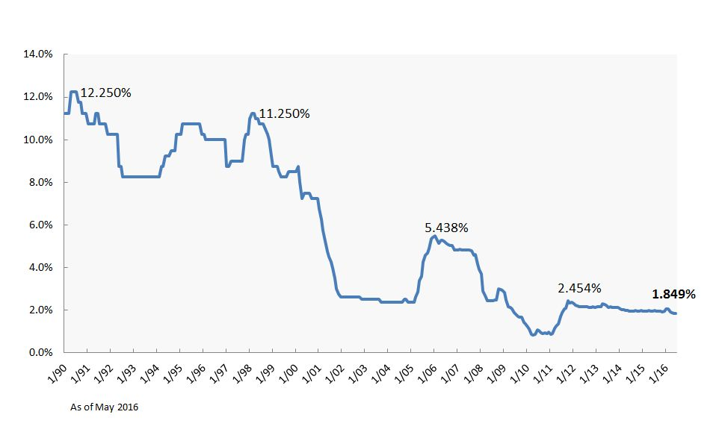
HK Property Market
The property price went down to the bottom in 2003 and rebounded quickly
The long lasting low interest rate environment fuelled the property market, leading to a rocket rise since 2009.
Mortgage rate

Slide 4
Should You Buy Your Home?
Opportunity costs of homeownership
  Closing Costs
  Interest Charged on Mortgage Payments
  Taxes
  Insurance
    Fire insurance
    Homeowner’s insurance
  Maintenance
  Lost of interest on Down Payment and Closing Costs

Slide 5
Closing Costs
Closing costs are all expenses that borrowers ordinarily pay when a mortgage loan is closed and they receive title to the purchased property
  Loan application and loan origination fees paid to the lender
  Mortgage points
  Insurance fees
  Appraisal fees
  Title check
    The research of legal documents and courthouse record to verify the seller conveying title actually has the legal interest he or she claims and that the title is free of all liens and encumbrances
  Attorneys’ fees
  and other miscellaneous fees
    Property agent commission – 1% of the property price

Slide 6
Interest Charged on Mortgage Payments
Most of the people purchase their properties that make use of the mortgage services from the bank
Mortgage loan is secured on the borrower's property
According to the guideline issued by the Hong Kong Monetary Authority, banks have to comply with a 60% loan-to-value (LTV) requirement on owner-occupied residential mortgage lending for properties valued below HK$7 million
  A down payment 40% of the full purchase price

Slide 7
Interest Charged on Mortgage Payments
There are two types of mortgage
Fixed-Rate, Fixed Repayment Mortgage
  Conventional
  Both the rate of interest and the monthly mortgage payment are fixed over the full term of the loan
  20-year, 25-year and 30-year
Adjusted-Rate Mortgage (ARM)
  During the life of the loan the interest rate varies
  Two commonly used ARM in Hong Kong
    Prime-based Mortgage
    HIBOR-based Mortgage

Slide 8
Interest Charged on Mortgage Payments
Prime-based Mortgage
  Prime rate
    A reference interest rate used by banks lending to customers with good credit
  Mortgage rate = Prime rate – spread
    eg: 5.25% - 3.1% = 2.15%
  The interest rate is relatively stable
    Interest rate change when banks adjust the prime rate

Slide 9
Interest Charged on Mortgage Payments
How to find the interest charges on the loan?
Mortgage payment is made up partly of principal repayment on the loan and partly of interest charges on the loan.
Amortization table is an method to identify how much of your repayment is used to repay the principal of the loan
  Amortization is the paying off of debt with a fixed repayment schedule in regular installments over a period of time
Example
  The property worth 3m and applied a 70% mortgage loan with 15 years. Assume prime rate = 5% and does not change in the whole period

Slide 10
Interest Charged on Mortgage Payments
Step 1: Find the monthly payment
L = 3m x 70% = 2.1m
r = 3%/12 = 0.25%
n = 15 x 12 = 180 months
P = $14502.2 per month
$$\text{P}\text{=}\frac{r(L)}{1−{(1+r)}^{−n}}$$

Slide 11
Interest Charged on Mortgage Payments
Step 2: Calculate your interest part for the 1st month
  2.1m x 0.25% = $5250
Step 3: Repayment – interest part for the 1st month = principal repayment for the 1st month
  $14502.2 - $5250 =$9252.2
Step 4: Your beginning outstanding balance – your principal repayment = Your ending outstanding balance.
  $2,100,000 - $9252.2 = $2,090,747,8
Step 5 repeat the step 2-4 for the subsequent month

Slide 12
Interest Charged on Mortgage Payments
Month | Month Beginning balance (A) | Monthly payment (B) | Interest part (C) | Principal repayment (D) | Ending balance
 | Equal to pervious ending balance | Compute with the equation | Equal to (A) X r | Equal to (B) – (C) | Equal to (A) – (D)
1 | 2100000 | 14502.21 | 5250 | 9252.2 | 2090747.79
2 | 2090747.79 | 14502.21 | 5226.87 | 9275.3 | 2081472.45
3 | 2081472.449 | 14502.21 | 5203.68 | 9298.5 | 2072173.92
4 | 2072173.921 | 14502.21 | 5180.43 | 9321.8 | 2062852.15

Slide 13

Interest Charged on Mortgage Payments
Mortgage Insurance Programme (MIP)
  Government financing programme
As long as an application meets the relevant eligibility criteria (e.g. the maximum property value and the maximum loan amount, etc.), the bank can provide a mortgage loan of up to 80% LTV ratio under the MIP
Lower down payment than conventional
  20% down payment

Slide 14
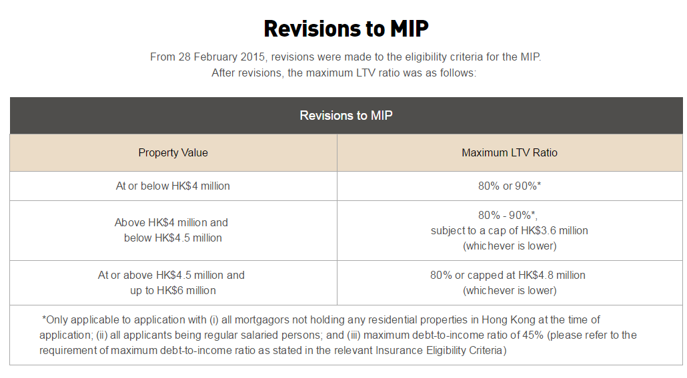
Interest Charged on Mortgage Payments

Slide 15
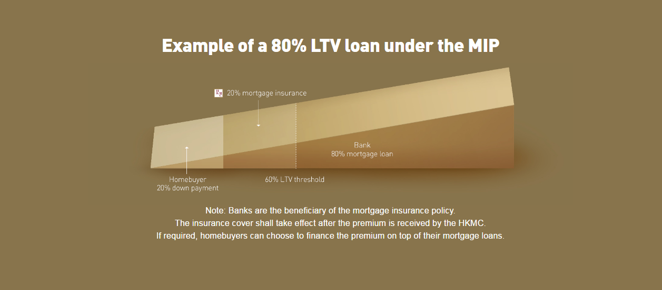
Interest Charged on Mortgage Payments

Slide 16
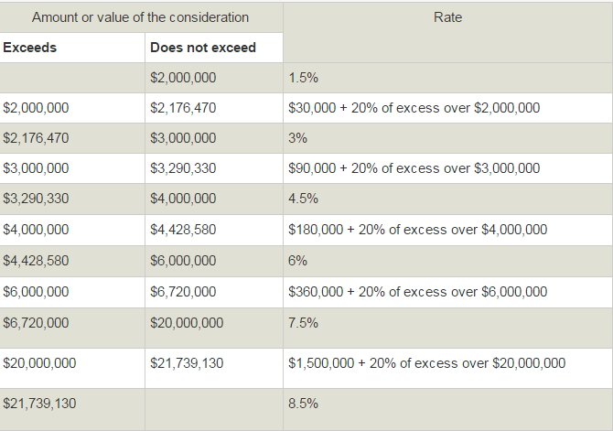
Taxes
With effect from 23 February 2013, unless specifically exempted or otherwise provided, stamp duty on sale or transfer of immovable property in Hong Kong is chargeable with ad valorem stamp duty (AVD) at higher rates

Slide 17
Alternative – Renting
Advantages of renting
  Easier to move
  Fewer maintenance and repair responsibilities
  Lower initial costs
Disadvantages of renting
  No tax benefits
  Limitations regarding remodeling
  Restrictions regarding pets and other activities
  Legal concerns of a lease
  Costs including a security deposit, utilities and renter’s insurance
  Not a permanent residence

Slide 18
The Rental Contract (Lease Agreement)
When you rent an apartment, duplex, house, or any other type of residence, you’ll be required to sign a rental contract or lease agreement
Contract Protects
  Lessor/Landlord = Owner
  Lessee/Tenant = One who leases
Contract Specifies
  Monthly rent and due date
  Penalties for late payment
  Length of lease agreement
  Deposit requirement
  Renewal options
  Amount of security deposit
  The right to sublet the unit

Slide 19
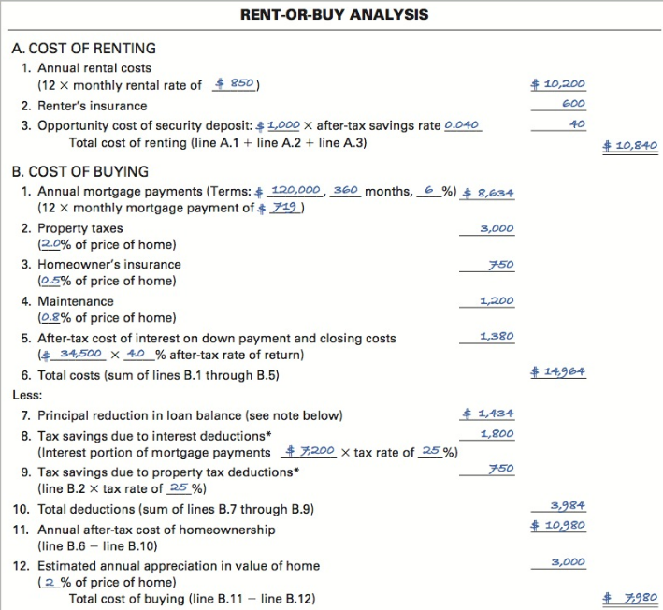
Buy? Rent?
To choose the lowest-cost alternative, compare the cost of renting with the cost of buying
Use different assumptions
  Rent increases
  Mortgage rates
  Home appreciation rates
  The rate of return that you can earn on the funds you could invest
Need to consider non-monetary items

Slide 20
Should You Buy Your Home?
Benefits of Home Ownership
  Financial benefits
    Deduct property taxes and mortgage interest
    Potential increase in value of your home
    Building equity in your home
  Psychological reward
    Pride of ownership, feeling of permanence and sense of stability
  Lifestyle flexibility
    Privacy
    The desire to personalize your home,
  Stability

Slide 21
Home Affordability
How large a monthly mortgage payment can you afford?
Traditional financial guidelines suggest
  Spend no more than 25-33% of take-home pay on housing
Mortgage Calculator
  http://www.gohome.com.hk/mortgage-calculator/en/
Stress Testing
  Banks must assume a mortgage rate increased of 300 basis points (3%) in stress-testing mortgage applicants’ repayment ability

Slide 22
Home Buying Process
Evaluate your homeownership needs
  Be rational when make a decision
    Benefit > Cost
Find a property to purchase
  Selecting a Location
    Be aware of zoning laws
      The regulation of the use of real property by government, restricts particular territory to residential, commercial, industrial, or other uses
    Assess the school system if you have children.
  Using a real estate agent
    They present your offer, negotiate the price, assist you in obtaining financing, and represent you at the closing
  Conduct a home inspection or hire an inspector
  Mortgage company may want an appraisal

Slide 23
Home Buying Process
Pricing the property
  Determine the home price
    Price is affected by whether it is a seller’s or a buyer’s market
    Property valuation by mortgage firms
      Upper limit = 5% higher than the estimated value
  Calculate the costs
    Determine the amount of the down payment
      30% down payment
    Investigate the rates, types, & terms of mortgages

Slide 24
Home Buying Process
Negotiating the Purchase Price
  Counteroffers are common
  Earnest money
  Contingency clauses
    Buyer must be able to obtain financing
    Sale contingent on the sale of the buyer’s current home
Obtain financing
  Apply for a mortgage and evaluate types of mortgages.
  Qualifying for a mortgage
    Includes your income, debts, credit history, down payment amount, length of the loan, and current mortgage rates
    Guarantor

Slide 25
Home Buying Process
Closing the transaction
  Documents signed; meeting of buyer, seller, and lender
  Closing costs include:
  Title check
    The research of legal documents and courthouse record to verify the seller conveying title actually has the legal interest he or she claims and that the title is free of all liens and encumbrances
  Attorney’s and appraisers fees
  Property survey
  Stamp duty
  Real estate commission

Slide 26
How To Acquire a Mortgage
There are in general Five steps to apply mortgage
Complete the application form and enclose the relevant documents
The bank will then arrange for a valuation of the property and determine the maximum loan amount based on the appraised property value and your repayment ability
Upon loan approval, the bank will:
  Arrange for you to sign the Letter of Offer
  Notify the solicitor(s) to prepare the legal charge

Slide 27
How To Acquire a Mortgage
After all legal documents have been signed, the solicitor will notify the bank to disburse the mortgage amount to the seller via the solicitor and the transaction is then completed.
Finally, the bank will send you a schedule of monthly mortgage repayment, detailing the principal and interest to be repaid and the outstanding balance of each month

Slide 28
Sources of Mortgage Loans
Retail Bank
Mortgage broker
  A firm that solicits borrowers, originates primarily conventional loans, and places them with mortgage lenders, the broker merely takes loan applications and then finds lenders willing to grant the mortgage loans under the desired terms.
  http://mreferral.com/index.php

Slide 29
Mortgage Selection
When you see this situation in two banks
  BANK A “prime – 2.8%”
  BANK B “prime – 2.65%”
Is bank A more preferable?
There are some terms we need to consider
  Mortgage amount
  Cash reimbursement
  Interest penalty period

Slide 30
When To Buy Your First Home?
The timing of when to buy a first home depends on your
  Current and expected income and expenses
    Reliable income
    Ability to make at least 10% down payment and to cover closing costs
    Ability to finance home-maintenance and improvement projects
    Adequate savings and a cash reserve sufficient to handle the loss of your job or another financial challenge for at least a few months
  Credit history
  Future plans
    The desire to build equity and to be eligible for homeowner tax breaks and credits
  Your preferred lifestyle
    A plan to stay in your home for a least a few years

Slide 31
Effective Home-Buying Strategies
Don’t wipe out your savings
Pick the right neighborhood
Stay away from the most expensive home in the neighborhood
Interview your agent and ask hard questions
Rely on professional advice
Use traditional financing
Don’t change the financial picture before closing
Be sure to do the home inspection
Be careful about taking on additional debt after closing

