Slide 1
After-class tutoring

Slide 2
EE3211 Modelling Techniques
Lecture 6
Regression and Correlation Methods

Slide 3
Overview
Methods of regression and correlation analysis
2. Multiple-regression analysis
3. Linear regression methods

Slide 4
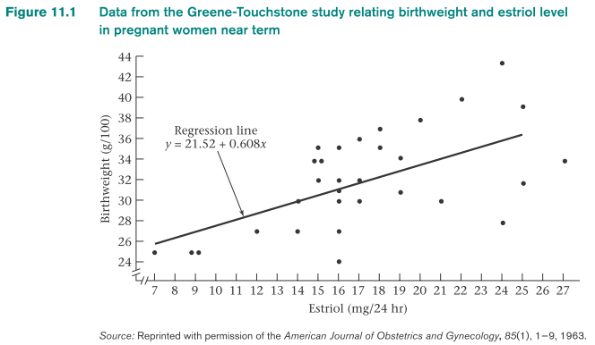
Example: Some researchers (Greene and Touchstone)
conducted a study to relate birthweight and estriol (a female
hormone) level in pregnant women
x = estriol level
y = birthweight
we can postulate a linear relationship between y and x:
E(y|x) = α + βx
y = α + βx : regression line; α: intercept; β: slope of the line

Slide 5
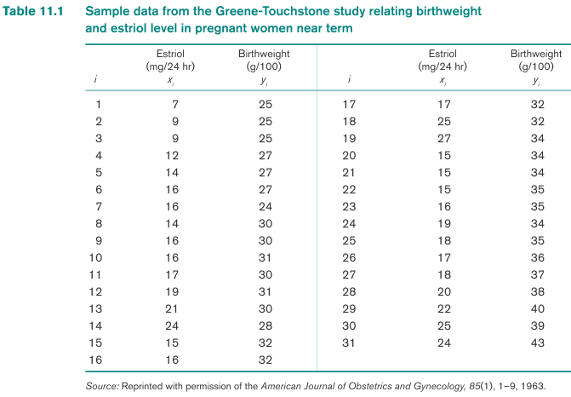
y = α + βx : not expected to be true for every woman
e: error term ~N(0, σ²)
Full regression line: y = α + βx + e

Slide 6
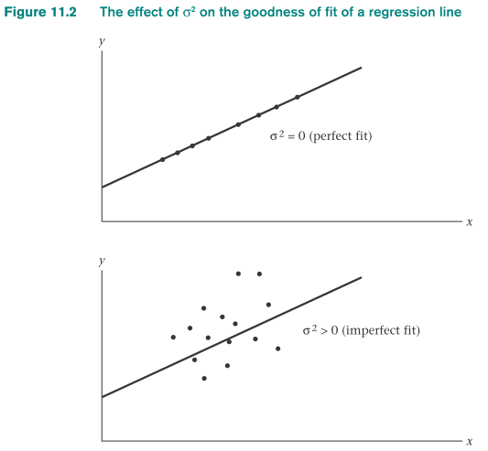
Linear-regression equation: y = α + βx + e
y : dependent variable
x : independent variable (predict y as a function of x)
Birthweight: dependent variable
Estriol level: independent variable (used to predict birthweight)
Interpretation of regression line:
For a women with estriol level x:
her birthweight will be normally distributed with mean α+β*x and variance σ²
σ² = 0:
every point falls exactly on the
regression line
Larger σ² : more scatter occurs about the regression line
β > 0: x increases → expected value y = α + βx increases

Slide 7
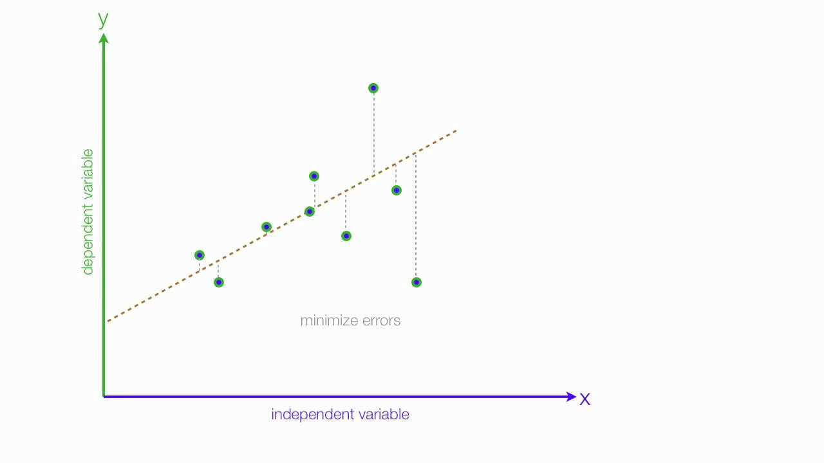

Slide 8
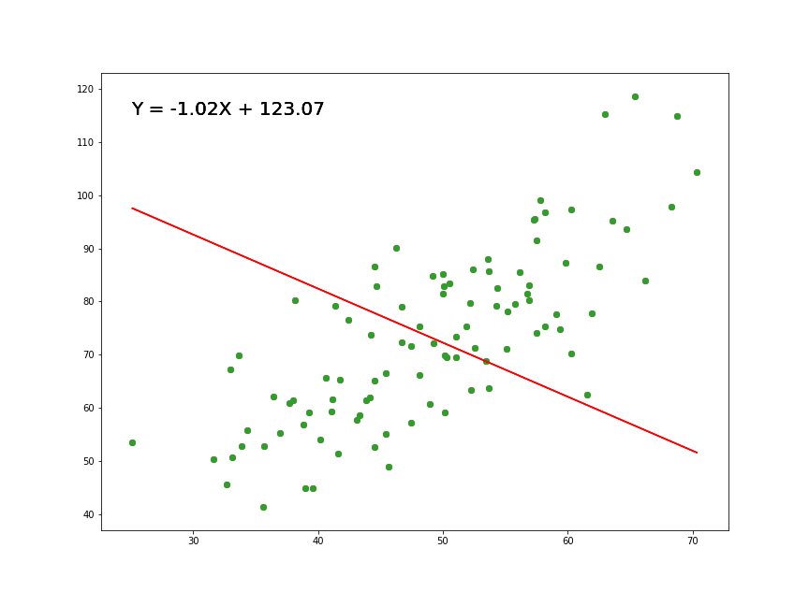

Slide 9
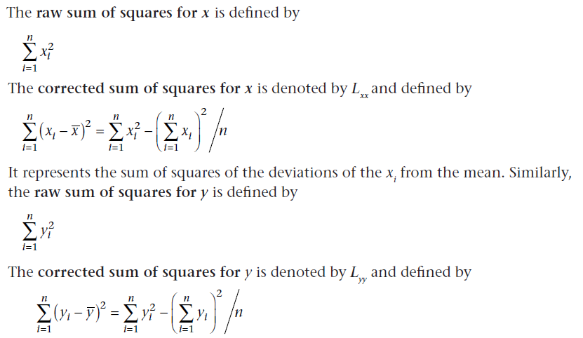
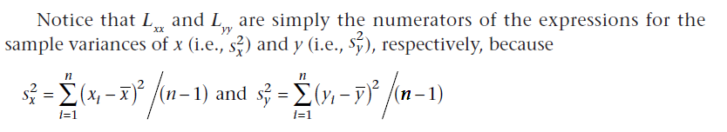

Slide 10
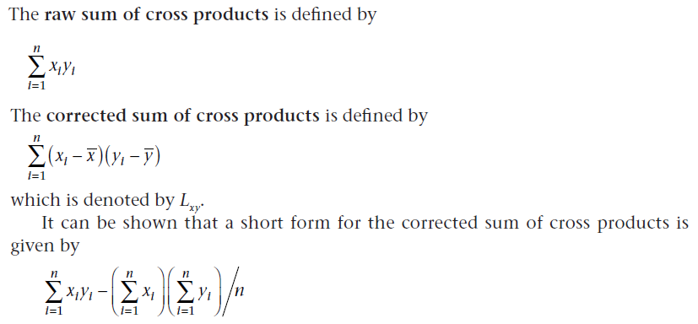
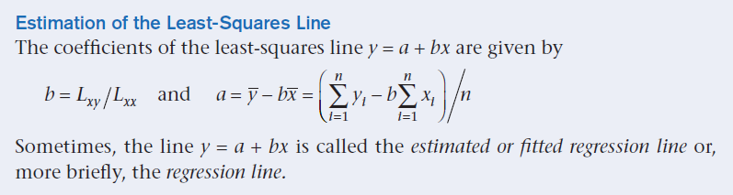

Slide 11
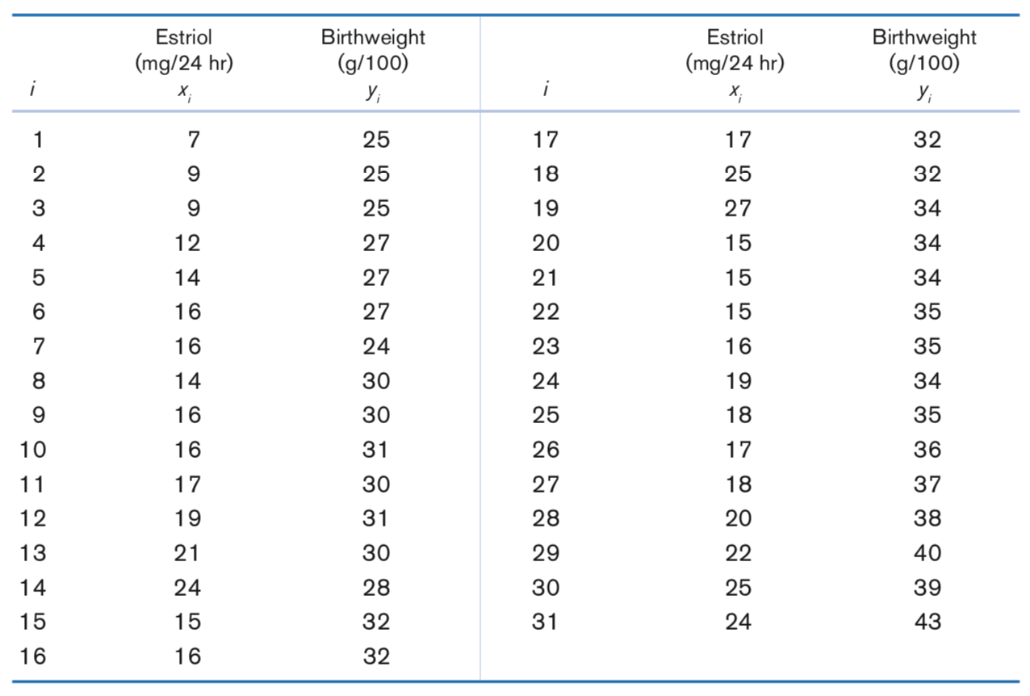
Table 11.1 Sample data from the Greene-Touchstone study relating birthweight and estriol level in pregnant women near term
Source: Based on the American Journal of Obstetrics and Gynecology, 85(1), 1–9, 1963.

Slide 12
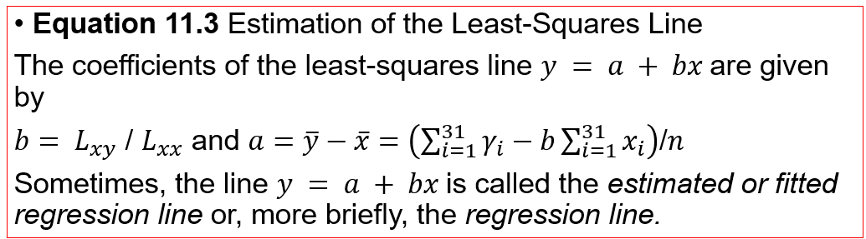
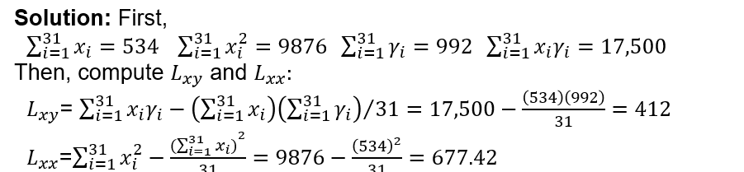

Example:
Q: Derive the estimated regression line for the data in Table 11.1.
31
31

Slide 13





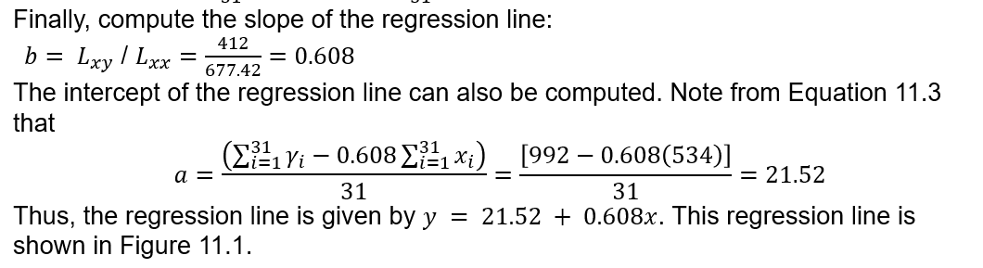

Slide 14
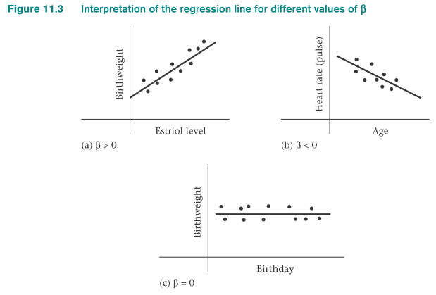
β = 0: no linear relationship between x and y (figure c)

Slide 15

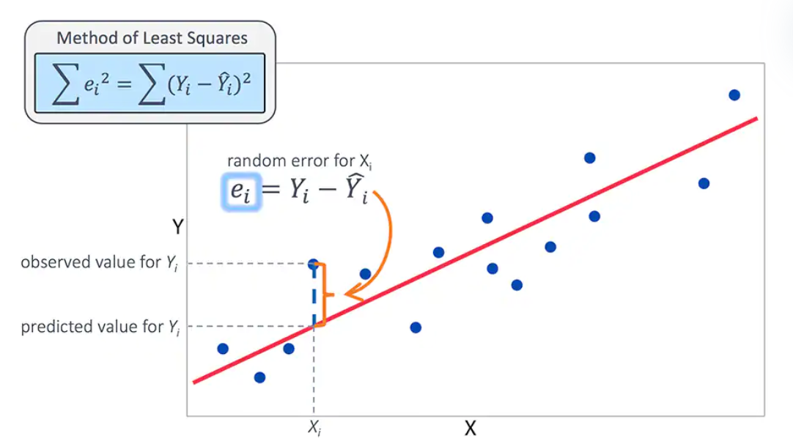
Residuals and fitted regression line
(x_{i},y_{i}): regression line, y = α + βx.
If y = a + bx is the estimated regression line and
= residual for the point (x_{i},y_{i}) about the estimated regression line, then
= y_{i} – (a + bx_{i}) and
The Studentized residual corresponding to the point (x_{i},y_{i}):
Unequal residual variances:
Variance-stabilizing transformation: transform y to a different scale e.g. ln and square-root

Slide 16
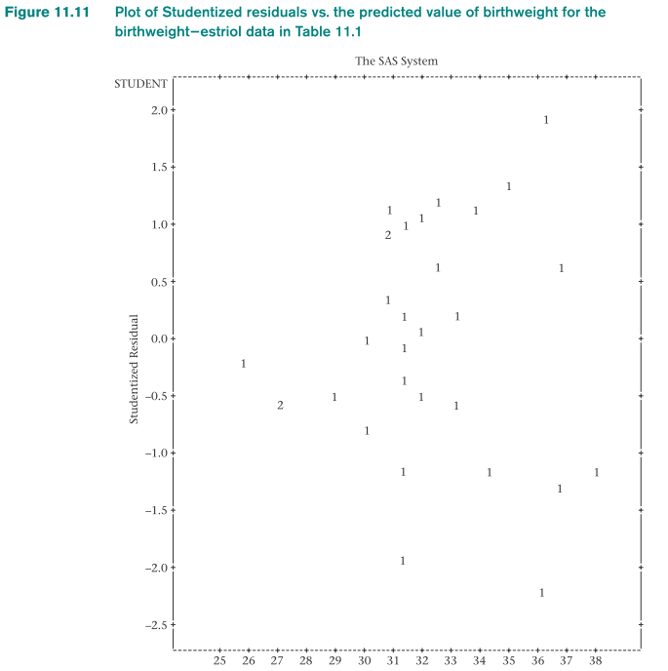
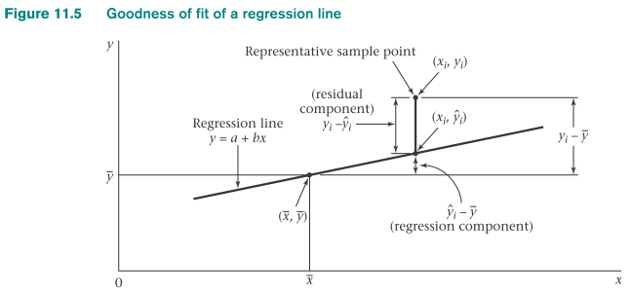
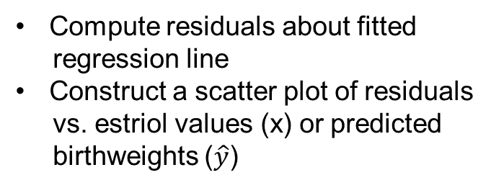
Compute residuals about fitted
regression line
Construct a scatter plot of residuals
vs. estriol values (x) or predicted
birthweights ($\hat{y}$)
2 identical
data points
Spread increases slightly as the predicted
birthweight increases
Data points with lowest predicted values
have residuals close to 0

Slide 17
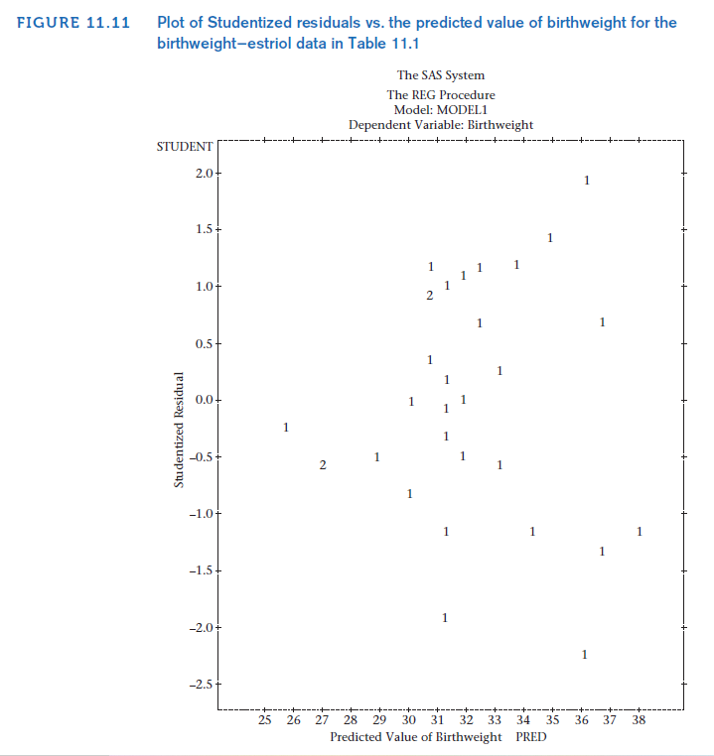
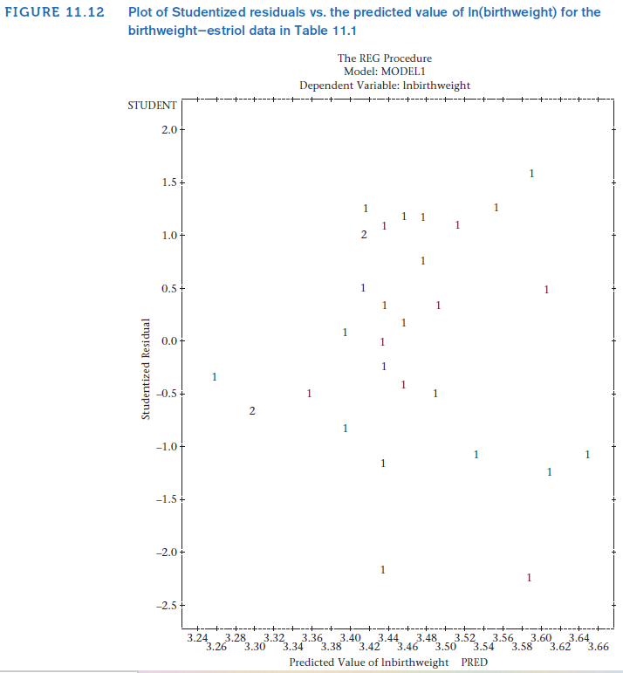
The two plots are similar
Simplicity: keep the data in the original scale
*Appropriate transformation is critical→ meeting linearity, equal-variance and normality
assumptions (conflict between different assumptions e.g. equal-variance and linearity)

Slide 18
Residual variance is proportional to average value of y: square-root transformation is useful
Residual variance is proportional to the square of the average values : log transformation is useful
Outliers and influential points: goodness-of-fit of a regression line
Influential points: have an important influence on the coefficients of the fitted regression lines
Outlier (x_{i},y_{i}): may or may not be influential, depends on its location relative to the remaining sample points
If |x_{i} – x| is small: even a gross outlier will have a relatively small influence on the slope estimate, but important influence on the intercept estimate

Slide 19
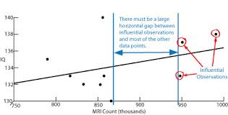
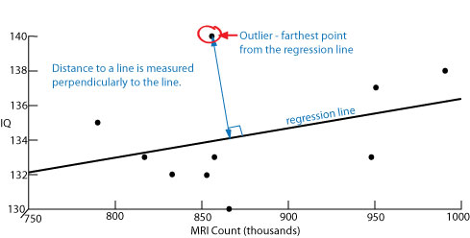
Influential points
Outlier

Slide 20



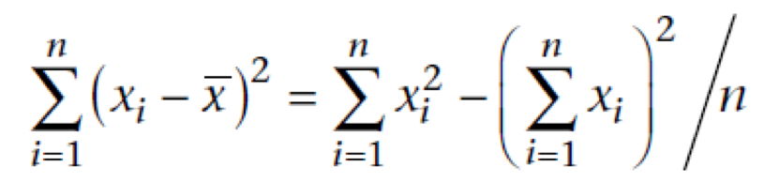
=
Correlation Coefficient
Sample (Pearson) correlation coefficient (r) : L_{xy}/√L_{xx}L_{yy.}
not affected by changes in location or scale in either variable
lie between -1 and +1
useful for quantifying relationship between variables
Interpretation of the sample correlation coefficient
Correlation > 0: variables are positively correlated
Correlation < 0: variables are negatively correlated
Correlation = 0: variables are uncorrelated
R command to obtain a correlation coefficient
#use cor.test command
>a=cor.test(Birthweight, Estriol)
#obtain the estimate
>a$estimate
=

Slide 21
Correlation coefficient: a quantitative measure of the dependence between two variables
closer |r| is to 1: more closely related the variables are
|r| = 1: one variable can be predicted exactly from the other
Interpretation of the sample correlation coefficient (r): degree of dependence is only correct if the variables x and y are normally distributed

Slide 22
Example on Correlation Coefficient
FEV is related to both age and height.
Focus: boys who are ages 10−15 and postulate a regression model of the form FEV = α + β(height) + e.
Data were collected on FEV and height for 655 boys in this age group residing in Tecumseh, Michigan.
Table 11.4 presents the mean FEV in liters for each of twelve 4-cm height groups.

Slide 23
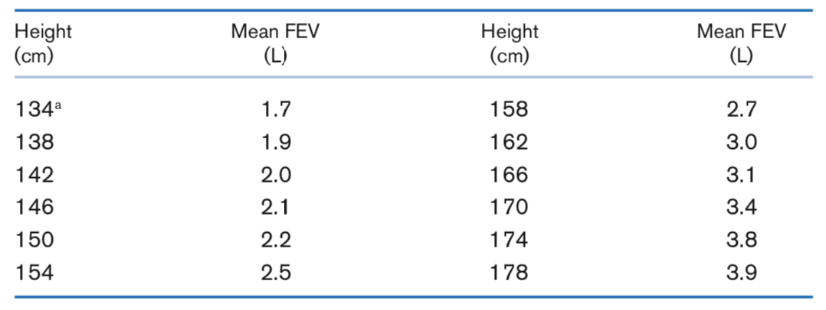
Table 11.4. Mean FEV by height group for boys ages 10−15 in Tecumseh, Michigan
ªThe middle value of each 4-cm height group is given here.
Source: Based on the American Review of Respiratory Disease, 108, 258−272, 1973.

Slide 24
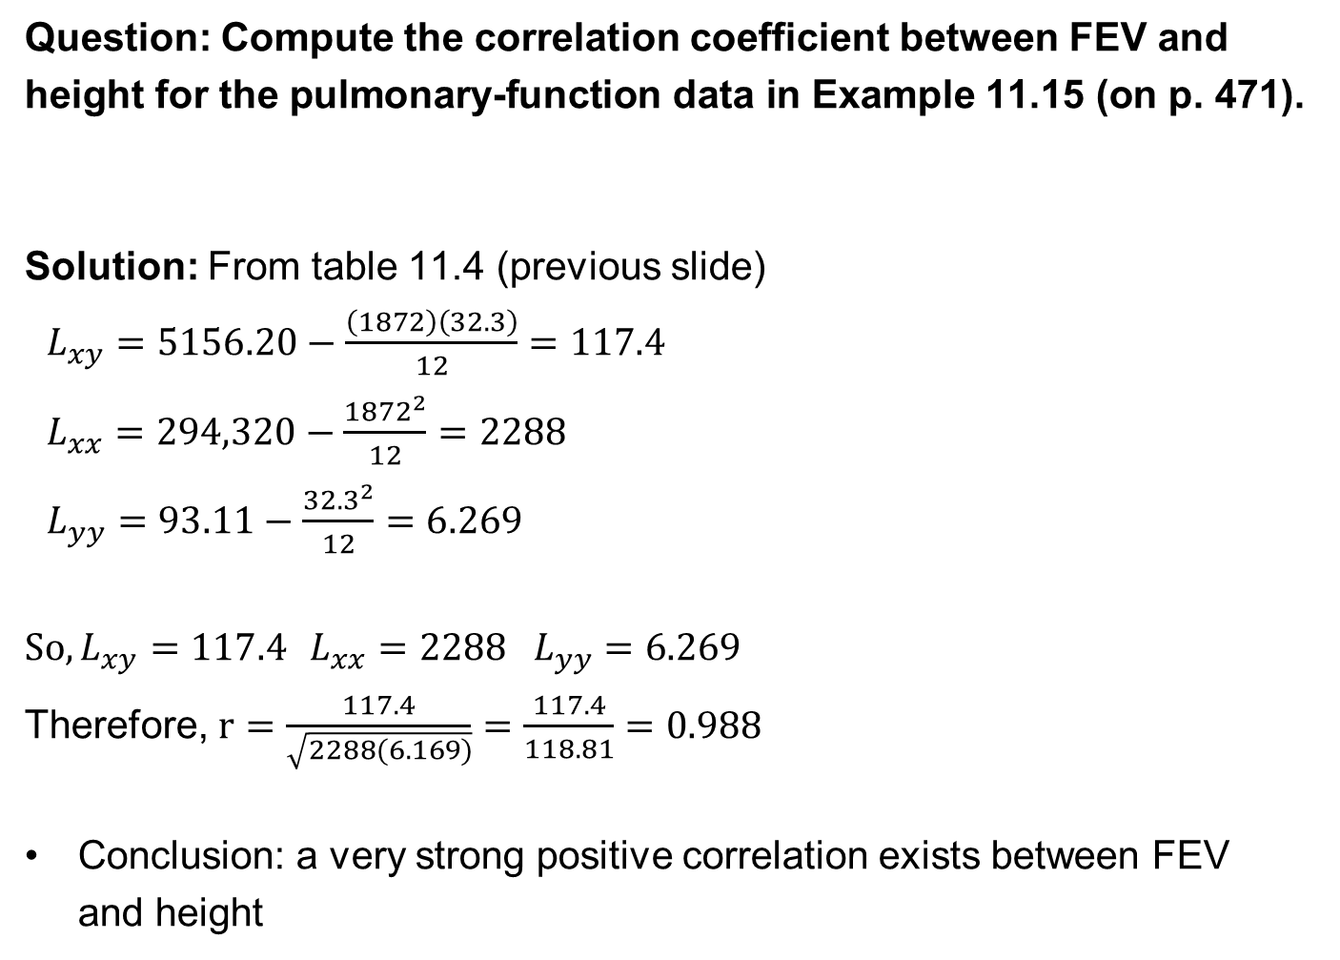
Question: Compute the correlation coefficient between FEV and height for the pulmonary-function data in Example 11.15 (on p. 471).
Solution: From table 11.4 (previous slide)
$L_{xy}=5156.20−\frac{\left(1872\right)\left(32.3\right)}{12}=117.4$
$L_{xx}=294,320−\frac{{1872}^{2}}{12}=2288$
$L_{yy}=93.11−\frac{{32.3}^{2}}{12}=6.269$
$So, L_{xy}=117.4$ $L_{xx}=2288 L_{yy}=6.269$
Therefore, $r=\frac{117.4}{\sqrt{2288(6.169)}}=\frac{117.4}{118.81}=0.988$
Conclusion: a very strong positive correlation exists between FEV and height
=
=
r = L_{xy}/√L_{xx}L_{yy}

Slide 25
Multiple Regression
Multiple regression analysis : examine relationship between each of the more than one independent variables (x₁,…,x_{k}) and the dependent variable (y) after taking into account the remaining independent variables
Estimation of the regression equation: y = α + β₁x₁ + β₂x₂ + e
e is an error: normally distributed with mean 0 and variance σ²
(y=SBP, x₁=birthweight, x₂= age in days)
If we have k independent variables x₁,…, x_{k} then a linear-regression model relating y to x₁,…, x_{k} : y = α + β_{j}x_{j} + e

Slide 26
Example: Pediatrics Hypertension
Investigate how the relationship between the blood-pressure levels of newborns and infants relate to subsequent adult blood pressure.
Problem: blood pressure of a newborn is affected by several extraneous factors that make this relationship difficult to study.
Newborn blood pressures are influenced by:
Birthweight
(2) the day of life on which blood pressure is measured

Slide 27
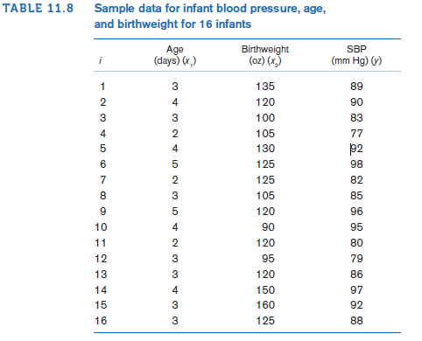
Infants: weighed at the time of the blood-pressure measurements
Expect: infants seen at 5 days of life would on average have a greater weight than those seen at 2 days of life
Dependent variable: SBP
Independent variables: age and birthweight

Slide 28
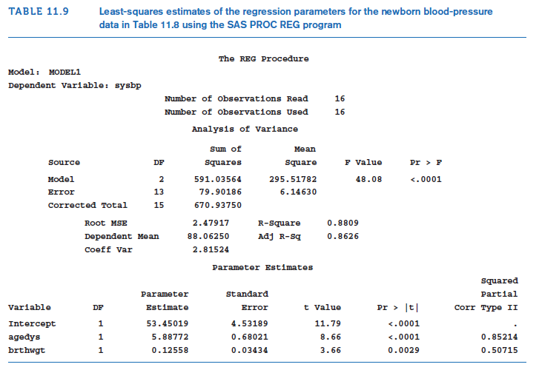
Estimates were obtained with SAS PROC REG program
y=53.45+5.89x1+0.126x2
For a newborn, the average blood pressure increases by an estimated
5.89 mm Hg per day of age, and 0.126 mm Hg per ounce of birthweight.

Slide 29
Multiple-regression model:
y = α + β_{j}x_{j} + e where e ~N(0, σ² )
β_{j}, j = 1, 2…,k
partial-regression coefficients:
  - represents the average increase in y per unit increase in x_{j}, with
  all other variables held constant (adjusting all other variables)
- estimated by the parameter b_{j}
Partial regression coefficients vs. simple linear-regression coefficients
Simple linear-regression coefficients: average increase in y per unit increase in x (do not consider any other independent variables)
Strong relationships among the independent variables in a multiple-regression model: partial-regression coefficients and simple linear-regression coefficients are different considerably

Slide 30
ranking the independent variables according to their predictive relationship with the dependent variable y
- hard to rank based on magnitude of partial-regression coefficients
(different units)
Standardized regression coefficient (b_{s}) : b × (s_{x}/s_{y})
represents the estimated average increase in y per standard deviation increase in x, after adjusting for all other variables in the model
useful measure for comparing the predictive value of several independent variables
can control for differences in the units of measurement for different independent variables by expressing change in standard-deviation units of x

Slide 31
Example: Pediatrics Hypertension
Question: Calculate the predicted average SBP of a three-day-old baby with birthweight 8 lb (128 oz).
Solution: The average SBP is estimated by 53.45 + 5.89(3) + 0.126(128) = 87.2 mm Hg
The regression coefficients in Table 11.9 are called partial-regression coefficients.

Slide 32
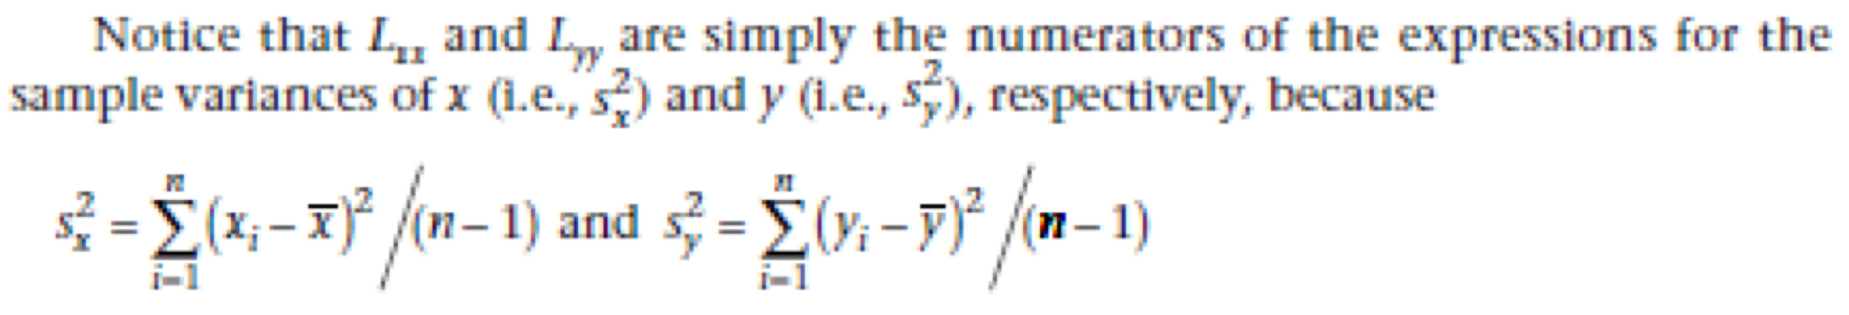
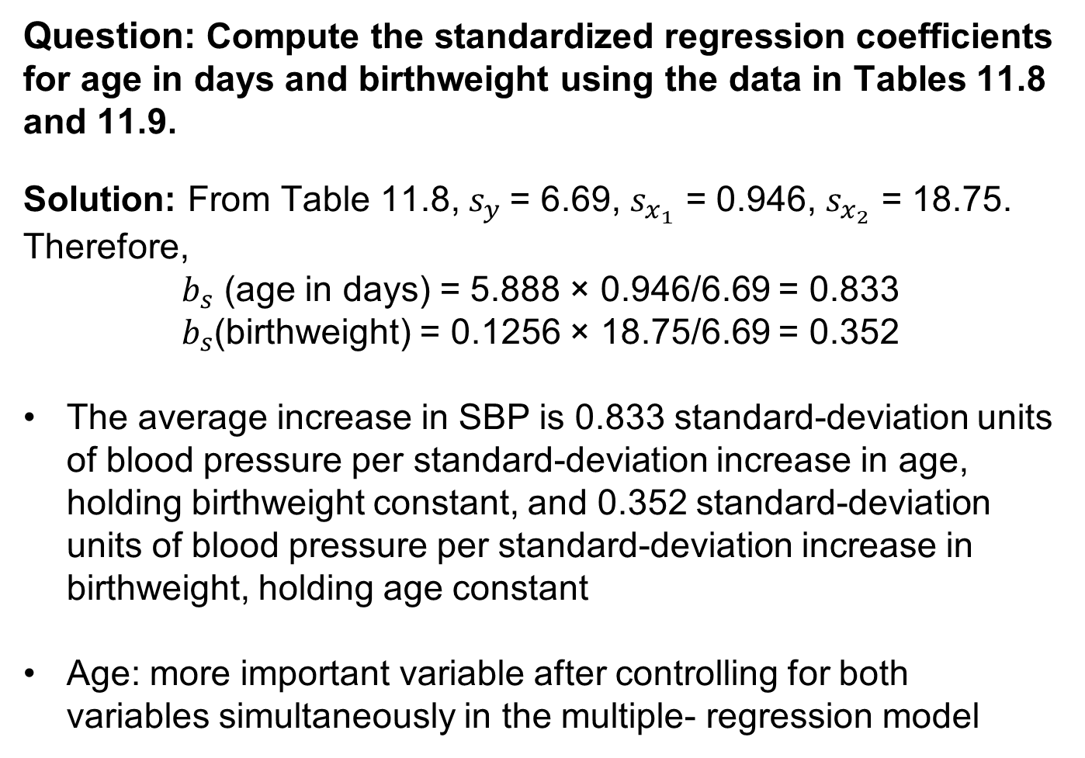
Example: Pediatrics Hypertension
Question: Compute the standardized regression coefficients for age in days and birthweight using the data in Tables 11.8 and 11.9.
Solution: From Table 11.8, $s_{y}$= 6.69, $s_{x_{1}}$ = 0.946, $s_{x_{2}}$ = 18.75. Therefore,
$b_{s}$ (age in days) = 5.888 × 0.946/6.69 = 0.833
$b_{s}$(birthweight) = 0.1256 × 18.75/6.69 = 0.352
The average increase in SBP is 0.833 standard-deviation units of blood pressure per standard-deviation increase in age, holding birthweight constant, and 0.352 standard-deviation units of blood pressure per standard-deviation increase in birthweight, holding age constant
Age: more important variable after controlling for both variables simultaneously in the multiple- regression model

Slide 33
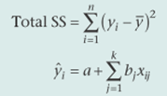
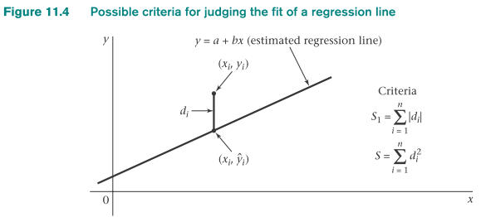

Hypothesis Testing
H₀: β₁ = β₂ = …= β_{k} = 0
vs. H₁: at least one of the β_{j} ≠ 0 in multiple linear regression
Estimate the regression parameters and compute Reg SS and Res SS using method of least squares
xij = jth independent variable for the ith subject, j = 1,…,k; i = 1,…,n
Compute Reg MS = Reg SS/k, Res MS = Res SS/(n-k-1)
Compute the test statistic F = Reg MS/Res MS following an F_{k,n-k,k-1} distribution under H₀.
For a level α test:
F > F_{k,n-k-1,1-α} → reject H_{0.}
F ≤ F_{k,n-k-1,1-α} → accept H_{0.}
5. Exact p-value : area to the right of F under an F > F_{k,n-k-1} distribution
= Pr(F_{k,n-k-1} >F)

Slide 34
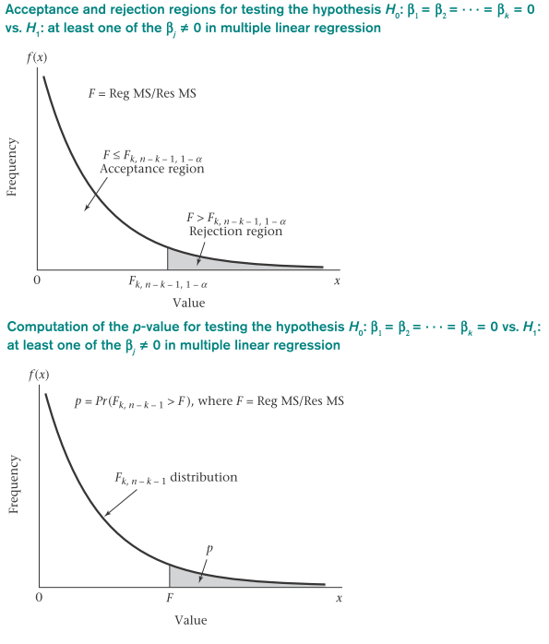

Slide 35
t test for testing the hypothesis H₀: β_{l} = 0, All other β_{j} ≠ 0 vs. H₁: β_{l} ≠ 0 , all other β_{j} ≠ 0 in multiple linear regression
Compute t = b_{l}/se(b_{l}) which should follow a t distribution with n – k -1 df under H₀.
If t < t_{n-k-1,α/2} or t > t_{n-k-1,α/2} → reject H₀
If t_{n-k-1,α/2} ≤ t ≤ t_{n-k-1,1-α/2} → accept H₀
The exact p-value :
t ≥ 0: 2 × Pr(t_{n-k-1} > t)
t < 0: 2 × Pr(t_{n-k-1} ≤ t)

Slide 36
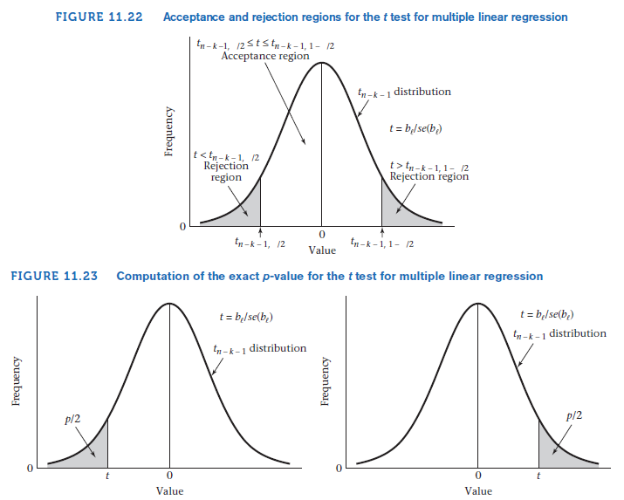

Slide 37
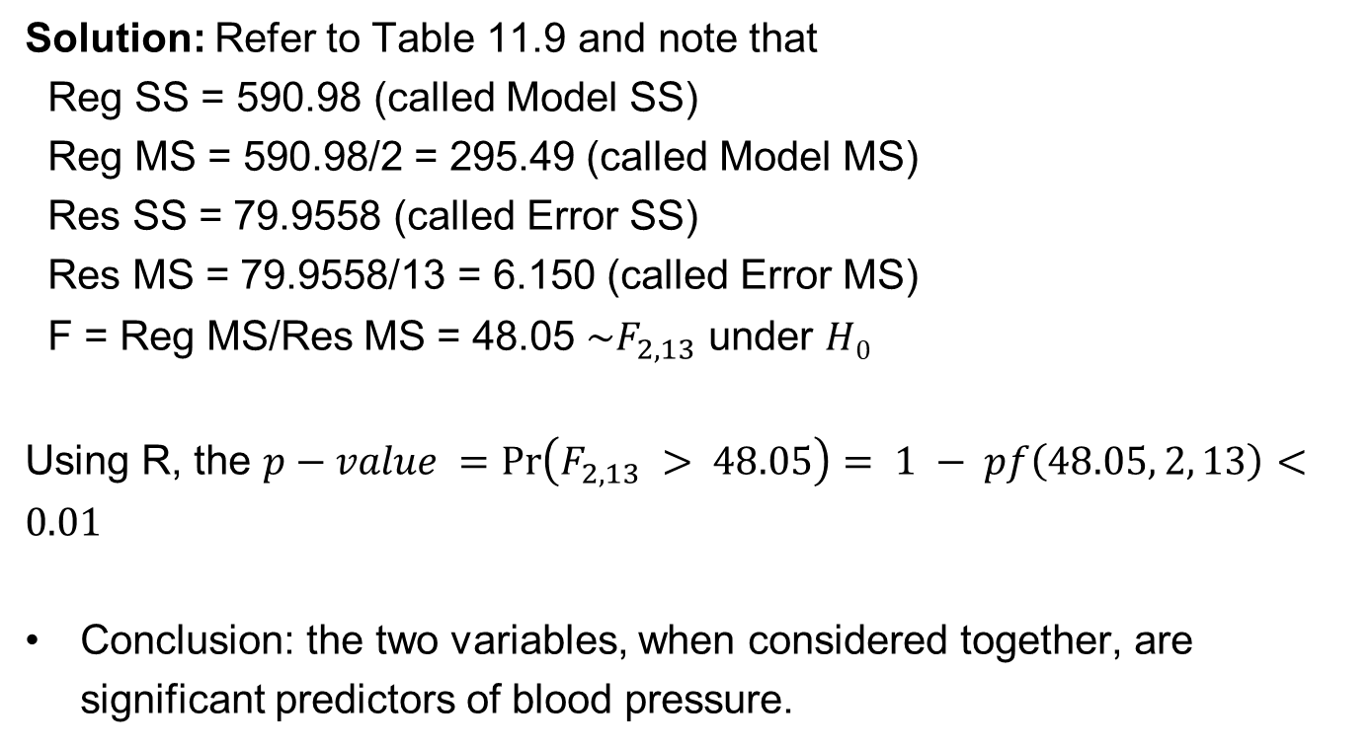
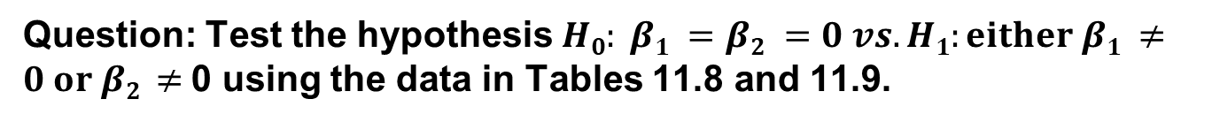
Example: Pediatrics Hypertension
Question: Test the hypothesis $H0: β1 =β2 =0 vs. H1:either β1 ≠0 or β2 ≠$0 using the data in Tables 11.8 and 11.9.
Solution: Refer to Table 11.9 and note that
Reg SS = 590.98 (called Model SS)
Reg MS = 590.98/2 = 295.49 (called Model MS)
Res SS = 79.9558 (called Error SS)
Res MS = 79.9558/13 = 6.150 (called Error MS)
F = Reg MS/Res MS = 48.05 $\sim F_{2,13}$ under $H0$
Using R, the $p−value =\operatorname{Pr}\left(F_{2,13} > 48.05\right)= 1 − pf\left(48.05, 2, 13\right)<0.01$
Conclusion: the two variables, when considered together, are significant predictors of blood pressure.
Reg MS = Reg SS/k
Res MS = Res SS/(n-k-1)

Slide 39
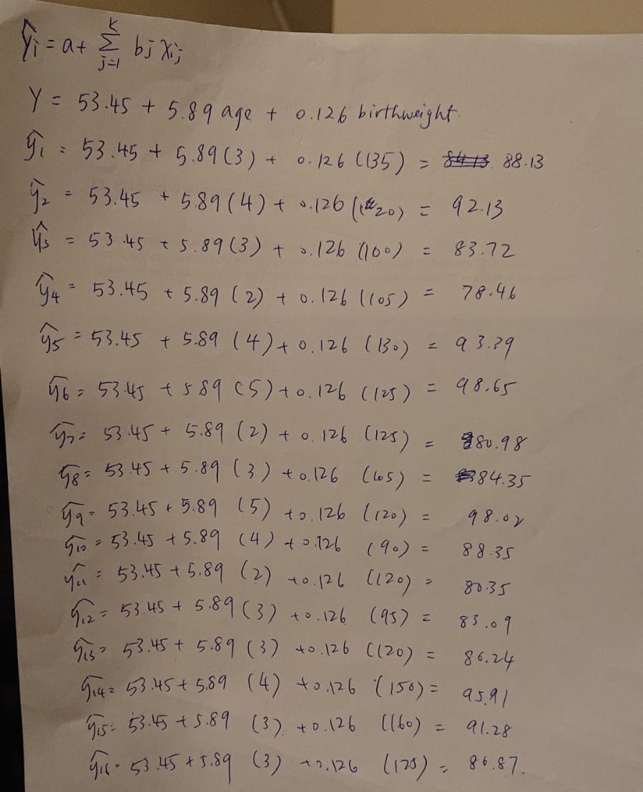

Slide 40
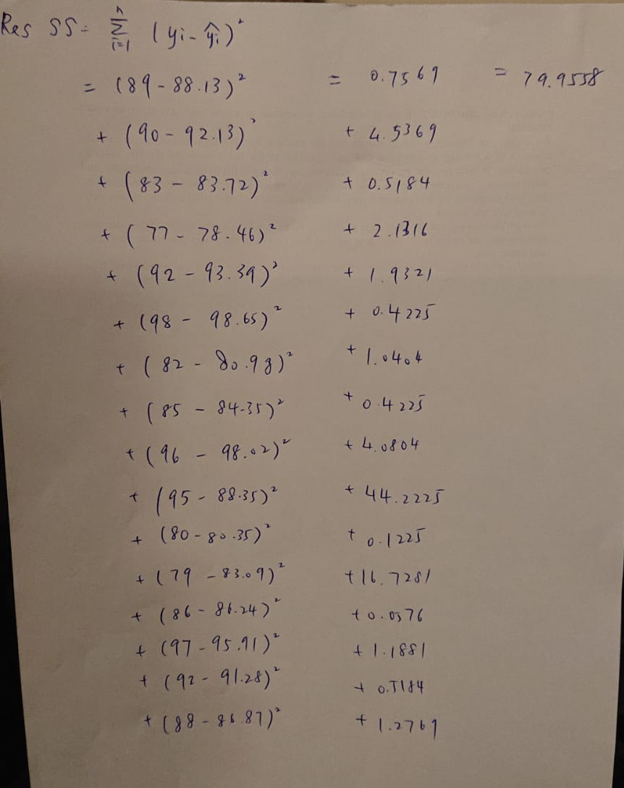

Slide 41
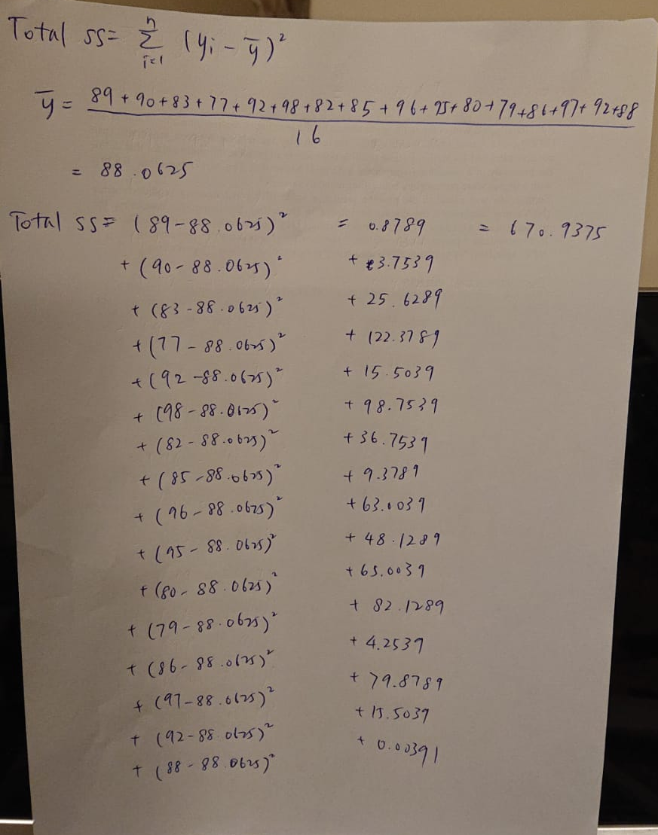

Slide 42
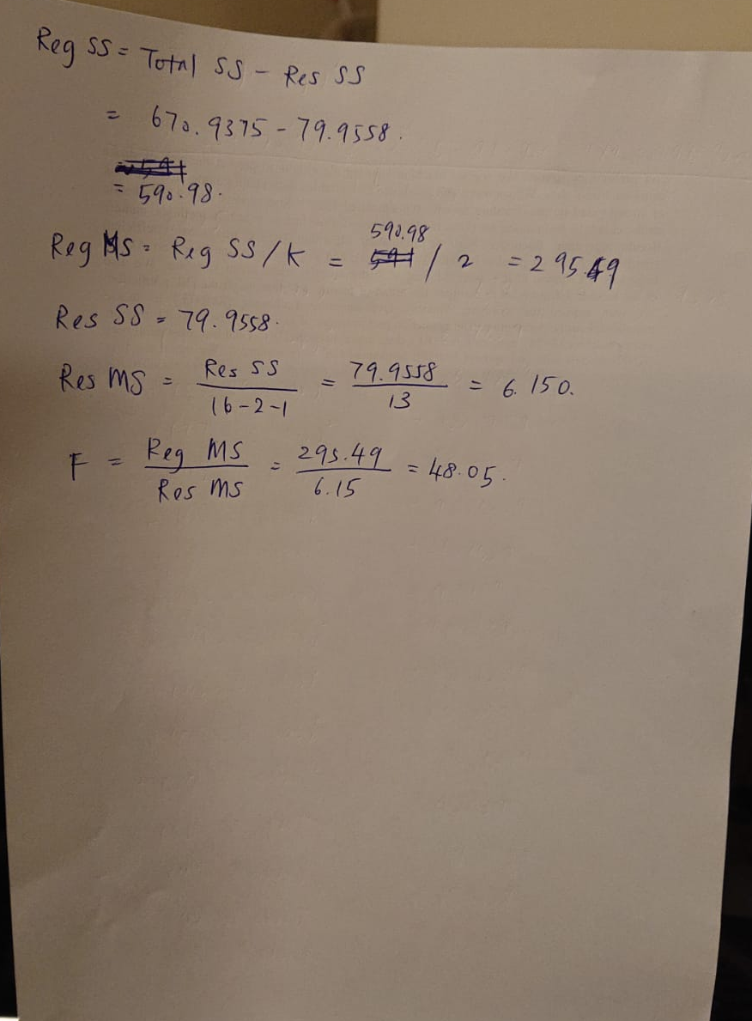

Slide 43
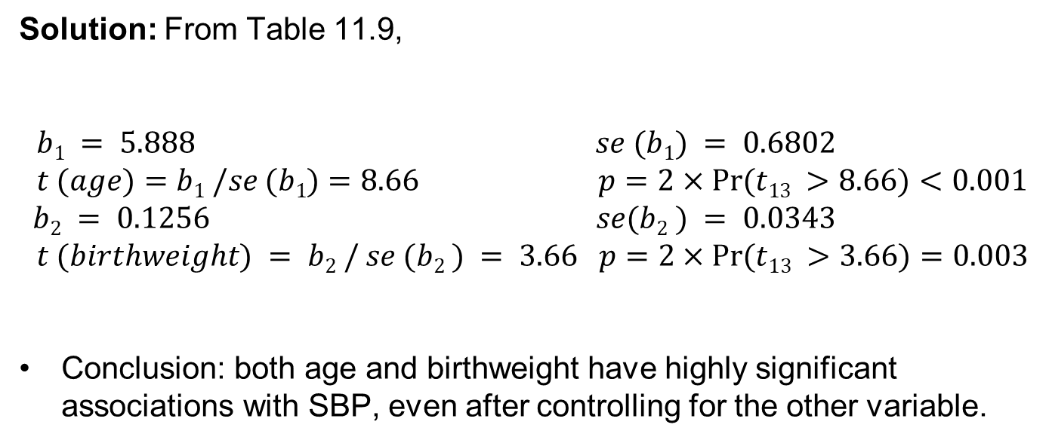
Example: Pediatrics Hypertension
Question: Test for the independent contributions of age and birthweight in predicting SBP in infants, using the output in Table 11.9 .
Solution: From Table 11.9,
$b1 = 5.888 se (b1) = 0.6802$
$t (age)=b1 /se (b1)=8.66 p=2×Pr(t13 >8.66)<0.001$
$$b2 = 0.1256 se(b2 ) = 0.0343$$
$t (birthweight) = b2 / se (b2 ) = 3.66 p=2×Pr(t13 >3.66)=0.003$
Conclusion: both age and birthweight have highly significant associations with SBP, even after controlling for the other variable.
t = b_{l}/se(b_{l})
2*(1-pt(3.66, 13))

Slide 45
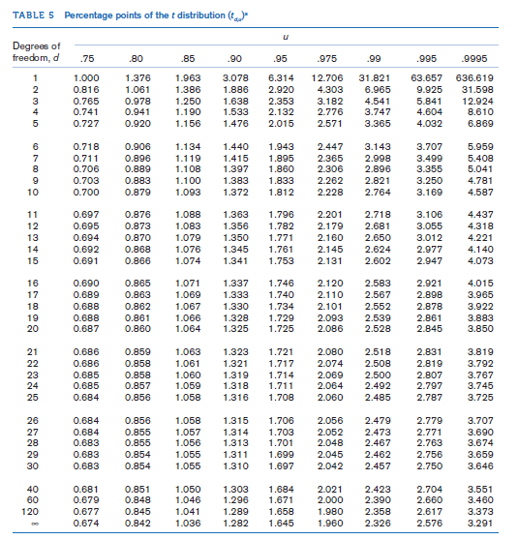

Slide 46
Spearman rank-correlation coefficient (r_{s}): ordinary correlation coefficient based on ranks
r_{s} = L_{xy}/ √L_{xx} × L_{xy}
L’s are computed from the rank (not actual score)
t test for Spearman Rank Correlation
H0: no correlation
  test statistic t_{s} = r_{s}(√n -2)/ √1-r_{s}² follows a t distribution with n-2 degrees of freedom.
For a two-sided level α test:
  if t_{s} > t_{n-2,1-α/2} or t_{s} < t_{n-2,α/2} = -t_{n-2,1-α/2} then reject H₀
  otherwise, accept H₀.
The exact p-value :
  t_{s} < 0 : p = 2 × (area to the left of t_{s} under a t_{n-2} distribution)
  t_{s} ≥ 0: p = 2 × (area to the right of t_{s} under a t_{n-2} distribution)
  *This test is valid only if n ≥ 10

Slide 47
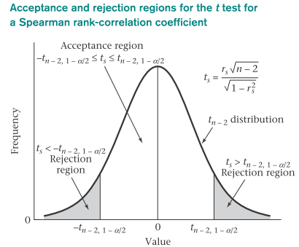
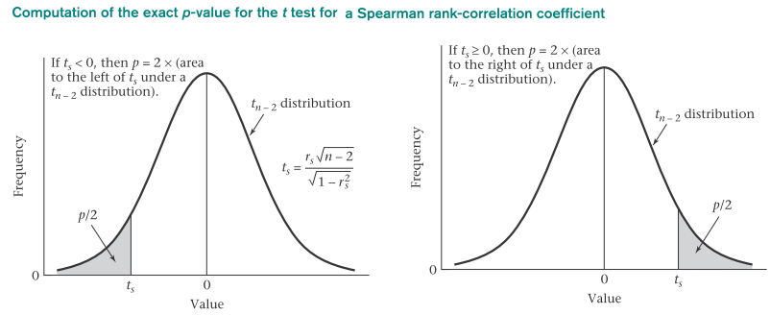

Slide 48
Summary
Statistical inference methods for investigating the relationship between two or more variables
If only two variables, both of which are continuous, are being studied, and we wish to predict one variable (the dependent variable) as a function of the other variable (the independent variable) then simple linear regression analysis is used.
Pearson correlation methods are used to determine the association between two normally distributed variables without distinguishing between dependent and independent variables.
Rank correlation may be used if both variables are continuous but not normally distributed or are ordinal variables.
Multiple regression methods may be used to predict the value of one variable (the dependent variable which is normally distributed) as a function of several independent variables.

